Slide 1
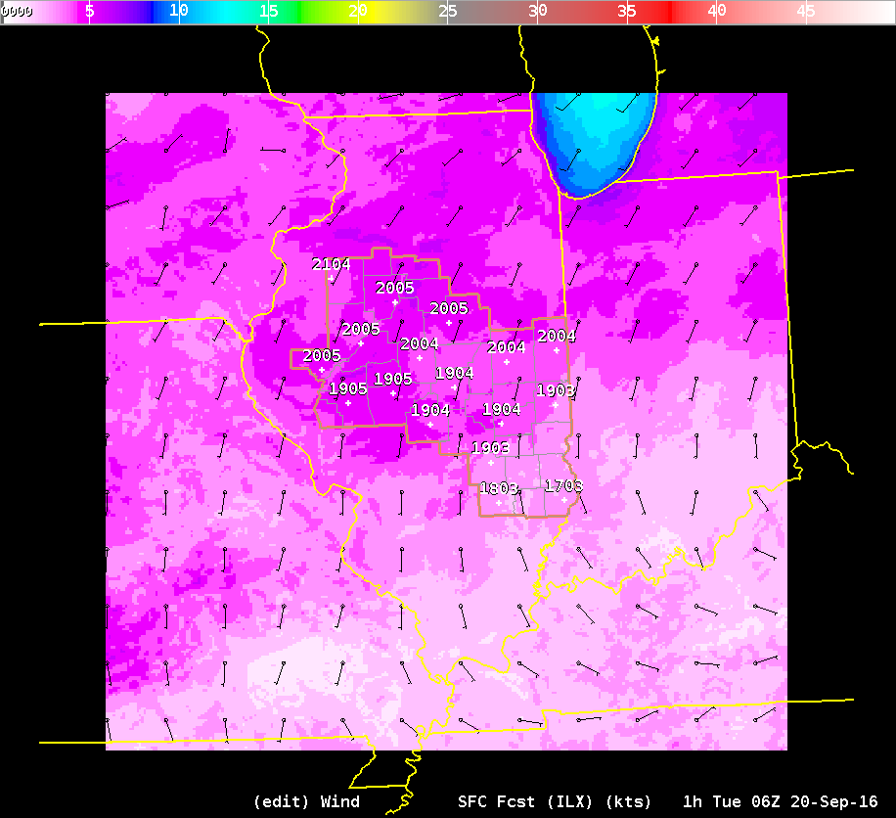
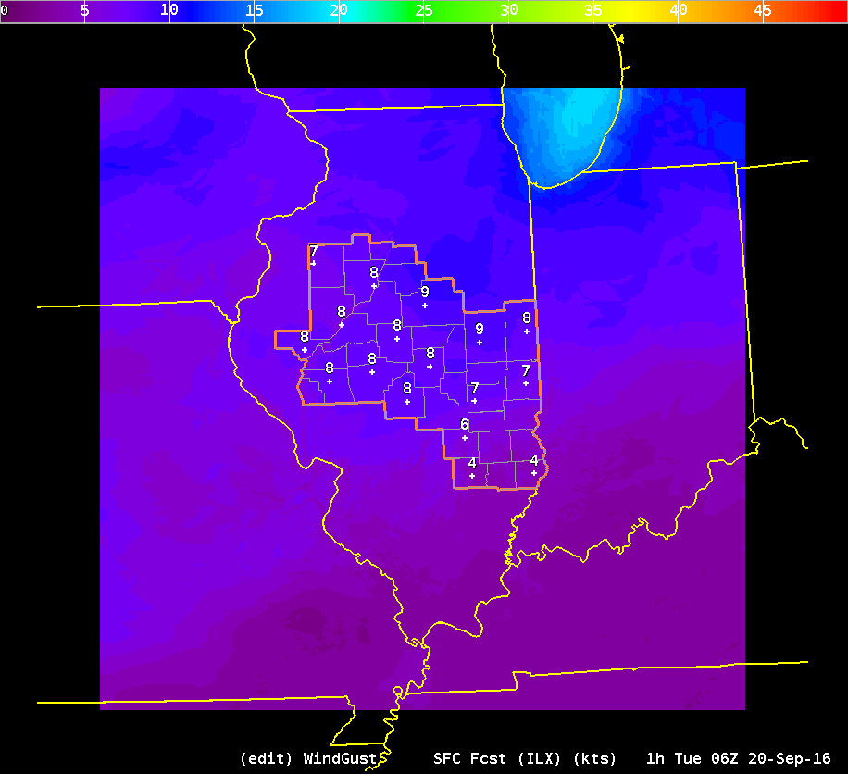
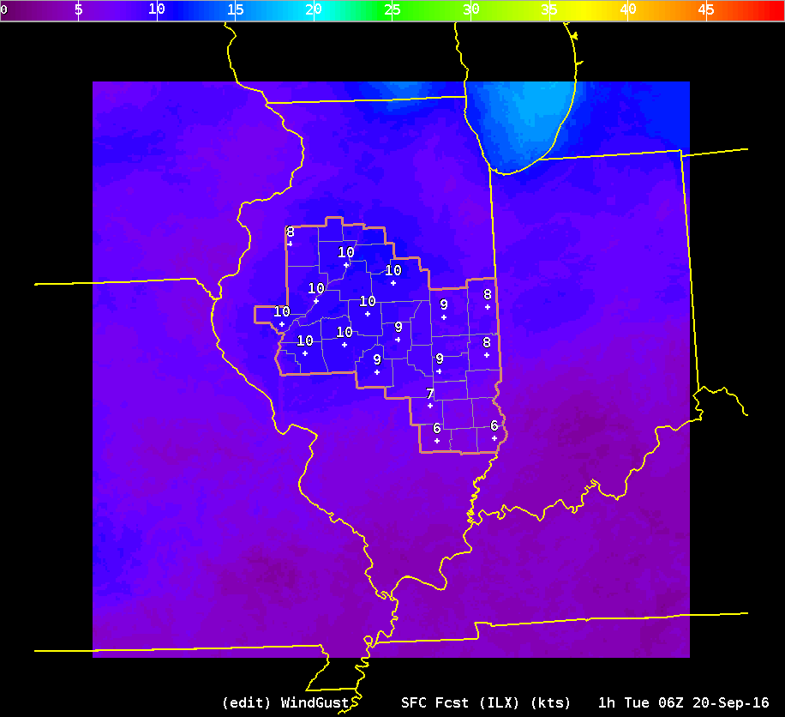
20 Sep – 06Z
ForecastBuilder Wind
CONSAll Gust
ForecastBuilder Gust

Slide 2
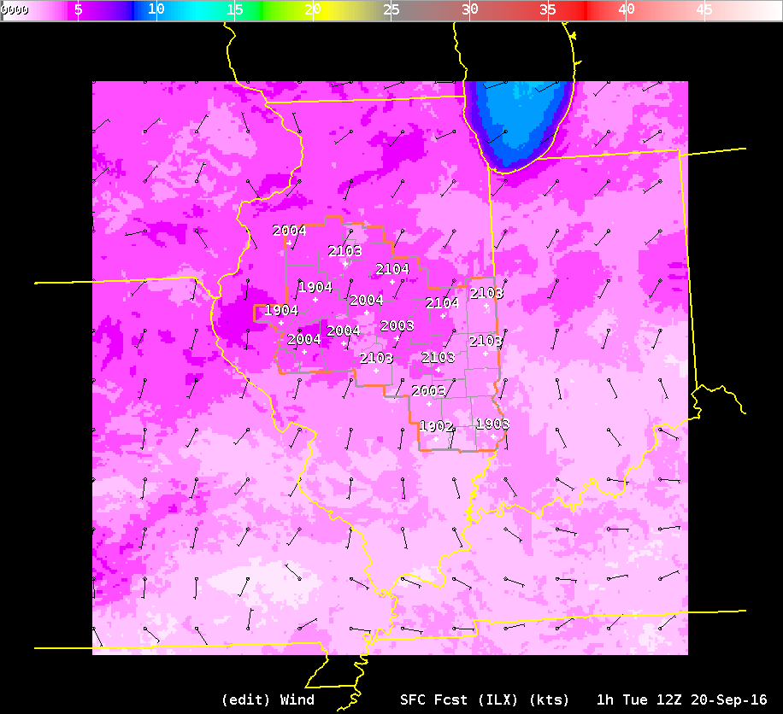
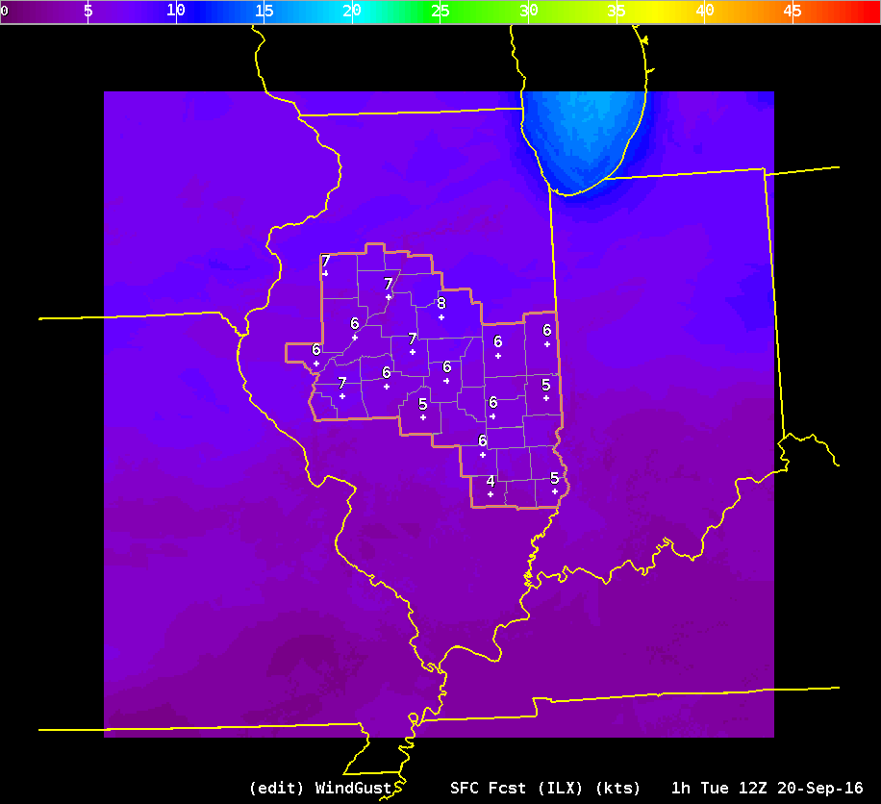
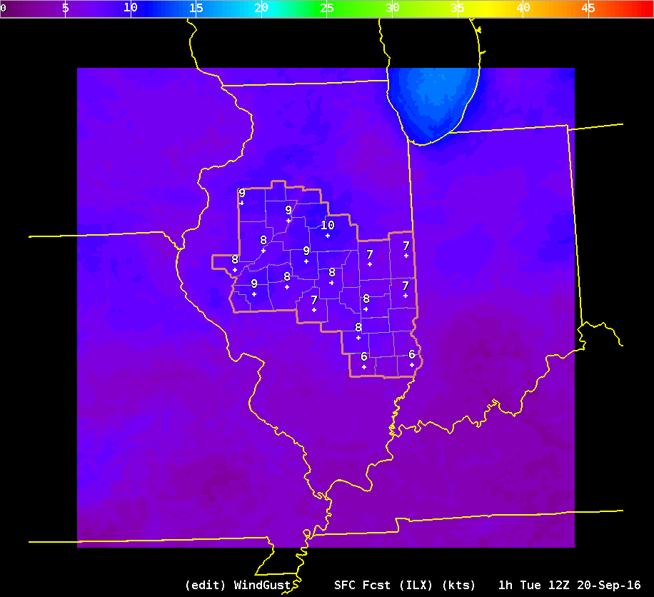
20 Sep – 12Z
ForecastBuilder Wind
CONSAll Gust
ForecastBuilder Gust

