Slide 1
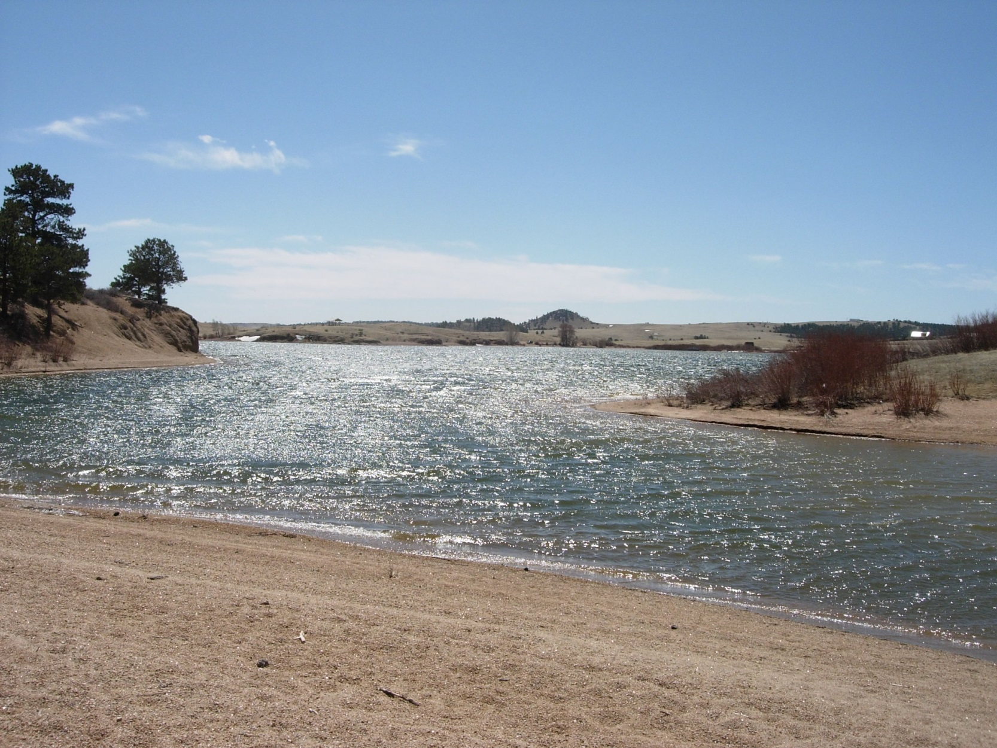
FV3/GFS Comparisons
The Good, Bad and Ugly
3 Case Reviews
Rob Cox
SOO NWS Cheyenne
FV3/GFS Comparisons
The Good and Bad
2 Case Reviews
Rob Cox
SOO NWS Cheyenne
Photo Courtesy of Mark Brennan

Slide 2
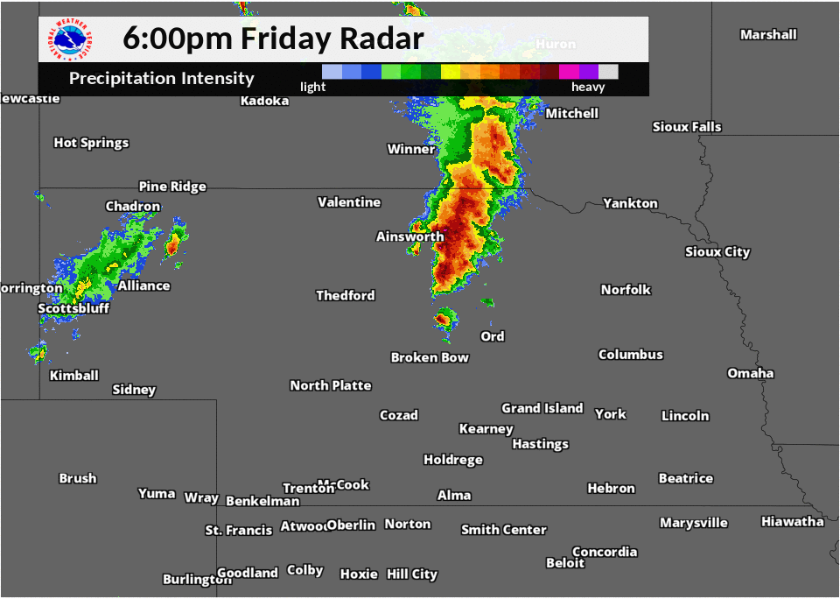
FV3/GFS Comparison (Good)
Case Study #1 (June 2nd 00Z-03z MRMS Loop)
Squall line moved through central Nebraska

Slide 3
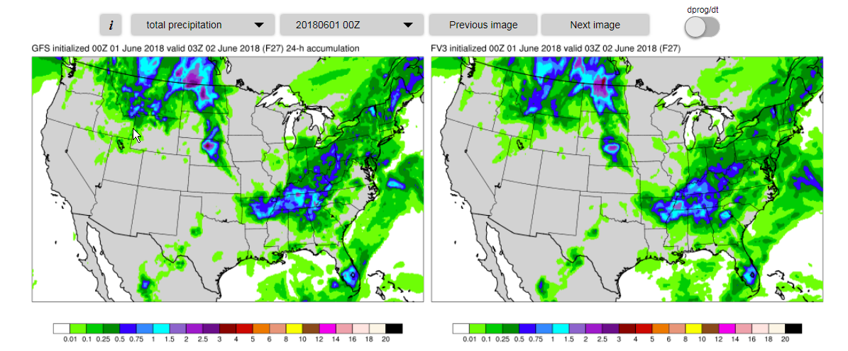
GFS/FV3 Precip. Comparison (Good)
Case Study #1 (Init. Jun 1 00Z, Valid Jun 2 03z)
Both Models handled the QPF well

Slide 4
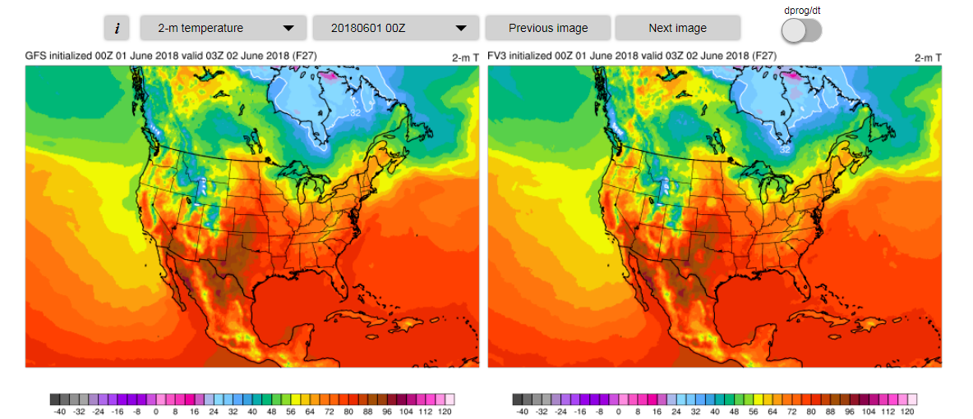
Cold Pool Caught during Convection (FV3 Good)
Case Study #1 (June 2nd 03z)

Slide 5
FV3/GFS Comparison (Good)
Case Study #1 (June 2nd 02Z-03z ORD Nebraska observations)

Slide 6
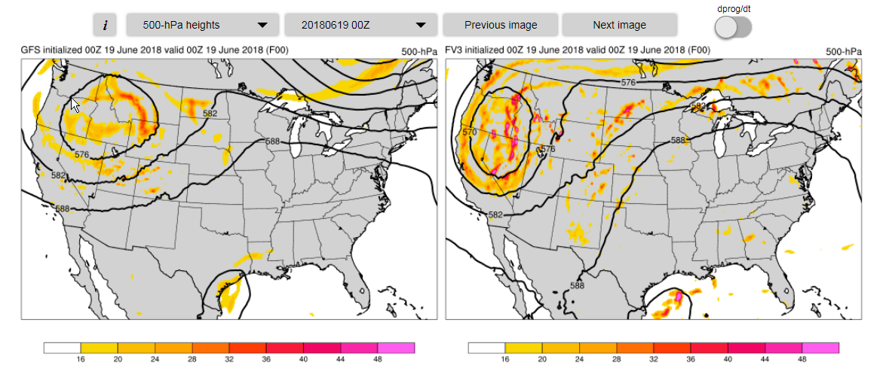
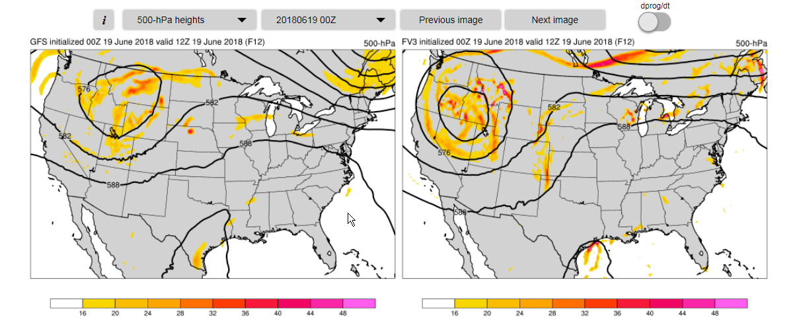
FV3/GFS Comparison (Bad)
Case Study #2
Init. June 19th 00Z (00-12hr 500mb Forecast)

Slide 7
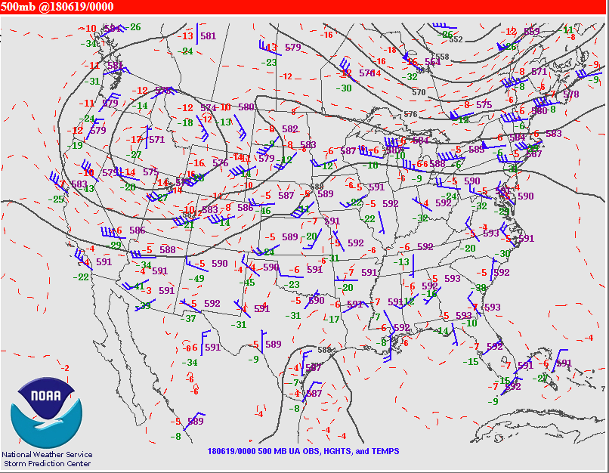
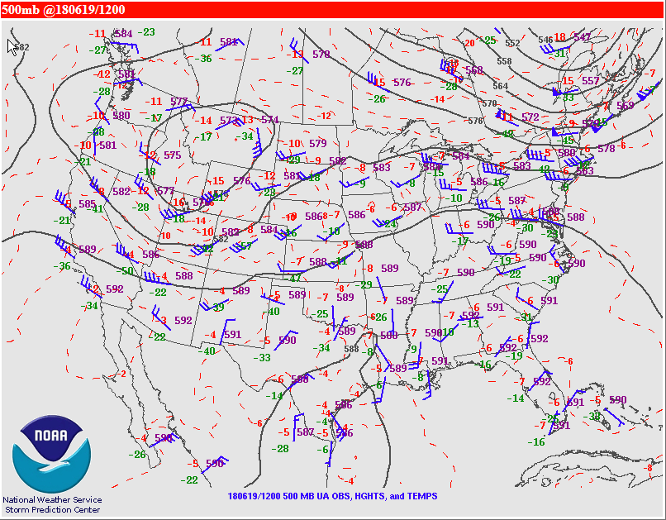
FV3/GFS Comparison (Bad)
Case Study #2 (FV3 had Poor Initialization)
Upper Air Analysis (June 19th 00Z/12Z)

Slide 8
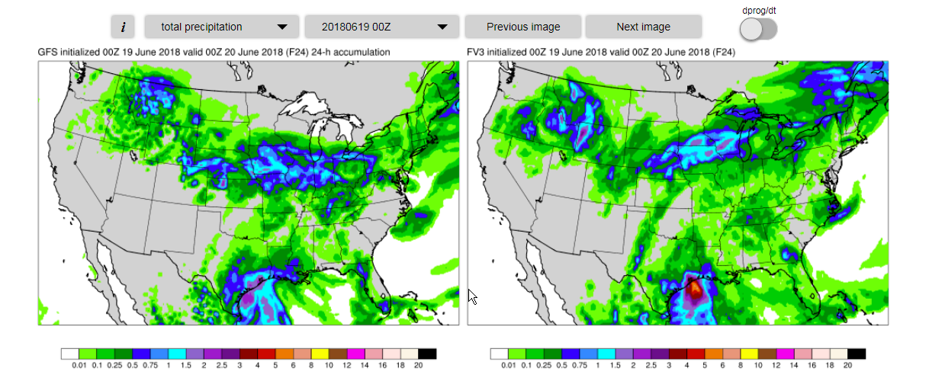
FV3/GFS Comparison (Bad)
Case Study #2
Init. June 19th 00Z 24hr QPF Forecast
Large amount of Rain in WY Mountains

Slide 9
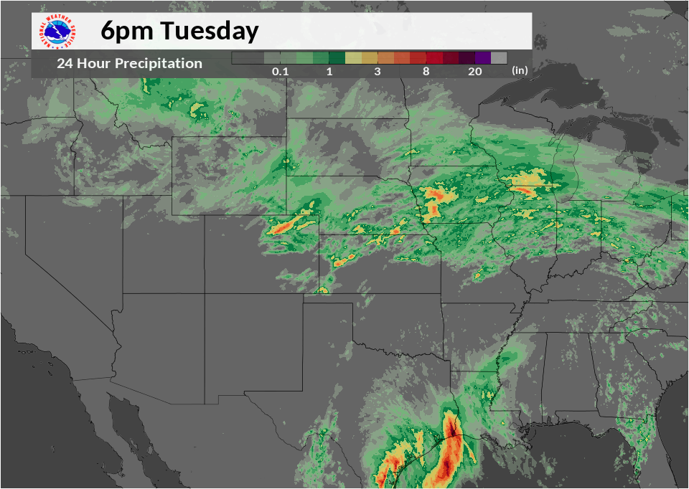
FV3/GFS Comparison (Bad)
Case Study #2
(Valid 00Z June 20th MRMS indicated No PRECIP. over western Wyoming)
Little or No Rain

