Slide 1
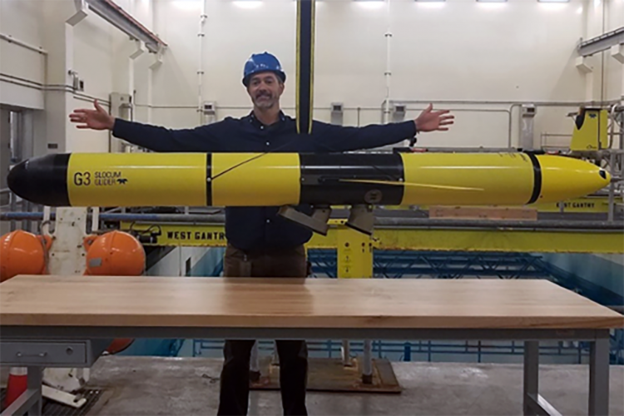
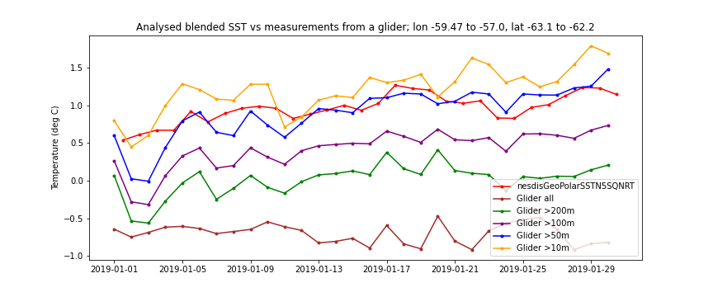
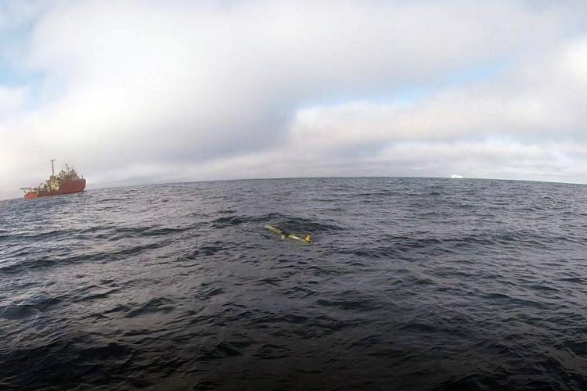
Sam Woodman, NOAA/SWFSC/AERD
Original project idea: explore how to ingest satellite data to improve situational awareness for our glider piloting.
Outcome: Use Python notebook to compare SST (NOAA Geo-Polar Blended Global Level 4) measurements with temperature measurements form AERD’s AMLR01 glider in Jan 2019

