Slide 1
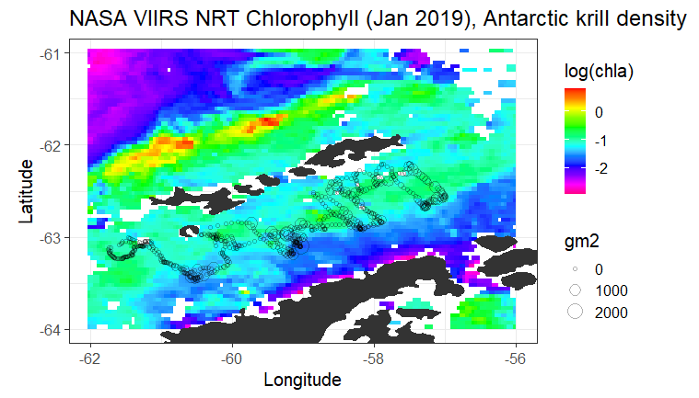
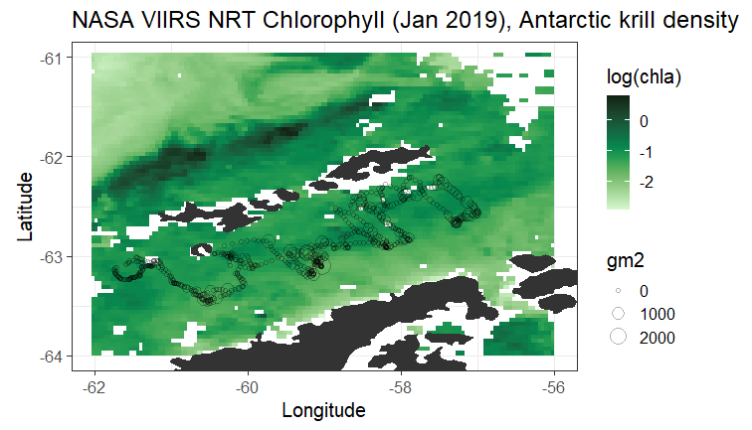
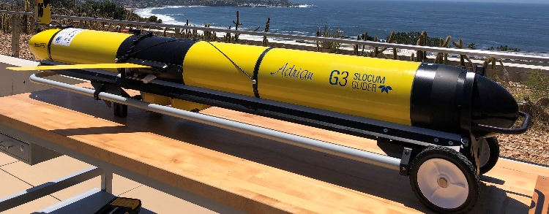
Jen Walsh: Final Project, CoastWatch Satellite Course May 2021
Chlorophyll a concentration (log) around the northern Antarctic Peninsula in January 2019 (monthly composite from NASA VIIRS Near-Real-Time, 4 km spatial resolution). Circles in the Bransfield Strait (area between the peninsula and the South Shetland Islands to the north) are Antarctic krill density values (g m⁻²) acoustically estimated from an autonomous underwater glider deployed from December 2018 – March 2019. Left plot is a rainbow palette, right plot is the “algae” palette from the cmocean package in R. Red circle on left plot highlights area of high krill density in a low chlorophyll area.
Glider (~8 ft)
Krill (~40 mm)

