Slide 1
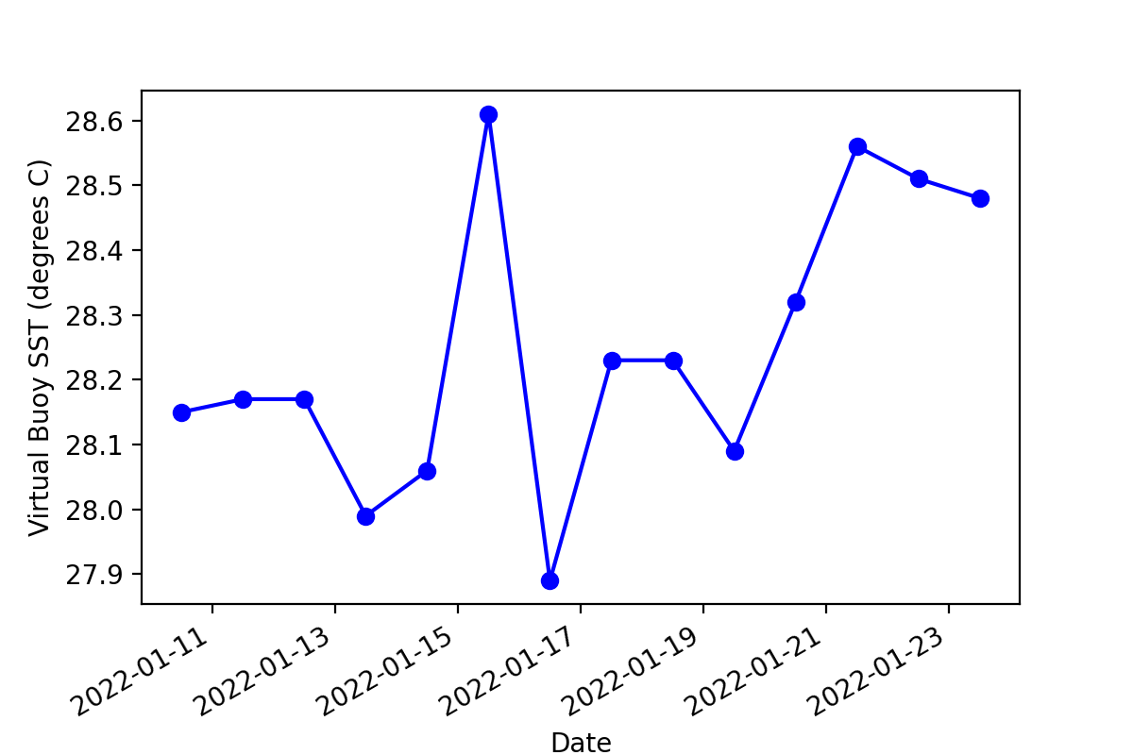
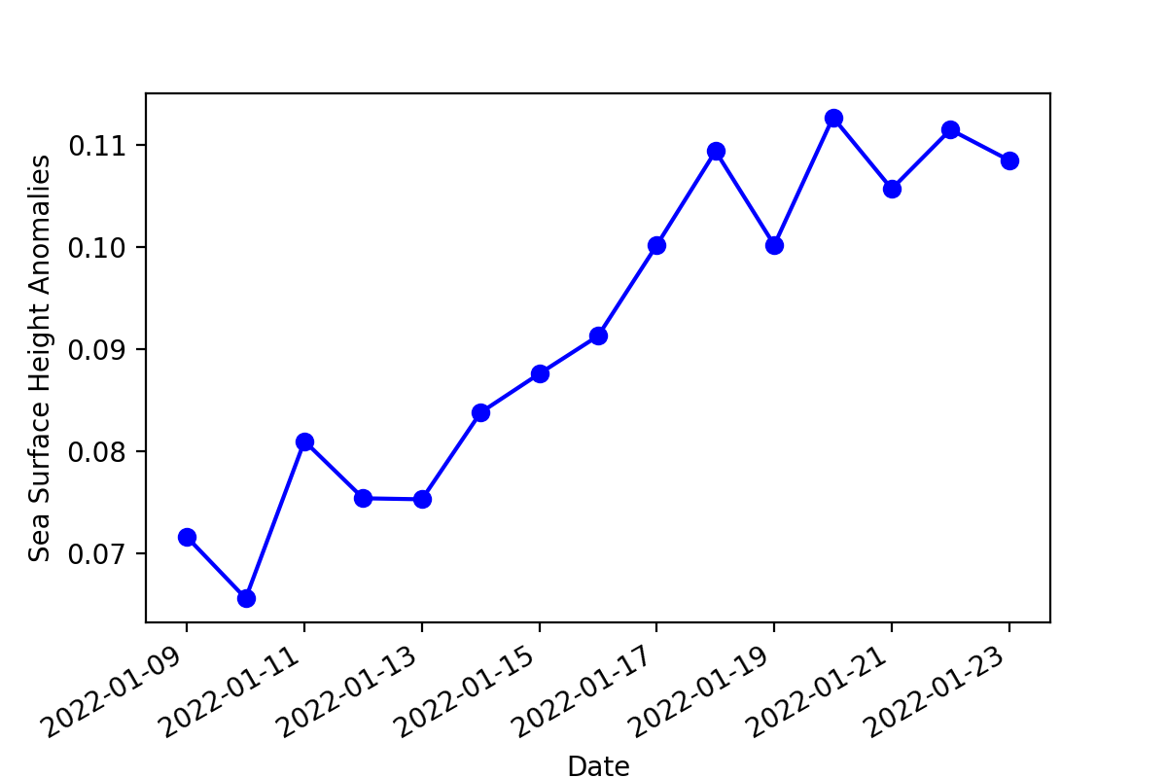
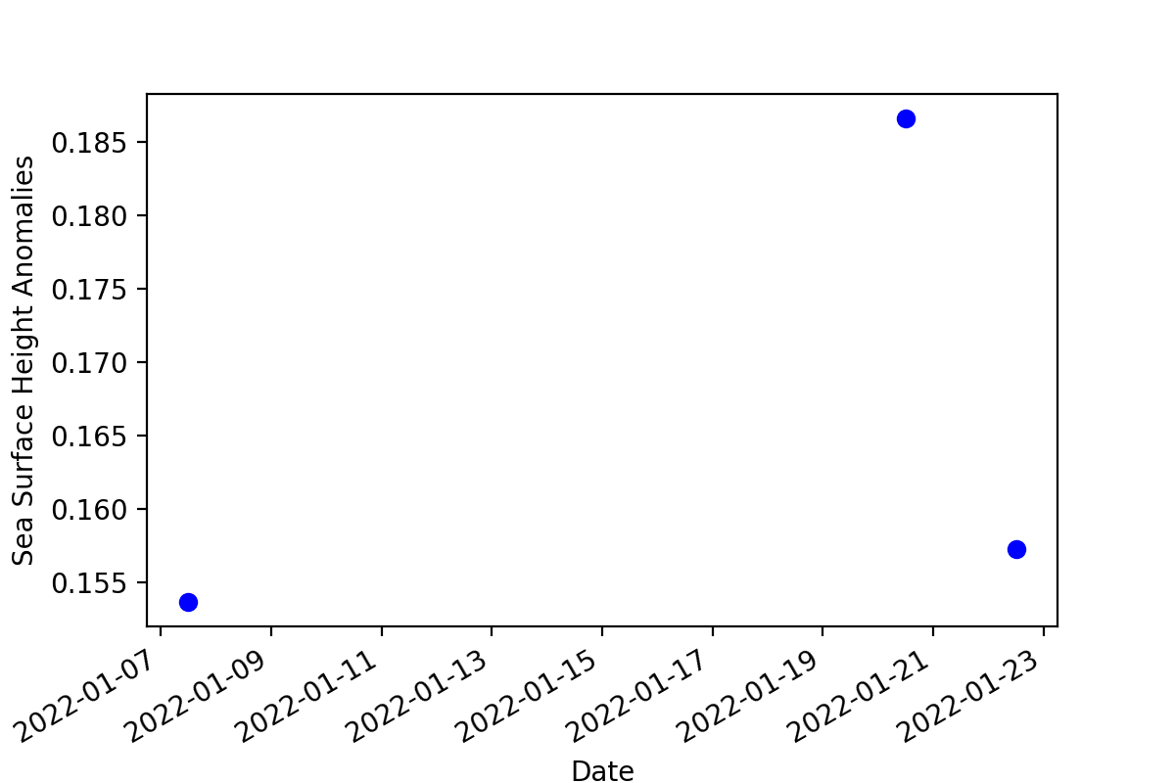
Will Drenta
NOAA CoastWatch Central
I decided to use this course to take a look at what the recent submarine volcanic eruption in Tonga did to the surrounding ocean.
I specifically used Python to create a virtual buoy at the epicenter of the eruption and noted the differences in the temperature, height, and clarity of the water before and after the eruption.
Datasets used:
NOAA GeoPolar SST Gap-Filled
NOAA CoastWatch Sea Surface Anomalies Height from Altimetry
NOAA VIIRS SNPP NRT KdPAR

