Slide 1
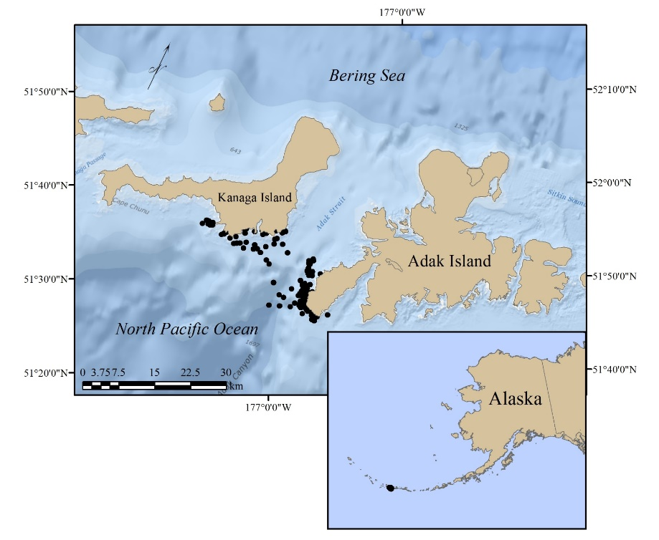
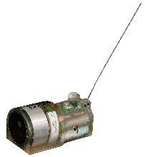
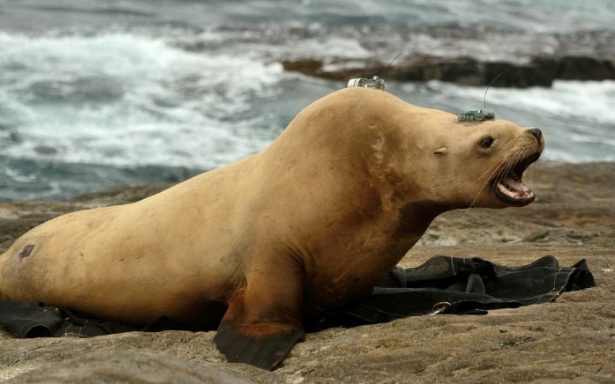
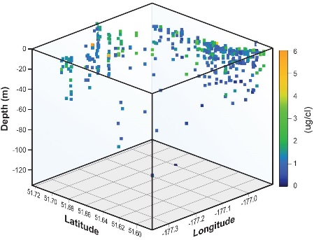
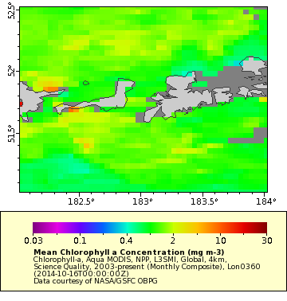
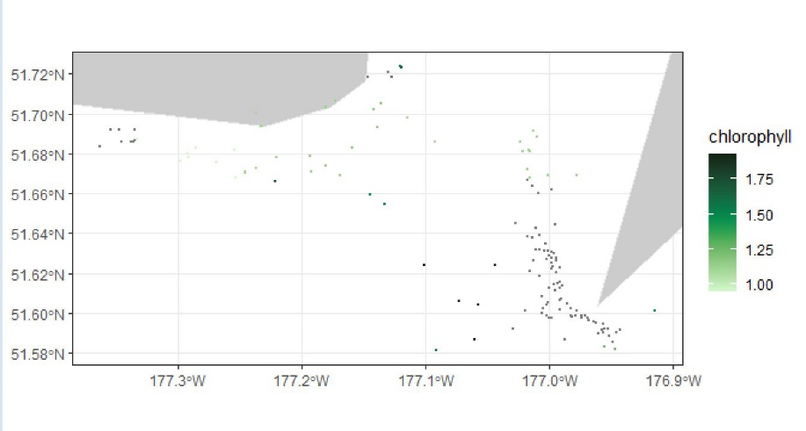
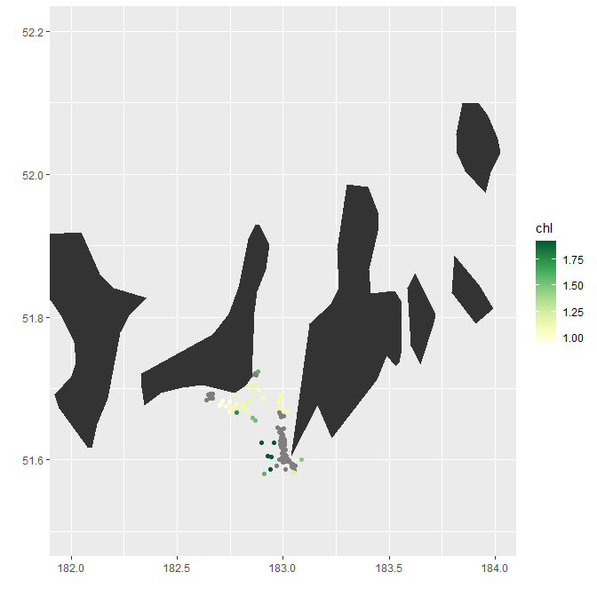
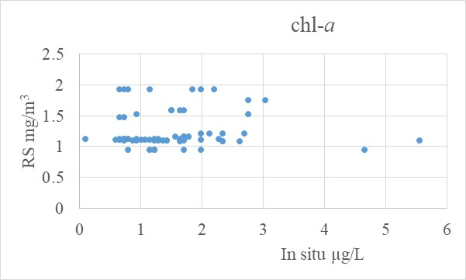
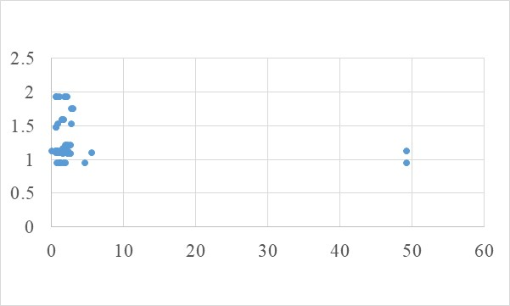
Michelle Lander
Marine Mammal Laboratory, Alaska Fisheries Science Center
NOAA CoastWatch Satellite Course 2022
Objective
Extract satellite remote sensing measurements of chlorophyll-a corresponding to locations for in situ measurements (n=190) for comparison
Alexey Altukhov
Lander et al. (2015); DOI:10.1186/s40317-015-0070-7
n=77
=
R software

