Slide 1
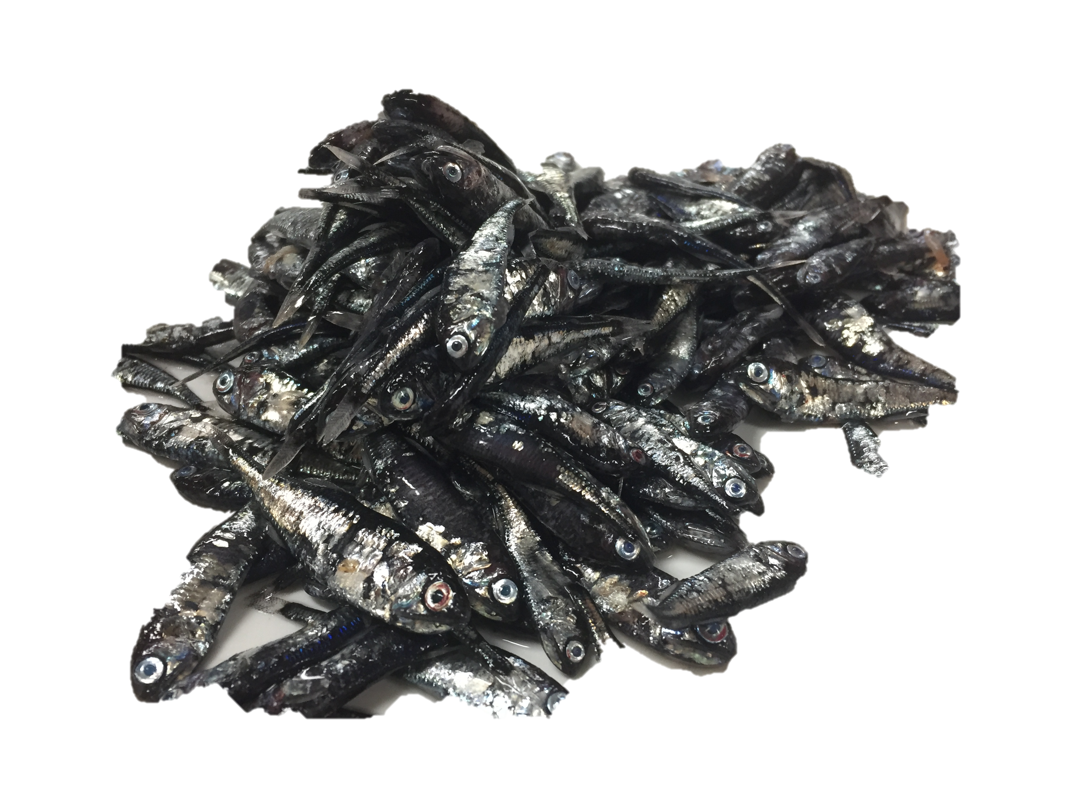
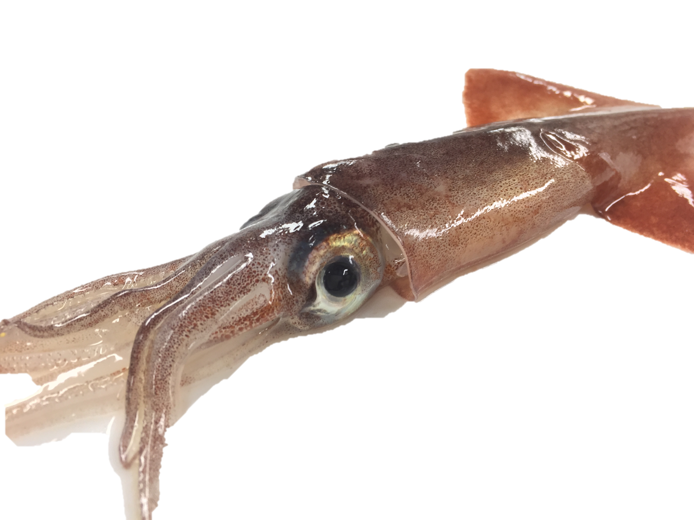
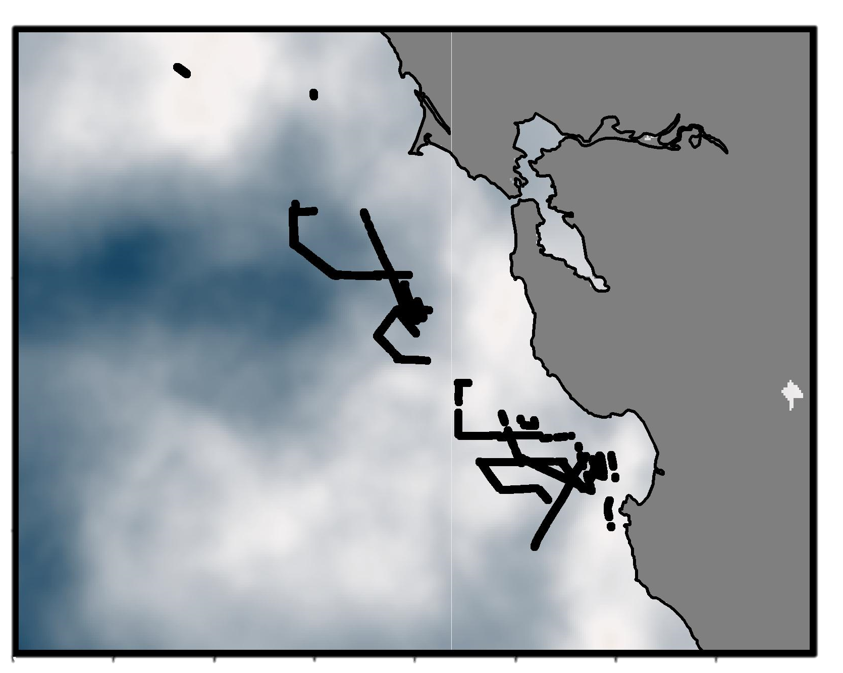
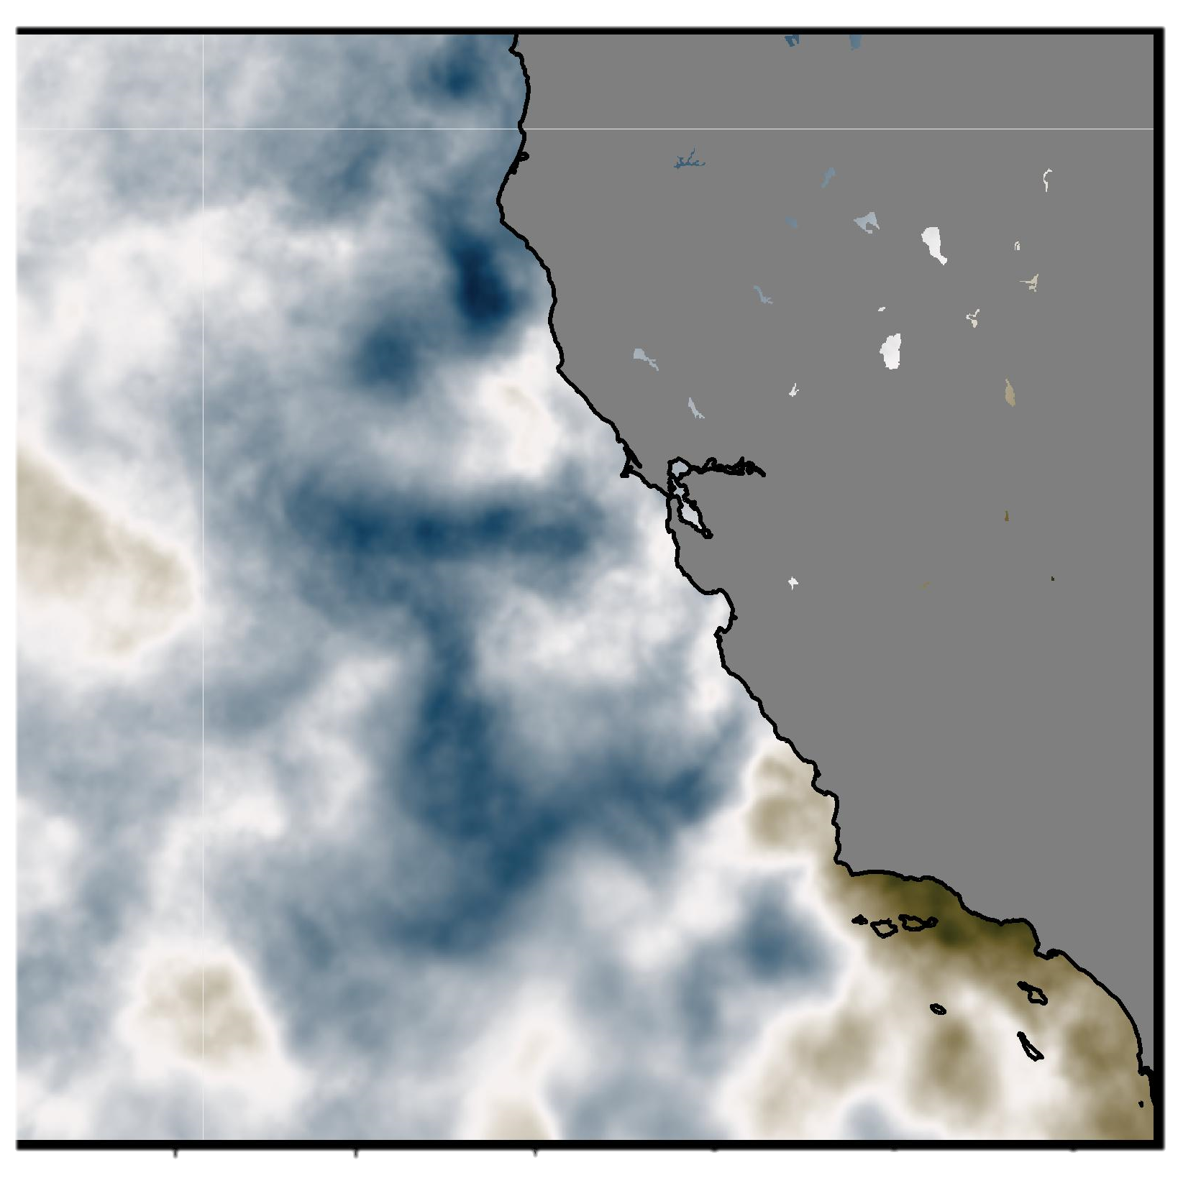
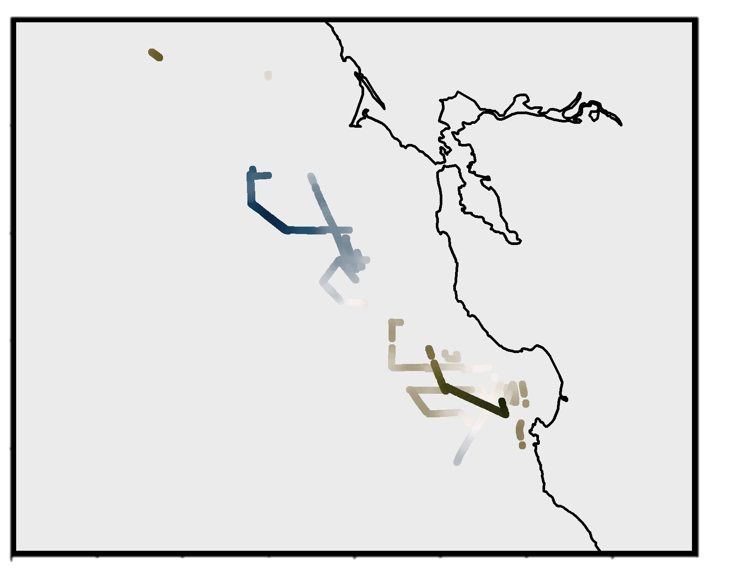
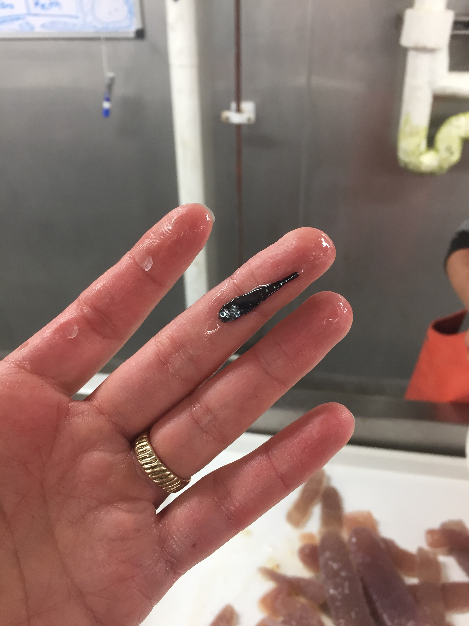
Effects of oceanographic variability on mesopelagic organisms within the California Current
Ily Iglesias
PhD Candidate in Ocean Sciences UCSC, affiliate NOAA NMFS SWFSC
2018
2017
2018
2013
2014
2015
SST Anomaly May
Chl-a May
Upwelling indices May
2016
2017
Data source: MODIS global science quality (4km)
2018
Data source: MUR blended (monthly)
Data source: MODIS aqua, global (monthly)
Data source: ASCAT-B MetOp (monthly)
Thank you!
Challenges: sub setting by time stamp (multiple years of data)

