Slide 1
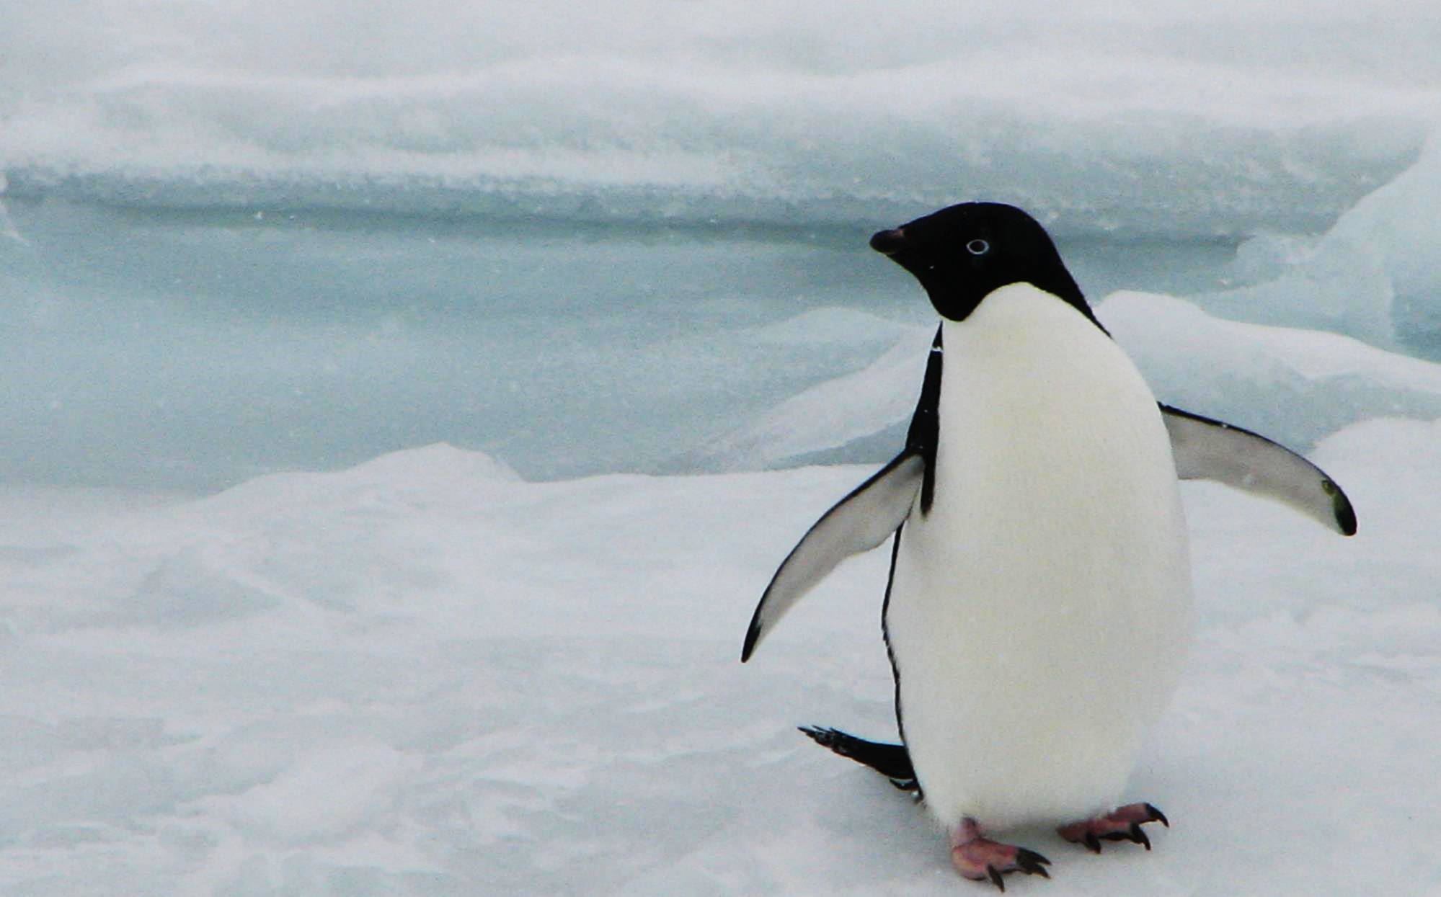
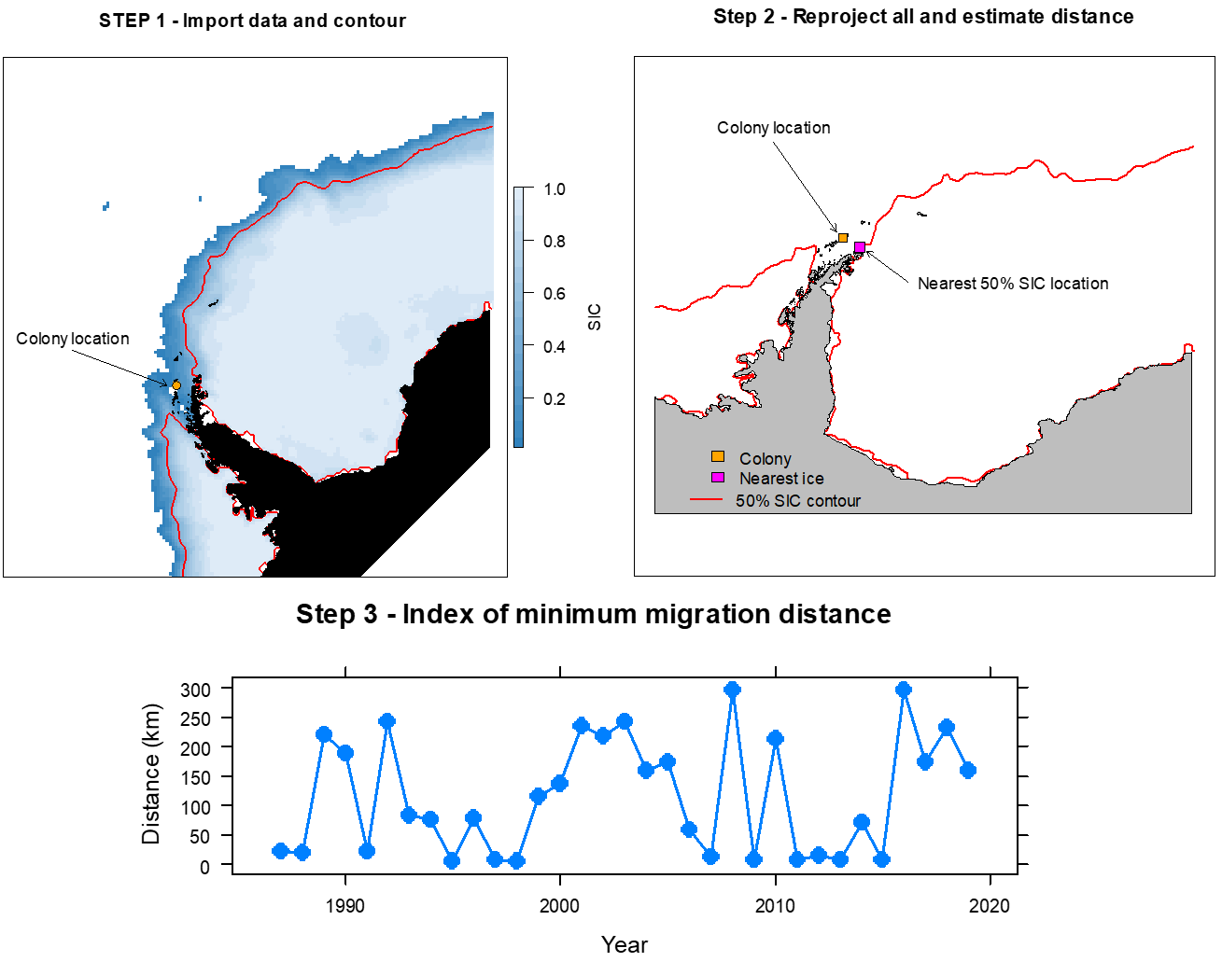
Jefferson Hinke – AERD/SFWSC
CoastWatch Satellite Course 3-7 May 2021
My project assessed the distance from a penguin breeding colony to the nearest location with a sea ice concentration (SIC) >=50% in September. Adélie penguins usually spend the winter in pack ice with SIC ≥50%.
In September, birds migrate from the ice to their colony. The travel distance from winter habitats to breeding sites may impact their reproductive success.
I estimated the annual minimum migration distance using NSIDC SIC data with 25km resolution available monthly from 1985-2019.
The pseudo code to do this is
Import a sector of SIC data: 90W to 0W and north of 90S
Estimate location of 50% SIC contour
Estimate distance from colony to nearest 50% contour position (blocking potential locations that require traversing mountain ranges).
Progress toward the index is illustrated in Steps 1 and 2 with data from September 2019. An index for all years is presented in Step 3.

