Slide 1
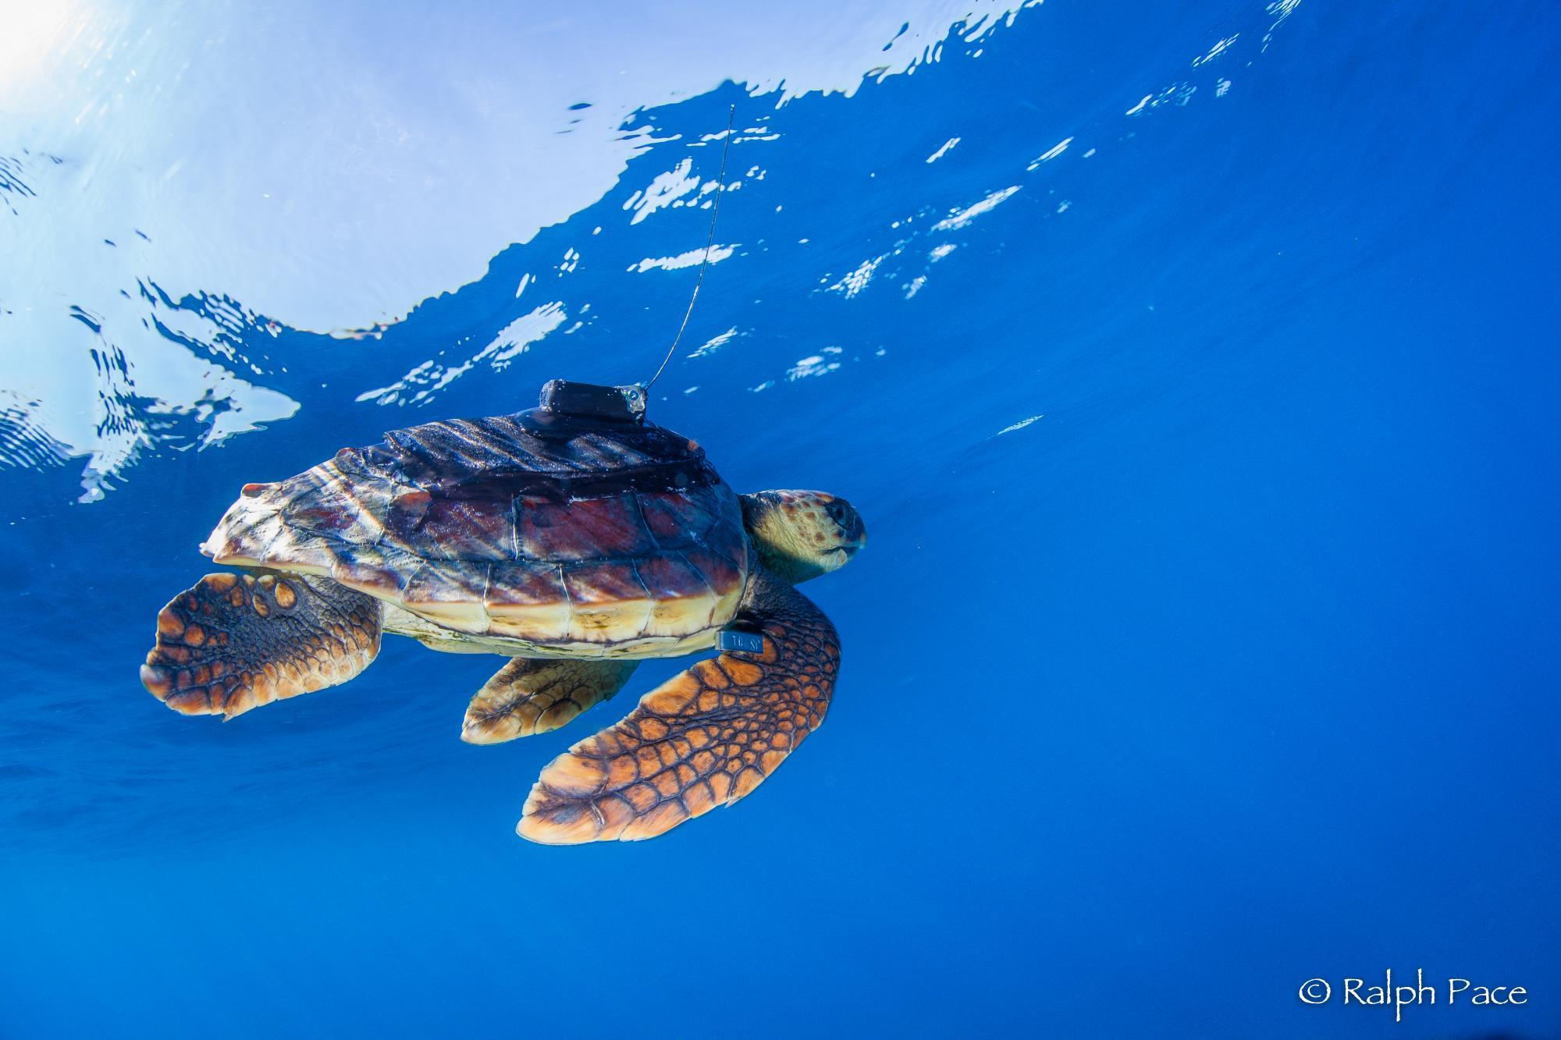
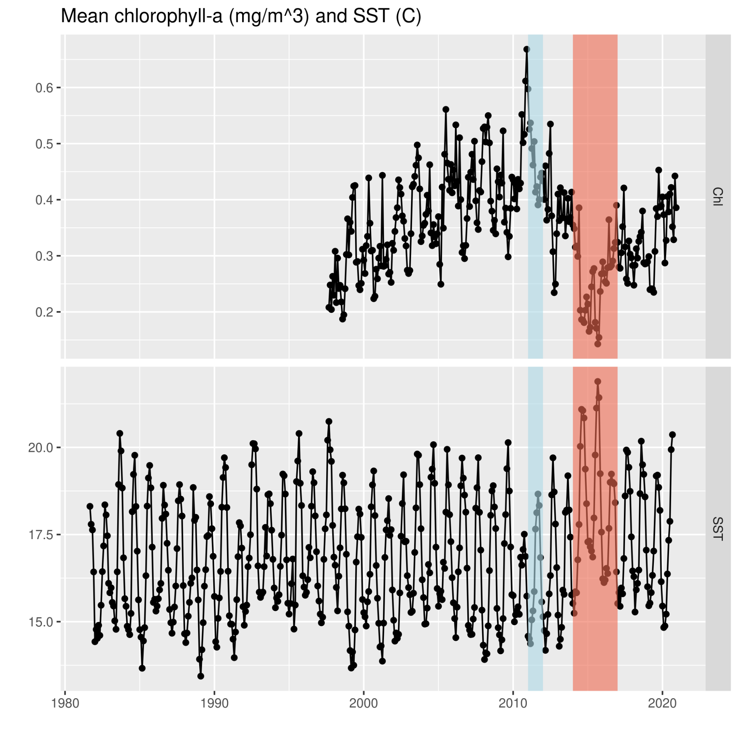
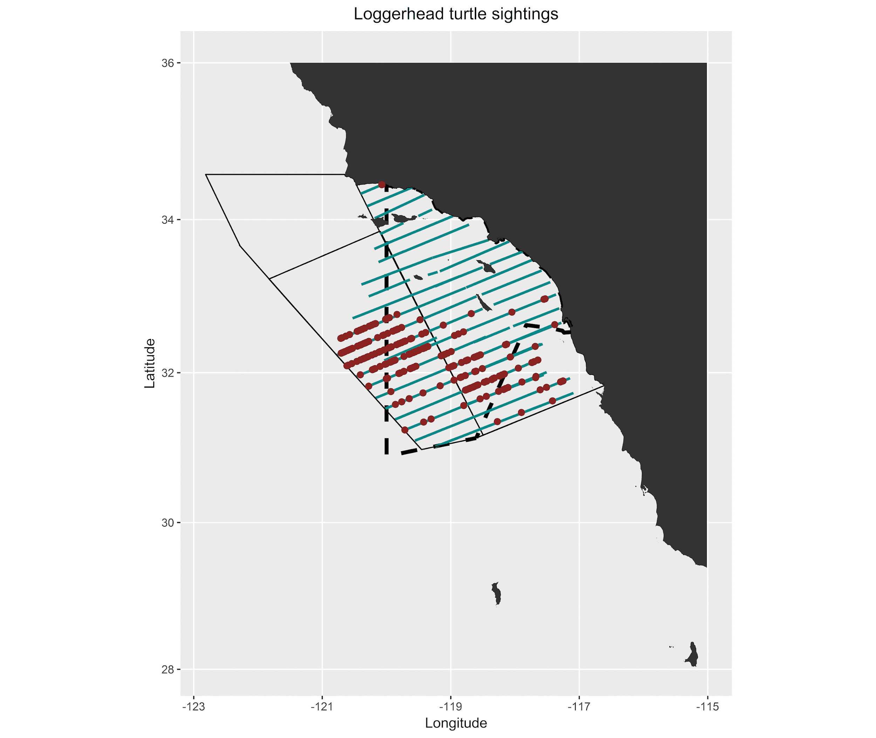
Tomo Eguchi (NOAA, SWFSC)
LAX
2015 Survey effort
European Space Agency, Climate Change Initiative, Ocean Color product: pmlEsaCCI50OceanColorMonthly
Advanced Very High Resolution Radiometer (AVHRR) Pathfinder Version 5.3: erdPH53sstnmday

