Slide 1
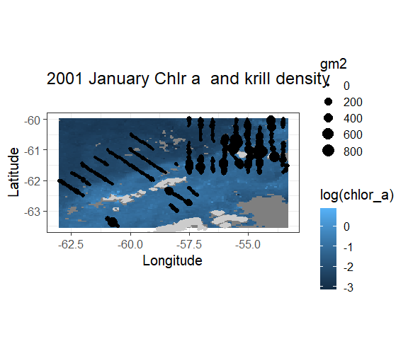
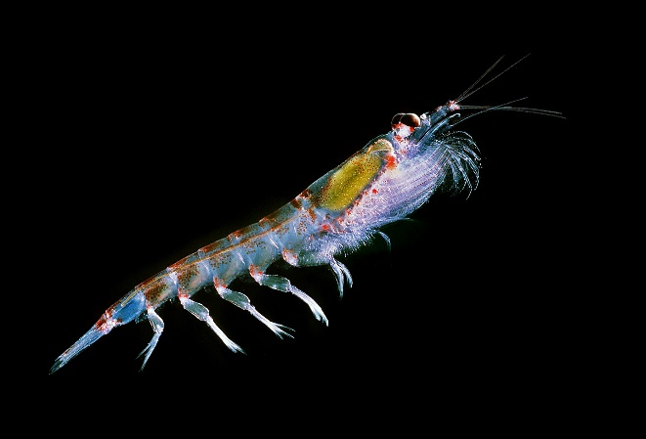
Anthony Cossio
NOAA/SWFSC/ AERD
My project was to see if there was a correlation between surface Chlorophyll a and Antarctic krill (Euphausia superba) densities.
I used the OC-CCI monthly composite satellite data and acoustic data from a time series. I plan to expand this to the full time series of acoustic data and look at other satellite products such as SST, sea ice, and SSS.

