Slide 1
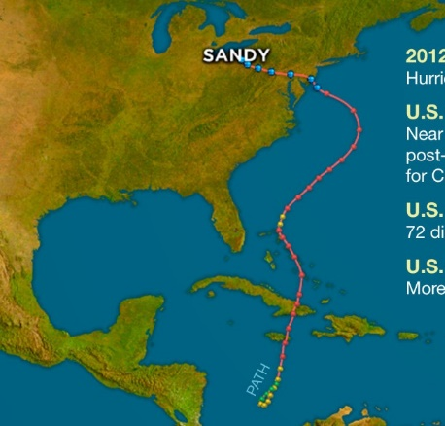
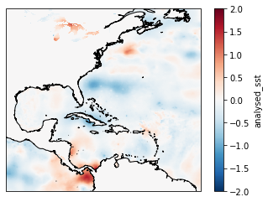
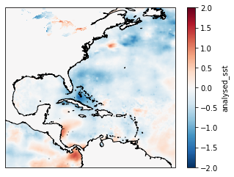
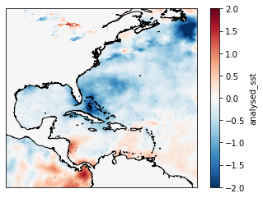
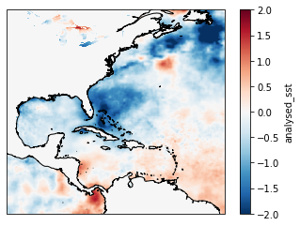
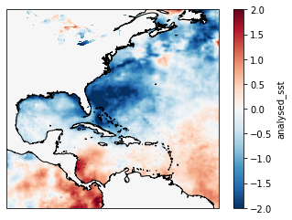
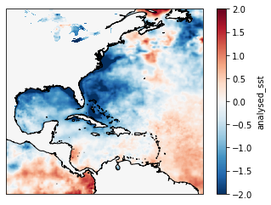
Event: Hurricane Sandy 2012 (10/23-10/29) Data set used: Global SST & Sea Ice Analysis, L4 OSTIA, Daily. Data ID: jplUKMO_OSTIAv20 Calculated: SST difference between 10/23 and each day after, until 10/29. Programming tool: Python
Hurricane Induced SST Cooling
Yan Hao IMSG@NOAA/NCEP/EMC
Day1
Day2
Day3
Day4
Day5
Day6

