Slide 1
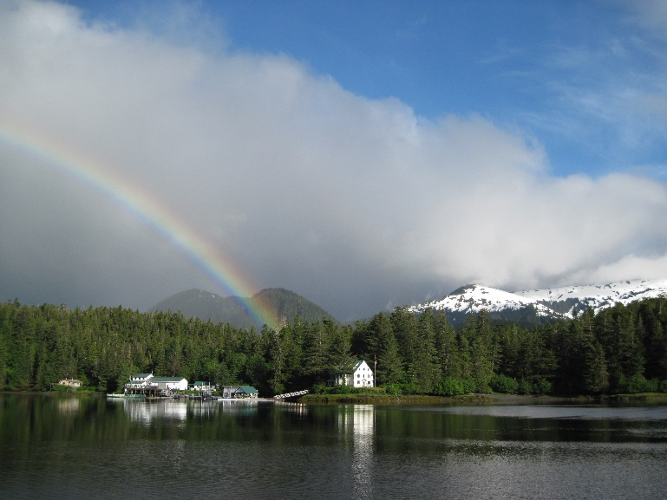
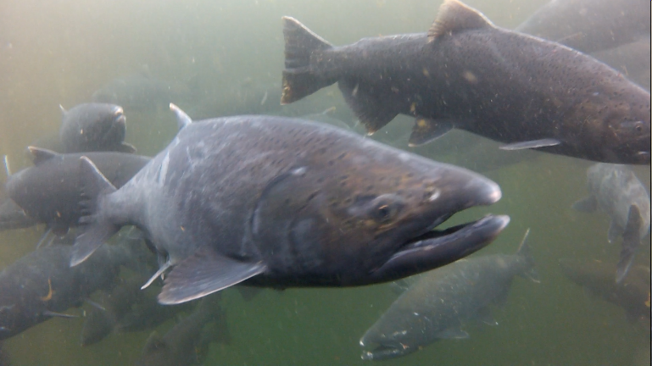
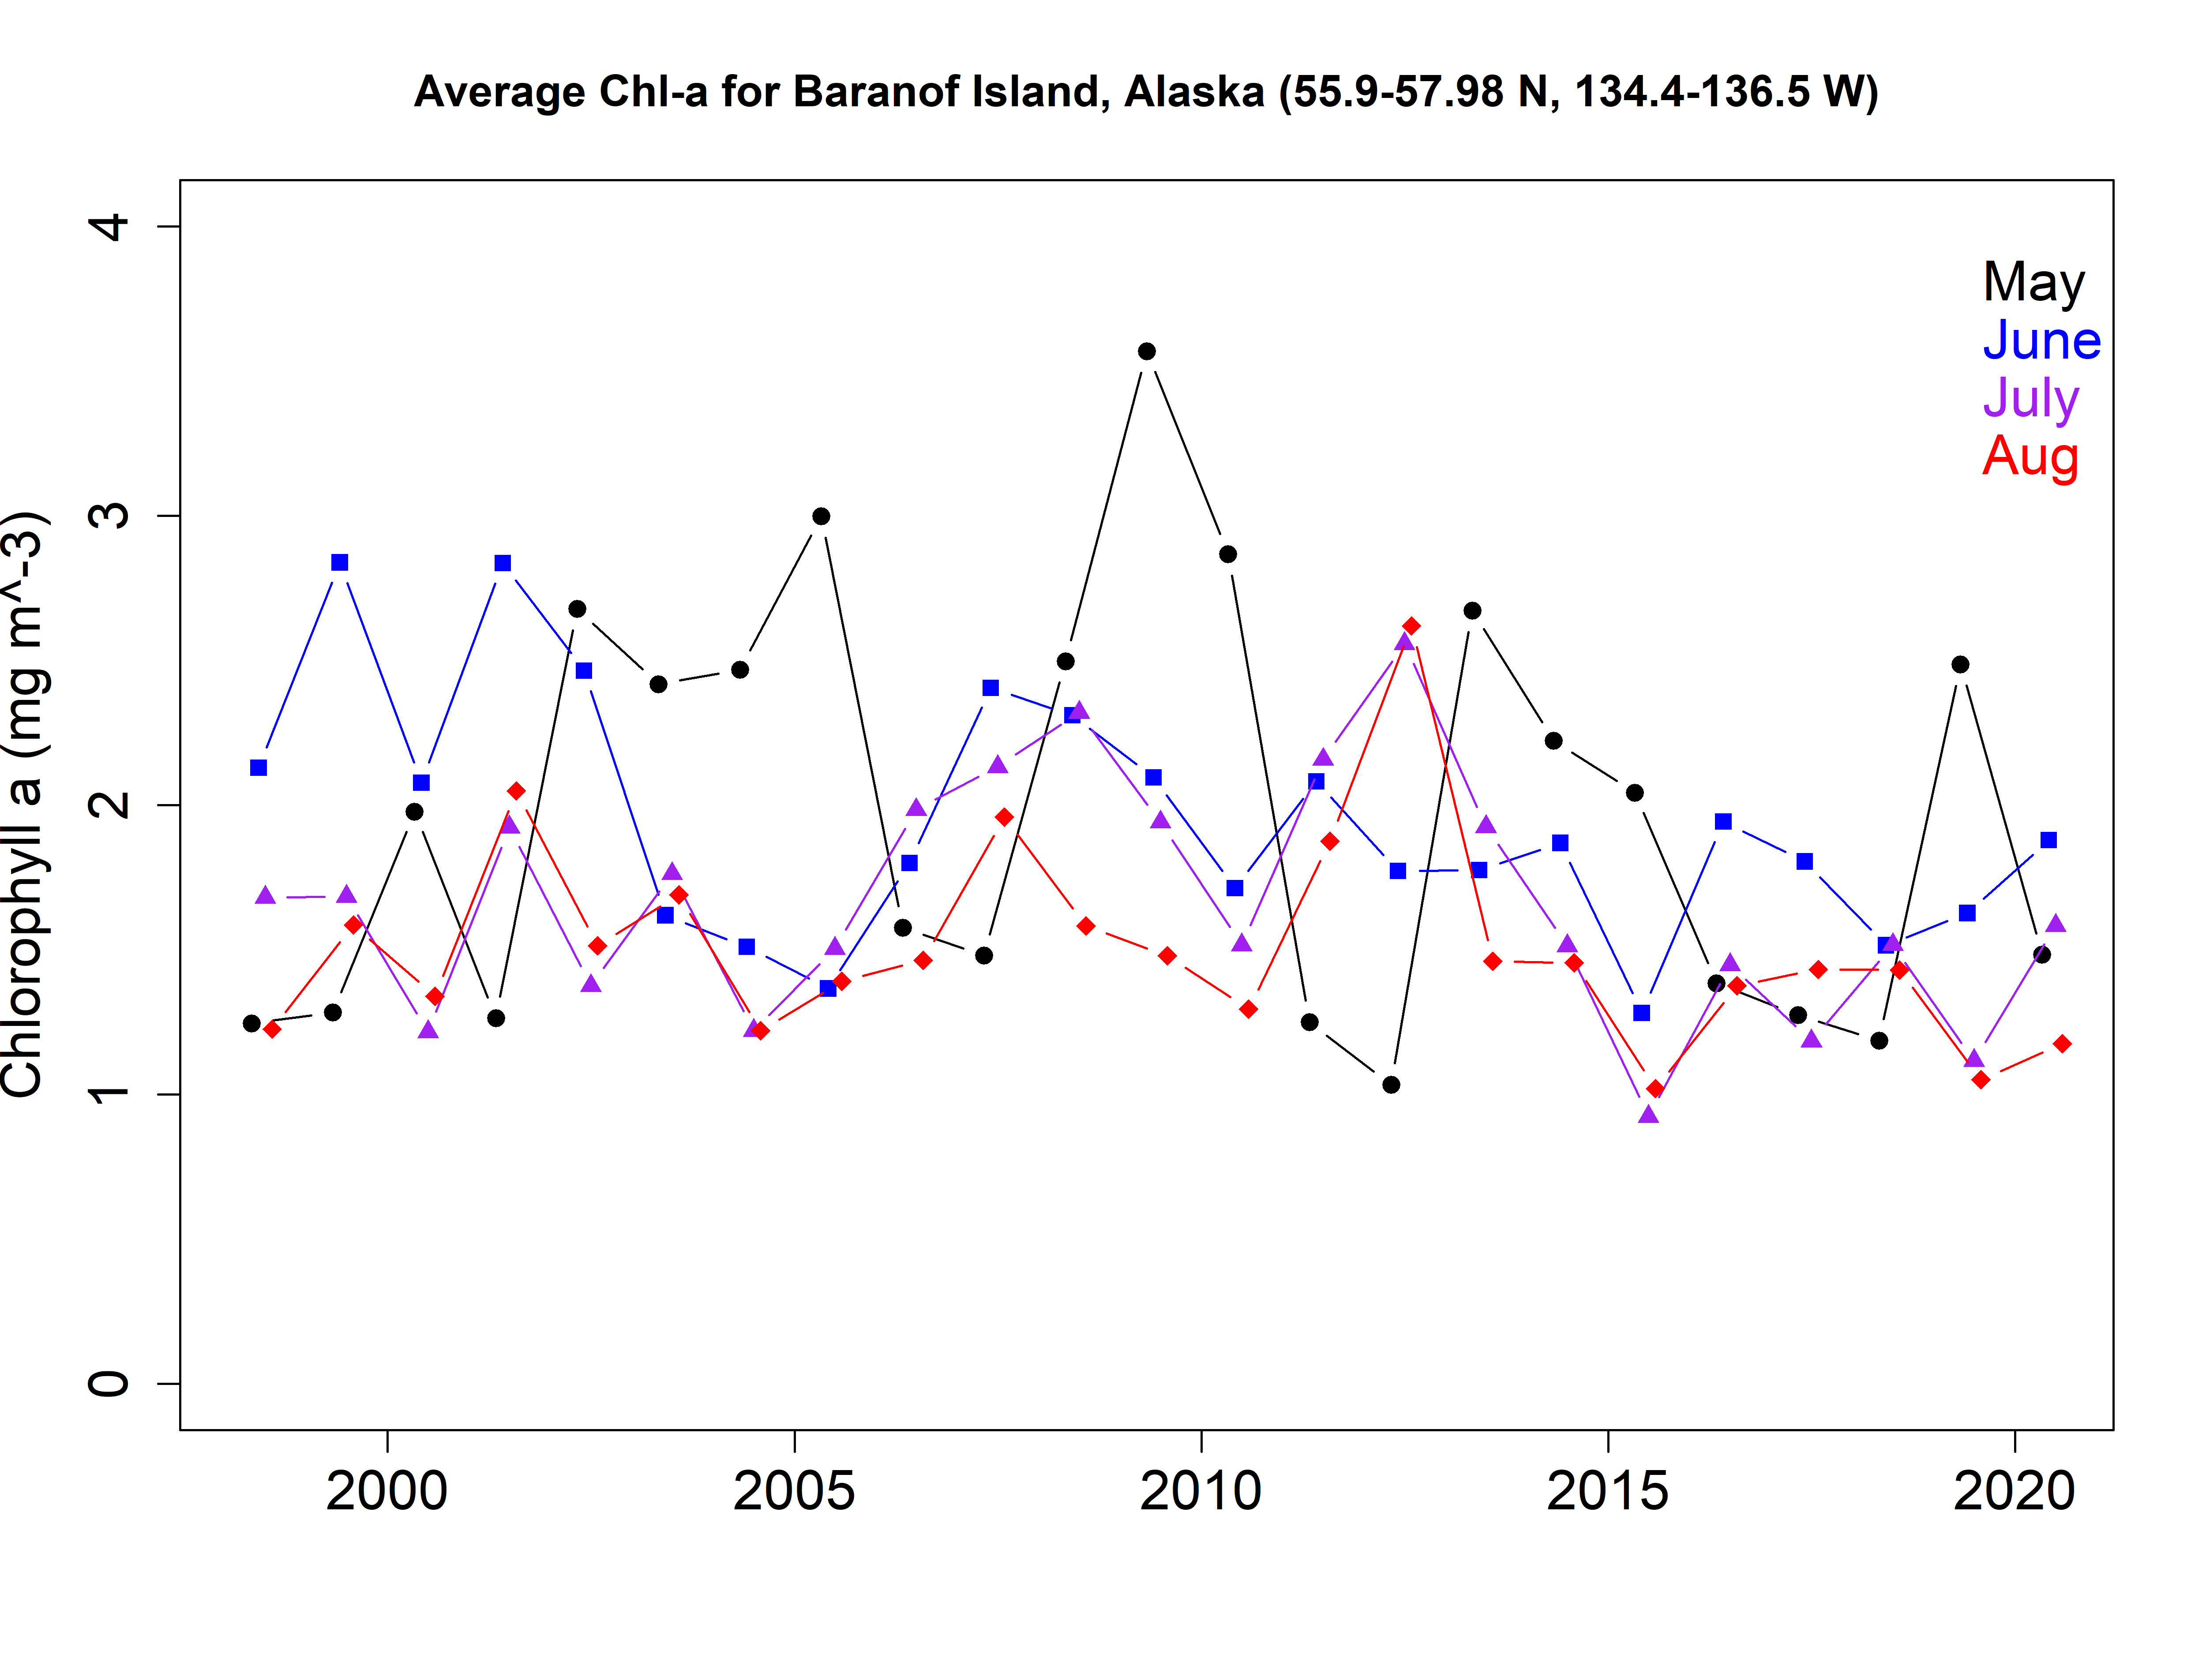
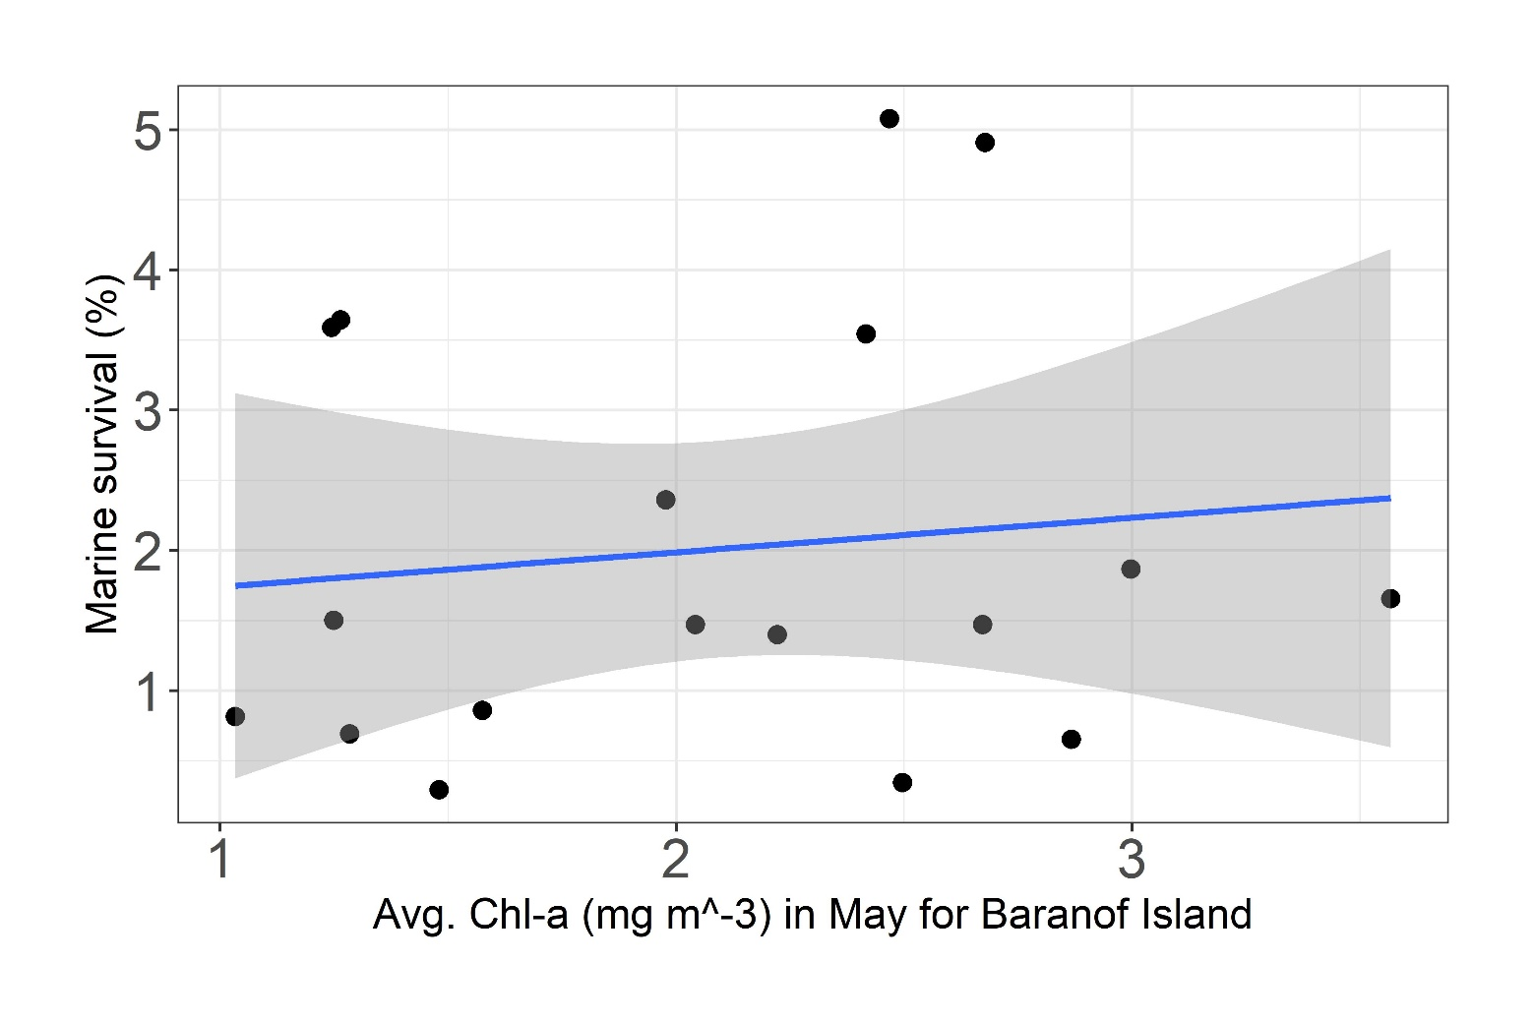
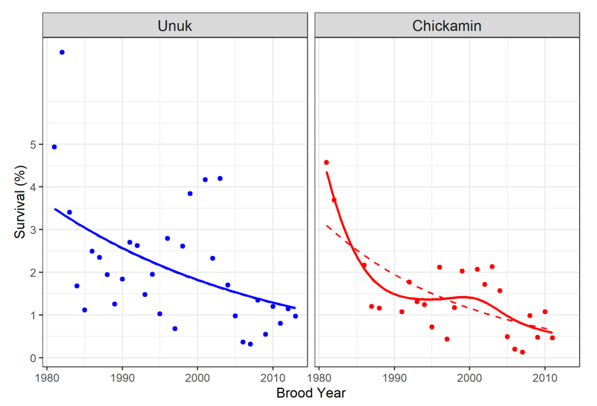
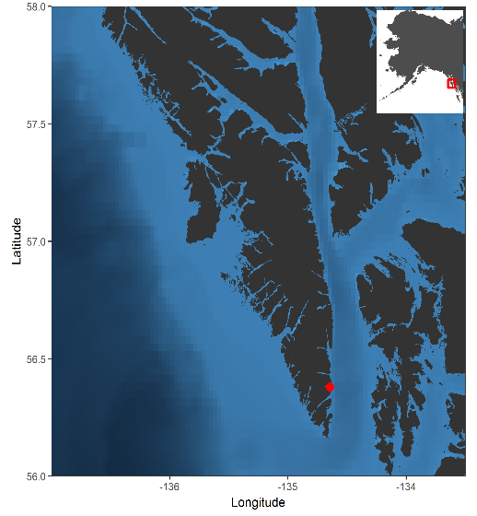
Influence of environmental factors on marine survival of Chinook salmon
Charlie Waters, Alaska Fisheries Science Center, Auke Bay Lab
Study system: Little Port Walter, AK Chinook salmon research hatchery 1976-2020 40+ years marine survival, declining over time
Aim: Assess influence of environmental factors on marine survival
First attempt: ESA OC-CCI dataset, Chl-a blended, 1997-present, 4km spatial res.
Next: NOAA AVHRR Optimum Interpolation v2.1, SST Anom., 1981-present, 5km res.
p=0.61

