Slide 1
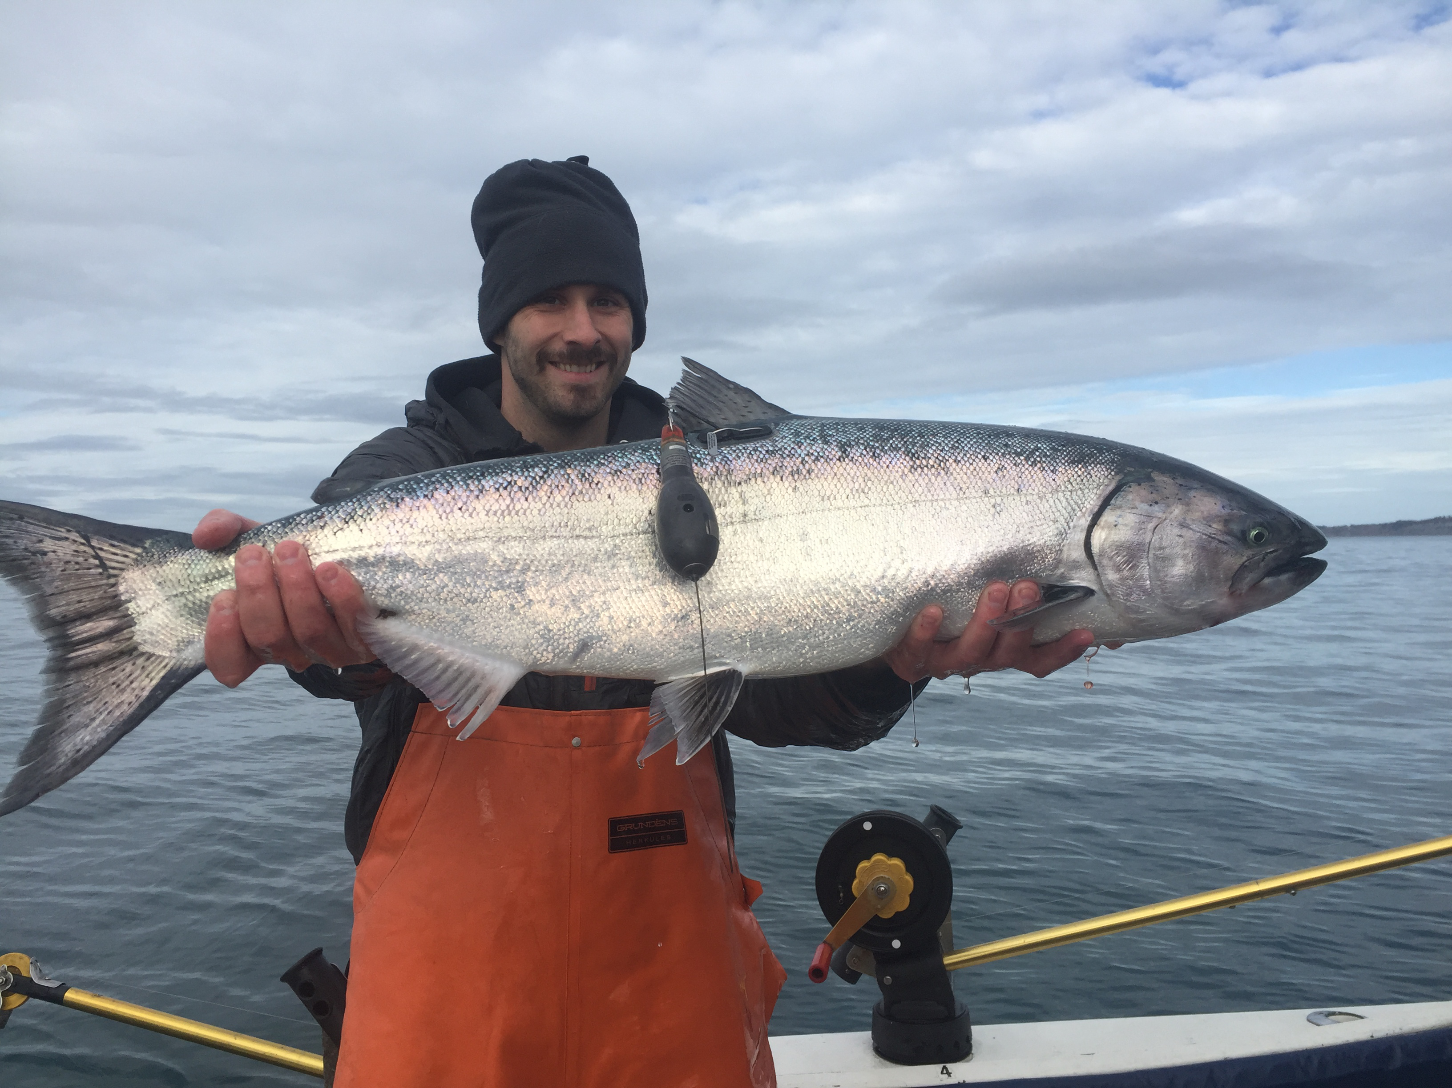
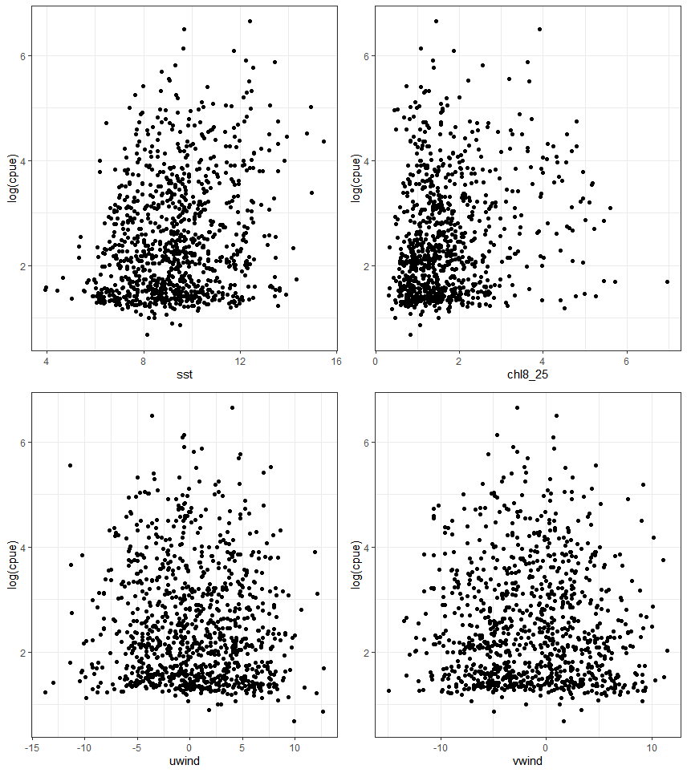
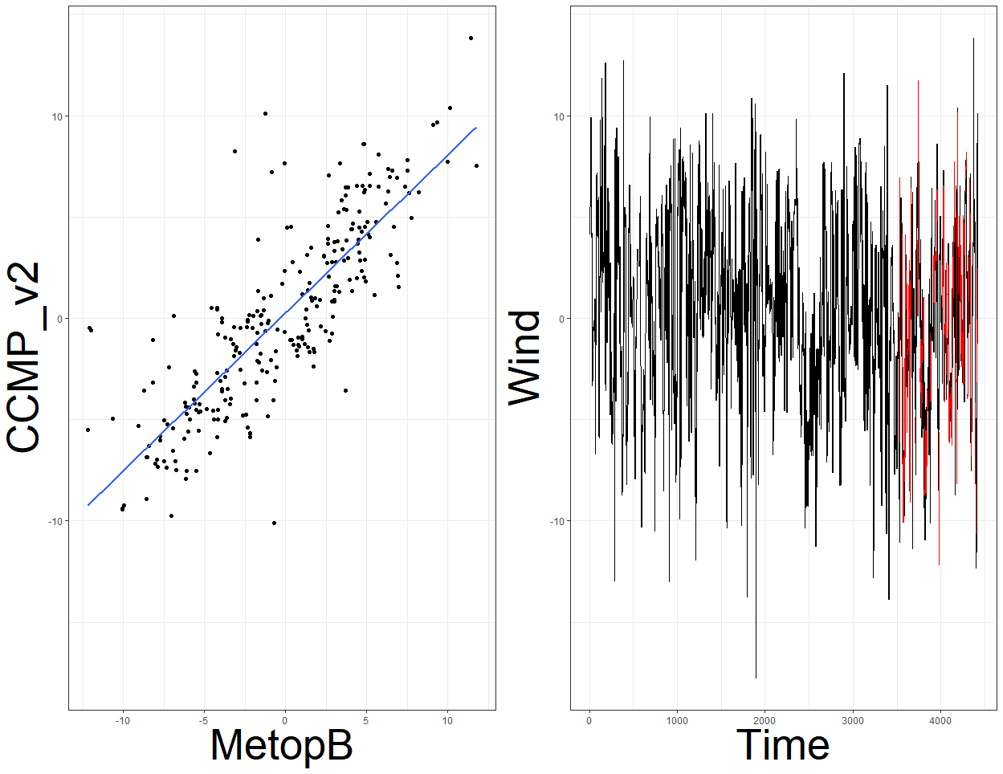
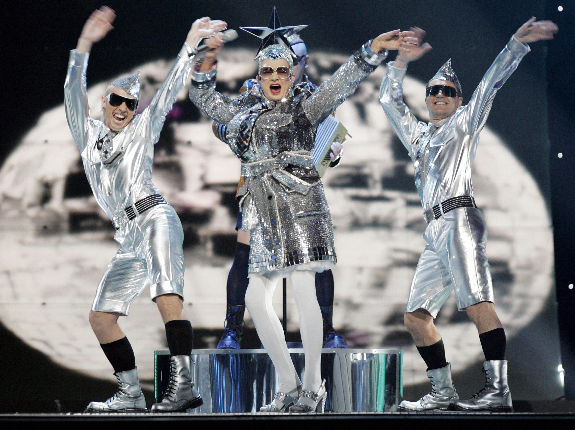
Environmental impacts on chinook salmon catch
Matt Callahan, AKFIN (NOAA-AFSC affiliate), R user
Data
Chinook CPUE from NOAA surveys
CRW SST
CCI 8 day chla
CCMP wind
Metop wind
Preliminary results
Nature hasn’t returned my calls.
sst
chl
Log CPUE
xwind
ywind
Challenges
Choosing dataset
Gap free
Real data
Long duration
Europe hogging EKE
Andy Seitz
CCMP
Metop
Next steps:
Finer spatial and temporal scales
Expand analysis to commercial fishing data within AKFIN

