Slide 1
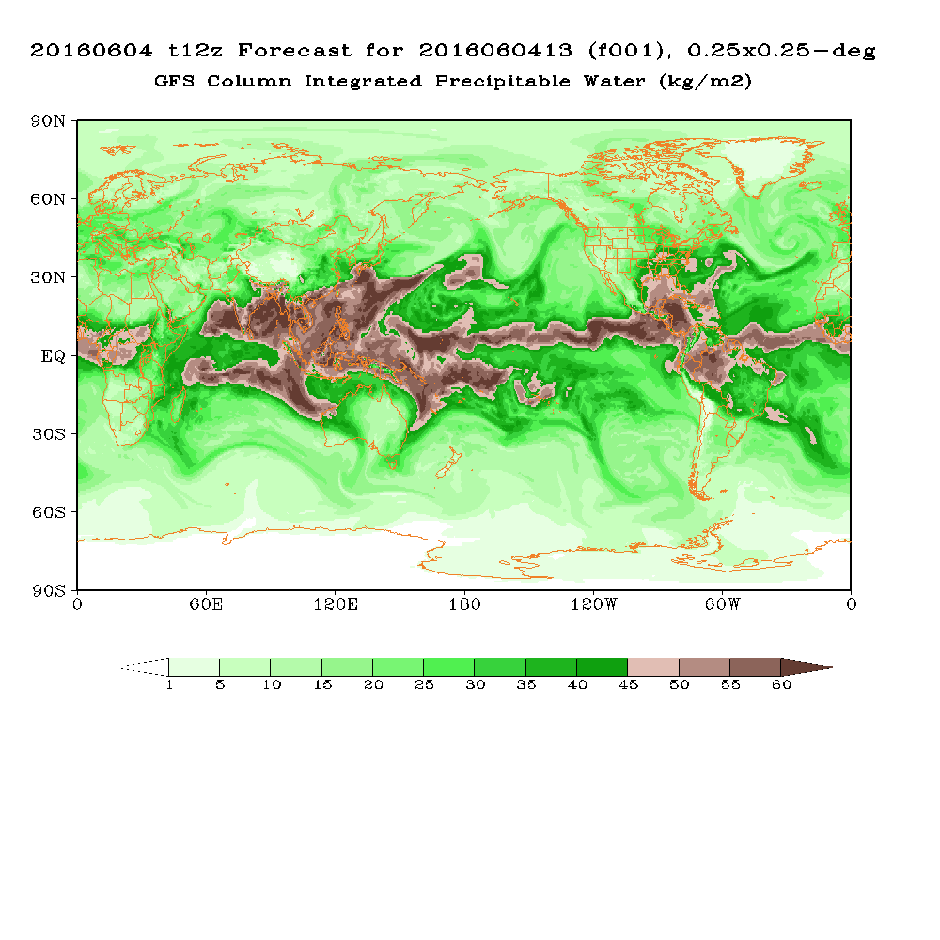
Review of GFS Forecast Skills in 2015
Colin
Fanglin Yang
IMSG - Environmental Modeling Center
National Centers for Environmental Prediction
Acknowledgments : All NCEP EMC Global Climate and Weather Modeling Branch members are acknowledged for their contributions to the development and application of the Global Forecast Systems. Disclaimer: The review does not cover all aspects of the complex system, and is biased towards the presenter’s personal experience.

Slide 2
Change History of GFS Configurations
Mon/Year |  | Levels | Truncations | Z-cor/dyncore | Major components upgrade
Aug 1980 | 12 |  | R30 (375km) | Sigma Eulerian | first global spectral model, rhomboidal
Oct 1983 | 12 |  | R40 (300km) | Sigma Eulerian
Apr 1985 | 18 |  | R40 (300km) | Sigma Eulerian | GFDL Physics
Aug 1987 | 18 |  | T80 (150km) | Sigma Eulerian | First triangular truncation; diurnal cycle
Mar 1991 | 18 |  | T126 (105km) | Sigma Eulerian
Aug 1993 | 28 |  | T126 (105km) | Sigma Eulerian | Arakawa-Schubert convection
Jun 1998 | 42 |  | T170 (80km) | Sigma Eulerian | Prognostic ozone; SW from GFDL to NASA
Oct 1998 | 28 |  | T170 (80km) | Sigma Eulerian | the restoration
Jan 2000 | 42 |  | T170 (80km) | Sigma Eulerian | first on IBM
Oct 2002 | 64 |  | T254 (55km) | Sigma Eulerian | RRTM LW;
May 2005 | 64 |  | T382 (35km) | Sigma Eulerian | 2L OSU to 4L NOAH LSM; high-res to 180hr
May 2007 | 64 |  | T382 (35km) | Hybrid Eulerian | SSI to GSI
Jul 2010 | 64 |  | T574 (23km) | Hybrid Eulerian | RRTM SW; New shallow cnvtion; TVD tracer
Jan 2015 | 64 |  | T1534 (13km) | Hybrid Semi-Lag | SLG; Hybrid EDMF; McICA etc
May2016 | 64 |  | T1534 (13km) | Hybrid Semi-Lag | 4-D Hybrid En-Var DA
Vertical layers double every ~11 yrs; change of horizontal resolution is rapid (~30 times in 35 years); sigma-Eulerian used for 27 yrs!
2
Source http://www.emc.ncep.noaa.gov/gmb/STATS/html/model_changes.html

Slide 3
Major GFS Changes
3/1999
AMSU-A and HIRS-3 data
2/2000
Resolution change: T126L28 → T170L42 (100 km → 70 km)
Next changes
7/2000 (hurricane relocation)
8/2000 (data cutoff for 06 and 18 UTC)
10/2000 – package of minor changes
2/2001 – radiance and moisture analysis changes
5/2001
Major physics upgrade (prognostic cloud water, cumulus momentum transport)
Improved QC for AMSU radiances
Next changes
6/2001 – vegetation fraction
7/2001 – SST satellite data
8/200 – sea ice mask, gravity wave drag adjustment, random cloud tops, land surface evaporation, cloud microphysics…)
10/ 2001 – snow depth from model background
1/2002 – Quikscat included

Slide 4
Major GFS Changes (cont’d)
11/2002
Resolution change: T170L42 → T254L64 (70 km → 55 km)
Recomputed background error
Divergence tendency constraint in tropics turned off
Next changes
3/2003 – NOAA-17 radiances, NOAA-16 AMSU restored, Quikscat 0.5 degree data
8/2003 – RRTM longwave and trace gases
10/2003 – NOAA-17 AMSU-A turned off
11/2003 – Minor analysis changes
2/2004 – mountain blocking added
5/2004 – NOAA-16 HIRS turned off
5/2005
Resolution change: T254L64 → T382L64 ( 55 km → 38 km )
2-L OSU LSM → 4-L NOHA LSM
Reduce background vertical diffusion
Retune mountain blocking
Next changes
6/2005 – Increase vegetation canopy resistance
7/2005 – Correct temperature error near top of model

Slide 5
Major GFS Changes (cont’d)
8/2006
Revised orography and land-sea mask
NRL ozone physics
Upgrade snow analysis
5/2007
SSI (Spectral Statistical Interpolation) → GSI ( Gridpoint Statistical Interpolation).
Vertical coordinate changed from sigma to hybrid sigma-pressure
New observations (COSMIC, full resolution AIRS, METOP HIRS, AMSU-A and MHS)
12/2007
JMA high resolution winds and SBUV-8 ozone observations added
2/2009
Flow-dependent weighting of background error variances
Variational Quality Control
METOP IASI observations added
Updated Community Radiative Transfer Model coefficients
7/2010
Resolution Change: T382L64 → T574L64 ( 38 km → 23 km )
Major radiation package upgrade (RRTM2 , aerosol, surface albedo etc)
New mass flux shallow convection scheme; revised deep convection and PBL scheme
Positive-definite tracer transport scheme to remove negative water vapor

Slide 6
Major GFS Changes (cont’d)
05/09/2011
GSI: Improved OMI QC; Retune SBUV/2 ozone ob errors; Relax AMSU-A Channel 5 QC; New version of CRTM 2.0.2 ; Inclusion of GPS RO data from SAC-C, C/NOFS and TerraSAR-X satellites; Inclusion of uniform (higher resolution) thinning for satellite radiances ; Improved GSI code with optimization and additional options; Recomputed background errors; Inclusion of SBUV and MHS from NOAA-19 and removal of AMSU-A NOAA-15 .
GFS: New Thermal Roughness Length -- Reduced land surface skin temperature cold bias and low level summer warm bias over arid land areas; Reduce background diffusion in the Stratosphere .
5/22/2012
GSI Hybrid EnKF-3DVAR : A hybrid variational ensemble assimilation system is employed. The background error used to project the information in the observations into the analysis is created by a combination of a static background error (as in the prior system) and a new background error produced from a lower resolution (T254) Ensemble Kalman Filter.
Other GSI Changes: Use GPS RO bending angle rather than refractivity; Include compressibility factors for atmosphere ; Retune SBUV ob errors, fix bug at top ; Update radiance usage flags; Add NPP ATMS satellite data, GOES-13/15 radiance data, and SEVERI CSBT radiance product ; Include satellite monitoring statistics code in operations ; Add new satellite wind data and quality control.
09/05/2012
GFS : A look-up table used in the land surface scheme to control Minimum Canopy Resistance and Root Depth Number was updated to reduce excessive evaporation. This update was aimed to mitigate GFS cold and moist biases found in the late afternoon over the central United States when drought conditions existed in summer of 2012.

Slide 7
Major GFS Changes (cont’d)
07-08/2013
- GFS was moved from IBM CCS to WCOSS supercomputers. They two systems have different architectures.
GSI change on August 20: New satellite data, including METOP-B, SEVIRI data from Meteosat-10, and NPP CrIS data.
01/14/2015
Upgrade to T1534 Semi-Lagrangian (~13km) : Use Lagrangian instead Hermite vertical interpolation; Use high resolution daily RGT SST and daily sea ice analysis; Extend high resolution forecast from 8 days to 10 days; Use McICA radiation approximation; Reduced drag coefficient at high wind speeds; Hybrid EDMF PBL scheme and TKE dissipative heating; Retuned ice and water cloud conversion rates, background diffusion of momentum and heat, orographic gravity-wave forcing and mountain block; Updated physics restart and sigio library; Consistent diagnosis of snow accumulation in post and model; Compute and output frozen precipitation fraction; Divergence damping in the stratosphere to reduce noise; Added a tracer fixer for maintaining global column ozone mass; Stationary convective gravity wave drag; New blended snow analysis to reduce reliance on AFWA snow; Changes to treatment of lake ice to remove unfrozen lake in winter; Modified initialization to reduce a sharp decrease in cloud water in the first model time step; Replace Bucket soil moisture climatology with CFS/GLDAS; Add vegetation dependence to the ratio of the thermal and momentum roughness.
GSI Changes: increase horizontal resolution of ensemble from T254 to T574; reduce number of second outer loop iterations from 150 to 100; upgrade to CRTM v2.1.3 ; move to enhanced radiance bias correction scheme; correct bug in AMSU-A cloud liquid water bias correction term; assimilate new radiances: F17 an F18 SSMIS, MetOp-B IASI ; increase ATMS observation errors; turn on cloud detection channels for monitored instruments: NOAA-17, -19 HIRS, GOES-13 and -14 sounders; changes in assimilation of atmospheric motion vectors (AMV): assimilate NESDIS GOES hourly AMVs, improve AMV quality control ; improve GPS RO quality control .
7

Slide 8
Major GFS Changes (cont’d)
05/11/2016
- Data Assimilation Upgrade * Upgrade the 3D Hybrid Ensemble-Variational to 4D Hybrid Ensemble-Variational Data Assimilation. * Multivariate Ozone update * Assimilate all-sky (clear and cloudy) radiances * Bias correct aircraft data * Modify relocation and storm tracking to allow hourly tropical cyclone relocation * other upgrades (e.g. CRTM, Data selection/thinning, AMV winds, etc.)
-Model Upgrade * Corrections to land surface to reduce summertime warm, dry bias over Great Plains * Hourly output fields through 120-hr forecasts * add five more levels from 10 hPa to 1 hPa in post-processed pgb files
8

Slide 9
2015 Performance Stats

Slide 10
2005 Annual Mean 500-hPa HGT AC
NH
SH

Slide 11
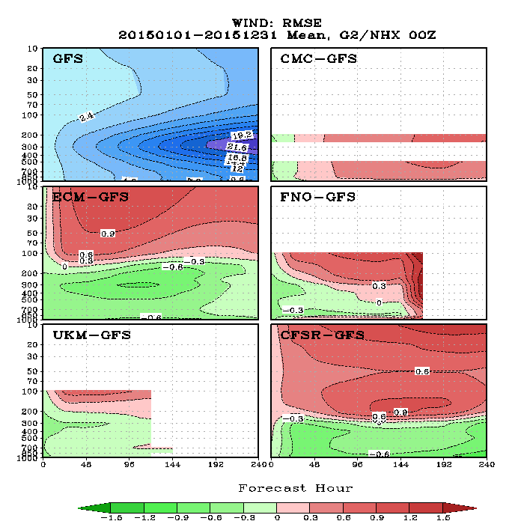
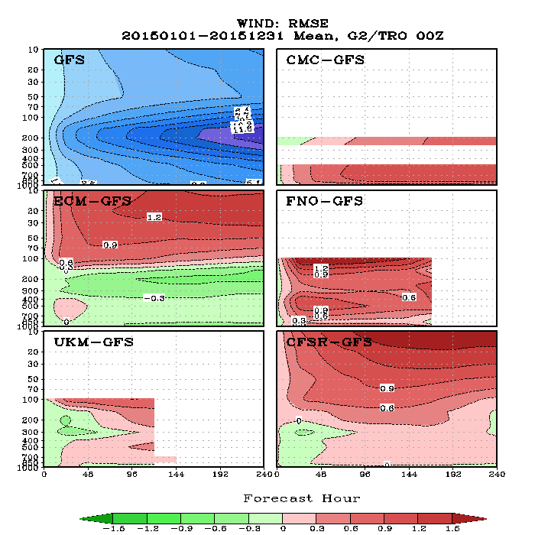
2005 Annual Mean Wind RMSE
Tropics
NH
http://www.emc.ncep.noaa.gov/gmb/STATS_vsdb/annual/2015/www/scorecard/mainindex.html Scorecard

Slide 12
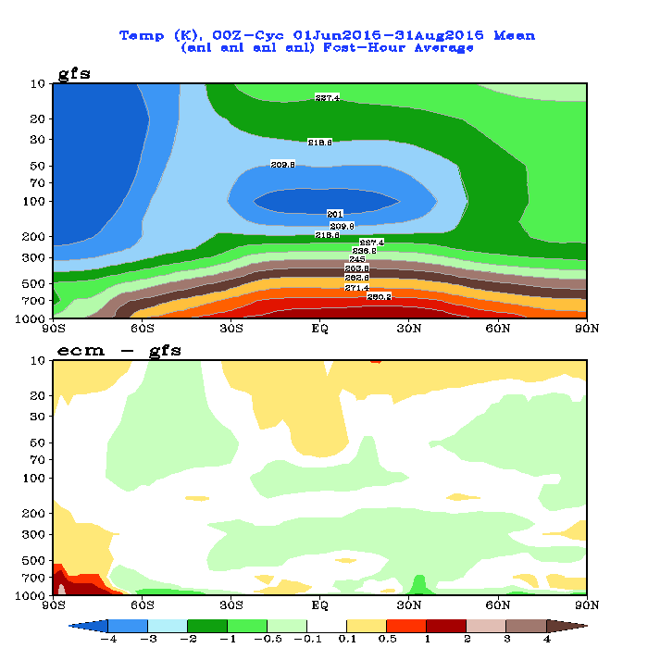
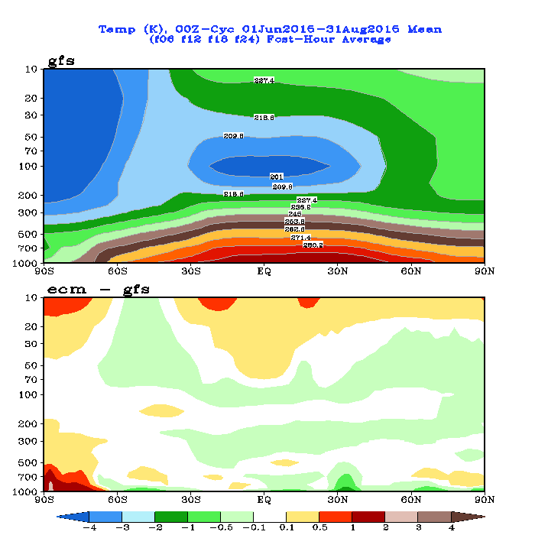
Zonal-Mean Temperature Analysis and Forecast Differences Between GFS and ECMWF (JJA 2015)
ANL
5-d FCST

Slide 13
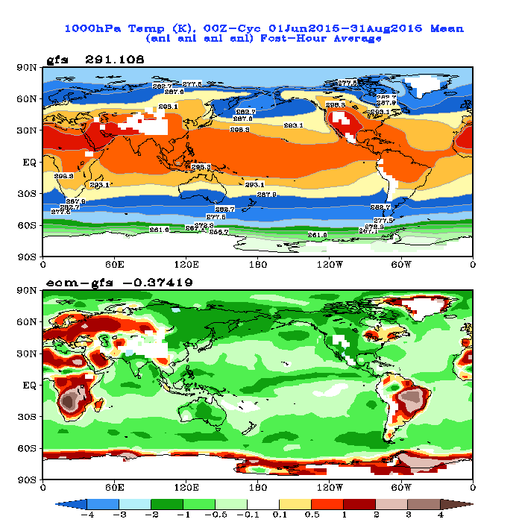
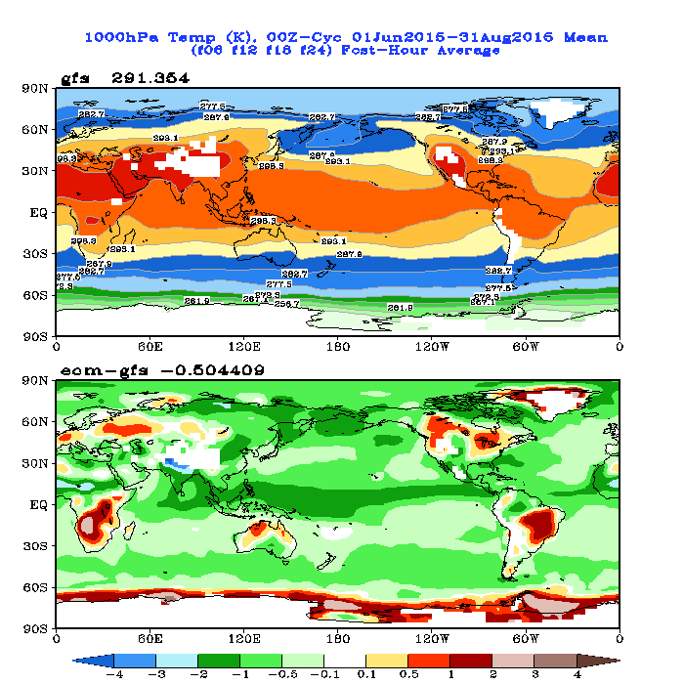
1000-hPa Temperature Analysis and Forecast Differences Between GFS and ECMWF (JJA 2015)
ANL
5-d FCST
Is GFS SST much warmer than ECMWF SST?

Slide 14
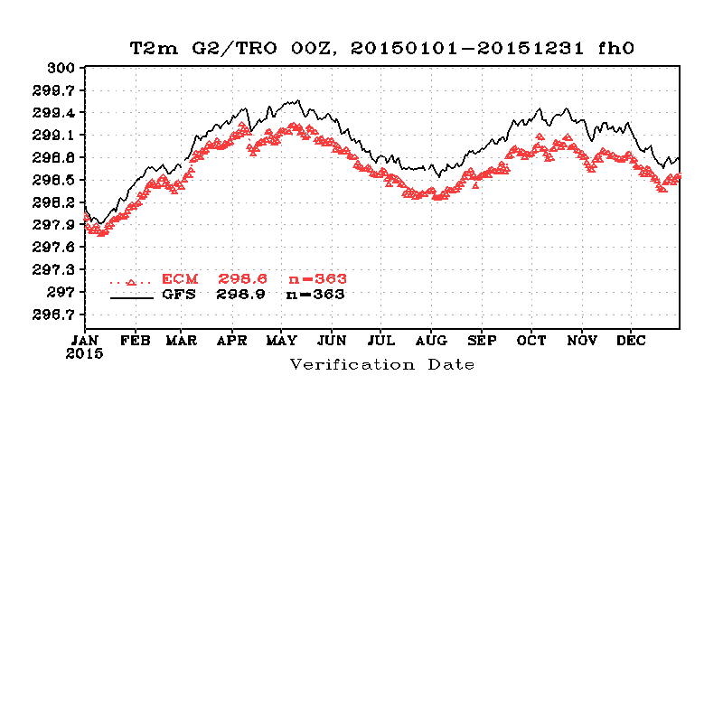
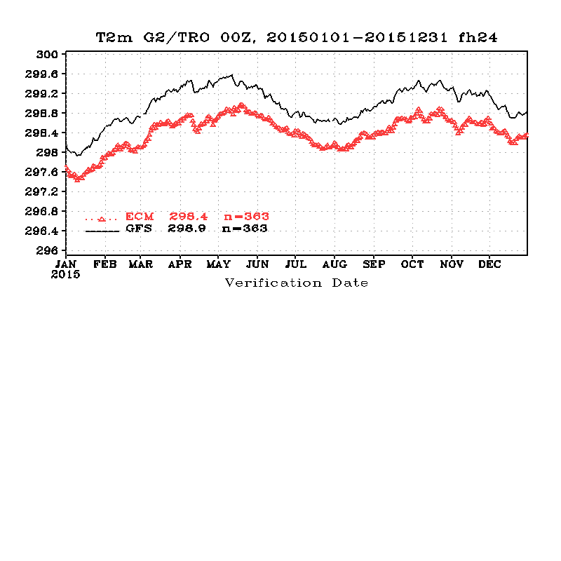
Tropical (20S-20N) Mean T2m
FH00
FH24

Slide 15
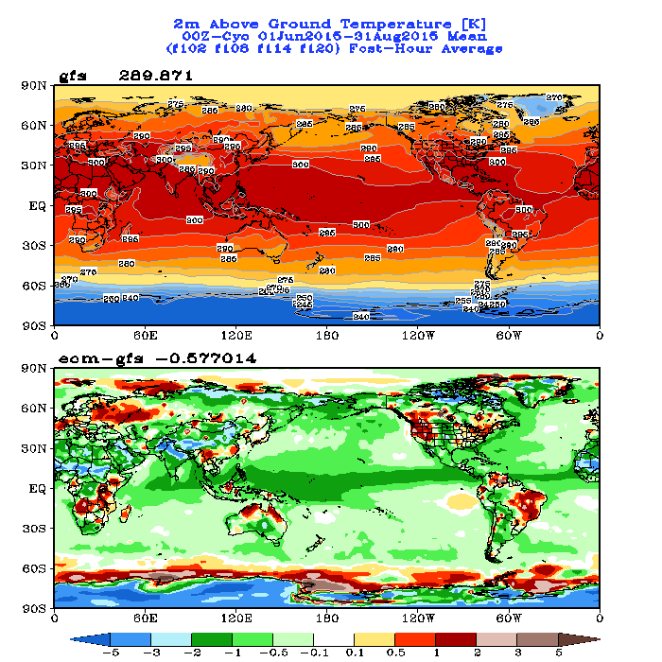
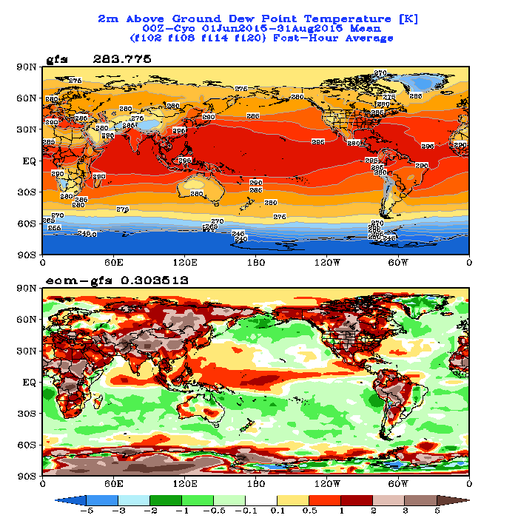
T2m and Td 5-day Forecast Differences Between GFS and ECMWF (JJA 2015)
T2m
Td

Slide 16
GFS Temperature Analysis Increment (June Mean)
Model
too warm
June 2013
Model
too cold
T574 Eulerian GFS
June 2014
T1534 SLG GFS
Model
too cold
June 2015

Slide 17
Historical Score

Slide 18
Annual Mean 500-hPa HGT Day-5 Anomaly Correlation
Increase is about 0.1 per decade
CDAS is a legacy GFS (T64) used for NCEP/NCAR Reanalysis circa 1995.
CFSR is the coupled GFS (T126) used for reanalysis circa 2006.

Slide 19
Annual Mean 500-hPa HGT Day-5 Anomaly Correlation GFS minus CFSR
19

Slide 20
Annual Mean NH 500hPa HGT Day-5 AC
20

Slide 21
Annual Mean SH 500hPa HGT Day-5 AC
21

Slide 22
8.22d
NCEP/GFS
7.92d
Notes:
22

Slide 23
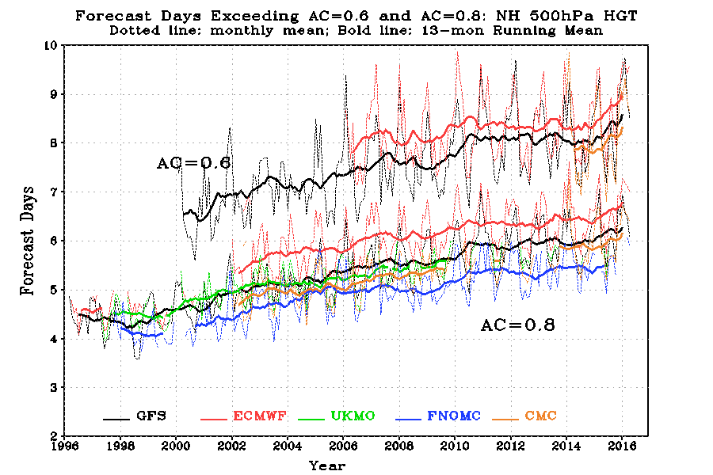
Useful Forecast Days for Major NWP Models, NH
http://www.emc.ncep.noaa.gov/gmb/STATS_vsdb/longterm/

Slide 24
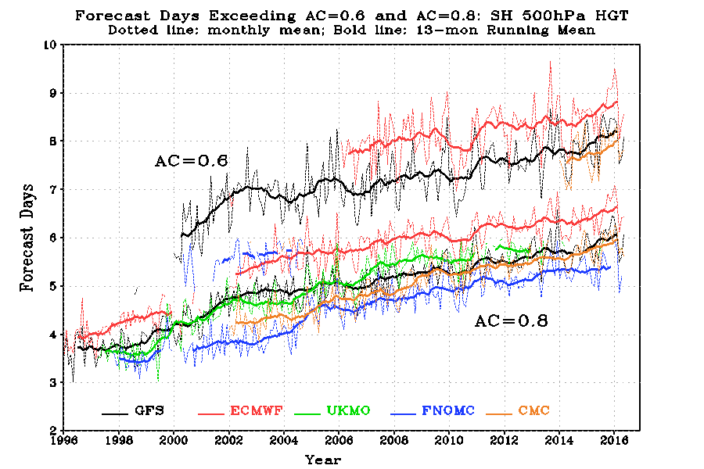
Useful Forecast Days for Major NWP Models, SH

Slide 25
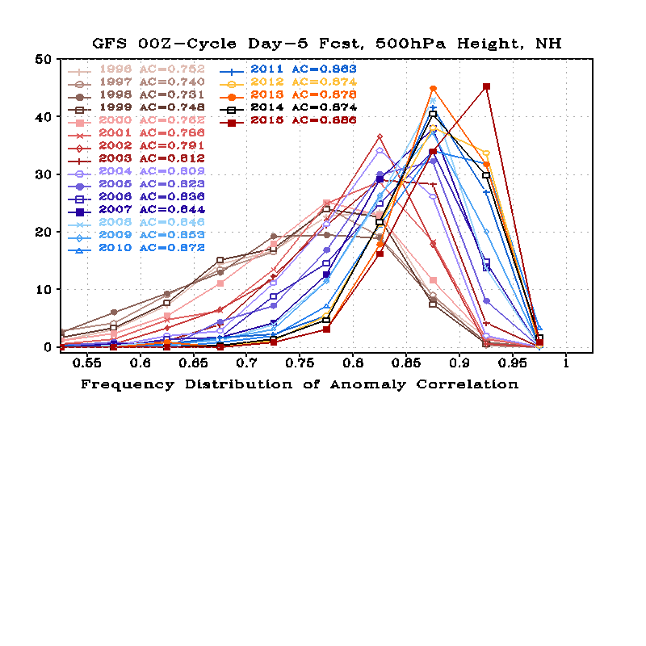
AC Frequency Distribution
Twenty bins were used to count for the frequency distribution, with the 1st bin centered at 0.025 and the last been centered at 0.975. The width of each bin is 0.05.
GFS NH
2015
Jan 2000: T126L28 → T170L42
May 2001: prognostic cloud
Oct 2002: T170L42 → T254L64
May 2005: T254L64 → T382L64;
2-L OSU LSM →4-L NOHA LSM
May 2007: SSI → GSI Analysis;
Sigma → sigma-p hybrid coordinate
July 2010: T382L64 → T574L64; Major Physics Upgrade
May 2012: Hybrid-Ensemble 3D-VAR Data Assimilation
Aug 2013: New data from METOP-B, SEVIRI, and NPP CrIS.
Jan 2015: T1534 SL-GFS

Slide 26
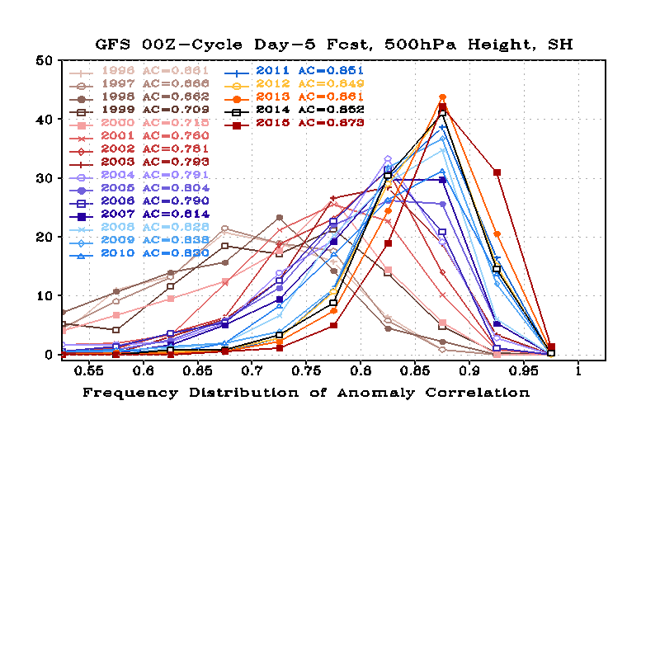
AC Frequency Distribution
GFS SH
2015
May 2007: SSI → GSI Analysis;
Sigma → sigma-p hybrid coordinate
July 2010: T382L64 → T574L64; Major Physics Upgrade
May 2012: Hybrid-Ensemble 3D-VAR Data Assimilation
Aug 2013: New data from METOP-B, SEVIRI, and NPP CrIS.
Jan 2015: T1534 SL-GFS
Jan 2000: T126L28 → T170L42
May 2001: prognostic cloud
Oct 2002: T170L42 → T254L64
May 2005: T254L64 → T382L64;
2-L OSU LSM →4-L NOHA LSM

Slide 27
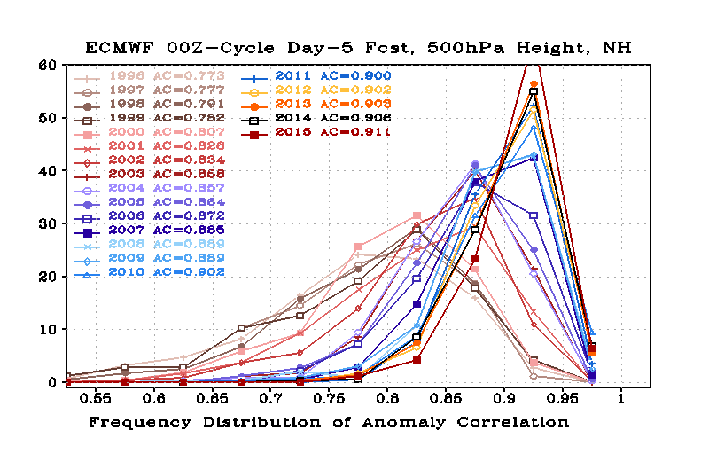
AC Frequency Distribution
ECMWF NH

Slide 28
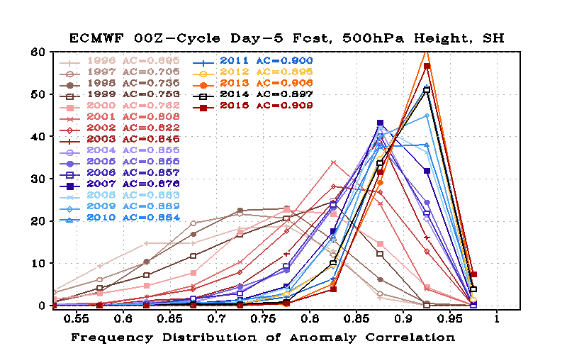
AC Frequency Distribution
ECMWF SH

Slide 29
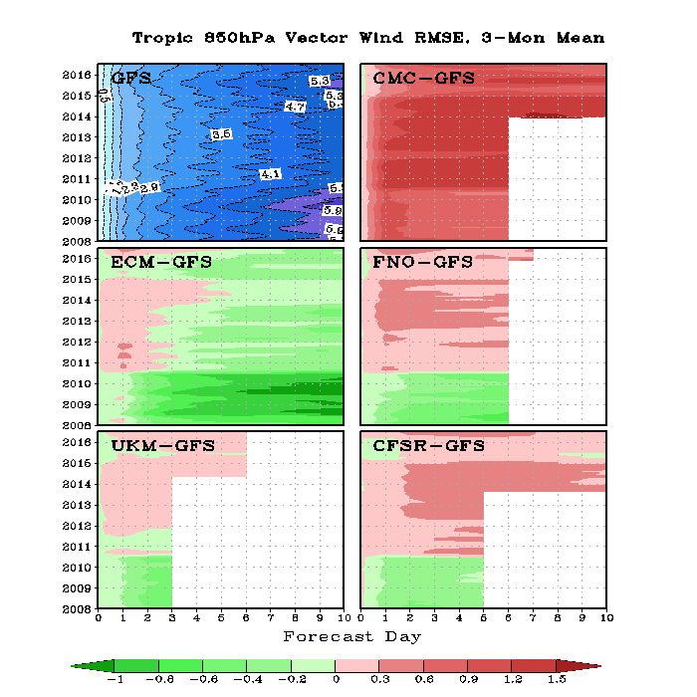
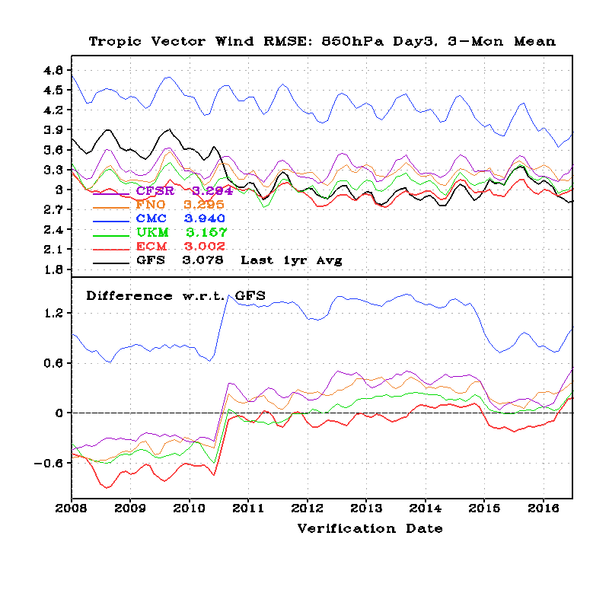
Tropical Wind RMSE (850 hPa, Jan2008-Jun2016)

Slide 30
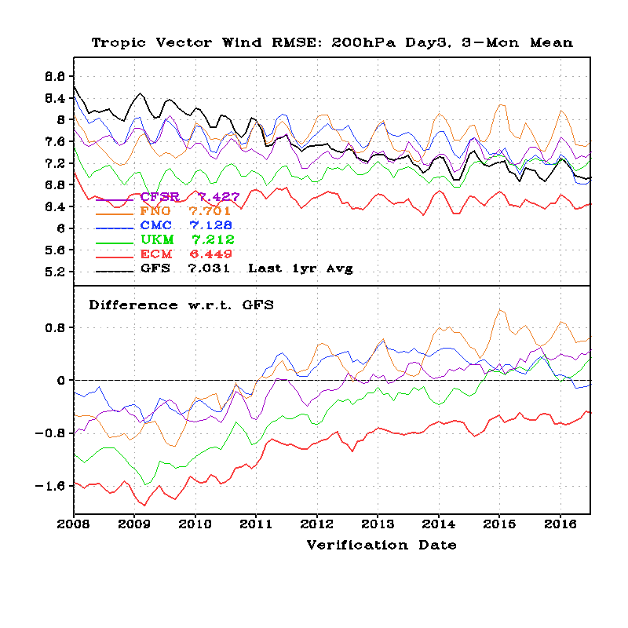
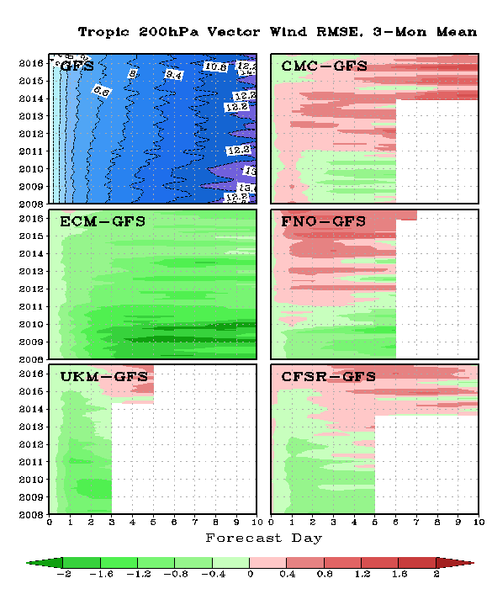
Tropical Wind RMSE (200 hPa, Jan2008-Jun2016)

Slide 31
Precipitation

Slide 32
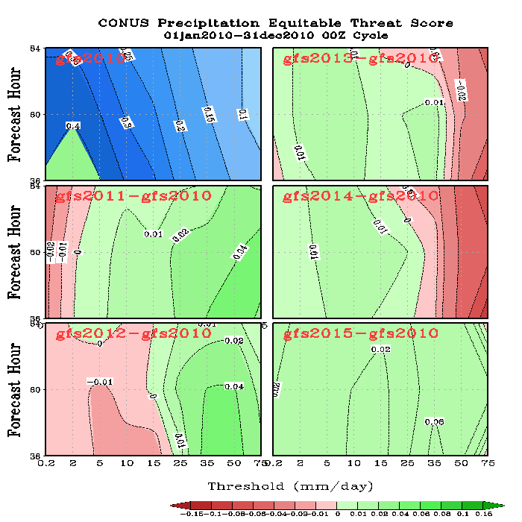
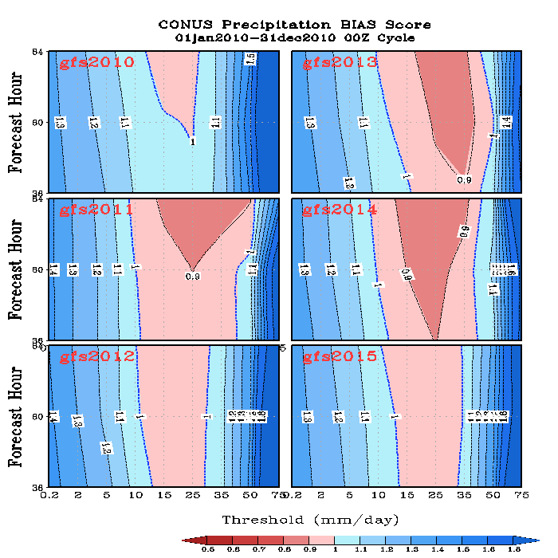
GFS Annual Precip ETS and BIAS Scores over CONUS

Slide 33
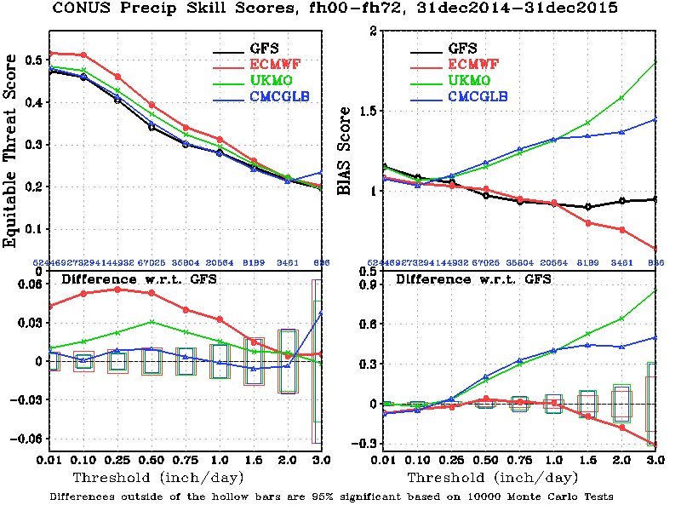
2015 Annual Mean CONUS Precipitation Skill Scores, 00-72 hour Fcst
BIAS=1
is perfect
Larger ETS is better
ECMWF has the best ETS score.
Both GFS and ECMWF underestimated moderate and heavy rainfall events. UKM and CMC had large wet biases.

Slide 34
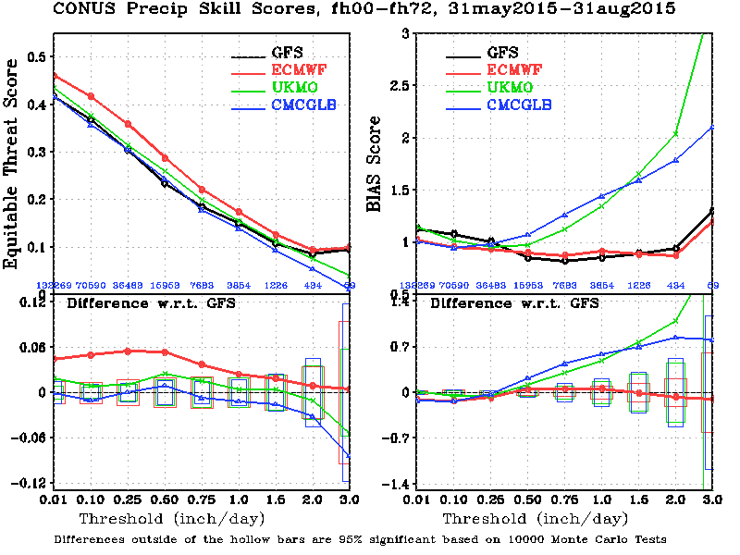
2015 JJA CONUS Precipitation Skill Scores, 00-72 hour Forecast
BIAS=1
is perfect
Larger ETS is better
ECMWF had the best ETS score. GFS, UKM and CMC were close to each other.
ECMWF underestimated heavy rainfall events. GFS was dry for moderate rainfall events..

Slide 35
Verification against Surface and Rawinsonde Observations

Slide 36
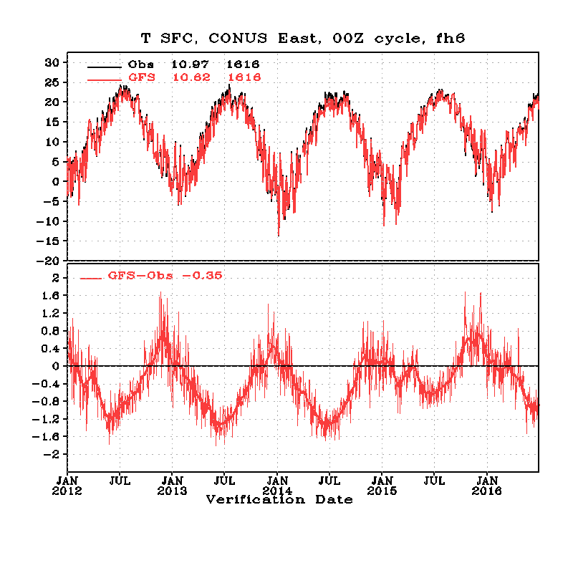
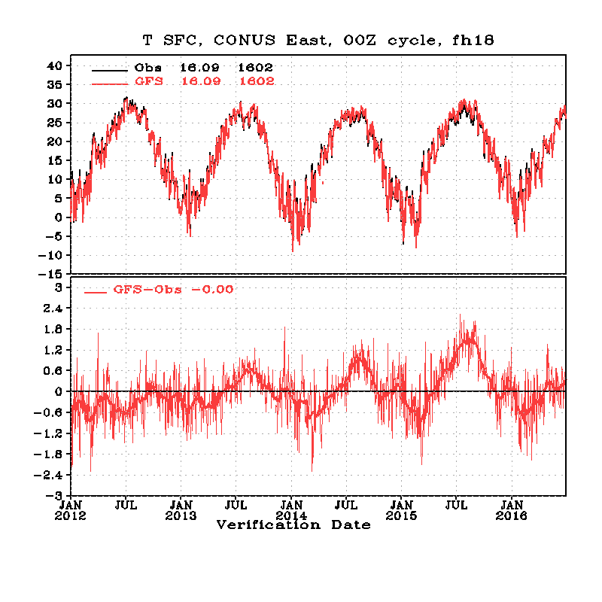
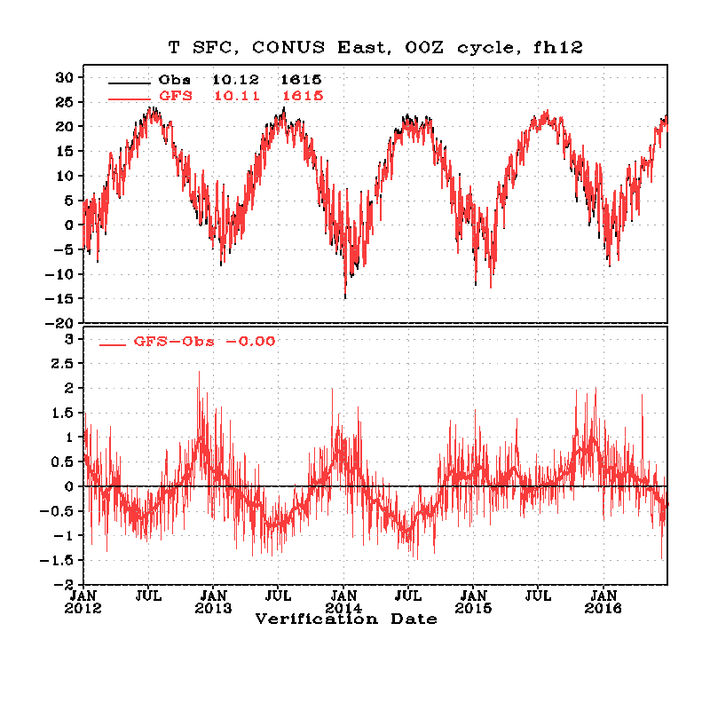
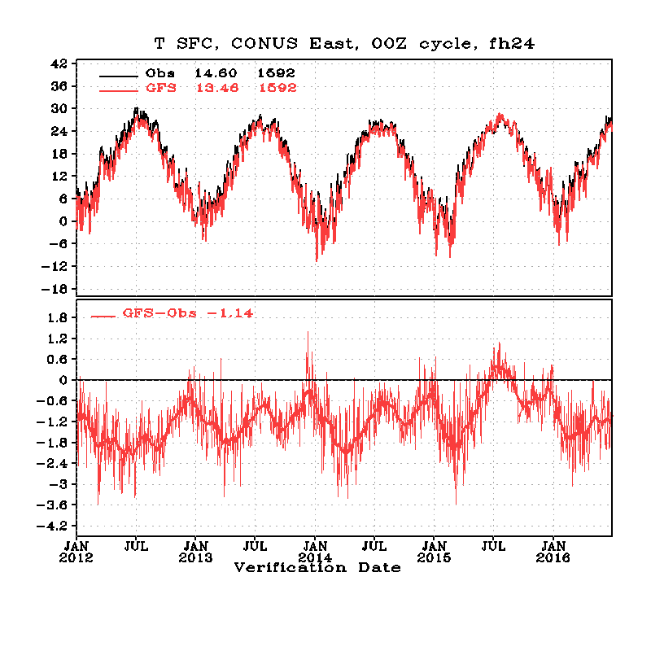
T2m over CONUS East, Jan2012 ~ Jun2016
F06, mid-night
F18, noon
Reduced summer cold bias
T574 Eulerian
T1534 SLG
2015 summer warm bias
F12, morning
F24, late afternoon
Mostly cold bias, PBL?

Slide 37
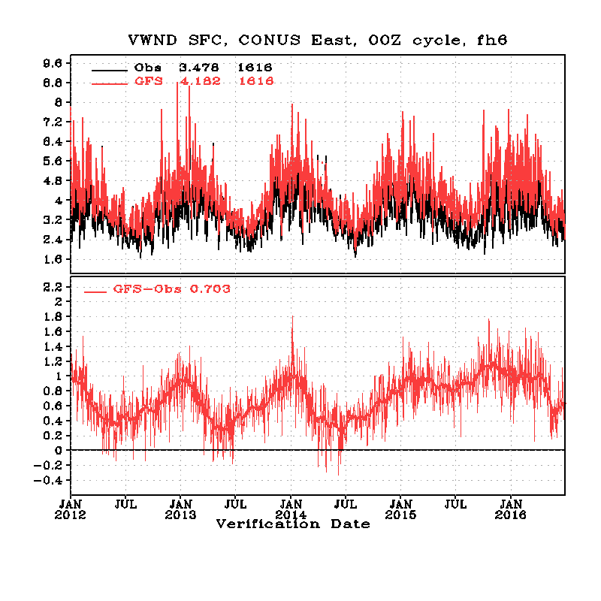
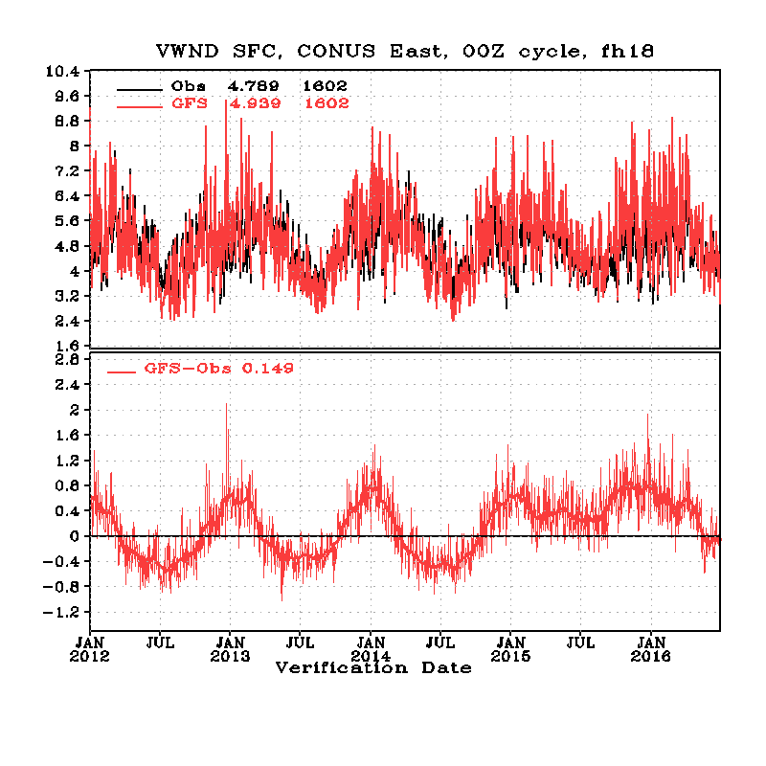
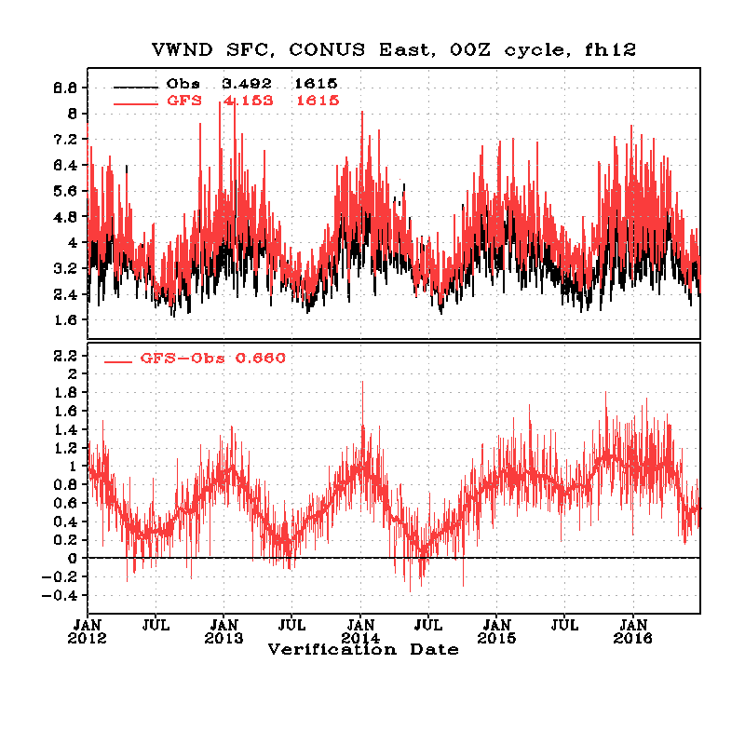
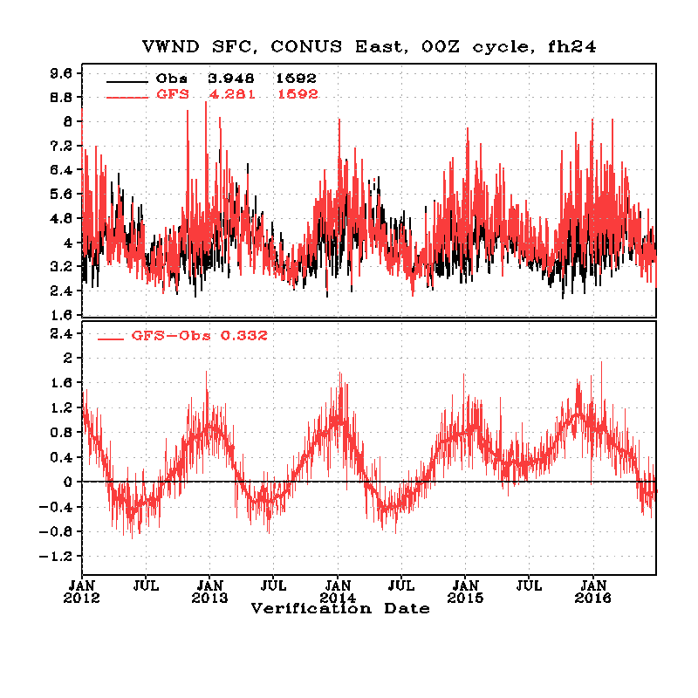
10-m Wnds over CONUS East, Jan2012 ~ Jun2016
F06, mid-night
F18, noon
T574 Eulerian
T1534 SLG
Wind stronger in JJA 2015
F12, morning
F24, late afternoon

Slide 38
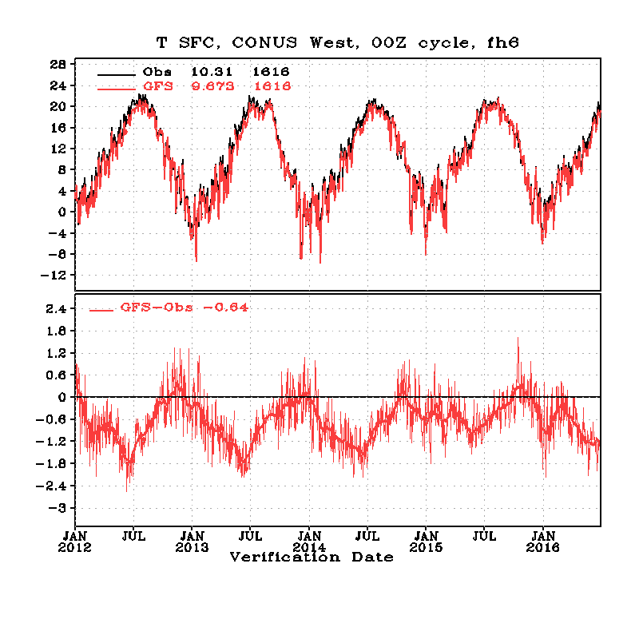
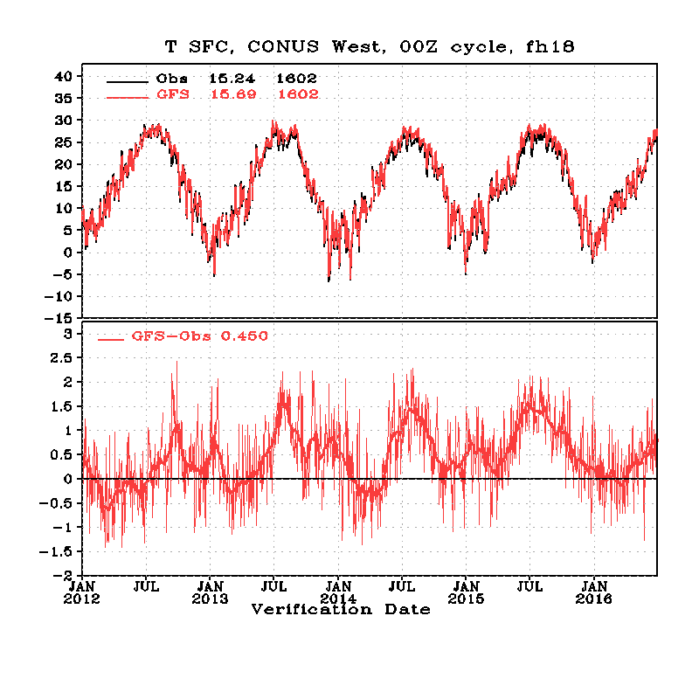
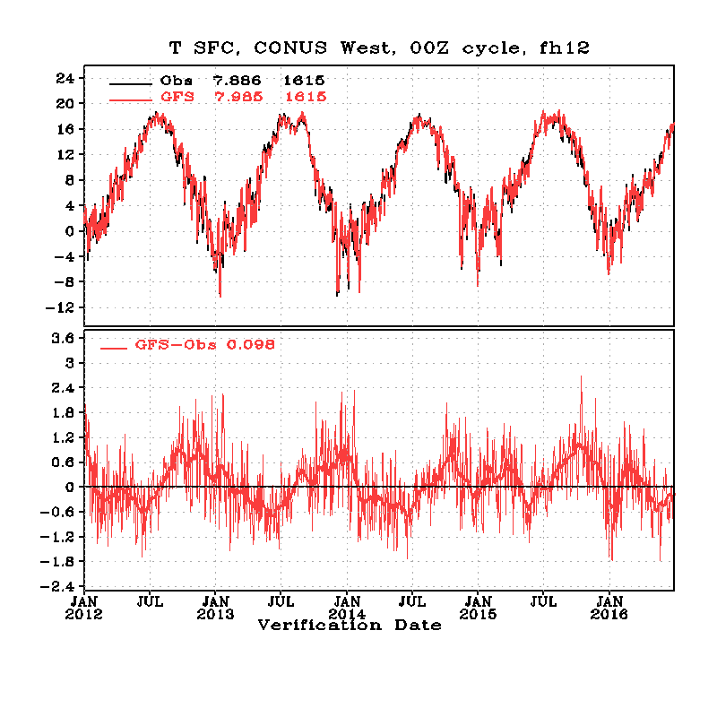
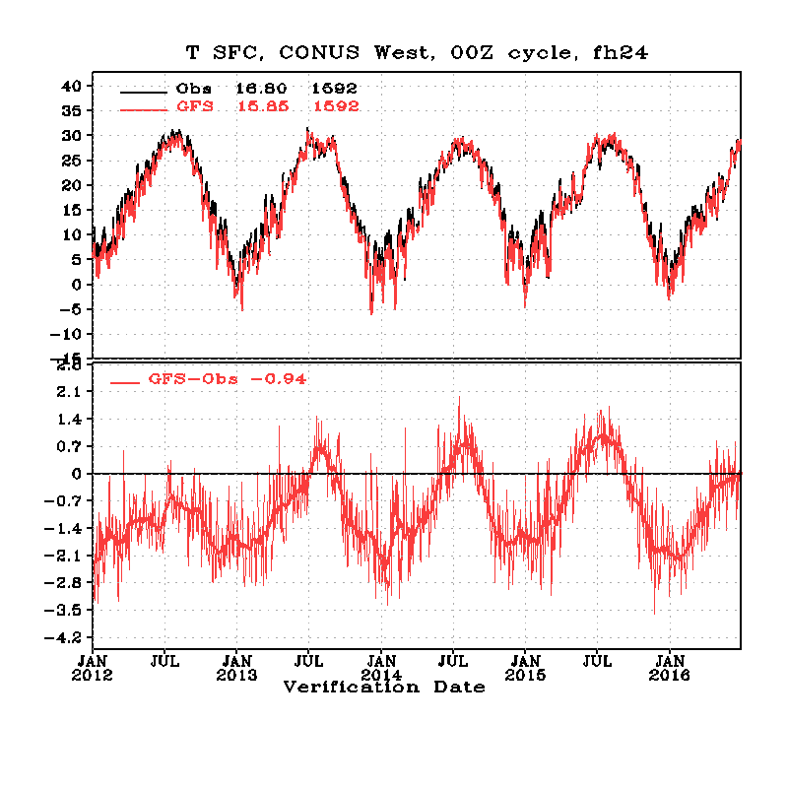
T2m over CONUS West, Jan2012 ~ Jun2016
F06,late evening
F18, late morning
T574 Eulerian
T1534 SLG
F12, night
F24, mid- afternoon

Slide 39
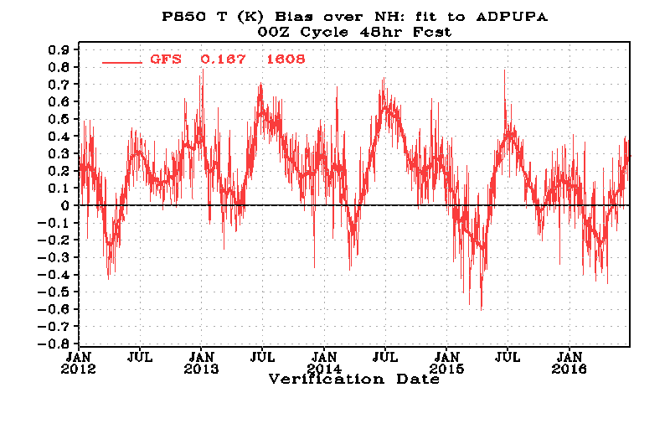
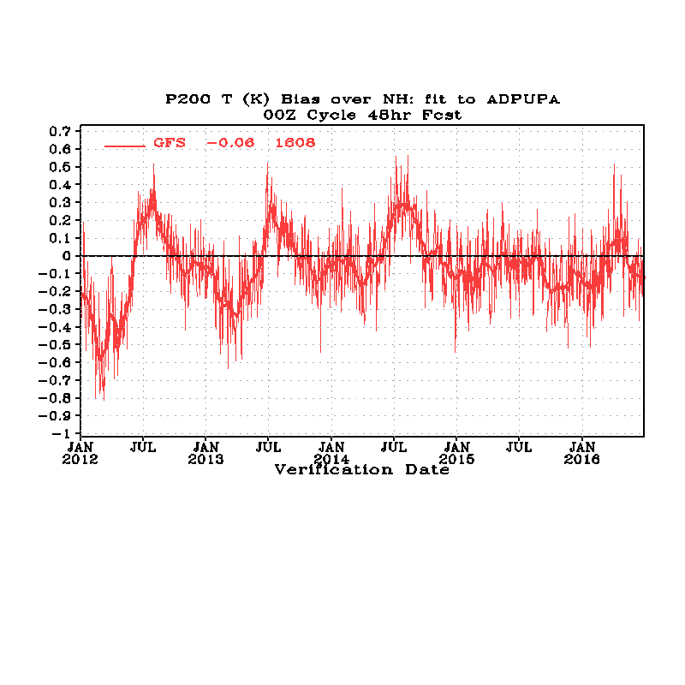
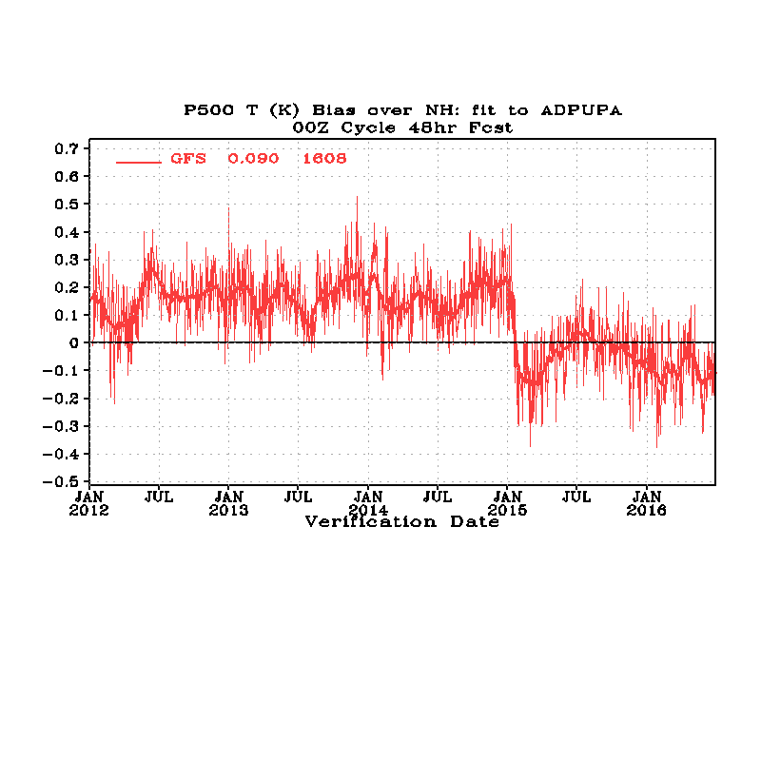
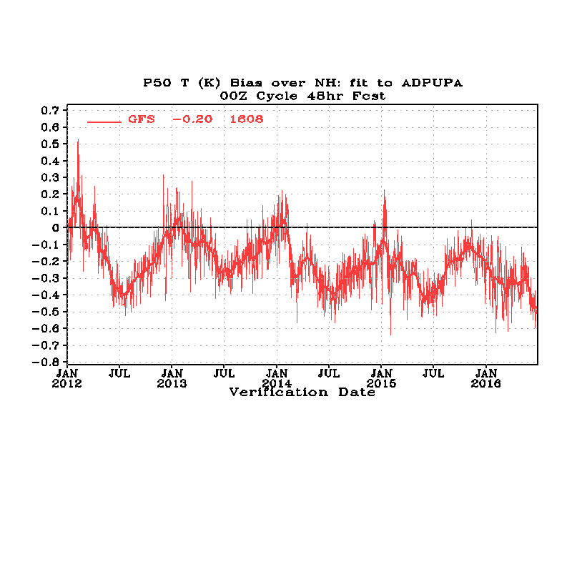
48-Fcst, NH Temperature Fit to RAOBS, Jan2012 ~ Jun2016
850hPa
T1534-SLG GFS
200hPa
Lower stratosphere remains to be cold
T1534-SLG GFS
500hPa
50hPa

Slide 40
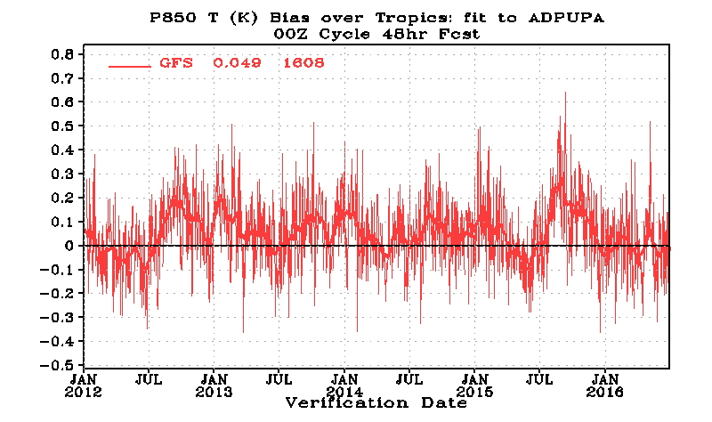
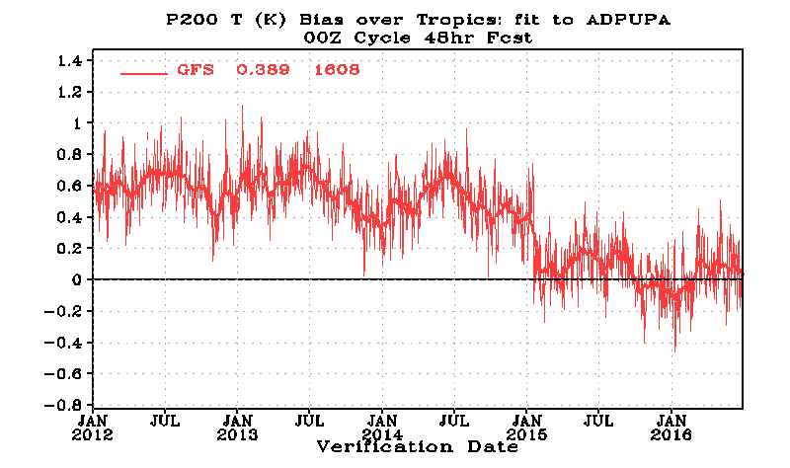
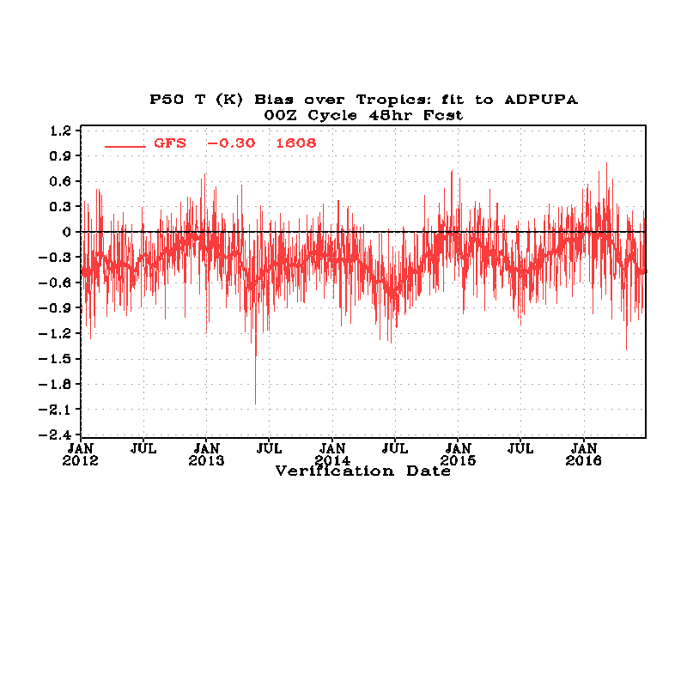
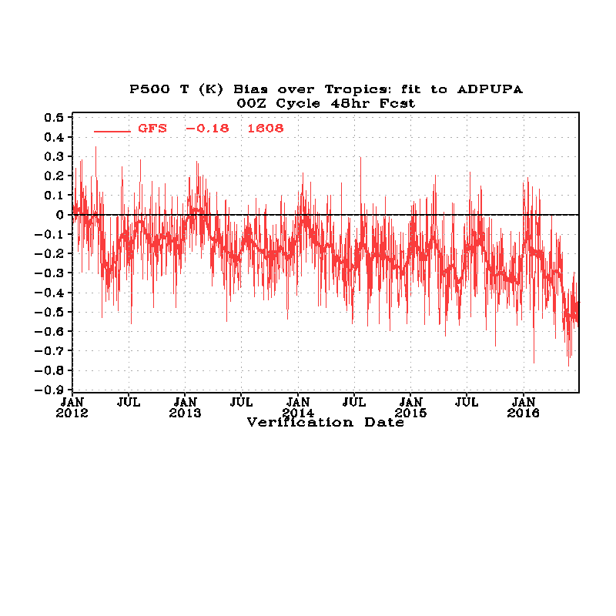
48-Fcst, Tropical Temperature Fit to RAOBS, Jan2012 ~ Jun2016
Reduced
warm bias
850hPa
T1534-SLG GFS
200hPa
T1534-SLG GFS
Lower stratosphere remains to be cold
500hPa
50hPa

Slide 41
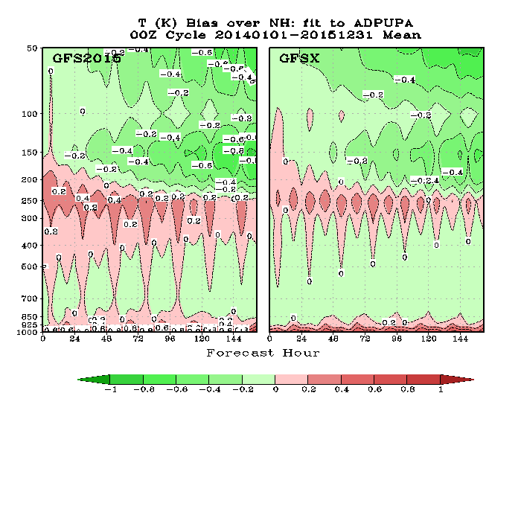
NH Temperature Bias, Verified against Rawinsonde Observations
2015 Operational Model
Current operational Model

Slide 42
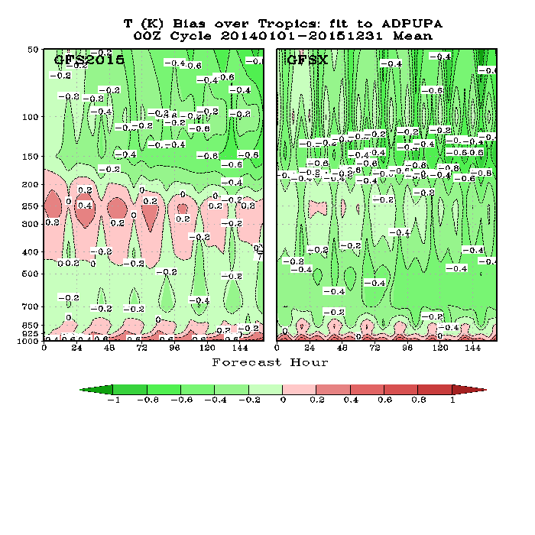
Tropical Temperature Bias, Verified against Rawinsonde Observations

Slide 43
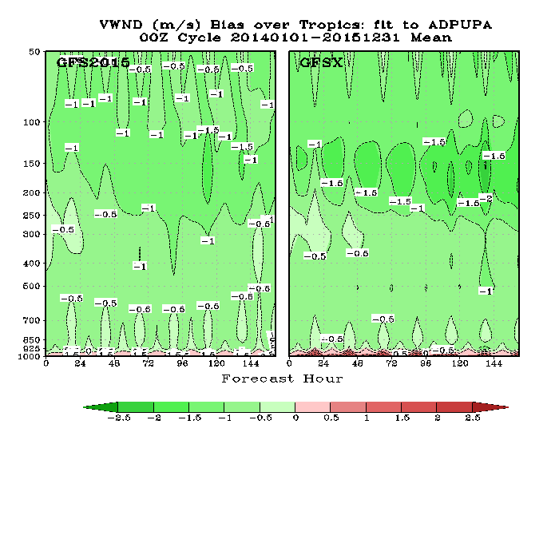
Tropical Wind Bias, Verified against Rawinsonde Observations

Slide 44
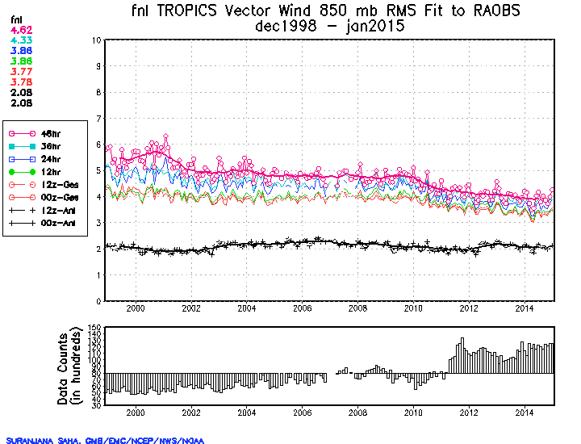
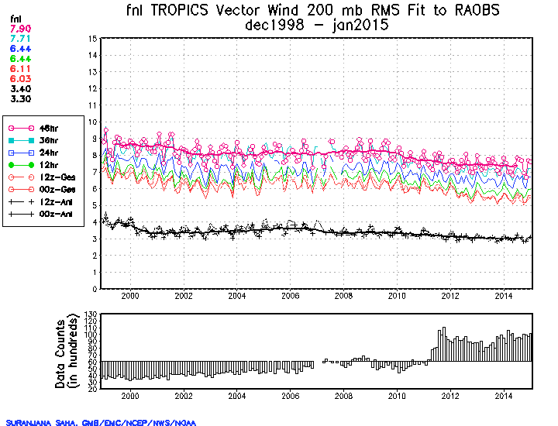
Long-Term Fit-to-Obs : Tropical Wind, 1998-2014 Credit: Suru Saha
RMSE of predicted tropical wind has been gradually reduced from year to year.
The improvement after 2010 T574 implementation was the largest.
RMSE of analyses was reduced by 1.0 m/s from 1998 to 2014 at 200 hPa, but showed little change at 850hPa.
850 hPa
200 hPa

Slide 45
Hurricane Track and Intensity

Slide 46
Track for all forecast leading time has been improved in the past 15 years; 72-hr track error reduced from 200nm to ~100nm
46

Slide 47
Intensity improved in 2010 and 2011 due to GFS resolution increase from 35km to 23km and major physics upgrade;
in 2012 and 2013 due to ENKF-3DVAR GSI Implementation in May 2012;
in 2015 due to T1534 SLG GFS (~13km) implementation.
2014 was a difficult year to forecast
47

Slide 48
Significant track error reduction in the past 15 years. 36-hr track error reduced from 100nm to 50nm; 72-hr track reduced from 200 nm in 2004 to 100 nm in 2015 .
48

Slide 49
Large reduction after 2010 T574 GFS Implementation. No changes in past few years.
49

Slide 50
72-hr forecast error reduced from 150 to 100 nm in 5 years.

Slide 51
2015 Atlantic – Track Errors (00Z and 12Z Cycles)
GFS (AVNO) tied with UKM; ECMWF had the best skill.

Slide 52
2015 Eastern Pacific – Track Errors (00Z and 12Z Cycles)
GFS (AVNO), HWRF and ECMWF had similar skills.

Slide 53
2015 Wesatern Pacific – Track Errors (00Z and 12Z Cycles)
GFS (AVNO) and HWRF had similar skills.

Slide 54
GFS Hourly Output

Slide 56
Hurricane Sandy
GFS2: T1534 GFS implemented in January 2015 (3D En-Var)
GFSX: T1534 GFS to be implemented in May 2016 (4D En-Var)
AVNO: 2012 operational GFS (T574 Eulerian GFS, 3D En-Var, ~23km)
56

Slide 57
Mean track indicates GFSX has much a better forecast than AVNO and GFS2015 at the 7-day lead time, evidently showing in the 2012102212 individual track plot. GFSX also did well for the cycle 2012102306 case. Other than that, it appears GFSX's performance is similar to GFS2015. One case (2012102412) showed GFSX is worse than AVNO and GFS2015.
GFSX better
GFSX better
GFSX worse
7 day in advance!
57

Slide 58
2012 Operational GFS
Current Operational SL-GFS
GFSX
GFSX has slightly better cycle-to-cycle forecast consistency

Slide 59
T2m over Northern Great Plains, Jan2012 ~ Jun2016
F00, later afternoon
F12, morning
Persistent cold bias
T574 Eulerian
T1534 SLG
2015 summer warm bias
F06, mid night
F18, noon
Bias varies with season

Slide 60
T2m over US Northeast, Jan2012 ~ Jun2016
F00, later afternoon
F12, morning
Persistent cold bias
F06, mid night
F18, noon
Summer cold bias,

