Slide 1
Evaluation of the Q3FY16 GFS
National Hurricane Center
March 3, 2016

Slide 2
Evaluation Details:
Track and intensity error analysis from the 2012-2016 retrospective runs for the Atlantic and eastern North Pacific basins
Q3FY2016 GFS is also called “GFSX” or “GFSP”
GFS2 is the 2015 GFS
combined 2012-2016 track error statistics by basin
comparison of error characteristics with respect to the 2015 GFS
Closer examination of a few high-impact events during the retrospective time period
Verification of model-predicted TC genesis
Evaluation by Tropical Analysis and Forecast Branch

Slide 3
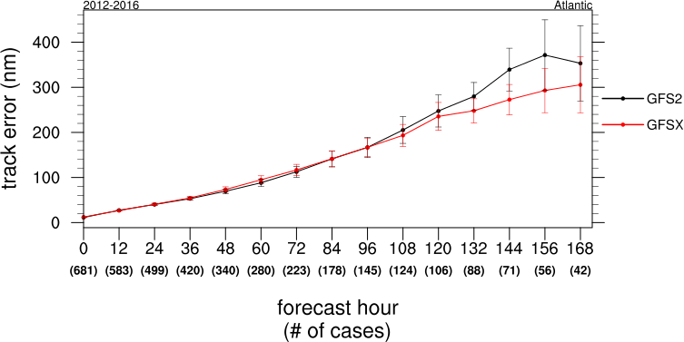
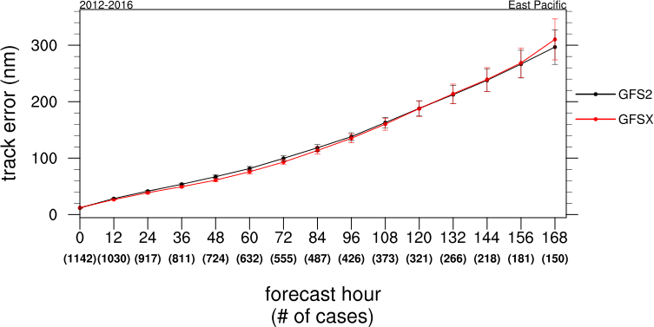
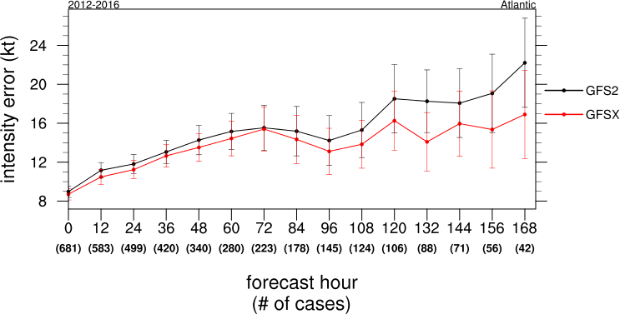
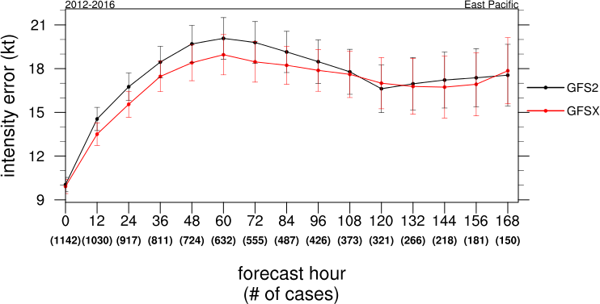
2012-2016
Atlantic
Track/Intensity Error
East Pacific
TRACK
INTENSITY
INTENSITY

Slide 4
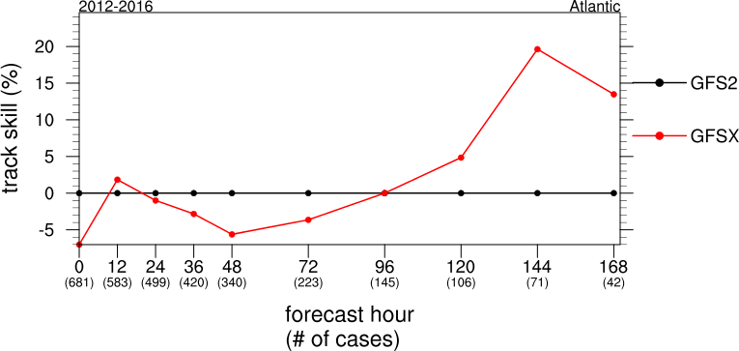
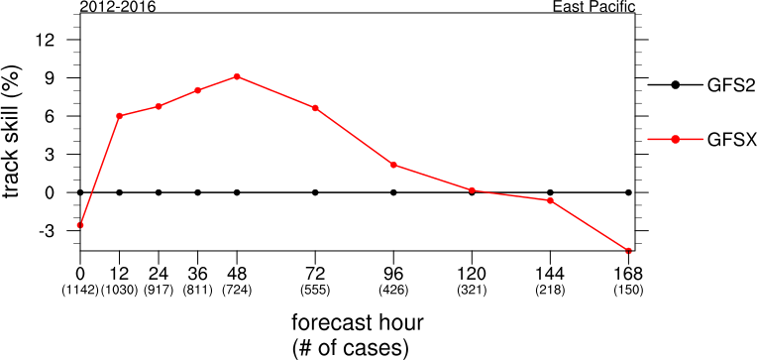
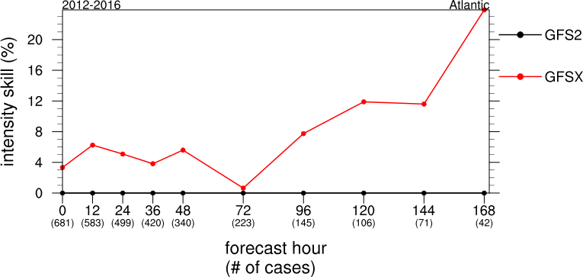
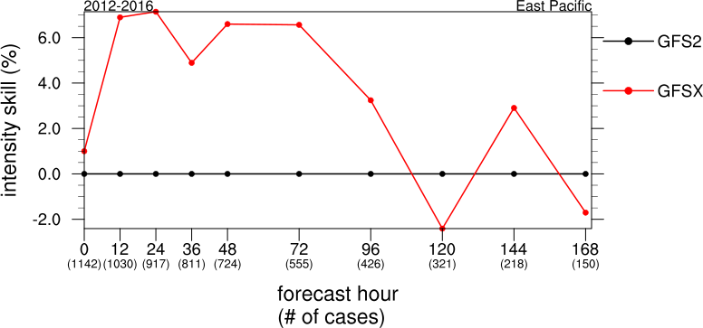
2012-2016
Atlantic
Track/Intensity Skill
(with respect to GFS2)
East Pacific
TRACK
INTENSITY
INTENSITY

Slide 5
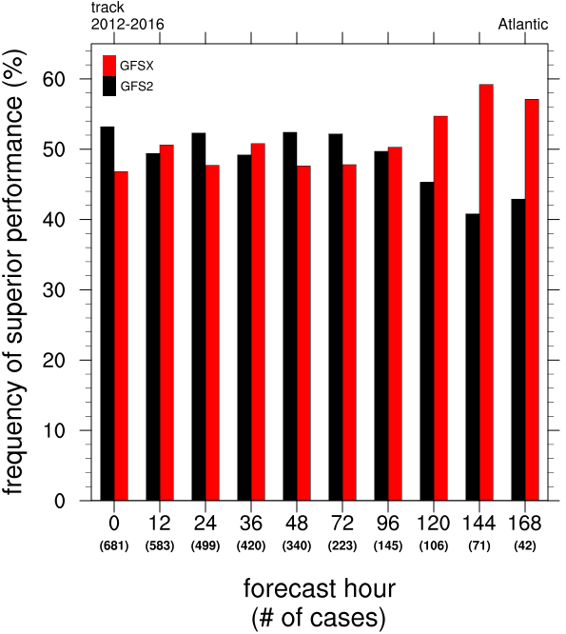
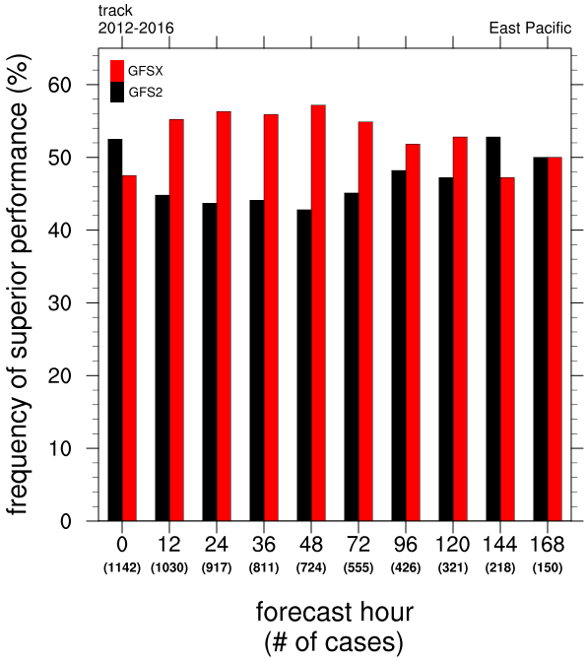
2012-2016
Frequency of Superior Performance - Track
Atlantic
East Pacific

Slide 6
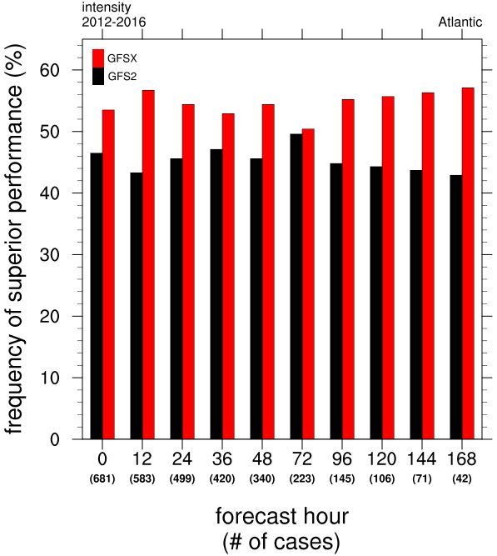
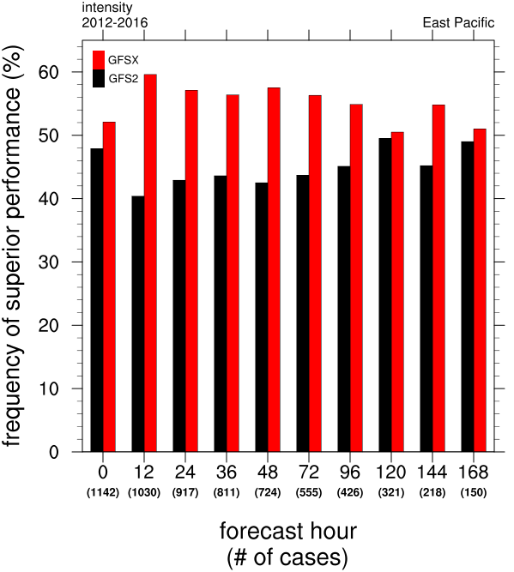
2012-2016
Frequency of Superior Performance - Intensity
Atlantic
East Pacific

Slide 7
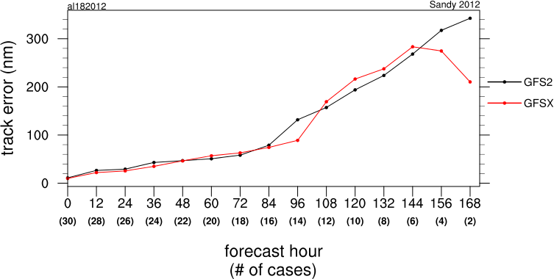
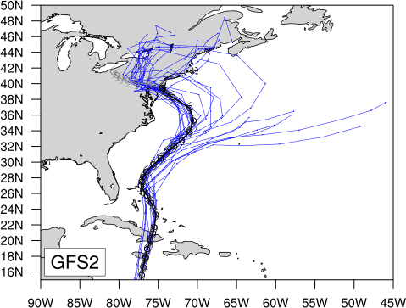
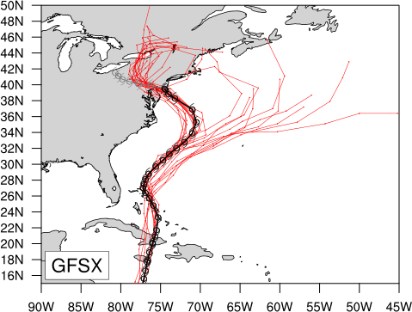
Sandy 2012
AL182012
Track

Slide 8
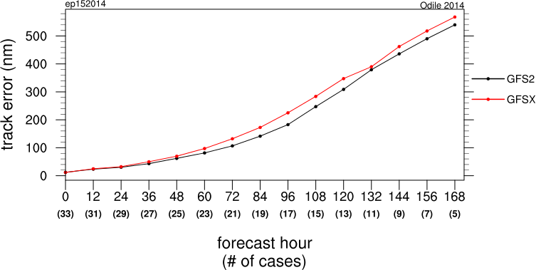
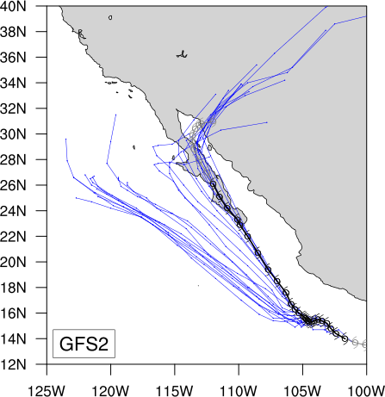
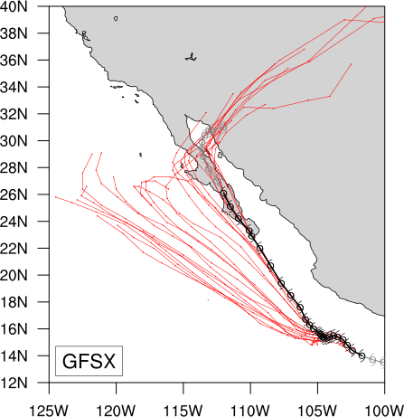
Odile 2014
EP152014
Track

Slide 9
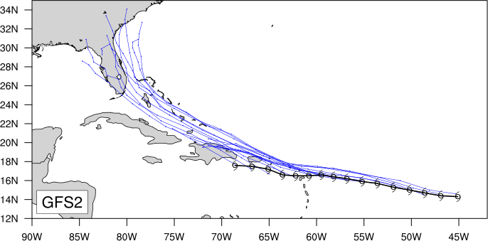
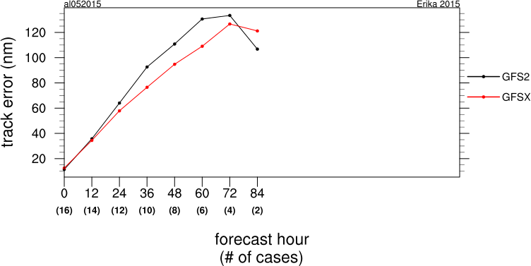
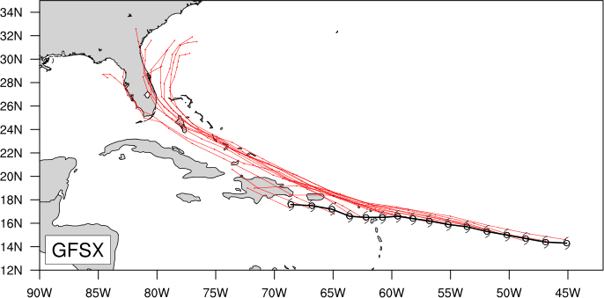
Erika 2015
AL052015
Track

Slide 10
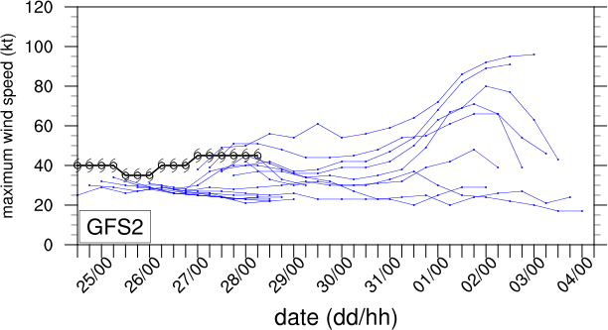
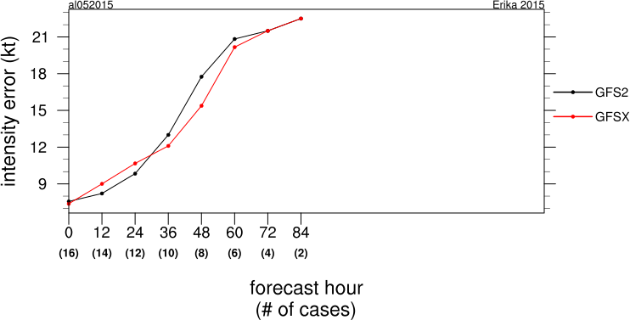
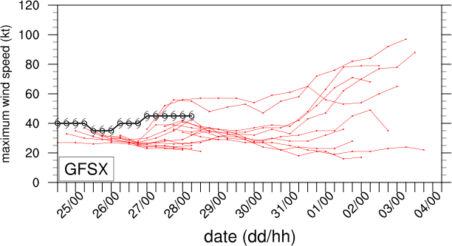
Erika 2015
AL052015
Intensity

Slide 11
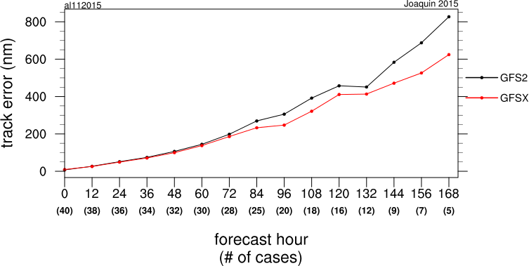
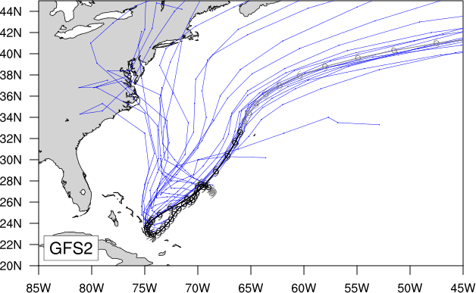
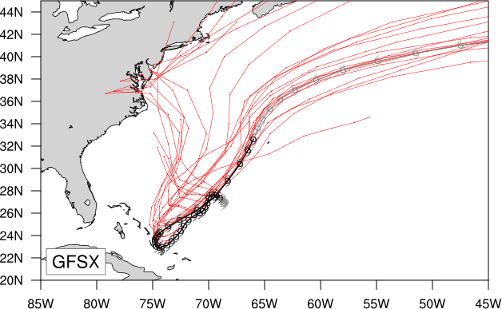
Joaquin 2015
AL112015
Track
2015-09-28 0000 – 2015-10-05 0000

Slide 12
AL | Track | Intensity
0-48 h | - 3% | +5%
72-120 h | +7% | + 11%
EP | Track | Intensity
0-48 h | +5% | +5%
72-120 h | +1% | +2%
Track and intensity error improvements/degradation of Q3FY16 GFS vs. 2015 GFS for the 2012-2016 retrospective runs, by basin

Slide 13
Feedback from TAFB

Slide 14
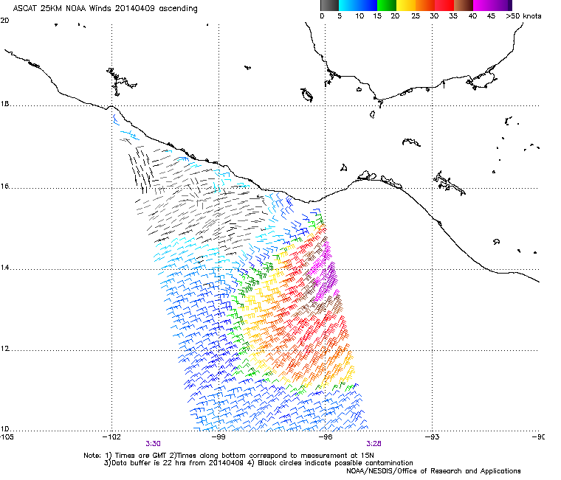
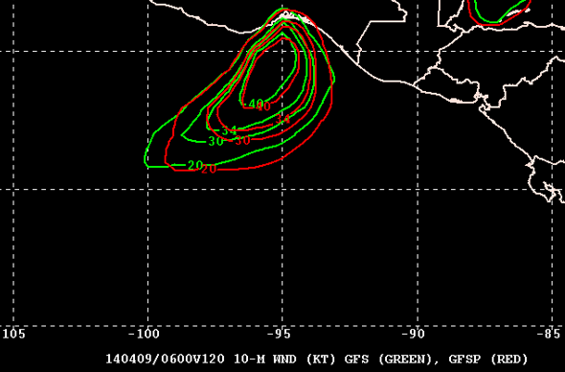
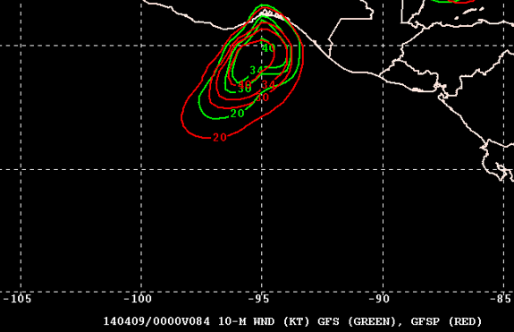
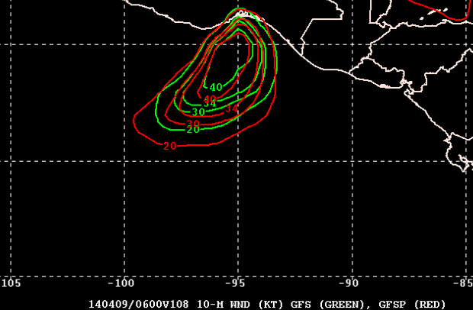
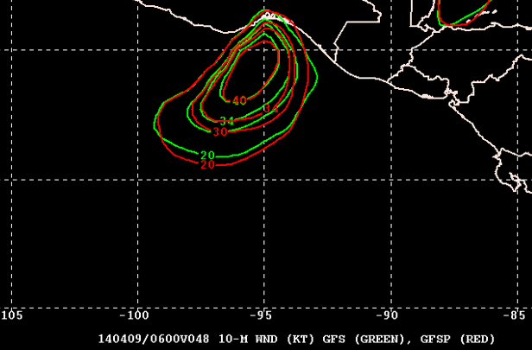
GFSP agrees better with path of strongest wind away from the coast (more to the east than the operational GFS)
Despite resolution differences, GFSP was stronger and more accurate with the winds forecast at F084 and F108

Slide 15
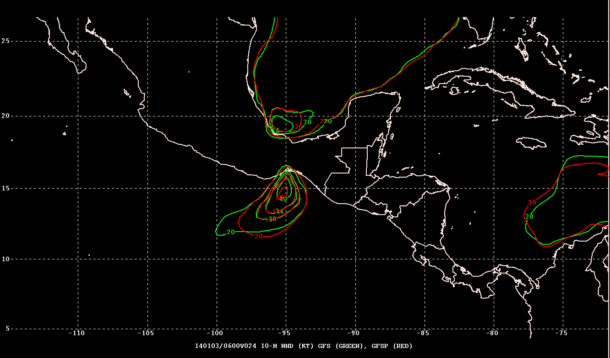
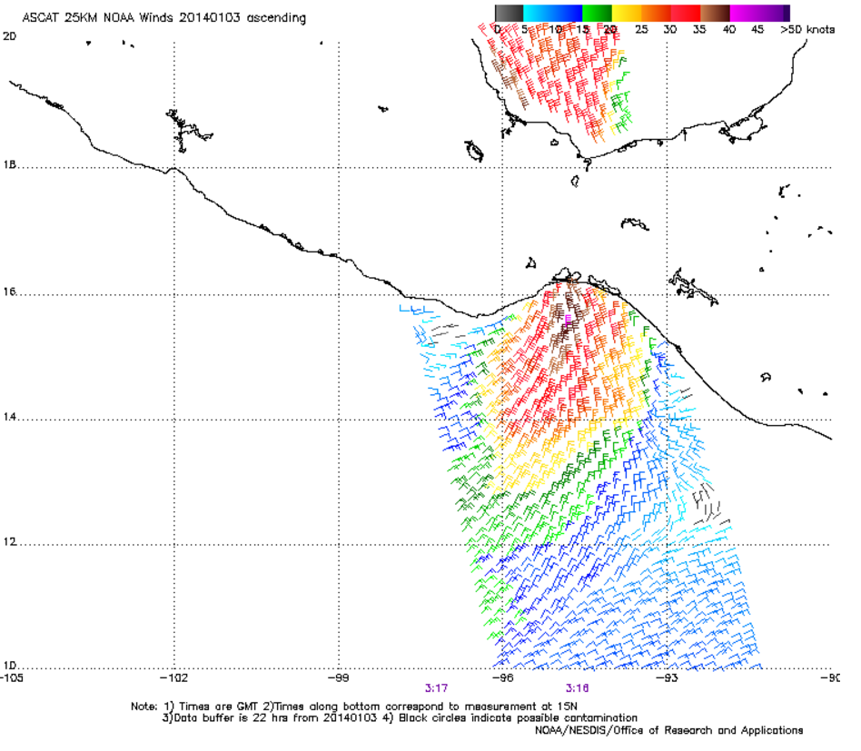
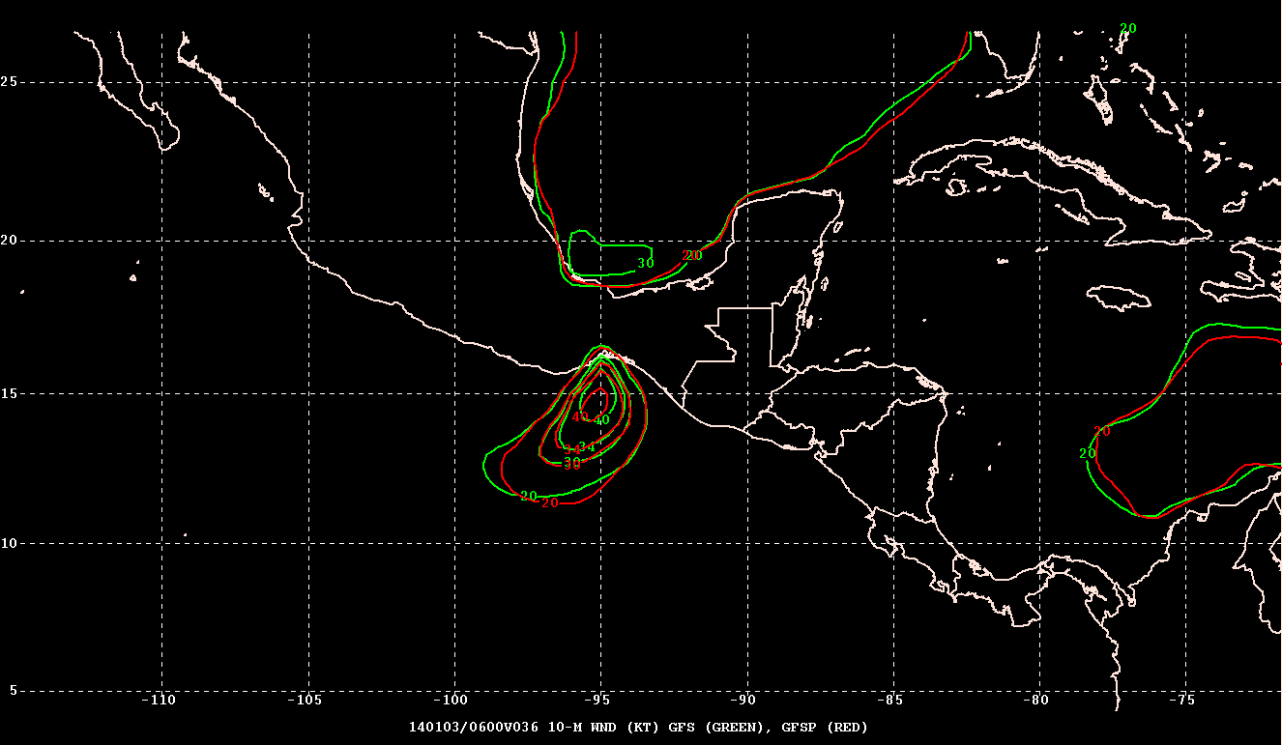
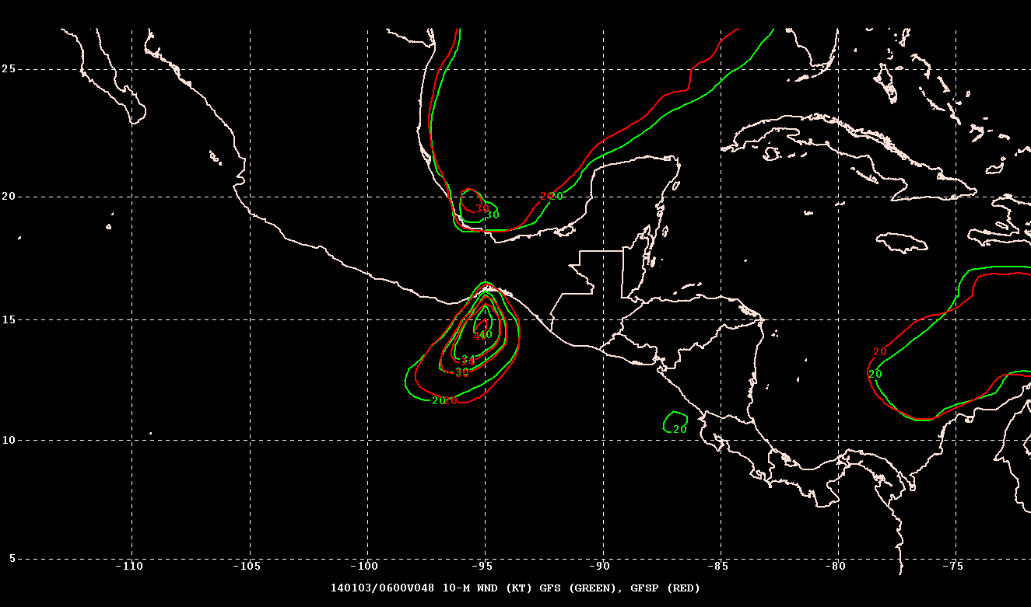
Stronger operational GFS better in SW GOMEX
Weaker GFSP better with the core winds south of Tehuantepec

Slide 16
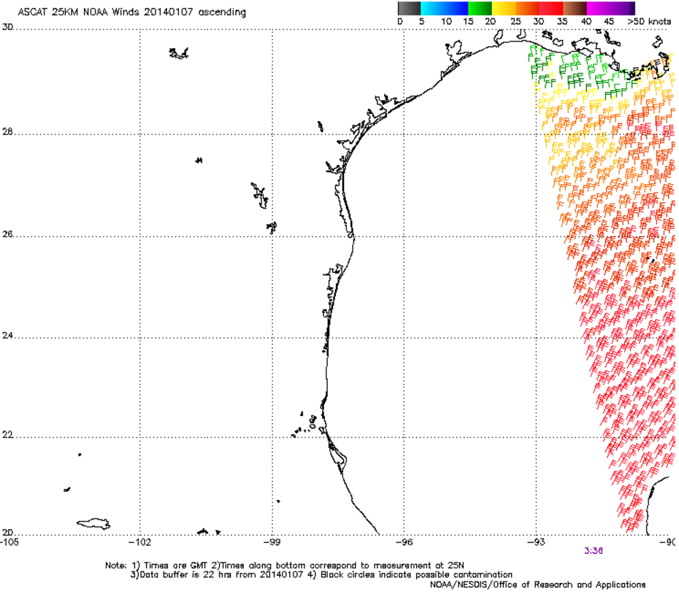
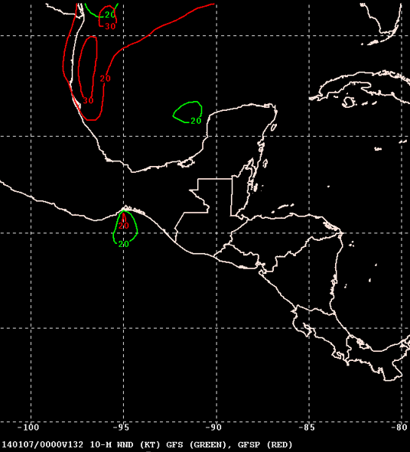
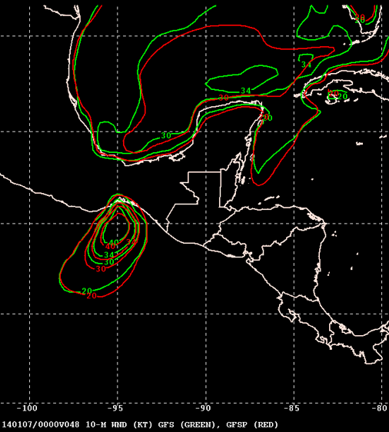
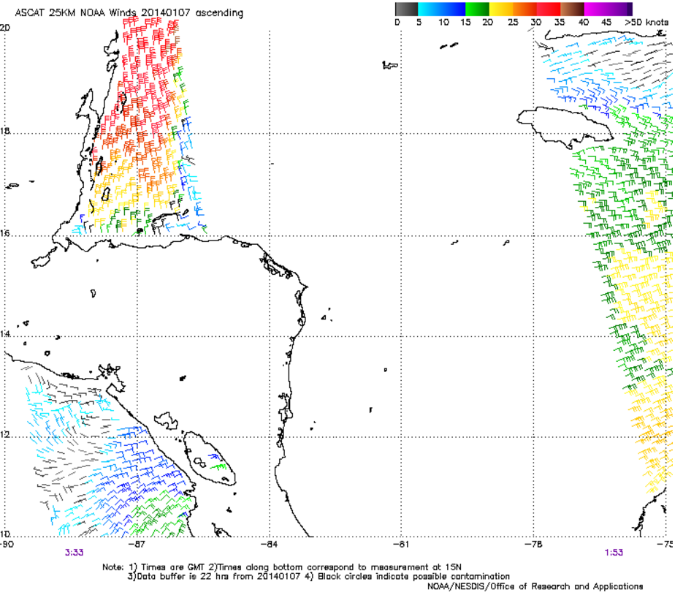
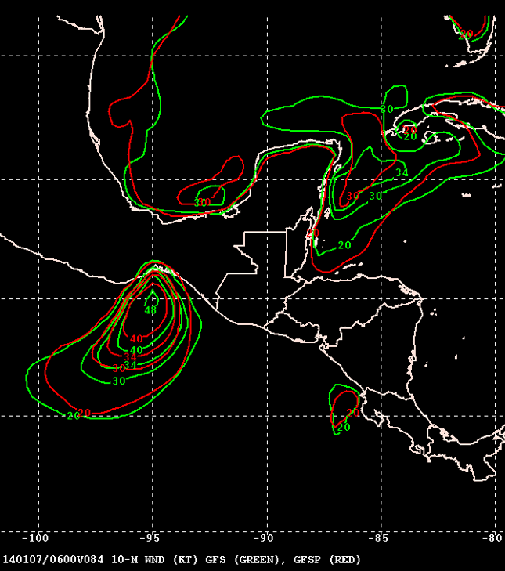
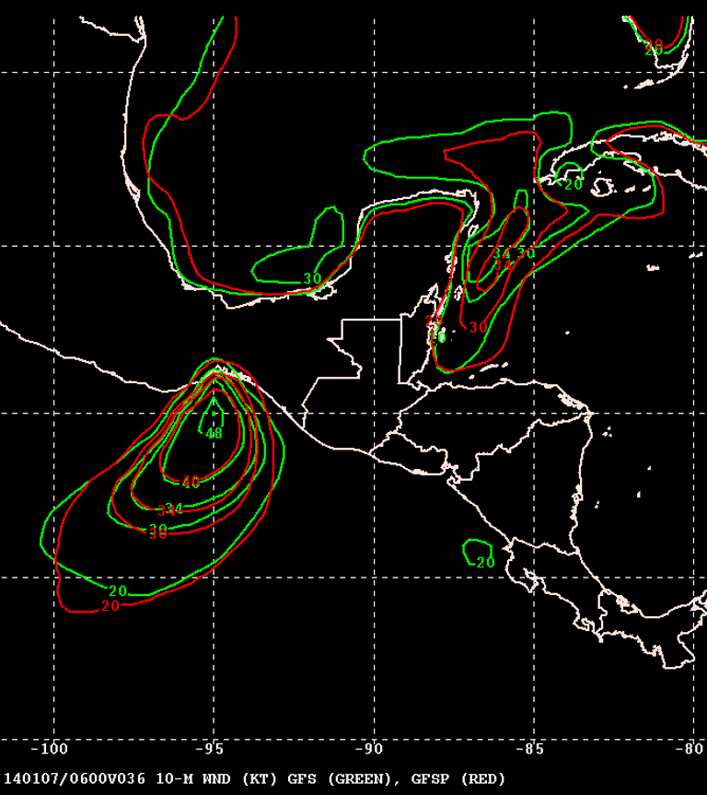
GFSP faster to catch on to the strength and timing of cold front in GOMEX
GFSP better with position & coverage of the gale force winds in NW Carib.
FH036 GFSP closer to 20 kt contour N of Honduras than op GFS

Slide 17
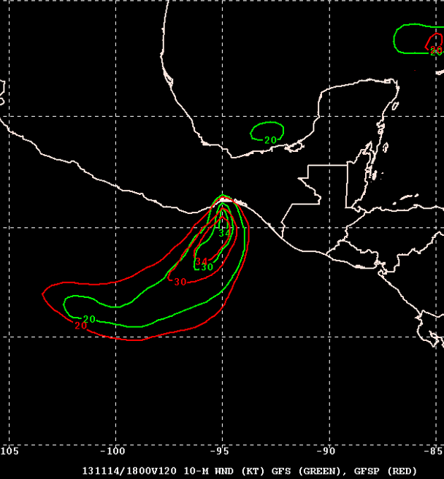
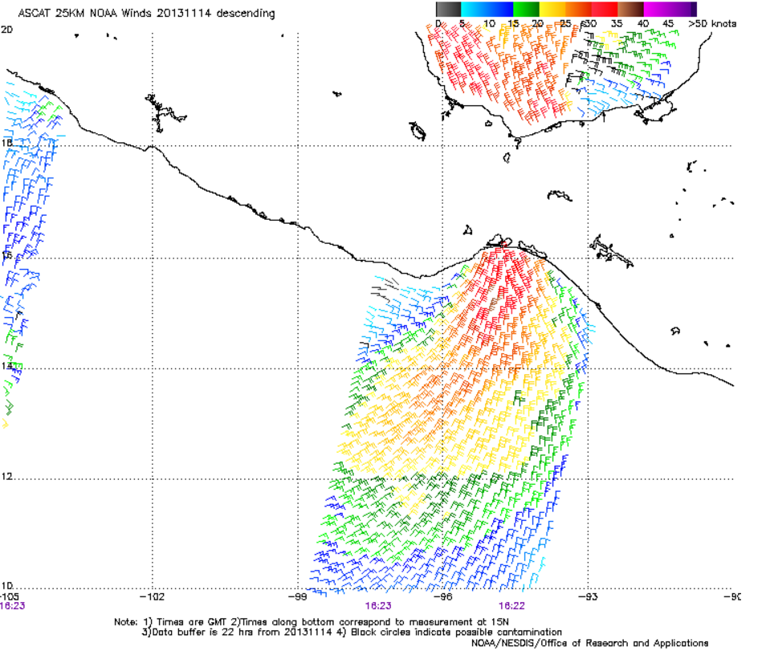
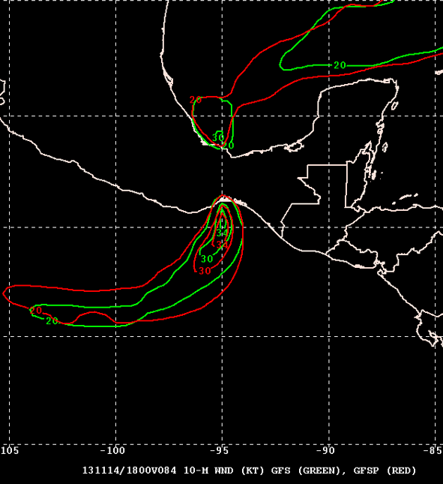
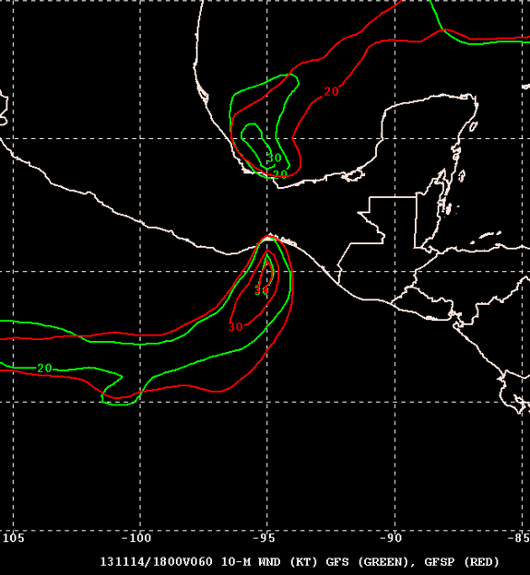
Neither version strong enough in SW GOMEX, but op GFS better than GFSP
GFSP forecast gradually gets better/weaker in Tehuantepec; Operational GFS overcompensates and becomes too weak

Slide 18
Comments from TAFB
Based on limited cases with archived operational GFS on 1° grids and the retrospectives (GFSP) on 0.5° degree grids
Results were a mixed bag, but the GFSP seemed to have an advantage at longer lead times

Slide 19
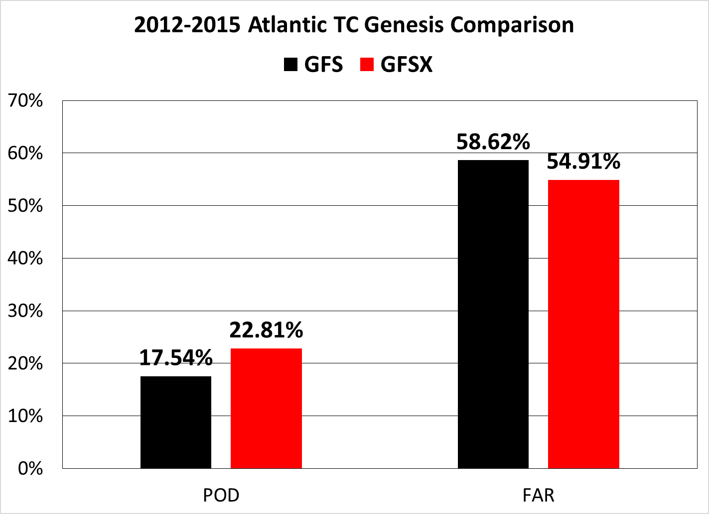
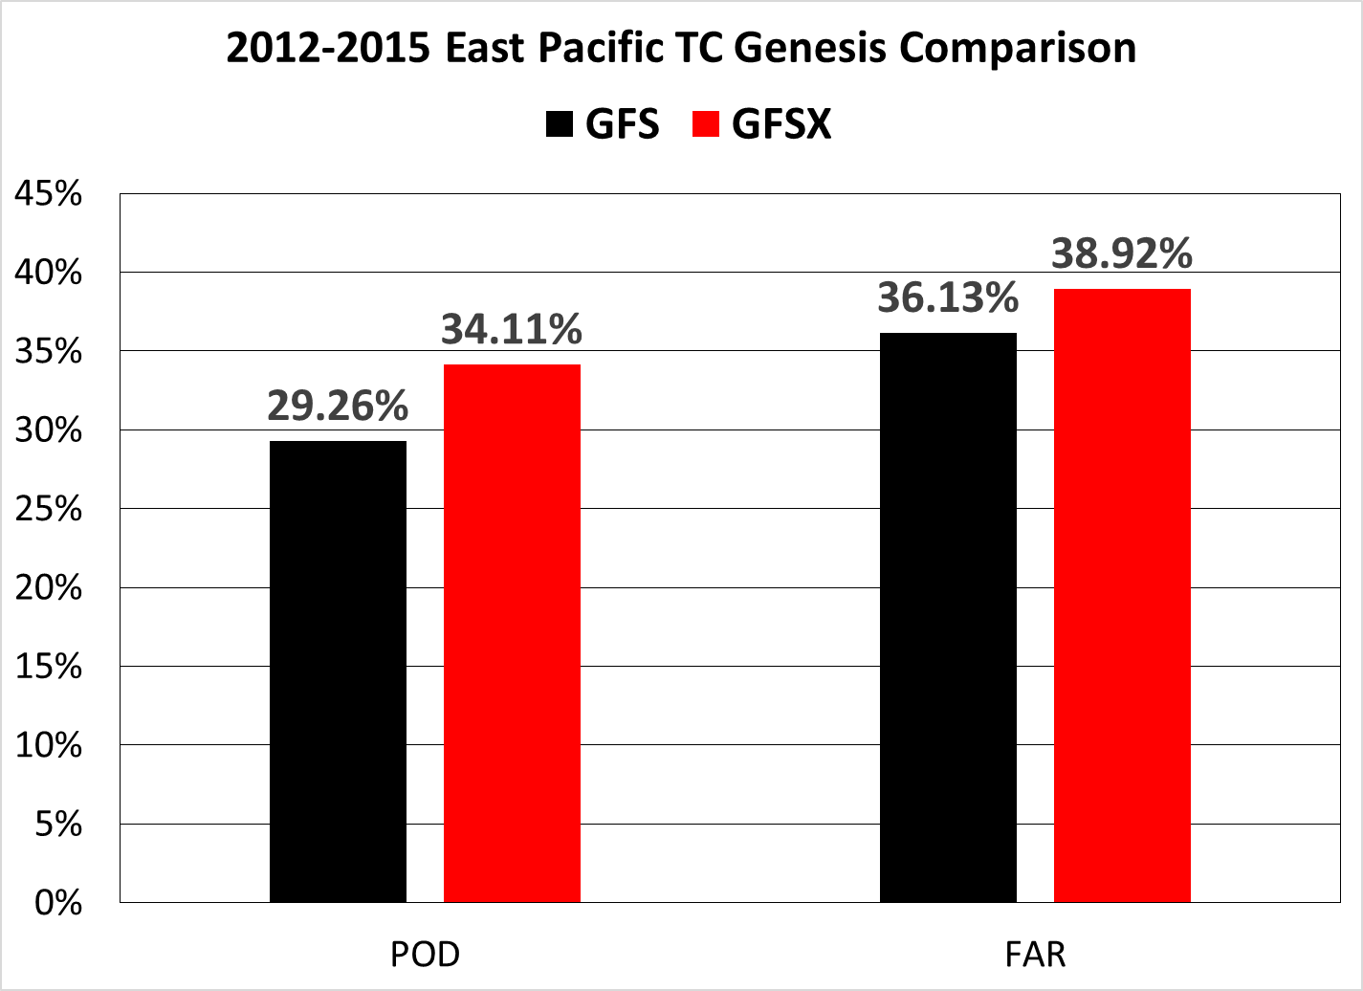
Verification of TC cyclogenesis in the GFSX – comparison to current and previous version of the GFS (courtesy of Dan Halperin and Bob Hart)

Slide 21
Concluding Remarks
GFSP has mostly improved TC track and intensity forecasts in comparison to current GFS.
GFSP in general handles gap wind events a little better than the current GFS, especially at longer time ranges.
In comparison to the current GFS, the GFSP has a higher POD for TC genesis in both basins and a lower FAR in the Atlantic, but a higher FAR in the east Pacific – so overall the new GFS is better at predicting genesis.

Slide 22
Concluding Remarks (cont.)
This evaluation was hampered by issues related to large volumes of data, particularly for the TC genesis verification which needed to be done externally, and the way the retrospective runs were done (split between EMC and NCO).
A remaining concern is the downstream impact of the GFSP on the HWRF and GFDL hurricane models. Reruns of these models for the 2012-2016 sample, which were promised, are not nearly complete, and time has apparently run out to finish the job.
Since the impact of the GFSP on the HWRF and GFDL hurricane models remains unknown, NHC cannot endorse this implementation. However, NHC does not oppose it.

