Slide 1
Evaluation Of Current and FY16 HWRF with GFSX
Zhan Zhang

Slide 2
Planned/Finished Retrospective HWRF Runs using new GFS
Year | 2012 | 2013 | 2014 | 2015 | Sum
Storm ID | 18L | 03L-14L | 01L-09L | 03L-12L
Verifiable Samples | 30 | 178 | 160 | 210 | 578
Completed/Total for AL storms: 242/578
Year | 2013 | 2014 | 2015 | Sum
Storm ID | 04E-18E | 01E-21E | 04E-20E
Verifiable Samples | 254 | 450 | 238 | 942
Completed/Total for EP storms: 459/942

Slide 3
Acronym:
FY15 HWRF: current operational HWRF
FY16 HWRF baseline: Several bug fixes from FY15, and smaller time step
H215: FY15 HWRF, current GFS
H16B: FY15 HWRF, new GFS
H16A: FY16 HWRF baseline , current GFS
H16C: FY16 HWRF baseline, new GFS
Most of the samples are from 2014 storms because new GFS archiving issue

Slide 4
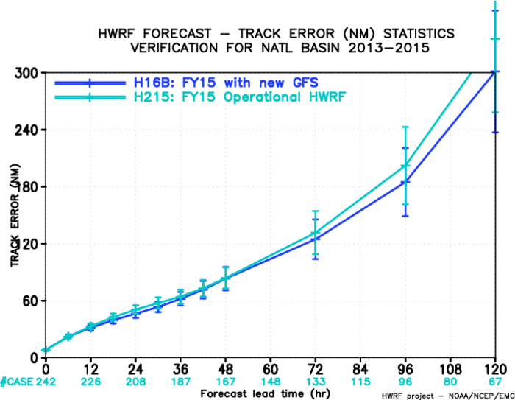
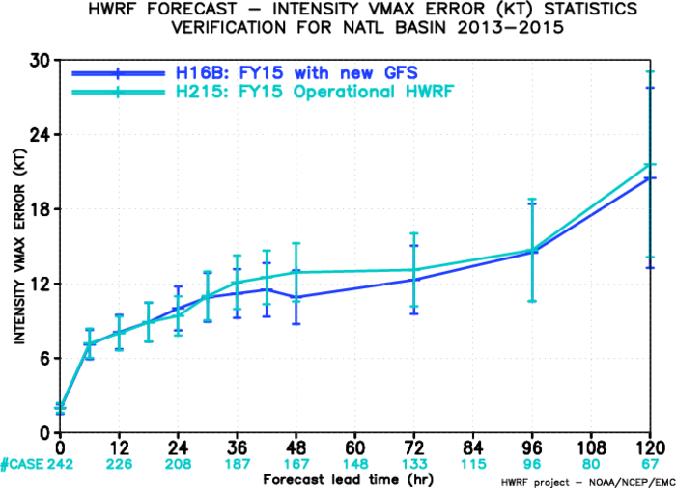
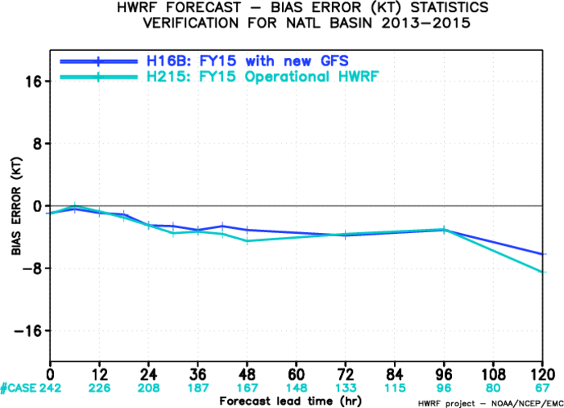
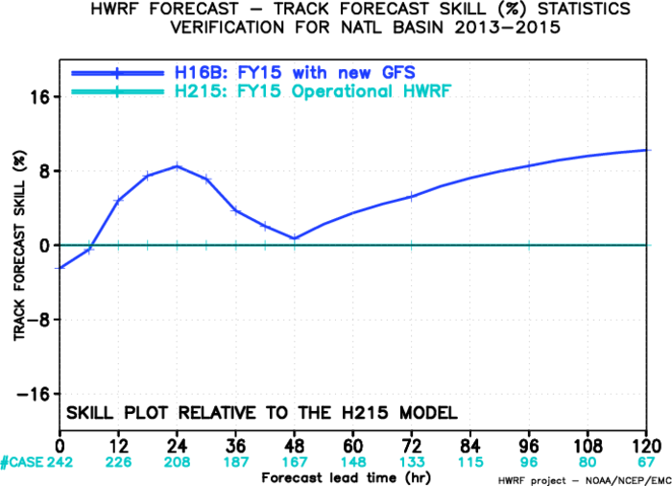
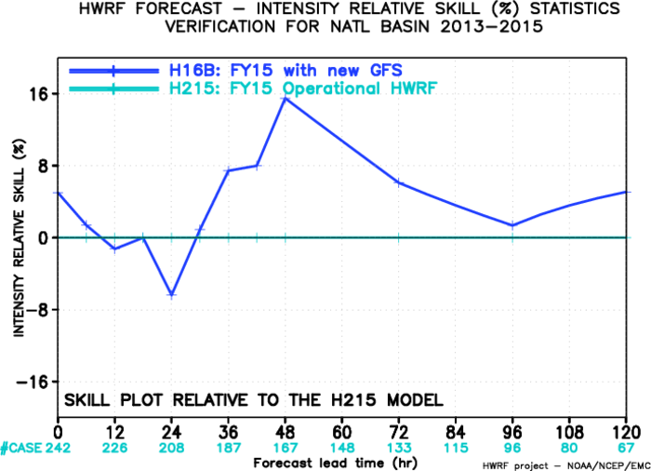
H16B vs. H215, AL
Track Error
Intensity Error
Intensity Bias
Track Skill improvement
Intensity Skill improvement

Slide 5
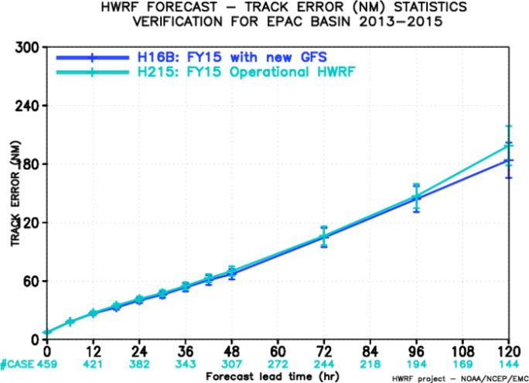
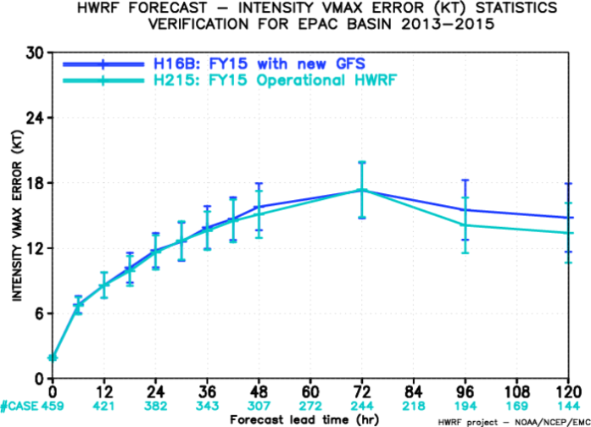
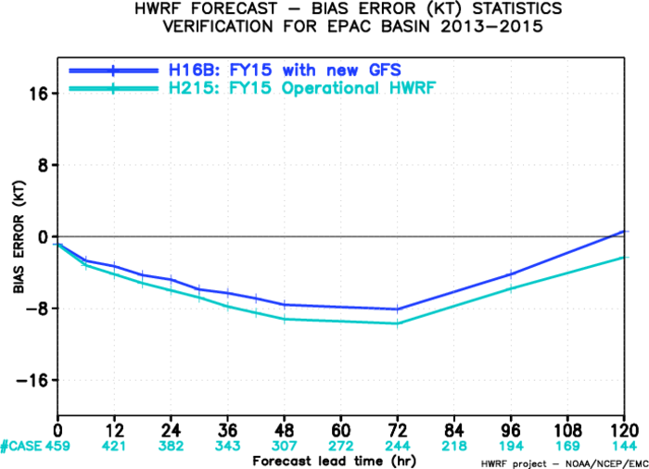
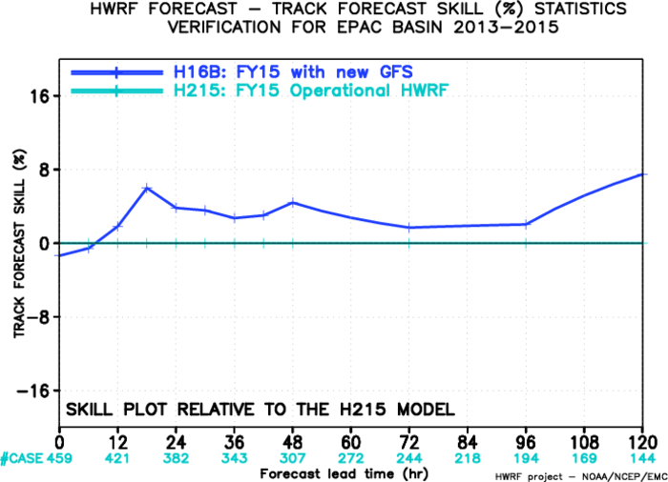
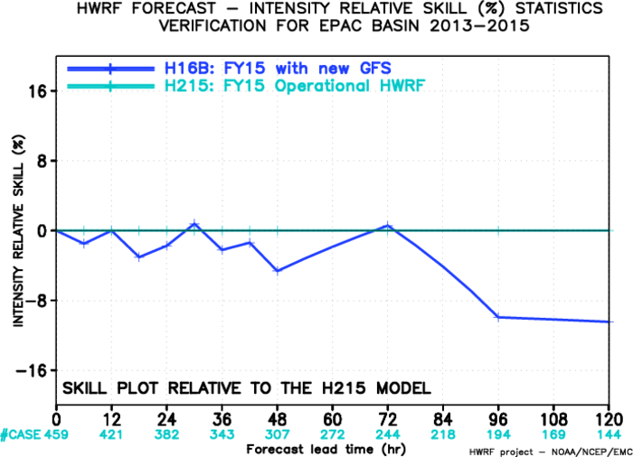
H16B vs. H215, EP
Track Error
Intensity Error
Intensity Bias
Track Skill improvement
Intensity Skill improvement

Slide 6
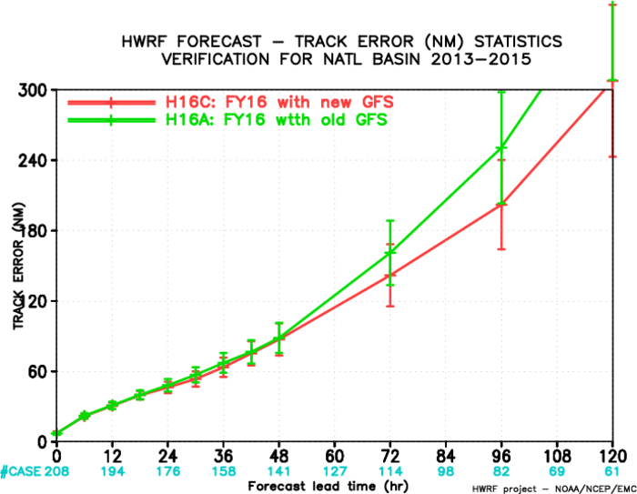
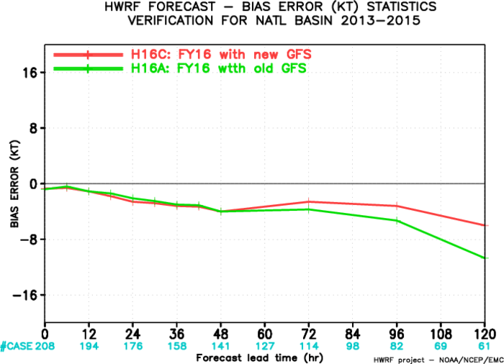
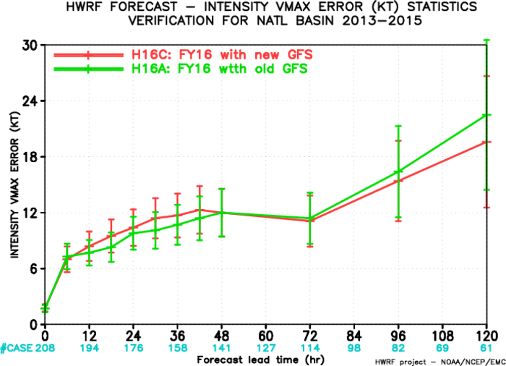
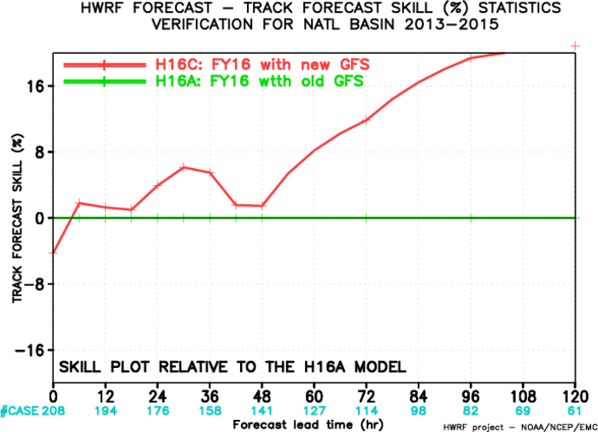
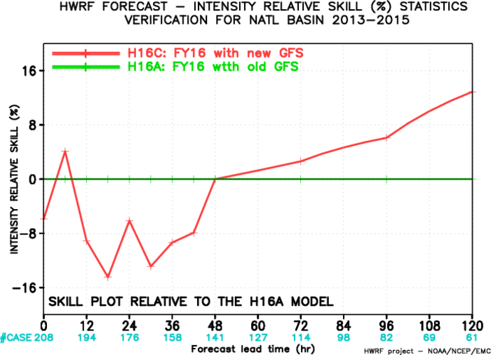
H16C vs. H16A, AL
Track Error
Intensity Error
Intensity Bias
Track Skill improvement
Intensity Skill improvement

Slide 7
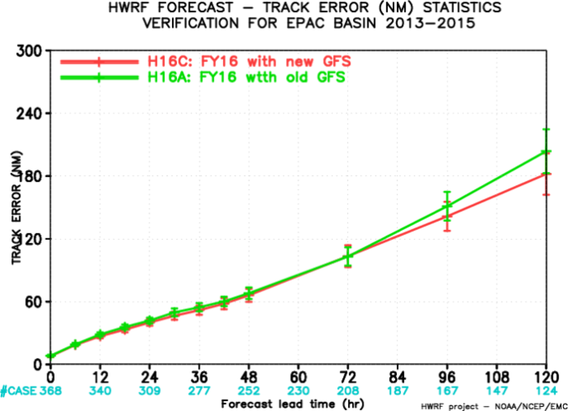
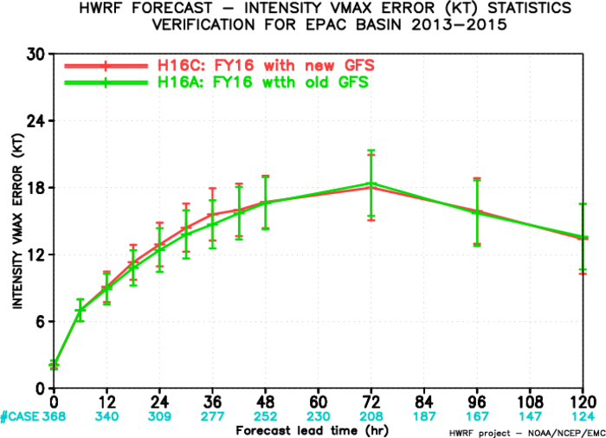
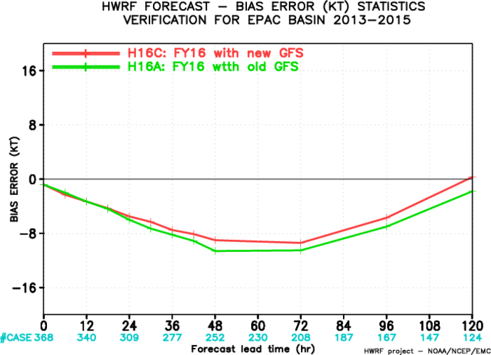
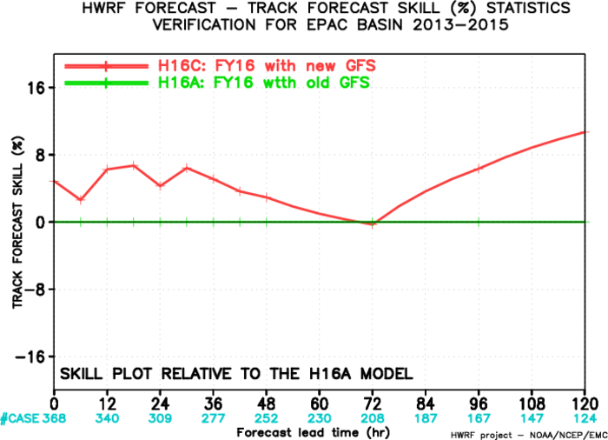
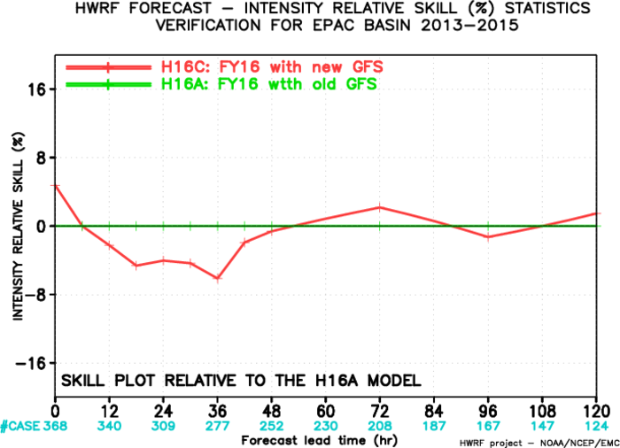
H16C vs. H16A, EP
Track Error
Intensity Error
Intensity Bias
Track Skill improvement
Intensity Skill improvement

Slide 8
HWRF Upgrade Plan for 2016 Implementation
Multi-season Pre-Implementation
 | Model upgrades | Physics and DA upgrades |  |  |  | Combined
 | Baseline (H16C) | Physics Test1 (H16D) | Physics Test2 (H16M) | Coupling test (H16N/H16Ñ) | Data Assimilation* | H216
Descriptions | 1. WRF-NMM V3.7.1a dynamic core with 1.a. retention of non-hydrostatic status during the nest movement; 1.b icloud=3 bugfix; 2. New GFS upgrade 3. Smaller time step | New GFS convective SAS, Eddy Diffusivity Mass-Flux Scheme w/ alpha in storm region | Alternative physics suite | Three-way HWRF-MPIPOM-WaveWatch-III coupled system for AL and HYCOM coupling | Hybrid GSI/HWRF-EPS based DA | Baseline + EDMF+newMP+3-Coupling+DA
Cases | Three-season 2013-2015 simulations in ATL/EPAC, cases (~1500) | Priority cases (TBD) | Priority cases (TBD) | Priority cases (TBD) | Only Aircraft DA cases for 2013-2015 | Three-season 2013-2015 retrospectives ~1500 simulations in ATL/EPAC
Platform | WCOSS | WCOSS | Jet | Jet/Zeus | WCOSS/Jet | Jet/WCOSS/Zeus
The plan is based on the assumption that 2016 operational HWRF system will have 2.5x computer resources as current system on WCOSS within HWRF operational time windows.
* DA experiment requires additional computer resources outside current operational time window.

