Slide 1
CPC Evaluation of PR4DEVB - D+8 & Week 2 - Stratosphere
Craig Long & Jae-Kyung Schemm

Slide 2
D+8 & Week 2 Forecasts
Test Period: June 1, 2013 – November 30, 2015
Differences are between the PR4DEVB and operational GFS during 2013-2015.
Focused on 500 hPa height and 850 hPa temperature forecasts over the Northern Hemisphere Extratropics (NH) and the Pacific-North America (PNA) sector.

Slide 3
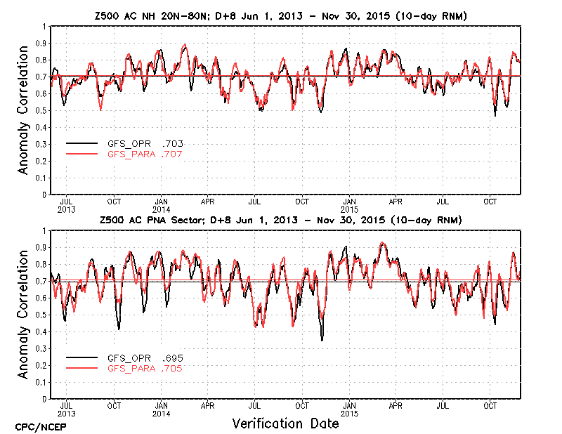
Z500 Anomaly Correlation Scores for D+8 Forecast

Slide 4
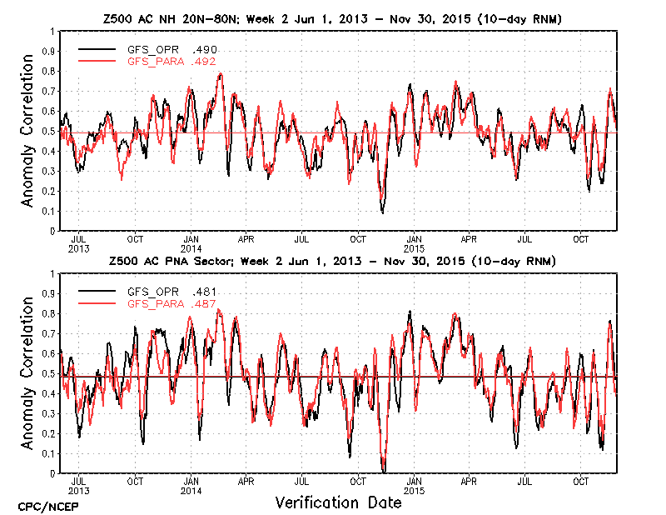
Z500 Anomaly Correlation Scores for Week 2 Forecast

Slide 5
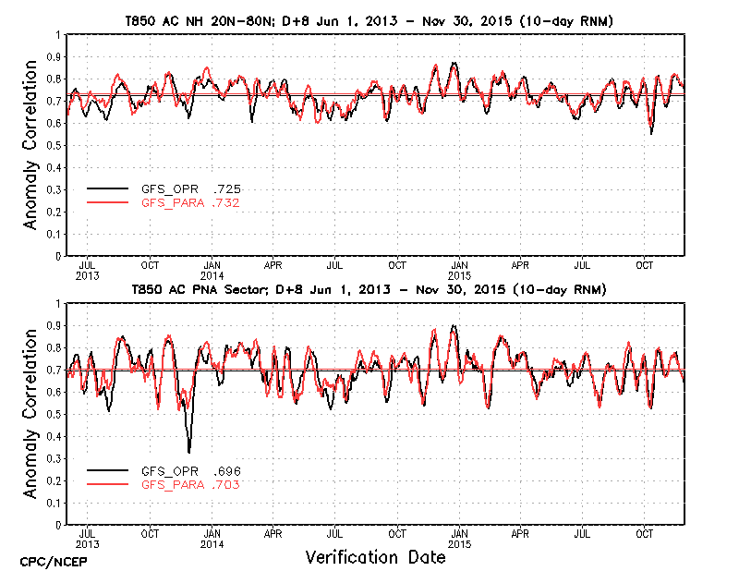
T850 Anomaly Correlation Scores for D+8 Forecast

Slide 6
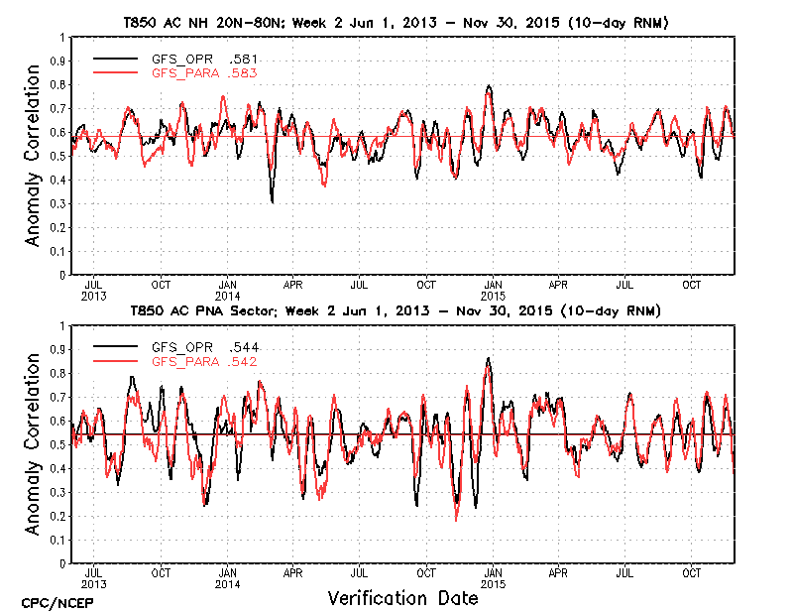
T850 Anomaly Correlation Scores for Week 2 Forecast

Slide 7
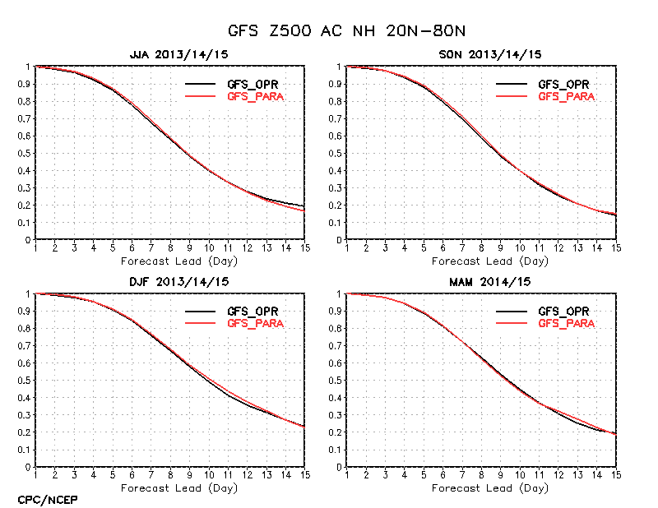
Z500 Anomaly Correlation Scores for Days 1-15; NH Extratropics (20N-80N)

Slide 8
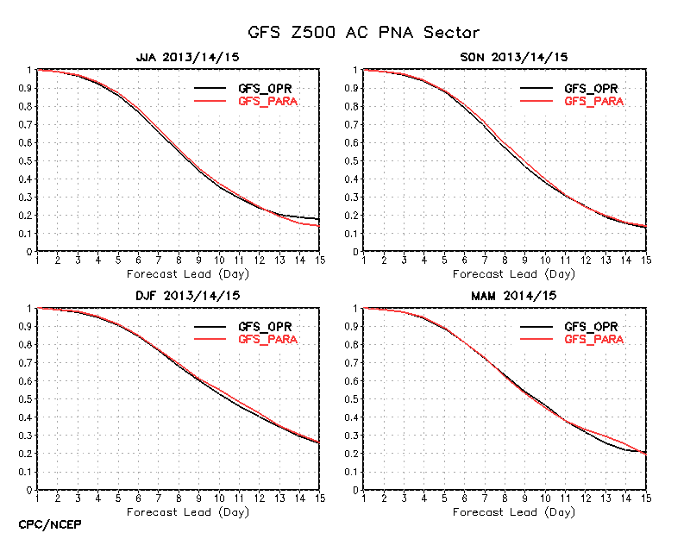
Z500 Anomaly Correlation Scores for Days 1-15; PNA Sector (180W-30W, 20N-70N)

Slide 9
Summary
500 hPa height and 850 hPa temperature AC scores and RMS error were compared for NH extra-tropics and the PNA sector for period Jun 1, 2013 – Nov 30, 2015.
The skill comparisons show no significant changes in forecast performance at all leads to 15 days over the operational GFS during the test period except slight degradation at longer leads during boreal summer season over the NH and PNA sector.
There is no negative impact in D+8 and Week 2 forecasts from this upgrade.

Slide 10
PR4DEVB Evaluation Stratosphere Temps, Winds and Ozone

Slide 11
Evaluation Tools
What was used for this evaluation:
Using Aura/MLS v4 monthly mean temperatures for 2014.
Monthly averaged the PR4DEVB temperatures for 2014.
Daily zonal temp, zonal wind, total ozone means from PR4DEVB runs for 2013/2014 winter, 2014 summer, and 2014/2015 winter.

Slide 12
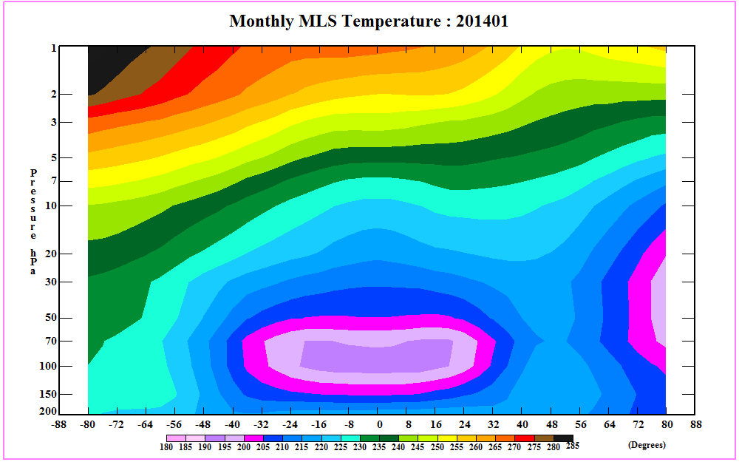
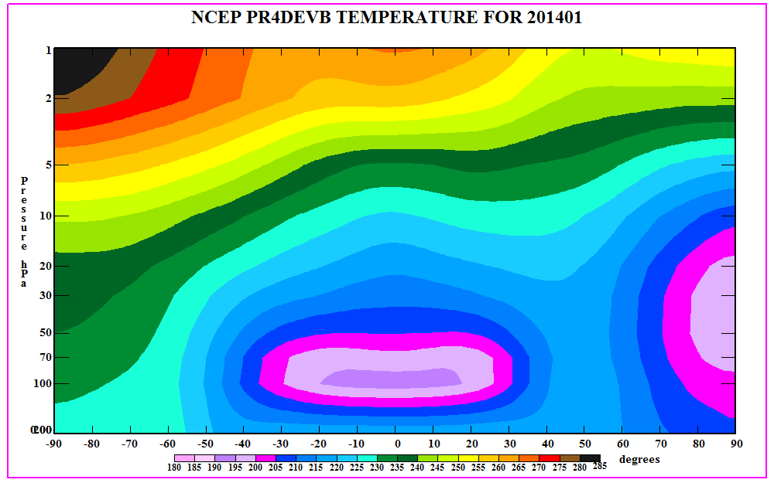
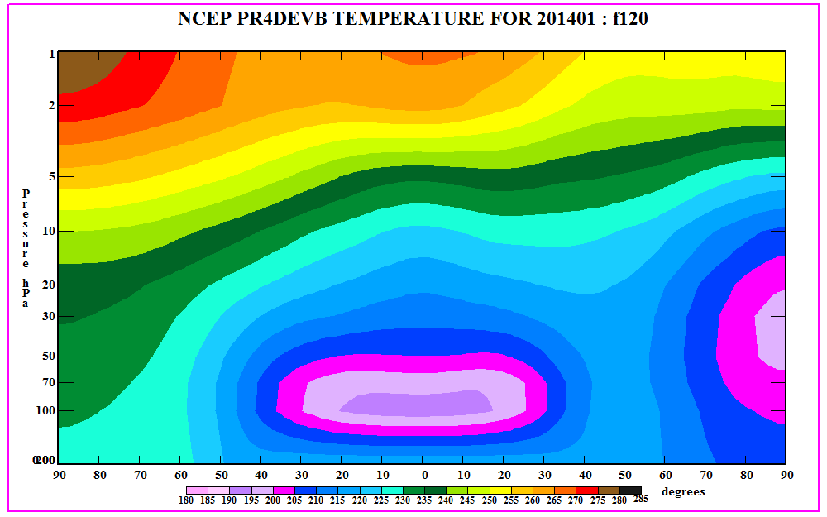
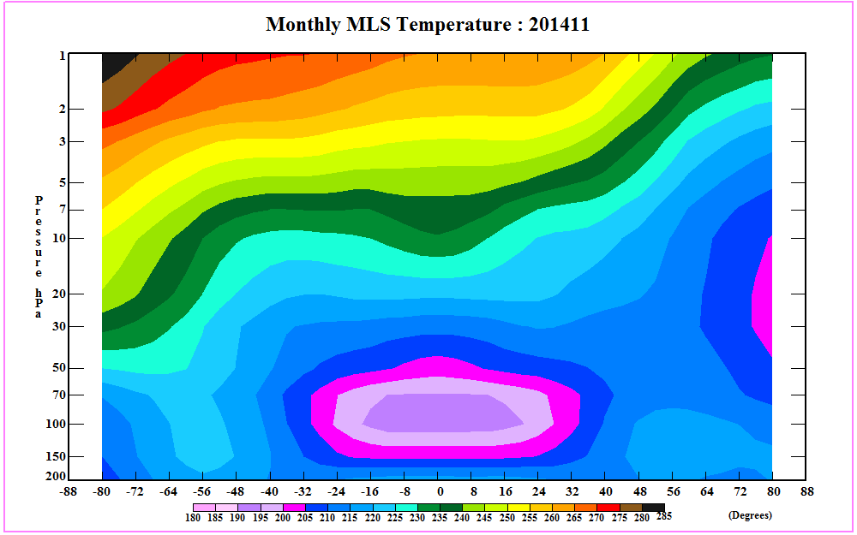
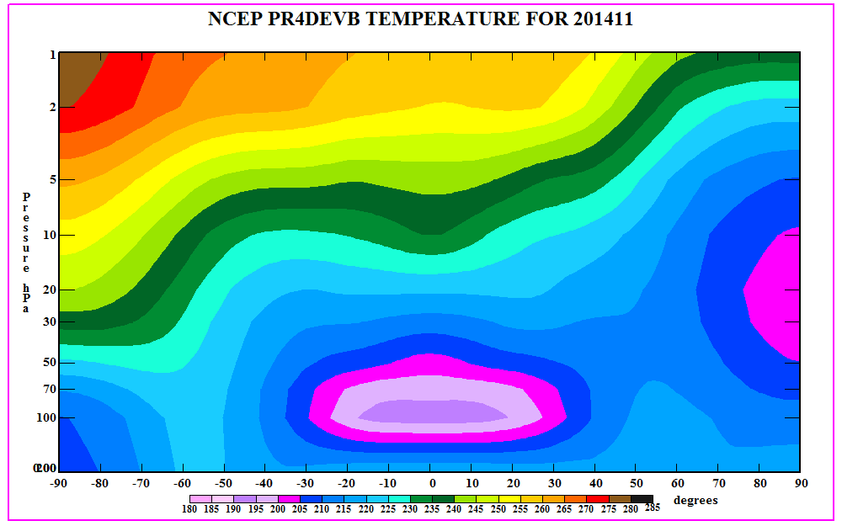
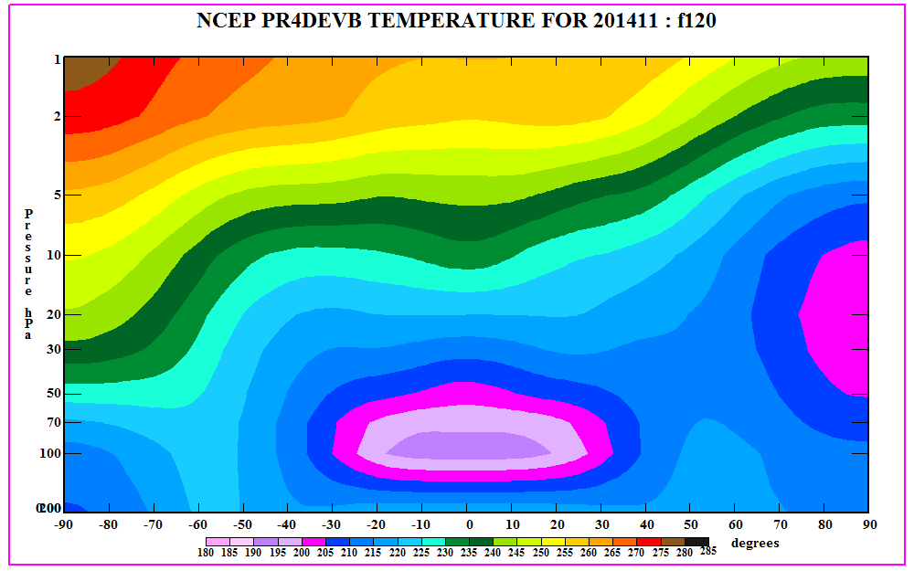
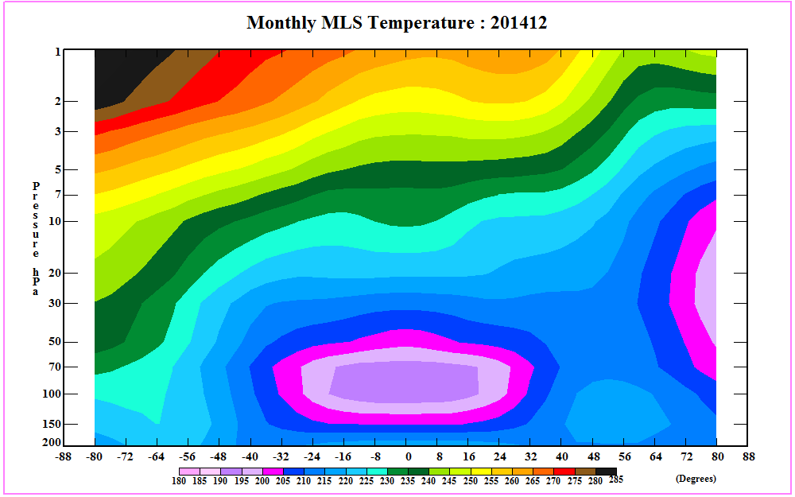
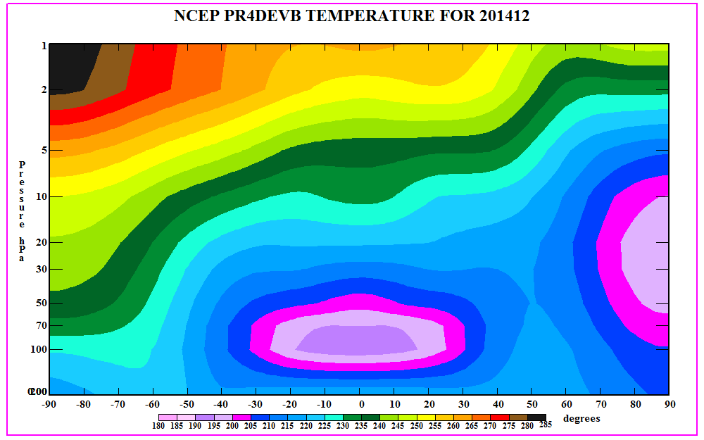
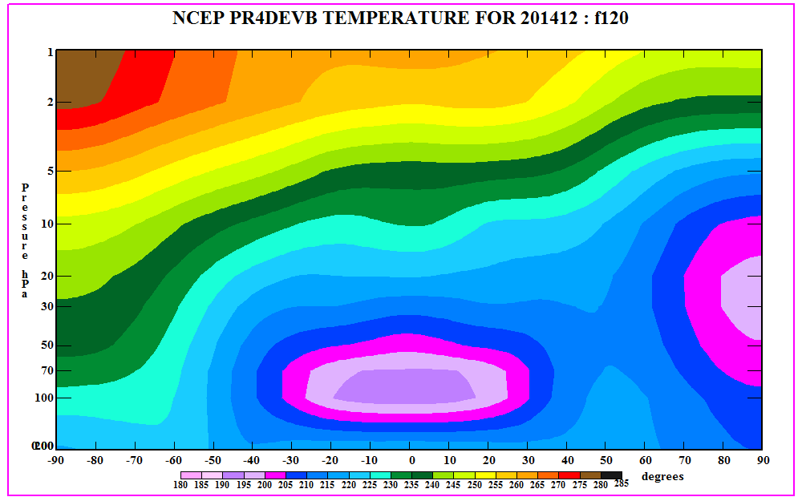
Monthly Mean Temperature Comparison with Aura/MLS: 2014
MLS
PR4DEVB : F00
PR4DEVB : F120
Jan
1
10
200
Nov
Dec
1
Pressure
200
Latitude
Latitude

Slide 13
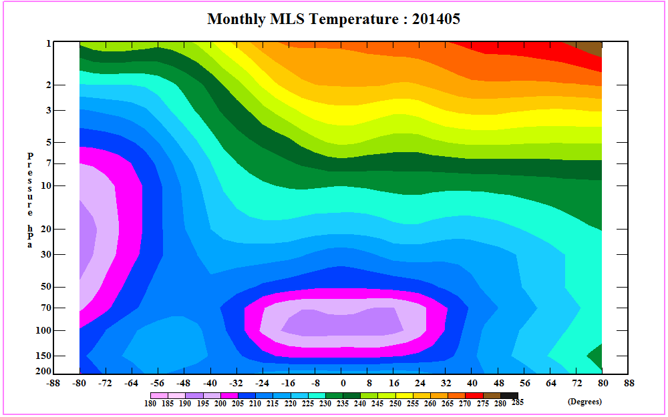
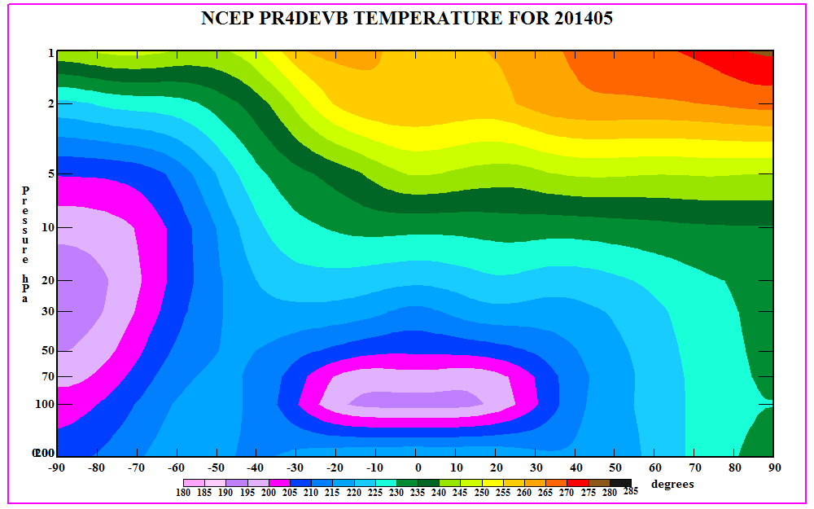
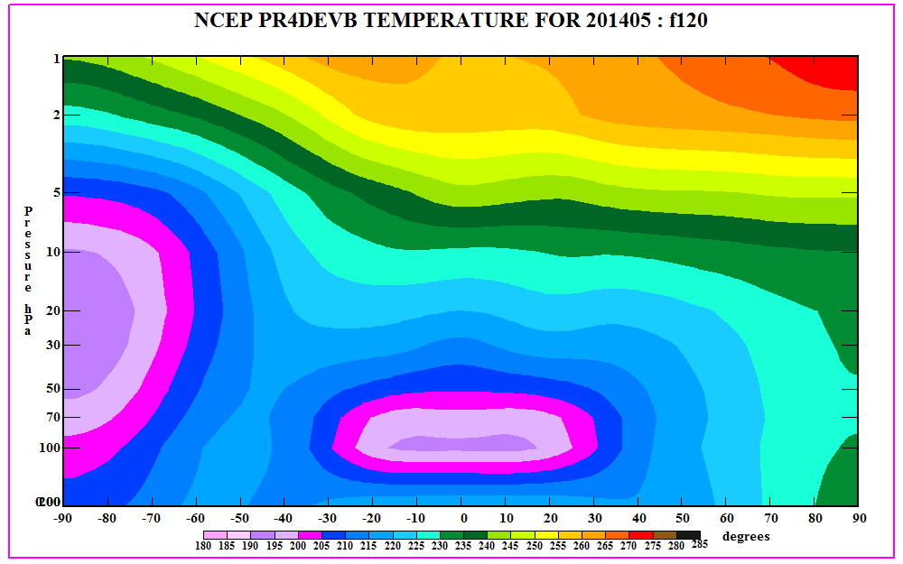
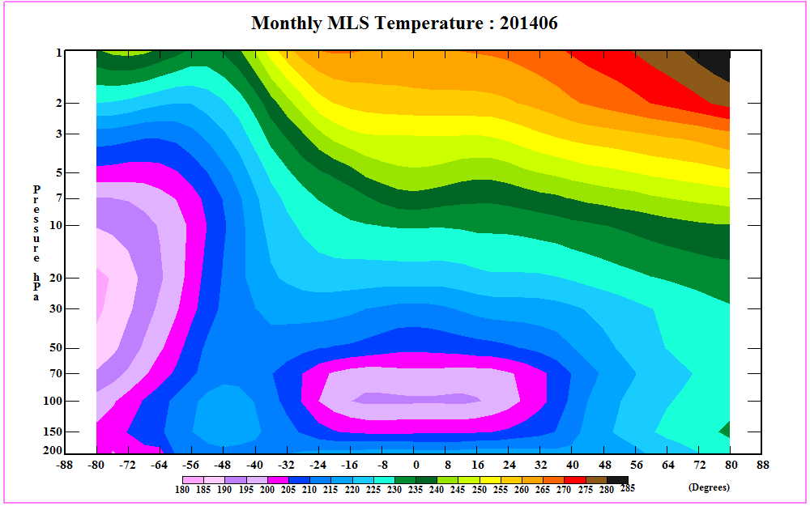
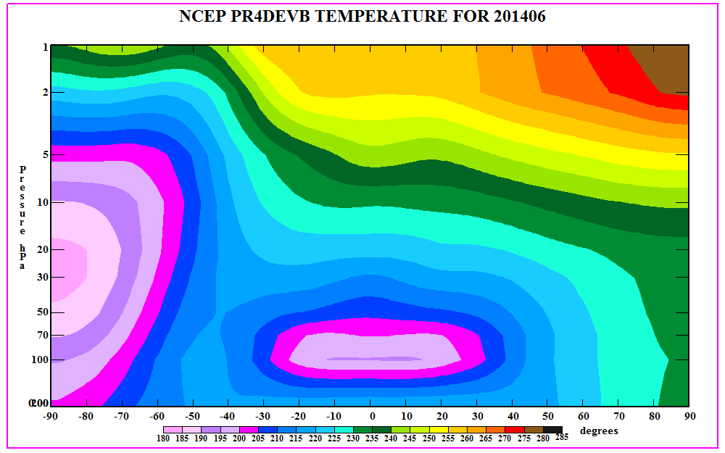
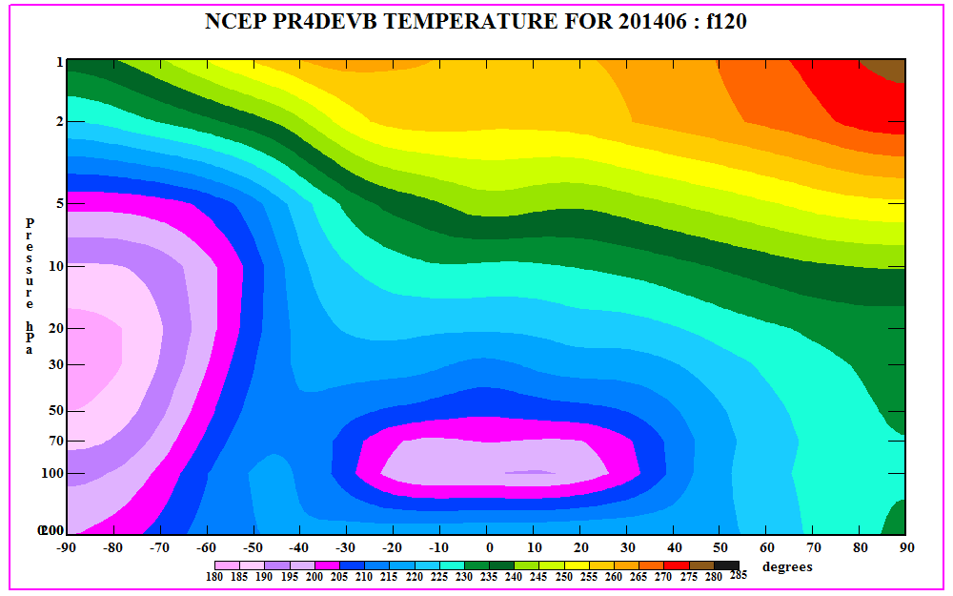
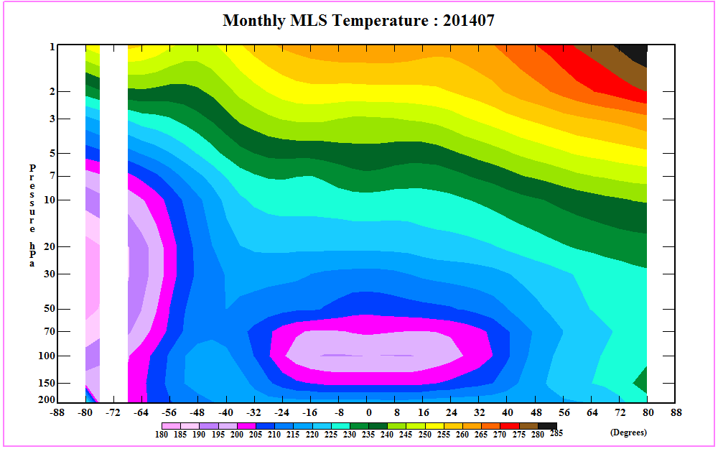
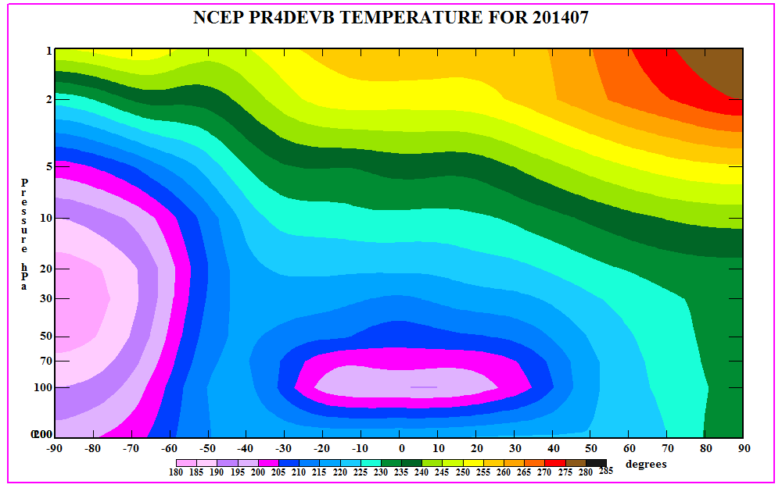
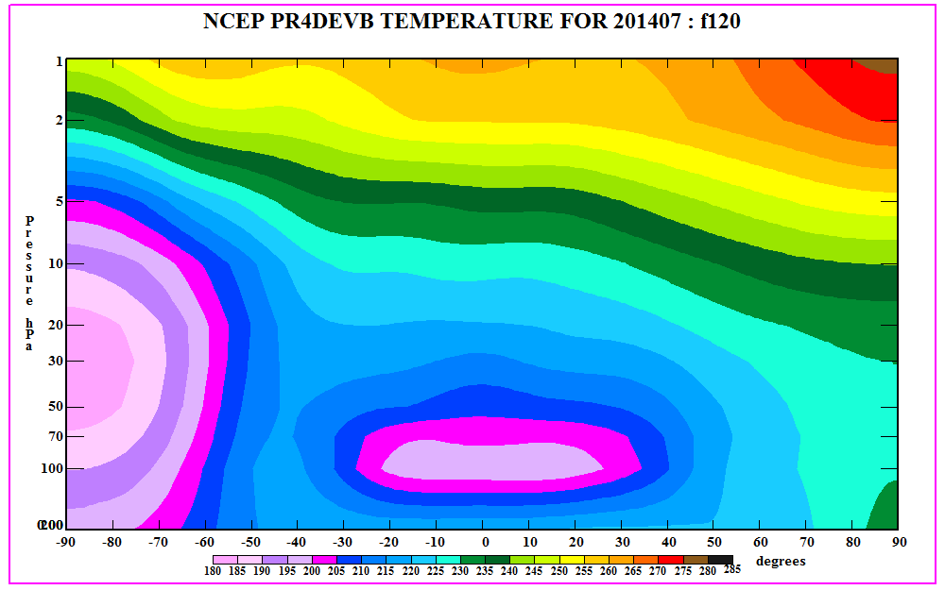
Monthly Mean Temperature Comparison with Aura/MLS: 2014
MLS
PR4DEVB : F00
PR4DEVB : F120
May
Jun
1
Pressure
200
Jul
1
10
200
Latitude

Slide 14
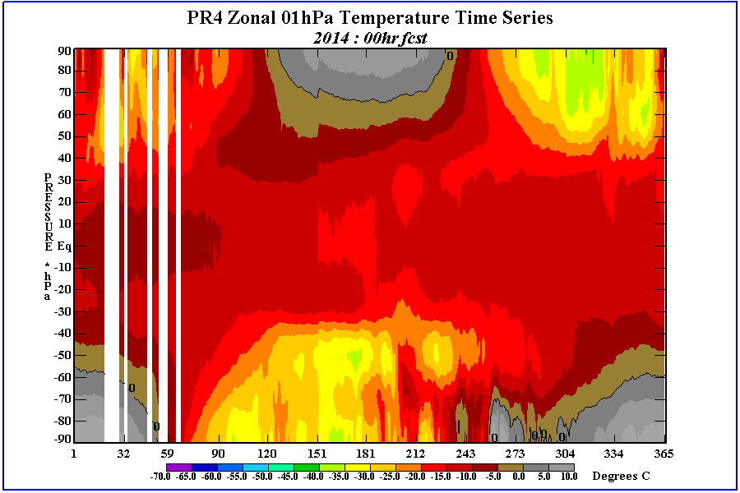
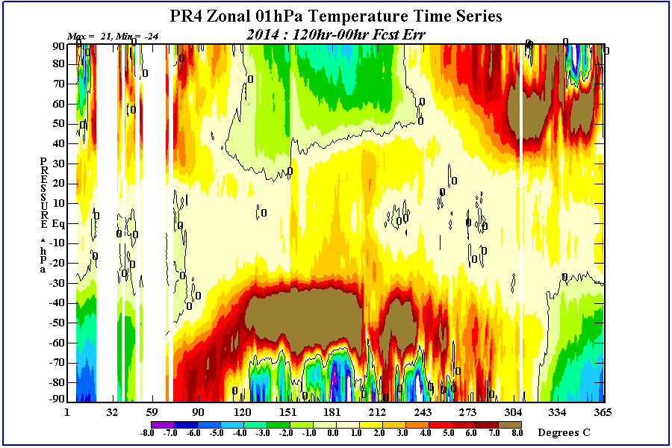
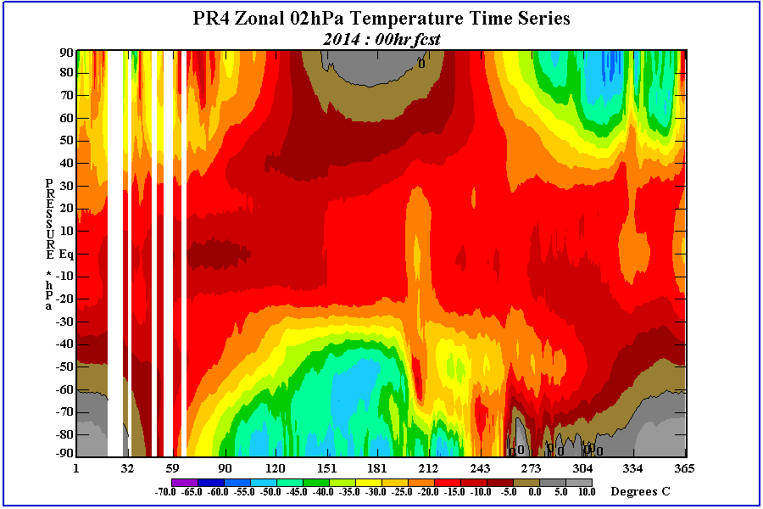
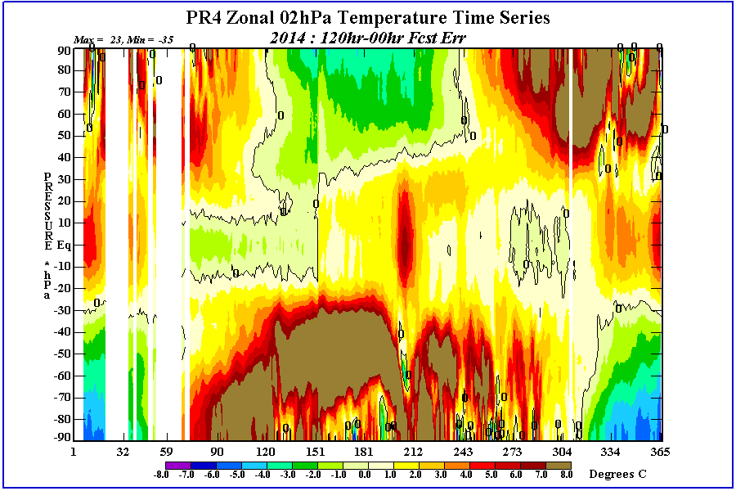
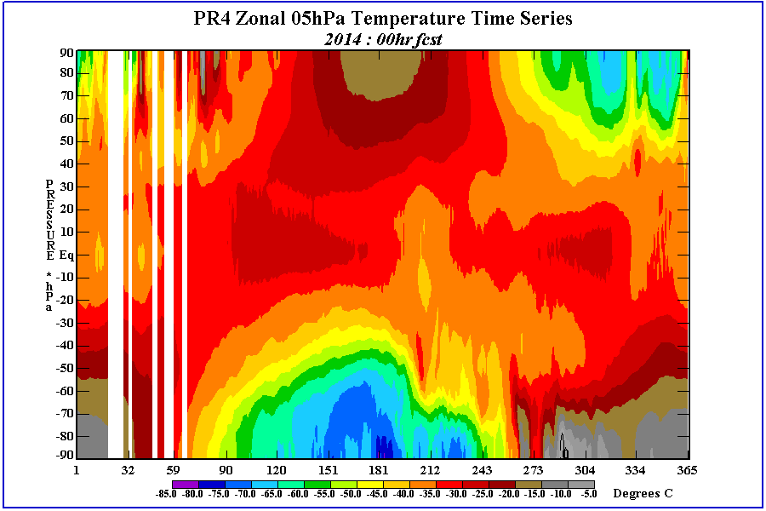
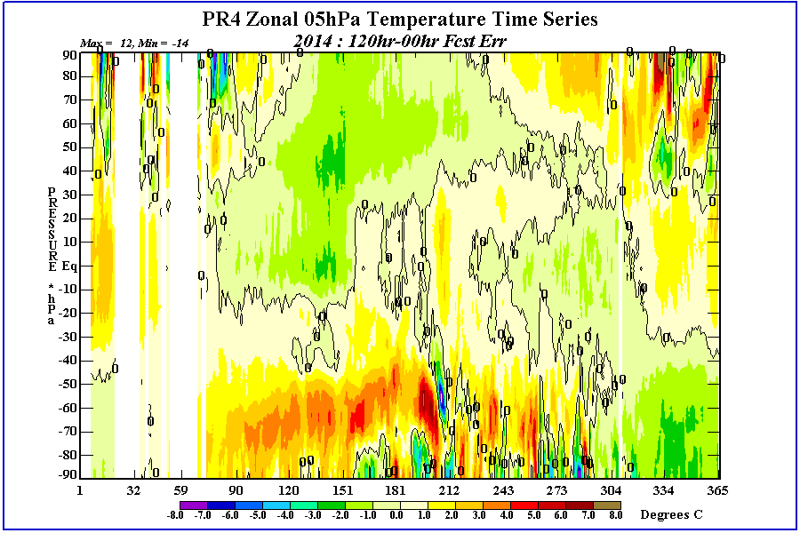
PR4DEVB Temperature Analysis and 120hr Forecast Err : 2014
1 mb
Anl
f120
-In upper stratosphere forecast errors are seasonal in each hemisphere’s extratropics being greatest + in winter months and greatest – errors in summer months. This means that the gradient across the polar vortex is decreased with fcst time. And summertime fcst temperatures are to cold by 5-10 degrees.
-The decrease in temperature gradient will affect zonal wind speed and PV barrier strength.
2 mb
Anl
f120
5 mb
Anl
f120
Latitude
Day of Year

Slide 15
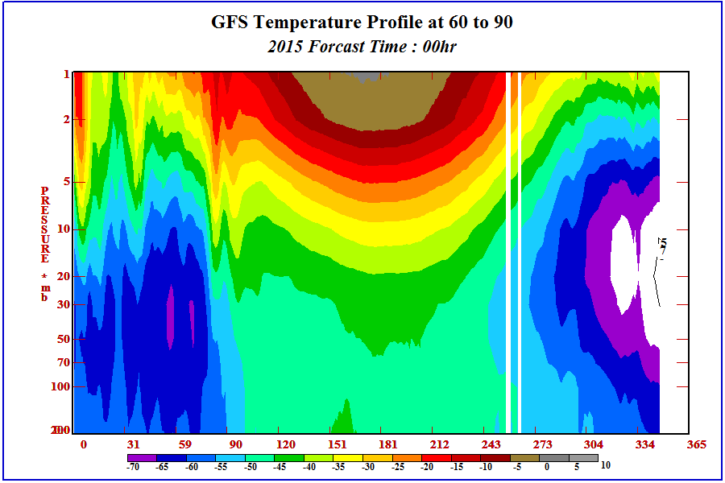
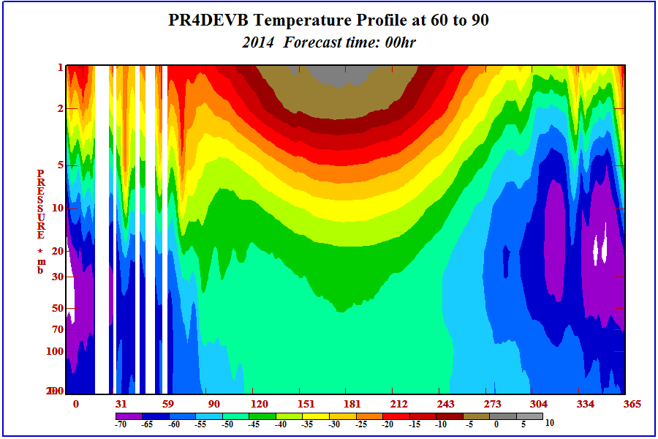
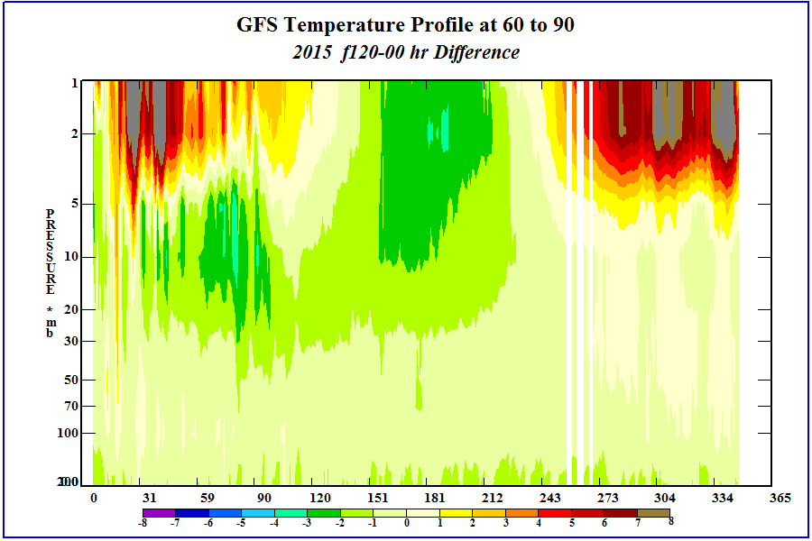
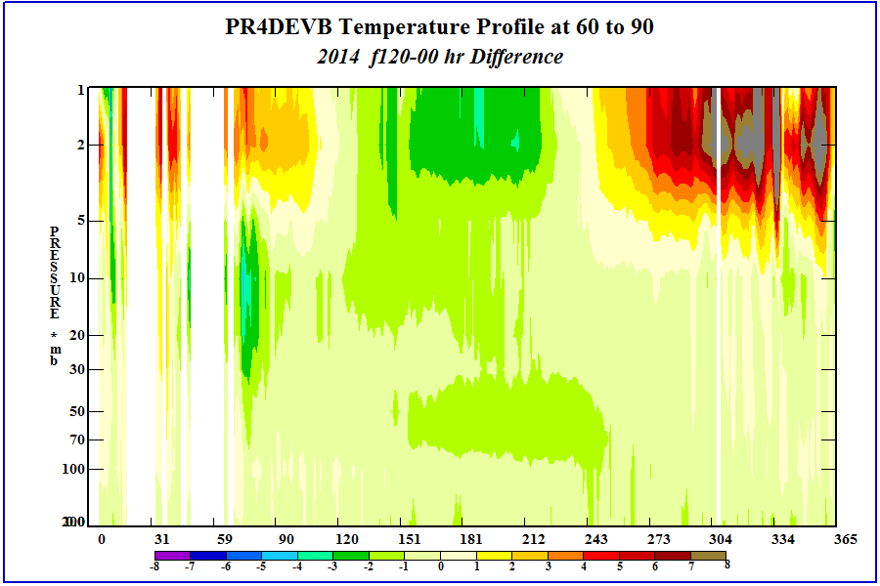

Slide 16
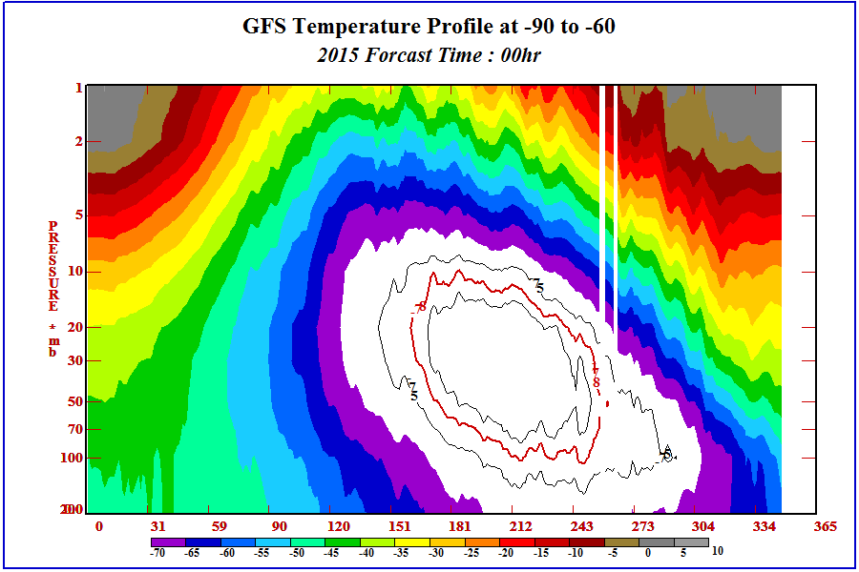
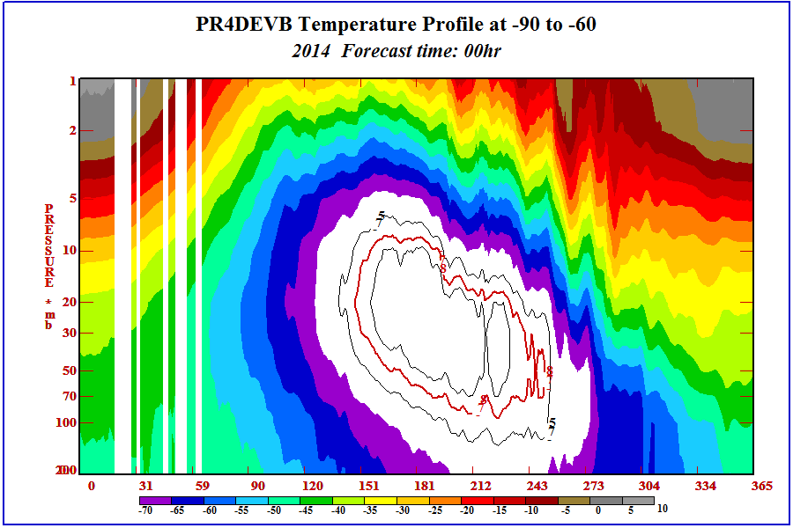
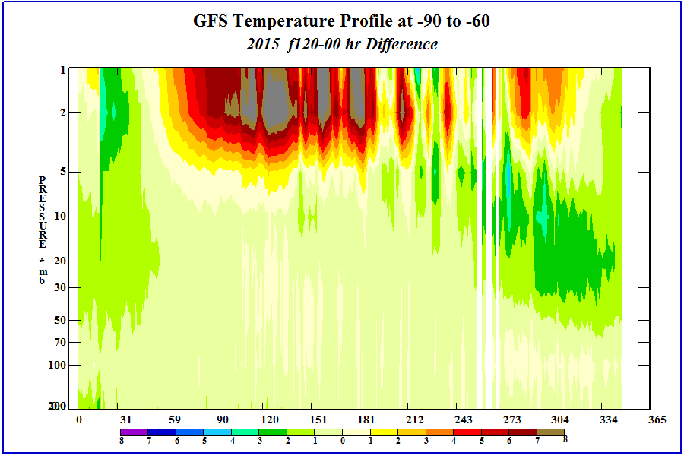
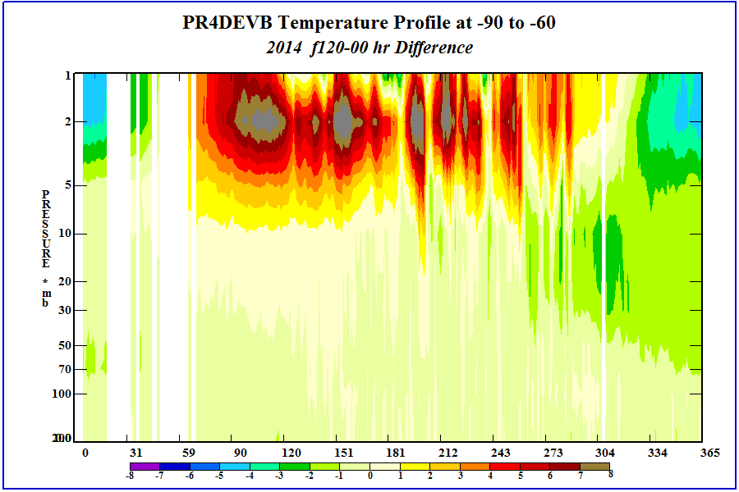

Slide 17
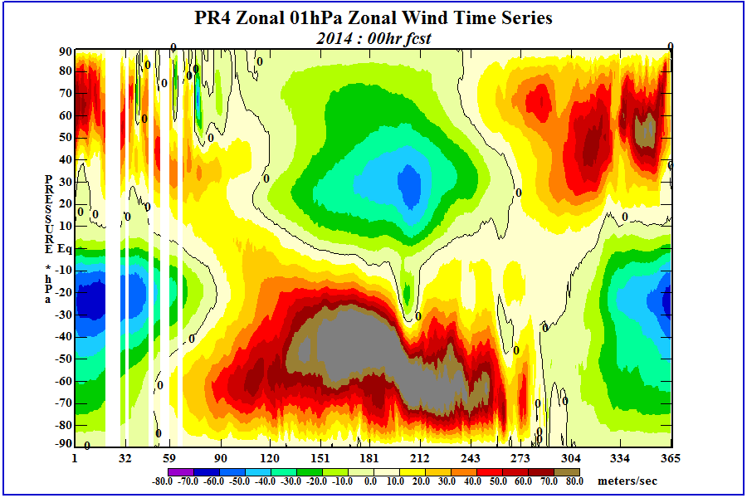
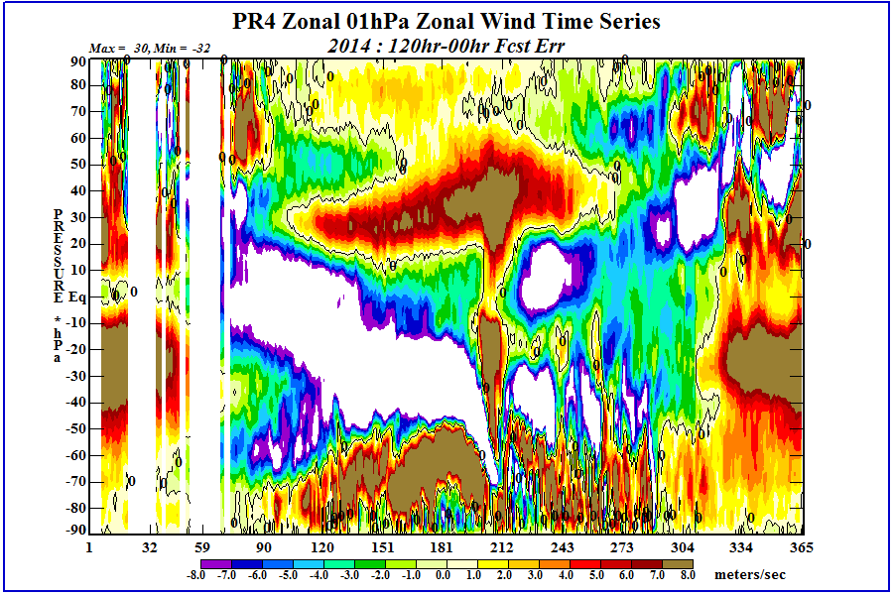
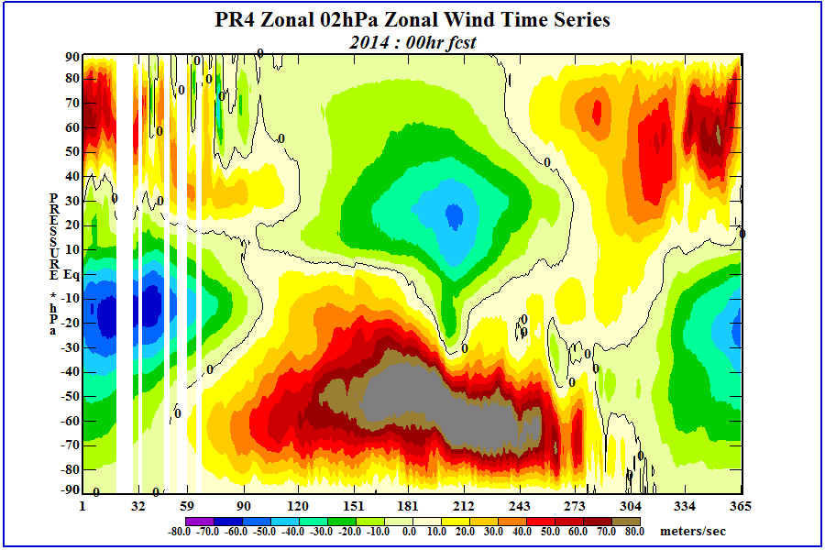
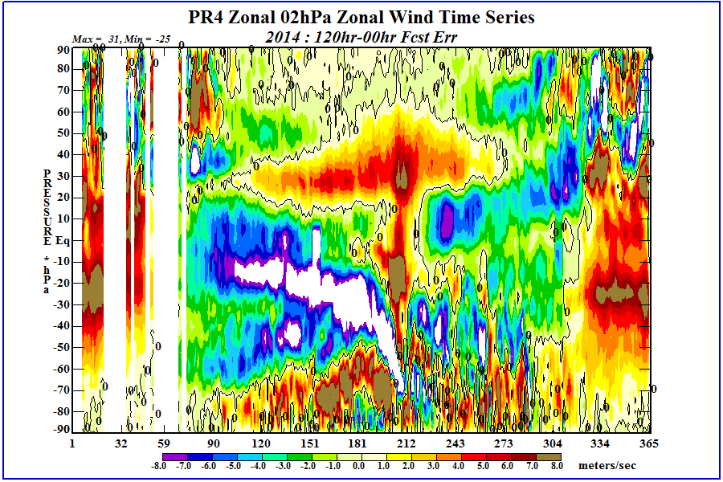
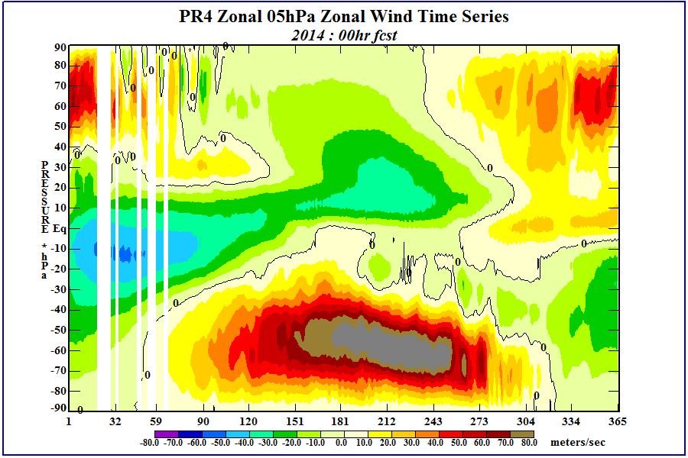
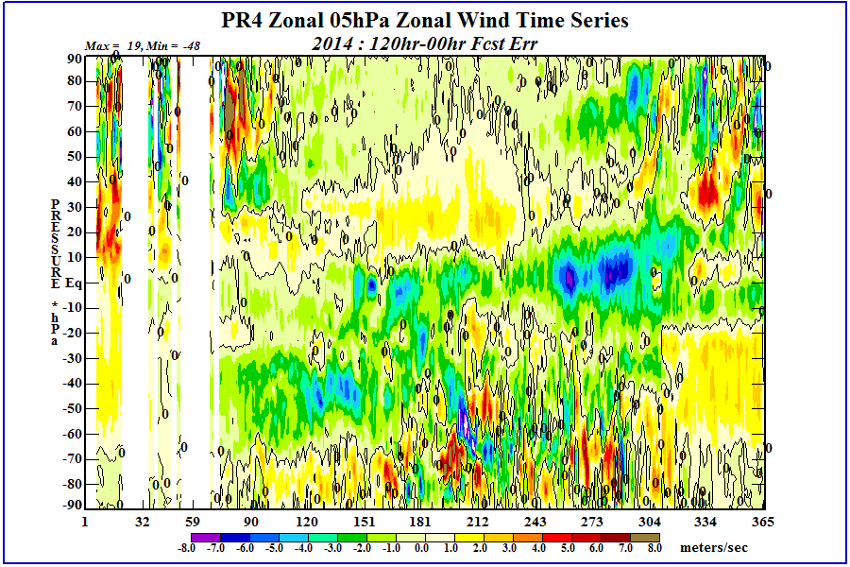
PR4DEVB Zonal Wind Analysis and 120hr Forecast Err : 2014
1 mb
Anl
f120
-In the upper stratosphere the decrease in the temp gradient across the winter hemisphere polar vortex decreases the jet max winds.
-The SH winter time jet max is moved poleward in the f120.
-The summer hemisphere’s decrease in its temperatures results in a decrease of the mid-latitude easterlies.
-These wind reductions decrease the amplitude of the SAO equatorial winds.
2 mb
Anl
f120
5 mb
Anl
f120
Latitude
Day of Year

Slide 18
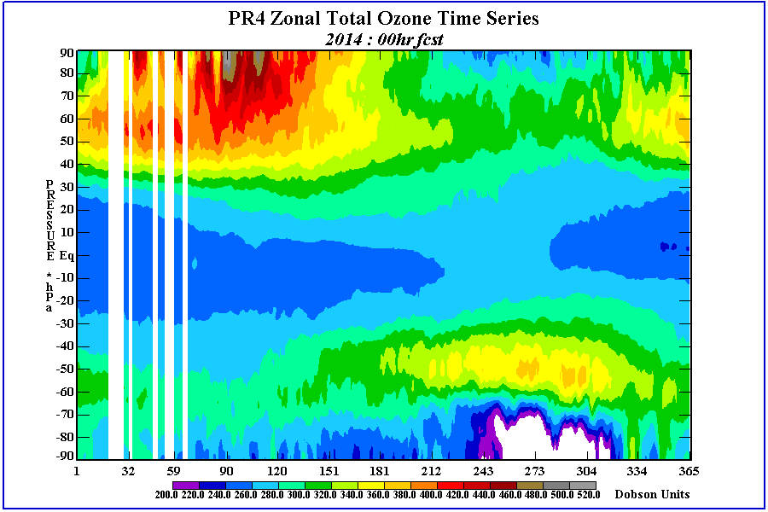
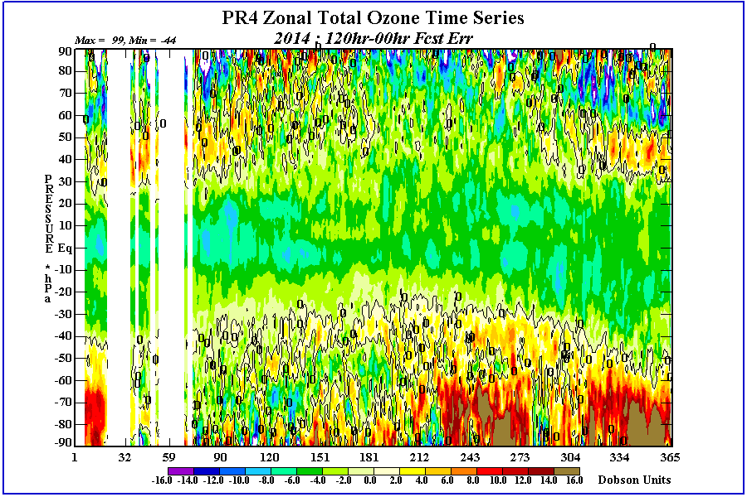
PR4DEVB Total Ozone Forecasts
Anl
f120
Latitude
Day of Year
-Total Ozone forecasts loose about 2 DU of ozone/day in the tropics.
-Large positive ozone errors in SH polar region August through January.
-Neg errors inside polar vortex with Pos errors equatorward of polar vortex.

Slide 19
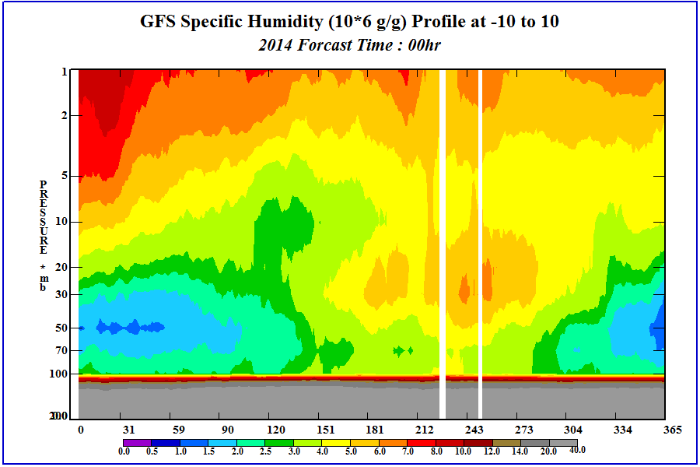
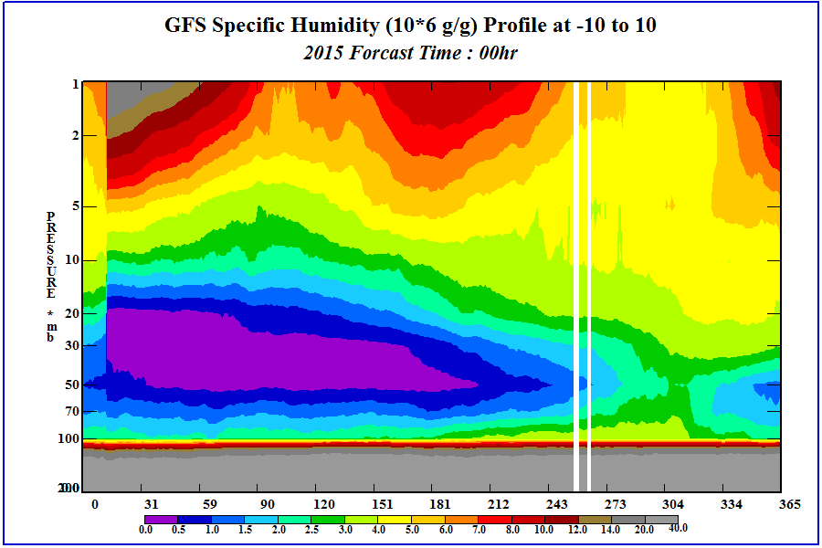
-SPFH conditions are very different between the 2014 and 2015 GFS.
- SPFH not available in all retrospective PR4DEVB runs.

Slide 20
Overall Evaluation
Take aways:
Temperatures
MLS is warmer than PR4DEVB in summer hemisphere upper stratosphere
PR4DEVB 5 day fcst is cooler than analysis.
Strong gradient at vortex edge is decreased in forecasts in winter hemisphere upper stratosphere.
Temp forecast errors are small in mid and lower stratosphere.
Temp forecast errors begin to increase in upper stratosphere and become seasonally dependent.
In upper stratosphere forecast errors are seasonal in each hemisphere’s extratropics being greatest + in winter months and greatest – errors in summer months. This means that the gradient across the polar vortex is decreased with fcst time. And summertime fcst temperatures are too cold by 5-10 degrees.
The decrease in temperature gradient will affect zonal wind speed and PV barrier strength.
Winds
In the upper stratosphere the decrease in the temp gradient across the winter hemisphere polar vortex decreases the jet max winds.
The SH winter time jet max is moved poleward in the f120.
The summer hemisphere’s decrease in its temperatures results in a decrease of the mid-latitude easterlies.
These wind reductions decrease the amplitude of the SAO equatorial winds.
Total Ozone
Total Ozone forecasts loose about 2 DU of ozone/day in the tropics.
Large positive ozone errors in SH polar region August through January.

Slide 21
Overall Evaluation - Stratosphere
Recommendations:
Not a show stopper since there is not adverse effects to the troposphere, but large temperature forecast errors need to be examined for a cause.
These results hopefully will improve when the GFS model top is lifted and more levels are added to the upper stratosphere/lower mesosphere (USLM).
Currently the top AMSU channel 14 is not assimilated because there are not enough model levels in the USLM for the foreward model to generate a good guess.
Adding more levels will allow the usage of AMSU channel 14 (unbias corrected) and should improve the temperature analysis in the USLM.

