Slide 1

Presented by:
Vijay Tallapragada
Chief, Global Climate and Weather Modeling Branch
Based on Work Done by EMC DA, Land Surface, Ensembles, Waves and Hurricane Teams and GCWMB
EMC CCB (Decisional Brief)
March 8, 2016
GDAS/GFS V13.0.0 Upgrades for 2016

Slide 2


GDAS/GFS upgrade
Project Status as of: 3/8/2016
Scheduling
G
Project Information and Highlights
G
Leads:
Vijay Tallapragada, EMC, Becky Cosgrove, NCO
Scope:
Upgrade to 4D hybrid EnVar data assimilation
Produce hourly output out to 120 hrs
Address high bias in 2m temp. during summer*
Estimated Benefits:
Generally more skillful forecasts
Estimated Resources:
In the process of determining resources
Milestone (NCEP) | Date | Status
Initial coordination with SPA team | 6/1/15 | Complete
Submit frozen codes to NCO to setup real-time and retrospective runs | 8/21/15 → 8/25 →10/29/2015 | Complete
Pre-CCB Briefing to EMC and OD | 1/26/16 -→ 1/29/2016 | Complete
Completion of full retrospective runs | 2/1/16 →2/15/2016 | Complete
EMC testing complete/external evaluation complete | 10/22/15*→ 2/19//2016 → 2/29/2016 | Complete
EMC CCB approval | 10/23/15→ 2/22/2016 → 3/8/2016 | TODAY
Management Briefing | 1/15/2016 → 2/25/2016 → 3/10/2016 →3/17 | Scheduled
Final GFS and all downstream codes submitted to NCO | 10/27/15 → 1/15/2016 → 1/22/2016 → 1/27/2016 → 2/3/16 | Complete
All non-GFS downstream codes submitted to NCO | 2/9/2016 →2/19/2016 →3/4 | Complete
Technical Information Notice Issued | 11/30/15→ 2/23/2016 -->4/1
SPA begins prep work for 30 day test | 10/28/15 → 1/19/2016 →1/23/2016 → 1/28/16 → 2/4/2016 | Complete
24-hr parallel production test | 3/25/2016
30-day evaluation begins | 12/14/15→ 2/23/2016 →3/25 →3/30 →4/6
30-day evaluation Ends | 1/13/16→ 3/24 → 4/23 →4/28 →5/5
IT testing ends | 1/27/16→ 3/31/16 →4/23 →4/29
Final Management Briefing | 2/2/16→ 4/18 →4/29 →5/4 → 5/11
Operational Implementation | 2/16/16→ 4/19 → 5/3 →5/10 →5/17
G
Issues/Risks
Issues:
Mitigation:
Management Attention Required | Potential Management Attention Needed | On Target
R
Y
G

Slide 3
Table of Contents
The GDAS/GFS is being upgraded to 4D-Hybrid En-VAR System
Land surface improvements to address summertime warm/dry biases in surface fields
Hourly output fields through 120-hr forecasts
Evaluation of GDAS/GFS upgrades based on 34 months of retrospective and real-time experiments

Slide 4
Next GFS/GDAS in 2016
The 4D Hybrid En-Var
4-D hybrid
Improved use of satellite radiances
Improved use of satellite winds and aircraft observations
Corrections to land surface to reduce summertime warm, dry bias over Great Plains
CRTM v2.2.1
NCEP_POST v7.0
3 years of forecasts produced and evaluated
4D Schematic
t-3
t=0
t+3
The ensemble provides an updated estimate of situation dependent background error every hour as it evolves through the assimilation window. This flow dependent statistical estimate is combined with a fixed estimate.

Slide 5
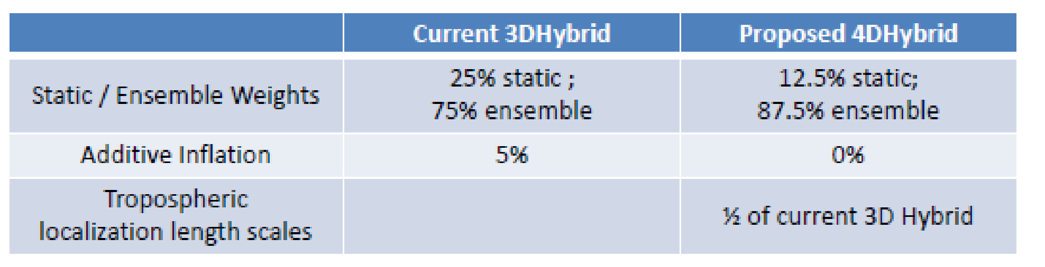
DA and Model Changes
DA Changes: Theoretical and Observational
Forecast Model and Product Changes
3D to 4D ensemble covariances
Increase in ensemble contribution from 75% to 87.5%
Reduction of horizontal localization length scales in the troposphere
Removal of additive inflation
Code optimization
Limit moisture perturbations for improved minimization
Inclusion of ozone cross-covariances
Removal of time component for data selection
4D thinning of AMVs
Aircraft temperature bias correction
All sky microwave radiances
CRTM upgrade
Convective gravity wave upgrade,
Tracer adjustment upgrade
Corrections to land surface to reduce summertime warm, dry bias over Great Plains
Improved icing probability products and new icing severity product
Hourly output through 120-hr forecast
5 more levels above 10 hPa

Slide 6
Addressing Summer-time Warm/Dry Biases
GFS showed too little evaporation and too much sensible heat flux, hence Bowen ratio is too high. The factors include:
Thermal roughness and momentum roughness
Canopy resistance
Soil moisture
……..
We proposed the following parameter refinements in Q3FY16 GFS:
rsmin for grassland from 45 to 20
rsmin for cropland from 45 to 20
roughness length for cropland from 3.5cm to 12.5cm (used to address too strong surface winds)

Slide 7
New Model Upgrade Evaluation Strategy
GCWMB real time (pr4devb)
period: 2015070100 - real time
GCWMB 2015 summer retrospective (pr4devbs15) --- Completed
period: 2015041500 - 2015120100 (230 days)
GCWMB 2013 summer retrospective (pr4devbs13)
---Completed
period: 2013041500 - 2013120100 (230 days)
NCO 2013-2014 winter retrospective
(pr4devbw13) --- Completed
period: 2013110100 - 2014060100 (212 days)
NCO 2014 summer retrospective
(pr4devbs14)---Completed
period: 2014050100 - 2014120100 (214 days)
GCWMB 2014-2015 winter retrospective (pr4devbw14) --- Completed
period: 2014110100 - 2015070100 (242 days)
GCWMB Special retrospective for H. Sandy
period: 2012101700 - 201213100 (15 days) --- Completed
Involve field in real-time and retrospective evaluation of science upgrades --- Completed
Identify case studies and provide data for extended evaluation period beyond last 30-day parallel --- Completed
NCO 30-day parallel is only for IT evaluation

Slide 8
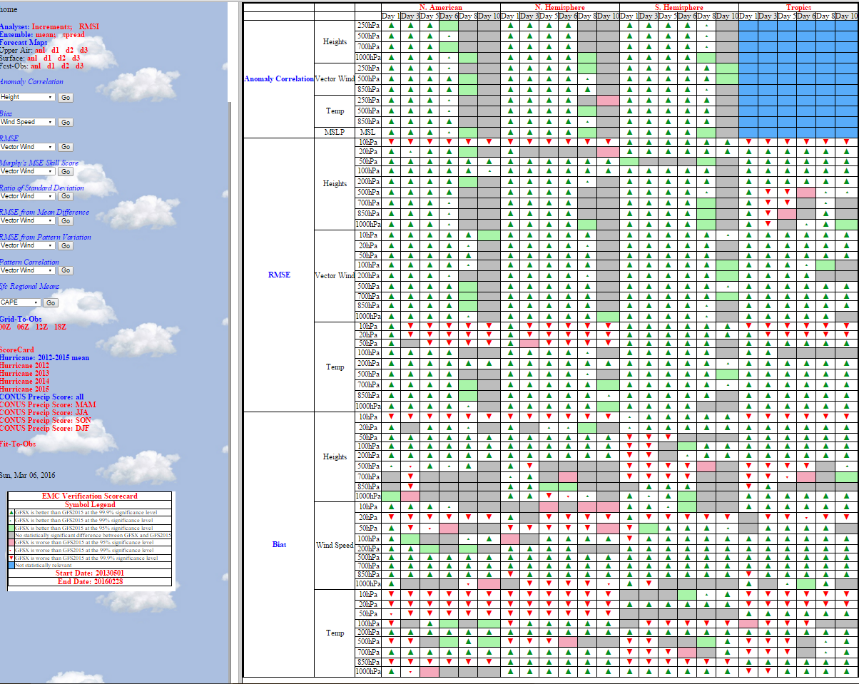
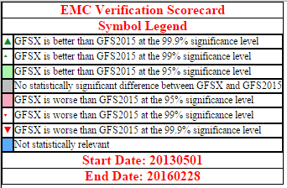
Comprehensive Evaluation from EMC
Part 1
Retrospectives—Standard verification page against own analyses, GFS2015 vs. GFS2016: http://www.emc.ncep.noaa.gov/gmb/wx24fy/vsdb/gfs2016/

Slide 9
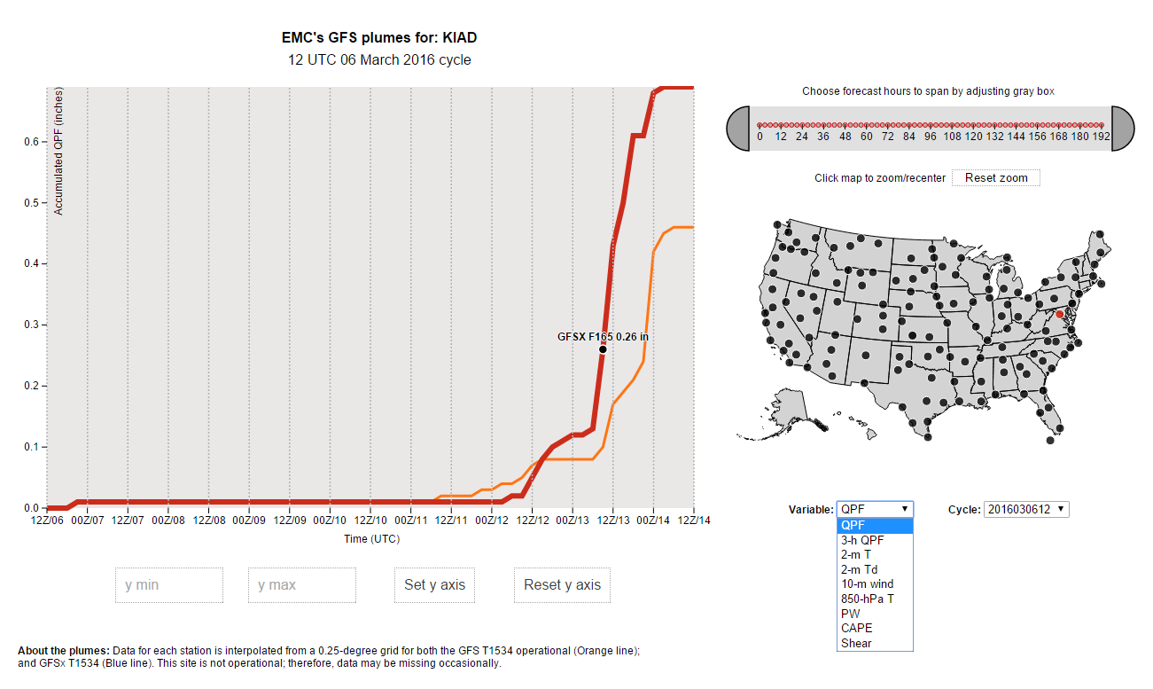
Comprehensive Evaluation from EMC
Part 2
Real time plots of near surface variables at representative stations: http://www.emc.ncep.noaa.gov/gc_wmb/parthab/Plume_test/GFSx/EMCGEFSplumes.html

Slide 10
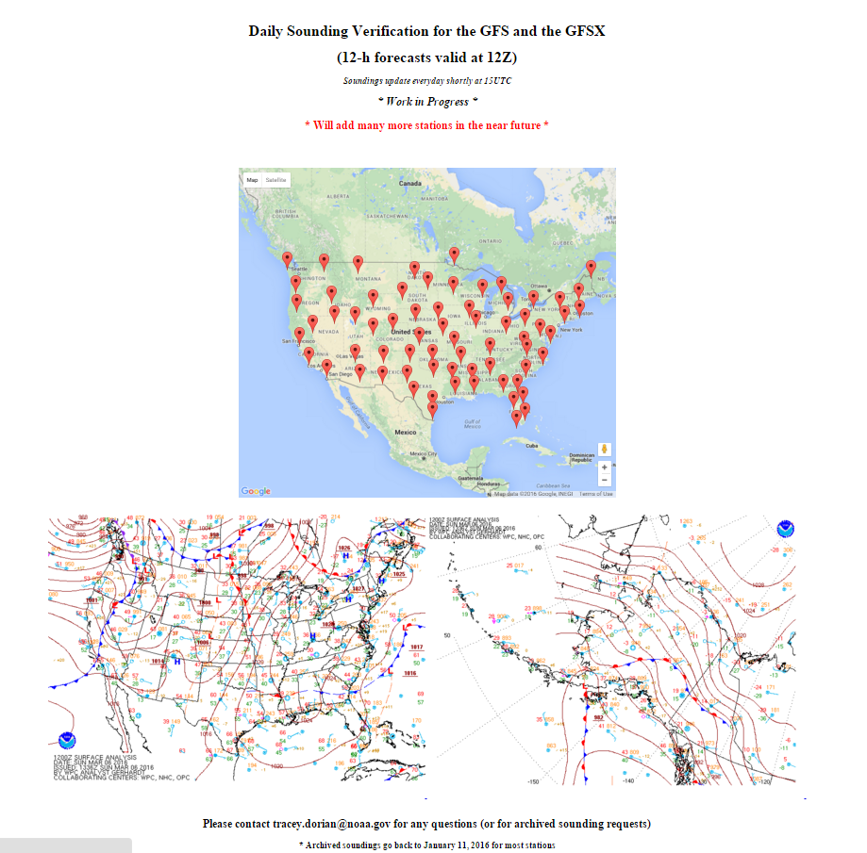
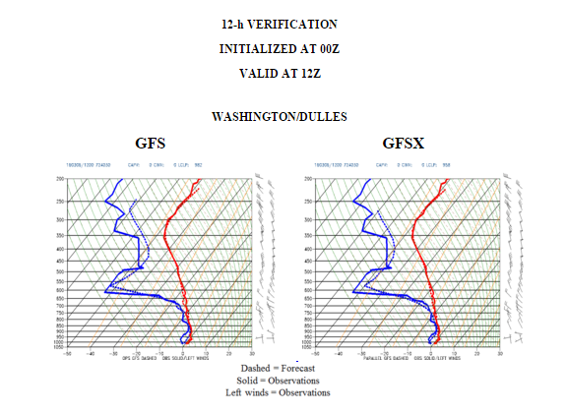
Comprehensive Evaluation from EMC
Part 3
GFS Soundings available on case by case basis, real-time page for selected cities: http://www.emc.ncep.noaa.gov/gc_wmb/tdorian/meg/index.html

Slide 11
Comprehensive evaluation Part 4 (Centers, Regions & case studies)
Case Studies | Case Studies
MEG review of case studies proposed by WPC, Western Region and Central Region | A case study for Dec. 5-6, 2013 requested by Southern Region
MEG review of additional case studies | Blizzard of January 22-23, 2016
Presentation to WPC on case studies | Precipitation cases for WPC
Western Region/Central region case study | Height field evaluation for WPC
Central Region case study, Alaska case study and Southern Region case study | Operational and experimental GFS forecasts for Atsani (extratropical transition, Alaska region)
Case studies for Central Region March 23, 2015; April 2, 2015; June 4-5, 2015; July 6, 2015 | MODE evaluations of new GFS: Precip; Total Winds; Zonal Winds; Meridional Winds; and CAPE
A case study of the Nov. 16-17, 2015 tornado outbreak in Texas and Oklahoma | WPC documentation of dry bias over the southeast US in the GFS and GFSX
Evaluation from EMC Teams: HWRF; Ensemble; Wave | Case study of GFS and GFSX cold bias over snowpack
Hurricane Joaquin and South Carolina flooding | Verification from Data Assimilation perspective
Warm dry bias over Great Plains in summer: Here and Here; Case study: Here | MEG presentations reviewing the new GFS Nov. 12 ; Nov. 19; Dec. 17; and Feb. 11
Extratropical storm tracks | Evaluation from the Centers: CPC; NHC; SPC; OPC;
Comparison of systematic errors in the GFS and GFSX | Forecast tracks for Sandy

Slide 12
Evaluation of Q3FY16 GDAS/GFS Upgrade:
EMC Perspective

Slide 13
Summary of various evaluation metrics
Evaluation | Remarks
Analysis increments | 2016 GFS much smaller increments --analysis and first guess in better agreement
Score card | Significant improvements in many aspects of the evaluation metrics. Upper Stratospheric biases showed degradation.
500 hPa ACC | 0.004 gain in NH; 0.007 gain in SH; statistically significant improvements through 168 hrs
Surface heights | Significant improvements through 192 hrs in both hemispheres
Winds | Significant reduction of RMSE through 240 hrs in both hemispheres and global tropics
Temperature RMSE | Big improvements in Southern Hemisphere. Upper troposphere/ Stratosphere in Northern Hemisphere has increased RMSE. 850 hPa temperatures significantly improved.
Temperature fit to obs | Better fit to obs except in the upper stratosphere. Significant reduction of RMSE in NH, SH and global tropics.

Slide 14
Summary of various evaluation metrics
Evaluation | Remarks
Vector wind RMSE | Better fit to obs, significant reduction of RMSE in NH, SH at 850 and 200 hPa. No significant change in global tropics.
CONUS Precip | Rain/no rain (Threshold of 0.2 mm/day) worse in GFSX Thresholds of 2 to 25 mm/day significantly improved
CONUS Near Surface Fields | Significant improvements in T2m, Td2m, Latent Heat, CAPE and Surface Winds
Hurricane Tracks and cyclogenesis | Positive improvements in both NATL and EPAC, for tracks and intensity. Significant improvement in tropical cyclogenesis forecasts.
TAFB | GFSP seemed to have an advantage at longer lead times for gap wind events
Extra tropical cyclone tracks | 7 out 10 times, errors in GFSX are smaller than in GFSO in winter. During summer months, the errors are always smaller in parallel GFS.
OPC Evaluation | Track errors for winter season are a slight improvement shorter term and no significant improvement medium range

Slide 15
Summary of various evaluation metrics
Evaluation | Remarks
MODE verification | Jet Streams: GFSX generally looks “better” and closer to the ECMWF; QPF: GFSX has higher MMI (Median of Maximum Interest) values for all forecast hours except at 60-h; CAPE: GFSX somewhat better than GFS. Both underestimate compared to RAP analysis
Case studies from Field | GFSX better in 6 cases out of 9, operational GFS better in 3 (subjective evaluation)
Typhoon Astani | GFSX better in 7 verification times, operational GFS in 3 verification times.
WPC Case studies | Of the 6 precipitation case studies (36 hour forecasts), the GFSX did better for 3 cases, the operational GFS was better for 1 case, and both models tied for 2 cases.
Ensemble Team verification | 2014 Winter: Good for short forecast (days 1-3); Slight degradation (days 5-10). 2014 Summer: Good for all lead time (out to day 12)
HWRF Team | New GFS shows improved track and intensity forecasts in the N. Atlantic and neutral impact in the E. Pacific

Slide 16
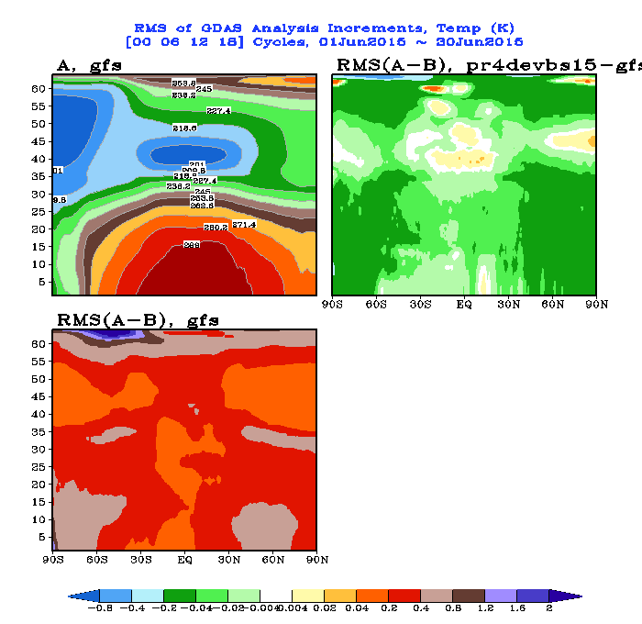
2016 GFS much smaller increments --analysis and first guess in better agreement

Slide 17
Fit to Obs Evaluation
Red: Worse
Green: Better
Temperature
 | Analysis fit to radiosondes | Forecast fit to radiosondes
NH | 1000-400, 150-20 hPa 200-300 hPa | 30, 20 hPa 1000-100 hPa
SH | 925-700, 100-20 hPa 400-200 hPa | 30 hPa 1000-100 hPa
Tropics | 975-100, 150-20 hPa 250, 300 hPa | 850-400, 200-100, 20 hPa 300, 250, 70, 50 hPa
Winds
 | Analysis fit to radiosondes | Forecast fit to radiosondes
NH | 1000-500, 150-20 hPa 300, 250hPa | 30, 20 hPa 1000-70 hPa
SH | 1000-400, 150-20 hPa 250 hPa | 1000-70, 20 hPa
Tropics | 1000-400; 150-50 hPa 250, 300 hPa | 1000, 850-250, 150-50 hPa

Slide 18
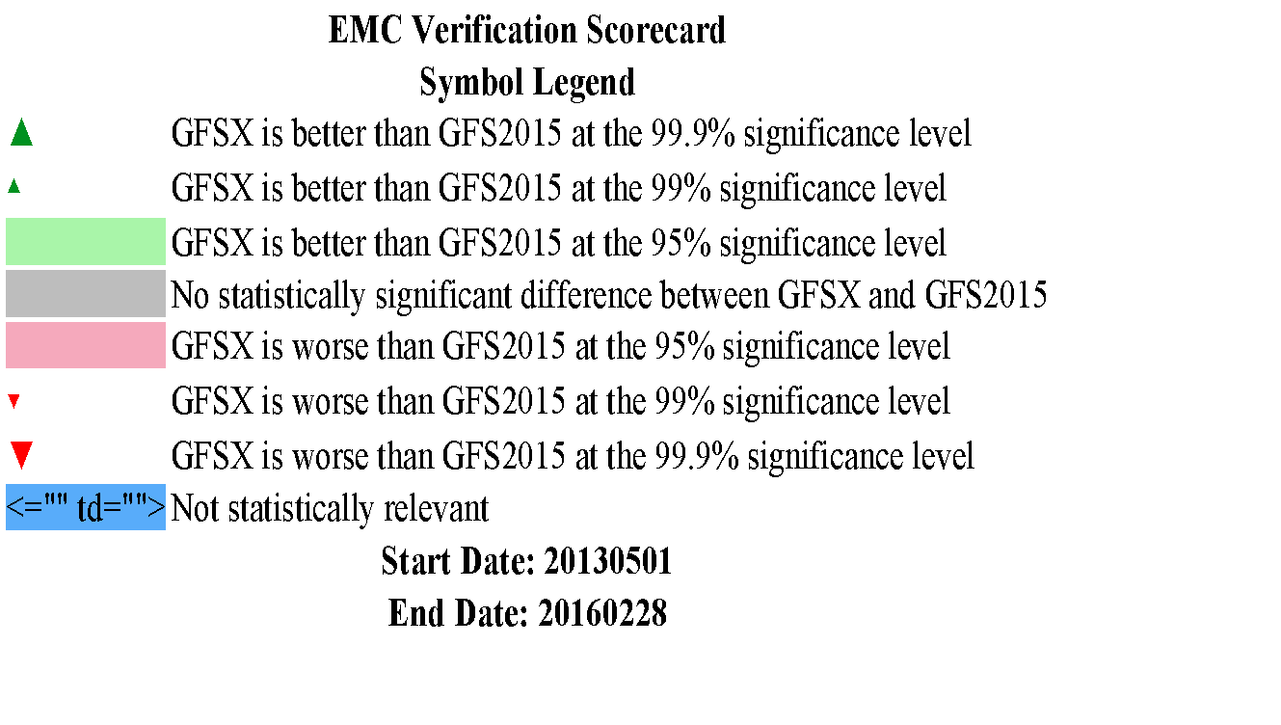
Score Card for Verification of Q3FY16
34 months of retrospectives (2013-2016)
34 months
Verified against own analyses

Slide 19
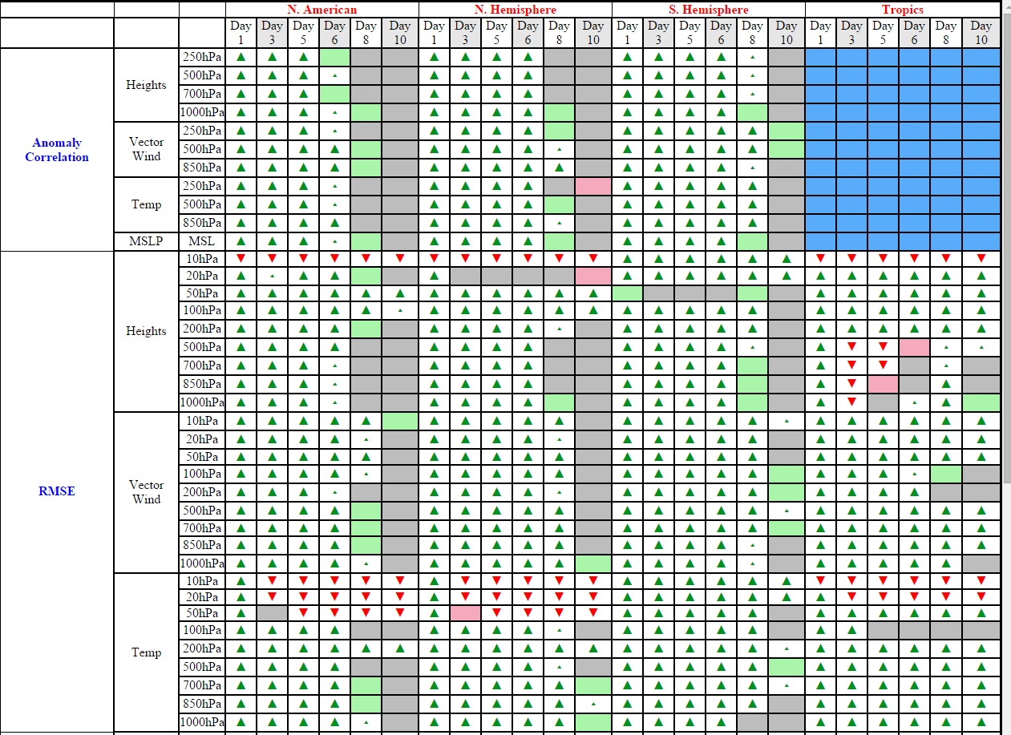
Anomaly Correlations & RMSE
GFSX vs. GFS

Slide 20
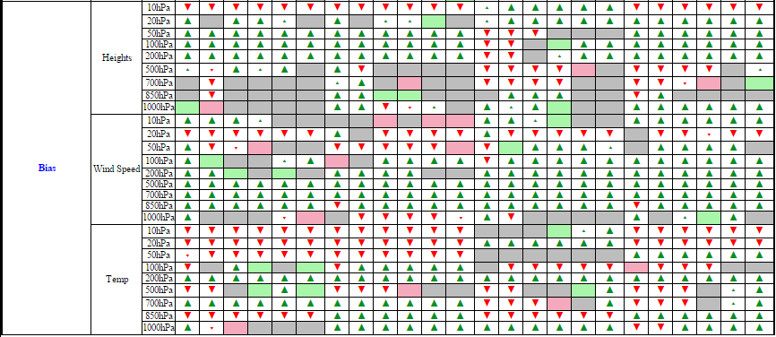
Biases
GFSX vs. GFS
Significant improvements in many aspects of the evaluation metrics.
Upper Stratospheric biases showed degradation.

Slide 21
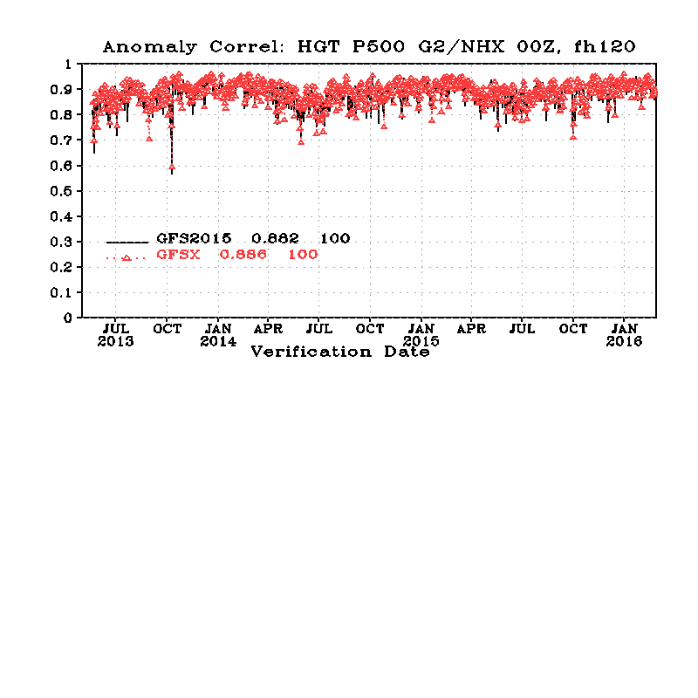
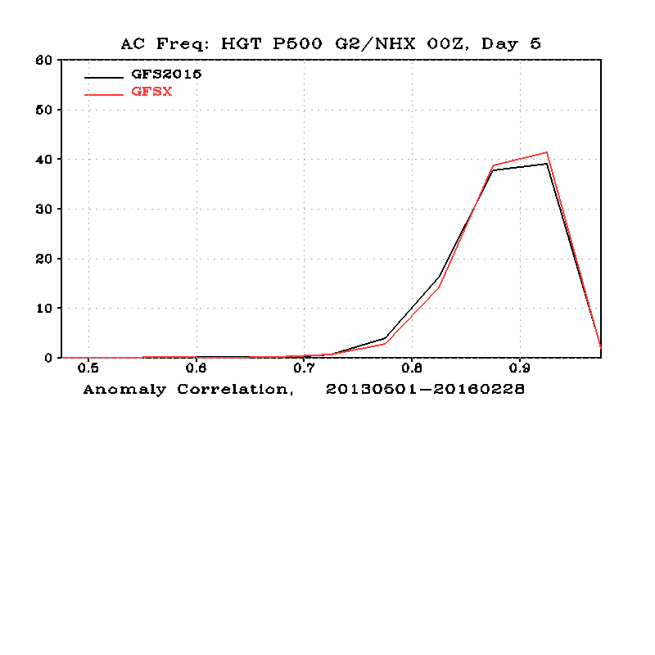
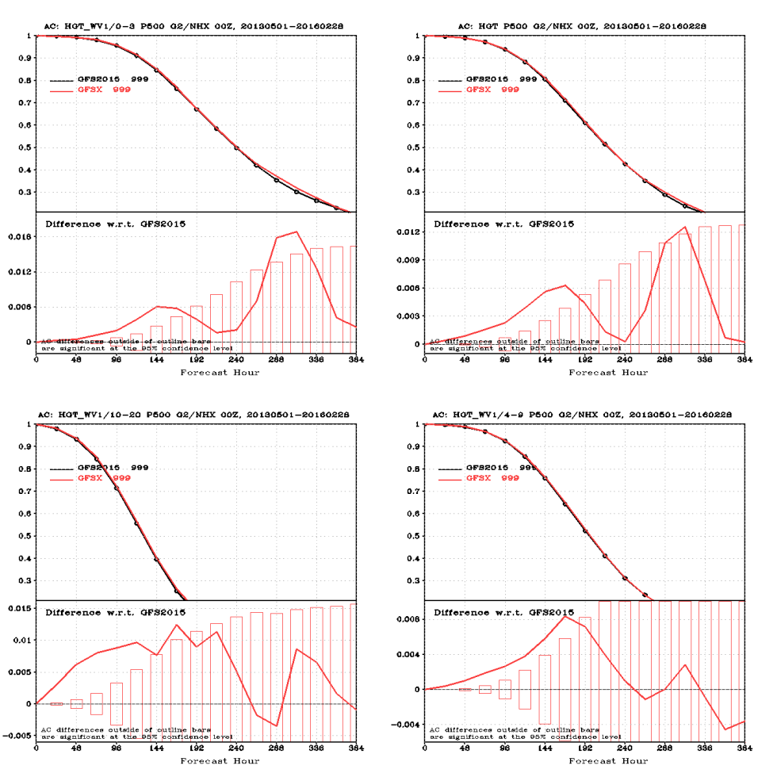
Northern Hemisphere

Slide 22
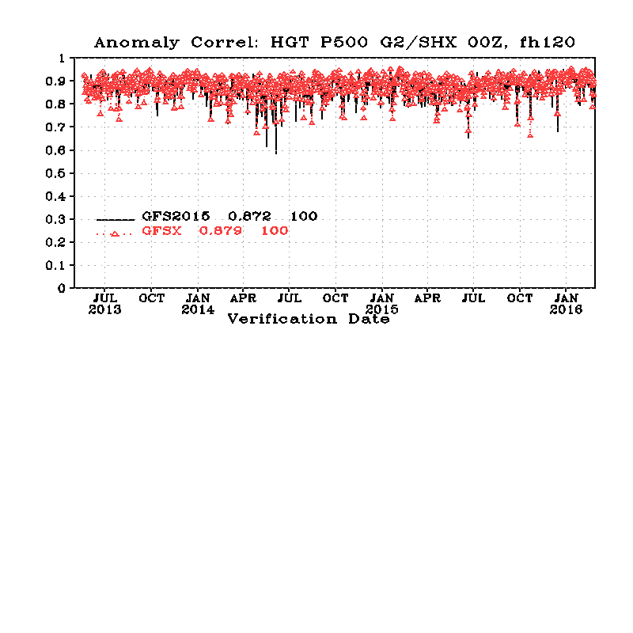
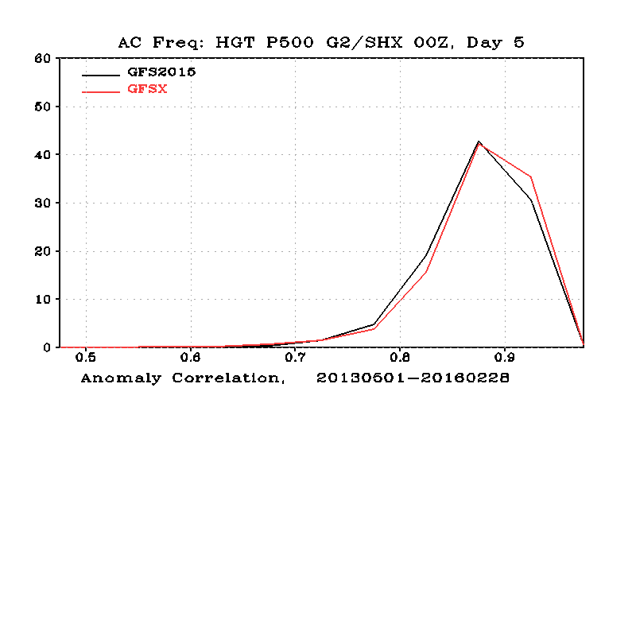
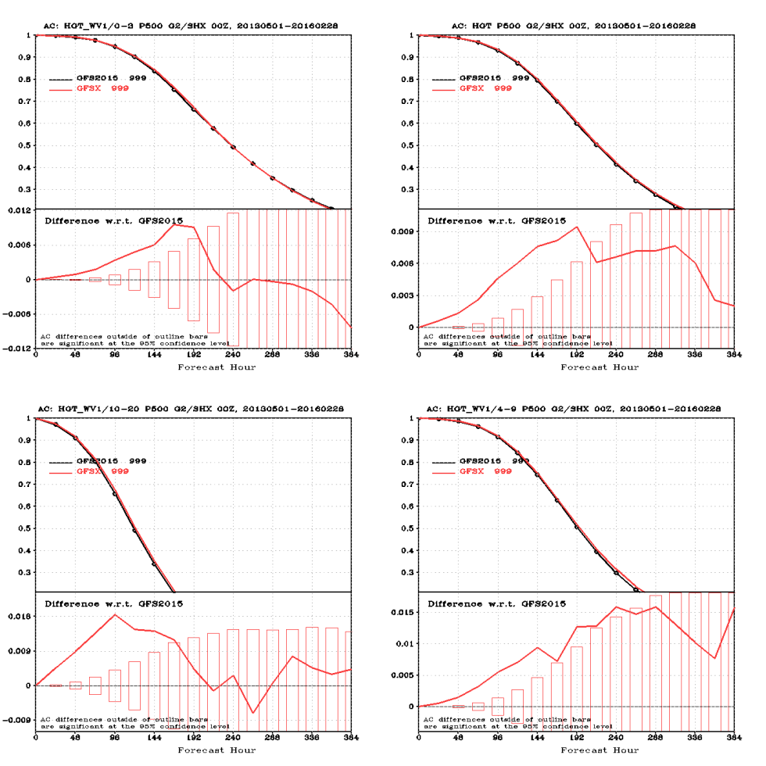
Southern Hemisphere

Slide 23
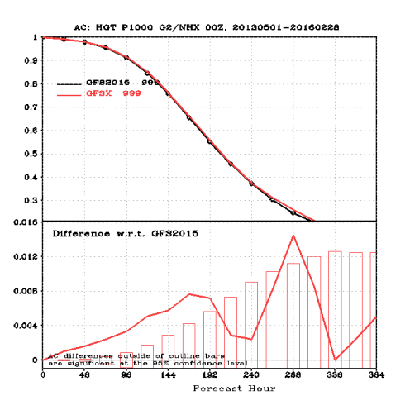
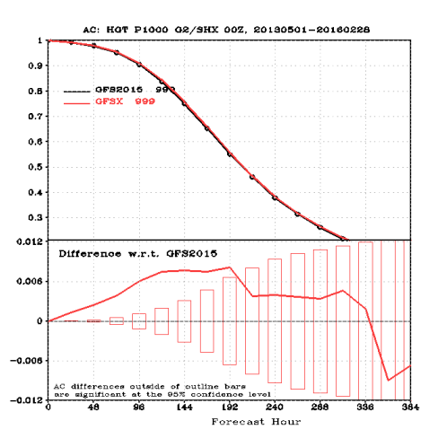
Surface heights
Northern Hemisphere
Southern Hemisphere

Slide 24
Assessment of impact of LSM changes
2m T cooler, bias is worse over the Northern Plains and Northeast, Better over southern plains and southeast
RMS error improved over northern and southern plains, Southeast and Alaska, worse over northwest
10 m winds decreased, RMS error improved
The land surface parameter refinements have significantly reduced the warm/dry biases in the summer
The change has little impact in the winter. However there are some degradations in the spring/fall. Also it is worst in 00Z (sunset). Some of them will be addressed in the next GFS physics implementation.

Slide 25
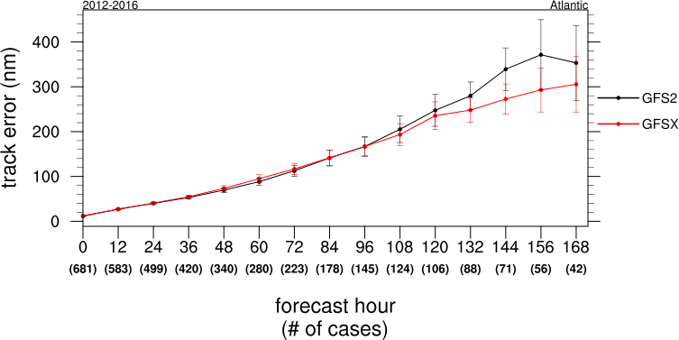
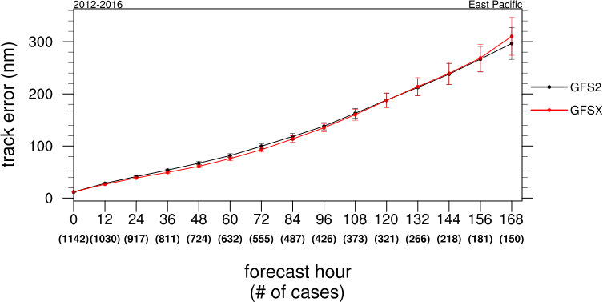

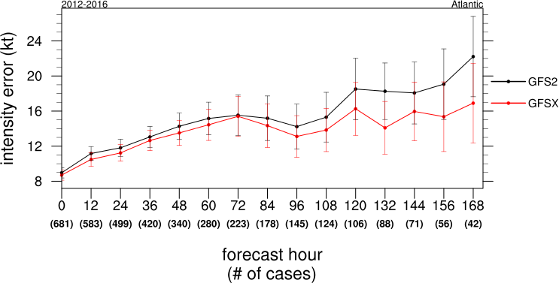
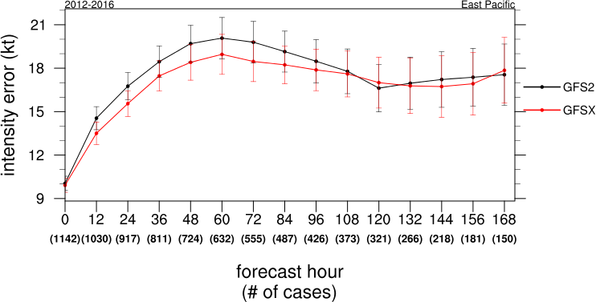
Impact on Hurricanes: NHC Evaluation
2012-2016
Atlantic
Track/Intensity Error
East Pacific
TRACK
INTENSITY
INTENSITY

Slide 26
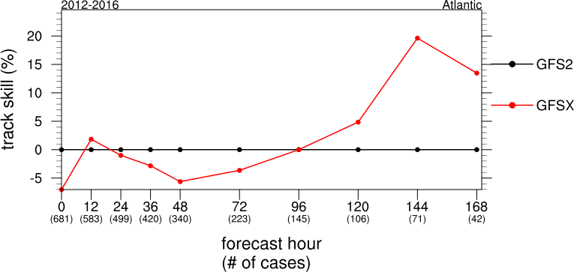
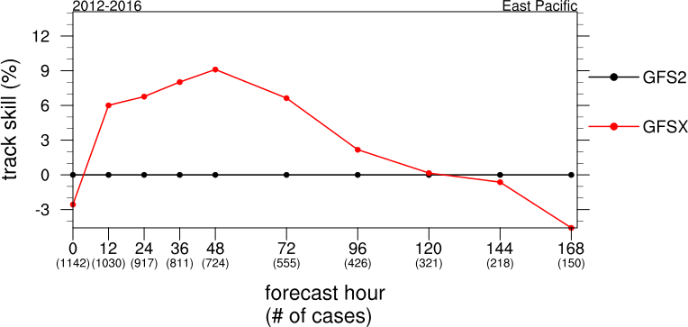
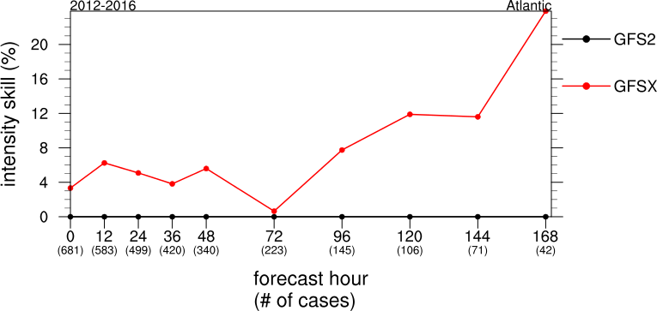
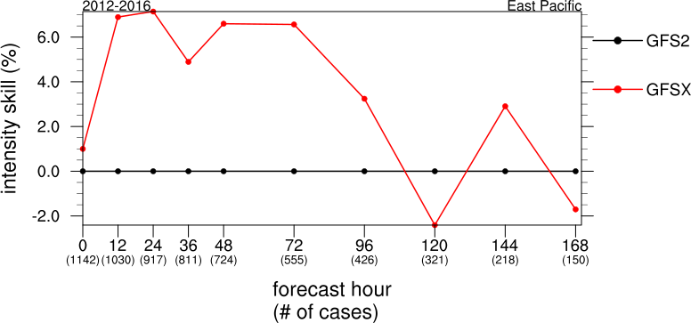
Impact on Hurricanes: NHC Evaluation
2012-2016
Atlantic
Track/Intensity Skill
(with respect to GFS2)
East Pacific
TRACK
INTENSITY
INTENSITY

Slide 27
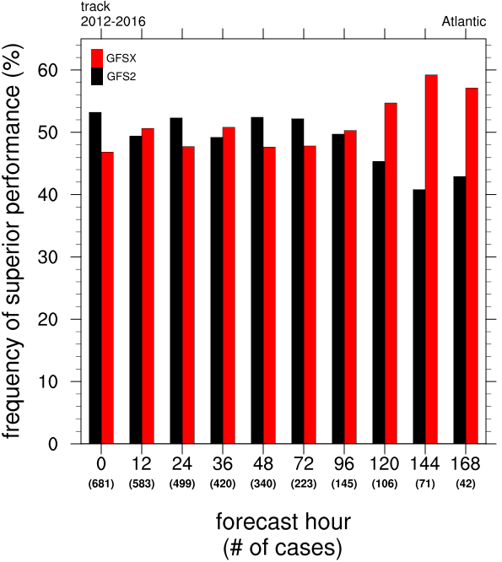
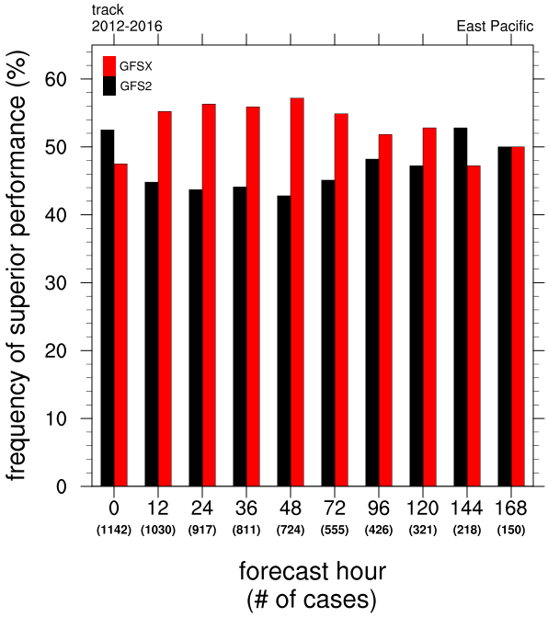
Impact on Hurricanes: NHC Evaluation
2012-2016
Frequency of Superior Performance - Track
Atlantic
East Pacific

Slide 28
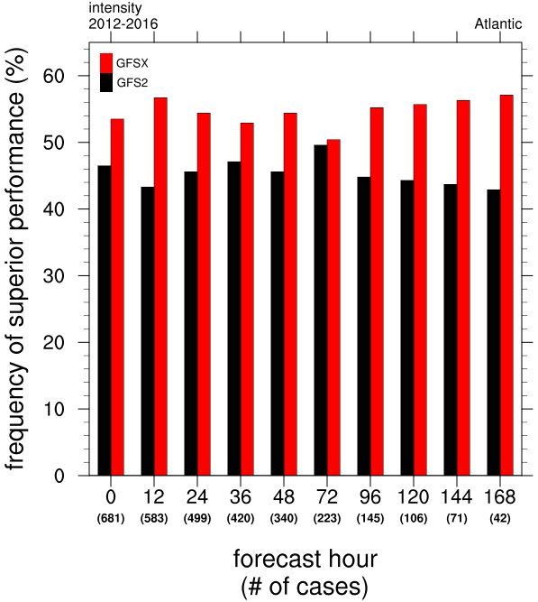
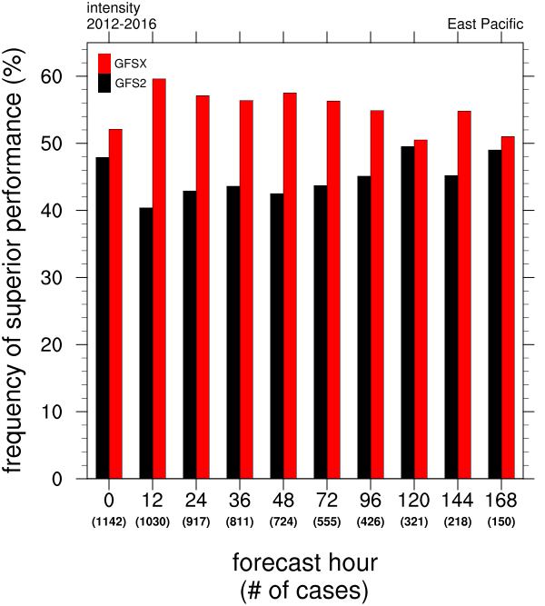
Impact on Hurricanes: NHC Evaluation
2012-2016
Frequency of Superior Performance - Intensity
Atlantic
East Pacific

Slide 29
Impact on Hurricanes: NHC Evaluation
AL | Track | Intensity
0-48 h | - 3% | +5%
72-120 h | +7% | + 11%
EP | Track | Intensity
0-48 h | +5% | +5%
72-120 h | +1% | +2%
Track and intensity error improvements/degradation of Q3FY16 GFS vs. 2015 GFS for the 2012-2016 retrospective runs, by basin

Slide 30
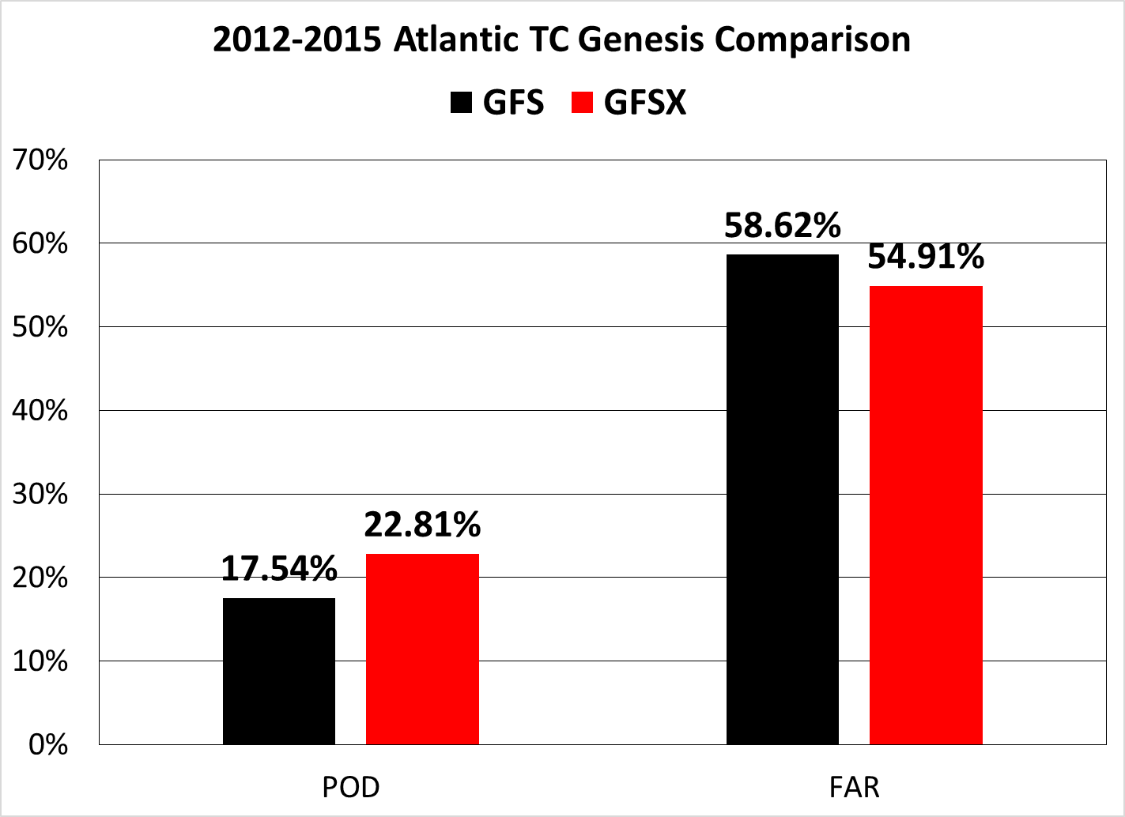
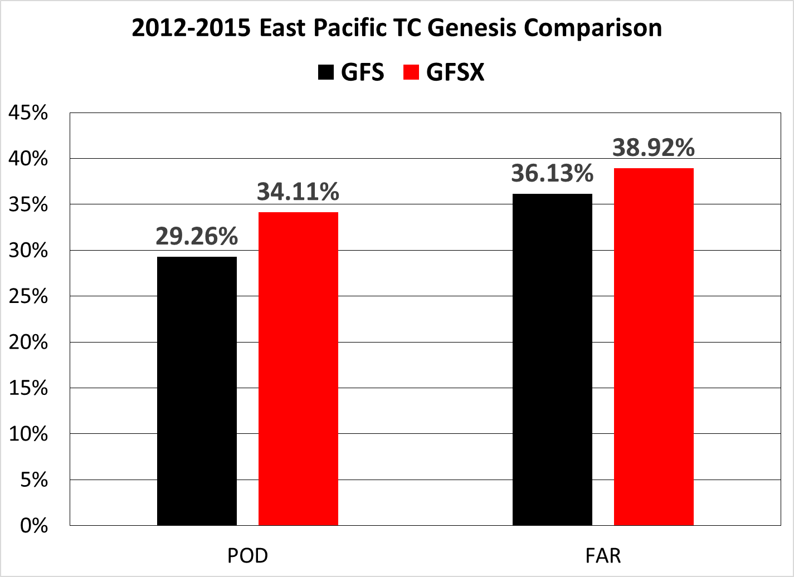
Verification of TC cyclogenesis in the GFSX – comparison to current and previous version of the GFS (courtesy of Dan Halperin and Bob Hart)

Slide 31
Comments from NHC and TAFB
GFSP has mostly improved TC track and intensity forecasts in comparison to current GFS.
GFSP in general handles gap wind events a little better than the current GFS, especially at longer time ranges.
In comparison to the current GFS, the GFSP has a higher POD for TC genesis in both basins and a lower FAR in the Atlantic, but a higher FAR in the east Pacific – so overall the new GFS is better at predicting genesis.
Based on limited cases with archived operational GFS on 1° grids and the retrospectives (GFSP) on 0.5° degree grids
Results were a mixed bag, but the GFSP seemed to have an advantage at longer lead times
Since the impact of the GFSP on the HWRF and GFDL hurricane models remains unknown, NHC cannot endorse this implementation. However, NHC does not oppose it.

Slide 32
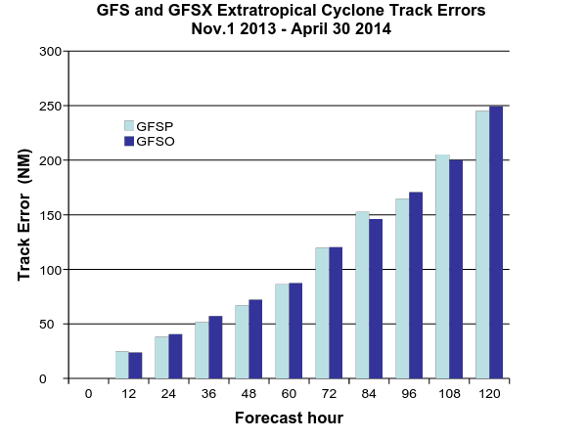
GFSO (blue) – Control GFS; GFSX (cyan) – Parallel GFS
7 out 10 times, errors in GFSX are smaller than in GFSO.
Fcst hr | 0 | 12 | 24 | 36 | 48 | 60 | 72 | 84 | 96 | 108 | 120
Cases | 520 | 508 | 487 | 391 | 259 | 155 | 98 | 62 | 42 | 29 | 22
Guang Ping Lou

Slide 33
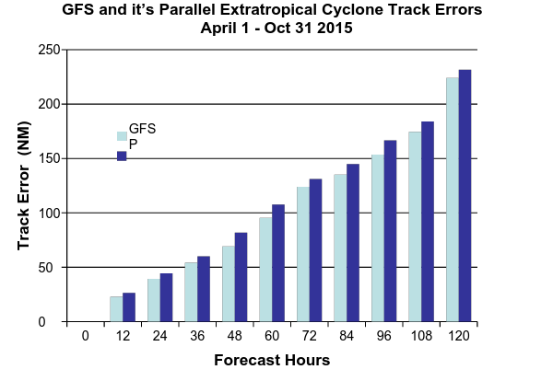
GFSO (blue) – Operational GFS (Control); GFSP (cyan) – Parallel GFS
Errors in GFSX are smaller than in GFSO.
Fcst hr | 0 | 12 | 24 | 36 | 48 | 60 | 72 | 84 | 96 | 108 | 120
Cases | 1093 | 1075 | 1011 | 687 | 366 | 201 | 104 | 64 | 35 | 26 | 17
Guang Ping Lou

Slide 34
Case Studies from the Field: EMC Evaluation
GFSX 6/9
GFS 3/9
Case | Model Performance
CR 1/29-2/2/2015 | GFSX somewhat better
WR 10/3-10/4/2015 | GFSX slightly better
WR 11/8-11/10/2014 | GFS slightly better
WR 11/20-23/2014 | GFSX better
WR 8/28-8/30/2015 | GFSX slightly better
Case | Model Performance
SR 12/5-12/6/2013 | GFSX did better
CR 3/23/2015 | GFSX did slightly better
CR 6/4-6/5/2015 | GFS did slightly better
CR 7/6/2015 | GFS did slightly better

Slide 35
Typhoon Astani Findings
Focus on 12Z 8/20/15 cycle
Forecasts 108-192 valid 00Z 8/25/15 – 00Z 8/29/15
Starting with 108-h forecasts and going to 204-h, GFS too far to the north and east, then too far to the east, followed by too far to the north (except for 204-h forecast, GFS too far south)
Starting with the 108-h forecasts and going to 204-h, GFSX started off with good position for Atsani, then was too far south and east, then slightly too far north, was too far south for 204-h forecast
In general, the GFSX was closer to analysis
* Extra-tropical transition around 12Z 8/25/15
Forecasts | GFS | GFSX
108 |  | ✔
120 |  | ✔
132 |  | ✔
144 | ✔ | ✔
156 |  | ✔
168 | ✔
180 |  | ✔
192 |  | ✔
204 | ✔

Slide 36
WPC Case Studies | Remarks
Tornado outbreak over Kansas, Texas Nov. 16-17, 2015 | GFSX better in forecast from 000 GMT Nov. 16
Sandy Oct .22-30, 2012 | GFS, GFSX track errors similar
Joaquin Sept. 25-Oct. 4, 2015 | GFSX better track, adopted out to sea track 6 hours before operational GFS
South Carolina flooding Oct. 3, 4, 2015 | GFS, GFSX similar
GFS dry bias in southeast US autumn 2015, winter 2015-2016 | GFS, GFSX similar
GFS cold bias over snow cover | GFS, GFSX similar
Blizzard Jan. 22-23, 2016 | GFS, GFSX similar
Warm, dry bias Great Plains 000 GMT Aug. 16 | GFSX better
New England blizzard Jan 26-27 2015 | GFSX better 2.5 day forecast

Slide 37
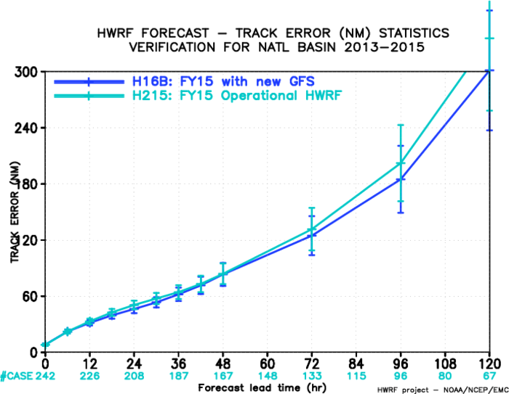
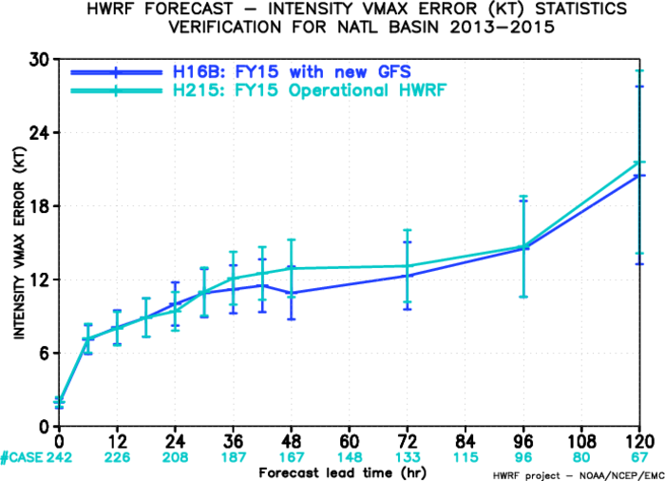
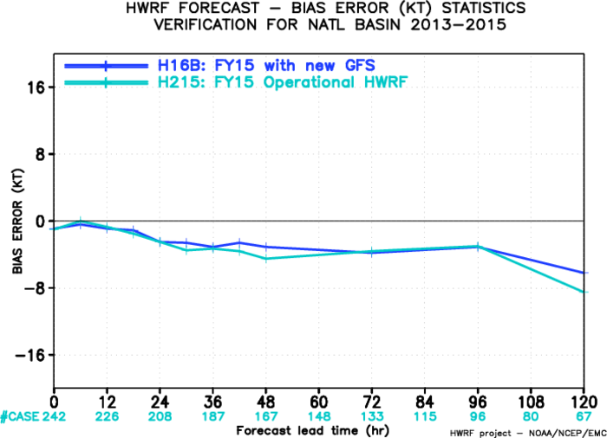
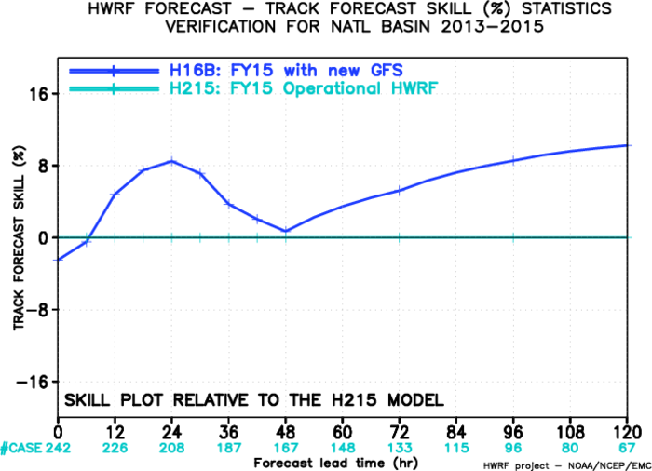
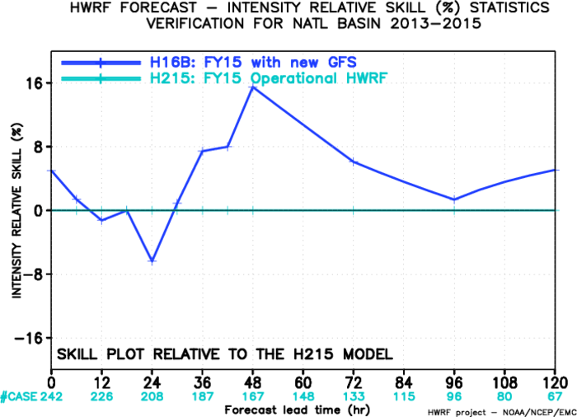
HWRF Evaluation: H16B vs. H215, AL (242/578)
Track Error
Intensity Error
Intensity Bias
Track Skill improvement
Intensity Skill improvement

Slide 38
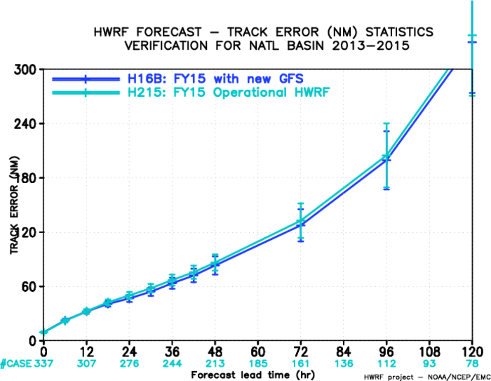
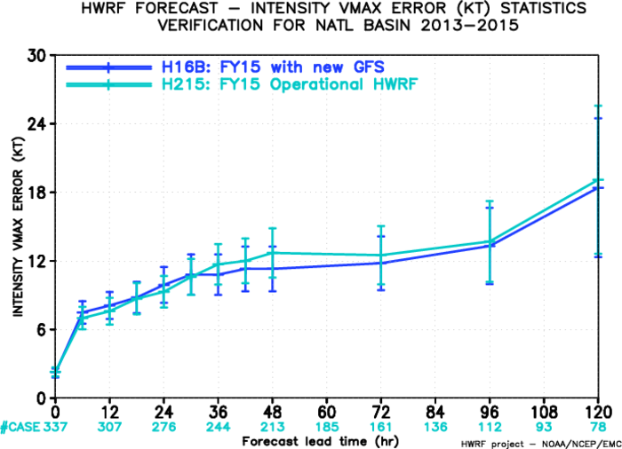
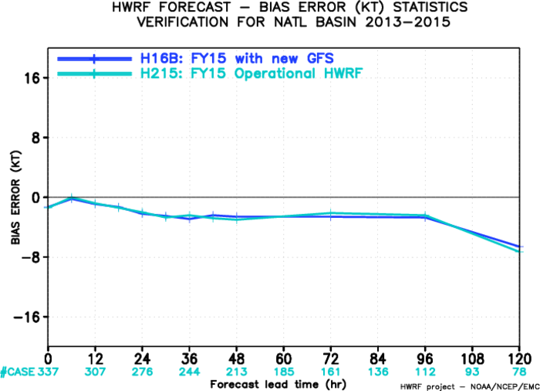
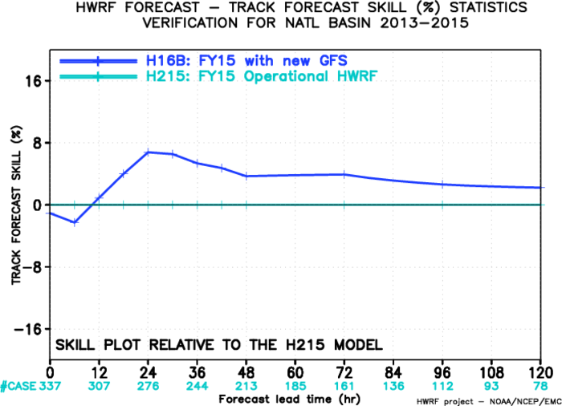
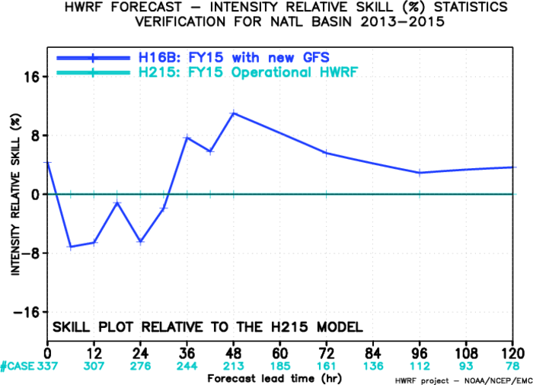
H16B vs. H215, AL (337/578)
Track Error
Intensity Error
Intensity Bias
Track Skill improvement
Intensity Skill improvement

Slide 39
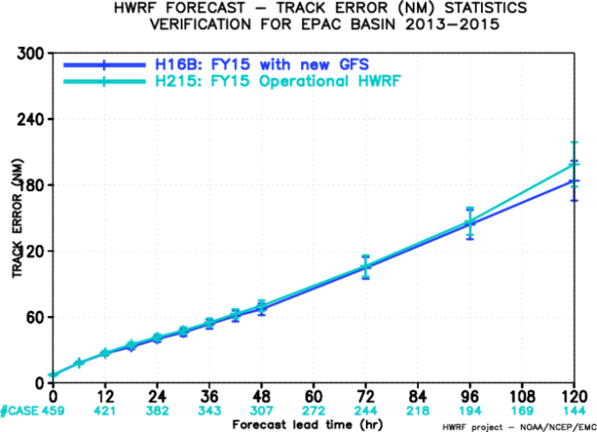
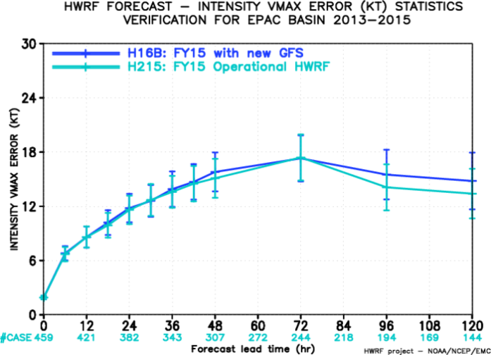
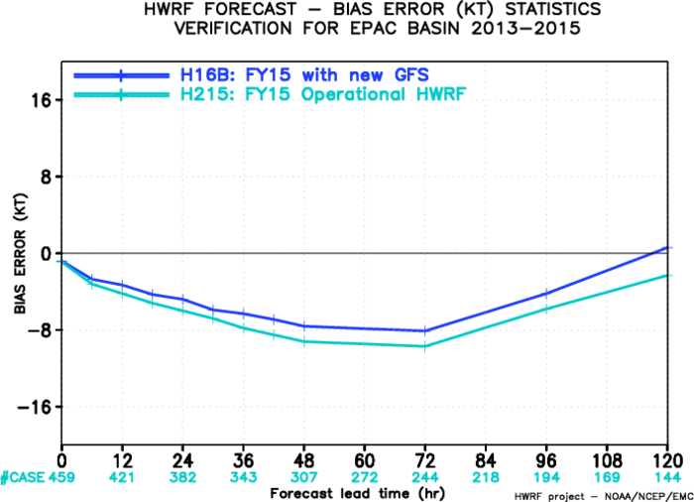
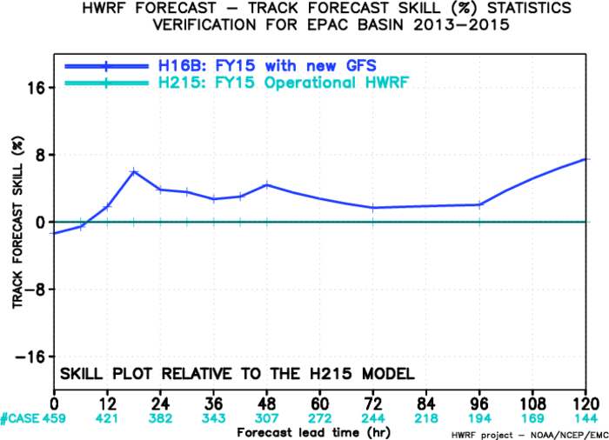
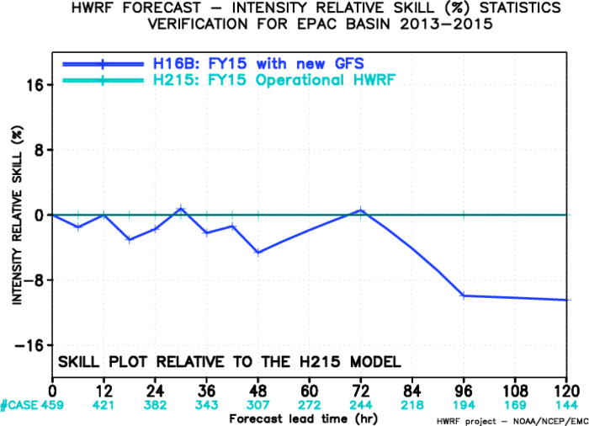
HWRF Evaluation: H16B vs. H215, EP (459/942)
Track Error
Intensity Error
Intensity Bias
Track Skill improvement
Intensity Skill improvement

Slide 40
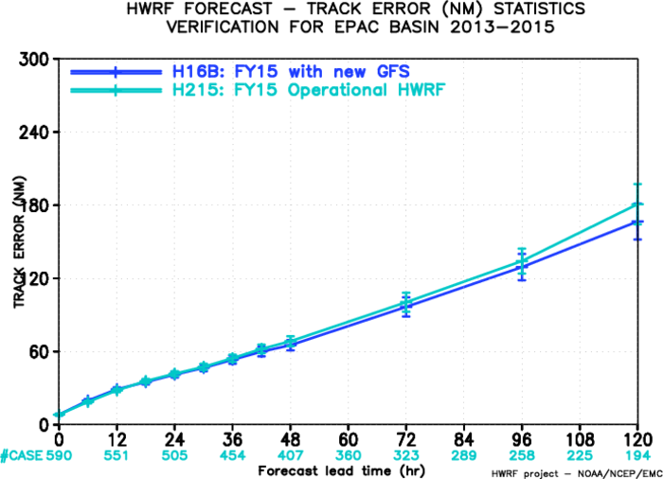




H16B vs. H215, EP (590/942)
Intensity Bias
Track Error
Intensity Error
Track Skill improvement
Intensity Skill improvement

Slide 41
Endorsements from Stakeholders
Region/Center | Recommendation | Remarks
Western Region | Implement | Neutral
Central Region | Implement with reservations | Little improvement
Southern Region | Implement | No striking differences
Eastern Region | Implement | Minor improvements
Pacific Region | Implement | Models performed well with Winston
Alaska Region | Implement | No specific problems
WPC | Implement | Similar, GFSX slightly better sometimes
NHC | Neither endorse nor oppose | Improved tropical forecasts, downstream tests incomplete

Slide 42
Endorsements from Stakeholders
Region/Center | Recommendation | Remarks
AWC | Implement | Better winds, temperatures
CPC | Implement | Large errors upper stratosphere
OPC | Implement | Extratropical storm tracks better
SWPC | Implement | Need improvements in upper atmosphere
MDL | Implement | Redeveloped MOS better
NWC | Implement | Hourly files should improve NWC fcsts
SPC | Implement | Improved in warm season
Weather It Is Ltd. (Prof. Barry Lynn) | under situations where the observational network is more dense, there has been improvement in the initial state (and lateral boundary conditions) of the GFSX compared to GFS
AccuWeather | Hourly output is of significant value for Weather Industry

Slide 43
EMC/GCWMB Assessment
Positive evaluation (significantly positive improvements in majority of the metrics)
DA upgrades have been effective in reducing the forecast errors in the short-range, and improving analysis increment for almost all prognostic variables
Results shown significant improvement in week 1 forecasts verified against own analyses except for heights and temperatures in stratosphere
Rain no rain forecasts worse, but overall conus precipitation improved significantly

Slide 44
EMC/GCWMB Assessment
2m temperature, dewpoint, 10 m wind forecasts against station obs over CONUS, Alaska improved.
CAPE forecasts over CONUS improved
Forecasts of tropical storm genesis. track and intensity forecasts improved.
Mode verification of CAPE, Jet Streams, QPF and winds shows GFSX slightly better
Synoptic evaluations of GFSX produced no red flags. GFSX, GFS similar; GFSX slightly better in some cases
Forecasts of heights, temperatures, winds significantly improved except for heights and temperatures in stratosphere. Large errors in upper stratosphere
CONUS precipitation forecasts improved for thresholds of 2-25 mm/day, worse for thresholds of 0.2 mm/day

Slide 45
Hourly Output from GFS through 120 hrs & Additional Fields
Hourly GFS forecast output at 0.25 deg. resolution (grib2) will be made available through 120 hr (ftp only)
GFS Post is adding output on 5 more pressure levels in stratosphere 1, 2, 3, 5, and 7 mb per request of CPC.
Each additional level has 6 records:
Geopotential Height (HGT); Temperature (TMP); Relative Humidity (RH);
U- and V Components of Wind (UGRD & VGRD)
Ozone Mixing Ratio (O3MR)
Two New Products: Icing probability and Icing Severity are also added to Aviation Weather (WAFS)

Slide 46
Q3FY16 GFS/GDAS New Vertical Structure https://svnemc.ncep.noaa.gov/projects/gfs/branches/
gdas.v13.0.0
gfs.v13.0.0
global_shared.v13.0.0
Included Packages
GSI & Enkf (analysis)
GSM (forecast)
ncep_post
emcsfc
tropcy_qc_relo
wafs
gfs_post (downstream)
Gempak (downstream)
smartinit
misc
MinMon (monitoring)
RadMon (monitoring)
parm|ush|sorc|
Jobs|scripts|exec
parm|ush|sorc|
Jobs|scripts|exec
parm|ush|sorc|
scripts|exec
JGDAS_TROPCY_QC_RELOC
JGDAS_NCEPPOST
JGDAS_EMCSFC_SFC_PREP
JGDAS_TROPC
JGDAS_MKNAVYBULLS
JGDAS_GEMPAK_META
JGDAS_BULLS
JGDAS_GEMPAK_NCDC
JGDAS_GEMPAK
JGDAS_ENKF_INFLATE_RECENTER
JGDAS_ANALYSIS_HIGH
JGDAS_ENKF_SELECT_OBS
JGDAS_ENKF_UPDATE
JGDAS_ENKF_POST
JGDAS_ENKF_INNOVATE_OBS
JGDAS_ENKF_FCST
JGDAS_FORECAST_HIGH
JGFS_PRDGEN_MANAGER
JGFS_POST_MANAGER
JCPC_GET_GFS_6HR
JGFS_NPOESS_PGRB2_0P5DEG
JGFS_CYCLONE_TRACKER
JGFS_FBWIND
JGFS_AWIPS_G2
JGFS_PGRB2
JGFS_AWIPS_20KM
JGFS_AWIPS_1P0DEG
JGFS_TROPCY_QC_RELOC
JGFS_PGRB2_SPEC_POST
JGFS_SMINIT
JGFS_NCEPPOST
JGFS_EMCSFC_SFC_PREP
JGFS_WAFS_GRIB2
JGFS_WAFS
JGFS_WAFS_BLENDING
JGFS_WAFS_GCIP
JGFS_PGRB2_SPEC_GEMPAK
JGFS_GEMPAK_UPAPGIF
JGFS_GEMPAK_NCDC
JGFS_POSTSND
JGFS_GEMPAK_META
JGFS_FAX
JGFS_ANALYSIS
JGFS_FORECAST_LOW
JGFS_FAX_WAFS
JGFS_GEMPAK
JGFS_FORECAST_HIGH
No jobs
Will be included
Unification of EMC parallels with NCO Operational structure

Slide 47
Q3FY16 GFS/GDAS New Vertical Structure https://svnemc.ncep.noaa.gov/projects/gfs/branches/
gdas.v13.0.0
gfs.v13.0.0
global_shared.v13.0.0
Included Packages
GSI & Enkf (analysis)
GSM (forecast)
ncep_post
emcsfc
tropcy_qc_relo
wafs
gfs_post (downstream)
Gempak (downstream)
smartinit
misc
MinMon (monitoring)
RadMon (monitoring)
parm|ush|sorc|
Jobs|scripts|exec
parm|ush|sorc|
Jobs|scripts|exec
parm|ush|sorc|
scripts|exec
Getsigensmeanp
_smooth_ncep.fd
recentersigp.fd
Adderrspec
_nmcmeth_spec.fd
getsfcensmeanp.fd
enkf_update.fd
build_enkf.sh
gdas_trpsfcmv.fd
gridbull.fd
navybull.fd
build_gdas_gridbull.sh
build_gdas_navybull.sh
build_gdas_trpsfcmv.sh
awc_wafavn.fd
gcip.fd
wafs_blending.fd
build_wafs_wcoss.sh
cnvgrib2_wafs.fd
gfs_bufr.fd
tocsbufr.fd
smartprecip.fd
smartinit.fd
overpdtg2.fd
gfs_flux.fd
build_smartinit_wcoss.sh
build_tocsbufr
_gfs_flux_wcoss.sh
wintemv.fd
makewafs.fd
fbwndgfs.fd
build_gfs_wintemv.sh
build_gfs_overpdtg2.sh
build_gfs_fbwndgfs.sh
ncep_post.fd
supvit.fd
tave.fd
gettrk.fd
syndat_getjtbul.fd
syndat_maksynrc.fd
vint.fd
gsi.fd
emcsfc_ice_blend.fd
relocate_mv_nvortex.fd
emcsfc_snow2mdl.fd
syndat_qctropcy.fd
build_ncep_post.sh
build_emcsfc.sh
build_tropcy.sh
build_gsi.sh
global_sfchdr.fd
global_chgres.fd
global_sighdr.fd
global_cycle.fd
global_fcst.fd
build_gsm_wcoss.sh
Will be included
Unification of EMC parallels with NCO Operational structure

Slide 48
GCWMB requests EMC Director to approve implementation of Q3FY16 GDAS/GFS upgrade package.
Special acknowledgements:
John Derber, Russ Treadon, Glenn White, Fanglin Yang, Tracey Dorian, Partha Bhattacharjee, Lin Gan, Boi Vuong, Qingfu Liu, Guangping Liu, Diane Stokes, Dennis Keyser, Yali Mao, Eugene Mirvis, George Gayno, Zhan Zhang, Lin Zhu, Cathy Thomas, Ed Safford, Rahul Mahajan, Jeff Whitaker,
Yuejian Zhu, Steven Earle, Jen Yang & Becky Cosgrove

Slide 49
Next Steps
Code Hand-off to NCO: Completed
All non-GFS downstream codes submitted to NCO: Completed
Collect Evaluation Reports from the field: Completed
Final EMC CCB: Today (Completed)
OD Briefing: 3/17/16 (Scheduled)
TIN: 4/1/2016 (on track)
30-day evaluation: 4/06 – 5/5
Final OD Briefing by NCO: 5/11
Implementation: 5/17

Slide 50
Backup Slides

Slide 51
Fit to Obs Evaluation with aircraft Obs
GFSX analyzed temperatures fit aircraft obs better all 3 layers
forecast temperatures fit aircraft obs better in upper and lower layers
GFSX analyzed and forecast winds fit aircraft obs better in all 3 layers
GFSX analyzed temperatures fit ACARS obs better in all 3 layers
forecast temperatures fit ACARS obs better in lower layer
GFSX analyzed and forecast winds fit ACARS obs better in all 3 layers

Slide 52



Northern Hemisphere
Winds RMSE

Slide 53



Southern Hemisphere
Winds RMSE

Slide 54



Global Tropics
Winds RMSE

Slide 55



Temperature RMSE
Big improvements in Southern Hemisphere
Upper troposphere/Stratosphere in Northern Hemisphere has increased RMSE

Slide 56



NH
SH
Tropics

Slide 57


Slide 58


Slide 59



Slide 60



Slide 61


Slide 62


Slide 63



Slide 64



Slide 65



Slide 66


CONUS Precip ETS (00Z & 12Z)

Slide 67


Slide 68
Equitable threat and bias scores for May 2013-February 2016 for CONUS
14 forecast lengths 00-24 hr to 156-180 hr for 00Z and 12Z forecasts
Nine Thresholds of 0.2 mm/day to 75 mm/day
GFSX forecasts for thresholds of 0.2 mm/day significantly worse for 0-24 to 84-108 h forecasts
Worse wet bias for thresholds of 0.2 mm/day
GFSX forecasts for thresholds of 2, 5, 10 mm/day significantly better for 35/42 fcst lengths
for thresholds of 15 mm/day significantly better 7/14 fcst lengths
for thresholds of 25 mm/day significantly better 3/14 fcst lengths
Slight tendency for less of dry bias 15-35 mm/day
Rain/no rain (Threshold of 0.2 mm/day) worse in GFSX
Thresholds of 2 to 25 mm/day significantly improved

Slide 69
Verification of near surface fields
against surface observations
CONUS (six regions, also west and east)
and Alaska
Two years 0 and 12Z forecasts
One year 6 and 18Z forecasts

Slide 70




Surface Temperature, CONUS West and East, 00Z Cycle

Slide 71




Surface Temperature, N. Plains and Mid-West, S. Plains 00Z Cycle

Slide 72




Surface Temperature, N. Plains and Mid-West, All four cycles

Slide 73



Slide 74



Slide 75



Slide 76




Significantly improve the biases brought up in the EMC MEG meeting
T2m
Td2m
Latent heat
CAPE

Slide 77




Surface wind, CONUS West and East, 00Z Cycle

Slide 78
Preliminary assessment of impact of LSM changes
2m T bias is worse over the Northern Plains and Northeast,
Better over southern plains and southeast
RMS error improved over northern and southern plains,
Southeast and Alaska, worse over northwest
10 m winds decreased, RMS error improved
The land surface parameter refinements have significantly reduced the warm/dry biases in the summer
The change has little impact in the winter. However there are some degradations in the spring/fall. Also it is worst in 00Z (sunset). Some of them will be addressed in the next GFS physics implementation.

Slide 79
CPC Evaluation of GFSX
- D+8 & Week 2; - Stratosphere
Craig Long & Jae-Kyung Schemm
500 hPa height and 850 hPa temperature AC scores and RMS error were compared for NH extra-tropics and the PNA sector for period Jun 1, 2013 – Nov 30, 2015.
The skill comparisons show no significant changes in forecast performance at all leads to 15 days over the operational GFS during the test period except slight degradation at longer leads during boreal summer season over the NH and PNA sector.
There is no negative impact in D+8 and Week 2 forecasts from this upgrade.
Comparisons of GFSX analyses with MLS show GFSX temps to be about 1 deg colder from 200 to 10 mb. GFSX then become warmer between 10 and 1mb by as much as 4-6 degrees,
Comparison of GFSX f120 with Anl show that f120 is 5-10 deg warm in winter hemisphere temp gradient latitudes above 10mb and about 5 deg cooler in summer hemisphere above 10mb.

Slide 80




GFSX Temperature Analysis and 120hr Forecast Err : 2014
10 mb
Anl
f120
-Temperature analyses and forecasts in stratosphere are quite good in the lower stratosphere at all latitudes and seasons.
-Based upon comparisons with MLS temperatures (see slide 4-8)
-But forecast errors begin to increase in middle stratosphere and become seasonally dependent.
50 mb
Anl
f120
Latitude
Day of Year
Craig Long, CPC

Slide 81






GFSX Temperature Analysis and 120hr Forecast Err : 2014
1 mb
Anl
f120
-In upper stratosphere forecast errors are seasonal in each hemisphere’s extratropics being greatest + in winter months and greatest – errors in summer months. This means that the gradient across the polar vortex is decreased with fcst time. And summertime fcst temperatures are to cold by 5-10 degrees.
-The decrease in temperature gradient will affect zonal wind speed and PV barrier strength.
2 mb
Anl
f120
5 mb
Anl
f120
Latitude
Craig Long, CPC
Day of Year

Slide 82
Overall Evaluation - Stratosphere
Recommendations:
  Not a show stopper since there is not adverse effects to the troposphere, but large temperature forecast errors need to be examined for a cause.
  These results hopefully will improve when the GFS model top is lifted and more levels are added to the upper stratosphere/lower mesosphere (USLM).
  Currently the top AMSU channel 14 is not assimilated because there are not enough model levels in the USLM for the foreward model to generate a good guess.
  Adding more levels will allow the usage of AMSU channel 14 (unbias corrected) and should improve the temperature analysis in the USLM.

Slide 83




N. Atlantic
E. Pacific

Slide 84


W. Pacific

Slide 85
Mode Verification: GFS vs. GFSX
Jet Streams: Overall models forecast jets well but present possible systematic biases according to MODE & GFSX generally looks “better” and closer to the ECMWF
QPF: GFSX has higher MMI (Median of Maximum Interest) values for all forecast hours except at 60-h where it is lower than GFS and statistically significant; GFSX generally forecasts more objects than GFS and observations
Total winds at 250mb: GFSX did seem a little bit better than the operational GFS based on the MODE statistics. Will look at meridional winds (which already show bigger differences between the GFS and GFSX) and then zonal winds.

Slide 86
Blizzard of January 2016
High predictability of the 22–24 January 2016 blizzard that affected the East Coast: Medium-range models had a signal for a significant low along the East Coast about a week in advance of the storm
Forecasts for the Mid-Atlantic were good. GFS, GFSX, and EC shifted the northern extent of the precipitation shield southward as the event neared, which caused uncertainty in the NYC area

Slide 87
DOWNSTREAM MODEL EVALUATION: GEFS & HWRF

Slide 88



ACC
RMSE
GEFSv11 with different initial analysis/perturbation
PROD (black) – GEFSv10 – older production
PARA (red) – GEFSv11 operation
PR4DEVB (green) – Testing
2014 Winter
  Good for short forecast (days 1-3)
  Slightly degradation (days 5-10)
CRPS

Slide 89



ACC
RMSE
GEFSv11 with different initial analysis/perturbation
PROD (black) – GEFSv10 – older production
PARA (red) – GEFSv11 operation
PR4DEVB (green) – Testing
2014 Summer
  Good for all lead time (out to day 12)
  Overall:
  initial spread is smaller than before
  Growth of spread is similar to current
CRPS

Slide 90



2015 HWRF with new GFS, ATL
H16A, FY16 HWRF, Current GFS
H16B, FY15 HWRF, new GFS
H16C, FY16 HWRF, new GFS
H215, FY15 HWRF, current GFS
New GFS (blue/red) shows improved track and intensity forecasts in the N. Atlantic

Slide 91



2015 HWRF with new GFS, EPAC
H16A, FY16 HWRF, Current GFS
H16B, FY15 HWRF, new GFS
H16C, FY16 HWRF, new GFS
H215, FY15 HWRF, current GFS
New GFS (blue/red) shows neutral impact on track and intensity forecasts in the E. Pacific

Slide 92
Extratropical Tracks
For the winter, Nov.1 2013 - April 30 2014, position error is smaller in GFSX than in GFS control seven out of ten forecast hours (0 - 120hr in 12hr interval).
For the summer, April 1 2015 - Oct. 31 2015, GFSX errors are always smaller than GFS control's.

Slide 93
Sounding and Height Case Studies
For sounding case studies, GFSX looked better than operational GFS for North Platte, NE, looked the same for Aberdeen, SD, and looked much better near the surface for Omaha, NE for Aug. 16, showing reduction in
warm dry bias
For the spaghetti plots of a height contour, of 5 cases requested by WPC, GFSX did better for 3 cases, did the same for 1 case, and did worse for 1 case. The case the GFSX did worse on was the 180-h forecast from 00Z 12/7/14 valid on 12Z 12/14/14.

Slide 94

12h GFS FCST vs OBS for Omaha, NE
GFS
T. Dorian

Slide 95

GFSX
T. Dorian

Slide 96
Super Typhoon Atsani Findings
GFS too far to the north and east, then too far to the east, followed by too far to the north (except for 204-h forecast, GFS too far south)
GFSX started off with good position for Atsani, then was too far south and east, then slightly too far north, then too far south for 204-h forecast
In general, the GFSX was closer to analysis
Forecast Lead Time | GFS | GFSX
108 |  | ✔
120 |  | ✔
132 |  | ✔
144 | ✔ | ✔
156 |  | ✔
168 | ✔
180 |  | ✔
192 |  | ✔
204 | ✔

Slide 97
Compute / runtime changes
GFS/GDAS Forecasts for hourly output through 120 h
Job Step | Current phase 1 production, (slow bacio) |  | Proposed phase 2 production, (fast bacio)
 | Nodes /Tasks | Runtime (min) | Nodes /Tasks | Runtime (min)
gfs_fcst_high (hourly output for the first 12 hours, then 3 hourly up to 240 hours) | 432/108 | 83.0 | 390/65 | 82.2
gfs_fcst_high (hourly output for the first 120 hours, then 3 hourly up to 240 hours) |  |  | 540/90 | 81.2
gfs_fcst_low (12 hourly output, from 240 to 384 hours) | 216/27 | 15.0 | 216/18 | 14.5
gdas_fcst_high (hourly output up to 9 hours) | 432/108 | 10.5 | 258/43 | 8.5
Current operation takes 48*6GB=288GB for the first 120 hours of forecast. Additional 73*6GB=438GB disk is required for storing hourly output up to 120 hours.

Slide 98
Evaluation plans for Q3FY16 GDAS/GFS
Hurricane tracks days 6 and 7 (done) with statistical significance
Data to NHC for assessing forecasts of tropical cyclone genesis and other evaluation --- Completed
EMC producing Gempak files from real time parallel
MAG evaluation page activated
Western Region using side by side maps for N. America, N. Pac, WPC also using Gempak files
Files for hourly output data developed (evaluated by CPC and NWC)
Data from real time parallel on paraNOMADS (NCO) (problem with availability time)
Synoptic maps and daily precip verification for real time parallel available on EMC web pages
g2o (near surface verification) for all 4 cycles (done)
Precip, jet stream, CAPE MODE verification
Worked with Western, Central, Alaska, Southern, Eastern and Pacific Regions --- Completed
Worked with WPC, NHC, NCO, CPC, SPC, AWC, OPC, SWPC, MDL, NWS, Academia and private industry --- Completed
Continuity objective score-needs long term development

Slide 99
Evaluation plans for Q3FY16 GDAS/GFS
GFS Soundings—available on case by case basis, real-time web page for selected cities
Real time plots of near surface variables at representative stations –available for GFS, GEFS
http://www.emc.ncep.noaa.gov/gc_wmb/parthab/Plume_test/GFSx/EMCGEFSplumes.html
Retrospectives—Standard verification page—against own analyses, GFS2015 vs. GFS2016
http://www.emc.ncep.noaa.gov/gmb/wx24fy/vsdb/gfs2016/
Case studies— Hurricane Sandy: http://www.emc.ncep.noaa.gov/gmb/wd20rt/vsdb/pr4devbs12/
Case studies from Centers and Regions
http://www.emc.ncep.noaa.gov/gmb/noor/4dGFS/docs/MEGGFSxCaseStudies.pptx
http://www.emc.ncep.noaa.gov/gmb/noor/4dGFS/docs/RetroRunsWRcases.pptx
http://www.emc.ncep.noaa.gov/gmb/noor/4dGFS/docs/26Mar2015CentralRegion.pptx
http://www.emc.ncep.noaa.gov/gmb/noor/4dGFS/docs/CentralRegionJune45.pptx
http://www.emc.ncep.noaa.gov/gmb/noor/4dGFS/docs/CentralRegionCaseJuly6.pptx
http://www.emc.ncep.noaa.gov/gmb/noor/4dGFS/docs/centralnov17.pptx
http://www.emc.ncep.noaa.gov/gmb/noor/4dGFS/docs/joaquinsum.pptx
http://www.emc.ncep.noaa.gov/gmb/noor/4dGFS/docs/WPCstudies226.pptx
http://www.emc.ncep.noaa.gov/gmb/noor/4dGFS/docs/GFSXEvaluations.pptx
EMC could plot basic maps and place online, could make data for cases available
Examine time-means, systematic errors
Synoptic assessment of PBL structure and other fields by MEG; Revisit MEG cases
http://www.emc.ncep.noaa.gov/gmb/noor/4dGFS/docs/extracasesMEGa.pptx

Slide 100
--keep websites comparing GFS and GFSX up
until implementation
--start to plan next implementation procedure March 18
real time—experimental GFS in AWIPS
`
retrospective—generate synoptic maps dprog/dt
(Western Region program?)
zoomable? Differences, errors?
precipitation verification maps (Fanglin Yang)
enable forecasters (SOOs?) to do case studies

Slide 101
Future work
Reduce “socialist rain”
Increase amount of moderate rain
Cold bias over snow
Improve upper stratospheric forecasts
Reduce near surface biases, improve
diurnal cycle
Improve boundary layer
Reduce dry bias in southeast US

