Slide 1
Evaluation of Hurricane Forecast Skills of NCEP GFS Retrospective Experiments for the FY2016 Implementation
Fanglin Yang
IMSG - Environmental Modeling Center
National Centers for Environmental Prediction
NCEP EMC MEG Meeting
May 5, 2016
Acknowledgments : All NCEP EMC Global Climate and Weather Modeling Branch members are acknowledged for their contributions to the development of the Global Forecast Systems.

Slide 2
Outline
GFS Forecast Skill of Hurricane Track and Intensity in the Past 15 Years
Review of 2015 Performance
Upcoming GFS Upgrade in May 2016
Evaluation of GFS Retrospective Experiments: 2012-2015
Hurricane Sandy and Hurricane Joaquin

Slide 3
Change History of GFS Configurations
Mon/Year |  | Levels | Truncations | Z-cor/dyncore | Major components upgrade
Aug 1980 | 12 |  | R30 (375km) | Sigma Eulerian | first global spectral model, rhomboidal
Oct 1983 | 12 |  | R40 (300km) | Sigma Eulerian
Apr 1985 | 18 |  | R40 (300km) | Sigma Eulerian | GFDL Physics
Aug 1987 | 18 |  | T80 (150km) | Sigma Eulerian | First triangular truncation; diurnal cycle
Mar 1991 | 18 |  | T126 (105km) | Sigma Eulerian
Aug 1993 | 28 |  | T126 (105km) | Sigma Eulerian | Arakawa-Schubert convection
Jun 1998 | 42 |  | T170 (80km) | Sigma Eulerian | Prognostic ozone; SW from GFDL to NASA
Oct 1998 | 28 |  | T170 (80km) | Sigma Eulerian | the restoration
Jan 2000 | 42 |  | T170 (80km) | Sigma Eulerian | first on IBM
Oct 2002 | 64 |  | T254 (55km) | Sigma Eulerian | RRTM LW;
May 2005 | 64 |  | T382 (35km) | Sigma Eulerian | 2L OSU to 4L NOAH LSM; high-res to 180hr
May 2007 | 64 |  | T382 (35km) | Hybrid Eulerian | SSI to GSI
Jul 2010 | 64 |  | T574 (23km) | Hybrid Eulerian | RRTM SW; New shallow cnvtion; TVD tracer
Jan 2015 | 64 |  | T1534 (13km) | Hybrid Semi-Lag | SLG; Hybrid EDMF; McICA etc
Vertical layers double every ~11 yrs; change of horizontal resolution is rapid (~30 times in 35 years); sigma-Eulerian used for 27 yrs!
3
Source http://www.emc.ncep.noaa.gov/gmb/STATS/html/model_changes.html

Slide 4
Major GFS Changes Since 2000
2/2000: Resolution change: T126L28 → T170L42 (100 km → 70 km)
7/2000 --hurricane relocation
5/2001: Major physics upgrade (prognostic cloud water, cumulus momentum transport)
Improved QC for AMSU radiances
11/2002: Resolution change: T170L42 → T254L64 (70 km → 55 km)
2003: NOAA-17 radiances, NOAA-16 AMSU restored, Quikscat 0.5 degree data
2004: RRTM longwave and trace gases; mountain blocking added
5/2005: Resolution change: T254L64 → T382L64 ( 55 km → 38 km )
2-L OSU LSM → 4-L NOHA LSM
8/2006: NRL ozone physics
Upgrade snow analysis
5/2007: SSI (Spectral Statistical Interpolation) → GSI ( Gridpoint Statistical Interpolation).
Vertical coordinate changed from sigma to hybrid sigma-pressure
New observations (COSMIC, full resolution AIRS, METOP HIRS, AMSU-A and MHS)

Slide 5
Major GFS Changes (cont’d)
2/2009: Flow-dependent weighting of background error variances; Variational Quality Control;
METOP IASI observations added; Updated Community Radiative Transfer Model coefficients
7/2010: Resolution Change: T382L64 → T574L64 ( 38 km → 23 km )
Major radiation package upgrade (RRTM2 , aerosol, surface albedo etc)
New mass flux shallow convection scheme; revised deep convection and PBL scheme
Positive-definite tracer transport scheme to remove negative water vapor
5/22/2012: GSI Hybrid EnKF-3DVAR : lower resolution (T254) Ensemble Kalman Filter.
1/2015: Upgrade to T1534 Semi-Lagrangian (~13km)
Use high resolution daily RGT SST and daily sea ice analysis; Use McICA radiation approximation; Reduced drag coefficient at high wind speeds; Hybrid EDMF PBL scheme and TKE dissipative heating; Divergence damping in the stratosphere to reduce noise; Stationary convective gravity wave drag; New blended snow analysis; Changes to treatment of lake ice to remove unfrozen lake in winter; Replace Bucket soil moisture climatology with CFS/GLDAS
GSI Changes: increase horizontal resolution of ensemble from T254 to T574; move to enhanced radiance bias correction scheme; assimilate new radiances: F17 an F18 SSMIS, MetOp-B IASI; assimilate NESDIS GOES hourly AMVs.

Slide 6
Track for all forecast leading time has been improved in the past 15 years; 72-hr track error reduced from ~150nm to ~100nm
6

Slide 7
Intensity improved in 2010 and 2011 due to GFS resolution increase from 35km to 23km and major physics upgrade;
in 2012 and 2013 due to ENKF-3DVAR GSI Implementation in May 2012;
in 2015 due to T1534 SLG GFS (~13km) implementation.

Slide 8
Significant track error reduction in the past 15 years.
72-hr track reduced from 200 nm in 2004 to 100 nm in 2015 .

Slide 9
Large reduction after 2010 T574 GFS Implementation
3D En-Var DA (May 2012) reduced initialization error (?)

Slide 10
72-hr forecast error reduced from 150 to 100 nm in 5 years.

Slide 11
Outline
GFS Forecast Skill of Hurricane Track and Intensity in the Past 15 Years
Review of 2015 Performance
Upcoming GFS Upgrade in May 2016
Evaluation of GFS Retrospective Experiments: 2012-2015
Hurricane Sandy and Hurricane Joaquin

Slide 12
2015 Atlantic – Track Errors (00Z and 12Z Cycles)
GFDL
UKM
HWRF
GFS
CMC
ECMWF has larger initial error than GFS !
ECMWF
GFS (AVNO) tied with UKM; ECMWF had the best skill.

Slide 13
2015 Eastern Pacific – Track Errors (00Z and 12Z Cycles)
GFS (AVNO), HWRF and ECMWF had similar skills.

Slide 14
2015 Western Pacific – Track Errors (00Z and 12Z Cycles)
GFS (AVNO) and HWRF had similar skills.

Slide 15
Outline
GFS Forecast Skill of Hurricane Track and Intensity in the Past 15 Years
Review of 2015 Performance
Upcoming GFS Upgrade in May 2016 (05/11/2016)
Evaluation of GFS Retrospective Experiments: 2012-2015
Hurricane Sandy and Hurricane Joaquin

Slide 16
Implementation Overview
The GDAS/GFS is being upgraded to 4D-Hybrid En-VAR System
Research supported by Sandy Supplemental transitioning to operations
Land surface improvements to address summertime warm/dry biases in surface fields
Hourly output fields through 120-hr forecasts
36 months of retrospective runs for evaluation

Slide 17
Data Assimilation Upgrades
Use 4D covariances instead of 3D
Multivariate Ozone update
Assimilate all-sky (clear and cloudy) radiances
Bias correct aircraft data
And other upgrades (e.g. CRTM, Data selection/thinning, AMV winds, etc.)

Slide 18
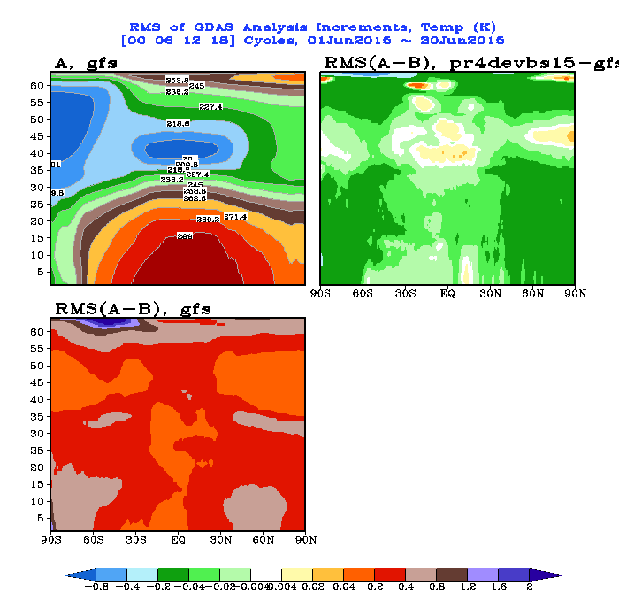
GFSX much smaller increments
Analysis and first guess in better agreement
DA Impact Highlights:
Better Fit-to-obs for Temperature and Winds at various levels
Improved minimization
Significant improvement in the short-range forecasts for several variables

Slide 19
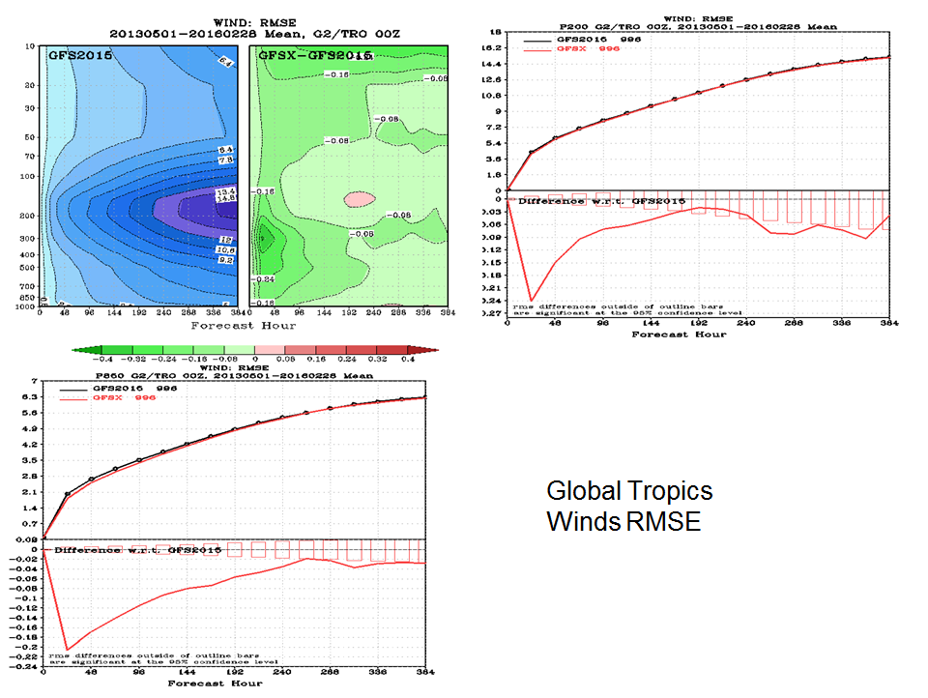
RMSE for Winds: Global Tropics
200 hPa
850 hPa

Slide 20
Forecast Model and Product Changes
Convective gravity wave upgrade
Tracer adjustment upgrade
Corrections to land surface to reduce summertime warm, dry bias over Great Plains
GFS showed too little evaporation and too much sensible heat flux, hence Bowen ratio is too high. Upgraded LSM includes
rsmin for grassland from 45 to 20
rsmin for cropland from 45 to 20
roughness length for cropland from 3.5cm to 12.5cm (used to address too strong surface winds)
Improved icing probability products and new icing severity product
5 more levels above 10 hPa
Hourly output through 120-hr forecast
Credit: Slide from GFS Implementation Review

Slide 21
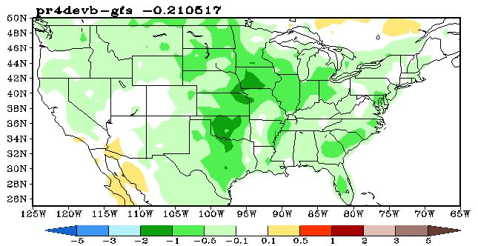
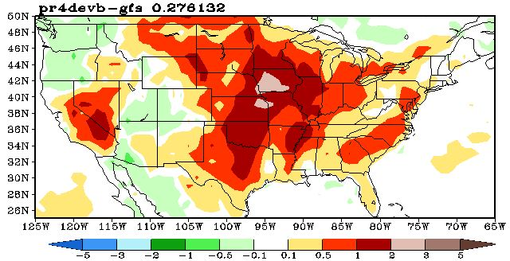
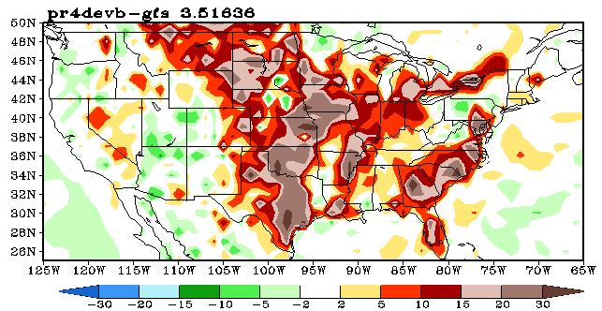
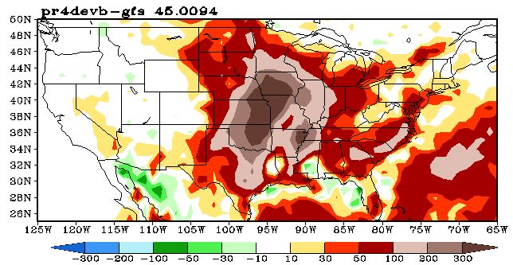
Significantly improve the biases brought up in the EMC MEG meeting
EMC land surface team
T2m
Td2m
Latent heat
CAPE

Slide 22
Outline
GFS Forecast Skill of Hurricane Track and Intensity in the Past 15 Years
Review of 2015 Performance
Upcoming GFS Upgrade in May 2016 (05/11/2016)
Evaluation of GFS Retrospective Experiments: 2012-2015
verification extended from 5 days to 7 days
5. Hurricane Sandy and Hurricane Joaquin

Slide 23
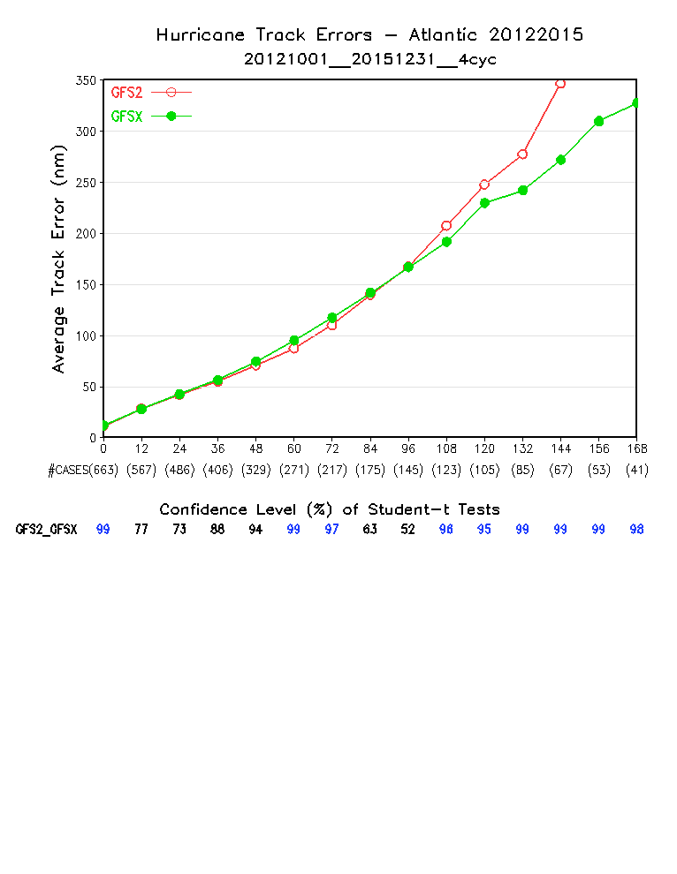
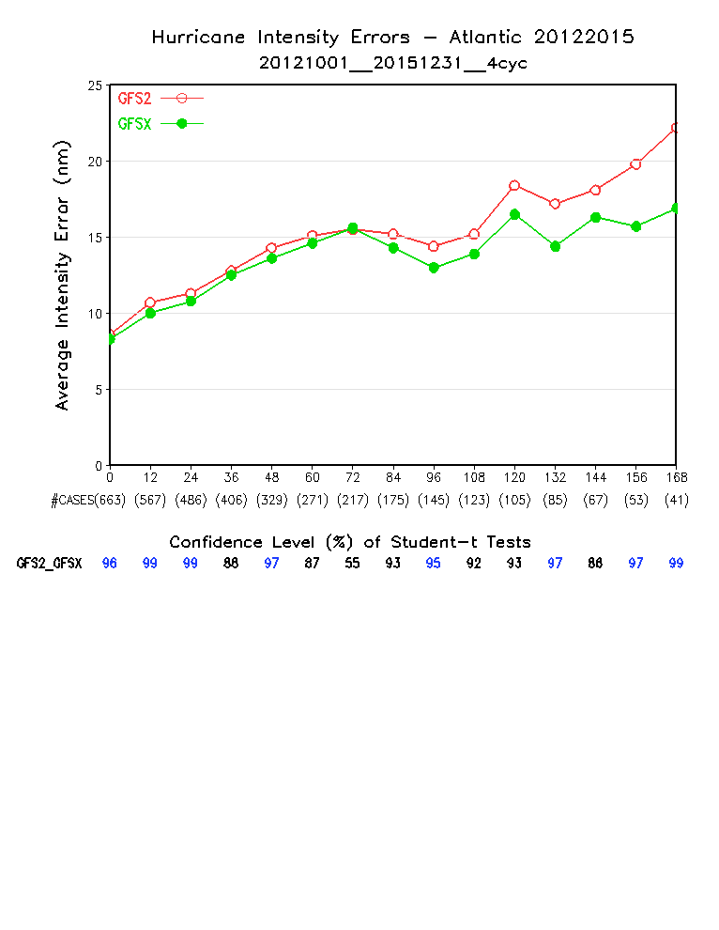
GFS2: T1534 GFS implemented in January 2015 (3D En-Var)
GFSX: T1534 GFS to be implemented in May 2016 (4D En-Var)

Slide 24
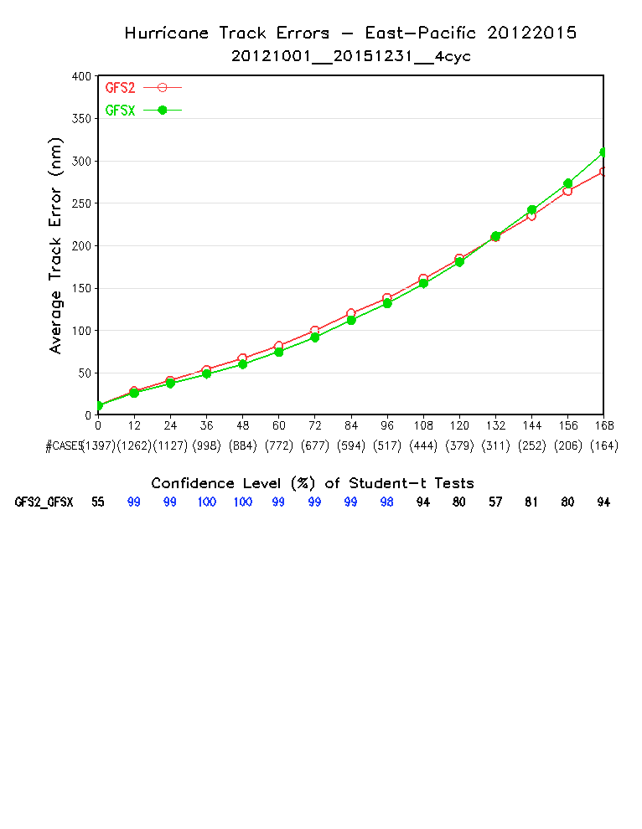
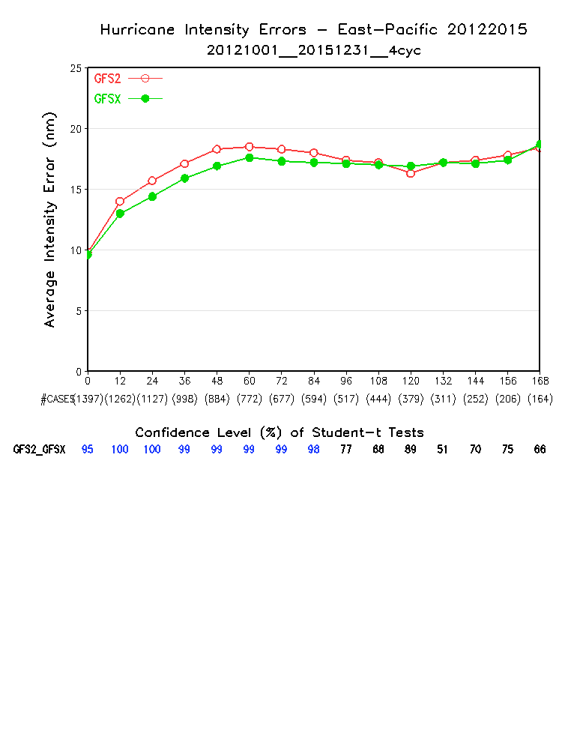
Small but significant improvement

Slide 25
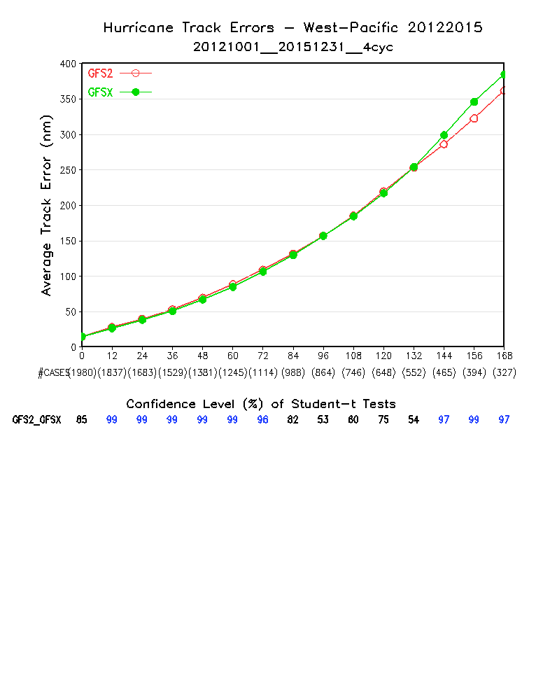
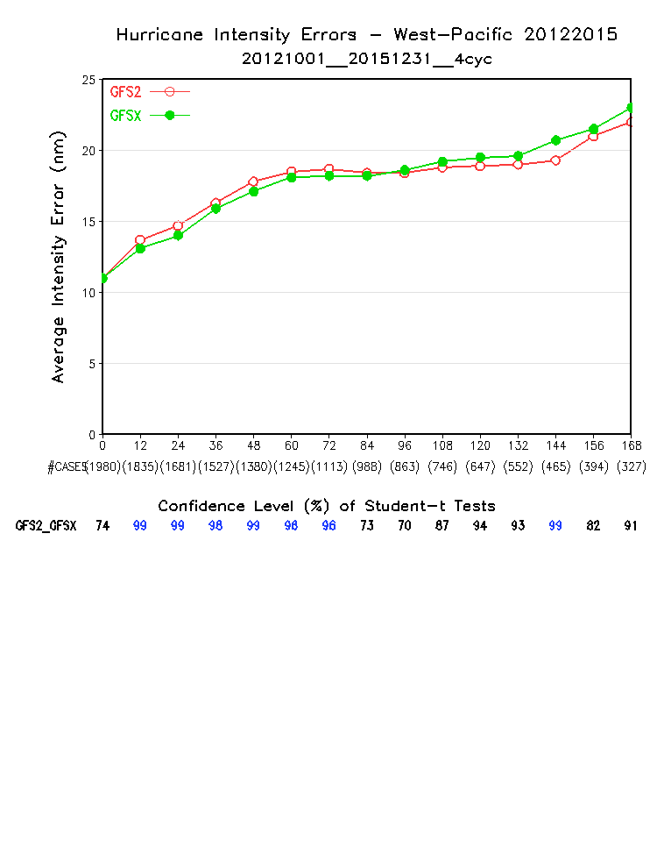

Slide 26
Impact on Hurricanes: NHC Evaluation
AL | Track | Intensity
0-48 h | - 3% | +5%
72-120 h | +7% | + 11%
EP | Track | Intensity
0-48 h | +5% | +5%
72-120 h | +1% | +2%
Track and intensity error improvements/degradation of Q3FY16 GFS vs. 2015 GFS for the 2012-2016 retrospective runs, by basin

Slide 27
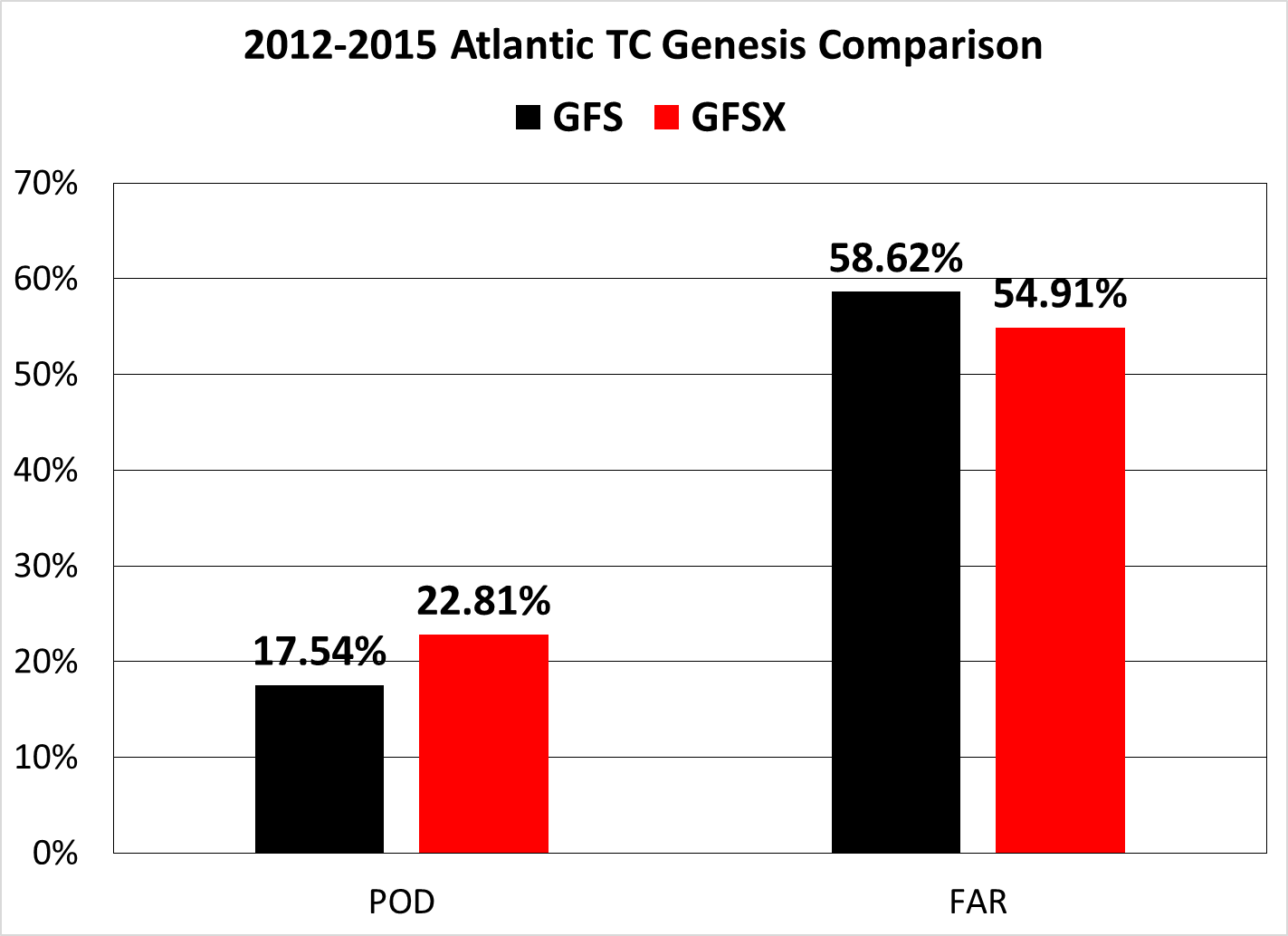
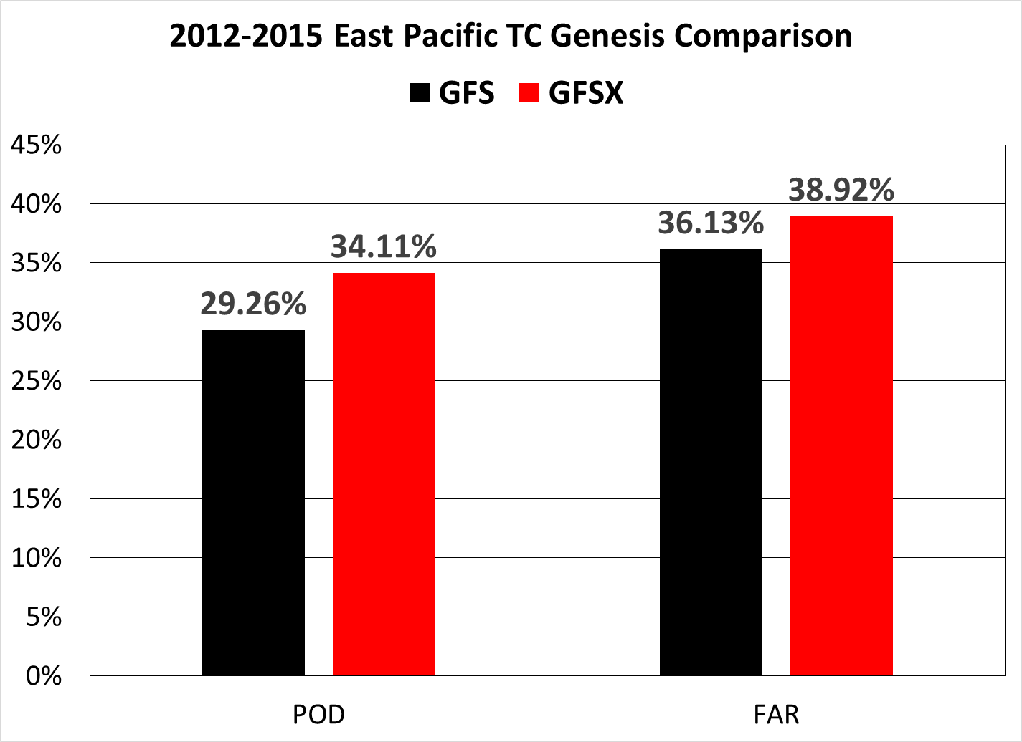
Verification of TC cyclogenesis in the GFSX – comparison to current and previous version of the GFS (courtesy of Dan Halperin and Bob Hart)
Increased POD, reduced False Alarm
Increased POD, increased False Alarm

Slide 28
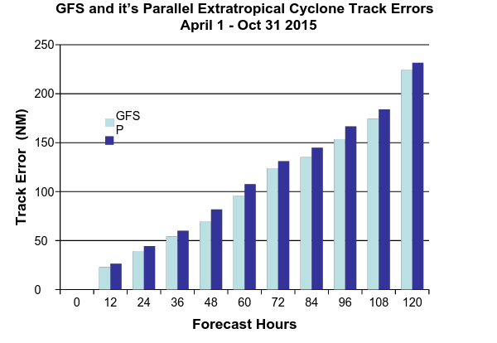
GFSO (blue) – Operational GFS (Control); GFSP (cyan) – Parallel GFS Errors in GFSX are smaller than that in GFSO.
GFSX
Ops
GFS
Fcst hr | 0 | 12 | 24 | 36 | 48 | 60 | 72 | 84 | 96 | 108 | 120
Cases | 1093 | 1075 | 1011 | 687 | 366 | 201 | 104 | 64 | 35 | 26 | 17
Guang Ping Lou

Slide 29
Outline
GFS Forecast Skill of Hurricane Track and Intensity in the Past 15 Years
Review of 2015 Performance
Upcoming GFS Upgrade in May 2016 (05/11/2016)
Evaluation of GFS Retrospective Experiments: 2012-2015
Hurricane Sandy and Hurricane Joaquin

Slide 30
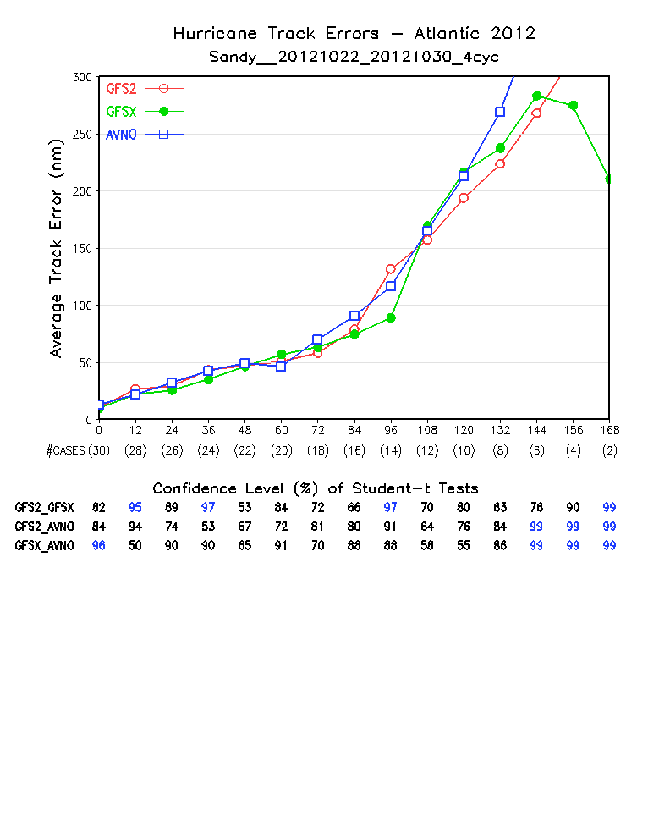
Hurricane Sandy
GFS2: T1534 GFS implemented in January 2015 (3D En-Var)
GFSX: T1534 GFS to be implemented in May 2016 (4D En-Var)
AVNO: 2012 operational GFS (T574 Eulerian GFS, 3D En-Var, ~23km)

Slide 31
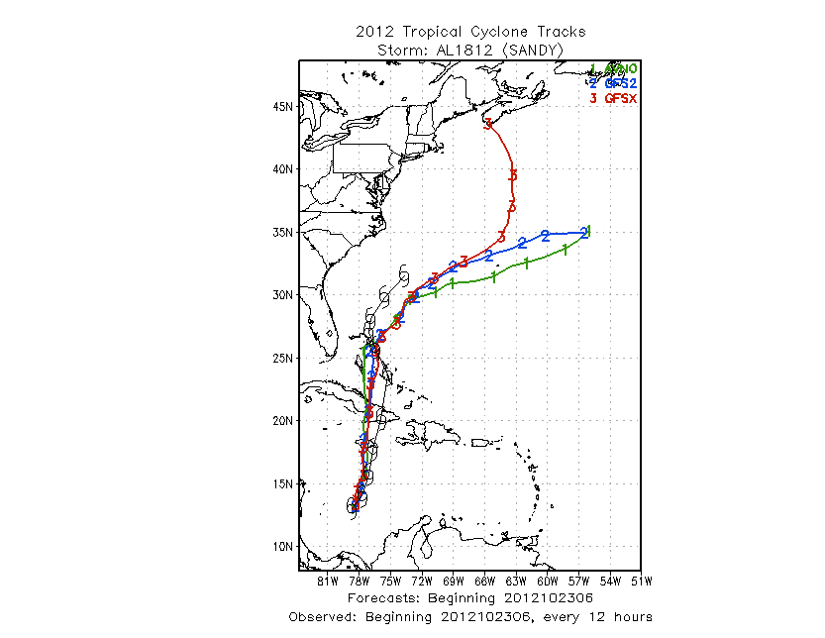
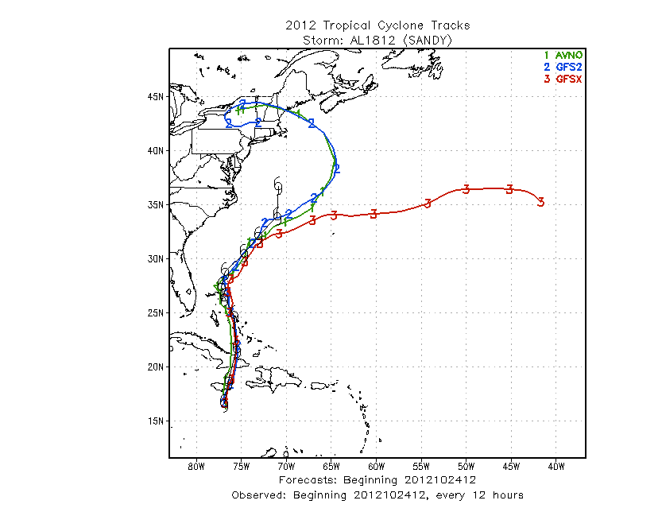
Hurricane Sandy: Mean track indicates GFSX has much a better forecast than 2012 operational GFS and the current operational GFS2015 at the 7-day lead time.
Overall, GFSX's performance is similar to GFS2015.
One case (2012102412) showed GFSX is worse.
GFSX
GFSX better
GFSX better
GFSX worse
7 day in advance!

Slide 32
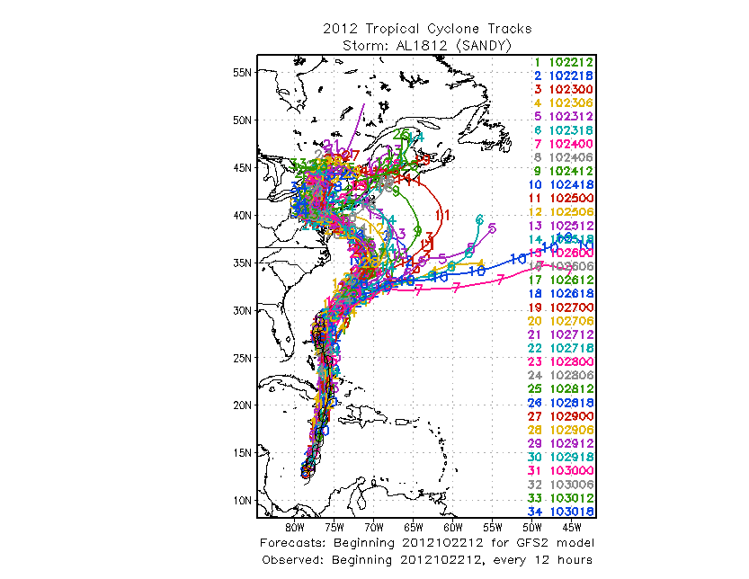
2012 Operational GFS
Current Operational SL-GFS
GFSX
No significant difference
GFSX has slightly better cycle-to-cycle consistency

Slide 33
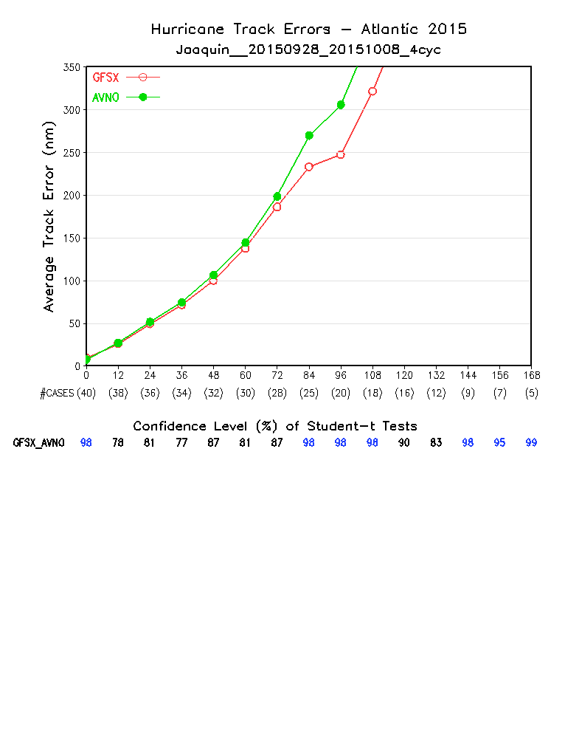

Slide 34
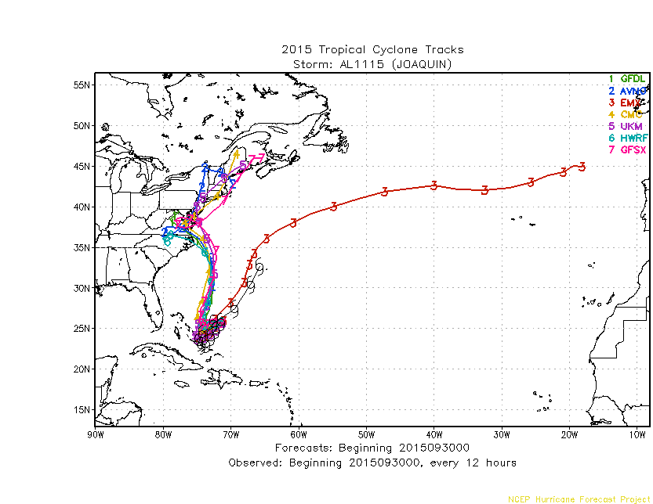
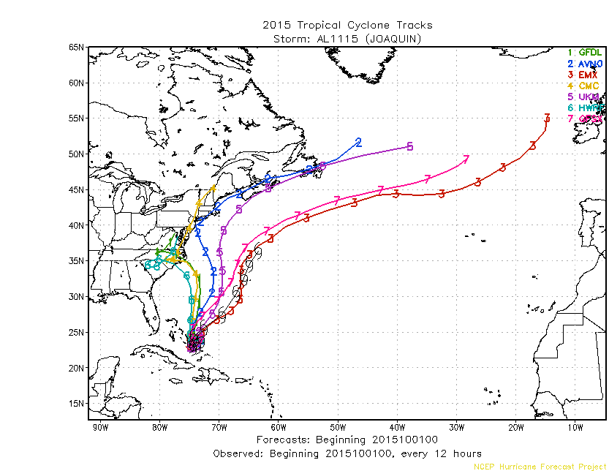
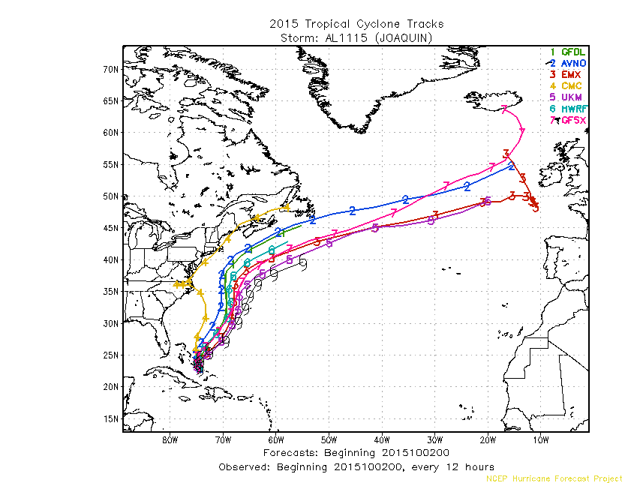
Hurricane Joaquin
AVNO
GFSX
GFSX
ECM
ECM
AVNO
ECM
Ops
GFS
2015093000
2015100100
2015100200
GFSX performed much better than AVNO starting from the 2015100100 cycle

Slide 35
Credit: Tracey Dorian
The European Center Model (ECMWF) fairly quickly figured out that the storm would not make landfall, while NCEP’s Global Forecast System (GFS) was slower to capture the decreasing threat. …
The GFS parallel … was very slightly better than the operational GFS. …The 00z 1 October cycle (Fig. 6) still saw the GFS and GFS turn Joaquin too far to the west after the initial southwest motion. …
The GFS simulation of Joaquin was therefore possibly influenced by the large upper low over the southeast, and the model still made a landfall, although dramatically further north than previous cycles.
The GFSX, however, did not show landfall, although its track was still too far to the west. .. The GFSX parallel was 6 hours faster than the operational GFS in dismissing the east coast threat.
ECMWF 00Z Sep 29
GFSX 00Z Oct 1
UKMET 00Z Oct 1
GFS 06Z Oct 1
HWRF 12Z Oct 1
Table 1. Lists of the first cycles for which various forecast models first indicated that Joaquin would not make landfall along the east coast and kept the storm offshore in all subsequent cycles

Slide 36
Thanks
http://www.emc.ncep.noaa.gov/gmb/wx24fy/vsdb/gfs2016/
http://www.emc.ncep.noaa.gov/gmb/wx24fy/vsdb/gfs2015/
http://www.emc.ncep.noaa.gov/gmb/STATS_vsdb/

Slide 37
Extra slides

Slide 38
Retrospective Forecast Experiments 36 months from 2012 to 2016
GCWMB real time (pr4devb): period: 2015070100 - real time
GCWMB 2015 summer retrospective (pr4devbs15) period: 2015041500 - 2015120100 (230 days)
GCWMB 2013 summer retrospective (pr4devbs13)
period: 2013041500 - 2013120100 (230 days)
NCO 2013-2014 winter retrospective (pr4devbw13) period: 2013110100 - 2014060100 (212 days)
NCO 2014 summer retrospective (pr4devbs14) period: 2014050100 - 2014120100 (214 days)
GCWMB 2014-2015 winter retrospective (pr4devbw14) period: 2014110100 - 2015070100 (242 days)
GCWMB Special retrospective for Hurricane Sandy
period: 2012101700 - 201213100 (15 days)

Slide 39
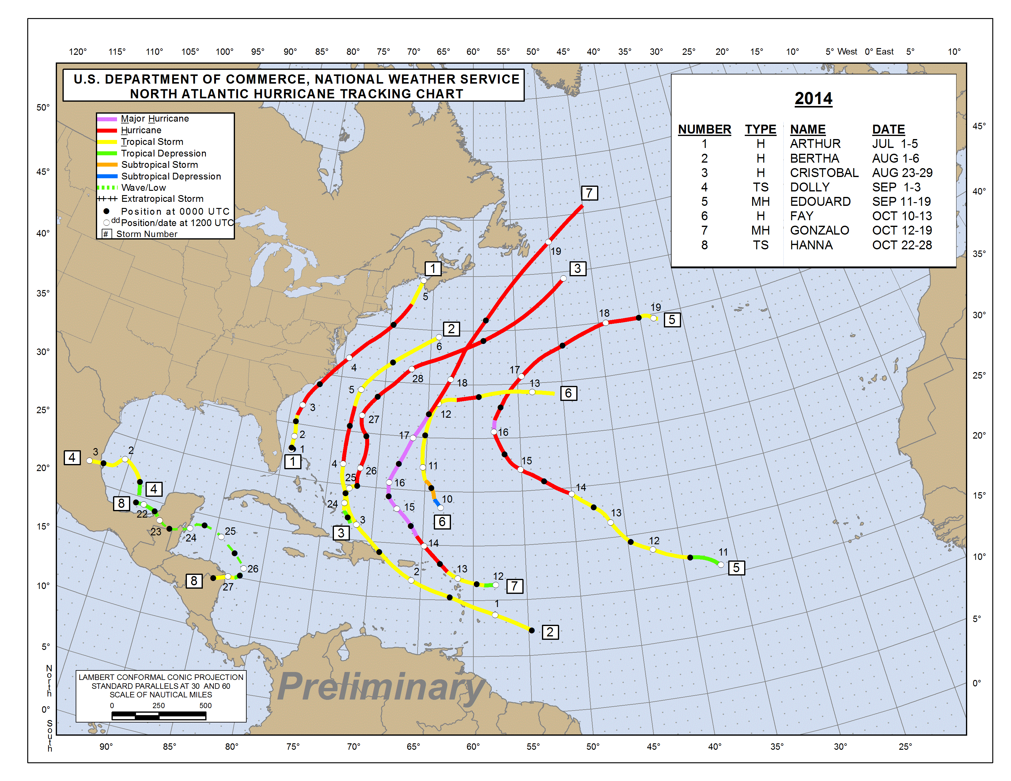
2014 Atlantic Hurricanes
First system formed | July 1, 2014
Last system dissipated | October 28, 2014
Strongest storm | Gonzalo – 940 hPa , 145 mph
Total depressions | 9
Total storms | 8
Hurricanes | 6
Major hurricanes (Cat. 3+) | 2
Total fatalities | 19 total
Total damage | ~ $262 million
http://www.wikipedia.org
A quiet year. One landfall storm over US
NOAA’s Atlantic Hurricane Season Outlook (08/07/2014): 7-12 named storms, 3-6 hurricanes, 0-2 major hurricanes
www.nhc.noaa.gov

Slide 40
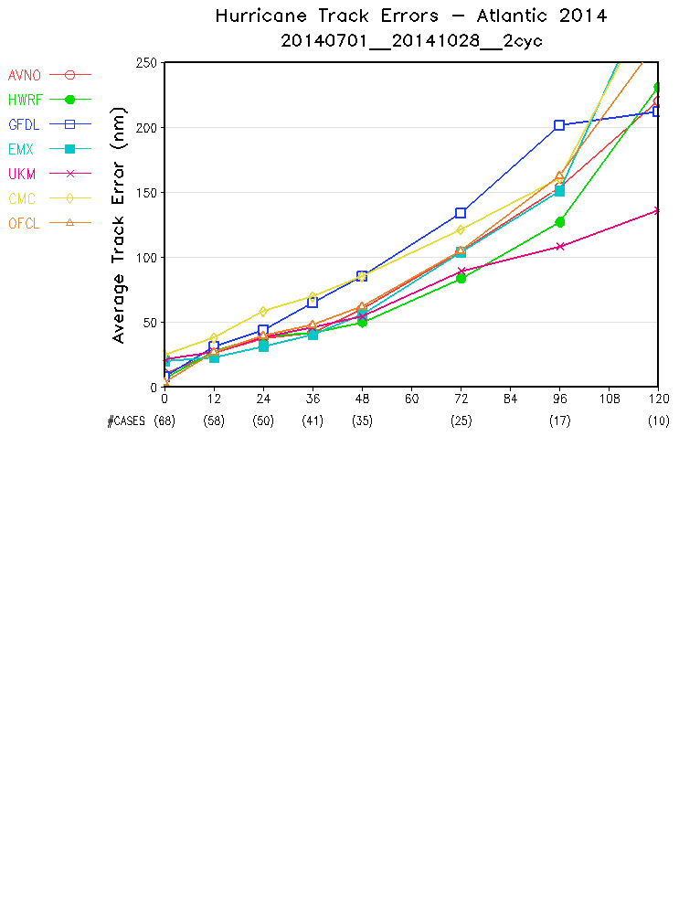
GFDL
GFS
ECMWF
HWRF
UKM
CMC
HWRF and UKM had better track forecasts. ECMWF had smaller errors than GFS for day1-2 forecasts, and larger error for day-5 forecast.
Among all global NWP models, GFS had the smallest initial track error (because of the use of hurricane relocation ?)
Note: OFCL are based on guidance of “early” models

Slide 41
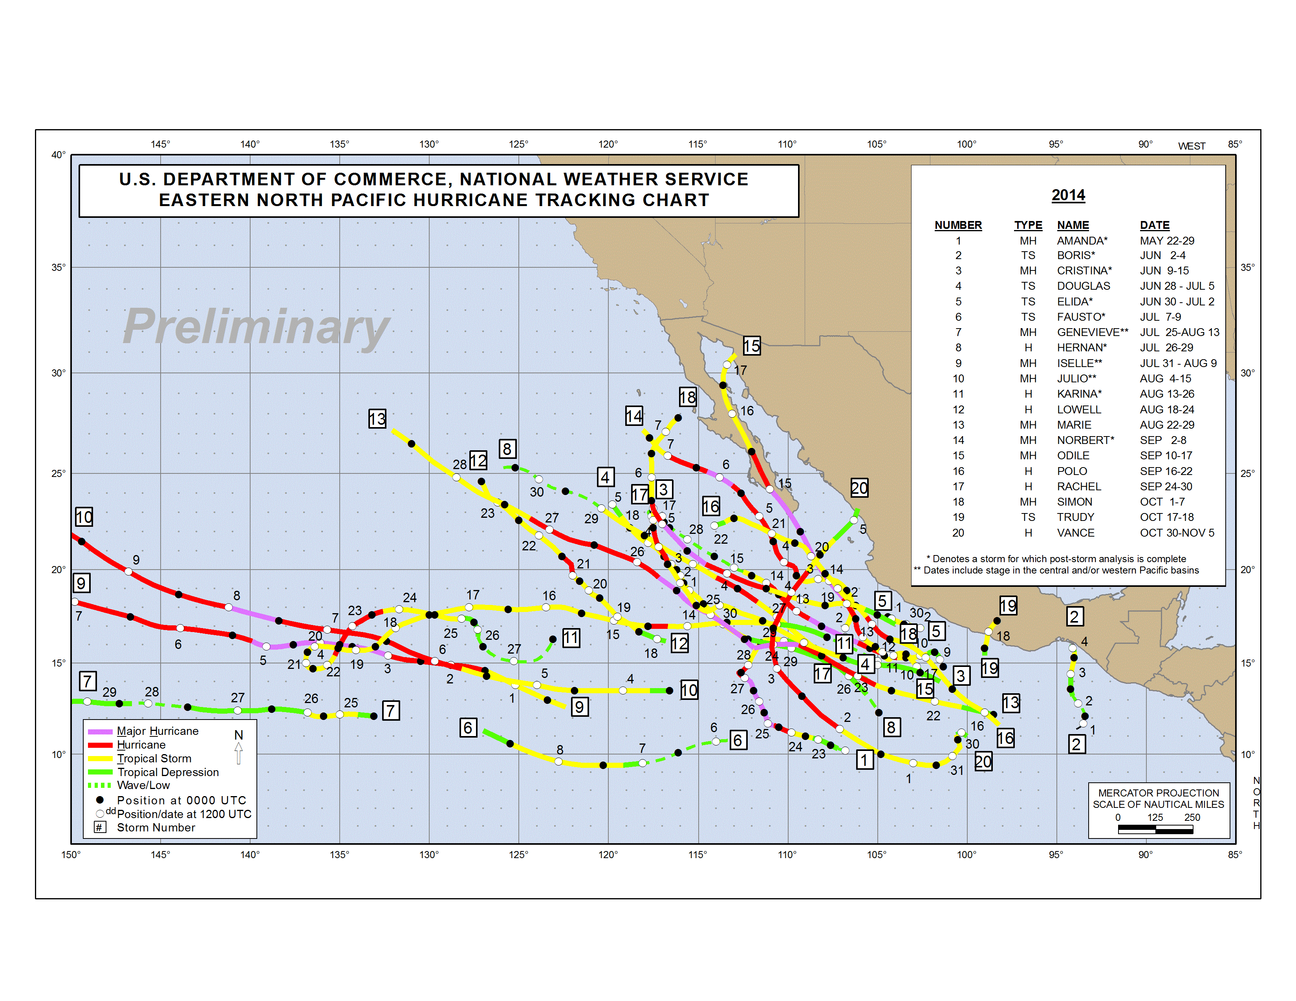
2014 Eastern Pacific Hurricanes
First system formed | May 22, 2014
Last system dissipated | November 5, 2014
Strongest storm | Marie – 918 hPa, 160 mph
Total depressions | 23
Total storms | 22
Hurricanes | 16 (record high, tied with 1990 and 1992)
Major hurricanes (Cat. 3+) | 9
Total fatalities | 42
Total damage | $1.24 billion
www.nhc.noaa.gov/
http://www.wikipedia.org

Slide 42
GFDL
GFS
HWRF
UKM
CMC
ECMWF
ECMWF had the smallest track errors.
GFS was slightly worse than HWRF, but better than GFDL and UKM.
CMC had the largest track error.

Slide 43
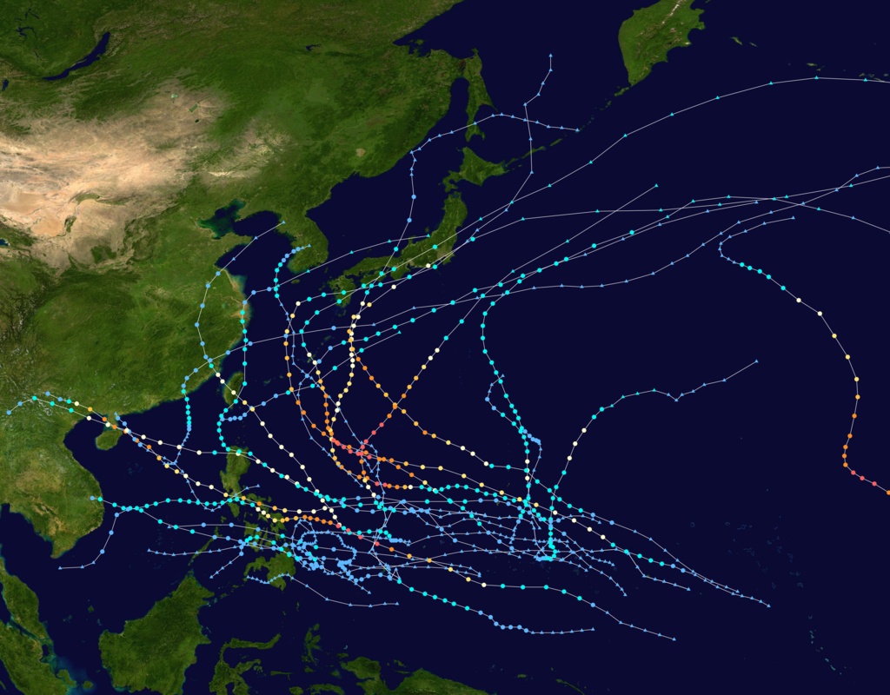
2014 Western Pacific Typhoons
First system formed | January 10, 2014
Last system dissipated | January 1, 2015
Strongest storm | Vongfong: 900 hPa, 130 mph
Total depressions | 30
Total storms | 23
Typhoons | 11
Supper Typhoons | 8
Total fatalities | 538
Total damage | $8.4 billion
http://www.wikipedia.org

Slide 44
JTWC are based on guidance of early models

