Slide 1
GFSX Evaluations
Tracey Dorian
IMSG at NOAA/NCEP/EMC
February 18, 2016

Slide 2
Soundings

Slide 3
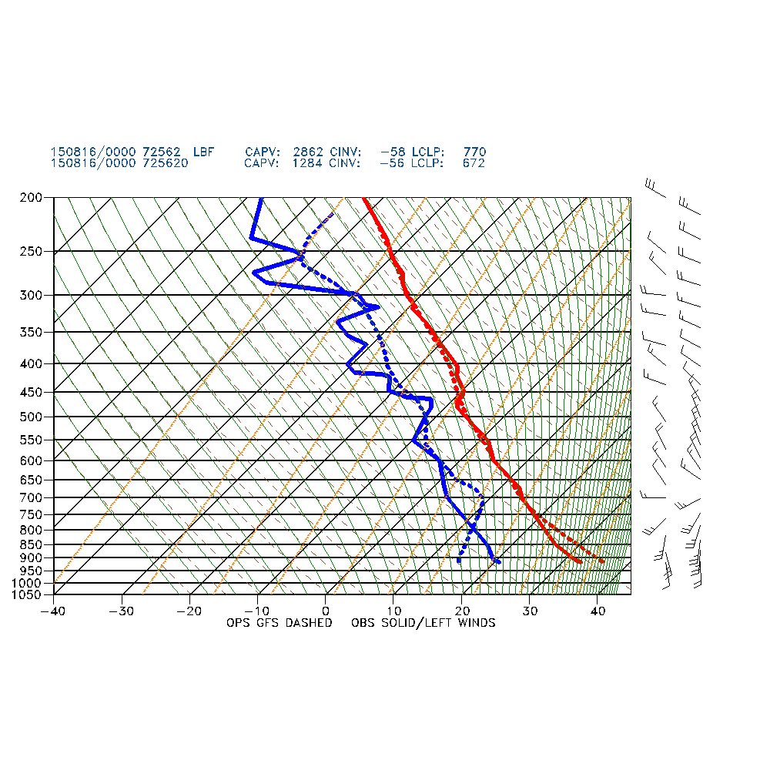
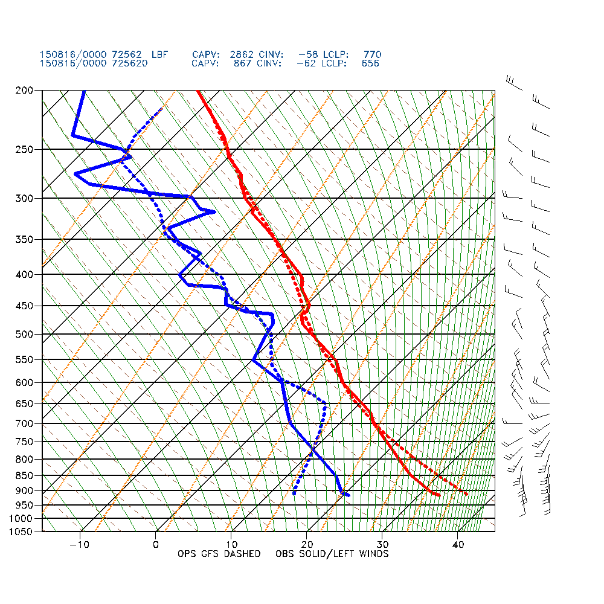
12h GFS FCST vs OBS for North Platte, NE
pr4devb
GFS

Slide 4
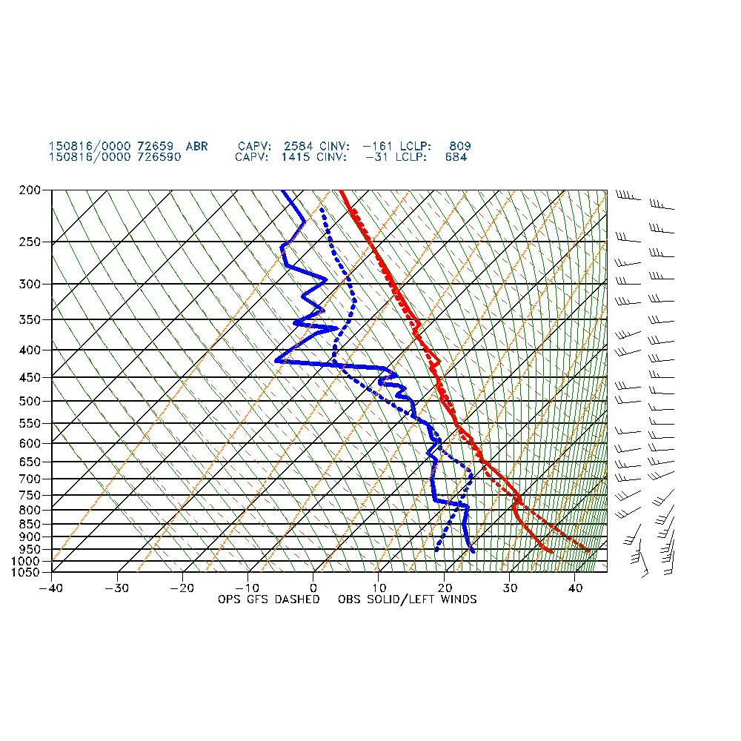
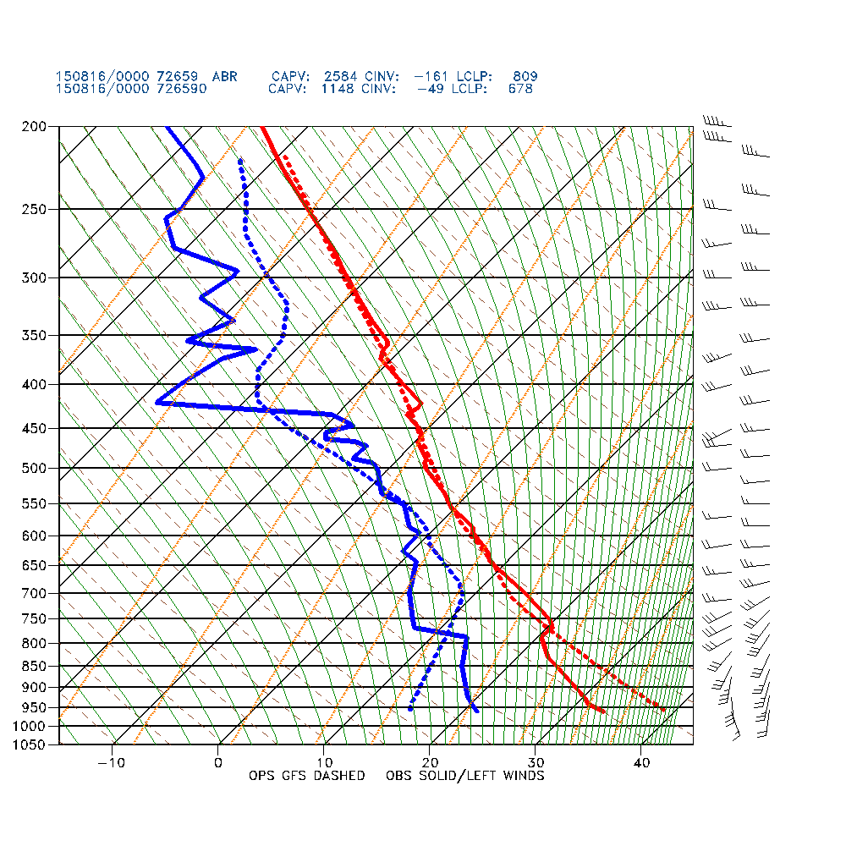
12h GFS FCST vs OBS for Aberdeen, SD
pr4devb
GFS

Slide 5
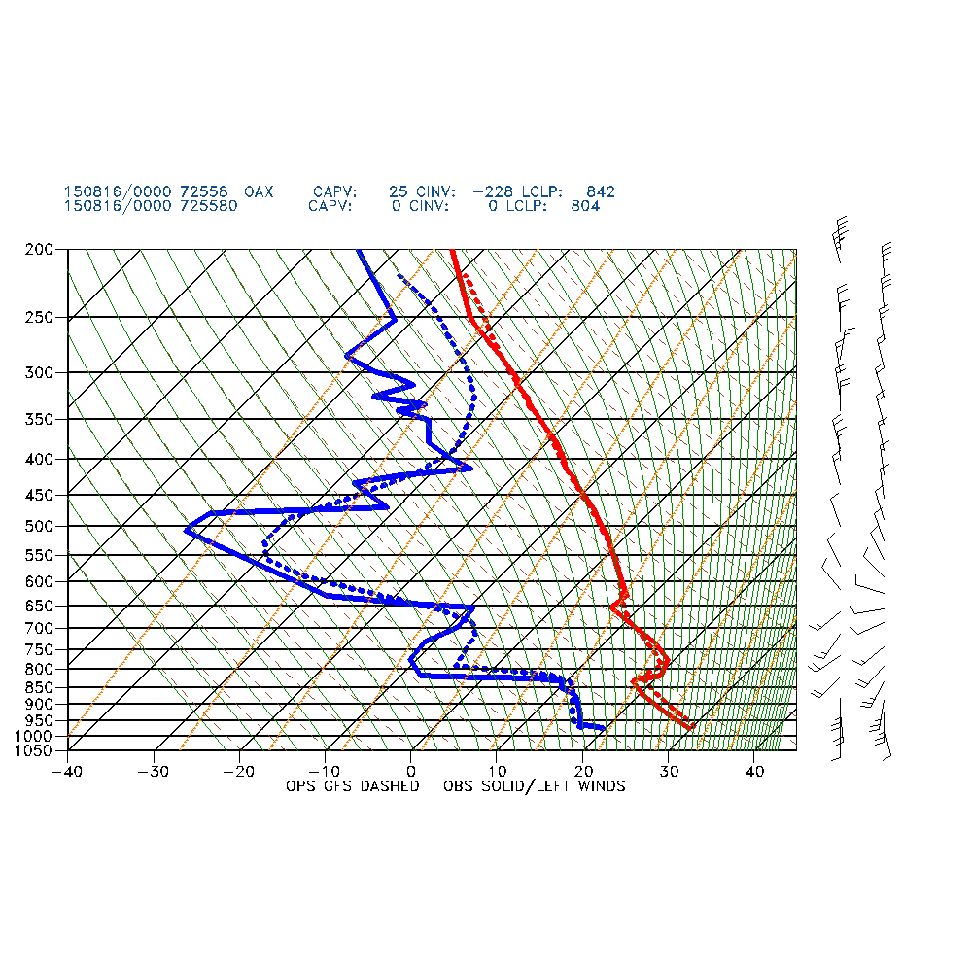
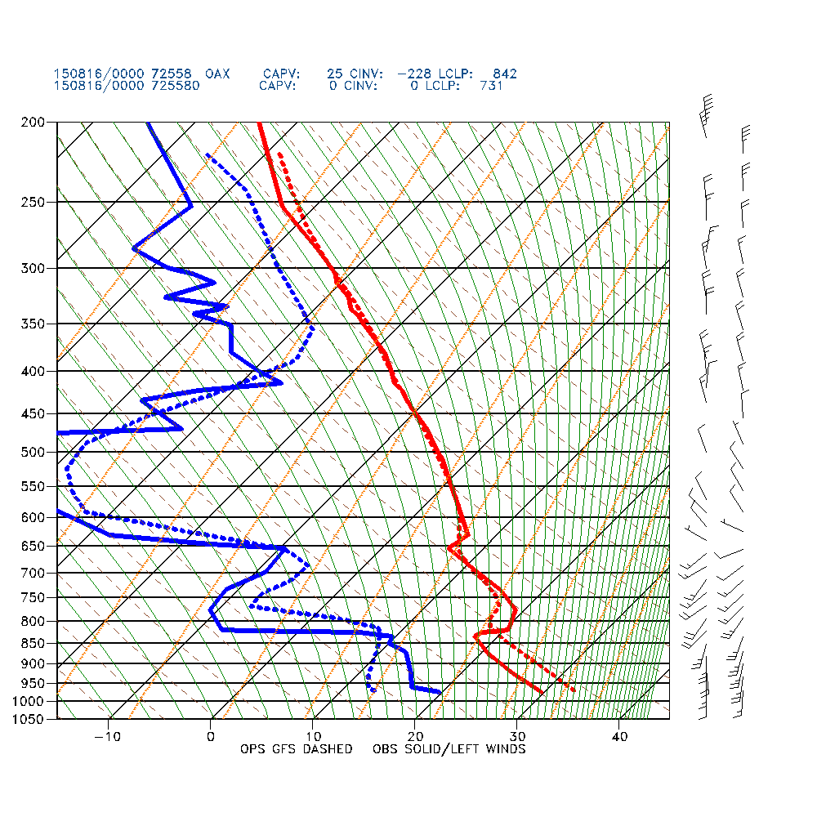
12h GFS FCST vs OBS for Omaha, NE
pr4devb
GFS

Slide 6
Atsani extratropical transition

Slide 7
Findings for 12Z 8/20/15 cycle
GFS too far to the north and east, then too far to the east, followed by too far to the north (except for 204-h forecast, GFS too far south)
Pr4devbs15 started off with good position for Atsani, then was too far south and east, then slightly too far north, then too far south for 204-h forecast
In general, the pr4devbs15 was closer to analysis
Forecast Lead Time | GFS | GFSX
108 |  | ✔
120 |  | ✔
132 |  | ✔
144 | ✔ | ✔
156 |  | ✔
168 | ✔
180 |  | ✔
192 |  | ✔
204 | ✔

Slide 8
Southern Region Case Study

Slide 9
Dec 5-6, 2013 Very cold temperatures and widespread 2-4" sleet resulted in I-35 being closed near Denton TX. "Cobblestone ice" event

Slide 10
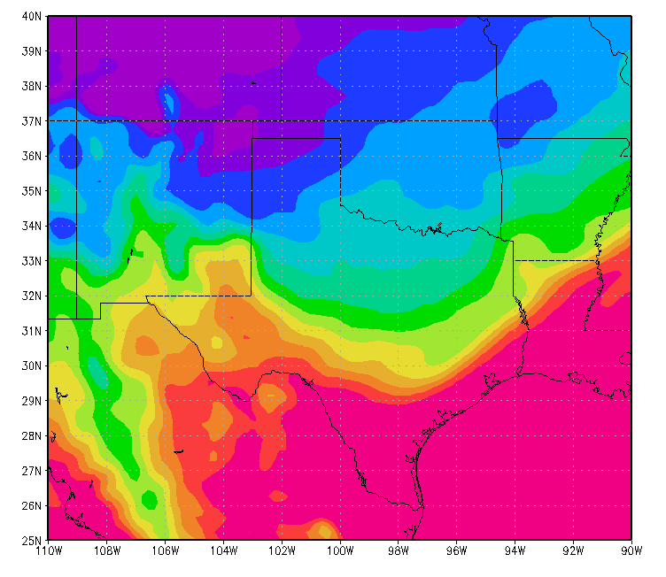
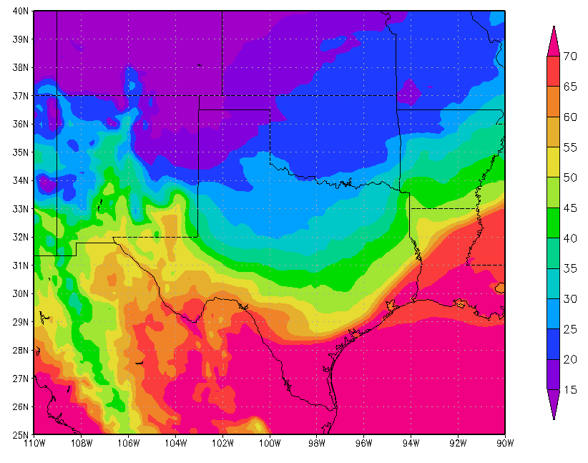
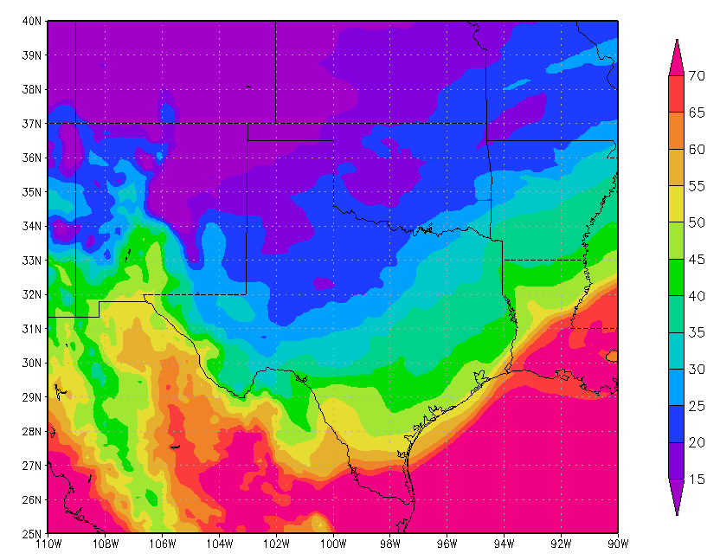
2m temperature forecasts
72-h forecast valid 00Z on 12/6/13
GFS
GFSX
Analysis
Denton about 25-35°F
GFSX has pretty good forecast of 30-35°F, though still too warm
GFS is warmer than GFSX with 2m temperatures around 30-40°F

Slide 11
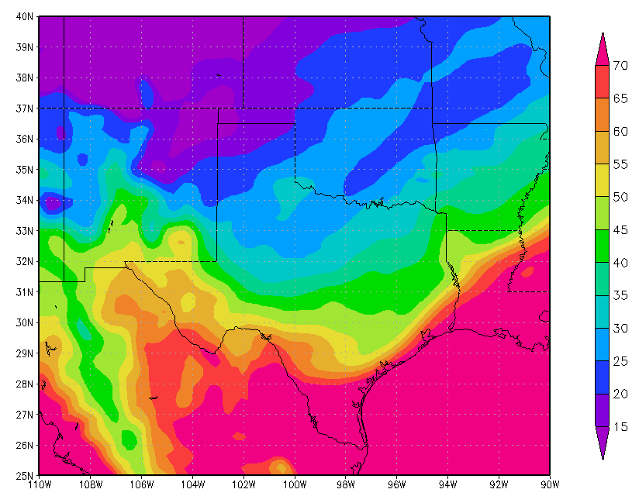
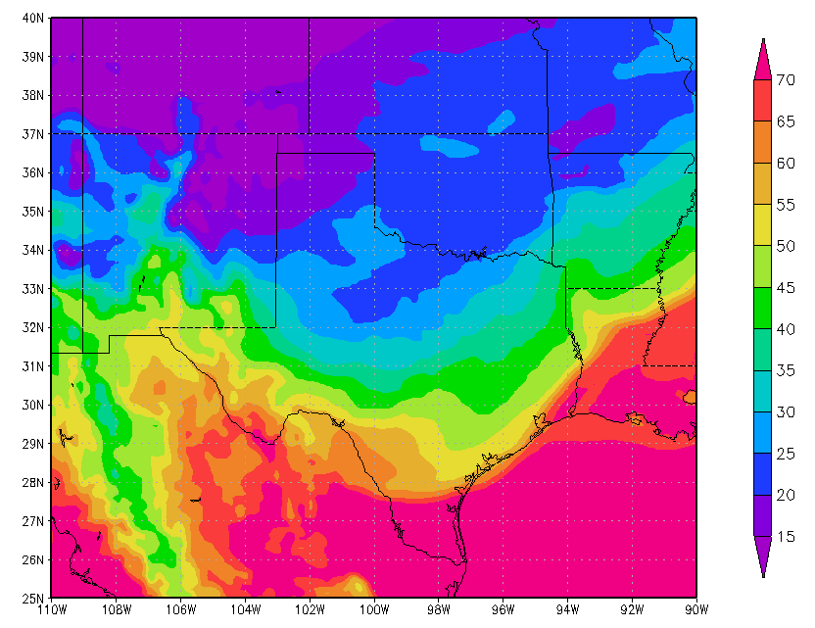
2m temperature forecasts
48-h forecast valid 00Z on 12/6/13
GFS
GFSX
Analysis
Denton about 25-35°F
GFSX has a good forecast for Denton, TX of 2m temperatures around 25-35°F
GFS is still too warm with 2m temperatures around 30-40°F
Both GFS and GFSX are not cold enough in parts of northern TX

Slide 12
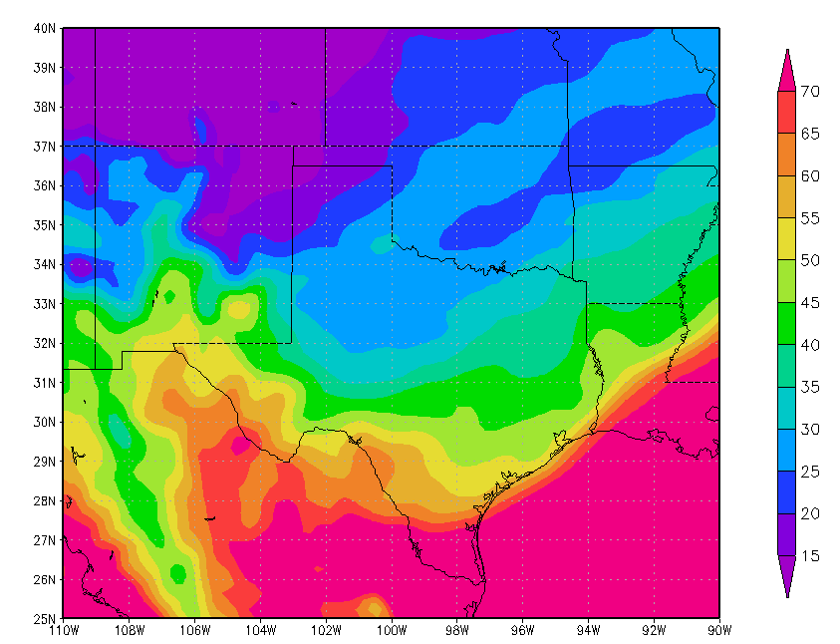
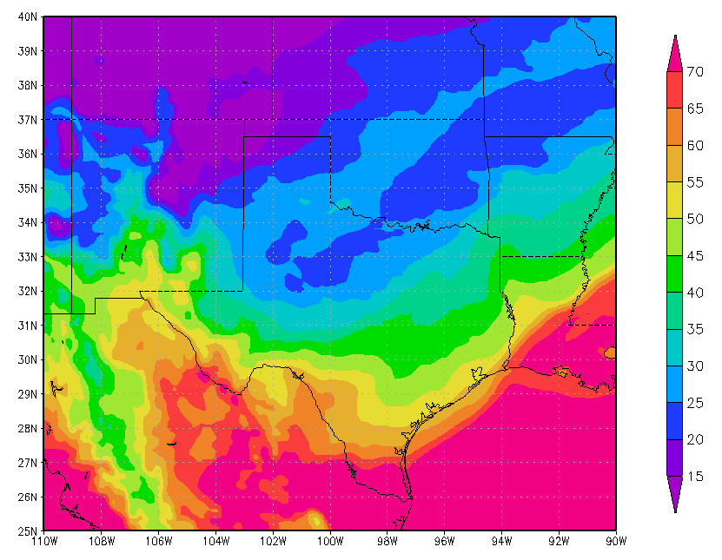
2m temperature forecasts
24-h forecast valid 00Z on 12/6/13
GFS
GFSX
Analysis
Denton about 25-35°F
GFSX good forecast for Denton, though still not cold enough in northern TX
GFS still looks too warm with 2m temperatures around 30-35°F

Slide 13
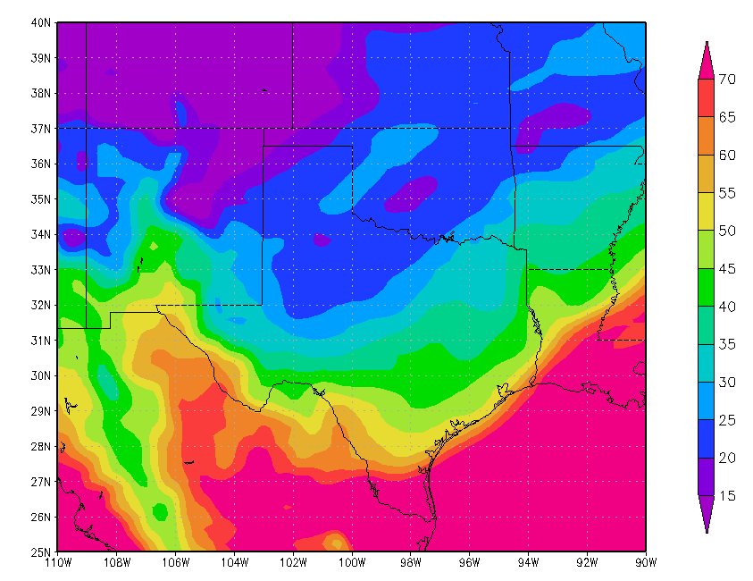
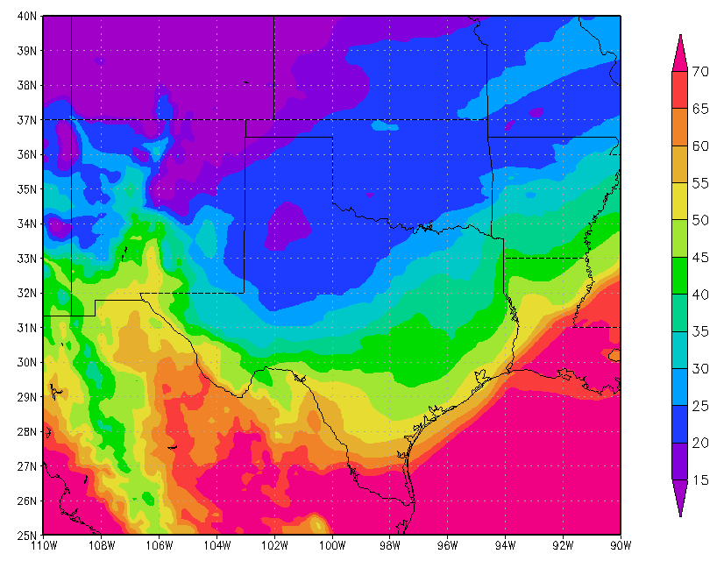
2m temperature forecasts
12-h forecast valid 00Z on 12/6/13
This run shows northern TX much colder, but not cold enough
GFS
GFSX
Analysis
Denton about 25-35°F
Both the GFS and GFSX have pretty good forecasts for Denton, TX
Both GFS and GFSX not cold enough in northern tip of TX
GFSX does look slightly better with temperature forecasts for northern TX

Slide 14
Findings
Overall, GFSX did better than GFS
GFSX had a pretty decent temperature forecast for Denton, TX about 72 hours out
GFS did not have a good forecast for Denton, TX until about 12 hours out
Both the GFS and GFSX struggled with temperature forecasts for northern TX (were too warm even 12 hours out in some locations), though GFSX looked slightly better

Slide 15
Central Region Case Study

Slide 16
0000 UTC 21 March 2015 – 0000 UTC 22 March 2015: From FSD SOO: “A narrow and intense band that extended from northeast SD through southern MN and southern WI. Maximum amounts of 10+’’ in SE MN. This band was not well forecast days in advance, but there was evidence of banding at least 24 hours out in the NMM and/or WRF ARM as well as in a couple of the larger-scale models.

Slide 17
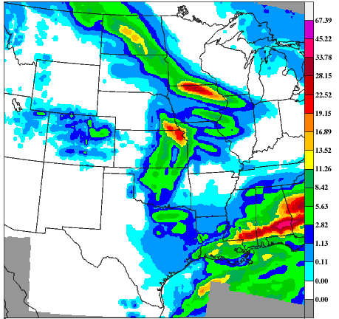
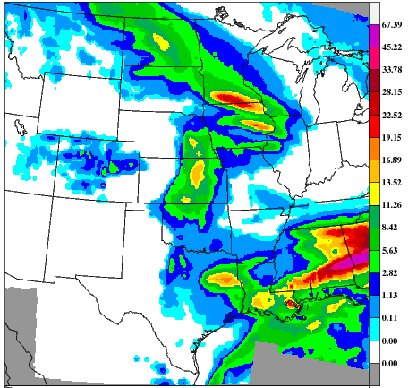
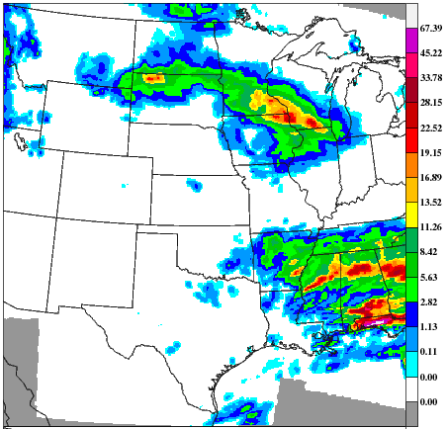
108-hour forecast Valid 12Z 3/23/15
GFS
GFSX
CCPA
GFS the narrow precipitation band is too far south, max amounts too far west
GFSX has narrow band pretty well positioned, too light with amounts in southern WI, too heavy in ND

Slide 18
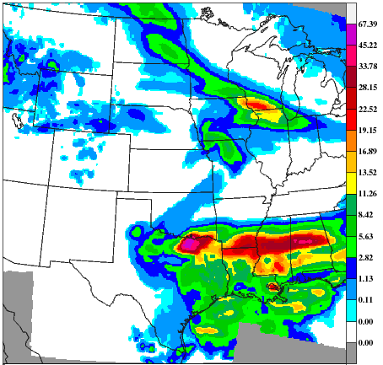
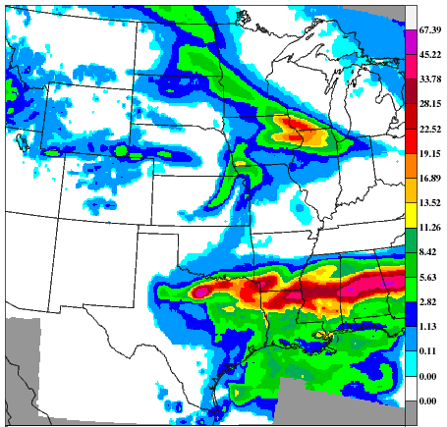
84-hour forecast Valid 12Z 3/23/15
GFS
GFSX
CCPA
Both GFS and GFSX have narrow band well-positioned, but missing precip on ND/SD
GFSX may look slightly better than GFS around ND/SD border

Slide 19
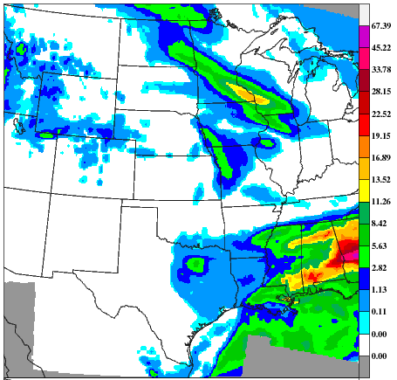
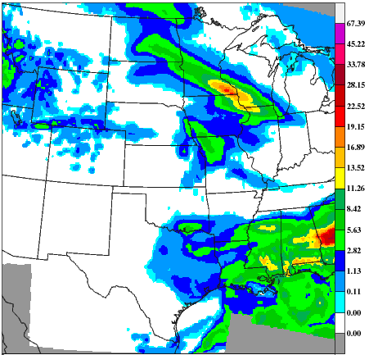
60-hour forecast Valid 12Z 3/23/15
GFS
GFSX
CCPA
GFSX forecasting higher amounts SE Minnesota and SW Wisconsin
Both GFS and GFSX still missing ND/SD border rainfall

Slide 20
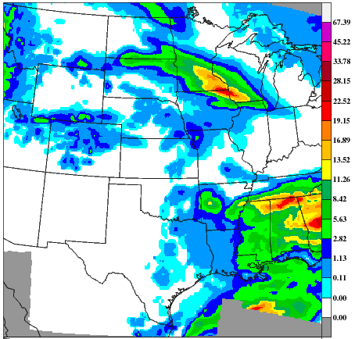
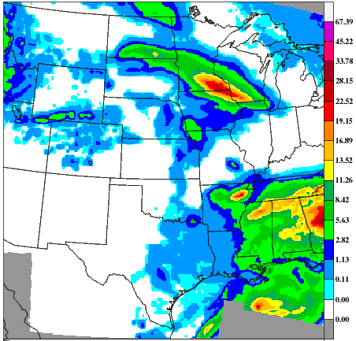
36-hour forecast Valid 12Z 3/23/15
GFS
GFSX
CCPA
Both GFS and GFSX have pretty good forecasts but missing some heavier rainfall in northern IL
GFSX looks better in SE

Slide 21
Findings
156 hour forecast: GFS and GFSX completely missed the band from North Dakota to Wisconsin
132 hour forecast: Both GFS and GFSX had some precipitation in ND/SD border, but missed precipitation in southern WI and northern IL
108 hour forecast: Both GFS and GFSX had maximum amounts too far west with some false alarms, missed precipitation in ND/SD border
84 hour forecast: Both models captured max in southern WI but both are missing maximum extending into SE Minnesota
60 hour forecasts: Pretty good position of rain in southern WI and SE Minnesota but both models too weak (GFSX better)
36 hour forecasts: Both GFS and GFSX have pretty good forecasts, but missed some heavy rain in northern IL

