Slide 1
Task | Milestones | Due Dates | POC/ Lead
Benchmark Q3FY16 GDAS/GFS on Cray (v13.1.0) | Port all components of Q3FY16 GDAS/GFS to Cray Conduct 3-month cycled tests to confirm comparable results to pr4devb (control) | April 1, 2016 May 1, 2016 | Nicole McKee
Transition and benchmark NEMS/GSM on Phase 2 (v14.0.0) | Transition all components of Q3FY16 GDAS/GFS to NEMS/GSM Conduct 3-month forecast only tests to confirm acceptable results compared to pr4devb Conduct 3-month fully cycled tests to confirm comparable results to pr4devb | April 1, 2016 May 1, 2016 May 15, 2016 | Fanglin Yang
Port and benchmark NEMS/GSM on Cray (v14.1.0) | Port all components of v14.0.0 to Cray Conduct 3-month fully cycled tests to confirm comparable results to pr4devb Run the parallel end-to-end system in real-time | April 15, 2016 May 1, 2016 May 15, 2016 | Lin Gan

Slide 2
NEMS Transitions
Development of GFS (non-NEMS) frozen soon after porting to Cray (task 1)
All developers migrate to NEMS/GSM framework by May 1, 2016
V14.1 forms the control configuration for FY17 GFS/GDAS implementation
Scripting & workflow changes to address the needs

Slide 3
Potential Science upgrades for FY17 NEMS GSM/GDAS
Resolution; Physics, Data Assimilation;
Products/Downstream Changes
Resource Requirements
Test Plan and execution
Need inputs by March 21, 2016
Charter and Project Management established by April 1, 2016
Briefing to Louis on April 4, 2016

Slide 4
Plans for 2017: Transition to NEMS GSM
NOAA Environmental Modeling System (NEMS) version of GFS using ESMF
Global atmosphere divided into dynamics and physics components (easier to switch to NGGPS dynamics in the future)
Using common write component outside of science components
May use NUOPC physics driver if ready
Possible Physics Options
Simplified Higher Order Closure (SHOC) sub-grid scale turbulence with prognostic TKE & Unified deep convection (Chikira-Sugiyama with Arakawa-Wu scale-aware extension) – OR –
Scale- & aerosol-aware deep & shallow convection schemes with convective cloudiness enhancement
Improving the interactions of cloud macrophysics, microphysics, and radiation
Double-moment cloud microphysics scheme
Improved land surface modeling
Dynamics
GSM with a two time-level Semi-Lagrangian Semi-implicit (SLSI) dynamics with a reduced linear transform grid.
T2046 spectral resolution: 4096x2048 (~ 9.8 km near the equator)
Vertical: Either 64 or 91 or 128 hybrid σ – p layers.
Time step – 450s
Reference pressure – 101350 Pa for stable two-time level semi-implicit scheme – reduced divergence damping

Slide 5
Q2FY17 NEMS/GSM
Global Spectral Model Resolution and Physics:
  Various options (T1534 L91/L128; T2046 L91)
  Update Rayleigh damping and divergence damping to improve forecast in the upper stratosphere (Fanglin Yang and Moorthi)
  Scale- & aerosol-aware deep & shallow convection schemes with convective cloudiness enhancement (Jongil)
  TKE based EDMF parameterization of moist boundary layer turbulence (Jongil)
  Add MPIIO in write grid component (Jun Wang)
Land Surface Model:
  Use high resolution(1km) IGBP vegetation and STASGO soil type data to replace current coarse resolution (1 degree) UMD/Zolber. (Helin Wei)
  Use high resolution MODIS snow and snow free albedo to address the cold bias over snow. (Helin Wei)
  Add decoupling prevention to address the rapid temperature drop during sunset. (Weizhong Zheng)
  Use standalone GLDAS forced by observed precipitation to provide initial land states to GSM. (Jesse Meng and Helin Wei)

Slide 6
Q2FY17 NEMS/GSM
Sea Ice:
  Using 15% as a cutoff for sea ice concentration to represent sea ice cover; it is more realistic, and consistent between the coupled and uncoupled case (Xingren Wu)
SST:
  Turn on the NSST (Near-Surface Sea Temperature), which has been built in GSI and NEMS/GSM. It leads to a better ocean and better use of satellite data in NWP. The impact on weather prediction is neutral to positive.
Terrain/Lakes:
    Use new USGS GMTED2010 terrain data, which is the replacement for the USGS GTOPO30 data. (George Gayno)
    As model resolution increases, more small lakes will be resolved. Need to ensure the temperature and ice content of these small lakes can be accurately specified. (George Gayno)

Slide 7
Q2FY17 NEMS/GSM
Post:
  Use NCEPPOST to read nemsio flux files in binary format and write out flux files in grib2 to save disk space (Huiya Chuang)
  Add to NCEPPOST the computation of vertical velocity using gridded data as input. (Huiya Chuang)
Products:
  Output number concentration and mixing ratio of cloud liquid, cloud ice, rain, and snow if there is not such output including convective clouds.
  Output TKE for diagnostic purpose. Large TKE in PBL will prompt surface latent and sensible heat fluxes, influencing both the surface and near surface 2m and 10m temperature. TKE in the free troposphere directly links to cloud production and dissipation if SHOC is in GSM/NEMS (Anning Cheng)

Slide 8
Q2FY17 NEMS/GDAS
Data Assimilation:
Radiance Assimilation
  Near Sea Surface Temperature (NSST)
  CrIS Full spectral Resolution data and generalization of hyperspectral sounder reading capability
  Modification to Megha-Tropiques SAPHIR QC (positive impact on upper Trop. humidity analysis/forecast)
  Assimilation of VIIRS
AMV Assimilation
  VIIRS
  GOES-R algorithm new BUFR for current satellites
  Log-normal(wind) quality control
  Turn AVHRR winds ON
Resolution and Configuration Changes:
  Analysis resolution TBD
  IAU ??
  Replace EnKF with LETKF ??

Slide 10
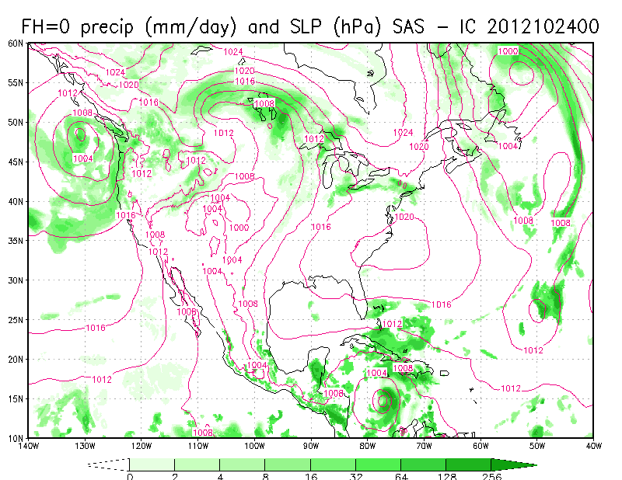
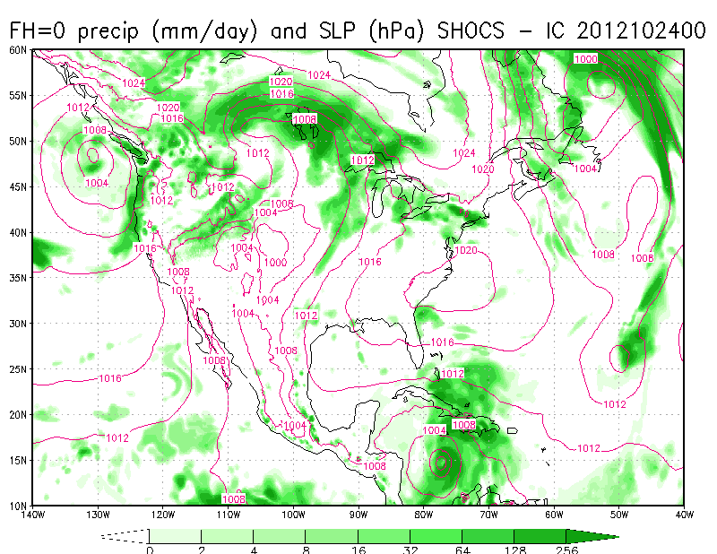
Simulation of Hurricane Sandy: Impact of resolution & physics
NEMS/GSM run at T2046: opr physics
NEMS/GSM run at T2046: SHOC+CS

Slide 11
TKE-based EDMF Parameterization of Moist Boundary Layer Turbulence
Accomplishment Title: A TKE-based Eddy-Diffusivity Mass-Flux (EDMF) Parameterization for Convective Boundary Layer (CBL) and Stratocumulus-top-driven Turbulence Mixing
Single Column Model Test Results
CBL
Stratocumulus-topped Boundary Layer

Slide 12
TKE-based EDMF Parameterization of Moist Boundary Layer Turbulence
Key Take Away Message
A TKE-based EDMF planetary boundary layer (PBL) scheme has been developed and successfully simulates daytime well-mixed CBL with a good agreement with the LES result.
For the CBL, the new TKE-based EDMF PBL scheme predicts a PBL feature very similar to that from the current operational GFS hybrid EDMF PBL scheme (which is based on first-order K-profile method).
Compared to the LES result, the new scheme also well simulates the marine stratocumulus-topped boundary layer, showing somewhat better prediction than the operational one.

