Slide 1
v2.6 RTMA/URMA and Rapid Update RTMA Science Briefing
Manuel Pondeca, Steven Levine, Runhua Yang, Ying Lin, Jacob Carley, Stylianos Flampouris, Henrique Alves, Jeff Whiting, Shelley Melchior, Annette Gibbs, George Gayno, Jim Purser, Ting Lei, Wan-Shu Wu, David Parrish, Ben Blake, Corey Guastini, Geoff Manikin, and John Derber
June 26th, 2017

Slide 2
Quick update on “Good enough” items
Task Tracking Document Here
Developed in consultation with EMC management
This goes over the issues described by the ‘RTMA Good Enough Group’ led by Dave Bernhardt et al.
Entries worked on in v2.6 and/or upcoming implementations in support of RTMA:
Item 2e: Relaxation of gross error check tolerances to allow use of more observations
Item 2b: Simplified updating of reject lists through Obs Processing change: expanded to include mesonets
Awaiting NCO implementation of RFC to get into production (see back-up slides)
Entries worked on (and still being worked on) and anticipated for v2.7:
Item 3a/d: Much expanded ability for different weighting for different observations in varied situations.
Addressing via significant development effort on background error to include regime-dependence, thus fitting data more closely (see back-up slides)
May extend to item 4: improving the estimate of the analysis uncertainty
Item 3b: Inclusion of mesonet provider dependent errors

Slide 3
v2.6 Bundle: Timeline
Note* This is the first RTMA/URMA upgrade under the new procedures, means the evaluation occurs before hand off to NCO for their 30 IT day test
EMC devs conduct and run all pre-implementation testing.
Need to have continued discussions with user community to consider other ways to facilitate evals (e.g. retrospectives).
Implementation scheduled for October.

Slide 4
v2.6 Bundle: Contents + Outline
Rapid Update RTMA (15-minute cycle) - support AWC, HEMS, and aviation users
Hourly precip URMA for ConUS and Puerto Rico - support NBM
New terrain and land/sea mask in use for CONUS/PR/HI
AK files to come in 2.7
New output fields:
min/max RH product (URMA) - support NBM
Significant wave height analysis (URMA) - support NBM and coastal WFOs

Slide 5
v2.6 Bundle: Contents + Outline
Relax QC criteria to increase use of mesonet temperature and moisture data
Assists with good enough item 2e
New obs for URMA
Pseudo obs over Great Lakes via GLERL adjustment (long awaited item)
New data from UrbaNet and COOP
Bug fix: Ceiling background from downscaled RAP/HRRR
Reduce steepening in background error model along land/water boundaries based upon forecaster feedback

Slide 6
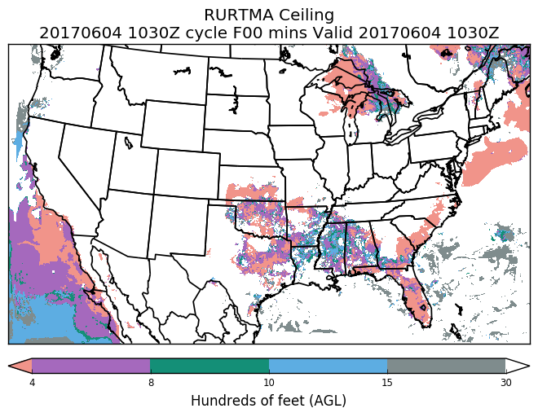
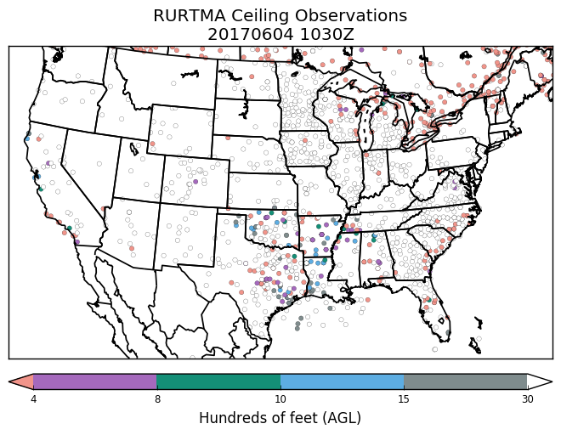
v2.6 Bundle: Rapid Update RTMA
RTMA system with updates every 15 minutes instead of every hour
Focus is aviation applications
Helicopter Emergency Med. Services tool
Collaborative FAA AWRP project with AWC
Uses closest in time available data for C&V
No time interpolation among a window of observations
Closer fit to data
Uses 15 min output from HRRR
Available at T+20 mins.
For v2.7, plan to go to T+15 mins.

Slide 7
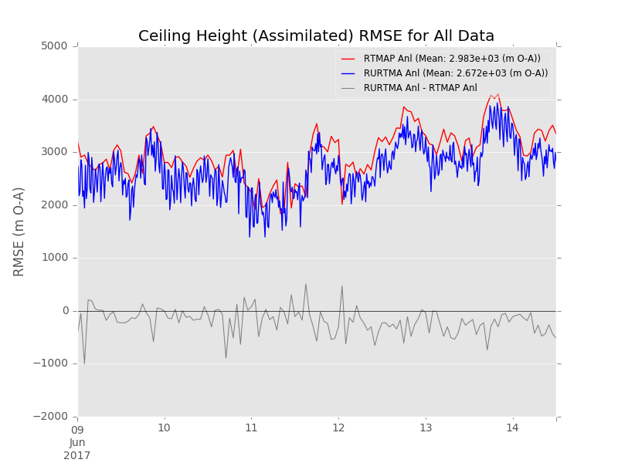
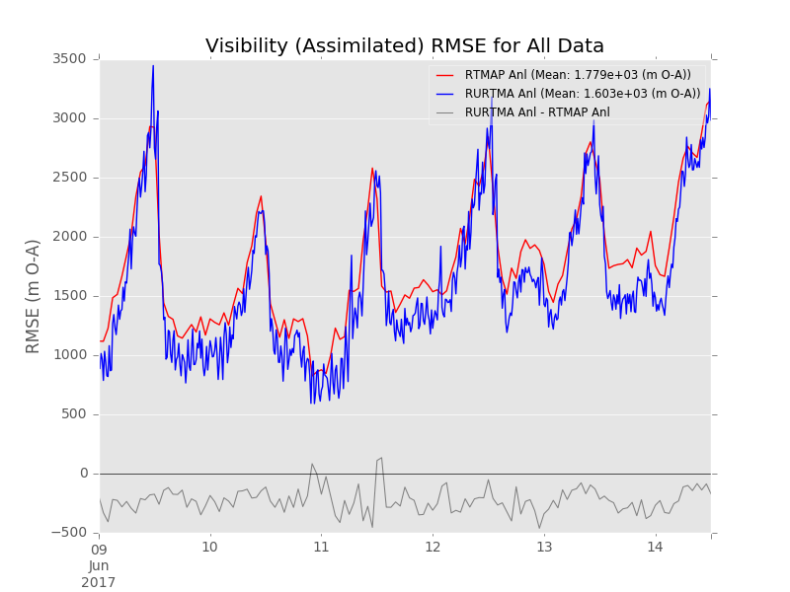
v2.6 Bundle: Rapid Update RTMA
RURTMA (blue) fits ceiling and vis data more closely than hourly v2.6 RTMA (red)
For C&V RU-RTMA only uses the observation closest to the analysis time

Slide 8
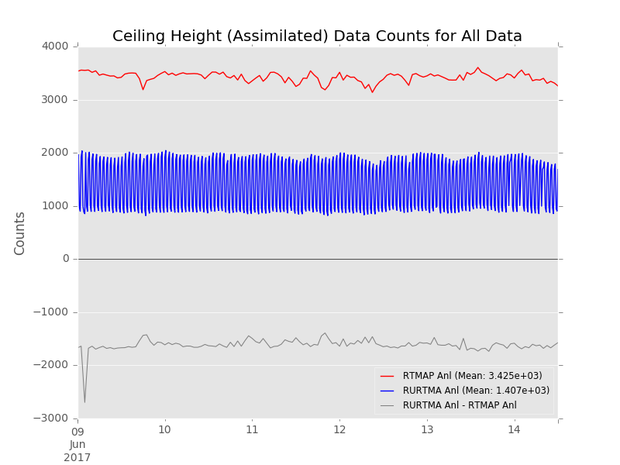
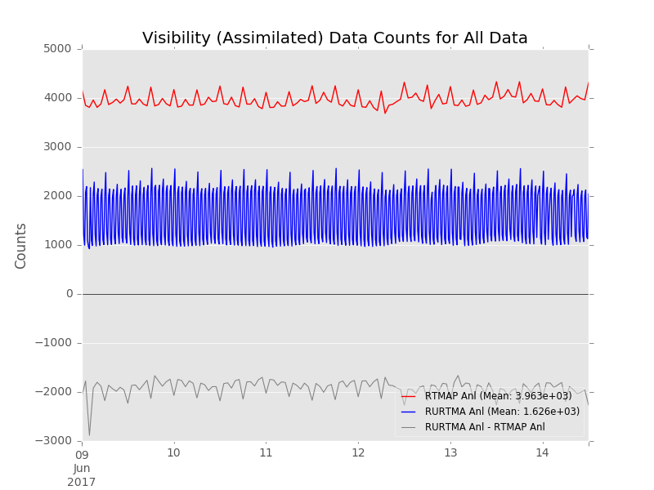
v2.6 Bundle: Rapid Update RTMA
RURTMA (blue) uses less data per cycle than hourly v2.6 RTMA (red)
The number of assimilated obs for each 15-min window is less than hourly v2.6 RTMA.
BUT the sum of assimilated obs in RURTMA in one hour is, on average, more than that in the hourly v2.6 RTMA

Slide 9
v2.6 Bundle: Precipitation URMA
Currently in operation: 6-hourly URMA for ConUS, Alaska and Puerto Rico (from hourly/6h RFC QPEs)
v2.6: add hourly ConUS and PR URMA - supports the NBM
PR: SERFC produces hourly and 6h QPEs for Puerto Rico
Issue for ConUS hourly: NWRFC and CNRFC only have 6h QPEs, the other 10 ConUS RFCs produce hourly QPEs. MRMS has hourly QPEs, but in the complex terrain out West the gauge-based RFC QPEs often has an advantage over the MRMS.
Solution: time-disaggregate 6h QPEs from NWRFC/CNRFC into hourly QPEs using hourly gauge-corrected MRMS as weights (if MRMS is missing or has zero precip in an area for the entire 6h, weight for each hour is assumed to be ⅙), and combine these with the hourly QPEs from the 10 other RFCs for a ConUS mosaic.
Kick off precip RTMA/URMA processing from pcpanl package (separate out precip RTMA/URMA from Stage II/IV processing)

Slide 10
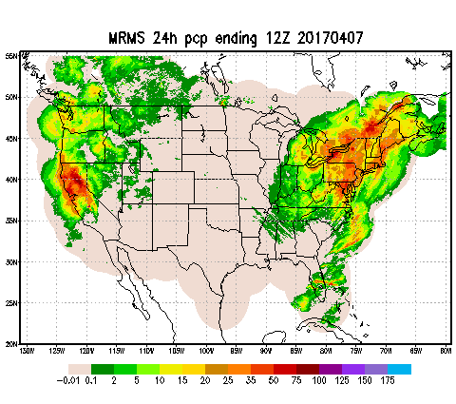
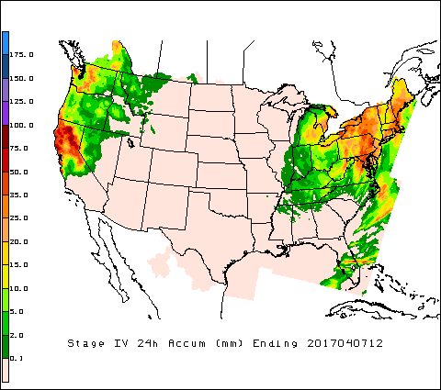
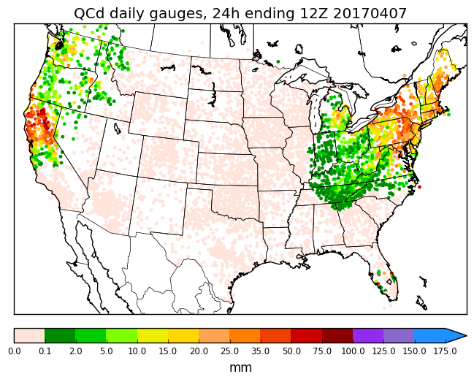
v2.6 Bundle: Precipitation URMA
24h totals ending 12Z 7 Apr 2017
MRMS
QC’d Daily Gauges
Stage IV

Slide 11
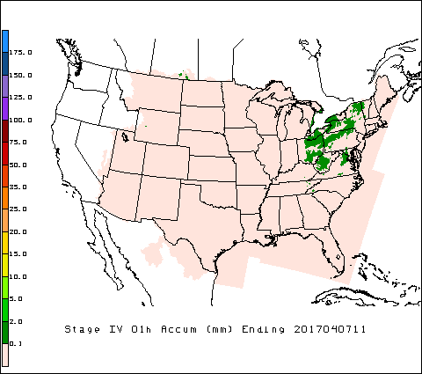
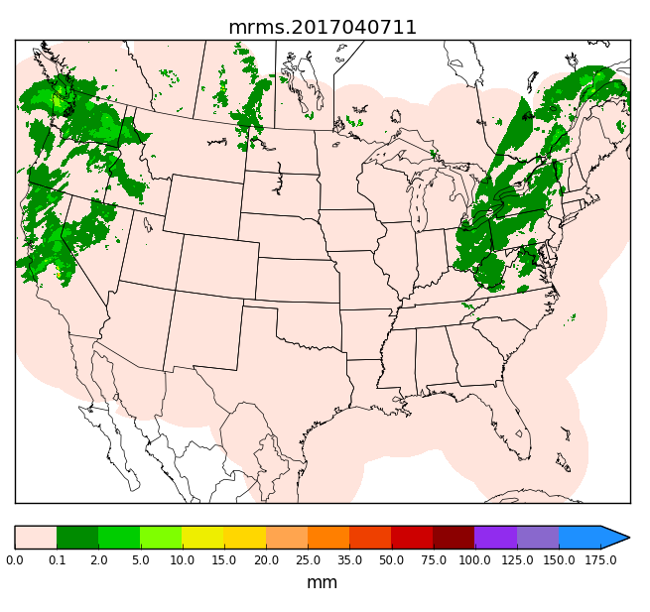
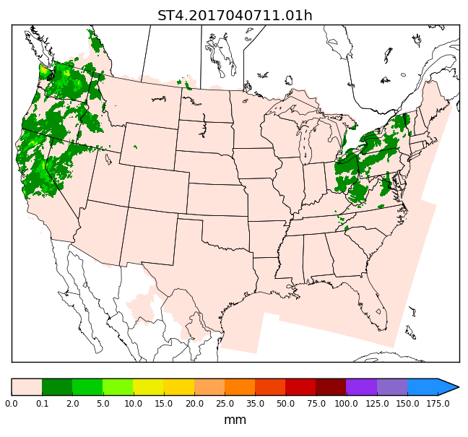
v2.6 Bundle: Precipitation URMA
1h ending 07Z 20140411
Current Hourly Stage IV (mosaic
of RFC QPE): no coverage in
NWRFC and CNRFC areas
Hourly MRMS
V2.6: hourly Stage IV/URMA
** Note: NWRFC/CNRFC have no offshore coverage
Plan to fill in gaps with MRMS and/or satellite data in RTMA/URMA v2.7.

Slide 12
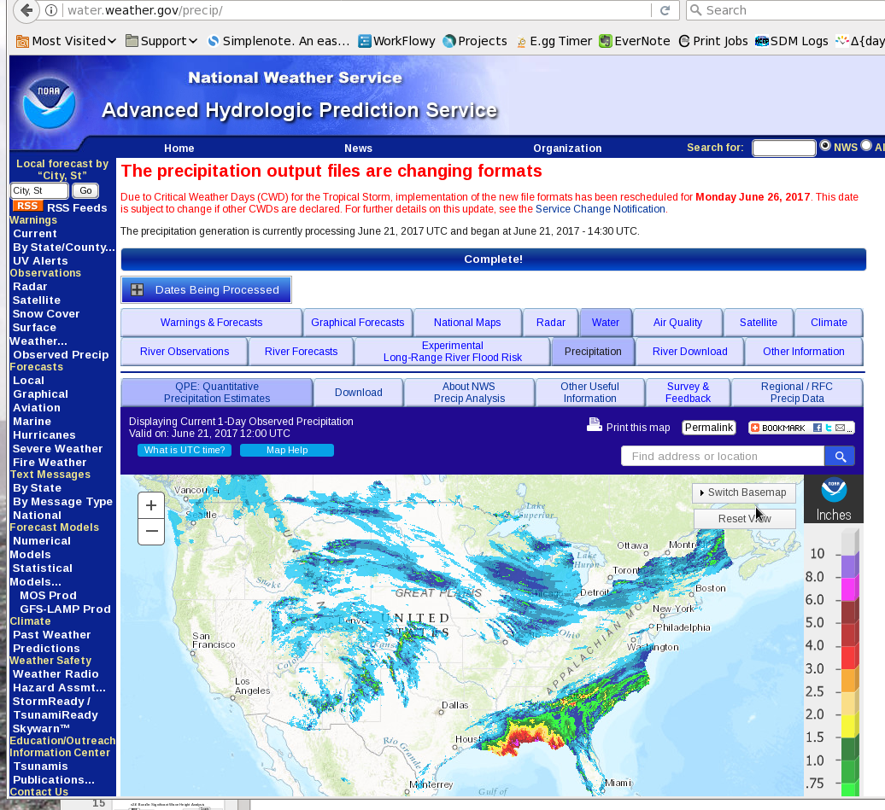
Stage IV to become source for water.weather.gov/precip
AHPS will switch to using NCEP Stage IV the week of 26 June (some minor changes in Stage IV processing for RTMA/URMA v2.5 was to accommodate its usage in water.weather.gov/precip)

Slide 13
v2.6 Bundle: New terrain and land/sea mask
For CONUS/PR/HI
AK files to come in 2.7
Thanks to Geoff Wagner, Brian Miretzky, George Gayno, WFOs, Regions, and others for all the help!

Slide 14
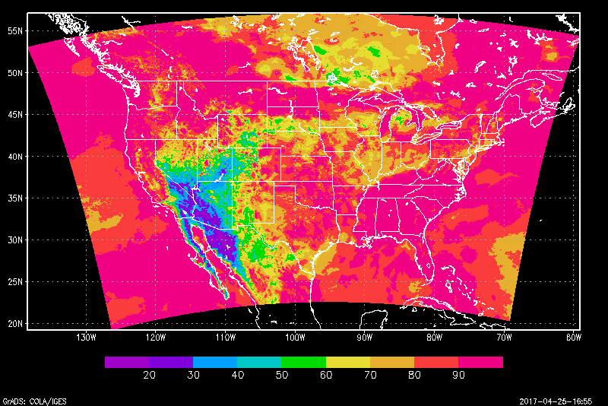
v2.6 Bundle: Min/Max RH
Requested by NBM/MDL
Maximum of hourly RH values from previous 12 hourly URMAs
RH derived from temperature and dew point analyses
MaxRH: 06-18Z, minRH: 18-06Z
For CONUS, AK, HI and PR domains
No local time zone adjustment
Co-indices with min/max T analyses
CONUS maxRH (%) valid 4/24/17

Slide 15
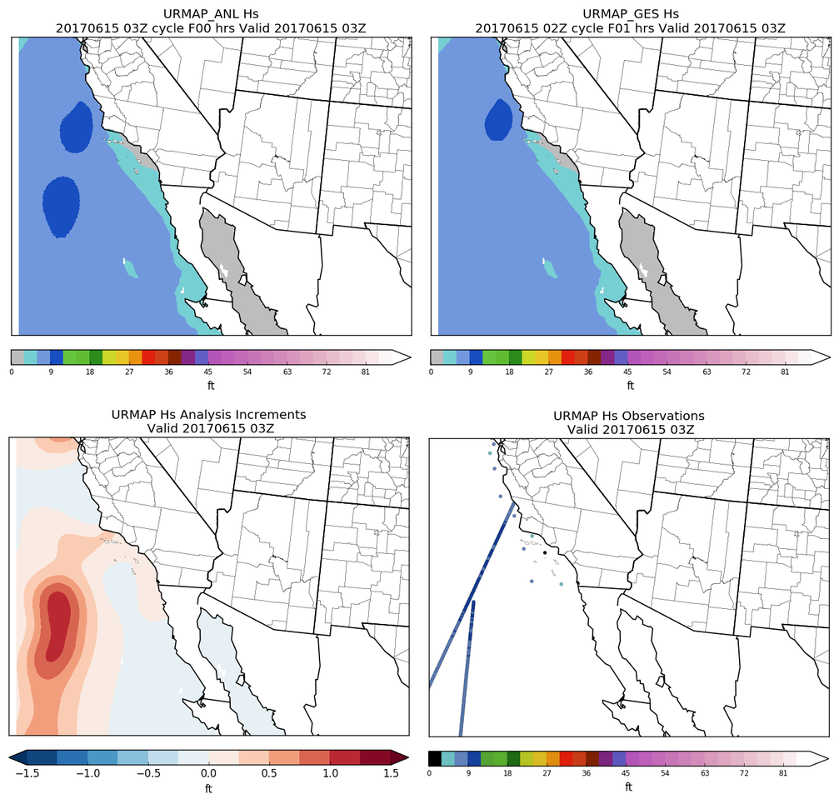
V2.6 Bundle: URMA Significant Wave Height
Analysis
Background
Background is from Global WW3
Assimilates buoy and satellite altimeter observations
Satellite data:
~650 Obs per hour
Jason-3, Saral/Altika and CryoSat-2
In-situ buoy data:
~60 obs per hour
Increments
Observations

Slide 16
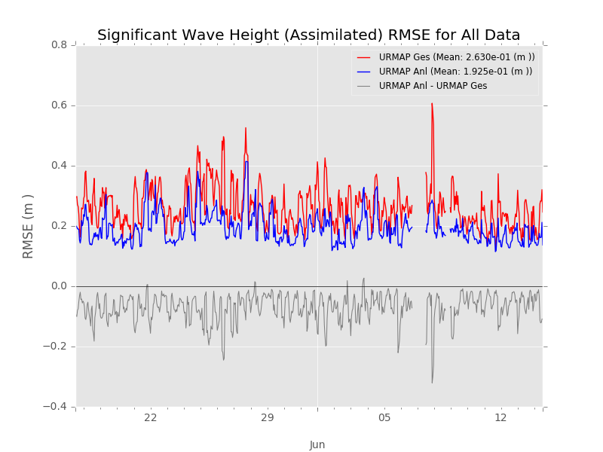
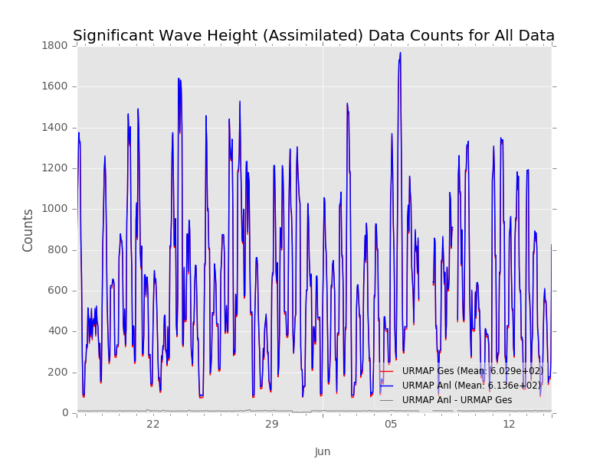
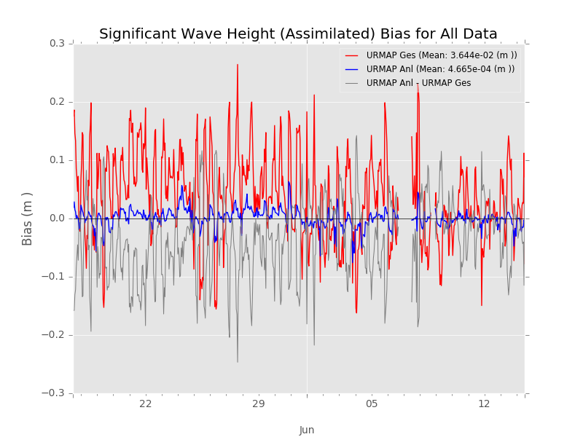
v2.6 Bundle: Significant Wave Height Analysis
RMSE
Counts
URMA Guess
URMA Analysis
Bias (O-F)

Slide 17
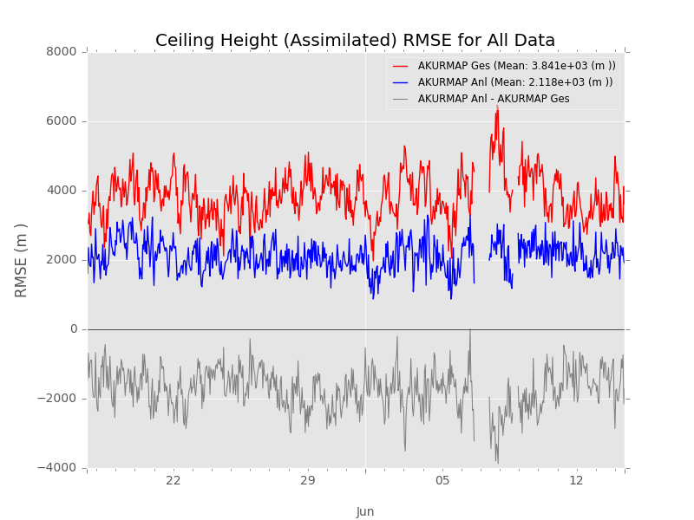
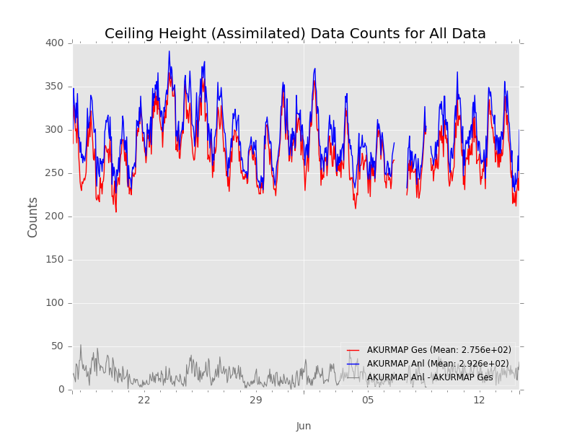
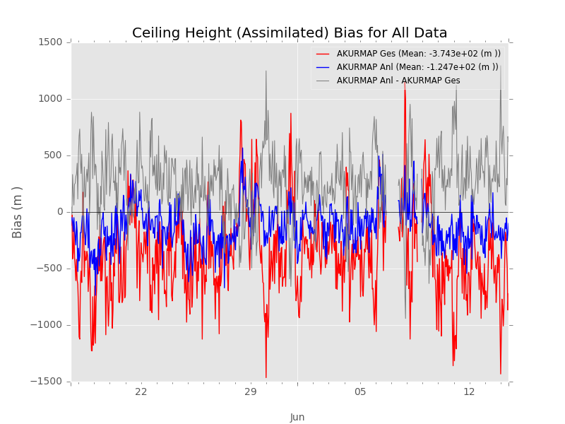
v2.6 Bundle: Adding ceiling to Alaska
RMSE
Counts
URMA Guess
URMA Analysis
Bias (O-F)
250-300 obs per analysis

Slide 18
v2.6: Relax Gross Error QC for Mesonet T and Q data
Relaxed by 10%
Help address ‘Good Enough’ item 2e
Why?
During the iterative analysis procedure more mesonet T and Q observations would trickle in as the background adjusted to the analysis
Implies we are too strict with the gross error QC for these ob types
What does this mean?
We assimilate more observations
Those additional observations have a larger deviation from the background
As a result, bulk stats will show a slightly larger RMSE
For CONUS RTMA:
About 200-300 additional T and Q obs per analysis
Mostly stations with multiple reports
Applied to all domains

Slide 19
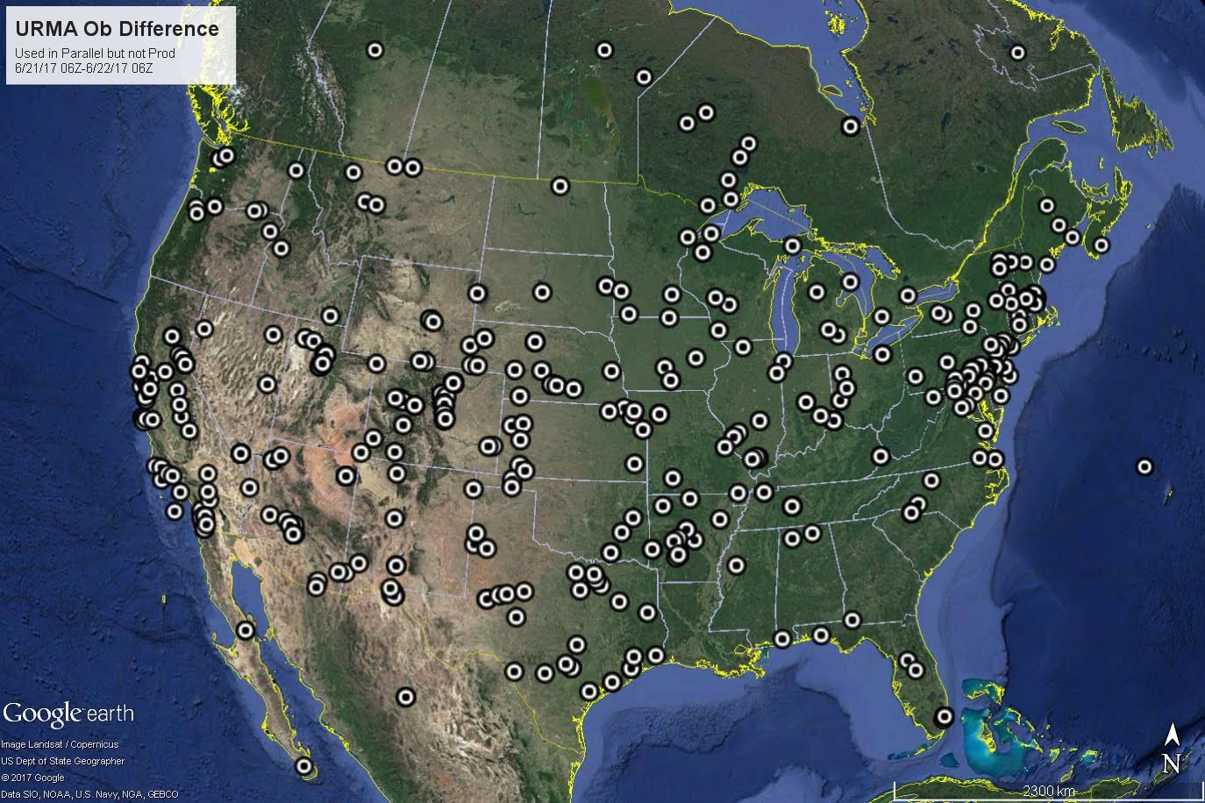
v2.6: Relax Gross Error QC for Mesonet T and Q data
Additional stations allowed in over a 24 hour period ending 06Z June 22, 2017
*Stations may have multiple reports/observations

Slide 20
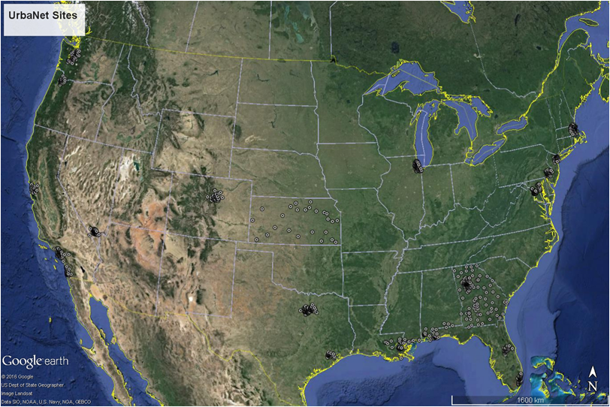
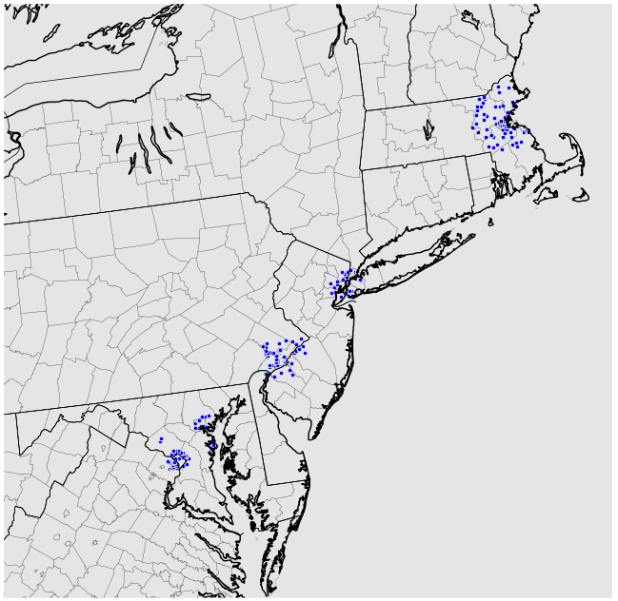
v2.6 Bundle: New UrbaNet Observation Locations (URMA)

Slide 21
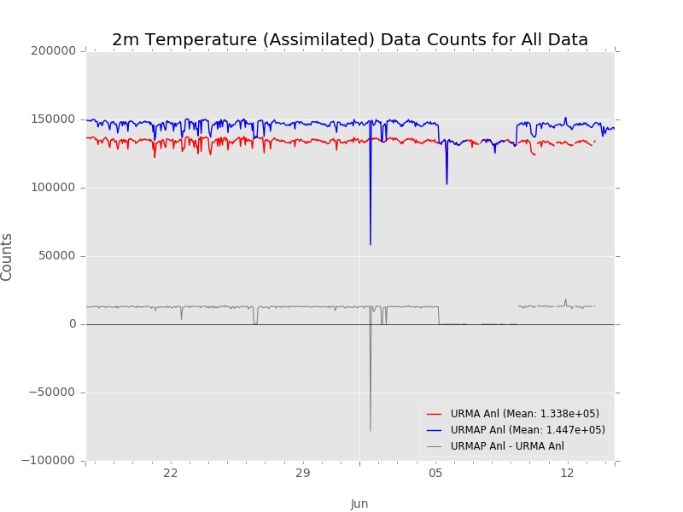
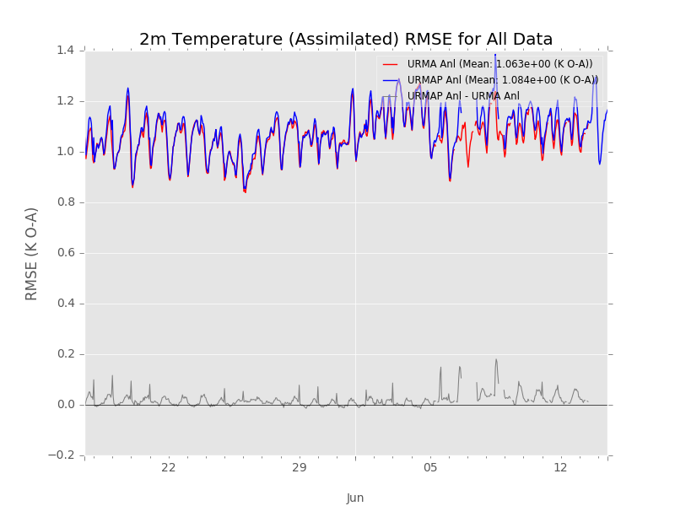
v2.6: New data and relaxed gross error QC impacts
2m T Counts
~11 thousand new T and Q obs per URMA analysis
~ 5 thousand new wind obs per analysis
Very small increase in analysis RMSE due to relaxed gross error QC
Larger O-Fs allowed into analysis translates to having larger O-As in the analysis
~0.02 K for T and and Min/Max T
~0.04 g/kg for specific humidity
WCOSS prod switches/downtime - used prod data
Ops URMA Analysis
v2.6 URMA Analysis
2m T RMSE

Slide 22
v2.6 Bundle: Bugfix for ceiling background
Bug fix in RAP/HRRR SmartInit code for Ceiling
GRIB2 Precision issue
Will be fixed in RAP/HRRR SmartInit implemented along with v2.6 RTMA/URMA upgrade
Ops Ceiling Analysis
v2.6 Ceiling Analysis

Slide 23
V2.6 Bundle: Coastline background error change
Artifacts noted around Great Salt Lake (provided by Darren Van Cleave on Jan. 9)
Refresher:
Initial impression: Likely a mismatch between terrain and land/sea mask data sets
After getting the terrain updates for v2.6 we re-checked the issue - but it remained!

Slide 24
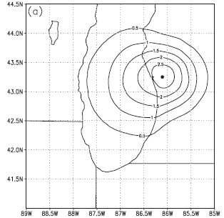
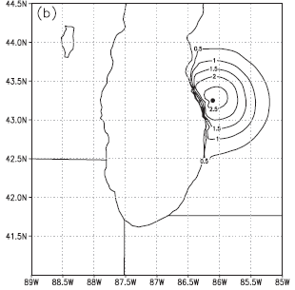
v2.6 Bundle: Coastline background error change
Further investigation revealed it is an issue with how we analyze temperature across water and land boundaries
RTMA/URMA steepens the coastlines to retain land/water contrasts
Effectively sharpens the background error covariance
No steepening
With steepening

Slide 25
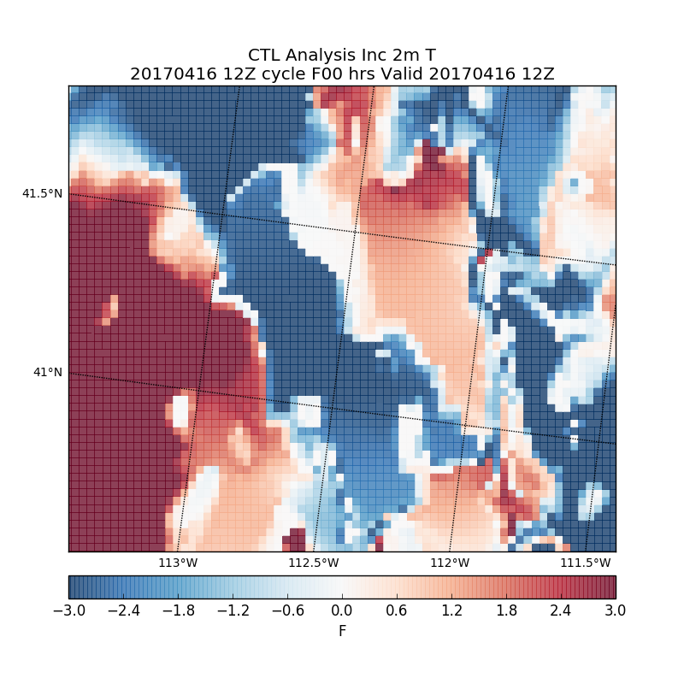
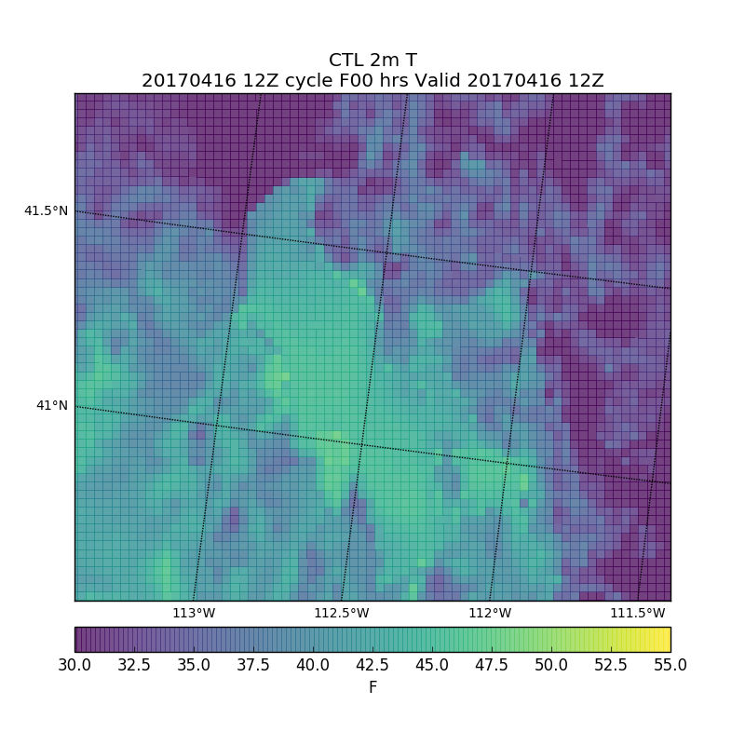
v2.6 Bundle: Coastline background error change
This steepening is overdone and leading to artifacts
Note the ring around the lake in the analysis increments
An artifact in Ops URMA
In this “ring” the background is not being updated - which leads to the artifacts

Slide 26
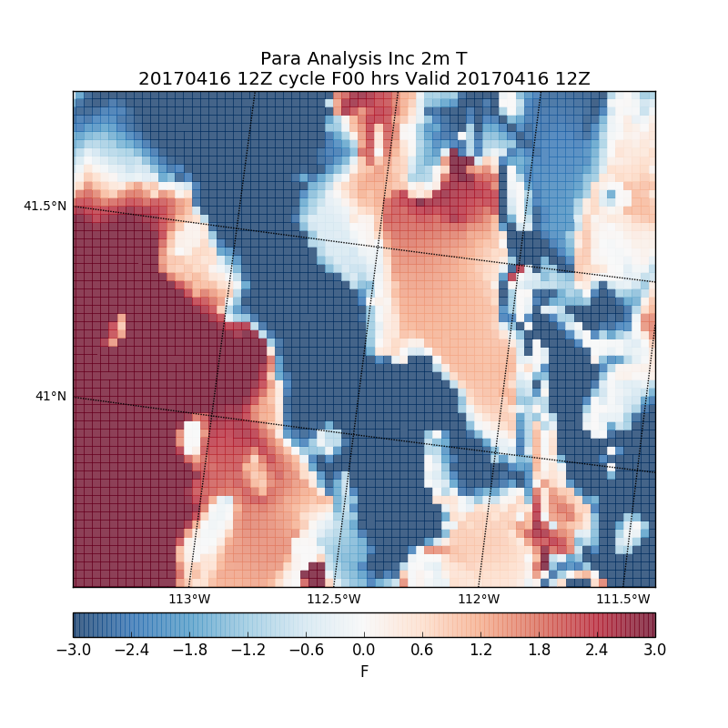
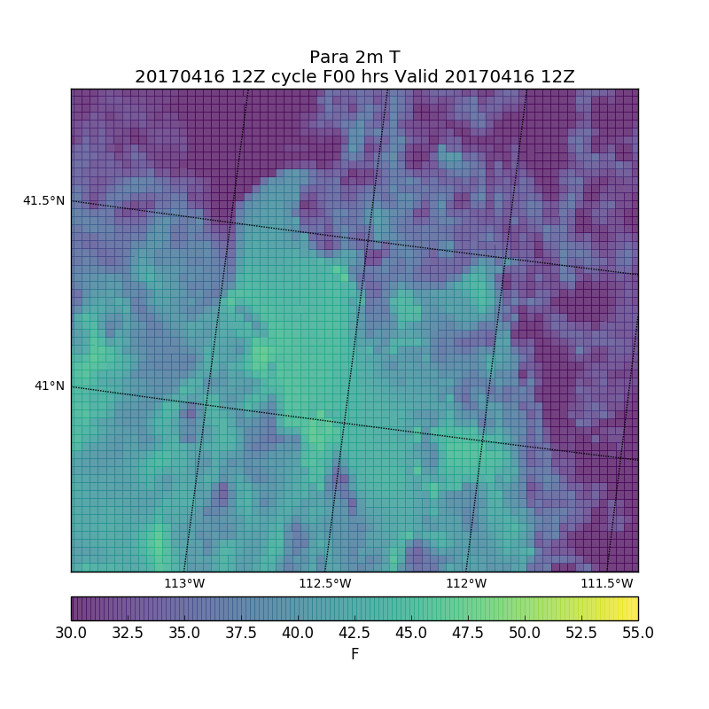
v2.6 Bundle: Coastline background error change
Solution is to reduce the steepening
Artifact around lake improved
Increments now spread across coastline - more diffuse

Slide 27
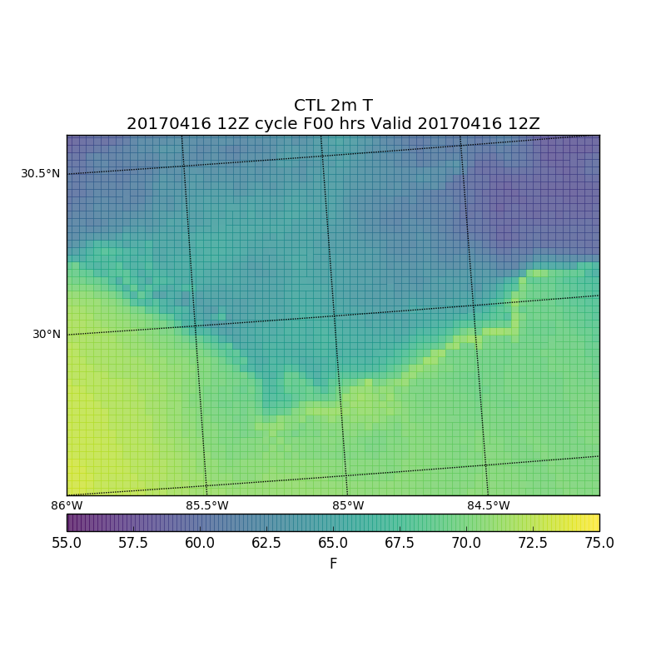
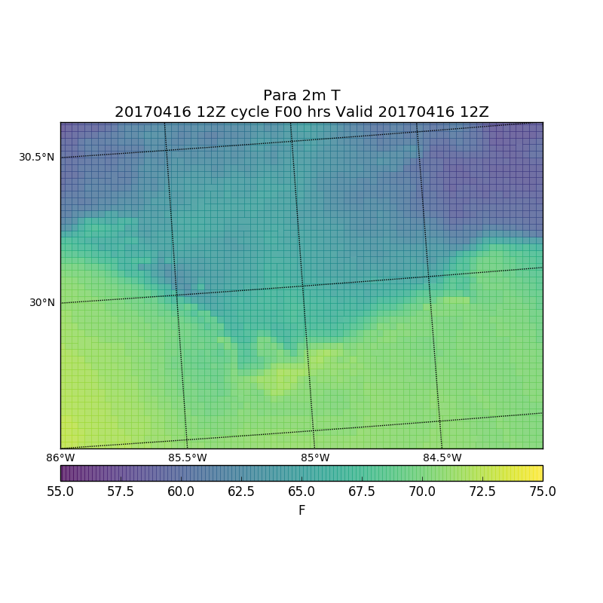
v2.6 Bundle: Coastline background error change
Further investigation showed RTMA/URMA had this issue around many coastlines.
Example: Central Florida Panhandle
An artifact in Ops URMA
Artifact is gone in v2.6 URMA
Thanks to Darren Van Cleave for bringing this (tricky!) issue to our attention!

Slide 28
v2.6 Bundle: GLERL Method over Great Lakes
Goal: Create a smooth wind analysis over the Great Lakes that can be used to initialize Great Lakes Wave model
MMAB (Henrique Alves) suggested that URMA try to mimic analysis produced at GLERL.
Analysis relies on additional ‘adjusted’ observations.
Selected land-based sites used
Formula developed at GLERL to adjust observations to represent over-water conditions
Adjusted obs are then placed over the lake, terrain escarpment prevents cross-contamination
Original ob remains at original site
Additional ob sites were relocated so their location was consistent with land/sea mask
Adjustments are made in a new subroutine in observation file
Due to runtime, process runs in URMA only
Increase correlation length scales for winds over Great Lakes by 50% for a smoother analysis

Slide 29
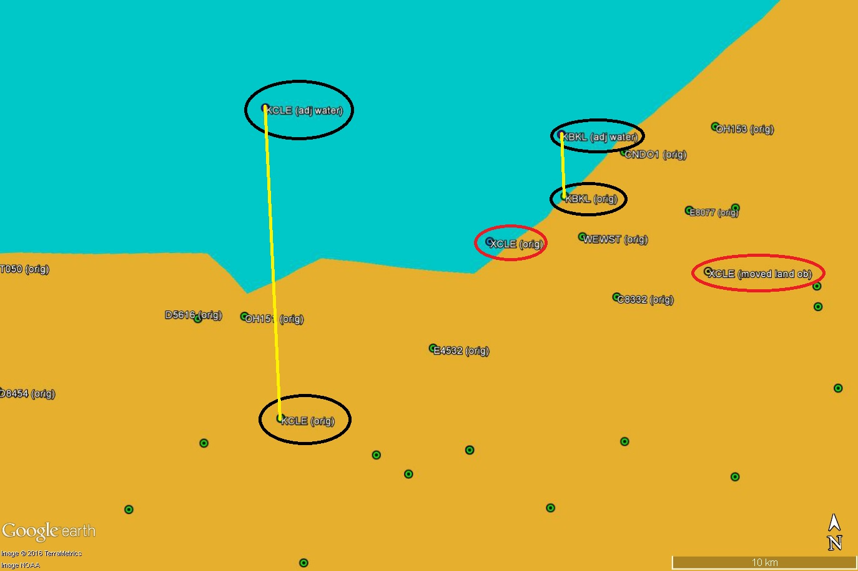
GLERL Ob Adjustments
Ob with adjusted value is placed in the water
Same distance + increment from shore
Increment for obs along coast
3.5 km
9.5 km
7.5 km
Relocate land ob according to land mask
Original selected ob

Slide 30
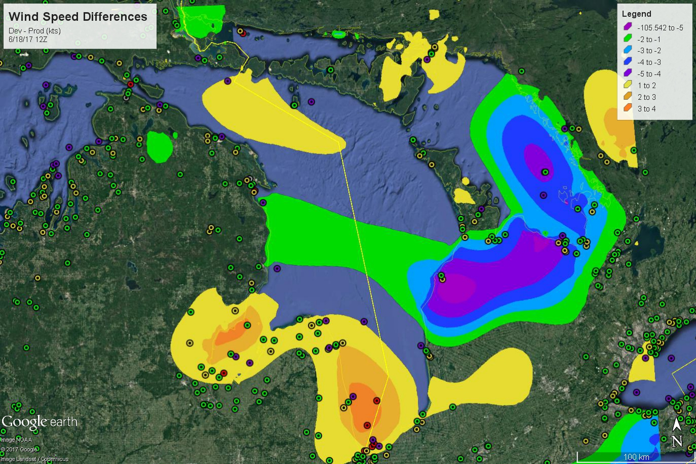
Observations:
Original
Moved over land
Moved over water
Adjusted l->w

Slide 31
Evaluations - Part 1
MDL: Recommends implementation
New wave height and min/max RH helpful for NBM
Hourly precip is helpful for the blend
Alaska Region: Recommends implementation
Will continue evaluating new ceiling
New AK NAM nest is improving surface T
Southern Region: Recommends implementation
Like the RU-RTMA, some forecasters have noted analyses improvements at and near the coast, URMA significant wave height will help with verification and validation of some marine forecasts, hourly precipitation fields will provide beneficial record for post-event studies of excessive rainfall events.
Western Region:
Wind and gusts have low bias
Continue aggressive implementation schedule
SLC: “happy with the fix for the issue of ‘rings’ around lakes, namely the Great Salt Lake. We're looking forward to having that fix in the operational version in September.”

Slide 32
Evaluations - Part 2
Eastern Region: Recommends implementation
RU-RTMA not yet beneficial until dissemination to WFOs is addressed (data is available on ftp)
Great Lakes
Wind: seems a bit better, but difficult to tell.
Temp: parallel is warmer, potentially degraded (coastline steepening change?)
[EMC also addressed a bug in the GLERL temp adjustment that would cause warm temps]
Dissemination issues during eval
Hourly precip is helpful and new terrain may be improving analysis
OPC: Provided informal feedback - No recommendation
Prefer more extensive coverage of the wave height analysis beyond CONUS
We do have OCONUS coverage planned for v2.8
Major, oceanic domain coverage is outside the current scope of RTMA/URMA
Would like an RTMA version of the wave height analysis
Investigating now, however observation latency may limit quality (~70 obs per analysis)

Slide 33
Evaluations - Part 3
AWC: Recommends implementation
Noted trouble with dev-machine related latency on RU-RTMA
“The addition of the 15-min RURTMA is critical for our users from an aviation perspective. This product is very consistent with the hourly product yet has greatly reduced latency.”
WPC: Recommends implementation
Mostly evaluated temperature and moisture
Temps over Great Lakes were sometimes 2-4 F warmer (coastline steepening change + GLERL obs)
FAA: Provided informal feedback and recommends implementation
Differences noticed in cloud amount and ceiling
Parallel had less restrictive ceilings and more gradual transition between flight categories

Slide 34
What’s next? v2.7
Updated background error covariance - better fit to observations
Good enough item: 3
Significant change
May extend to analysis uncertainty (Good enough item 4)
Improve C&V analysis via changing the variable transformation approach in the analysis algorithm
Better fit to the observations
Update terrain and land/sea mask for AK
Introduce provider-specific observation errors
Good enough item 3b (also helps with item 2)
RU-RTMA latency to 15 mins
Fill gaps in precip analysis near CONUS coastlines
Expected start for evaluation parallel: Mid-October, 2017
Implementation in March, 2018.
Thanks! Questions about v2.6, future developments, etc.?:
rtma.feedback.vlab@noaa.gov

Slide 35
BACKUP
SLIDES

Slide 36
Ahead to v2.7: Improving the Background Error Model
Improved background error covariance model
Will fit data closer, good enough item 3a/d
Testing is in progress. Will broadcast a test parallel to the field as soon as possible.
When the background deviates considerably from an observation the analysis struggles to fit the observation well
Decreasing the observation error can help - but it’s not the observation that is in error
Increasing the background error will guide the analysis to fit the data more closely

Slide 37
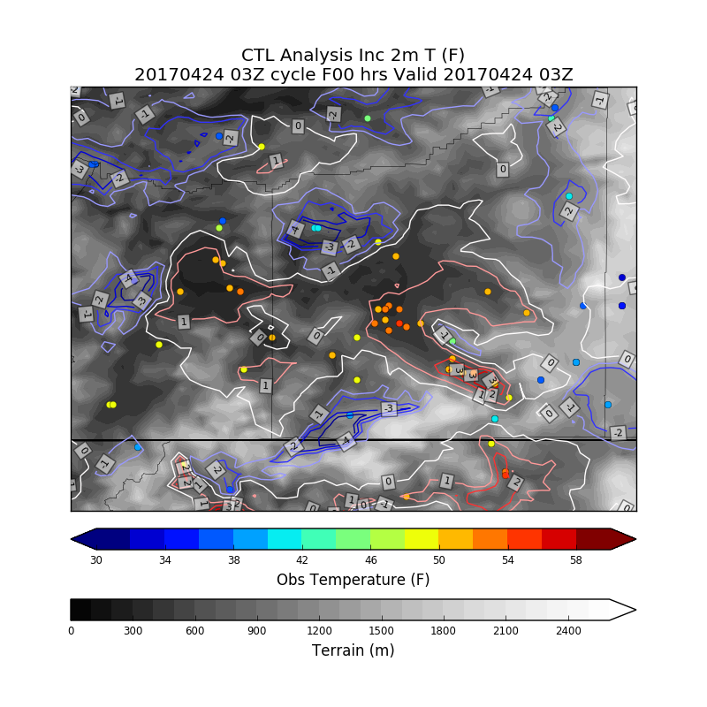
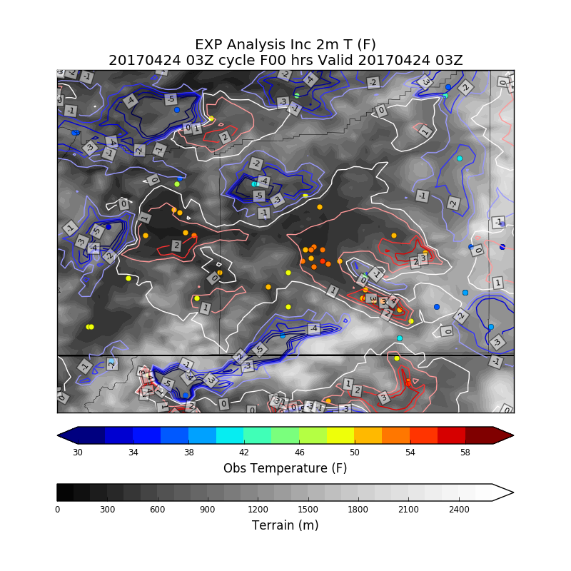
Looking Ahead to v2.7: Updated background error
Medford, Oregon
Control: Temperature Analysis Increments
Experiment: Temperature Analysis Increments
With updated background error covariance model EXP is able to more closely fit the observations

Slide 38
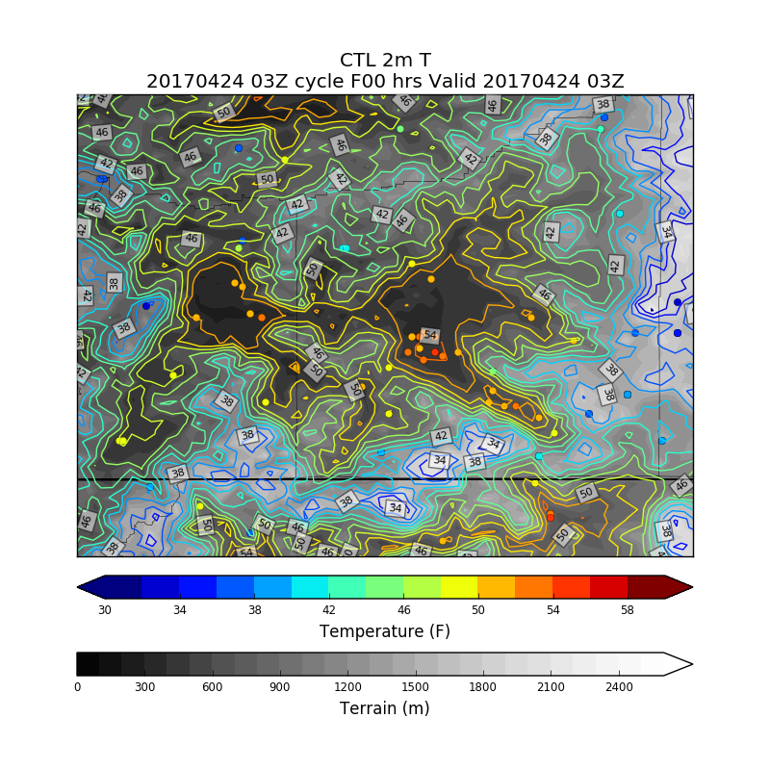
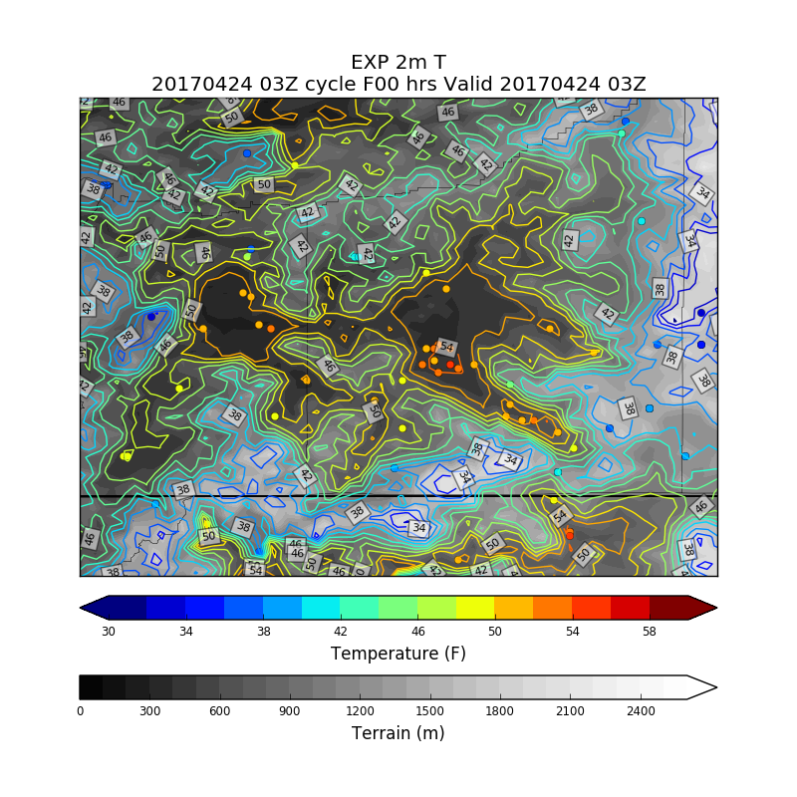
Looking Ahead to v2.7: Updated background error
Medford, Oregon
Control Temperature Analysis
Experiment Temperature Analysis
With updated background error covariance model EXP is able to more closely fit the observations

Slide 39
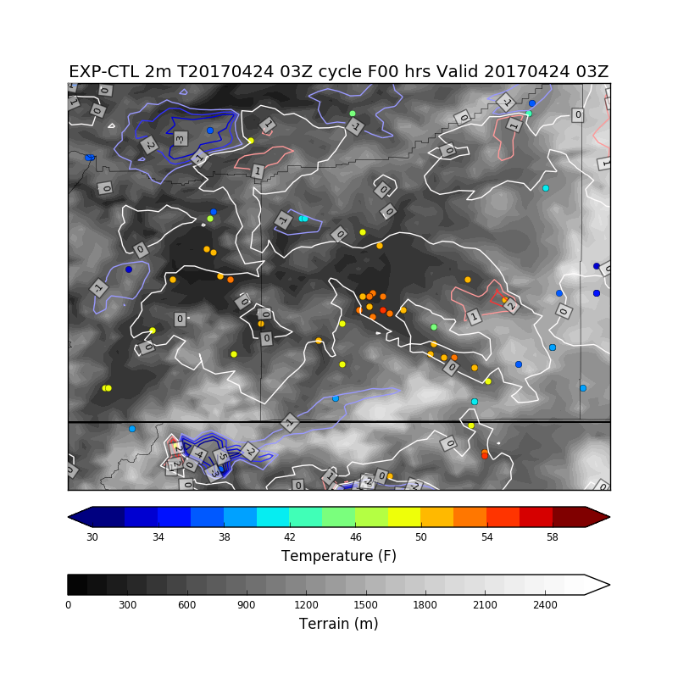
Looking Ahead to v2.7
EXP-CTL Temperature Analysis
EXP shows closer fit to observations over CTL
Current test revises the background error based upon terrain variability in a neighborhood of a gridpoint
Expandable to the variability in the field of interest
May improve utility of estimate of analysis error by providing some flow-dependence
More testing is needed - field input will be critical
e.g., valley cold pool case studies

Slide 40
Mesonet QC Enhancements
Enhanced QC requested in ‘good enough’ document (item 2B)
Meeting with stakeholders (interested WR SOOs and ERH) held in April
Created form that SOO/DOH/center can use to identify bad stations
Finding was that SOOs and DOHs should control this, not individual forecasters.
List of stations is entered on sharable spreadsheet for easy tracking
Form also approved by NCO (Carissa Klemmer/Patrick O’Reilly)
We will investigate and flag via SDM’s desk as needed
Requires decoder RFC (BUFR table change to mesonets) to process SDM edit marks
Has been submitted but no date for implementation yet

Slide 41
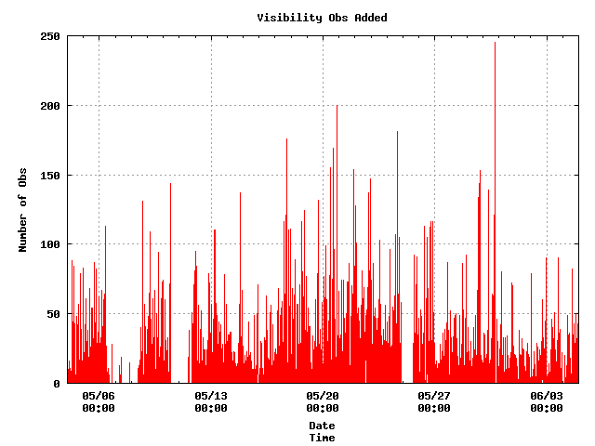
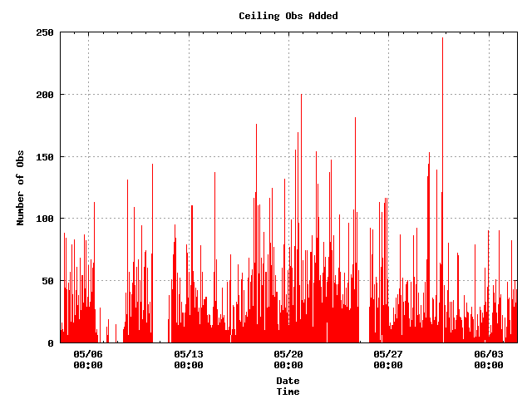
Improving Data Latency
Max Possible Additional Obs From Updating Tanks Every Minute vs. Two Minutes (current)

