Slide 1
TOWR-S Update
October 29, 2021
https://meet.google.com/thn-pkwe-wbr
Total Operational Weather Readiness - Satellites
NWS Office of Observations

Slide 2
Overview
Recent additions to Satellite data portfolio
New and forthcoming satellite data products
TOWR-S RPM v22 overview
GOES-17 updates
GOES-T / GOES-18 preparations
New Meso Domain proposals in Meso Mission Manager (MMM)
Satellite Book Club seminars
TOWR-S Satellite Portfolio and Dataset guides

Slide 3
New Satellite Data Products in AWIPS
19 new GOES-West L2 Derived Products
Incl. new Mesoscale Fire Hotspots from both GOES-East and GOES-West
Incl. new GOES-17 Fog & Low Stratus (W. CONUS)
New pqact.conf entries required at AWIPS sites:
IXT[A-R]89 KNES
IXT[WXY]81 KNES
See detailed instructions for pqact changes using Data Add-ons Manager
GOES-{East,West} L2 Product | WMO ID | Sectors
Aerosol Detection | IXTA89 KNES | F | C | M
Aerosol Optical Depth | IXTB89 KNES | F | C
Cloud Top Phase | IXTD89 KNES | F | C | M
Fog & Low Stratus | IXTE89 KNES |  | C
Rain Rate / Quant. Precip. Est. | IXTF89 KNES | F
Cloud Top Height | IXTG89 KNES | F | C | M
Clear Sky Mask | IXTH89 KNES | F | C | M
Cloud Top Temperature | IXTI89 KNES | F |  | M
Fire Hotspots | IXTJ89 KNES | F | C | M^{[1]}
Land Surface Temperature | IXTK89 KNES | F | C | M
Sea Surface Temperature | IXTM89 KNES | F
Derived Stability Indices | IXTN89 KNES | F | C | M
Total Precipitable Water | IXTO89 KNES | F | C | M
Legacy Vert. Moisture Profile | IXTP89 KNES |  | C
Legacy Vert. Temp. Profile | IXTQ89 KNES |  | C
Derived Motion Winds | IXTU89 KNES |  | C^{[2]} | M
Cloud Particle Size Distribution | IXTW81 KNES | F | C | M
Cloud Top Pressure | IXTX81 KNES | F | C
Cloud Optical Depth | IXTY81 KNES | F | C
F = Full Disk; C = West CONUS; M = Mesoscale sectors [1] New Meso Fire Hotspots for both GOES-16 and GOES-17 are on SBN as of Sept. 8, 2021. [2] GOES-17 Derived Motion Winds (W. CONUS) have been on SBN since Mar. 2020.

Slide 4
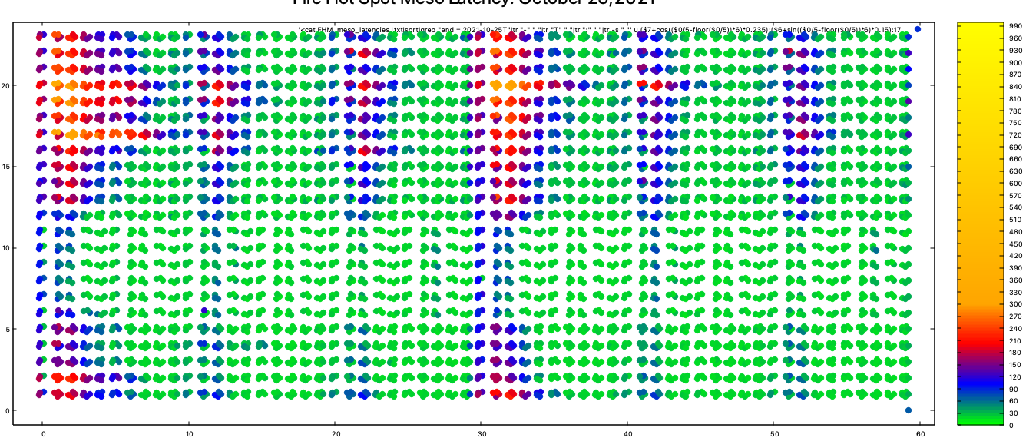
New Satellite Data Products in AWIPS
Using SBN “EXP” channel (low priority)
=> Monitoring dissemination latency (esp. new Meso Fires product)
PDA Dedicated Connections (Starting Nov. 2021) may reduce latencies
900
600
Hour (0-23)
Latency (seconds)
300
120
60
0
Minute (0-59)
h/t Derek Van Pelt

Slide 5
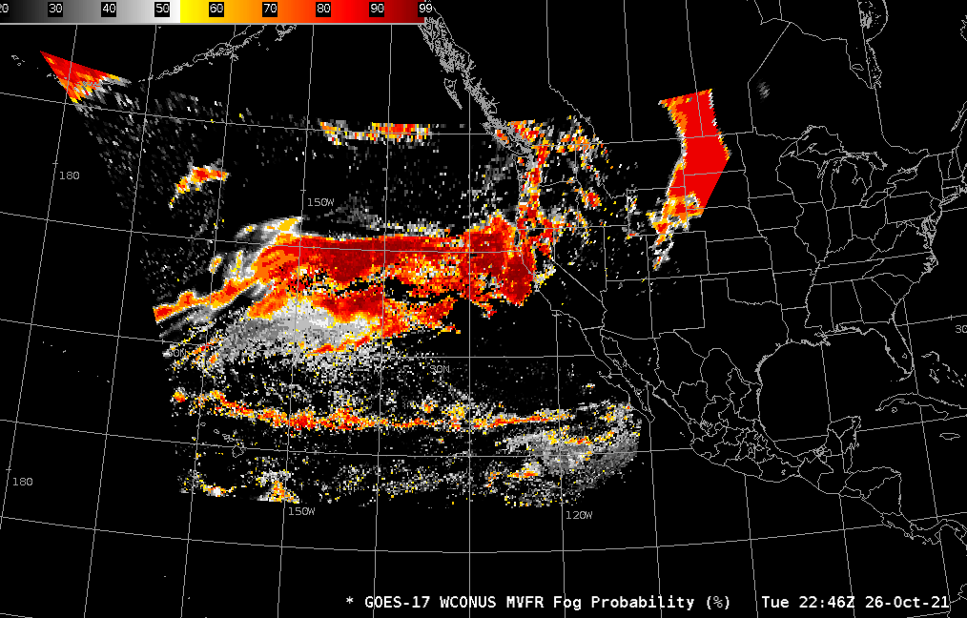
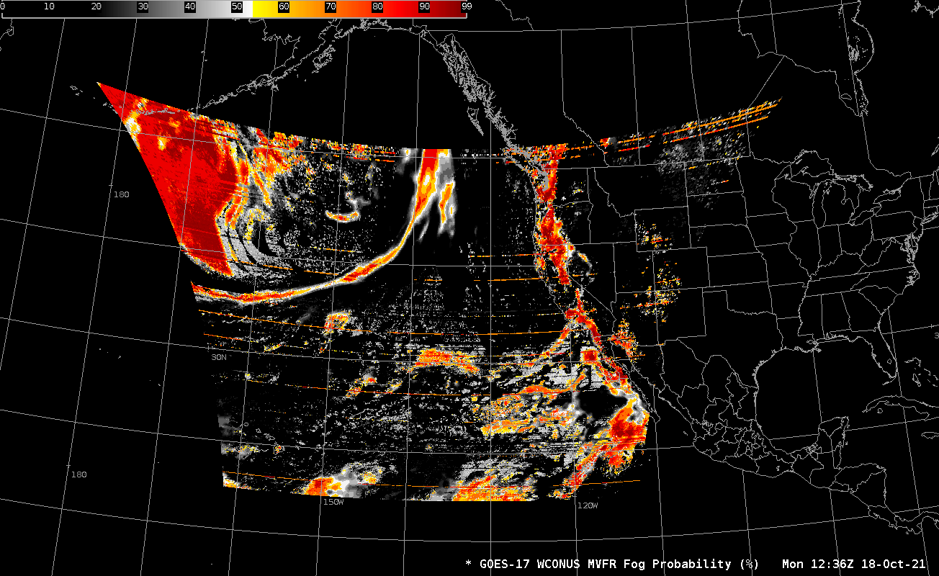
New Satellite Data Products in AWIPS
GOES-17 Fog & Low Stratus
Requires new pqact entry (see prev. slide)
On SBN “GRW” channel
Mitigates effects of Loop-Heat-Pipe (LHP) degradation
GOES-17 Fog & Low Stratus (West CONUS sector), Oct. 26-27, 2021
GOES-17 Fog & Low Stratus during LHP anomaly period: Oct. 18, 11-15z

Slide 6
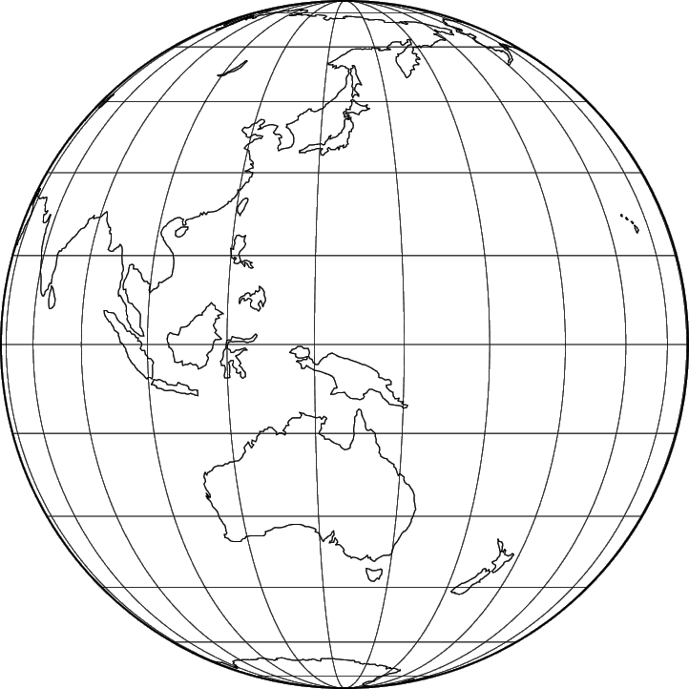
Himawari-8 Cloud & Moisture Imagery
Available now from NESDIS / PDA: tiled Himawari-8 Cloud and Moisture Imagery (CMI) -- Full-Disk tiles and floating (target) sector
Currently available via IDP and AWC & NHC ISatSS
Also publicly available via the Amazon cloud: https://noaa-himawari8.s3.amazonaws.com/index.html
NCF will obtain CMI tiles from PDA using Standing Subscriptions and will disseminate data to the Alaska and Pacific Regions via LDM
NCF will fetch 61 of 88 tiles (x 16 channels) from PDA and send
tiles 02-06 and 09-14 to Alaska Region; and tiles 16-23, 26-33, 36-43 46-53, 56-63, and 66-73 to Pacific Region
Now scheduling network configurations for data flows to OCONUS
 |  | 01 | 02 | 03 | 04 | 05 | 06
 | 07 | 08 | 09 | 10 | 11 | 12 | 13 | 14
15 | 16 | 17 | 18 | 19 | 20 | 21 | 22 | 23 | 24
25 | 26 | 27 | 28 | 29 | 30 | 31 | 32 | 33 | 34
35 | 36 | 37 | 38 | 39 | 40 | 41 | 42 | 43 | 44
45 | 46 | 47 | 48 | 49 | 50 | 51 | 52 | 53 | 54
55 | 56 | 57 | 58 | 59 | 60 | 61 | 62 | 63 | 64
65 | 66 | 67 | 68 | 69 | 70 | 71 | 72 | 73 | 74
 | 75 | 76 | 77 | 78 | 79 | 80 | 81 | 82
 |  | 83 | 84 | 85 | 86 | 87 | 88
Himawari Product | Sector | Refresh Rate |  | Nadir ground resolution
Cloud & Moisture Imagery | Full Disk tiles | 10 min |  | 1 & 2 km
Cloud & Moisture Imagery | Floating Sector | 2.5 min |  | 0.5 km
h/t Joe Zajic

Slide 7
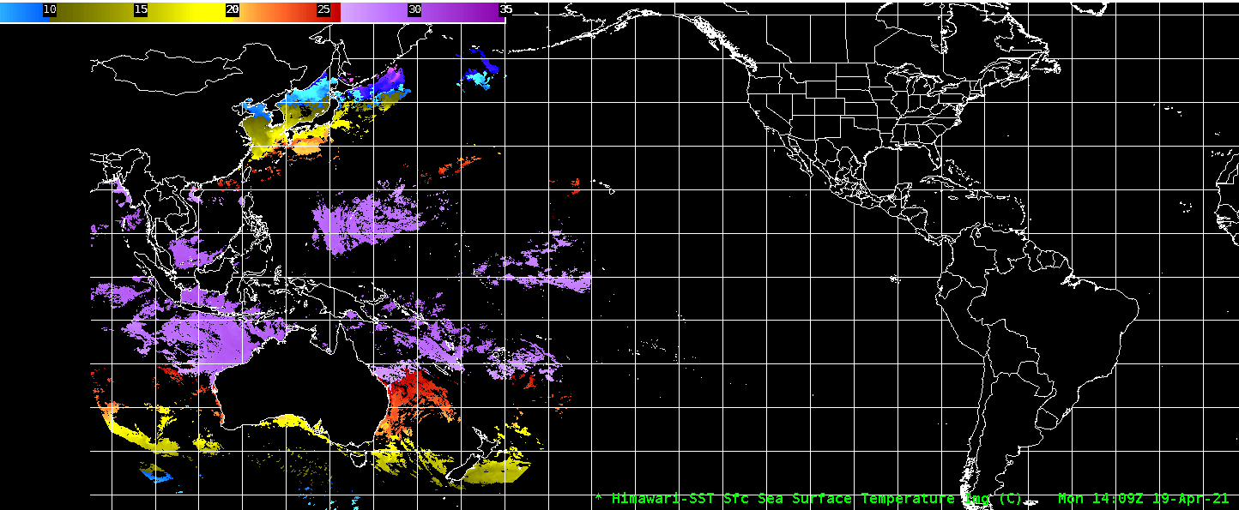
In preparation: Himawari-8 L2 Derived Products
Available now from NESDIS / PDA: Full Disk L2 products
Also publicly available via the Amazon cloud: https://noaa-himawari8.s3.amazonaws.com/index.html
Now adapting data formats and configuring AWIPS
(Himawari Derived Motion Winds already going to Pacific Region)
Himawari Product | Sector | Refresh Rate |  | Latency | Nadir ground resolution
Rainfall Rate | Full Disk | 10 min |  | 10 min | 2 km
Sea Surface Temperature | Full Disk | 60 min |  | 10 min | 2 km
Clear Sky Mask | Full Disk | 10 min |  | 10 min | 2 km
Cloud Top Height, Pressure, Temperature | Full Disk | 10 min |  | 10 min | 2 km
Cloud Top Phase | Full Disk | 10 min |  | 10 min | 2 km
Derived Motion Winds | Full Disk | 10 min |  | 30 min | 2 km
NCF will obtain a subset (TBD) of these data products from PDA (trimmed to a few essential data fields) and disseminate them via LDM to the Alaska and Pacific Regions
National Centers will access these data directly from PDA

Slide 8
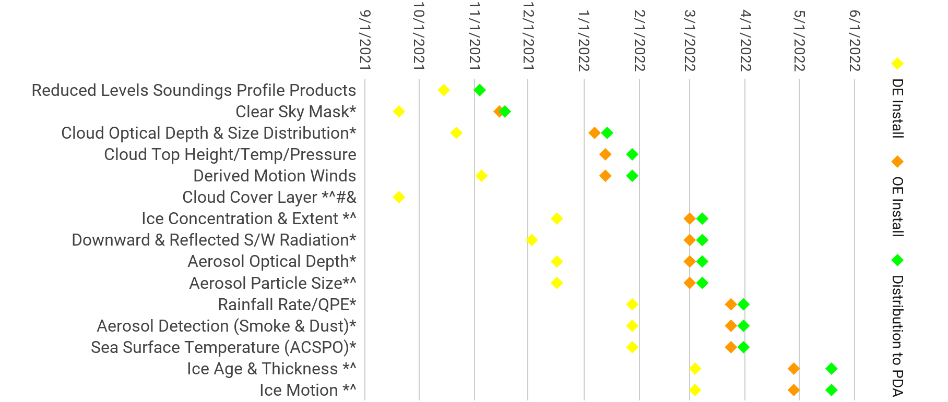
Enterprise GOES-R L2 products
GOES-R Ground System development timeline
October 29, 2021
Updated 2021-10-28
From GOES-R PRO PASS Dev’t Schedule
Note: Some of these data products will reach AWIPS sites via SBN; others via LDM, Cloud, or other mechanisms
Notes: * Enterprise Algorithm with GOES-17 LHP mitigation ^ NOAT Funded Algorithm # New Product to PDA & Enables Provisional

Slide 9
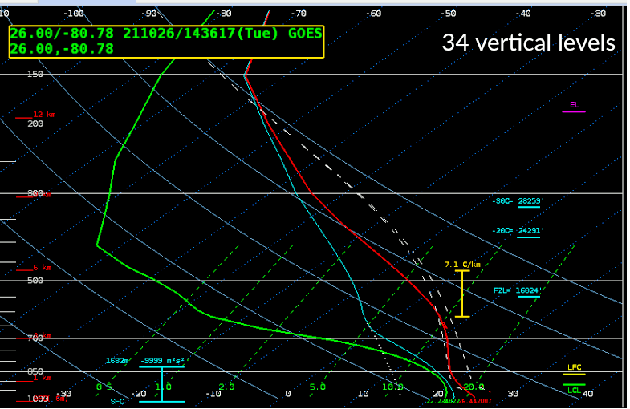
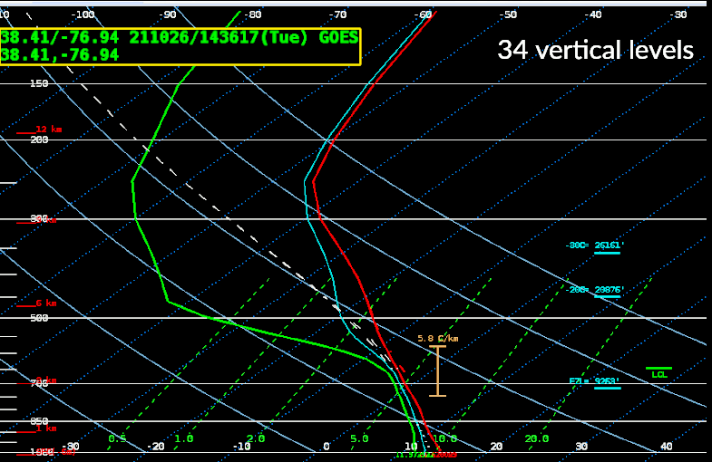
Thinned GOES-R Profiles:
34 vertical levels (instead of 101)
h/t Lee Byerle
h/t Lee Byerle

Slide 10
Satellite Data Product Changes Under Consideration
Changes to the geographic and spectral coverage of GOES-16,17 SCMI on SBN (no sooner than FY23 Q1) (cf. Public Information Statement PNS21-60)
Phase 1:
Cease creation/transmission of the "Hawaii Regional" SCMI sector, for all bands (1-16)
Increase spatial resolution of Channel 13 (IR Window) to full (2 km) resolution for Northern Hemisphere
Add "American Samoa Regional" sector for Channel 13 (IR Window) at full (2 km) resolution
Phase 2: Cease SBN transmission of all reduced-resolution (6 km) Southern Hemisphere imagery from the Full Disk, for all bands
Phase 3: Transition Channel 16 (CO₂ Band) from SBN to PDA/Data Delivery (for northern hemisphere), for all sectors (Full Disk, CONUS, Meso)
Dissemination of JPSS Derived Products
S-NPP, NOAA-20 VIIRS Active Fires^{[1]}, Aerosols, Volcanic Ash, and Ice Concentration ^{[2]}
S-NPP, NOAA-20 ATMS MiRS ^{[2]}
S-NPP, NOAA-20 VIIRS Imagery (now being produced for all 22 channels) ^{[3]}
GCOM AMSR-2 Ocean Winds & Microwave Brightness ^{[2]}
[1] AWIPS sites are currently receiving a modified VIIRS Active Fires product via LDM [2] AWIPS 20.2.3 Baseline provides EDEX ingest support [3] TOWR-S RPM v22 (Dec. 2021) will provide EDEX ingest support for all channels
Metop-B,C L2 products
Synthetic Aperture Radar (SAR) from Sentinel and RadarSat (over coastal regions)

Slide 11
Satellite Data Product Changes Under Consideration
ASCAT Ocean Surface Winds (Metop-B,C): expanded geographic coverage
ISRO OceanSat-3 scatterometer data products
Launching in Dec. 2021 / Jan. 2022
First Surface Winds data expected in Mar. 2022; operational products in May 2023
MeteoSat 3rd Gen. (MTG) imagery & L2 products
Metop 2nd Gen. (Metop-SG) imagery & L2 products

Slide 12
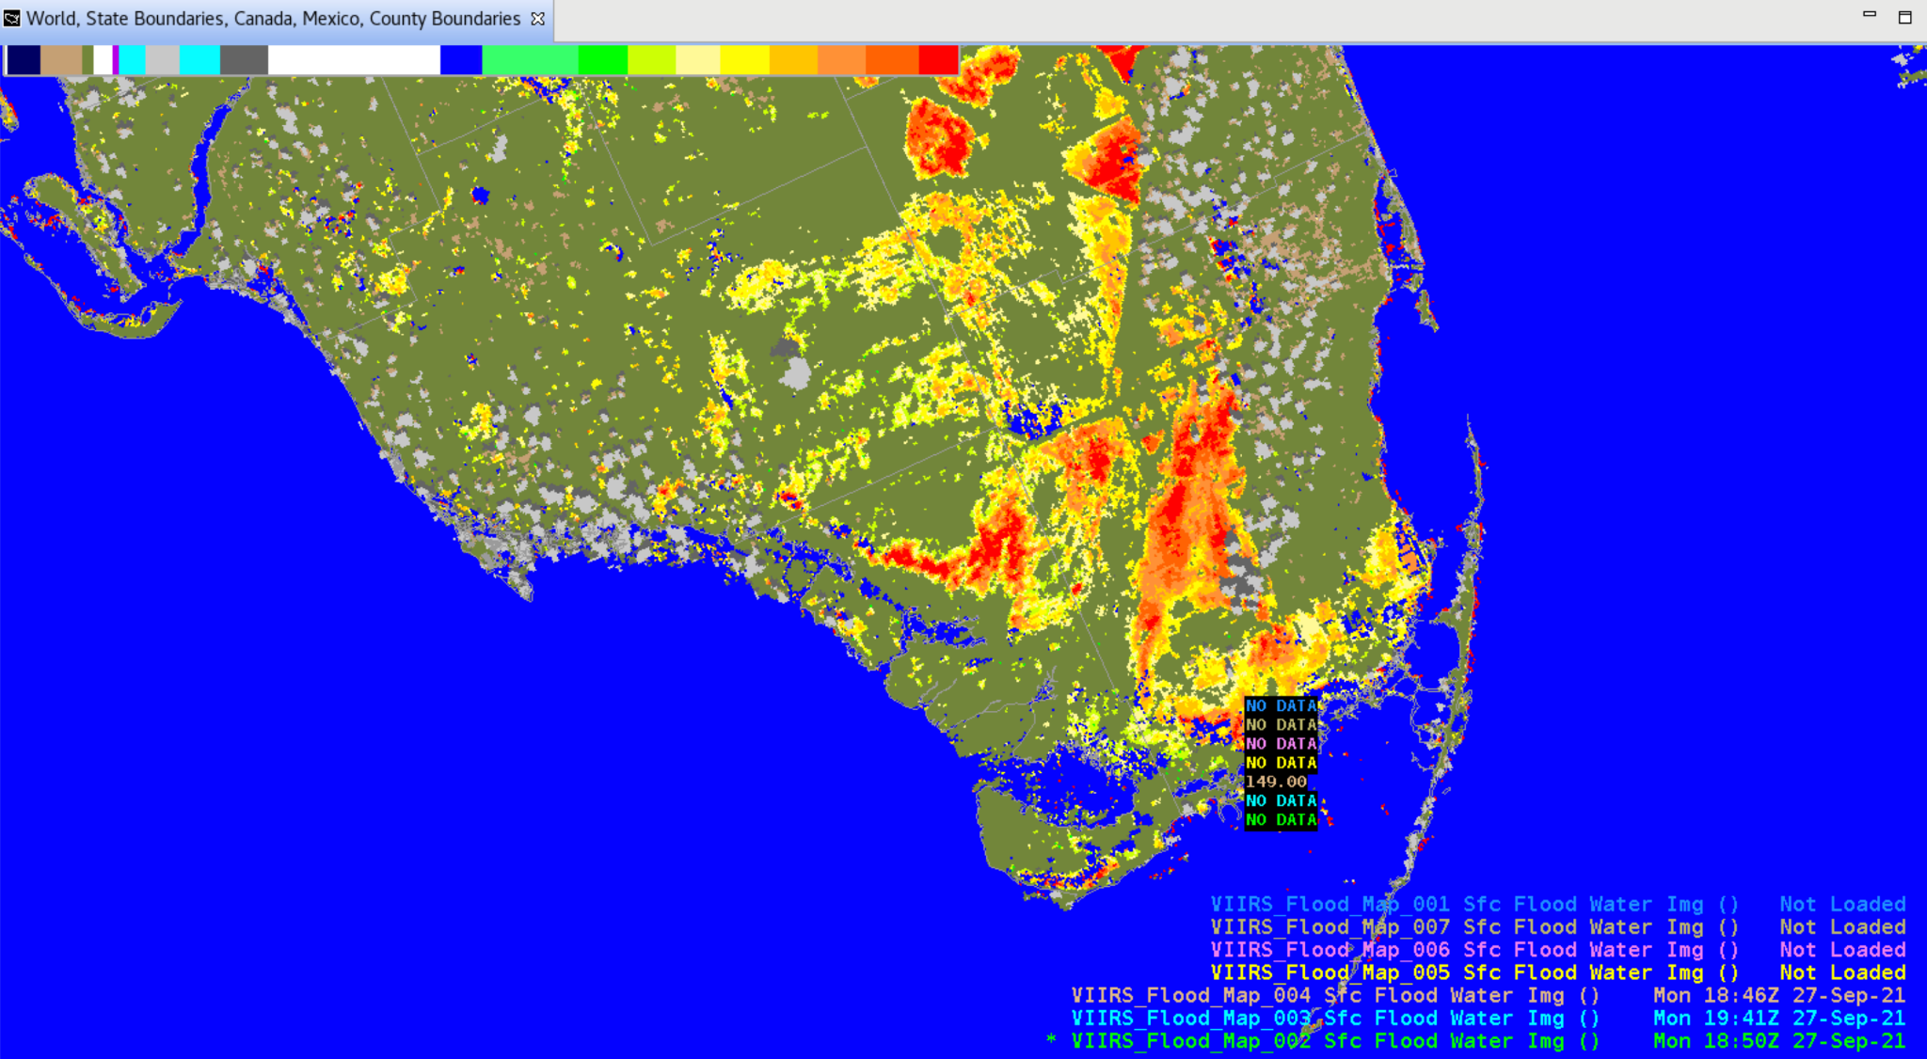
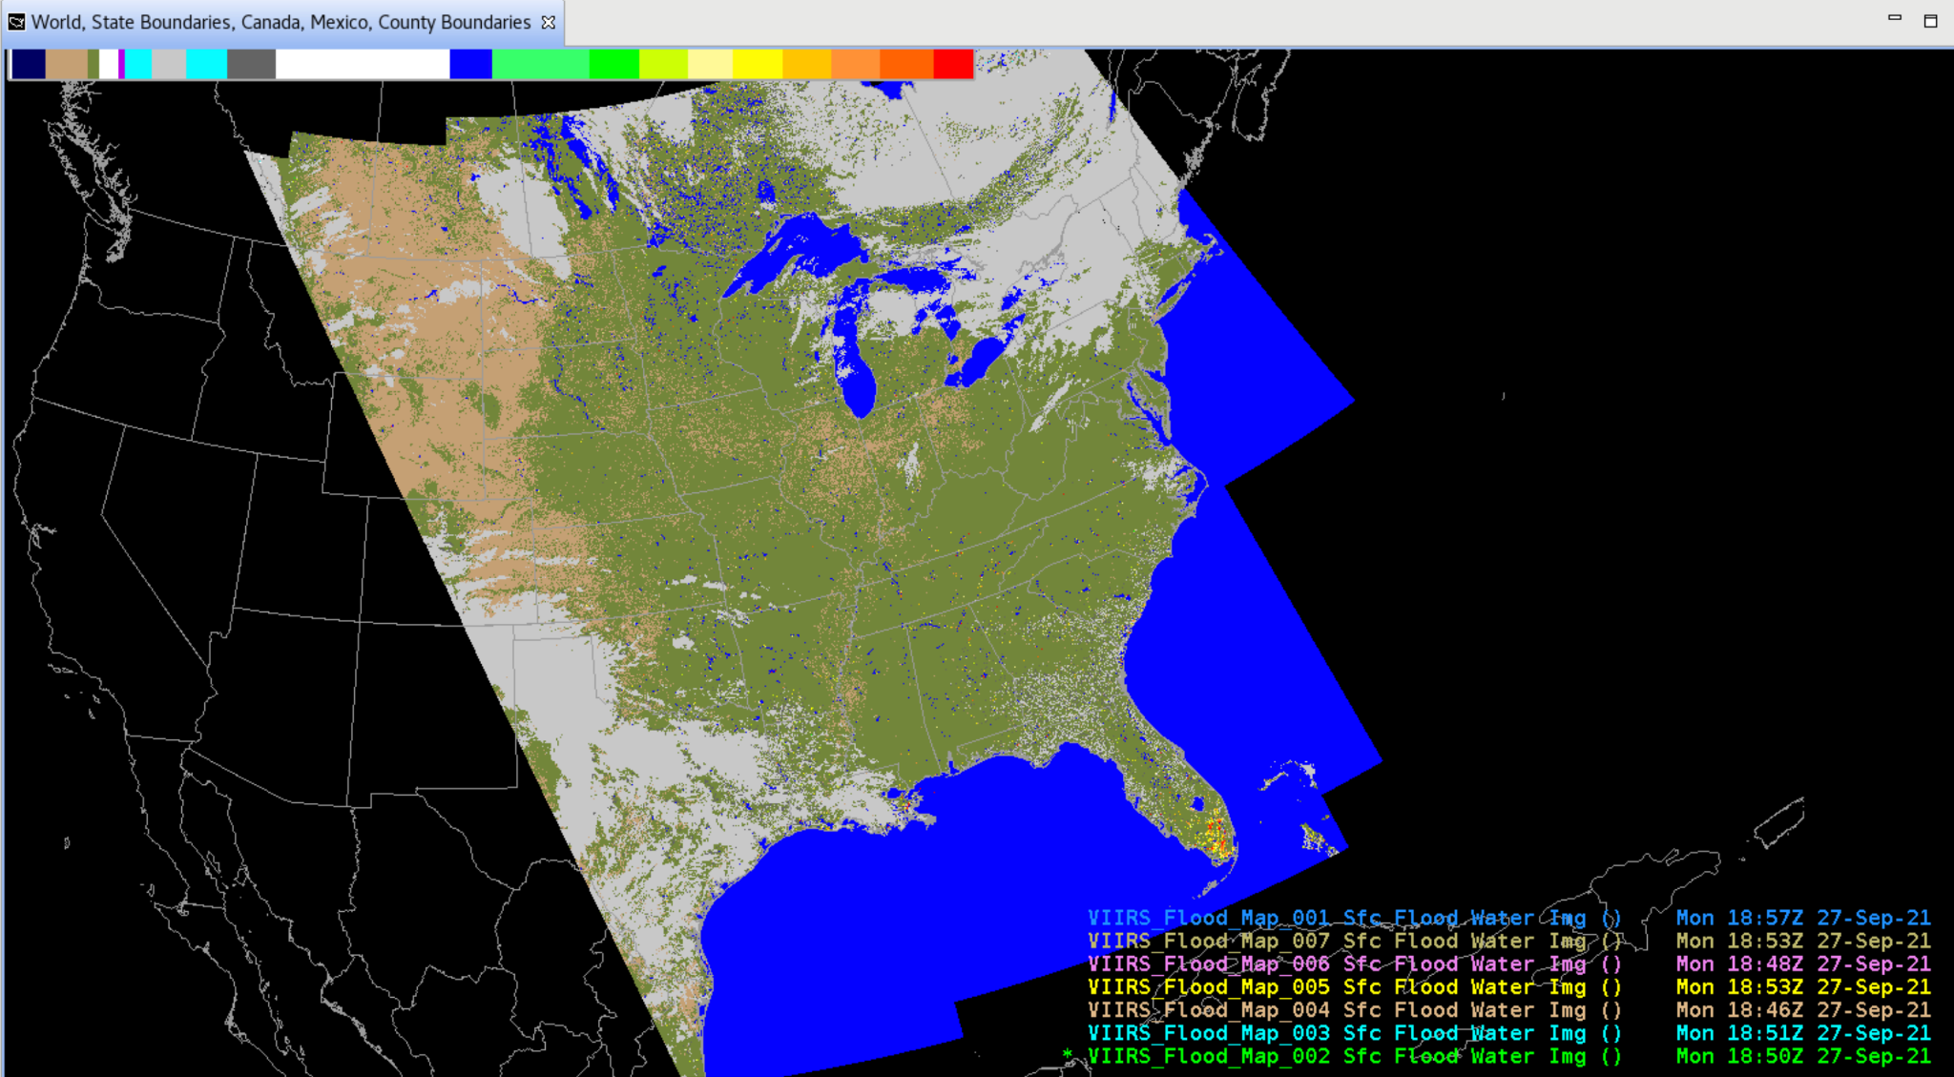
Satellite Data Product Changes Under Consideration
VIIRS Flood Mapping
h/t Derek van Pelt
h/t Derek van Pelt

Slide 13
Coming in Dec. 2021: TOWR-S RPM v22
EDEX configuration for thinned GOES-R soundings (Moisture / Temperature Profiles)
New “dataset_name” attribute value:
OR_ABI-L2-LVMPR..etc
OR_ABI-L2-LVTPR..etc
GOES-R Cloud Type RGB Recipe under development
VIIRS I-Band Active Fires support (DMW-friendly files via AWC ISatSS)
Support for GOES-R Enterprise Cloud Phase and Land Surface Temperature (retained from v21)
APP Geocolor in main Satellite menu
Removes dmw geographic filtering config file (allows for more site customization)
Rocket Plume RGB (under Local options menu)
Gridded NUCAPS improvements:
2m Temperature in °F (Upper Level Temps still degC) Precipitable Water in inches Haines Index layers
Readiness for future Blended Hydro Products
Readiness for reduced (34-) level GOES soundings
ASCAT 4-category legend (includes 25-33 kt category)
Improved colormap for CIMSS Turbulence product
Remove 20.2.3 base content
RPM for APP v22 (incl. Geocolor, GLM averaging, VIIRS Active Fires RGB)
Configurations to ingest all 22 VIIRS Imagery bands

Slide 14
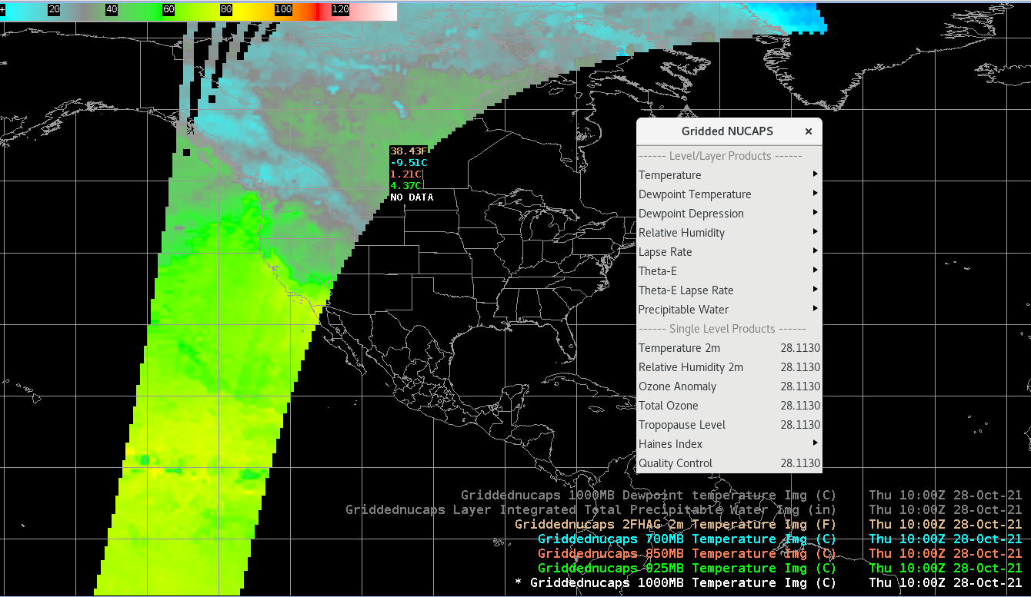
Coming in Dec. 2021: TOWR-S RPM v22
h/t Lee Byerle
Gridded NUCAPS: 2m Temperature in °F (with other levels in °C)

Slide 15
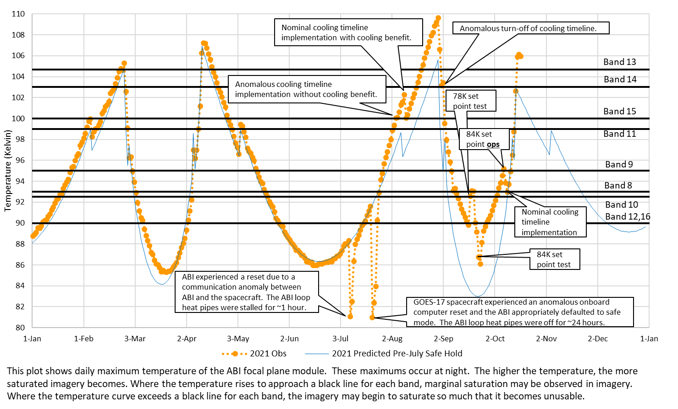
GOES-17 ABI Cooling Anomaly:
2021 warming trend and effects of July anomaly
h/t GOES-R Program
Mode 3 Cooling Timeline
Thru Nov 21 10
GOES-15 Supplemental Operations
Thru Nov 5, 2021
NWS has requested GOES-15 Supplemental Operations for all 4 upcoming “warm periods”

Slide 16
GOES-17 ABI Cooling Anomaly: Looking ahead
Cooling appears to have worsened after the July spacecraft anomaly.
FPM temperatures may remain 3 to 4 °K warmer than projections.
Thus, in each of the G-17 “warm seasons,” image degradation will start sooner and last longer.
In particular, some degradation of water vapor imagery (Bands 8, 10) is likely through most of Oct. ‘21-Feb. ‘22
NWS has requested GOES-15 operations for all 4 upcoming GOES-17 “warm seasons” until GOES-18 ABI imagery becomes widely available to NWS.
Until the July spacecraft anomaly is better understood, GOES-14 (at 105°W) has been placed in "hot backup" status, for 24-hr failover from GOES-16 or GOES-17.
NESDIS is looking into GOES backup options for the GOES-18 era
h/t GOES-R Program

Slide 17
Preparations for GOES-T (GOES-18)
Launch date: Feb. 16, 2022
NWS has requested operational availability as soon as possible
Aiming for GOES-18 ABI data products (partially validated) to be available to NWS by Aug. 2022
Accelerated Transition to Operations
Split Post-Launch Test schedule (Part 1 @ 89.5°W; Part 2 @ 136.8°W) should allow dissemination of Beta-mature ABI data products from GOES-18 by Aug. 2022
GOES-18 data dissemination:
GRB will interleave GOES-18 ABI data with GOES-17 GLM and space weather data in the GOES-17 GRB stream
The NWS Satellite Broadcast Network will send GOES-18 or GOES-17 data (but not both)
Supplemental dissemination via NOAA’s cloud computing platform (GeoCloud)
NWS / GOES-R coordinated planning & readiness process now underway

Slide 18
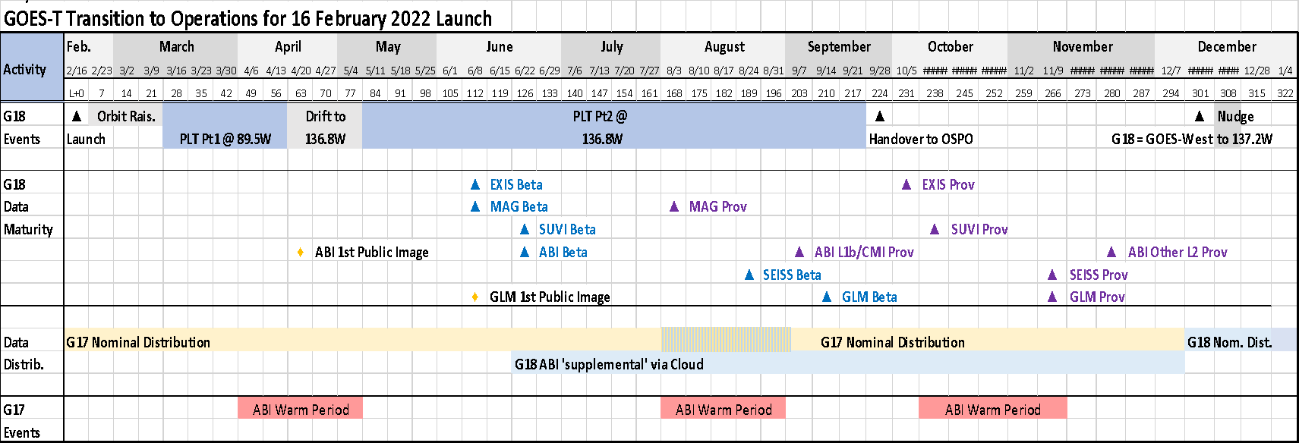
GOES-West Transition Plan for GOES-17→18
Pacific Hurricane Season
h/t GOES-R Program
Interleaved GRB
Broad(er) cloud-based supplemental distribution of GOES-18 ABI data will start at Beta maturity in June.
GOES-18 ABI L1b/CMI will reach Provisional Maturity in September, shortly after the GOES-17 warm season / GRB interleave period.

Slide 19
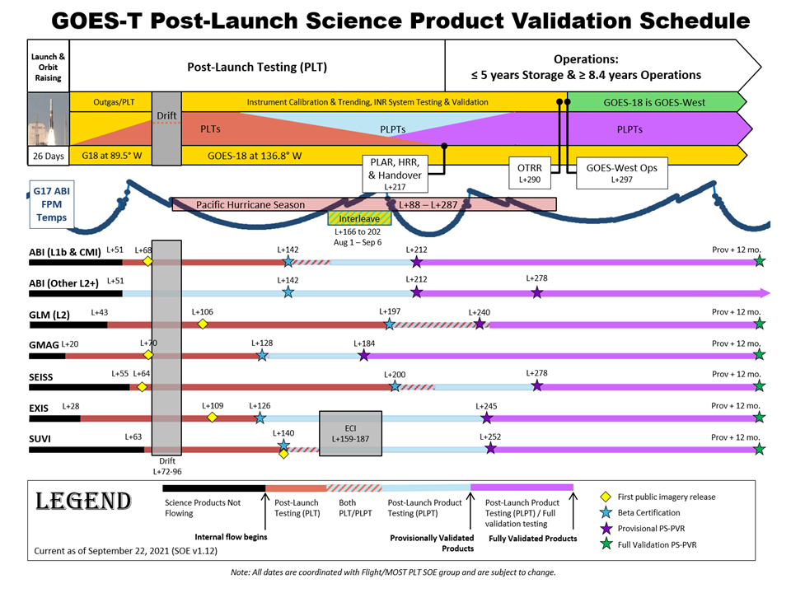
Feb. 2022 | Mar. 2022 | Apr. 2022 | May 2022 | Jun. 2022 | Jul. 2022 | Aug. 2022 | Sep. 2022 | Oct. 2022 | Nov. 2022 | Dec. 2022 | Jan. 2023 | Feb. 2023 | Mar. 2023
-> More details on GOES-T/18 Transition to Operations are available from the GOES-R Steering Group via OSPO
Months are approximate
h/t GOES-R Steering Group

Slide 20
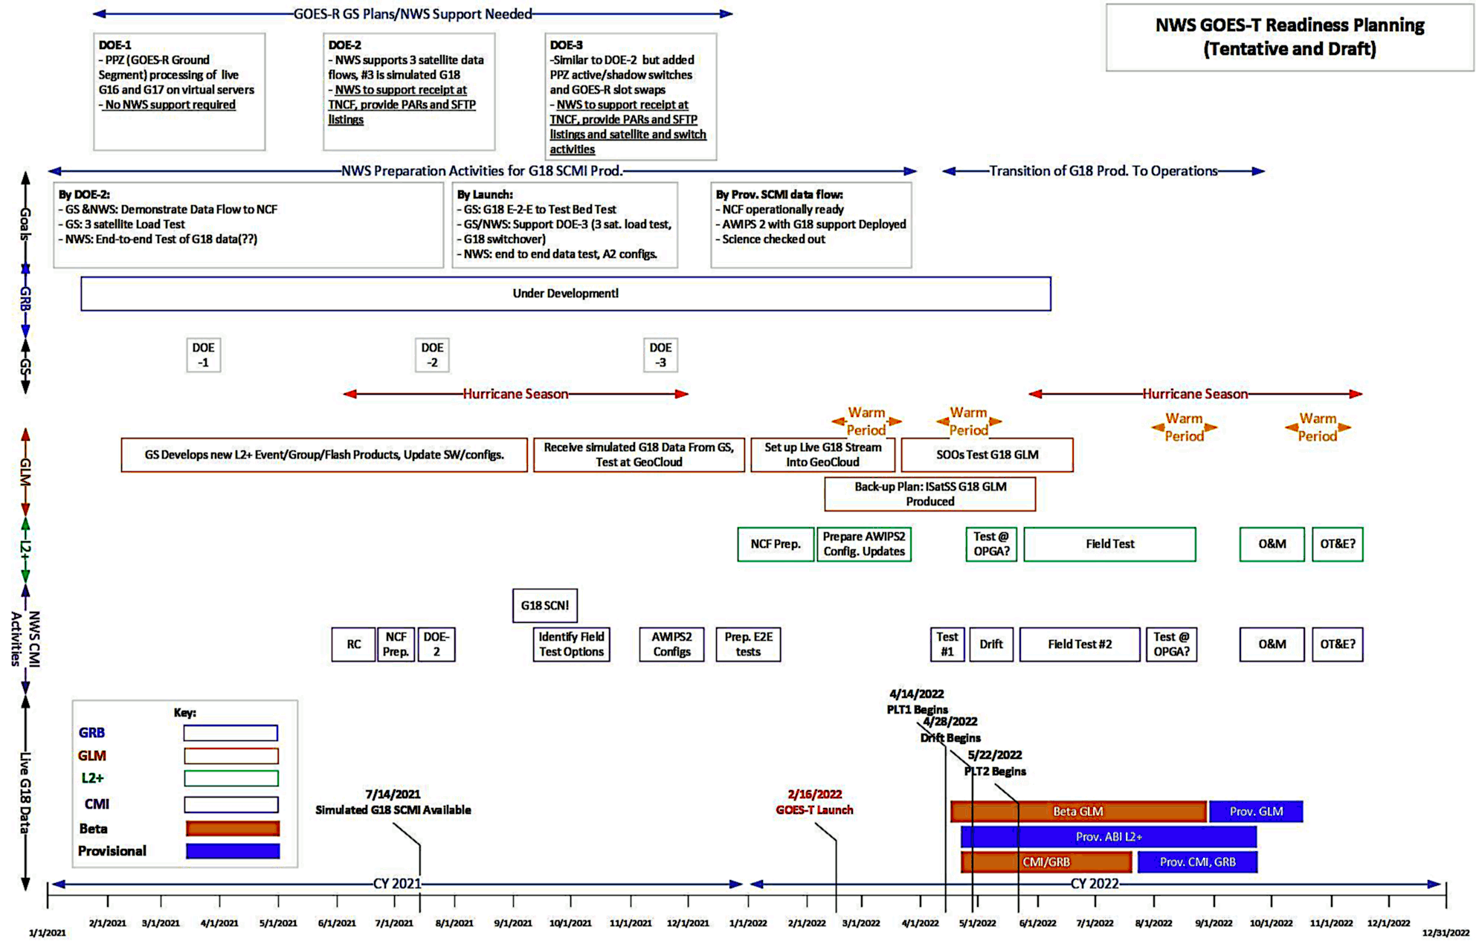
NWS GOES-T readiness planning
Feb. 2022 | Mar. 2022 | Apr. 2022 | May 2022 | Jun. 2022 | Jul. 2022 | Aug. 2022 | Sep. 2022 | Oct. 2022 | Nov. 2022 | Dec. 2022 | Jan. 2023 | Feb. 2023 | Mar. 2023
Dariush Khadjenouri - Tentative and draft
October 29, 2021
h/t GOES-R Program

Slide 21
NWS GOES-T readiness planning
October 29, 2021
h/t Dariush Khadjenouri - Tentative and Draft

Slide 22
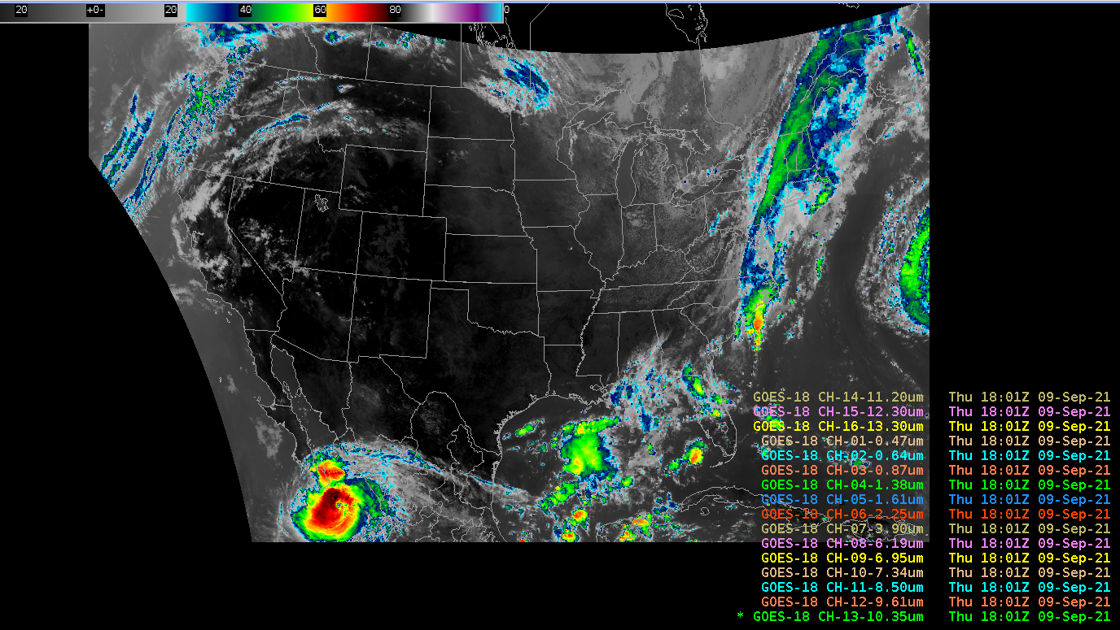
NWS GOES-T readiness planning (continued)
Sept. 9 GRE-I1 interleave test: 4 hours of GOES-18 SCMI test data (using live GOES-16): Baseline AWIPS handled GOES-18 Full Disk, CONUS, Meso1, Meso2
TOWR-S is engaging with several NWS systems to ensure their timely readiness for interleaved and operational dissemination of GOES-T/GOES-18 data:
AWIPS Network Control Facility (NCF)
NCEP Central Operations (NCO) incl. Integrated Dissemination Program (IDP) and Weather and Climate Operational Supercomputing System (WCOSS)
GOES Rebroadcast (GRB) and Geostationary Weather Satellite Antenna System (GWSAS)
Space Weather Prediction Center (SWPC)
h/t Lee Byerle

Slide 23
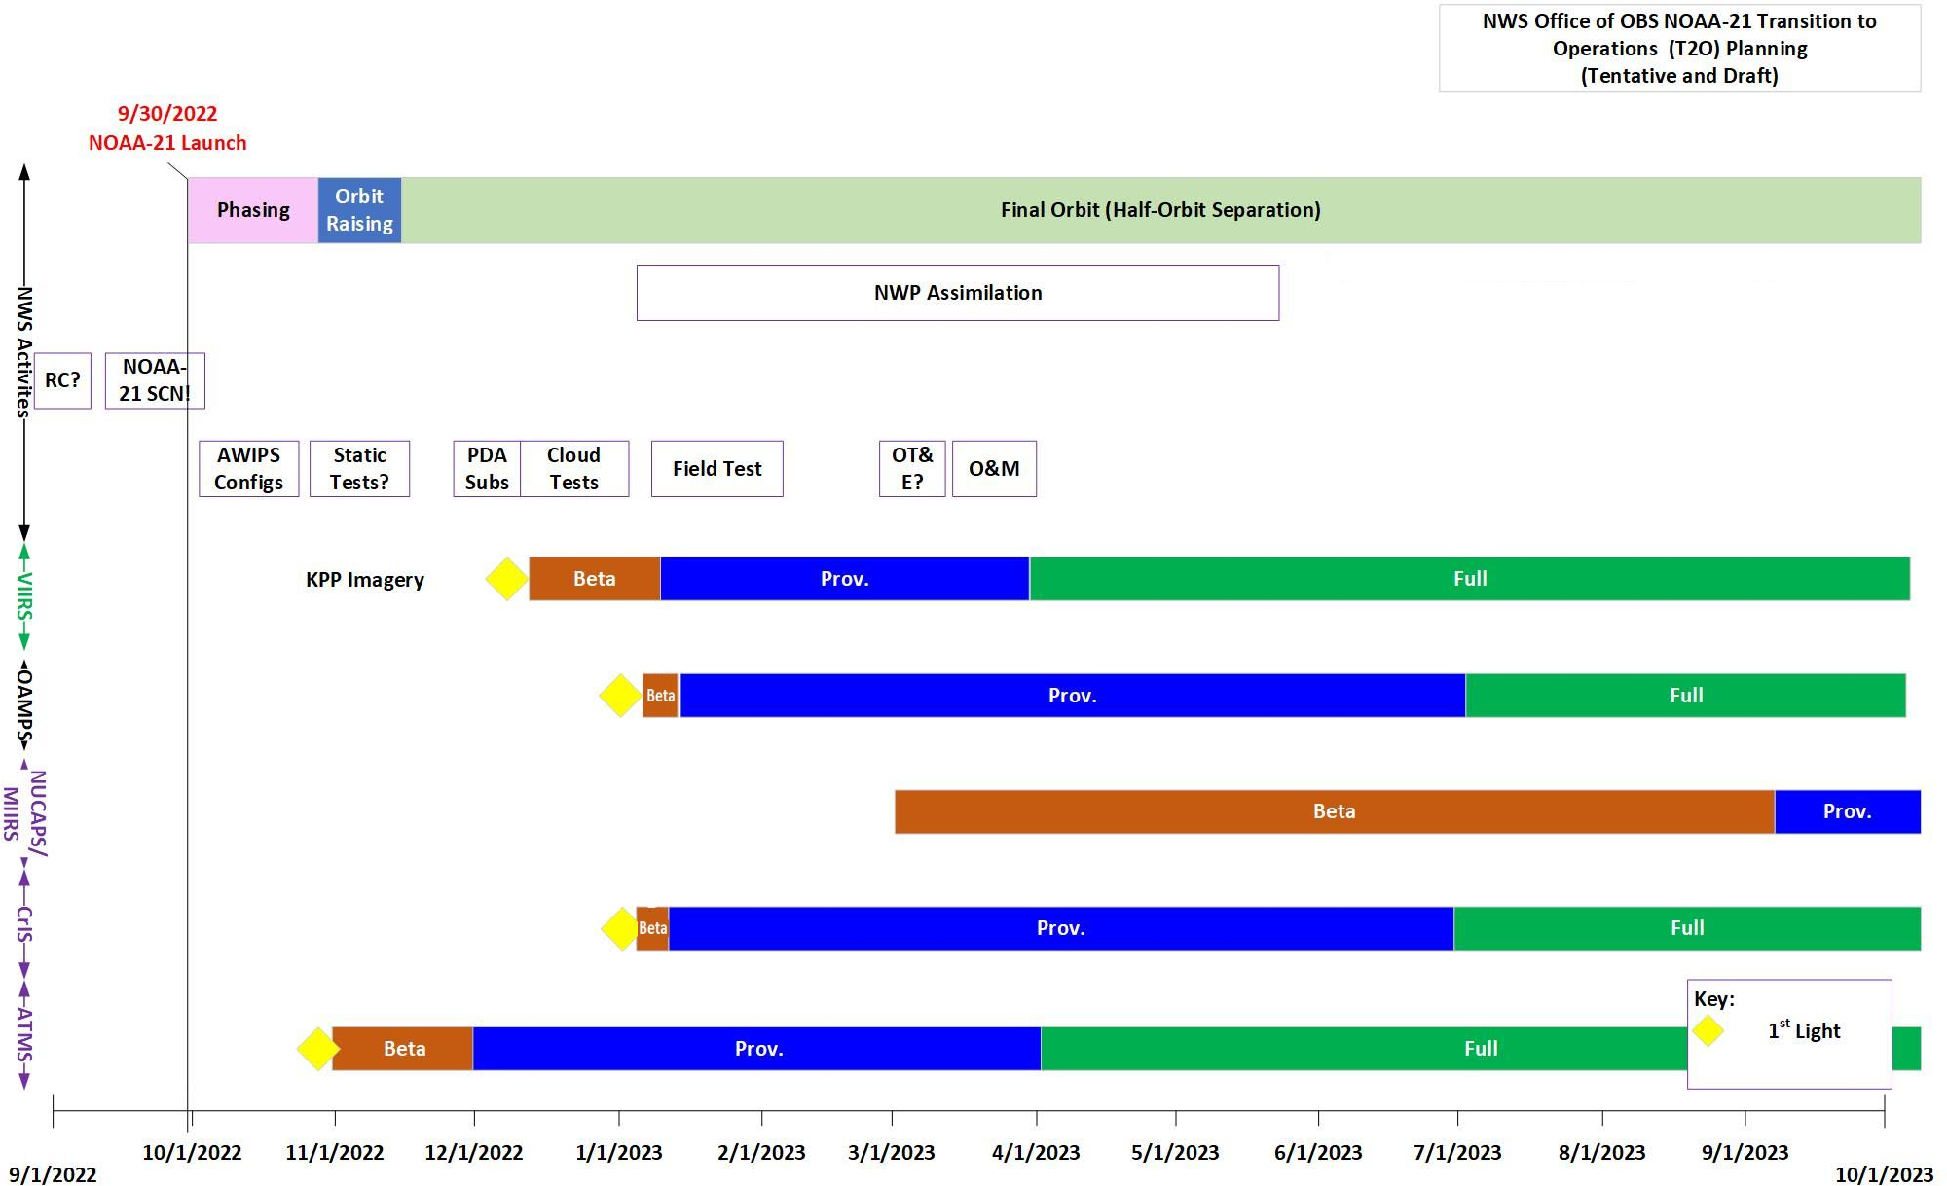
NWS readiness planning for JPSS-2/NOAA-21
ht / Dariush Khadjenouri - Tentative and Draft

Slide 24
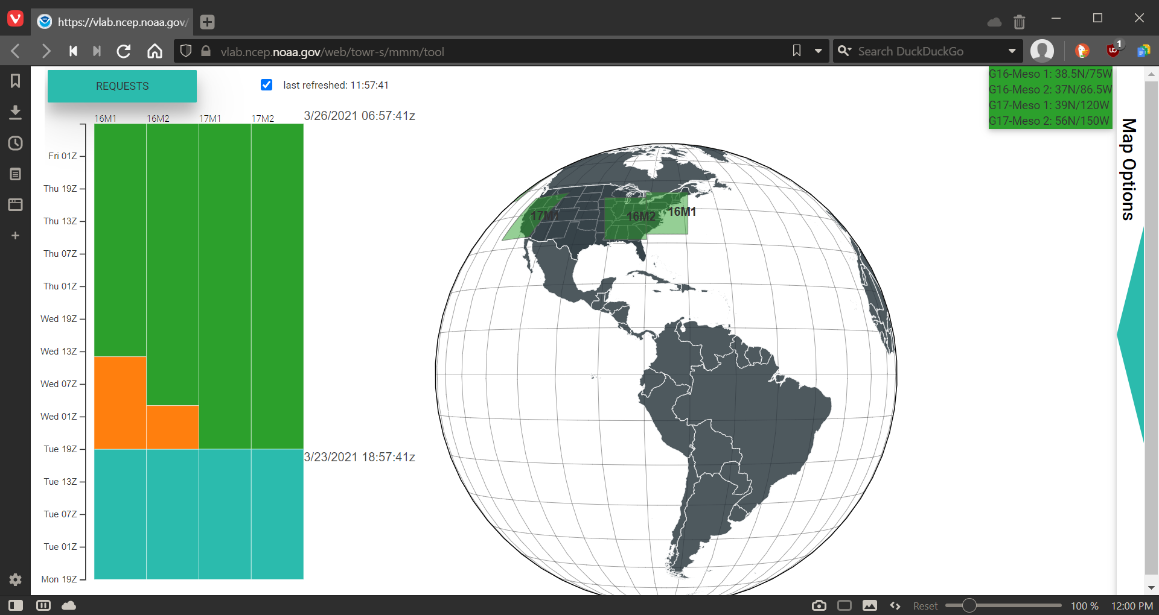
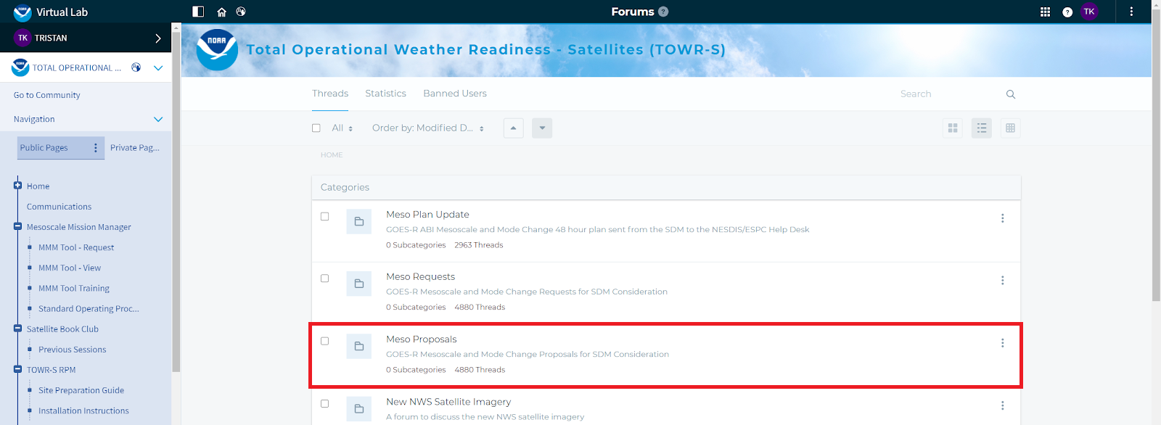
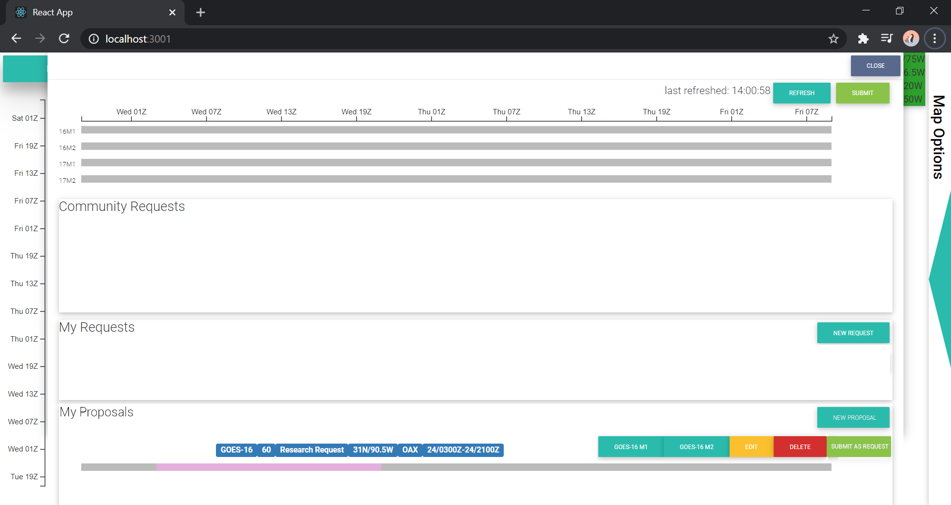
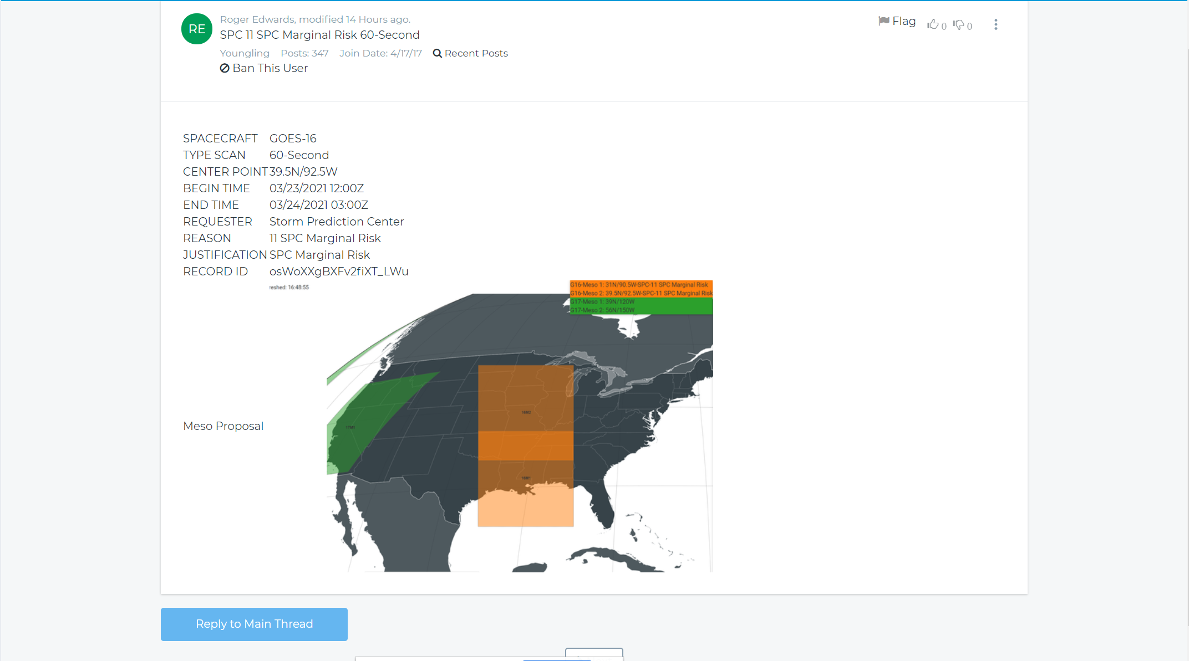
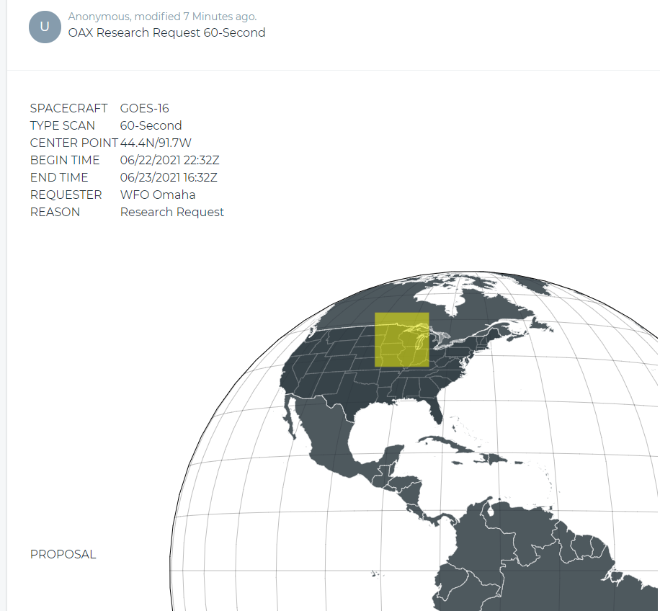
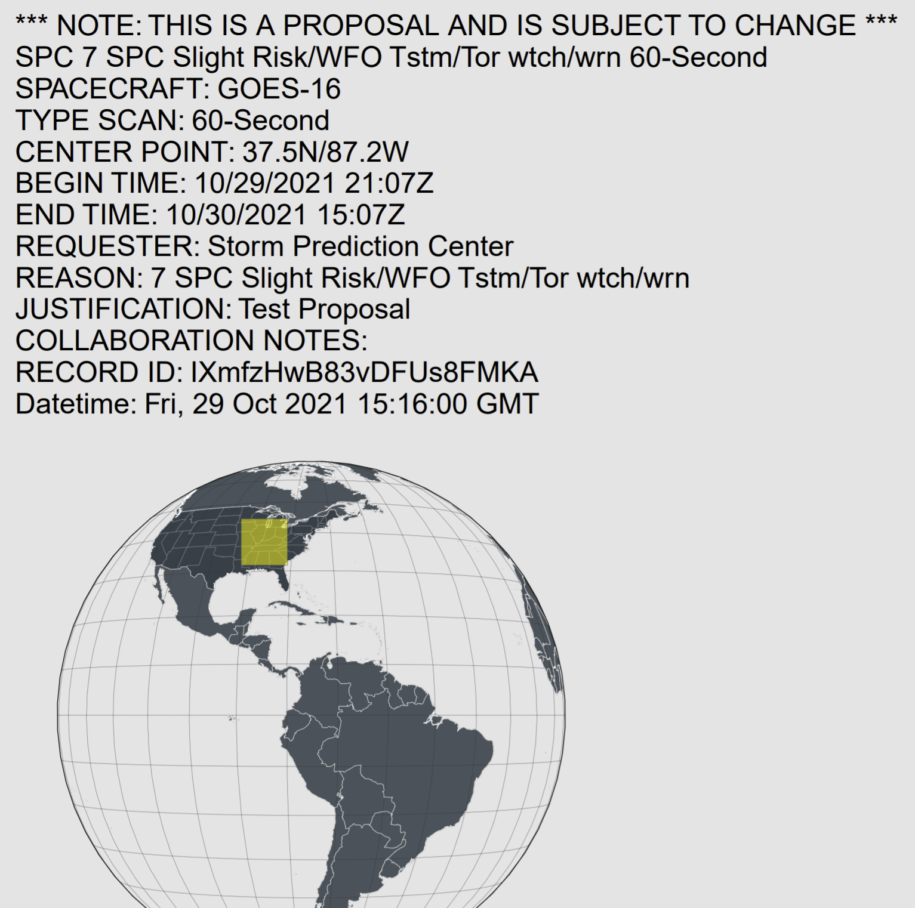
Mesoscale Mission Manager (MMM) Meso Domain Sector Proposals
h/t Zac NcCullough
Development was driven by requirements from the MDS Core Team
MDS Standard Operating Procedure revised accordingly
General availability starting Mon., Nov. 1, 2021

Slide 25
Satellite Book Club (SBC) Seminar Series
Thursdays, usually at Noon ET
Usage examples shed light on user requirements for satellite data products and capabilities
Recordings are on the SBC page in the NOAA VLab and the NWS Commerce Learning Center (CLC) website
Recent Sessions:
Sept. 2: Patrick Dills and Bill Line (UCAR/STAR), Satellite RGB Composite Imagery & Applications
Sept. 9: Kaitlin Rutt (AMA), Utilizing NUCAPS for Supplemental Observations in a Convective Environment
Sept. 16: Bill Line, Satellite Imagery Applications During Burn Scar Flash Flood Events
Sept. 23: Mike Pavolonis (CIMSS), ProbSevere LightningCast
Sept. 30: Curtis Seaman (CIRA), Value of VIIRS
Oct. 7: Patrick Ayd & Joe Moore, Radar Down, Severe Risk Up
Oct. 14: Andy Heidinger (NESDIS), The 1.38 Cirrus NIR Band
Oct. 21: Jim Yoe (NCEP), Satellite Data Assimilation
Oct. 28: Chad G. (SR HQ), Usage of GOES Meso Sectors
Upcoming topics:
NWS Operations Proving Ground
GOES-T plans
TOWR-S RPM v22 spotlight
AWIPS Satellite Enhancements at National Centers
Notes:
The Satellite Book Club Seminar Series is convened weekly on Thursdays, providing an opportunity for scientists throughout the NOAA satellite domain to share a topic of interest to them with their peers. Topics may include applications of satellite data in the field, new and exciting changes to both polar and geostationary programs, and anything else satellite-related that the field would like to discuss.

Slide 26
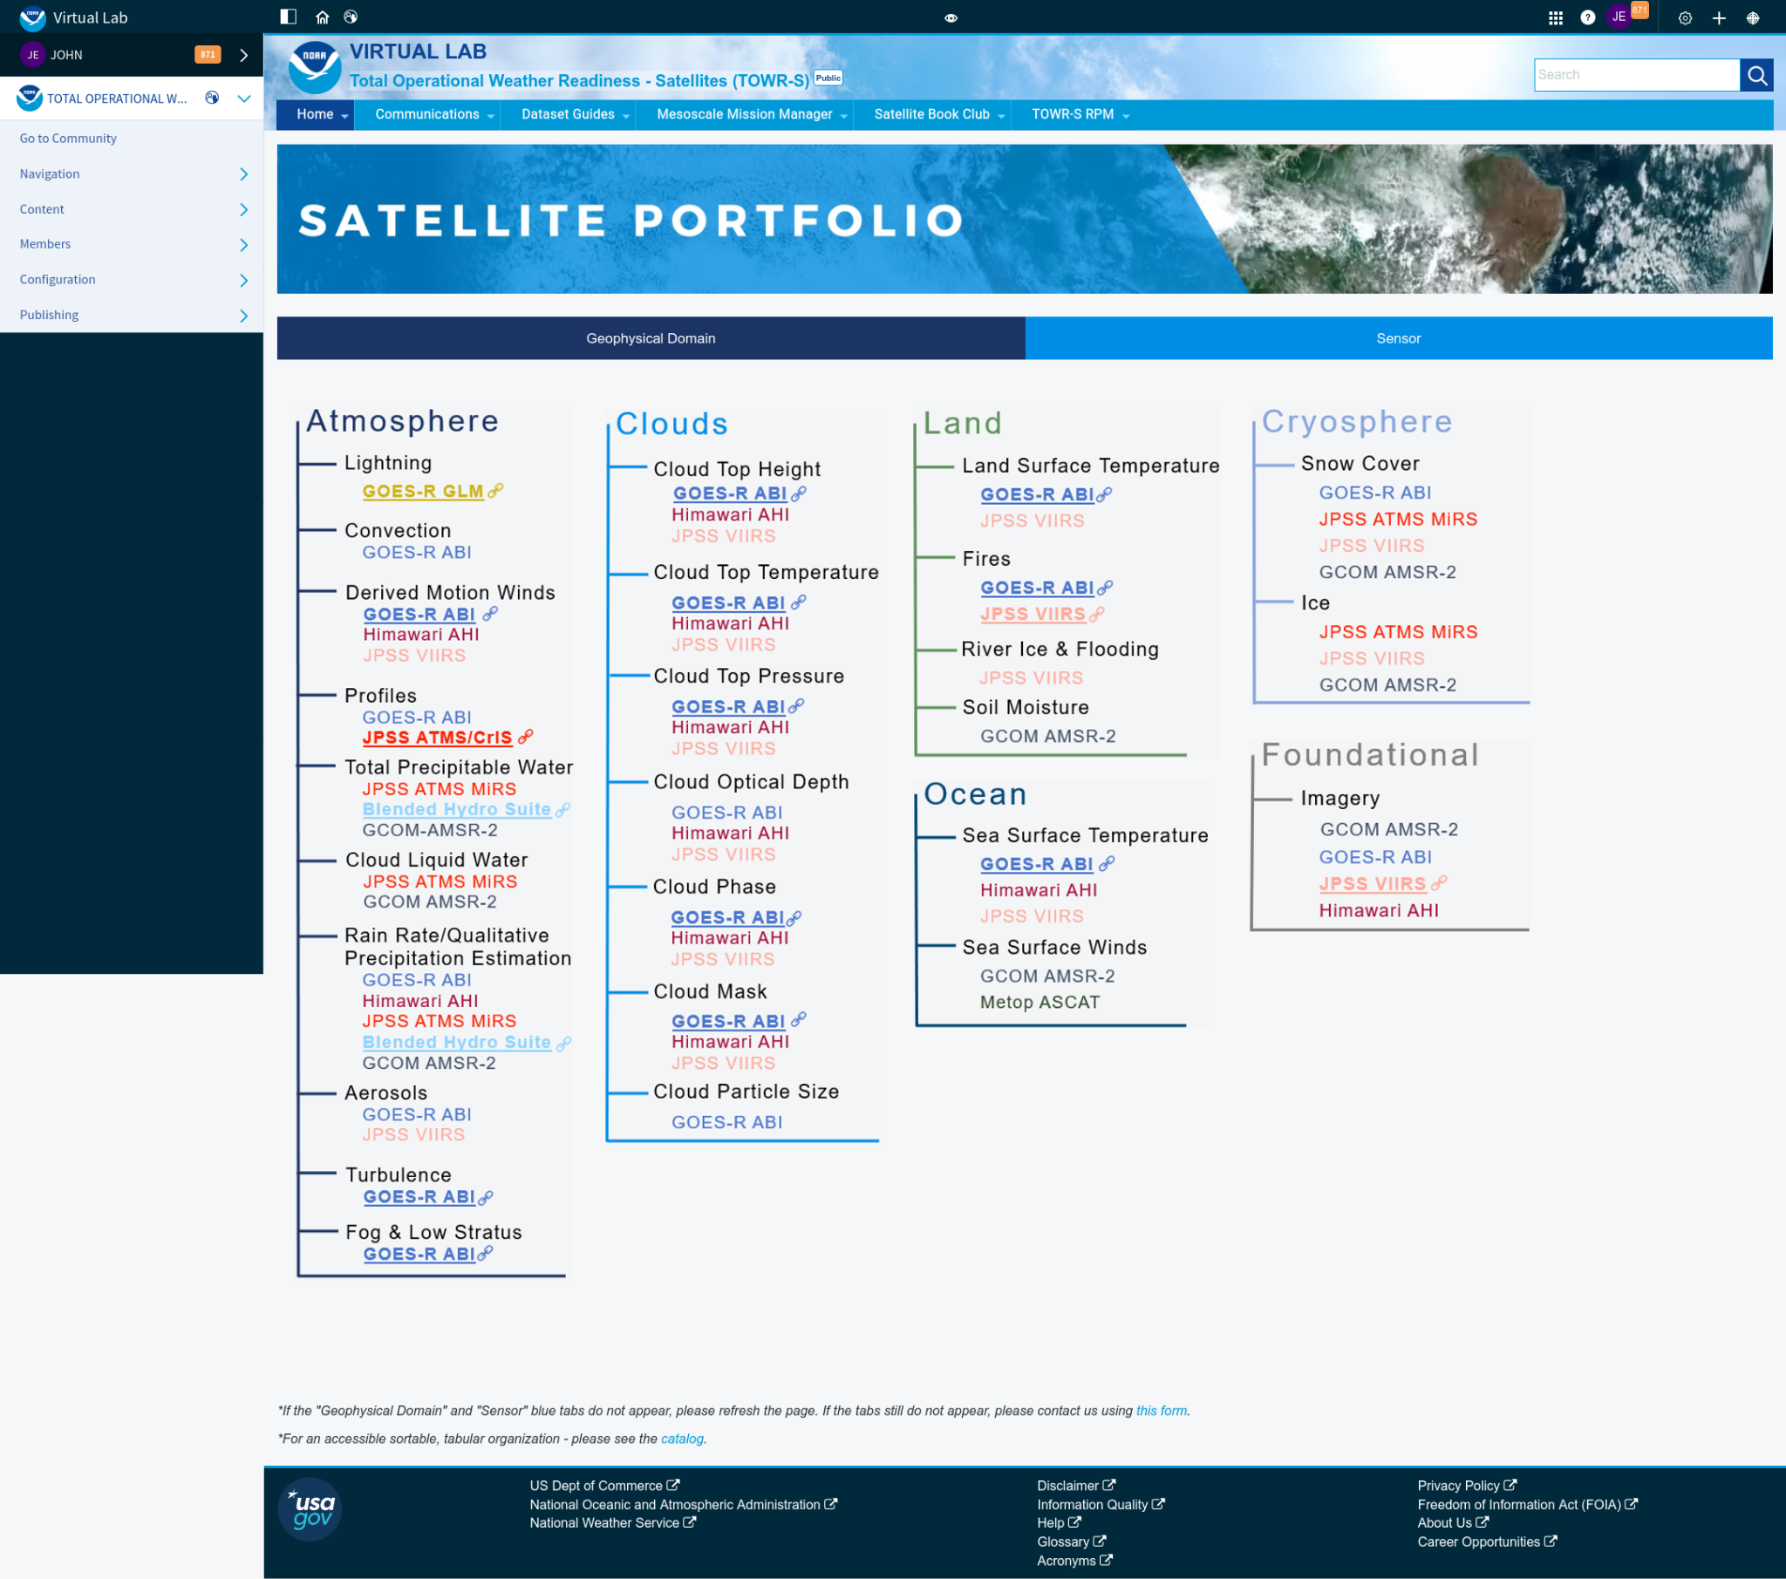
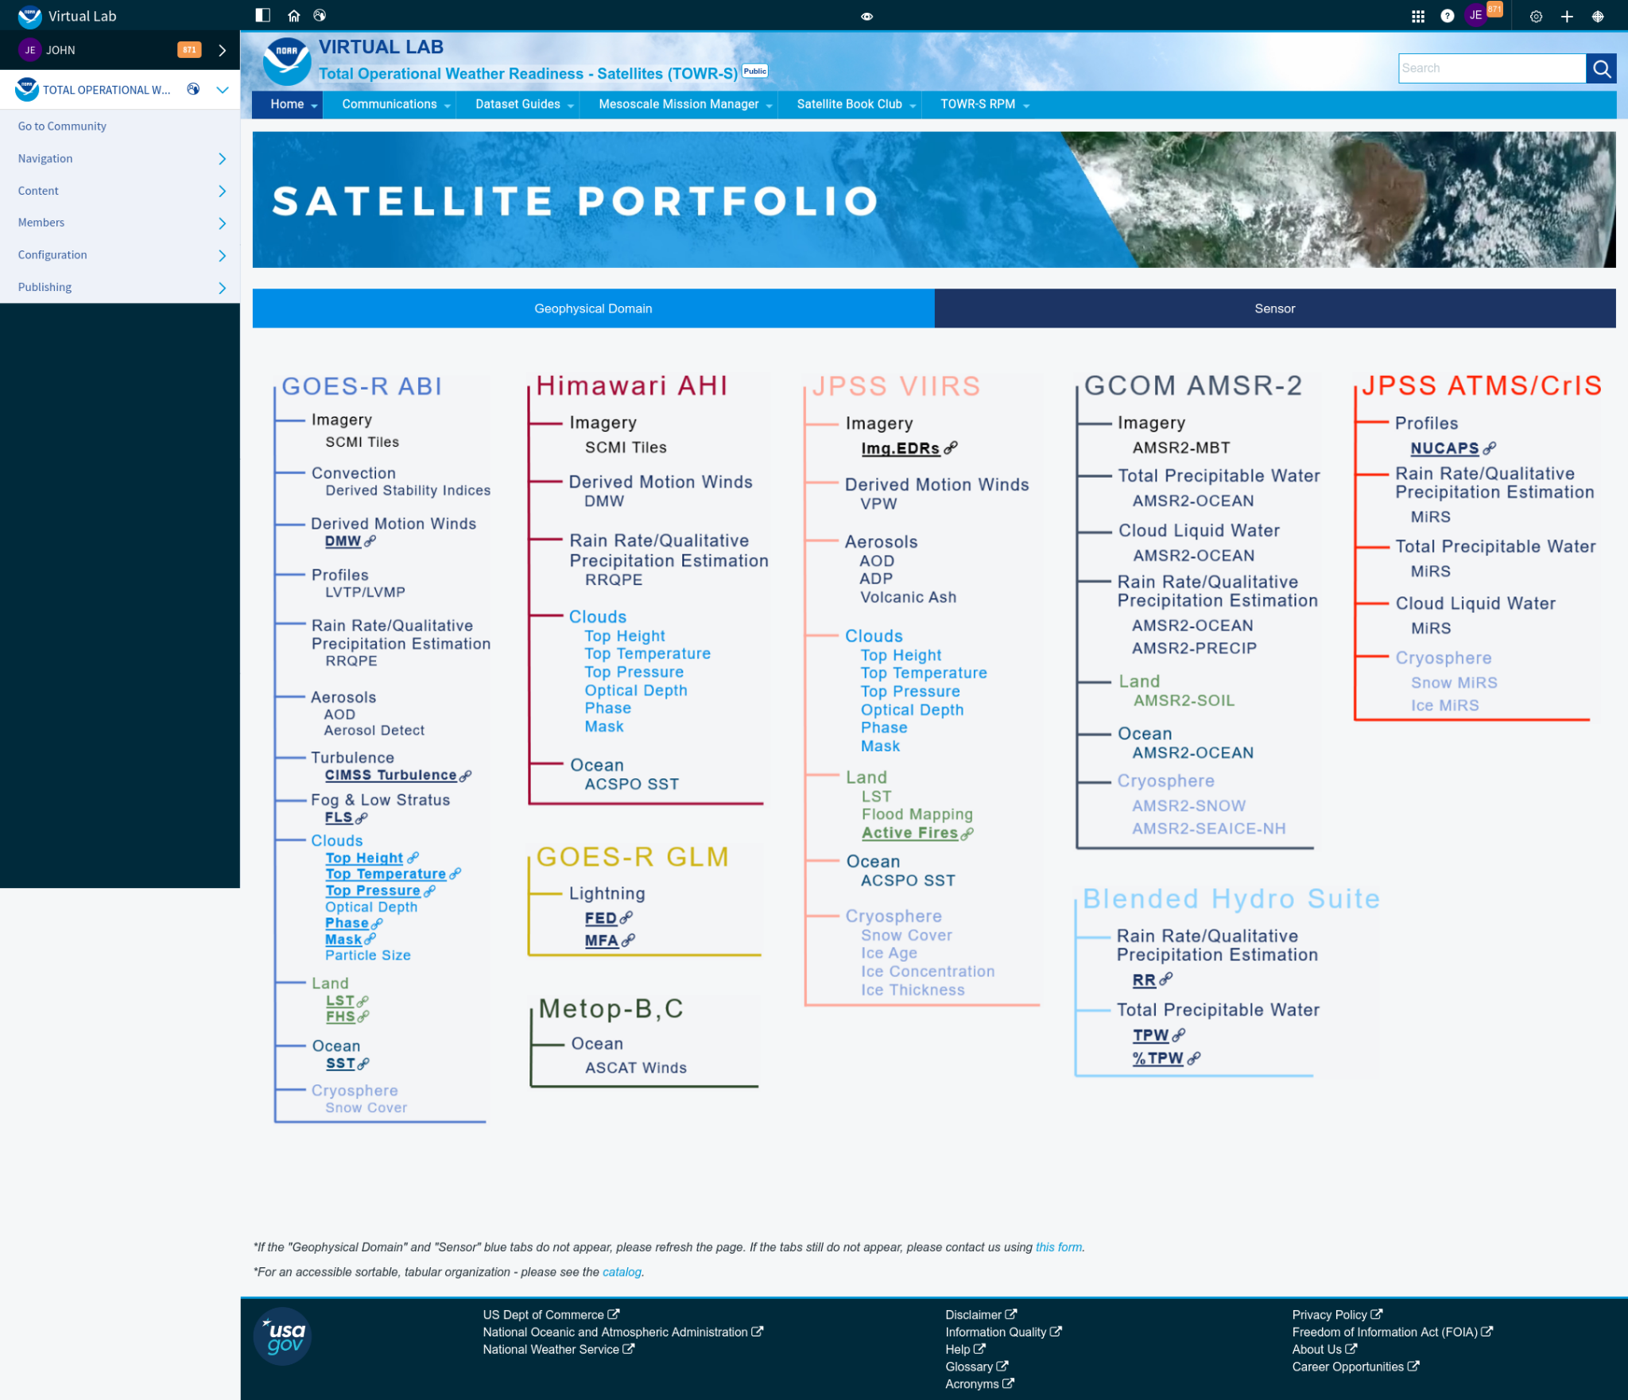
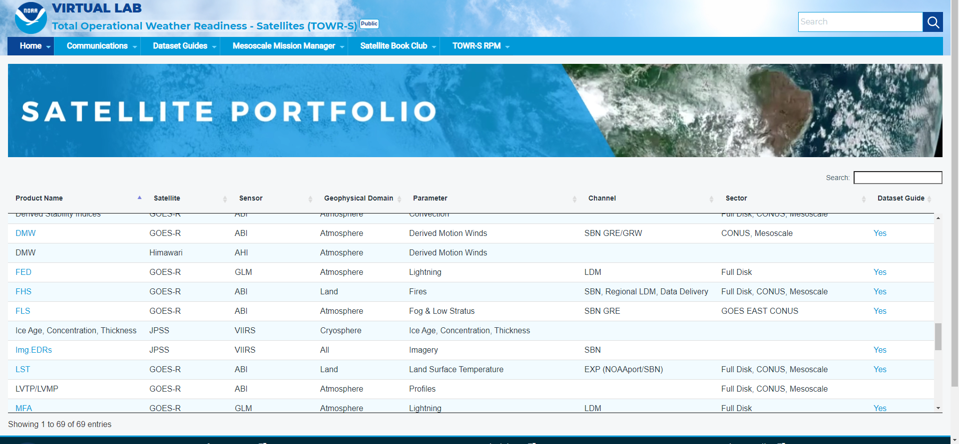
TOWR-S Satellite Portfolio & Dataset Guides
h/t V Wegman
Under construction at https://vlab.noaa.gov/web/towr-s/portfolio
Notes:
The Satellite Book Club Seminar Series is convened weekly on Thursdays, providing an opportunity for scientists throughout the NOAA satellite domain to share a topic of interest to them with their peers. Topics may include applications of satellite data in the field, new and exciting changes to both polar and geostationary programs, and anything else satellite-related that the field would like to discuss.

Slide 27
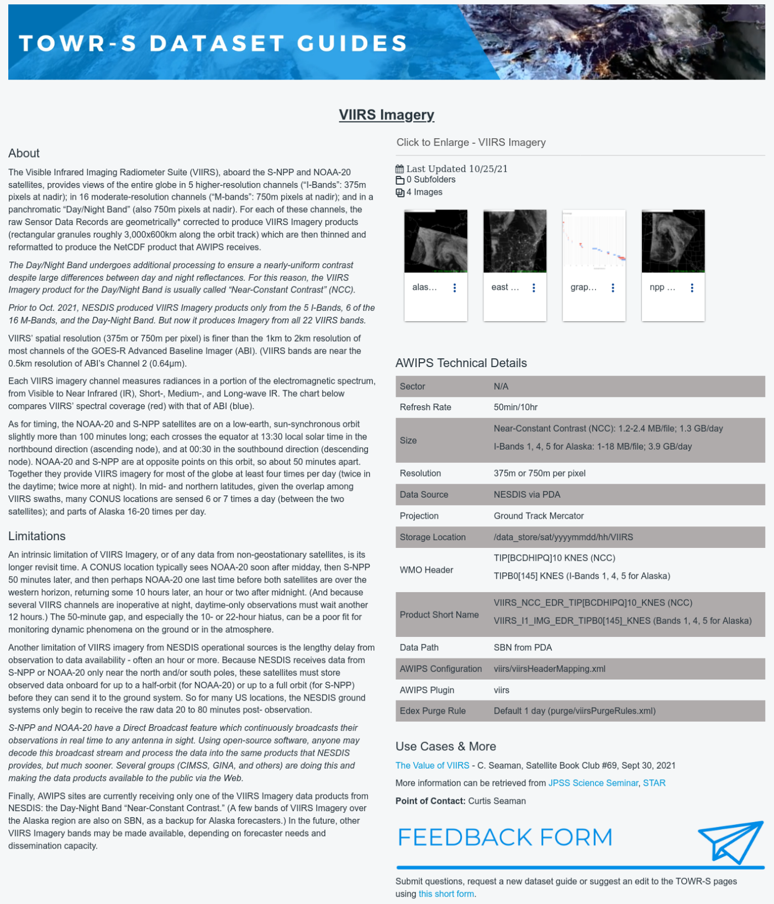
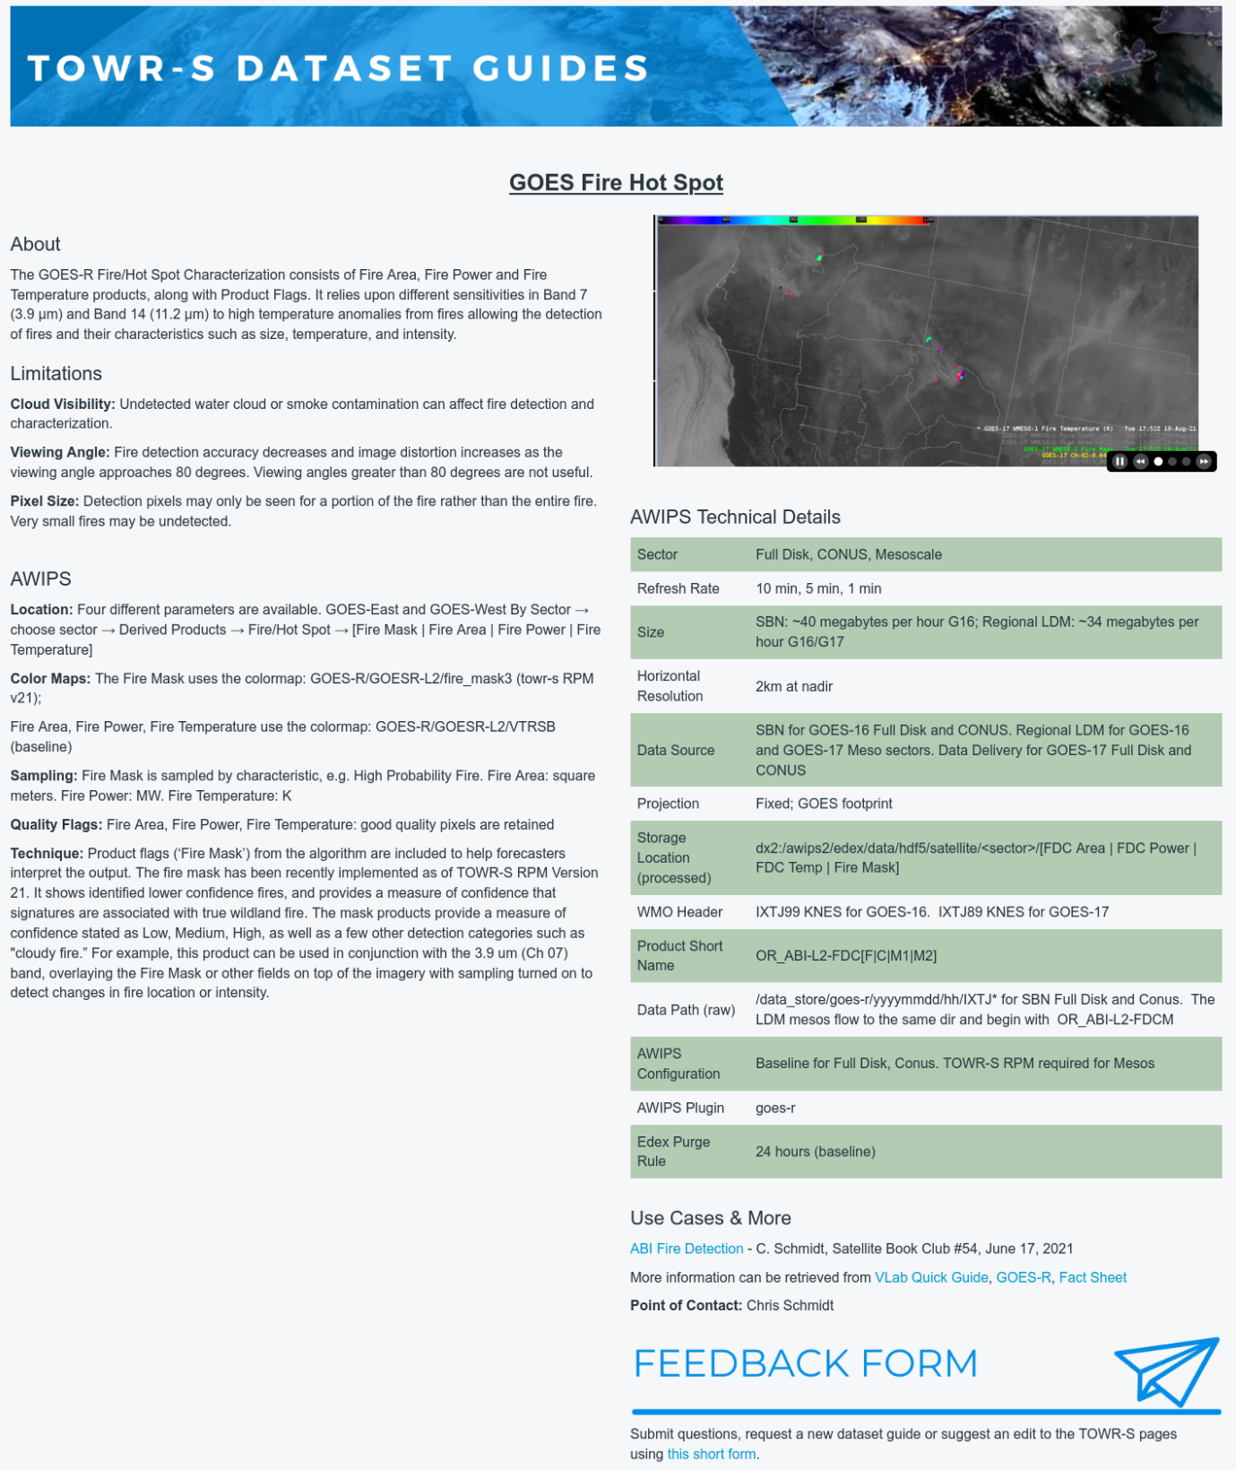
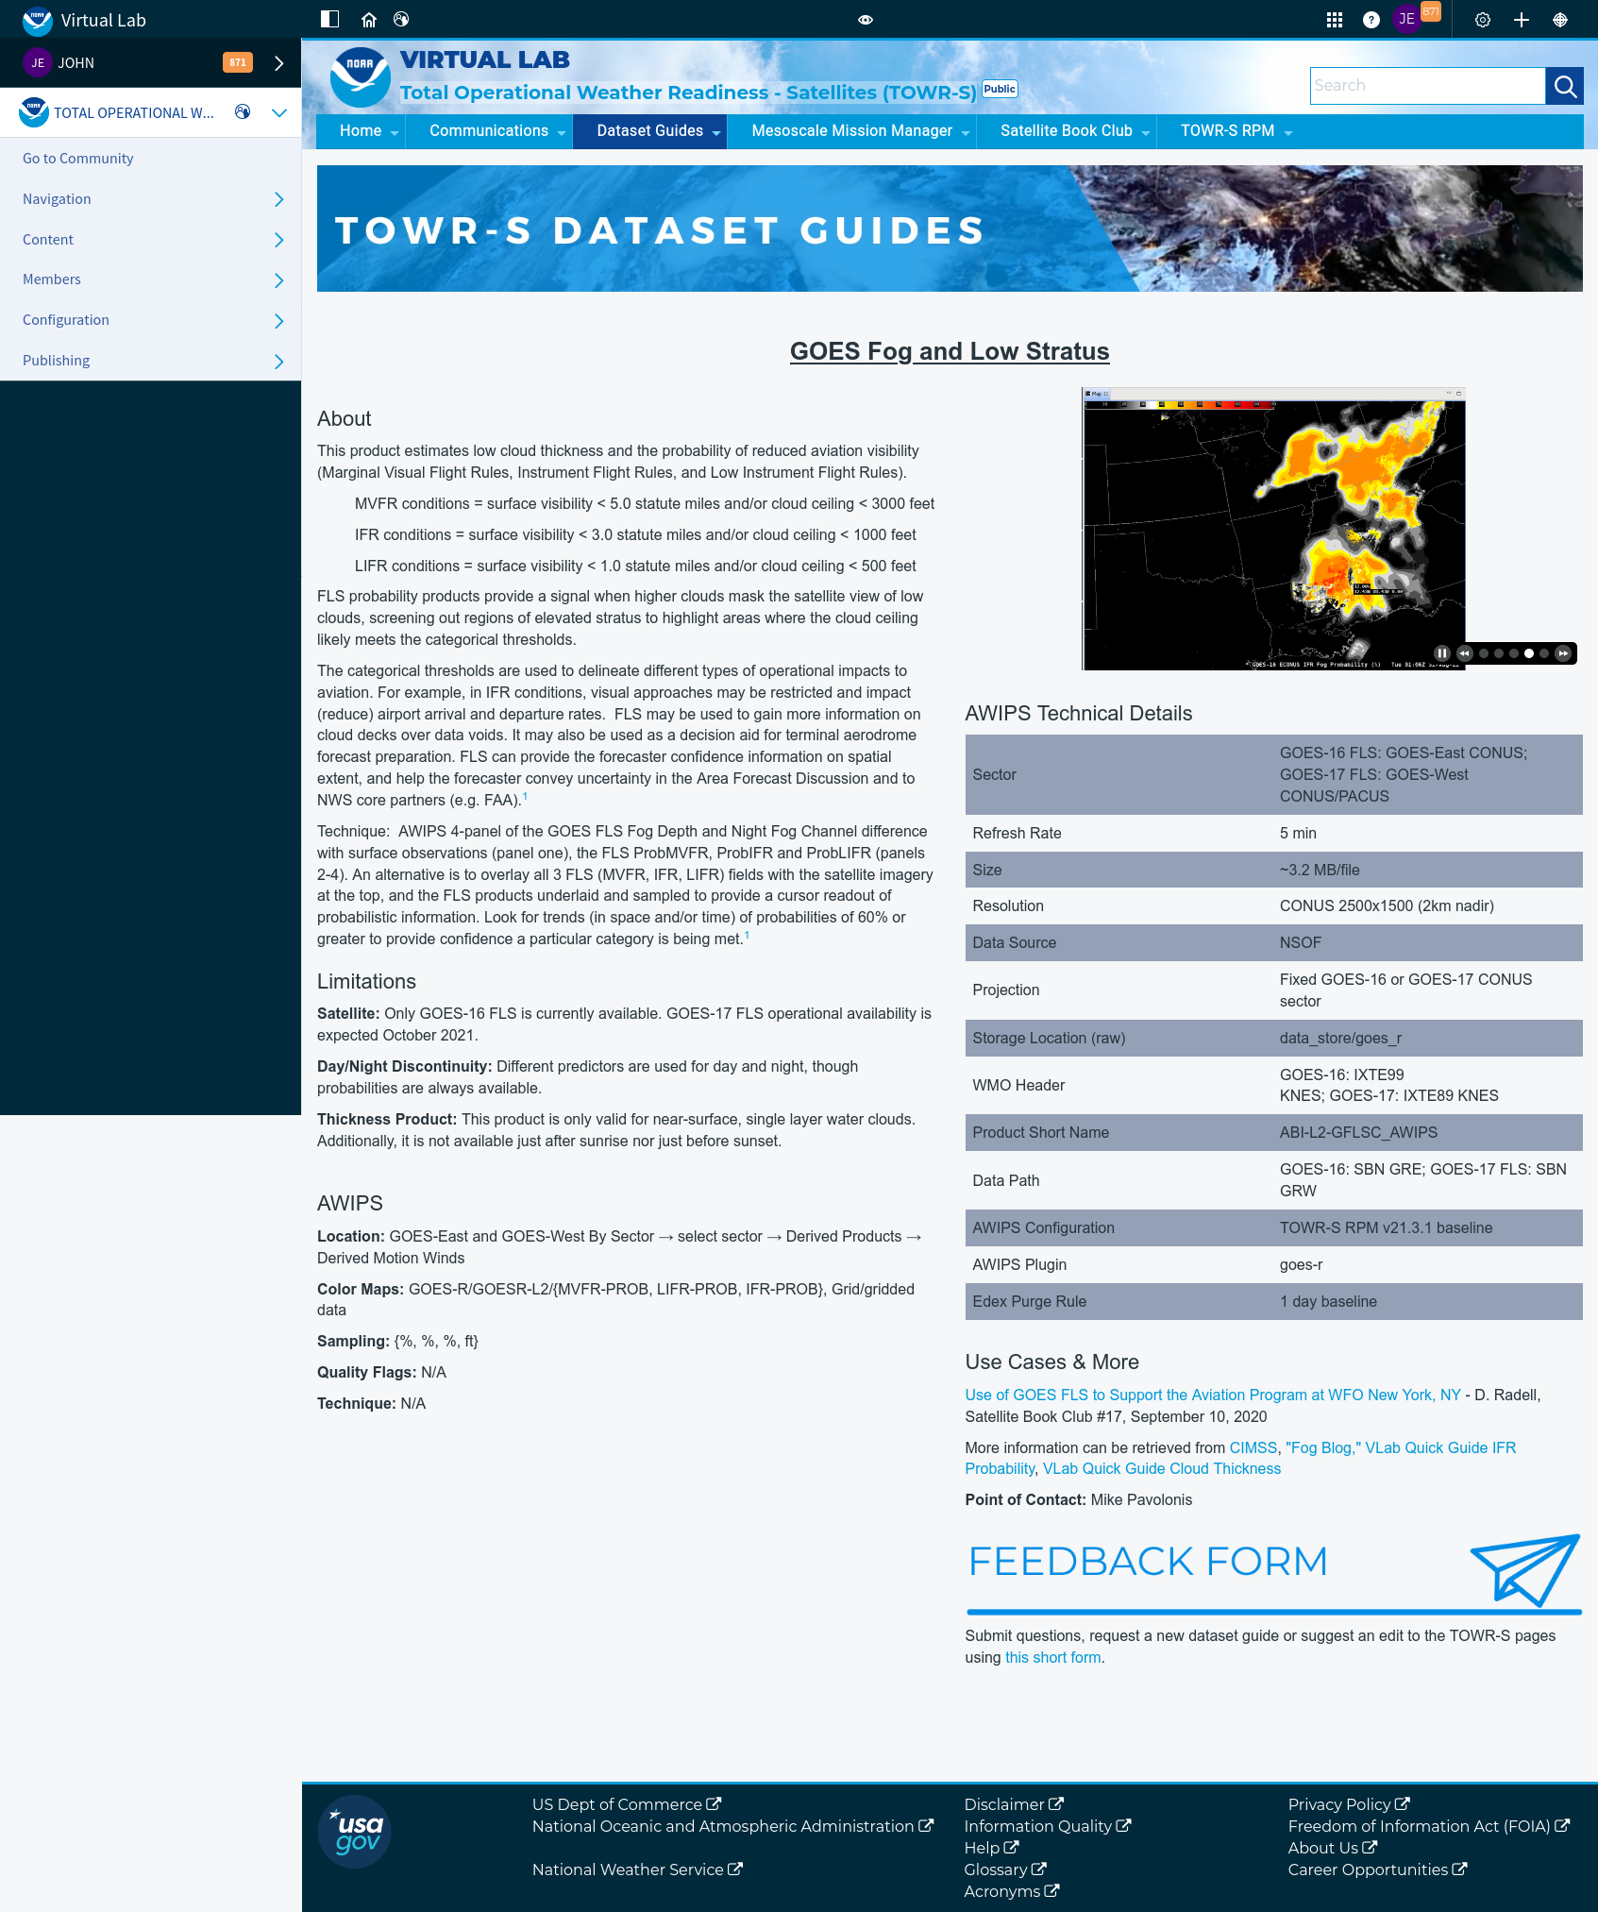
TOWR-S Satellite Portfolio & Dataset Guides
h/t V Wegman
Under construction at https://vlab.noaa.gov/web/towr-s/dataset-guides
Notes:
The Satellite Book Club Seminar Series is convened weekly on Thursdays, providing an opportunity for scientists throughout the NOAA satellite domain to share a topic of interest to them with their peers. Topics may include applications of satellite data in the field, new and exciting changes to both polar and geostationary programs, and anything else satellite-related that the field would like to discuss.

Slide 28
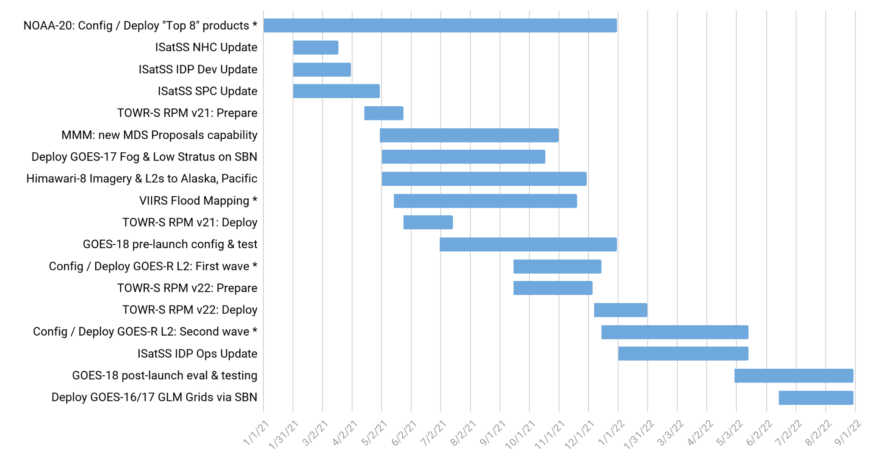
TOWR-S Activity Plan
CY2021 |  |  |  |  |  |  |  |  |  |  |  | CY2022
J | F | M | A | M | J | J | A | S | O | N | D | J | F | M | A | M | J | J | A
Notes:
Future dates are tentative / subject to change due to external dependencies
* Availability of some data products at AWIPS sites may depend on progress of AWIPS Data Delivery or other dissemination alternatives
October 29, 2021

Slide 29
Contact Information
Office of Observations
Brian Gockel – brian.gockel@noaa.gov
Jordan Gerth – jordan.gerth@noaa.gov
Total Operational Weather Readiness – Satellites (TOWR-S) Team
John Evans – john.d.evans@noaa.gov
Lee Byerle – lee.byerle@noaa.gov
Links
NWSChat (“towr-s” chatroom)
TOWR-S in the NOAA VLab

Slide 30
Next TOWR-S Updates
(tentative)
January 21, 2022
March 25, 2022

Slide 31
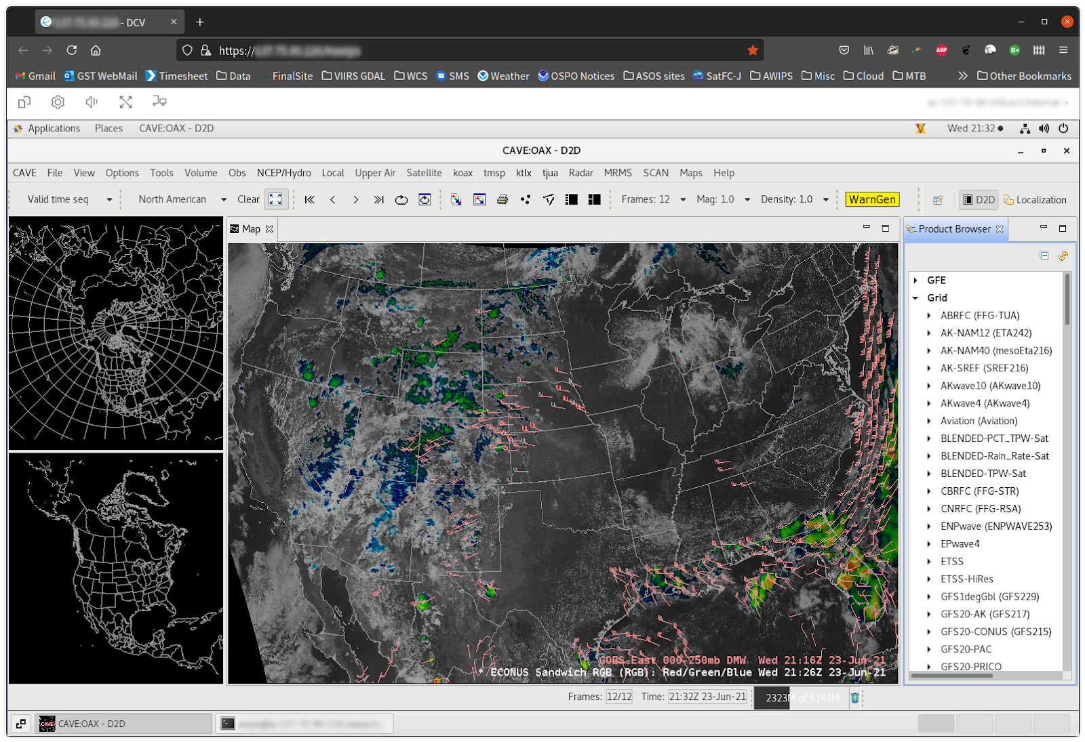
cloudReach: Share an AWIPS session in Web browsers
Example focus areas
Severe weather
Dust / snow events
Forecaster orientation
Acquainting data providers with data usage patterns
Activities include
Revisit weather events using saved data streams
Preview data products, color tables, menus
Prepare seminar presentations …. etc.
Outcomes
Address any “easy fixes” like color maps, display units
Identify performance/application questions early in the transition process
Enhanced dialog among & between forecasters, developers, and scientists
Sharpen understanding of how to improve forecasts with satellite data

Slide 32
(1) Current Product Posture
Product | Delivery Mechanism (Activation) | Product Maturity | AWIPS Treatment (enhancement tables, ranges, units, rules…) | AWIPS Status (TOWR RPM date) | Target AWIPS Release (Blue = submitted)
ABI SCMI | G16 Mar ’17 SBN E | G16 Full |  | GOES-16/17 menus appear by default under Sat in v18.2.1
 | G17 Aug ‘18 SBN W | G17 Provisional: 11/28/18 G17 Full: 02/19/20
Bands 1-6 | “ | “ | Default General viewing VIS | Feb ‘17, Mature | 18.2.1
Band 7 | “ | “ | Default General viewing SWIR | Mar ‘17, Mature | 18.2.1
Band 7, 13-14 | “ | “ | Ocean/Land in winter IR | Mar ’17, Mature | 18.2.1
Bands 8-10 | “ | “ | Default General viewing WV | Mar ‘17, Mature | 18.2.1
Bands 8-10 | “ | “ | Low-level WV | Jun ‘17, Mature | 18.2.1
Bands 8-16 | “ | “ | Rainbow colors for dual IR, WV | Mar ‘17, Mature | 18.2.1
Bands 11-16 | “ | “ | Default General viewing IR | Mar ‘17, Mature | 18.2.1
Bands 11-16 | “ | “ | Summer, warm land areas | Mar ‘17, Mature | 18.2.1
Split Window Ch Diff |  |  | Blowing dust, volcanic ash, low-level water vapor (10.3-12.3um) | Jun ‘17, Mature | 18.2.1
Split Water Vapor Ch Diff |  |  | Gradients in UL WV (6.2-7.3um) | Jan ‘18, Mature | 18.2.1
Two Night Fog Ch Diffs |  |  | Gray/blue (2 menu buttons 10.3-3.9um, and 11.2-3.9um) | Jan ‘18, Mature, Aug ‘19 | 18.2.1 / 20.2.1

Slide 33
(2) Current Product Posture
Product | Delivery Mechanism (Activation) | Product Maturity | AWIPS Treatment (enhancement tables, ranges, units, rules…) | AWIPS Status (TOWR RPM date) | Target AWIPS Release (Blue = submitted)
Day Fog Ch Diff |  |  | Highlights fog over warmer surfaces, Opposite of Night fog CH diff (3.9-10.3um) | Jan ‘18, Mature | 18.2.1
Split Snow Ch Diff |  |  | Highlights snow cover over land (1.6-0.64um) | Jan ‘18, Mature (Avail all sectors-FG) | 18.2.1
Split Fire Ch Diff |  |  | Fire hot spot detection (2.2-1.6um) | Jan ‘18, Mature (Avail all sectors-FG) | 18.2.1
Split Ozone Ch Diff |  |  | Ozone detection (9.6-10.3um) | Jan ‘18, Mature | 18.2.1
Split Cloud Top Phase Ch Diff |  |  | Highlights ice clouds, phase variation (11.2-8.4um) | Jan ‘18, Mature | 18.2.1
Vegetation Ch Diff |  |  | Highlights Vegetation, land sfc variation (0.64-0.87um) | Mar ‘17, Mature (Avail all sectors-FG) | 18.2.1
GOES-16/GOES-15 Supernational “CONUS with Legacy” | (Menu to only show G-16 as of March 2, 2020) |  | ABI CHs 2,7,8,11,16 w/corresponding G-15 CHs | Feb ‘18, Eval | N/A
Day Cloud Phase Distinction RGB |  |  | Daytime cloud phase variation (10.35,0.64,1.61um) | Aug ‘17, Mature | 19.2.1
Fire Temperature RGB |  |  | Fire hot spot detection (3.90,2.25,1.61um) | Jun ‘17, Mature | 19.2.1
Day Land Cloud RGB |  |  | Day land cloud (1.61,0.87,0.64um) | Jun ‘17, Mature | 19.2.1
Day Cloud Convection RGB |  |  | Day convection as warm colors (0.64,0.64,10.35um) | Aug ‘17, Mature | 19.2.1

Slide 34
(3) Current Product Posture
Product | Delivery Mechanism (Activation) | Product Maturity | AWIPS Treatment (enhancement tables, ranges, units, rules…) | AWIPS Status (TOWR RPM date) | Target AWIPS Release (Blue = submitted)
Day Land Cloud Fire RGB |  |  | Day land clouds, fire (2.25,0.87,0.64um) | Jun ‘17, Mature | 19.2.1
Simple Water Vapor RGB |  |  | WV, Upper level circulation (10.35,6.19,7.34um) | Mar ‘17, Mature | 19.2.1
Air Mass RGB |  |  | Delineate air masses (6.19-7.34,9.61-10.35,6.19um) | Mar ‘17, Mature | 19.2.1
Ash RGB |  |  | Ash detection (12.3-10.35,11.2-8.5,10.35um) | Mar ‘17, Mature | 19.2.1
Day Convection RGB |  |  | Day convection (6.19-7.34,3.9-10.35,1.61-0.64um) | Aug ‘17, Mature (Avail all sectors-FG) | 19.2.1
Differential Water Vapor RGB |  |  | Water vapor contrast (7.34- 6.19,7.34,6.19) | Mar ‘17, Mature | 19.2.1
Day Snow Fog RGB |  |  | Day snow, fog (0.87,1.61,3.9-10.35um) | Jun ‘17, Mature | 19.2.1
Dust RGB |  |  | Dust (12.3-10.35,11.2-8.5,10.35um) | Mar ‘17, Mature | 19.2.1
Nighttime Microphysics RGB |  |  | Delineate night cloud phase (12.3-10.35,10.35-3.9,10.35um) | Mar ‘17, Mature | 19.2.1
SO2 RGB |  |  | Ash, S02 detection (6.95-7.34,10.35-8.5,10.35um) | Jun ‘17, Mature | 19.2.1

Slide 35
(4) Current Product Posture
Product | Delivery Mechanism (Activation) | Product Maturity | AWIPS Treatment (enhancement tables, ranges, units, rules…) | AWIPS Status (TOWR RPM date) | Target AWIPS Release (Blue = submitted)
Daytime Composite #1 RGB |  |  | Highlight cold surfaces, cirrus (0.64,1.61,11.2um) | Baselined 16.1.x
Daytime Composite #5 RGB |  |  | Grayscale, Cirrus (0.64,0.87,0.64um) | Baselined 16.1.x
Day Ocean Cloud Convection |  |  | Daytime Ocean Convection (0.87,0.87, 10.35um) | June ’17, Mature | 19.2.1
CIMSS Natural Color RGB |  |  | Natural color, computes Green | Jan. ‘18, Mature (Avail all sectors-FG) | 19.2.1
GOES-East,West Clear Sky Mask | SBN Exp (G-16: May 2017; G-17: Sep. 2021) F,C,M | G16: Provisional | Display as binary mask | Baselined 16.1.x
 |  | *G17: Provisional (May 6, ’19)
GOES-East,West Cloud Top Height, Temperature, Pressure | SBN Exp (G-16: 31 May 2017; G-17: Sep. 2021) Height: F,C,M / Temp: F,M / Pressure: F,C | G16: Provisional | Cloud Top Height in Ft, Temp in degC | June ‘17, Mature | 18.2.1
 |  | *G17: Provisional (May 6, ’19)
GOES-East,West Cloud Top Phase | SBN Exp (G-16: May 2017; G-17: Sep. 2021) F,C,M | G16: Provisional | Clear, Water, Supercooled, Mixed, Ice, Uncertain | Baselined 16.1.x
 |  | *G17: Provisional (May 6, ’19)
GOES-East,West Derived Stability Indices (CAPE,LI, KI, SI, TT) | SBN Exp (G-16: May 2017; G-17: Sep. 2021) F,C,M | G16: Provisional *G17: Provisional (May 16, ’19) | 10-bit colormap. Syncs to legacy GOES Sounder ranges | Aug. ‘17, Mature | 18.2.1
GOES-East,West Aerosol Detection (ADP) | SBN Exp (G-16: May 2017; G-17: Sep. 2021) F,C,M | G16: Provisional (Dec. 6, ‘18) | Separate Dust, Smoke. Hi/Lo/Med confidence | Feb. ‘18 RPM, Eval | 20.2.1
 |  | *G17: Provisional (June 27, ‘19)
*G-17 PS-PVRs are based upon cool season evaluations
F = Full Disk, C= CONUS, M= Mesoscale

Slide 36
(5) Current Product Posture
Product | Delivery Mechanism (Activation) | Product Maturity | AWIPS Treatment (enhancement tables, ranges, units, rules…) | AWIPS Status (RPM date) | Target AWIPS Release (Blue = submitted)
GOES-East,West Aerosol Optical Depth | SBN Exp (G-16: May 2017; G-17: Sep. 2021) F,C | G16: Provisional (Sept. 14, ’18) | Display as binary mask. Fixed display range (0-1) | June ‘17, Mature | 18.2.1
 |  | *G17: Provisional (June 27, ’19)
GOES-East,West Land Surface Temperature | SBN Exp (G-16: May 2017; G-17: Sep. 2021) F,C,M | G16: Provisional | LST in degF | June ‘17, Eval | 19.2.1
 |  | *G17 Provisional (June 13, ’19)
GOES-East,West Fire/Hot Spot | SBN Exp (G-16: May 2017; G-17: Sep. 2021) F,C + New Meso Sep. ‘21 | G16 Provisional (Apr 24, ‘18) | Fire Temp, Power, Area | Aug. ‘17, Eval | 19.2.1
 |  | *G17: Provisional (July 25, ’19)
GOES-East,West TPW | SBN Exp (G-16: May 2017; G-17: Sep. 2021) F,C,M | G16: Provisional *G17: Provisional (May 16, ‘19) | TPW in Inches. 10-bit colormap based legacy GOES Sounder | Aug. ‘17, Mature | 18.2.1
GOES-East,West Cloud Optical Depth | SBN Exp (G-16: May 2017; G-17: Sep. 2021) F,C | G16: Provisional *G17: Provisional Day: 6/13/19 Night: 9/24/19 | Fixed max display range to 100% | Aug. ‘17, Mature | 18.2.1
GOES-East,West Cloud Particle Size Distribution | SBN Exp (G-16: June 2017; G-17: Sep. 2021) F,C,M | G16: Provisional (Dec. 14, ’18) *G17: Provisional Day: 6/13/19 Night: 9/24/19 | Range 0-100um | Baselined
GOES-East,West Derived Motion Winds | SBN GRE/GRW (G-16: June 2017; G-17: Mar. 2020) C (15min), M (5min) | G16: Provisional | By-Pressure displays as single color like legacy. Meso 1,2 now separate displays/database entries | Feb. ‘18, Mature | 19.2.1
 |  | *G17: Provisional (May 16, ’19)
GOES-East,West Sea Surface Temperature | SBN Exp (G-16: Jan 2018; G-17: Sep. 2021) F (hourly) | G16: Provisional | Colormap highlights TC threshold, Default display as DegF and DegC | March ‘18, Mature | 19.2.1
 |  | *G17: Provisional (July 25, ’19)
*G-17 PS-PVRs are based upon cool season evaluations
F = Full Disk, C= CONUS, M= Mesoscale

Slide 37
(6) Current Product Posture
AWIPS Release Dates:
20.2.1,2,3 – June 2021
20.3.1,2 – Jan. 2022
Product | Delivery Mechanism (Activation) | Product Maturity | AWIPS Treatment (enhancement tables, ranges, units, rules…) | AWIPS Status (TOWR RPM date) | Target AWIPS Release (Blue = submitted)
GOES-East,West Rainfall Rate, Quantitative Precipitation Est | SBN Exp (G-16: Jan. 2018; G-17: Sep. 2021) F | G16: Provisional (March 31, ‘18) | Display in inches. Colormap syncs w/typical radar colors | March ‘18 | 18.2.1
 |  | *G17: Provisional May 16, ‘19
GOES-East,West Legacy Vertical Temperature/Moisture Profiles | G16: SBN Exp (G-16: Feb 2018; G-17: Sep. 2021) C (30min) | G16: Provisional | NSHARP profiles. Move menu under Derived products section | Baselined (16.1.x), Eval, profile cadence | 19.2.1
 |  | *G17: Provisional (May 16, ‘19)
NOAA-20 VIIRS Imagery (KPP to AK via terrestrial Networks) | ~Feb. ‘18 | Validated | I, M-bands, NCC | Feb. ‘18, Eval | 19.2.1
Snow Cover | TBD | G16/G17 Provisional 8/13/20
JASON 3 Wave Altimetry | SBN ExpNMC3 (July 17, ‘18) | Operational, TT 194990 for slow load times, under investigation |  | Feb. ’18, dbgeo plugin | 19.2.1
GOES-East,West GLM Full Disk Punctured Tiles | LDM migration | G16/17 Full | 1- & 5-minute Flash Extent Density (FED), Total Optical Energy, Min. Flash Area | Nov. ‘20
GOES-East,West Ice Products: Ice Concentration, Ice Age / Thickness, Ice Motion | LDM migration | Ice Concentration, Ice Age & Thickness: Provisional |  | Nov. ‘20
CIMSS Turbulence Probability (CONUS) | LDM migration |  |  | Nov. ‘20
*G-17 PS-PVRs are based upon cool season evaluations

Slide 38
(7) Current Product Posture
AWIPS Release Dates:
20.2.1,2,3 – June 2021
20.3.1,2 – Jan. 2022
Product | Delivery Mechanism (Activation) | Product Maturity | AWIPS Treatment (enhancement tables, ranges, units, rules…) | AWIPS Status (TOWR RPM date) | Target AWIPS Release (Blue = submitted)
Full Disk Geostationary Lightning Mapper (GLM) | LDM Migration Ops / Local Generation | G16: Full G17 Full: 11/21/19 | Flash Extent Density (FED) Grid, Average Flash Area, and Total Optical Energy | NHCN/NTBN/OPCN/ AWCN | TBD
GOES VIS/IR Sandwich RGB | N/A | N/A | CH 02, CH 13 Combo | March ’19 RPM | 20.2.1
GOES NDVI Vegetation Channel Difference | N/A | N/A | CH02, CH03 Combo | March ‘19 RPM Next RPM to include CSM | 20.2.1
ASCAT A, B, C Wind Speed / Direction and Ambiguities | N/A | N/A | DMW plugin | NHCN/NTBN/OPCN | Eval
SSMI F-15 85 GHz H,V and 36.5GHz H,V Microwave Imagery | ISatSS | N/A | GOES-R plugin, PCT RGBs | NHCN/NTBN | Eval
AMSR2 89.5 GHz AH, AV and 36.5 GHz AH, AV Microwave Imagery | ISatSS | N/A | GOES-R plugin, PCT RGBs | NHCN/NTBN/OPCN | Eval
GPM GMI 89.5 GHz H,V and 37 GHz H,V Microwave Imagery | ISatSS | N/A | GOES-R plugin, PCT RGBs | NHCN/NTBN | Eval
S-NPP ATMS QV 88 GHz Microwave Imagery | ISatSS | N/A | GOES-R plugin | NHCN/NTBN | Eval
AMSR2 Ocean products: Rain Rate, SST, TPW, Cloud Liquid Water, Wind Speed | ISatSS | N/A | GOES-R plugin | NHCN/NTBN/OPCN | Eval
JASON-3 Wave Heights and Wind Speeds | ISatSS | N/A | DMW plugin for numeric read-outs | NHCN/NTBN/OPCN | Eval
Cryosat-2 Wave Heights and Wind Speeds | ISatSS | N/A | DMW plugin for numeric read-outs | NHCN/NTBN/OPCN | Eval
Altika Wave Heights and Wind Speed | ISatSS | N/A | DMW plugin for numeric read-outs | NHCN/NTBN/OPCN | Eval
Sentinel-3A/3B Wave Heights and Wind Speeds | ISatSS | N/A | DMW plugin for numeric read-outs | NHCN/NTBN/OPCN | Eval
S-NPP & NOAA-20 VIIRS Active Fires | ISatSS | Validated | DMW plugin | All | TBD

Slide 39
(8) Current Product Posture
AWIPS Release Dates:
20.2.1,2,3 – June 2021
20.3.1,2 – Jan. 2022
Product | Delivery Mechanism (Activation) | Product Maturity | AWIPS Treatment (enhancement tables, ranges, units, rules…) | AWIPS Status (TOWR RPM date) | Target AWIPS Release (Blue = submitted)
NOAA-20 NUCAPS | SBN Jul 2, ‘19 |  | VIIRS NUCAPS plugin | Feb. ‘18 RPM | 19.2.1
NOAA-20 NCC/Day Night Band | SBN Jul 24/25, ’19 |  | VIIRS plugin | Feb. ‘18 RPM | 19.2.1 (DR 20707, 20708 fix “S-NPP” legend)
SSMIS F-16 91 GHz H,V and 37GHz H,V Microwave Imagery | ISatSS | N/A | GOES-R plugin, PCT RGBs derived param | NHC | Eval
SSMIS F-17 91 GHz H,V and 37GHz H,V Microwave Imagery | ISatSS | N/A | GOES-R plugin, PCT RGBs derived param | NHC | Eval
SSMIS F-18 91 GHz H,V and 37GHz H,V Microwave Imagery | ISatSS | N/A | GOES-R plugin, PCT RGBs derived param | NHC | Eval
National Center G-16 Full Disk GLM Grids | ISatSS | Full Nov ‘18 | GOES-R plugin | AWC, NHC, OPC, WPC | Eval
Himawari DMWs for Pacific Region | ISatSS | N/A | DMW plugin | N/A | Eval
SCATSAT Winds for OPC and NHC | ISatSS | Eval | DMW plugin | RPM v20 Nov. 2020 | TBD
GOES-16 Fog and Low Stratus (FLS) (STAR product) for OPC and NHC | ISatSS | Eval | GOES-R plugin | NHC, OPC | 21.3.1
GOES-16 Fog and Low Stratus (FLS) | SBN Sep. ‘20 |  | GOES-R plugin | TOWR-S RPM v19 (Aug. 2020)
GOES-17 Fog and Low Stratus (FLS) | SBN Oct. ‘21 |  | GOES-R plugin | TOWR-S RPM v21 (May 2021)

Slide 40
(9) Current Product Posture
AWIPS Release Dates:
20.2.1,2,3 – June 2021
20.3.1,2 – Jan. 2022
Product | Delivery Mechanism (Activation) | Product Maturity | AWIPS Treatment (enhancement tables, ranges, units, rules…) | AWIPS Status (TOWR RPM date) | Target AWIPS Release (Blue = submitted)
NESDIS multi-sat Imagery Composite (VIS/IR/LWIR/SWIR) | ISatSS SBN | N/A | NetcdfGrid plugin | NHC | 21.3.1
G-17 PACUS & Meso Sector DMWs | SBN Mar 2020 (PACUS) / Sep. 2021 (Meso) | Provisional May 16, ’19 | GOES-R plugin | Mar ‘20 | 20.2.1 (LDM, edex cfg)
NESDIS Global Blended (polar) TPW, % Normal TPW | SBN Mar 12, ‘20 | N/A | NetcdfGrid plugin | Mar ‘20 | 20.2.1
NESDIS Global Blended (polar) Rain Rate | SBN Mar 12, ‘20 | N/A | NetcdfGrid plugin | Mar ‘20 | 20.2.1
Meteosat Imagery for Ctrs (VIS/IR/SWIR/WV) | Oct ‘19 AWC, Feb ‘20 NHC | N/A | GOES-R plugin | N/A | TBD
G-16 ASOS Satellite Cloud Products (SCP) | SBN (May 27, 2020) | N/A | Text Db | N/A | N/A
G-17 ASOS Satellite Cloud Products (SCP) | SBN (Sept. 30, 2020) | N/A | Text Db | N/A | N/A

Slide 41
(1) Current Non-Product RPM Features
AWIPS Release Dates:
20.2.1,2,3 – June 2021
20.3.1,2 – Jan. 2022
Feature | Function/Description | AWIPS Status (TOWR RPM date) | Target AWIPS Release (Blue = submitted)
Legacy bundle for GOES-15 | Enables legacy display of G-15 | Jan ’18, Eval | Eval
Geostationary Map Scales | West, Center, East geostationary scales | Jan ‘18, Eval | 21.3.1
Frame controls from 64 to 300 | Ability to loop 300 frames | Eval | 21.3.1
CSPP/CIMSS Polar data description | Handles description of VIIRS/CIMSS prods (e.g. CSPP in goes-r plugin) | Feb ‘18 | Eval
LDM (pqact) Updates | LDM configuration for GOES-17 PACUS DMWs, and Blended Hydro (TPW, Rain Rate, PCT Normal TPW) | Updates steps are in RPM install instructions, but not in RPM | 18.2.1 / 20.2.1
GOES-East, GOES-West menu | Update from “GOES-17” to “GOES-West” | May/Jun ‘18 | 20.2.1
Add Sector, Satellite to CAVE Legend for G-16/G-17 RGBs, Derived Products, respectively | Improves Legend to delineate between loaded Sectors/Satellites | May/Jun ‘18 Eval | 20.2.1
Link to pqact setting examples for tailored sectors is here.

Slide 42
(2) Current Non-Product RPM Features
AWIPS Release Dates:
20.2.1,2,3 – June 2021
20.3.1,2 – Jan. 2022
Feature | Function/Description | AWIPS Status (TOWR RPM date) | Target AWIPS Release (Blue = submitted)
Color By Pressure for GOES wind vectors | Bundle/Menu to color by p-level or range (SET/WFO PUB contribution) | Feb ‘18 Eval | 20.2.1
Legend update to GOES wind vectors | Adds satellite (e.g. GOES-17/GOES-16) to display legend | Mar ’20 | 20.2.1
A2 Edex Ingest | Ingest patterns for GOES-17 DMWs/ Blended Hydro | Mar ’20 | 20.2.1
A2 Edex Plugin Descriptions | GLM AFA, TOE. Aerosol Detection (ADP) Hi/Med/Low confidence specification | Jun ‘18/ Feb ’18 | Eval (GLM) / 20.2.1 (ADP)
A2 Edex Purge Rules | Edex purging of processed Blended Hydro products | Mar ’20 | 20.2.1
GOES 10.35um (CH 13) DegF display cfg | Menu, colormap, style rules for Deg Fahrenheit option | Mar ‘20 Eval | TBD

