Slide 1
TOWR-S Update
August 27, 2021
https://meet.google.com/thn-pkwe-wbr
Total Operational Weather Readiness - Satellites
NWS Office of Observations

Slide 2
Overview
Upcoming satellite data products
Satellite data products in planning
TOWR-S RPM v22 preview
New Meso Domain proposals in Meso Mission Manager (MMM)
Satellite Book Club seminars
GOES-17 updates
GOES-T / GOES-18 updates

Slide 3
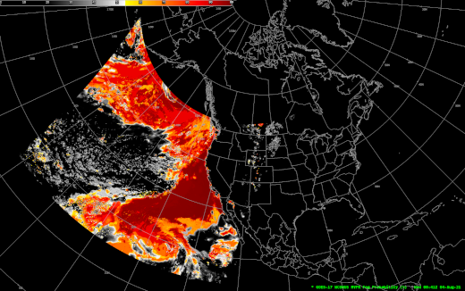
Satellite Data Products coming soon
New GOES-16,17 Mesoscale Sector Fire Hotspots on SBN (Sept. 8, 2021)
18 GOES-17 L2 Derived Products to be added to SBN (Sept. 27, 2021)
GOES-17 Fog & Low Stratus on SBN (Oct. 2021)
Operational Readiness Review Aug. 24; SPSRB decision Sept. 15
GOES-17 L2 Product Name | WMO ID | Sectors
Aerosol Detection | IXTA89 KNES | F | C | M
Aerosol Optical Depth | IXTB89 KNES | F | C
Cloud Top Phase | IXTD89 KNES | F | C | M
Rain Rate / Quant. Precip. Est. | IXTF89 KNES | F
Cloud Top Height | IXTG89 KNES | F | C | M
Clear Sky Mask | IXTH89 KNES | F | C | M
Cloud Top Temperature | IXTI89 KNES | F |  | M
Fire Hotspots | IXTJ89 KNES | F | C | Note 1
Land Surface Temperature | IXTK89 KNES | F | C | M
Sea Surface Temperature | IXTM89 KNES | F
Derived Stability Indices | IXTN89 KNES | F | C | M
Total Precipitable Water | IXTO89 KNES | F | C | M
Legacy Vert. Moisture Profile | IXTP89 KNES |  | C*
Legacy Vert. Temp. Profile | IXTQ89 KNES |  | C*
Derived Motion Winds | IXTU89 KNES |  | Note 2 | M
Cloud Particle Size Distribution | IXTW81 KNES | F | C | M
Cloud Top Pressure | IXTX81 KNES | F | C
Cloud Optical Depth | IXTY81 KNES | F | C
F = Full Disk; C = West CONUS; M = Mesoscale sectors * Profiles will be available at a reduced cadence: only 2/hour (like the G-16 profiles) Note 1: GOES-16,17 Meso Fire Hotspots will be on SBN as of Sept. 8, 2021. Note 2: GOES-17 Derived Motion Winds (W. CONUS) have been on SBN since 2019.
GOES-17 Fog & Low Stratus (West CONUS sector) seen in AWIPS

Slide 4
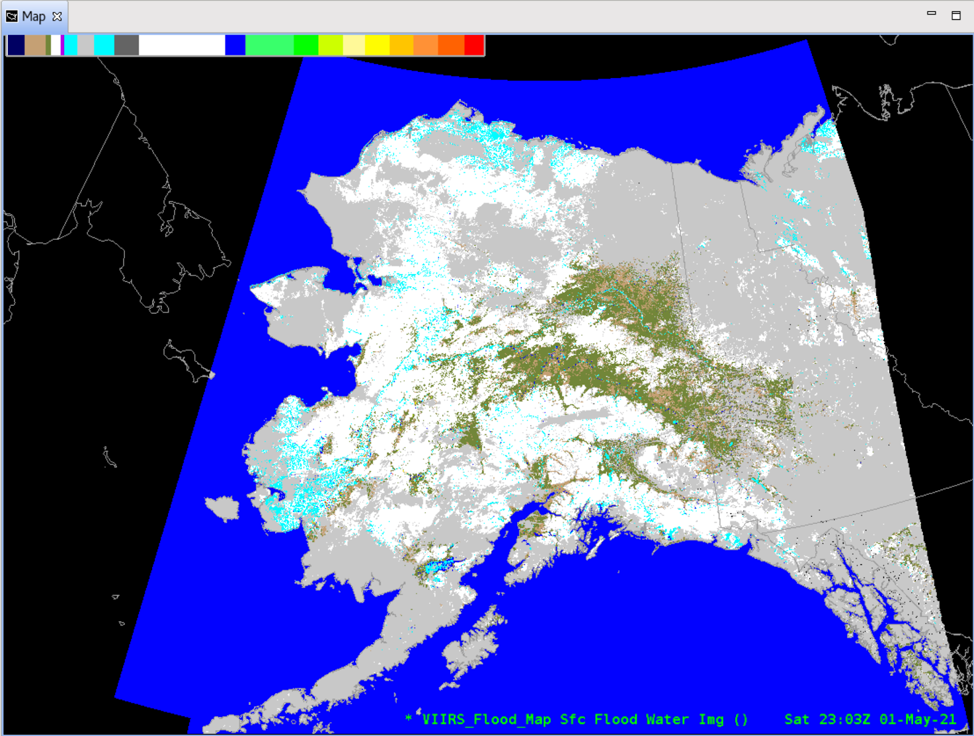
Additional Satellite Data Products in Planning
VIIRS Flood Mapping: new operational product w/ 6 regional grids
Himawari-8 Imagery and L2 products via PDA
Synthetic Aperture Radar (SAR) from Sentinel and RadarSat (coastal regions)
ASCAT Ocean Surface Winds (Metop-B,C): expanded geographic coverage
Exploring dissemination options for expanded set of VIIRS M-Band (750m) Imagery from S-NPP and NOAA-20
JPSS EDRs / Level-2 Derived Products:
S-NPP, NOAA-20 VIIRS Active Fires (I-Band), Aerosols, Volcanic Ash, and Ice Concentration
S-NPP, NOAA-20 ATMS MiRS
GCOM AMSR-2 Ocean Winds and Microwave Brightness
(... in addition to S-NPP, NOAA-20 VIIRS Imagery and NOAA-20 CrIS/ATMS NUCAPS soundings)
Changes to GOES-16,17 SCMI bands and sectors on SBN (Public Information Statement [PNS] in progress)
Phase 1
Cease creation/transmission of the "Hawaii Regional" SCMI sector, for all bands (1-16)
Increase spatial resolution of Channel 13 (IR Window) to full (2 km) resolution for Northern Hemisphere
Add "American Samoa Regional" sector for Channel 13 (IR Window) at full (2 km) resolution
Phase 2: Cease SBN transmission of all reduced-resolution (6 km) Southern Hemisphere imagery from the Full Disk, for all bands
Phase 3: Transition Channel 16 (CO2 Band) from SBN to PDA/Data Delivery (for northern hemisphere), for all sectors (Full Disk, CONUS, Meso)
ISRO OceanSat-3 to launch in Oct. / Nov. 2021
First Surface Winds data expected in Mar. 2022; operational products in May 2023
VIIRS Flood Mapping (Alaska mosaic) seen in AWIPS

Slide 5
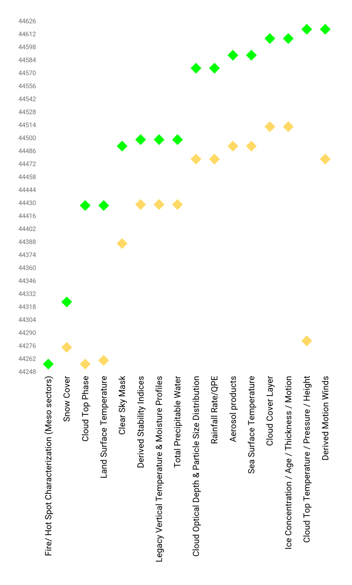
Enterprise GOES-R L2 products
GOES-R Ground System development timeline
Reviewed products in AWIPS
CY2021 |  |  |  |  |  |  |  |  |  | CY 2022
Mar | Apr | May | Jun | Jul | Aug | Sep | Oct | Nov | Dec | Jan | Feb | Mar
(GOES-R Meso Fire Hotspots now available to AWIPS sites via Regional LDM)
NESDIS Development Environment (DE)
=> Integration
- AWIPS config
- Initial feedback
- Preliminary cloudReach
- focus is on champions
Operational PDA availability
- RPM Configured
- Dataflow to sites in process
- cloudReach
- training
- SBC
- focus on SatAware community
TOWR-S RPM v 21
TOWR-S RPM v 22
August 27, 2021
Reviewed precursor products (fielded in TOWR-S RPM v20)
Updated 2021-08-23
Note: Some of these data products will reach AWIPS sites via SBN; others via AWIPS Data Delivery or other mechanisms

Slide 6
Coming soon: TOWR-S RPM v22
Targeting October 2021. Tentative contents (subject to change):
VIIRS I-Band Active Fires support (DMW-friendly files via AWC ISatSS)
Support for GOES-R Enterprise LST and Cloud Phase (retained from v21)
Meso/CONUS Combo menus
Gridded NUCAPS: 2m Temperature in °F; Precipitable Water in inches; Haines Index atmospheric layers
Rocket Plume RGB
APP Geocolor will appear in main Satellite menu
Configuration for future Blended Hydro Products (details under discussion w/ STAR)
ASCAT 4-category legend (includes 25-33 kt category)
Improved colormap for CIMSS GOES-R Turbulence Probability product
Remove AWIPS 20.2.3 baseline content
APP v22 (incl. Geocolor, GLM averaging, VIIRS Active Fires RGB)

Slide 7
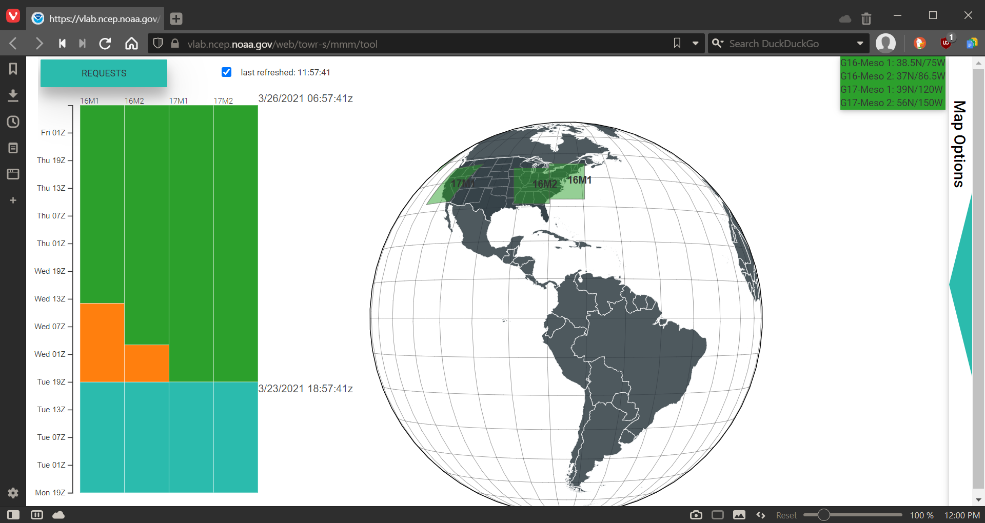
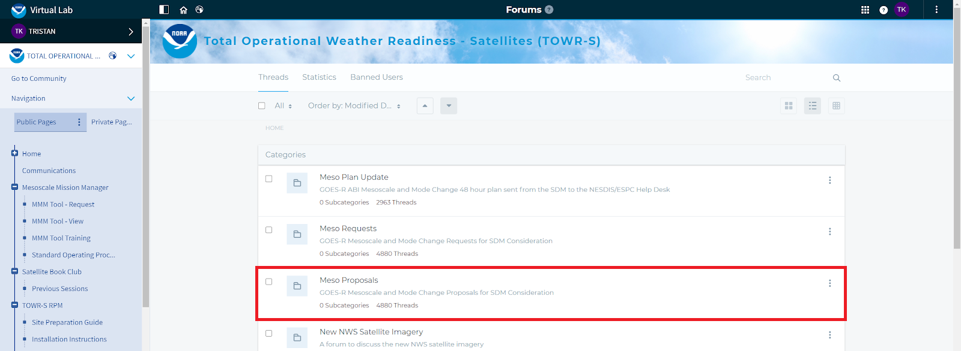
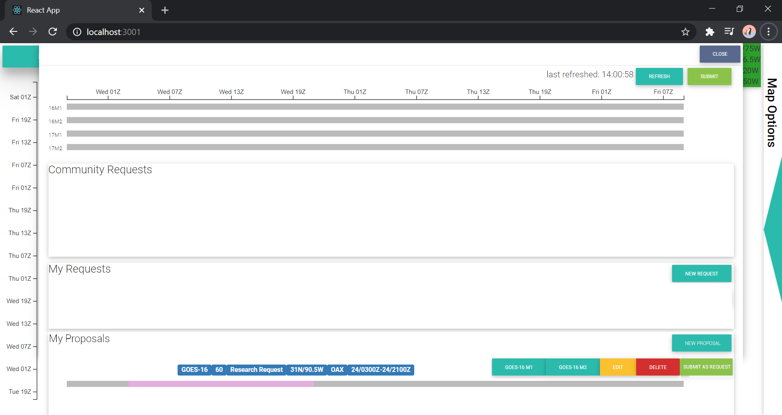
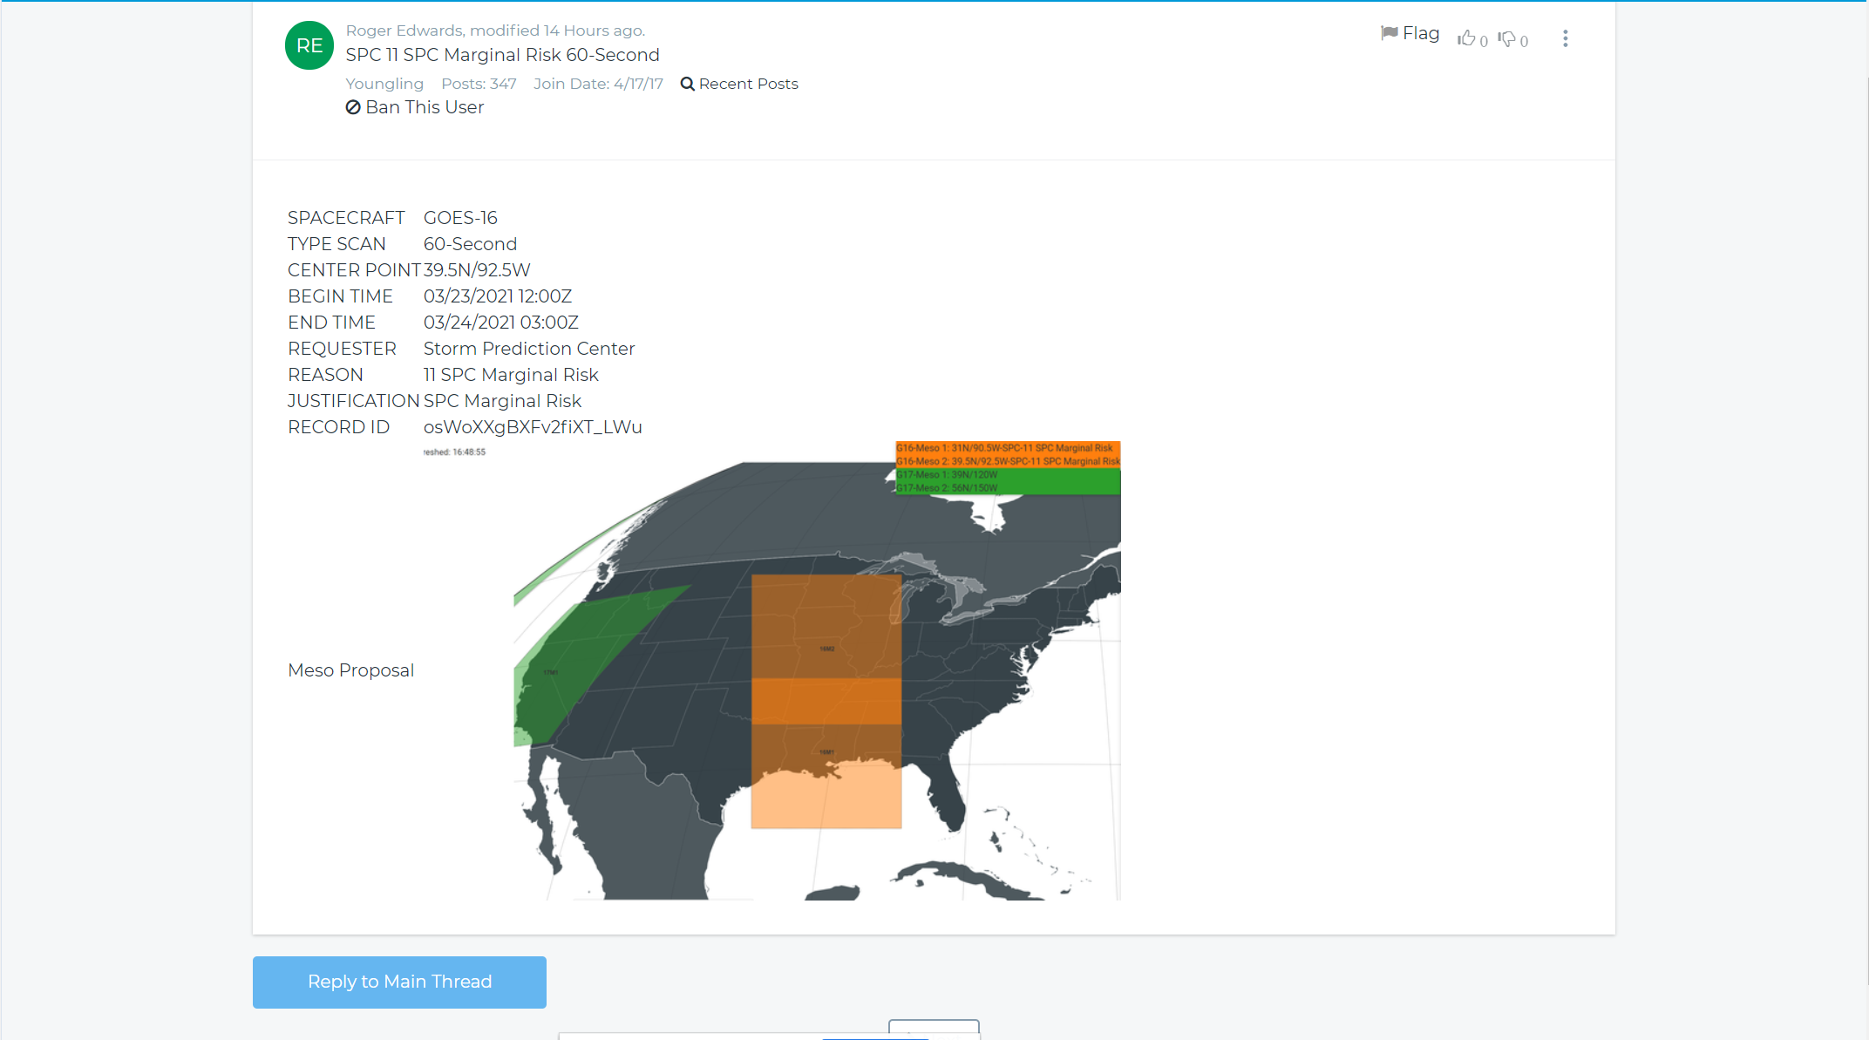
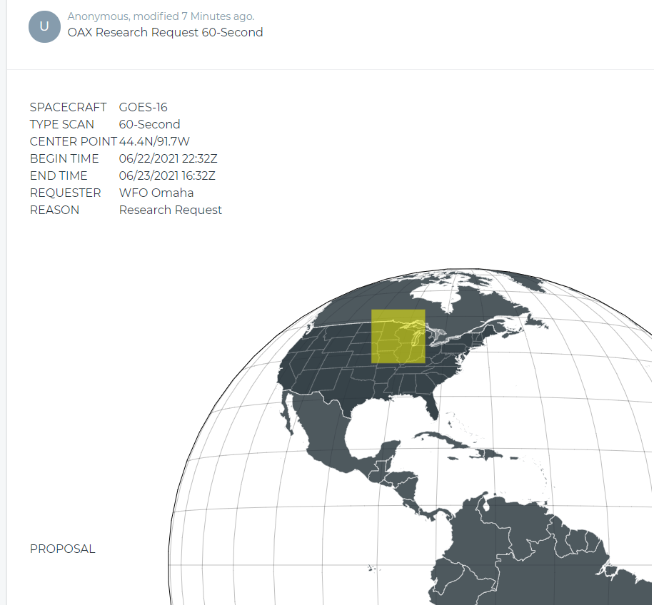
Mesoscale Mission Manager (MMM) Meso Domain Sector Proposals
Development was driven by requirements from the MDS Core Team
Revisions to MDS Standard Operating Procedure now in progress

Slide 8
Satellite Book Club (SBC) Seminar Series
Thursdays, usually at Noon ET
Usage examples shed light on user requirements for satellite data products and capabilities
Recordings are on the SBC page in the NOAA VLab and the NWS Commerce Learning Center (CLC) website
Recent Sessions:
July 8: Kevin Thiel (SPC / SSB), Summer 2021 Hazardous Weather Testbed Activities
July 15: Dan Bikos/Jim Ladue (OCLO), Data Fusion Techniques for Forecasting and Decision Making for Severe Thunderstorms
July 22: Chad Gravelle (SR HQ) and Jordan Rabinowitz (ER HQ), GOES-R Mesoscale Mission Manager Tool Overview and Demonstration
July 29: Sean Helfrich and Chris Jackson (NESDIS/STAR), Tropical Cyclone Winds from Synthetic Aperture Radar
Aug 5: Rebeka Esmaili (STC), Satellite Soundings via Open-source Tools for Situational Awareness
Aug. 12: Sean Campbell (Leesburg CWSU), Satellite data in aviation support
Aug. 19: Katie Crandall Vigil (CIMMS / OPGA), Color Vision Deficiency and Interpreting Satellite RGBs
Aug. 26: Jeremy Michael (TWC), Satellite Applications at WFO Tucson
Upcoming topics:
Using NUCAPS soundings
Satellite data assimilation
Burn scars and flash floods
VIIRS applications
GOES-R Socioeconomic Benefits
Notes:
The Satellite Book Club Seminar Series is convened weekly on Thursdays, providing an opportunity for scientists throughout the NOAA satellite domain to share a topic of interest to them with their peers. Topics may include applications of satellite data in the field, new and exciting changes to both polar and geostationary programs, and anything else satellite-related that the field would like to discuss.

Slide 9
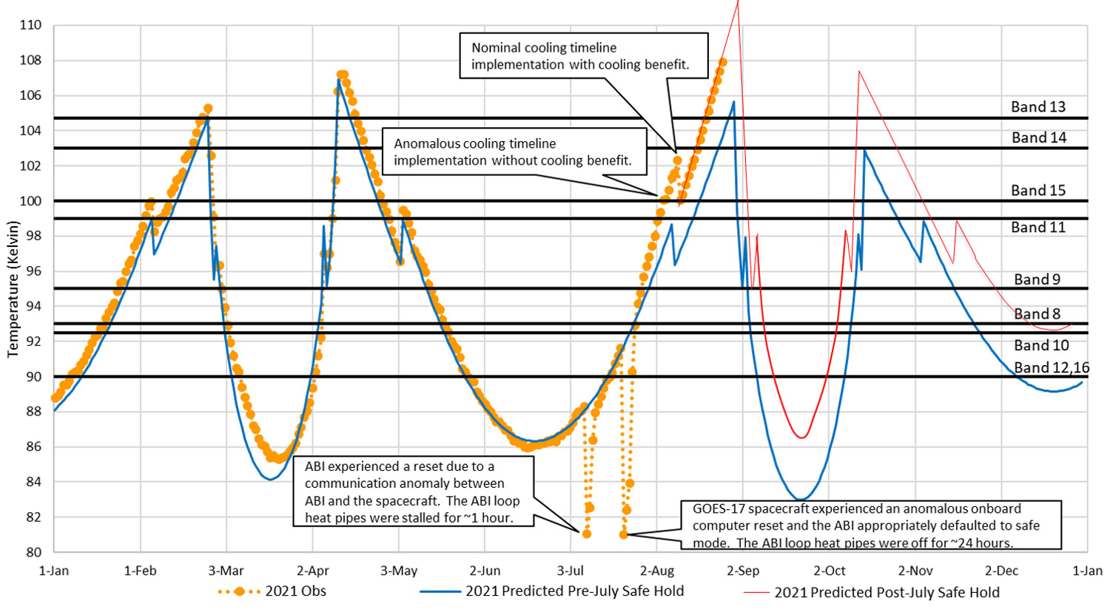
GOES-17 ABI Cooling Anomaly:
2021 warming trend and effects of July anomaly
Post-meeting update
GOES-R Program - Aug. 27
This plot shows daily maximum temperature of the ABI focal plane module. These maximums occur at night. The higher the temperature, the more saturated imagery becomes. Where the temperature rises to approach the black line for each band, marginal saturation may be observed in imagery. Where the temperature curve exceeds the black line for each band, the imagery may be degraded or even unusable.

Slide 10
GOES-17 ABI Cooling Anomaly: Looking ahead
Post-meeting update
Cooling appears to have worsened after the July spacecraft anomaly.
FPM temperatures may remain 3 to 4 °K warmer than projections.
Thus, in each of the G-17 “warm seasons,” image degradation will start sooner and last longer.
In particular, some degradation of water vapor imagery (Bands 8, 10) is likely through most of Oct. ‘21-Feb. ‘22
NWS may request GOES-15 operations for all 4 upcoming G-17 “warm seasons.”
Until the July spacecraft anomaly is better understood, GOES-14 (at 105°W) has been placed in "hot backup" status, for 24-hr failover from GOES-16 or GOES-17.

Slide 11
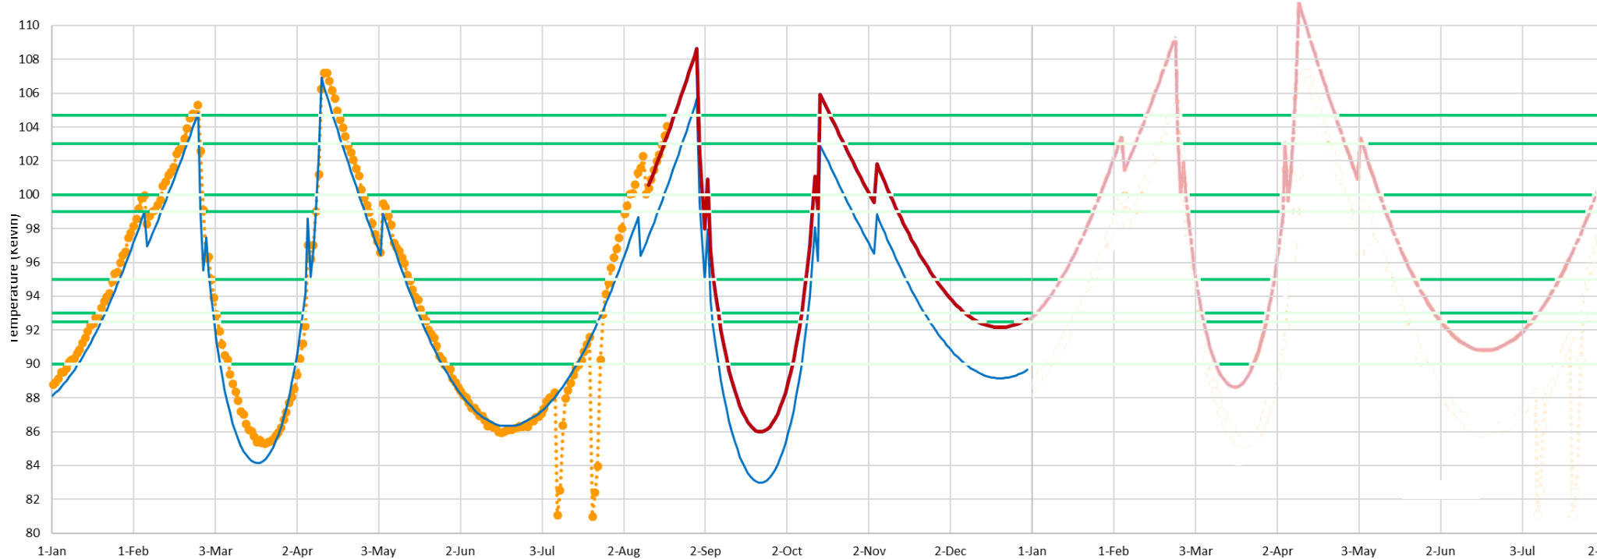
GOES-17 ABI Cooling Anomaly
To be updated
Band 13
Band 13
Band 14
Band 14
Band 15
Band 15
Band 11
Band 11
Band 9
Band 9
Band 8
Band 8
Band 10
Band 10
Band 12,16
August 27, 2021
Band 12,16
2021 G-17 FPM temperatures observed and predicted by GOES-R
2022 extrapolation by TOWR-S
2021
2022
This plot extrapolates the 2021 plot from GOES-R into 2022 (assuming 2021’s exact warming trend continues).
NOTE: This is not GOES-R’s projection; GOES-R expects to update its predictive model in Dec. 2021.
But for now, this may suggest when to expect degradation in the various ABI bands in 2022.

Slide 12
NWS preparations for GOES-T (GOES-18)
Launch dates under consideration: Jan. 8, Jan. 16, or Feb. 16, 2022
NWS has requested operational availability as soon as possible
Aiming for GOES-18 ABI data products (partially validated) to be available to NWS by Aug. 2022
Accelerated Transition to Operations
Split Post-Launch Test schedule (Part 1 @ 89.5°W; Part 2 @ 136.8°W) should allow dissemination of (at least) Beta ABI data products from GOES-18 by Aug. 2022
GOES-18 data dissemination:
Via GOES Rebroadcast (GRB) and NOAA’s cloud computing platform
GRB will interleave GOES-18 ABI data with GOES-17 GLM and space weather data
The NWS Satellite Broadcast Network will send GOES-18 or GOES-17 data (but not both)
Plans/schedules remain tentative. NWS / GOES-R planning & readiness process will ramp up in Sept. 2021 as the launch schedule and other variables firm up

Slide 13
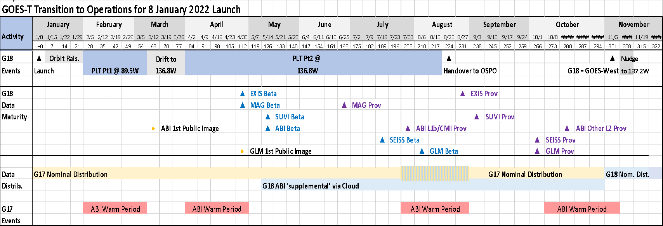
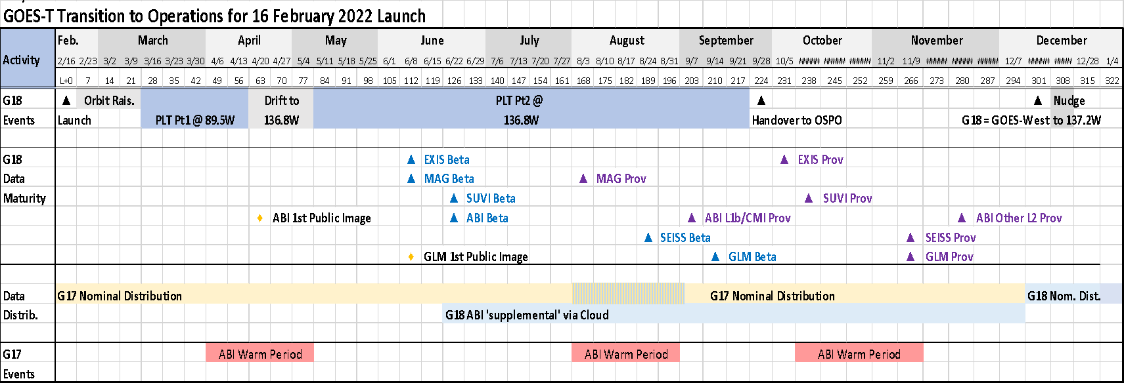
GOES-West Transition Plan for GOES-17→18
Comparing Jan. 8 vs. Feb. 16, 2022 Launch Dates
Only difference: GOES-18 ABI L1b/CMI reaches Provisional Maturity at the beginning vs. end of the GOES-17 warm season / GRB interleave period.
Note cloud-based distribution of GOES-18 ABI data starting at Beta maturity (May / June).
Pacific Hurricane Season
Interleaved GRB
Based on graphics from the GOES-R Program
Pacific Hurricane Season
Interleaved GRB

Slide 14
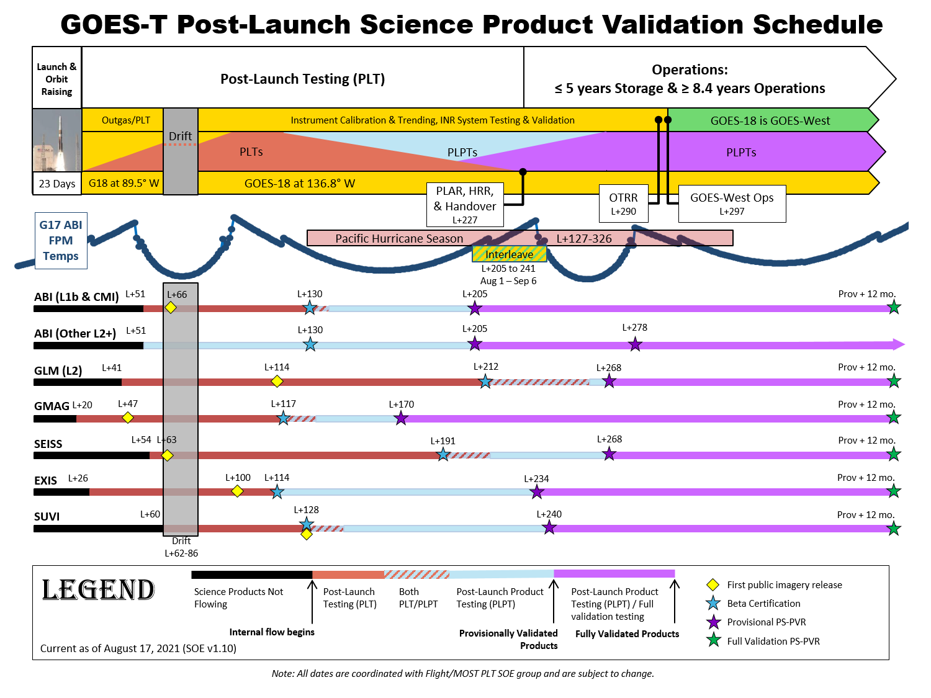
Jan. 8, 2022 launch
Jan. 2022 | Feb. 2022 |  | Apr. 2022 | May 2022 | Jun. 2022 | Jul. 2022 | Aug. 2022 | Sep. 2022 | Oct. 2022 | Nov. 2022 | Dec. 2022 | Jan. 2023 | Feb. 2023
Based on graphics from the GOES-R Program
Months are approximate

Slide 15
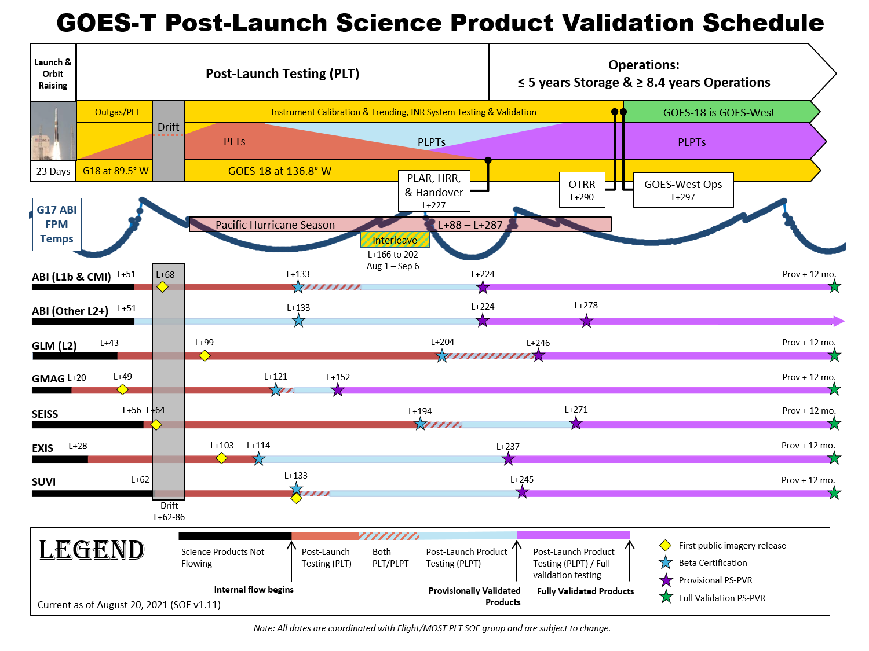
Feb. 16, 2022 launch
Jan. 2022 | Feb. 2022 | Mar. 2022 |  | May 2022 | Jun. 2022 | Jul. 2022 | Aug. 2022 | Sep. 2022 | Oct. 2022 | Nov. 2022 | Dec. 2022 | Jan. 2023 | Feb. 2023
Based on graphics from the GOES-R Program
Months are approximate
Jan. 2022 | Feb. 2022 | Mar. 2022 |  | May 2022 | Jun. 2022 | Jul. 2022 | Aug. 2022 | Sep. 2022 | Oct. 2022 | Nov. 2022 | Dec. 2022 | Jan. 2023 | Feb. 2023

Slide 16
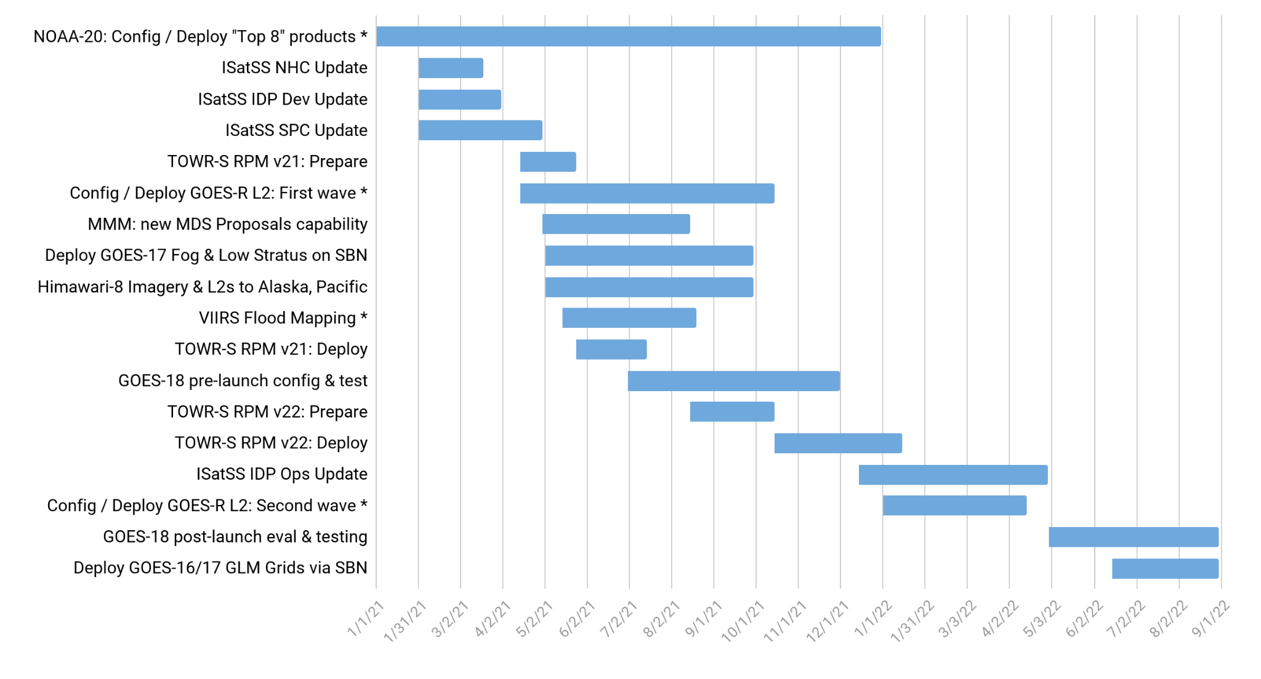
TOWR-S Activity Plan
CY2021 |  |  |  |  |  |  |  |  |  |  |  | CY2022
J | F | M | A | M | J | J | A | S | O | N | D | J | F | M | A | M | J | J | A
August 27, 2021
Notes:
Future dates are tentative / subject to change due to external dependencies
* Furthermore, availability of some data products at AWIPS sites may depend on progress of the AWIPS Data Delivery project

Slide 17
Contact Information
Office of Observations
Brian Gockel – brian.gockel@noaa.gov
Jordan Gerth – jordan.gerth@noaa.gov
Total Operational Weather Readiness – Satellites (TOWR-S) Team
John Evans – john.d.evans@noaa.gov
Lee Byerle – lee.byerle@noaa.gov
Links
NWSChat (“towr-s” chatroom)
TOWR-S in the NOAA VLab

Slide 18
TOWR-S Update
Next Updates (tentative):
October 29, 2021
December 30, 2021 > January 21, 2022

Slide 19
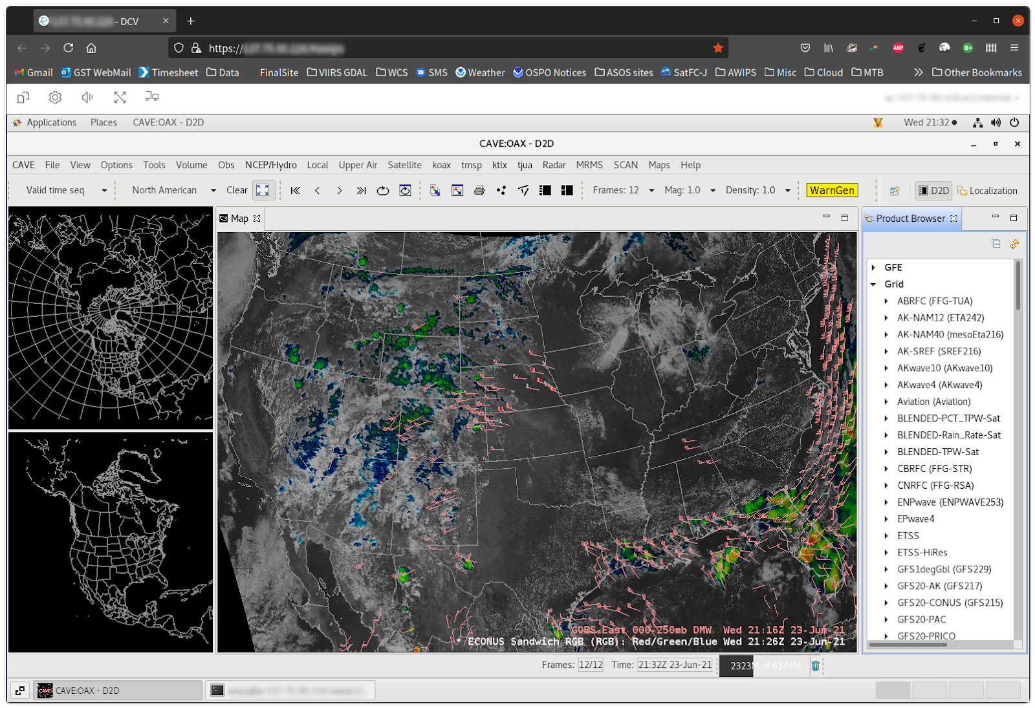
cloudReach: Share an AWIPS session in Web browsers
Example focus areas
Severe weather
Dust / snow events
Forecaster orientation
Acquainting data providers with data usage patterns
Activities include
Revisit weather events using saved data streams
Preview data products, color tables, menus
Prepare seminar presentations …. etc.
Outcomes
Address any “easy fixes” like color maps, display units
Identify performance/application questions early in the transition process
Enhanced dialog among & between forecasters, developers, and scientists
Sharpen understanding of how to improve forecasts with satellite data

Slide 20
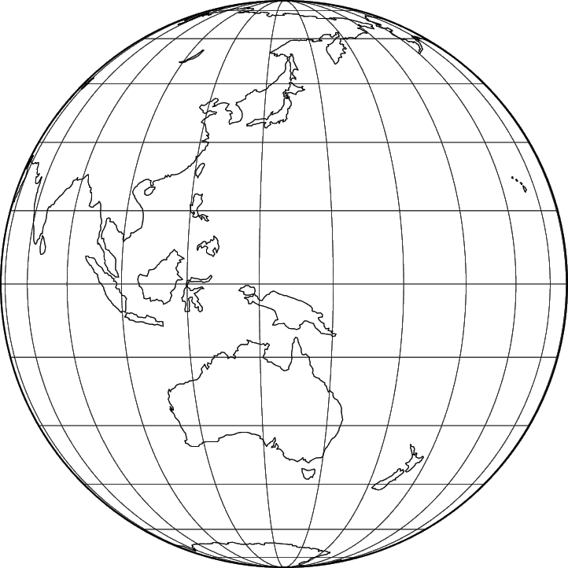
Himawari-8 AHI Cloud & Moisture Imagery
Available summer ‘21 from NESDIS / PDA: tiled Himawari-8 Cloud and Moisture Imagery (CMI) -- Full-Disk tiles and floating (target) sector
Currently available via IDP and AWC & NHC ISatSS
Also publicly available via the Amazon cloud: https://noaa-himawari8.s3.amazonaws.com/index.html
NCF will obtain tiles from PDA using Standing Subscriptions and will disseminate data via LDM to the Alaska and Pacific Regions
NCF can send specific CMI tiles (01-88) needed by these regions
Now scheduling network configurations for data flows to OCONUS
 |  | 01 | 02 | 03 | 04 | 05 | 06
 | 07 | 08 | 09 | 10 | 11 | 12 | 13 | 14
15 | 16 | 17 | 18 | 19 | 20 | 21 | 22 | 23 | 24
25 | 26 | 27 | 28 | 29 | 30 | 31 | 32 | 33 | 34
35 | 36 | 37 | 38 | 39 | 40 | 41 | 42 | 43 | 44
45 | 46 | 47 | 48 | 49 | 50 | 51 | 52 | 53 | 54
55 | 56 | 57 | 58 | 59 | 60 | 61 | 62 | 63 | 64
65 | 66 | 67 | 68 | 69 | 70 | 71 | 72 | 73 | 74
 | 75 | 76 | 77 | 78 | 79 | 80 | 81 | 82
 |  | 83 | 84 | 85 | 86 | 87 | 88
Himawari Product | Sector | Refresh Rate |  | Latency | Nadir ground resolution
Cloud & Moisture Imagery | Full Disk tiles | 10 min |  | 10 min | 1, 2 km
Cloud & Moisture Imagery | Floating Sector | 2.5 min |  | 2.5 min | 0.5 km

Slide 21
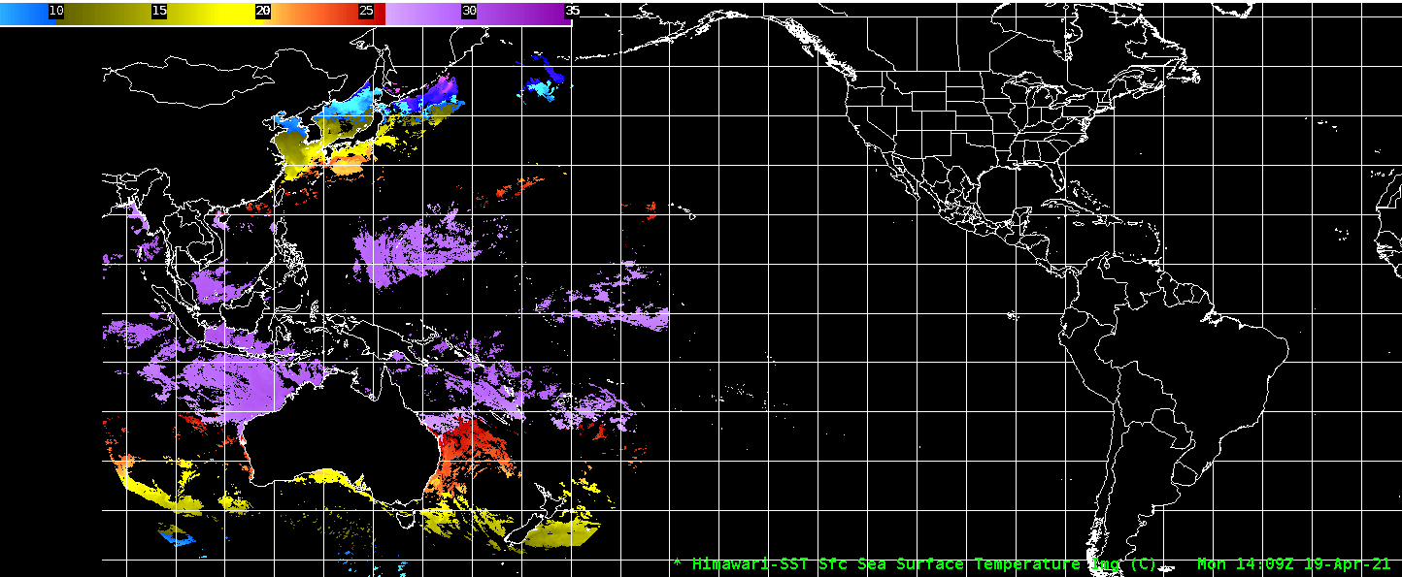
Himawari-8 L2 Derived Products
Available summer ‘21 from NESDIS / PDA: Full Disk L2 products
Also publicly available via the Amazon cloud: https://noaa-himawari8.s3.amazonaws.com/index.html
Now adapting data formats and configuring AWIPS
(Himawari Derived Motion Winds already going to Pacific Region)
Himawari Product | Sector | Refresh Rate |  | Latency | Nadir ground resolution
Rainfall Rate | Full Disk | 10 min |  | 10 min | 2 km
Sea Surface Temperature | Full Disk | 60 min |  | 10 min | 2 km
Clear Sky Mask | Full Disk | 10 min |  | 10 min | 2 km
Cloud Top Height, Pressure, Temperature | Full Disk | 10 min |  | 10 min | 2 km
Cloud Top Phase | Full Disk | 10 min |  | 10 min | 2 km
Derived Motion Winds | Full Disk | 10 min |  | 30 min | 2 km
NCF will obtain a subset (TBD) of these data products from PDA (trimmed to a few essential data fields) and disseminate them via LDM to the Alaska and Pacific Regions
National Centers will access these data directly from PDA

Slide 22
(1) Current Product Posture
Product | Delivery Mechanism (Activation) | Product Maturity | AWIPS Treatment (enhancement tables, ranges, units, rules…) | AWIPS Status (TOWR RPM date) | Target AWIPS Release (Blue = submitted)
ABI SCMI | G16 Mar ’17 SBN E | G16 Full |  | GOES-16/17 menus appear by default under Sat in v18.2.1
 | G17 Aug ‘18 SBN W | G17 Provisional: 11/28/18 G17 Full: 02/19/20
Bands 1-6 | “ | “ | Default General viewing VIS | Feb ‘17, Mature | 18.2.1
Band 7 | “ | “ | Default General viewing SWIR | Mar ‘17, Mature | 18.2.1
Band 7, 13-14 | “ | “ | Ocean/Land in winter IR | Mar ’17, Mature | 18.2.1
Bands 8-10 | “ | “ | Default General viewing WV | Mar ‘17, Mature | 18.2.1
Bands 8-10 | “ | “ | Low-level WV | Jun ‘17, Mature | 18.2.1
Bands 8-16 | “ | “ | Rainbow colors for dual IR, WV | Mar ‘17, Mature | 18.2.1
Bands 11-16 | “ | “ | Default General viewing IR | Mar ‘17, Mature | 18.2.1
Bands 11-16 | “ | “ | Summer, warm land areas | Mar ‘17, Mature | 18.2.1
Split Window Ch Diff |  |  | Blowing dust, volcanic ash, low-level water vapor (10.3-12.3um) | Jun ‘17, Mature | 18.2.1
Split Water Vapor Ch Diff |  |  | Gradients in UL WV (6.2-7.3um) | Jan ‘18, Mature | 18.2.1
Two Night Fog Ch Diffs |  |  | Gray/blue (2 menu buttons 10.3-3.9um, and 11.2-3.9um) | Jan ‘18, Mature, Aug ‘19 | 18.2.1 / 20.2.1

Slide 23
(2) Current Product Posture
Product | Delivery Mechanism (Activation) | Product Maturity | AWIPS Treatment (enhancement tables, ranges, units, rules…) | AWIPS Status (TOWR RPM date) | Target AWIPS Release (Blue = submitted)
Day Fog Ch Diff |  |  | Highlights fog over warmer surfaces, Opposite of Night fog CH diff (3.9-10.3um) | Jan ‘18, Mature | 18.2.1
Split Snow Ch Diff |  |  | Highlights snow cover over land (1.6-0.64um) | Jan ‘18, Mature (Avail all sectors-FG) | 18.2.1
Split Fire Ch Diff |  |  | Fire hot spot detection (2.2-1.6um) | Jan ‘18, Mature (Avail all sectors-FG) | 18.2.1
Split Ozone Ch Diff |  |  | Ozone detection (9.6-10.3um) | Jan ‘18, Mature | 18.2.1
Split Cloud Top Phase Ch Diff |  |  | Highlights ice clouds, phase variation (11.2-8.4um) | Jan ‘18, Mature | 18.2.1
Vegetation Ch Diff |  |  | Highlights Vegetation, land sfc variation (0.64-0.87um) | Mar ‘17, Mature (Avail all sectors-FG) | 18.2.1
GOES-16/GOES-15 Supernational “CONUS with Legacy” | (Menu to only show G-16 as of March 2, 2020) |  | ABI CHs 2,7,8,11,16 w/corresponding G-15 CHs | Feb ‘18, Eval | N/A
Day Cloud Phase Distinction RGB |  |  | Daytime cloud phase variation (10.35,0.64,1.61um) | Aug ‘17, Mature | 19.2.1
Fire Temperature RGB |  |  | Fire hot spot detection (3.90,2.25,1.61um) | Jun ‘17, Mature | 19.2.1
Day Land Cloud RGB |  |  | Day land cloud (1.61,0.87,0.64um) | Jun ‘17, Mature | 19.2.1
Day Cloud Convection RGB |  |  | Day convection as warm colors (0.64,0.64,10.35um) | Aug ‘17, Mature | 19.2.1

Slide 24
(3) Current Product Posture
Product | Delivery Mechanism (Activation) | Product Maturity | AWIPS Treatment (enhancement tables, ranges, units, rules…) | AWIPS Status (TOWR RPM date) | Target AWIPS Release (Blue = submitted)
Day Land Cloud Fire RGB |  |  | Day land clouds, fire (2.25,0.87,0.64um) | Jun ‘17, Mature | 19.2.1
Simple Water Vapor RGB |  |  | WV, Upper level circulation (10.35,6.19,7.34um) | Mar ‘17, Mature | 19.2.1
Air Mass RGB |  |  | Delineate air masses (6.19-7.34,9.61-10.35,6.19um) | Mar ‘17, Mature | 19.2.1
Ash RGB |  |  | Ash detection (12.3-10.35,11.2-8.5,10.35um) | Mar ‘17, Mature | 19.2.1
Day Convection RGB |  |  | Day convection (6.19-7.34,3.9-10.35,1.61-0.64um) | Aug ‘17, Mature (Avail all sectors-FG) | 19.2.1
Differential Water Vapor RGB |  |  | Water vapor contrast (7.34- 6.19,7.34,6.19) | Mar ‘17, Mature | 19.2.1
Day Snow Fog RGB |  |  | Day snow, fog (0.87,1.61,3.9-10.35um) | Jun ‘17, Mature | 19.2.1
Dust RGB |  |  | Dust (12.3-10.35,11.2-8.5,10.35um) | Mar ‘17, Mature | 19.2.1
Nighttime Microphysics RGB |  |  | Delineate night cloud phase (12.3-10.35,10.35-3.9,10.35um) | Mar ‘17, Mature | 19.2.1
SO2 RGB |  |  | Ash, S02 detection (6.95-7.34,10.35-8.5,10.35um) | Jun ‘17, Mature | 19.2.1

Slide 25
(4) Current Product Posture
AWIPS Release Dates:
20.2.1,2,3 – June 2021
20.3.1 – Sept. 2021
Product | Delivery Mechanism (Activation) | Product Maturity | AWIPS Treatment (enhancement tables, ranges, units, rules…) | AWIPS Status (TOWR RPM date) | Target AWIPS Release (Blue = submitted)
Daytime Composite #1 RGB |  |  | Highlight cold surfaces, cirrus (0.64,1.61,11.2um) | Baselined 16.1.x
Daytime Composite #5 RGB |  |  | Grayscale, Cirrus (0.64,0.87,0.64um) | Baselined 16.1.x
Day Ocean Cloud Convection |  |  | Daytime Ocean Convection (0.87,0.87, 10.35um) | June ’17, Mature | 19.2.1
CIMSS Natural Color RGB |  |  | Natural color, computes Green | Jan. ‘18, Mature (Avail all sectors-FG) | 19.2.1
Clear Sky Mask | G16 SBN Exp (May 31, ‘17) F,C,M | G16: Provisional | Display as binary mask | Baselined 16.1.x
 |  | *G17: Provisional (May 6, ’19)
Cloud Top Height, Temperature, Pressure | SBN Exp (31 May 17) Height: F,C,M Temp: F,M Pressure: F,C | G16: Provisional | Cloud Top Height in Ft, Temp in degC | June ‘17, Mature | 18.2.1
 |  | *G17: Provisional (May 6, ’19)
Cloud Top Phase | SBN Exp (May 31, ‘17) F,C,M | G16: Provisional | Clear, Water, Supercooled, Mixed, Ice, Uncertain | Baselined 16.1.x
 |  | *G17: Provisional (May 6, ’19)
Derived Stability Indices (CAPE,LI, KI, SI, TT) | SBN Exp (May 31, ‘17) F,C,M | G16: Provisional *G17: Provisional (May 16, ’19) | 10-bit colormap. Syncs to legacy GOES Sounder ranges | Aug. ‘17, Mature | 18.2.1
Aerosol Detection (ADP) | SBN Exp (May ‘17) F,C,M | G16: Provisional (Dec. 6, ‘18) | Separate Dust, Smoke. Hi/Lo/Med confidence | Feb. ‘18 RPM, Eval | 20.2.1
 |  | *G17: Provisional (June 27, ‘19)
*G-17 PS-PVRs are based upon cool season evaluations
F = Full Disk, C= CONUS, M= Mesoscale

Slide 26
(5) Current Product Posture
Product | Delivery Mechanism (Activation) | Product Maturity | AWIPS Treatment (enhancement tables, ranges, units, rules…) | AWIPS Status (RPM date) | Target AWIPS Release (Blue = submitted)
Aerosol Optical Depth | G16 SBN Exp (31 May 17) F,C | G16: Provisional (Sept. 14, ’18) | Display as binary mask. Fixed display range (0-1) | June ‘17, Mature | 18.2.1
 |  | *G17: Provisional (June 27, ’19)
Land Surface Temperature | SBN Exp (31 May 17) F,C,M | G16: Provisional | LST in degF | June ‘17, Eval | 19.2.1
 |  | *G17 Provisional (June 13, ’19)
Fire/Hot Spot | SBN Exp (31 May 17) F,C LDM: new Meso | G16 Provisional (Apr 24, ‘18) | Fire Temp, Power, Area | Aug. ‘17, Eval | 19.2.1
 |  | *G17: Provisional (July 25, ’19)
TPW | SBN Exp (31 May 17) F,C,M | G16: Provisional *G17: Provisional (May 16, ‘19) | TPW in Inches. 10-bit colormap based legacy GOES Sounder | Aug. ‘17, Mature | 18.2.1
COD | SBN Exp (31 May 17) F,C | G16: Provisional *G17: Provisional Day: 6/13/19 Night: 9/24/19 | Fixed max display range to 100% | Aug. ‘17, Mature | 18.2.1
Cloud Particle Size Distribution | SBN Exp (June 4, ‘17) F,C,M | G16: Provisional (Dec. 14, ’18) *G17: Provisional Day: 6/13/19 Night: 9/24/19 | Range 0-100um | Baselined
Derived Motion Winds | SBN Exp (June 14, ‘17) C (15min), M (5min) | G16: Provisional | By-Pressure displays as single color like legacy. Meso 1,2 now separate displays/database entries | Feb. ‘18, Mature | 19.2.1
 |  | *G17: Provisional (May 16, ’19)
Sea Surface Temperature | SBN Exp (17 Jan 18) F (hourly) | G16: Provisional | Colormap highlights TC threshold, Default display as DegF and DegC | March ‘18, Mature | 19.2.1
 |  | *G17: Provisional (July 25, ’19)
*G-17 PS-PVRs are based upon cool season evaluations
F = Full Disk, C= CONUS, M= Mesoscale

Slide 27
(6) Current Product Posture
Product | Delivery Mechanism (Activation) | Product Maturity | AWIPS Treatment (enhancement tables, ranges, units, rules…) | AWIPS Status (TOWR RPM date) | Target AWIPS Release (Blue = submitted)
Rainfall Rate, Quantitative Precipitation Est | SBN Exp (Jan 17, ‘18) F | G16: Provisional (March 31, ‘18) | Display in inches. Colormap syncs w/typical radar colors | March ‘18 | 18.2.1
 |  | *G17: Provisional May 16, ‘19
Legacy Vertical Temperature/Moisture Profiles | G16: SBN Exp (28 Feb 18) C (30min) | G16: Provisional | NSHARP profiles. Move menu under Derived products section | Baselined (16.1.x), Eval, profile cadence | 19.2.1
 |  | *G17: Provisional (May 16, ‘19)
NOAA-20 VIIRS Imagery (KPP to AK via terrestrial Networks) | ~Feb. ‘18 | Validated | I, M-bands, NCC | Feb. ‘18, Eval | 19.2.1
Snow Cover | TBD | G16/G17 Provisional 8/13/20
JASON 3 Wave Altimetry | SBN Exp (July 17, ‘18) | Operational, TT 194990 for slow load times, under investigation |  | Feb. ’18, dbgeo plugin | 19.2.1
CONUS Geostationary Lightning Mapper (GLM) | LDM Migration Ops G16 July 11, ’18 G17 Jun 10, ‘19 | G16: Full G17 Full: 5/21/20 | Flash Extent Density (FED) Grid, Average Flash Area, and Total Optical Energy for CONUS | April ’18 / June ‘18, Eval | 19.2.1 (FED)
G16/17 GLM Full Disk Punctured Tiles | LDM migration | G16/17 Full | 1- & 5-minute Flash Extent Density (FED), Total Optical Energy, Min. Flash Area | Nov. ‘20
GOES-16/17 Ice Products: Ice Concentration, Ice Age / Thickness, Ice Motion | LDM migration | Ice Concentration, Ice Age & Thickness: Provisional |  | Nov. ‘20
CIMSS Turbulence Probability (CONUS) | LDM migration |  |  | Nov. ‘20
*G-17 PS-PVRs are based upon cool season evaluations

Slide 28
(7) Current Product Posture
AWIPS Release Dates:
20.2.1,2,3 – June 2021
20.3.1 – Sept. 2021
Product | Delivery Mechanism (Activation) | Product Maturity | AWIPS Treatment (enhancement tables, ranges, units, rules…) | AWIPS Status (TOWR RPM date) | Target AWIPS Release (Blue = submitted)
Full Disk Geostationary Lightning Mapper (GLM) | LDM Migration Ops / Local Generation | G16: Full G17 Full: 11/21/19 | Flash Extent Density (FED) Grid, Average Flash Area, and Total Optical Energy | NHCN/NTBN/OPCN/ AWCN | TBD
GOES VIS/IR Sandwich RGB | N/A | N/A | CH 02, CH 13 Combo | March ’19 RPM | 20.2.1
GOES NDVI Vegetation Channel Difference | N/A | N/A | CH02, CH03 Combo | March ‘19 RPM Next RPM to include CSM | 20.2.1
ASCAT A, B, C Wind Speed / Direction and Ambiguities | N/A | N/A | DMW plugin | NHCN/NTBN/OPCN | Eval
SSMI F-15 85 GHz H,V and 36.5GHz H,V Microwave Imagery | ISatSS | N/A | GOES-R plugin, PCT RGBs | NHCN/NTBN | Eval
AMSR2 89.5 GHz AH, AV and 36.5 GHz AH, AV Microwave Imagery | ISatSS | N/A | GOES-R plugin, PCT RGBs | NHCN/NTBN/OPCN | Eval
GPM GMI 89.5 GHz H,V and 37 GHz H,V Microwave Imagery | ISatSS | N/A | GOES-R plugin, PCT RGBs | NHCN/NTBN | Eval
S-NPP ATMS QV 88 GHz Microwave Imagery | ISatSS | N/A | GOES-R plugin | NHCN/NTBN | Eval
AMSR2 Ocean products: Rain Rate, SST, TPW, Cloud Liquid Water, Wind Speed | ISatSS | N/A | GOES-R plugin | NHCN/NTBN/OPCN | Eval
JASON-3 Wave Heights and Wind Speeds | ISatSS | N/A | DMW plugin for numeric read-outs | NHCN/NTBN/OPCN | Eval
Cryosat-2 Wave Heights and Wind Speeds | ISatSS | N/A | DMW plugin for numeric read-outs | NHCN/NTBN/OPCN | Eval
Altika Wave Heights and Wind Speed | ISatSS | N/A | DMW plugin for numeric read-outs | NHCN/NTBN/OPCN | Eval
Sentinel-3A/3B Wave Heights and Wind Speeds | ISatSS | N/A | DMW plugin for numeric read-outs | NHCN/NTBN/OPCN | Eval
S-NPP & NOAA-20 VIIRS Active Fires | ISatSS | Validated | DMW plugin | All | TBD

Slide 29
(8) Current Product Posture
AWIPS Release Dates:
20.2.1,2,3 – June 2021
20.3.1 – Sept. 2021
Product | Delivery Mechanism (Activation) | Product Maturity | AWIPS Treatment (enhancement tables, ranges, units, rules…) | AWIPS Status (TOWR RPM date) | Target AWIPS Release (Blue = submitted)
NOAA-20 NUCAPS | SBN Jul 2, ‘19 |  | VIIRS NUCAPS plugin | Feb. ‘18 RPM | 19.2.1
NOAA-20 NCC/Day Night Band | SBN Jul 24/25, ’19 |  | VIIRS plugin | Feb. ‘18 RPM | 19.2.1 (DR 20707, 20708 fix “S-NPP” legend)
SSMIS F-16 91 GHz H,V and 37GHz H,V Microwave Imagery | ISatSS | N/A | GOES-R plugin, PCT RGBs derived param | NHC | Eval
SSMIS F-17 91 GHz H,V and 37GHz H,V Microwave Imagery | ISatSS | N/A | GOES-R plugin, PCT RGBs derived param | NHC | Eval
SSMIS F-18 91 GHz H,V and 37GHz H,V Microwave Imagery | ISatSS | N/A | GOES-R plugin, PCT RGBs derived param | NHC | Eval
National Center G-16 Full Disk GLM Grids | ISatSS | Full Nov ‘18 | GOES-R plugin | AWC, NHC, OPC, WPC | Eval
Himawari DMWs for Pacific Region | ISatSS | N/A | DMW plugin | N/A | Eval
SCATSAT Winds for OPC and NHC | ISatSS | Eval | DMW plugin | RPM v20 Nov. 2020 | TBD
GOES-16 Fog and Low Stratus (FLS) (STAR product) for OPC and NHC | ISatSS | Eval | GOES-R plugin | NHC, OPC | 21.3.1
GOES-16 Fog and Low Stratus (FLS) | SBN |  | GOES-R plugin | TOWR-S RPM v19 (Aug. 2020)

Slide 30
(9) Current Product Posture
AWIPS Release Dates:
20.2.1,2,3 – June 2021
20.3.1 – Sept. 2021
Product | Delivery Mechanism (Activation) | Product Maturity | AWIPS Treatment (enhancement tables, ranges, units, rules…) | AWIPS Status (TOWR RPM date) | Target AWIPS Release (Blue = submitted)
NESDIS multi-sat Imagery Composite (VIS/IR/LWIR/SWIR) | ISatSSSBN | N/A | NetcdfGrid plugin | NHC | 21.3.1
G-17 PACUS Sector DMWs | SBN Mar 10, ‘20 | Provisional May 16, ’19 | GOES-R plugin | Mar ‘20 | 20.2.1 (LDM, edex cfg)
NESDIS Global Blended (polar) TPW, % Normal TPW | SBN Mar 12, ‘20 | N/A | NetcdfGrid plugin | Mar ‘20 | 20.2.1
NESDIS Global Blended (polar) Rain Rate | SBN Mar 12, ‘20 | N/A | NetcdfGrid plugin | Mar ‘20 | 20.2.1
Meteosat Imagery for Ctrs (VIS/IR/SWIR/WV) | Oct ‘19 AWC, Feb ‘20 NHC | N/A | GOES-R plugin | N/A | TBD
G-16 ASOS Satellite Cloud Products (SCP) | SBN (May 27, 2020) | N/A | Text Db | N/A | N/A
G-17 ASOS Satellite Cloud Products (SCP) | SBN (Sept. 30, 2020) | N/A | Text Db | N/A | N/A

Slide 31
(1) Current Non-Product RPM Features
AWIPS Release Dates:
20.2.1,2,3 – June 2021
20.3.1 – Sept. 2021
Feature | Function/Description | AWIPS Status (TOWR RPM date) | Target AWIPS Release (Blue = submitted)
Legacy bundle for GOES-15 | Enables legacy display of G-15 | Jan ’18, Eval | Eval
Geostationary Map Scales | West, Center, East geostationary scales | Jan ‘18, Eval | 21.3.1
Frame controls from 64 to 300 | Ability to loop 300 frames | Eval | 21.3.1
CSPP/CIMSS Polar data description | Handles description of VIIRS/CIMSS prods (e.g. CSPP in goes-r plugin) | Feb ‘18 | Eval
LDM (pqact) Updates | LDM configuration for GOES-17 PACUS DMWs, and Blended Hydro (TPW, Rain Rate, PCT Normal TPW) | Updates steps are in RPM install instructions, but not in RPM | 18.2.1 / 20.2.1
GOES-East, GOES-West menu | Update from “GOES-17” to “GOES-West” | May/Jun ‘18 | 20.2.1
Add Sector, Satellite to CAVE Legend for G-16/G-17 RGBs, Derived Products, respectively | Improves Legend to delineate between loaded Sectors/Satellites | May/Jun ‘18 Eval | 20.2.1
Link to pqact setting examples for tailored sectors is here.

Slide 32
(2) Current Non-Product RPM Features
AWIPS Release Dates:
20.2.1,2,3 – June 2021
20.3.1 – Sept. 2021
Feature | Function/Description | AWIPS Status (TOWR RPM date) | Target AWIPS Release (Blue = submitted)
Color By Pressure for GOES wind vectors | Bundle/Menu to color by p-level or range (SET/WFO PUB contribution) | Feb ‘18 Eval | 20.2.1
Legend update to GOES wind vectors | Adds satellite (e.g. GOES-17/GOES-16) to display legend | Mar ’20 | 20.2.1
A2 Edex Ingest | Ingest patterns for GOES-17 DMWs/ Blended Hydro | Mar ’20 | 20.2.1
A2 Edex Plugin Descriptions | GLM AFA, TOE. Aerosol Detection (ADP) Hi/Med/Low confidence specification | Jun ‘18/ Feb ’18 | Eval (GLM) / 20.2.1 (ADP)
A2 Edex Purge Rules | Edex purging of processed Blended Hydro products | Mar ’20 | 20.2.1
GOES 10.35um (CH 13) DegF display cfg | Menu, colormap, style rules for Deg Fahrenheit option | Mar ‘20 Eval | TBD

