Slide 1
TOWR-S Update
September 30, 2022
https://meet.google.com/thn-pkwe-wbr
Total Operational Weather Readiness - Satellites
NWS Office of Observations
All are invited to insert comments on these slides

Slide 2
Overview
1. GOES-West Transition
2. Changes to GOES-R imagery on SBN
3. Preparing for JPSS-2 / NOAA-21 and changes to the JPSS constellation
4. Data Product updates & lookahead
GOES-R Profiles • GOES-R Fire Meso Hotspots • ASCAT winds
VIIRS Flood Maps • Himawari-9 transition • Himawari L2 products
Gridded GLM • GOES-R Enterprise products • Upcoming satellite launches
5. New from TOWR-S
ISatSS updates in IDP • TOWR-S Product Posture: searchable catalog
Satellite Book Club • TOWR-S monthly newsletter

Slide 3
1. GOES-West Transition

Slide 4
Daily Peak Temperatures of GOES-17 ABI Longwave Infrared Focal Plane Module
GOES-17 will have one final “Warm Season” and Mode 3 Cooling Timeline, Oct. 14 to Nov. 20, 2022 .
Oct. 13 - Nov. 16, 2022: operational interleave: GOES-West imagery on the Satellite Broadcast Network (SBN) and GOES Rebroadcast (GRB) will be from GOES-18 instead of GOES-17 (see next slide).
GOES-17 will be taken out of operations in January 2023.
Sept. 30, 2022
New dates announced Oct. 6

Slide 5
GOES-West Transition (1)
(now - Oct. 13, 2022) Normal operations:
All GOES-West data products on the GOES Rebroadcast (GRB) and Satellite Broadcast Network (SBN) are from GOES-17. No GOES-18 data are on GRB or SBN.
Supplemental Operations: GOES-18 ABI imagery and gridded GLM are disseminated to selected sites via the GeoCloud.
(Oct. 13 - Nov. 16, 2022) Interleaved operations: (SCN22-37 - dates have changed since the SCN was posted)
On GRB: GOES-17 GRB will convey GOES-18 ABI L1b, GOES-17 GLM, and GOES-17 Space Wx observations.
On SBN: GOES-West ABI imagery (SCMI) will be from GOES-18, not GOES-17; but GOES-West ABI L2+ products will continue to be from GOES-17 (despite any GOES-17 Loop-Heat Pipe degradation)
GOES-18 L1b / SCMI imagery attained Provisional maturity on July 27: ready for operational use and free to share
No GOES-18 L2 products will be activated on the SBN until Jan. 2023.
If obtaining data products outside of the SBN or GRB:
Any sharing or display of GOES-18 pre-Provisional data requires the caveat: “GOES-18 Preliminary, Non-Operational Data”
GOES-18 pre-Provisional data products are not approved for operational use.

Slide 6
GOES-West transition (2)
(Nov. 16, 2022 - ~Jan. 3>4, 2023) Back to Normal operations
Note: On Nov. 29 GOES-17 ABI Imagery on SBN will undergo several changes detailed below.
(As of ~Jan. 3>4, 2023) GOES-18 is operational as GOES-West:
All GOES-West data on GRB and SBN will be from GOES-18
On SBN: SCMI and L2 products will both be from GOES-18. (All are expected to be Provisional by then.)
Note: GOES-18 ABI imagery on SBN will undergo the same changes as GOES-17 ABI imagery (detailed below)
On GRB: GOES-18 GRB data stream begins; GOES-17 GRB stream ends
PDA will cease serving GOES-17 L1b and L2+ products
GOES-17 will be taken out of operations and moved to a storage orbit
Also see the GOES-18 Operational Readiness Timeline on VLab

Slide 7
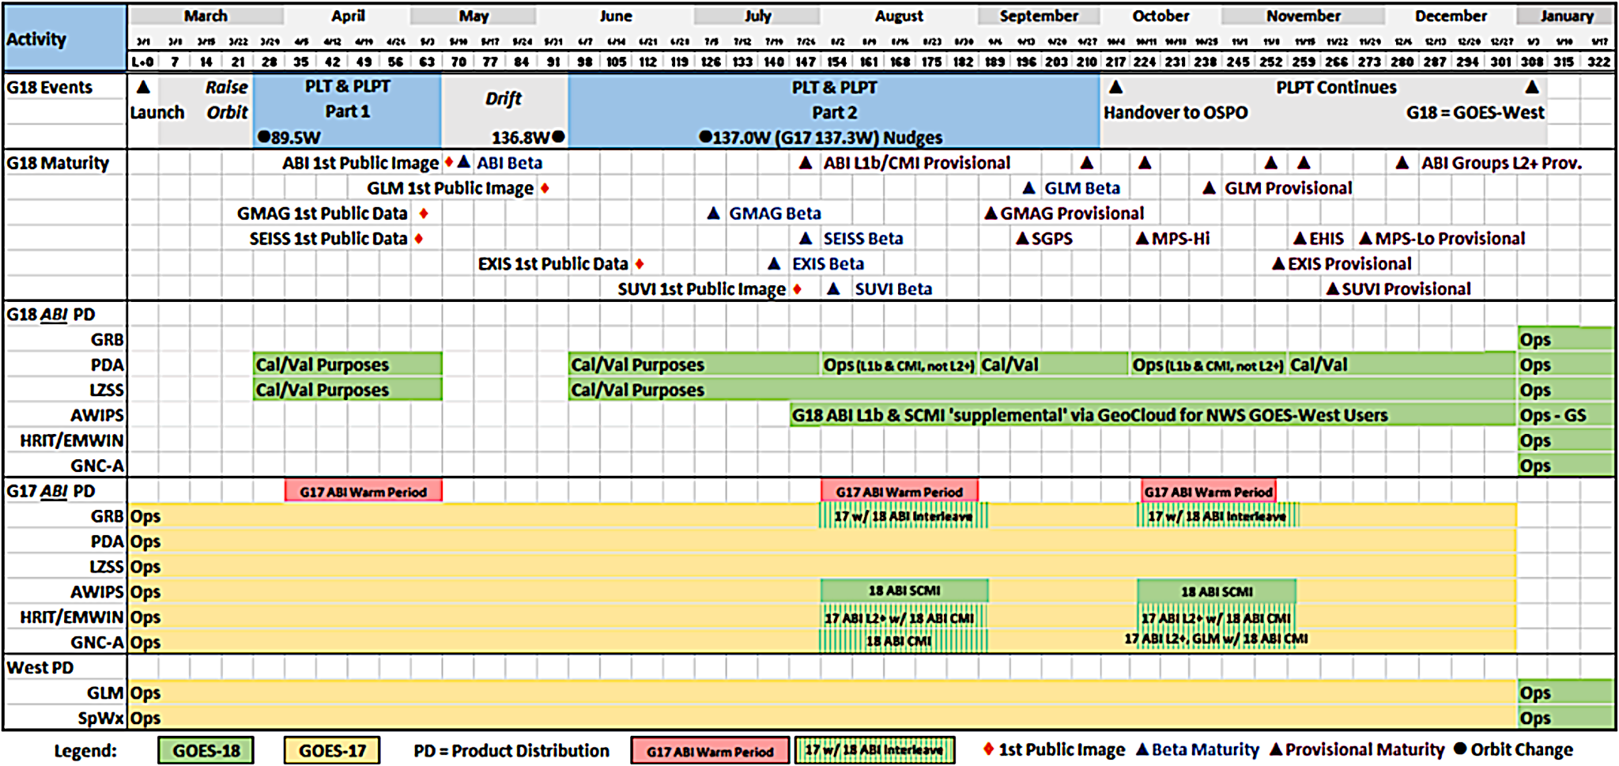
GOES-West Transition Plan for GOES-17→18
Sept. 30, 2022
GOES-18 SPLASH WG - Updated Sept. 9

Slide 8
GOES-18 Post-Launch Product Validation Schedule
More details on GOES-18 Transition to Operations are available from the GOES-R program
Jan. 4, 2023 (per GOES-R Pgm. on Oct. 7, 2022)
 | Mar. 2022 | Apr. 2022 | May 2022 | Jun. 2022 | Jul. 2022 | Aug. 2022 | Sep. 2022 | Oct. 2022 | Nov. 2022 | Dec. 2022 | Jan. 2023 | Feb. 2023 | Mar. 2023
Sept. 30, 2022
Months are approximate
Source: GOES-18 SPLASH WG

Slide 9
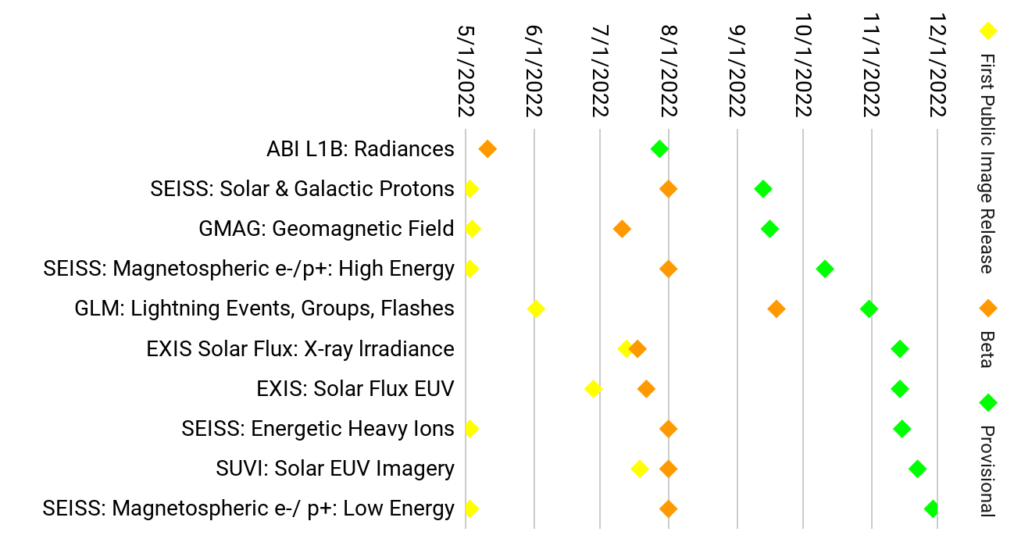
GOES-18 L1b products: Beta / Provisional Maturity timelines
GOES-18 L1B Products
Sept. 30, 2022
Based on GOES-18 SPLASH WG

Slide 10
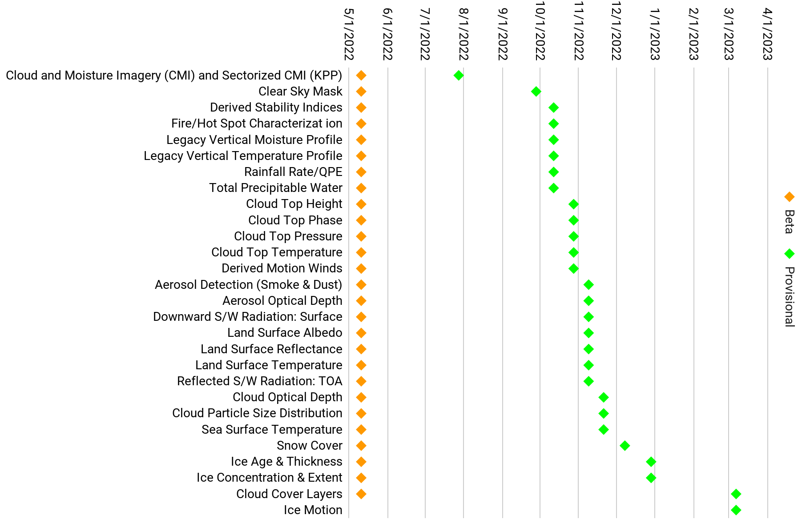
GOES-18 ABI L2+ products: Beta / Provisional Maturity timelines
GOES-18 ABI L2+ Products
GOES-18 ABI L2+ Products
Updated Oct. 6
Sept. 30, 2022
Based on GOES-18 SPLASH WG

Slide 11
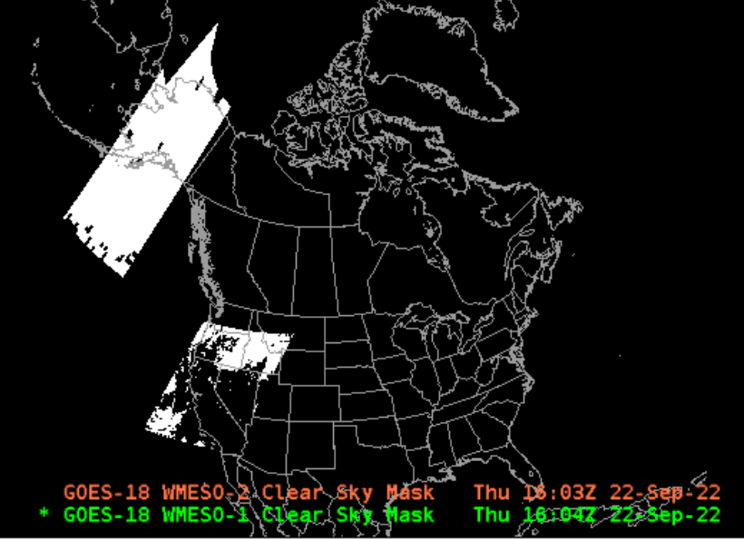
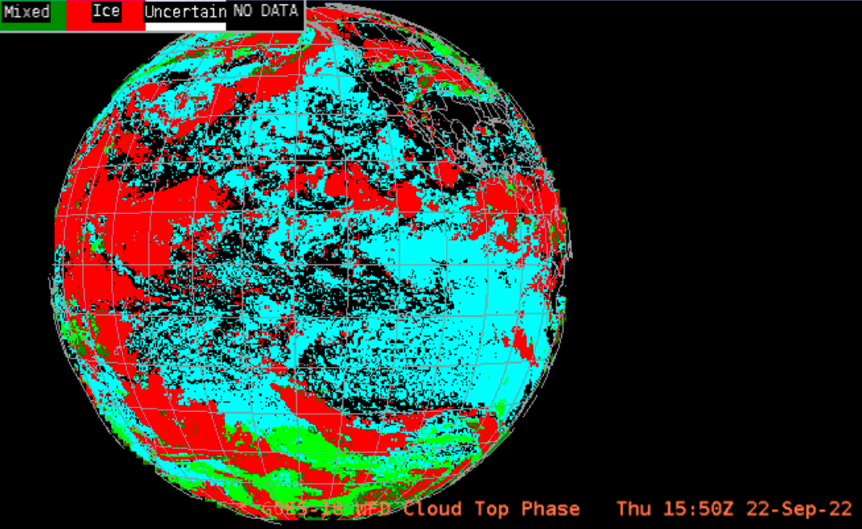
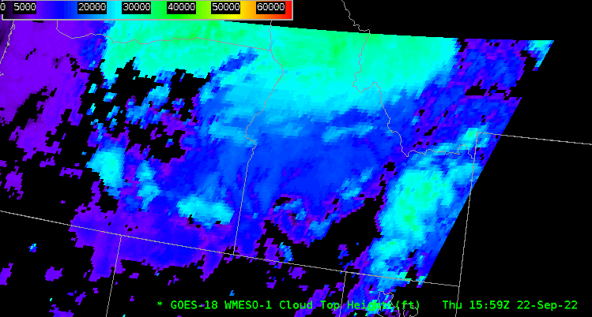
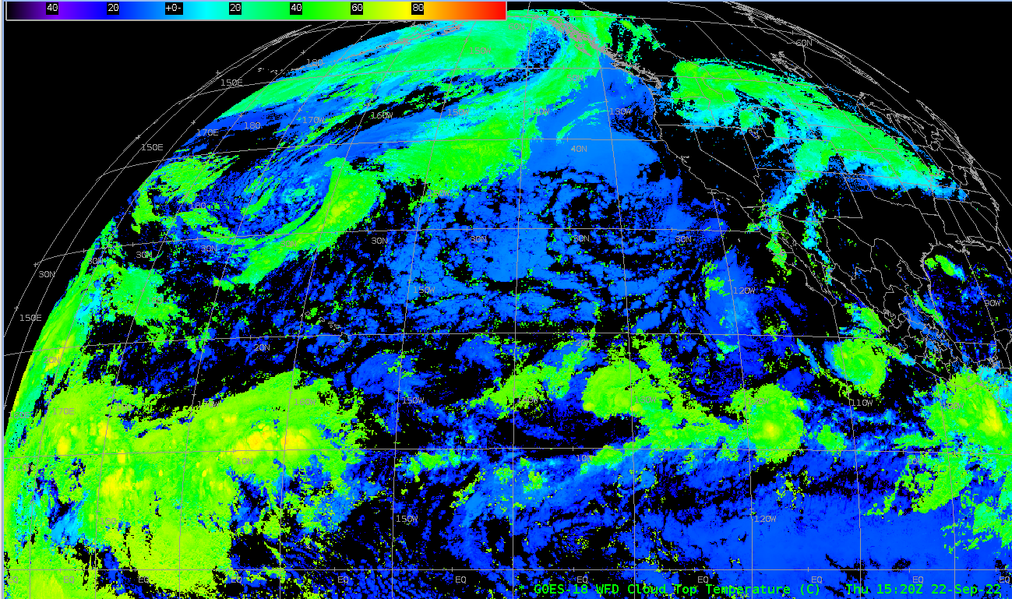
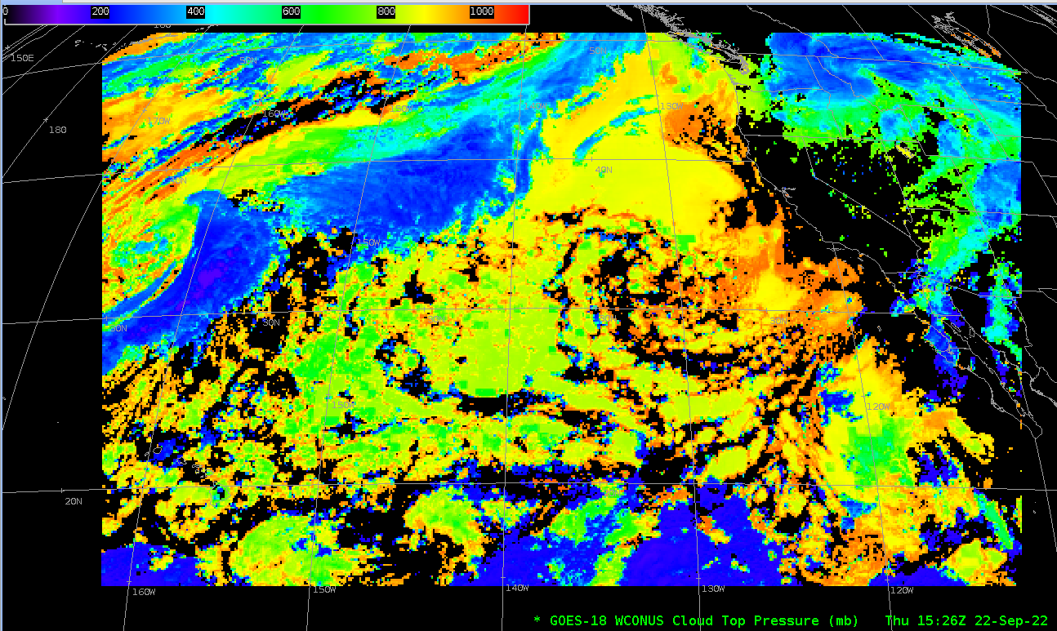
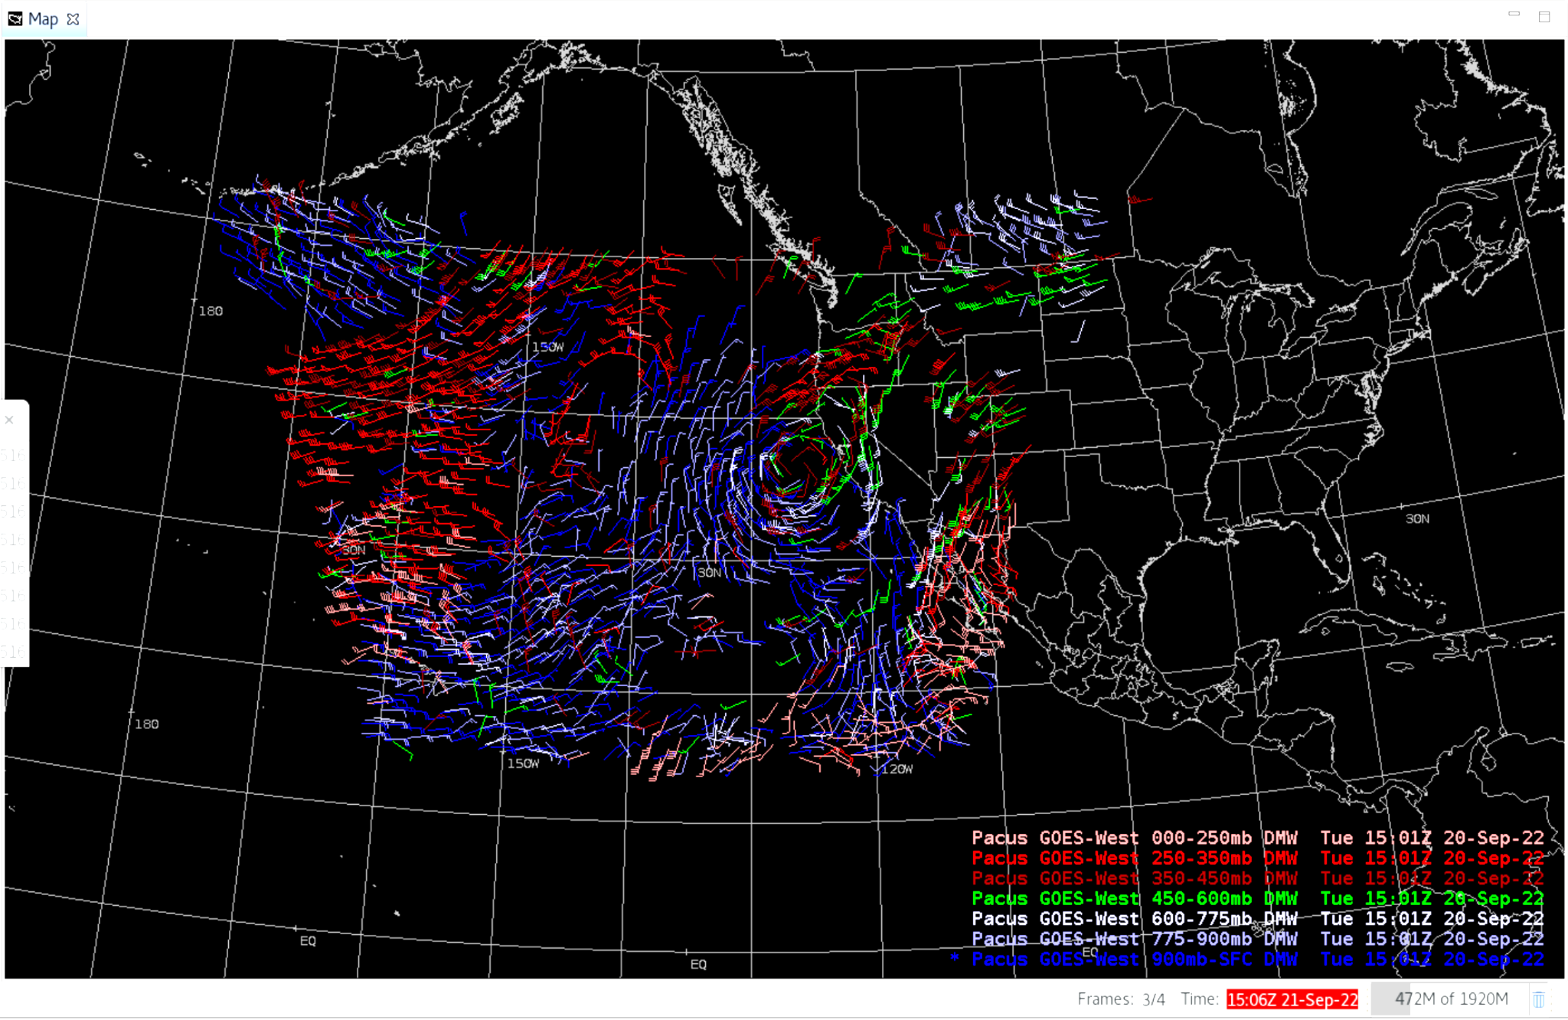
GOES-18 L2 products: Provisional maturity assessments
Between Sept. and Dec. 2022, 25 GOES-18 ABI L2 products will be evaluated for Provisional maturity. They are expected to be declared Provisional by the time GOES-18 is declared operational in Jan. 2023.
At that time (but not before) GOES-18 Provisional L2 products will replace their GOES-17 counterparts on SBN.
GOES-18 Cloud Mask
(Meso)
GOES-18 Cloud Phase
(Full Disk)
GOES-18 Cloud Top Height
(Meso)
GOES-18 Preliminary, Non-Operational Data
GOES-18 Derived Motion Winds
(W. CONUS)
GOES-18 Cloud Top Temperature
(Full Disk)
GOES-18 Cloud Top Pressure
(W. CONUS)

Slide 12
NWS readiness planning for GOES-18
ABI Imagery on SBN:
Configured NCF for GOES-18 for June 14 live test (GND-008) and Interleaved Operations.
Obtained informal evaluations from field sites (pre-OT&E) in June and August.
OT&E expected in Jan. 2023.
ABI L2 products:
Live tests, OPG review, and informal field evaluations (pre-OT&E) in Oct. - Dec. 2022.
OT&E expected in Jan. 2023.
GLM:
Obtained concurrence from ADMAC / SBNRC and AWIPS CCB to activate GOES-East,West gridded GLM onto SBN GRE/GRW channels.
Now configuring NCF to route G-16,17,18 gridded GLM. (G-17 will no longer be in operation when operational gridded GLM is expected.)
Internal and end-to-end tests to follow.
GRB:
Participated in mid-May live tests (GND-006, GND-009).
Installed GOES-18 configs for June 14 live test (GND-008) and Interleaved Operations.
Now ready for G-18 GRB stream in Jan. 2023.

Slide 13
2. Changes to GOES-R imagery on SBN

Slide 14
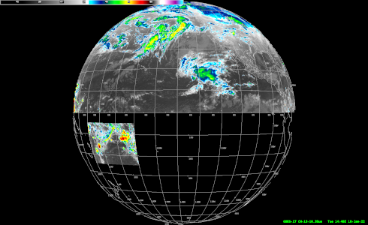
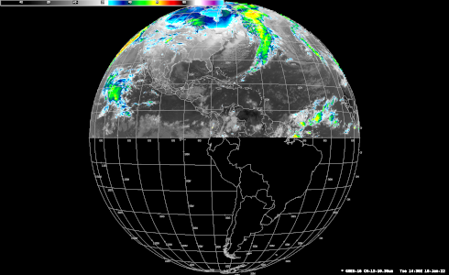
Changes to GOES-East,West ABI imagery on SBN: Dec. 1, Dec. 6
New dates announced Oct. 7, 11
Alaska regional
sector
W. CONUS (PACUS)
sector
CONUS
sector
Hawaii regional sector (until 12/06/2022)
Puerto Rico regional sector
(Bands 1-10, 13, 15 only as of 12/01/2022)
GOES-West “Full Disk” (as of 12/06/2022)
GOES-East “Full Disk” (as of 12/01/2022)
American Samoa regional sector (as of 12/06/2022)
(Band 13 only)
Full Disk
Band 13: 2 km pixels (as of 12/06/2022)
All other bands: 6 km pixels
Full Disk
Band 13: 2 km pixels (as of 12/01/2022)
All other bands: 6 km pixels
(Details on next slide)

Slide 15
Changes to GOES-East,West ABI imagery on SBN: Dec. 1, 6
GOES-R ABI Imagery (SCMI) on SBN will undergo the following changes as of Nov. 16>Dec. 1, 2022 (for GOES-16), Nov. 29>Dec. 6, 2022 (for GOES-17) (SCN22-94), and Jan. 13 for GOES-18.
Cease SBN transmission of all (reduced-resolution, 6 km) Southern Hemisphere imagery from the Full Disk, for all 16 bands*
Cease SBN transmission of the GOES-West Hawaii Regional sector*
Increase spatial resolution of Band 13 (IR Window) “Full Disk” imagery to full 2 km resolution on SBN*
Add Band 13 imagery (IR Window) at full 2 km resolution for a new GOES-West American Samoa Regional sector
New WMO header: TIRZ13 KNES
Omit Bands 11, 12, 14, and 16 from GOES-East Puerto Rico sector imagery
(* Listed in Public Information Statement PNS21-60 - Sept. 8, 2021)
Alaska regional
sector
Full Disk
Band 13: 2km pixels
All other bands: 6km
New dates announced Oct. 7, 11
W. CONUS (PACUS)
sector
GOES-West
Hawaii regional sector (until 12/06/2022)
American Samoa regional sector (as of 12/06/2022)
(Band 13 only)
Full Disk
Band 13: 2km pixels
All other bands: 6km
CONUS
sector
GOES-East
Puerto Rico regional sector
(Bands 1-10, 13, 15 only as of 12/01/2022)
NOTES:
The change will affect only GOES-R ABI imagery over SBN – not ABI L2 products; other instruments; or dissemination other than SBN.
Mesoscale and CONUS / W. CONUS (PACUS) sectors will not change.
These changes will be rolled back on ~Feb. 1, 2023 for a month; then reinstated permanently on ~Mar. 1, 2023.

Slide 16
3. Preparing for JPSS-2 / NOAA-21
and changes to the JPSS constellation

Slide 17
JPSS-2 launch and the JPSS Constellation
Launch, Early Orbit and Activation (LEO&A) (Launch to L+90 days)
after J. McNitt et al.
JPSS-2 launch: Nov. 1, 2022
Source: J. McNitt

Slide 18
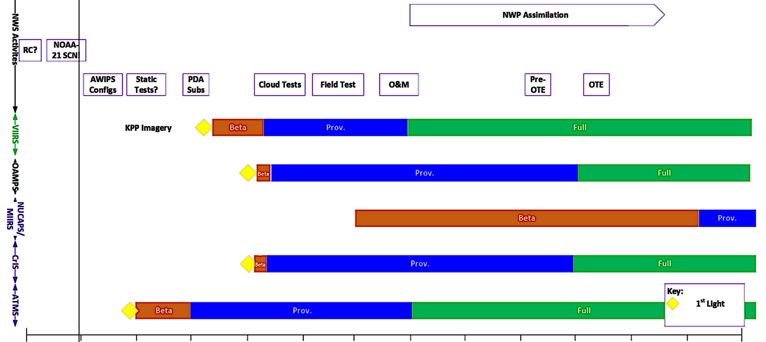
NWS readiness planning for JPSS-2/NOAA-21
JPSS-2 launch: Nov. 1, 2022
Source: Dariush Khadjenouri
NOAA-21 LEO&A
NOAA-21 tertiary
NOAA-21 secondary
NOAA-21 primary

Slide 19
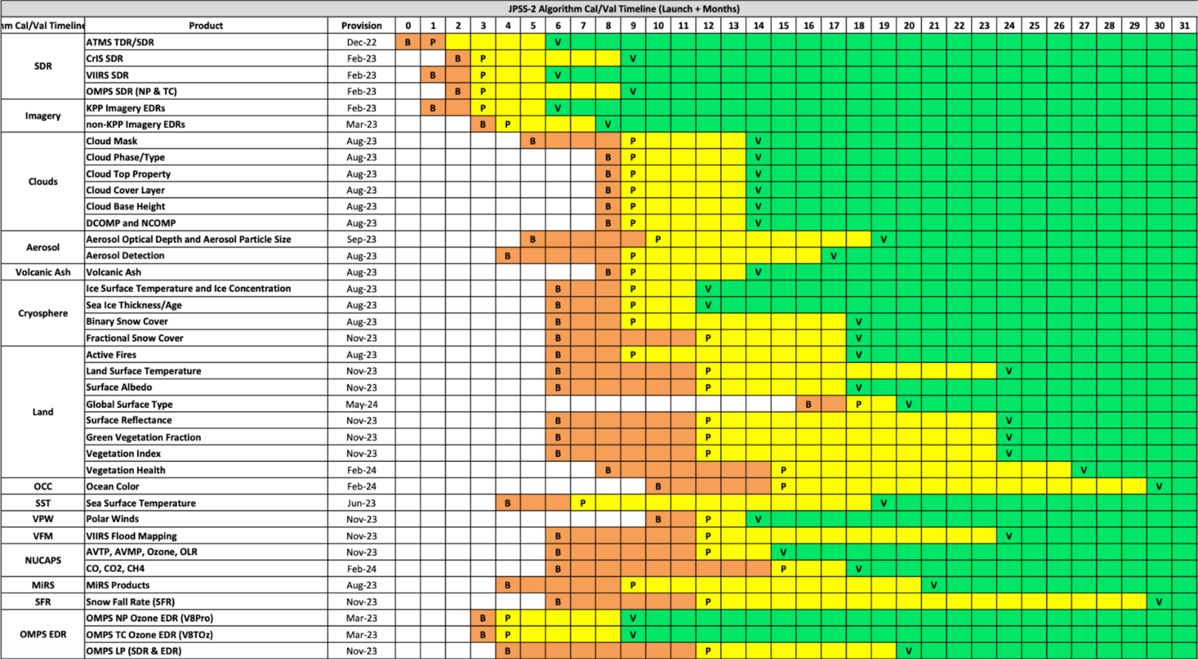
JPSS-2 (NOAA-21) Product Maturity timeline
 | CY2022 | CY2023 | CY2024 | CY2024
Nov | Dec | Jan | Feb | Mar | Apr | May | Jun | Jul | Aug | Sep | Oct | Nov | Dec | Jan | Feb | Mar | Apr | May | Jun | Jul | Aug | Sep | Oct | Nov | Dec | Jan | Feb | Mar | Apr | May | Jun
Subject to change
From the JPSS-2 Product Operations Plan (Sept. 2022)
All are invited to complete the JPSS-2 / NOAA-21 User Readiness Survey
through October 31

Slide 20
S-NPP continuity as the tertiary JPSS satellite
On SBN: NOAA-21 data products, once they’re operational, will replace their S-NPP counterparts.
As detailed in the JPSS-2 Product Operations Plan (Sept. 2022):
The S-NPP satellite will remain operational at least until NOAA-21 is designated the primary satellite (9 to 12 months after launch). No formal guidance to decommission the satellite has been provided.
The S-NPP spacecraft will be operated at a lower priority than the primary and secondary satellites (NOAA-20,21).
NDE / PDA operational systems will produce and provide S-NPP products on a “best-effort” basis, as long as this does not impact data product operations from NOAA-20,21 or from other missions.
If NDE/PDA data loading nears its capacity, lower-priority S-NPP products will be moved off the operational systems.
All are invited to complete the JPSS-2 / NOAA-21 User Readiness Survey through October 31

Slide 21
4. Data product updates & lookahead

Slide 22
Data product notes (1) (with links to prior TOWR-S Update slides or other resources)
Recent changes on SBN:
Thinned GOES-R Temperature & Moisture Profiles were activated on July 13, 2022 (SCN22-53)
GOES-R Meso Fire Hotspots were moved to the GRE/GRW channels on Aug. 24, 2022 (SCN22-79)
Global ASCAT ocean winds from Metop-B were activated on Sept. 8, 2022 (SCN22-72)
Looking ahead:
VIIRS Flood Maps to be evaluated in AWIPS by NWS Ops Proving Ground
Transitioning from Himawari-8 to Himawari-9 starting in Dec. 2022
Himawari-9 has been in geostationary orbit since Nov. 2016
Transition will require changes to PDA subscriptions; LDM feeds to Pacific & Alaska regions; ISatSS; GWSAS (IRC and Guam); and regional data flows
Himawari-9 L2 products to follow in CY2023
Sentinel-6A Altimetry (wave heights/wind speeds) from EUMETSAT now available on PDA
TOWR-S is working configurations/subscriptions for OPC and NHC
Metop-C ASCAT winds will be available on PDA (->SBN) in Jan. 2023.

Slide 23
Data product notes (2) (with links to prior TOWR-S Update slides or other resources)
Looking ahead (continued):
Several GOES-R Enterprise products will go into operations (and some on SBN) in Feb. / Mar. 2023.
Operational gridded GLM products (G-16, G-18) will go on SBN in Mar. 2023
Development of AWIPS-friendly Himawari-8,9 L2 products is now complete; they will go into PDA operations in Mar./Apr. 2023
Upcoming satellite launches:
OceanSat-3 launch: estimated Nov. 2022
OSCAT-3 scatterometer will fill the gap left when SCATSAT ceased operations in Feb. 2021.
(MeteoSat 3rd Gen.) MTG-Imager 1 launch: Dec. 2022
Geostationary @ Longitude 0°
Pre-launch test data is available now
(Metop 2nd Gen.) Metop-SG-A1 launch: Dec. 2024 or later
Sun-synchronous polar (morning) orbit
GOES-U: Spring 2024
Geostationary @ Longitude 137°W or 75° W

Slide 24
5. New from TOWR-S

Slide 25
ISatSS updates in IDP
Approach: Series of Small Updates
RPM/v4.3 framework; GLM Grids for OPC and WPC; GOES-18 compatibility
Now operational on IDP's Operational system
Currently providing G16/G17 imagery and gridded GLM to OPCN and HPCN
Himawari-8 support (=> retire AHIProc); first use of PDA
Support for Meteosat, GeoColor, and ProxyVis
Support for Scatterometers, Altimeters, Microwave Imagery, SAR
Each will update to latest NWSPy library

Slide 26
Satellite Book Club (SBC) Seminar Series
Thursdays, usually at Noon ET
Usage examples shed light on user requirements for satellite data products and capabilities
Recordings are on the SBC page in the NOAA VLab and the NWS Commerce Learning Center (CLC) website
Full-text transcripts are available for all 115 SBC sessions – searchable from within VLab
New!
Recent sessions:
6/30/22 | YJ Noh | CIRA | Progress and Improvements for Cloud Layers and 3D cloud data
7/7/22 | Javier Villegas-Bravo | OPC | NOAA-20 VIIRS and Sentinel-1 Synthetic Aperture Radar Fusion Burn Scar Extent and Severity Mask
7/14/22 | Chad Gravelle, John Cintineo, Ted Ryan, Steve Zubrick | SR HQ | LightningCast Eval: Description and Initial Observations
7/21/22 | Andrea Lloyd | EROS Landsat Science Office | USGS Landsat Science Products
7/28/22 | Elizabeth Kline, Chad Gravelle | GOES-R, SR HQ | GOES-18 Operations Preview: Interleave!
8/4/22 | Jennifer Delamere | GINA | 2022 Alaska Fire Season
8/18/22 | Brian Curran | MAF | Hermleigh, TX EF-2 Case: A Study in Mesoanalysis
8/25/22 | Galina Chirokova | CIRA | CIRA ProxyVisible Satellite Imagery
9/1/22 | Vanessa Vicente & Brian Haines | COMET & PHI | Heavy rainfall/flash flooding
9/8/22 | Carl Dierking | GINA | A High Latitude Proving Ground Aids Satellite Research to Operations
9/15/22 | Doug Kahn | CLE | Use of the Modified SHERBE Parameter To Identify Tornadic HSLC Environments – An Examination of the Oct 21, 2021 Event Over OH/PA
9/22/22 | Kevin Thiel | SPC | Results from the 2022 HWT Satellite Proving Ground Experiment
Devin Chehak / 2022-06-02 (more)

Slide 27
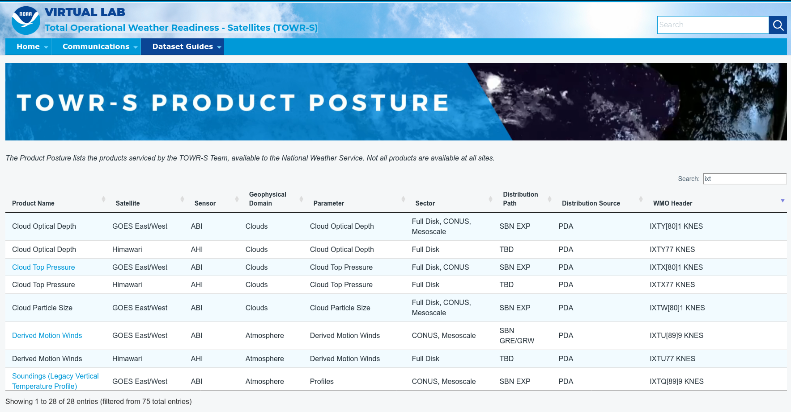
TOWR-S Product Posture
https://vlab.noaa.gov/web/towr-s/product-posture
VLab now hosts a table of all satellite data products that TOWR-S is involved with (integrating them into NWS forecast operations).
Instant search, filter, and sort capability provides access by keyword, satellite, sensor, etc.
Many rows link to Dataset Guides with more AWIPS details
Note: Distribution Path “TBD” indicates a product not yet disseminated to users

Slide 28
TOWR-S monthly
Supplements the quarterly TOWR-S Update briefings and the weekly / occasional TOWR-S mailers
Emailed to TOWR-S Update attendees and posted to VLab (https://vlab.noaa.gov/web/towr-s/communications)
Aiming for a monthly cadence

Slide 29
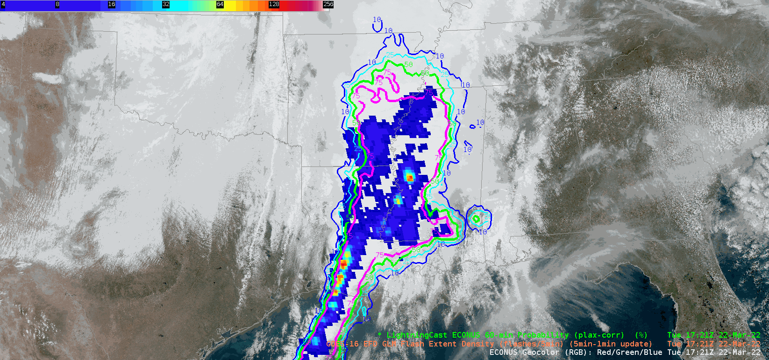
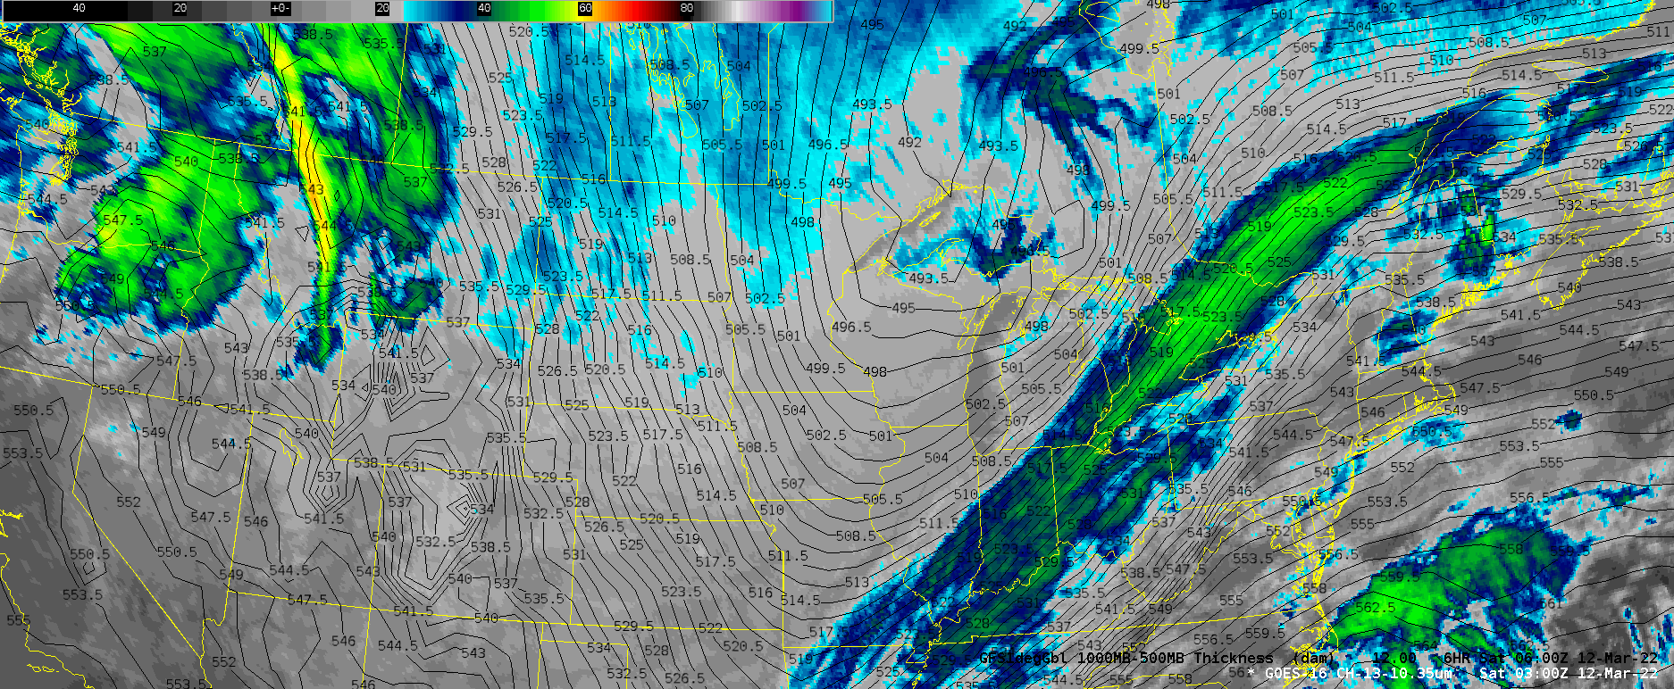
geoCloud AWIPS for Collaboration
TOWR-S team has an initiative to bring people together in the AWIPS environment to foster collaboration on ways satellite data can enhance the NWS mission
TOWR-S facilitates small groups of forecasters, technique development meteorologists, and algorithm developers from across the NWS and NESDIS
More details are in Satellite Book Club Session 38
Please contact Lee Byerle to schedule a session with your office

Slide 30
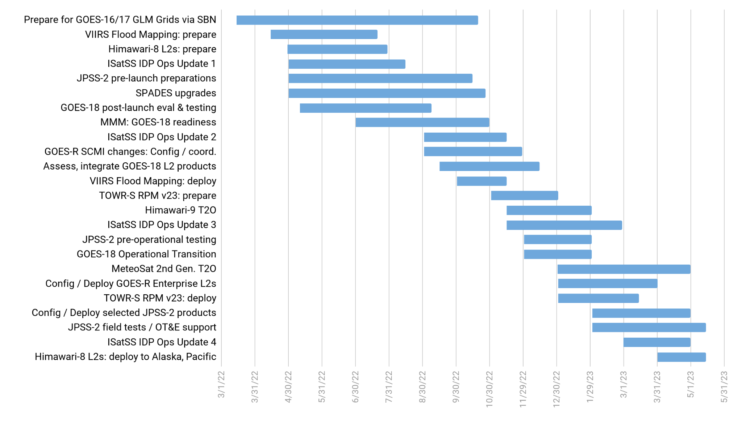
TOWR-S Activity Plan
CY2022 |  |  |  |  |  |  |  |  |  | CY2023
Mar | Apr | May | Jun | Jul | Aug | Sep | Oct | Nov | Dec | Jan | Feb | Mar | Apr | May
Sept. 30, 2022

Slide 31
Contact Information
Office of Observations
Brian Gockel – brian.gockel@noaa.gov
Jordan Gerth – jordan.gerth@noaa.gov
Total Operational Weather Readiness – Satellites (TOWR-S) Team
John Evans – john.d.evans@noaa.gov
Lee Byerle – lee.byerle@noaa.gov
Links
NWSChat (“towr-s” chatroom)
TOWR-S in the NOAA VLab

Slide 32
Next TOWR-S Update
(tentative)
Dec. 16, 2022

Slide 33
Sept. 30 Attendees
First name | Last name | Affiliation | Email
Fawaz | Al-Mtwali | NOAA Federal | fawaz.al-mtwali@noaa.gov
Kashaud | Bowman | NOAA Affiliate | kashaud.bowman@noaa.gov
Ryan | Brown | NOAA Federal | ryan.brown@noaa.gov
Matthew | Comerford | NOAA Affiliate | matthew.comerford@noaa.gov
James | Darlow | NOAA Affiliate | james.darlow@noaa.gov
Ernesto | Diaz | NOAA Affiliate | ernesto.diaz@noaa.gov
John | Evans | NOAA Affiliate | john.d.evans@noaa.gov
Joseph | Fiore | NOAA Federal | joseph.fiore@noaa.gov
Jordan | Gerth | NOAA Federal | jordan.gerth@noaa.gov
Brian | Gockel | NOAA Federal | brian.gockel@noaa.gov
Jeremy | Goldstein | NOAA Affiliate | jeremy.p.goldstein@noaa.gov
Chad | Gravelle | NOAA Federal | chad.gravelle@noaa.gov
Eric | Jacobsen | NOAA Federal | eric.p.jacobsen@noaa.gov
Dariush | Khadjenouri | NOAA Affiliate | dariush.khadjenouri@noaa.gov
Dan | Lindsey | NOAA Federal | dan.lindsey@noaa.gov
William | Line | NOAA Federal | bill.line@noaa.gov
Mark | Loeffelbein | NOAA Federal | mark.loeffelbein@noaa.gov
Jeffrey | Manion | NOAA Federal | jeffrey.manion@noaa.gov
Maurice | McHugh | NOAA Federal | maurice.mchugh@noaa.gov
First name | Last name | Affiliation | Email
Gary | McWilliams | NOAA Affiliate | gary.mcwilliams@noaa.gov
Brandon | Molyneaux | NOAA Affiliate | brandon.molyneaux@noaa.gov
Jaina | Morgan | NOAA Affiliate | jaina.morgan@noaa.gov
Sherrie | Morris | NOAA Affiliate | sherrie.morris@noaa.gov
Brian | Motta | NOAA Federal | brian.motta@noaa.gov
Jordan | Rabinowitz | NOAA Federal | jordan.rabinowitz@noaa.gov
Willy | Roisman | NOAA Affiliate | willy.roisman@noaa.gov
Matthew | Seybold | NOAA Federal | matthew.seybold@noaa.gov
Bill | Sjoberg | NOAA Affiliate | bill.sjoberg@noaa.gov
Michael | Stavish | NOAA Federal | michael.stavish@noaa.gov
Victor | Stegemiller | NOAA Federal | victor.stegemiller@noaa.gov
Douglas | Tilly | NOAA Federal | douglas.tilly@noaa.gov
Jorel | Torres | NOAA Affiliate | jorel.torres@noaa.gov
Derek | VanPelt | NOAA Affiliate | derek.vanpelt@noaa.gov
Bert | Viloria | NOAA Federal | bert.viloria@noaa.gov
Joshua | Watson | NOAA Federal | joshua.watson@noaa.gov
Victoria | Wegman | NOAA Affiliate | victoria.wegman@noaa.gov
Chung | Wu | NOAA Federal | chung.wu@noaa.gov
Joe | Zajic | NOAA Affiliate | joe.zajic@noaa.gov

Slide 34
Sept. 30 Google Meet chat record
Victoria Wegman - NOAA Affiliate - 1:01 PM
Yes the static is from Brian
Brian Motta - NOAA Federal - 1:08 PM
what's the GeoCloud ?
Brian Gockel - NOAA Federal - 1:08 PM
upcoming slide on this, I think
slide 29
Brian Motta - NOAA Federal - 1:18 PM
when will the rpm have the G-18 changes ready ? will all sites install at one time ?
Brian Motta - NOAA Federal - 1:19 PM
yes
James Darlow - NOAA Affiliate - 1:20 PM
How long does it take for products to receive Full Validation?
Brian Motta - NOAA Federal - 1:22 PM
why was it pushed back to March ?
will G-17 GLM remain available via SBN ?
Brian Gockel - NOAA Federal - 1:24 PM
G-17 GLM is not on SBN, but G18 will be added to SBN
Brian Motta - NOAA Federal - 1:24 PM
ok, thanks
Jordan Gerth - NOAA Federal - 1:24 PM
We are anticipating full validation in FY23 for most if not all products.
Joseph Fiore - NOAA Federal - 1:25 PM
correct Jordan
James Darlow - NOAA Affiliate - 1:25 PM
Thank you Jordan/Joseph.
Victor Stegemiller - NOAA Federal - 1:26 PM
Good news about the FD resolution!
James Darlow - NOAA Affiliate - 1:27 PM
and JTWC [Air Force & Navy Joint Typhoon Warning Center] need SHEM [Southern Hemisphere]
James Darlow - NOAA Affiliate - 1:29 PM
You mentioned the best replacement source?
for SHEM
Thank you
Victoria Wegman - NOAA Affiliate - 1:29 PM
https://www.weather.gov/media/notification/pdf2/scn22-94_geo_spectral_coverage_goes-eastwest.pdf
Jordan Gerth - NOAA Federal - 1:29 PM
GRB antennas will still receive the full disk.
James Darlow - NOAA Affiliate - 1:31 PM
@victoria- Thank You
Victoria Wegman - NOAA Affiliate - 1:36 PM
https://docs.google.com/forms/d/e/1FAIpQLScwzPthECRgGdK5V3FbtVsgS_x--MK8fOWOP09NRUeUY8GGMg/viewform
Brian Gockel - NOAA Federal - 1:39 PM
correct assumption
Dan Lindsey - NOAA Federal - 1:45 PM
MTG-I1 is now on a ship headed for French Guiana! https://twitter.com/esa/status/1575824368890187778?s=20&t=eND96BSrfbwplJWHu-LDRw
Victoria Wegman - NOAA Affiliate - 1:48 PM
Clarification: the transcripts are not searchable from any engine, they are only in VLab
Jordan Gerth - NOAA Federal - 1:49 PM
Thanks V for your work on this!
James Darlow - NOAA Affiliate - 1:53 PM
Great presentation and content. Thank you
Michael Stavish - NOAA Federal - 1:54 PM
Any news lately on the "barcode artifact" issue with the G18 3.9channel?
Michael Stavish - NOAA Federal - 1:56 PM
I noticed it's gone looking at the 3.9 loop on the slider today.
thanks Dan
Dan Lindsey - NOAA Federal - 1:56 PM
Thanks for the prompt, Mike.
Michael Stavish - NOAA Federal - 1:57 PM
great info all, thanks
TOWR-S Update

