Slide 1
TOWR-S Update
June 24, 2022
https://meet.google.com/thn-pkwe-wbr
Total Operational Weather Readiness - Satellites
NWS Office of Observations

Slide 2
Overview
Satellite data products and capabilities in preparation
GOES-18 preparations
GOES-17 update
Preparations for JPSS-2 / NOAA-21
Satellite data products and capabilities under consideration
Satellite Book Club seminars
TOWR-S VLab pages
cloudReach
TOWR-S 2022 workplan

Slide 3
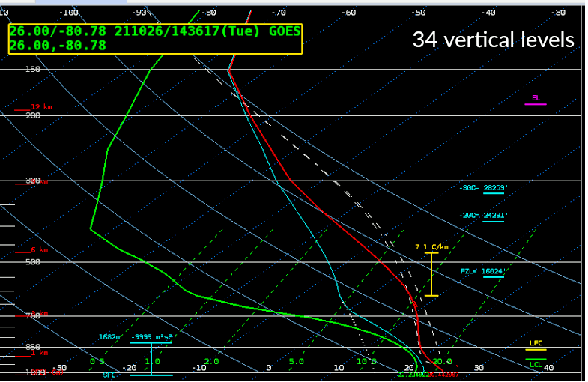
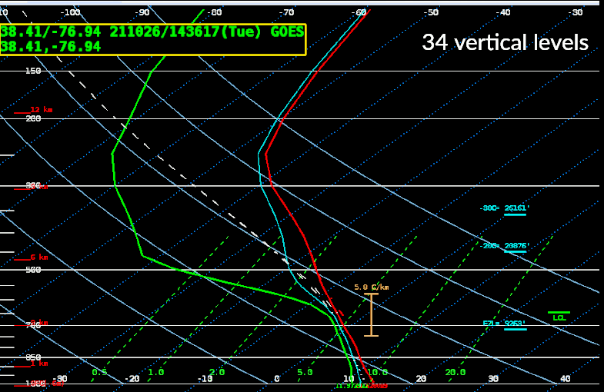
Coming soon to SBN: Thinned GOES-R Profiles
Thinned (34-level) Temperature and Moisture Profiles will replace current (101-level) profiles on SBN as of July 13, 2022.
This change will save 3.68 GB/day on SBN (EXP channel).
TOWR-S RPM v22 is needed to ingest the thinned profiles.
h/t Lee Byerle
h/t Lee Byerle

Slide 4
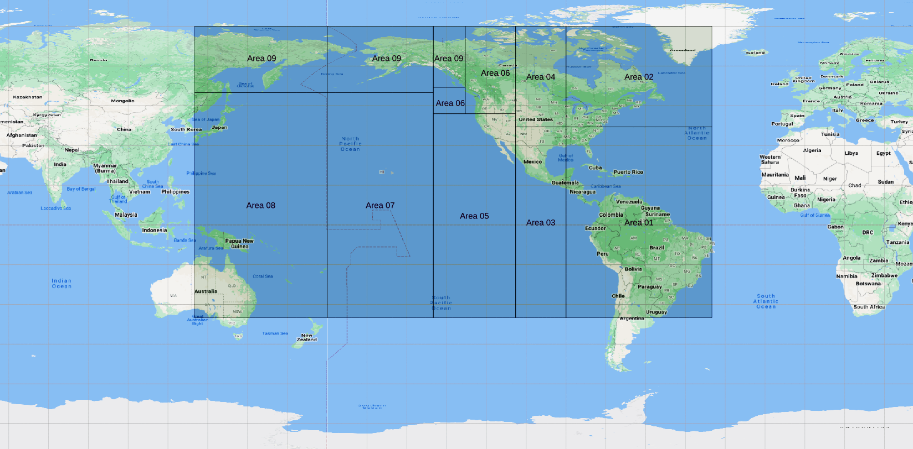
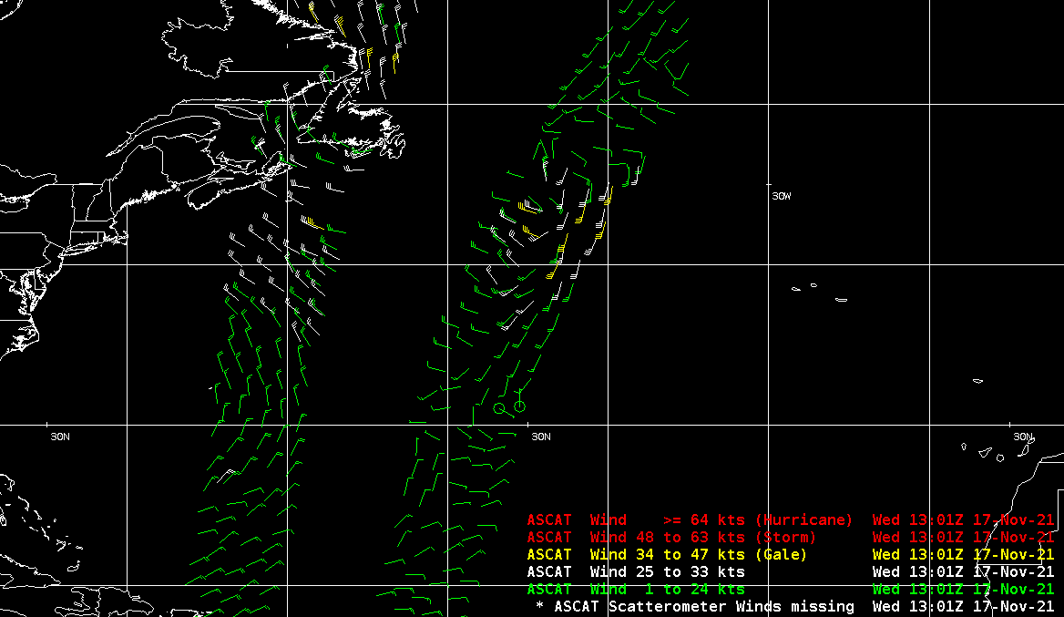
Coming soon to SBN: Global ASCAT Ocean Surface Winds
ASCAT ocean surface winds from Metop-B for Areas 01-09 have been on SBN since 2008. (cf. TIN08-28)
(Also from Metop-A, which ceased operating in Nov. 2021)
ASCAT winds for Area 10 became available from PDA in June 2019.
Adding Area 10 will complete global coverage of ASCAT winds – and will add only 12 MB/day [0.5 MB/hr; 1 kbps]
Metop-C ASCAT winds are expected from NESDIS operational sources (e.g. PDA) in ~August 2022
Area 10
Area 10
Area 10
Area 10
Area 10
Area 10
Area 10
Area 10
Area 10
Area 10
Area 10
Area 10
Area 10
Area 10
Area 10
Area 10
Area 10
Area 10
Area 10
Area 02
Area 10
Area 01

Slide 5
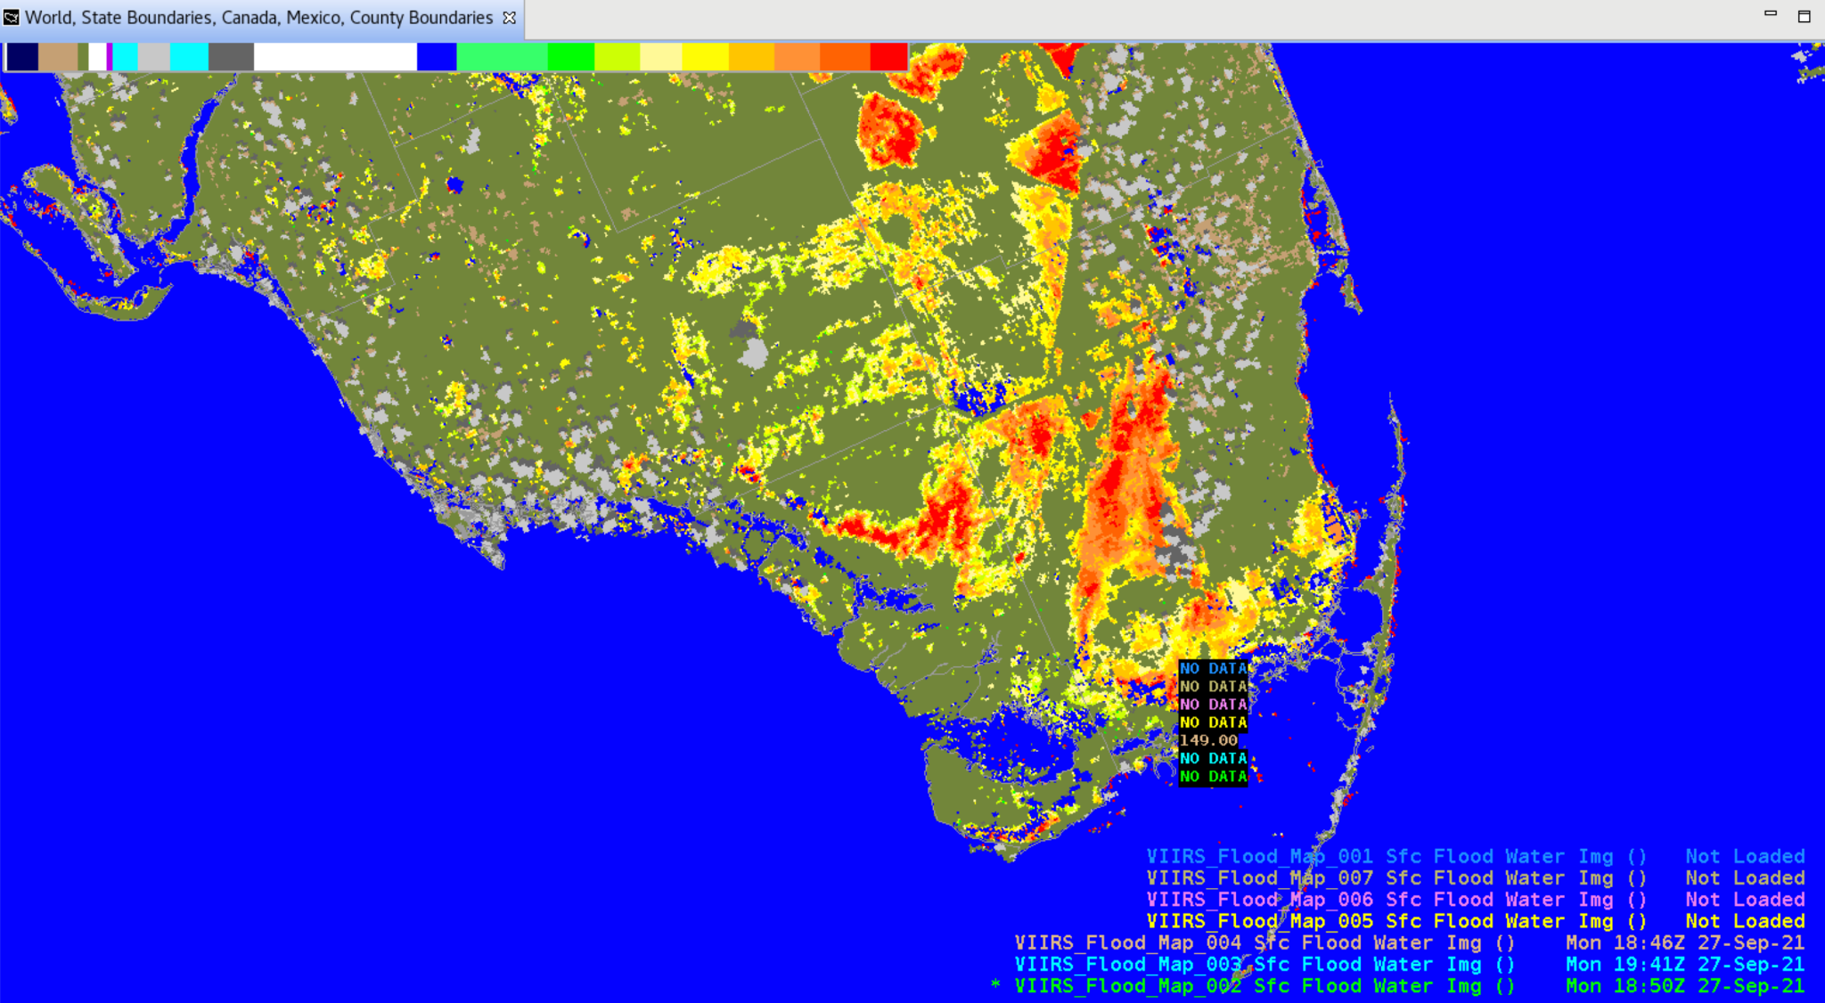
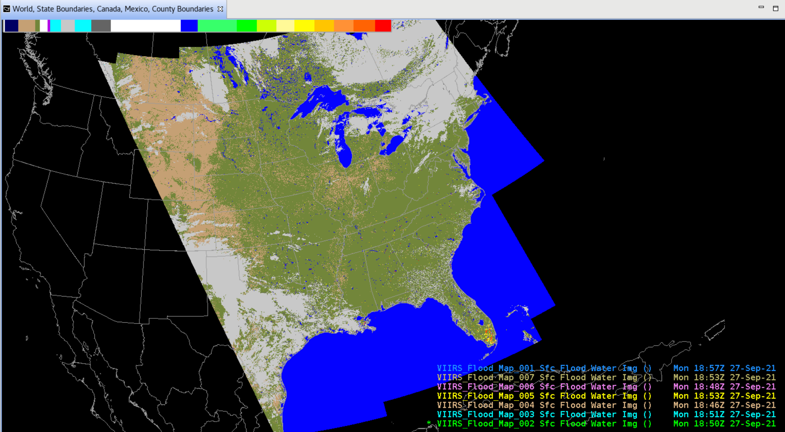
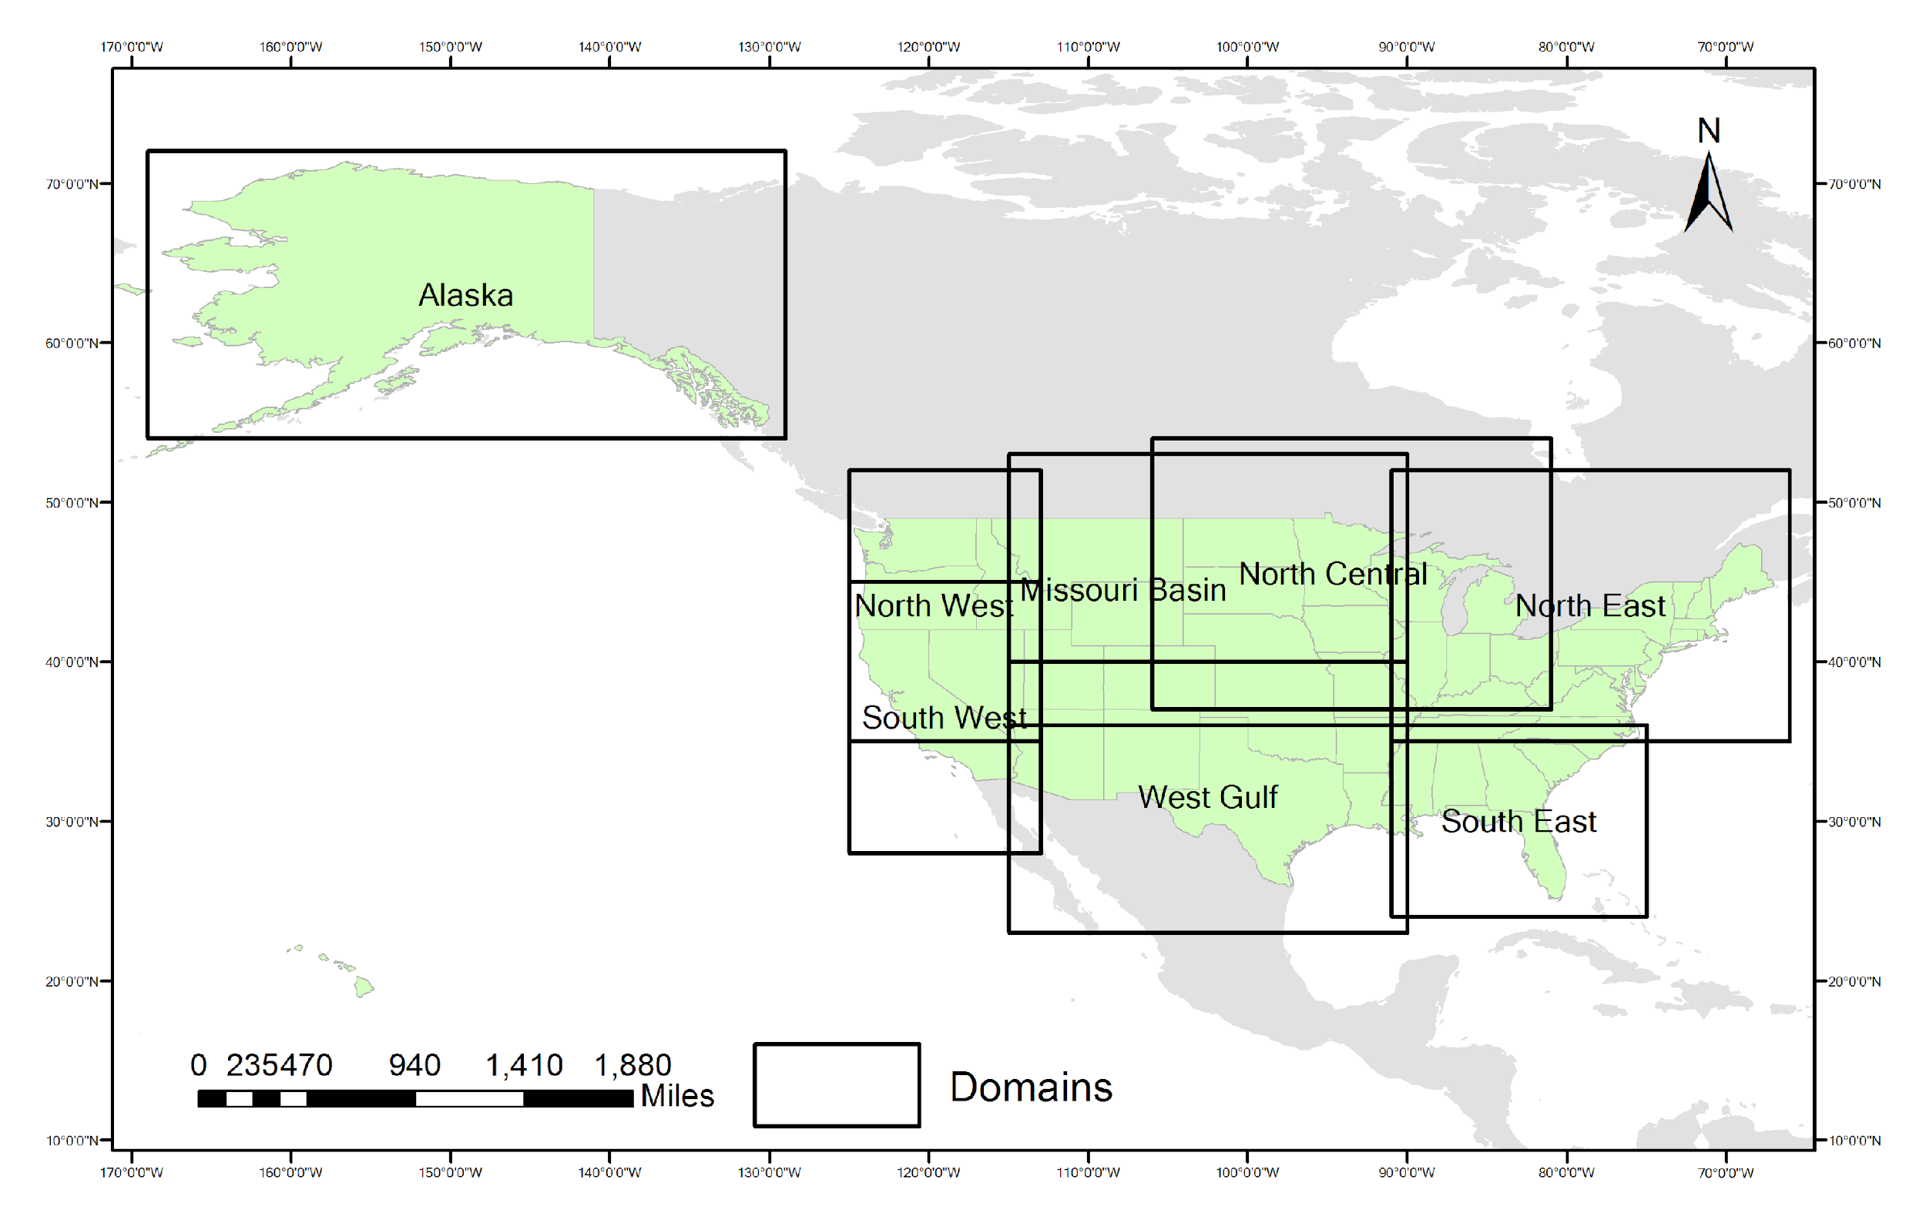
Coming soon: VIIRS Flood Mapping
VIIRS granules:
GITCO
SVI01 SVI02
SVI03 SVI05
Cloud Mask
Reproject to standard grid
Reprojected
VIIRS data
Flood Detection
Processing
VFM
Granule
Files
VFM
Mosaics
For Areas of Interest
Consolidate Granules
Into Mosaics for
Defined Areas
Area Definition Files
8 NWS regional mosaics
Derek van Pelt
Operational Readiness Review (ORR) June 21
PDA operational release announced for July 21; will be followed by
NWS evaluation w/ Ops Proving Ground and selected field offices
Distribution mechanism to AWIPS sites remains to be determined

Slide 6
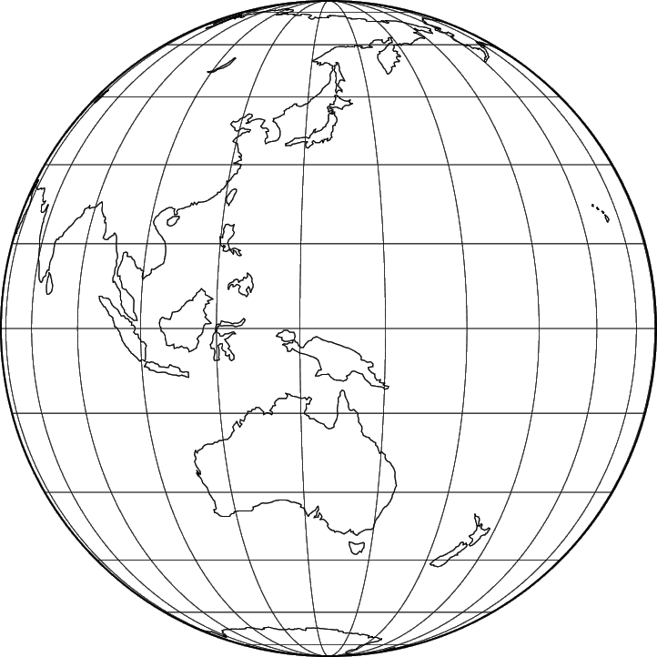
Still going strong: Himawari-8 Imagery from NESDIS
Now being disseminated from NESDIS / PDA via NWS NCF to Alaska and Pacific Regions: Full-Disk tiles and (now) floating [a.k.a. “target”] mesoscale sector
(These are also publicly available via the Amazon cloud: https://noaa-himawari8.s3.amazonaws.com/index.html)
NCF fetches 67 of 88 tiles (x 16 channels) from PDA and uses LDM
to send tiles 02-06 and 09-14 to Alaska Region HQ; and tiles 07-14, 16-24, 26-34, 36-44, 46-54, 56-64, and 66-74 to Pacific Region HQ
HQs forward them to WFOs in each region
88x16=1,408 PDA subscriptions (w/ 1,408 WMO headers) allows full flexibility by tile & by channel
Pacific and Alaska regions report that imagery tiles are arriving with short, consistent latencies. Final Operational Transition expected soon.
 |  | 01 | 02 | 03 | 04 | 05 | 06
 | 07 | 08 | 09 | 10 | 11 | 12 | 13 | 14
15 | 16 | 17 | 18 | 19 | 20 | 21 | 22 | 23 | 24
25 | 26 | 27 | 28 | 29 | 30 | 31 | 32 | 33 | 34
35 | 36 | 37 | 38 | 39 | 40 | 41 | 42 | 43 | 44
45 | 46 | 47 | 48 | 49 | 50 | 51 | 52 | 53 | 54
55 | 56 | 57 | 58 | 59 | 60 | 61 | 62 | 63 | 64
65 | 66 | 67 | 68 | 69 | 70 | 71 | 72 | 73 | 74
 | 75 | 76 | 77 | 78 | 79 | 80 | 81 | 82
 |  | 83 | 84 | 85 | 86 | 87 | 88
Himawari Product | Sector | Refresh Rate |  | Nadir ground resolution
Cloud & Moisture Imagery | Full Disk tiles | 10 min |  | 1 & 2 km
Cloud & Moisture Imagery | Floating Sector | 2.5 min |  | 0.5 km
Corrected tile list
h/t Joe Zajic

Slide 7
In final stages: Himawari-8 L2 Products from NESDIS
Available now from NESDIS / PDA: Full Disk L2 products
(Original (non-AWIPS-ready) products are publicly available via the Amazon cloud: https://noaa-himawari8.s3.amazonaws.com/index.html)
Now adapting data format & content for AWIPS
(Himawari Derived Motion Winds already going to Pacific Region)
AWIPS-ready Himawari L2 Product | Sector | Refresh Rate |  | Latency | Nadir ground resolution
Sea Surface Temperature | Full Disk | 60 min |  | 10 min | 2 km
Rainfall Rate |  | 10 min
Clear Sky Mask
Cloud Top Height
Cloud Top Pressure
Cloud Top Temperature
Cloud Optical Depth
Cloud Top Phase
Derived Motion Winds |  |  |  | 30 min
Final steps: renaming Sea Surface Temperature dimensions; trimming SST to essential fields only; linking SST fields to geostationary projection info; shrinking Cloud Height, Pressure, and Temperature products
When these AWIPS-ready data products are available from PDA, NCF will disseminate them via LDM to the Alaska and Pacific Regions.
National Centers will access these data directly from PDA.
h/t Derek van Pelt, 2022-03-31

Slide 8
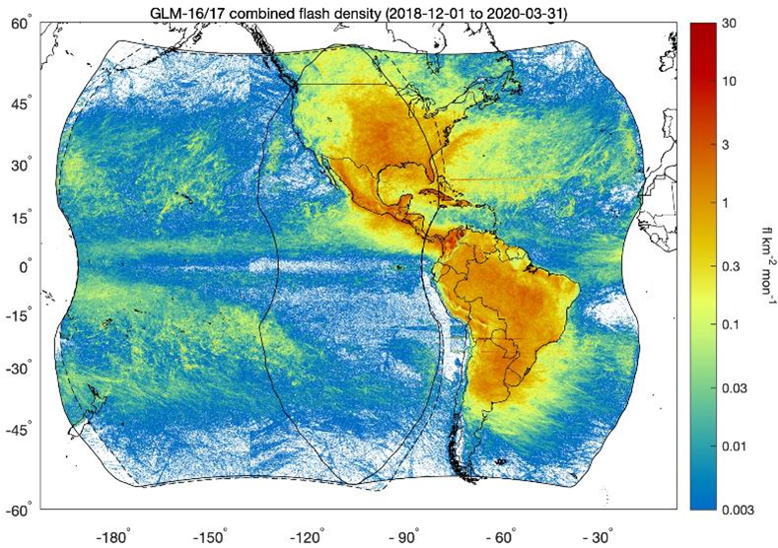
In preparation: Operational GLM Flash Extent Density
Flash Extent Density (FED) “punctured tiles” have been produced by the IDP Satellite Support System (ISatSS) and disseminated via the NWS Regional LDM since Nov. 2020.
Necessary AWIPS configs are in TOWR-S RPM v20+
Sometime after Oct. 2022, operational FED tiles from NESDIS will be activated on AWIPS / SBN.
Footprint: 1.99GB/day (GOES-East) + 0.87 GB/day (GOES-West)
Now preparing for dissemination via SBN:
Setting filenames, Reserving WMO headers
SBN bandwidth allocation (w/ AWIPS Data Mgmt.)
Configuring NCF routing rules
Test
Inform users via Service Change Notice, VLab, etc.

Slide 9
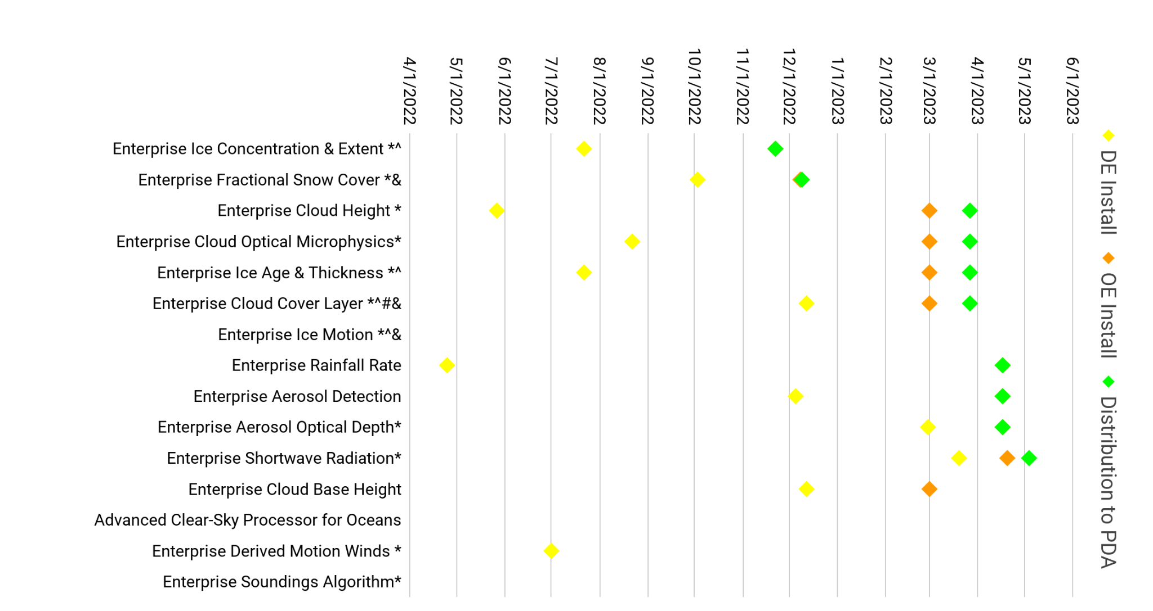
Enterprise GOES-R ABI L2 products
GOES-R Ground System development timeline
GOES-R ABI L2+ Enterprise Products already on PDA | … as of
Fire/ Hot Spots (Meso sectors) | 03/01/2021
Snow Cover | 05/07/2021
Cloud Top Phase | 08/19/2021
Land Surface Temperature | 08/19/2021
Reduced Levels Soundings Profile Products # | 11/08/2021
Clear Sky Mask* | 11/29/2021
Several of these products will replace their counterparts on SBN, shortly after they’re distributed to PDA.
Others may reach AWIPS sites via LDM, Cloud, or other mechanisms.
Enterprise products apply improved science and consistency with other satellite sensors
June 24, 2022
Notes: ^ NOAT Funded Algorithm # New Product to PDA & Enables Provisional * Enterprise Algorithm with GOES-17 LHP mitigation
From GOES-R PRO PASS Dev’t Schedule, updated 2023/02/23

Slide 10
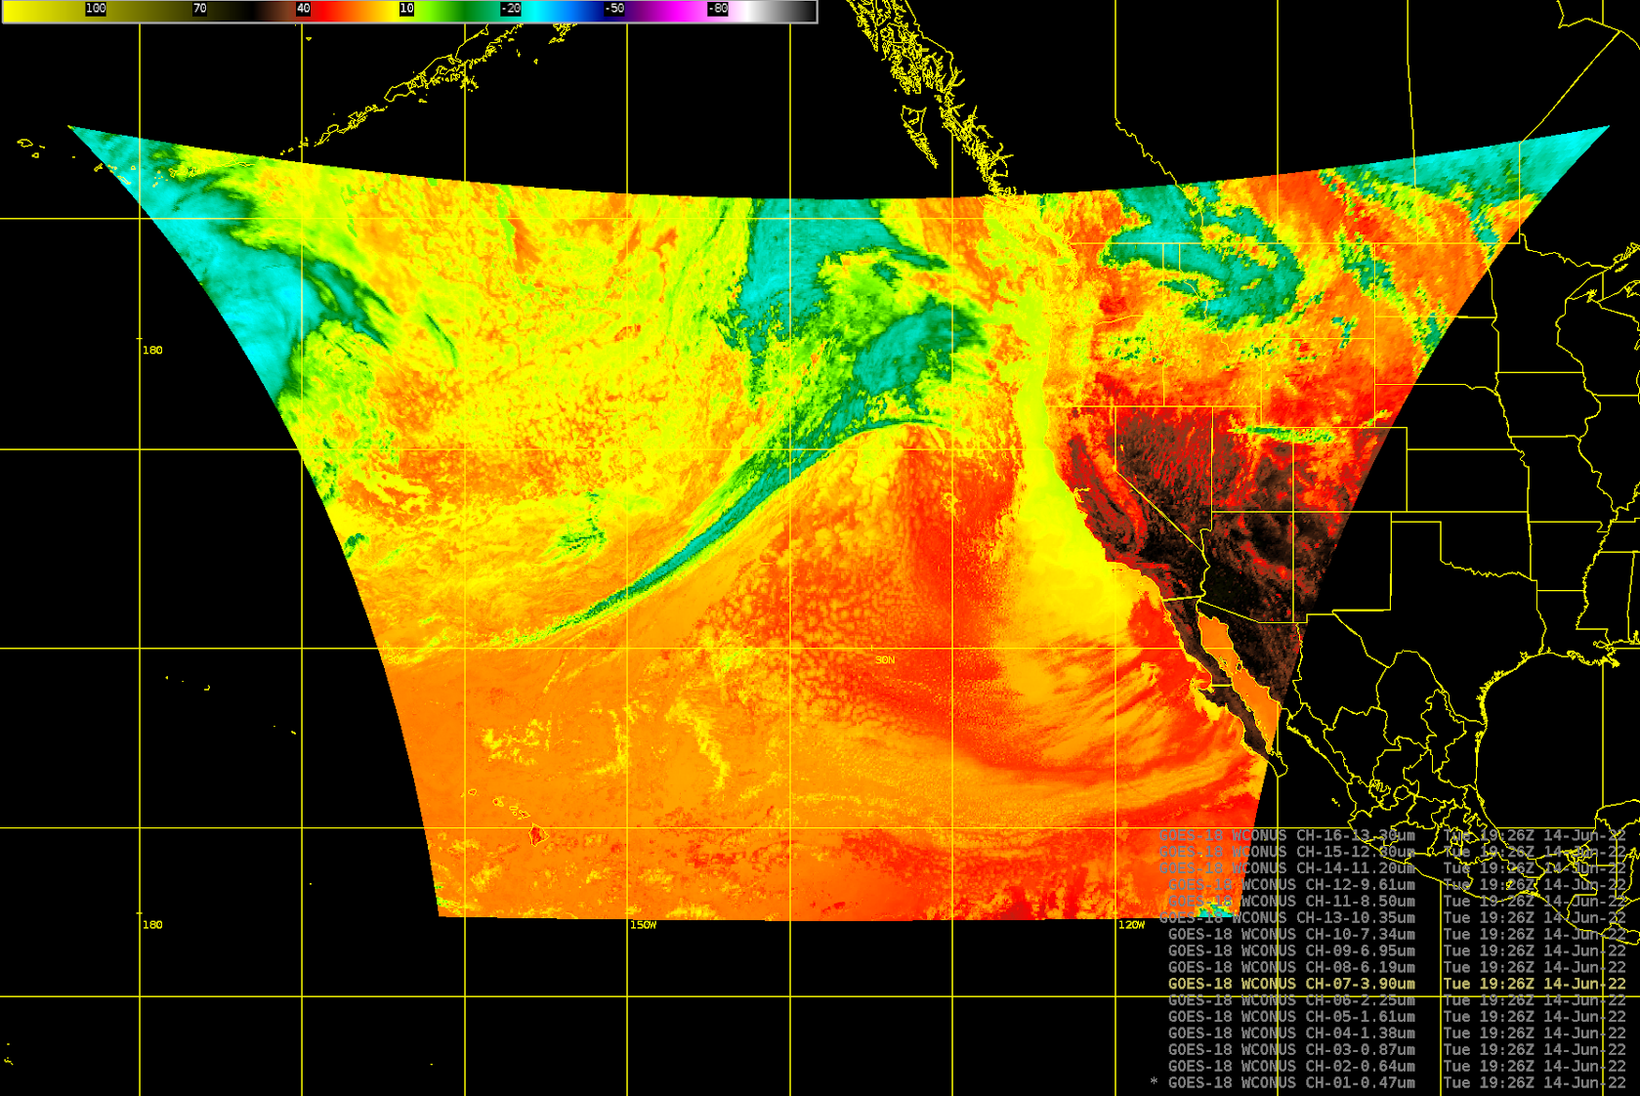
Preparations for GOES-18
Accelerated Transition to Operations
Operational transition targeted for Jan. 3, 2023
Pre-operational GOES-18 data dissemination:
Aug. 1-Sept. 6 and Oct. 15-Nov. 11 / Interleaved operations:
On GRB: during these periods, the GOES-17 stream will consist of GOES-18 ABI L1b, GOES-17 GLM, and GOES-17 space weather instruments.
On SBN: during these periods, GOES-West SCMI data will be from GOES-18, rather than GOES-17.
GOES-West L2+ products will continue to be from GOES-17 – despite any GOES-17 Loop-Heat Pipe degradation
GOES-18 L1b and SCMI are expected to reach Provisional maturity before these Interleave periods begin.
A 4-hour test of GOES-18/17 interleaving on GRB and SCN took place June 14 =>
Supplemental Operations: Dissemination of GOES-18 ABI imagery via the GeoCloud platform will begin in July.
Outside of those time periods:
GOES-17 will continue to serve as GOES-West; and
GOES-18 data will not be on GRB or SBN.

Slide 11
GOES-18 Supplemental Operations
Summary:
Continuous* delivery of GOES-18 ABI and GLM products to AWIPS sites from geoCloud during West Station PLT (~July to December 2022) (* not just during Interleave periods)
Current Activities:
Using LZSSc for TOWR processing (G16/G17 ABI L1B, GLM LCFA)
Continuing “placeholder” DevOps product flows to Alaska and Pacific Regions to maintain BucketFlow capability
Updates being deployed to AWC, NHC, SPC, IDPDev, Pacific Region, Alaska Region for initial SuppOps and Interleave Test
Integration and Test of dataflow capability at NWS Operations Proving Ground for Western Region

Slide 12
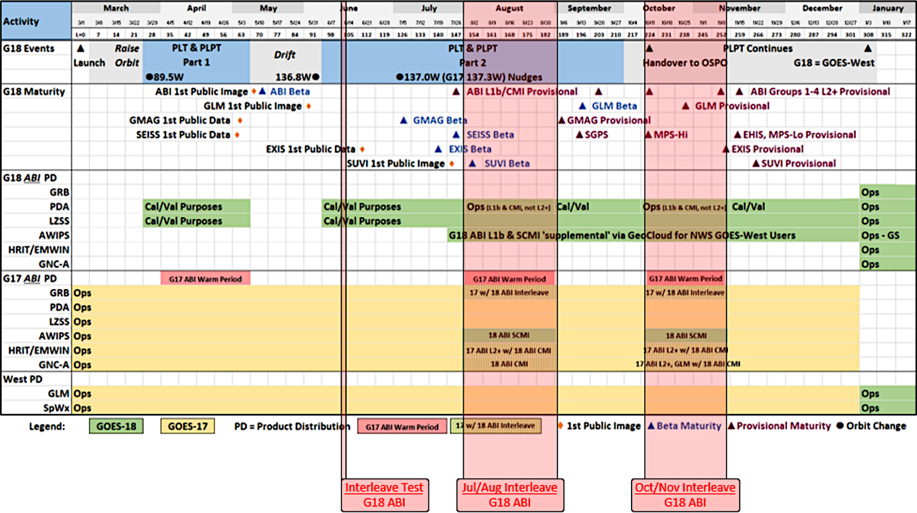
GOES-West Transition Plan for GOES-17→18
June 24, 2022
GOES-18 ABI L1b/CMI will reach Provisional Maturity in July, shortly before the GOES-17 warm season / GRB interleave period.
GOES-18 SPLASH WG

Slide 13
 | Mar. 2022 | Apr. 2022 | May 2022 | Jun. 2022 | Jul. 2022 | Aug. 2022 | Sep. 2022 | Oct. 2022 | Nov. 2022 | Dec. 2022 | Jan. 2023 | Feb. 2023 | Mar. 2023
More details on GOES-18 Transition to Operations are available from the GOES-R program
June 24, 2022
Months are approximate
GOES-18 SPLASH WG

Slide 14
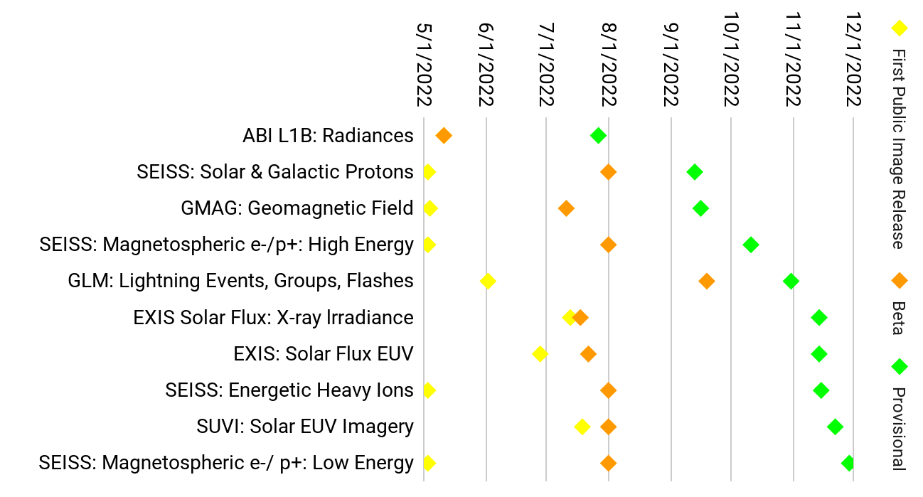
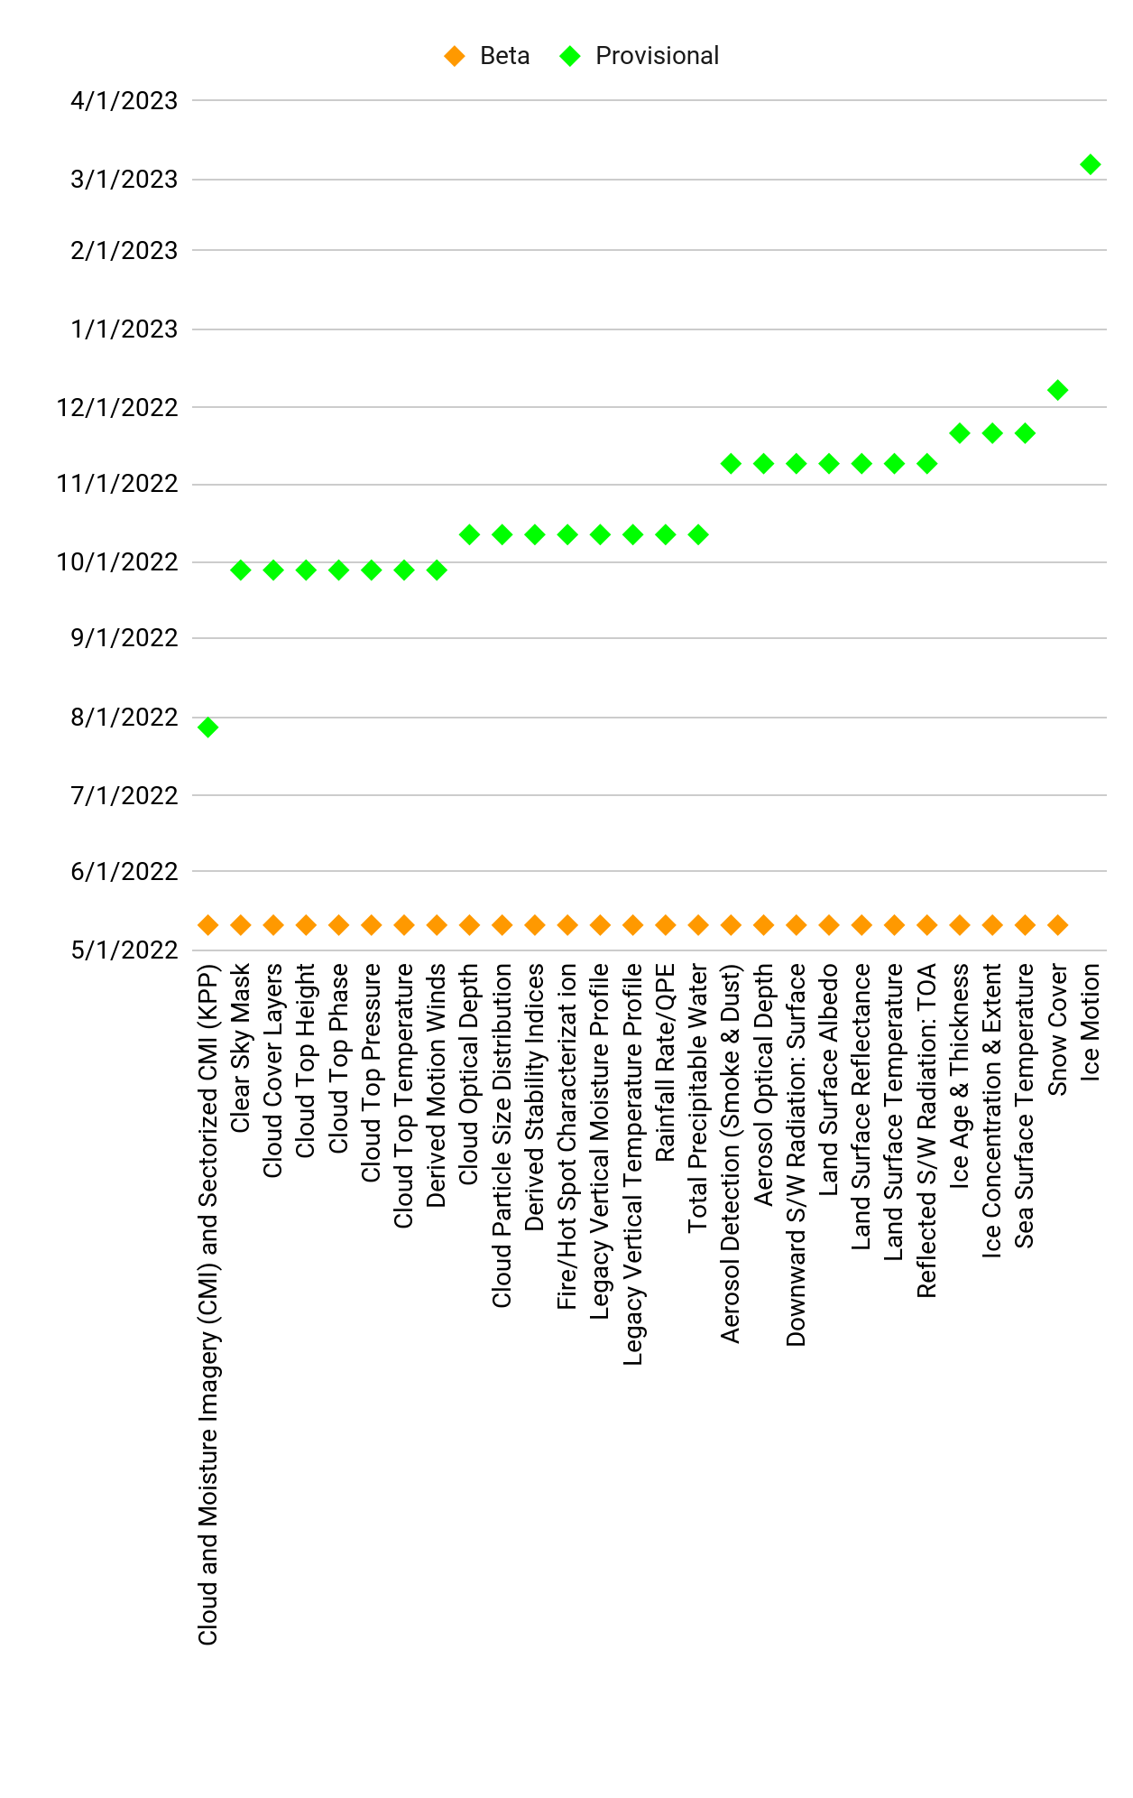
GOES-18 L1B Products
GOES-18 ABI L2+ Products
GOES-18 products: Beta / Provisional Maturity timelines
June 24, 2022
Based on GOES-18 SPLASH WG (Updated Sept. 9, 2022)

Slide 15
GOES-18 ABI Data Sharing Policy
Policy for sharing images, data files, and publications from the ABI instrument during upcoming phases of satellite / instrument testing and data maturity:
 | Images/Social Media | Data Files | Publications
Between Beta and Provisional | Allowed; must contain the caveat: “GOES-18 Preliminary, Non-Operational Data” | Not allowed | Allowed; You may include pre-Provisional instrument data/images/plots as long as it will not be published until after Provisional validation is declared for that instrument. Exercise caution in publishing data regarding apparent anomalies or artifacts especially during ongoing instrument and product tests (PLTs and PLPTs).
ABI Interleaved Data (Aug. 1-Sept. 6 & Oct. 15-Nov. 11) | Allowed (ABI Only) | Allowed (ABI Only)
Between Provisional (or Interleave Period(s) for ABI) and Operational Declaration | Allowed; must contain the caveat: “GOES-18 Preliminary, Non-Operational Data” | Allowed; must contain the caveat: “GOES-18 Preliminary, Non-Operational Data”
GOES-West Operations onwards | Allowed | Allowed
GOES-18 SPLASH WG
NOTE:
This table only pertains to GOES-18 ABI data (post-Beta). For other GOES-18 instruments (GLM, EXIS, etc.) see the full GOES-18 Data Sharing policy

Slide 16
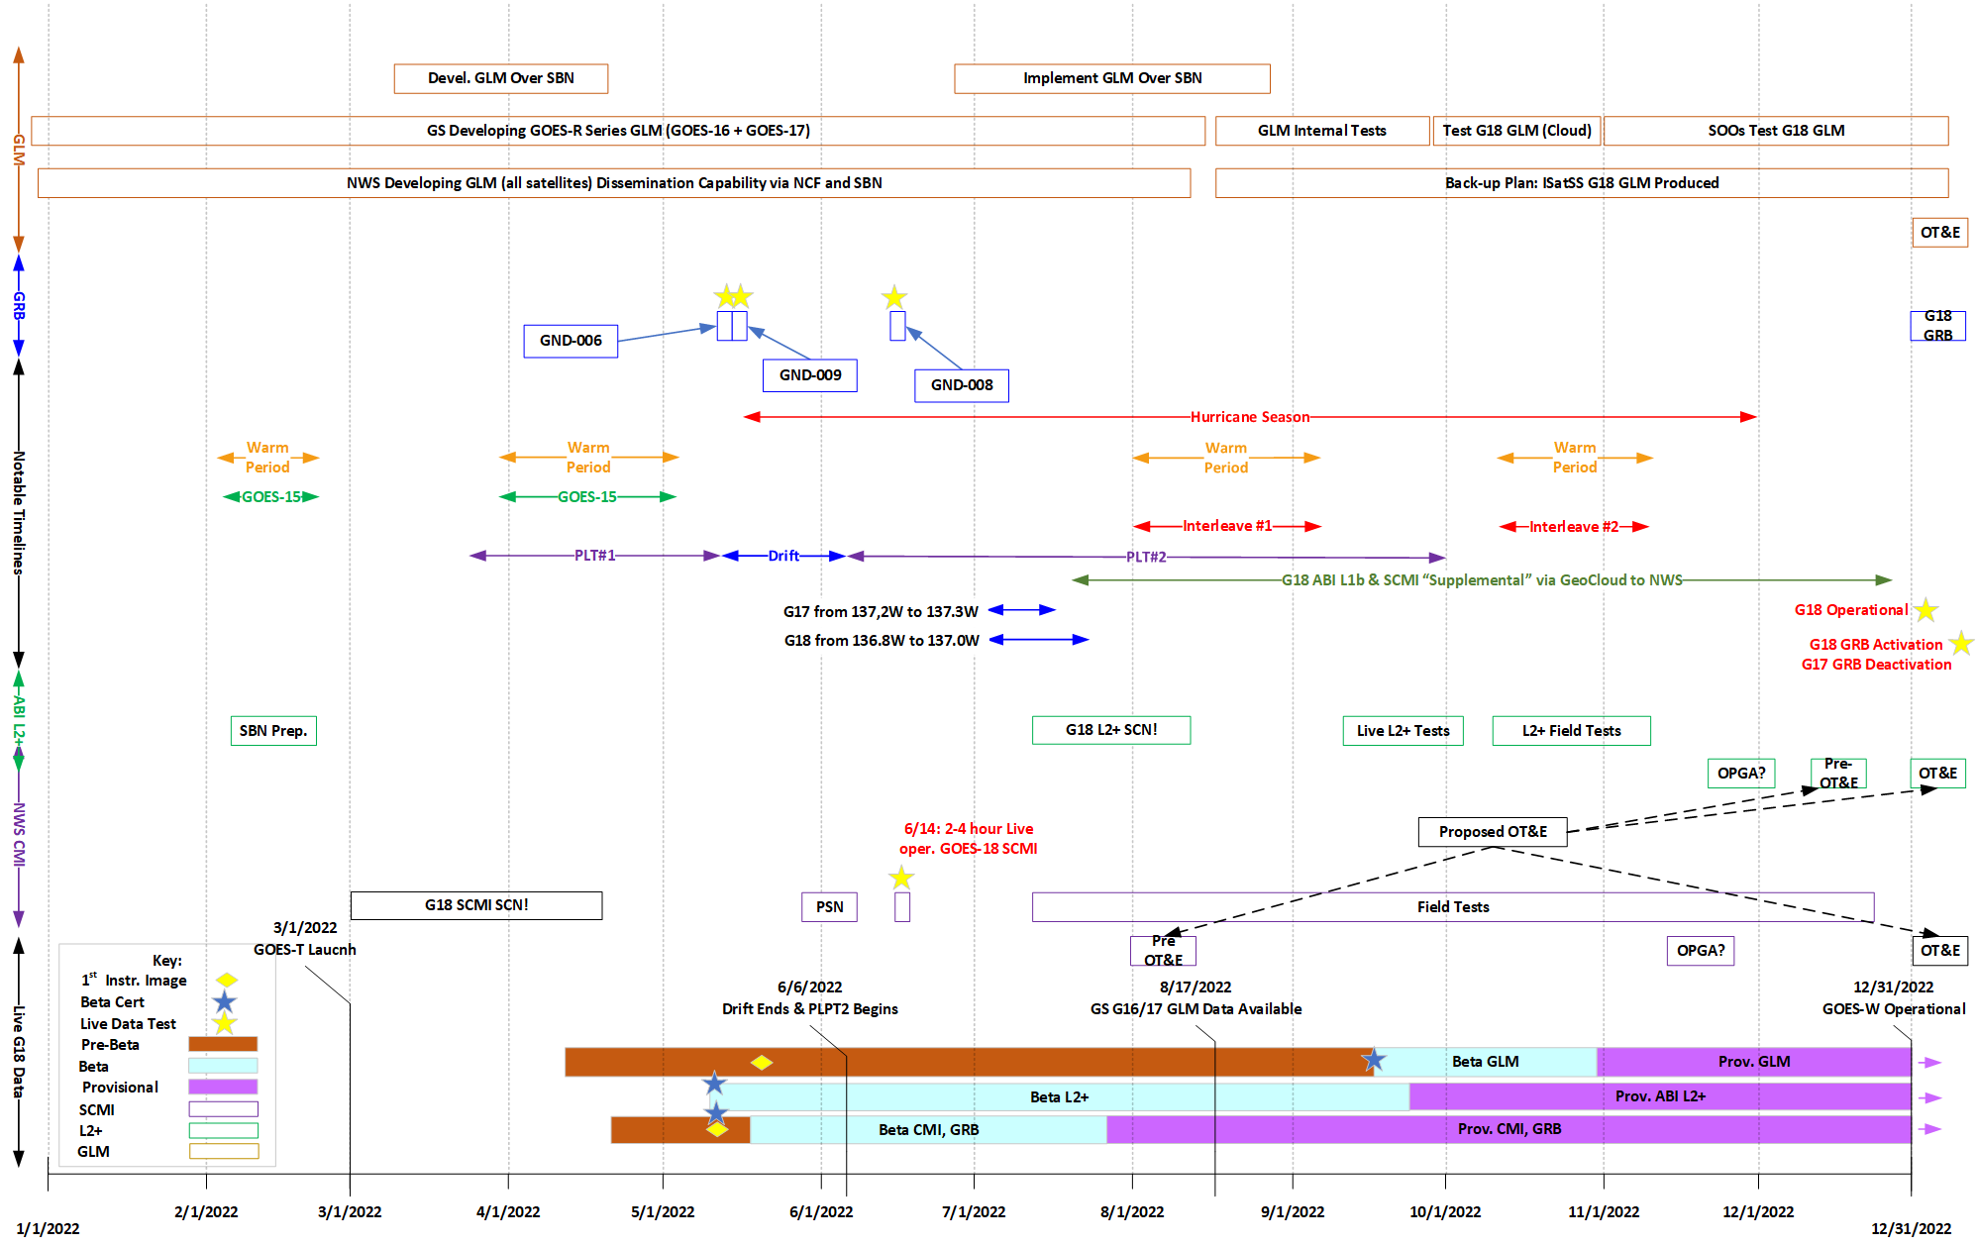
NWS readiness planning for GOES-18
June 24, 2022
Dariush Khadjenouri

Slide 17
GOES-17 ABI Cooling Anomaly:
2022 measured and predicted daily peak temperatures of LWIR Focal Plane Module
GOES-18 SPLASH WG (2022-06-17)

Slide 18
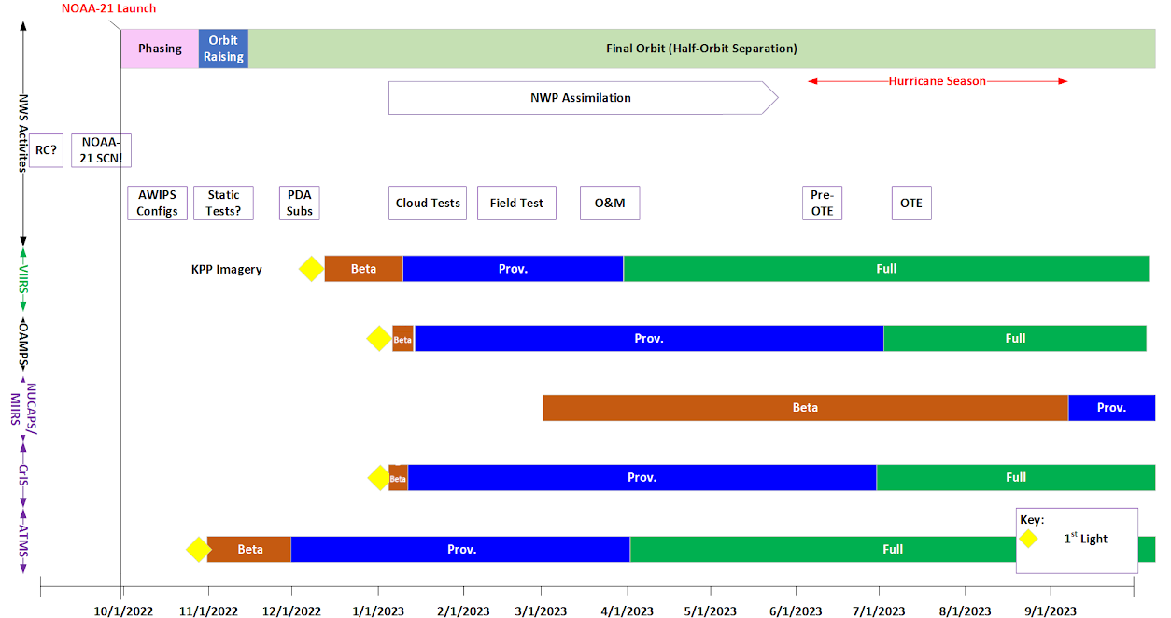
NWS readiness planning for JPSS-2/NOAA-21
JPSS-2 launch: Nov. 1, 2022
S-NPP data products on SBN will be replaced by NOAA-21 counterparts once operational
Dariush Khadjenouri

Slide 19
Satellite Data Product Changes Under Consideration
JPSS Derived Products *
VIIRS Active Fires^{[1]}, Aerosols, Volcanic Ash^{[2]}
ATMS MiRS ^{[2]}
AMSR-2 Ocean Winds & Microwave Brightness ^{[2]}
Add’l VIIRS Imagery (now being produced for all 22 channels) ^{[3]}
[1] AWIPS sites are currently receiving a modified VIIRS Active Fires product via LDM
[2] AWIPS 20.2.3 Baseline provides EDEX ingest support for VIIRS Active Fires, Aerosols, and Volcanic Ash; ATMS MiRS; and GCOM AMSR-2 Ocean Winds & Microwave Brightness
[3] TOWR-S RPM v22 (Feb. 2022) provides [only] EDEX ingest support for all VIIRS Imagery channels
Metop-B,C L2 products *
Synthetic Aperture Radar (SAR) from Sentinel and RadarSat (over coastal regions) *
ISRO OceanSat-3 scatterometer data products
OceanSat-3 launch: Aug. 2022
MeteoSat 3rd Gen. (MTG) imagery & L2 products *
MTG-I1 launch: Dec. 2022
Metop 2nd Gen. (Metop-SG) imagery & L2 products *
Metop-SG A1 launch: Dec. 2024
Metop-SG B1 launch: Q1 2025
* The NWS dissemination method for these products remains to be determined, as implementation of AWIPS Data Delivery (“DD”) remains on hold.

Slide 20
Satellite Book Club (SBC) Seminar Series
Thursdays, usually at Noon ET
Usage examples shed light on user requirements for satellite data products and capabilities
Recordings are on the SBC page in the NOAA VLab and the NWS Commerce Learning Center (CLC) website
Recent Sessions:
4/7/22 | Ivan Csiszar (STAR) | VIIRS Fire Detection
4/14/22 | Joseph Patton (CISESS) | How GLM Lightning Observations Can Explain Aircraft Flight Paths During Thunderstorm Events
4/21/22 | Bill Line (NESDIS-STAR) | Using NOAA Satellite Data to Detect and Track Blowing Dust
4/28/22 | Michael Bowlan (TSA) | Mesoanalysis of February 24, 2022 Convective Winter Precipitation Event in Eastern Oklahoma and Northwest Arkansas
5/5/22 | Jorel Torres (CIRA) | JPSS Applications: Datasets, Training Resources, & User Feedback
5/12/22 | Chris Schmidt (CIMSS) | Making Use and Sense of the ABI Fire Detection and Characterization Algorithm Data
5/19/22 | Tim Schmit and Dan Lindsey (GOES-R Pgm.) | GOES-18 ABI Update and Plans Moving Forward
5/26/22 | Justin Schultz (DLH) | Lakeshore Flooding Across Western Lake Superior: Forecast and Impact Challenges
6/2/22 | Devin Chehak (MAF) | May 18th, 2021 Long Track Tornadic Permian Basin Supercell
6/9/22 | Kirk Lombardy (CLE) | Lake Erie Ice Rescue 22 February 2021
6/16/22 | Mark DeMaria (CIRA) | CIRA Update on Satellite Support Activities
6/23/22 | Kari Sheets (NWS Ofc of Dissemination) | The NWS National GIS Map Viewer
100th SBC Session! June 2nd
Devin Chehak / 2022-06-02 (more)
Notes:
The Satellite Book Club Seminar Series is convened weekly on Thursdays, providing an opportunity for scientists throughout the NOAA satellite domain to share a topic of interest to them with their peers. Topics may include applications of satellite data in the field, new and exciting changes to both polar and geostationary programs, and anything else satellite-related that the field would like to discuss.

Slide 21
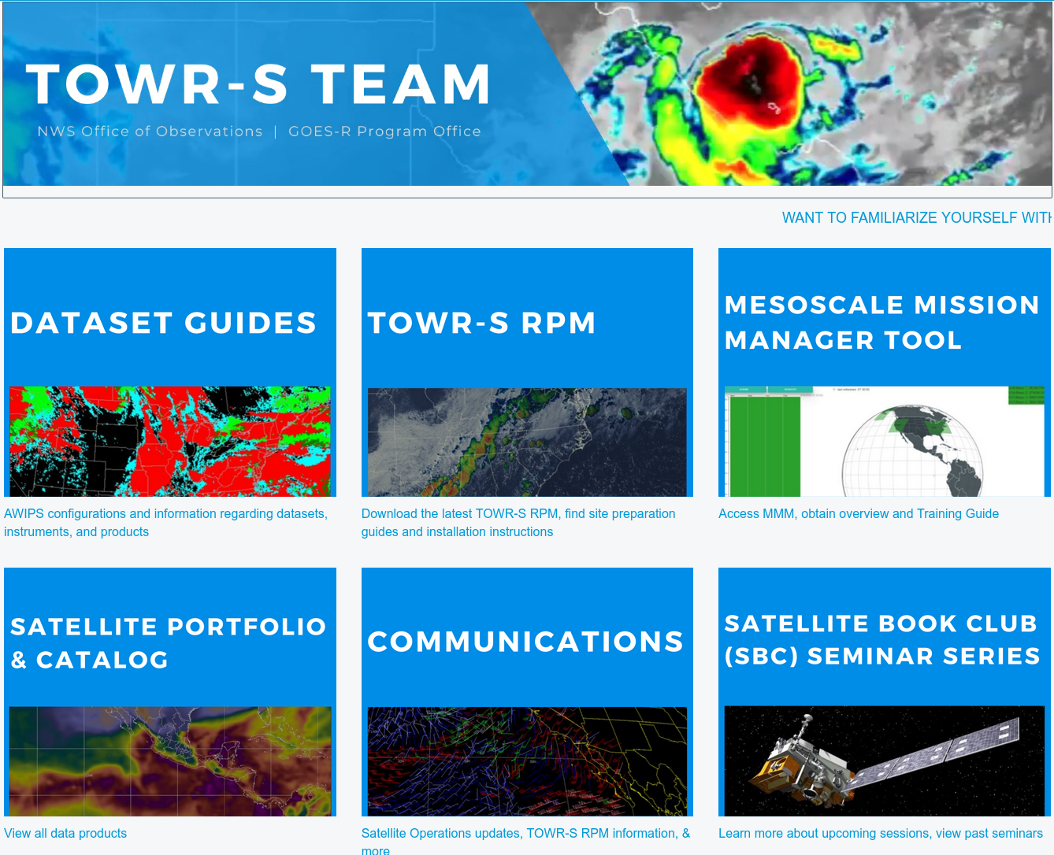
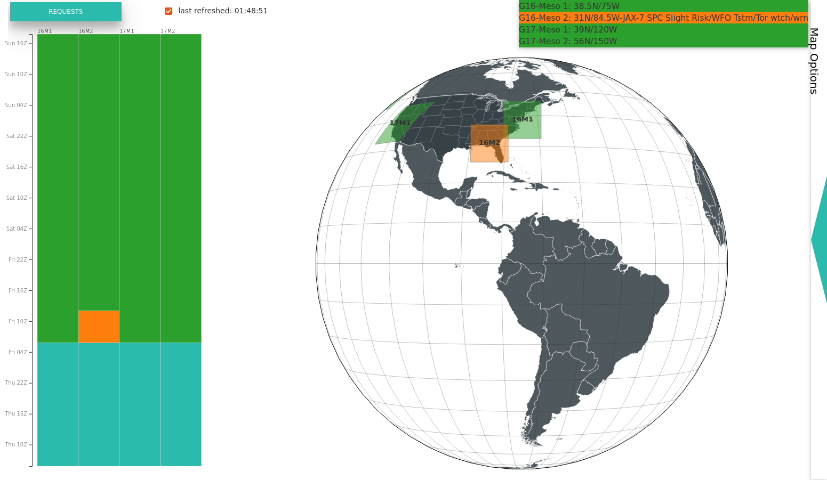
TOWR-S page on VLab: AWIPS Dataset Guides and more
https://vlab.noaa.gov/web/towr-s
Meso Mission Manager

Slide 22
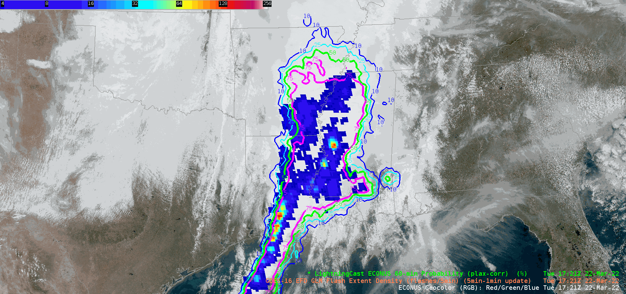
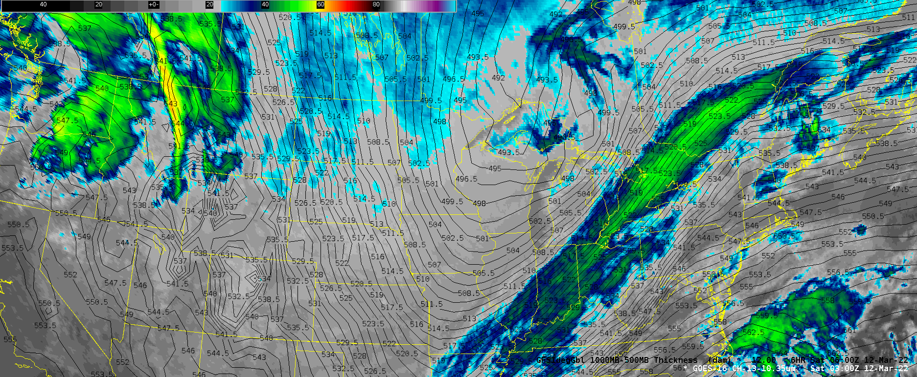
geoCloud AWIPS for Collaboration
TOWR-S team has an initiative to bring people together in the AWIPS environment to foster collaboration on ways satellite data can enhance the NWS mission
TOWR-S facilitates small groups of forecasters, technique development meteorologists, and algorithm developers from across the NWS and NESDIS
More details are in Satellite Book Club Session 38
Please contact Lee Byerle to schedule a session with your office

Slide 23
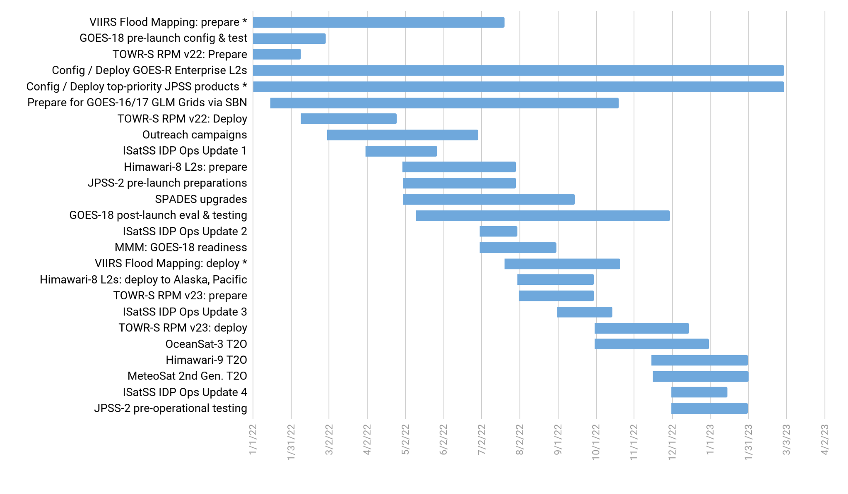
TOWR-S Activity Plan
CY2022 |  |  |  |  |  |  |  |  |  |  |  | CY2023
J | F | M | A | M | J | J | A | S | O | N | D | J | F | M
June 24, 2022

Slide 24
Contact Information
Office of Observations
Brian Gockel – brian.gockel@noaa.gov
Jordan Gerth – jordan.gerth@noaa.gov
Total Operational Weather Readiness – Satellites (TOWR-S) Team
John Evans – john.d.evans@noaa.gov
Lee Byerle – lee.byerle@noaa.gov
Links
NWSChat (“towr-s” chatroom)
TOWR-S in the NOAA VLab

Slide 25
Next TOWR-S Update
(tentative)
Sept. 30, 2022

Slide 26
(1) Current Product Posture
These lists may be out of date. Please use TOWR-S Product Posture instead.
Product | Delivery Mechanism (Activation) | Product Maturity | AWIPS Treatment (enhancement tables, ranges, units, rules…) | AWIPS Status (TOWR RPM date) | Target AWIPS Release (Blue = submitted)
ABI SCMI | G16 Mar ’17 SBN E | G16 Full |  | GOES-16/17 menus appear by default under Sat in v18.2.1
 | G17 Aug ‘18 SBN W | G17 Provisional: 11/28/18 G17 Full: 02/19/20
Bands 1-6 | “ | “ | Default General viewing VIS | Feb ‘17, Mature | 18.2.1
Band 7 | “ | “ | Default General viewing SWIR | Mar ‘17, Mature | 18.2.1
Band 7, 13-14 | “ | “ | Ocean/Land in winter IR | Mar ’17, Mature | 18.2.1
Bands 8-10 | “ | “ | Default General viewing WV | Mar ‘17, Mature | 18.2.1
Bands 8-10 | “ | “ | Low-level WV | Jun ‘17, Mature | 18.2.1
Bands 8-16 | “ | “ | Rainbow colors for dual IR, WV | Mar ‘17, Mature | 18.2.1
Bands 11-16 | “ | “ | Default General viewing IR | Mar ‘17, Mature | 18.2.1
Bands 11-16 | “ | “ | Summer, warm land areas | Mar ‘17, Mature | 18.2.1
Split Window Ch Diff |  |  | Blowing dust, volcanic ash, low-level water vapor (10.3-12.3um) | Jun ‘17, Mature | 18.2.1
Split Water Vapor Ch Diff |  |  | Gradients in UL WV (6.2-7.3um) | Jan ‘18, Mature | 18.2.1
Two Night Fog Ch Diffs |  |  | Gray/blue (2 menu buttons 10.3-3.9um, and 11.2-3.9um) | Jan ‘18, Mature, Aug ‘19 | 18.2.1 / 20.2.1

Slide 27
(2) Current Product Posture
These lists may be out of date. Please use TOWR-S Product Posture instead.
Product | Delivery Mechanism (Activation) | Product Maturity | AWIPS Treatment (enhancement tables, ranges, units, rules…) | AWIPS Status (TOWR RPM date) | Target AWIPS Release (Blue = submitted)
Day Fog Ch Diff |  |  | Highlights fog over warmer surfaces, Opposite of Night fog CH diff (3.9-10.3um) | Jan ‘18, Mature | 18.2.1
Split Snow Ch Diff |  |  | Highlights snow cover over land (1.6-0.64um) | Jan ‘18, Mature (Avail all sectors-FG) | 18.2.1
Split Fire Ch Diff |  |  | Fire hot spot detection (2.2-1.6um) | Jan ‘18, Mature (Avail all sectors-FG) | 18.2.1
Split Ozone Ch Diff |  |  | Ozone detection (9.6-10.3um) | Jan ‘18, Mature | 18.2.1
Split Cloud Top Phase Ch Diff |  |  | Highlights ice clouds, phase variation (11.2-8.4um) | Jan ‘18, Mature | 18.2.1
Vegetation Ch Diff |  |  | Highlights Vegetation, land sfc variation (0.64-0.87um) | Mar ‘17, Mature (Avail all sectors-FG) | 18.2.1
GOES-16/GOES-15 Supernational “CONUS with Legacy” | (Menu to only show G-16 as of March 2, 2020) |  | ABI CHs 2,7,8,11,16 w/corresponding G-15 CHs | Feb ‘18, Eval | N/A
Day Cloud Phase Distinction RGB |  |  | Daytime cloud phase variation (10.35,0.64,1.61um) | Aug ‘17, Mature | 19.2.1
Fire Temperature RGB |  |  | Fire hot spot detection (3.90,2.25,1.61um) | Jun ‘17, Mature | 19.2.1
Day Land Cloud RGB |  |  | Day land cloud (1.61,0.87,0.64um) | Jun ‘17, Mature | 19.2.1
Day Cloud Convection RGB |  |  | Day convection as warm colors (0.64,0.64,10.35um) | Aug ‘17, Mature | 19.2.1

Slide 28
(3) Current Product Posture
These lists may be out of date. Please use TOWR-S Product Posture instead.
Product | Delivery Mechanism (Activation) | Product Maturity | AWIPS Treatment (enhancement tables, ranges, units, rules…) | AWIPS Status (TOWR RPM date) | Target AWIPS Release (Blue = submitted)
Day Land Cloud Fire RGB |  |  | Day land clouds, fire (2.25,0.87,0.64um) | Jun ‘17, Mature | 19.2.1
Simple Water Vapor RGB |  |  | WV, Upper level circulation (10.35,6.19,7.34um) | Mar ‘17, Mature | 19.2.1
Air Mass RGB |  |  | Delineate air masses (6.19-7.34,9.61-10.35,6.19um) | Mar ‘17, Mature | 19.2.1
Ash RGB |  |  | Ash detection (12.3-10.35,11.2-8.5,10.35um) | Mar ‘17, Mature | 19.2.1
Day Convection RGB |  |  | Day convection (6.19-7.34,3.9-10.35,1.61-0.64um) | Aug ‘17, Mature (Avail all sectors-FG) | 19.2.1
Differential Water Vapor RGB |  |  | Water vapor contrast (7.34- 6.19,7.34,6.19) | Mar ‘17, Mature | 19.2.1
Day Snow Fog RGB |  |  | Day snow, fog (0.87,1.61,3.9-10.35um) | Jun ‘17, Mature | 19.2.1
Dust RGB |  |  | Dust (12.3-10.35,11.2-8.5,10.35um) | Mar ‘17, Mature | 19.2.1
Nighttime Microphysics RGB |  |  | Delineate night cloud phase (12.3-10.35,10.35-3.9,10.35um) | Mar ‘17, Mature | 19.2.1
SO2 RGB |  |  | Ash, S02 detection (6.95-7.34,10.35-8.5,10.35um) | Jun ‘17, Mature | 19.2.1

Slide 29
(4) Current Product Posture
These lists may be out of date. Please use TOWR-S Product Posture instead.
Product | Delivery Mechanism (Activation) | Product Maturity | AWIPS Treatment (enhancement tables, ranges, units, rules…) | AWIPS Status (TOWR RPM date) | Target AWIPS Release (Blue = submitted)
Daytime Composite #1 RGB |  |  | Highlight cold surfaces, cirrus (0.64,1.61,11.2um) | Baselined 16.1.x
Daytime Composite #5 RGB |  |  | Grayscale, Cirrus (0.64,0.87,0.64um) | Baselined 16.1.x
Day Ocean Cloud Convection |  |  | Daytime Ocean Convection (0.87,0.87, 10.35um) | June ’17, Mature | 19.2.1
CIMSS Natural Color RGB |  |  | Natural color, computes Green | Jan. ‘18, Mature (Avail all sectors-FG) | 19.2.1
GOES-East,West Clear Sky Mask | SBN Exp (G-16: May 2017; G-17: Sep. 2021) F,C,M | G16: Provisional | Display as binary mask | Baselined 16.1.x
 |  | *G17: Provisional (May 6, ’19)
GOES-East,West Cloud Top Height, Temperature, Pressure | SBN Exp (G-16: 31 May 2017; G-17: Sep. 2021) Height: F,C,M / Temp: F,M / Pressure: F,C | G16: Provisional | Cloud Top Height in Ft, Temp in degC | June ‘17, Mature | 18.2.1
 |  | *G17: Provisional (May 6, ’19)
GOES-East,West Cloud Top Phase | SBN Exp (G-16: May 2017; G-17: Sep. 2021) F,C,M | G16: Provisional | Clear, Water, Supercooled, Mixed, Ice, Uncertain | Baselined 16.1.x
 |  | *G17: Provisional (May 6, ’19)
GOES-East,West Derived Stability Indices (CAPE,LI, KI, SI, TT) | SBN Exp (G-16: May 2017; G-17: Sep. 2021) F,C,M | G16: Provisional *G17: Provisional (May 16, ’19) | 10-bit colormap. Syncs to legacy GOES Sounder ranges | Aug. ‘17, Mature | 18.2.1
GOES-East,West Aerosol Detection (ADP) | SBN Exp (G-16: May 2017; G-17: Sep. 2021) F,C,M | G16: Provisional (Dec. 6, ‘18) | Separate Dust, Smoke. Hi/Lo/Med confidence | Feb. ‘18 RPM, Eval | 20.2.1
 |  | *G17: Provisional (June 27, ‘19)
*G-17 PS-PVRs are based upon cool season evaluations
F = Full Disk, C= CONUS, M= Mesoscale

Slide 30
(5) Current Product Posture
These lists may be out of date. Please use TOWR-S Product Posture instead.
Product | Delivery Mechanism (Activation) | Product Maturity | AWIPS Treatment (enhancement tables, ranges, units, rules…) | AWIPS Status (RPM date) | Target AWIPS Release (Blue = submitted)
GOES-East,West Aerosol Optical Depth | SBN Exp (G-16: May 2017; G-17: Sep. 2021) F,C | G16: Provisional (Sept. 14, ’18) | Display as binary mask. Fixed display range (0-1) | June ‘17, Mature | 18.2.1
 |  | *G17: Provisional (June 27, ’19)
GOES-East,West Land Surface Temperature | SBN Exp (G-16: May 2017; G-17: Sep. 2021) F,C,M | G16: Provisional | LST in degF | June ‘17, Eval | 19.2.1
 |  | *G17 Provisional (June 13, ’19)
GOES-East,West Fire/Hot Spot | SBN Exp (G-16: May 2017; G-17: Sep. 2021) F,C + New Meso Sep. ‘21 | G16 Provisional (Apr 24, ‘18) | Fire Temp, Power, Area | Aug. ‘17, Eval | 19.2.1
 |  | *G17: Provisional (July 25, ’19)
GOES-East,West TPW | SBN Exp (G-16: May 2017; G-17: Sep. 2021) F,C,M | G16: Provisional *G17: Provisional (May 16, ‘19) | TPW in Inches. 10-bit colormap based legacy GOES Sounder | Aug. ‘17, Mature | 18.2.1
GOES-East,West Cloud Optical Depth | SBN Exp (G-16: May 2017; G-17: Sep. 2021) F,C | G16: Provisional *G17: Provisional Day: 6/13/19 Night: 9/24/19 | Fixed max display range to 100% | Aug. ‘17, Mature | 18.2.1
GOES-East,West Cloud Particle Size Distribution | SBN Exp (G-16: June 2017; G-17: Sep. 2021) F,C,M | G16: Provisional (Dec. 14, ’18) *G17: Provisional Day: 6/13/19 Night: 9/24/19 | Range 0-100um | Baselined
GOES-East,West Derived Motion Winds | SBN GRE/GRW (G-16: June 2017; G-17: Mar. 2020) C (15min), M (5min) | G16: Provisional | By-Pressure displays as single color like legacy. Meso 1,2 now separate displays/database entries | Feb. ‘18, Mature | 19.2.1
 |  | *G17: Provisional (May 16, ’19)
GOES-East,West Sea Surface Temperature | SBN Exp (G-16: Jan 2018; G-17: Sep. 2021) F (hourly) | G16: Provisional | Colormap highlights TC threshold, Default display as DegF and DegC | March ‘18, Mature | 19.2.1
 |  | *G17: Provisional (July 25, ’19)
*G-17 PS-PVRs are based upon cool season evaluations
F = Full Disk, C= CONUS, M= Mesoscale

Slide 31
(6) Current Product Posture
These lists may be out of date. Please use TOWR-S Product Posture instead.
AWIPS Release Dates:
20.2.1,2,3 – June 2021
20.3.1,2 – Jan. 2022
Product | Delivery Mechanism (Activation) | Product Maturity | AWIPS Treatment (enhancement tables, ranges, units, rules…) | AWIPS Status (TOWR RPM date) | Target AWIPS Release (Blue = submitted)
GOES-East,West Rainfall Rate, Quantitative Precipitation Est | SBN Exp (G-16: Jan. 2018; G-17: Sep. 2021) F | G16: Provisional (March 31, ‘18) | Display in inches. Colormap syncs w/typical radar colors | March ‘18 | 18.2.1
 |  | *G17: Provisional May 16, ‘19
GOES-East,West Legacy Vertical Temperature/Moisture Profiles | G16: SBN Exp (G-16: Feb 2018; G-17: Sep. 2021) C (30min) | G16: Provisional | NSHARP profiles. Move menu under Derived products section | Baselined (16.1.x), Eval, profile cadence | 19.2.1
 |  | *G17: Provisional (May 16, ‘19)
NOAA-20 VIIRS Imagery (KPP to AK via terrestrial Networks) | ~Feb. ‘18 | Validated | I, M-bands, NCC | Feb. ‘18, Eval | 19.2.1
Snow Cover | TBD | G16/G17 Provisional 8/13/20
JASON 3 Wave Altimetry | SBN NMC3 (July 17, ‘18) | Operational, TT 194990 for slow load times, under investigation |  | Feb. ’18, dbgeo plugin | 19.2.1
GOES-East,West GLM Full Disk Punctured Tiles | LDM migration | G16/17 Full | 1- & 5-minute Flash Extent Density (FED), Total Optical Energy, Min. Flash Area | Nov. ‘20
GOES-East,West Ice Products: Ice Concentration, Ice Age / Thickness, Ice Motion | LDM migration | Ice Concentration, Ice Age & Thickness: Provisional |  | Nov. ‘20
CIMSS Turbulence Probability (CONUS) | LDM migration |  |  | Nov. ‘20
*G-17 PS-PVRs are based upon cool season evaluations

Slide 32
(7) Current Product Posture
These lists may be out of date. Please use TOWR-S Product Posture instead.
AWIPS Release Dates:
20.2.1,2,3 – June 2021
20.3.1,2 – Jan. 2022
Product | Delivery Mechanism (Activation) | Product Maturity | AWIPS Treatment (enhancement tables, ranges, units, rules…) | AWIPS Status (TOWR RPM date) | Target AWIPS Release (Blue = submitted)
Full Disk Geostationary Lightning Mapper (GLM) | LDM Migration Ops / Local Generation | G16: Full G17 Full: 11/21/19 | Flash Extent Density (FED) Grid, Average Flash Area, and Total Optical Energy | NHCN/NTBN/OPCN/ AWCN | TBD
GOES VIS/IR Sandwich RGB | N/A | N/A | CH 02, CH 13 Combo | March ’19 RPM | 20.2.1
GOES NDVI Vegetation Channel Difference | N/A | N/A | CH02, CH03 Combo | March ‘19 RPM Next RPM to include CSM | 20.2.1
ASCAT A, B, C Wind Speed / Direction and Ambiguities | N/A | N/A | DMW plugin | NHCN/NTBN/OPCN | Eval
SSMI F-15 85 GHz H,V and 36.5GHz H,V Microwave Imagery | ISatSS | N/A | GOES-R plugin, PCT RGBs | NHCN/NTBN | Eval
AMSR2 89.5 GHz AH, AV and 36.5 GHz AH, AV Microwave Imagery | ISatSS | N/A | GOES-R plugin, PCT RGBs | NHCN/NTBN/OPCN | Eval
GPM GMI 89.5 GHz H,V and 37 GHz H,V Microwave Imagery | ISatSS | N/A | GOES-R plugin, PCT RGBs | NHCN/NTBN | Eval
S-NPP ATMS QV 88 GHz Microwave Imagery | ISatSS | N/A | GOES-R plugin | NHCN/NTBN | Eval
AMSR2 Ocean products: Rain Rate, SST, TPW, Cloud Liquid Water, Wind Speed | ISatSS | N/A | GOES-R plugin | NHCN/NTBN/OPCN | Eval
JASON-3 Wave Heights and Wind Speeds | ISatSS | N/A | DMW plugin for numeric read-outs | NHCN/NTBN/OPCN | Eval
Cryosat-2 Wave Heights and Wind Speeds | ISatSS | N/A | DMW plugin for numeric read-outs | NHCN/NTBN/OPCN | Eval
Altika Wave Heights and Wind Speed | ISatSS | N/A | DMW plugin for numeric read-outs | NHCN/NTBN/OPCN | Eval
Sentinel-3A/3B Wave Heights and Wind Speeds | ISatSS | N/A | DMW plugin for numeric read-outs | NHCN/NTBN/OPCN | Eval
S-NPP & NOAA-20 VIIRS Active Fires | ISatSS | Validated | DMW plugin | All | TBD

Slide 33
(8) Current Product Posture
These lists may be out of date. Please use TOWR-S Product Posture instead.
AWIPS Release Dates:
20.2.1,2,3 – June 2021
20.3.1,2 – Jan. 2022
Product | Delivery Mechanism (Activation) | Product Maturity | AWIPS Treatment (enhancement tables, ranges, units, rules…) | AWIPS Status (TOWR RPM date) | Target AWIPS Release (Blue = submitted)
NOAA-20 NUCAPS | SBN Jul 2, ‘19 |  | VIIRS NUCAPS plugin | Feb. ‘18 RPM | 19.2.1
NOAA-20 NCC/Day Night Band | SBN Jul 24/25, ’19 |  | VIIRS plugin | Feb. ‘18 RPM | 19.2.1 (DR 20707, 20708 fix “S-NPP” legend)
SSMIS F-16 91 GHz H,V and 37GHz H,V Microwave Imagery | ISatSS | N/A | GOES-R plugin, PCT RGBs derived param | NHC | Eval
SSMIS F-17 91 GHz H,V and 37GHz H,V Microwave Imagery | ISatSS | N/A | GOES-R plugin, PCT RGBs derived param | NHC | Eval
SSMIS F-18 91 GHz H,V and 37GHz H,V Microwave Imagery | ISatSS | N/A | GOES-R plugin, PCT RGBs derived param | NHC | Eval
National Center G-16 Full Disk GLM Grids | ISatSS | Full Nov ‘18 | GOES-R plugin | AWC, NHC, OPC, WPC | Eval
Himawari DMWs for Pacific Region | ISatSS | N/A | DMW plugin | N/A | Eval
GOES-16 Fog and Low Stratus (FLS) (STAR product) for OPC and NHC | ISatSS | Eval | GOES-R plugin | NHC, OPC | 21.3.1
GOES-East,West Fog and Low Stratus (FLS) | SBN GOES-East: Sep. ‘20 GOES-West: Sep. ‘21 |  | GOES-R plugin | TOWR-S RPM v19 (Aug. 2020)

Slide 34
(9) Current Product Posture
These lists may be out of date. Please use TOWR-S Product Posture instead.
AWIPS Release Dates:
20.2.1,2,3 – June 2021
20.3.1,2 – Jan. 2022
Product | Delivery Mechanism (Activation) | Product Maturity | AWIPS Treatment (enhancement tables, ranges, units, rules…) | AWIPS Status (TOWR RPM date) | Target AWIPS Release (Blue = submitted)
NESDIS multi-sat Imagery Composite (VIS/IR/LWIR/SWIR) | ISatSS SBN | N/A | NetcdfGrid plugin | NHC | 21.3.1
G-17 PACUS & Meso Sector DMWs | SBN Mar 2020 (PACUS) / Sep. 2021 (Meso) | Provisional May 16, ’19 | GOES-R plugin | Mar ‘20 | 20.2.1 (LDM, edex cfg)
NESDIS Global Blended (polar) TPW, % Normal TPW | SBN Mar 12, ‘20 | N/A | NetcdfGrid plugin | Mar ‘20 | 20.2.1
NESDIS Global Blended (polar) Rain Rate | SBN Mar 12, ‘20 | N/A | NetcdfGrid plugin | Mar ‘20 | 20.2.1
Meteosat Imagery for Ctrs (VIS/IR/SWIR/WV) | Oct ‘19 AWC, Feb ‘20 NHC | N/A | GOES-R plugin | N/A | TBD
G-16 ASOS Satellite Cloud Products (SCP) | SBN (May 27, 2020) | N/A | Text Db | N/A | N/A
G-17 ASOS Satellite Cloud Products (SCP) | SBN (Sept. 30, 2020) | N/A | Text Db | N/A | N/A

Slide 35
(1) Current Non-Product RPM Features
This table may be out of date. Please contact John Evans before using or quoting these details.
AWIPS Release Dates:
20.2.1,2,3 – June 2021
20.3.1,2 – Jan. 2022
Feature | Function/Description | AWIPS Status (TOWR RPM date) | Target AWIPS Release (Blue = submitted)
Legacy bundle for GOES-15 | Enables legacy display of G-15 | Jan ’18, Eval | Eval
Geostationary Map Scales | West, Center, East geostationary scales | Jan ‘18, Eval | 21.3.1
Frame controls from 64 to 300 | Ability to loop 300 frames | Eval | 21.3.1
CSPP/CIMSS Polar data description | Handles description of VIIRS/CIMSS prods (e.g. CSPP in goes-r plugin) | Feb ‘18 | Eval
LDM (pqact) Updates | LDM configuration for GOES-17 PACUS DMWs, and Blended Hydro (TPW, Rain Rate, PCT Normal TPW) | Updates steps are in RPM install instructions, but not in RPM | 18.2.1 / 20.2.1
GOES-East, GOES-West menu | Update from “GOES-17” to “GOES-West” | May/Jun ‘18 | 20.2.1
Add Sector, Satellite to CAVE Legend for G-16/G-17 RGBs, Derived Products, respectively | Improves Legend to delineate between loaded Sectors/Satellites | May/Jun ‘18 Eval | 20.2.1
Link to pqact setting examples for tailored sectors is here.

Slide 36
(2) Current Non-Product RPM Features
This table may be out of date. Please contact John Evans before using or quoting these details.
AWIPS Release Dates:
20.2.1,2,3 – June 2021
20.3.1,2 – Jan. 2022
Feature | Function/Description | AWIPS Status (TOWR RPM date) | Target AWIPS Release (Blue = submitted)
Color By Pressure for GOES wind vectors | Bundle/Menu to color by p-level or range (SET/WFO PUB contribution) | Feb ‘18 Eval | 20.2.1
Legend update to GOES wind vectors | Adds satellite (e.g. GOES-17/GOES-16) to display legend | Mar ’20 | 20.2.1
A2 Edex Ingest | Ingest patterns for GOES-17 DMWs/ Blended Hydro | Mar ’20 | 20.2.1
A2 Edex Plugin Descriptions | GLM AFA, TOE. Aerosol Detection (ADP) Hi/Med/Low confidence specification | Jun ‘18/ Feb ’18 | Eval (GLM) / 20.2.1 (ADP)
A2 Edex Purge Rules | Edex purging of processed Blended Hydro products | Mar ’20 | 20.2.1
GOES 10.35um (CH 13) DegF display cfg | Menu, colormap, style rules for Deg Fahrenheit option | Mar ‘20 Eval | TBD

