Slide 1
TOWR-S Update
January 21, 2022
https://meet.google.com/thn-pkwe-wbr
Total Operational Weather Readiness - Satellites
NWS Office of Observations

Slide 2
Overview
Satellite data products and capabilities newly available
Satellite data products and capabilities in preparation
Satellite data products and capabilities under consideration
TOWR-S RPM v22 update
GOES-T / GOES-18 preparations
GOES-17 update
Preparations for JPSS-2 / NOAA-21
Satellite Book Club seminars
TOWR-S Dataset Guides and Satellite / Sensor reference guide
TOWR-S 2022 workplan

Slide 3
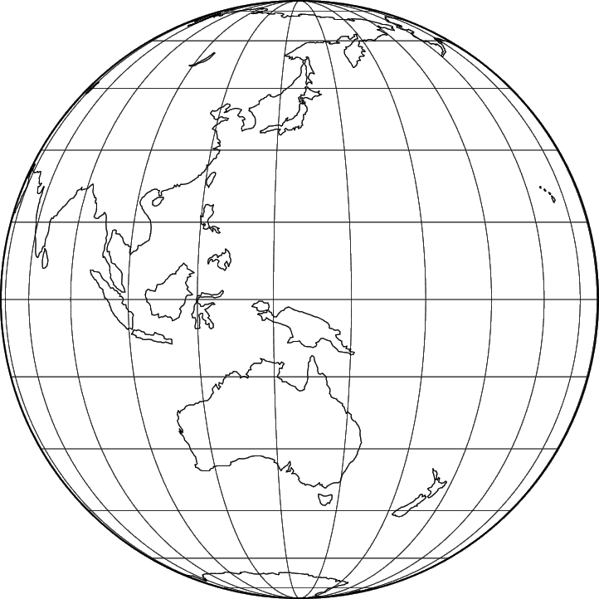
Operational dissemination of Himawari-8 Imagery
Now being disseminated from NESDIS / PDA via NWS NCF to Alaska and Pacific Regions: Full-Disk tiles (and soon, floating [target] sector)
Also publicly available via the Amazon cloud: https://noaa-himawari8.s3.amazonaws.com/index.html
NCF fetches 61 of 88 tiles (x 16 channels) from PDA and sends
tiles 02-06 and 09-14 to Alaska Region HQ; and tiles 07-14, 16-23, 26-33, 36-43 46-53, 56-63, and 66-73 to Pacific Region HQ
HQs forward them to WFOs in each region
88x16=1,408 PDA subscriptions (w/ 1,408 WMO headers) will allow full flexibility by tile & by channel
 |  | 01 | 02 | 03 | 04 | 05 | 06
 | 07 | 08 | 09 | 10 | 11 | 12 | 13 | 14
15 | 16 | 17 | 18 | 19 | 20 | 21 | 22 | 23 | 24
25 | 26 | 27 | 28 | 29 | 30 | 31 | 32 | 33 | 34
35 | 36 | 37 | 38 | 39 | 40 | 41 | 42 | 43 | 44
45 | 46 | 47 | 48 | 49 | 50 | 51 | 52 | 53 | 54
55 | 56 | 57 | 58 | 59 | 60 | 61 | 62 | 63 | 64
65 | 66 | 67 | 68 | 69 | 70 | 71 | 72 | 73 | 74
 | 75 | 76 | 77 | 78 | 79 | 80 | 81 | 82
 |  | 83 | 84 | 85 | 86 | 87 | 88
Himawari Product | Sector | Refresh Rate |  | Nadir ground resolution
Cloud & Moisture Imagery | Full Disk tiles | 10 min |  | 1 & 2 km
Cloud & Moisture Imagery | Floating Sector | 2.5 min |  | 0.5 km
h/t Joe Zajic

Slide 4
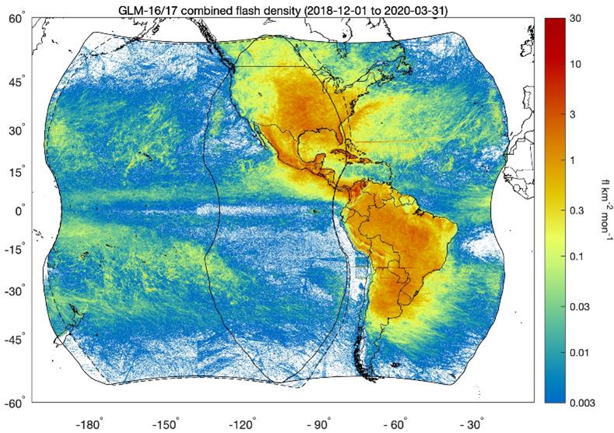
In preparation: Operational production & dissemination of GLM Flash Extent Density (FED)
FED “Punctured tiles,” currently being produced by ISatSS and disseminated via Regional LDM
AWIPS configs are available via TOWR-S RPM
Operational FED punctured tiles expected from GOES-R Ground System in ~ Oct. 2022.
Now preparing for dissemination via SBN:
Set file naming conventions, WMO headers
Assess bandwidth (Mbps) and choose SBN channel
Configure NCF routing
Test
Inform users via Service Change Notice, VLab, etc.

Slide 5
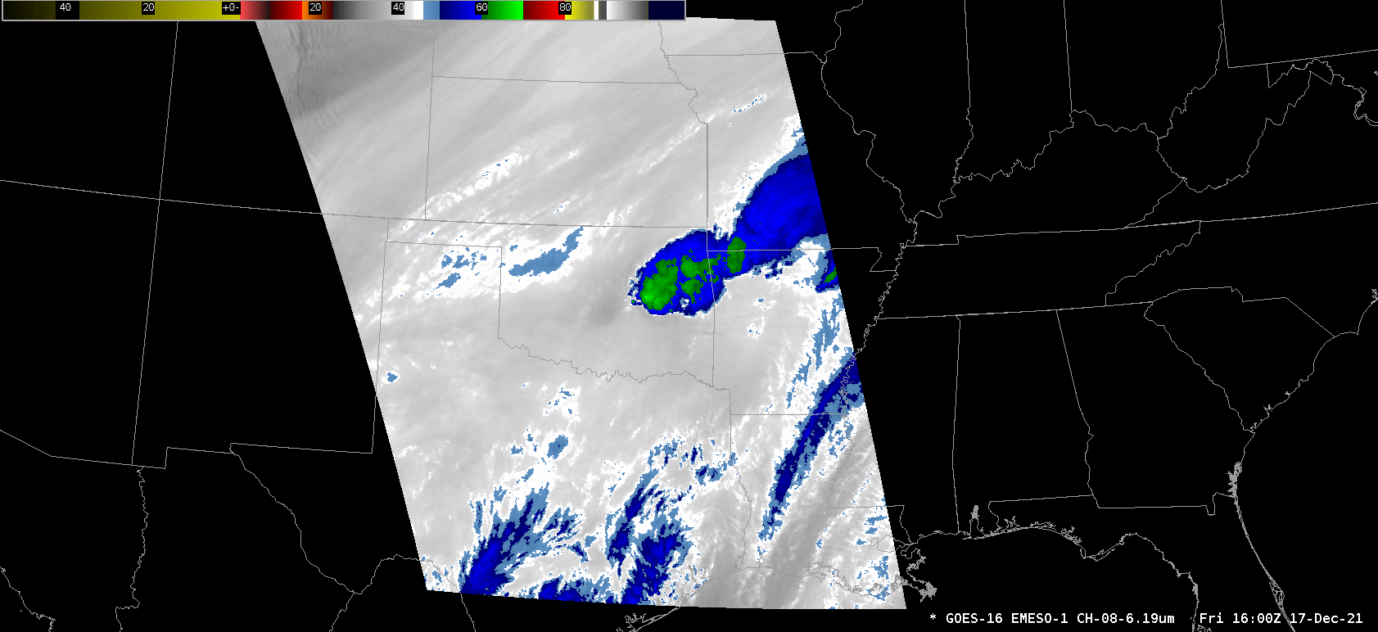
In preparation: GOES-R ABI 2.5-minute CONUS scan schedule
2-> 4 CONUS sector scans every 10 minutes
20-> 4 Meso sector scans every 10 minutes
1 FD scan every 10 minutes
Mode 6 scan schedule (repeats every 10 minutes)
Example CONUS 2.5 minute scan schedule (repeats every 10 minutes)
AWIPS view of 2.5 minute scan schedule (using Meso sector imagery)

Slide 6
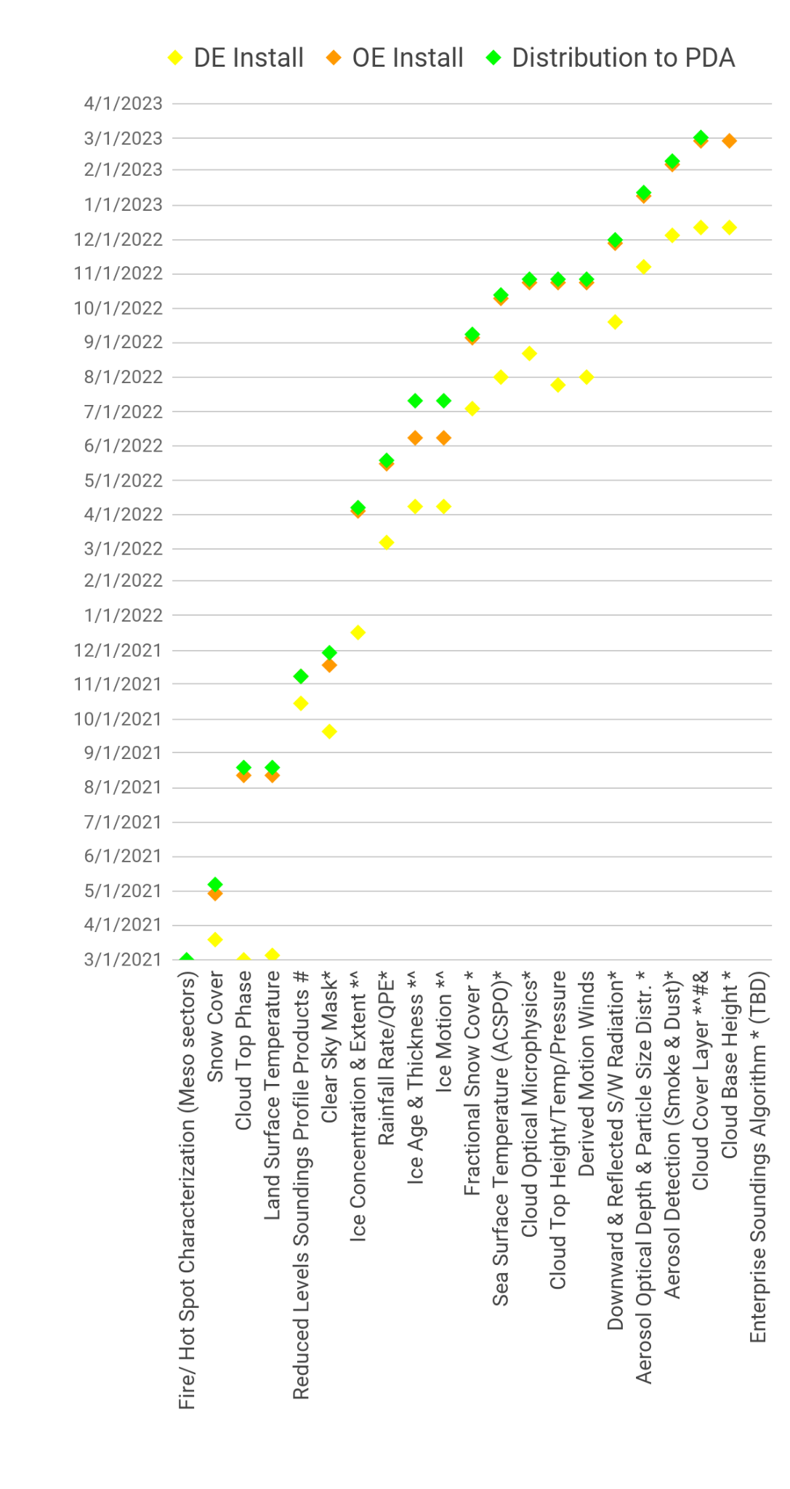
Enterprise GOES-R ABI L2 products
GOES-R Ground System development timeline
Updated Jan. 25
January 21, 2022
Notes: * Enterprise Algorithm with GOES-17 LHP mitigation ^ NOAT Funded Algorithm # New Product to PDA & Enables Provisional
NOTE: Several GOES-R Enterprise L2 product schedules changed significantly in early 2022, after ECMWF determined that the Enterprise Cloud Top Height alters DMWs, resulting in an unacceptable negative impact to model skill. Addressing this required changes to the Cloud Top Height algorithm, which affected the schedule of numerous algorithms that depend on it. (per GOES-R PSR Dec. 2)
From GOES-R PRO PASS Dev’t Schedule
Note: Some of these data products will reach AWIPS sites via SBN; others via LDM, Cloud, or other mechanisms

Slide 7
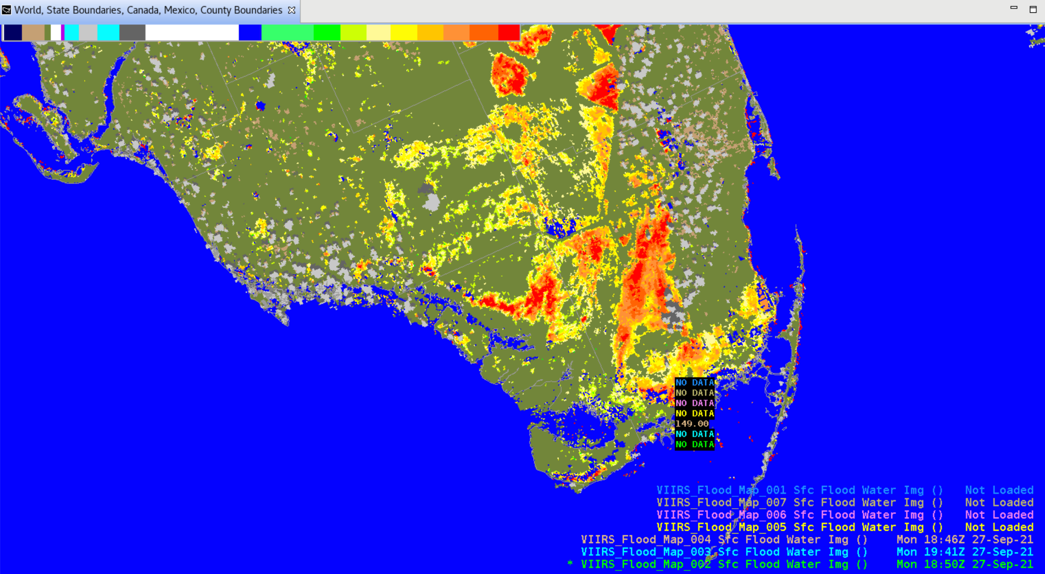
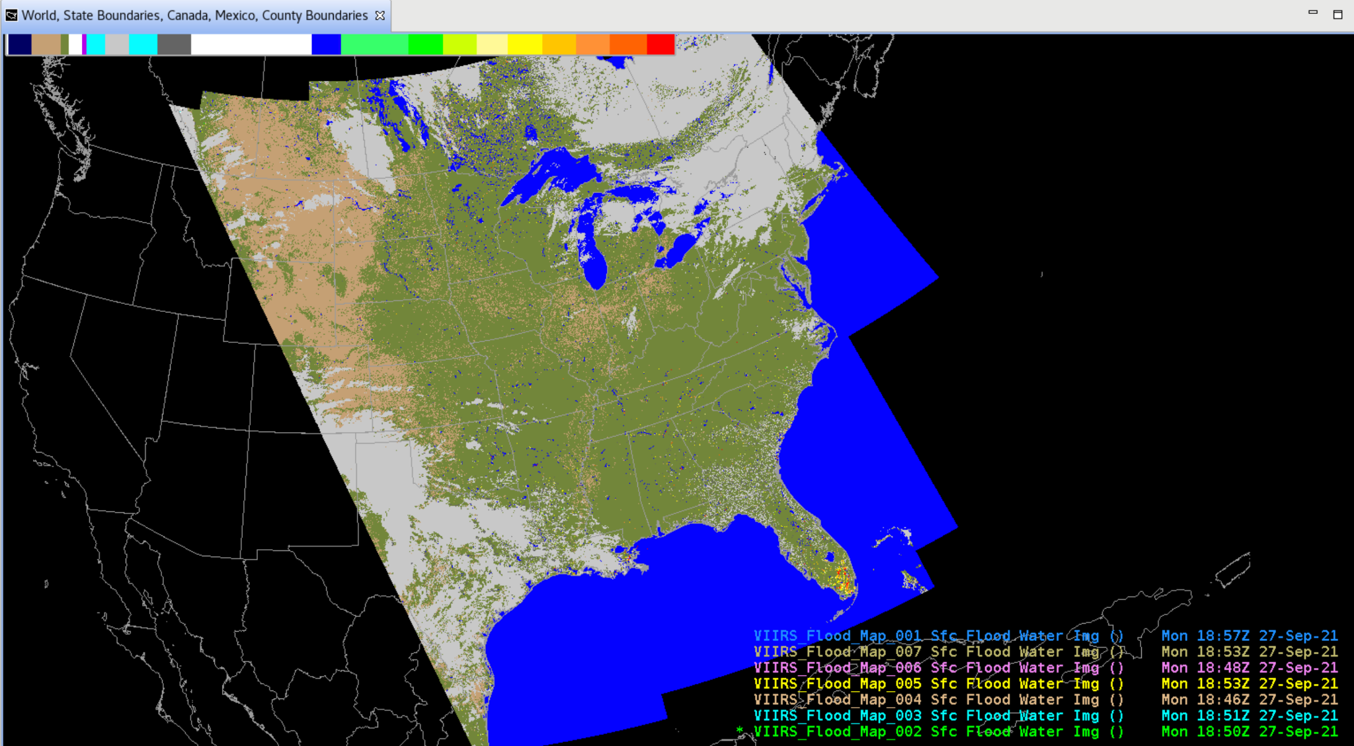
Satellite Data Product Changes Under Consideration
VIIRS Flood Mapping
Expected via NDE/PDA in Feb. 2022
h/t Derek van Pelt
h/t Derek van Pelt

Slide 8
Satellite Data Product Changes Under Consideration
JPSS Derived Products
S-NPP, NOAA-20 VIIRS Active Fires^{[1]}, Aerosols, Volcanic Ash^{[2]}
S-NPP, NOAA-20 ATMS MiRS ^{[2]}
GCOM AMSR-2 Ocean Winds & Microwave Brightness ^{[2]}
S-NPP, NOAA-20 VIIRS Imagery (now being produced for all 22 channels) ^{[3]}
[1] AWIPS sites are currently receiving a modified VIIRS Active Fires product via LDM
[2] AWIPS 20.2.3 Baseline provides EDEX ingest support for VIIRS Active Fires, Aerosols, and Volcanic Ash; ATMS MiRS; and GCOM AMSR-2 Ocean Winds & Microwave Brightness
[3] TOWR-S RPM v22 (Feb. 2022) will provide EDEX ingest support for all VIIRS Imagery channels
Metop-B,C L2 products
ASCAT Ocean Surface Winds (Metop-B,C): expanded geographic coverage
Synthetic Aperture Radar (SAR) from Sentinel and RadarSat (over coastal regions)
(Sentinel-1B unavailable since Dec. 23, 2021; Sentinel-1C to launch in mid-2023)
ISRO OceanSat-3 scatterometer data products
OceanSat-3 to launch in 2022
MeteoSat 3rd Gen. (MTG) imagery & L2 products
MTG-I1 to launch in late 2022
Metop 2nd Gen. (Metop-SG) imagery & L2 products
Metop-SG A1 to launch in 2024

Slide 9
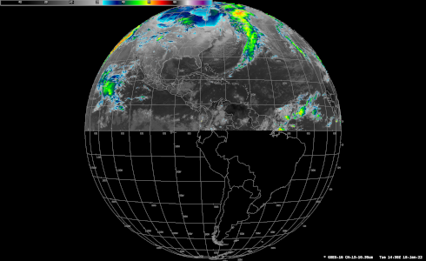
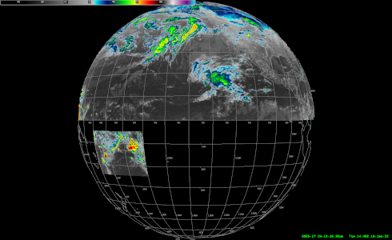
Under Consideration: Changes to the geographic and spectral coverage of GOES-East,West SCMI disseminated over SBN
(No sooner than FY23 Q1; cf. Public Information Statement PNS21-60)
Phase 1:
Cease creation/transmission of the "Hawaii Regional" SCMI sector, for all bands (1-16)
Increase spatial resolution of Channel 13 (IR Window) to full (2 km) resolution for Northern Hemisphere
Add "American Samoa Regional" sector for Channel 13 (IR Window) at full (2 km) resolution
Phase 2: Cease SBN transmission of all (reduced-resolution, 6 km) Southern Hemisphere imagery from the Full Disk, for all bands
Phase 3: Transition Channel 16 (CO2 Band) from SBN to PDA/Data Delivery (for northern hemisphere), for all sectors (Full Disk, CONUS, Meso)
GOES-East
GOES-West

Slide 10
Coming in February 2022: TOWR-S RPM v22
Likely features:
Configuration for thinned GOES-R soundings (Moisture / Temperature Profiles)
GOES-R Cloud Type RGB
VIIRS I-Band Active Fires support (DMW-friendly files via AWC ISatSS)
RGB + L2 product readout added to Local Options
Add sector name to legends for channel differences and imagery
Support for GOES-R Enterprise Cloud Phase and Land Surface Temperature (retained from v21)
APP Geocolor in main Satellite menu
Rocket Plume RGB (under Local options menu)
Gridded NUCAPS improvements:
2m Temperature in °F (Upper Level Temps still degC) Precipitable Water in inches Haines Index layers
Readiness for future Blended Hydro Products
ASCAT 4-category legend (includes 25-33 kt category)
Improved colormap for CIMSS Turbulence product
Configurations to ingest all 22 VIIRS Imagery bands
Remove dmw geographic filtering config file (for more site customization)
Remove 20.2.3 base content

Slide 11
Preparations for GOES-T (GOES-18)
Launch date: March 1, 2022
NWS has requested operational availability as soon as possible
Aiming for GOES-18 ABI data products (partially validated) to be available to NWS by Aug. 2022
Accelerated Transition to Operations
Split Post-Launch Test schedule (Part 1 @ 89.5°W; Part 2 @ 136.8°W) should allow dissemination of Beta-mature ABI data products from GOES-18 by Aug. 2022
GOES-18 data dissemination:
GRB will interleave GOES-18 ABI data with GOES-17 GLM and space weather data in the GOES-17 GRB stream
The NWS Satellite Broadcast Network (SBN) will send GOES-18 or GOES-17 data (but not both)
Supplemental dissemination via NOAA’s cloud computing platform (GeoCloud)
NWS / GOES-R coordinated planning & readiness process now underway

Slide 12
GOES-West Transition Plan for GOES-17→18
h/t GOES-R Program
Broad(er) cloud-based supplemental distribution of GOES-18 ABI data will start at Beta maturity in July.
GOES-18 ABI L1b/CMI will reach Provisional Maturity in September, shortly after the GOES-17 warm season / GRB interleave period.

Slide 13
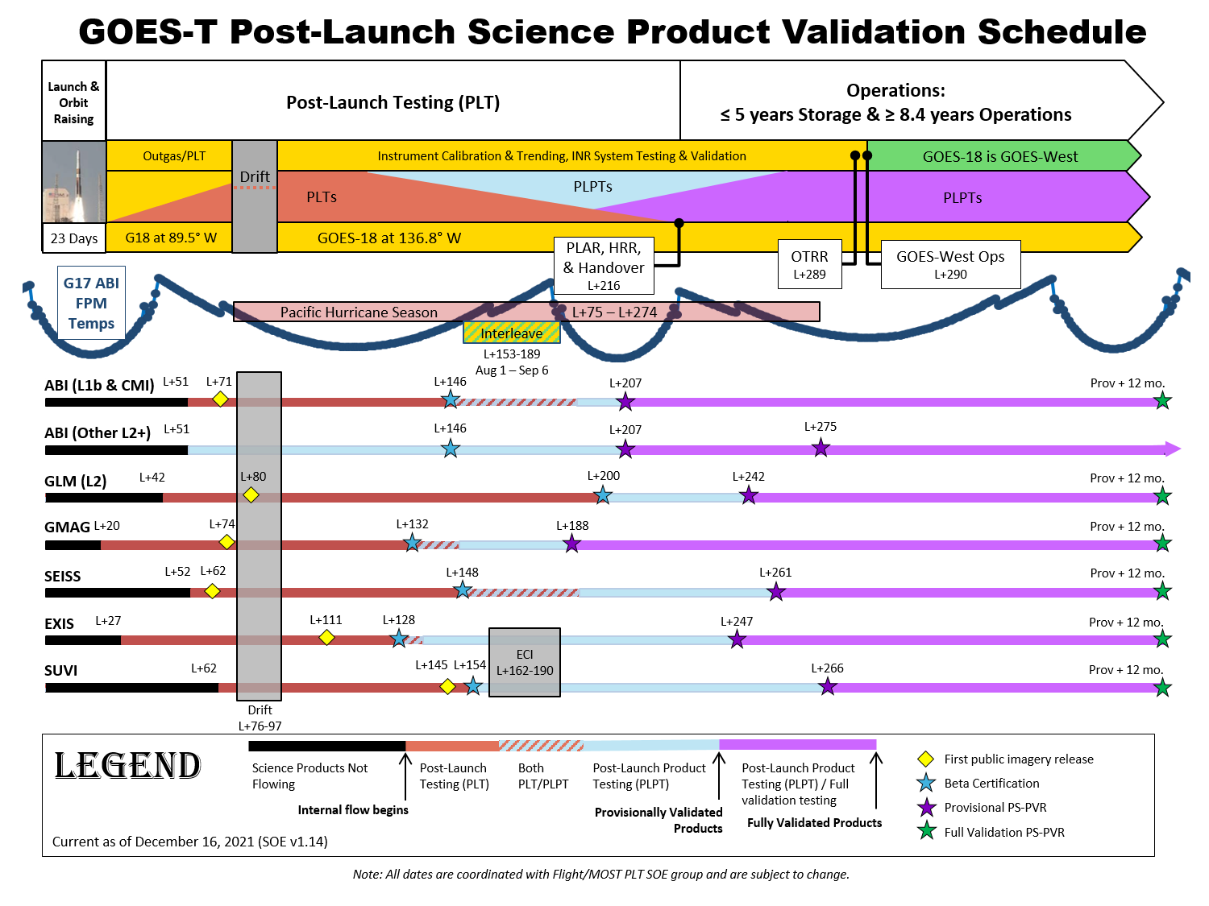
 | Mar. 2022 | Apr. 2022 | May 2022 | Jun. 2022 | Jul. 2022 | Aug. 2022 | Sep. 2022 | Oct. 2022 | Nov. 2022 | Dec. 2022 | Jan. 2023 | Feb. 2023 | Mar. 2023
-> More details on GOES-T/18 Transition to Operations are available from the GOES-R Steering Group via OSPO
Months are approximate
h/t GOES-R Steering Group

Slide 14
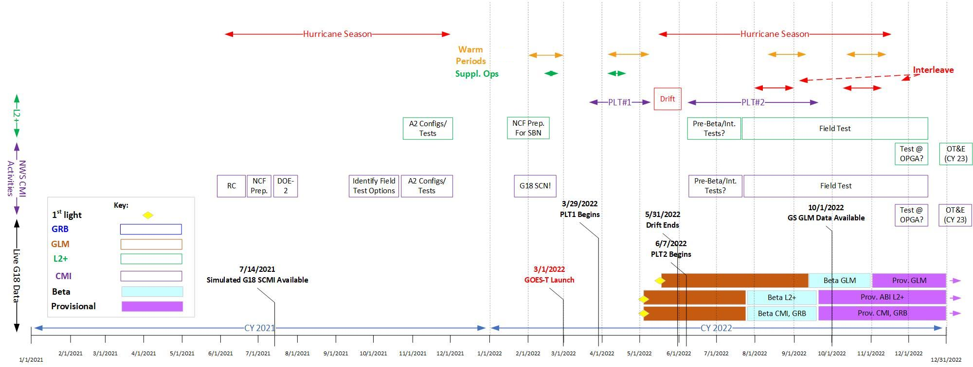
NWS GOES-T readiness planning
Preliminary / Subject to change
January 21, 2022
Dariush Khadjenouri - Tentative and draft
 | Mar. 2022 | Apr. 2022 | May 2022 | Jun. 2022 | Jul. 2022 | Aug. 2022 | Sep. 2022 | Oct. 2022 | Nov. 2022 | Dec. 2022 | Jan. 2023 | Feb. 2023 | Mar. 2023
Months are approximate
h/t GOES-R Program

Slide 15
NWS GOES-T readiness planning: 2022 timeline
GOES-15
Preliminary / Subject to change
January 21, 2022
Dariush Khadjenouri - Tentative and draft

Slide 16
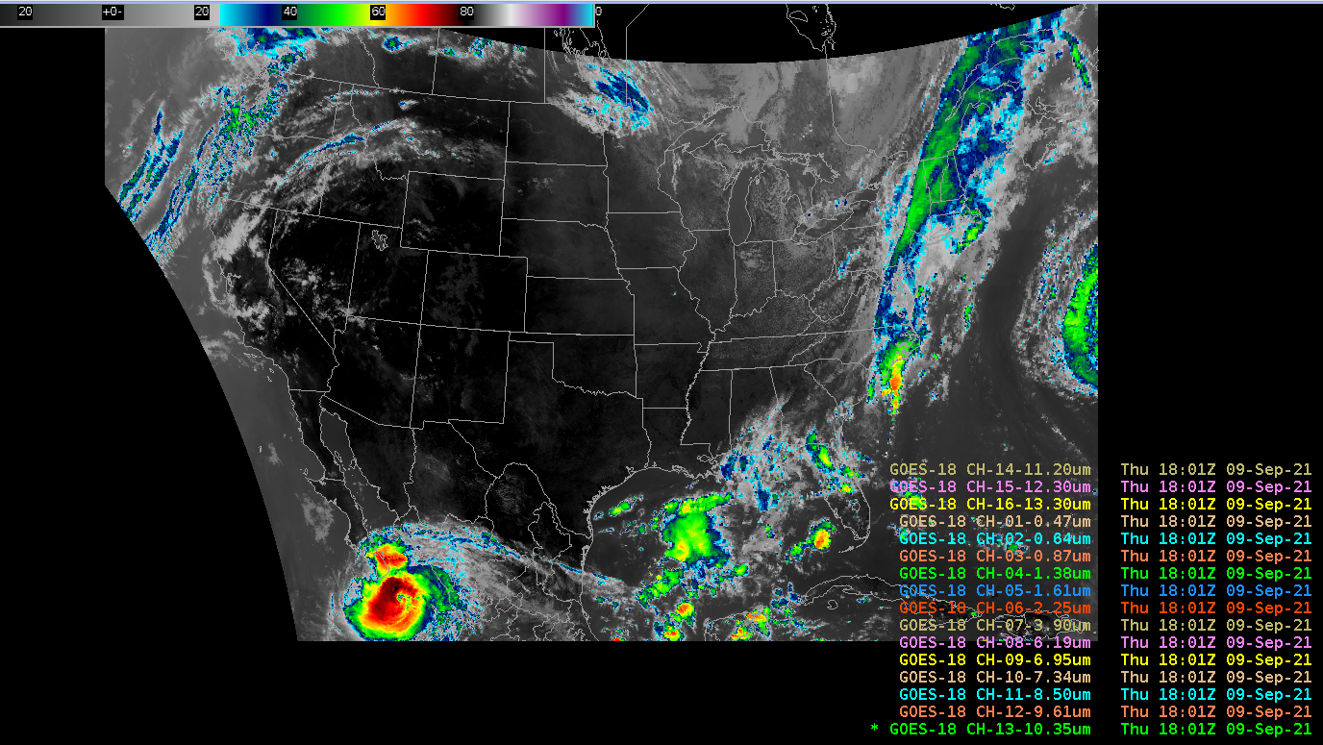
NWS GOES-T readiness planning: GRE-I1 test
Sept. 9 GRE-I1 interleave test: 4 hours of GOES-18 SCMI test data (using live GOES-16): Baseline AWIPS handled GOES-18 Full Disk, CONUS, Meso1, Meso2
TOWR-S is engaging with several NWS systems to ensure their timely readiness for interleaved and operational dissemination of GOES-T/GOES-18 data:
AWIPS Network Control Facility (NCF)
NCEP Central Operations (NCO) incl. Integrated Dissemination Program (IDP) and Weather and Climate Operational Supercomputing System (WCOSS)
GOES Rebroadcast (GRB) and Geostationary Weather Satellite Antenna System (GWSAS)
Space Weather Prediction Center (SWPC)
h/t Lee Byerle

Slide 17
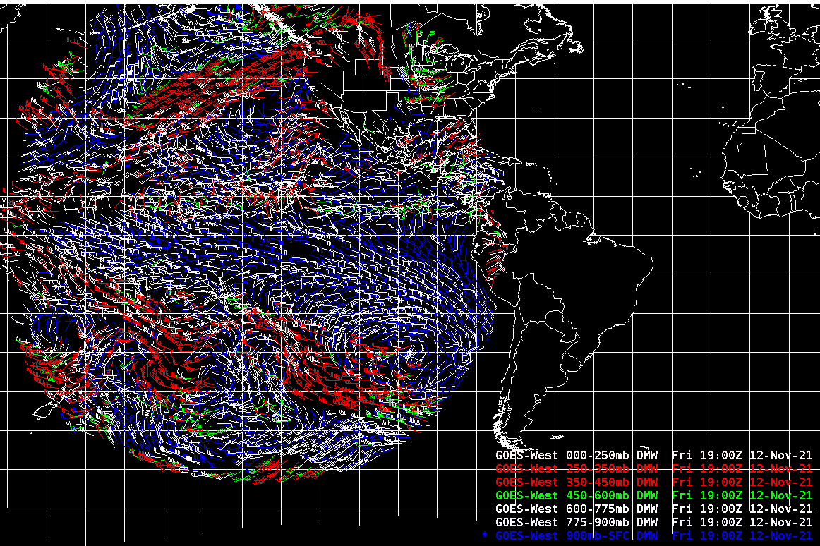
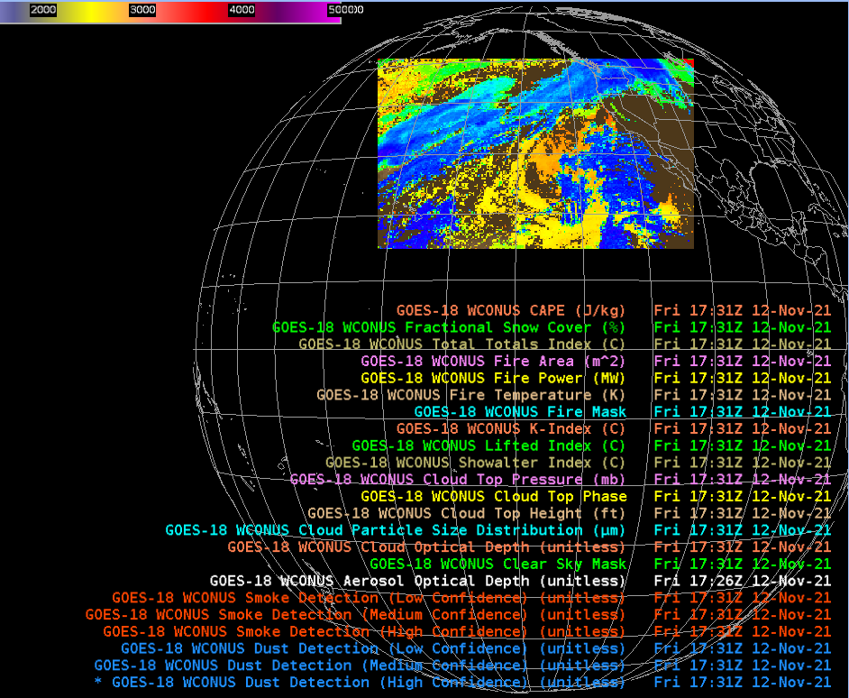
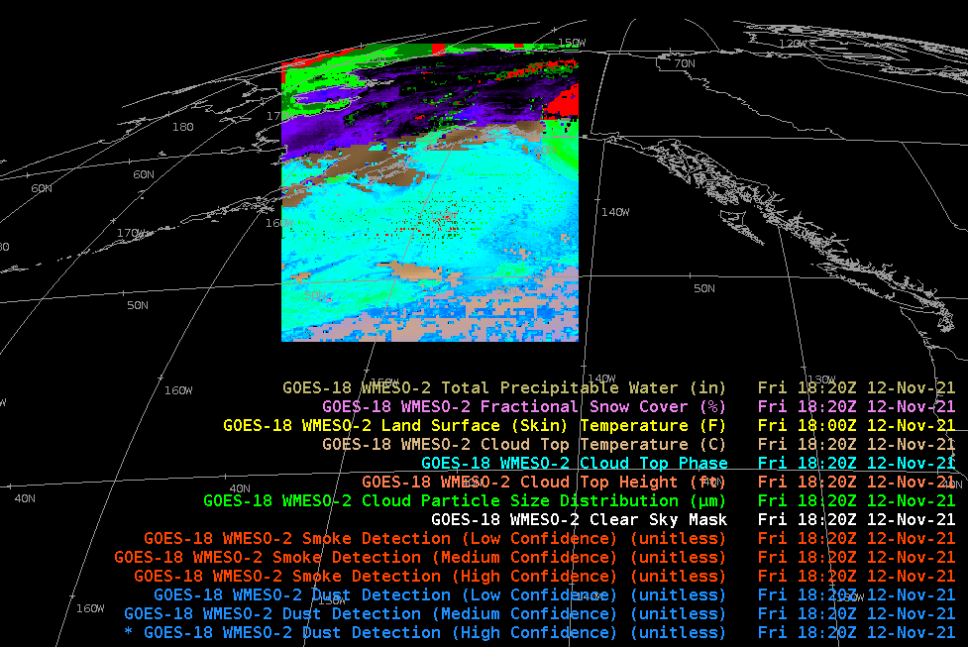
NWS GOES-T readiness planning: DOE-T3 test
DOE-T3 test event Nov. 8-19:
GOES-R Ground System produced and provided valid GOES-18 L2 products; and
With only configuration changes, AWIPS correctly ingested and displayed these products.
Add’l L2 algorithms in NDE (e.g., Fog & Low Stratus) will be ready for GOES-18 in the summer / fall of 2022.
h/t Lee Byerle

Slide 18
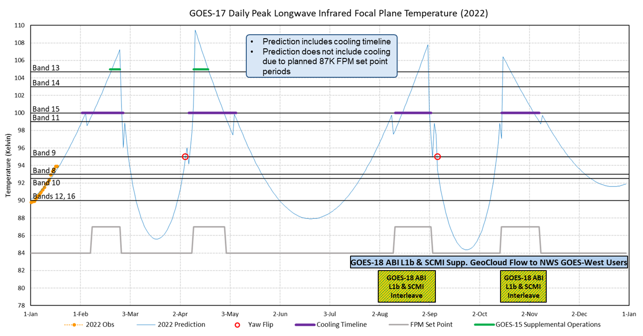
GOES-17 ABI Cooling Anomaly:
2022 predicted daily peak temperatures of LWIR Focal Plane Module
Next Mode 3 cooling timeline: Feb. 3-27
h/t GOES-R Program

Slide 19
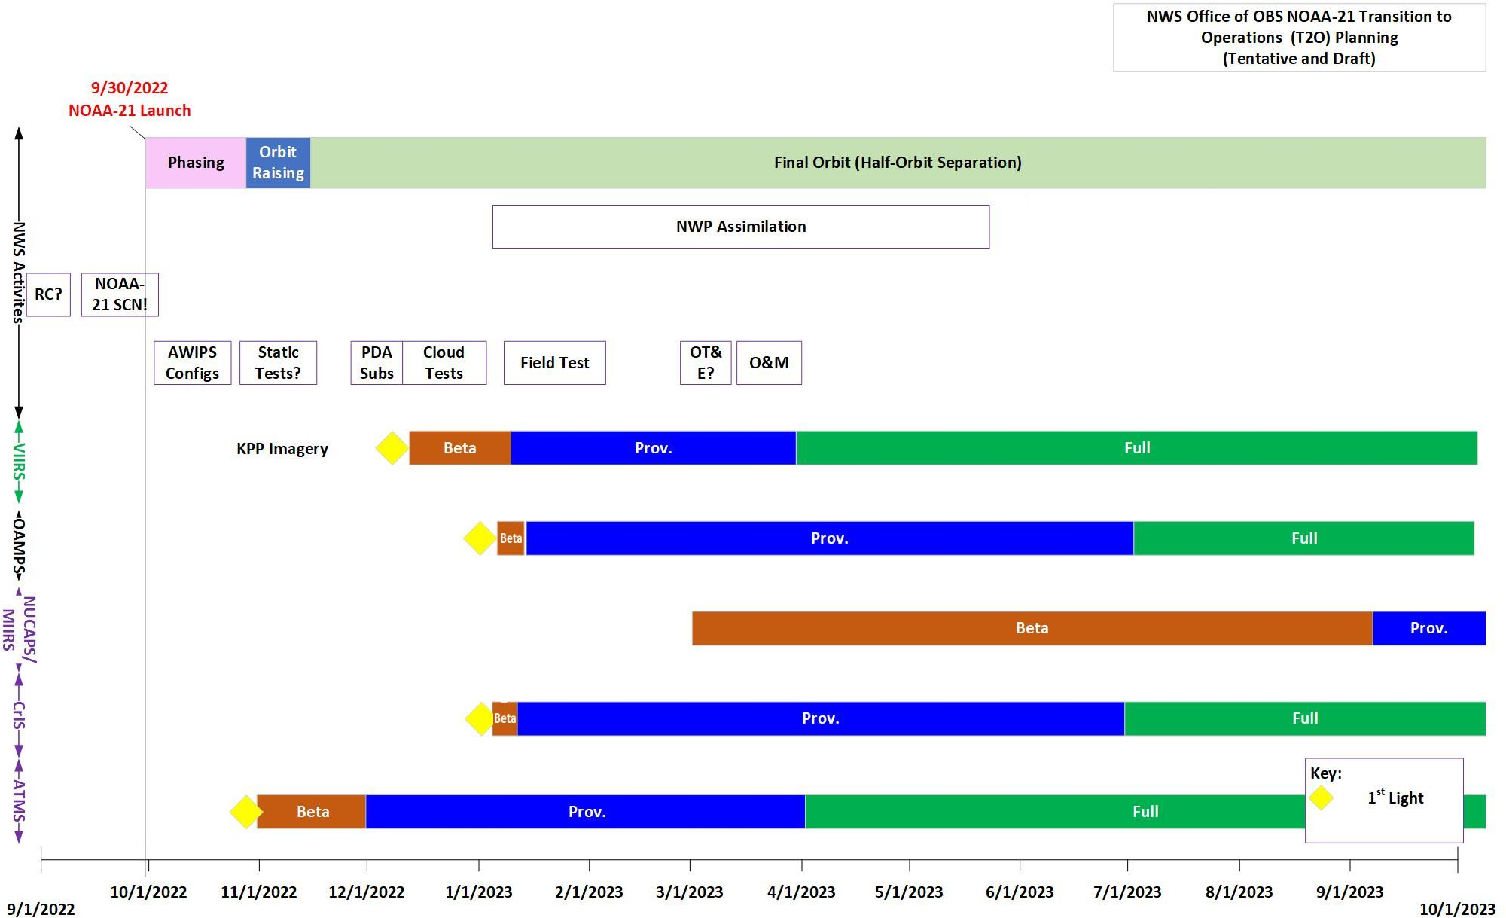
NWS readiness planning for JPSS-2/NOAA-21
Upcoming TVAC tests for JPSS-2:
Mar. 27-31
Apr. 7-9
Apr. 17-18
(dates to be confirmed)
ht / Dariush Khadjenouri - Tentative and Draft
S-NPP data products on SBN will be replaced by NOAA-21 counterparts once operational

Slide 20
Satellite Book Club (SBC) Seminar Series
Thursdays, usually at Noon ET
Usage examples shed light on user requirements for satellite data products and capabilities
Recordings are on the SBC page in the NOAA VLab and the NWS Commerce Learning Center (CLC) website
Recent Sessions:
Nov. 4: Connor Nelson (CIRA/OPG), The Use of Satellite Data in the Spring 2021 OPG Grassland Fire Weather Experiment and its Implications for Future Operations
Nov. 18: Joseph Patton (CISESS), GLM False Flashes
Dec. 2: Brett Borchardt (LOT), The August 10, 2020 Derecho: Hints of Evolving Threats in Satellite Data
Dec. 9: Pam Sullivan (GOES-R), GOES-T Road to Launch and Operations
Dec. 16: Michael Jamilkowski (GOES-R), GOES-R Socioeconomic Benefits Study: Phase 1 – Benefits of Improved Hurricane Forecasts to the General Public
Jan. 6: Monica Bozeman (NWS/CP), AWIPS Satellite Enhancements at the National Centers
Jan. 13: Tony Reale (NESDIS-STAR), NUCAPS Performance in Winter Ice, Sleet and Snow Environments: NOAA Products Validation System (NPROVS)
Jan. 20: Connor Nelson (CIRA/OPG), The Impact of Satellite Data in Mesoanalysis: Results from the 2021 OPG Real-Time Severe Weather Experiment
Upcoming topics:
Historical perspectives
TOWR-S RPM spotlight
ProbSevere Testbed Activities
ProxyVisible Satellite Imagery
Detecting Ice Concentration from Satellites
Notes:
The Satellite Book Club Seminar Series is convened weekly on Thursdays, providing an opportunity for scientists throughout the NOAA satellite domain to share a topic of interest to them with their peers. Topics may include applications of satellite data in the field, new and exciting changes to both polar and geostationary programs, and anything else satellite-related that the field would like to discuss.

Slide 21
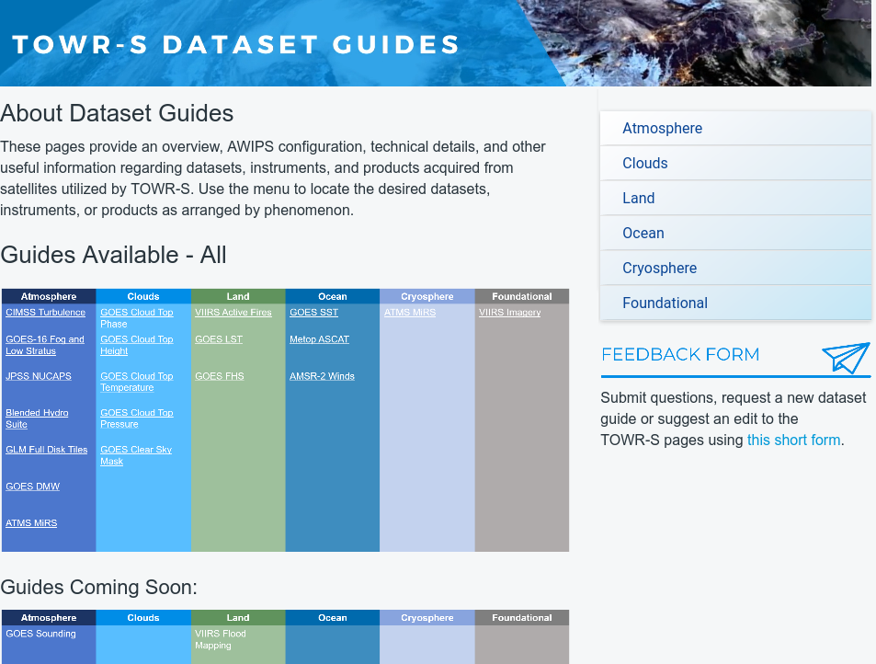
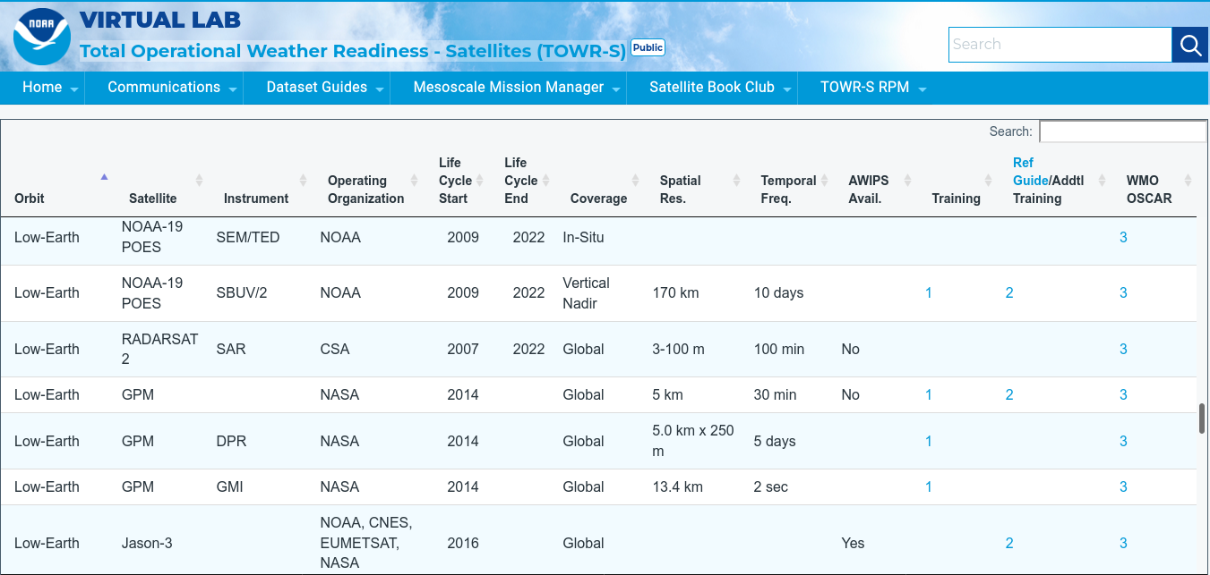
AWIPS Dataset Guides and Satellite / Sensor Reference Guide
https://vlab.noaa.gov/web/towr-s

Slide 22
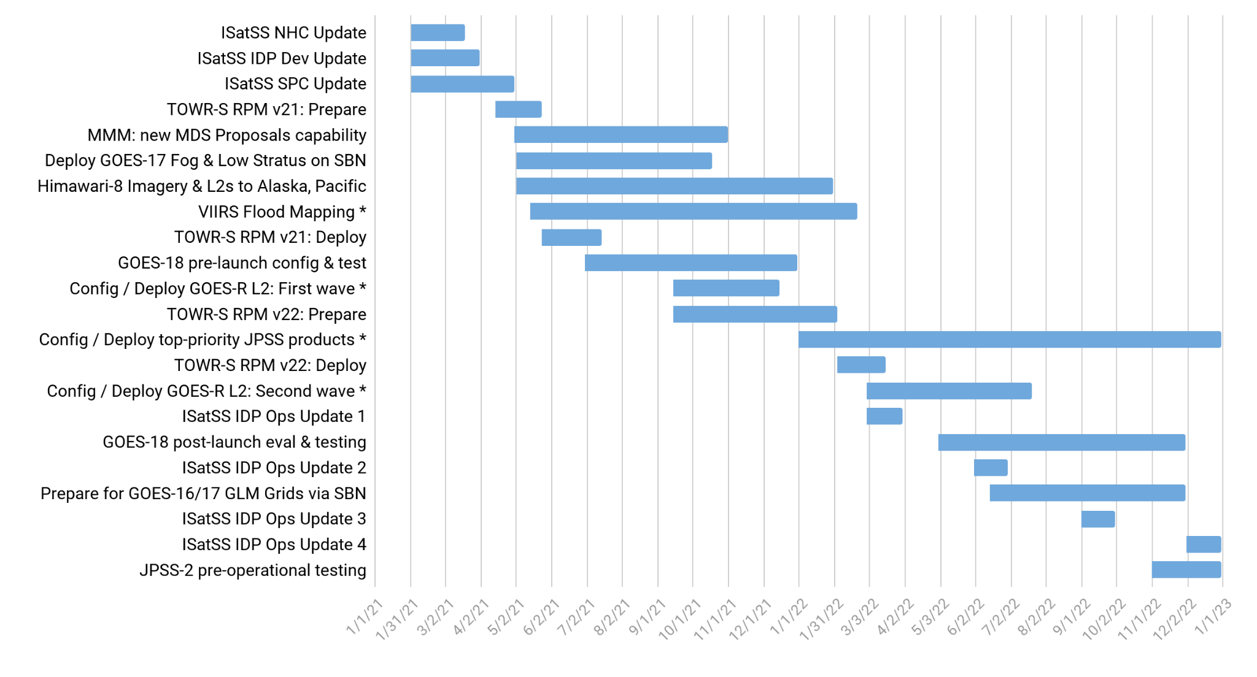
TOWR-S Activity Plan
CY2021 |  |  |  |  |  |  |  |  |  |  |  | CY2022
J | F | M | A | M | J | J | A | S | O | N | D | J | F | M | A | M | J | J | A | S | O | N | D
Notes:
Future dates are tentative / subject to change due to external dependencies
* Availability of some data products at AWIPS sites may depend on progress of AWIPS Data Delivery or other dissemination alternatives
January 21, 2022

Slide 23
Contact Information
Office of Observations
Brian Gockel – brian.gockel@noaa.gov
Jordan Gerth – jordan.gerth@noaa.gov
Total Operational Weather Readiness – Satellites (TOWR-S) Team
John Evans – john.d.evans@noaa.gov
Lee Byerle – lee.byerle@noaa.gov
Links
NWSChat (“towr-s” chatroom)
TOWR-S in the NOAA VLab

Slide 24
Next TOWR-S Updates
(tentative)
March 25, 2022
May 20, 2022

Slide 25
(1) Current Product Posture
Product | Delivery Mechanism (Activation) | Product Maturity | AWIPS Treatment (enhancement tables, ranges, units, rules…) | AWIPS Status (TOWR RPM date) | Target AWIPS Release (Blue = submitted)
ABI SCMI | G16 Mar ’17 SBN E | G16 Full |  | GOES-16/17 menus appear by default under Sat in v18.2.1
 | G17 Aug ‘18 SBN W | G17 Provisional: 11/28/18 G17 Full: 02/19/20
Bands 1-6 | “ | “ | Default General viewing VIS | Feb ‘17, Mature | 18.2.1
Band 7 | “ | “ | Default General viewing SWIR | Mar ‘17, Mature | 18.2.1
Band 7, 13-14 | “ | “ | Ocean/Land in winter IR | Mar ’17, Mature | 18.2.1
Bands 8-10 | “ | “ | Default General viewing WV | Mar ‘17, Mature | 18.2.1
Bands 8-10 | “ | “ | Low-level WV | Jun ‘17, Mature | 18.2.1
Bands 8-16 | “ | “ | Rainbow colors for dual IR, WV | Mar ‘17, Mature | 18.2.1
Bands 11-16 | “ | “ | Default General viewing IR | Mar ‘17, Mature | 18.2.1
Bands 11-16 | “ | “ | Summer, warm land areas | Mar ‘17, Mature | 18.2.1
Split Window Ch Diff |  |  | Blowing dust, volcanic ash, low-level water vapor (10.3-12.3um) | Jun ‘17, Mature | 18.2.1
Split Water Vapor Ch Diff |  |  | Gradients in UL WV (6.2-7.3um) | Jan ‘18, Mature | 18.2.1
Two Night Fog Ch Diffs |  |  | Gray/blue (2 menu buttons 10.3-3.9um, and 11.2-3.9um) | Jan ‘18, Mature, Aug ‘19 | 18.2.1 / 20.2.1

Slide 26
(2) Current Product Posture
Product | Delivery Mechanism (Activation) | Product Maturity | AWIPS Treatment (enhancement tables, ranges, units, rules…) | AWIPS Status (TOWR RPM date) | Target AWIPS Release (Blue = submitted)
Day Fog Ch Diff |  |  | Highlights fog over warmer surfaces, Opposite of Night fog CH diff (3.9-10.3um) | Jan ‘18, Mature | 18.2.1
Split Snow Ch Diff |  |  | Highlights snow cover over land (1.6-0.64um) | Jan ‘18, Mature (Avail all sectors-FG) | 18.2.1
Split Fire Ch Diff |  |  | Fire hot spot detection (2.2-1.6um) | Jan ‘18, Mature (Avail all sectors-FG) | 18.2.1
Split Ozone Ch Diff |  |  | Ozone detection (9.6-10.3um) | Jan ‘18, Mature | 18.2.1
Split Cloud Top Phase Ch Diff |  |  | Highlights ice clouds, phase variation (11.2-8.4um) | Jan ‘18, Mature | 18.2.1
Vegetation Ch Diff |  |  | Highlights Vegetation, land sfc variation (0.64-0.87um) | Mar ‘17, Mature (Avail all sectors-FG) | 18.2.1
GOES-16/GOES-15 Supernational “CONUS with Legacy” | (Menu to only show G-16 as of March 2, 2020) |  | ABI CHs 2,7,8,11,16 w/corresponding G-15 CHs | Feb ‘18, Eval | N/A
Day Cloud Phase Distinction RGB |  |  | Daytime cloud phase variation (10.35,0.64,1.61um) | Aug ‘17, Mature | 19.2.1
Fire Temperature RGB |  |  | Fire hot spot detection (3.90,2.25,1.61um) | Jun ‘17, Mature | 19.2.1
Day Land Cloud RGB |  |  | Day land cloud (1.61,0.87,0.64um) | Jun ‘17, Mature | 19.2.1
Day Cloud Convection RGB |  |  | Day convection as warm colors (0.64,0.64,10.35um) | Aug ‘17, Mature | 19.2.1

Slide 27
(3) Current Product Posture
Product | Delivery Mechanism (Activation) | Product Maturity | AWIPS Treatment (enhancement tables, ranges, units, rules…) | AWIPS Status (TOWR RPM date) | Target AWIPS Release (Blue = submitted)
Day Land Cloud Fire RGB |  |  | Day land clouds, fire (2.25,0.87,0.64um) | Jun ‘17, Mature | 19.2.1
Simple Water Vapor RGB |  |  | WV, Upper level circulation (10.35,6.19,7.34um) | Mar ‘17, Mature | 19.2.1
Air Mass RGB |  |  | Delineate air masses (6.19-7.34,9.61-10.35,6.19um) | Mar ‘17, Mature | 19.2.1
Ash RGB |  |  | Ash detection (12.3-10.35,11.2-8.5,10.35um) | Mar ‘17, Mature | 19.2.1
Day Convection RGB |  |  | Day convection (6.19-7.34,3.9-10.35,1.61-0.64um) | Aug ‘17, Mature (Avail all sectors-FG) | 19.2.1
Differential Water Vapor RGB |  |  | Water vapor contrast (7.34- 6.19,7.34,6.19) | Mar ‘17, Mature | 19.2.1
Day Snow Fog RGB |  |  | Day snow, fog (0.87,1.61,3.9-10.35um) | Jun ‘17, Mature | 19.2.1
Dust RGB |  |  | Dust (12.3-10.35,11.2-8.5,10.35um) | Mar ‘17, Mature | 19.2.1
Nighttime Microphysics RGB |  |  | Delineate night cloud phase (12.3-10.35,10.35-3.9,10.35um) | Mar ‘17, Mature | 19.2.1
SO2 RGB |  |  | Ash, S02 detection (6.95-7.34,10.35-8.5,10.35um) | Jun ‘17, Mature | 19.2.1

Slide 28
(4) Current Product Posture
Product | Delivery Mechanism (Activation) | Product Maturity | AWIPS Treatment (enhancement tables, ranges, units, rules…) | AWIPS Status (TOWR RPM date) | Target AWIPS Release (Blue = submitted)
Daytime Composite #1 RGB |  |  | Highlight cold surfaces, cirrus (0.64,1.61,11.2um) | Baselined 16.1.x
Daytime Composite #5 RGB |  |  | Grayscale, Cirrus (0.64,0.87,0.64um) | Baselined 16.1.x
Day Ocean Cloud Convection |  |  | Daytime Ocean Convection (0.87,0.87, 10.35um) | June ’17, Mature | 19.2.1
CIMSS Natural Color RGB |  |  | Natural color, computes Green | Jan. ‘18, Mature (Avail all sectors-FG) | 19.2.1
GOES-East,West Clear Sky Mask | SBN Exp (G-16: May 2017; G-17: Sep. 2021) F,C,M | G16: Provisional | Display as binary mask | Baselined 16.1.x
 |  | *G17: Provisional (May 6, ’19)
GOES-East,West Cloud Top Height, Temperature, Pressure | SBN Exp (G-16: 31 May 2017; G-17: Sep. 2021) Height: F,C,M / Temp: F,M / Pressure: F,C | G16: Provisional | Cloud Top Height in Ft, Temp in degC | June ‘17, Mature | 18.2.1
 |  | *G17: Provisional (May 6, ’19)
GOES-East,West Cloud Top Phase | SBN Exp (G-16: May 2017; G-17: Sep. 2021) F,C,M | G16: Provisional | Clear, Water, Supercooled, Mixed, Ice, Uncertain | Baselined 16.1.x
 |  | *G17: Provisional (May 6, ’19)
GOES-East,West Derived Stability Indices (CAPE,LI, KI, SI, TT) | SBN Exp (G-16: May 2017; G-17: Sep. 2021) F,C,M | G16: Provisional *G17: Provisional (May 16, ’19) | 10-bit colormap. Syncs to legacy GOES Sounder ranges | Aug. ‘17, Mature | 18.2.1
GOES-East,West Aerosol Detection (ADP) | SBN Exp (G-16: May 2017; G-17: Sep. 2021) F,C,M | G16: Provisional (Dec. 6, ‘18) | Separate Dust, Smoke. Hi/Lo/Med confidence | Feb. ‘18 RPM, Eval | 20.2.1
 |  | *G17: Provisional (June 27, ‘19)
*G-17 PS-PVRs are based upon cool season evaluations
F = Full Disk, C= CONUS, M= Mesoscale

Slide 29
(5) Current Product Posture
Product | Delivery Mechanism (Activation) | Product Maturity | AWIPS Treatment (enhancement tables, ranges, units, rules…) | AWIPS Status (RPM date) | Target AWIPS Release (Blue = submitted)
GOES-East,West Aerosol Optical Depth | SBN Exp (G-16: May 2017; G-17: Sep. 2021) F,C | G16: Provisional (Sept. 14, ’18) | Display as binary mask. Fixed display range (0-1) | June ‘17, Mature | 18.2.1
 |  | *G17: Provisional (June 27, ’19)
GOES-East,West Land Surface Temperature | SBN Exp (G-16: May 2017; G-17: Sep. 2021) F,C,M | G16: Provisional | LST in degF | June ‘17, Eval | 19.2.1
 |  | *G17 Provisional (June 13, ’19)
GOES-East,West Fire/Hot Spot | SBN Exp (G-16: May 2017; G-17: Sep. 2021) F,C + New Meso Sep. ‘21 | G16 Provisional (Apr 24, ‘18) | Fire Temp, Power, Area | Aug. ‘17, Eval | 19.2.1
 |  | *G17: Provisional (July 25, ’19)
GOES-East,West TPW | SBN Exp (G-16: May 2017; G-17: Sep. 2021) F,C,M | G16: Provisional *G17: Provisional (May 16, ‘19) | TPW in Inches. 10-bit colormap based legacy GOES Sounder | Aug. ‘17, Mature | 18.2.1
GOES-East,West Cloud Optical Depth | SBN Exp (G-16: May 2017; G-17: Sep. 2021) F,C | G16: Provisional *G17: Provisional Day: 6/13/19 Night: 9/24/19 | Fixed max display range to 100% | Aug. ‘17, Mature | 18.2.1
GOES-East,West Cloud Particle Size Distribution | SBN Exp (G-16: June 2017; G-17: Sep. 2021) F,C,M | G16: Provisional (Dec. 14, ’18) *G17: Provisional Day: 6/13/19 Night: 9/24/19 | Range 0-100um | Baselined
GOES-East,West Derived Motion Winds | SBN GRE/GRW (G-16: June 2017; G-17: Mar. 2020) C (15min), M (5min) | G16: Provisional | By-Pressure displays as single color like legacy. Meso 1,2 now separate displays/database entries | Feb. ‘18, Mature | 19.2.1
 |  | *G17: Provisional (May 16, ’19)
GOES-East,West Sea Surface Temperature | SBN Exp (G-16: Jan 2018; G-17: Sep. 2021) F (hourly) | G16: Provisional | Colormap highlights TC threshold, Default display as DegF and DegC | March ‘18, Mature | 19.2.1
 |  | *G17: Provisional (July 25, ’19)
*G-17 PS-PVRs are based upon cool season evaluations
F = Full Disk, C= CONUS, M= Mesoscale

Slide 30
(6) Current Product Posture
AWIPS Release Dates:
20.2.1,2,3 – June 2021
20.3.1,2 – Jan. 2022
Product | Delivery Mechanism (Activation) | Product Maturity | AWIPS Treatment (enhancement tables, ranges, units, rules…) | AWIPS Status (TOWR RPM date) | Target AWIPS Release (Blue = submitted)
GOES-East,West Rainfall Rate, Quantitative Precipitation Est | SBN Exp (G-16: Jan. 2018; G-17: Sep. 2021) F | G16: Provisional (March 31, ‘18) | Display in inches. Colormap syncs w/typical radar colors | March ‘18 | 18.2.1
 |  | *G17: Provisional May 16, ‘19
GOES-East,West Legacy Vertical Temperature/Moisture Profiles | G16: SBN Exp (G-16: Feb 2018; G-17: Sep. 2021) C (30min) | G16: Provisional | NSHARP profiles. Move menu under Derived products section | Baselined (16.1.x), Eval, profile cadence | 19.2.1
 |  | *G17: Provisional (May 16, ‘19)
NOAA-20 VIIRS Imagery (KPP to AK via terrestrial Networks) | ~Feb. ‘18 | Validated | I, M-bands, NCC | Feb. ‘18, Eval | 19.2.1
Snow Cover | TBD | G16/G17 Provisional 8/13/20
JASON 3 Wave Altimetry | SBN NMC3 (July 17, ‘18) | Operational, TT 194990 for slow load times, under investigation |  | Feb. ’18, dbgeo plugin | 19.2.1
GOES-East,West GLM Full Disk Punctured Tiles | LDM migration | G16/17 Full | 1- & 5-minute Flash Extent Density (FED), Total Optical Energy, Min. Flash Area | Nov. ‘20
GOES-East,West Ice Products: Ice Concentration, Ice Age / Thickness, Ice Motion | LDM migration | Ice Concentration, Ice Age & Thickness: Provisional |  | Nov. ‘20
CIMSS Turbulence Probability (CONUS) | LDM migration |  |  | Nov. ‘20
*G-17 PS-PVRs are based upon cool season evaluations

Slide 31
(7) Current Product Posture
AWIPS Release Dates:
20.2.1,2,3 – June 2021
20.3.1,2 – Jan. 2022
Product | Delivery Mechanism (Activation) | Product Maturity | AWIPS Treatment (enhancement tables, ranges, units, rules…) | AWIPS Status (TOWR RPM date) | Target AWIPS Release (Blue = submitted)
Full Disk Geostationary Lightning Mapper (GLM) | LDM Migration Ops / Local Generation | G16: Full G17 Full: 11/21/19 | Flash Extent Density (FED) Grid, Average Flash Area, and Total Optical Energy | NHCN/NTBN/OPCN/ AWCN | TBD
GOES VIS/IR Sandwich RGB | N/A | N/A | CH 02, CH 13 Combo | March ’19 RPM | 20.2.1
GOES NDVI Vegetation Channel Difference | N/A | N/A | CH02, CH03 Combo | March ‘19 RPM Next RPM to include CSM | 20.2.1
ASCAT A, B, C Wind Speed / Direction and Ambiguities | N/A | N/A | DMW plugin | NHCN/NTBN/OPCN | Eval
SSMI F-15 85 GHz H,V and 36.5GHz H,V Microwave Imagery | ISatSS | N/A | GOES-R plugin, PCT RGBs | NHCN/NTBN | Eval
AMSR2 89.5 GHz AH, AV and 36.5 GHz AH, AV Microwave Imagery | ISatSS | N/A | GOES-R plugin, PCT RGBs | NHCN/NTBN/OPCN | Eval
GPM GMI 89.5 GHz H,V and 37 GHz H,V Microwave Imagery | ISatSS | N/A | GOES-R plugin, PCT RGBs | NHCN/NTBN | Eval
S-NPP ATMS QV 88 GHz Microwave Imagery | ISatSS | N/A | GOES-R plugin | NHCN/NTBN | Eval
AMSR2 Ocean products: Rain Rate, SST, TPW, Cloud Liquid Water, Wind Speed | ISatSS | N/A | GOES-R plugin | NHCN/NTBN/OPCN | Eval
JASON-3 Wave Heights and Wind Speeds | ISatSS | N/A | DMW plugin for numeric read-outs | NHCN/NTBN/OPCN | Eval
Cryosat-2 Wave Heights and Wind Speeds | ISatSS | N/A | DMW plugin for numeric read-outs | NHCN/NTBN/OPCN | Eval
Altika Wave Heights and Wind Speed | ISatSS | N/A | DMW plugin for numeric read-outs | NHCN/NTBN/OPCN | Eval
Sentinel-3A/3B Wave Heights and Wind Speeds | ISatSS | N/A | DMW plugin for numeric read-outs | NHCN/NTBN/OPCN | Eval
S-NPP & NOAA-20 VIIRS Active Fires | ISatSS | Validated | DMW plugin | All | TBD

Slide 32
(8) Current Product Posture
AWIPS Release Dates:
20.2.1,2,3 – June 2021
20.3.1,2 – Jan. 2022
Product | Delivery Mechanism (Activation) | Product Maturity | AWIPS Treatment (enhancement tables, ranges, units, rules…) | AWIPS Status (TOWR RPM date) | Target AWIPS Release (Blue = submitted)
NOAA-20 NUCAPS | SBN Jul 2, ‘19 |  | VIIRS NUCAPS plugin | Feb. ‘18 RPM | 19.2.1
NOAA-20 NCC/Day Night Band | SBN Jul 24/25, ’19 |  | VIIRS plugin | Feb. ‘18 RPM | 19.2.1 (DR 20707, 20708 fix “S-NPP” legend)
SSMIS F-16 91 GHz H,V and 37GHz H,V Microwave Imagery | ISatSS | N/A | GOES-R plugin, PCT RGBs derived param | NHC | Eval
SSMIS F-17 91 GHz H,V and 37GHz H,V Microwave Imagery | ISatSS | N/A | GOES-R plugin, PCT RGBs derived param | NHC | Eval
SSMIS F-18 91 GHz H,V and 37GHz H,V Microwave Imagery | ISatSS | N/A | GOES-R plugin, PCT RGBs derived param | NHC | Eval
National Center G-16 Full Disk GLM Grids | ISatSS | Full Nov ‘18 | GOES-R plugin | AWC, NHC, OPC, WPC | Eval
Himawari DMWs for Pacific Region | ISatSS | N/A | DMW plugin | N/A | Eval
GOES-16 Fog and Low Stratus (FLS) (STAR product) for OPC and NHC | ISatSS | Eval | GOES-R plugin | NHC, OPC | 21.3.1
GOES-East,West Fog and Low Stratus (FLS) | SBN GOES-East: Sep. ‘20 GOES-West: Sep. ‘21 |  | GOES-R plugin | TOWR-S RPM v19 (Aug. 2020)

Slide 33
(9) Current Product Posture
AWIPS Release Dates:
20.2.1,2,3 – June 2021
20.3.1,2 – Jan. 2022
Product | Delivery Mechanism (Activation) | Product Maturity | AWIPS Treatment (enhancement tables, ranges, units, rules…) | AWIPS Status (TOWR RPM date) | Target AWIPS Release (Blue = submitted)
NESDIS multi-sat Imagery Composite (VIS/IR/LWIR/SWIR) | ISatSS SBN | N/A | NetcdfGrid plugin | NHC | 21.3.1
G-17 PACUS & Meso Sector DMWs | SBN Mar 2020 (PACUS) / Sep. 2021 (Meso) | Provisional May 16, ’19 | GOES-R plugin | Mar ‘20 | 20.2.1 (LDM, edex cfg)
NESDIS Global Blended (polar) TPW, % Normal TPW | SBN Mar 12, ‘20 | N/A | NetcdfGrid plugin | Mar ‘20 | 20.2.1
NESDIS Global Blended (polar) Rain Rate | SBN Mar 12, ‘20 | N/A | NetcdfGrid plugin | Mar ‘20 | 20.2.1
Meteosat Imagery for Ctrs (VIS/IR/SWIR/WV) | Oct ‘19 AWC, Feb ‘20 NHC | N/A | GOES-R plugin | N/A | TBD
G-16 ASOS Satellite Cloud Products (SCP) | SBN (May 27, 2020) | N/A | Text Db | N/A | N/A
G-17 ASOS Satellite Cloud Products (SCP) | SBN (Sept. 30, 2020) | N/A | Text Db | N/A | N/A

Slide 34
(1) Current Non-Product RPM Features
AWIPS Release Dates:
20.2.1,2,3 – June 2021
20.3.1,2 – Jan. 2022
Feature | Function/Description | AWIPS Status (TOWR RPM date) | Target AWIPS Release (Blue = submitted)
Legacy bundle for GOES-15 | Enables legacy display of G-15 | Jan ’18, Eval | Eval
Geostationary Map Scales | West, Center, East geostationary scales | Jan ‘18, Eval | 21.3.1
Frame controls from 64 to 300 | Ability to loop 300 frames | Eval | 21.3.1
CSPP/CIMSS Polar data description | Handles description of VIIRS/CIMSS prods (e.g. CSPP in goes-r plugin) | Feb ‘18 | Eval
LDM (pqact) Updates | LDM configuration for GOES-17 PACUS DMWs, and Blended Hydro (TPW, Rain Rate, PCT Normal TPW) | Updates steps are in RPM install instructions, but not in RPM | 18.2.1 / 20.2.1
GOES-East, GOES-West menu | Update from “GOES-17” to “GOES-West” | May/Jun ‘18 | 20.2.1
Add Sector, Satellite to CAVE Legend for G-16/G-17 RGBs, Derived Products, respectively | Improves Legend to delineate between loaded Sectors/Satellites | May/Jun ‘18 Eval | 20.2.1
Link to pqact setting examples for tailored sectors is here.

Slide 35
(2) Current Non-Product RPM Features
AWIPS Release Dates:
20.2.1,2,3 – June 2021
20.3.1,2 – Jan. 2022
Feature | Function/Description | AWIPS Status (TOWR RPM date) | Target AWIPS Release (Blue = submitted)
Color By Pressure for GOES wind vectors | Bundle/Menu to color by p-level or range (SET/WFO PUB contribution) | Feb ‘18 Eval | 20.2.1
Legend update to GOES wind vectors | Adds satellite (e.g. GOES-17/GOES-16) to display legend | Mar ’20 | 20.2.1
A2 Edex Ingest | Ingest patterns for GOES-17 DMWs/ Blended Hydro | Mar ’20 | 20.2.1
A2 Edex Plugin Descriptions | GLM AFA, TOE. Aerosol Detection (ADP) Hi/Med/Low confidence specification | Jun ‘18/ Feb ’18 | Eval (GLM) / 20.2.1 (ADP)
A2 Edex Purge Rules | Edex purging of processed Blended Hydro products | Mar ’20 | 20.2.1
GOES 10.35um (CH 13) DegF display cfg | Menu, colormap, style rules for Deg Fahrenheit option | Mar ‘20 Eval | TBD

