Slide 1
TOWR-S Update
December 16, 2022
https://meet.google.com/thn-pkwe-wbr
Total Operational Weather Readiness - Satellites
NWS Office of Observations
Best viewed in Google Slides.
All are invited to insert comments.

Slide 2
Overview
1. GOES-West Transition
2. Changes to GOES-R imagery on SBN
3. NOAA-21 and changes to the JPSS constellation
4. Himawari-9 transition
5. Looking ahead
VIIRS Flood Maps • Sentinel-6A altimetry • Metop-C ASCAT winds
Gridded GLM • GOES-R Enterprise products • Image compression • New and upcoming satellites
6. New from TOWR-S
ISatSS updates in IDP • TOWR-S RPM v23 preview • Satellite Book Club and vvSearch
Product Posture • Monthly newsletter • geoCloud AWIPS collaboration

Slide 3
1. GOES-West Transition
Return to overview

Slide 4
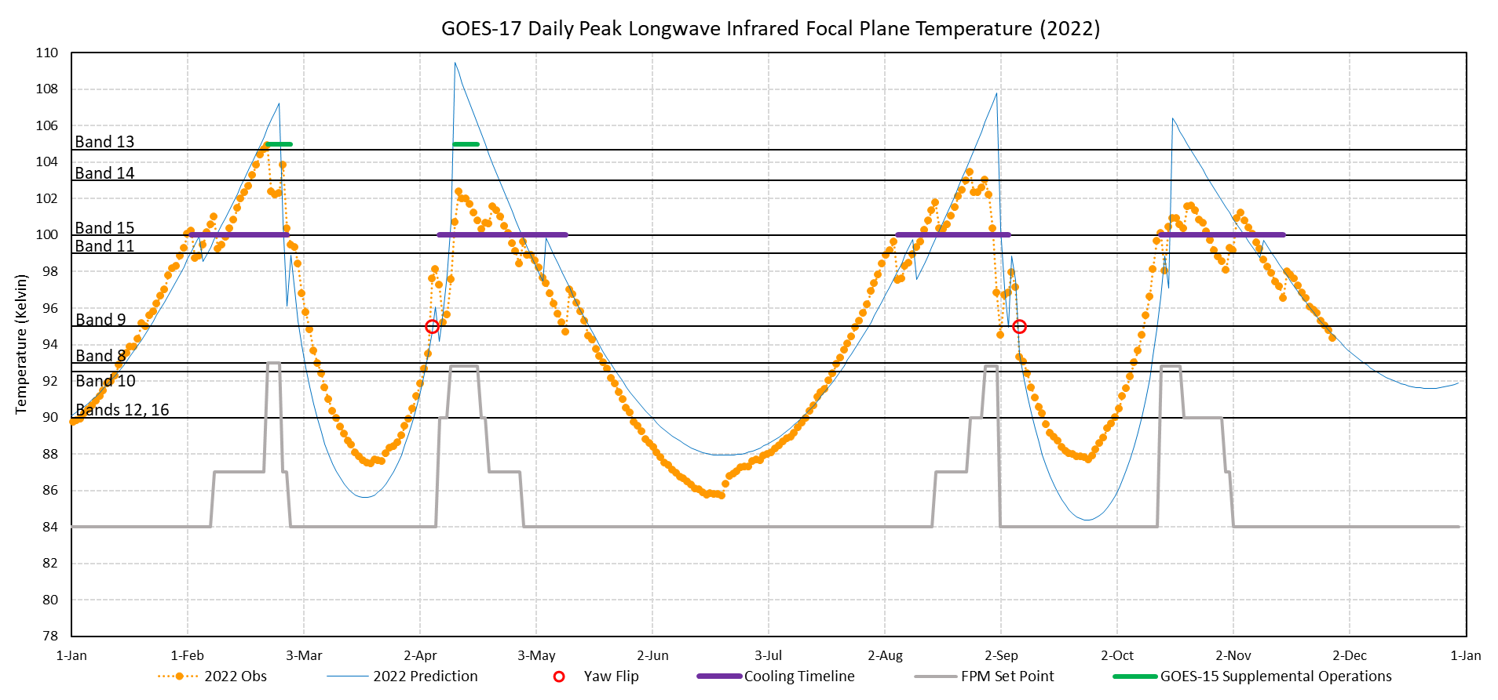
Daily Peak Temperatures of GOES-17 ABI Longwave Infrared Focal Plane Module
GOES-17 had its final “Warm Season” and Mode 3 Cooling Timeline, Oct. 14 to Nov. 15, 2022.
Oct. 13 - Nov. 16, 2022: operational interleave of GOES-18 ABI imagery in place of GOES-17 on the Satellite Broadcast Network (SBN) and GOES Rebroadcast (GRB).
GOES-17 will be taken out of operations after GOES-18 transitions to operations in Jan. 2023.
Dec. 16, 2022
Return to overview

Slide 5
Timeline: GOES-17 and the NWS Satellite Broadcast Network
Aug 24, 2018: SCN18-85: Addition of GOES-17 Imagery to the Satellite Broadcast Network: Effective August 28, 2018
Aug 31, 2018: SCN18-87: Testing of GOES-17 Advanced Baseline Imager (ABI) Mode 6 Imagery on the Satellite Broadcast Network: Effective September 10-21, 2018
Nov 19, 2018: SCN18-106: Changes to GOES-17 Imagery on the Satellite Broadcast Network Leading to the GOES West Transition: Effective November 15, 2018
Feb 08, 2019: SCN19-04: Transition of GOES-17 to GOES West February 11-15, 2019
Aug 27, 2019: SCN19-53: Enterprise EMWIN Service Transition to Operations for GOES-East and GOES-West Satellite Broadcasts: Effective August 29, 2019
Feb 13, 2020: SCN20-22: Add (GOES-West) CONUS Sector Derived Motion Winds Product and Channel Reassignments for Other Satellite Products on Satellite Broadcast Network: Effective March 10, 2020
Sep 08, 2020: SCN20-83: Add GOES-17 ASOS Satellite Cloud Product to the Satellite Broadcast Network on or after September 28, 2020
Sep 11, 2020: SCN20-84: Add Loop Heat Pipe Metadata to GOES-R ABI Imagery on the Satellite Broadcast Network (a.k.a., NOAAPort): Effective September 2, 2020
Aug 10, 2021: SCN21-74 Updated: GOES-East and GOES-West Fire Hotspots for Mesoscale Sectors to be Added to the Satellite Broadcast Network on or after September 8, 2021
Aug 30, 2021: SCN21-79: GOES-West ABI Level-2 Products to be Added to the Satellite Broadcast Network on or after September 30, 2021
Sep 08, 2021: PNS21-60: Seeking Comments through October 8, 2021 on Changing the Geographic Coverage of GOES-R SCMI Data Available via the Satellite Broadcast Network
Sep 17, 2021: SCN21-83: Addition of GOES-West Fog and Low Stratus Data Product for the West CONUS / PACUS Sector to the Satellite Broadcast Network on or after October 18, 2021
Jun 13, 2022: SCN22-53: Change to GOES-R Legacy Vertical Temperature and Moisture Profiles on the Satellite Broadcast Network on or about July 13, 2022
Aug 23, 2022: SCN22-79: GOES-R Mesoscale Fire Hotspots Promoted to the GOES-East and GOES-West Channels of the Satellite Broadcast Network: Effective August 23, 2022
Sep 29, 2022: SCN22-94: Changes to the Geographic and Spectral Coverage of GOES-East/West Imagery on the Satellite Broadcast Network: Effective on or About November 16, 2022 (GOES-East) and November 29, 2022 (GOES-West)
Dec 02, 2022: SCN22-94 (updated): Changes to the Geographic and Spectral Coverage of GOES-East/West Imagery on the Satellite Broadcast Network Effective December 1, 2022 (GOES-East) and January 4, 2023 (GOES-West)
Dec 06, 2022: SCN22-113: Operational Transition of the GOES-18 Satellite to Become GOES-West on January 4, 2023
Return to overview

Slide 6
GOES-West transition (1)
Until Jan. 4, 2023, 1800 UTC - GOES-17 in operation as GOES-West:
GOES-17 supplies all GOES-West data on the GOES Rebroadcast (GRB) and Satellite Broadcast Network (SBN). No GOES-18 imagery, L1b, L2+ products are on GRB or SBN.
Supplemental Operations: GOES-18 ABI imagery and gridded GLM are disseminated to selected sites via the GeoCloud.
GOES-18 data products are not yet advised for operational use (even if algorithms / products have reached Provisional maturity).
Any sharing or display of GOES-18 images or data files requires the caveat: “GOES-18 Preliminary, Non-Operational Data” (even if algorithms / products have reached Provisional maturity).
Also see the GOES-18 Operational Readiness Timeline and GOES-18 transition notes on VLab.
Return to overview

Slide 7
GOES-West transition (2)
After Jan. 4, 2023, 1800 UTC - GOES-18 in operation as GOES-West:
GOES-18 will supply all GOES-West data on GRB and SBN. No GOES-17 data will be on GRB or SBN.
GOES-18 data products that have reached Provisional maturity will be ready for operational use.
GOES-18 images or data files may be freely shared or displayed.
SBN: All GOES-West imagery and L2 products will be from GOES-18.
All GOES-18 imagery / L1b and ABI L2 products going on SBN are at Provisional maturity (detailed below).
This includes GOES-18 products from NDE (Fog & Low Stratus, ASOS Satellite Cloud Products) and composite products using GOES-18 (global imagery mosaic, global hydro-estimator).
Note: SBN will carry “DO.11” imagery from GOES-18 ABI (until Jan. 31; then again after Mar. 6 … details below).
GRB: GOES-18 data stream will begin; GOES-17 stream will end.
NWS Central Region LDM: GOES-18 gridded GLM will replace GOES-17 gridded GLM (see LDM instructions).
PDA & NODD: will cease serving GOES-17 L1b and L2+ products (and will serve GOES-18 products instead).
(NODD = NOAA Open Data Dissemination – formerly NOAA Big Data Program)
Jan. 10-Feb. 11: GOES-17 will drift to longitude 104.7°W for storage.
March 6: Gridded GLM data from GOES-West (and GOES-East) will debut on SBN. (SCN22-112)
AWIPS sites will need to install TOWR-S RPM v23 before then (details below).
Service Change Notice SCN22-113 details the data products affected.
Also see the GOES-18 Operational Readiness Timeline and GOES-18 transition notes on VLab.
Return to overview

Slide 8
GOES-18 Post-Launch Product Validation Schedule
More details on the GOES-18 Transition to Operations are available from OSPO.
 | Mar. 2022 | Apr. 2022 |  | Jun. 2022 |  | Aug. 2022 | Sep. 2022 | Oct. 2022 | Nov. 2022 | Dec. 2022 | Jan. 2023 | Feb. 2023 | Mar. 2023
Months are approximate
Dec. 16, 2022
Source: GOES-18 SPLASH WG
Return to overview

Slide 9
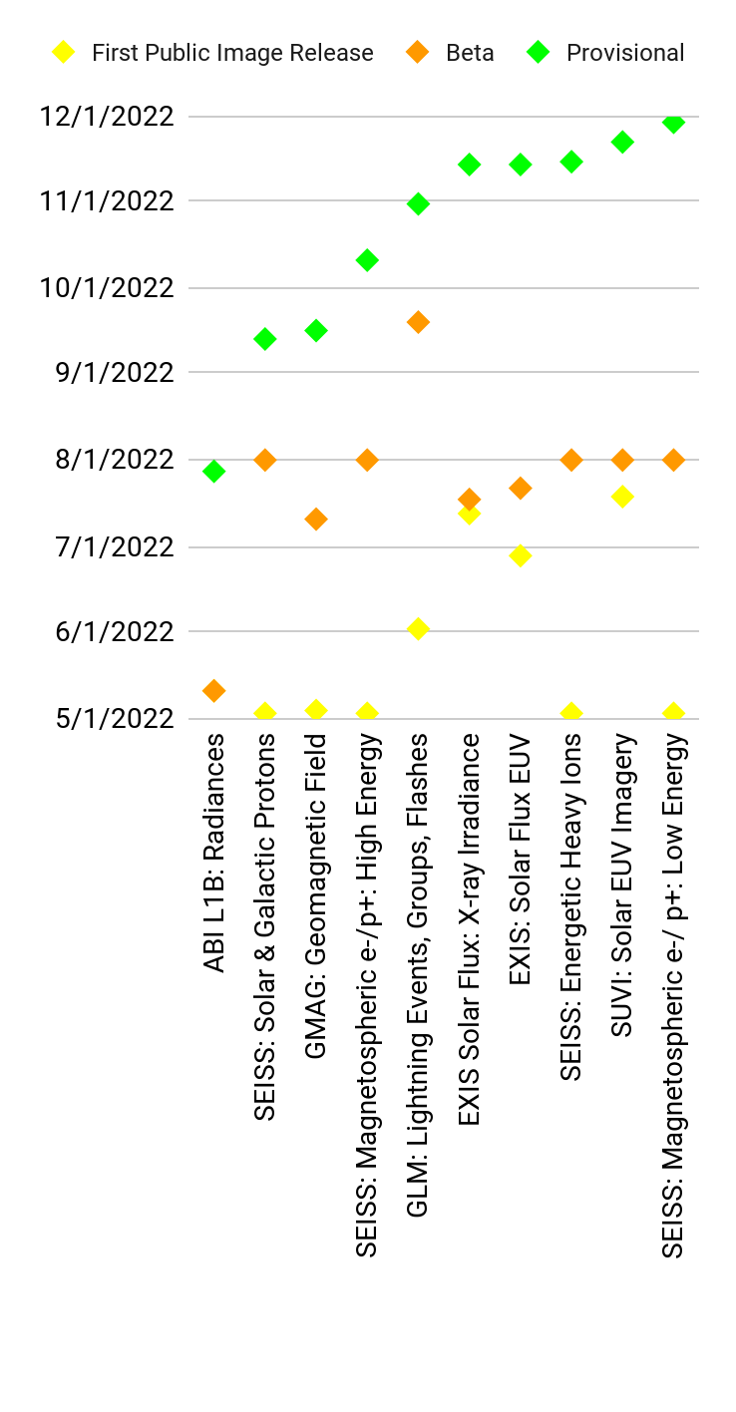
GOES-18 L1b products: Beta / Provisional Maturity timelines
GOES-18 L1B Products
Dec. 16, 2022
Based on GOES-18 SPLASH WG
Return to overview

Slide 10
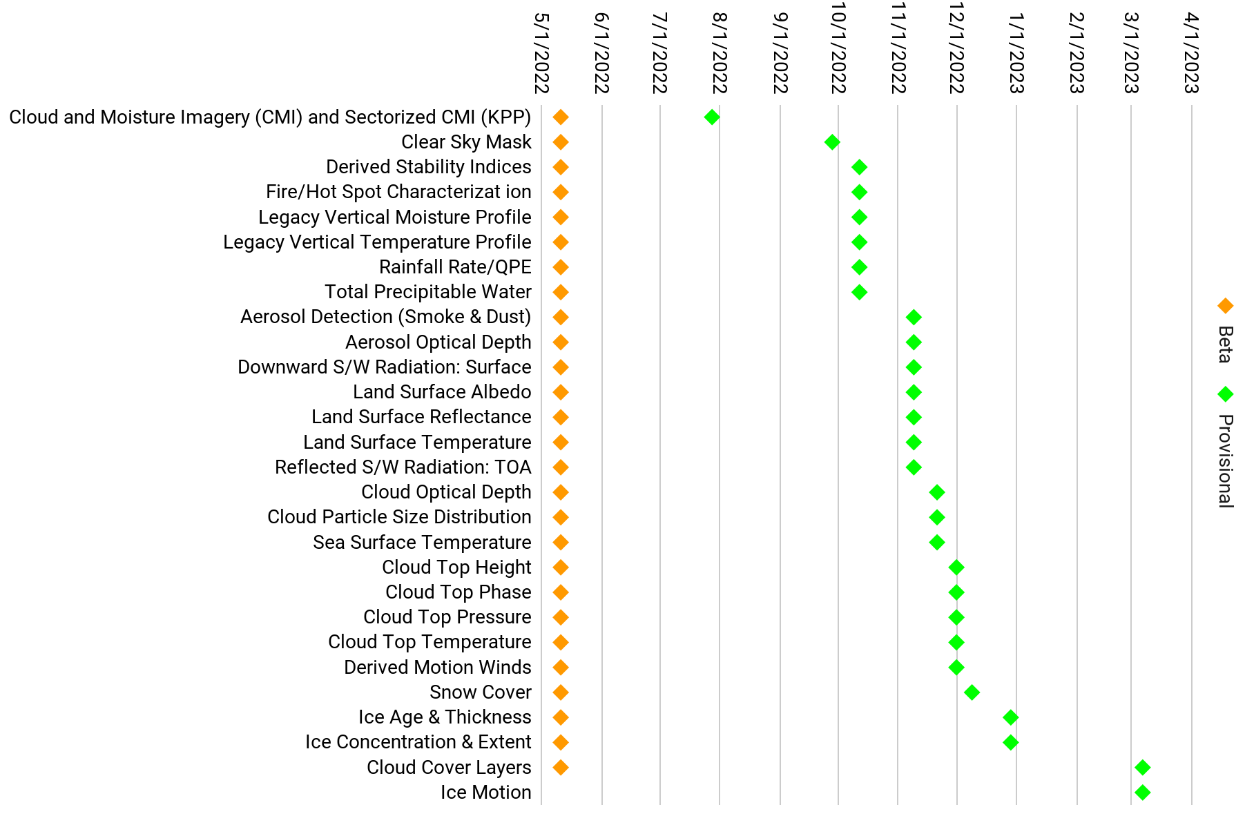
GOES-18 ABI L2+ products: Beta / Provisional Maturity timelines
GOES-18 ABI L2+ Products
Based on GOES-18 SPLASH WG
Also Provisional as of Dec. 14, produced by NDE: (* on SBN after Jan. 4, 2023)
GOES-18 Fog & Low Stratus *
GOES-18 ASOS Satellite Cloud Products *
GOES-18 All Sky / Clear Sky Radiance
GOES-18 Derived Motion Winds BUFR
(Availability of these products is limited until Jan. 4, 2023. See OSPO Notice for details.)
Dec. 16, 2022
Return to overview

Slide 11
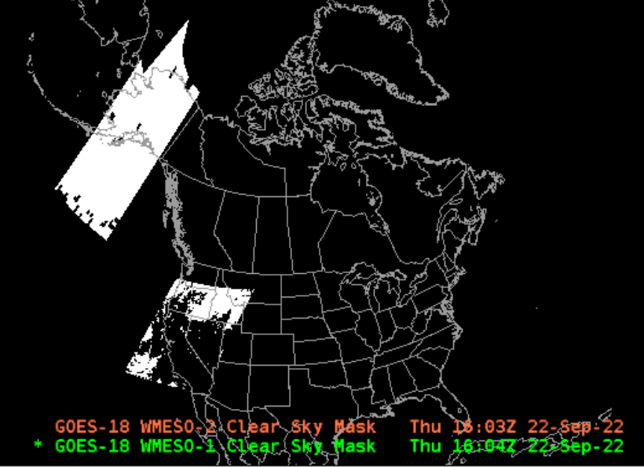
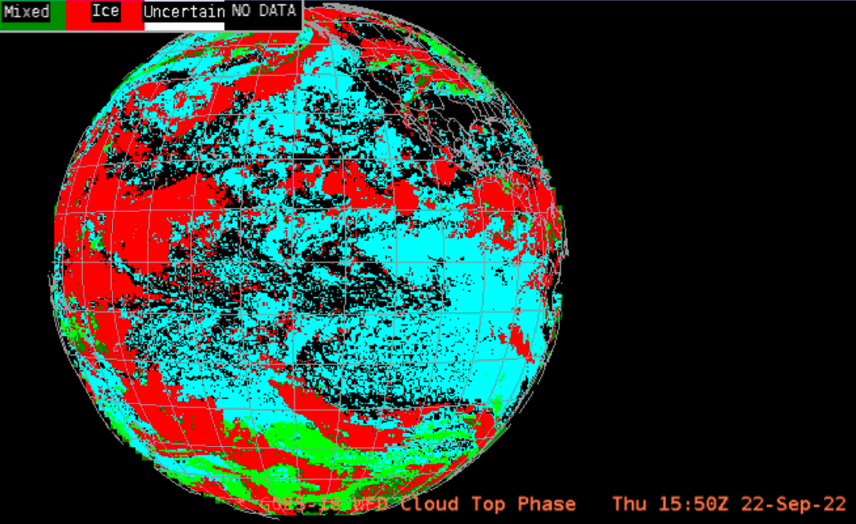
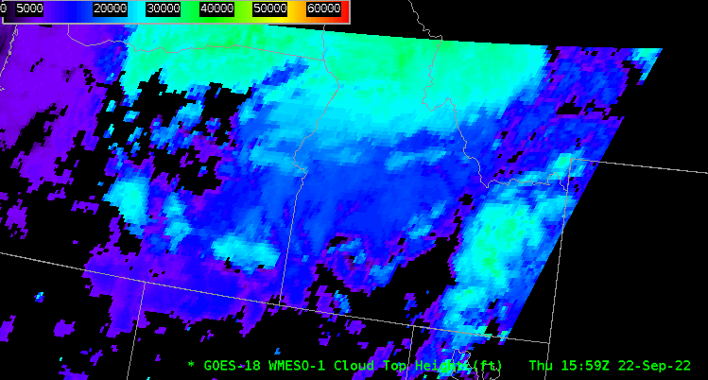
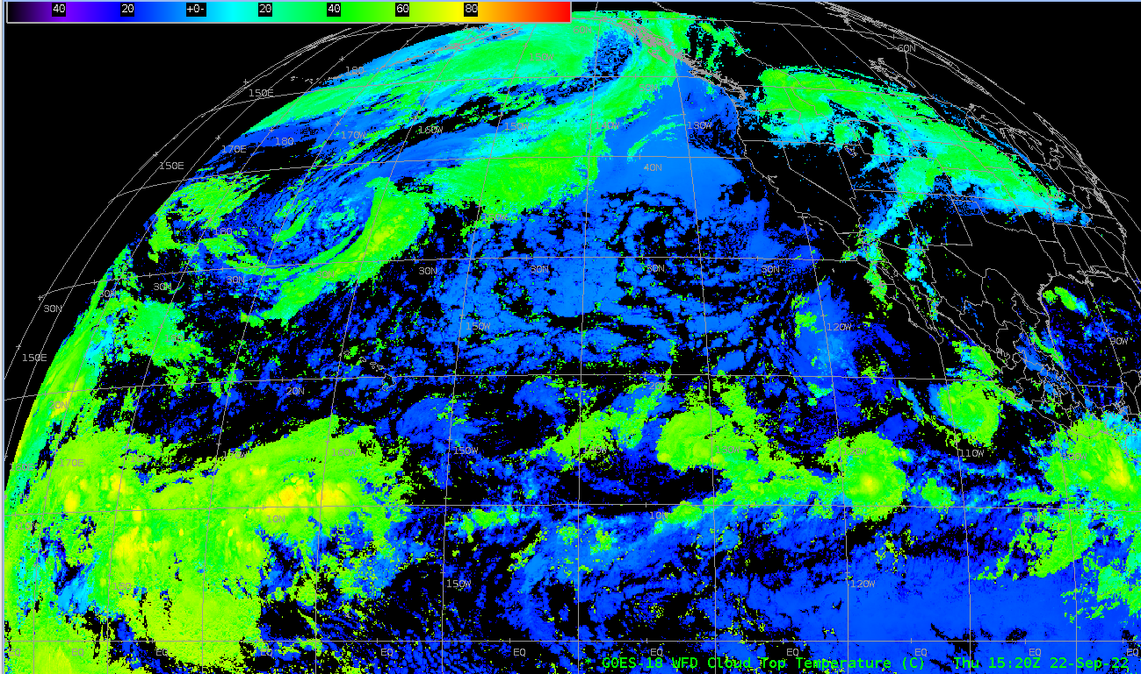
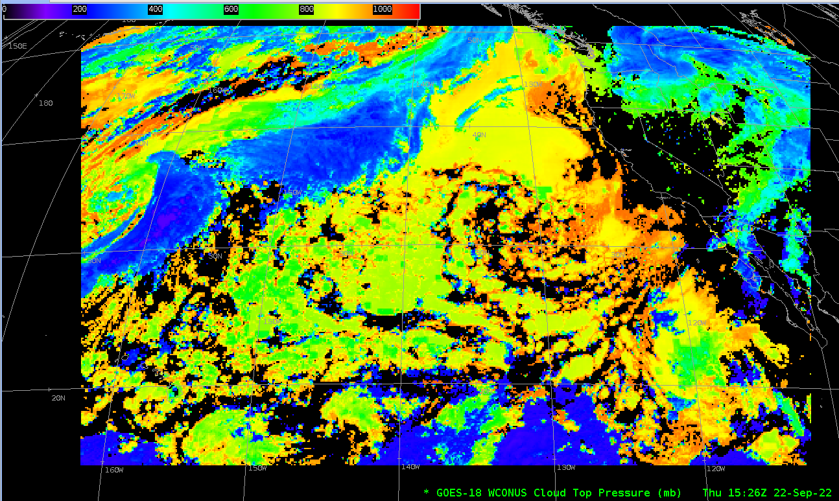
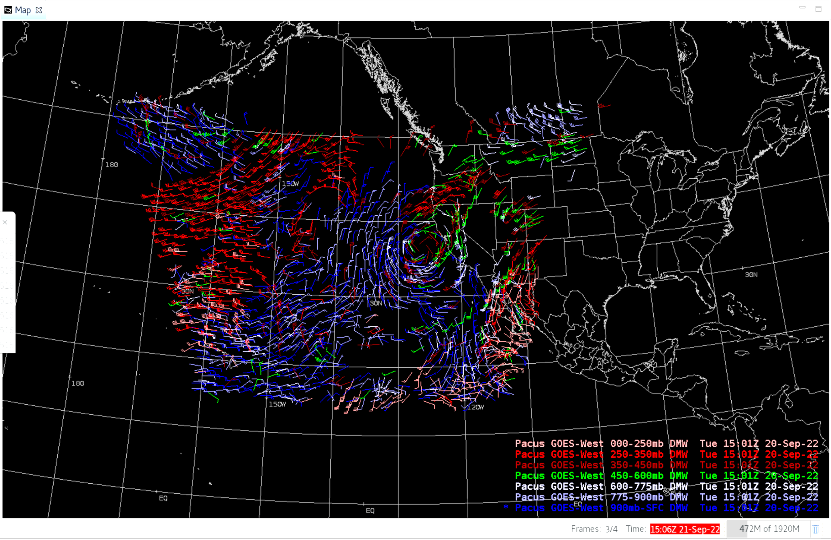
GOES-18 data products: Provisional maturity
All GOES-18 L1b products (from ABI, GLM, SEISS, EXIS, SUVI, GMAG) have reached Provisional maturity.
24 GOES-18 ABI L2 products, and GLM gridded data, have reached Provisional maturity. 2 more GOES-18 ABI L2 products will be assessed for Provisional maturity later this month; Additional reviews are scheduled for March 2023.
GOES-18 Cloud Mask
(Meso)
GOES-18 Cloud Phase
(Full Disk)
GOES-18 Cloud Top Height
(Meso)
GOES-18 Preliminary, Non-Operational Data
GOES-18 Derived Motion Winds
(W. CONUS)
GOES-18 Cloud Top Temperature
(Full Disk)
GOES-18 Cloud Top Pressure
(W. CONUS)
Return to overview

Slide 12
NWS is ready for GOES-18
GOES-18 ABI Imagery on SBN:
NCF is configured for GOES-18 imagery (SCMI) coming to SBN.
Confirmed via GOES-17/18 Interleaved Operations (June, August, October) and DOE-T4 test event October 27-28
Obtained informal evaluations from field sites (pre-OT&E) in June and August.
OT&E expected in Jan. 2023.
GOES-18 ABI L2 data products on SBN:
NWS / AWIPS verification and assessments for GOES-18 PS-PVRs, Oct. - Dec. 2022.
OT&E expected in Jan. 2023.
GRB:
Conducted successful Interleaved Operations in June, August, and October.
Community Satellite Processing Package (CSPP) is ready for GOES-18.
Now ready for G-18 GRB stream in Jan. 2023.
GOES-18 (and GOES-16) gridded GLM data on SBN:
Gridded GLM will go on SBN Mar. 6, 2023 (SCN22-112).
NCF is configured to route GOES-16/18 1-minute gridded GLM.
Confirmed via DOE-T4 test event October 27-28
Now configuring NCF for “GLMFDSTAT” summary files.
Used for 5-minute compilations of gridded GLM
AWIPS sites will need to edit their EDEX and LDM configurations.
EDEX configurations were confirmed to work during end-to-end test on Dec. 1
OT&E expected in March 2023.
Return to overview

Slide 13
2. Changes to GOES-R imagery on SBN
Return to overview

Slide 14
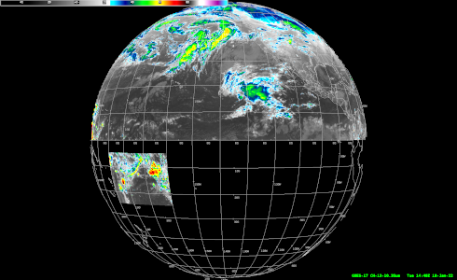
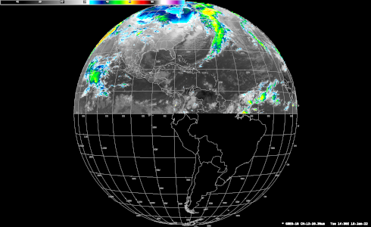
Changes to GOES-East,West ABI imagery on SBN: Dec. 1, Jan. 4
Alaska regional
sector
(starting 2023-01-04)
(since 2022-12-01)
W. CONUS (PACUS)
sector
CONUS
sector
No Hawaii regional sector
Puerto Rico regional sector
(Bands 1-10, 13, 15 only)
GOES-West “Full Disk”
GOES-East “Full Disk”
American Samoa regional sector
(Band 13 only)
“Full Disk” -> Northern Hemisphere
Band 13: 2 km pixels
All other bands: 6 km pixels
“Full Disk” -> Northern Hemisphere
Band 13: 2 km pixels
All other bands: 6 km pixels
(Details on next slide)
Return to overview

Slide 15
Changes to GOES-East,West ABI imagery on SBN: Dec. 1, Jan. 4
GOES-R ABI Imagery (SCMI) on SBN is undergoing the following changes (a.k.a. “DO.11”) as of Dec. 1, 2022 / GOES-East and Jan. 4 / GOES-West (see SCN22-94 - Updated):
(GOES-East, GOES-West) Cease transmission of Southern Hemisphere imagery from the Full Disk (all 16 bands);
(GOES-East, GOES-West) Full 2 km resolution for Band 13 (Clean IR Window) “Full Disk” (Full Hemisphere);
(GOES-East) Omit Bands 11, 12, 14, and 16 from GOES-East Puerto Rico sector imagery;
(GOES-West) Cease transmission of the GOES-West Hawaii Regional sector;
(GOES-West) Add Band 13 imagery (IR Window) for a new GOES-West American Samoa Regional sector.
Full Disk
Band 13: 2km pixels
All other bands: 6km
CONUS
sector
GOES-East
Puerto Rico regional sector
(Bands 1-10, 13, 15 only as of Dec. 1, 2022)
NOTES:
The change will affect only GOES-R ABI imagery over SBN – not ABI L2 products; or other instruments; or dissemination other than SBN.
Mesoscale and CONUS / W. CONUS (PACUS) sectors will not change.
These changes will be rolled back ~Jan. 31, 2023; then reinstated permanently ~Mar. 6, 2023:
Alaska regional
sector
Full Disk
Band 13: 2km pixels
All other bands: 6km
W. CONUS (PACUS)
sector
GOES-West
Hawaii regional sector (until Jan. 4, 2023)
American Samoa regional sector (as of Jan. 4, 2023)
(Band 13 only)
DO.09
Dec. 16, 2022
DO.09
DO.09
DO.09
Return to overview

Slide 16
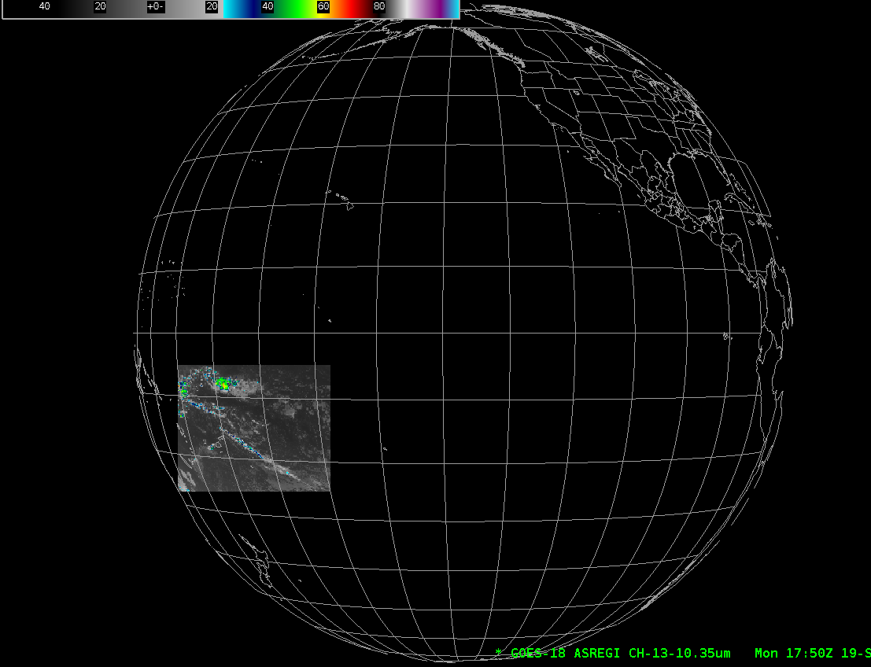
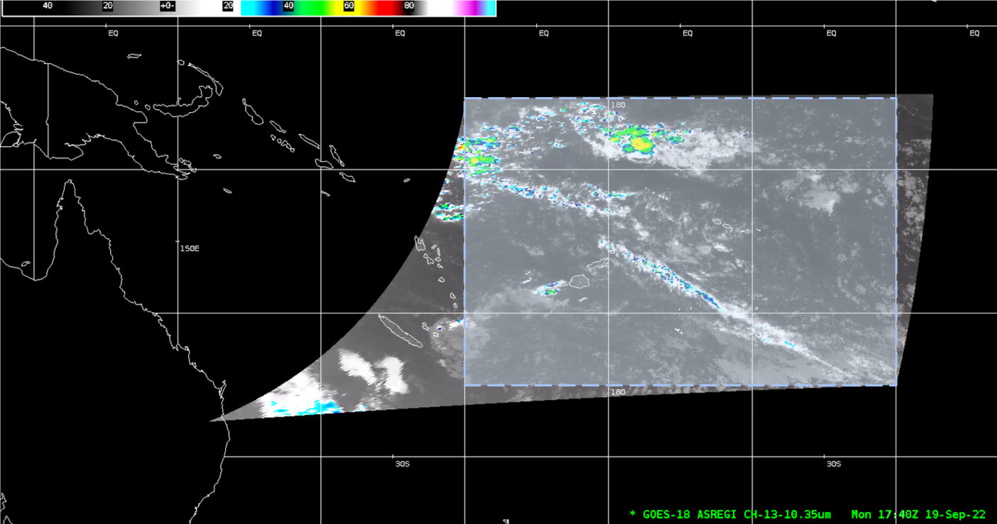
American Samoa regional sector
5º S
American Samoa
American Samoa
25º S
170º E
~1,000km
160º W
Return to overview

Slide 17
3. Preparing for JPSS-2>NOAA-21
and changes to the JPSS constellation
Return to overview

Slide 18
NOAA-21 and the JPSS Constellation
Launch, Early Orbit and Activation (LEO&A) (Launch to L+90 days)
JPSS-2 launch: Nov. 10, 2022
after J. McNitt et al.
Dec. 16, 2022
Source: J. McNitt
November 10, 2022
~ February 2023
May – July 2023
July – October 2023
Return to overview

Slide 19
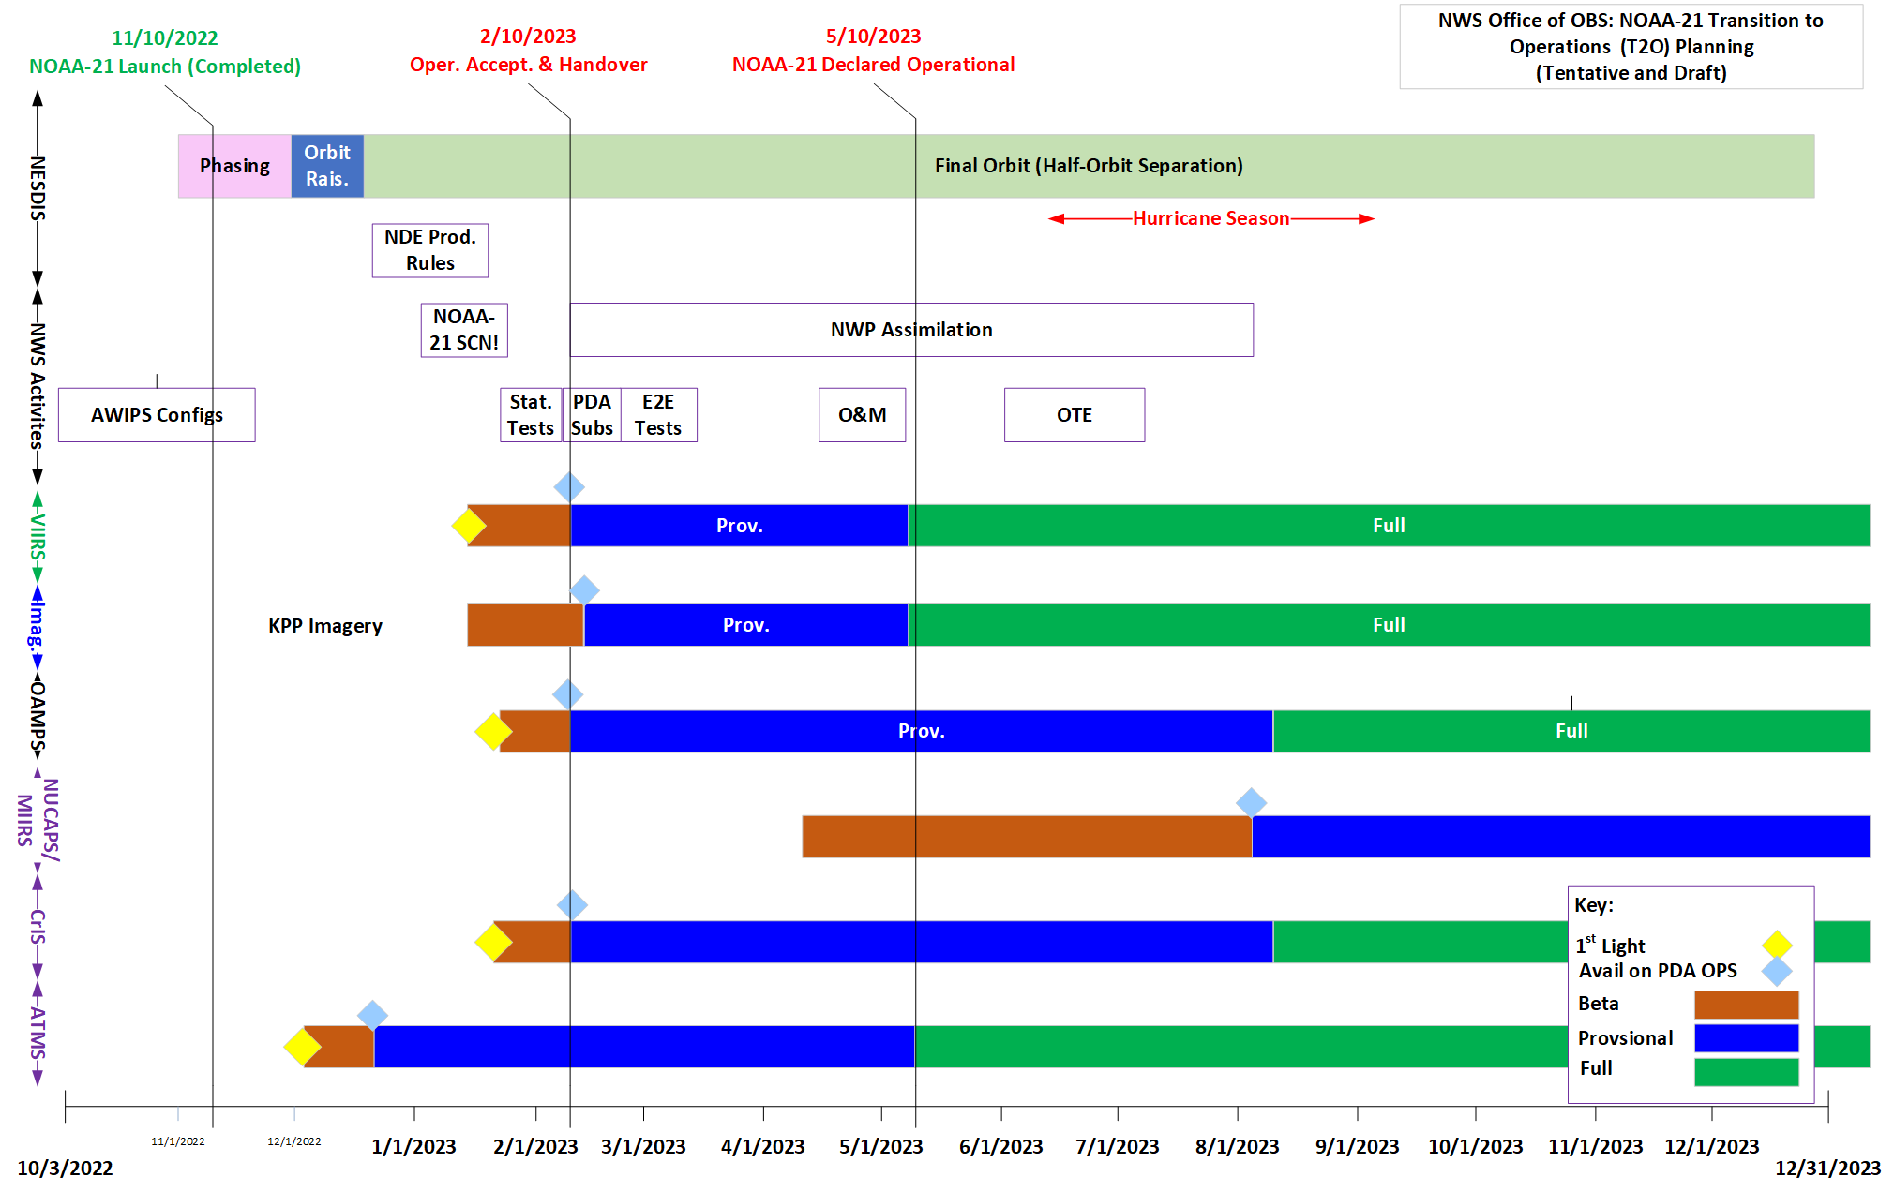
NWS readiness planning for JPSS-2/NOAA-21
Phasing
Dec. 16, 2022
h/t: Dariush Khadjenouri
NOAA-21 LEO&A
NOAA-21 tertiary
NOAA-21 secondary
NOAA-21 primary
Return to overview

Slide 20
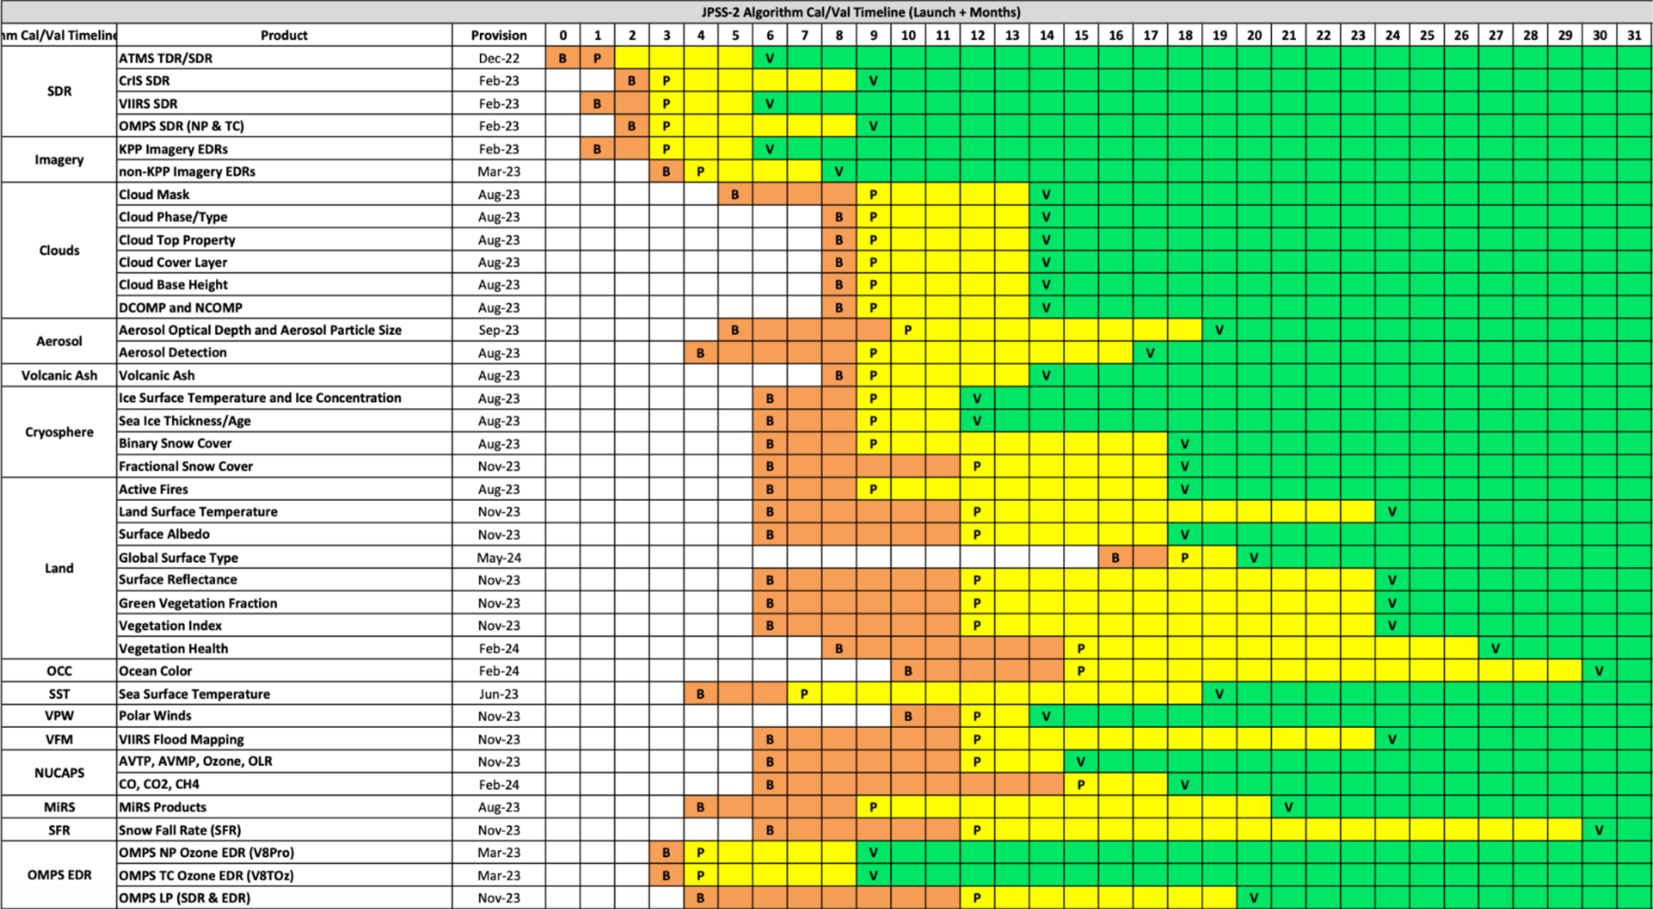
JPSS-2 (NOAA-21) Product Maturity timeline
 | CY2022 | CY2023 | CY2024 | CY2024
Nov | Dec | Jan | Feb | Mar | Apr | May | Jun | Jul | Aug | Sep | Oct | Nov | Dec | Jan | Feb | Mar | Apr | May | Jun | Jul | Aug | Sep | Oct | Nov | Dec | Jan | Feb | Mar | Apr | May | Jun
P
From the JPSS-2 Product Operations Plan (Sept. 2022)
Dec. 16, 2022
Return to overview

Slide 21
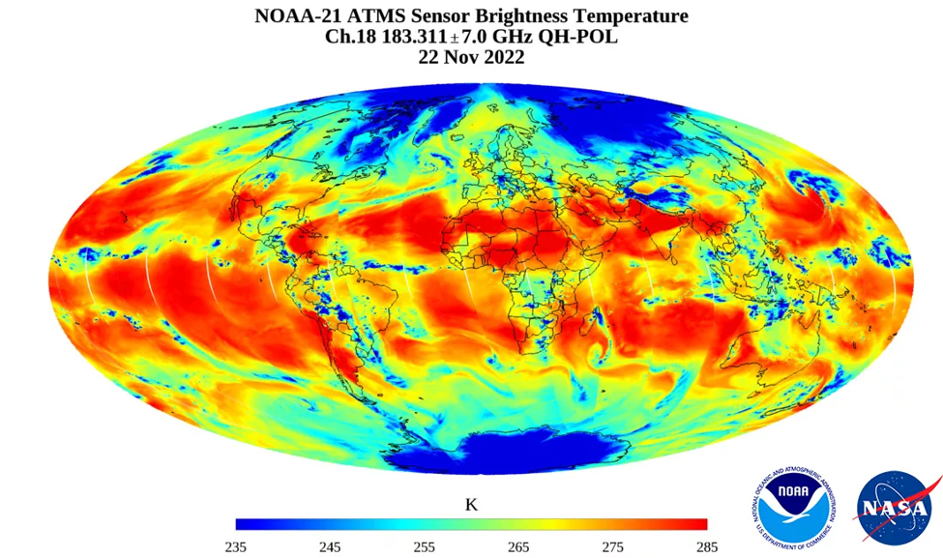
NOAA-21 ATMS First Light image
NOAA-21 ATMS RDR, TDR, SDR, ATMS SDR GEO, and ATMS BUFR products reached provisional maturity on Dec. 15, and are operationally available via PDA (per OSPO)
Note: This image was constructed from preliminary, non-operational data.
NOAA-NESDIS
Return to overview

Slide 22
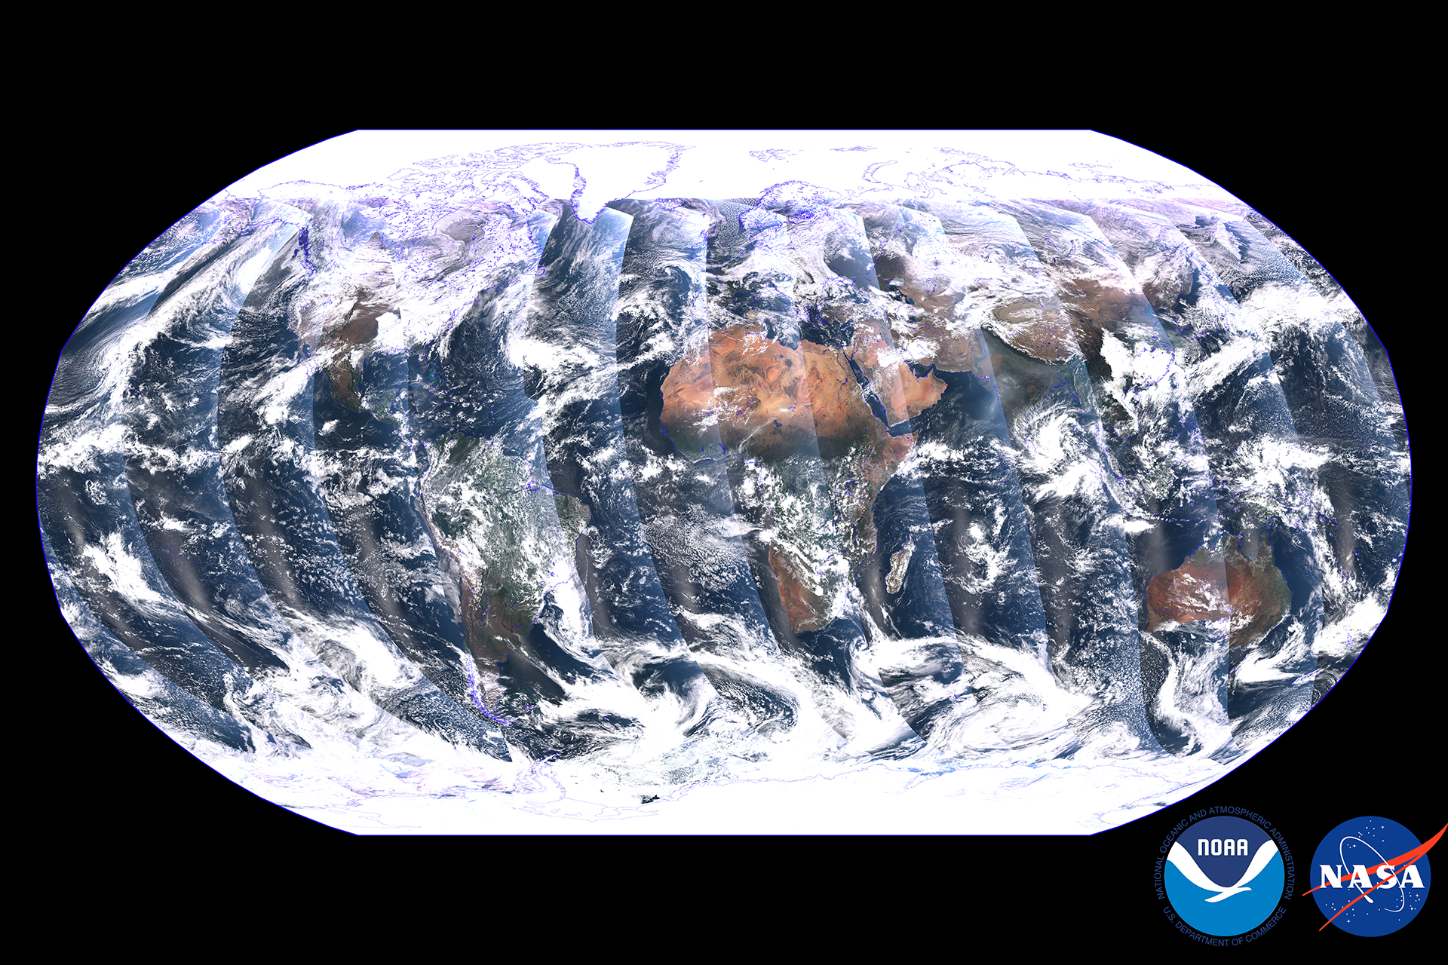
NOAA-21 VIIRS First Light image
This global mosaic, captured by the VIIRS instrument on the recently launched NOAA-21 satellite, is a composite image created over a period of 24 hours between Dec. 5 and Dec. 6, 2022. Credit: NOAA STAR VIIRS SDR team.
NOAA-NESDIS
Note: This image was constructed from preliminary, non-operational data.
Return to overview

Slide 23
S-NPP continuity as the tertiary JPSS satellite
On SBN: NOAA-21 data products, once they’re operational, will replace their S-NPP counterparts.
As detailed in the JPSS-2 Product Operations Plan (Sept. 2022):
Once NOAA-21 is operational (~6 months after launch), the S-NPP spacecraft will be the tertiary satellite: it will be operated at a lower priority than NOAA-20 and NOAA-21.
S-NPP will remain operational at least until NOAA-21 is designated the primary satellite (~9 to 12 months after launch). No formal guidance to decommission the satellite has been provided.
NDE, PDA, and NCCF operational systems will produce and provide S-NPP products on a “best-effort” basis, as long as this does not impact data product operations from NOAA-20,21 or from other missions.
If NDE/PDA data loading nears its capacity, lower-priority S-NPP products will be moved off the operational systems.
Return to overview

Slide 24
4. Himawari-9 transition
Return to overview

Slide 25
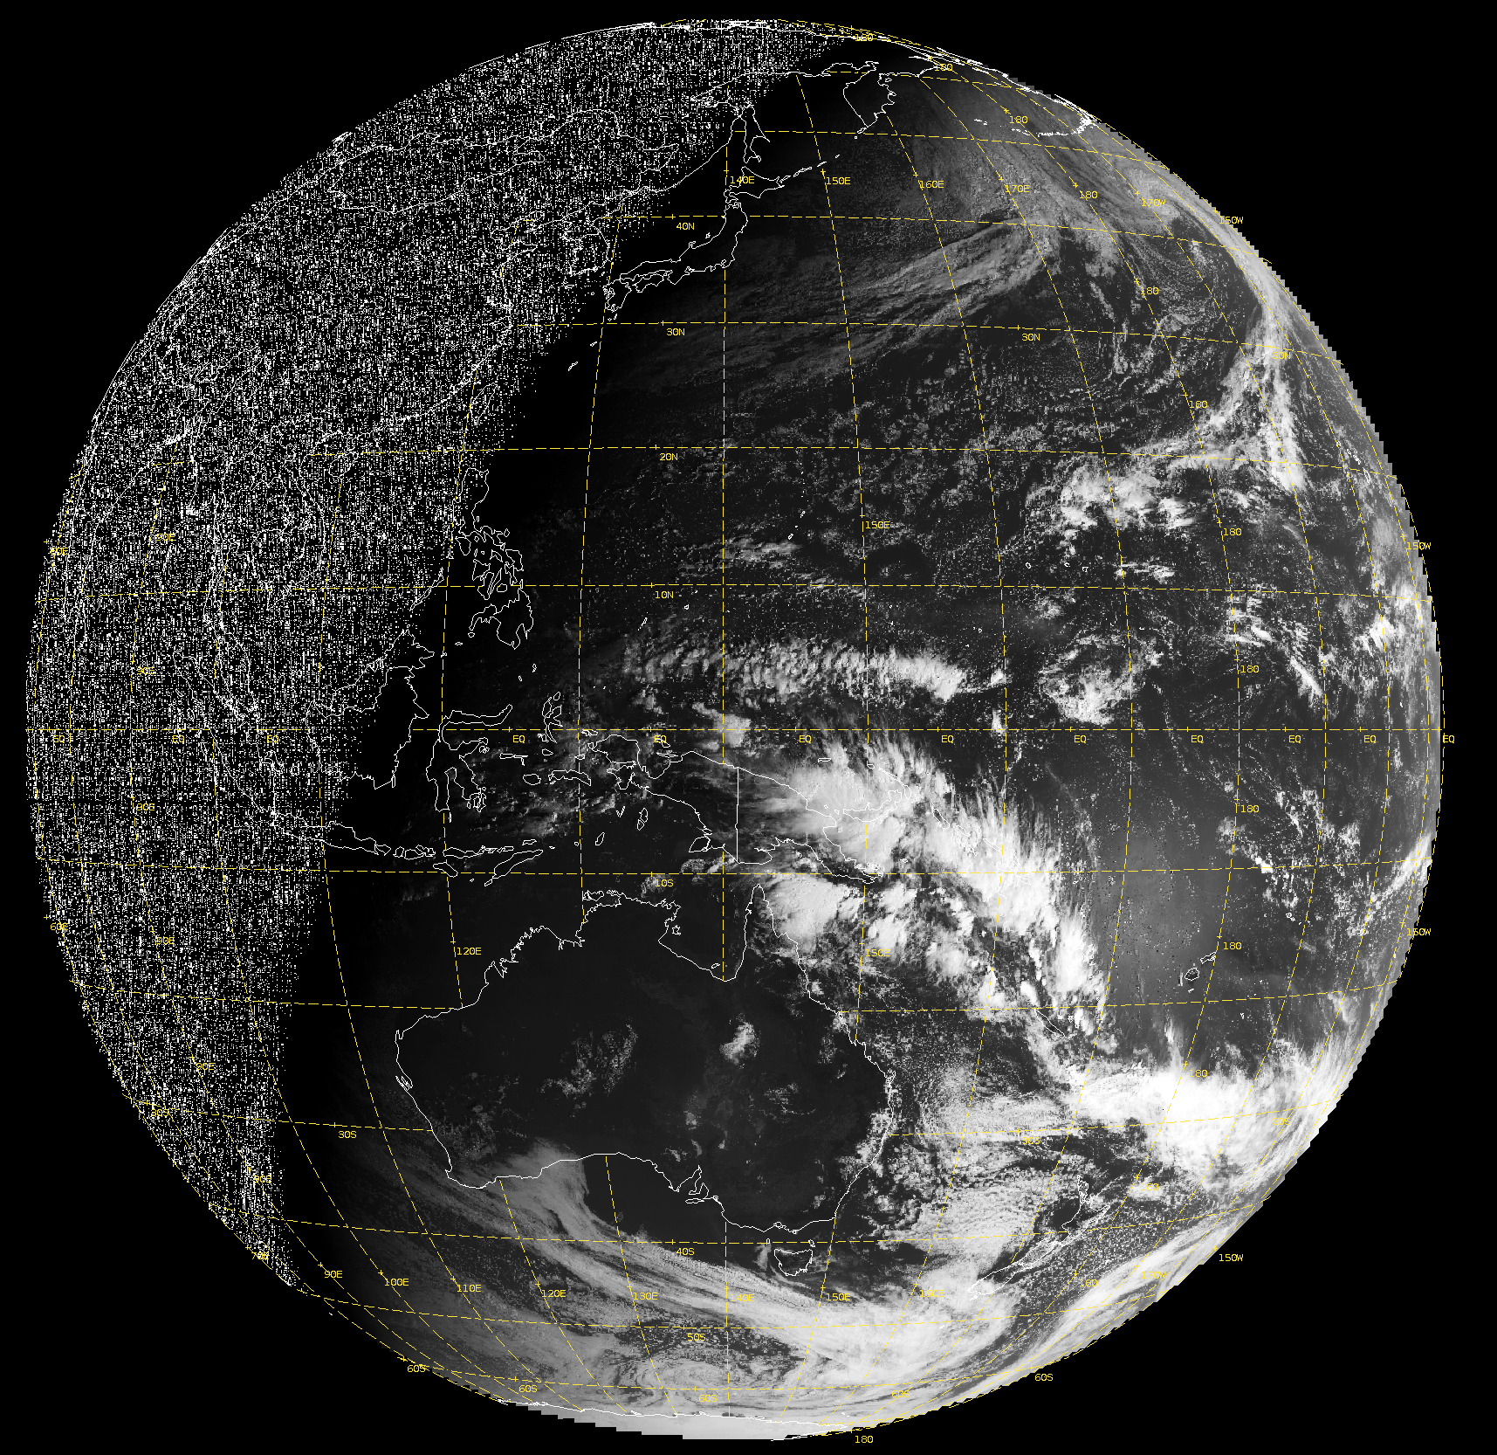
Himawari-9 transition
NWS / NOAA operations transitioned from Himawari-8 to Himawari-9 imagery on Dec. 12, 2022. Himawari-8 data ceased on Dec. 13.
Himawari-9 L2 products will become available to NWS / NOAA operations around April - June 2023.
Including AWIPS-friendly product contents and formats
01
02
03
04
05
06
07
08
09
10
11
12
13
14
15
16
17
18
19
20
21
22
23
24
Operational Release (per OSPO) | Himawari-9 products
Dec. 13 2022 | Imagery Full Disk Tiles
 | Imagery R3 Floating Sector
Apr. to June 2023 (estimated) | Clouds
 | Winds
 | Sea Surface Temperature
 | Rainrate
25
26
27
28
29
30
31
32
33
34
35
36
37
38
39
40
41
42
43
44
45
46
47
48
49
50
51
52
53
54
55
56
57
58
59
60
61
62
63
64
65
66
67
68
69
70
71
72
73
74
75
76
77
78
79
80
81
82
h/t: Derek van Pelt
Himawari-9 data may also become available on https://noaa-himawari9.s3.amazonaws.com/index.html
83
84
85
86
87
88
Himawari-8 AHI Ch. 11 imagery tiles (Dec. 2, 2022)
Return to overview

Slide 26
5. Looking ahead
Return to overview

Slide 27
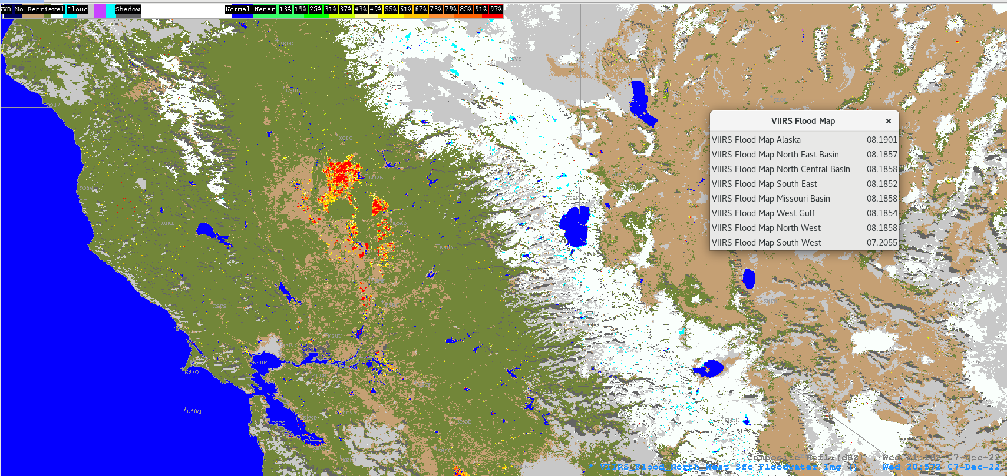
Looking ahead
VIIRS Flood Maps are being evaluated in AWIPS by the NWS Operations Proving Ground (OPG).
Sentinel-6A Altimetry (wave heights & wind speeds) from EUMETSAT is now available on PDA.
TOWR-S is working with OPC and NHC to process using their PDA subscriptions
Metop-C ASCAT winds will be available on PDA in Jan. 2023. (SBN activation: Feb. 2023)
Confirmed AWIPS compatibility of BUFR and NetCDF variants
Reusing WMO headers “JSXX.. KNES” formerly used for Metop-A ASCAT winds
Several GOES-R Enterprise products will go into operations (and some on SBN) in winter / spring 2023.
Operational gridded GLM products (G-16, G-18) will go on SBN in Mar. 2023. (SCN22-112)
(Gridded GLM products are on NWS Regional LDM now)
“Shuffle” and GZip compression of GOES-R imagery slated for April / May 2023: this may shrink GOES-R imagery data volumes on SBN by nearly 15%.
h/t: Derek van Pelt
VIIRS Flood Map - Dec. 7, 2022
Return to overview

Slide 28
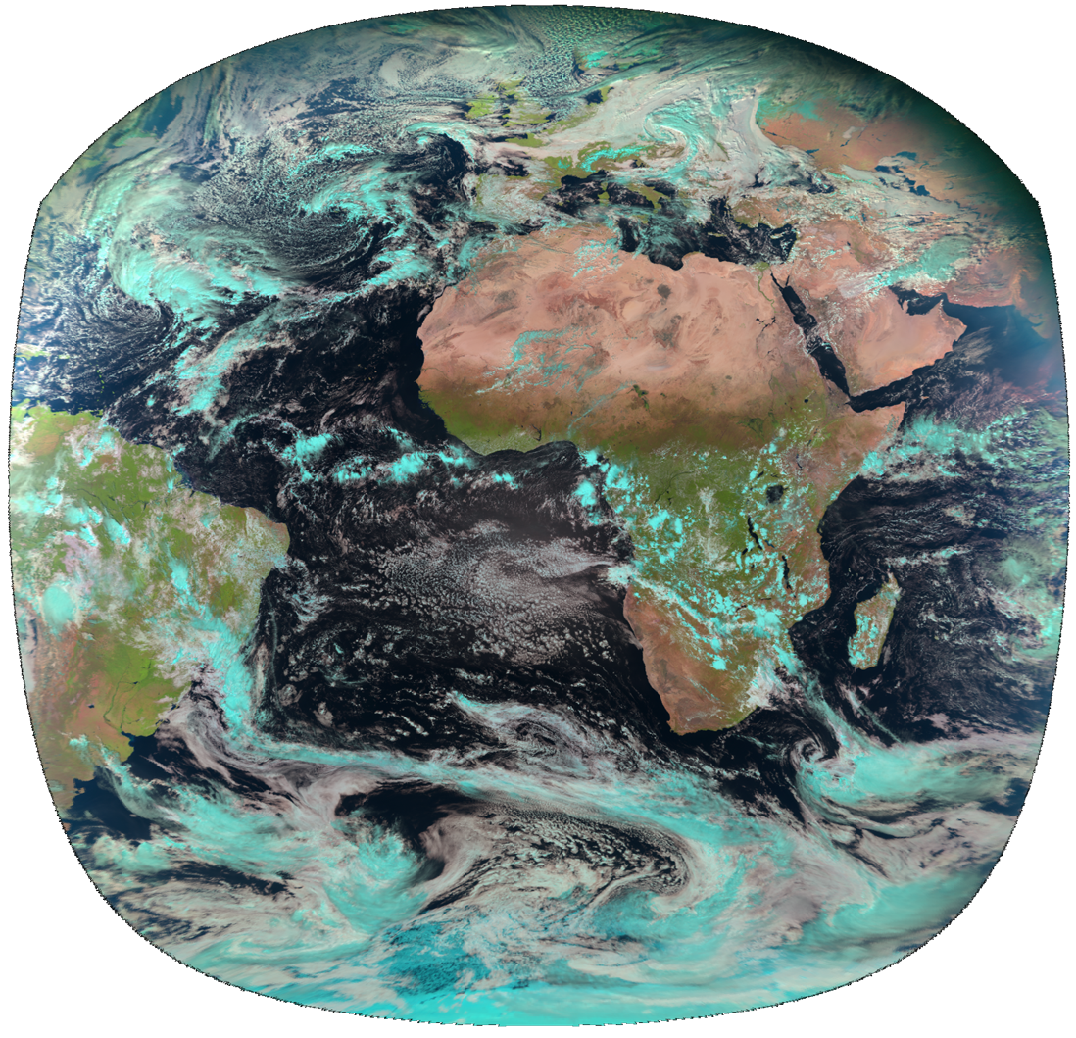
Recent and upcoming satellite launches
NOAA-21 launched Nov. 10, 2022.
OceanSat-3 (a.k.a. EOS-06) launched Nov. 26, 2022.
The OSCAT-3 scatterometer will fill the gap left when SCATSAT ceased operations in Feb. 2021.
(MeteoSat 3rd Gen.) MTG-Imager 1 launched Dec. 13, 2022.
Geostationary @ Longitude 0°
GOES-U to launch April 30, 2024 or later.
Geostationary @ Longitude 137°W or 75°W
Completed thermal vacuum (TVAC) testing Nov. 4, 2022.
(Metop 2nd Gen.) Metop-SG-A1 to launch 1st Q. CY2025.
Sun-synchronous polar (morning) orbit
h/t: V Wegman
The view from Longitude 0° (MeteoSat-11)
Return to overview

Slide 29
5. New from TOWR-S
Return to overview

Slide 30
ISatSS updates in IDP
Approach: Series of Small Updates
RPM/v4.3 framework; providing GLM Grids for OPC and WPC; and GOES-18 compatibility
Now operational on IDP's Operational system
Currently providing G16/G17 imagery and gridded GLM to OPCN and HPCN
Himawari-9 support (=> retire legacy AHIProc application in Jan. 2023)
Support for Meteosat, GeoColor, and ProxyVis
Support for Scatterometers, Altimeters, Microwave Imagery, SAR
Each will update to latest NWSPy library
Return to overview

Slide 31
TOWR-S RPM Ver 23 Preview
Planned availability to eval sites on January 19th, 2023
Planned field-wide availability on Feb 9th, 2023
Updates the current Ver 22 released in Feb of 2022
Key planned features:
Readiness for GOES GLM (1-min/1-min update) on SBN in Mar 2023 (replaces LDM)
Adds LightningCast probability products (sourced from CR LDM)
Adds “Day Fire” RGB (R: 3.9um (0-70C), G: 0.86um (0-100%), B: 0.64um (0-100%)
Adds VIIRS Flood Mapping products
Readiness for GOES Ice Concentration and Thickness products on SBN
Return to overview

Slide 32
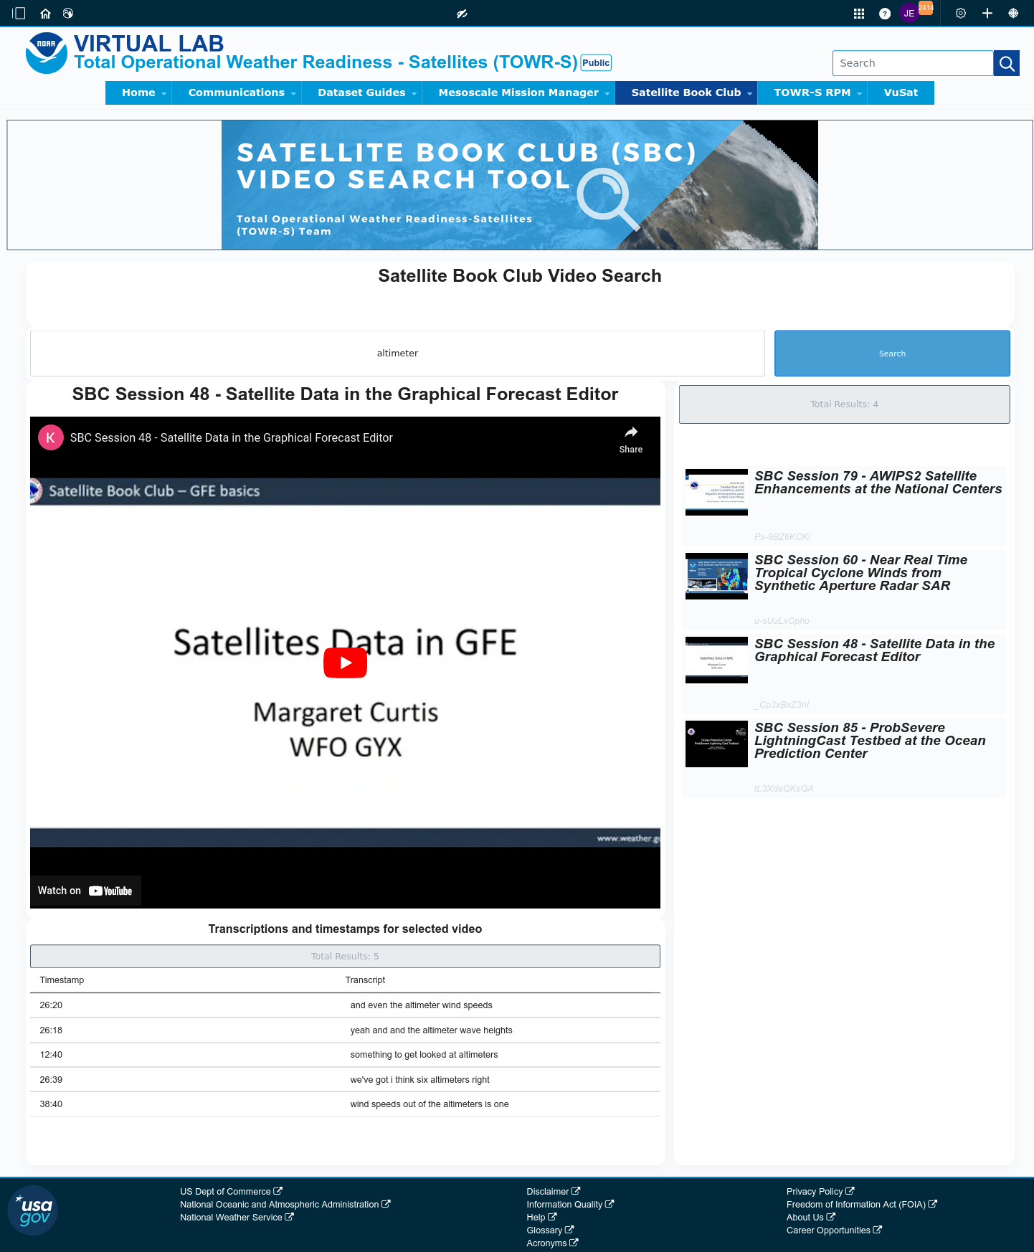
Satellite Book Club (SBC) Seminar Series
Thursdays, usually at Noon ET
Usage examples shed light on user requirements for satellite data products and capabilities.
Recordings are on the SBC page in the NOAA VLab and the NWS Commerce Learning Center (CLC) website.
Full-text transcripts are available for all SBC sessions – searchable from within VLab.
vvSearch: SBC videos are now searchable by keyword: https://vlab.noaa.gov/web/towr-s/sbc-video-search
New!
Return to overview

Slide 33
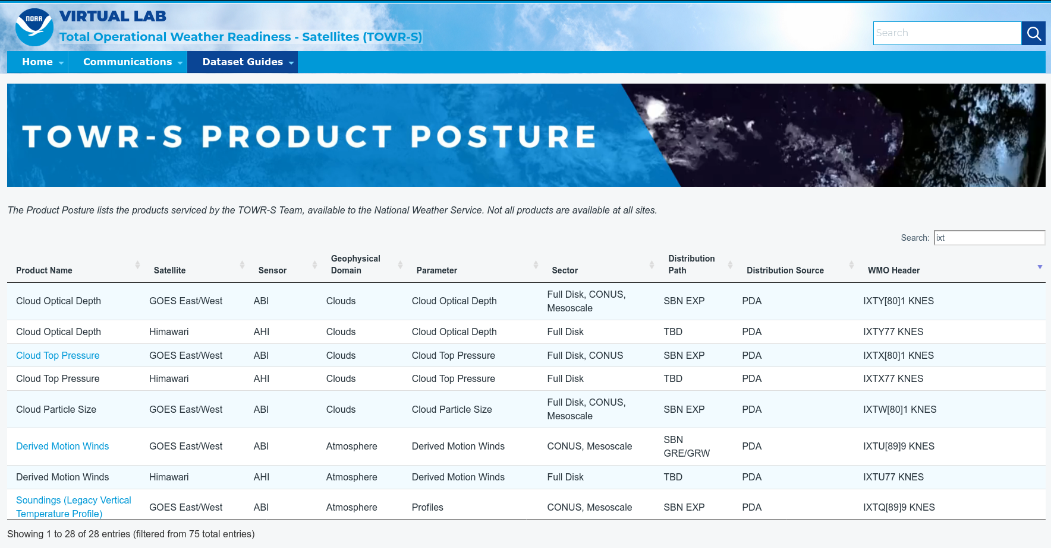
TOWR-S Product Posture
VLab now hosts a table of all satellite data products that TOWR-S is involved with (integrating them into NWS forecast operations).
Instant search, filter, and sort capability provides access by keyword, satellite, sensor, etc.
Many rows link to Dataset Guides with more AWIPS details.
Note: Distribution Path “TBD” indicates a product in planning - not yet disseminated to users
https://vlab.noaa.gov/web/towr-s/product-posture
Return to overview

Slide 34
TOWR-S monthly
Supplements the quarterly TOWR-S Update briefings and the weekly / occasional TOWR-S mailers.
Emailed to TOWR-S Update attendees and posted to VLab. (https://vlab.noaa.gov/web/towr-s/communications)
Return to overview

Slide 35
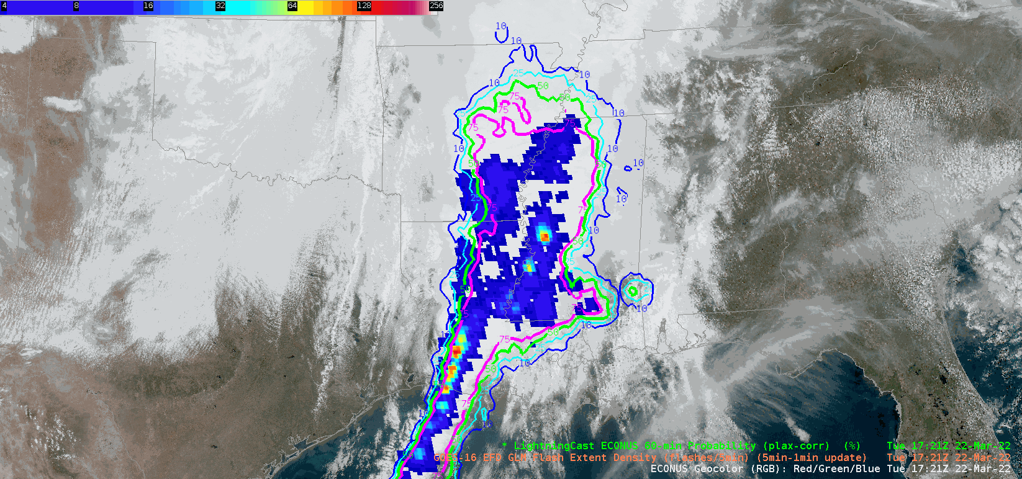
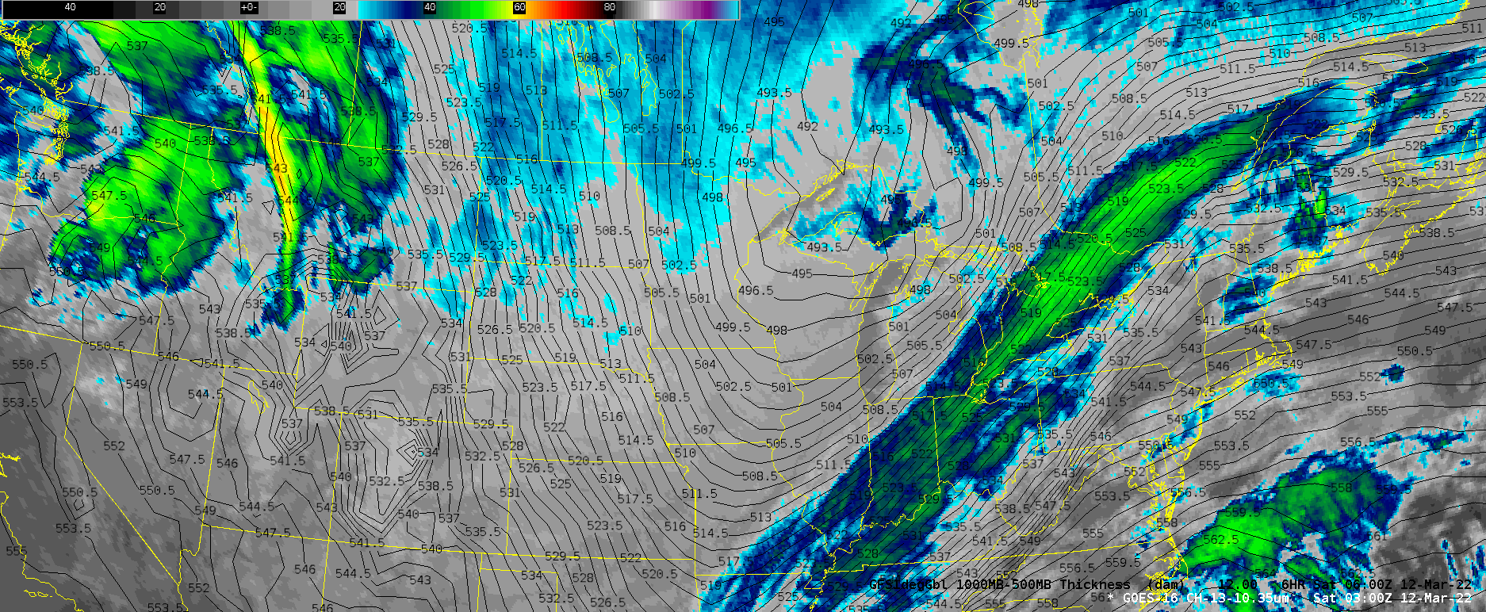
geoCloud AWIPS for Collaboration
TOWR-S team has an initiative to bring people together in the AWIPS environment to foster collaboration on ways satellite data can enhance the NWS mission.
TOWR-S facilitates small groups of forecasters, technique development meteorologists, and algorithm developers from across the NWS and NESDIS.
More details are in Satellite Book Club Session 38.
Please contact Lee Byerle to schedule a session with your office.
h/t: Lee Byerle
Return to overview

Slide 36
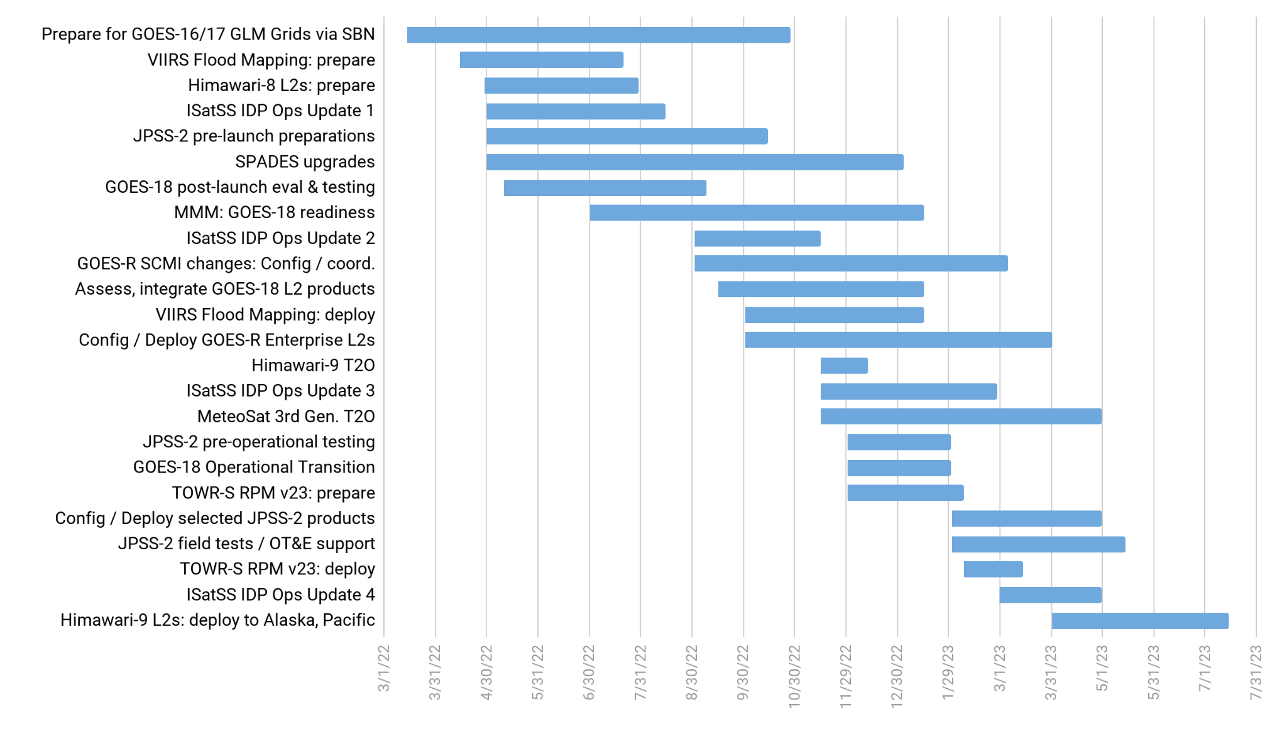
TOWR-S Activity Plan
CY2022 |  |  |  |  |  |  |  |  |  | CY2023
Mar | Apr | May | Jun | Jul | Aug | Sep | Oct | Nov | Dec | Jan | Feb | Mar | Apr | May | June | July
Dec. 16, 2022
Return to overview

Slide 37
Contact Information
Office of Observations
Brian Gockel – brian.gockel@noaa.gov
Jordan Gerth – jordan.gerth@noaa.gov
Total Operational Weather Readiness – Satellites (TOWR-S) Team
John Evans – john.d.evans@noaa.gov
Lee Byerle – lee.byerle@noaa.gov
Links
NWSChat (“towr-s” chatroom)
TOWR-S in the NOAA VLab
Return to overview

Slide 38
Next TOWR-S Update
(tentative)
March 24, 2023
Return to overview

