Slide 1
TOWR-S Update
April 1, 2022
https://meet.google.com/thn-pkwe-wbr
Total Operational Weather Readiness - Satellites
NWS Office of Observations

Slide 2
Overview
TOWR-S RPM v22 update
Satellite data products and capabilities in preparation
Satellite data products and capabilities under consideration
GOES-18 preparations
GOES-17 update
Preparations for JPSS-2 / NOAA-21
Satellite Book Club seminars
TOWR-S VLab pages
cloudReach
TOWR-S 2022 workplan

Slide 3
TOWR-S RPM v22
Provided via NCF on Feb. 8, 2022
Features:
Configuration for thinned GOES-R soundings (Moisture / Temperature Profiles)
GOES-R Cloud Type RGB
VIIRS I-Band Active Fires support (DMW-friendly files via AWC ISatSS)
RGB + L2 product readout added to Local Options
Add sector name to legends for channel differences and imagery
Support for GOES-R Enterprise Cloud Phase and Land Surface Temperature (retained from v21)
Rocket Plume RGB (under Local options menu)
Gridded NUCAPS improvements:
2m Temperature in °F (Upper Level Temps still degC) Precipitable Water in inches Haines Index layers
Readiness for future Blended Hydro Products (cf. Service Change Notice SCN22-31)
ASCAT 4-category legend (includes 25-33 kt category)
Improved colormap for CIMSS Turbulence product
Configurations to ingest all 22 VIIRS Imagery bands
Remove dmw geographic filtering config file (for more site customization)
Remove 20.2.3 base content
See also Feb. 8 Satellite Book Club presentation

Slide 4
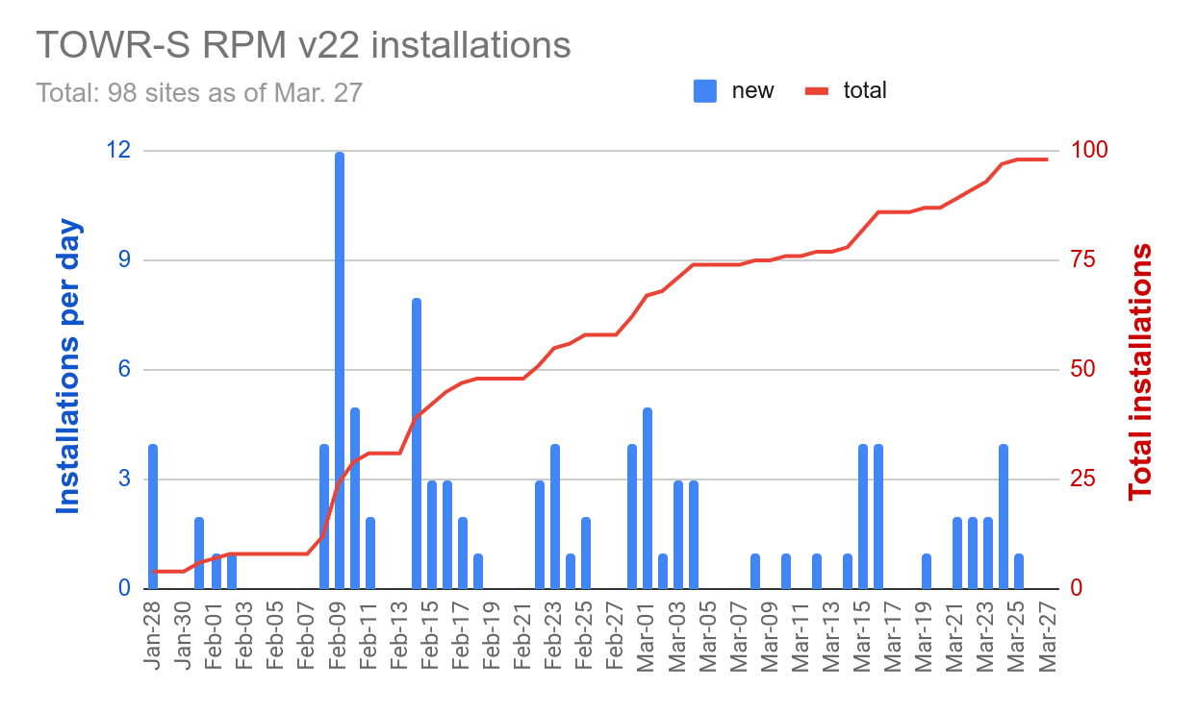
TOWR-S RPM v22 adoption
as of Mar. 27
WFOs only:
 | RPM Version
Region | 17.1 | 18.5 | 20.1 | 21 | 22 | N/A | Total | %
AR | 1 |  | 1 | 1 |  |  | 3 | 0%
CR |  |  | 1 |  | 36 | 1 | 38 | 95%
ER |  | 1 | 1 | 2 | 18 | 1 | 23 | 78%
PR |  |  |  |  |  | 2 | 2 | 0%
SR |  |  | 7 | 3 | 22 |  | 32 | 69%
WR |  |  | 4 | 5 | 15 |  | 24 | 63%
Total | 1 | 1 | 14 | 11 | 91 | 4 | 122 | 75%
All AWIPS sites incl. WFOs, RFCs, Reg.HQs, support, testing, & training:
 | RPM Version
Region | 15.1 | 16.1 | 17 | 17.1 | 18.5 | 19 | 20.1 | 21 | 22 | N/A | Total | %
AR |  |  |  | 2 |  |  | 1 | 1 |  | 2 | 6 | 0%
CR |  |  |  |  |  |  | 3 | 1 | 39 | 10 | 53 | 74%
ER |  |  | 1 |  | 1 |  | 1 | 2 | 19 | 17 | 43 | 49%
NCEP | 2 | 4 |  |  |  | 1 |  |  |  | 3 | 10 | 0%
PR |  |  |  |  |  |  |  |  |  | 4 | 4 | 0%
SR | 1 | 2 |  |  |  |  | 8 | 4 | 23 | 10 | 48 | 48%
WR |  |  |  | 1 |  |  | 4 | 7 | 15 | 5 | 32 | 47%
Total | 3 | 6 | 1 | 3 | 1 | 1 | 17 | 15 | 98 | 51 | 196 | 50%
- From weekly tallies compiled by Sanford Garrard, NWS Office of Central Processing.
Note: Actual numbers may be higher than shown here, as some RPM installations may not be detected by the automated script.

Slide 5
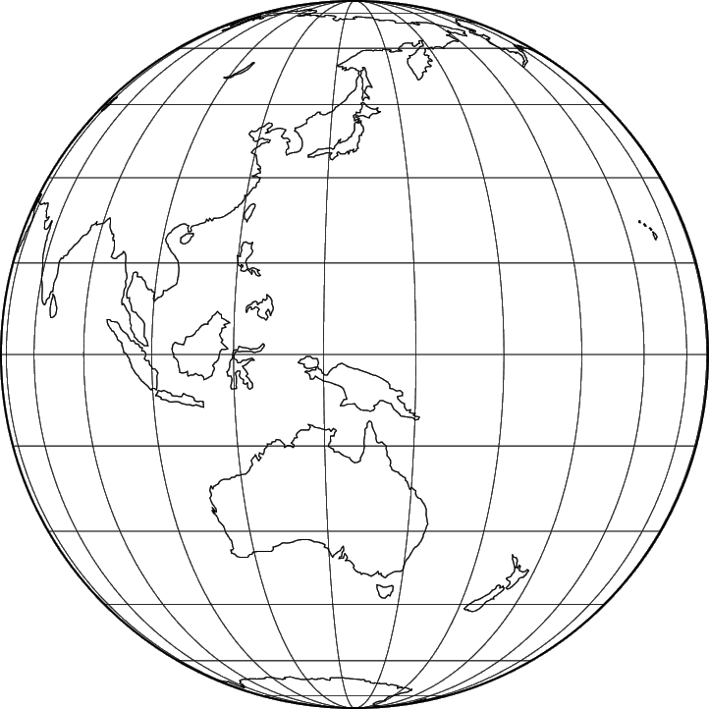
Operational dissemination of Himawari-8 Imagery
Now being disseminated from NESDIS / PDA via NWS NCF to Alaska and Pacific Regions: Full-Disk tiles and (now) floating [a.k.a. “target”] mesoscale sector
(These are also publicly available via the Amazon cloud: https://noaa-himawari8.s3.amazonaws.com/index.html)
NCF fetches 67 of 88 tiles (x 16 channels) from PDA and sends
tiles 02-06 and 09-14 to Alaska Region HQ; and tiles 07-14, 16-24, 26-34, 36-44, 46-54, 56-64, and 66-74 to Pacific Region HQ
HQs forward them to WFOs in each region
88x16=1,408 PDA subscriptions (w/ 1,408 WMO headers) allows full flexibility by tile & by channel
Pacific and Alaska regions report that imagery tiles are arriving with short, consistent latencies. Final T2O expected soon.
This fully operational path will improve user support and increase data availability.
 |  | 01 | 02 | 03 | 04 | 05 | 06
 | 07 | 08 | 09 | 10 | 11 | 12 | 13 | 14
15 | 16 | 17 | 18 | 19 | 20 | 21 | 22 | 23 | 24
25 | 26 | 27 | 28 | 29 | 30 | 31 | 32 | 33 | 34
35 | 36 | 37 | 38 | 39 | 40 | 41 | 42 | 43 | 44
45 | 46 | 47 | 48 | 49 | 50 | 51 | 52 | 53 | 54
55 | 56 | 57 | 58 | 59 | 60 | 61 | 62 | 63 | 64
65 | 66 | 67 | 68 | 69 | 70 | 71 | 72 | 73 | 74
 | 75 | 76 | 77 | 78 | 79 | 80 | 81 | 82
 |  | 83 | 84 | 85 | 86 | 87 | 88
Himawari Product | Sector | Refresh Rate |  | Nadir ground resolution
Cloud & Moisture Imagery | Full Disk tiles | 10 min |  | 1 & 2 km
Cloud & Moisture Imagery | Floating Sector | 2.5 min |  | 0.5 km
Corrected tile list
h/t Joe Zajic

Slide 6
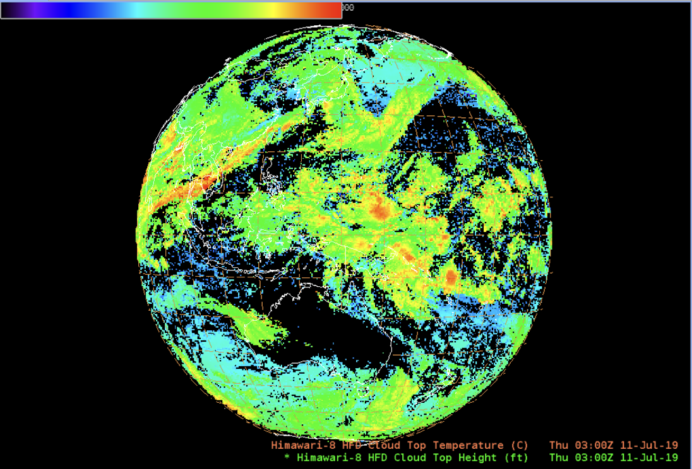
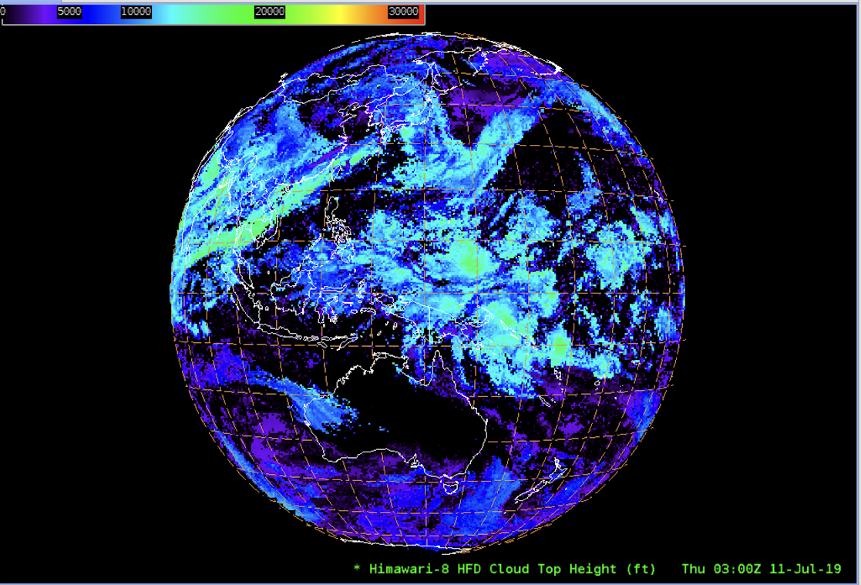
In preparation: Himawari-8 L2 Derived Products
Available now from NESDIS / PDA: Full Disk L2 products
(These are also publicly available via the Amazon cloud: https://noaa-himawari8.s3.amazonaws.com/index.html)
Now adapting data format & content for AWIPS
(Himawari Derived Motion Winds already going to Pacific Region)
AWIPS-ready Himawari L2 Product | Sector | Refresh Rate |  | Latency | Nadir ground resolution
✅ Sea Surface Temperature | Full Disk | 60 min |  | 10 min | 2 km
✅ Rainfall Rate |  | 10 min
⬜ Clear Sky Mask
⬜ Cloud Top Height, Pressure, Temperature
⬜ Cloud Top Phase
✅ Derived Motion Winds |  |  |  | 30 min
When these data products are ready for AWIPS and available from PDA, NCF will disseminate them via LDM to the Alaska and Pacific Regions.
National Centers will access these data directly from PDA.
h/t Derek van Pelt, 2022-03-31

Slide 7
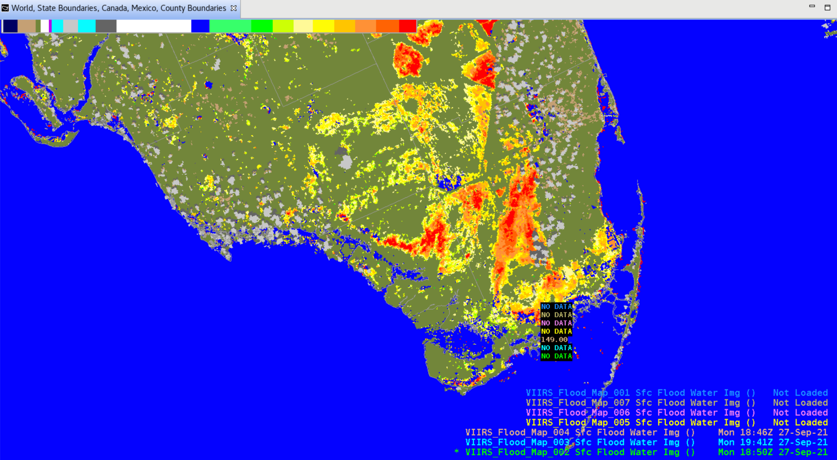
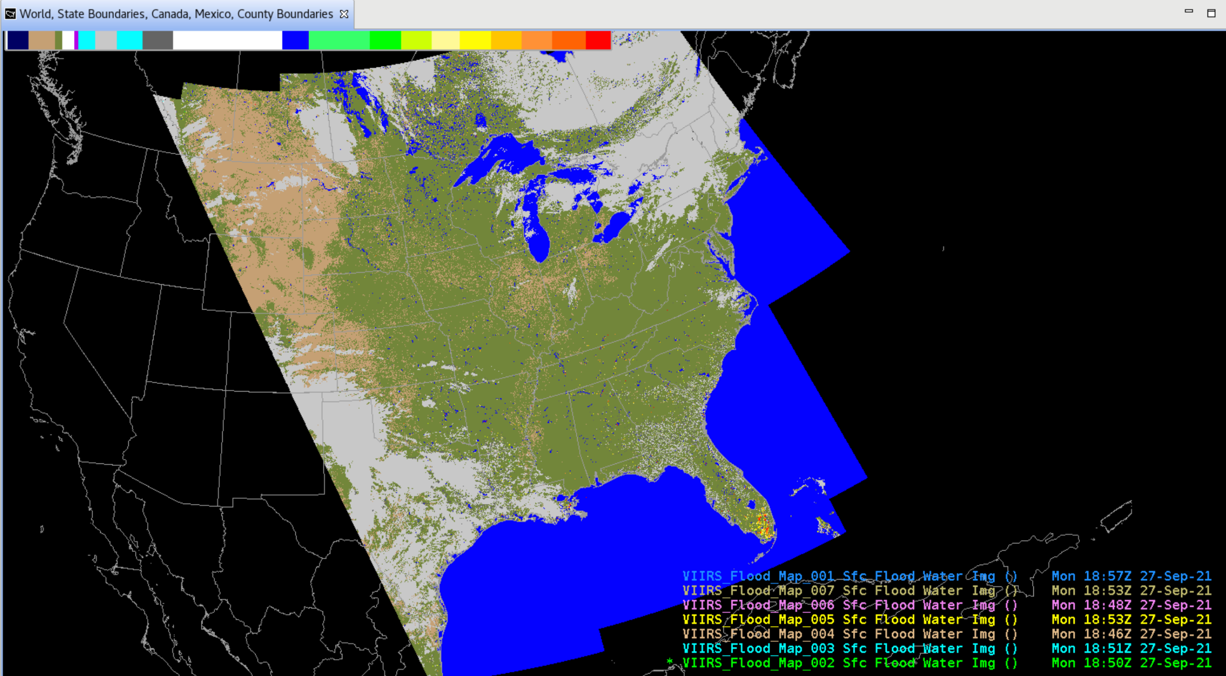
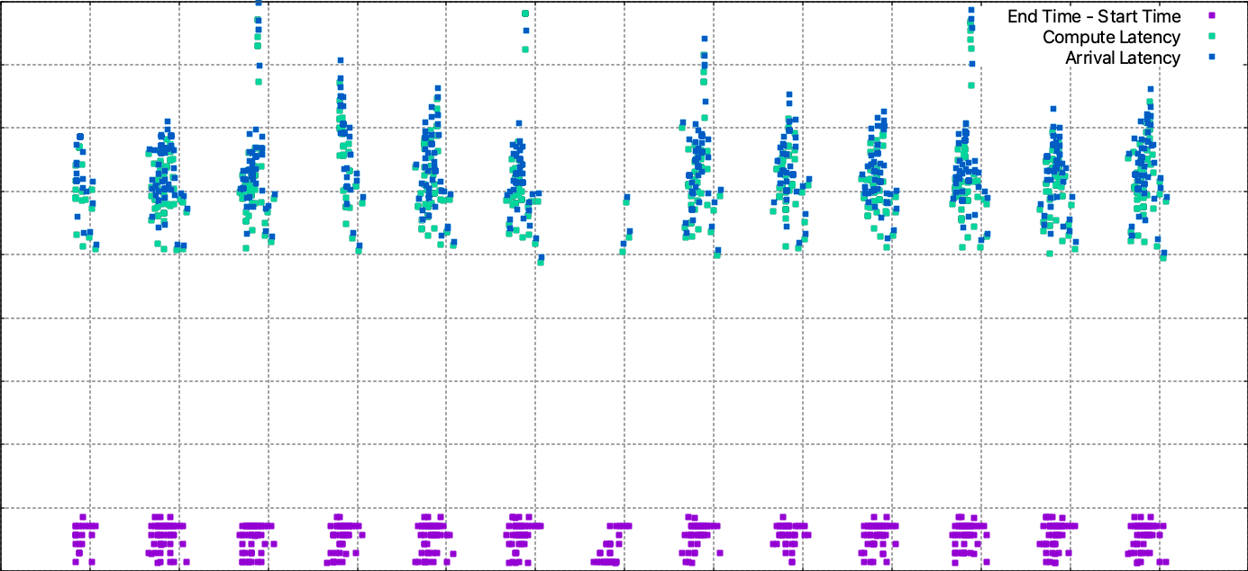
In Preparation: VIIRS Flood Mapping
Now on NDE/PDA I&T
O.R.R. expected this month
Currently evaluating data flow performance
90
80
70
60
50
40
30
20
10
0
h/t Derek van Pelt
Latency (minutes)
Mar. 15 | 16 | 17 | 18 | 19 | 20 | 21 | 22 | 23 | 24 | 25 | 26 | 27 | 28

Slide 8
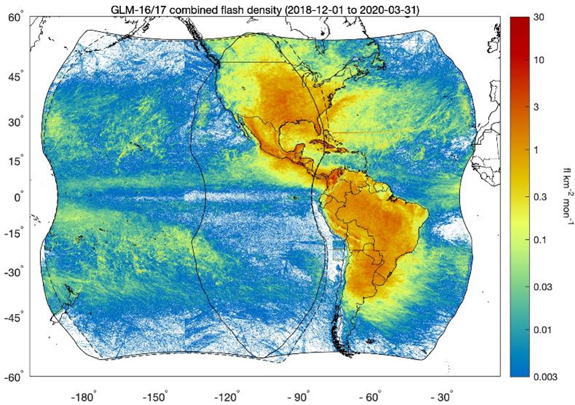
In preparation: Operational GLM Flash Extent Density
Flash Extent Density (FED) “punctured tiles” are currently produced by ISatSS and disseminated via Regional LDM
AWIPS configs are in TOWR-S RPM v20+
AWIPS / SBN activation of operational FED tiles from NESDIS is expected around or after Oct. 2022.
Now preparing for dissemination via SBN:
Assess bandwidth (Mbps) and file cadence
Set file naming conventions, WMO headers
Configure NCF routing
Test
Inform users via Service Change Notice, VLab, etc.
No change since January TOWR-S Update

Slide 9
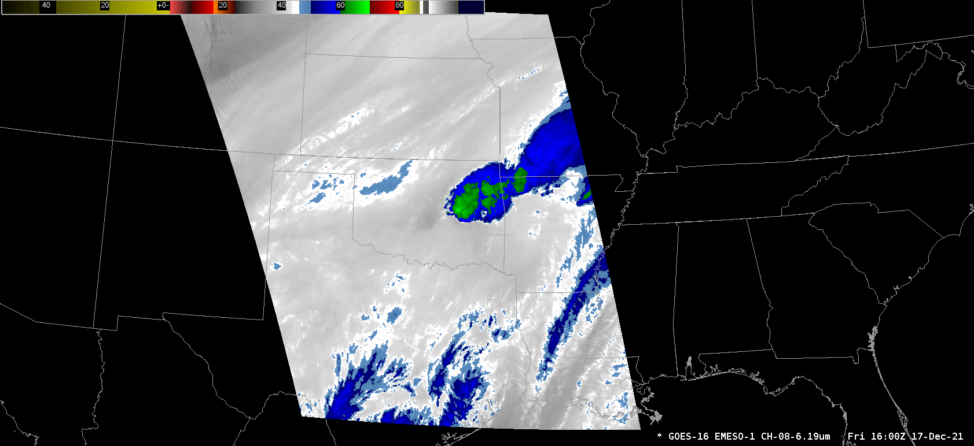
In preparation: GOES-R ABI 2.5-minute CONUS scan schedule
No change since January TOWR-S Update
2-> 4 CONUS sector scans every 10 minutes
20-> 4 Meso sector scans every 10 minutes
1 FD scan every 10 minutes
Mode 6 scan schedule (repeats every 10 minutes)
Example CONUS 2.5 minute scan schedule (repeats every 10 minutes)
AWIPS view of 2.5 minute scan schedule (using Meso sector imagery)

Slide 10
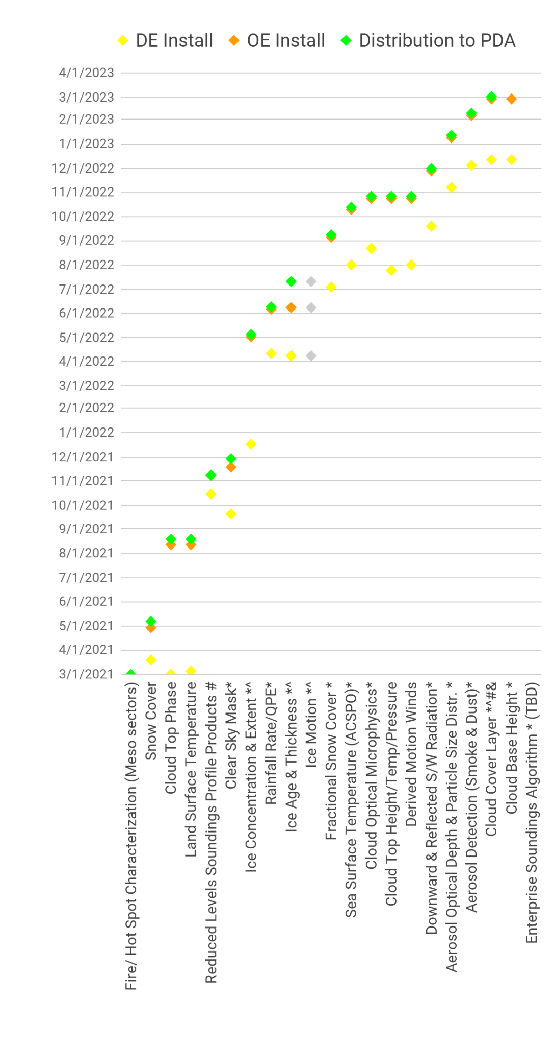
Enterprise GOES-R ABI L2 products
GOES-R Ground System development timeline
Enterprise products apply improved science and consistency with other satellite sensors
April 1, 2022
Several of these products will replace their counterparts on SBN, shortly after they’re distributed to PDA.
Others may reach AWIPS sites via LDM, Cloud, or other mechanisms.
Notes: * Enterprise Algorithm with GOES-17 LHP mitigation ^ NOAT Funded Algorithm # New Product to PDA & Enables Provisional
From GOES-R PRO PASS Dev’t Schedule, 2022-03-31

Slide 11
Satellite Data Product Changes Under Consideration
JPSS Derived Products *
S-NPP, NOAA-20 VIIRS Active Fires^{[1]}, Aerosols, Volcanic Ash^{[2]}
S-NPP, NOAA-20 ATMS MiRS ^{[2]}
GCOM AMSR-2 Ocean Winds & Microwave Brightness ^{[2]}
S-NPP, NOAA-20 VIIRS Imagery (now being produced for all 22 channels) ^{[3]}
[1] AWIPS sites are currently receiving a modified VIIRS Active Fires product via LDM
[2] AWIPS 20.2.3 Baseline provides EDEX ingest support for VIIRS Active Fires, Aerosols, and Volcanic Ash; ATMS MiRS; and GCOM AMSR-2 Ocean Winds & Microwave Brightness
[3] TOWR-S RPM v22 (Feb. 2022) provides [only] EDEX ingest support for all VIIRS Imagery channels
Metop-B,C L2 products *
Metop-B,C ASCAT Ocean Surface Winds: expanded geographic coverage
Synthetic Aperture Radar (SAR) from Sentinel and RadarSat (over coastal regions) *
ISRO OceanSat-3 scatterometer data products
OceanSat-3 to launch in April 2022
MeteoSat 3rd Gen. (MTG) imagery & L2 products *
MTG-I1 to launch in late 2022
Metop 2nd Gen. (Metop-SG) imagery & L2 products *
Metop-SG A1 to launch in 2024
* AWIPS Data Delivery is on hold

Slide 12
Satellite Data Products and AWIPS Data Delivery (DD)
Satellite | Sensor & Product | Dissemination
S-NPP, NOAA-20,-21 | VIIRS SDRs (22 channels: DNB; I1-I5; M01-M16) | EMC via NWave Also DB / LDM from CIs
S-NPP, NOAA-20,-21 | ATMS TDR | EMC via NWave
S-NPP, NOAA-20,-21 | CrIS SDR | EMC via NWave
S-NPP, NOAA-20,-21 | VIIRS Polar Winds | EMC via NWave Also DB / LDM from CIs
S-NPP, NOAA-20,-21 | VIIRS Active Fires | DD
S-NPP, NOAA-20,-21 | VIIRS Ice Concentration & Ice Surface Temp. | DD
S-NPP, NOAA-20,-21 | VIIRS Aerosol: Volcanic Ash Detection & Height | DD
S-NPP, NOAA-20,-21 | VIIRS Aerosol Optical Depth | DD
S-NPP, NOAA-20,-21 | VIIRS Aerosol Detection Product | DD
S-NPP, NOAA-20,-21 | ATMS MiRS 2D parameters | DD (also DB / LDM via CIs)
GCOM-W1 | AMSR-2 Microwave Brightness Temp. | DD
GCOM-W1 | AMSR-2 L2 Ocean | DD
GOES-East,West | ABI L2 products (see list -> ) | DD (now on SBN EXP Channel)
GCOM-W1 | AMSR-2 L2 Precip | Potentially DD
GCOM-W1 | AMSR-2 L2 Snow | Potentially DD
GCOM-W1 | AMSR-2 L2 Sea Ice | Potentially DD
GCOM-W1 | AMSR-2 L2 Soil | Potentially DD
S-NPP, NOAA-20,-21 | VIIRS Flood Mapping | Potentially DD
S-NPP, NOAA-20,-21 | VIIRS Cloud Top (Height, Temperature, Pressure) | Potentially DD
S-NPP, NOAA-20,-21 | VIIRS Cloud Base Height | Potentially DD
S-NPP, NOAA-20,-21 | VIIRS Cloud Mask | Potentially DD
S-NPP, NOAA-20,-21 | VIIRS Cloud Phase | Potentially DD
S-NPP, NOAA-20,-21 | VIIRS Cloud Composition (Daytime) | Potentially DD
S-NPP, NOAA-20,-21 | VIIRS Cloud Composition (Nighttime) | Potentially DD
S-NPP, NOAA-20,-21 | ATMS MiRS 3D parameters (Soundings) | Potentially DD
S-NPP, NOAA-20,-21 | VIIRS Img. EDRs (21 channels: I01-I05; M01-M16) | Potentially DD (S-NPP I1,4,5 for Alaska are on SBN)
S-NPP, NOAA-20,-21 | VIIRS ACSPO Sea Surface Temperature | Potentially DD (also DB / LDM via CIs)
S-NPP, NOAA-20,-21 | VIIRS Ice Age & Thickness | Potentially DD
S-NPP, NOAA-20,-21 | VIIRS Snow Fraction | Potentially DD
S-NPP, NOAA-20,-21 | VIIRS Land Surface Temperature | Potentially DD
S-NPP, NOAA-20,-21 | VIIRS Land Surface Albedo | Potentially DD
Sentinel, RADARSAT | Synthetic Aperture Radar | Potentially DD
Meteosat 3rd Gen (MTG) | Imagery and L2s | Potentially DD
Metop 2nd Gen (MSG) | Imagery and L2s | Potentially DD
Metop-B,C | Imagery, L2 products | Potentially DD
Metop-B,C | ASCAT ocean surface winds | SBN
OceanSat-3 (CY 2023) | Ocean surface winds | SBN likely
(7 different polar satellites) | Polar Blended Total Precipitable Water (TPW) estimates | SBN
(7 different polar satellites) | Polar Blended % Normal TPW | SBN
(7 different polar satellites) | Polar Blended Rain Rate estimates | SBN
S-NPP, NOAA-20,-21 | CrIS-ATMS NUCAPS | SBN
S-NPP, NOAA-20,-21 | VIIRS Img. EDR (Day-Night Band / NCC) | SBN
GOES-East,West | ABI Imagery tiles (FD, CONUS, Meso) (16 channels) | SBN
GOES-East,West | ABI Derived Motion Winds, Fog & Low Stratus (CONUS) | SBN
GOES-East,West | GLM Flash Extent Density (Fall 2022) | SBN
GOES-East | Aerosol Detection | CONUS / Full Disk / Meso
GOES-East | Aerosol Optical Depth | CONUS / Full Disk
GOES-East | Cloud Top Phase | CONUS / Full Disk / Meso
GOES-East | Rain Rate/QPE | Full Disk
GOES-East | Cloud Top Height | CONUS / Full Disk / Meso
GOES-East | Clear Sky Mask | CONUS / Full Disk / Meso
GOES-East | Cloud Top Temperature | Full Disk / Meso
GOES-East | Fire/Hot Spot | CONUS / Full Disk / Meso
GOES-East | Land Surface Temperature | CONUS / Full Disk / Meso
GOES-East | Sea Surface Temperature | Full Disk
GOES-East | Derived Stability Indices | CONUS / Full Disk / Meso
GOES-East | Total Precipitable Water | CONUS / Full Disk / Meso
GOES-East | Legacy Vertical Moisture Profile | CONUS Sector
GOES-East | Legacy Vertical Temperature Profile | CONUS Sector
GOES-East | Cloud Particle Size | CONUS / Full Disk / Meso
GOES-East | Cloud Top Pressure | CONUS / Full Disk
GOES-East | Cloud Optical Depth | CONUS / Full Disk
GOES-West | Aerosol Detection | CONUS / Full Disk / Meso
GOES-West | Aerosol Optical Depth | CONUS / Full Disk
GOES-West | Cloud Top Phase | CONUS / Full Disk / Meso
GOES-West | Rain Rate/QPE | Full Disk
GOES-West | Cloud Top Height | CONUS / Full Disk / Meso
GOES-West | Clear Sky Mask | CONUS / Full Disk / Meso
GOES-West | Cloud Top Temperature | Full Disk / Meso
GOES-West | Fire/Hot Spot | CONUS / Full Disk / Meso
GOES-West | Land Surface Temperature | CONUS / Full Disk / Meso
GOES-West | Sea Surface Temperature | Full Disk
GOES-West | Derived Stability Indices | CONUS / Full Disk / Meso
GOES-West | Total Precipitable Water | CONUS / Full Disk / Meso
GOES-West | Legacy Vertical Moisture Profile | CONUS Sector
GOES-West | Legacy Vertical Temperature Profile | CONUS Sector
GOES-West | Derived Motion Winds | Meso
GOES-West | Cloud Particle Size | CONUS / Full Disk / Meso
GOES-West | Cloud Top Pressure | CONUS / Full Disk
GOES-West | Cloud Optical Depth | CONUS / Full Disk
NOTE: The list of “Potential DD” products is open-ended: AWIPS DD was intended for forecaster access to any satellite products not on SBN.
NOTE: This is not an exhaustive list of satellite data products on SBN. See these tables.

Slide 13
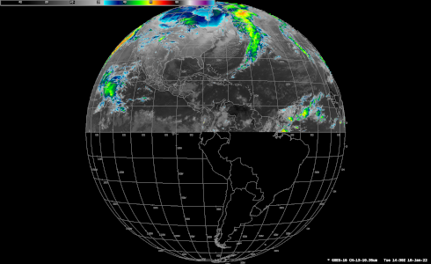
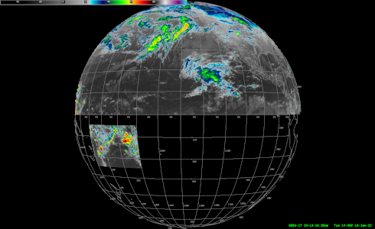
Under Consideration: Changes to the geographic and spectral coverage of GOES-East,West SCMI disseminated over SBN
No change since January TOWR-S Update
(No sooner than FY23 Q1; cf. Public Information Statement PNS21-60)
Phase 1:
Cease creation/transmission of the "Hawaii Regional" SCMI sector, for all bands (1-16)
Increase spatial resolution of Channel 13 (IR Window) to full (2 km) resolution for Northern Hemisphere
Add "American Samoa Regional" sector for Channel 13 (IR Window) at full (2 km) resolution
Phase 2: Cease SBN transmission of all (reduced-resolution, 6 km) Southern Hemisphere imagery from the Full Disk, for all bands
Phase 3: Transition Channel 16 (CO2 Band) from SBN to PDA/Data Delivery (for northern hemisphere), for all sectors (Full Disk, CONUS, Meso)
GOES-East
GOES-West

Slide 14
Preparations for GOES-T> GOES-18
Launched March 1, 2022; reached geostationary orbit on March 14
First GOES-18 MAG, EXIS data reached PDA, SPADES, and other systems on Mar. 23, 30
Accelerated Transition to Operations
Dissemination of Provisionally-mature ABI data products from GOES-18 by Aug. 2022
Operational transition targeted for Jan. 3, 2023
Pre-operational GOES-18 data dissemination:
Interleaved operations (Aug. 1-Sept. 6 and Oct. 15-Nov. 11):
The GOES-17 GRB stream will consist of data from GOES-18 ABI, GOES-17 GLM, and GOES-17 space weather instruments.
The NWS Satellite Broadcast Network (SBN) will send GOES-18 SCMI data and not GOES-17 SCMI data.
=> A short (2-4 hour) test of interleaved operations will take place on June 30.
Outside of those time periods:
GOES-17 will continue to serve as GOES-West; and
GOES-18 data will not be on GRB or SBN.
Dissemination of GOES-18 data via NOAA’s cloud computing platform (GeoCloud) will begin in July.
TOWR-S and OPPSD are coordinating with affected NWS organizations and systems:
 | Weather & Climate Operational Supercomputing System (WCOSS)
AWIPS Network Control Facility (NCF) | GOES Rebroadcast (GRB)
NCEP Central Operations (NCO) | Geostationary Weather Satellite Antenna System (GWSAS)
Integrated Dissemination Program (IDP) | Space Weather Prediction Center (SWPC)

Slide 15
GOES-West Transition Plan for GOES-17→18
April 1, 2022
GOES-18 SPLASH WG
GOES-18 ABI L1b/CMI will reach Provisional Maturity in July, shortly before the GOES-17 warm season / GRB interleave period.

Slide 16
GOES-18 Data Sharing Policy
Policy for sharing images on social media, data files, and publications as it evolves during post-launch phases of satellite testing and data maturity:
 | Images/Social Media | Data Files | Publications
Between Launch and “First Light” Public Release | Not allowed | Not allowed | Allowed; You may include pre-Provisional instrument data/images/plots as long as it will not be published until after Provisional validation is declared for that instrument. Exercise caution in publishing data regarding apparent anomalies or artifacts especially during ongoing instrument and product tests (PLTs and PLPTs).
Between First Public Release and Beta Certification | Allowed; must contain the caveat: “GOES-18 Preliminary, Non-Operational Data” | Not allowed
Between Beta and Provisional | Allowed; must contain the caveat: “GOES-18 Preliminary, Non-Operational Data” | Not allowed
ABI Interleaved Data | Allowed (ABI Only) | Allowed (ABI Only)
Between Provisional (or Interleave Period(s) for ABI) and Operational Declaration | Allowed; must contain the caveat: “GOES-18 Preliminary, Non-Operational Data” | Allowed; must contain the caveat: “GOES-18 Preliminary, Non-Operational Data”
GOES-West Operations onwards | Allowed | Allowed
GOES-18 SPLASH WG

Slide 17
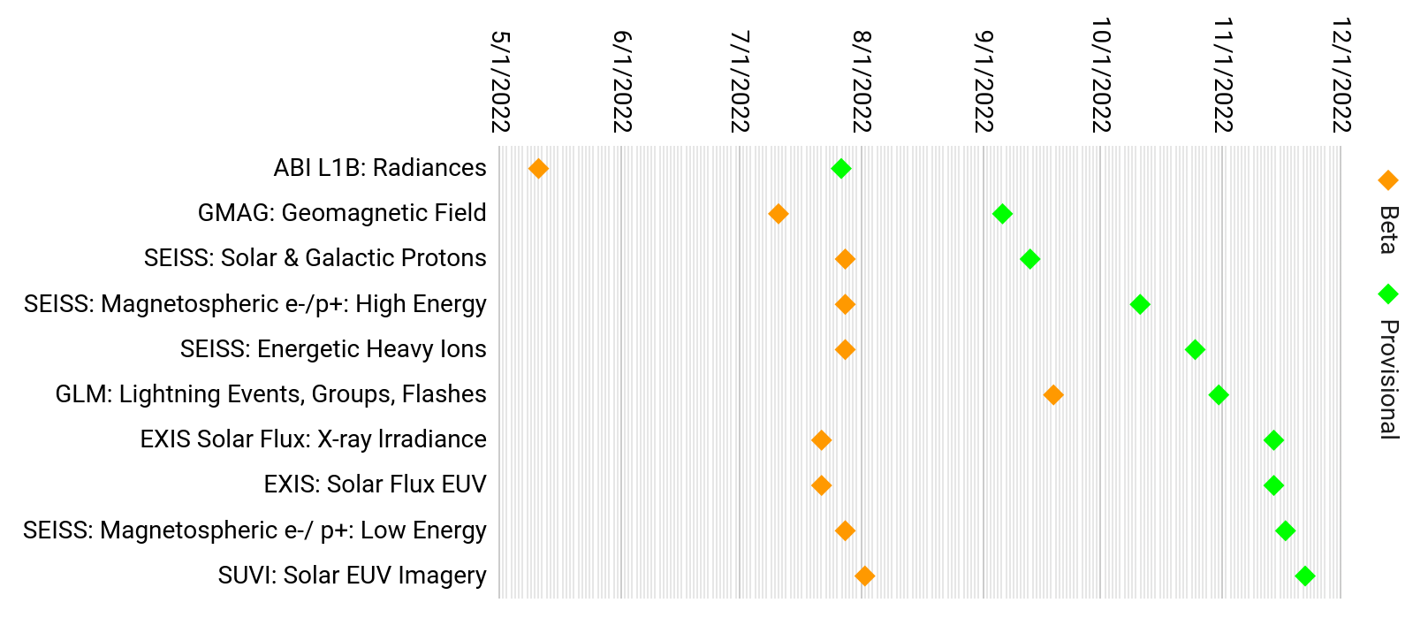
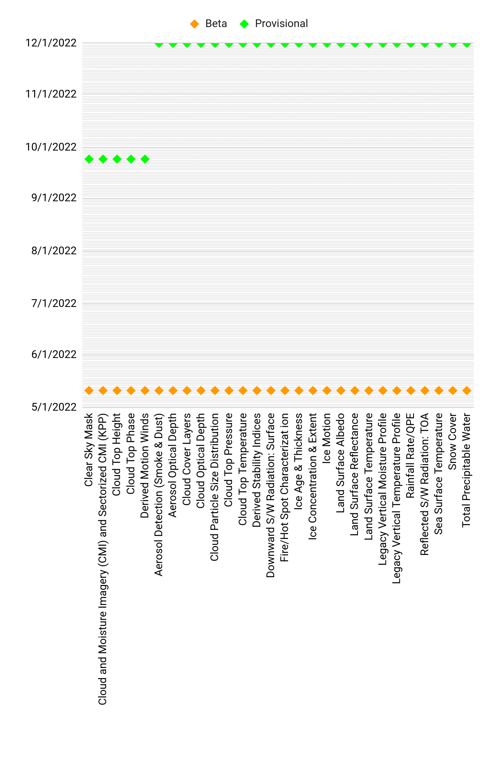
GOES-18 L1B Products
GOES-18 L2+ Products
GOES-18 products: Beta / Provisional Maturity timelines
Based on GOES-18 SPLASH WG

Slide 18
April 1, 2022
 | Mar. 2022 | Apr. 2022 | May 2022 | Jun. 2022 | Jul. 2022 | Aug. 2022 | Sep. 2022 | Oct. 2022 | Nov. 2022 | Dec. 2022 | Jan. 2023 | Feb. 2023 | Mar. 2023
More details on GOES-18 Transition to Operations are available from the GOES-R program
Months are approximate
GOES-18 SPLASH WG

Slide 19
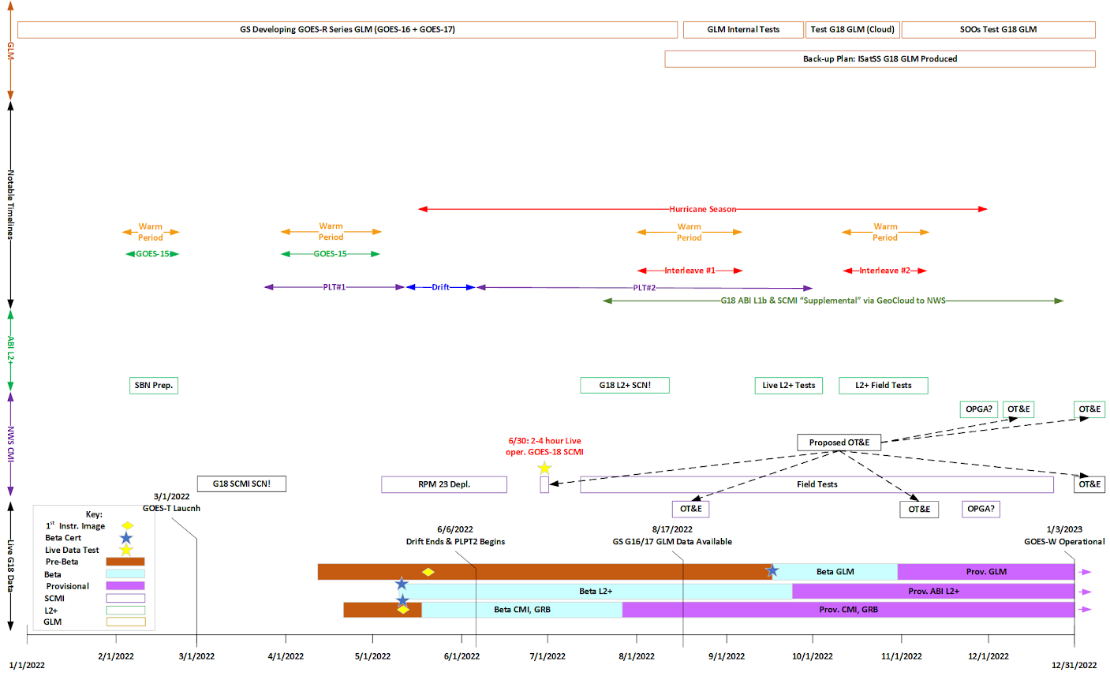
NWS GOES-18 readiness planning
 | Mar. 2022 | Apr. 2022 | May 2022 | Jun. 2022 | Jul. 2022 | Aug. 2022 | Sep. 2022 | Oct. 2022 | Nov. 2022 | Dec. 2022 | Jan. 2023 | Feb. 2023 | Mar. 2023
April 1, 2022
Preliminary / Subject to change
Months are approximate
h/t GOES-R Program

Slide 20
NWS GOES-18 readiness planning: 2022 timeline
Preliminary / Subject to change
April 1, 2022
Dariush Khadjenouri

Slide 21
GOES-17 ABI Cooling Anomaly:
2022 measured and predicted daily peak temperatures of LWIR Focal Plane Module
Next (last!) G-17 Mode 3 cooling timeline: Apr. 8 - May 11
April 1, 2022
GOES-18 SPLASH WG

Slide 22
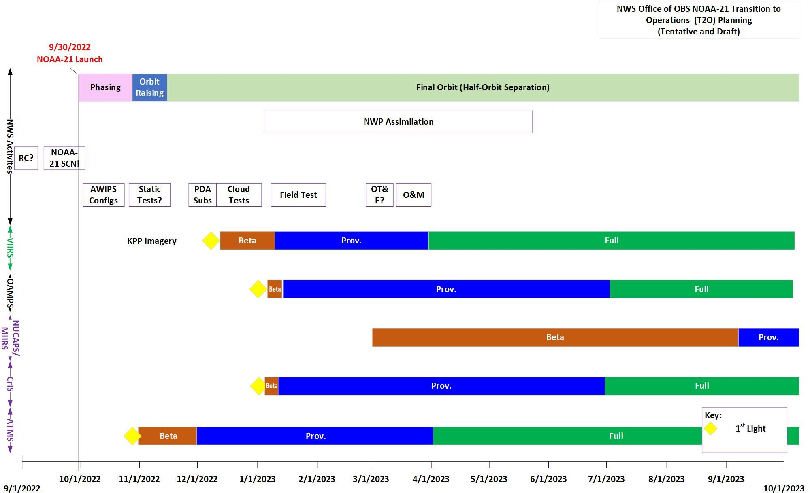
NWS readiness planning for JPSS-2/NOAA-21
Preliminary / Subject to change
JPSS-2 thermal-vacuum (TVAC) test events:
Apr. 9-12 (72 hrs)
Apr. 18-20 (48 hrs)
Apr. 25-26 (24 hrs)
S-NPP data products on SBN will be replaced by NOAA-21 counterparts once operational
Dariush Khadjenouri

Slide 23
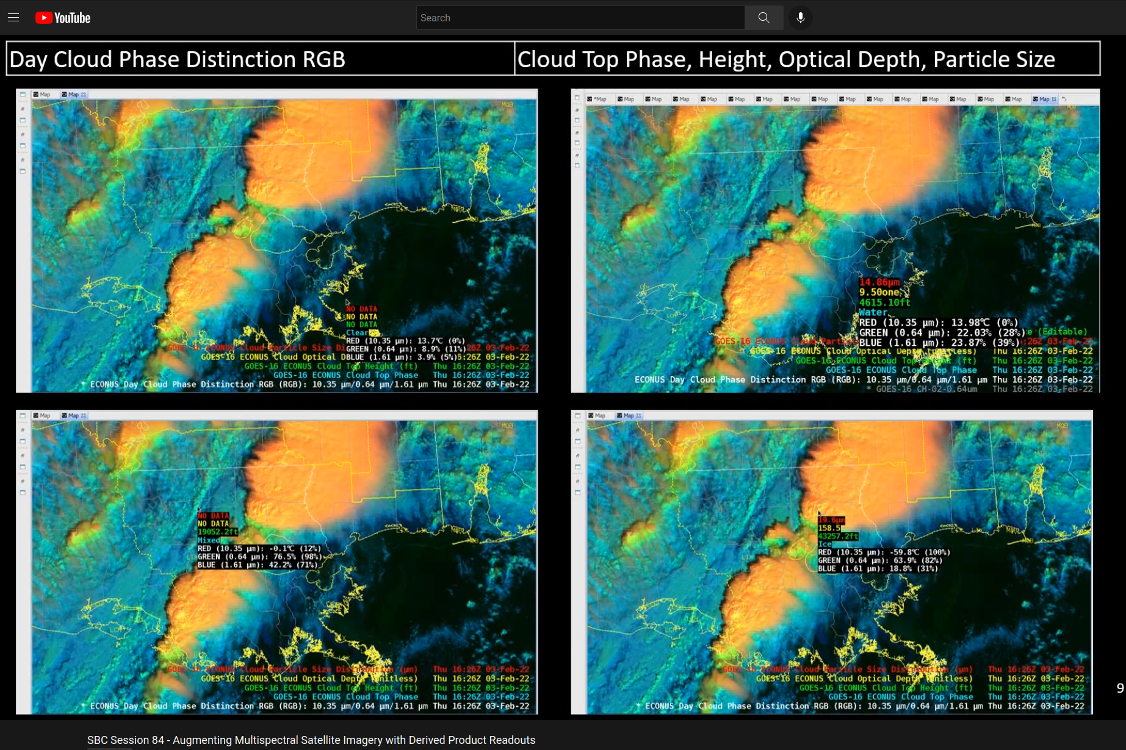
Satellite Book Club (SBC) Seminar Series
Thursdays, usually at Noon ET
Usage examples shed light on user requirements for satellite data products and capabilities
Recordings are on the SBC page in the NOAA VLab and the NWS Commerce Learning Center (CLC) website
Recent Sessions:
Jan. 27: Bob Rabin (NSSL), Nowcasting Storm Intensity from Satellites: Historical perspectives
Feb. 3: Lee Byerle and John Evans (TOWR-S), TOWR-S RPM v22 Spotlight
Feb. 10: Bill Line (CIRA / NESDIS), Augmenting Multispectral Satellite Imagery with Derived Product Readouts
Feb. 17: Javier Villegas-Bravo (OPC), Ocean Prediction Center Probsevere Lightning Cast Testbed
Feb. 24: John Forsythe and Sheldon Kusselson (CIRA and NESDIS), Development and Applications of Multisatellite Water Vapor Products for Forecasters
Mar. 3: Dan Bikos (CIRA), Evolution of Increased Temporal Resolution of GOES Data and its Effects on Select Severe Thunderstorm Applications
Mar. 10: Scott Lindstrom and Chris Gitro (CIMSS), Introduction to CIMSS Weighting Function Web Page
Mar. 17: Tim Garner (NWS Spaceflight Met Group), Satellite Data Usage in Support of Crewed Spaceflight
Mar. 24: Larry Flynn (NESDIS-STAR), Monitoring the Recovery of the Ozone Layer
Mar. 31: Yinghui Liu (CIMSS), Ice detection from Satellites
Bill Line (Feb. 10, 2022)
Notes:
The Satellite Book Club Seminar Series is convened weekly on Thursdays, providing an opportunity for scientists throughout the NOAA satellite domain to share a topic of interest to them with their peers. Topics may include applications of satellite data in the field, new and exciting changes to both polar and geostationary programs, and anything else satellite-related that the field would like to discuss.

Slide 24
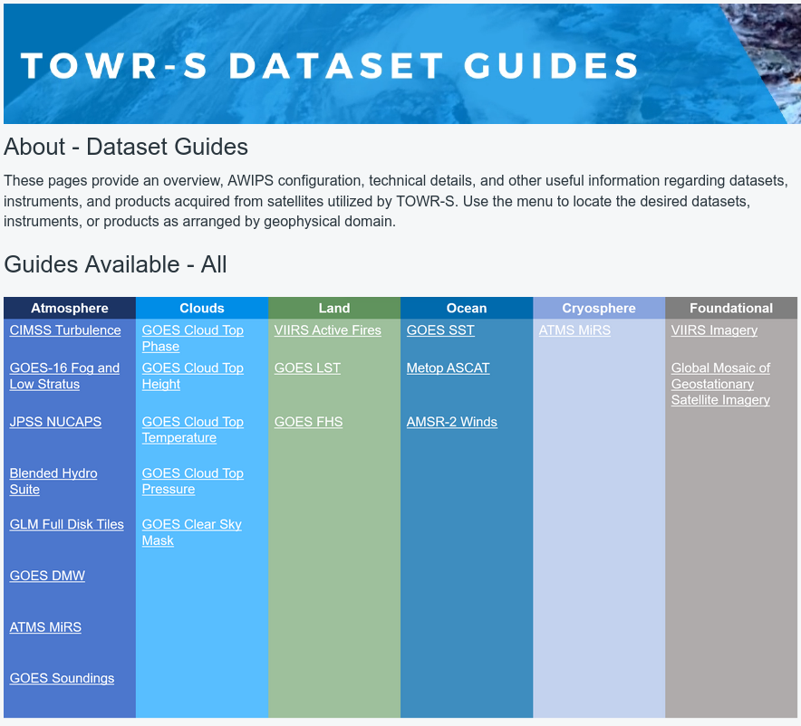
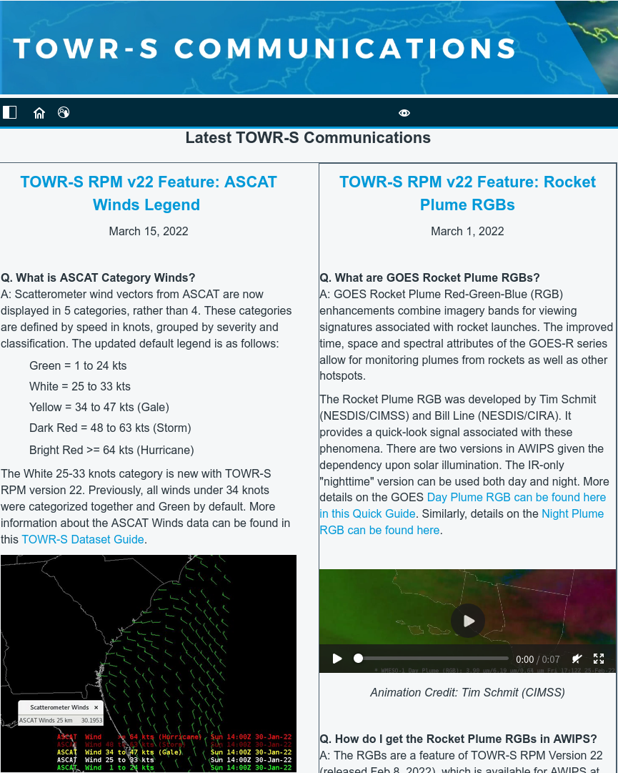
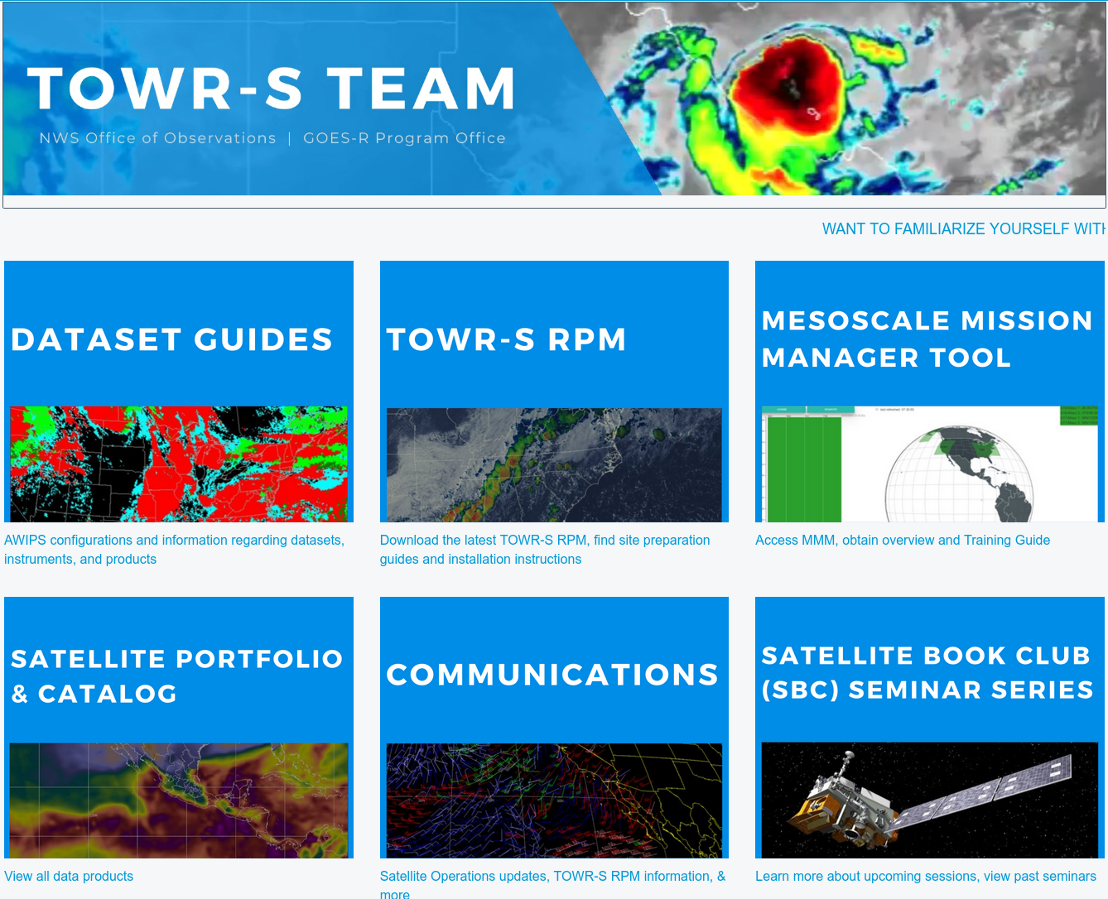
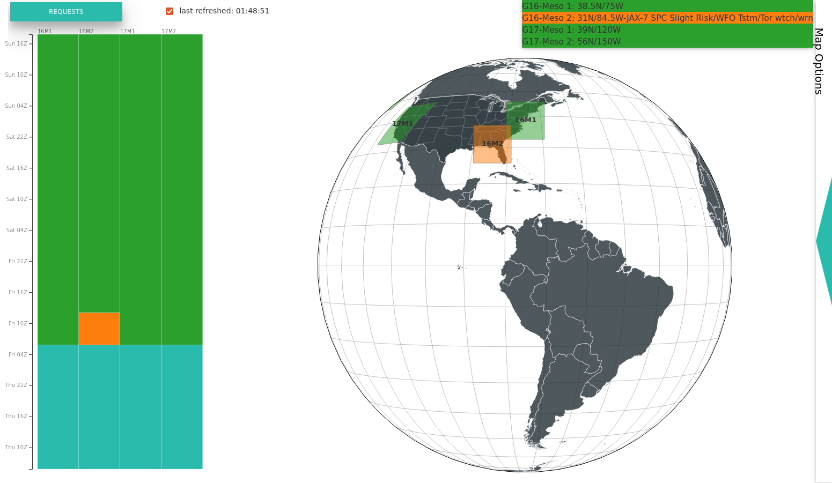
TOWR-S page on VLab: AWIPS Dataset Guides and more
https://vlab.noaa.gov/web/towr-s
Meso Mission Manager

Slide 25
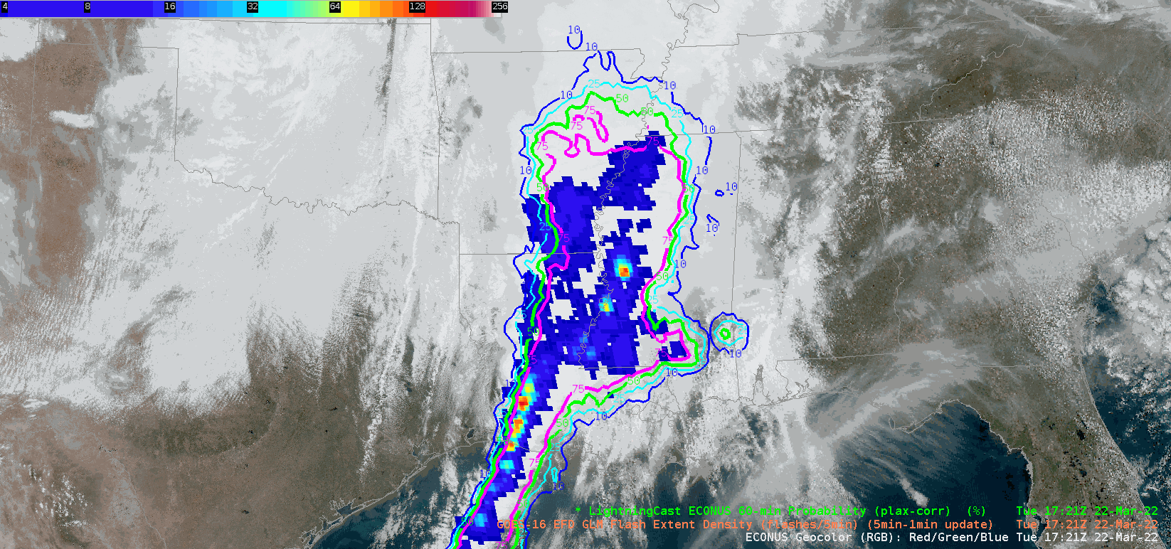
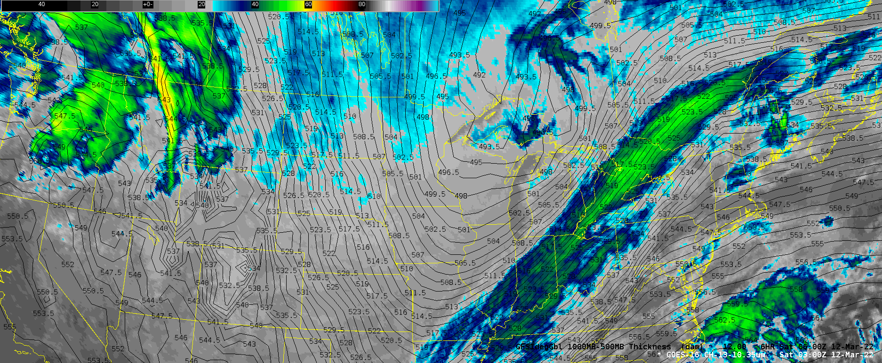
geoCloud AWIPS for Collaboration
TOWR-S team has an initiative to bring people together in the AWIPS environment to foster collaboration on ways satellite data can enhance the NWS mission
TOWR-S facilitates small groups of forecasters, technique development meteorologists, and algorithm developers from across the NWS and NESDIS
More details are in Satellite Book Club Session 38
Please contact Lee Byerle to schedule a session with your office

Slide 26
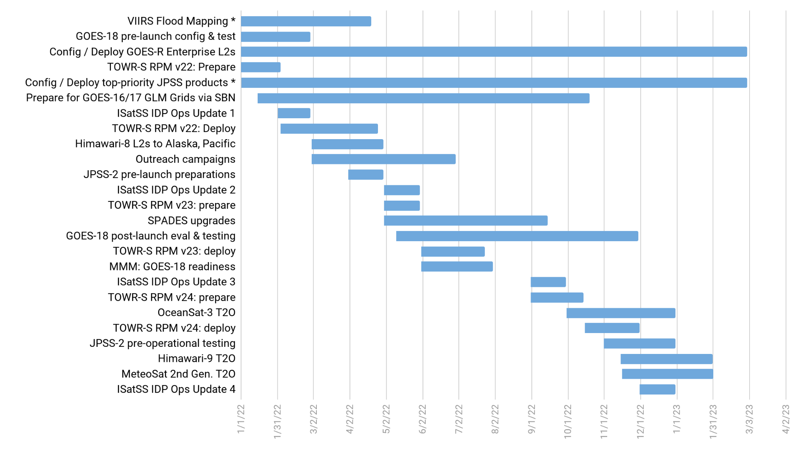
TOWR-S Activity Plan
CY2022 |  |  |  |  |  |  |  |  |  |  |  | CY2023
J | F | M | A | M | J | J | A | S | O | N | D | J | F | M
April 1, 2022

Slide 27
Contact Information
Office of Observations
Brian Gockel – brian.gockel@noaa.gov
Jordan Gerth – jordan.gerth@noaa.gov
Total Operational Weather Readiness – Satellites (TOWR-S) Team
John Evans – john.d.evans@noaa.gov
Lee Byerle – lee.byerle@noaa.gov
Links
NWSChat (“towr-s” chatroom)
TOWR-S in the NOAA VLab

Slide 28
Next TOWR-S Updates
(tentative)
June 24, 2022
Sept. 30, 2022

Slide 29
(1) Current Product Posture
Product | Delivery Mechanism (Activation) | Product Maturity | AWIPS Treatment (enhancement tables, ranges, units, rules…) | AWIPS Status (TOWR RPM date) | Target AWIPS Release (Blue = submitted)
ABI SCMI | G16 Mar ’17 SBN E | G16 Full |  | GOES-16/17 menus appear by default under Sat in v18.2.1
 | G17 Aug ‘18 SBN W | G17 Provisional: 11/28/18 G17 Full: 02/19/20
Bands 1-6 | “ | “ | Default General viewing VIS | Feb ‘17, Mature | 18.2.1
Band 7 | “ | “ | Default General viewing SWIR | Mar ‘17, Mature | 18.2.1
Band 7, 13-14 | “ | “ | Ocean/Land in winter IR | Mar ’17, Mature | 18.2.1
Bands 8-10 | “ | “ | Default General viewing WV | Mar ‘17, Mature | 18.2.1
Bands 8-10 | “ | “ | Low-level WV | Jun ‘17, Mature | 18.2.1
Bands 8-16 | “ | “ | Rainbow colors for dual IR, WV | Mar ‘17, Mature | 18.2.1
Bands 11-16 | “ | “ | Default General viewing IR | Mar ‘17, Mature | 18.2.1
Bands 11-16 | “ | “ | Summer, warm land areas | Mar ‘17, Mature | 18.2.1
Split Window Ch Diff |  |  | Blowing dust, volcanic ash, low-level water vapor (10.3-12.3um) | Jun ‘17, Mature | 18.2.1
Split Water Vapor Ch Diff |  |  | Gradients in UL WV (6.2-7.3um) | Jan ‘18, Mature | 18.2.1
Two Night Fog Ch Diffs |  |  | Gray/blue (2 menu buttons 10.3-3.9um, and 11.2-3.9um) | Jan ‘18, Mature, Aug ‘19 | 18.2.1 / 20.2.1

Slide 30
(2) Current Product Posture
Product | Delivery Mechanism (Activation) | Product Maturity | AWIPS Treatment (enhancement tables, ranges, units, rules…) | AWIPS Status (TOWR RPM date) | Target AWIPS Release (Blue = submitted)
Day Fog Ch Diff |  |  | Highlights fog over warmer surfaces, Opposite of Night fog CH diff (3.9-10.3um) | Jan ‘18, Mature | 18.2.1
Split Snow Ch Diff |  |  | Highlights snow cover over land (1.6-0.64um) | Jan ‘18, Mature (Avail all sectors-FG) | 18.2.1
Split Fire Ch Diff |  |  | Fire hot spot detection (2.2-1.6um) | Jan ‘18, Mature (Avail all sectors-FG) | 18.2.1
Split Ozone Ch Diff |  |  | Ozone detection (9.6-10.3um) | Jan ‘18, Mature | 18.2.1
Split Cloud Top Phase Ch Diff |  |  | Highlights ice clouds, phase variation (11.2-8.4um) | Jan ‘18, Mature | 18.2.1
Vegetation Ch Diff |  |  | Highlights Vegetation, land sfc variation (0.64-0.87um) | Mar ‘17, Mature (Avail all sectors-FG) | 18.2.1
GOES-16/GOES-15 Supernational “CONUS with Legacy” | (Menu to only show G-16 as of March 2, 2020) |  | ABI CHs 2,7,8,11,16 w/corresponding G-15 CHs | Feb ‘18, Eval | N/A
Day Cloud Phase Distinction RGB |  |  | Daytime cloud phase variation (10.35,0.64,1.61um) | Aug ‘17, Mature | 19.2.1
Fire Temperature RGB |  |  | Fire hot spot detection (3.90,2.25,1.61um) | Jun ‘17, Mature | 19.2.1
Day Land Cloud RGB |  |  | Day land cloud (1.61,0.87,0.64um) | Jun ‘17, Mature | 19.2.1
Day Cloud Convection RGB |  |  | Day convection as warm colors (0.64,0.64,10.35um) | Aug ‘17, Mature | 19.2.1

Slide 31
(3) Current Product Posture
Product | Delivery Mechanism (Activation) | Product Maturity | AWIPS Treatment (enhancement tables, ranges, units, rules…) | AWIPS Status (TOWR RPM date) | Target AWIPS Release (Blue = submitted)
Day Land Cloud Fire RGB |  |  | Day land clouds, fire (2.25,0.87,0.64um) | Jun ‘17, Mature | 19.2.1
Simple Water Vapor RGB |  |  | WV, Upper level circulation (10.35,6.19,7.34um) | Mar ‘17, Mature | 19.2.1
Air Mass RGB |  |  | Delineate air masses (6.19-7.34,9.61-10.35,6.19um) | Mar ‘17, Mature | 19.2.1
Ash RGB |  |  | Ash detection (12.3-10.35,11.2-8.5,10.35um) | Mar ‘17, Mature | 19.2.1
Day Convection RGB |  |  | Day convection (6.19-7.34,3.9-10.35,1.61-0.64um) | Aug ‘17, Mature (Avail all sectors-FG) | 19.2.1
Differential Water Vapor RGB |  |  | Water vapor contrast (7.34- 6.19,7.34,6.19) | Mar ‘17, Mature | 19.2.1
Day Snow Fog RGB |  |  | Day snow, fog (0.87,1.61,3.9-10.35um) | Jun ‘17, Mature | 19.2.1
Dust RGB |  |  | Dust (12.3-10.35,11.2-8.5,10.35um) | Mar ‘17, Mature | 19.2.1
Nighttime Microphysics RGB |  |  | Delineate night cloud phase (12.3-10.35,10.35-3.9,10.35um) | Mar ‘17, Mature | 19.2.1
SO2 RGB |  |  | Ash, S02 detection (6.95-7.34,10.35-8.5,10.35um) | Jun ‘17, Mature | 19.2.1

Slide 32
(4) Current Product Posture
Product | Delivery Mechanism (Activation) | Product Maturity | AWIPS Treatment (enhancement tables, ranges, units, rules…) | AWIPS Status (TOWR RPM date) | Target AWIPS Release (Blue = submitted)
Daytime Composite #1 RGB |  |  | Highlight cold surfaces, cirrus (0.64,1.61,11.2um) | Baselined 16.1.x
Daytime Composite #5 RGB |  |  | Grayscale, Cirrus (0.64,0.87,0.64um) | Baselined 16.1.x
Day Ocean Cloud Convection |  |  | Daytime Ocean Convection (0.87,0.87, 10.35um) | June ’17, Mature | 19.2.1
CIMSS Natural Color RGB |  |  | Natural color, computes Green | Jan. ‘18, Mature (Avail all sectors-FG) | 19.2.1
GOES-East,West Clear Sky Mask | SBN Exp (G-16: May 2017; G-17: Sep. 2021) F,C,M | G16: Provisional | Display as binary mask | Baselined 16.1.x
 |  | *G17: Provisional (May 6, ’19)
GOES-East,West Cloud Top Height, Temperature, Pressure | SBN Exp (G-16: 31 May 2017; G-17: Sep. 2021) Height: F,C,M / Temp: F,M / Pressure: F,C | G16: Provisional | Cloud Top Height in Ft, Temp in degC | June ‘17, Mature | 18.2.1
 |  | *G17: Provisional (May 6, ’19)
GOES-East,West Cloud Top Phase | SBN Exp (G-16: May 2017; G-17: Sep. 2021) F,C,M | G16: Provisional | Clear, Water, Supercooled, Mixed, Ice, Uncertain | Baselined 16.1.x
 |  | *G17: Provisional (May 6, ’19)
GOES-East,West Derived Stability Indices (CAPE,LI, KI, SI, TT) | SBN Exp (G-16: May 2017; G-17: Sep. 2021) F,C,M | G16: Provisional *G17: Provisional (May 16, ’19) | 10-bit colormap. Syncs to legacy GOES Sounder ranges | Aug. ‘17, Mature | 18.2.1
GOES-East,West Aerosol Detection (ADP) | SBN Exp (G-16: May 2017; G-17: Sep. 2021) F,C,M | G16: Provisional (Dec. 6, ‘18) | Separate Dust, Smoke. Hi/Lo/Med confidence | Feb. ‘18 RPM, Eval | 20.2.1
 |  | *G17: Provisional (June 27, ‘19)
*G-17 PS-PVRs are based upon cool season evaluations
F = Full Disk, C= CONUS, M= Mesoscale

Slide 33
(5) Current Product Posture
Product | Delivery Mechanism (Activation) | Product Maturity | AWIPS Treatment (enhancement tables, ranges, units, rules…) | AWIPS Status (RPM date) | Target AWIPS Release (Blue = submitted)
GOES-East,West Aerosol Optical Depth | SBN Exp (G-16: May 2017; G-17: Sep. 2021) F,C | G16: Provisional (Sept. 14, ’18) | Display as binary mask. Fixed display range (0-1) | June ‘17, Mature | 18.2.1
 |  | *G17: Provisional (June 27, ’19)
GOES-East,West Land Surface Temperature | SBN Exp (G-16: May 2017; G-17: Sep. 2021) F,C,M | G16: Provisional | LST in degF | June ‘17, Eval | 19.2.1
 |  | *G17 Provisional (June 13, ’19)
GOES-East,West Fire/Hot Spot | SBN Exp (G-16: May 2017; G-17: Sep. 2021) F,C + New Meso Sep. ‘21 | G16 Provisional (Apr 24, ‘18) | Fire Temp, Power, Area | Aug. ‘17, Eval | 19.2.1
 |  | *G17: Provisional (July 25, ’19)
GOES-East,West TPW | SBN Exp (G-16: May 2017; G-17: Sep. 2021) F,C,M | G16: Provisional *G17: Provisional (May 16, ‘19) | TPW in Inches. 10-bit colormap based legacy GOES Sounder | Aug. ‘17, Mature | 18.2.1
GOES-East,West Cloud Optical Depth | SBN Exp (G-16: May 2017; G-17: Sep. 2021) F,C | G16: Provisional *G17: Provisional Day: 6/13/19 Night: 9/24/19 | Fixed max display range to 100% | Aug. ‘17, Mature | 18.2.1
GOES-East,West Cloud Particle Size Distribution | SBN Exp (G-16: June 2017; G-17: Sep. 2021) F,C,M | G16: Provisional (Dec. 14, ’18) *G17: Provisional Day: 6/13/19 Night: 9/24/19 | Range 0-100um | Baselined
GOES-East,West Derived Motion Winds | SBN GRE/GRW (G-16: June 2017; G-17: Mar. 2020) C (15min), M (5min) | G16: Provisional | By-Pressure displays as single color like legacy. Meso 1,2 now separate displays/database entries | Feb. ‘18, Mature | 19.2.1
 |  | *G17: Provisional (May 16, ’19)
GOES-East,West Sea Surface Temperature | SBN Exp (G-16: Jan 2018; G-17: Sep. 2021) F (hourly) | G16: Provisional | Colormap highlights TC threshold, Default display as DegF and DegC | March ‘18, Mature | 19.2.1
 |  | *G17: Provisional (July 25, ’19)
*G-17 PS-PVRs are based upon cool season evaluations
F = Full Disk, C= CONUS, M= Mesoscale

Slide 34
(6) Current Product Posture
AWIPS Release Dates:
20.2.1,2,3 – June 2021
20.3.1,2 – Jan. 2022
Product | Delivery Mechanism (Activation) | Product Maturity | AWIPS Treatment (enhancement tables, ranges, units, rules…) | AWIPS Status (TOWR RPM date) | Target AWIPS Release (Blue = submitted)
GOES-East,West Rainfall Rate, Quantitative Precipitation Est | SBN Exp (G-16: Jan. 2018; G-17: Sep. 2021) F | G16: Provisional (March 31, ‘18) | Display in inches. Colormap syncs w/typical radar colors | March ‘18 | 18.2.1
 |  | *G17: Provisional May 16, ‘19
GOES-East,West Legacy Vertical Temperature/Moisture Profiles | G16: SBN Exp (G-16: Feb 2018; G-17: Sep. 2021) C (30min) | G16: Provisional | NSHARP profiles. Move menu under Derived products section | Baselined (16.1.x), Eval, profile cadence | 19.2.1
 |  | *G17: Provisional (May 16, ‘19)
NOAA-20 VIIRS Imagery (KPP to AK via terrestrial Networks) | ~Feb. ‘18 | Validated | I, M-bands, NCC | Feb. ‘18, Eval | 19.2.1
Snow Cover | TBD | G16/G17 Provisional 8/13/20
JASON 3 Wave Altimetry | SBN NMC3 (July 17, ‘18) | Operational, TT 194990 for slow load times, under investigation |  | Feb. ’18, dbgeo plugin | 19.2.1
GOES-East,West GLM Full Disk Punctured Tiles | LDM migration | G16/17 Full | 1- & 5-minute Flash Extent Density (FED), Total Optical Energy, Min. Flash Area | Nov. ‘20
GOES-East,West Ice Products: Ice Concentration, Ice Age / Thickness, Ice Motion | LDM migration | Ice Concentration, Ice Age & Thickness: Provisional |  | Nov. ‘20
CIMSS Turbulence Probability (CONUS) | LDM migration |  |  | Nov. ‘20
*G-17 PS-PVRs are based upon cool season evaluations

Slide 35
(7) Current Product Posture
AWIPS Release Dates:
20.2.1,2,3 – June 2021
20.3.1,2 – Jan. 2022
Product | Delivery Mechanism (Activation) | Product Maturity | AWIPS Treatment (enhancement tables, ranges, units, rules…) | AWIPS Status (TOWR RPM date) | Target AWIPS Release (Blue = submitted)
Full Disk Geostationary Lightning Mapper (GLM) | LDM Migration Ops / Local Generation | G16: Full G17 Full: 11/21/19 | Flash Extent Density (FED) Grid, Average Flash Area, and Total Optical Energy | NHCN/NTBN/OPCN/ AWCN | TBD
GOES VIS/IR Sandwich RGB | N/A | N/A | CH 02, CH 13 Combo | March ’19 RPM | 20.2.1
GOES NDVI Vegetation Channel Difference | N/A | N/A | CH02, CH03 Combo | March ‘19 RPM Next RPM to include CSM | 20.2.1
ASCAT A, B, C Wind Speed / Direction and Ambiguities | N/A | N/A | DMW plugin | NHCN/NTBN/OPCN | Eval
SSMI F-15 85 GHz H,V and 36.5GHz H,V Microwave Imagery | ISatSS | N/A | GOES-R plugin, PCT RGBs | NHCN/NTBN | Eval
AMSR2 89.5 GHz AH, AV and 36.5 GHz AH, AV Microwave Imagery | ISatSS | N/A | GOES-R plugin, PCT RGBs | NHCN/NTBN/OPCN | Eval
GPM GMI 89.5 GHz H,V and 37 GHz H,V Microwave Imagery | ISatSS | N/A | GOES-R plugin, PCT RGBs | NHCN/NTBN | Eval
S-NPP ATMS QV 88 GHz Microwave Imagery | ISatSS | N/A | GOES-R plugin | NHCN/NTBN | Eval
AMSR2 Ocean products: Rain Rate, SST, TPW, Cloud Liquid Water, Wind Speed | ISatSS | N/A | GOES-R plugin | NHCN/NTBN/OPCN | Eval
JASON-3 Wave Heights and Wind Speeds | ISatSS | N/A | DMW plugin for numeric read-outs | NHCN/NTBN/OPCN | Eval
Cryosat-2 Wave Heights and Wind Speeds | ISatSS | N/A | DMW plugin for numeric read-outs | NHCN/NTBN/OPCN | Eval
Altika Wave Heights and Wind Speed | ISatSS | N/A | DMW plugin for numeric read-outs | NHCN/NTBN/OPCN | Eval
Sentinel-3A/3B Wave Heights and Wind Speeds | ISatSS | N/A | DMW plugin for numeric read-outs | NHCN/NTBN/OPCN | Eval
S-NPP & NOAA-20 VIIRS Active Fires | ISatSS | Validated | DMW plugin | All | TBD

Slide 36
(8) Current Product Posture
AWIPS Release Dates:
20.2.1,2,3 – June 2021
20.3.1,2 – Jan. 2022
Product | Delivery Mechanism (Activation) | Product Maturity | AWIPS Treatment (enhancement tables, ranges, units, rules…) | AWIPS Status (TOWR RPM date) | Target AWIPS Release (Blue = submitted)
NOAA-20 NUCAPS | SBN Jul 2, ‘19 |  | VIIRS NUCAPS plugin | Feb. ‘18 RPM | 19.2.1
NOAA-20 NCC/Day Night Band | SBN Jul 24/25, ’19 |  | VIIRS plugin | Feb. ‘18 RPM | 19.2.1 (DR 20707, 20708 fix “S-NPP” legend)
SSMIS F-16 91 GHz H,V and 37GHz H,V Microwave Imagery | ISatSS | N/A | GOES-R plugin, PCT RGBs derived param | NHC | Eval
SSMIS F-17 91 GHz H,V and 37GHz H,V Microwave Imagery | ISatSS | N/A | GOES-R plugin, PCT RGBs derived param | NHC | Eval
SSMIS F-18 91 GHz H,V and 37GHz H,V Microwave Imagery | ISatSS | N/A | GOES-R plugin, PCT RGBs derived param | NHC | Eval
National Center G-16 Full Disk GLM Grids | ISatSS | Full Nov ‘18 | GOES-R plugin | AWC, NHC, OPC, WPC | Eval
Himawari DMWs for Pacific Region | ISatSS | N/A | DMW plugin | N/A | Eval
GOES-16 Fog and Low Stratus (FLS) (STAR product) for OPC and NHC | ISatSS | Eval | GOES-R plugin | NHC, OPC | 21.3.1
GOES-East,West Fog and Low Stratus (FLS) | SBN GOES-East: Sep. ‘20 GOES-West: Sep. ‘21 |  | GOES-R plugin | TOWR-S RPM v19 (Aug. 2020)

Slide 37
(9) Current Product Posture
AWIPS Release Dates:
20.2.1,2,3 – June 2021
20.3.1,2 – Jan. 2022
Product | Delivery Mechanism (Activation) | Product Maturity | AWIPS Treatment (enhancement tables, ranges, units, rules…) | AWIPS Status (TOWR RPM date) | Target AWIPS Release (Blue = submitted)
NESDIS multi-sat Imagery Composite (VIS/IR/LWIR/SWIR) | ISatSS SBN | N/A | NetcdfGrid plugin | NHC | 21.3.1
G-17 PACUS & Meso Sector DMWs | SBN Mar 2020 (PACUS) / Sep. 2021 (Meso) | Provisional May 16, ’19 | GOES-R plugin | Mar ‘20 | 20.2.1 (LDM, edex cfg)
NESDIS Global Blended (polar) TPW, % Normal TPW | SBN Mar 12, ‘20 | N/A | NetcdfGrid plugin | Mar ‘20 | 20.2.1
NESDIS Global Blended (polar) Rain Rate | SBN Mar 12, ‘20 | N/A | NetcdfGrid plugin | Mar ‘20 | 20.2.1
Meteosat Imagery for Ctrs (VIS/IR/SWIR/WV) | Oct ‘19 AWC, Feb ‘20 NHC | N/A | GOES-R plugin | N/A | TBD
G-16 ASOS Satellite Cloud Products (SCP) | SBN (May 27, 2020) | N/A | Text Db | N/A | N/A
G-17 ASOS Satellite Cloud Products (SCP) | SBN (Sept. 30, 2020) | N/A | Text Db | N/A | N/A

Slide 38
(1) Current Non-Product RPM Features
AWIPS Release Dates:
20.2.1,2,3 – June 2021
20.3.1,2 – Jan. 2022
Feature | Function/Description | AWIPS Status (TOWR RPM date) | Target AWIPS Release (Blue = submitted)
Legacy bundle for GOES-15 | Enables legacy display of G-15 | Jan ’18, Eval | Eval
Geostationary Map Scales | West, Center, East geostationary scales | Jan ‘18, Eval | 21.3.1
Frame controls from 64 to 300 | Ability to loop 300 frames | Eval | 21.3.1
CSPP/CIMSS Polar data description | Handles description of VIIRS/CIMSS prods (e.g. CSPP in goes-r plugin) | Feb ‘18 | Eval
LDM (pqact) Updates | LDM configuration for GOES-17 PACUS DMWs, and Blended Hydro (TPW, Rain Rate, PCT Normal TPW) | Updates steps are in RPM install instructions, but not in RPM | 18.2.1 / 20.2.1
GOES-East, GOES-West menu | Update from “GOES-17” to “GOES-West” | May/Jun ‘18 | 20.2.1
Add Sector, Satellite to CAVE Legend for G-16/G-17 RGBs, Derived Products, respectively | Improves Legend to delineate between loaded Sectors/Satellites | May/Jun ‘18 Eval | 20.2.1
Link to pqact setting examples for tailored sectors is here.

Slide 39
(2) Current Non-Product RPM Features
AWIPS Release Dates:
20.2.1,2,3 – June 2021
20.3.1,2 – Jan. 2022
Feature | Function/Description | AWIPS Status (TOWR RPM date) | Target AWIPS Release (Blue = submitted)
Color By Pressure for GOES wind vectors | Bundle/Menu to color by p-level or range (SET/WFO PUB contribution) | Feb ‘18 Eval | 20.2.1
Legend update to GOES wind vectors | Adds satellite (e.g. GOES-17/GOES-16) to display legend | Mar ’20 | 20.2.1
A2 Edex Ingest | Ingest patterns for GOES-17 DMWs/ Blended Hydro | Mar ’20 | 20.2.1
A2 Edex Plugin Descriptions | GLM AFA, TOE. Aerosol Detection (ADP) Hi/Med/Low confidence specification | Jun ‘18/ Feb ’18 | Eval (GLM) / 20.2.1 (ADP)
A2 Edex Purge Rules | Edex purging of processed Blended Hydro products | Mar ’20 | 20.2.1
GOES 10.35um (CH 13) DegF display cfg | Menu, colormap, style rules for Deg Fahrenheit option | Mar ‘20 Eval | TBD

