Slide 1
TOWR-S Update
March 31, 2023
https://meet.google.com/thn-pkwe-wbr
Best viewed in Google Slides.
All are invited to insert comments.

Slide 2
Overview
Since last time
GOES-18 operational transition
GOES-R SCMI changes
GOES-R lightning products on SBN
NOAA-21 first looks and operational transition
TOWR-S RPM v23 rollout
Metop-C ASCAT winds on SBN
New Meso Mission Manager
ISatSS in IDP and at National Centers
Looking ahead
VIIRS Flood Maps
GOES-R Enterprise products
Himawari-9 winds and other L2 products
Additional satellite products
GOES-R Image compression
Recent / upcoming satellite launches
TOWR-S RPM v24
AWIPS Pre-processor (APP)
Other updates
Galaxy-31 transition
BNCF transition
OT&E: GOES-18 and NOAA-21
Appendix: TOWR-S resources
Satellite Book Club
Product Posture
Monthly newsletter
Cloud AWIPS collaboration

Slide 3
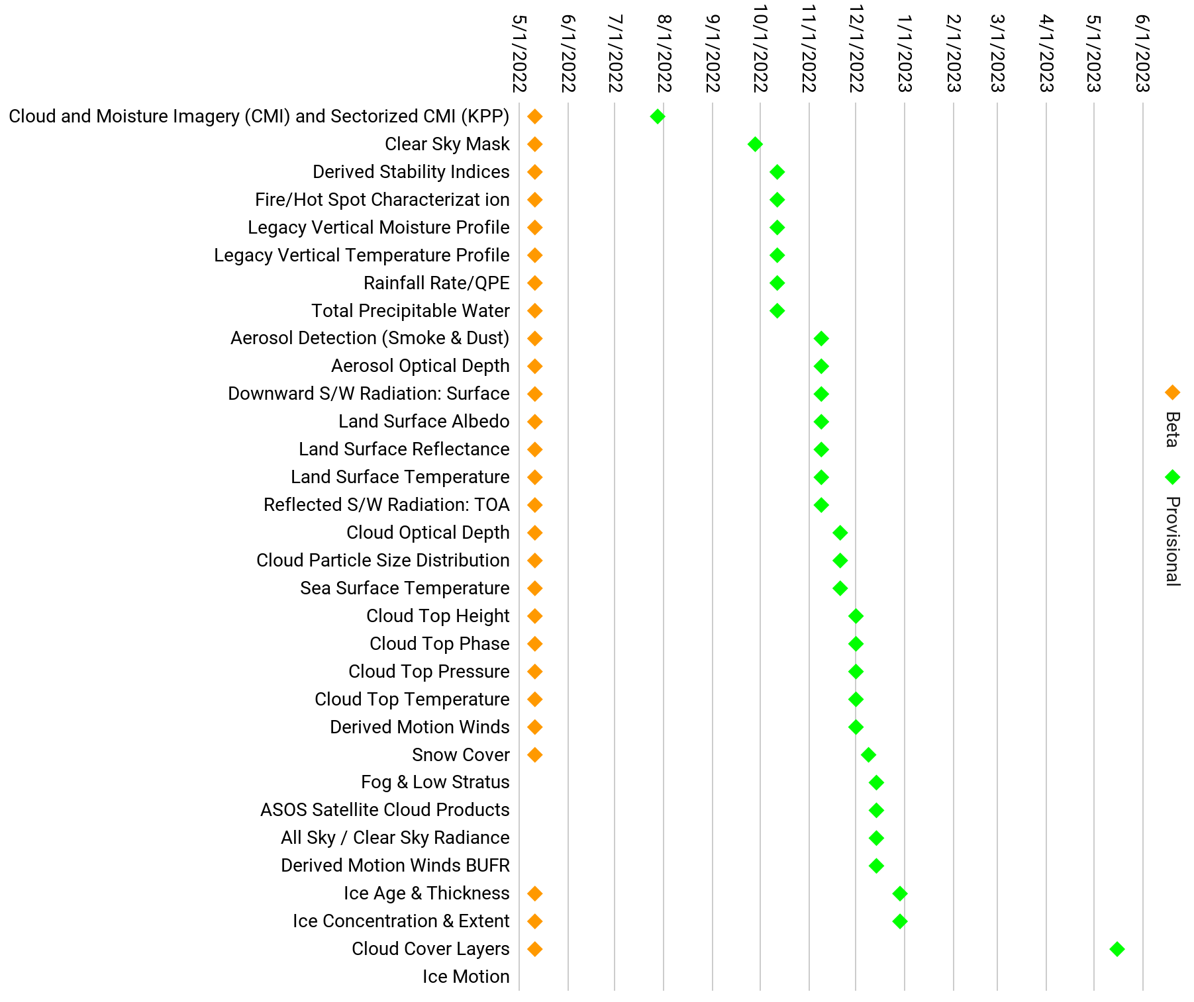
GOES-West operational transition
As of Jan. 4, 2023, GOES-18 is in operation as GOES-West
GOES-17 is in storage at longitude 104.7°W as of Feb. 10
GOES-17 science data was turned off on Mar. 14
All L1b products from GOES-18 reached Provisional Maturity by Dec. 1, 2022
Nearly all L2+ products from GOES-18 have now reached Provisional Maturity
SCN 22-113 details the GOES-18 data products available on the NWS Satellite Broadcast Network (SBN)
GOES-18 ABI L2+ Products
Mar. 31, 2023
Return to overview

Slide 4
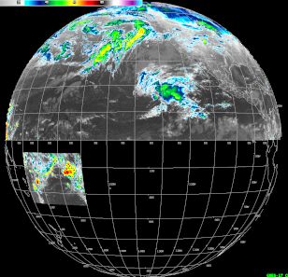
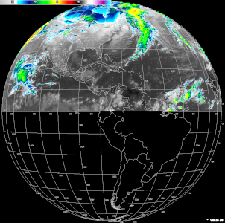
Changes to GOES-East,West Sectorized Cloud & Moisture Imagery (SCMI)
(permanent as of Mar. 1, 2023)
Alaska regional
sector
NOTES:
These changes affected only GOES-R ABI imagery over SBN (a.k.a. SCMI) – not ABI L1b or L2 products; other dissemination paths; or other GOES-R instruments.
These changes affected only Full Disk and Regional sectors; they did not affect imagery for Mesoscale or CONUS / W. CONUS (PACUS) sectors.
W. CONUS (PACUS)
sector
CONUS
sector
Puerto Rico regional sector
[5] (Bands 1-10, 13, 15 only)
[3] No Hawaii regional sector
[1] GOES-West “Full Disk”
[1] GOES-East “Full Disk”
[4] American Samoa regional sector (Band 13 only)
“Full Disk” -> Northern Hemisphere
[2] Band 13: 2 km pixels
All other bands: 6 km pixels
“Full Disk” -> Northern Hemisphere
[2] Band 13: 2 km pixels
All other bands: 6 km pixels
Return to overview

Slide 5
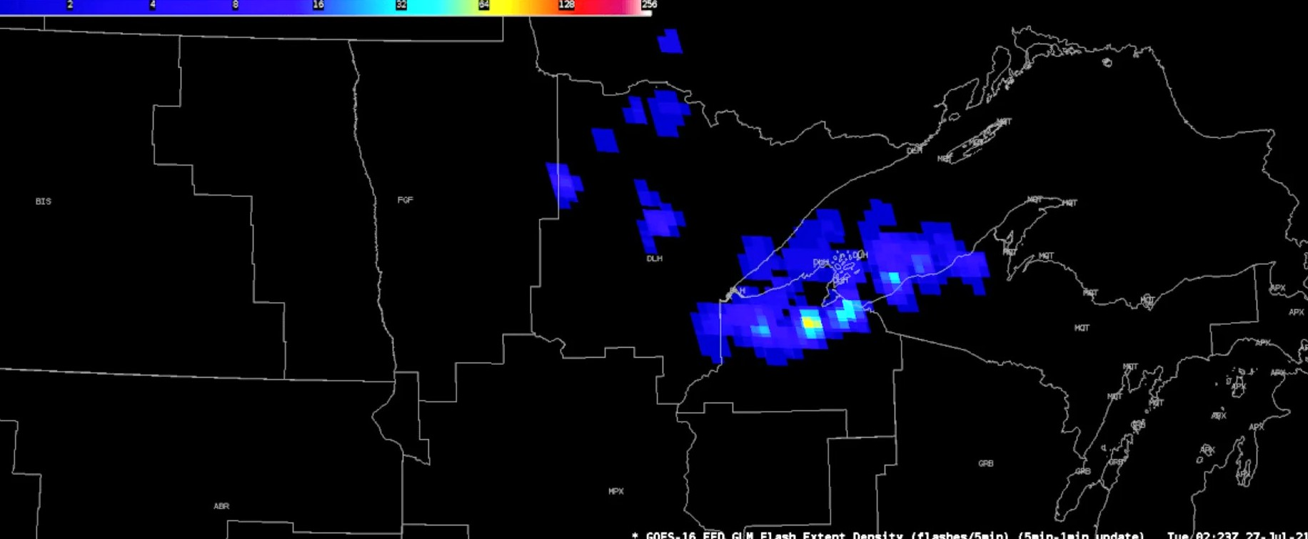
GOES-R Gridded GLM on SBN
as of Mar. 6, 2023
1-minute gridded GLM products (Flash Extent Density, Minimum Flash Area, Total Optical Energy) are now on SBN
1-minute gridded GLM is no longer on the NWS regional LDM
5-minute summaries are still on the NWS regional LDM – until the TOWR-S “AWIPS Pre-Processor” (APP) is more widely deployed. (More below on the APP)
To receive and handle the 1-minute GLM, AWIPS sites need to install TOWR-S RPM v23 and edit their LDM configurations, using these instructions.
SCN22-112, and TOWR-S’ GLM Dataset Guide on VLab, provide details on Gridded GLM product content, structure, etc.
Return to overview

Slide 6
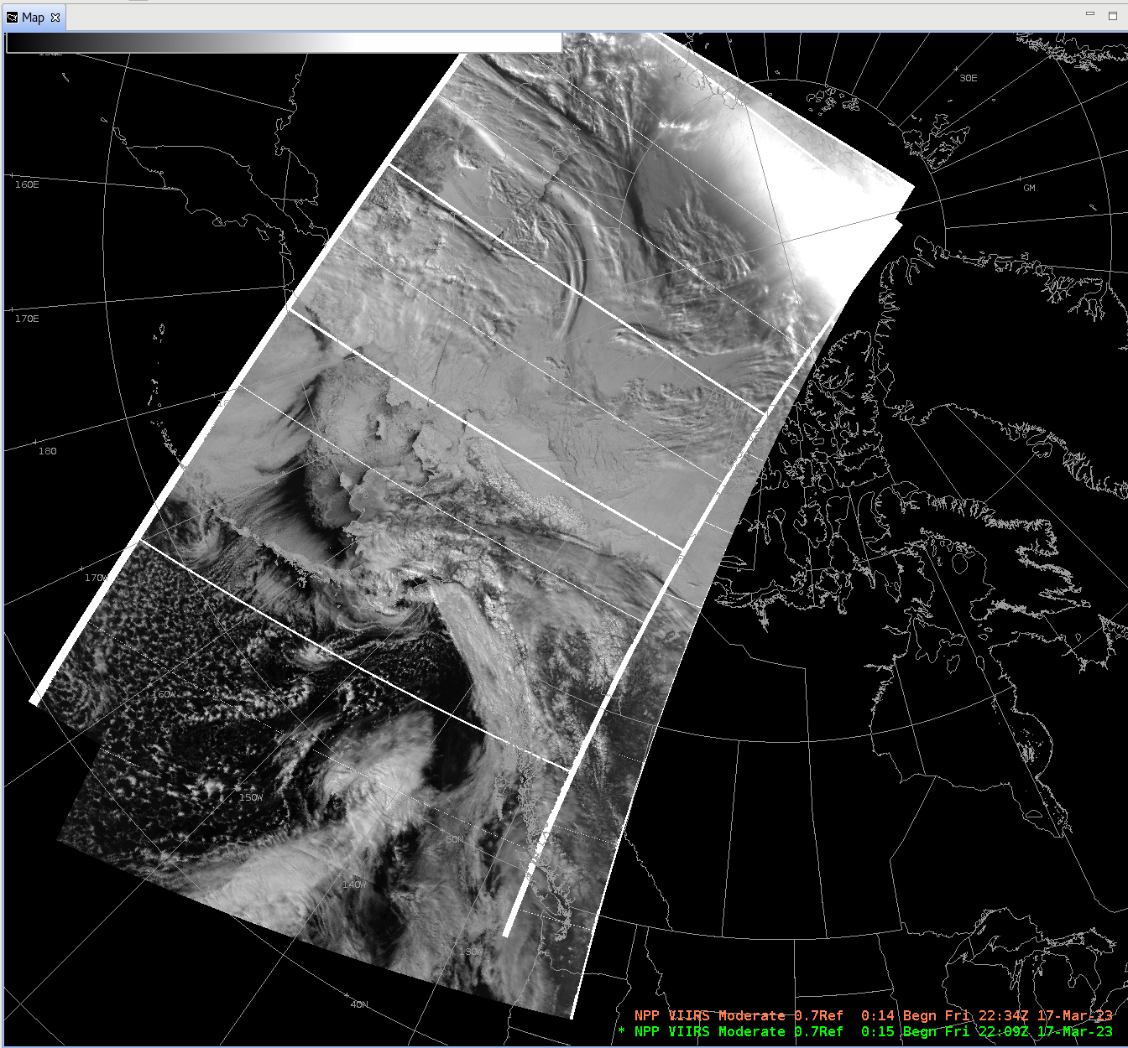
NOAA-21: Ka band transmission restored
NOAA-21’s Ka band transmitter #1 ceased operating on Dec. 15, 2022. Switched to Ka band transmitter #2 on Feb. 2, 2023.
First light images from VIIRS (IR bands), CrIS, and OMPS were posted in February.
NOAA-21 VIIRS Imagery reached Provisional Maturity effective yesterday, Mar. 30
Also verified tailoring of VIIRS imagery for AWIPS
NOAA-21 Handover to OSPO occurred yesterday, Mar. 30
NOAA-21 imagery will replace S-NPP imagery in AWIPS
Sometime after NOAA-21 becomes the Secondary JPSS satellite (see below)
“S-NPP…” menu entries in CAVE will be removed in TOWR-S RPM v24 (June / July 2023 – more below)
NOAA-21
h/t: Derek van Pelt
NOAA-20
NOAA-21 and NOAA-20 VIIRS Day-Night Band imagery in AWIPS CAVE
Return to overview

Slide 7
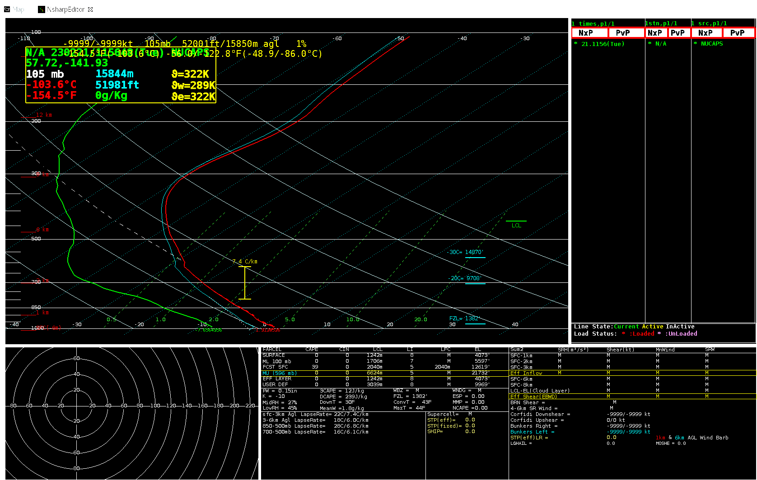
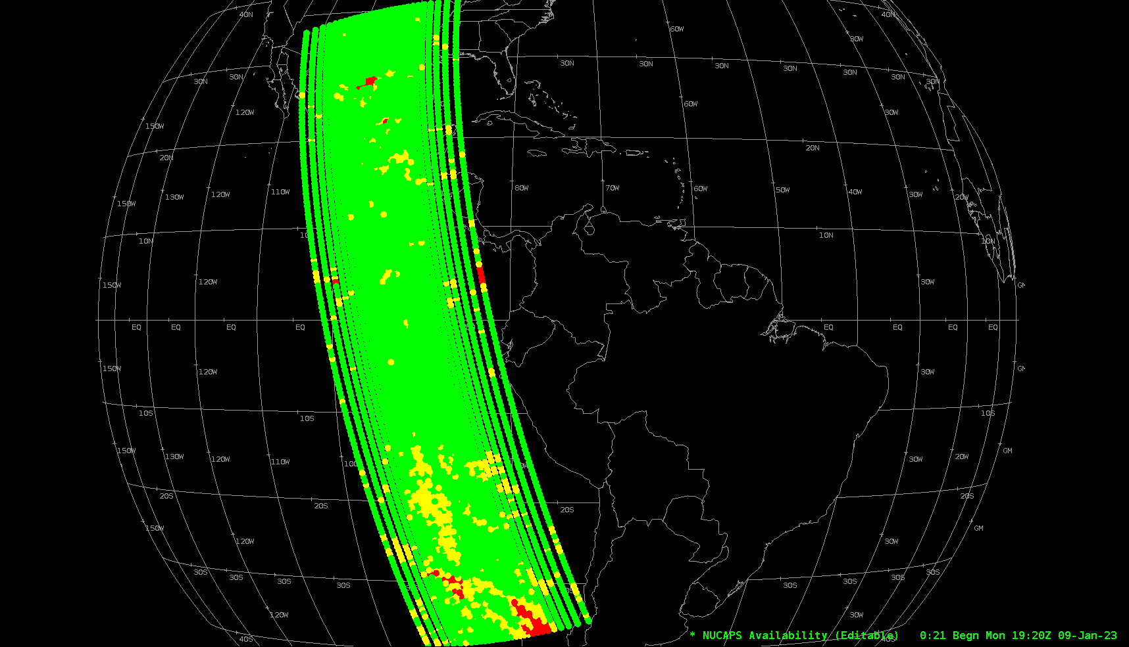
NOAA-21: Ka band transmission restored
Verified AWIPS tailoring of NOAA-21 NUCAPS soundings
Provisional maturity of NOAA-21 NUCAPS expected in ~Dec. 2023
Blended Hydro Products will incorporate NOAA-21 inputs as of ~Nov. 2023
These and other NOAA-21 EDR products will be made available to AWIPS field sites:
VIIRS Flood Maps
VIIRS Active Fires
(Others TBD)
Skew-t plot from a single sounding
Preliminary, non-operational data h/t: Derek van Pelt
NOAA-21 NUCAPS soundings seen in AWIPS CAVE
Return to overview

Slide 8
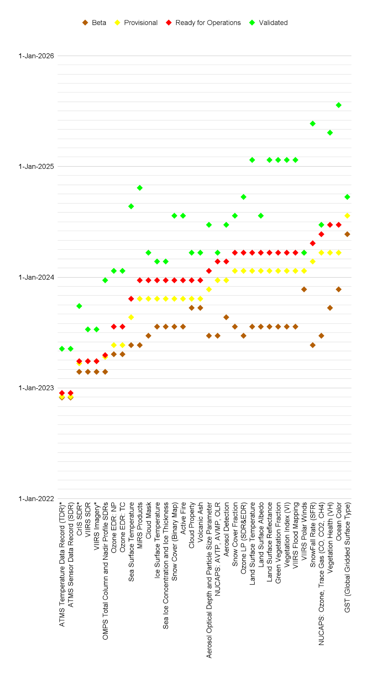
NOAA-21 Product Maturity timeline
Adjusted for delays due to Ka Band Transmitter anomaly
CY2022 | CY2023 | CY2024 | CY2025
Not all of these products will be made available in AWIPS.
Of those that are, some will be on the SBN; others may reach AWIPS sites via LDM, Cloud, or other mechanisms.
Mar. 31, 2023
h/t Lihang Zhou, JPSS Program - Updated 04/20/2022 (source)
Return to overview

Slide 9
NOAA-21 and the JPSS Constellation
Launch, Early Orbit and Activation (LEO&A) (Launch to L+90 days)
From the JPSS-2 Product Operations Plan
NWS SBN activation of NOAA-21 VIIRS NCC imagery
after J. McNitt et al.
November 10, 2022
March 30, 2023
May – July 2023
July – October 2023
Return to overview

Slide 10
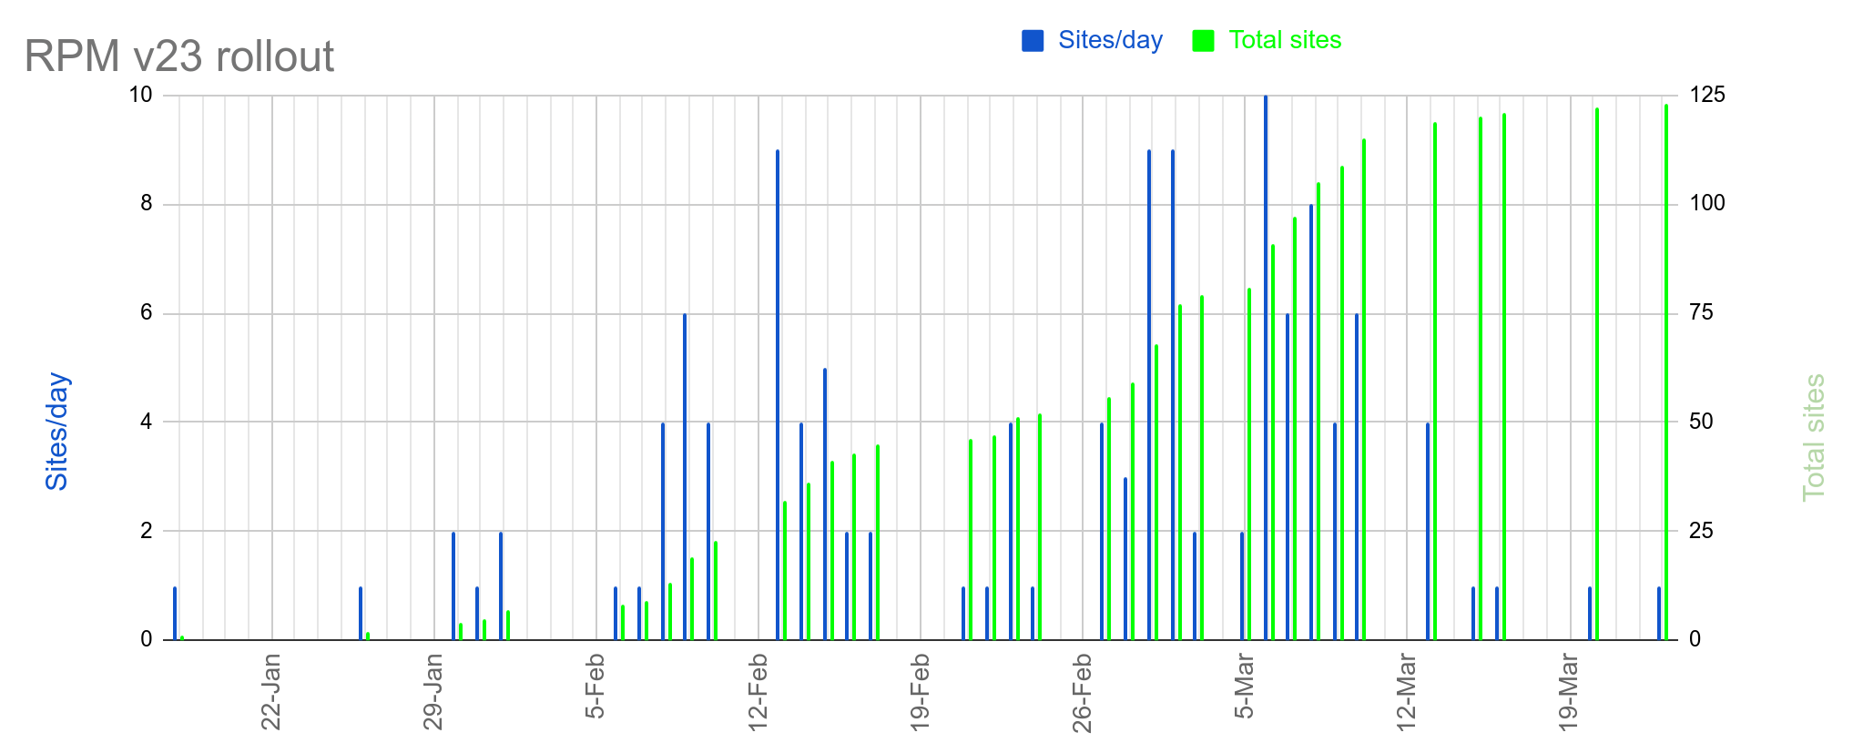
TOWR-S RPM v23
Key features:
GOES GLM (1-min/1-min update) on SBN
LightningCast probability products (sourced from CR LDM)
“Day Fire” RGB (R: 3.9um (0-70C), G: 0.86um (0-100%), B: 0.64um (0-100%))
VIIRS Flood Mapping products (currently in evaluation)
GOES Snow and Ice products (coming soon)
Installed in 123+ AWIPS sites
111+ of 117 CONUS WFOs
5+ of 12 CONUS RFCs
All 4 CONUS Regional HQs
3+ test sites
Updated: 03/26/2022 (source) – h/t Sanford Garrard
Return to overview

Slide 11
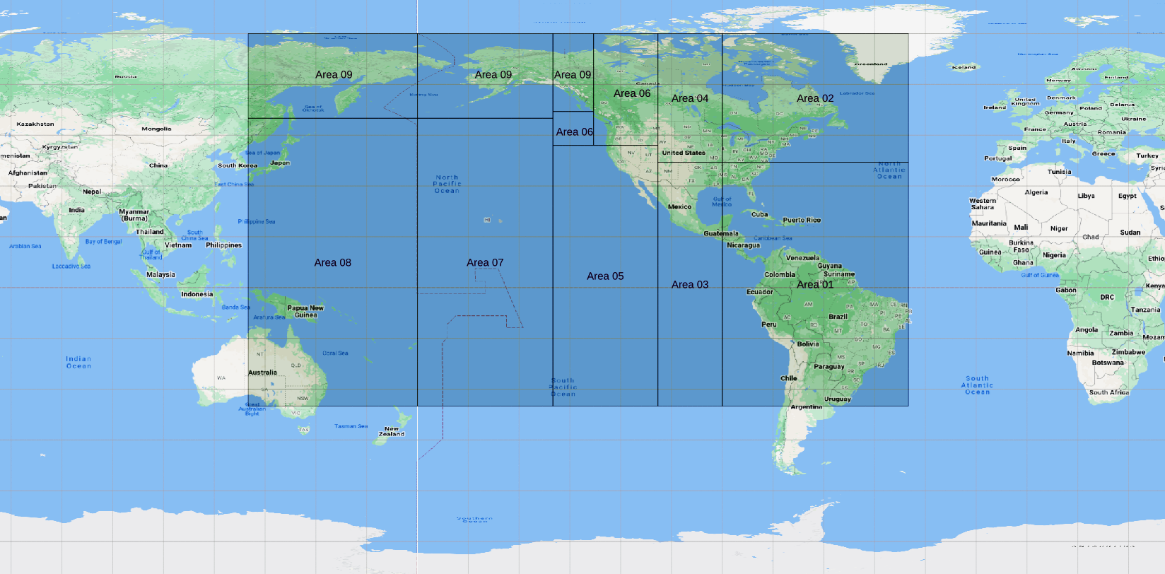
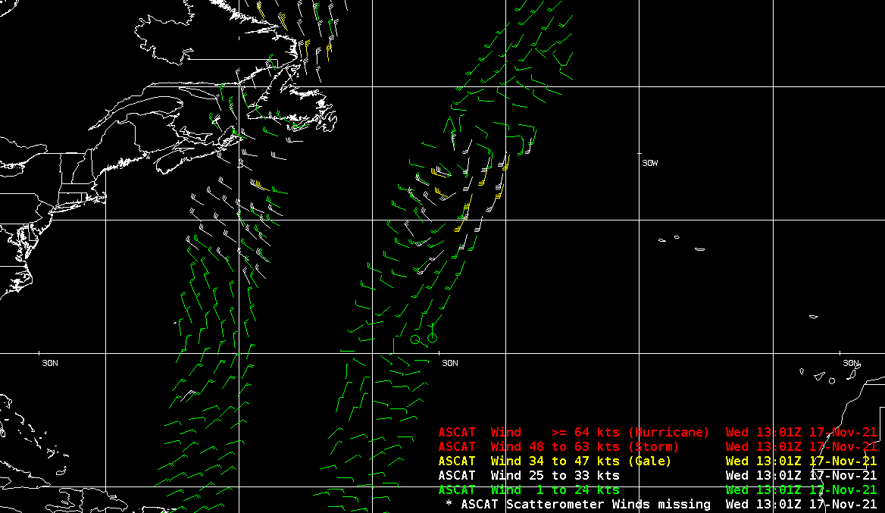
ASCAT ocean winds from Metop-C
Global coverage of ASCAT Ocean Surface Wind vectors is available via SBN from both Metop-B and Metop-C (as of Mar. 23, 2023).
See SCN23-19
ASCAT-C reuses the WMO headers previously used by ASCAT-A
“JSXX0[1-9] KNES” and “JSXX10 KNES”
Baseline configurations will fetch and display ASCAT-B and -C winds for Regions 01-09. To access global ASCAT winds:
Edit the LDM pqact.conf to recognize headers with “JSYY10” and “JSXX10”;
Edit the site distribution/bufrascat.xml to recognize headers with “JSYY10” and “JSXX10”;
Comment out the geographic restriction in the site plugin-filters/ascat_filters.xml
Area 10
Area 10
Area 10
Area 10
Area 10
Area 10
Area 10
Area 10
Area 10
Area 10
Area 10
Area 10
Area 10
Area 10
Area 10
Area 10
Area 10
Area 10
Area 10
Area 02
Area 10
Area 01

Slide 12
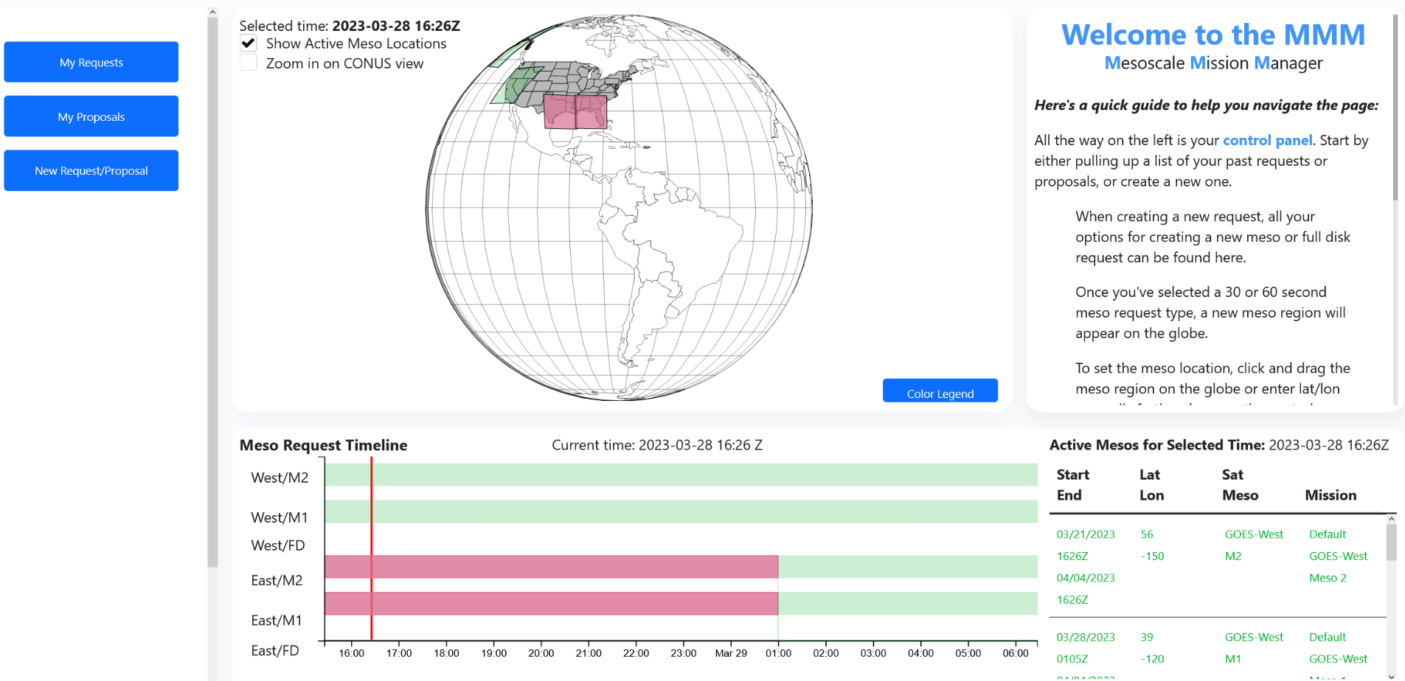
New Meso Mission Manager
New MMM tool went live on Feb. 15, 2023 at https://vlab.noaa.gov/web/towr-s/mmm/tool
Uses VUGraF (VLab User-Defined Graphical Framework) to facilitate creating Javascript graphical user-interactive components using only Python code. This simplifies maintenance and further development of MMM.

Slide 13
ISatSS in IDP and NCEP: highlights
IDP:
Upgrade to v5.0 code base in progress
Preparing to retire AHIProc software (legacy Himawari tiled imagery)
In progress at National Centers:
NHC and AWC: Meteosat-11 to MeteoSat-10 transition
NHC: Meteosat-based ProxyVis; Global IR Mosaics
OPC: Meteosat-10, Meteosat-9 for AWIPS
TOWR-S Configuration Control Board
Get input from stakeholders (on ISatSS, RPMs, MMM, APP)
Meets monthly. Next meeting: April 13
Return to overview
Notes:
Integrated Dissemination Platform Satellite Support System (ISatSS)

Slide 14
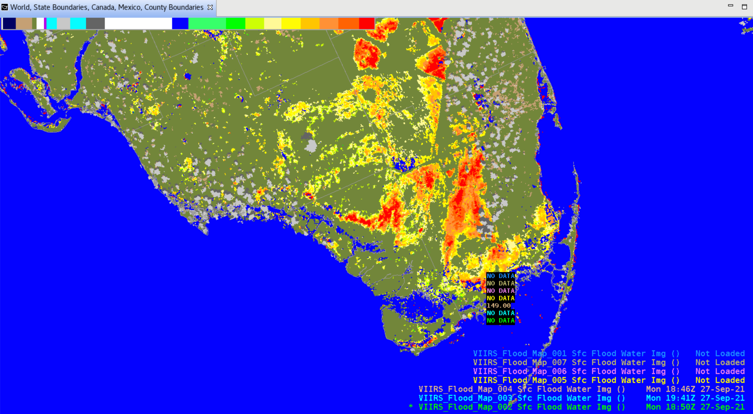
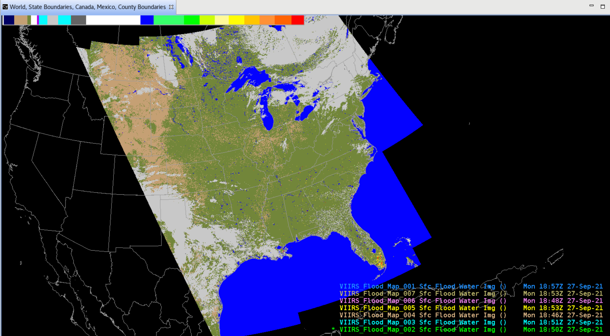
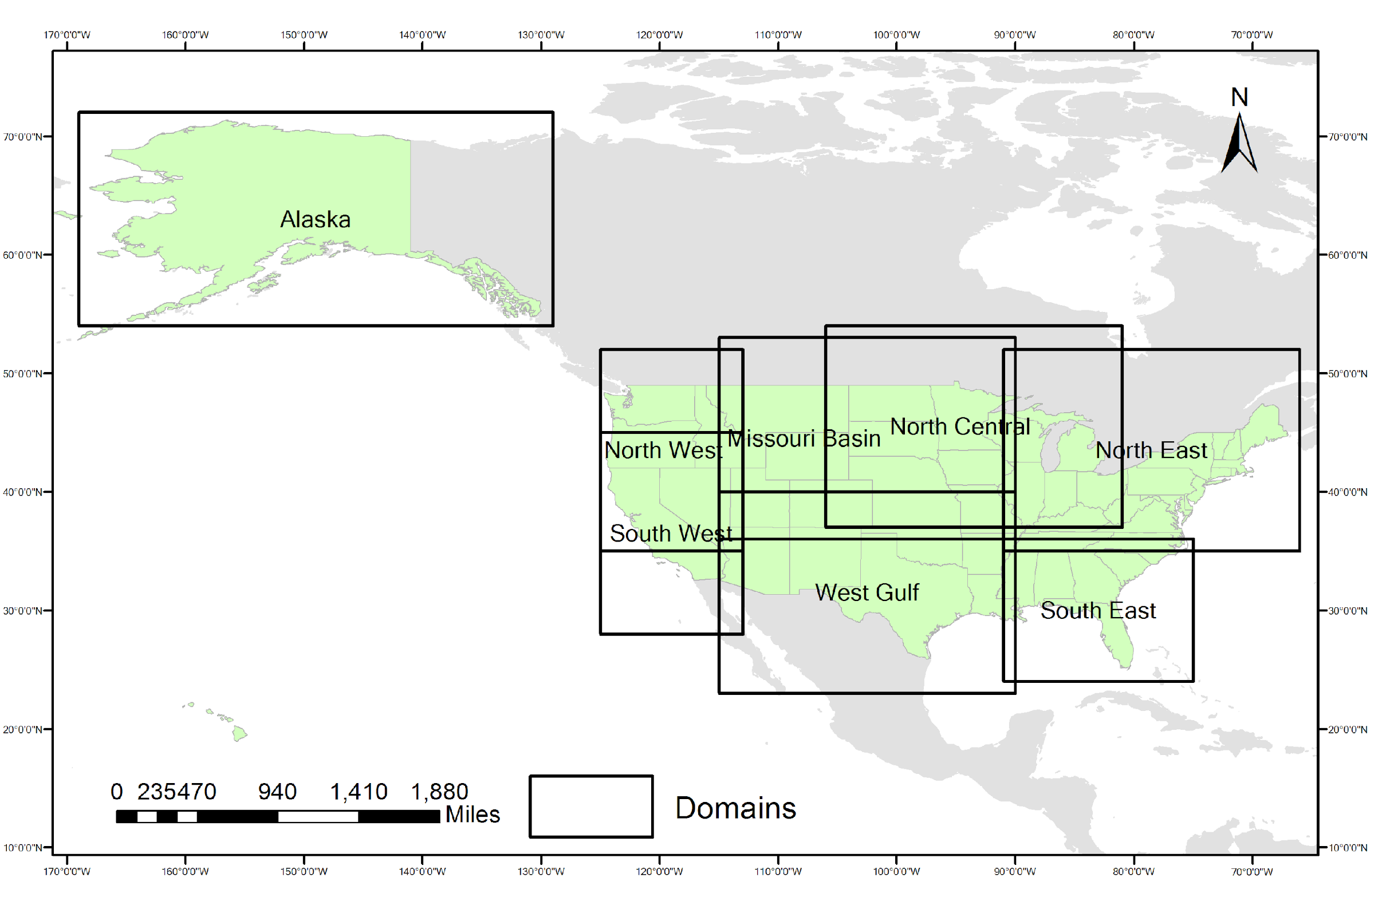
Looking ahead: VIIRS Flood Maps
VIIRS Flood Maps are being evaluated at 7 AWIPS sites; very favorable reception so far.
Most sites configure LDM (pqact.conf file) to bring in only one or two of the regional mosaics
This limits memory overload from high-resolution lon-lat grids
VIIRS Flood Maps: 8 NWS regional mosaics
h/t Derek van Pelt
Return to overview

Slide 15
Looking ahead: new GOES-R Enterprise L2 products
New Enterprise products are now being produced operationally:
2km Cloud Top Height & Pressure (FD, CONUS, Meso)
Full Disk file size: 1.6MB (10km) -> 27 MB (2km)
2km Cloud Optical Depth (FD)
Full Disk file size: 5MB (4km) -> 19 MB (2km)
New Cloud Cover Layers
CONUS & FD: hourly @ 10km
Meso: 5-minute @ 4km
Enterprise Ice Age & Thickness
More Enterprise products coming Apr. 17:
Ice Motion, Rainfall Rate, Aerosol Detection, Aerosol Optical Depth. (Same spatial resolution)
Enterprise products apply improved science and greater consistency with other satellite sensors.
Enterprise products will be evaluated and considered for AWIPS.
New 2km cloud products
March 31, 2023
From GOES-R PRO PASS Dev’t Schedule, with updates on 2023/03/31
Return to overview

Slide 16
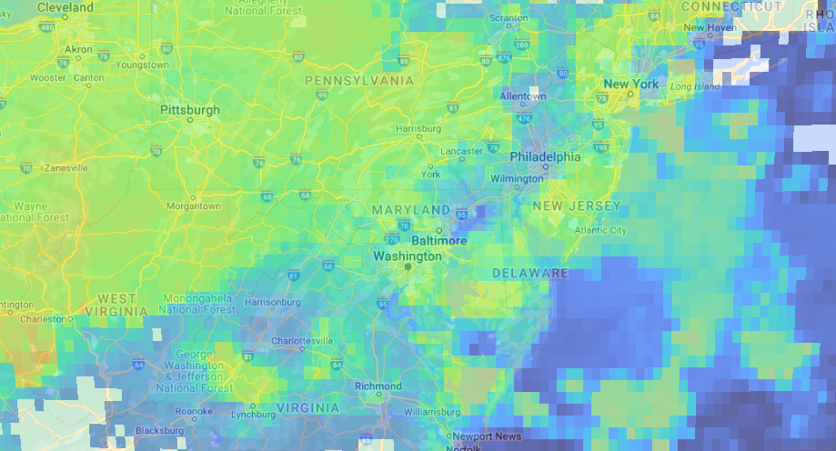
Looking ahead: new GOES-R Enterprise L2 products
10km pixels: GOES-16 Cloud Top Height
Return to overview

Slide 17
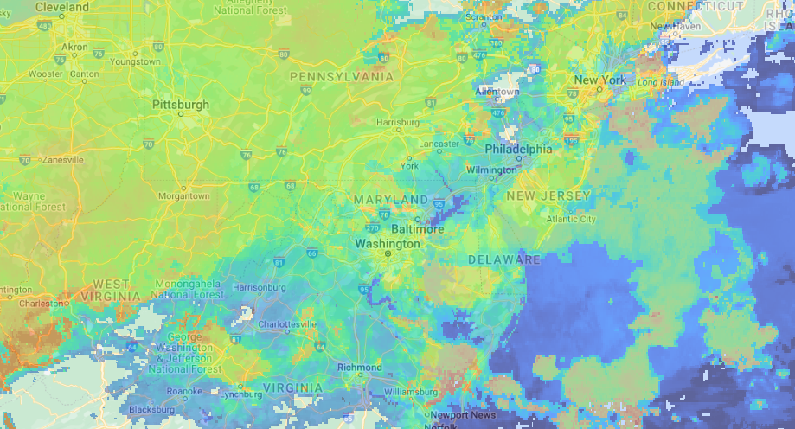
Looking ahead: new GOES-R Enterprise L2 products
2km pixels: GOES-16 Cloud Top Height
Return to overview

Slide 18
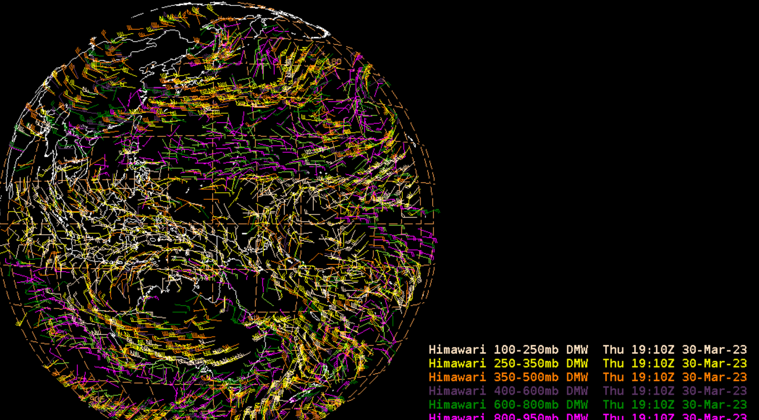
Looking ahead: Himawari-9 Winds and other L2 products
NWS / NOAA operations transitioned from Himawari-8 to Himawari-9 imagery on Dec. 12, 2022.
TOWR-S is preparing to deliver Himawari-9 Derived Motion Winds (pre-operational) from OSGS / STAR to the Pacific Region
Himawari-9 L2 products will be produced operationally beginning in April - June 2023.
Including AWIPS-friendly product contents and formats
OSPO Operational Release Date | Himawari-9 products
Dec. 13 2022 | Imagery Full Disk Tiles
 | Imagery R3 Floating Sector
Apr. to June 2023 (estimated) | Clouds
 | Winds
 | Sea Surface Temperature
 | Rainrate
h/t Stuti Deshpande
Near-Real-Time Himawari-9 Winds in AWIPS (Mar. 30, 2023)
(Image is from preliminary, non-operational data. Please do not distribute.)
Return to overview

Slide 19
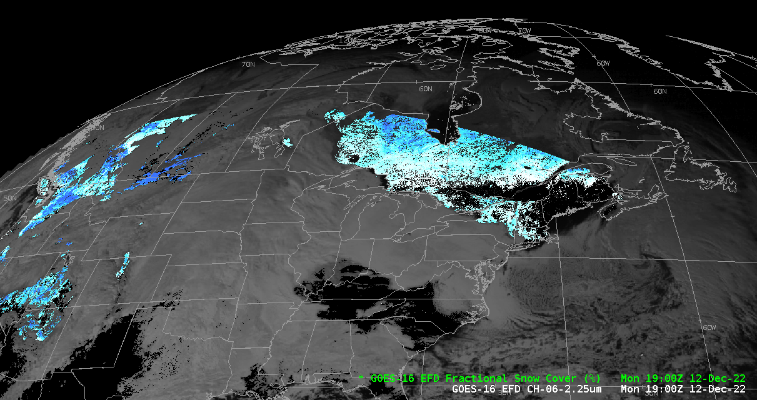
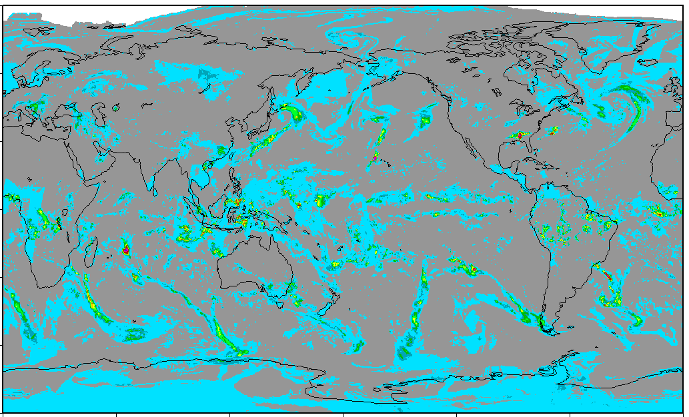
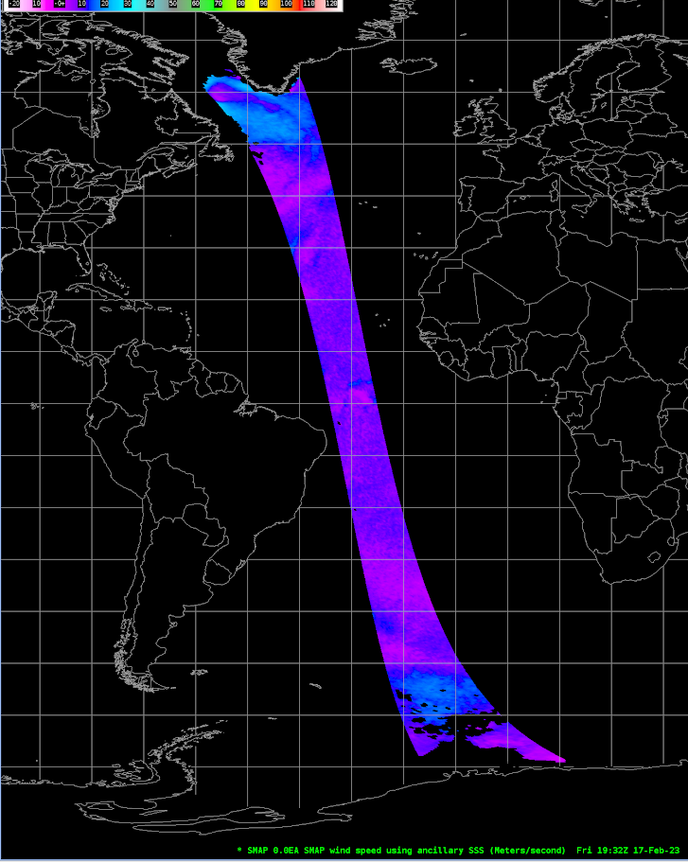
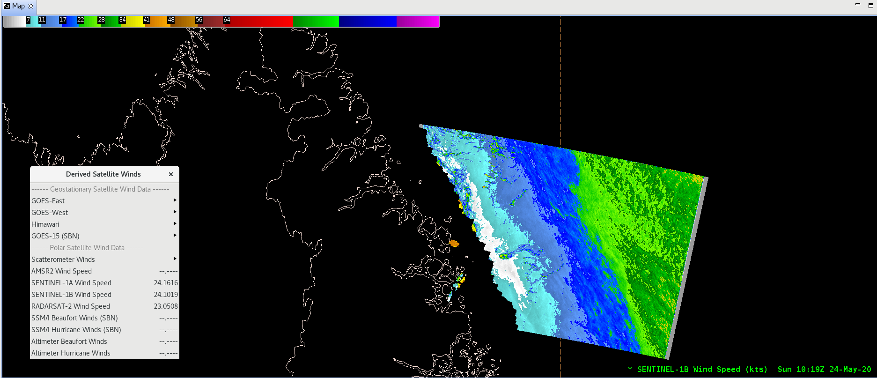
Looking ahead: Additional satellite products
GOES-R Ice and Snow products on SBN as of June 5, 2023
Ice Age & Thickness, Ice Concentration & Extent, and Fractional Snow Cover.
Details in SCN23-42
Sentinel-6A Radar Altimetry (wave heights & wind speeds) from EUMETSAT is now available on PDA.
OPC, NHC are ingesting the data into AWIPS
Also evaluating for AWIPS:
Ocean wind speeds from Soil Moisture Active Passive (SMAP) satellite
CMORPH2 integrated rainfall grids
GOES-16 Full Disk Fractional Snow Cover
CMORPH2 global precipitation estimate
Sentinel-1B wind speeds
SMAP ocean surface wind speeds
Return to overview

Slide 20
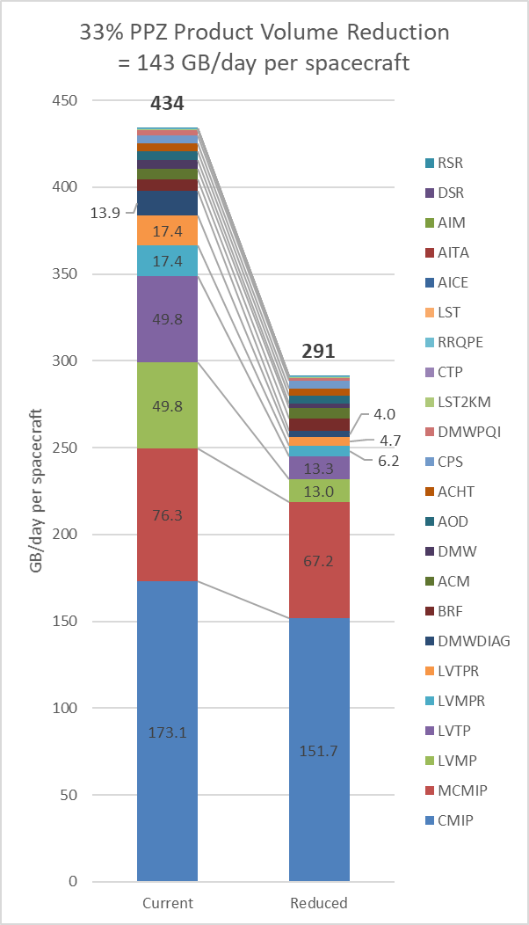
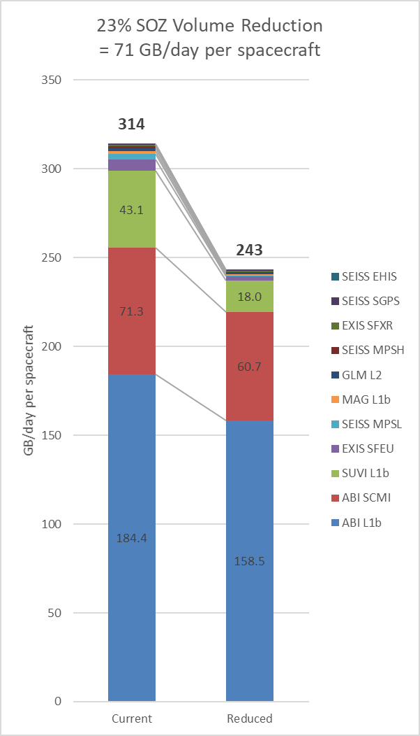
Looking ahead: Enhanced compression of GOES-R data products
ABI L2 products
Coming May 23: Lossless “shuffle” compression of GOES-R imagery (SCMI). This may shrink GOES-R imagery data volumes on SBN by nearly 15%:
GOES-East: 64 GB/day => estimated 9.5 GB/day savings
GOES-West: 69 GB/day => estimated 10.2 GB/day savings
Shuffle compression of one full day of GOES-West SCMI (Mar. 6) saved 11.4 GB/day (17.2%: 66.4->55.0 GB). Nearly half of the savings (5.5GB) was from Channel 2.
(h/t Randy Race, GOES-R Program)
Shuffle compression of L2 derived products is likely to yield significant savings as well.
Analysis still underway (August 2022 analysis seen here predates the new Enterprise products)
Operational release of most shuffle-compressed L2 products is not yet scheduled.
ABI SCMI and other L1 products
Return to overview
Analysis by Randy Race (Aug. 2022) [source]

Slide 21
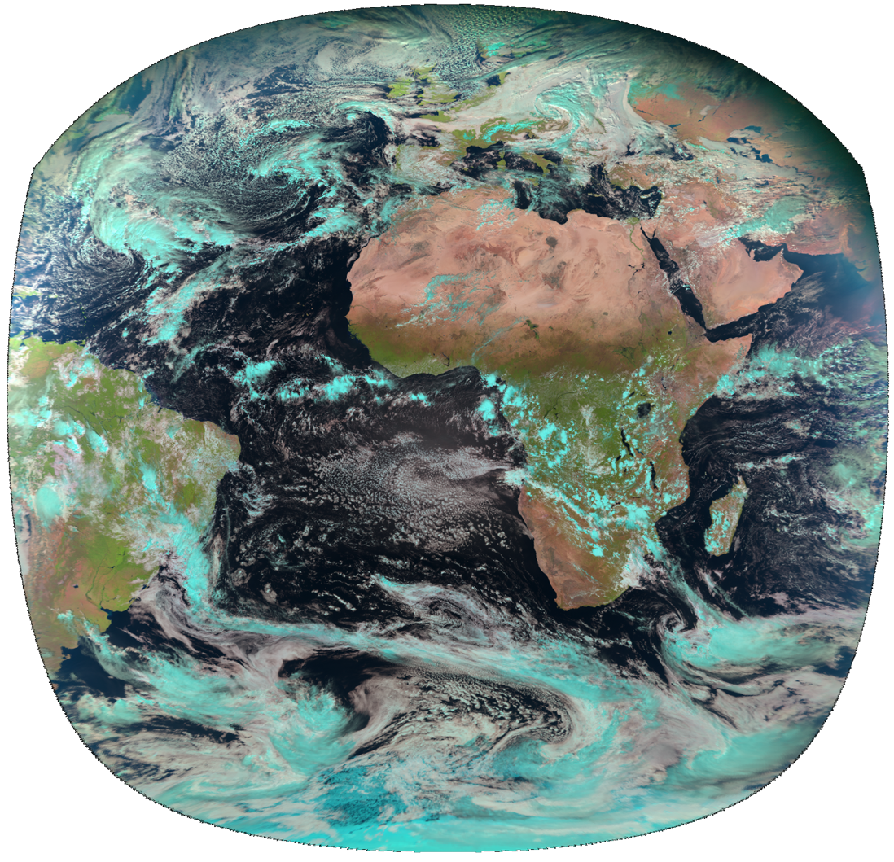
Recent and upcoming satellite launches
OceanSat-3 (a.k.a. EOS-06) launched Nov. 26, 2022.
The OSCAT-3 scatterometer will fill the gap left when SCATSAT ceased operations in Feb. 2021.
(MeteoSat 3rd Gen.) MTG-Imager 1 launched Dec. 13, 2022.
Geostationary @ Longitude 0°
GOES-U scheduled to launch April 30, 2024
Checkout at Longitude ~89.5°;
Eventual operations as GOES-East or GOES-West
(Metop 2nd Gen.) Metop-SG-A1 to launch 1st Q. CY2025.
Sun-synchronous polar (morning) orbit
h/t: V Wegman
The view from Longitude 0° (MeteoSat-11)
Return to overview

Slide 22
TOWR-S RPM v24: tentative highlights
Target release: late June 2023
Ingest / display of new products
New GOES-R Cloud Cover Layers product
Other new GOES-R Enterprise products
New Polar Blended Hydro products
GOES-R Turbulence contour lines
Sectors and basemap for GOES-R Storage slot (105° Longitude)
Global ASCAT Winds from Metop-B and Metop-C?
New / changed menu entries
NOAA-21 VIIRS imagery
Combine VIIRS menu entries (merge S-NPP, NOAA-20, NOAA-21)
Remove menu entries for GOES-West Hawaii regional sector
Remove menu entries for GOES-East Puerto Rico sector Bands 11, 12, 14, 16 and RGB / Channel Difference composites that use those bands
Add menu entry for American Samoa sector Band 13
WPC Day 4-5 Outlook Svc enhancement
GOES-R Storage slot @ 105° Longitude

Slide 23
Coming soon: APP (AWIPS Pre-Processor)
APP = a small bundle of software running alongside AWIPS, that can manipulate incoming data products – e.g., to
Produce CIRA Geocolor imagery from GOES-16/18 ABI channels 1, 2, 3, 7, and 13;
Compute GLM 5-minute accumulations (FED/TOE/MFA) from 1-min GLM grids
This avoids sending data over SBN or LDM that could be computed locally
Tentative schedule:
Testing underway now; will test with 10 sites in April
Available to all sites starting May 1
Goal: installed in all/most sites by June 15

Slide 24
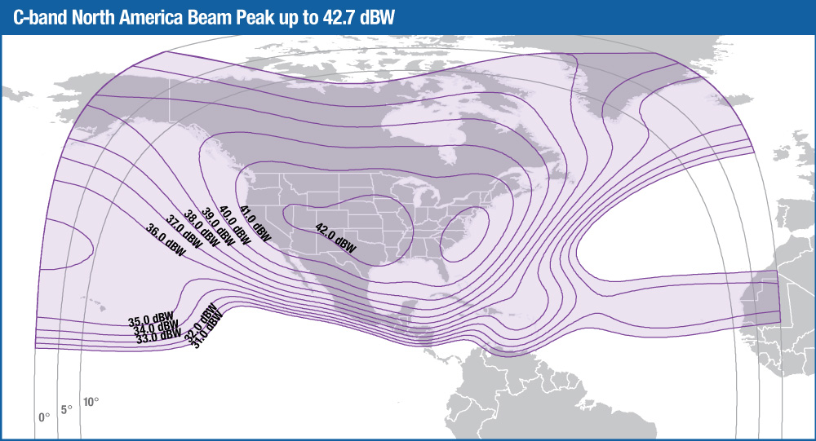
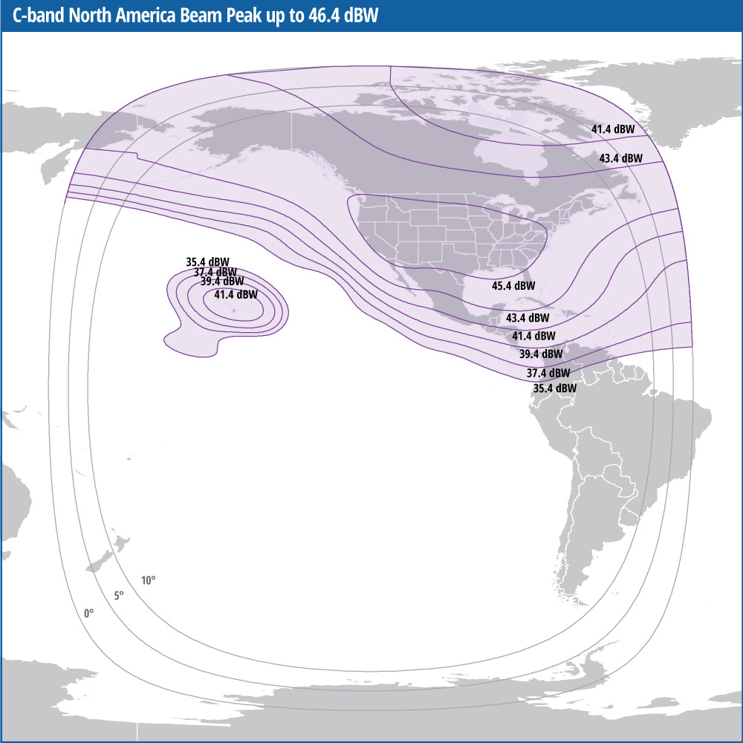
Galaxy-31 transition for SBN
The AWIPS SBN broadcast is switching from the Galaxy-28 communications satellite (Longitude 89°W) to the new Galaxy-31 satellite (Longitude 121°W)
Schedule (per SCN22-77):
November 12, 2022: Galaxy-31 Launch
February 5, 2023: Dual Illumination Period
February 17, 2023: Receive Site Transition Window Start
March 31, 2023: Receive Site Transition Window Ends
April 3, 2023: (AWIPS) Transition to Galaxy-31 Complete
Galaxy-28: North America C-Band coverage from 89°W
Galaxy-31: North America C-Band coverage from 121°W

Slide 25
BNCF/CNCF transition
The BNCF (backup Network Control Facility) and BMGS (backup Master Ground Station) used by the NWS Satellite Broadcast Network (SBN) were to be moved out of the NASA IV&V Facility in Fairmont, WV, by March 31.
BNCF’s replacement, CNCF, has been installed and tested at the nearby NOAA Vertex facility. Connectivity testing concluded this week.
Due to delays in construction of the CMGS antenna at the Vertex facility, BMGS will remain in operation at NASA IV&V past March 31.
CNCF will be commissioned on Mon., Apr. 3; and BNCF operations will be switched over to CNCF on Tues. Apr. 11. (If no Critical Weather Days on those dates)

Slide 26
Operational Testing & Evaluation (OT&E)
TOWR-S supports the NWS OPPSD (Office of Planning and Programming for Service Delivery) in engaging with AWIPS users and addressing technical issues, as part of formal Operational Test and Evaluation (OT&E) activities.
GOES-18 OT&E focused on imagery and L2 products in Jan./Feb. 2023
Involving 8 WFOs and 3 National Centers
Now gathering user feedback on GOES-18 Gridded GLM products
Test Review Group meets biweekly; next meeting April 6. (Latest TRG slides)
NOAA-21 OT&E will involve 6 test sites (5 WFOs + 1 RFC); schedule TBD
To begin after users are receiving operational NOAA-21 data feeds and have the necessary AWIPS configurations (tentatively July 2023)

Slide 27
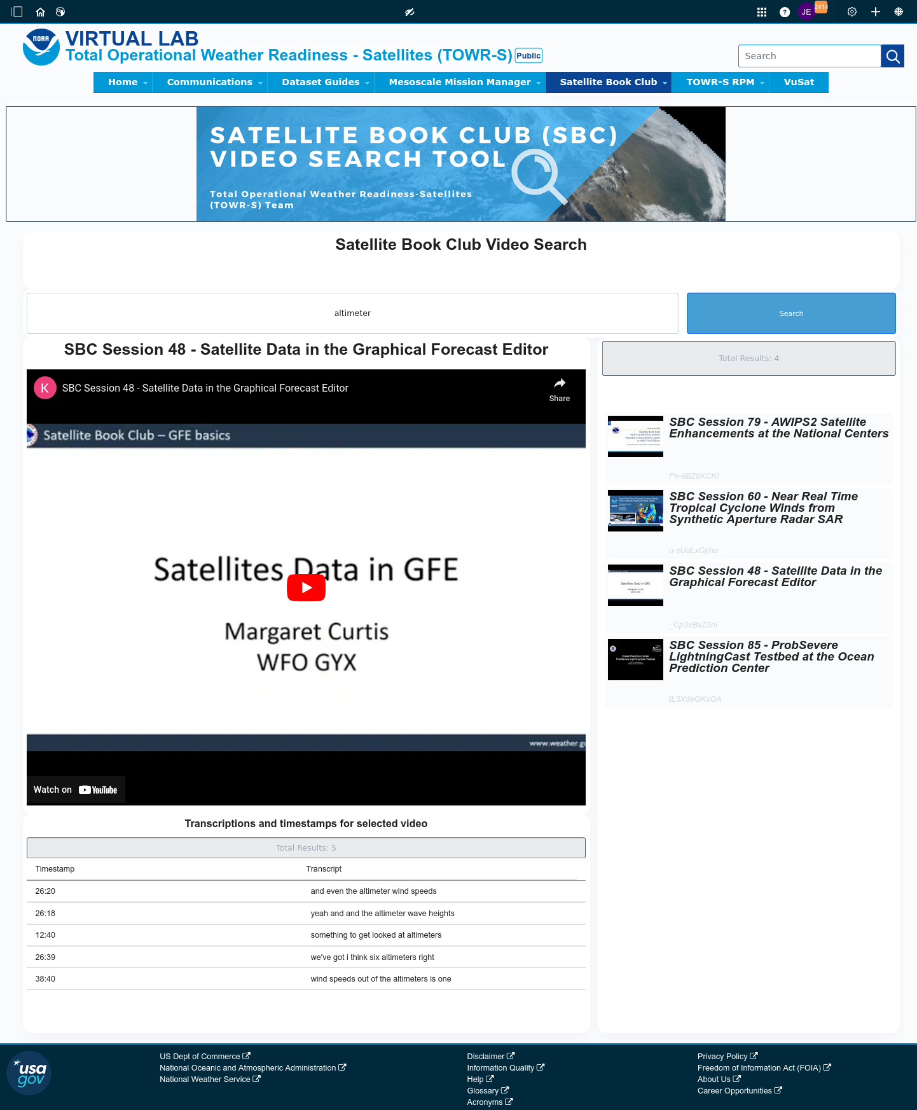
Satellite Book Club (SBC) Seminar Series
Thursdays, usually at Noon ET
New! “SBC On The Road”
Indianapolis, IN (Feb. 23)
College Park, MD (Mar. 9)
Mobile, AL (April 13)
National Hurricane Ctr., Miami, FL (May 11)
Usage examples shed light on user requirements for satellite data products and capabilities.
Recordings are on YouTube and the NWS Commerce Learning Center (CLC) website.
Full-text transcripts are available for all SBC sessions – searchable from within VLab.
SBC videos are now searchable by keyword: https://vlab.noaa.gov/web/towr-s/sbc-video-search
Return to overview

Slide 28
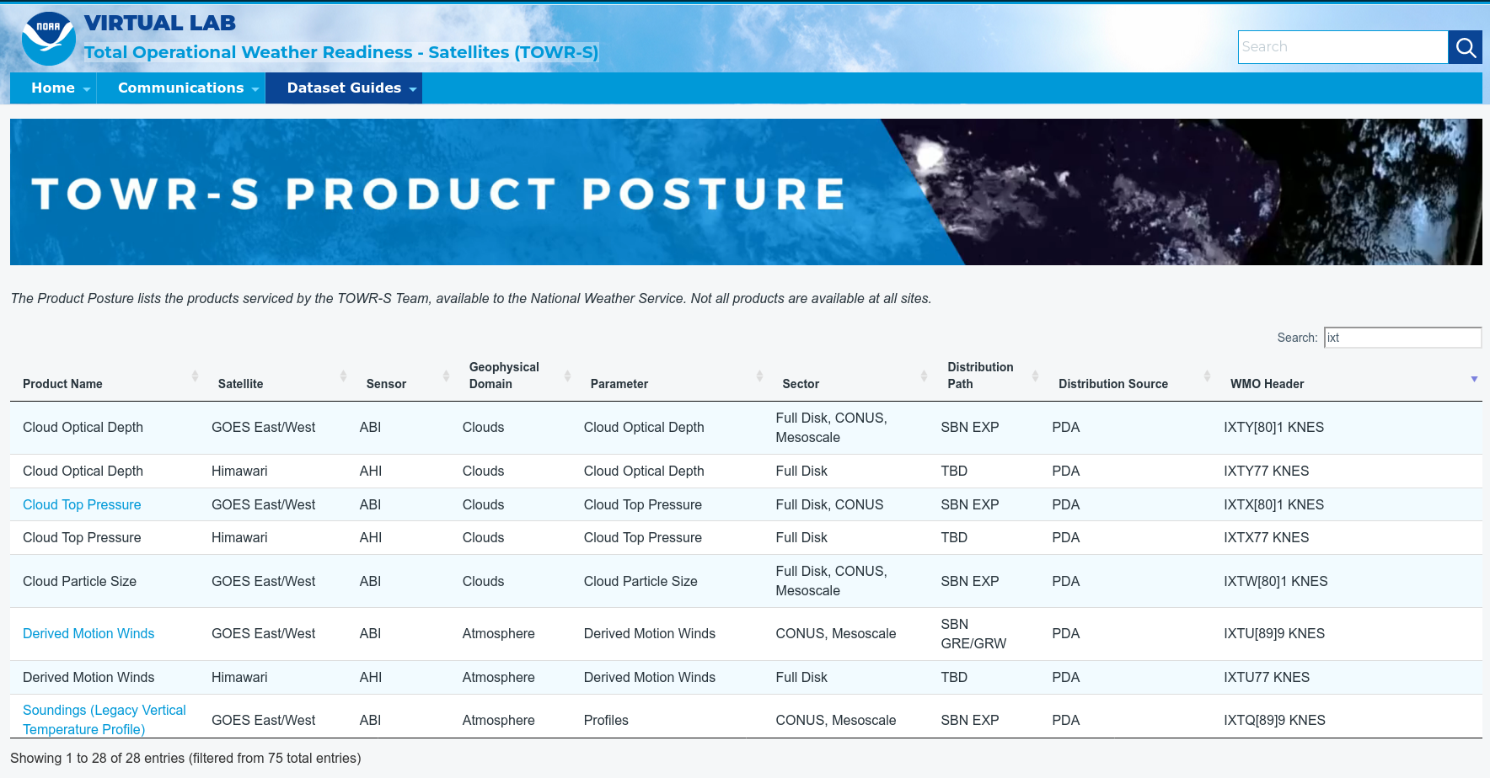
TOWR-S Product Posture
VLab now hosts a table of all satellite data products that TOWR-S is involved with (integrating them into NWS forecast operations).
Instant search, filter, and sort capability provides access by keyword, satellite, sensor, etc.
Many rows link to Dataset Guides with more AWIPS details.
Note: Distribution Path “TBD” indicates a product in planning - not yet disseminated to users
https://vlab.noaa.gov/web/towr-s/product-posture
Return to overview

Slide 29
TOWR-S monthly
Supplements the quarterly TOWR-S Update briefings and the weekly / occasional TOWR-S mailers.
Emailed to TOWR-S Update attendees and posted to VLab. (https://vlab.noaa.gov/web/towr-s/communications)
Return to overview

Slide 30
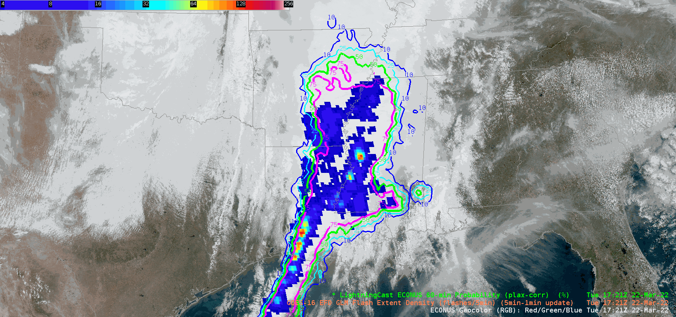
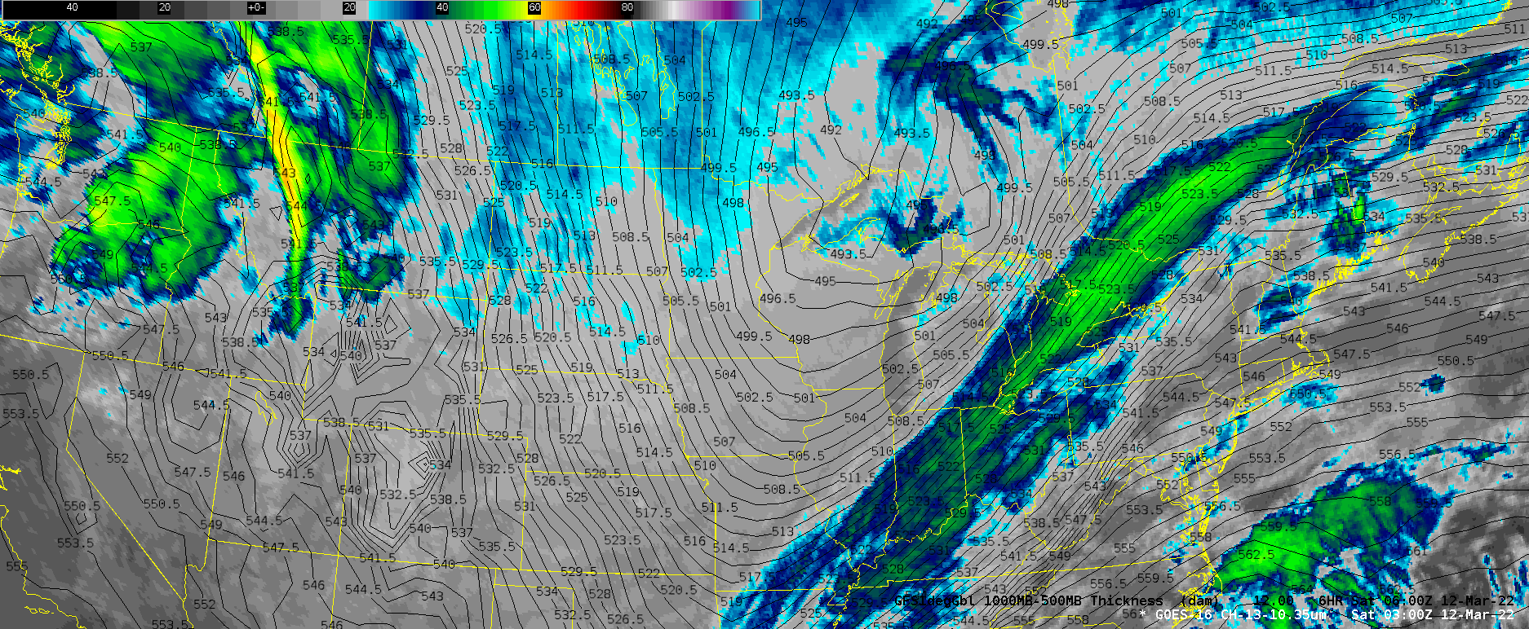
geoCloud AWIPS for Collaboration
TOWR-S team has an initiative to bring people together in the AWIPS environment to foster collaboration on ways satellite data can enhance the NWS mission.
TOWR-S facilitates small groups of forecasters, technique development meteorologists, and algorithm developers from across the NWS and NESDIS.
More details are in Satellite Book Club Session 38.
Please contact Lee Byerle to schedule a session with your office.
h/t: Lee Byerle
Return to overview

Slide 31
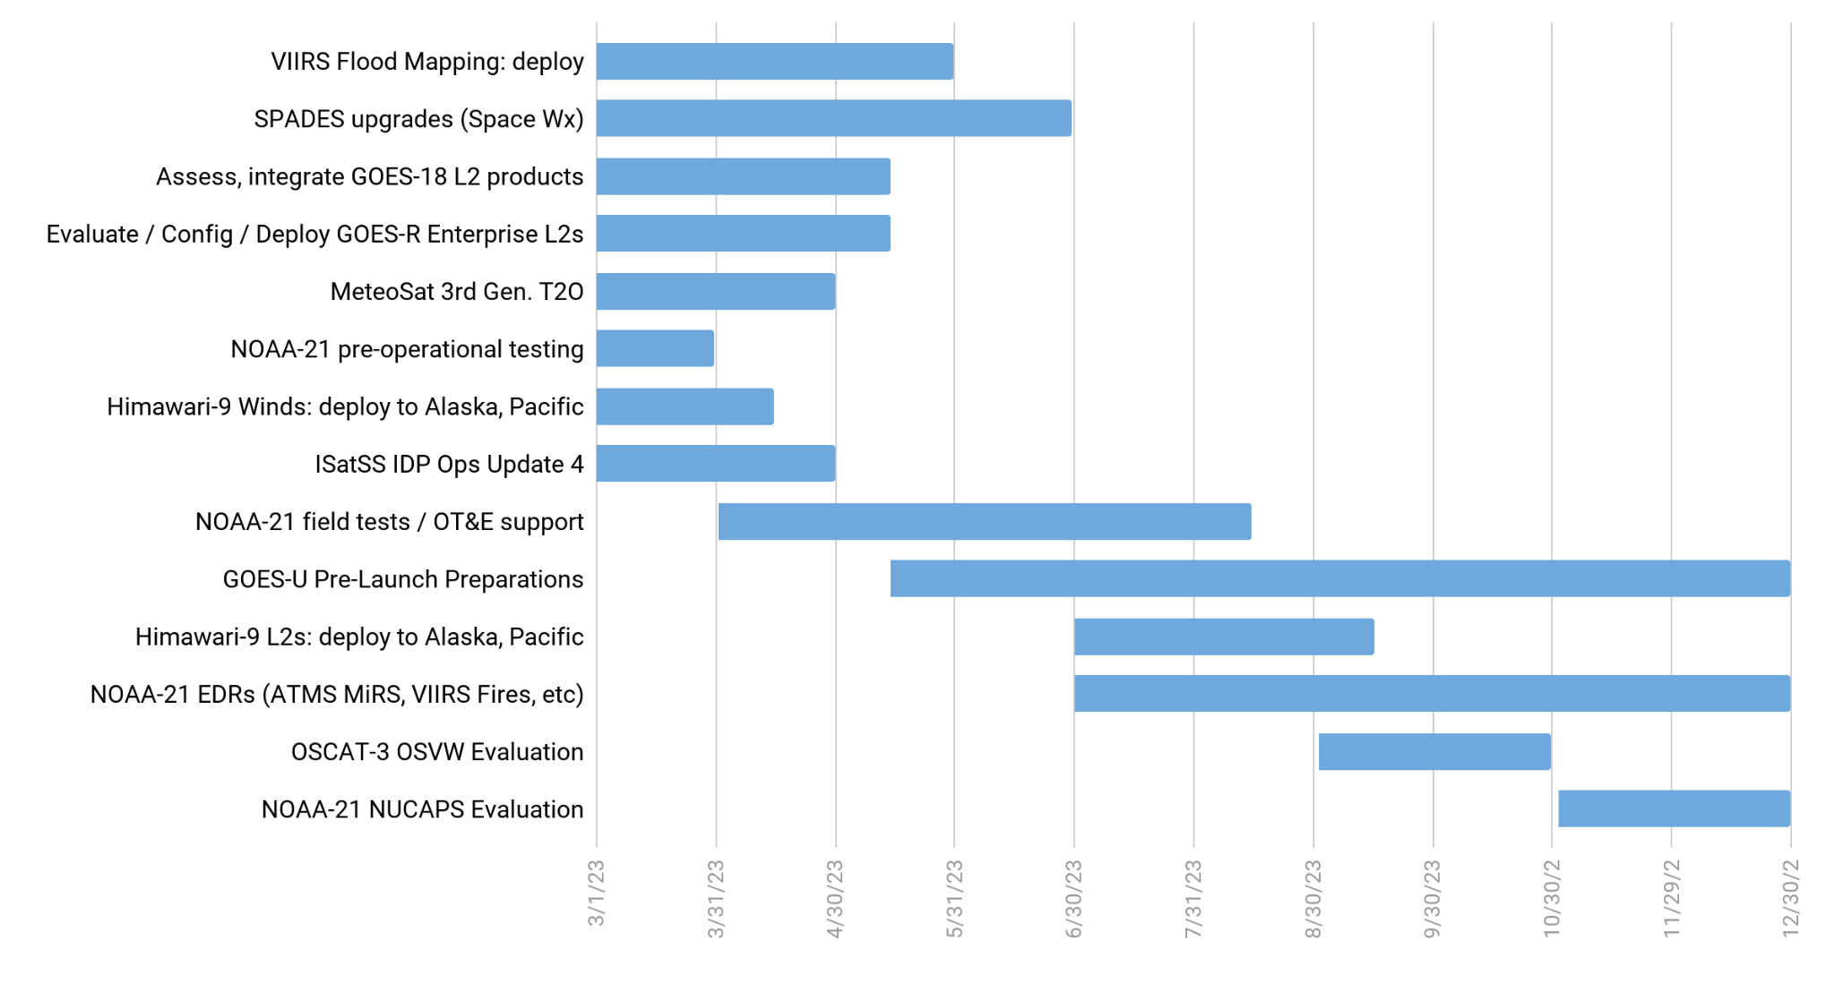
TOWR-S Activity Plan
CY2023
Mar | Apr | May | Jun | Jul | Aug | Sep | Oct | Nov | Dec
Mar. 31, 2023
Return to overview

Slide 32
Contact Information
Office of Observations
Brian Gockel – brian.gockel@noaa.gov
Jordan Gerth – jordan.gerth@noaa.gov
Total Operational Weather Readiness – Satellites (TOWR-S) Team
John Evans – john.d.evans@noaa.gov
Lee Byerle – lee.byerle@noaa.gov
Links
NWSChat (“towr-s” chatroom)
TOWR-S in the NOAA VLab
Return to overview

Slide 33
Next TOWR-S Update
(tentative)
June 30, 2023
Return to overview

