Slide 1
TOWR-S Update
June 23, 2023
https://meet.google.com/thn-pkwe-wbr
Best viewed in Google Slides.
All are invited to insert comments.

Slide 2
Overview
1. NOAA-21 Transition to Operations
Alaska; Other WFOs and RFCs; Pacific Region; National Centers
NWS Operational Test & Evaluation
Product maturity schedule; Product Operations plan
2. Recent and upcoming satellite data product changes
VIIRS Flood maps
GOES-R L2 Enterprise products
Himawari-9 L2 cloud products
GOES-R Satellite Cloud Products
3. Recent and upcoming satellite launches
4. Upcoming TOWR-S resources
TOWR-S RPM v24
AWIPS Pre-Processor (APP)
ISatSS updates
Appendix
TOWR-S Satellite Book Club
Product Posture
Monthly newsletter
Cloud AWIPS for Collaboration
Activity plan

Slide 3
NOAA-21 Transition to operations

Slide 4
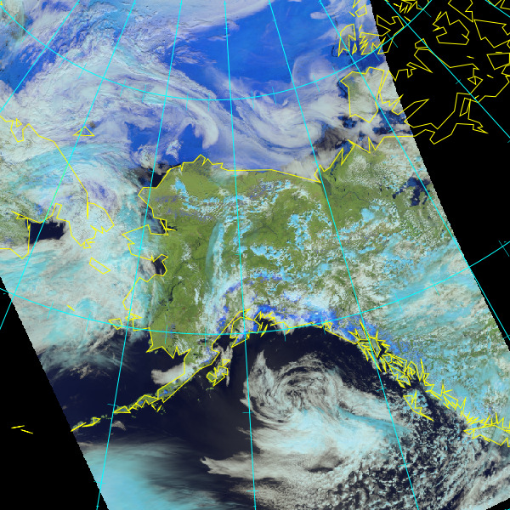
NOAA-21 Transition to Operations (T2O): Alaska
Direct Readout via 2 antennas in/near Fairbanks, Alaska ("Sandy Dog" @ Gilmore Creek / "Big Dog" on UAF Campus)
Geographic Information Network of Alaska (GINA) is producing NOAA-21 VIIRS imagery and other NOAA-21 data products, and sending VIIRS image tiles to NWS
NWS Alaska Reg. HQ installed the Community Satellite Processing Package (CSPP) v4.0 on June 20th, began producing NOAA-21 data products and sending them to AWIPS.
Dissemination of VIIRS Imagery "Key Performance Parameters" (KPPs)* to Alaska Reg. HQ from NESDIS/PDA
Activated feed across terrestrial networks on June 8, 2023
(* VIIRS I1, I3, I4, I5, M14, M15, M16, and DNB / NCC imagery granules for the Alaska Region, tailored for AWIPS. See AWIPS/VIIRS Imagery Tailoring Specifications)
NOAA-21 VIIRS Snowmelt RGB (via GINA)
2023/06/17 14:08 AKDT (22:08 GMT)
Return to overview

Slide 5
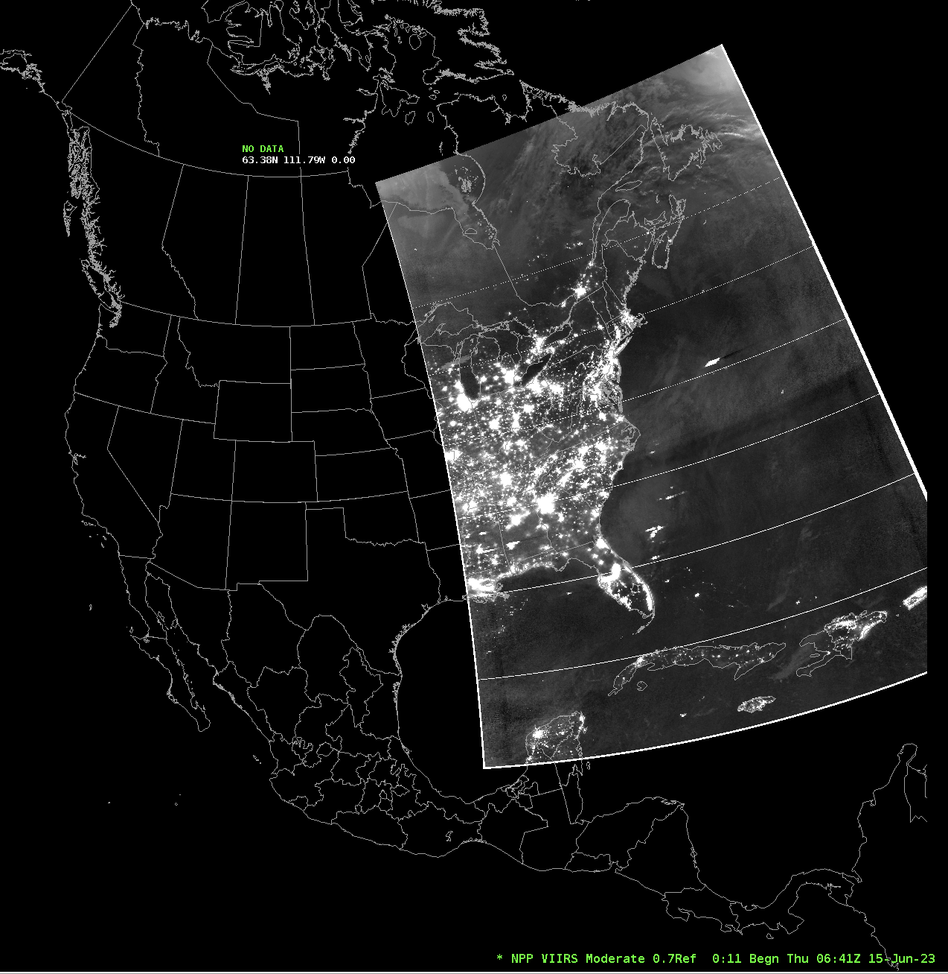
NOAA-21 T2O: WFOs and RFCs
NOAA-21 VIIRS NCC imagery will be disseminated on the Satellite Broadcast Network (SBN) starting on July 10, 2023. (see NWS Service Change Notice SCN23-64)
NOAA-21 VIIRS observations of the CONUS, Pacific, and Puerto Rico regions, tailored for AWIPS
S-NPP NCC Imagery will remain on SBN
In AWIPS CAVE, "S-NPP …" menu entries will display VIIRS NCC imagery from both S-NPP and NOAA-21
Until menu entries are updated by TOWR-S RPM v24 (available in late July)
TOWR-S is preparing to send NOAA-21 VIIRS Active Fires to AWIPS sites via NWS Regional LDM
in the July timeframe, alongside VIIRS Active Fires from S-NPP and NOAA-20
Other NOAA-21 products coming to SBN this fall / winter:
VIIRS Flood Maps
NUCAPS soundings (alongside NOAA-20 NUCAPS)
Global Blended Hydro Products with NOAA-21 inputs
Others TBD
Return to overview

Slide 6
NOAA-21 T2O: Pacific Region & National Ctrs.
Direct Readout systems in the Pacific Region: Hawaii, Guam
NWS Pacific Region HQ is receiving NOAA-21 data products from 2 DR antennas in Honolulu (NOAA Daniel K. Inouye Regional Center and Honolulu Community College) and evaluating them in AWIPS.
Guam DR plans system updates to allow AWIPS integration of NOAA-21 data products.
National Centers
Several (AWC, NHC, etc.) have direct PDA subscriptions
Some rely on postprocessing by ISatSS (e.g., MiRS tiles for Nat’l Hurricane Ctr.)
… in particular for use in NAWIPS (legacy / precursor to AWIPS2)
Return to overview

Slide 7
NOAA-21 T2O: NWS Operational Test & Evaluation
OT&E purpose: validate operational requirements independently from end to end in a live environment. Advise recommendation on full deployment to forecast operations.
Phase 1 (~ Aug. 7 to Sept. 22, 2023):
NOAA-21 VIIRS imagery for Alaska via Direct Readout / CSPP
NOAA-21 VIIRS KPP imagery for Alaska from NESDIS -> NCF (terrestrial)
NOAA-21 VIIRS NCC Imagery for CONUS, Pacific, Puerto Rico regions via SBN
Phase 2 (~ Dec. 1, 2023 to Jan. 4, 2024):
NOAA-21 VIIRS imagery with NOAA-21 in Primary role / new orbit
Blended Hydro products w/ NOAA-21 inputs
Phase 3 (~ Feb. 1 to Mar. 6, 2024):
NOAA-21 NUCAPS soundings
6 OT&E test sites:
Alaska Region HQ
WFO Medford, OR
WFO Gaylord, MI
WFO Houston/Galveston, TX
WFO Buffalo, NY
RFC Portland, OR
Return to overview

Slide 8
NOAA-21 T2O: Product Maturity timeline
CY2022 |  | CY2023 |  |  |  |  |  |  |  |  |  |  |  | CY2024 |  |  |  |  |  |  |  |  |  |  |  | CY2025
N | D | J | F | M | A | M | J | J | A | S | O | N | D | J | F | M | A | M | J | J | A | S | O | N | D | J | F | M | A | M | J | J
Not all of these products will be made available in AWIPS.
Of those that are, some will be on the SBN; others may reach AWIPS sites via LDM, Cloud, or other mechanisms.
June 23, 2023
(source: NOAA-21 Post-launch Product Validation Schedule - updated 2023-06-05
See also STAR / JPSS Algorithm Maturity Matrix - updated 2023-06-15)
Return to overview

Slide 9
NOAA-21 T2O and the JPSS Constellation
Launch, Early Orbit and Activation (LEO&A) (Launch to L+90 days)
From the JPSS-2 Product Operations Plan
after J. McNitt et al.
June 23, 2023
November 10, 2022
March 30, 2023
July - August 2023
Fall 2023 / Winter 2024
Return to overview

Slide 10
2. Recent and upcoming satellite data product changes

Slide 11
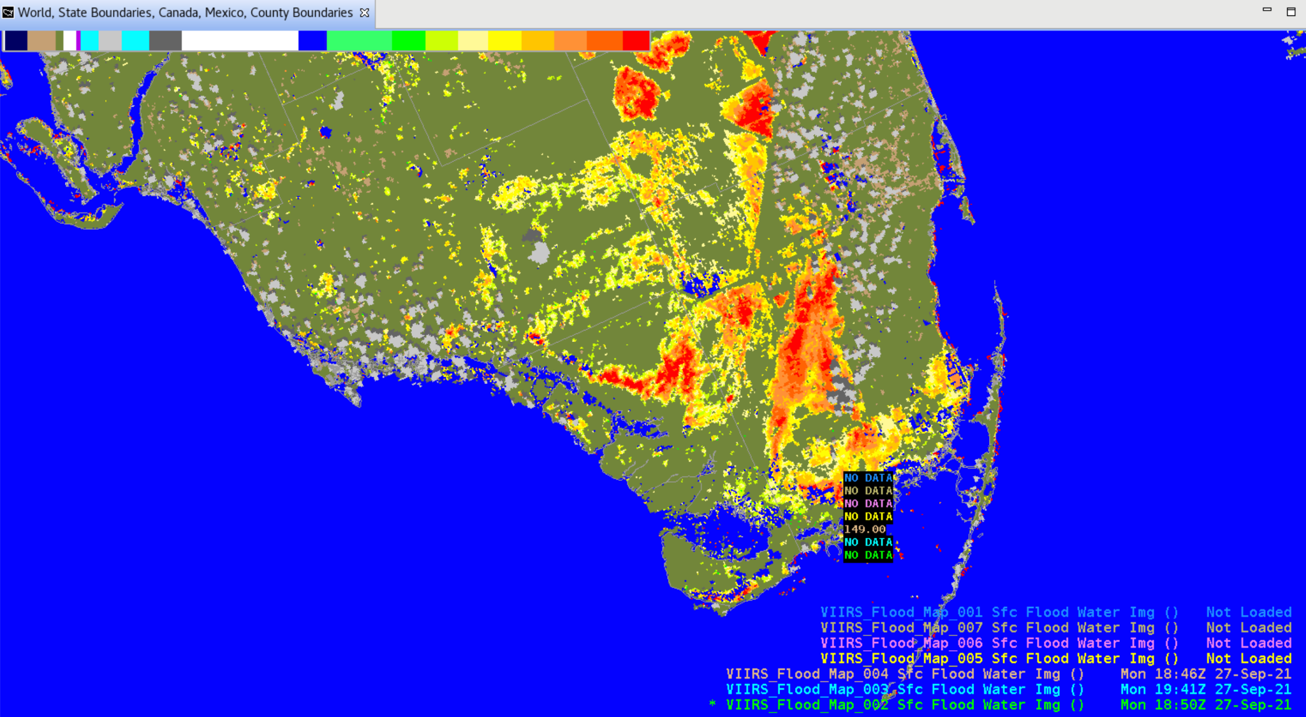
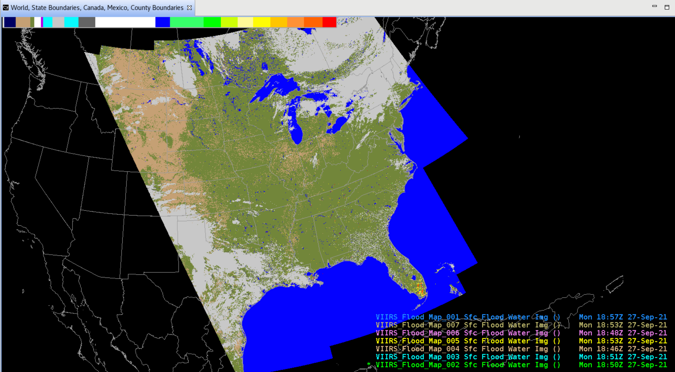
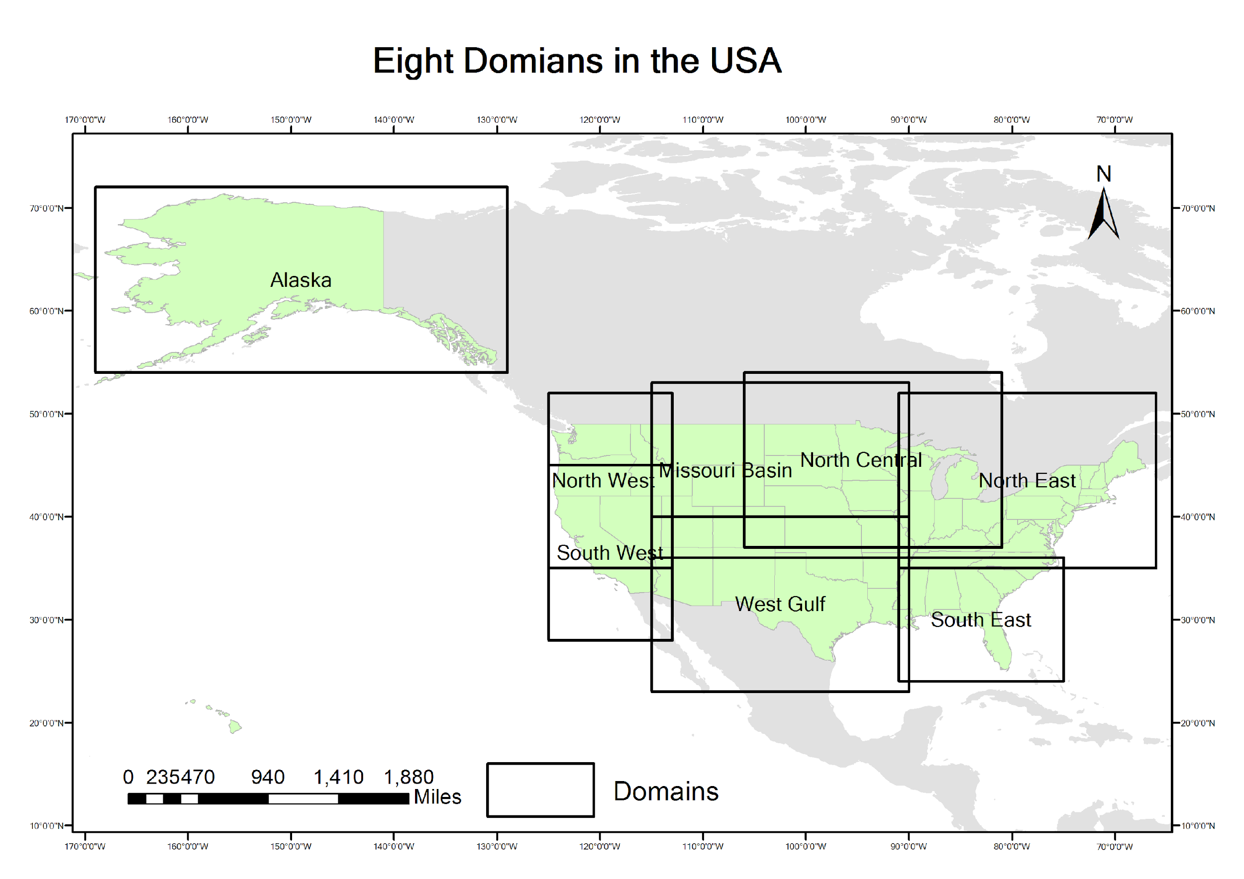
S-NPP and NOAA-20 VIIRS Flood Maps
VIIRS Flood Maps from NOAA-20 and S-NPP are going to all AWIPS sites via the NWS Regional LDM.
Site configuration instructions
New Dataset Guide on VLab
Most sites configure LDM (pqact.conf file) to bring in only one or two of the regional mosaics
This limits memory overload from high-resolution lon-lat grids
VIIRS Flood Maps: 8 NWS regional mosaics
h/t Derek van Pelt
Return to overview

Slide 12
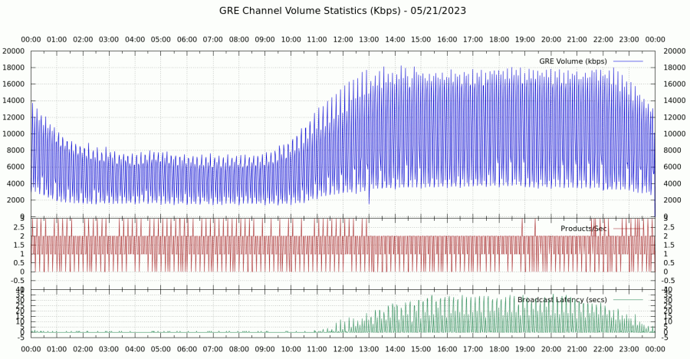
Enhanced compression of GOES-R data products
As of May 23, lossless “shuffle” compression of GOES-R imagery (SCMI) has reduced GOES-R imagery data volumes on SBN by nearly 27GB/day (~20%).
Peak SBN loading and latencies have dropped significantly; product throughput has increased
Note: Gridded GLM and most GOES-R L2 derived products have also been shuffle-compressed since March / April 2023.
Shuffle-compression of these L2 products resulted in no significant data-volume savings. However …
A few L2 products were not shuffle-compressed:
Fog & Low Stratus
Legacy Vertical Profiles
Derived Motion Winds
Shuffle-compression of L.V.Profiles & D.M.Winds would yield significant add'l volume savings
Minute-by-minute SBN loading (kbps), throughput (files/sec), and latency (seconds) on the SBN GOES-R East (GRE) channel. (GRW channel is similar.)
Return to overview

Slide 13
New GOES-R Enterprise L2 products
Enterprise products apply improved science and greater consistency with other satellite sensors.
Some Enterprise products are "drop-in" replacements for current ones; some are new products; some have changed data structures, or greater spatial resolution or temporal frequency.
New Enterprise products on SBN: (see SCN23-42)
Fractional Snow Cover (on SBN as of June 6, 2023)
Ice Concentration & Extent (on SBN as of June 6, 2023)
Ice Age & Thickness (on SBN as of June 6, 2023)
New Enterprise products being considered for AWIPS:
10km >2km Cloud Top Height
10km >2km Cloud Top Pressure
4km >2km Cloud Optical Microphysics
We will solicit user feedback on these products
More Enterprise products coming soon: (supported by TOWR-S RPM v24)
Cloud Cover Layers
CONUS & FD: hourly @ 10km
Meso: 5-minute @ 4km
Aerosol Detection (incl. CONUS @ 5min, Meso @ 1min)
Rainfall Rate
Aerosol Optical Depth
June 23, 2023
From GOES-R PRO PASS Dev’t Schedule, updated 2023/06/13
Return to overview

Slide 14
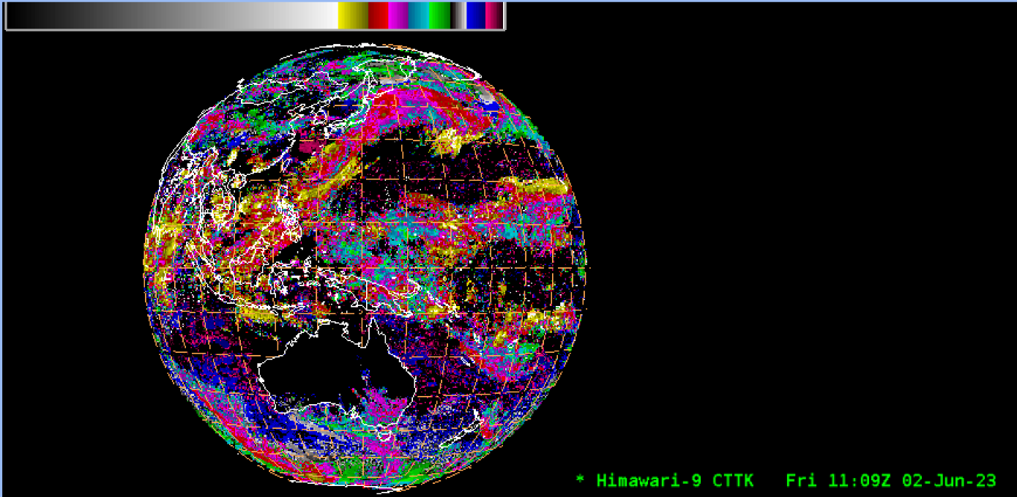
Himawari-9 Winds and other L2 products
Pacific Region has been receiving pre-operational Himawari-9 Derived Motion Winds from STAR since Apr. 19
As of June 13, 2023, OSPO is producing operational H-9 Winds and cloud L2 products (in AWIPS-friendly product contents & formats)
H-9 Cloud Top Phase
H-9 Cloud Top Height
H-9 Clear Sky Mask
H-9 Cloud Top Temperature
H-9 Cloud Top Pressure
H-9 Cloud Optical Depth
Now preparing to send these cloud products from NESDIS to Pacific Region users via LDM
~late June / early July
h/t Derek Van Pelt
Near-Real-Time Himawari-9 Cloud Top Temperatures in AWIPS (June 2, 2023)
(Image was from preliminary, non-operational data. Please do not distribute.)
Return to overview

Slide 15
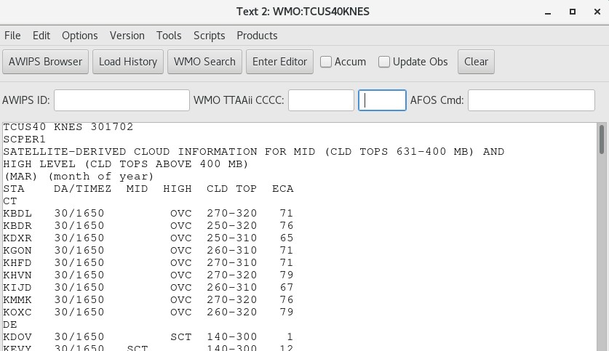
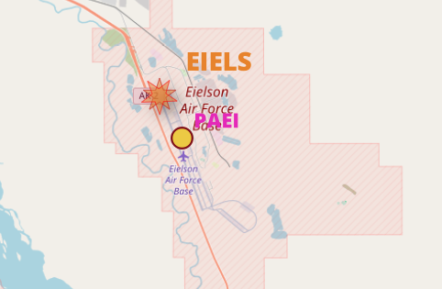
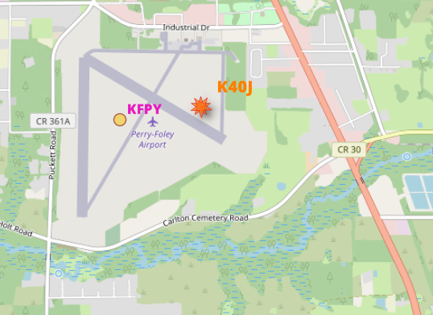
GOES-R Satellite Cloud Products (SCP): Towards improved maintenance
Background:
NESDIS produces hourly reports of cloud cover above ~2,000 surface weather stations (ASOS, AWOS, etc.) across the U.S. and beyond. These Satellite Cloud Products are used in TAFs (Terminal Aerodrome Forecasts) and published via weather.gov and NOAA Weather Radio.
The list of stations (originally provided by NWS many years ago) has not been consistently maintained; so as stations have come and gone, or changed their locations or callsigns, the SCP product hasn't had a good way to keep abreast of these changes.
Meanwhile NWS actively maintains its own list of (~4,000) weather stations as part of the AWIPS National Datasets Maintenance (NDM) project.
The TOWR-S team is now working with the SCP team in NESDIS to facilitate their use of the AWIPS NDM station list.
This will lead to SCPs for a more comprehensive, current, & accurate set of station locations – updated on a routine / regular basis.
Likely starting in the August / September timeframe: NDE is currently testing an NDM-based station list for use by the SCP algorithm

Slide 16
3. Recent and upcoming satellite launches

Slide 17
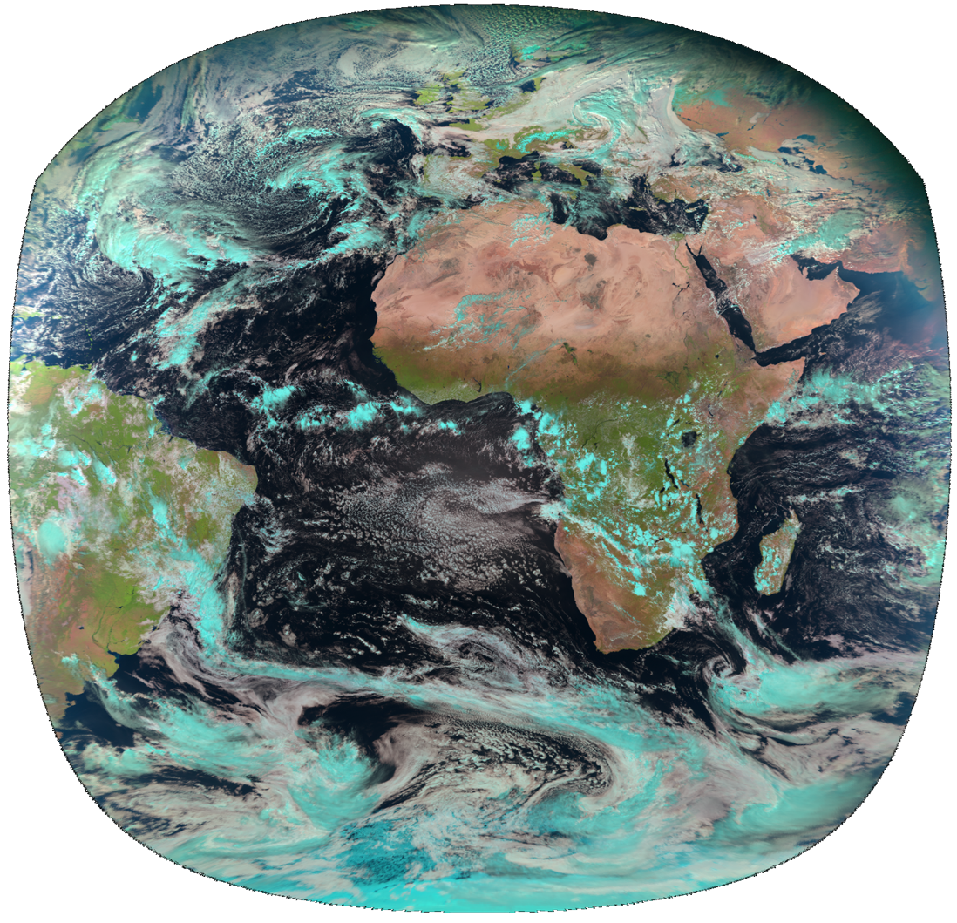
Recent and upcoming satellite launches
OceanSat-3 (a.k.a. EOS-06) launched Nov. 26, 2022.
The OSCAT-3 scatterometer will fill the gap left when SCATSAT ceased operations in Feb. 2021.
(MeteoSat 3rd Gen.) MTG-Imager 1 launched Dec. 13, 2022.
Geostationary @ Longitude 0°
See MTG-I1 data availability schedule
GOES-U scheduled to launch April 30, 2024
Checkout at Longitude ~89.5°; then into storage
Eventual operations as GOES-East or GOES-West
(Metop 2nd Gen.) Metop-SG-A1 to launch 1st Q. CY2025.
Sun-synchronous polar (morning) orbit
h/t: V Wegman
The view from Longitude 0° (MeteoSat-11)
Return to overview

Slide 18
3. Upcoming TOWR-S resources

Slide 19
Coming soon: TOWR-S RPM v24
Target release: late July 2023
Support for ingest / display of new products
New GOES-R Cloud Cover Layers product
Other new GOES-R Enterprise products
New Polar Blended Hydro products (w/ Metop-C, NOAA-21 data)
GOES-R Turbulence contour lines
Sectors and basemap for GOES-R Storage slot (105° Longitude)
Global ASCAT Winds from Metop-B and Metop-C?
New / changed menu entries
NOAA-21 VIIRS imagery
Combine VIIRS menu entries (merge S-NPP, NOAA-20, NOAA-21)
Remove menu entries for GOES-West Hawaii regional sector
Remove menu entries for GOES-East Puerto Rico sector Bands 11, 12, 14, 16 and RGB / Channel Difference composites that use those bands
Add menu entry for American Samoa sector Band 13
WPC Day 4-5 Outlook Svc enhancement
GOES-R Storage slot @ 105° Longitude

Slide 20
Coming soon: APP (AWIPS Pre-Processor)
APP = a small bundle of software running alongside AWIPS, that can automate site configurations and manipulate incoming data products – e.g., to
Produce CIRA Geocolor imagery from GOES-16/18 ABI channels 1, 2, 3, 7, and 13;
Compute GLM 5-minute accumulations (FED/TOE/MFA) from 1-min GLM grids;
Adjust pqact entries to get new data products via the SBN or NWS Regional LDM
This avoids sending data over SBN or LDM that could be computed locally (from data already received)
Tentative schedule:
Currently running at 23 sites
Goal: installed in all/most AWIPS sites by Sept. 2023

Slide 21
ISatSS in IDP and NWS National Centers
Completed:
IDP: Himawari 9 imagery (and updated ISatSS to v5.0 code base)
IDP: Retired AHIproc (legacy Himawari tiled imagery)
AWC: Global Mosaics for NAWIPS and websites
OPC: Meteosat 9/10 imagery
SPC: Replaced legacy GeoRGE with mojo/mm_george
In progress at National Centers:
NHC: Meteosat-based ProxyVis; Global IR Mosaics
AWC: Test ISatSS on RHEL 9
OPC: ProxyVis G16/18 AWIPS tiles
OPC: Geocolor G16/18 AWIPS tiles
SAB: SSMIS imagery and RGBs
SAB: GPM GMI
TOWR-S Configuration Control Board
Meets monthly to get input from stakeholders (on ISatSS, RPMs, MMM, APP)
OPC/SAB: FG16/G18 Full Disk Fog & Low Stratus
OPC/SAB: AMSR-2 Ocean & MBT
OPC/SAB: ATMS 88GHz Qv imagery
OPC/SAB: Jason-3 Wave altimetry
OPC/SAB: Sentinel-6a Wave altimetry
Return to overview
Notes:
Integrated Dissemination Platform Satellite Support System (ISatSS)

Slide 22
Appendix

Slide 23
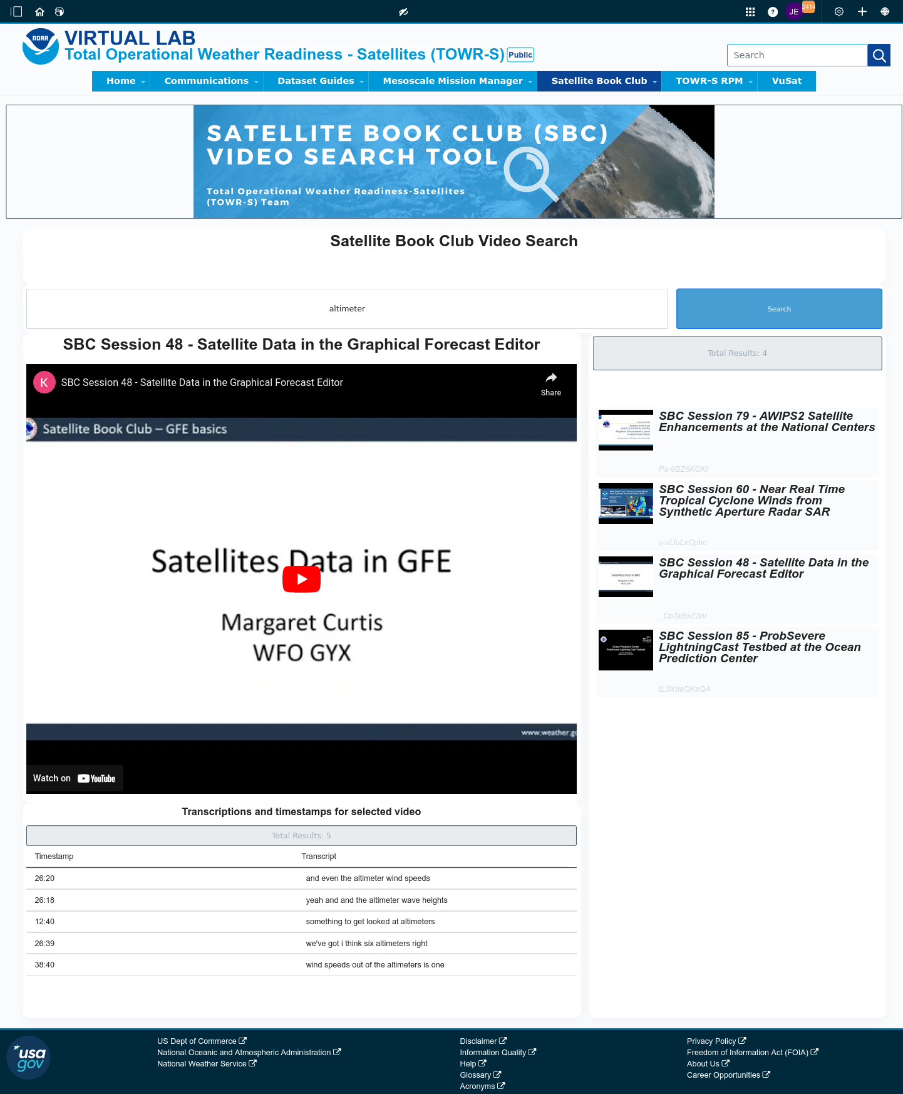
Satellite Book Club (SBC) Seminar Series
Thursdays, usually at Noon ET
Usage examples shed light on user requirements for satellite data products and capabilities.
Recordings are on YouTube and the NWS Commerce Learning Center (CLC) website.
Full-text transcripts are available for all SBC sessions – searchable from within VLab.
SBC videos are now searchable by keyword: https://vlab.noaa.gov/web/towr-s/sbc-video-search
Return to overview

Slide 24
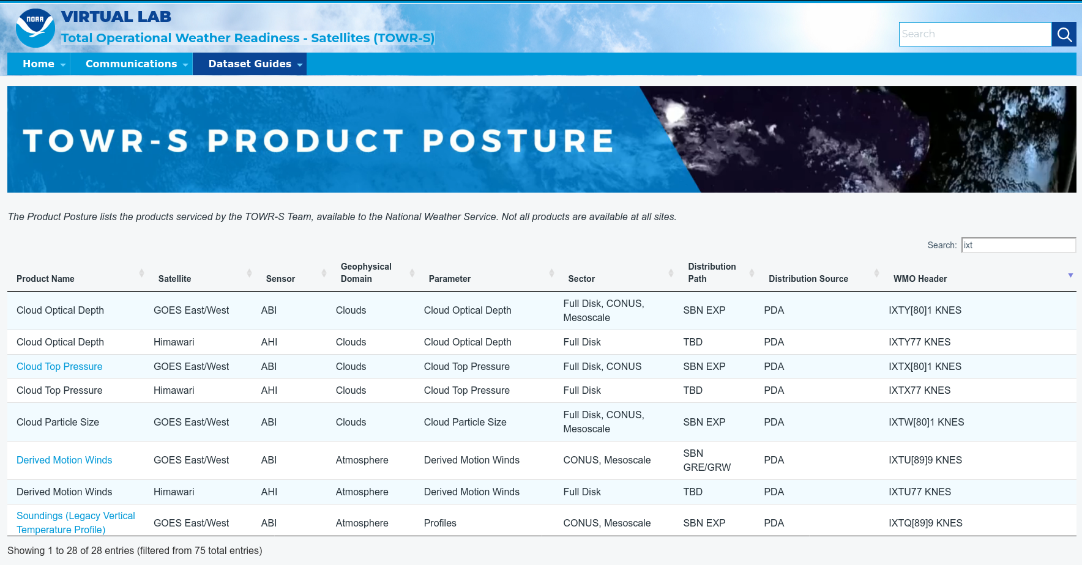
TOWR-S Product Posture
VLab now hosts a table of all satellite data products that TOWR-S is involved with (integrating them into NWS forecast operations).
Instant search, filter, and sort capability provides access by keyword, satellite, sensor, etc.
Many rows link to Dataset Guides with more AWIPS details.
Note: Distribution Path “TBD” indicates a product in planning - not yet disseminated to users
https://vlab.noaa.gov/web/towr-s/product-posture
Return to overview

Slide 25
TOWR-S monthly news
Supplements the quarterly TOWR-S Update briefings and the weekly / occasional TOWR-S mailers.
Emailed to TOWR-S Update attendees and posted to VLab. (https://vlab.noaa.gov/web/towr-s/communications)
Return to overview

Slide 26
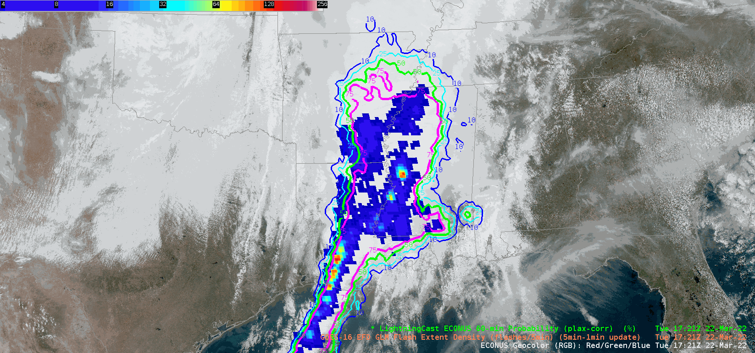
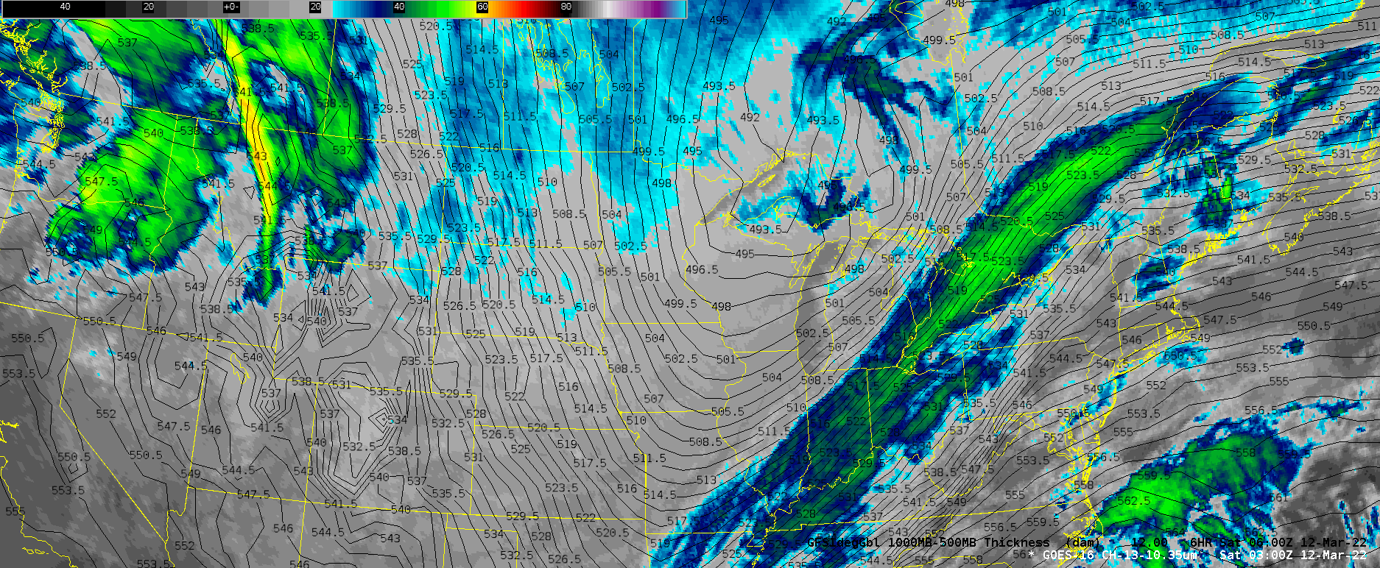
Cloud-based AWIPS for Collaboration
TOWR-S team has an initiative to bring people together in shared AWIPS sessions to foster collaboration on how satellite data can enhance the NWS mission.
TOWR-S facilitates small groups of forecasters, technique development meteorologists, and algorithm developers from across the NWS and NESDIS.
More details are in Satellite Book Club Session 38.
Please contact Lee Byerle to schedule a session with your office.
h/t: Lee Byerle
Return to overview

Slide 27
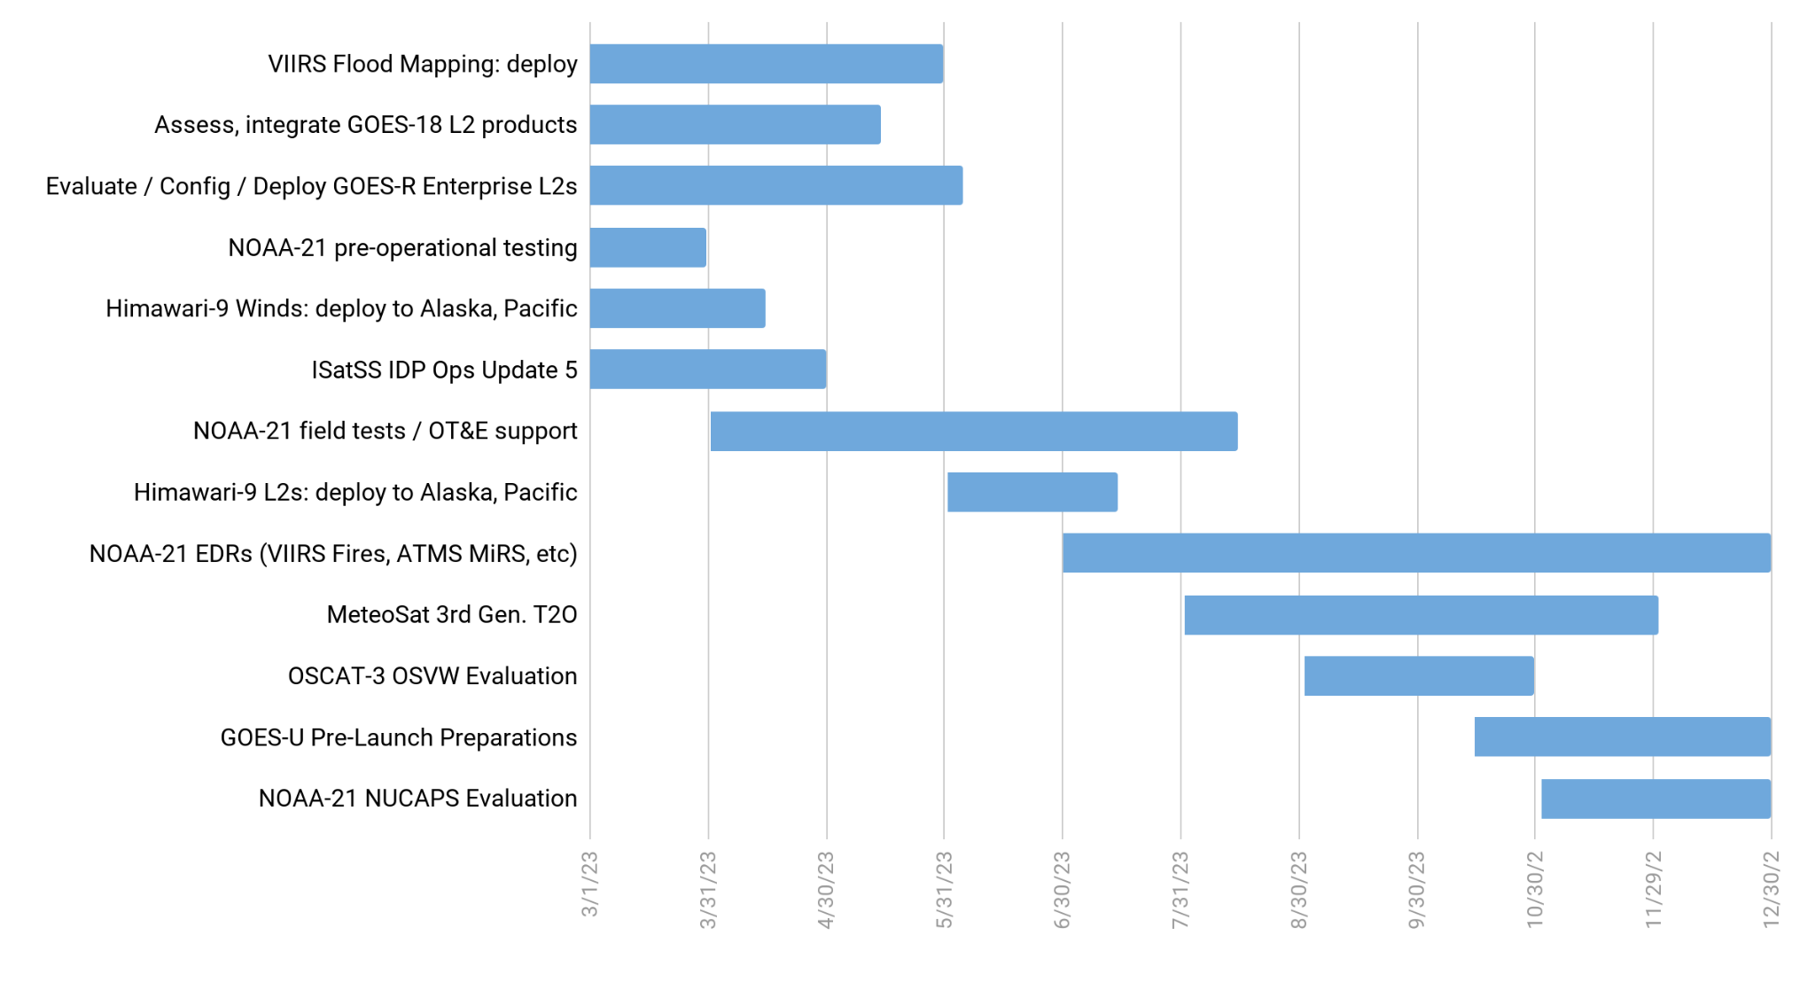
TOWR-S Activity Plan
CY2023
Mar | Apr | May | Jun | Jul | Aug | Sep | Oct | Nov | Dec
June 23, 2023
“It's tough to make predictions, especially about the future.”
― Yogi Berra
Return to overview

Slide 28
Contact Information
Office of Observations
Brian Gockel – brian.gockel@noaa.gov
Jordan Gerth – jordan.gerth@noaa.gov
Total Operational Weather Readiness – Satellites (TOWR-S) Team
John Evans – john.d.evans@noaa.gov
Lee Byerle – lee.byerle@noaa.gov
Links
NWSChat (“towr-s” chatroom)
TOWR-S in the NOAA VLab
Return to overview

Slide 29
Next TOWR-S Update
(tentative)
Sept. 29, 2023
Return to overview

