Slide 1
TOWR-S Update
December 15, 2023
https://meet.google.com/thn-pkwe-wbr
Best viewed in Google Slides.
All are invited to insert comments.

Slide 2
Overview
1. TOWR-S resources and activities
2. Operational note: Recent GLM artifacts
3. New / upcoming satellite data products
4. NOAA-21 Transition to Operations
5. New / upcoming satellites
Appendix

Slide 3
New TOWR-S resources

Slide 4
Please install TOWR-S RPM v24
NWS WFOs and RFCs: please contact Emily Maddox or join the TOWR-S Slack Room (https://nws-internal.slack.com/#towr-s) to find out about installing this RPM and APP.
Support for new products in AWIPS:
New GOES-R Cloud Cover Layers (quick guide)
Sectors and basemap for GOES-R Storage slot (105°W)
Updates GOES-14 NH/NA/US menus (for contingency)
NESDIS Blended Snowfall Rate (LDM via SPoRT) (Conus)
Upcoming GOES-R L2 products: Enterprise Aerosol Optical Depth, Aerosol Detection, Ice Motion
AWIPS configuration changes:
GOES-R Enterprise Cloud Particle Size ("PSD" >"CPS")
Gridded NUCAPS: Lapse Rates fix
Polar Blended Hydro products w/ Metop-C, NOAA-21 inputs
Improved handling of VIIRS imagery
Reduce overlap between successive overpasses
Avoid misplaced granules
New / changed CAVE menu entries:
VIIRS imagery from NOAA-21, NOAA-20, S-NPP
Change "SNPP …" to "S-NPP / NOAA-21 …"
Combine NOAA-21, NOAA-20, S-NPP imagery
Remove GOES-West Hawaii regional sector
Remove GOES-East Puerto Rico sector Bands 11, 12, 14, 16 (and imagery composites that use those bands)
Hide: AMSR-2 and ATMS derived products (Conus only)
WPC Excessive Rainfall Outlook (5-day vs 3)
GOES-R Storage slot Menus (@ 105° Longitude)
Includes Alaska Region Customizations (for Alaska version of RPM)
And the AWIPS Pre-Processor ("APP")
… see next slide

Slide 5
APP (AWIPS Pre-Processor)
APP = a small bundle of software running alongside AWIPS, that can automate site configurations and manipulate incoming data products – e.g., to
Produce CIRA Geocolor imagery from GOES-East/West ABI channels 1, 2, 3, 7, and 13;
Compute GLM 5-minute accumulations (FED/TOE/MFA) from 1-min GLM grids;
Adjust each site's LDM pqact entries to get new data products via the SBN or NWS Regional LDM
This avoids sending data over SBN or LDM that could be computed locally (from data already received)

Slide 6
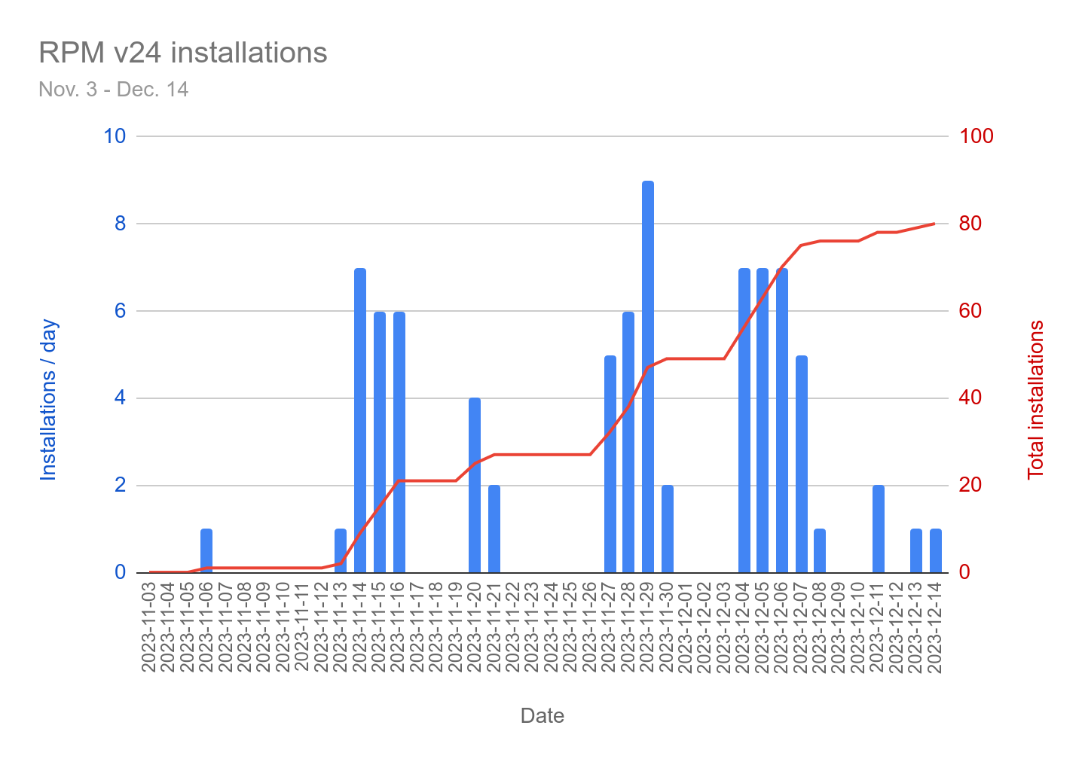
Deployment of TOWR-S RPM v24 and APP
Installed at 80 sites so far

Slide 7
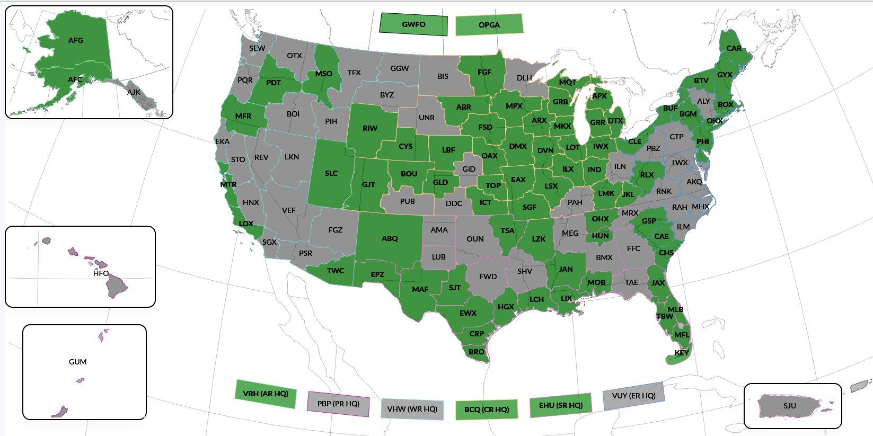
TOWR-S RPMv24 Sites Installed
12/7/2023
NWS WFOs and RFCs: please contact Emily Maddox or join the TOWR-S Slack Room (https://nws-internal.slack.com/#towr-s) to find out about installing this RPM & APP.

Slide 8
ISatSS in IDP and NWS National Centers
ISatSS = Integrated Satellite Support System
Recently completed:
NHC: Meteosat-based ProxyVis
AWC: Test ISatSS on RHEL 9
OPC: ProxyVis G16/18 AWIPS tiles
OPC: Geocolor G16/18 AWIPS tiles
OPC/SAB: Sentinel-6a Wave altimetry
OPC/SAB: G16/G18 Full Disk Fog & Low Stratus
In progress:
NHC: Global IR Mosaics
SAB: SSMIS imagery and RGBs
SAB: GPM GMI
OPC/SAB: AMSR-2 Ocean & MBT
OPC/SAB: ATMS 88GHz Qv imagery
OPC/SAB: Jason-3 Wave altimetry
Return to overview

Slide 9
Operational Note:
False detections by Geospatial Lightning Mapper (GLM)

Slide 10
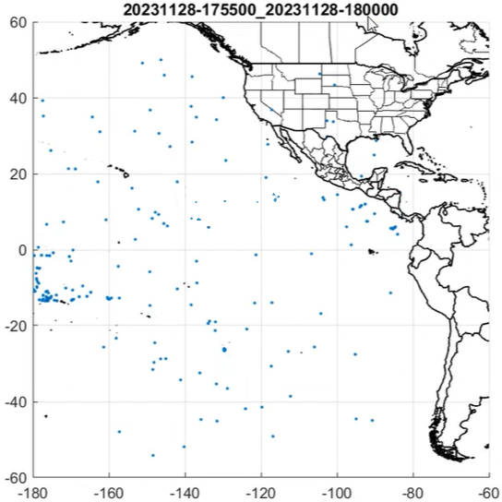
GLM False Detections
GLM is experiencing scattered false detections in all Lightning products delivered to AWIPS, GRB, and PDA
GOES-18 / GOES-West is worse than GOES-16 / GOES-East
Began Nov. 28 @ 17:11z (GOES-16), 17:51z (GOES-18) (see OSPO notice)
Coincides with debut of "DO.13" baseline in the GOES-R Product Generation system
GOES-R program is working intensively with L3Harris to pinpoint the root cause
Most likely related to L2 data processing/filtering; GLM instruments remain in good shape
GOES-West GLM FED 5-minute flash counts
Nov. 28 @ 17:35-17:40z
GOES-West GLM FED 5-minute flash counts
Nov. 28 @ 17:55-18:00z

Slide 11
GLM False Detections
h/t Kashaud Bowman , Lee Byerle

Slide 12
Recent and upcoming satellite data products / changes

Slide 13
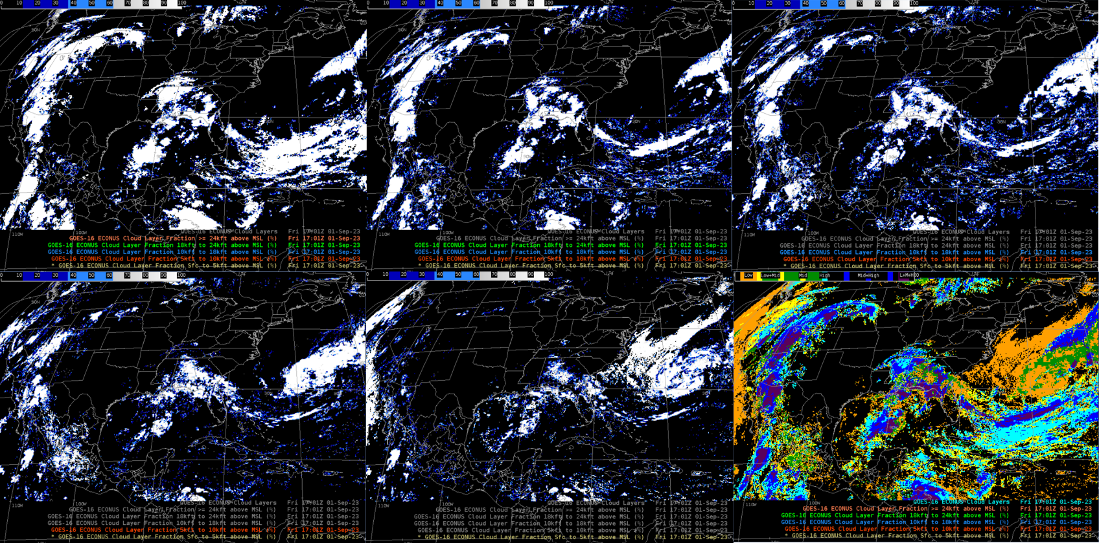
Now on SBN: GOES-East/West Cloud Cover Layers
Cloud fraction estimates in 5 altitude layers:
Full Disk and CONUS sectors: 10 km resolution;
Full Disk: every hour
CONUS: every 5 minutes
Mesoscale sectors: 4km; every 5 minutes
More information can be found in the Dataset Guide or in NWS Service Change Notice SCN23-93.
TOWR-S RPM v24 (see above) configures AWIPS to handle and display this product.
Cloud fraction: above 24 kft
Cloud Fraction: 18 to 24 kft
Cloud fraction: 10 to 18 kft
Cloud fraction: 5 to 10 kft
Cloud fraction: surface to 5 kft
Cloud presence / absence (all layers)
h/t V Wegman
Return to overview

Slide 14
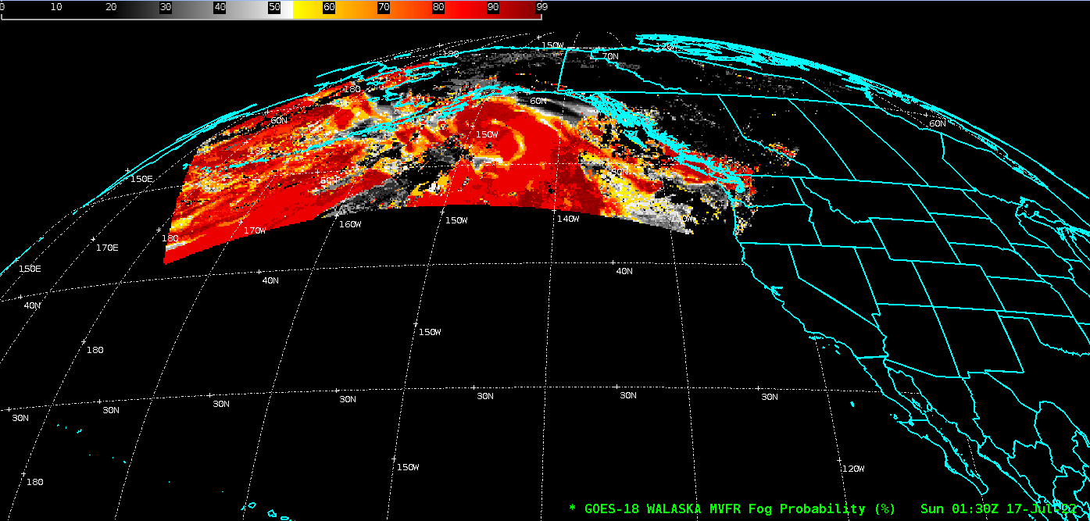
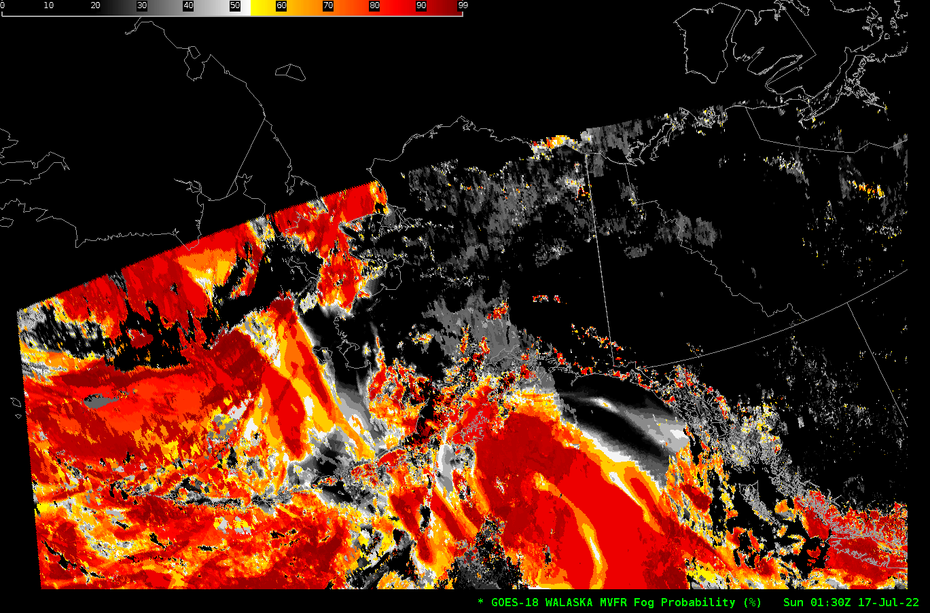
Available soon on PDA: GOES-West Alaska sector Fog & Low Stratus
(polar stereographic)
(GOES-West Geostationary)
This subset of the GOES-West Full Disk product covers the Alaska sector (defined in a Polar Stereographic projection).
Expected Dec. 2023 / Jan. 2024
Return to overview

Slide 15
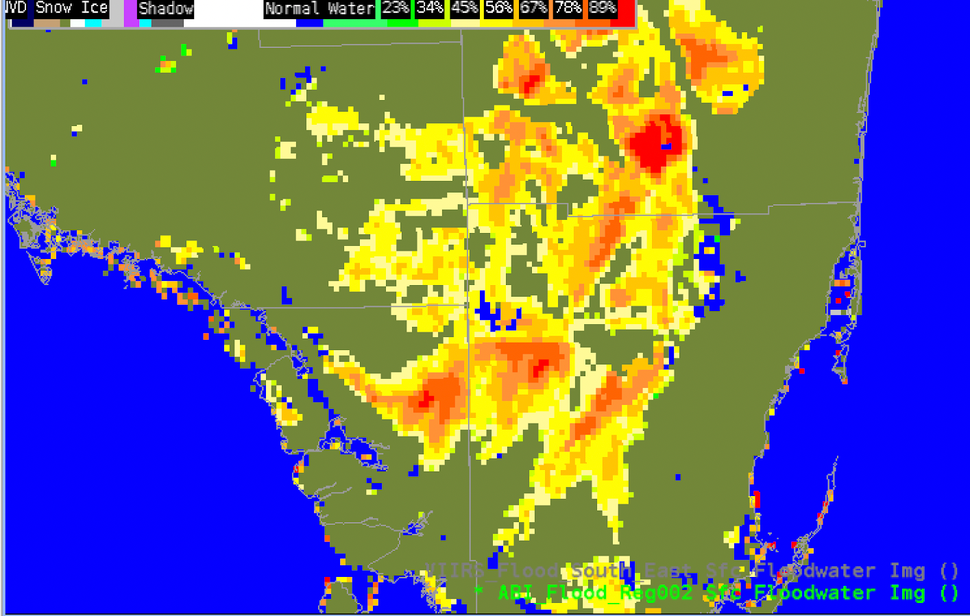
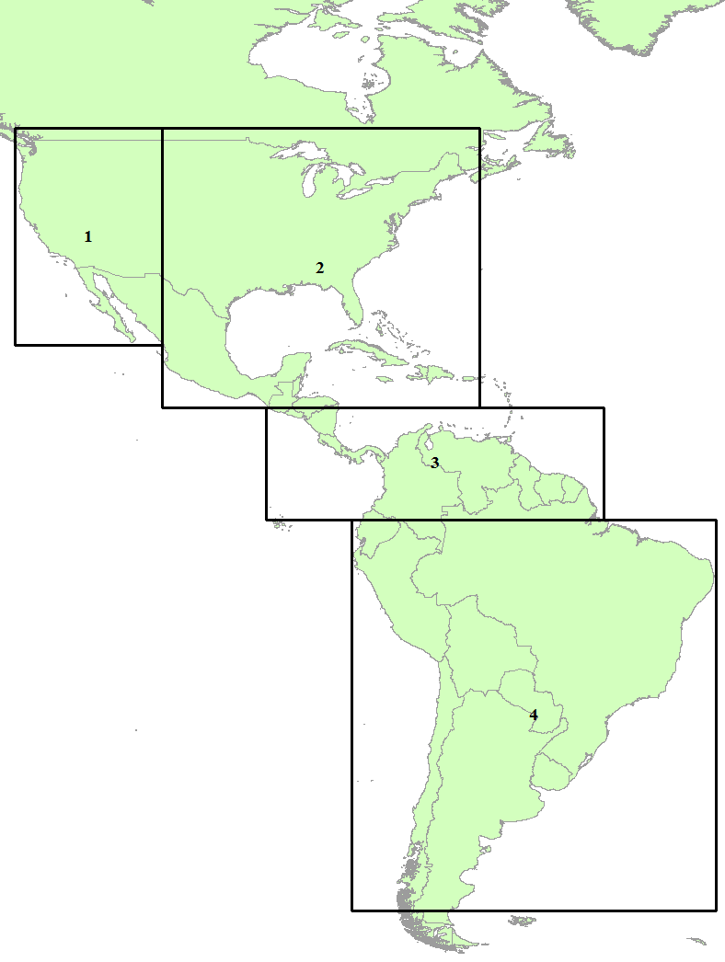
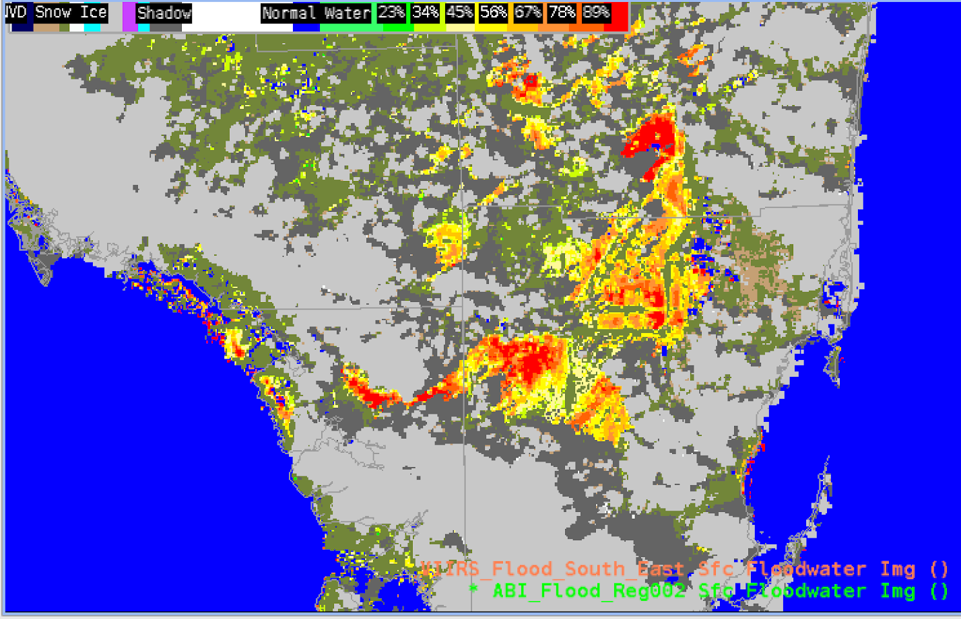
Now in evaluation: GOES-R ABI Flood Maps
Daily and hourly composites: maximum flood fraction between each day's first daytime observations and…
…the last daytime observations (daily); or
…the current hour's observations (hourly)
Preparing to send this over NWS Regional LDM and engage with users at several AWIPS test sites
ABI Flood map
h/t Derek Van Pelt
GOES-East
GOES-West
4 fixed domains
(VIIRS Flood map for comparison)
Cloud clearing through the day

Slide 16
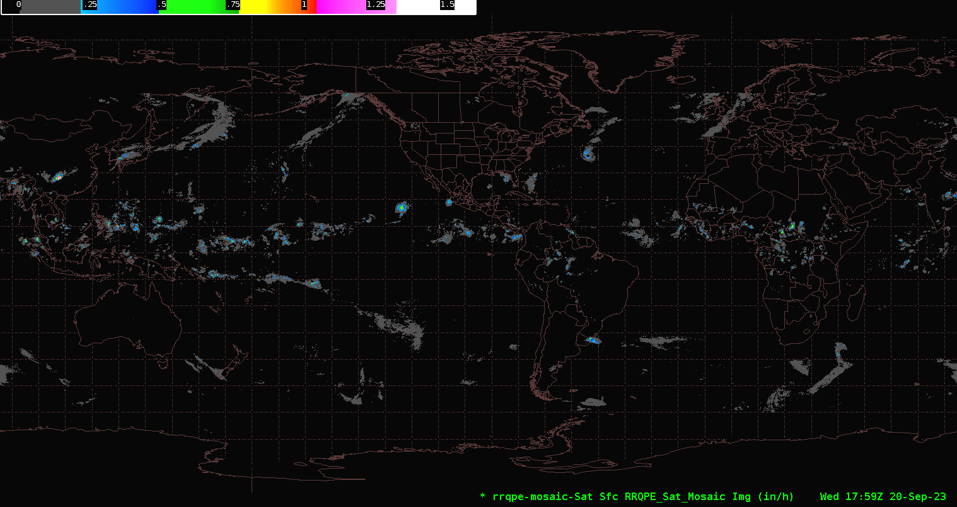
Under evaluation: Global Geo Blended Rainfall Rate
Mosaic of rain rate estimates from Himawari-9, GOES-East, GOES-West, Meteosat-9, and Meteosat-10
Every 10 minutes; also every hour
This would replace the Global Hydro-Estimator (a.k.a. Satellite Precipitation Estimate, SPE) and possibly the Rain Rate / Quantitative Precipitation Estimate (RRQPE) from GOES-East/West
More information on this product can be found in the Satellite Book Club presentation from Bob Kuligowski on Nov. 16, 2023.
Return to overview

Slide 17
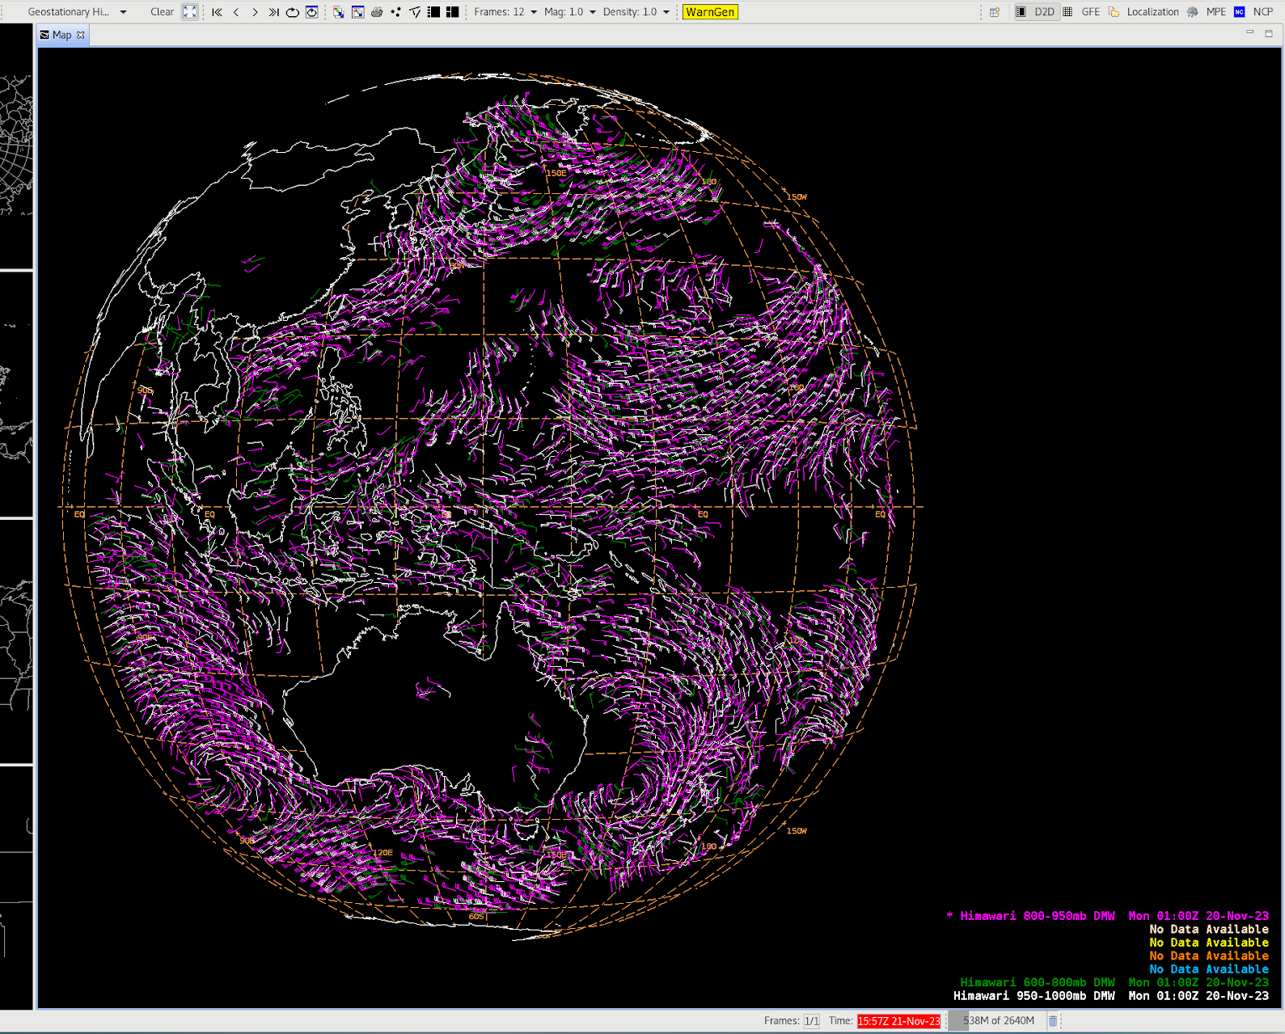
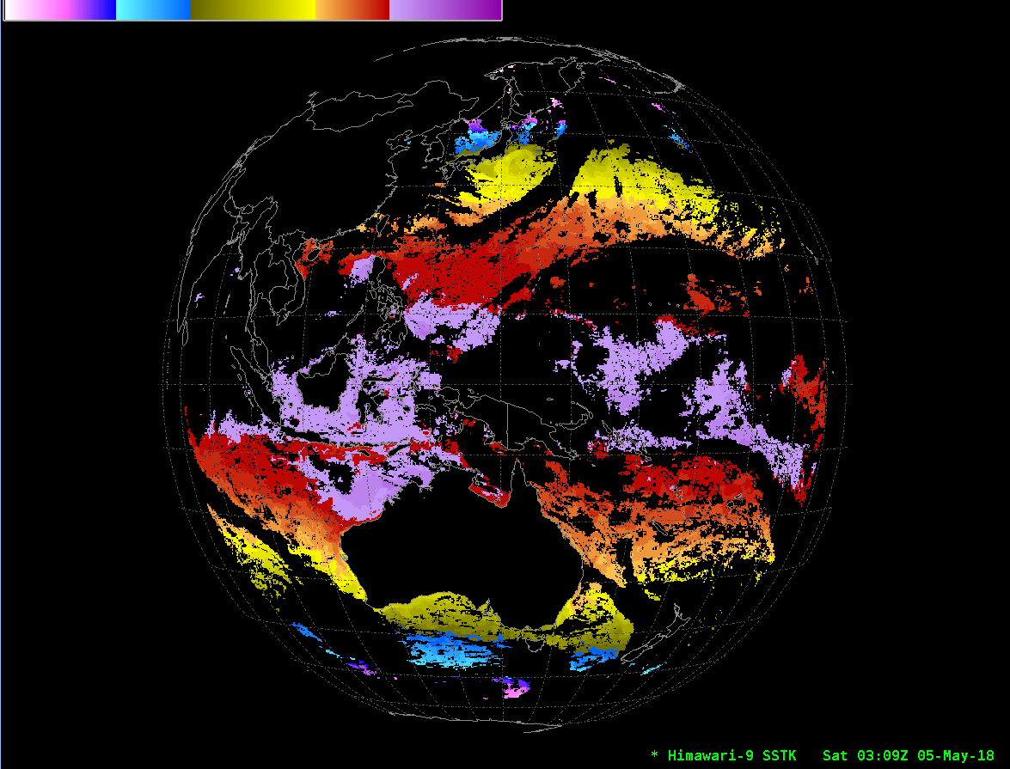
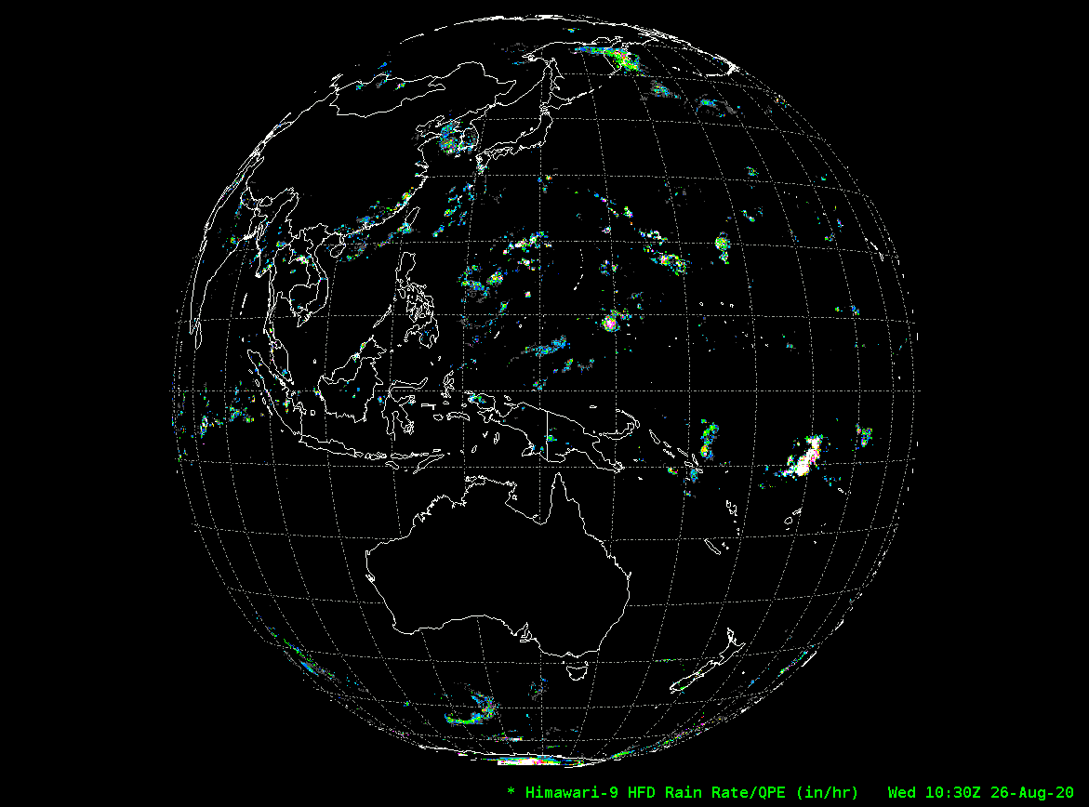
Himawari-9 L2 products -> Pacific Region AWIPS
Now ready for distribution to Pacific Region AWIPS sites via NCF:
H-9 Derived Motion Winds
(Pacific Region AWIPS sites have been receiving pre-operational H-9 Winds since Apr. 2023.)
H-9 ACSPO Sea Surface Temperature
Also expected soon: H-9 Rain Rate
Himawari-9 Derived Motion Winds in AWIPS
Himawari-9 Sea Surface Temperature in AWIPS
Himawari-9 Rainfall Rate in AWIPS
Return to overview

Slide 18
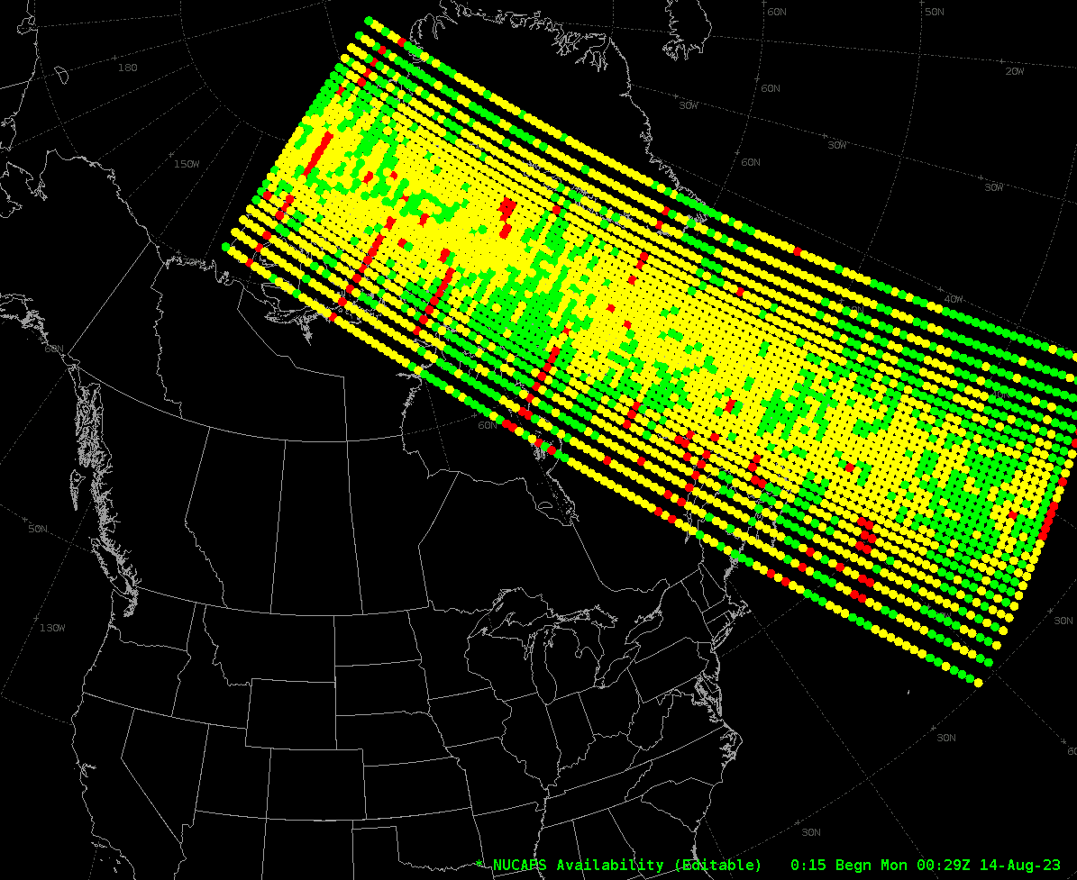
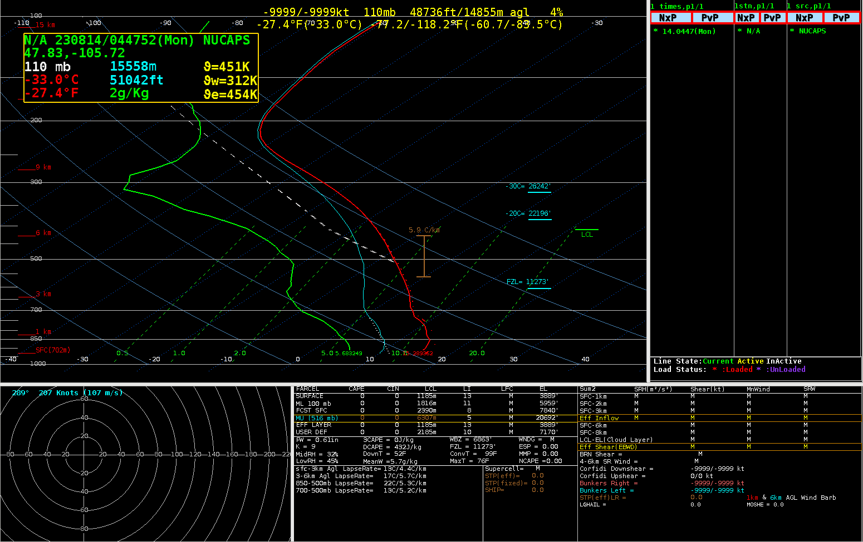
Coming soon: NUCAPS Soundings from Metop-B,C
Mid-morning soundings, ~ 4 hours before NOAA-20/21
Expected on SBN beginning in Jan./Feb. 2024
Return to overview

Slide 19
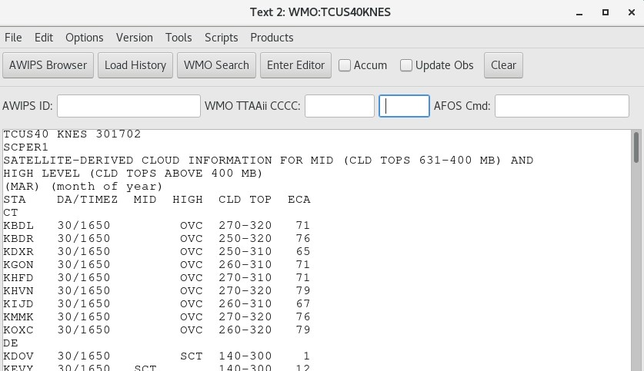
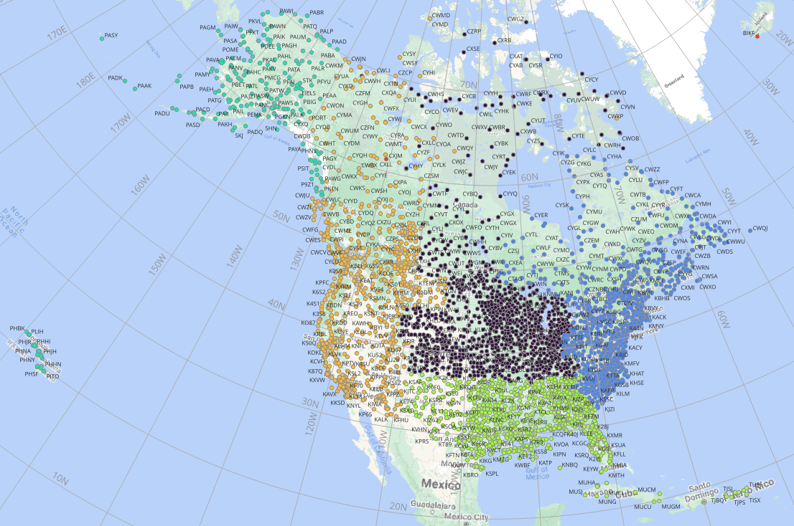
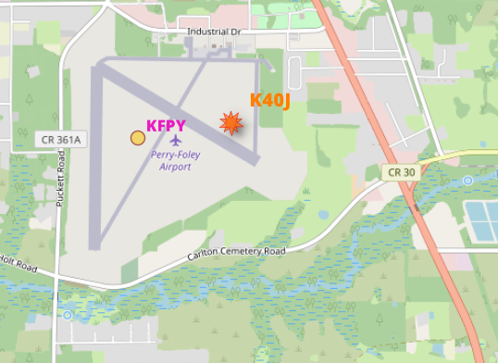
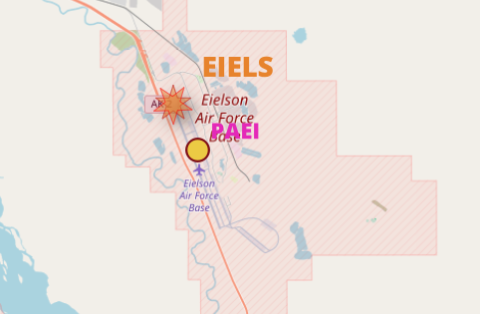
GOES-R Satellite Cloud Products (SCP): Streamlining maintenance
As of Aug. 2023, SCPs are using station locations from the AWIPS National Dataset Maintenance (NDM) list
This provides SCPs for a more comprehensive, current, & accurate set of station locations – updated on a routine / regular basis.
Now removing old stations & station identifiers to reduce duplication

Slide 20
NOAA-21 Transition to operations

Slide 21
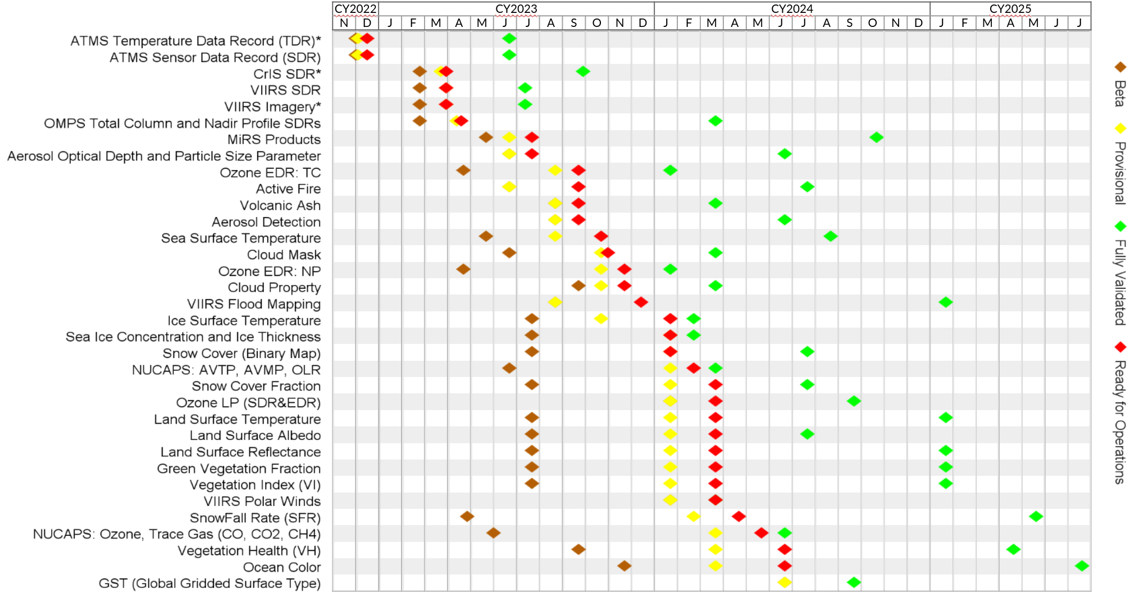
NOAA-21 T2O: Product Maturity timeline
Dec. 15, 2023
Source: NOAA-21 Post-launch Product Validation Schedule
(updated 2023-11-01)
See also STAR / JPSS Algorithm Maturity Matrix (updated 2023-12-07)
Not all of these products will be made available in AWIPS.
Of those that are, some will be on the SBN; others may reach AWIPS sites via LDM, Cloud, or other mechanisms.
Return to overview

Slide 22
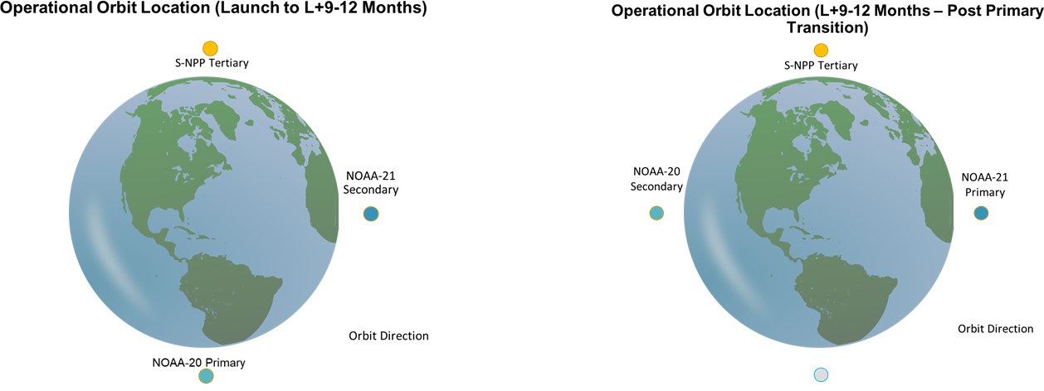
NOAA-21 and the JPSS Constellation
Nov. 2, 2023:
NOAA-21 became the Secondary JPSS satellite;
S-NPP became Tertiary
Feb / Mar. 2024:
NOAA-21 will become Primary;
NOAA-20 will become Secondary;
NOAA-20 orbit re-phased to be opposite NOAA-21
NOAA-20 orbit phasing (~Feb. 2024)
after J. McNitt et al.
Based on the JPSS-2 Product Operations Plan
Return to overview

Slide 23
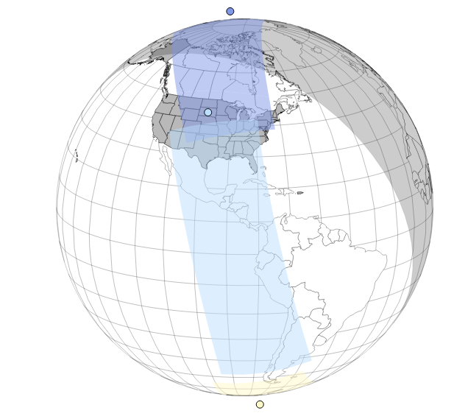
NOAA-21 and the JPSS Constellation (now)
orbit direction
https://vlab.noaa.gov/web/towr-s/polar-planner
Return to overview

Slide 24
NOAA-21 T2O: NWS Operational Test & Evaluation (OT&E)
OT&E purpose: validate operational requirements independently from end to end in a live environment. Advise recommendation on full deployment to forecast operations.
OT&E schedule - multiple phases Aug. 2023 - Mar. 2024:
NOAA-21 VIIRS imagery for Alaska (Aug.-Sep. 2023)
1. Imagery tiles via Direct Readout processed at GINA and AK HQ
2. Imagery granules from NESDIS / NCF via LDM
NOAA-21 VIIRS NCC Imagery via SBN (Nov.-Dec. 2023)
Imagery granules for CONUS, Puerto Rico, and Pacific regions (Required TOWR-S RPM v24, now installed at all OT&E test sites)
Revisit VIIRS imagery with NOAA-21 in new orbit (Feb.-Mar. 2024)
Tiles via Alaska Direct Readout and granules from NESDIS over LDM and SBN
NOAA-21 NUCAPS soundings (Feb.-Mar. 2024)
Also: Blended Hydro products w/ NOAA-21 inputs
6 OT&E test sites:
Alaska Region HQ
WFO Medford, OR
WFO Gaylord, MI
WFO Houston/Galveston, TX
WFO Buffalo, NY
RFC Portland, OR
Return to overview

Slide 25
New and upcoming satellites

Slide 26
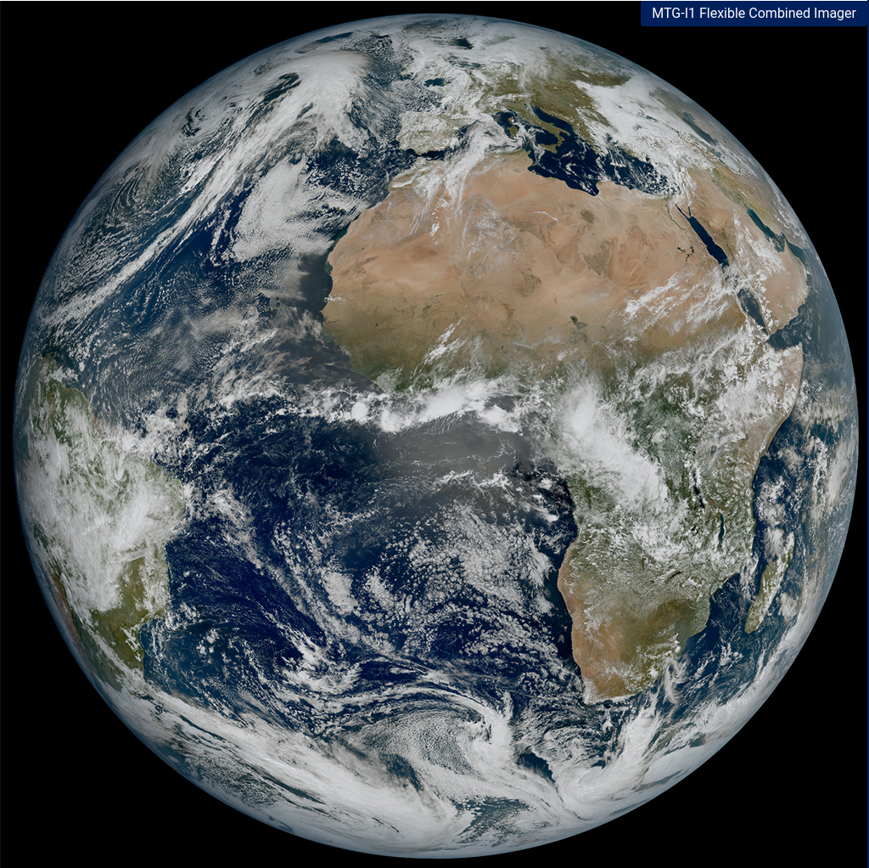
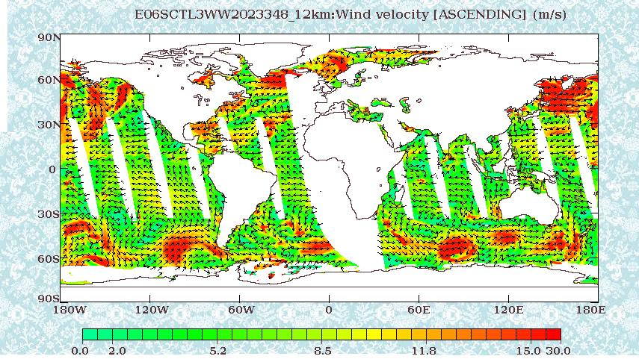
New / upcoming satellites
MTG-Imager 1 (MeteoSat 3rd Gen.)
Geostationary @ Longitude 0°; will be renamed Meteosat-12 in 2024.
Expected data availability to NWS: (rough guesses)
Mar. 2024: Flexible Combined Imager (FCI) L1 data
Apr. 2024: FCI L2 data
Apr. 2024: Lightning Imager (LI) data (See MTG-I1 data availability schedule)
MTG-I1 First Light image (Mar. 18, 2023)
https://www.eumetsat.int
OceanSat-3
First L2 Ocean Surface Winds files from OSCAT-3 scatterometer are now under evaluation for AWIPS
This product will fill the gap left when SCATSAT ceased operating in Feb. 2021.
https://bhoonidhi.nrsc.gov.in
Return to overview

Slide 27
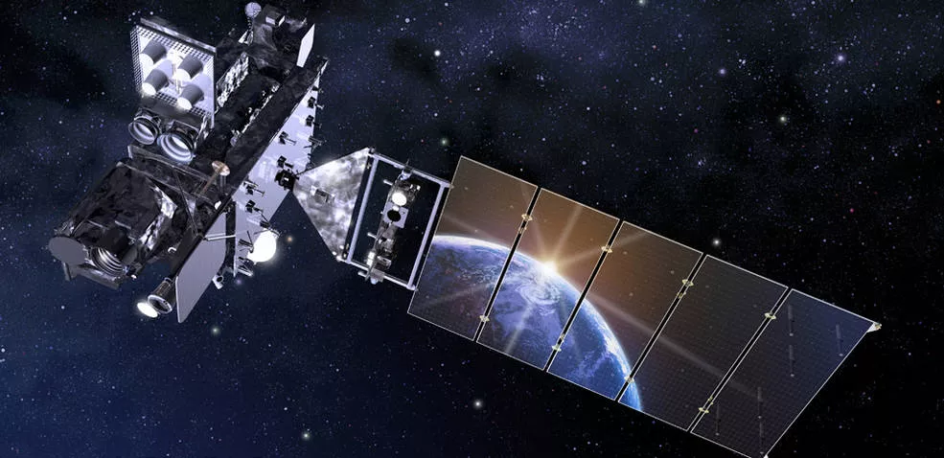
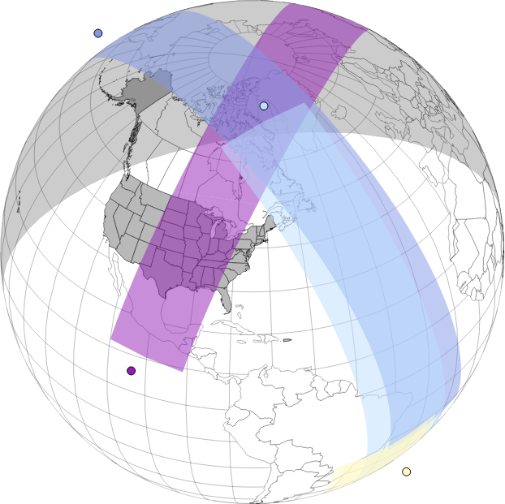
New / upcoming satellites
GOES-U to launch N.E.T. April 30, 2024
Will be commissioned as GOES-East in early CY2025, replacing GOES-16 (per OSPO)
Will carry the new Compact Coronagraph (CCOR)
Data Operations Exercise #2 (DOE-U2): Jan 3-10, 2024
Will send simulated G-19 data to NWS TNCF, PDA I&T, GeoCloud
https://www.nesdis.noaa.gov/next-generation/space-weather/ccor-goes-u
NOAA-20
NOAA-21
https://vlab.noaa.gov/web/towr-s/polar-planner
Metop-SG-A1 (Metop 2nd Gen.) to launch 1st Q. CY2025
Sun-synchronous polar (morning) orbit
TOWR-S will contribute to the NWS User Readiness Plan for Metop-SG.
Solar noon
Metop-SG
S-NPP
Return to overview

Slide 28
Appendix

Slide 29
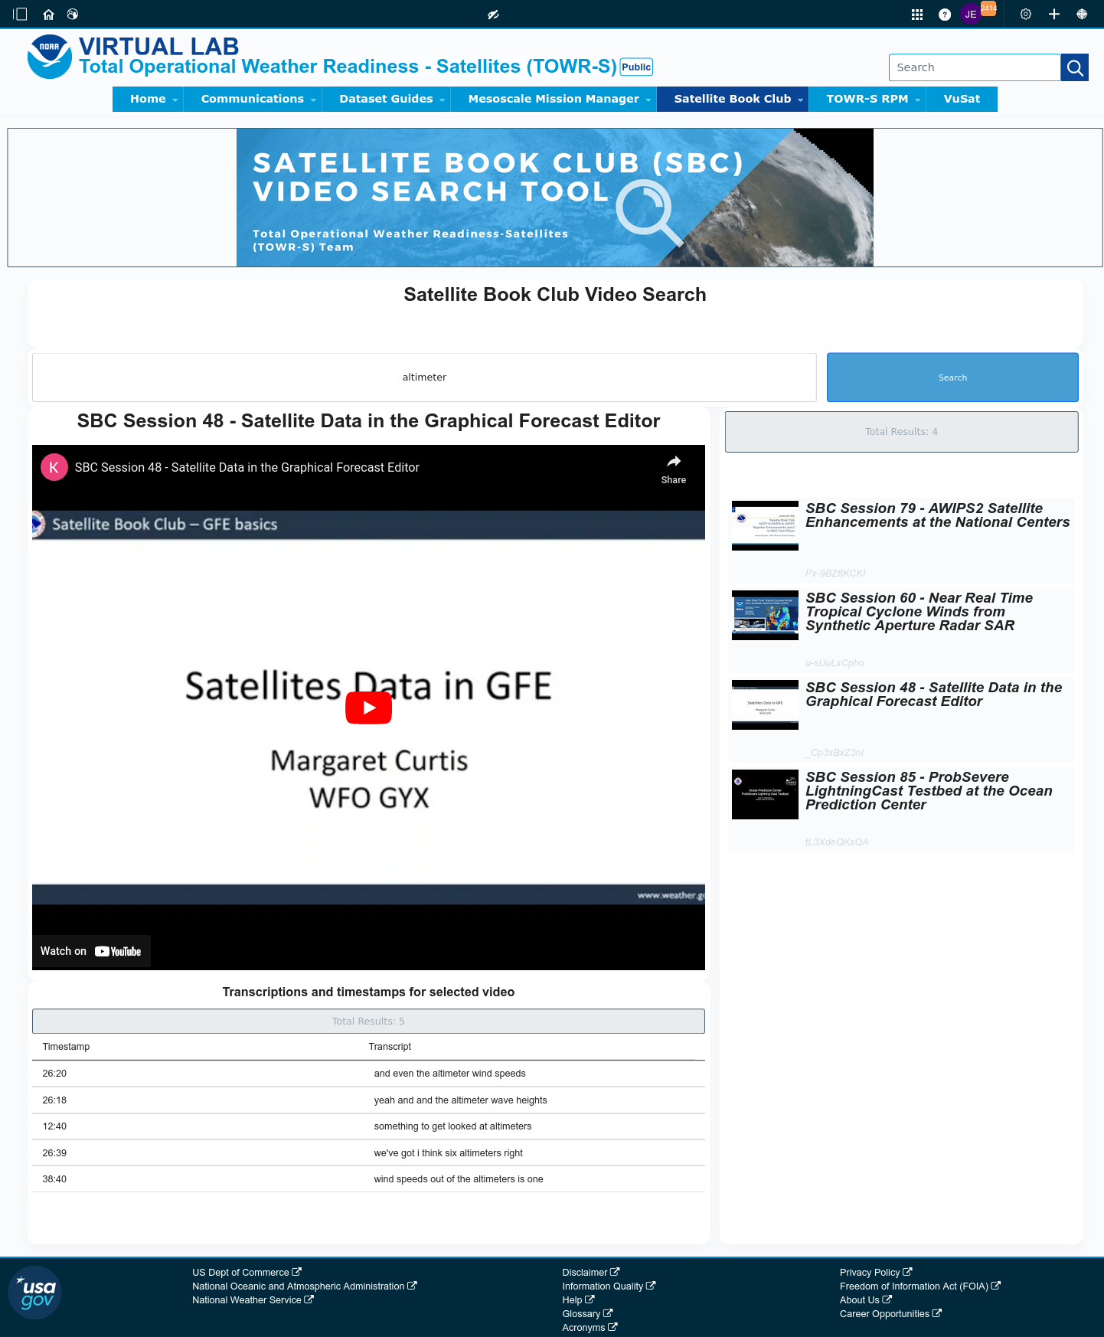
Satellite Book Club (SBC) Seminar Series
Thursdays, usually at Noon ET
Usage examples shed light on user requirements for satellite data products and capabilities.
Recordings are on YouTube and the NWS Commerce Learning Center (CLC) website.
Full-text transcripts are available for all SBC sessions – searchable from within VLab.
SBC videos are now searchable by keyword: https://vlab.noaa.gov/web/towr-s/sbc-video-search
Return to overview

Slide 30
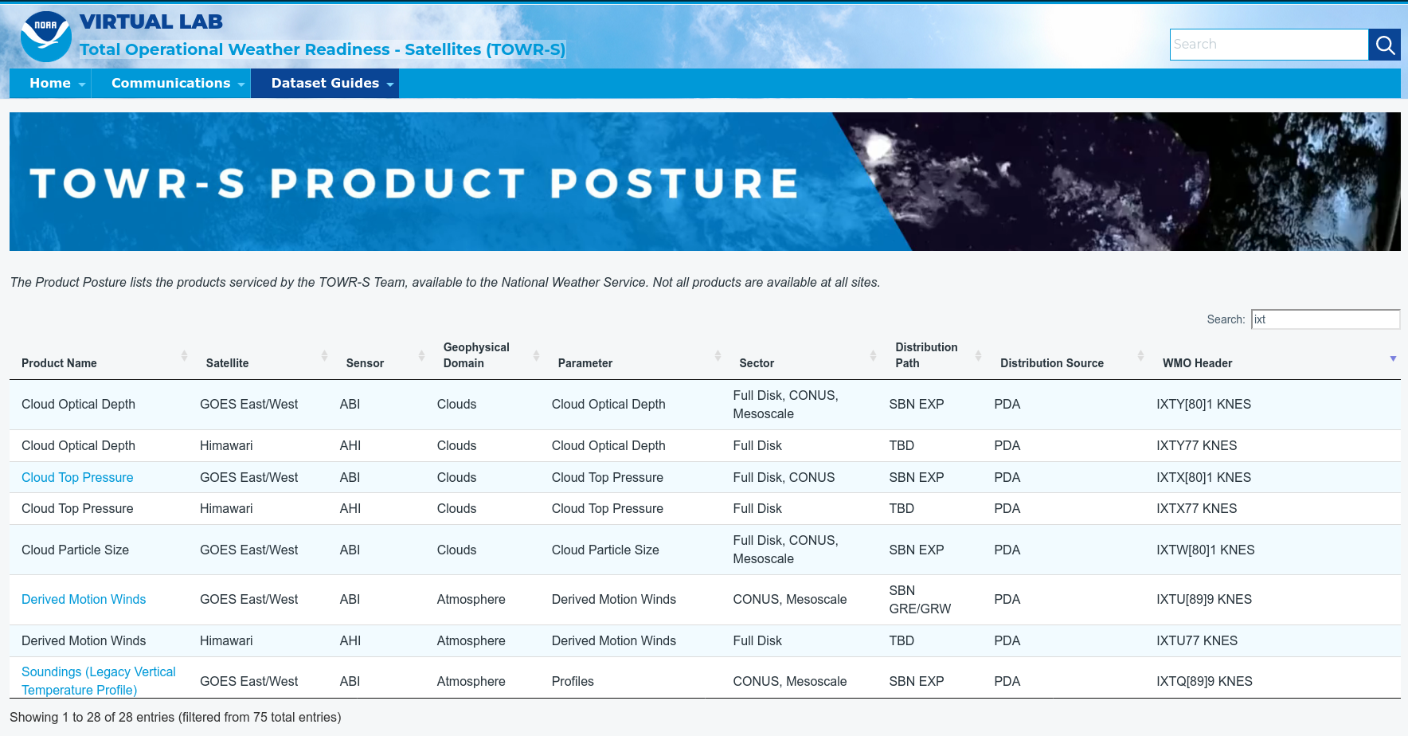
TOWR-S Product Posture
VLab now hosts a table of all satellite data products that TOWR-S is involved with (integrating them into NWS forecast operations).
Instant search, filter, and sort capability provides access by keyword, satellite, sensor, etc.
Many rows link to Dataset Guides with more AWIPS details.
Note: Distribution Path “TBD” indicates a product in planning - not yet disseminated to users
https://vlab.noaa.gov/web/towr-s/product-posture
Return to overview

Slide 31
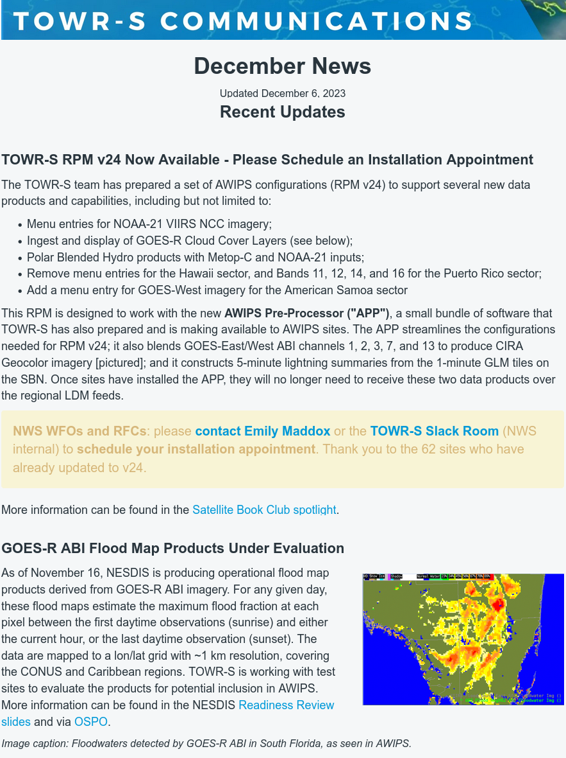
TOWR-S monthly news
Supplements the quarterly TOWR-S Update briefings and the weekly / occasional TOWR-S mailers.
See latest edition
Emailed to TOWR-S Update attendees and posted to VLab. (https://vlab.noaa.gov/web/towr-s/communications)
Return to overview

Slide 32
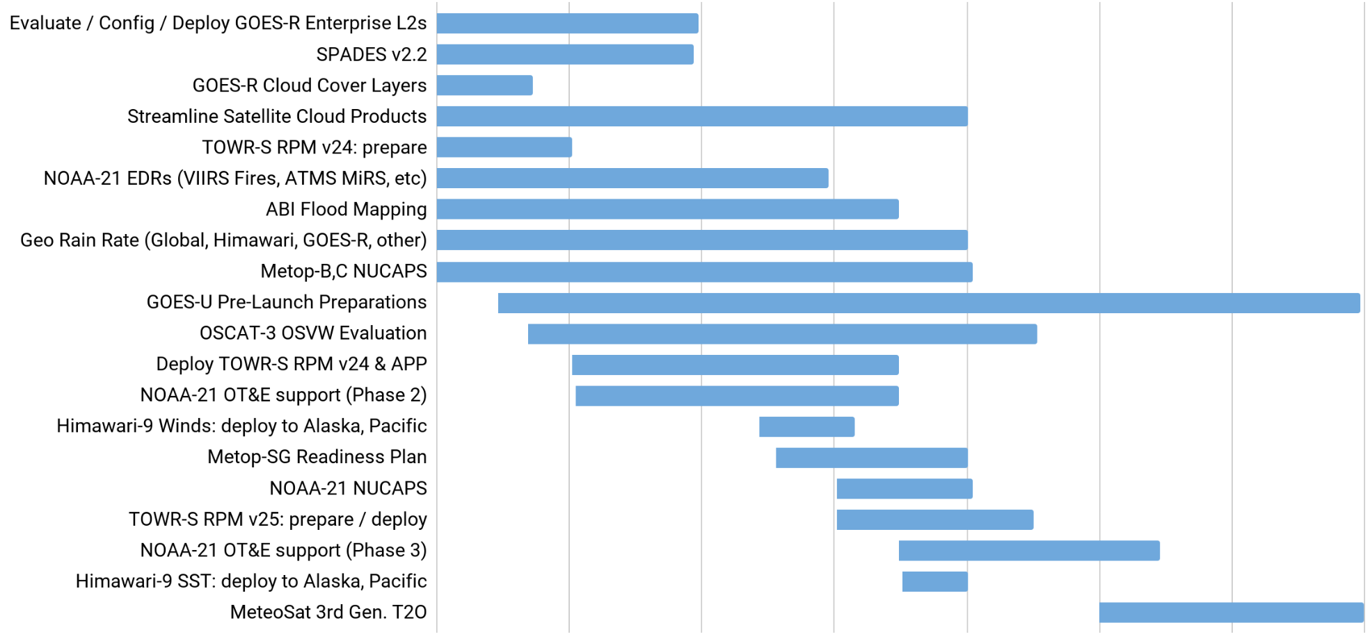
TOWR-S Activity Plan
CY2023 |  |  | CY2024
Oct | Nov | Dec | Jan | Feb | Mar | Apr
Dec. 15, 2023
Return to overview

Slide 33
Contact Information
NWS Office of Observations
Brian Gockel – brian.gockel@noaa.gov
Jordan Gerth – jordan.gerth@noaa.gov
Total Operational Weather Readiness – Satellites (TOWR-S) Team
John Evans – john.d.evans@noaa.gov
Emily Maddox – emily.maddox@noaa.gov
Links
NWSChat 2.0 #towr-s Channel
TOWR-S on VLab (https://vlab.noaa.gov/web/towr-s)
Return to overview

Slide 34
Next TOWR-S Update
(tentative)
Mar. 29, 2024
Return to overview

