Slide 1
IMS Transition
Lev Nagdimunov¹, Lingyan Xin²
¹NOAA/CIRA Meteorological Development Laboratory
²NOAA/NWS Meteorological Development Laboratory
Prepared in June, 2020

Slide 2
IMS Acronym Definition
Interactive Used by a Human (as opposed to Automated)
Multi-Sensor Multiple Satellites/Instruments/Sensors used for Inputs
Snow and Ice Snow and Ice are analyzed
Mapping System Visualization and analysis platform

Slide 3
IMS System Description
The Interactive Multisensor Snow and Ice Mapping System (IMS) is an operational software package for monitoring snow and ice coverage. This software enables qualified OSPO analysts to tag locations as snow covered or ice covered over the entire Northern Hemisphere.
The National Centers for Environmental Prediction (NCEP) relies on IMS for snow cover and lake cover initialization for the Global Forecast System (GFS), Climate Forecast System (CFS), N. American mesoscale Model (NAM) and Rapid Update Cycle (RUC) models.
The NOAA RUC model and Navy’s ACNFS and GOFS models also apply ice cover fields from the IMS for ice initialization.

Slide 4
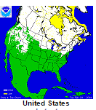
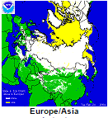
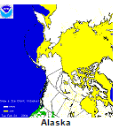
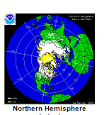
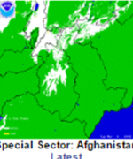
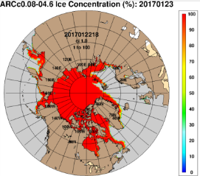
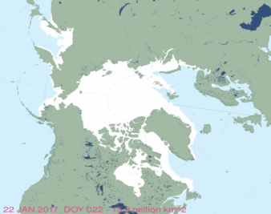
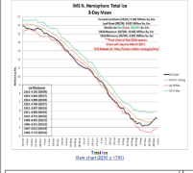
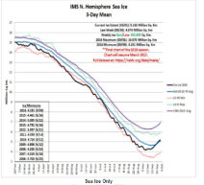
IMS History
From 1966 to 1997, once-a-week hand drawn analysis on physical maps at 190 km resolution.
Daily Northern Hemisphere Snow and Ice Cover chart production began in 1997 and migrated to USNIC in 2008.
Gridded product depicts ice edge and snow cover characterization for use in numerical weather prediction.
IMS in USN Models
NSIDC MASIE Product

Slide 5
IMS Version History
V1 (1997)
V2 (2004)
V3 (2014)
Daily snow and ice coverage over the Northern Hemisphere at 24-km resolution.
Daily snow and ice coverage over the Northern Hemisphere at 4-, 24-km resolution.
Twice daily snow and ice coverage over the Northern Hemisphere at 1-, 4-, 24-km resolution.
Daily snow depth products for both the Northern and Southern Hemispheres.

Slide 6
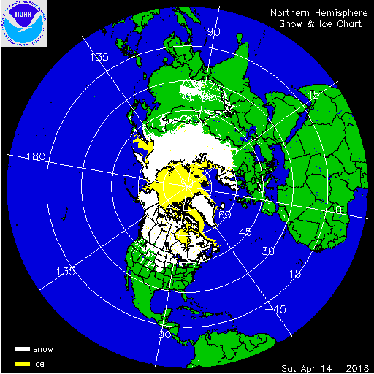
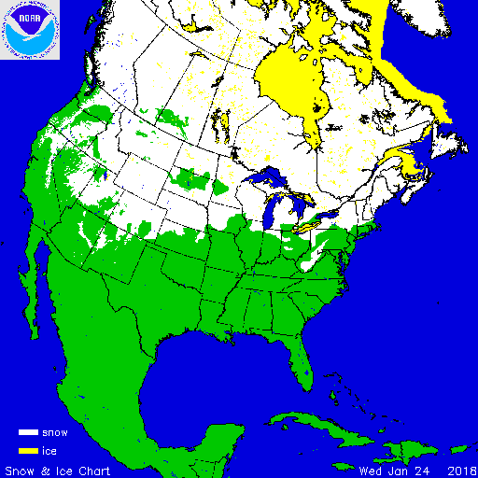
IMS Outputs
Parameters Analyzed: Snow Cover, Ice Cover, Snow Depth
Coverage Area: Northern Hemisphere
Standard Output Format(s): ASCII (1-, 4-, 24-km resolution), GeoTIFF (1-, 4-km resolution), GRIB2 (1-, 4-km resolution), GIF (quick look)
Standard Dissemination Method(s): Distributed operationally via the NOAA NESDIS PDA (Production Distribution and Access), and via USNIC website
Update Frequency: Twice Daily (18 UTC, 00 UTC)
Customers: NOAA, NAVY, National Snow and Ice Data Center, International NWS Partners, and Public.
*
*Snow Depth is output for both North and South hemispheres.

Slide 7
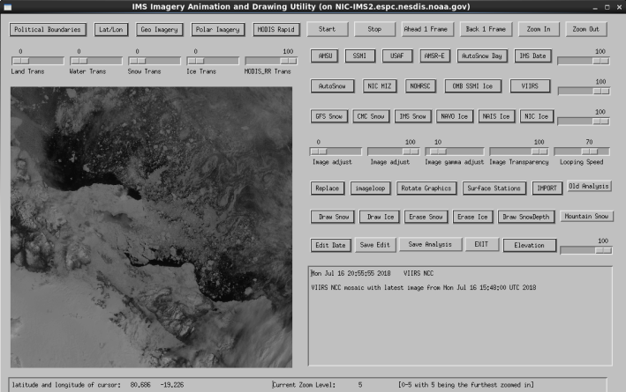
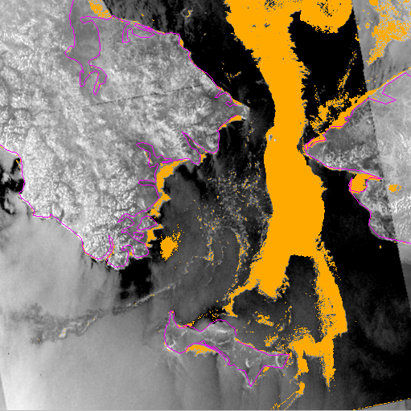
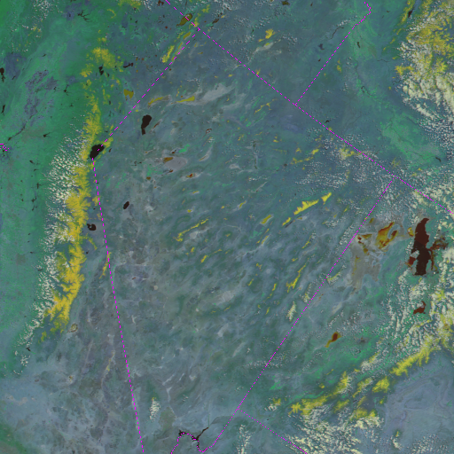
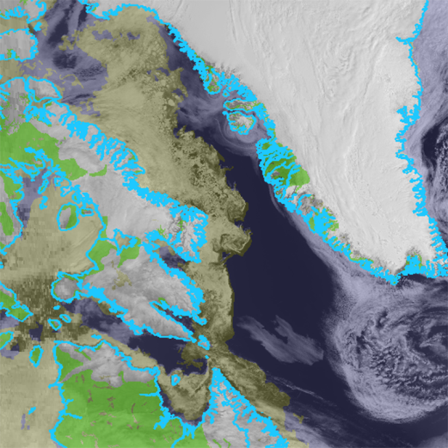
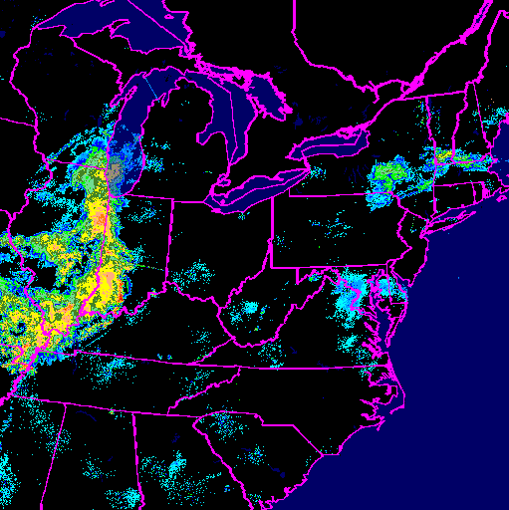
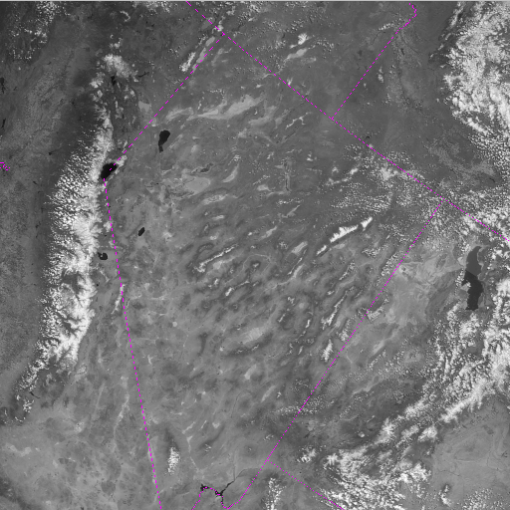
GUI and Data Inputs
The IMS system graphic-user interface (GUI) has a selection of data that can be displayed within the system such as geostationary satellite data, polar orbiting data, and derived algorithm data. IMS analysts also use a large number of external data sources, accessed via internet, to provide the most accurate product for distribution.
Selected Data Inputs:
- GOES-17 and GOES-16
- NOAA-20, NOAA-19, NOAA-18
- METEOSAT-8 and METEOSAT-11
- Himawarii-8
- Aqua and Terra MODIS
- METOP
- WSR-88D Radar Composite
- Arctic Satellite Composite
- Sentinel 1 A&B and RadarSAT 2
- AMSR-2
- Surface Observations
- GFS, NOHRSC, MMAB, GOFS,
557WF, CMC, webcams, and more
Ice

Slide 8
IMS “Architecture”
Imagery / Derived Input Data Sources
PDA
McIDAS
NIC’s FTP
Others
Preprocessor Machines
Input Data Tailoring
GUI Machines
Human Analysis
Output Post-Processing
Product Distribution
PDA
NIC’s Web

Slide 9
IMS Analysis GUI Demo

Slide 10
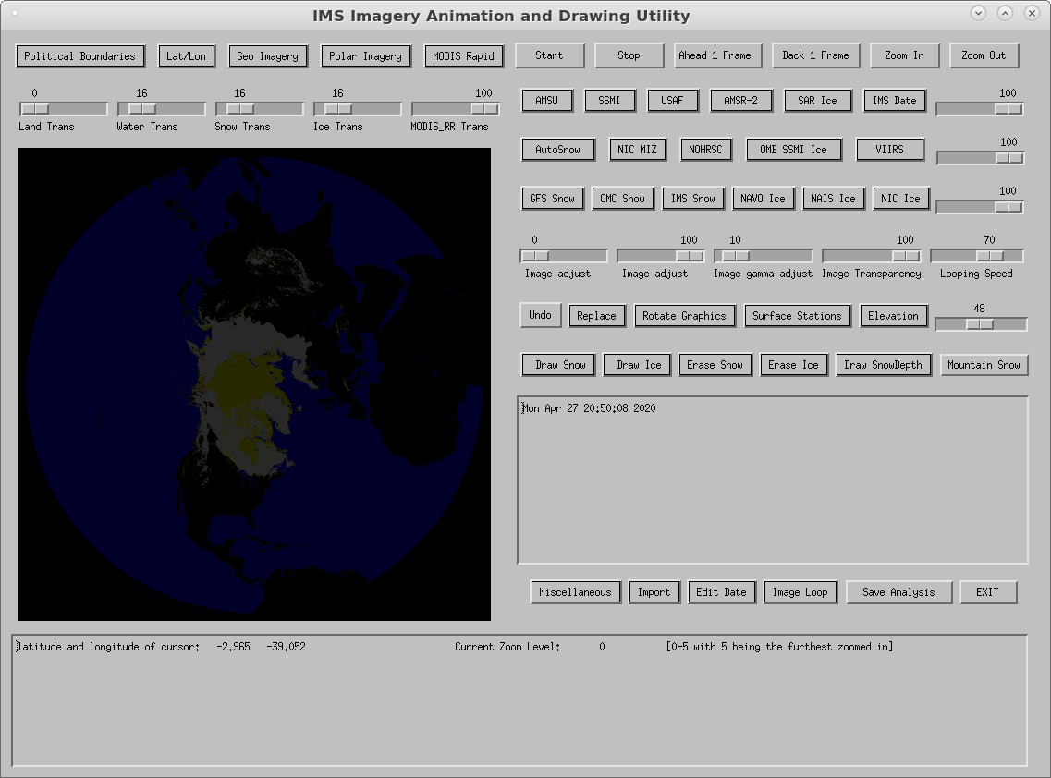
IMS GUI
Startup Screen
Entire
Northern-Hemisphere
View

Slide 11
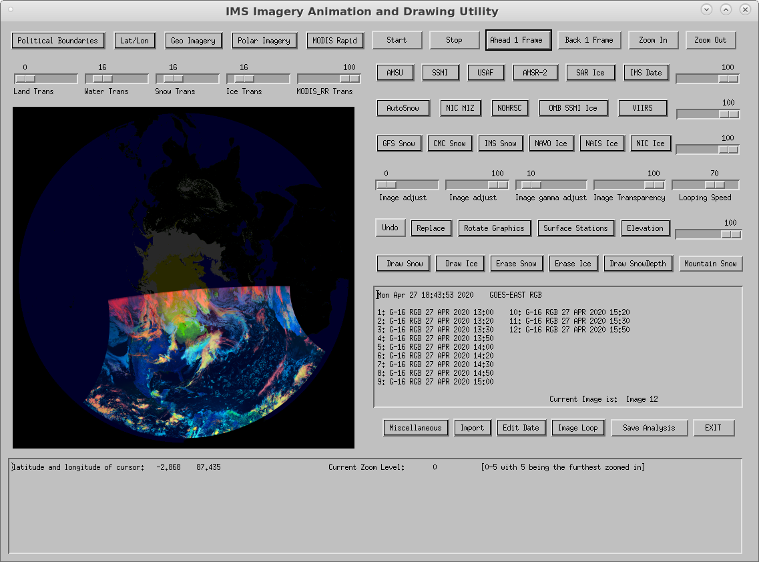
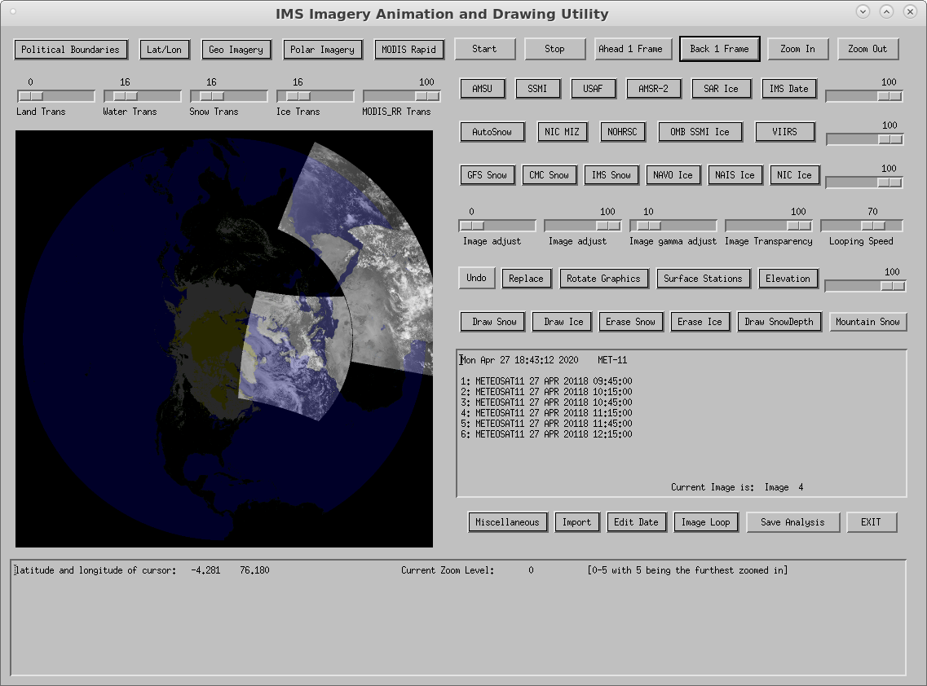
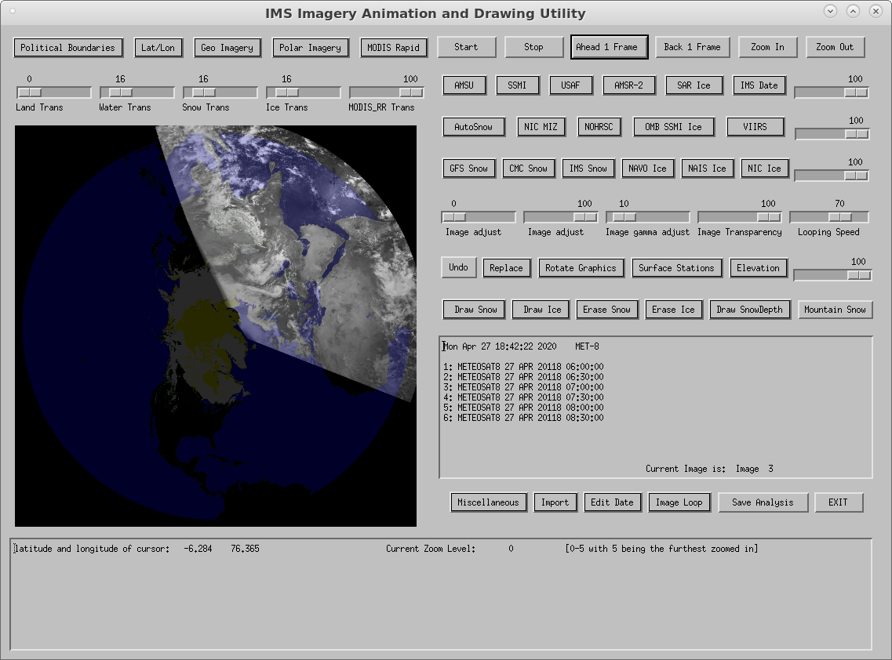
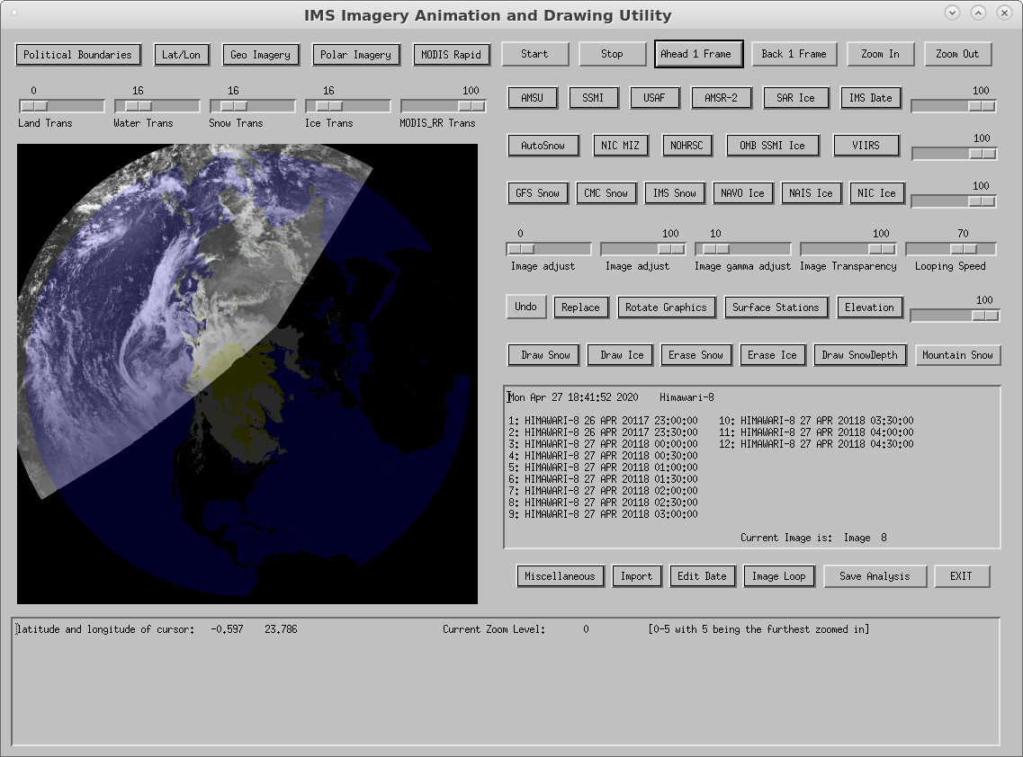
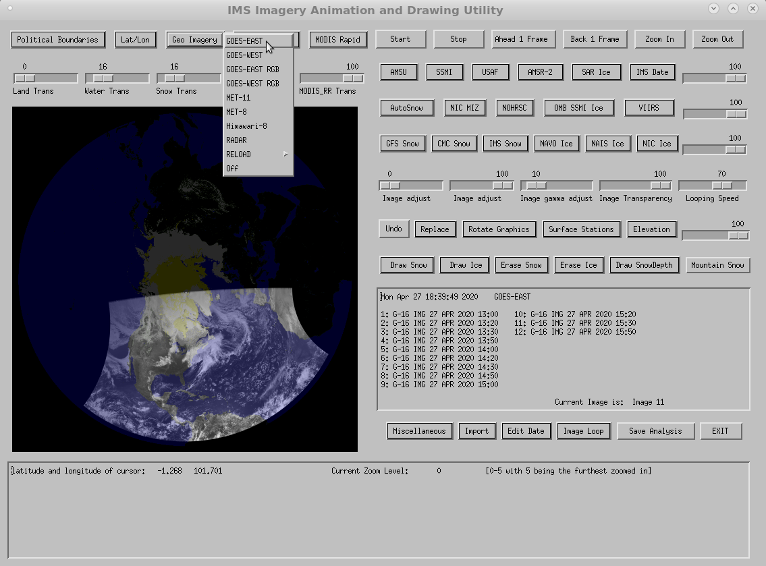
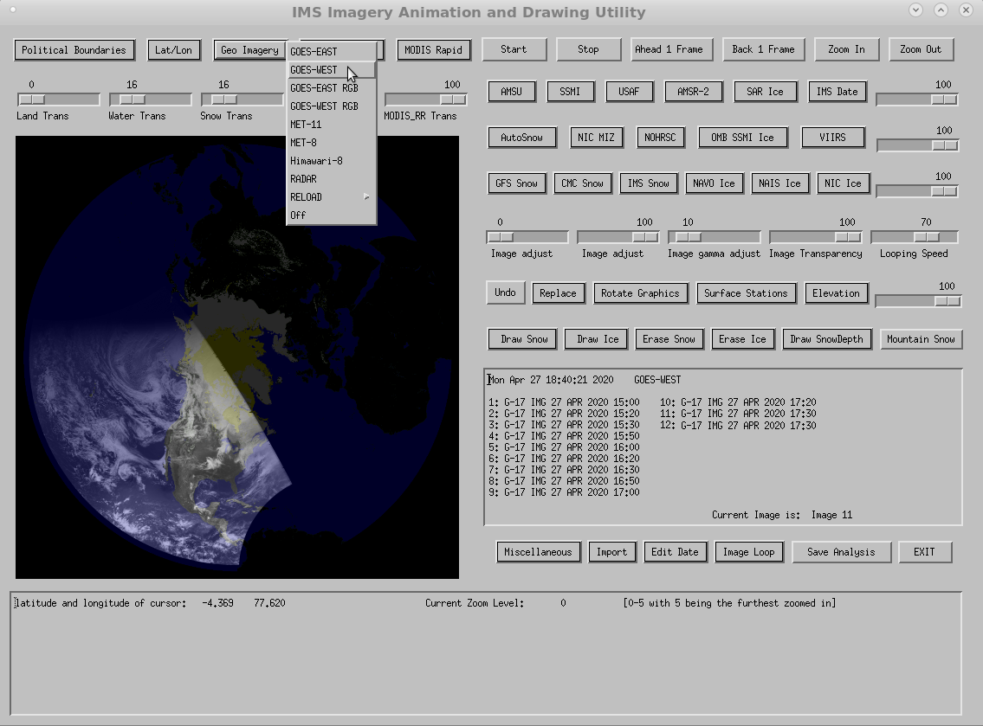
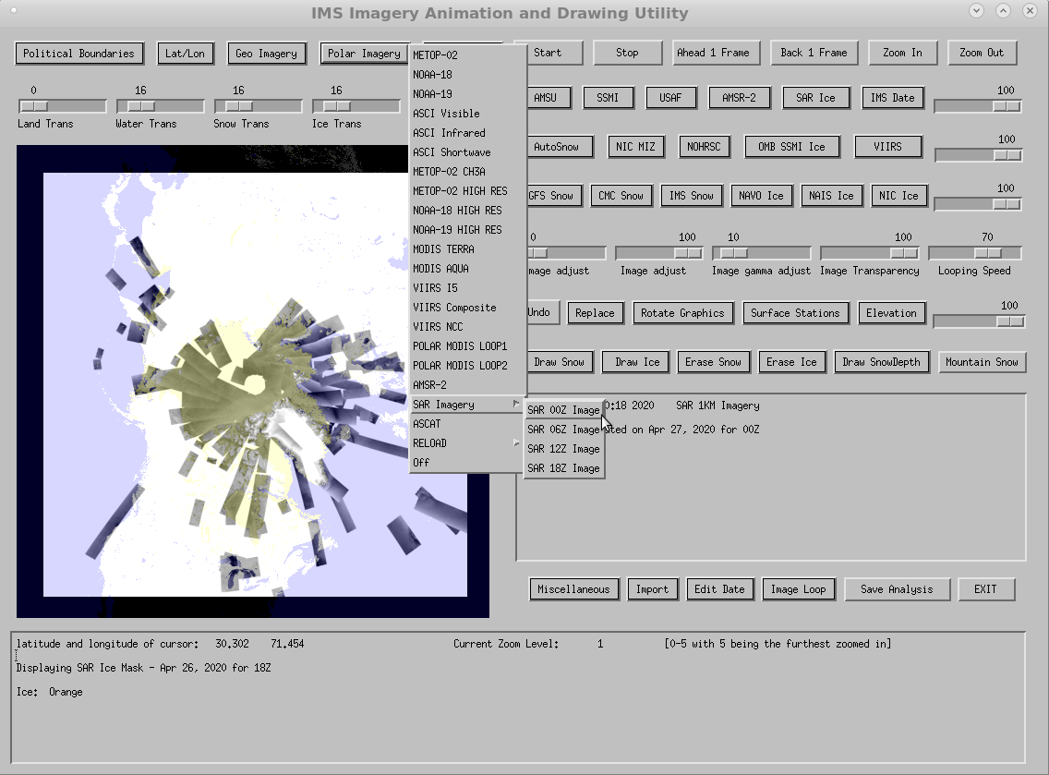
IMS GUI
Sample
Geostationary
Satellites

Slide 12
IMS GUI
Sample
Polar Orbiting
Satellites

Slide 13
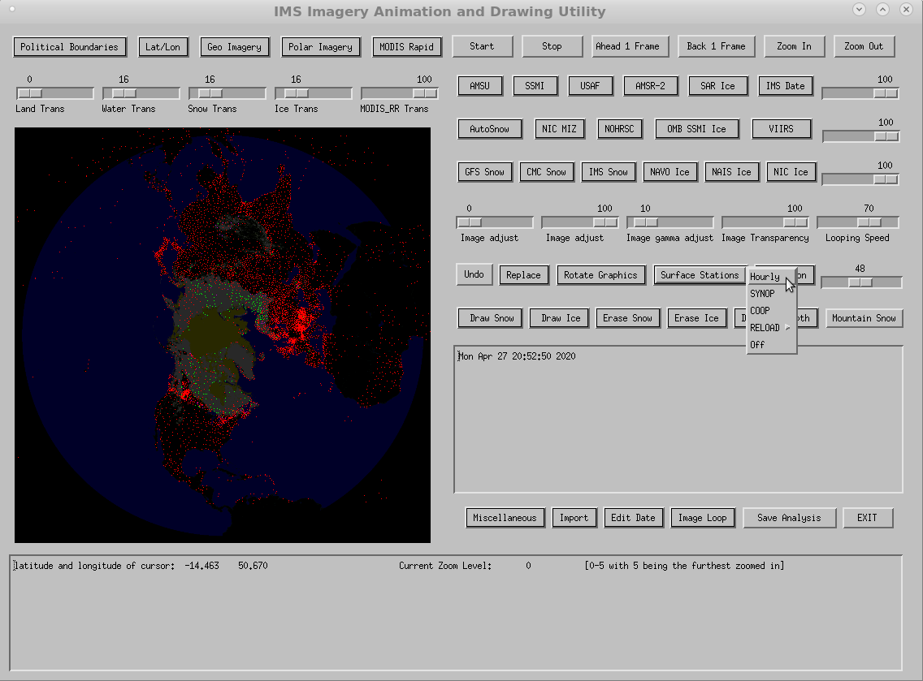
IMS GUI
Sample
Surface Stations

Slide 14
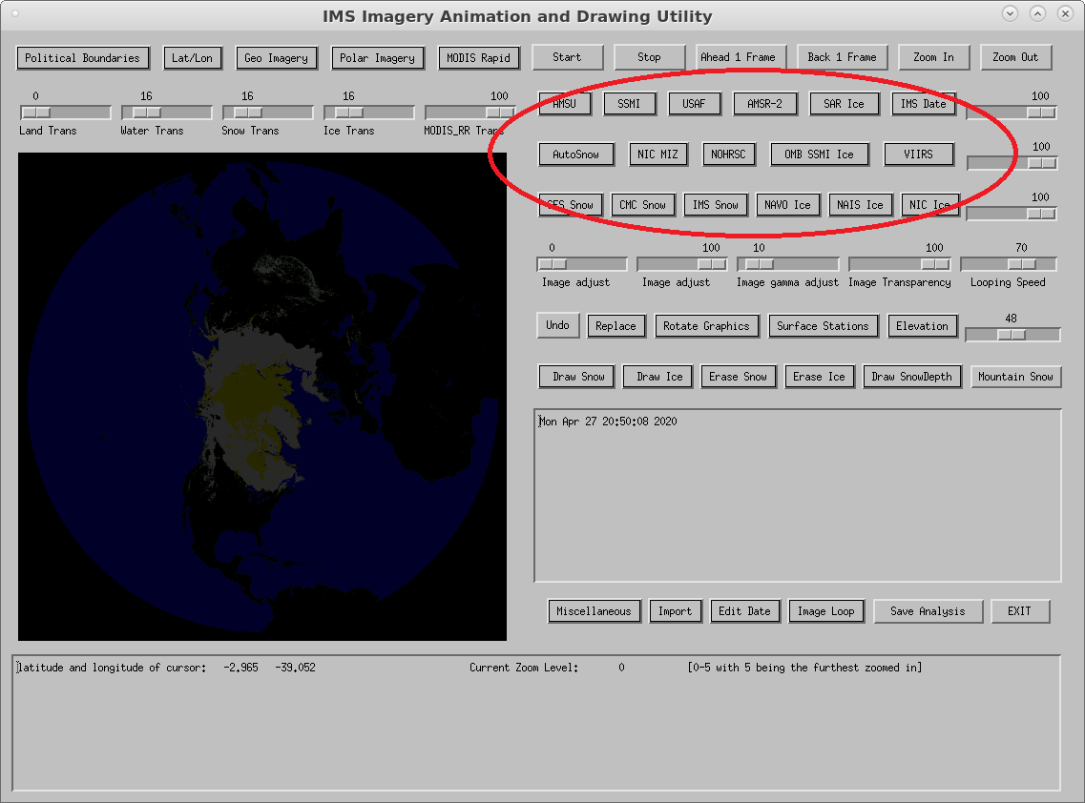
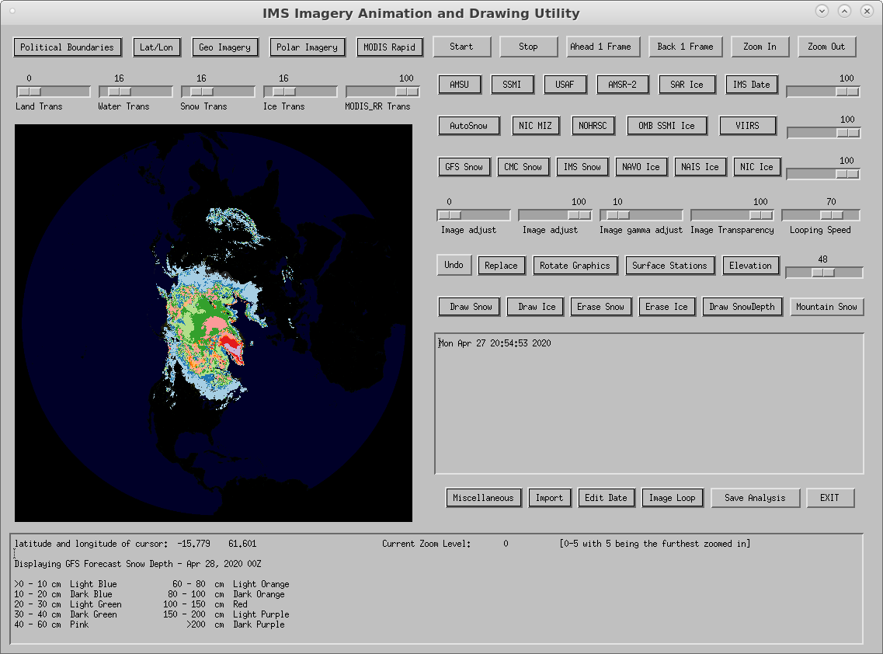
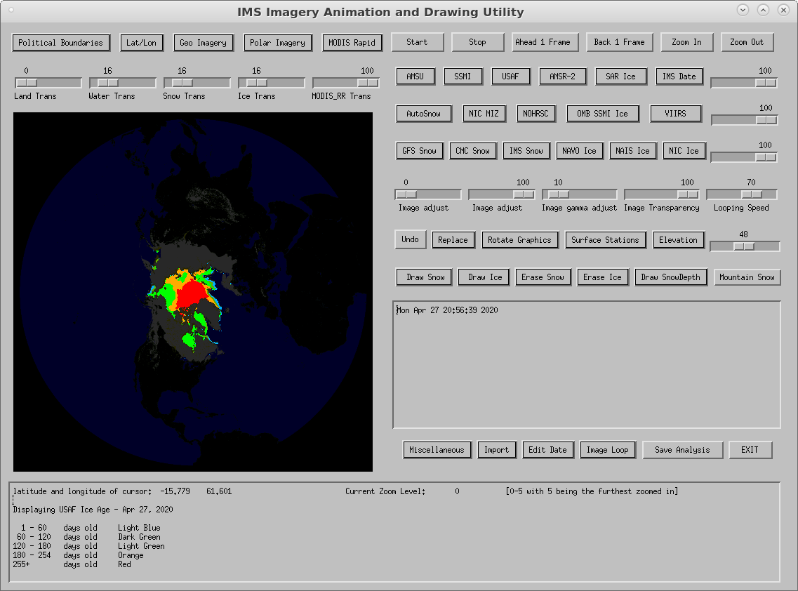
IMS GUI
Sample Models /
Derived Products

Slide 15
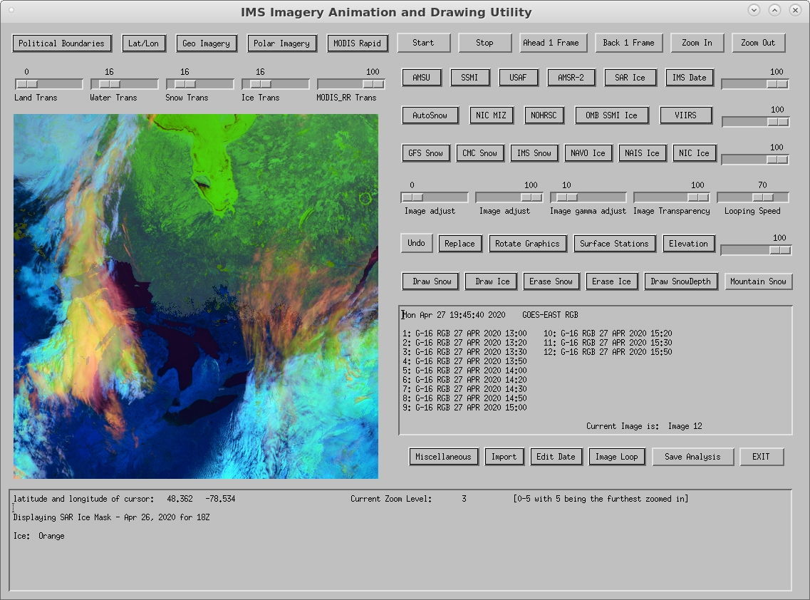
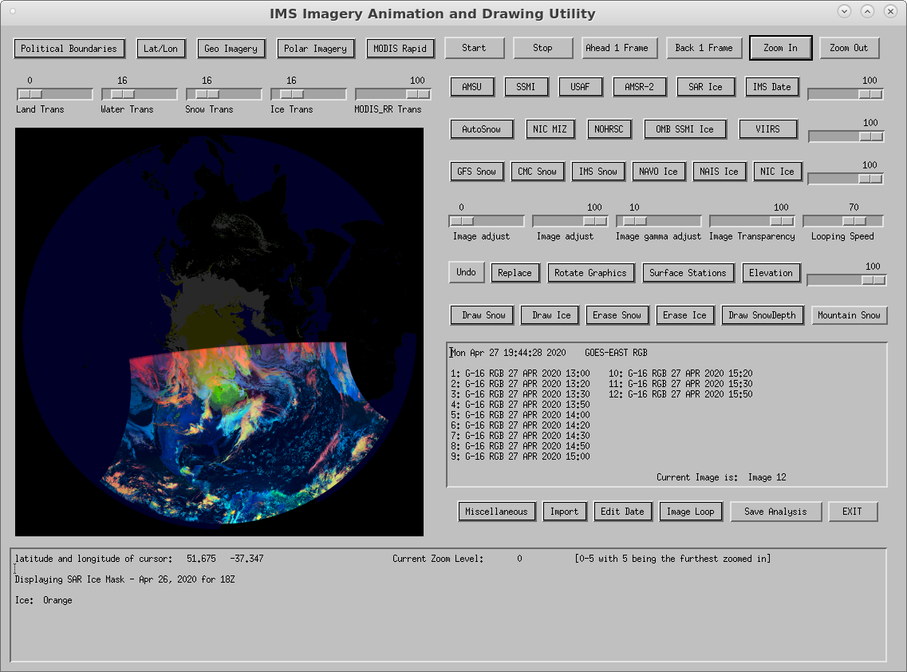
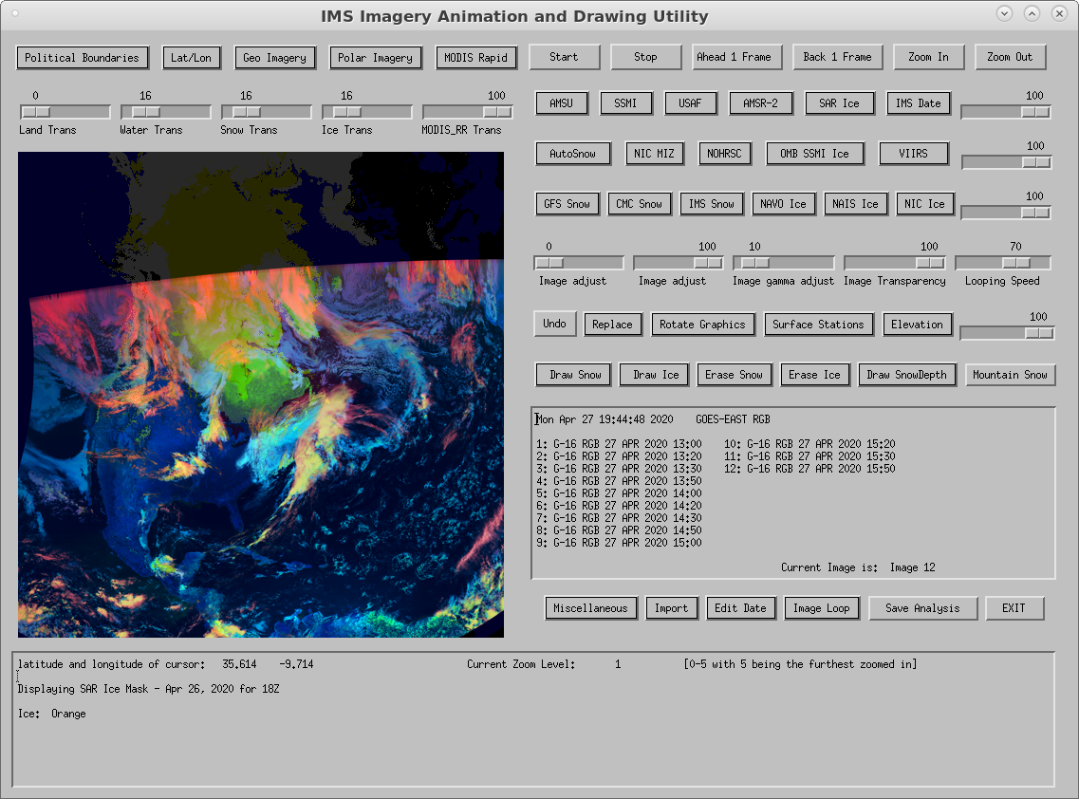
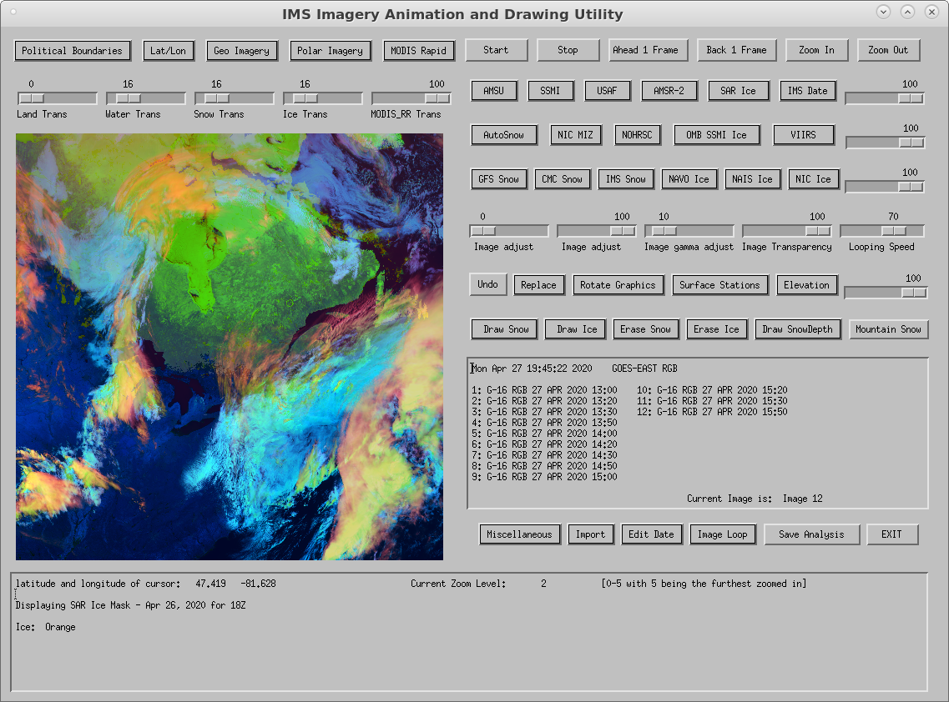
IMS GUI
Zoom In

Slide 16
IMS GUI
Mark / Erase
Snow and Ice

Slide 17
IMS GUI
Mark / Erase
Mountain Snow

Slide 18
IMS Transition Schedule (per NCO)
Key Milestones | Date | Status
NCO data flow acquisition | 02/28/2020 -> 06/12/2020 -> 08/24/2020 | On Track
NCO Dev machine build out | 03/03/2020 -> 06/05/2020 -> 08/07/2020 | On Track
Dev code install / testing | 06/05/2020 -> 10/02/2020 -> 08/10/2020 | On Track
Code handoff to QA | 06/15/2020 -> 10/08/2020 -> 12/10/2020 | On Track
30 day stability test | 08/18/2020 -> 12/06/2020 -> 01/13/2020 | On Track
Go Live | 09/29/2020 -> 12/25/2020 -> 02/25/2020 | On Track
From NCO Project Plan on 10/30/2019, 4/16/2020, 6/8/2020.

Slide 19
Potential Risks during Transition
Delays in establishing full development environment
Delays in establishing data flow for IMS (both dev and ops)
Establishing GUI hardware transition plan
McIDAS and PDA data transfer method
PDA distribution
Changes to web server distribution
*Non-exhaustive list.

Slide 20
Thank you for your attention.

