Slide 1
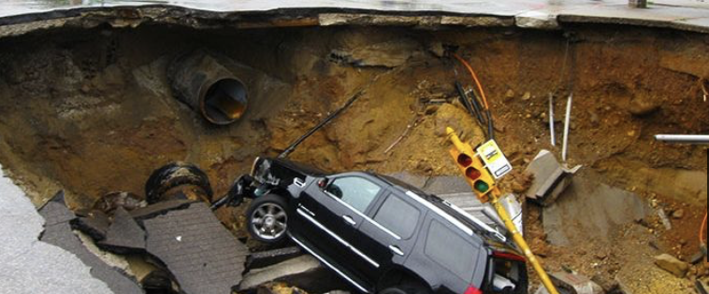
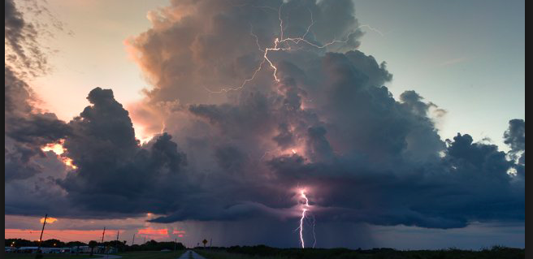
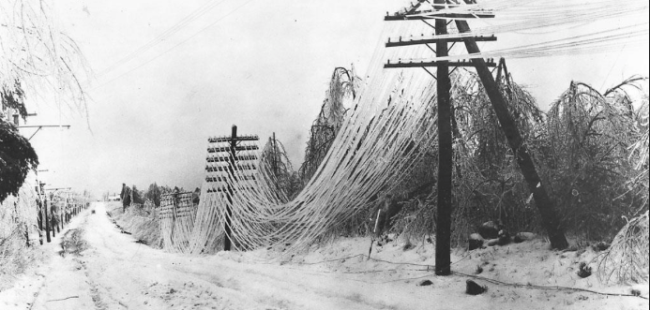
Data Requirements for
Machine Learning
Paul J. Roebber
UWM Distinguished Professor
University of Wisconsin at Milwaukee
February 3, 2022
VLAB Talk #1

Slide 2
The “immortal” Joe Schultz
Notes:
How are factors combined to produce evac decision?
Protective Action Decision Model
Describe Process
Walk through example
Ability to model
There’s a baseline understanding to be able to model the human system elements of hurricane evacuations. Rebecca’s work proves it.

Slide 3
Data Science = mapping inputs to outputs
Model
Input 1
Input 2
Input N
•••
Model
Multiple linear regression (MLR)
Multiple logistic regression (MLoR)
Decision trees, random forests
Neural Networks (hidden layer MLPs)
Agent-based modeling (ABM)
CNNs (Deep Learning)
Output

Slide 4
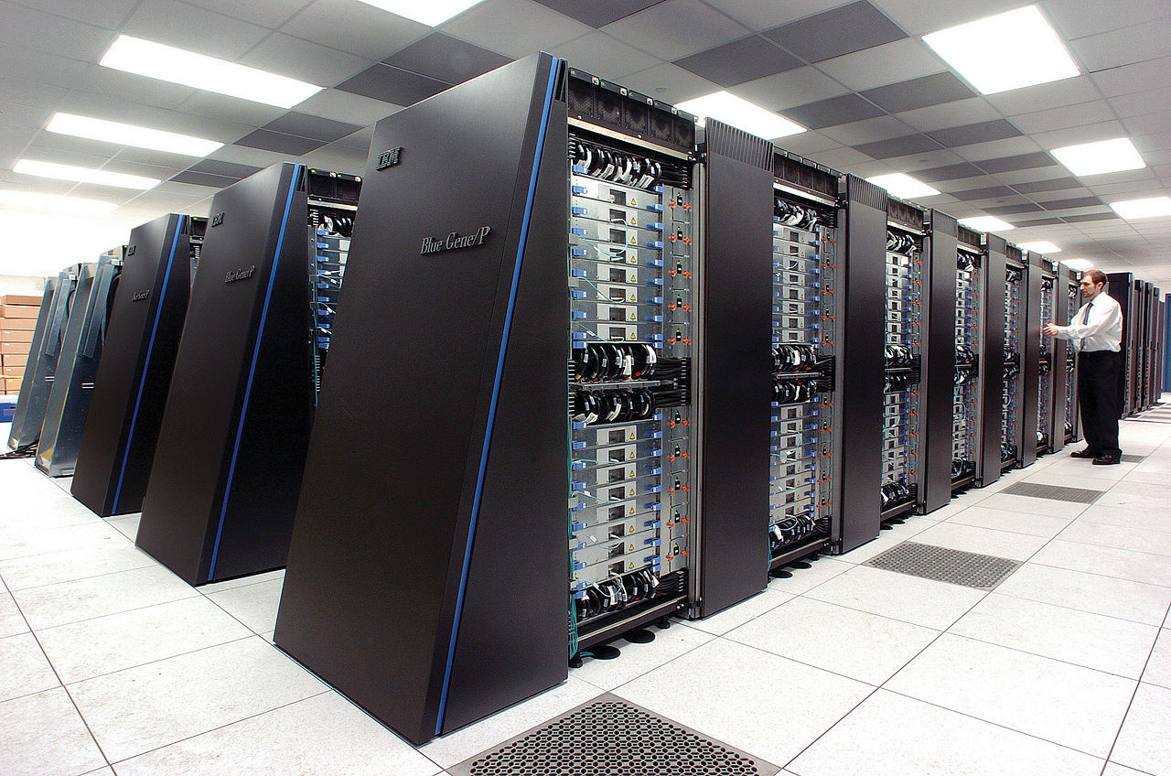

Slide 5
Slide courtesy of Rob Redmon, Lead, NOAA Center for Artificial Intelligence (NCAI)

Slide 6
Some first principles …
Need “good” data to build a model
Requires exploration to understand it (outliers, biases)
Need qualitative and quantitative approaches
Need a lot of “exemplars” to explore multiple dimensions of a problem
Split these into 3 sections (training, validation, testing)
Data imbalance issues

Slide 7
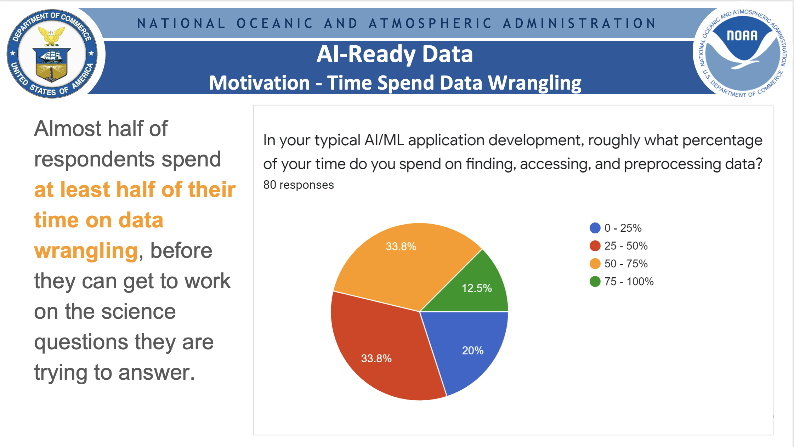
Slide courtesy of Rob Redmon, Lead, NOAA Center for Artificial Intelligence (NCAI)

Slide 8
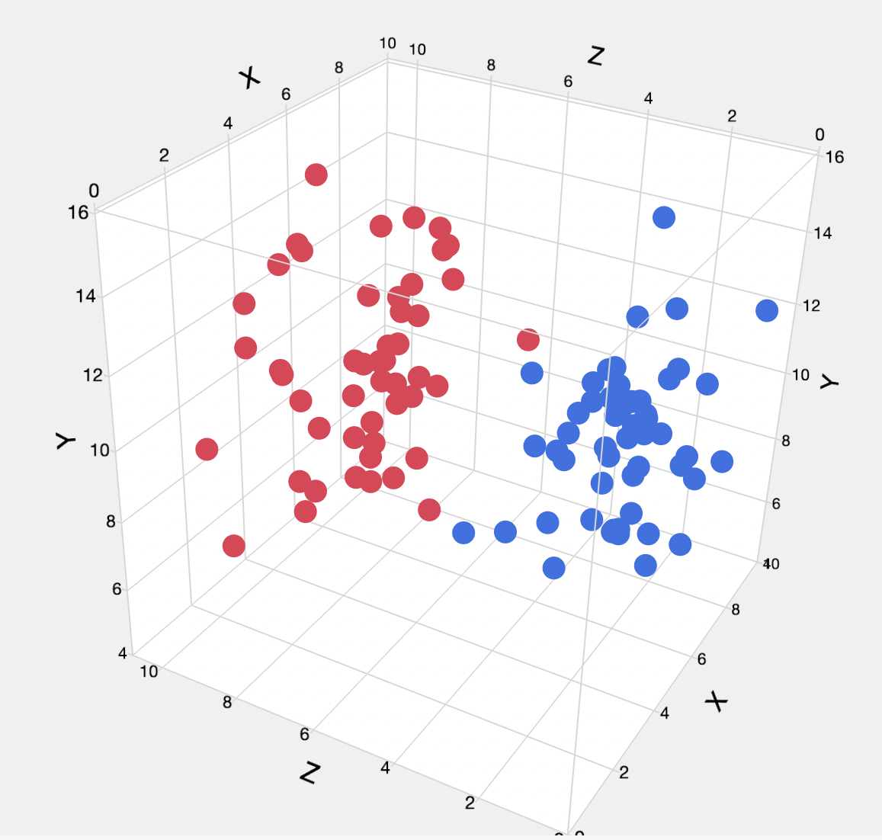
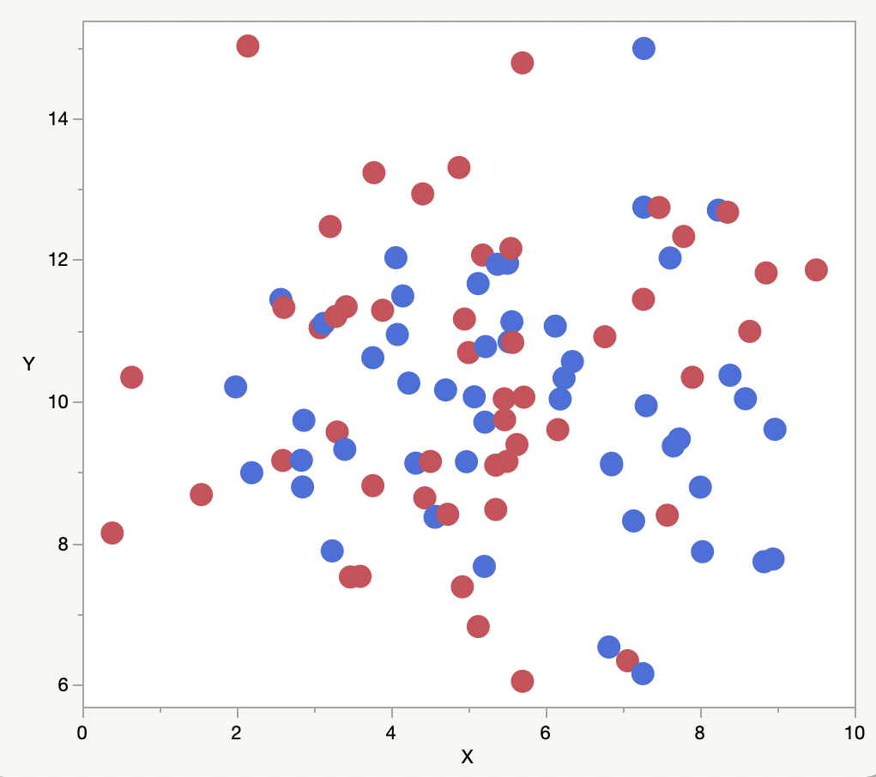
“Curse of Dimensionality”
Multiple dimensions to properly distinguish data points
Data required to sample multidimensional space increases rapidly with dimensions
Reduction of dimensionality?
A bag of red and blue rubber balls …
( 3 variables: color, volume, bounciness)

Slide 9
Data Management (beyond data wrangling)
Quality control is essential (GIGO, noise v.s. useful outliers)
Data splitting into 3 parts – train, validation, test
Sufficient number of exemplars (e.g. rare events, non-stationarity))
Rescaling of data?
Data Exploration – quantitative measures
Central tendencies – mean, median, mode
Dispersion and distribution - standard deviation, skewness, quantiles
Correlation – inputs with desired prediction and with each other
Data Exploration – qualitative (visualization)
Scatterplots
Histograms
Bubble plots

Slide 10
Diagnosis and Prediction Tools (next 3 talks)
Multiple Linear Regression and Multiple Logistic Regression
One and Two Hidden Layer Multilayer Perceptrons (MLP) – Artificial Neural Nets
Decision Trees and Random Forests
Evolutionary programming, agent-based models
Real Data Examples
MLB data
Snow-to-liquid water ratio
Minimum temperature data

Slide 11
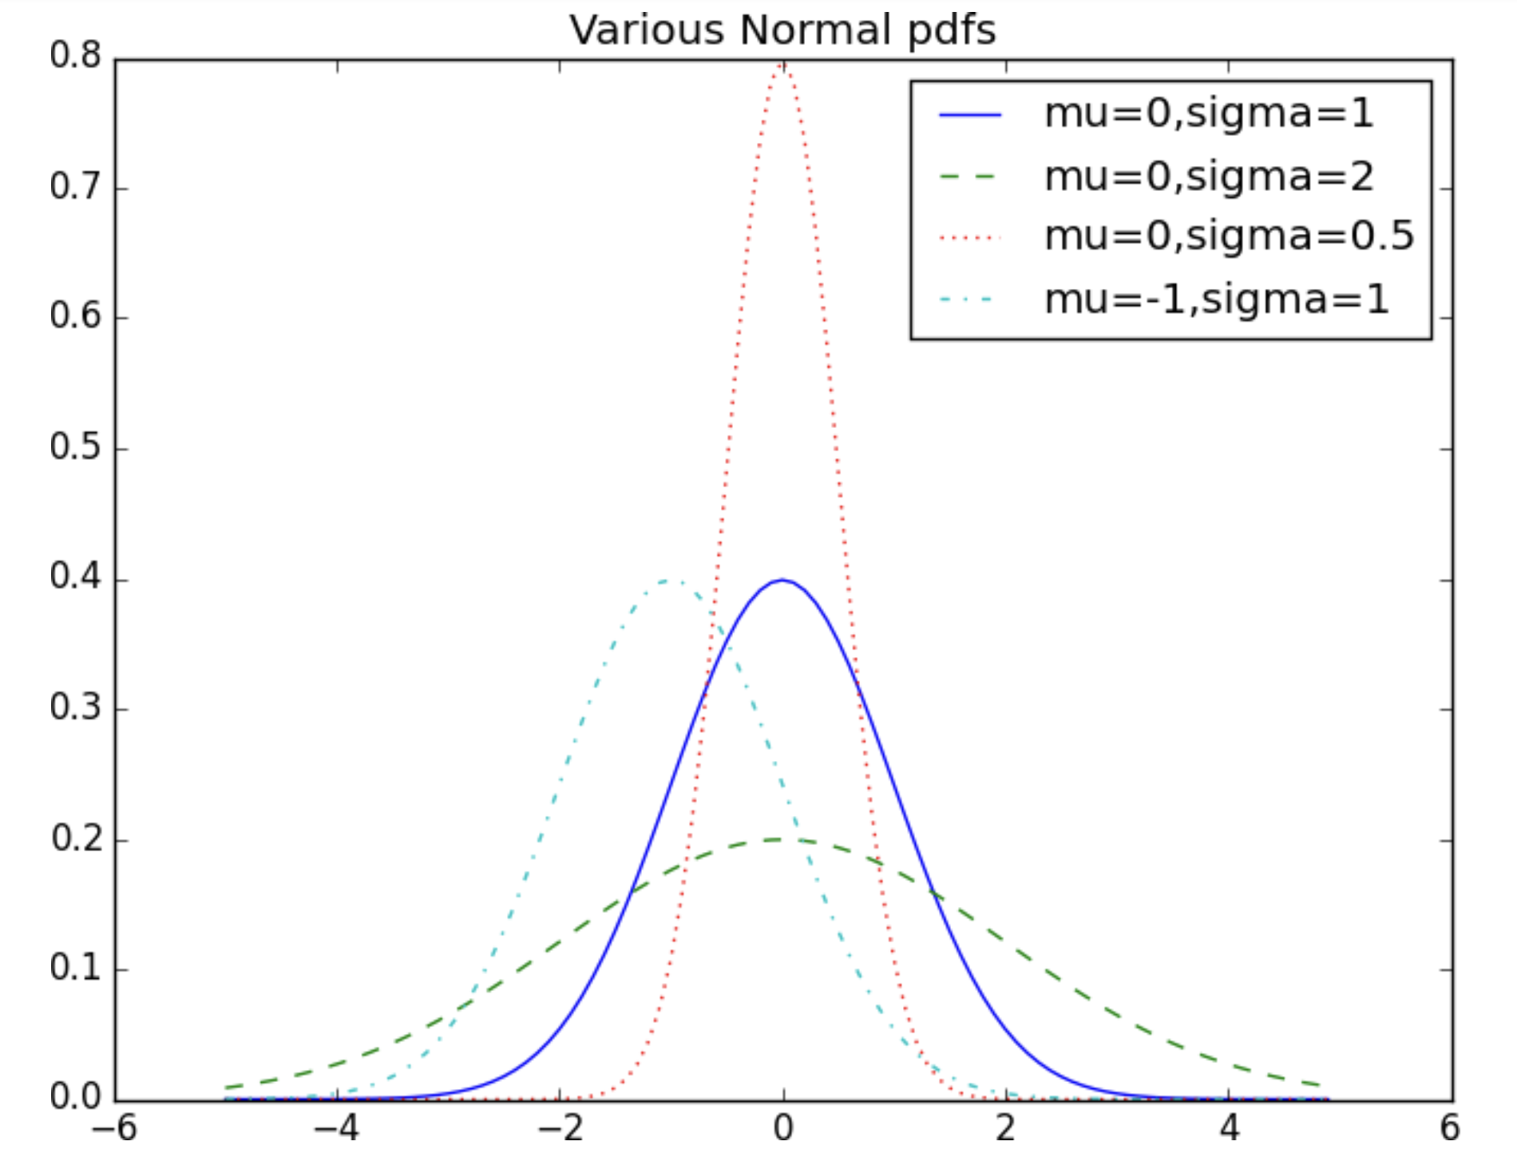
Source: Data Science from Scratch
by Joel Grus

Slide 12
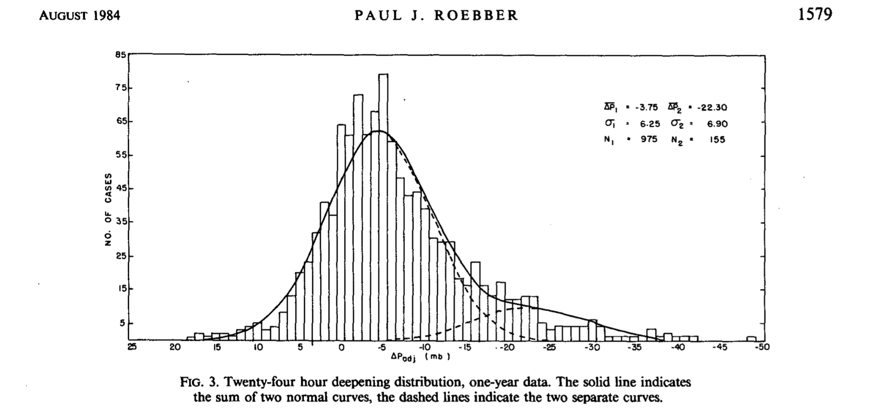
Rapidly Deepening Cyclones (bombs)

Slide 13
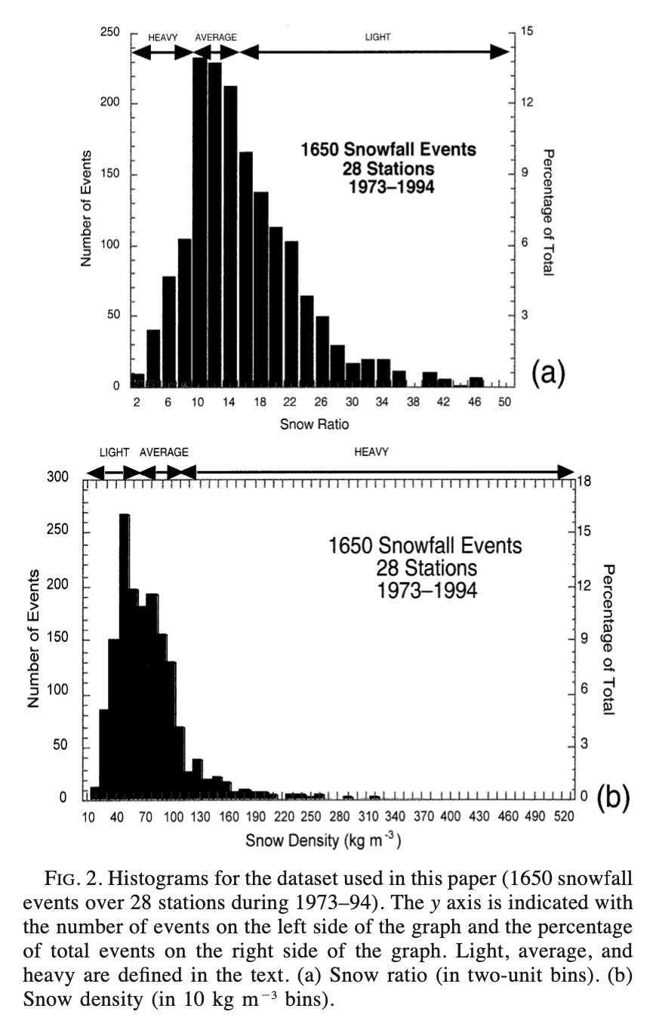
Snow-to-liquid water ratio

Slide 14
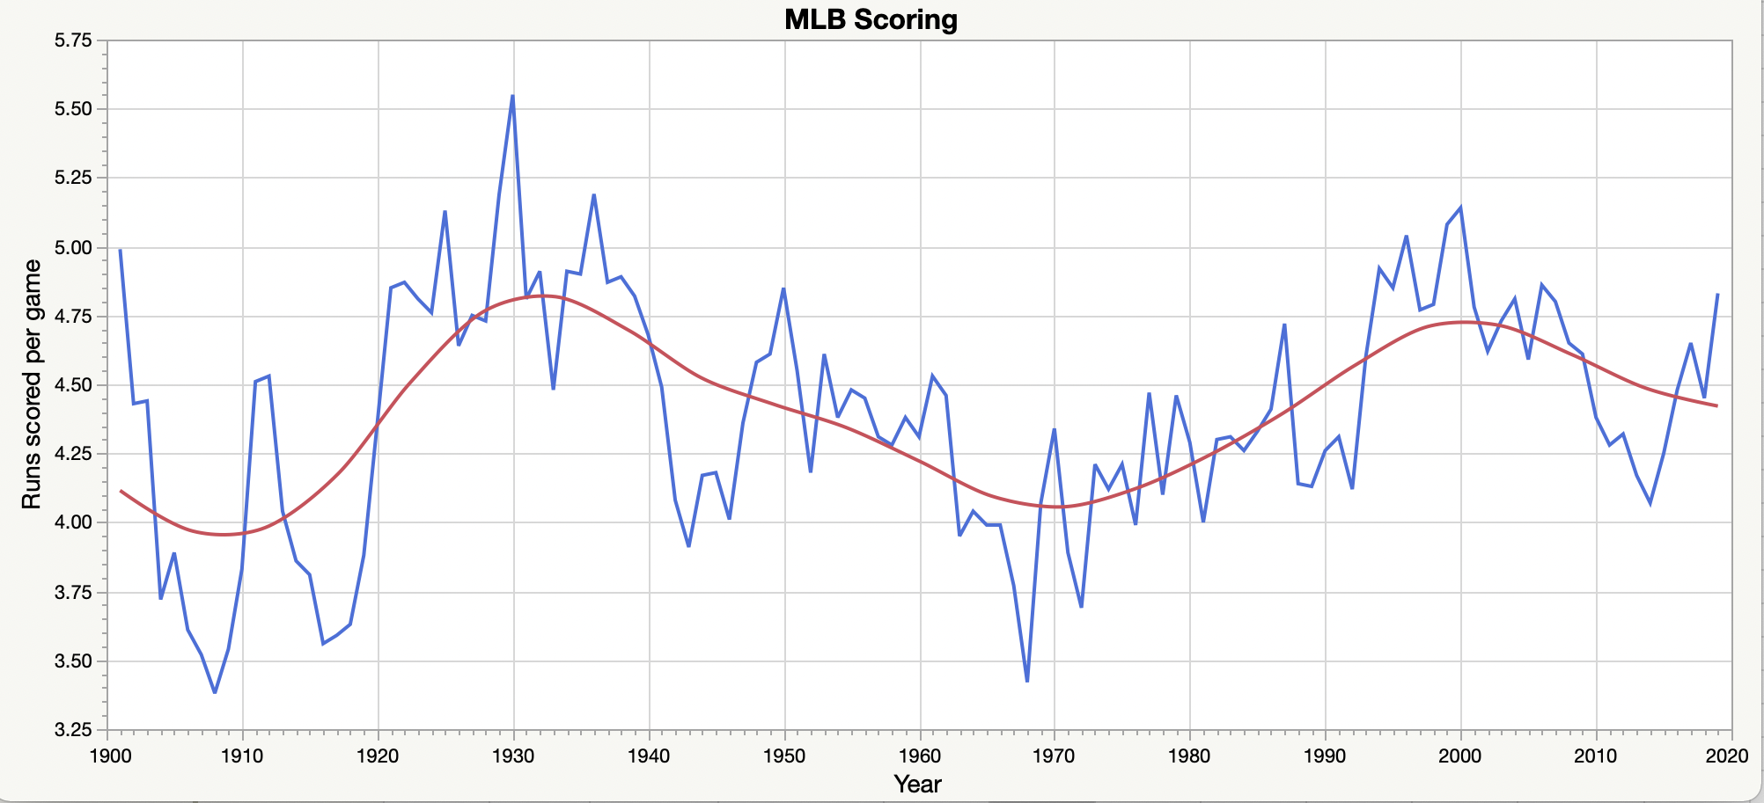
Run scoring in Major League Baseball

Slide 15
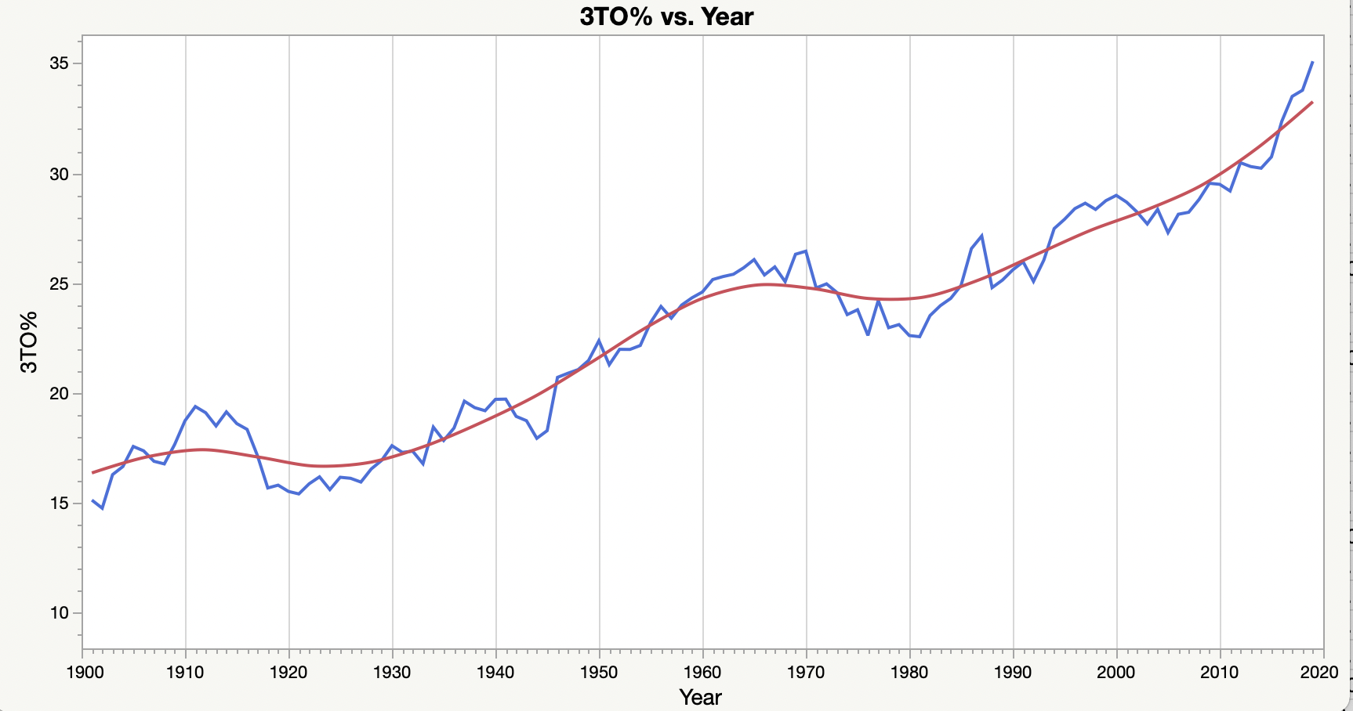
Three “true” outcomes – home runs, strikeouts, walks

Slide 16
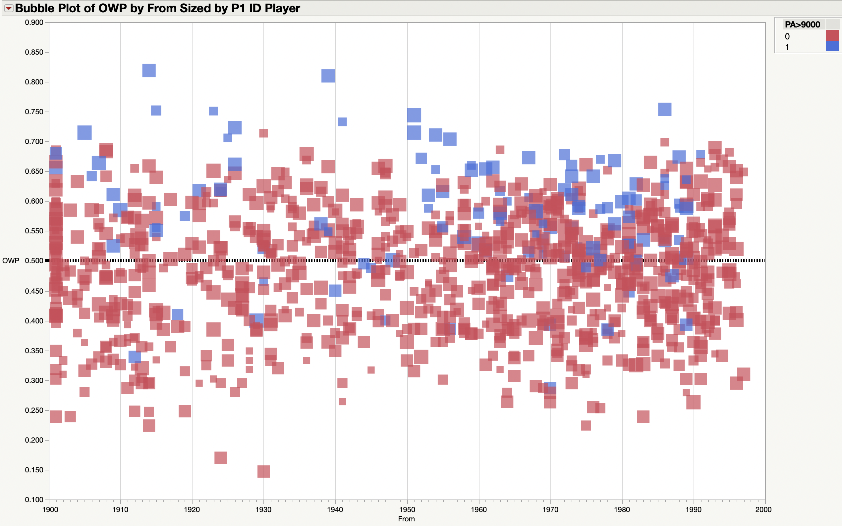
Individual MLB Player Career Performance

Slide 17
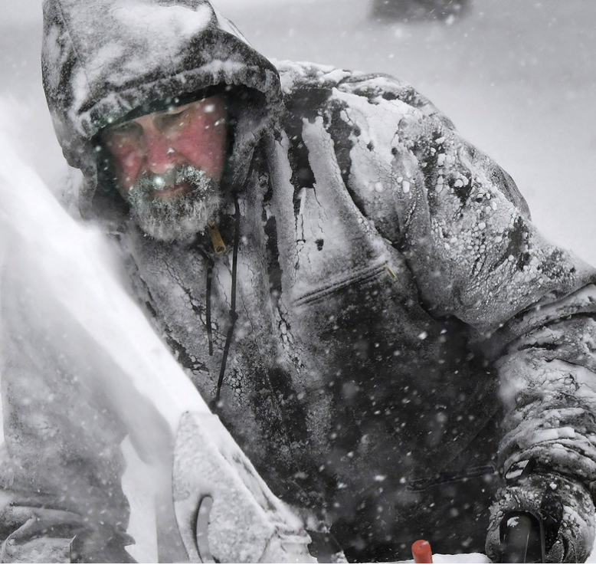
Back to snow ratio …
(Jan 29, 2022)

Slide 18
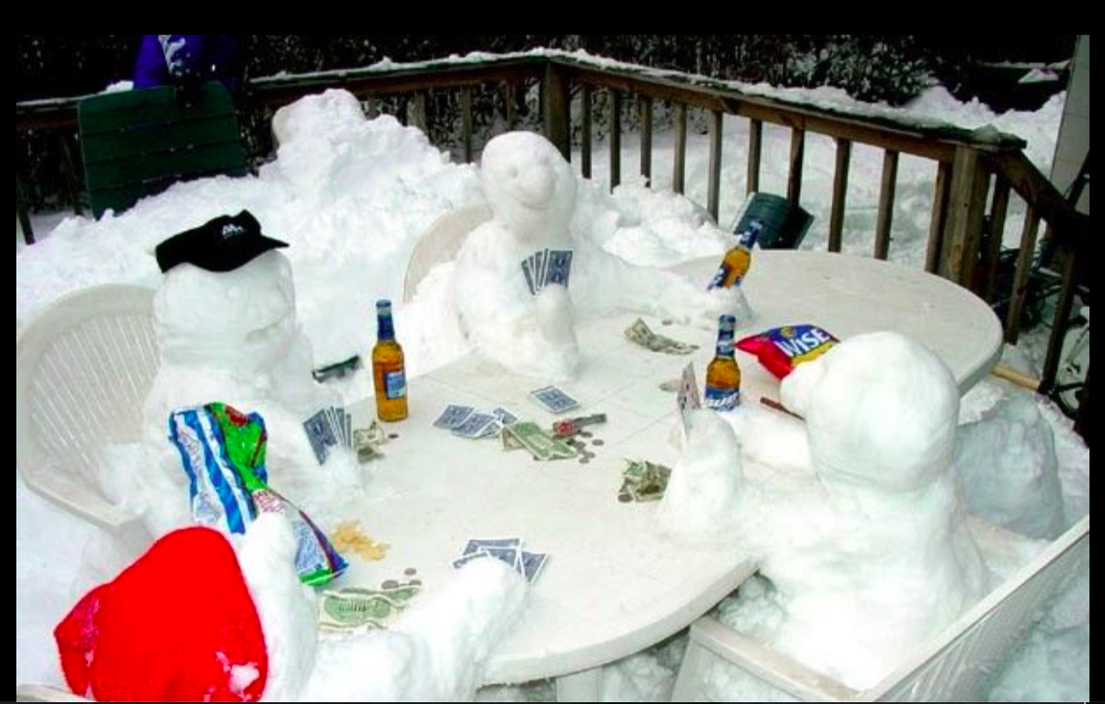
Surface temperature

Slide 19
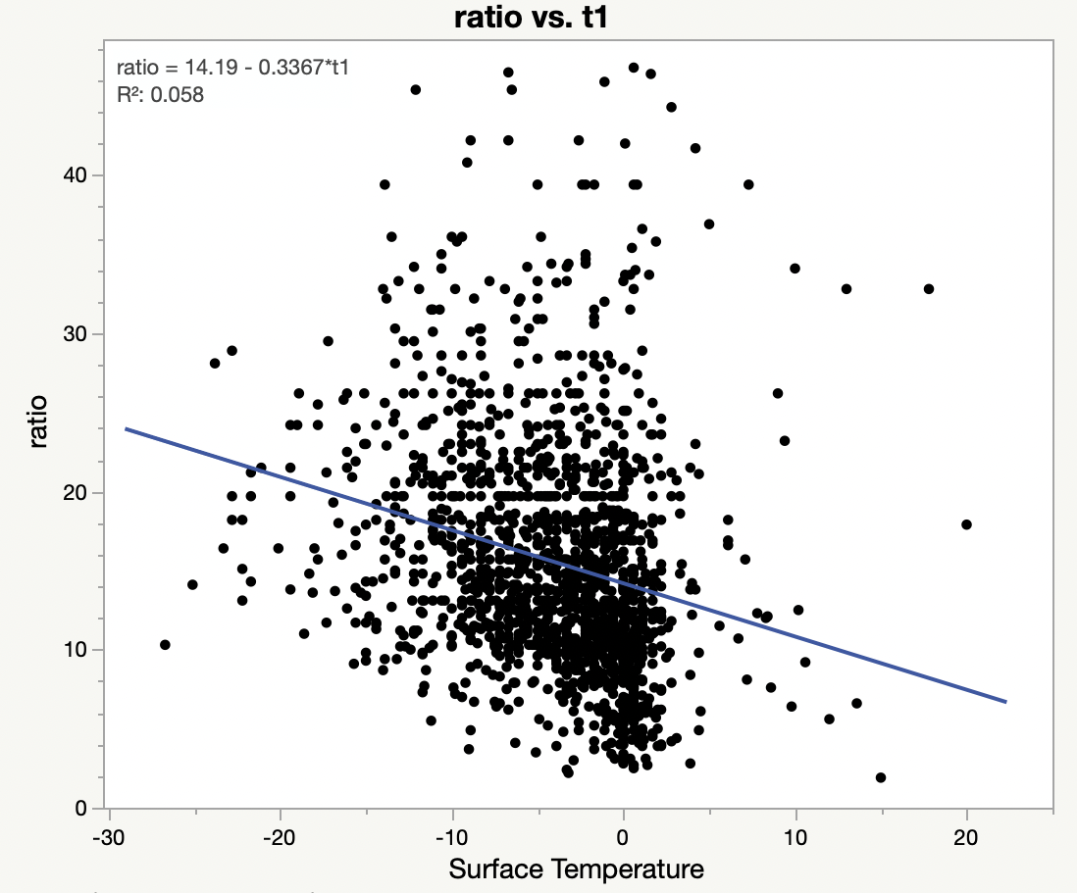

Slide 20
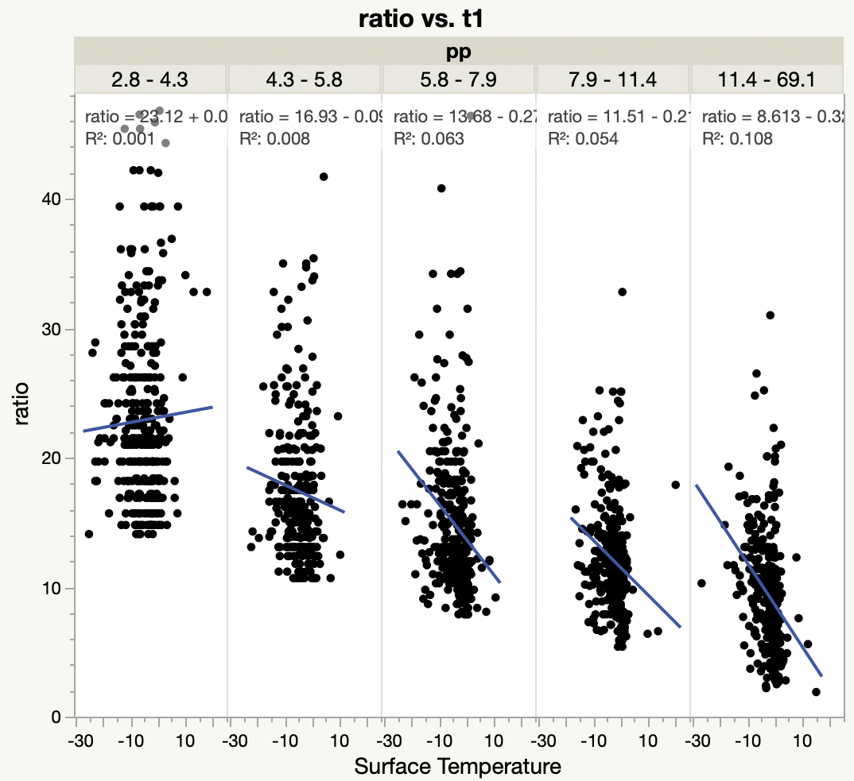

Slide 21
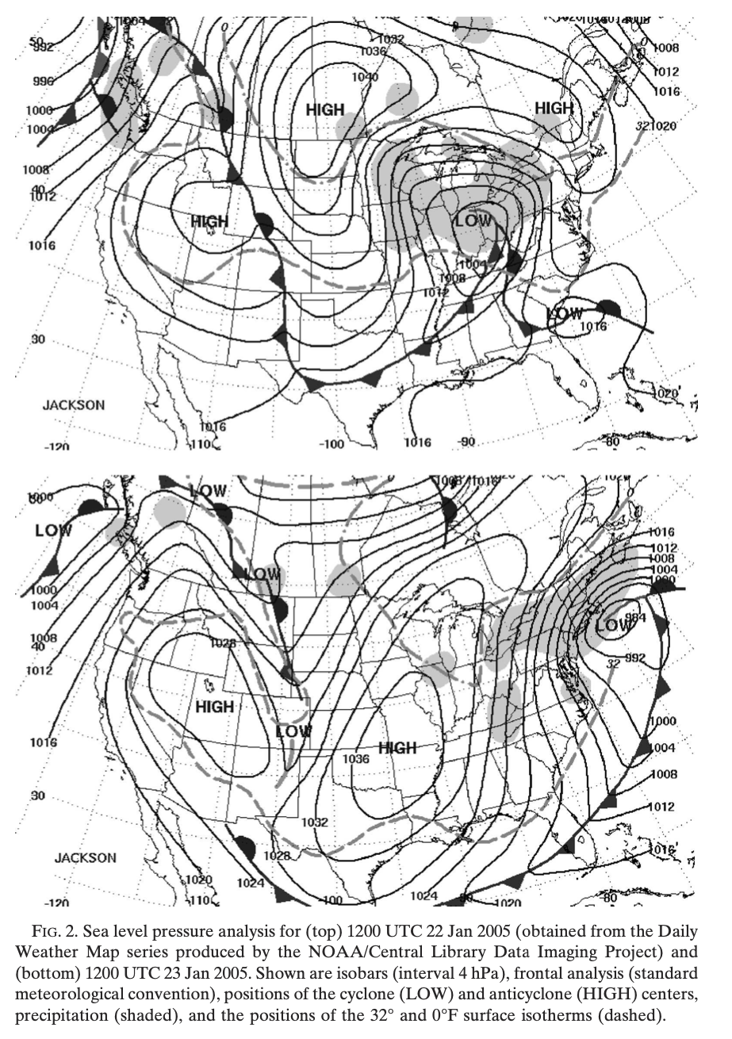
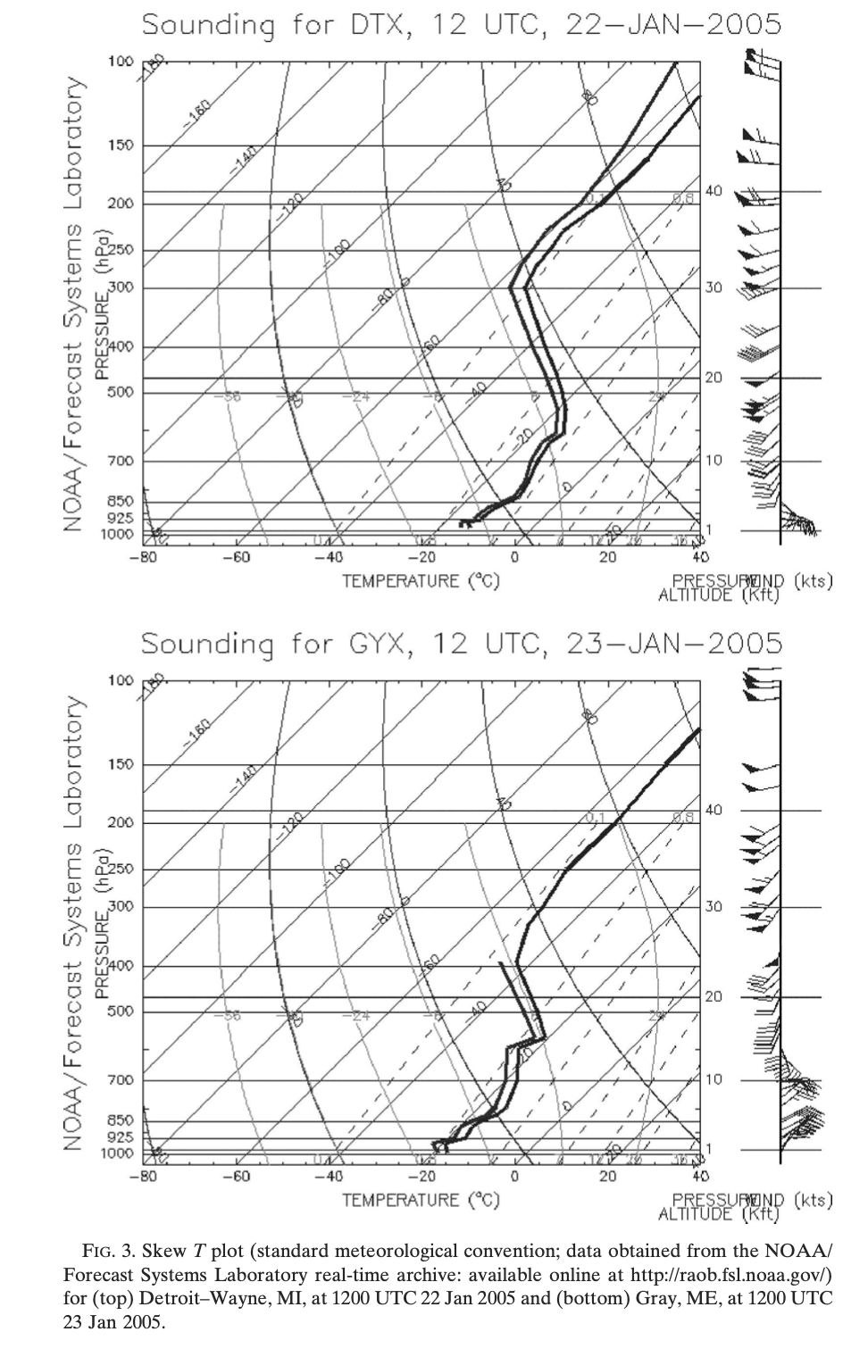
“Blizzard of 2005”

Slide 23
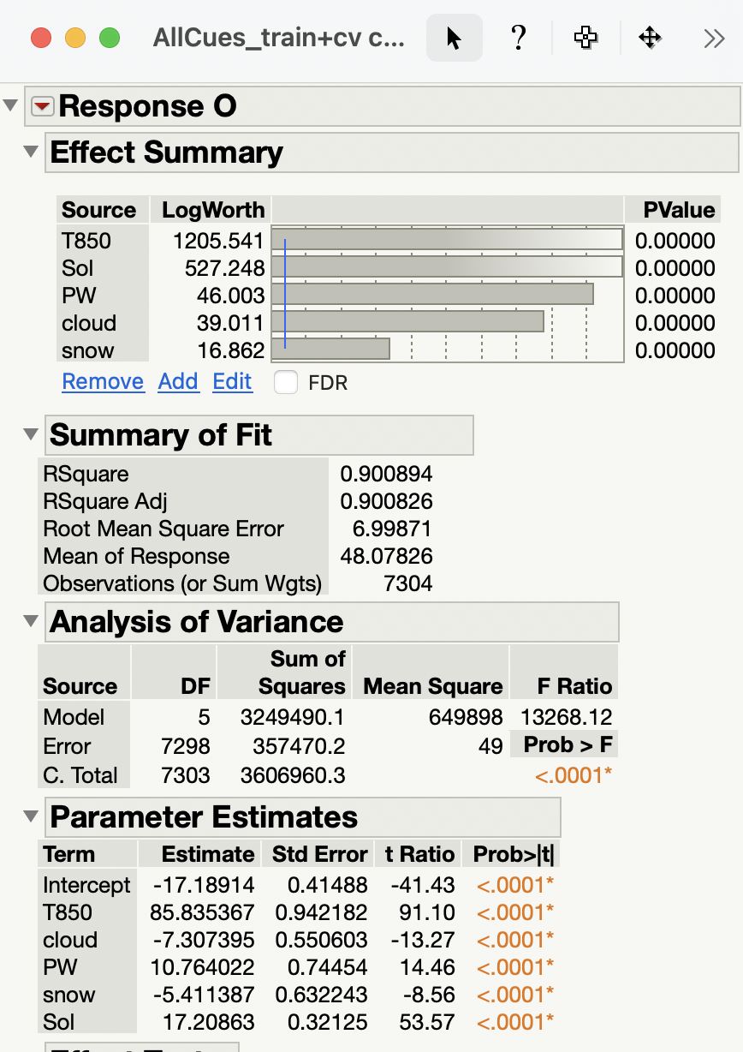
12-24h Minimum
Temp forecasts
(43°N/90°W)

Slide 24
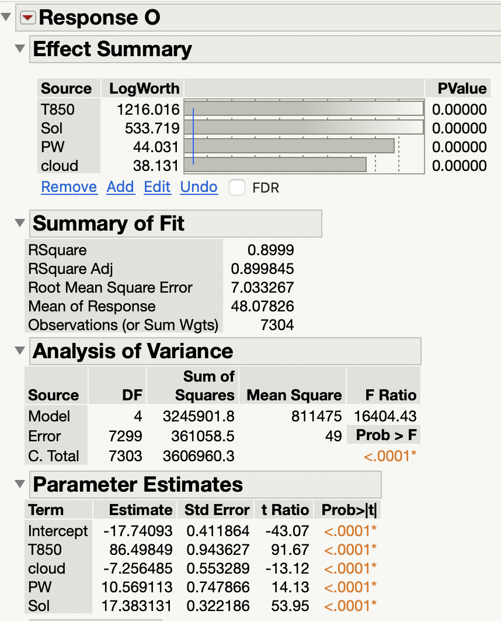
24-36h Minimum
Temp forecasts
(43°N/90°W)
=>MLR did not pick up
conditional effect of
snow

Slide 25
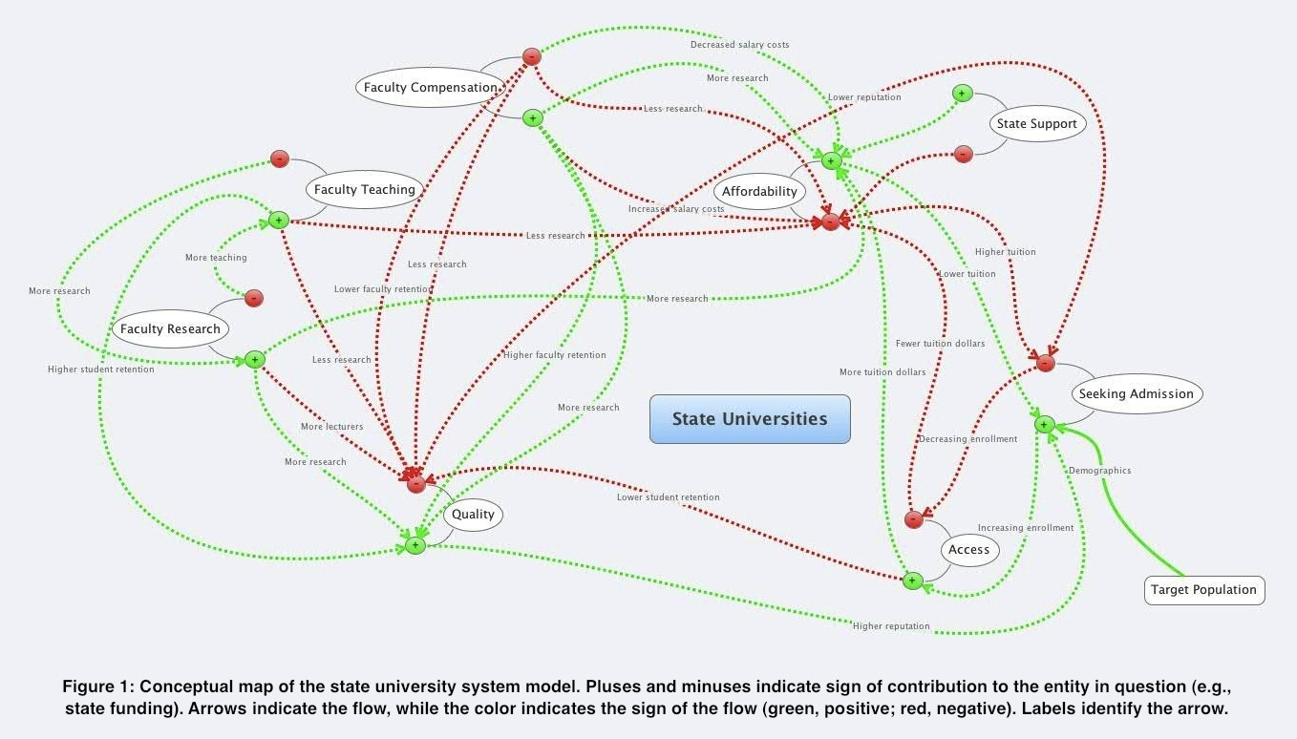
A Brief Introduction to Alternative Models …
(pub. Journal of Education Finance)

Slide 26
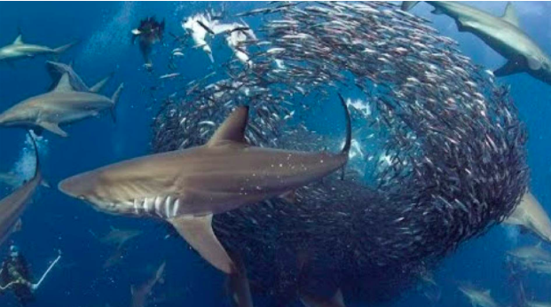
1. Impose interpretable algo structure 2. Initialize random structure 3. Measure “success” or “fitness” 4. Produce next generation (w/ mutations) based on “fitness” 5. Repeat #3-4
Evolutionary
Programming
Using the principles of evolution to produce skillful NWP postprocessors
MUTATIONS

Slide 27
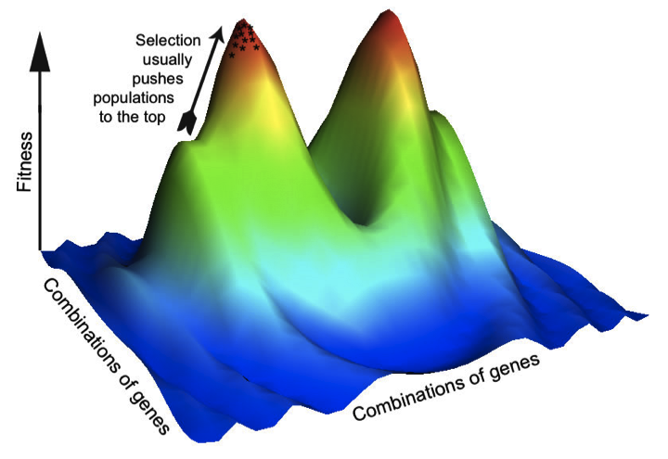
Machine Learning & Non-linearity

Slide 28
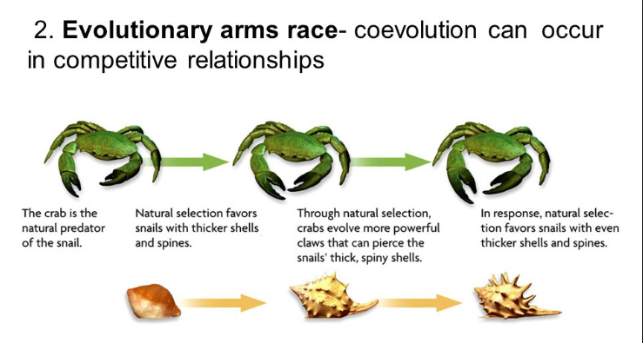

Slide 29
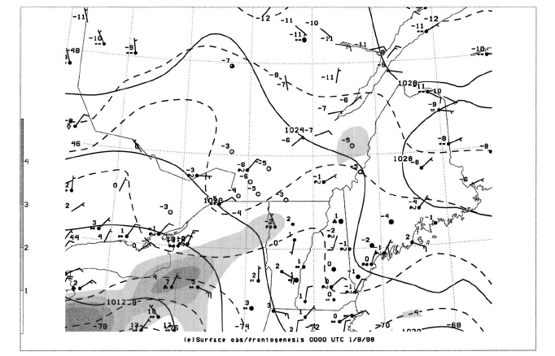
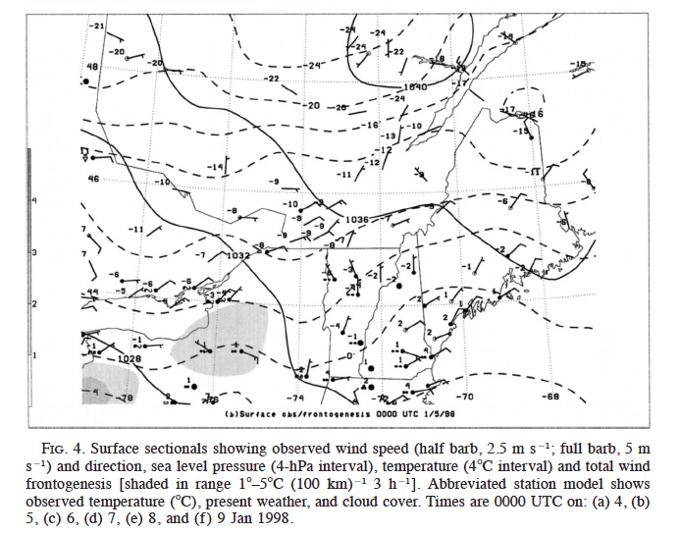
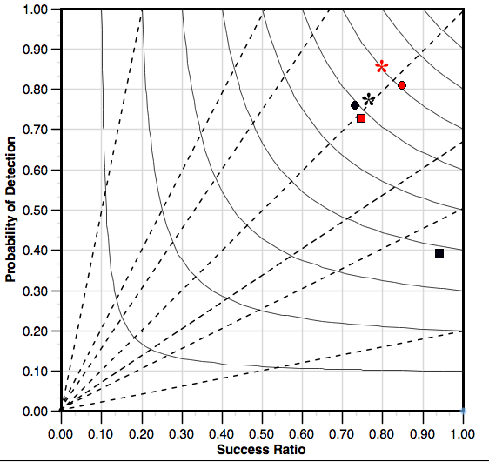
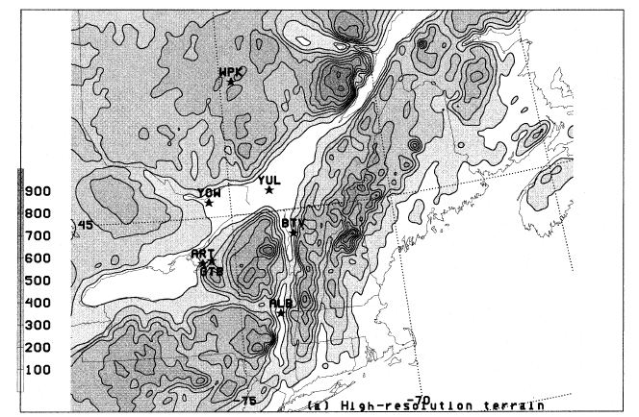
Montreal/St. Lawrence Valley
■ ZR (EP)
* Snow (EP)
• Rain (EP)
ZR (HRRR)
* Snow (HRRR)
• Rain (HRRR)
Roebber (2009)

Slide 30
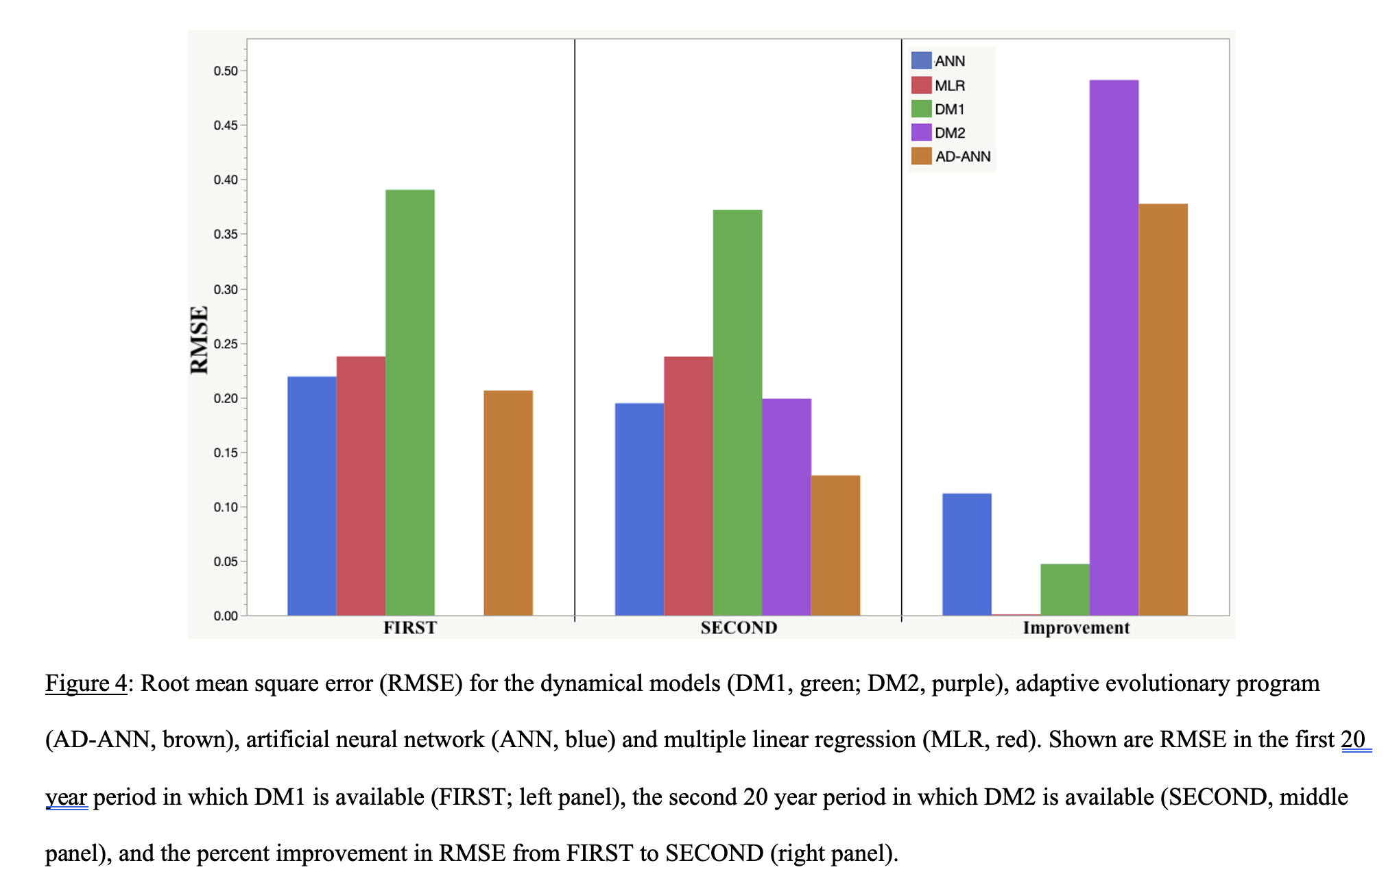
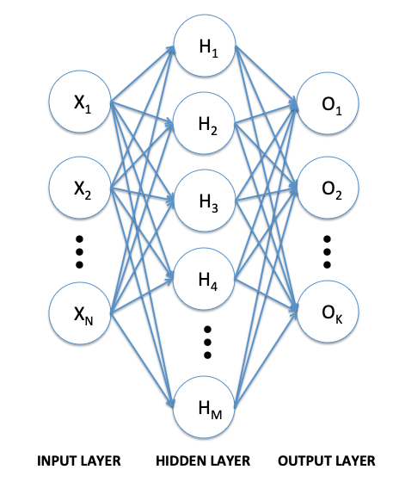
Adaptive Agent-based ANN model

Slide 31
Key Take-Aways
Need to know the problem (domain expertise), the techniques, and the application for effective development
=> Collaboration is important!
Data preparation is critical … and time intensive
Choose the right technique for the problem
Machine learning is not magic!
Notes:
How are factors combined to produce evac decision?
Protective Action Decision Model
Describe Process
Walk through example
Ability to model
There’s a baseline understanding to be able to model the human system elements of hurricane evacuations. Rebecca’s work proves it.

Slide 32
Questions/Discussion?
Notes:
How are factors combined to produce evac decision?
Protective Action Decision Model
Describe Process
Walk through example
Ability to model
There’s a baseline understanding to be able to model the human system elements of hurricane evacuations. Rebecca’s work proves it.

