Slide 1
Brief to NOAA/NWS
AI Team
on “Roebber Report”
Paul J. Roebber
UWM Distinguished Professor
University of Wisconsin at Milwaukee
August 1, 2022

Slide 2
Charge of NOAA/OSTI Director Steve Smith:
Summarize current AI/ML activity across NWS
Identify current obstacles
Recommend future directions that facilitate progress
•••

Slide 3
Some first principles …
2020 NOAA Artificial Intelligence Strategy (NAIS):
“Artificial Intelligence refers to computational systems able to perform tasks that normally require human intelligence, but with increased efficiency, precision, and objectivity. A subset of AI called machine learning refers to mathematical models able to perform a specific task without using explicit instructions, instead relying on patterns and inference.”

Slide 4
A better definition …
NSF AI Institute for Research on Trustworthy AI in Weather, Climate, and Coastal Oceanography (AI2ES):
“ML is a field of study involving computer algorithms that can improve and adapt automatically through continual experience with data.”
*I would add … the physics basis of atmospheric science argues for a need to understand as well as predict, and the confidence that ensues from understanding why a prediction is being made.

Slide 5
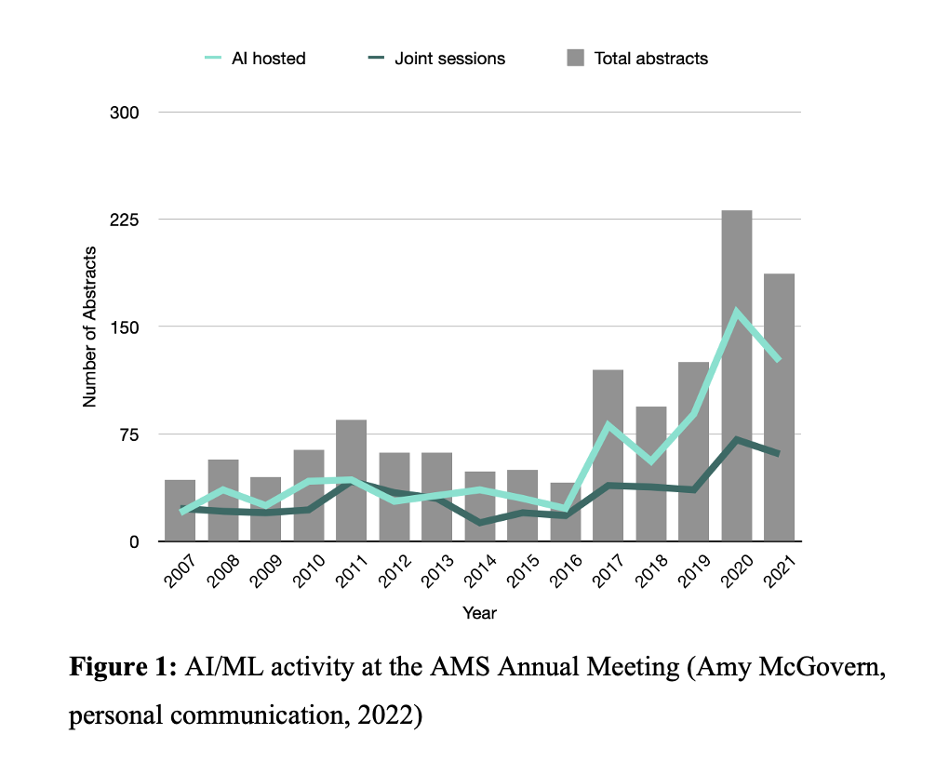
•••
NOAA’s Center for Artificial Intelligence (NCAI) data science project count:
2020: 188 self-reported
2022: 263
(Rob Redmon, personal communication, 2022)

Slide 6
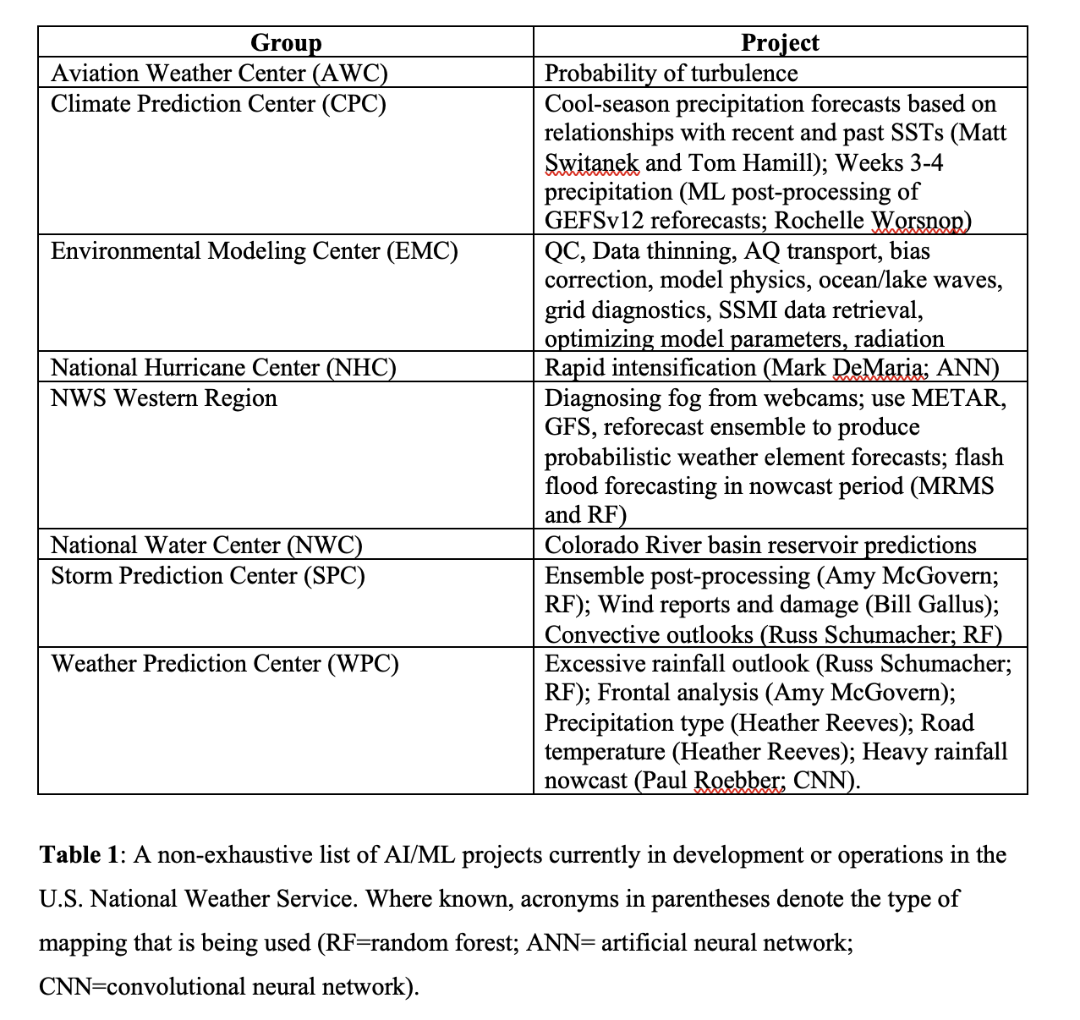
•••

Slide 7
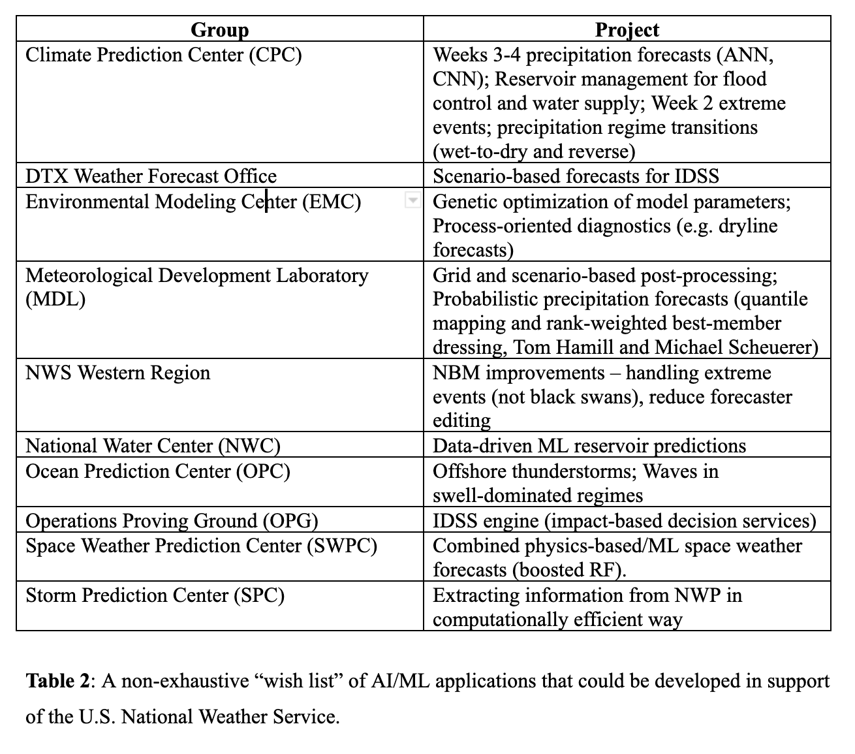
•••

Slide 8
Obstacle:
Lack of workforce training
•••
Possible solution:
Partner with NCAI to develop NWS-specific
training materials

Slide 9
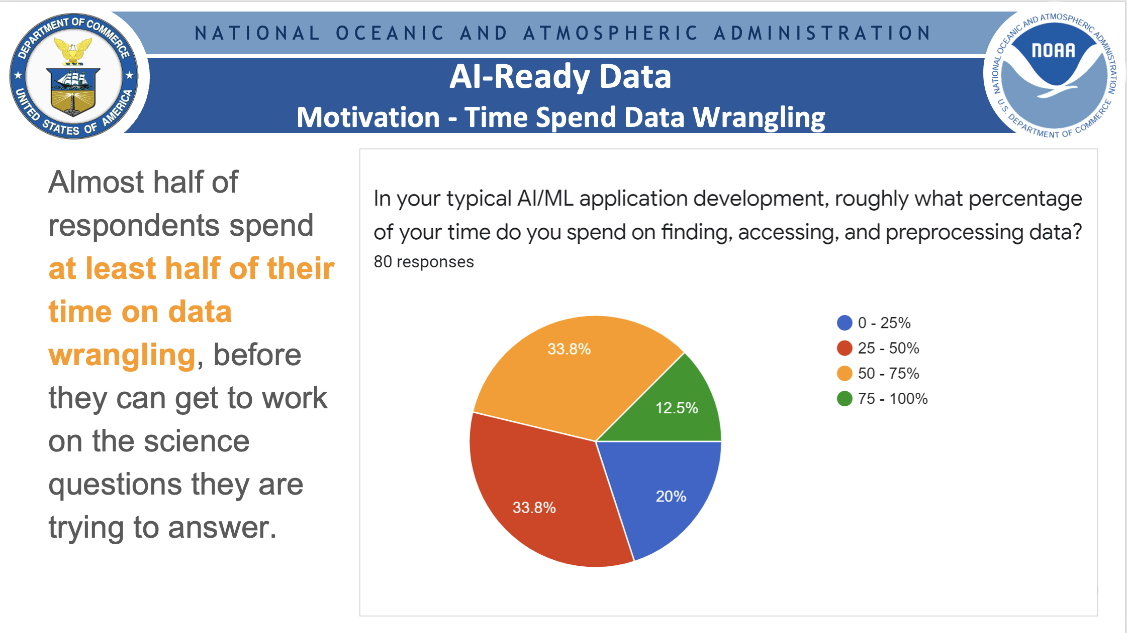
Slide courtesy of Rob Redmon, Lead, NOAA Center for Artificial Intelligence (NCAI),
in collaboration with Earth Science Information Partners (ESIP) Data Readiness Cluster.

Slide 10
Obstacles:
Lack of curated datasets and software for
development and evaluation
Absence of centralized clearinghouse for
technical consultation/partnering
•••
Possible solution:
Develop reference software and datasets
Construct consulting (project support) team

Slide 12
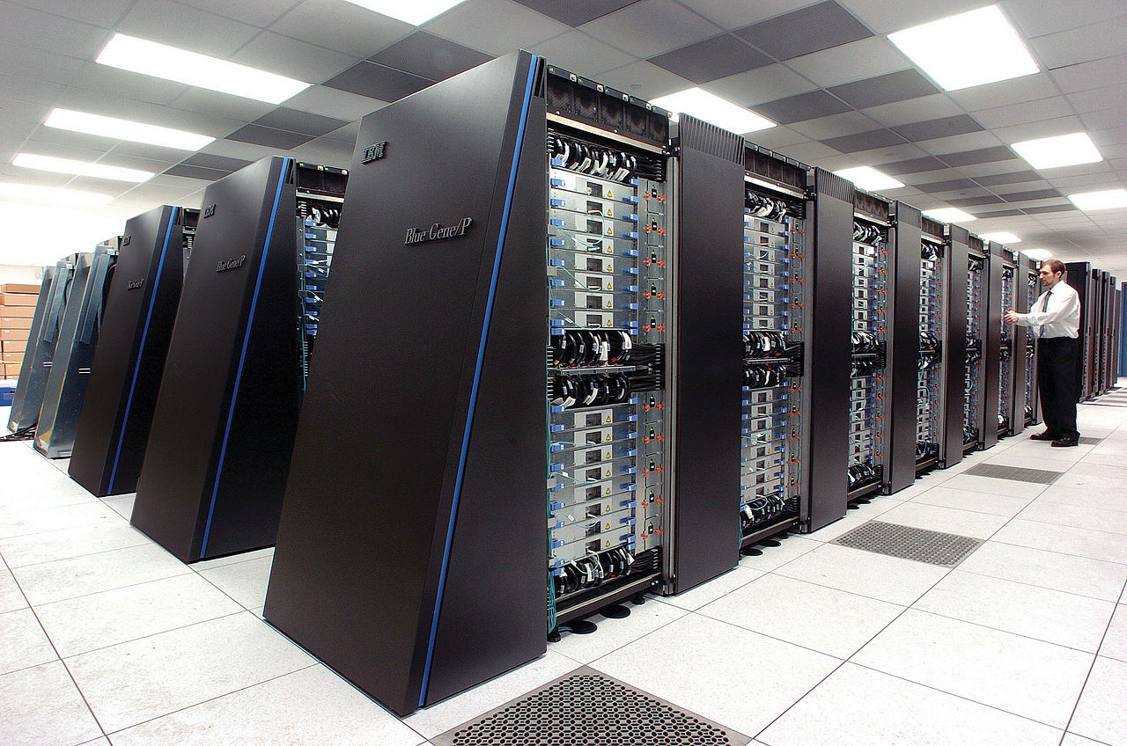

Slide 13
Obstacle:
Limited operational compute resources
•••
Possible solution:
?

Slide 14
Obstacle:
Lack of clear end-to-end pathway that
encompasses exploration, development,
testbed/proving ground and operational
implementation
•••
Possible solution:
Establish funding vehicles for theme-based
projects within a sustainable funding
framework to bridge R2O valley-of-death

Slide 15
A new direction:
Develop agent-based modeling capability
•••
Rationale:
ABMs are naturally connected to human
decision-making and the social
sciences => IDSS
Benefit:
Provides ability to understand complex,
multiparty interactions => improve IDSS

Slide 16
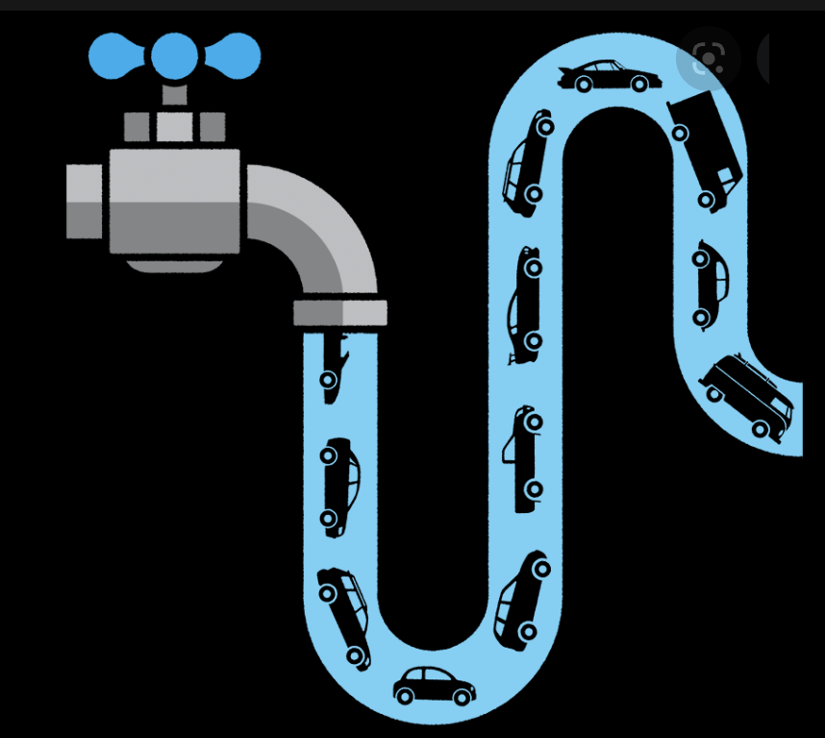
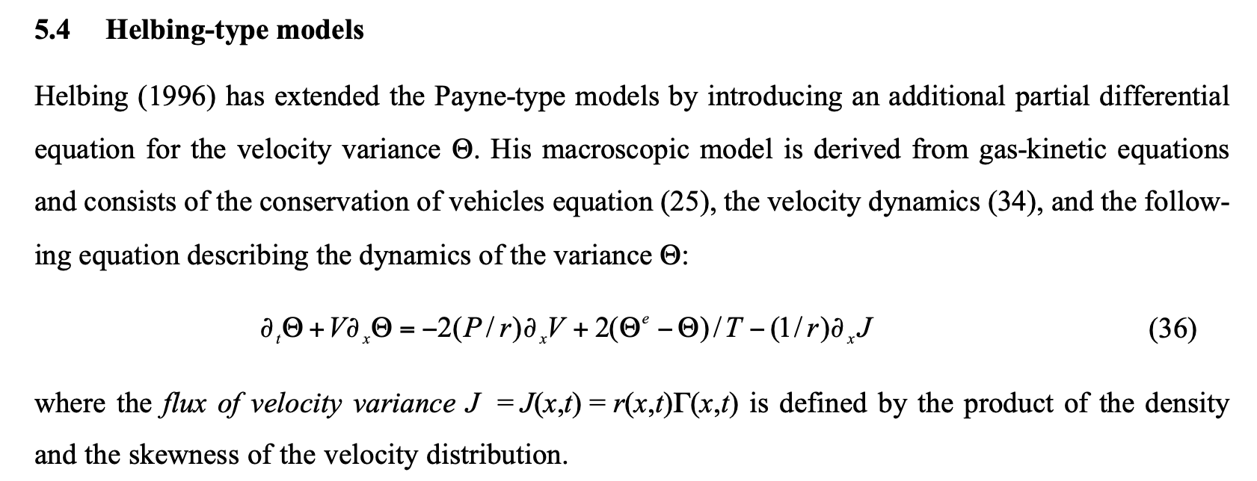

Slide 17
KEY FEATURES
system is governed by the interaction of individual “agents” which follow a set of “local” rules
behavior of the system (e.g. traffic flow) emerges from the collective behavior of the individual agents (e.g. vehicles)
bottom-up interaction of multiple systems at multiple scales, with concomitant emergent properties, can allow for a deeper understanding of complex systems
Such models have a natural connection to human decision-making and the social sciences and can represent the interactions and feedbacks between natural and human systems
Great potential application to NWS IDSS

Slide 18
Where has this been applied?
In biology
In epidemiology
In business (e.g. organizational theory)
In economics and social sciences
In water management

Slide 19
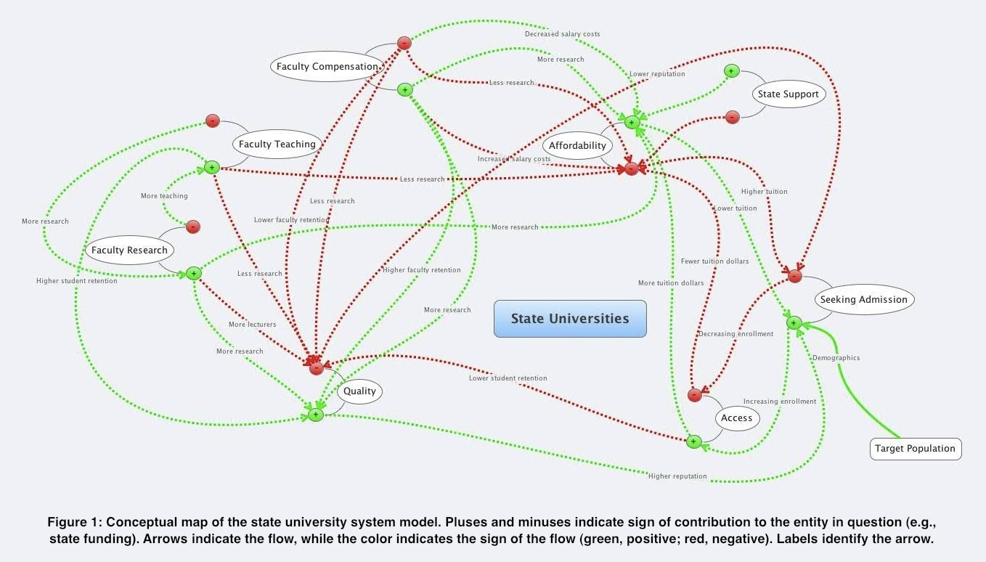
(pub. Journal of Education Finance)

Slide 20
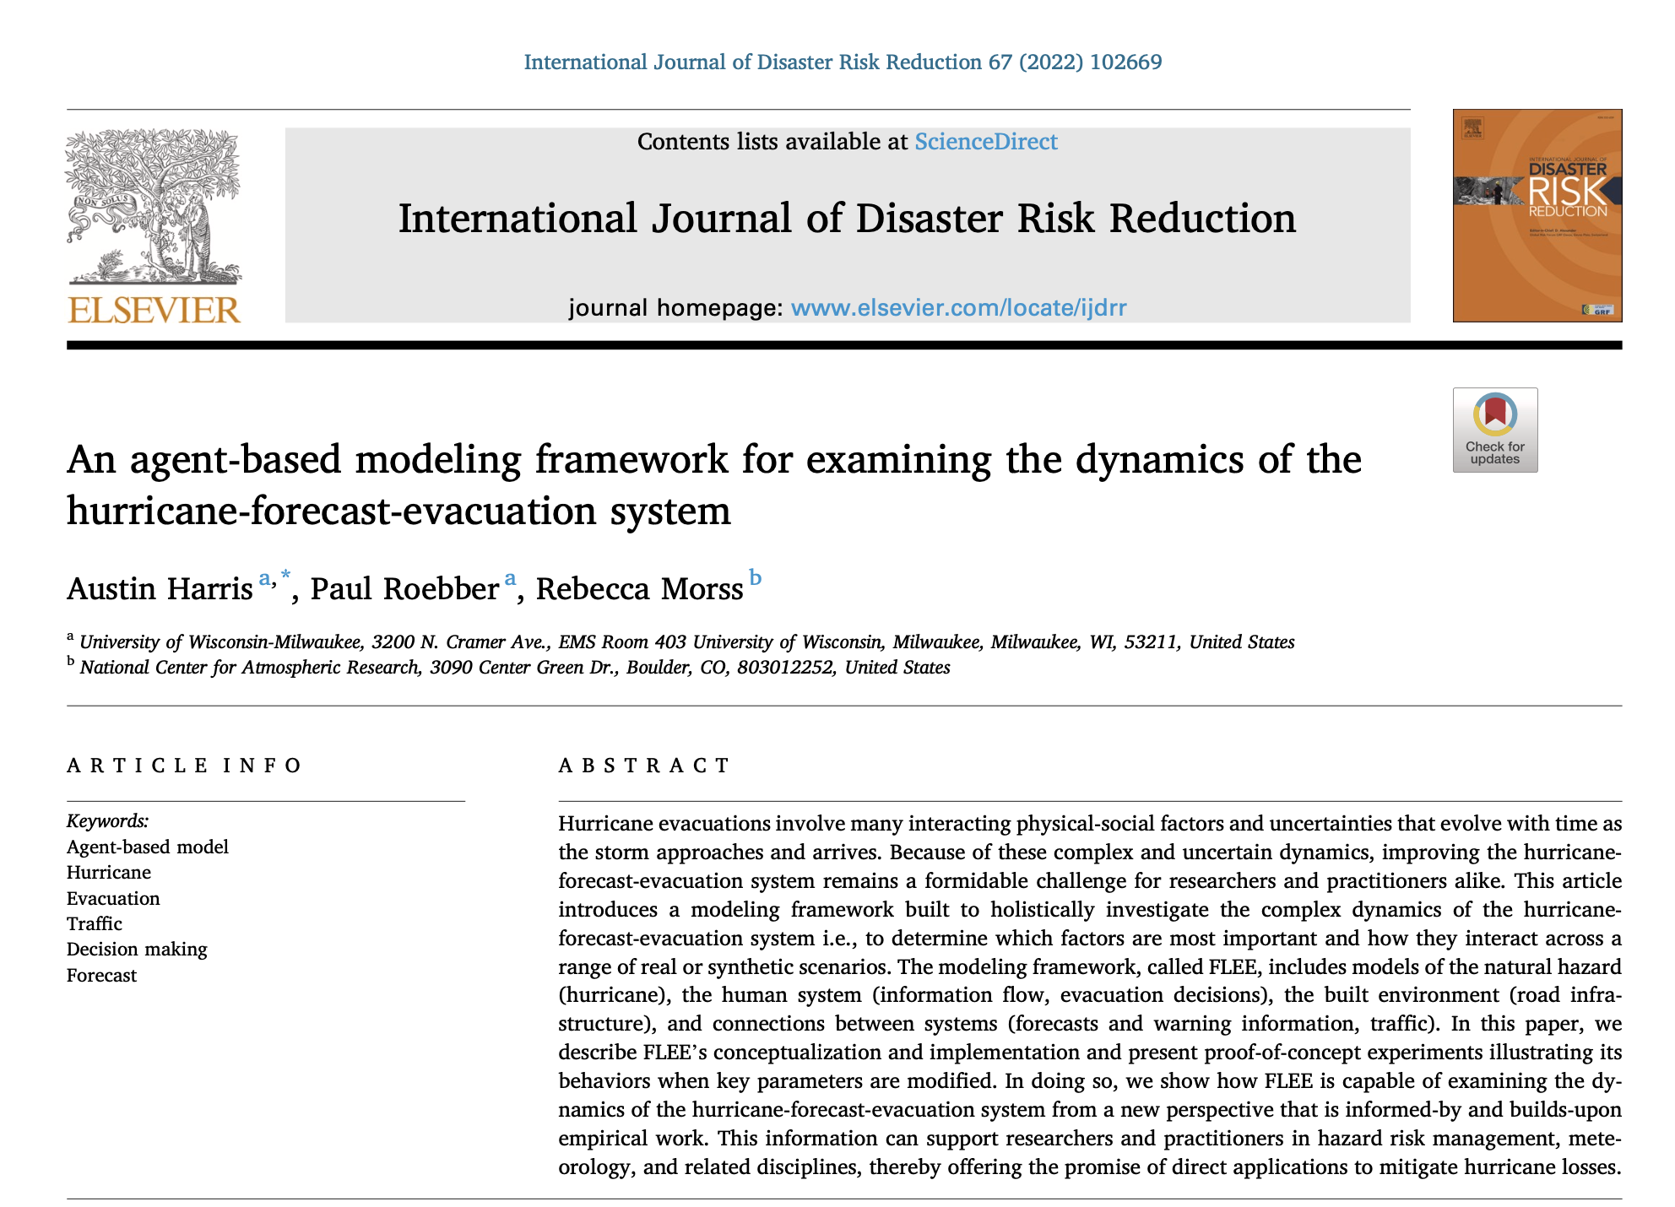

Slide 21
Questions/Discussion?
Notes:
How are factors combined to produce evac decision?
Protective Action Decision Model
Describe Process
Walk through example
Ability to model
There’s a baseline understanding to be able to model the human system elements of hurricane evacuations. Rebecca’s work proves it.

