Slide 1
Automating Draft Local Storm Reports (LSRs) using Generative AI
R&D Prototype Project
May 2025

Slide 2
Opportunities to Advance NWS’ Mission using AI
Saving Lives, Protecting Property, Enhancing the Economy
Numerical Weather Prediction
Probabilistic Impact- Based Decision Support Services
Product and Service Delivery
Operational Efficiencies
Software & Hardware Efficiencies
Community and Workforce Training
Data Management
Technology Infrastructure

Slide 3
Leveraging and Expanding Partnerships
Strategic Focus
Proactively building AI-focused partnerships
Enhancing public-private collaboration
Engagement Opportunities
High interest from private sector in AI/ML with NWS Models include: no-cost prototypes, pilot projects, shared use cases
Benefits of No-Cost Prototypes
Promote experimentation with minimal risk
Test new tools rapidly
Build business case for scaling innovation
Emphasizes public-private collaboration for innovation in weather services

Slide 4
Automating Draft Local Storm Reports
Challenge: Manual process of writing LSRs takes significant time and is inconsistent
Solution: Create a Generative AI system to automatically draft LSRs from common sources
Status: R&D proof-of-concept prototype is being developed at no cost under an MOU with AWS’ Generative AI Innovation Center
Generative AI System
Draft LSR
IRIS Submission
Reduced Level of Effort
Increased Situational Awareness
More Consistent Database
Notes:
Manual process of writing LSRs takes significant time and is inconsistent across the country. In addition, the resulting dataset, the Storm Events Database has significant gaps and inconsistencies.

Slide 5
Proof-of-Concept Overview
GenAI system will be developed at no cost under an MOU with AWS’ Generative AI Innovation Center
News and Social Media
Draft Local Storm Report
Final Local Storm Report
Slack w/EM Community
Forecaster
Dept. of Trans. Reports
Generative AI
mPing (public submissions)
NWS Connect Map
Storm Events Database
Audio Translations (future)
Cameras (future)
Real Time
Retrospective

Slide 6
POC Objectives and Milestones
Objectives
Milestones
Design text and metadata extraction system
Design and implement event cross-referencing
Review data, feature definition and prompts
System design review
Initial implementation of system and review of results/generation
Review UI and packaging of solution into IaC or container
Integration with NWS Connect
Location resolution
Generate LSR with associated confidence score
Future objective: multimodal event extraction
GenAIIC will build a light demo UI/UX, a final end-user UI/UX is out of scope

Slide 7
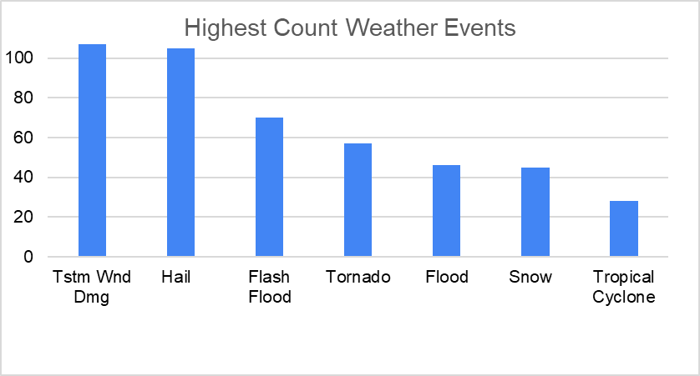
NWS Data Collection
Input/output pairings for LSRs based on 6 months of IRIS data
Generative AI Training Data
Event specific input/output pairings from a variety of sources to reflect LSRs of different weather types
Volunteers used a Google Form to enter pairings, >600 responses collected from 54 volunteers
Twitter/X
Other
Facebook
Slack-NWSChat
10 LSR source types, 29 weather events
Notes:
Goal was 1000 pairings- but model will work with less than received responses
Other category:
Extensive variety in this list. Some examples include:
Tri-County Electric Membership Corporation Website
Emergency manager called IWX with the report/information
Storm survey of extensive damage relayed by emergency management
Automated email from 911 center to WFO operational email account

Slide 8
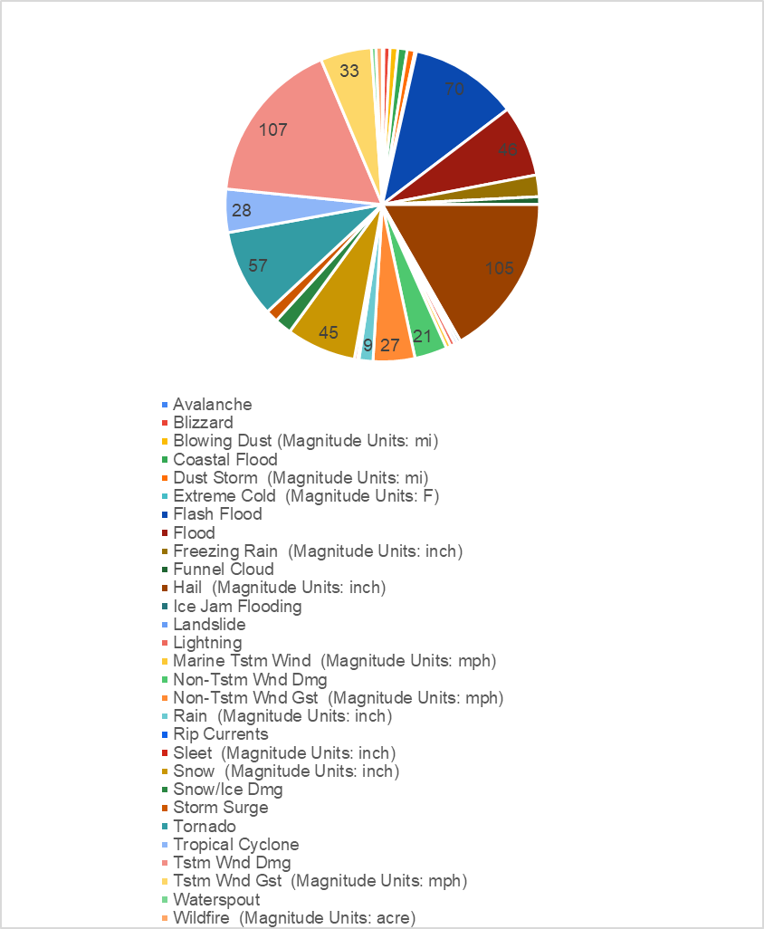
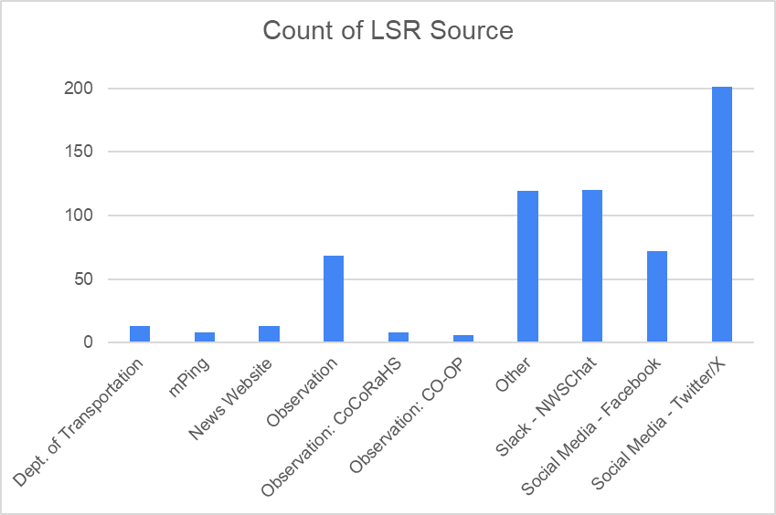
Input Data

Slide 9
Project Status
Pre-POC Completed
Discovery Workshop
Workshop Part 1: September 26, 2024, Workshop part 2: November 08, 2024
Finalized Discovery Workshop Readout document
NWS Data Collection Completed
Created S3 bucket within VLab Cloud Sandbox Account to store data
Create user accounts for AWS staff in VLab Cloud Sandbox Account
Kick Off Meeting with AWS and NWS - May 16
Data exploration and walkthrough completed
Basic preliminary results provided
Project Meetings on Weekly Basis
Bi-weekly meeting with larger stakeholder group

Slide 10
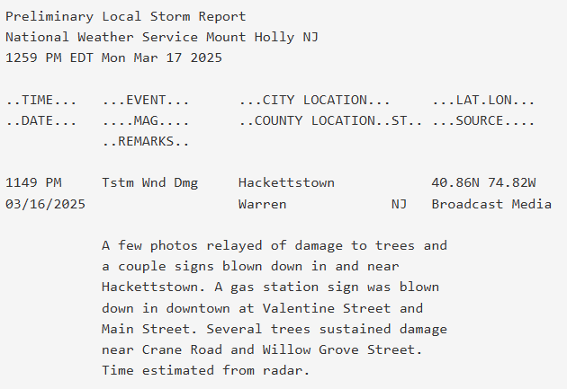
Very Early Results
Future analysis will include:
Comparing latitude and longitude
Verify descriptions and source
Verify city, county, state
Timestamps
Simple prompting:“You’re an expert in creating LSRs for the NWS, examine the image, extract information necessary, distinguish dates and times between the time of the event and the time it was reported, and don’t include any preamble”
LLM Output
Human-generated LSR
StormReport(event='Tstm Wnd Dmg', magnitude='None', magnitude_unit='None', date='2025-03-16', time='None', latitude='40.85', longitude='-74.83', city='Hackettstown', county='Warren', state='NJ', source='Broadcast Media', remarks='Downed trees and gas station sign knocked over from storm.')
Notes:
Early results:
Used Pydantic- which allows to control the types of data and fields that are returned
Used unique types in excel file: event type, time, date, lat, long, etc
Model can extract text from pictures/screenshots
Next steps:
Confidence level, timestamps, recognizing sources, lat/long specificity, rules for precision
Confidence level will need feedback from stakeholders on how to best implment

Slide 11
Proof-of-Concept Engagement Schedule
Engagement Kickoff
Basic
Functionality
Evaluation &
Refinement
Week 1
Week 2
Weeks 3-4
Logistics
Q&A
Data Exploration
Evaluation Metric Development
Basic Functionality
Algorithm Refinement
Evaluation
Application Infrastructure
Enterprise Readiness
Preparing for Production
Spring Cadence
Milestone based
Weeks 5-6
Week 7
Week 8+
Architecture & Services
Infrastructure as Code
Development Deployment
Basic Front-End
Performance Optimization
Runbook & Documentation
Code Delivery
Technical Walkthrough
Additional Support
Notes:
Project is milestone based so schedule is dependent on hitting milestones

Slide 12
Recognizing NWS Participants
Monica Youngman – Chief Scientist, Office of Science and Technology Integration
Kenneth Sperow – Senior Science Advisor for Cloud Computing
Armani Cassel – Meteorologist, SHV
Chris Maier – National Warning Coordination Meteorologist
Daniel Zumpfe – Science and Operations Officer, MSO
Eric Allen – Meteorologist, ER
Gina Selig – Project Manager
Gordon Strassberg – Meteorologist, PEB
Jamie Enderlen – Service Assessment & Service Evaluation Program Manager
Jason Burks – Cloud Consultant
Jarrod Loerzel – Social Behavioral & Economic Sciences Program
Jeremy Michael – Science and Operations Officer, RLX
Ji Sun Lee – Social Behavioral & Economic Sciences Program Director
JJ Brost – Operations Proving Ground Director
Keith Sherburn – Meteorologist, AFS Fire Weather
Mark Willis – MDL Weather Information Applications Division Chief
Mike Churma – Meteorologist, MDL Decision Support Division
Mike Sowko – Meteorologist, PEB
Nate Smith – IT Specialist, MDL Weather Information Applications Division
Randy Bowers – Meteorologist, AFS Severe
Additional support from 53 NWS volunteers who supported the generation of the training data

