Slide 1
Introducing Stock Synthesis (SS) Version 3.30
LaJolla, CA
Feb 21, 2018
Richard Methot, Ph.D.
NOAA Fisheries Senior Scientist for Stock Assessment

Slide 2
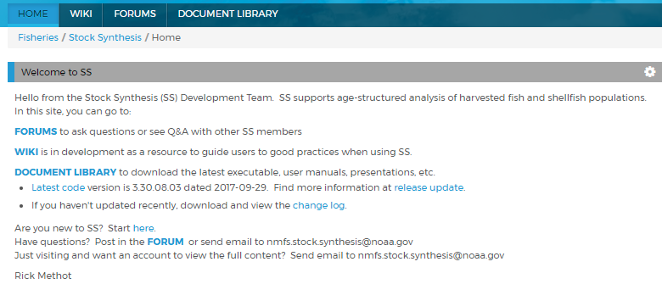
VLAB - Community
https://vlab.ncep.noaa.gov/group/stock-synthesis/home

Slide 3
VLAB - Developers
https://vlab.ncep.noaa.gov/redmine/projects/stock-synthesis
Site for developers
git repositories for:
SS code, now in over 20 sections appended together before tpl2cpp step
Latex documentation
QT graphical interface code
Issue tracking of bugs, tasks, wishlist
With issue # linked to git commits

Slide 4
Development Team
Richard Methot | Lead Developer
Chantel Wetzel | Documentation
Neal Schindler | Graphical Interface
Ian Taylor | r4ss
Matthew Supernaw | C++ Code Consultant
Jim Thorson | Statistical Innovation
Courtney Butler | VLAB support; testing
All of you | Ideas, Testing, Inspiration

Slide 5
SS Versions
No more SS3.exe (latest version is SS3.24ac)
Now 3.30.10.02 = 3 . major_features . minor_features . fixes
Versions:
ss_trans.exe
run this once to convert 3.24 files to 3.30 file formats
ss.exe
for safe mode running with bound checks
ss_opt.exe
Fast and optimized for speedy execution
ss_32bit.exe and ss_trans_32bit.exe
iOS and linux versions
All versions produce
ADMB outputs labelled ss.<xxx> , e.g. ss.par,
plus SS specific *.sso and *.ss_new

Slide 6
Code Modularity
Now has ~26,500 lines of tpl code
Split among 19 files
copy/b SS_biofxn.tpl+SS_miscfxn.tpl+SS_selex.tpl+SS_popdyn.tpl+SS_recruit.tpl
+SS_benchfore.tpl+SS_expval.tpl+SS_objfunc.tpl+SS_write.tpl+SS_ALK.tpl SS_functions.temp
copy/b SS_versioninfo_330safe.tpl+SS_readstarter.tpl+SS_readdata_330.tpl
+SS_readcontrol_330.tpl+SS_param.tpl+SS_prelim.tpl+SS_global.tpl
+SS_proced.tpl+SS_functions.temp+SS_timevaryparm.tpl "C:\Users\richard.methot\Documents\SS_model\Compile\ss.tpl"
Note, uses SS_readdata_324.tpl and ss_readcontrol.tpl to create ss_trans

Slide 7
Code Compilation
Easy script in my IDE using Visual C++
pushd "%VS140COMNTOOLS%\..\..\VC" & call vcvarsall.bat amd64 & popd
C:\ADMB64\bin\tpl2cpp ss
cl /c /nologo /EHsc /O2 /I. /I"C:\ADMB64" /I"C:\ADMB64\include" /I"C:\ADMB64\contrib\include" /Foss.obj ss.cpp
cl /Fess.exe ss.obj "C:\ADMB64\lib\admb-contrib.lib" /link

Slide 8
Big Changes
List-oriented inputs with explicit end-of-list
-9999 at end rather than N_records at beginning
Subseasons for optional finer temporal granularity of ALK calculation
Observation timing entered as year, month
Settlement events replace birth seasons
Generic approach to time-vary parameters

Slide 9
Time Steps in SS
ALK
ALK
First half of season; Spawning at beginning | Second half of season
V3.24
Continuous Z for entire season;
Fishery bodywt and survey body wt use mid-season ALK;
SpawnBio at begin of season and uses beginning of season ALK;
Survey_timing is survey-specific and specified as a fraction of a season
Survey numbers calculated at survey_timing using e^{-Z}
ALK
ALK*
ALK*
ALK
ALK*
ALK*
V3.30
Subseas_1 | Subseas_2 | Subseas_3 | Subseas_4; Mid_subseas | Subseas_5 | Subseas_6
Continuous Z for entire season;
even number (min = 2) of subseasons per season (regardless of season duration);
Fishery bodywt uses mid_subseas ALK;
SpawnBio has specified spawn_timing (in months.fraction); uses closest ALK to that timing;
Survey_timing is now observation-specific and specified in units of months.fraction (Apr 15 = 4.5);
Survey_season and spawn_season assigned at runtime based on month and on season duration(s);
Survey bodywt and length composition uses closest ALK to survey_timing;
ALK* only re-calculated when there is a survey that subseason;
Survey numbers calculated at survey_timing using e^{-Z}

Slide 10
Generic Fleet Order
Previously, fishing fleets were listed first, followed by survey only fleets. Input of catch was only associated with fishing fleets and there was an option for a fishing fleet to be designated as "bycatch only" such that the input catch values were ignored.
A problem with this approach is that addition or subtraction of a fishing fleet required renumbering the "fleet" ID on data for all higher numbered fleets and surveys.
Solution – Fishing and survey fleets can be in any order* and each has a specified fleet type.
Fleet types: 1=catch fleet, 2=bycatch only, 3=survey. Future types can be: environment, predator, ignore.
*Not yet for setups that use tag recapture

Slide 11
Fleet Description
#_fleet_type: 1=catch fleet; 2=bycatch only fleet; 3=survey; 4=ignore
#_survey_timing: -1=for use of catch-at-age to override the month value associated with a datum; ignored for surveys
#_fleet_area: area the fleet/survey operates in
#_units of catch: 1=bio; 2=num (ignored for surveys; their units read later)
#_catch_mult: 0=no; 1=yes
#_rows are fleets
#_fleet_type timing area units need_catch_mult fleetname
1 0.5 1 1 0 FISHERY1

Slide 12
Bycatch Fleets
Previously (v3.24) bycatch fleets must use F_Method=2 and are excluded from the catch logL. So their F must be determined from other data sources.
Bycatch fleets have selectivity and retention functions, so even though they are considered to have unknown catch levels, this does not mean that their calculated retained catch is zero.
Version 3.30 has added a option so that bycatch only fleet:
Can have retained and discarded catch calculated normally, or
All their catch will be assigned to discard
Because MSY and Yield per recruit are calculated in terms of dead catch, 3.24 included catch from bycatch fleets. This meant that the bycatch fleet F was scaled to search for reference F values. 3.30 provides options for how bycatch fleets are treated in reference point calculations and forecasts.

Slide 13
Fishery/Catch
Catch input as a list (like surveys), not a time x fleet table
Necessary because generic fleet order would have required including surveys in the table
Initial equilibrium catch now by season and part of the catch list

Slide 14
Catch Multiplier
Implement catch_mult(y,f) as a fleet-specific multiplier of catch;
A flag in fleet_setup indicates which fleets are requesting a catch_multiplier;
It has year-specific, not season-specific time-varying capabilities;
Do this as a MGparm, so can inherit all time-varying characteristics of Mgparms;
In the catch_like calculation, expected catch is multiplied by catch_mult(y,f) before being compared to the observed retained catch, so a value of 1.1 means that the observed catch has overestimated actual catch by 10%;
Also implement in Pope's and hybrid F calculations.

Slide 15
Survey
Observation timing now as year, real_month here and for composition data
Special surveys (like depletion) now are a survey type, not a special selectivity
Can add survey expected value to sdreport
Survey type = 35 will invoke setting e(survey(y))=f(parm_dev(k,y))
More link functions coming from Haikun

Slide 16
Length and Age Comp
Controls for each fleet now are:
#_mintailcomp: upper and lower distribution for females and males separately are accumulated until exceeding this level.
#_addtocomp: after accumulation of tails; this value added to all bins
#_males and females treated as combined gender below this bin number
#_compressbins: accumulate upper tail by this number of bins; acts simultaneous with mintailcomp; set=0 for no forced accumulation
#_Comp_Error: 0=multinomial, 1=dirichlet
#_Comp_Error2: parm number for Dirichlet (placeholder field)
#_minsamplesize: minimum sample size; set to 1 to match 3.24, minimum value is 0.001
Fishery composition observations can be from season-long catch, or from a specific point in time (real_month rounded to subseason)

Slide 17
Control File changes

Slide 18
Recruitment Timing; Settlement Events
V3.24
Recruitment happened at real age 0.0 at beginning of a season, including the spawning season
Were set to age 0 even if in year after spawning
Recruits distributed among areas, seasons, growth_pattern
Typically setup had spawning and a single recruitment event both on Jan 1
Multi-season model needed to have recruitment later in year
V3.30
Recruitment happens in specified settlement events (growth_pattern, Month, Area);
Number of unique settlement timings calculated at runtime;
Now there is explicit elapsed time between spawning and recruitment;
Growth and natural mortality of the platoon begins at time of settlement, which is its real age 0.0 for growth;
**** but pre-settlement fish exist from the beginning of the season of settlement, so can be caught if selected
Age at recruitment now user-controlled (should be 0 if in year of spawning)
All fish become integer age 1 (for age determination) on their first Jan 1;
Recruitment can occur >12 months after spawning
3 # number of recruitment settlement events
0 # unused option
#GPattern month area age (for each settlement assignment)
1 11.0 1 0
1 12.0 1 0
1 1.0 1 1

Slide 19
Time-Vary Parameter #1
# controls for all timevary parameters
1 #_env/block/dev_adjust_method for all time-vary parms (1=warn relative to base parm bounds; 3=no bound check) NOTE: Logistic bound check no longer an option, but autogen helps
# autogen
0 0 0 0 0 # autogen: 1st element for biology, 2nd for SR, 3rd for Q, 4th reserved, 5th for selex
# where: 0 = autogen all time-varying parms; 1 = read each time-varying parm line; 2 = read then autogen if parm min==-12345

Slide 20
Biology
More biology components now by growth pattern; re-ordered
Sex ratio is now a parameter
Empirical wt-at-age now an explicit, not backdoor, option at top of the control file
But catch_multiplier parameter is backdoored here as a biology parameter

Slide 21
Spawner-Recruitment
3 parameter Shepard stock-recruitment
Complete re-vamp of time-vary parameter controls
R1_offset is now a regime shift implemented as a block
#_Spawner-Recruitment
3 #_SR_function: 2=Ricker; 3=std_B-H; 4=SCAA; 5=Hockey; 6=B-H_flattop; 7=survival_3Parm; 8=Shepard_3Parm
0 # 0/1 to use steepness in initial equ recruitment calculation
0 # future feature: 0/1 to make realized sigmaR a function of SR curvature
Parameter Order:
SR_LN(R0) (can be time-vary, but careful in interpretation)
SR_BH_steep (can be time-vary, but careful in interpretation)
SR_sigmaR (no time-vary)
SR_regime (e.g. offset from R0 that has full time-vary functionality)
SR_autocorr (no time-vary)

Slide 22
Fishing Mortality
Streamline input for detailed F-as-parameters approach
Only input initial equil F for fleets needing it:
#_initial_F_parms; count = 2
#_ LO HI INIT PRIOR PR_SD PR_type PHASE
0 0.6 0.000105297 0.1 0.5 0 1 # InitF_seas_1_flt_1FISHERY1
0 0.6 0.00155487 0.1 0.5 0 1 # InitF_seas_1_flt_2FISHERY2

Slide 23
Catchability
Q_power is now one of several available link functions
Every fleet with survey now needs a Q parameter
But still can float like the old option 5
Major reorganization of the catchability setup
#_Q_setup for fleets with CPUE or survey data***
#_1: link type: (1=simple q, 1 parm; 2=mirror simple q, 1 mirrored parm; 3=q and power, 2 parm)
#_2: extra input for link, i.e. mirror fleet
#_3: 0/1 to select extra sd parameter
#_4: 0/1 for biasadj or not
#_5: 0/1 to float
#_ fleet link link_info extra_se biasadj float # fleetname
2 1 0 1 0 0 # SURVEY1
3 1 0 0 0 0 # SURVEY2
-9999 0 0 0 0 0

Slide 24
Selectivity
Non-parametric selectivity options scalable by specific age-range, rather than max()
2DAR – age (or length) x year deviations can be applied to any of the current selectivity forms
Dome-shaped retention function
Age-specific retention function
Dirichlet-multinomial parameters appear in this section
If any base parameter is made time-varying, then set autogen flag to 0 to create needed parms

Slide 25
Tag Recapture
In progress: Design matrix approach for parameter sharing so that for each tag group you specify which parameter it uses; similarly for each recapture fleet

Slide 26
Benchmark
Improve output to SPR/YPR profile
Global MSY calculated with knife edge and each age selectivity

Slide 27
Forecast
More list based inputs
Option to propagate random effects and blocks into forecast
Can calculate expected values for observations in future

Slide 28
Statistical
Variance adjustment now available for generalized size composition
Dirichlet multinomial now as estimable effN parameter
Output relevant to Francis weighting

Slide 29
Parameters
Change column order of prior std.dev. and prior type
Prior type renumbering, “0” is now no prior
Beginning of year summary biomass and rec_dev parameters are mapped to the “env” matrix to allow density-dependent time-vary parameters
Looking for someone to test this with us

Slide 30
Time-Vary Parameters
Full re-implementation and alignment of time-varying parameters for biology, SRR, Q, Selex
Time-varying SRR allows for regime shifts
Auto-generation of needed parameters
Repurpose dev_se to be dev_phase
In planning for Tag parameters (only for reporting rates and tag-loss)
Variance of parameter random effects now uses mean-reverting random walk with parameters for standard dev and for rho
Val_{(y)} = (1-rho)*mean + rho* Val_{(y-1)} + dev_{(y)} // where mean = 0.0
CHANGE: Devs are expected to be unit normal so vector of Val is multiplied by std.dev.

Slide 31
Example: Autogen regime shift
1 #_Nblock_Patterns
3 #_blocks_per_pattern
# begin and end years of blocks
1970 1970 1979 1985 1986 2011
# autogen
0 0 0 0 0 # autogen: 1st element for biology, 2nd for SR, 3rd for Q, 4th reserved, 5th for selex
# where: 0 = autogen all time-varying parms; 1 = read each time-varying parm line; 2 = read then autogen if parm min==-12345
…. Block Blk_Fxn # parm_name
….. 0 0 # SR_LN(R0)
…... 0 0 # SR_BH_steep
…… 0 0 # SR_sigmaR
…… 1 2 # SR_regime
…… 0 0 # SR_autocorr
Lines below are created by autogen in SS
#Next are short parm lines for timevary
-5 5 0 0 1 0 -4 # SR_regime_BLK1repl_1970
-5 5 0 0 1 0 -4 # SR_regime_BLK1repl_1979
-5 5 0 0 1 0 -4 # SR_regime_BLK1repl_1986

Slide 32
“Survey” of devs and Link functions
Survey type = 35 will invoke setting e(survey(y))=f(parm_dev(k,y))
But the link function, f, needs more options than simple proportionality

Slide 33
Still on Wish List
Tag-recapture major revamp
Area-specific SRR
Expanded SIS output
Customized report selection
More auto-generation of initial parameter values
Full implementation of time-varying size in plus_group

Slide 34
3.24 to 3.30 comparison

Slide 35
Converting to 3.30
Use the GUI
Detects whether reading 3.24 or 3.30 files
Runs ss_trans if reading 3.24 files
Walks you through folder and filename creation
Displays warnings that need manual updating
Manual
Run ss_trans with maxphase=0
Examine warning.sso for instructions
Rename the *.ss_new files

Slide 36
What Needs Manual Conversion
Multiple growth morphs
Some complex time-vary parameter setups
Logistic bound on time-vary parameters
R1 offset (now implemented as a regime shift for year styr-1)
Environmental effects on spawner-recruitment parameters
Q deviations

Slide 37
AutoGen for Time-Vary Parameters
# controls for all timevary parameters
1 #_env/block/dev_adjust_method for all time-vary parms (1=warn relative to base parm bounds; 3=no bound check)
# autogen
0 0 0 0 0 # autogen: 1st element for biology, 2nd for SR, 3rd for Q, 4th reserved, 5th for selex
# where: 0 = autogen all time-varying parms; 1 = read each time-varying parm line; 2 = read then autogen if parm min==-12345
Then include time-vary request for a base parameter
SS creates needed time-vary parameter and fills with recommended values
Suggest doing this with maxphase=0 so you can review what gets created

Slide 38
r4ss
devtools::install_github('r4ss/r4ss')
library(r4ss)
dir <- ("C:\\Users\\Richard.Methot\\Documents\\SS_Model\\Examples\\VLAB_examples\\Simple\\Simple_330\\")
setwd(dir)
tmp <- SS_output(dir,covar=T)
SS_plots(tmp, uncertainty=T)

Slide 39
Stock Synthesis Graphical Interface

Slide 40
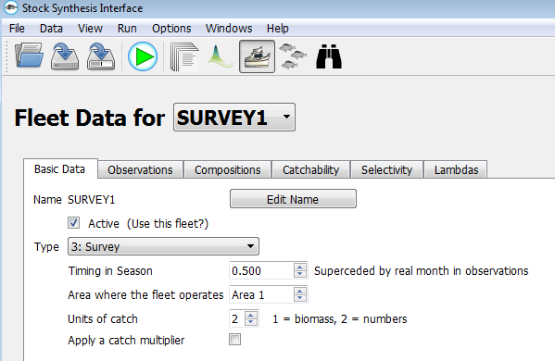
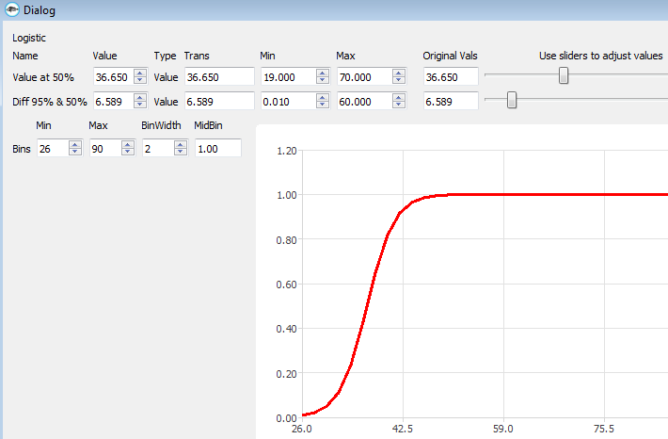
SS_GUI

Slide 41
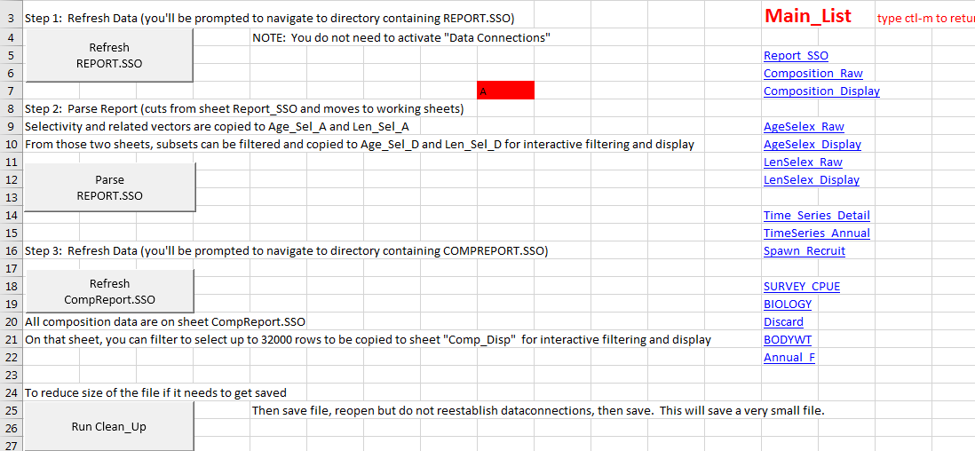
Excel Input and Output Processor

