Slide 1
Introduction to r4ss

Slide 2
Topics:
Introduction to r4ss
Functions and options
Demonstration

Slide 3
Prerequisites
R version 3.2.0 or later: https://www.r-project.org/ ;
https://cran.cnr.berkeley.edu/
RStudio (optional):
https://www.rstudio.com/products/RStudio/#Desktop
Notepad++ (optional): https://notepad-plus-plus.org/ ;
http://portableapps.com/apps/development/notepadpp_portable
Tinn-R (optional):
http://sourceforge.net/projects/tinn-r/

Slide 4
Download options for r4ss
From CRAN : this lags behind the most recent version
> install.packages(“r4ss")
> library(r4ss)
Directly from GitHub: the most recent, but may have issues
> install.packages("devtools")
> devtools::install_github("r4ss/r4ss")
> library(r4ss)
Alternative GitHub: for uncooperative R installations
> install.packages(“devtools”)
> build_github_r4ss()
> library(r4ss)

Slide 5
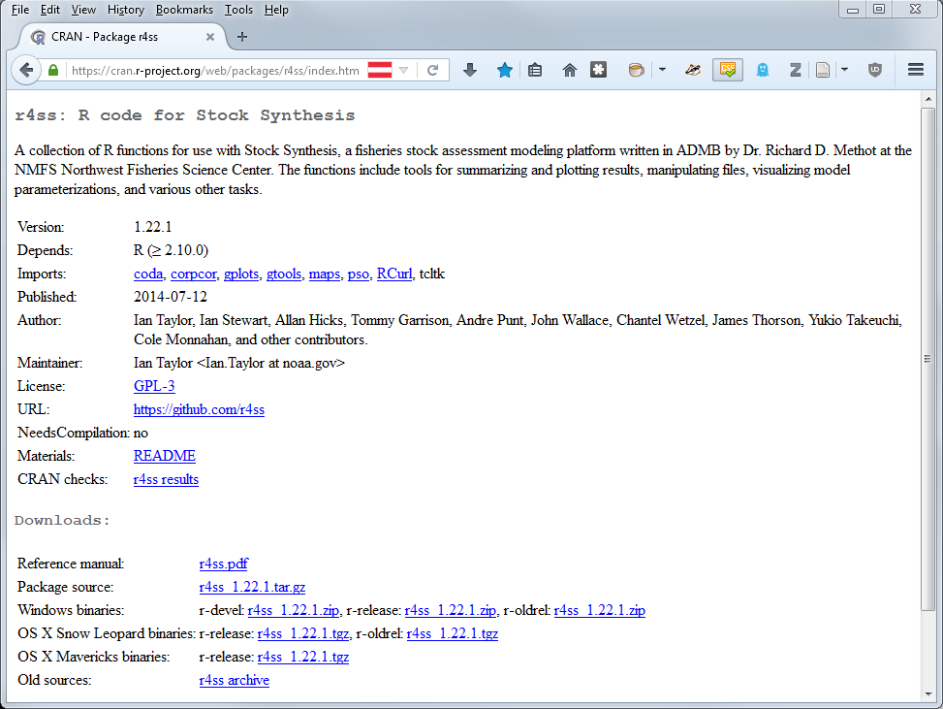

Slide 7
My general approach:
I usually alternate between:
Command line (for running models)
R (for diagnostics and visualizing model output)
A text editor (to track models and analyses)
This package is intended for “on-the-fly” modeling

Slide 8
Two primary functions:
SS_output()
- Grab all the output
- Summarize key quantities, statistics, diagnostics
- Create a list of objects for further processing
SS_plots()
- Make figures for model diagnosis
- Make figures for document preparation

Slide 9
Example
> library(r4ss)
> working.dir <- “C:\\Users\\Some.User\\SS model runs\\”
> setwd(working.dir)
> getwd()
> mymodelrun <- “base run directory”
> mymodel <- SS_output(dir=paste(working.dir, mymodelrun, sep=“”))
What is now in the console?
> names(mymodel)
> mymodel$derived_quants
…
{
}
optional

Slide 10
What are the inputs?
> args(SS_output)

Slide 11
Useful SS_output() arguments:
dir = “c:\\xxx\\yyy\\zzz\\...”
Locates the directory of the files to be read in
model = “ss3”
Name of the executable, you can rename
to indicate safe/optimized, or whatever you want.
ncols = 200
The maximum number of columns in files being read in.
If this value is too big, the function runs more slowly,
too small and you will get a warning. Find the right value for your model.
covar = TRUE
Check the Hessian quantities and produce uncertainty plots
forecast = TRUE
Read report and plot the forecast years
cormax = 0.95
The specified threshold for defining bad correlations

Slide 12
Example – more options
> mymodelrun <- “base run directory“
> mymodel <- SS_output(ncols=77, cormax=0.9, model="SS3",
dir=paste(working.dir, mymodelrun, sep=""))
…

Slide 13
Example
> SS_plots(mymodel)
> SS_plots(mymodel, plot=c(1:10,12:24))
- Where are these files?
- Can reopen later
> SS_plots(mymodel, png=FALSE, plot=c(1:10,12:24))
- Page up and down between plots
- Resizing
If you are using the R GUI plots (png=FALSE), add this before each new plotting call:
> rm(.SavedPlots,pos=1)

Slide 14
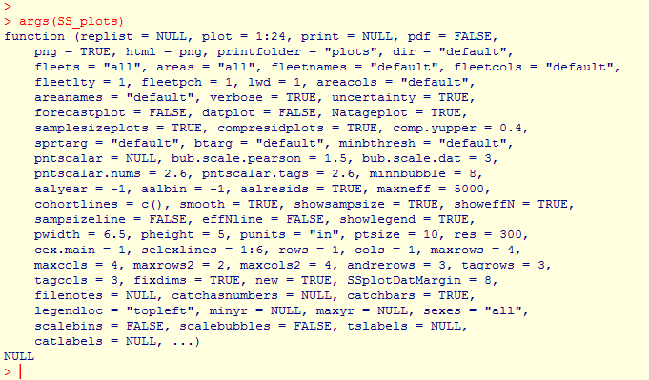
What are the other inputs?
> args(SS_plots)

Slide 15
Just a few of the plotting arguments:
plot = c(1:24)
Which plots to produce?
datplot = TRUE
Plot the data by itself? Useful in document preparation
and to make sure you got the inputs right
bub.scale.dat = 3
How big should you make the data bubbles?
tslabels, catlabels
Add your own custom axis labels

Slide 16
Example
> SS_plots(mymodel, datplot=TRUE, plot=c(1:10,12:24))
> SS_plots(mymodel, bub.scale.dat=7, datplot=TRUE, plot=c(1:10,12:24))
> SS_plots(mymodel, plot=c(1:10,12:24), png=FALSE)
> rm(.SavedPlots,pos=1)
> SS_plots(mymodel, comp.yupper = 0.6, plot=c(1:10,12:24), png=FALSE)
> abline(h=200000,col="red",lwd=2)
# Grab a slightly older version:
> devtools::install_github("r4ss/r4ss", ref="v1.23.1")

Slide 17
Other functions:
Compare two models
> mymodelrun2 <- “alternative model directory“
> mymodel2 <- SS_output(ncols=77, cormax=0.9, model="SS3",
dir=paste(working.dir, mymodelrun2, sep=""))
> mycomparisonlist <- list(mymodel, mymodel2)
> mycomparisonsummary <- SSsummarize(biglist=mycomparisonlist)
> rm(.SavedPlots,pos=1)
> SSplotComparisons(summaryoutput=mycomparisonsummary)

Slide 18
Other functions:
Compare two models
> SSplotComparisons(summaryoutput=mycomparisonsummary,
spacepoints=1, staggerpoints=0, legend=FALSE)
> SSplotComparisons(summaryoutput=mycomparisonsummary,
legendlabels=c(“Base model”, “Alternative model”),
indexfleets=rep(15,2), indexUncertainty=TRUE,
legendloc=“topleft”, xlim=c(1980,2016))
-- Don’t forget ---
> rm(.SavedPlots,pos=1)
> SStableComparisons(summaryoutput=mycomparisonsummary)

Slide 19
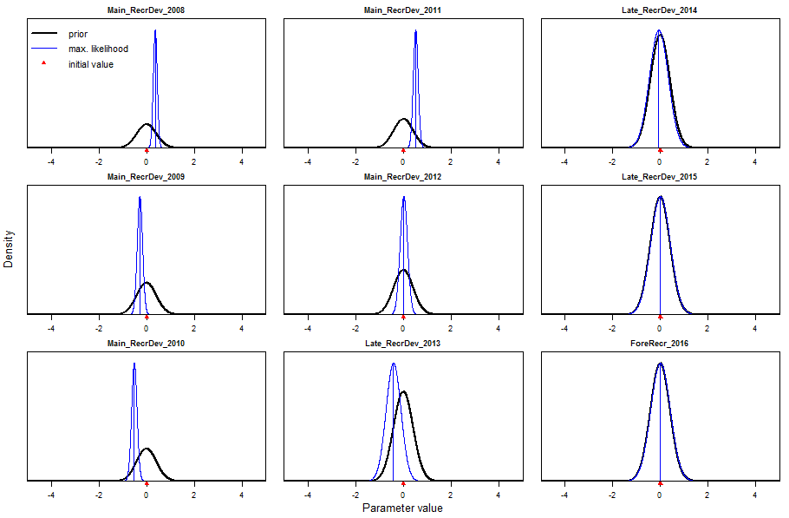
Plot the parameter estimates and uncertainty
> SSplotPars(dir=paste(working.dir, mymodelrun, sep=""))

Slide 20
A few notes:
Read the output to the R console! It has important information in it.
HTML doesn’t always update when directories are copied
-- delete old plots for each new model directory
Plots can (and often should be) resized manually at the GUI
Headers are designed to remind the user, and should be cropped off later
- Demo font size, save, load, crop

Slide 21
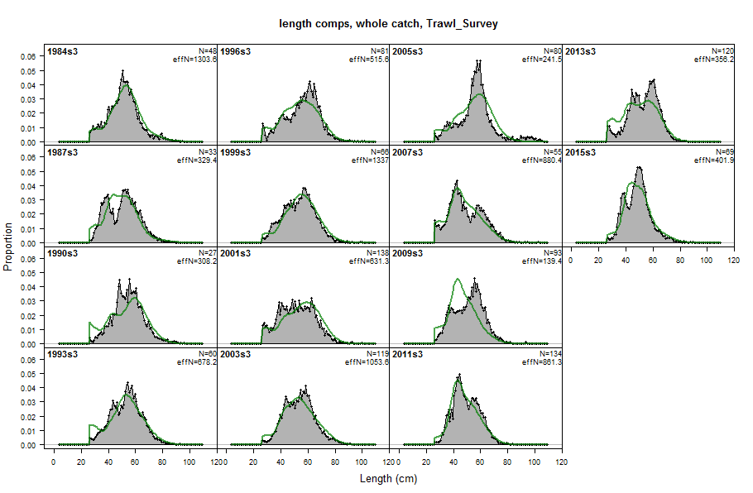
Headers:

Slide 22
Things r4ss doesn’t do:
At least one important aspect of any specific assessment
But you can:
Add to existing plots
Find and use objects directly
Pass specific arguments to functions: e.g. custom labels
Modify the code for your needs

Slide 23
r4ss is open source:
https://github.com/r4ss/r4ss
Download the code, post questions, report bugs, contribute!

