Slide 1

GFDL Micro Physics, ACC, and Hurricanes
Shian-Jiann Lin & Linjiong Zhou
and the GFDL FV³ Team
Basic design of GFDL MP
Learning the NWP culture: “ACC, ACC, ACC” – we want to be #1
(Atlantic Coast Conference / Antarctic Circumpolar Current / Anomaly Correlation Coefficient)
Hurricanes (2015-2016 stats, Harvey, and Irma)

Slide 2
GFDL MP
Lin et al., 1983
GFDL Zetac: regional cloud-resolving simulations (< 20 km)
HiRAM: seasonal to Sub-seasonal Prediction (10 – 100 km)
Super HiRAM: global cloud-resolving simulations (< 5 km)
fvGFS: tuned for NWP (13-km & 3-km)
Lord et al., 1984
Krueger et al., 1995
Chen and Lin, 2011 Chen and Lin, 2013
Zhou et al., 2017

Slide 3
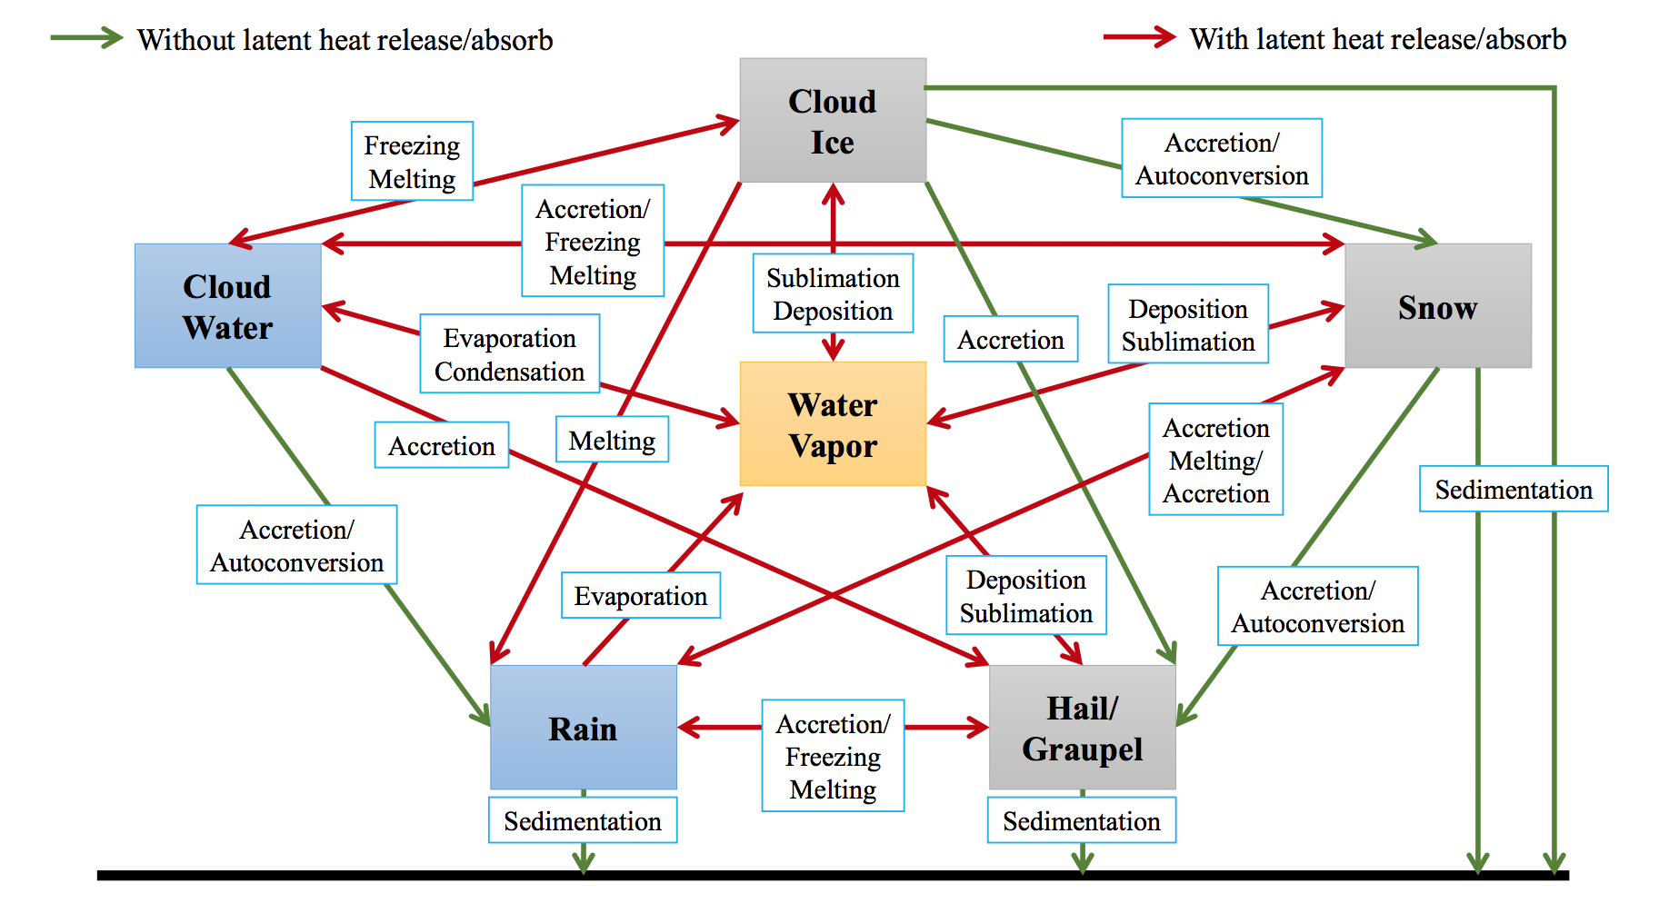
GFDL MP at a glance

Slide 4
Unique attributes of GFDL MP
Fast physics (phase changes ONLY, for now) between “Lagrangian-to-Eulerian” remapping in FV3
Time-split between warm-rain (faster) and ice-phase (slower) processes
Time implicit monotonic scheme for terminal fall of condensates
Thermodynamic consistency: exact moist energy conservation; condensates carry heat & momentum → heat and momentum transported during the sedimentation processes (ACC improves; hurricane intensity suffers)
“Scale-awareness” achieved by an assumed horizontal subgrid variability and a 2nd order FV-type vertical reconstruction for autoconversions

Slide 5
FV3 Configuration
#&fv_core_nml
npx = 769
npy = 769
npz = 91
grid_type = -1
make_nh = .T.
reset_eta = .F.
n_sponge = 30
nudge_qv = .T.
rf_fast = .F.
tau = 5.
rf_cutoff = 7.5e2
d2_bg_k1 = 0.15
d2_bg_k2 = 0.02
kord_tm = -9
kord_mt = 9
kord_wz = 9
kord_tr = 9
hydrostatic = .F.
phys_hydrostatic = .F.
use_hydro_pressure = .F.
beta = 0.
a_imp = 1.
p_fac = 0.1
k_split = 1
n_split = 8
nwat = 6
na_init = 1
d_ext = 0.0
dnats = 1
fv_sg_adj = 600
d2_bg = 0.
nord = 2
dddmp = 0.1
d4_bg = 0.12
vtdm4 = 0.02
delt_max = 0.002
ke_bg = 0.
do_vort_damp = .true.
external_ic = .T.
gfs_phil = .false.
nggps_ic = .T.
mountain = .F.
ncep_ic = .F.
d_con = 1.
hord_mt = 6
hord_vt = 6
hord_tm = 6
hord_dp = -6
hord_tr = 8
adjust_dry_mass = .F.
consv_te = 1.
do_sat_adj = .T.
consv_am = .F.
fill = .T.
dwind_2d = .F.
warm_start = .F.
no_dycore = .false.
z_tracer = .T.

Slide 6
GFDL MP Configuration
do_sedi_heat = .F. For “hurricane intensity”
&gfdl_cloud_microphysics_nml
sedi_transport = .true.
do_sedi_heat = .false.
rad_snow = .true.
rad_graupel = .true.
rad_rain = .true.
const_vi = .F.
const_vs = .F.
const_vg = .F.
const_vr = .F.
vi_max = 1.
vs_max = 2.
vg_max = 12.
vr_max = 12.
qi_lim = 1.
prog_ccn = .false.
do_qa = .true.
fast_sat_adj = .true.
tau_l2v = 300.
tau_l2v = 225.
tau_v2l = 150.
tau_g2v = 900.
rthresh = 10.e-6
dw_land = 0.16
dw_ocean = 0.10
ql_gen = 1.0e-3
ql_mlt = 1.0e-3
qi0_crt = 8.0E-5
qs0_crt = 1.0e-3
tau_i2s = 1000.
c_psaci = 0.05
c_pgacs = 0.01
rh_inc = 0.30
rh_inr = 0.30
rh_ins = 0.30
ccn_l = 300.
ccn_o = 100.
c_paut = 0.5
c_cracw = 0.8
use_ppm = .false.
use_ccn = .true.
mono_prof = .true.
z_slope_liq = .true.
z_slope_ice = .true.
de_ice = .false.
fix_negative = .true.
icloud_f = 1
mp_time = 150.

Slide 7
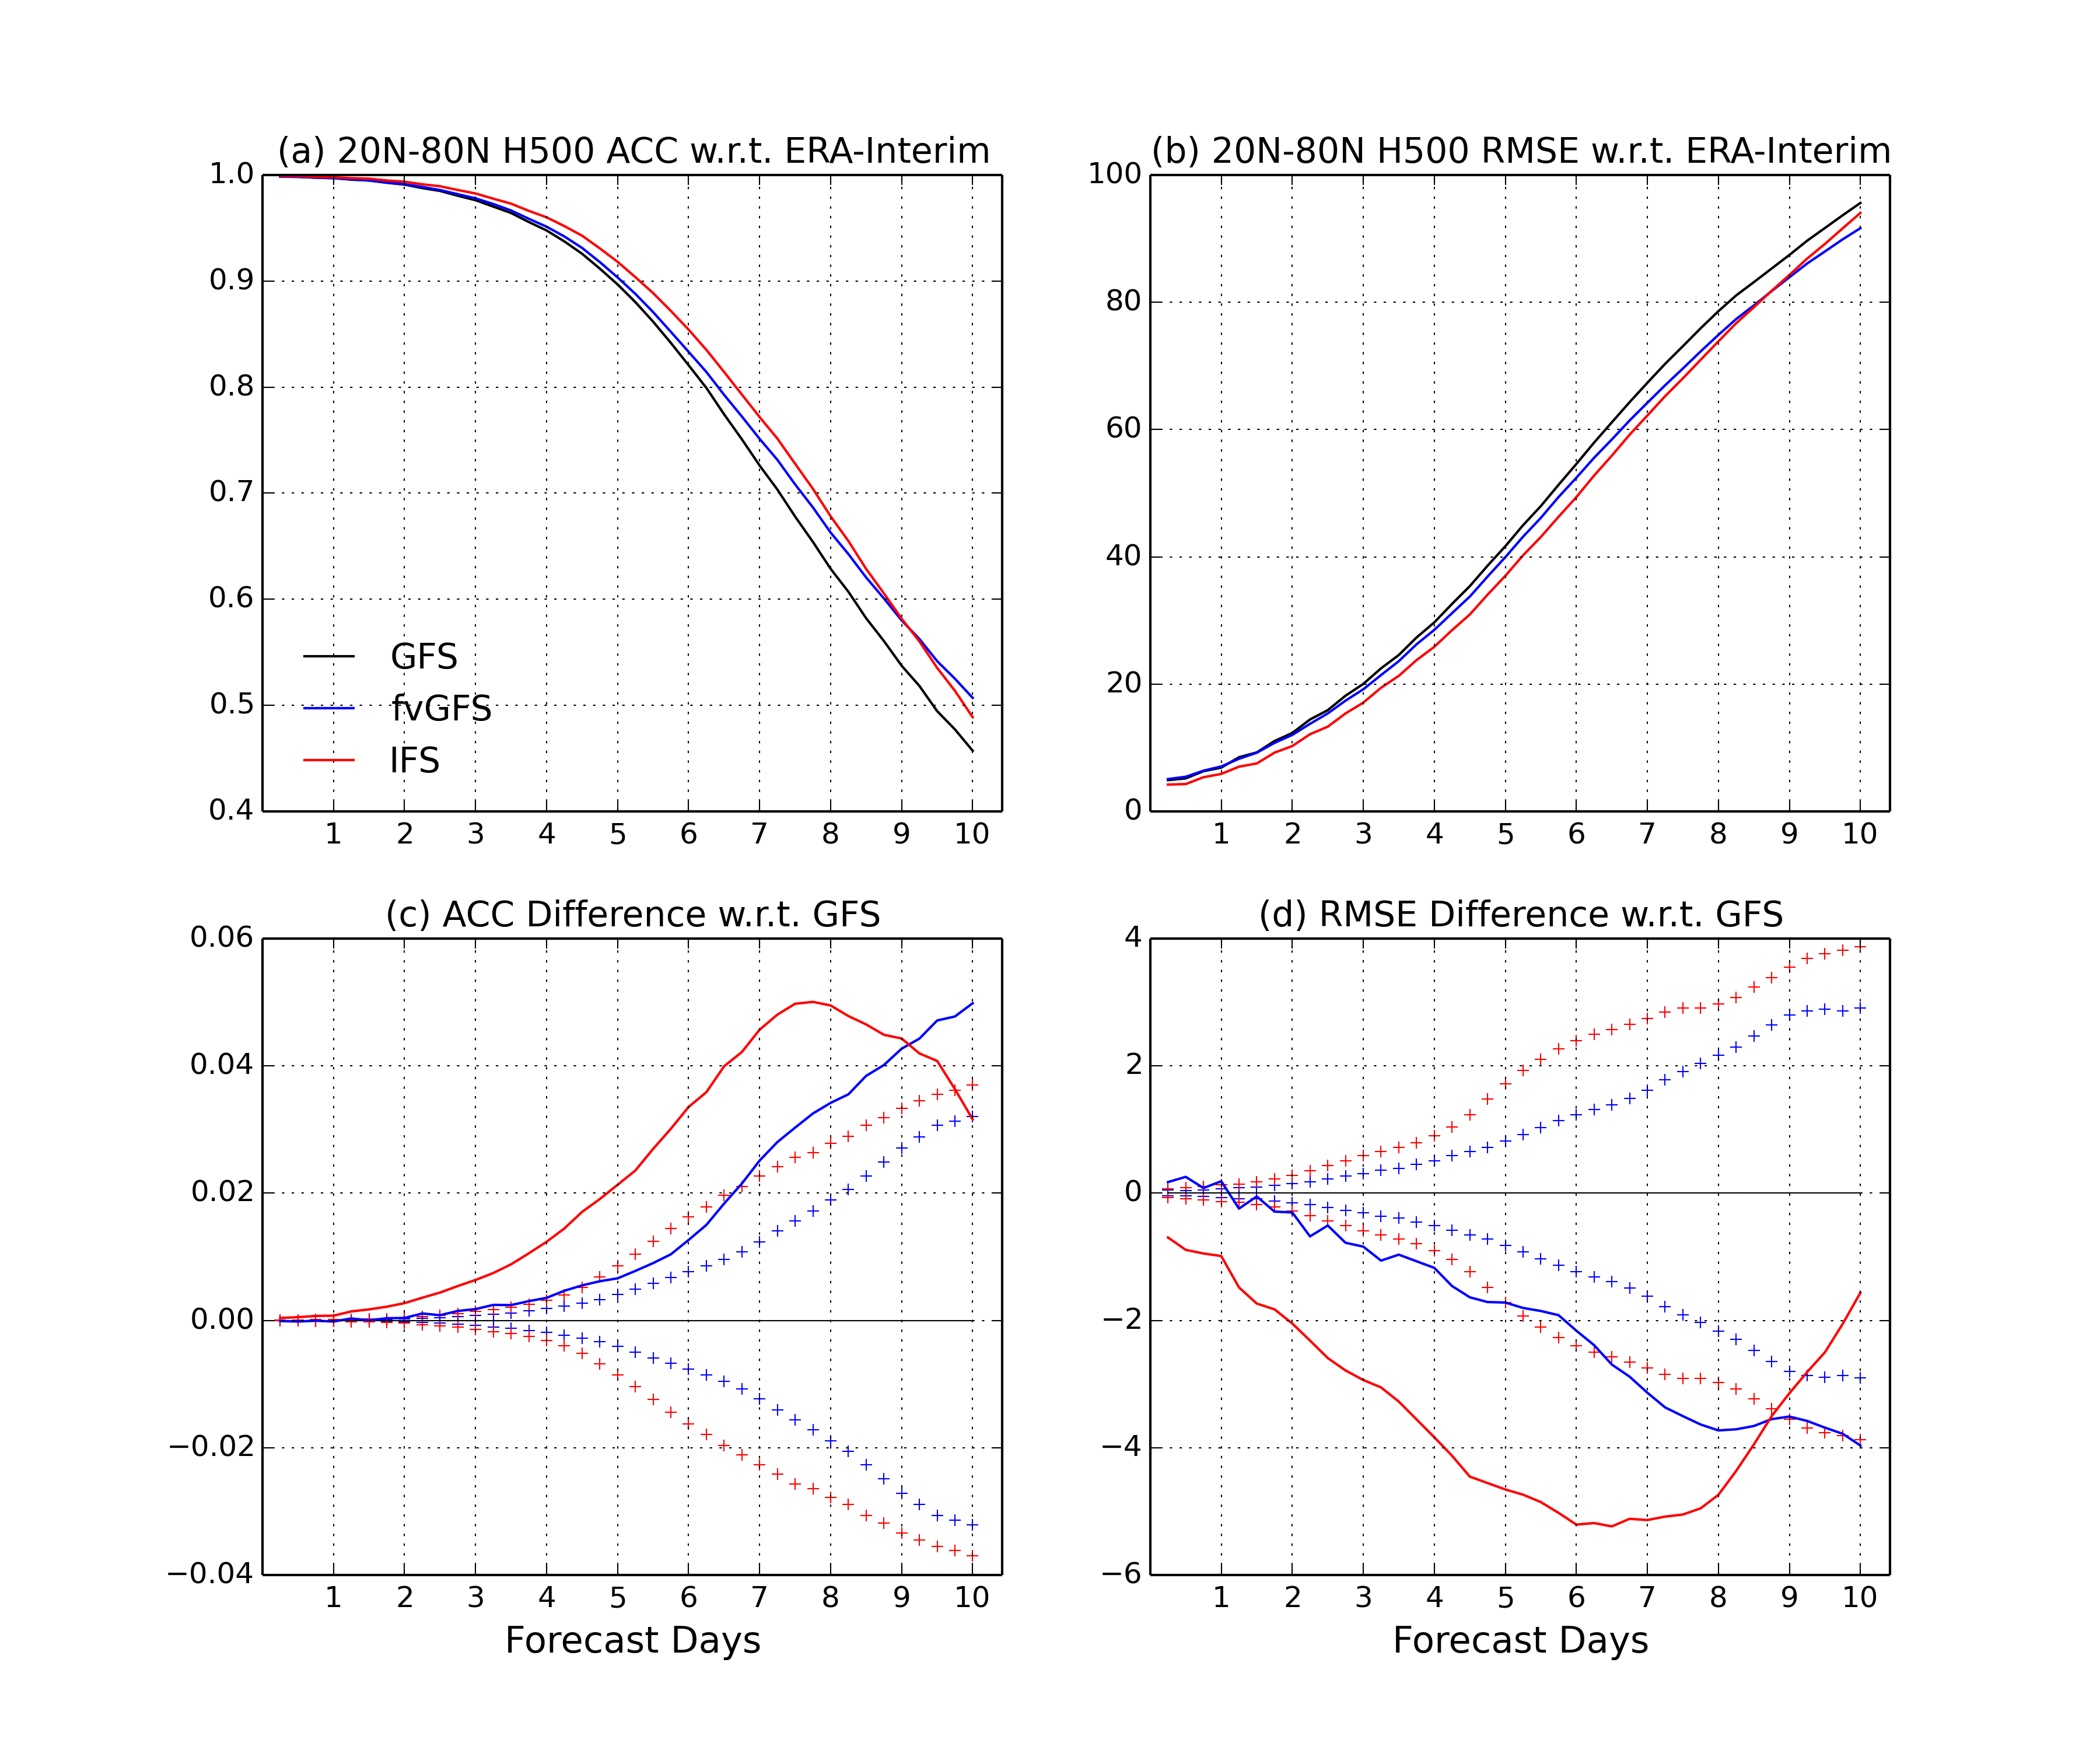
Aiming for ACC
(Jan 2015 – Jan 2016, 74 cases, NGGPS phase-2)
fvGFS with GFS IC
ACC
RMSE

Slide 8
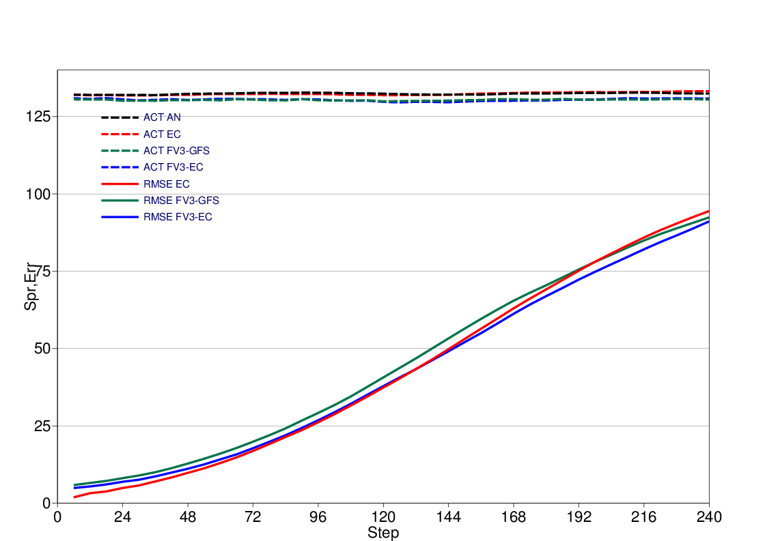
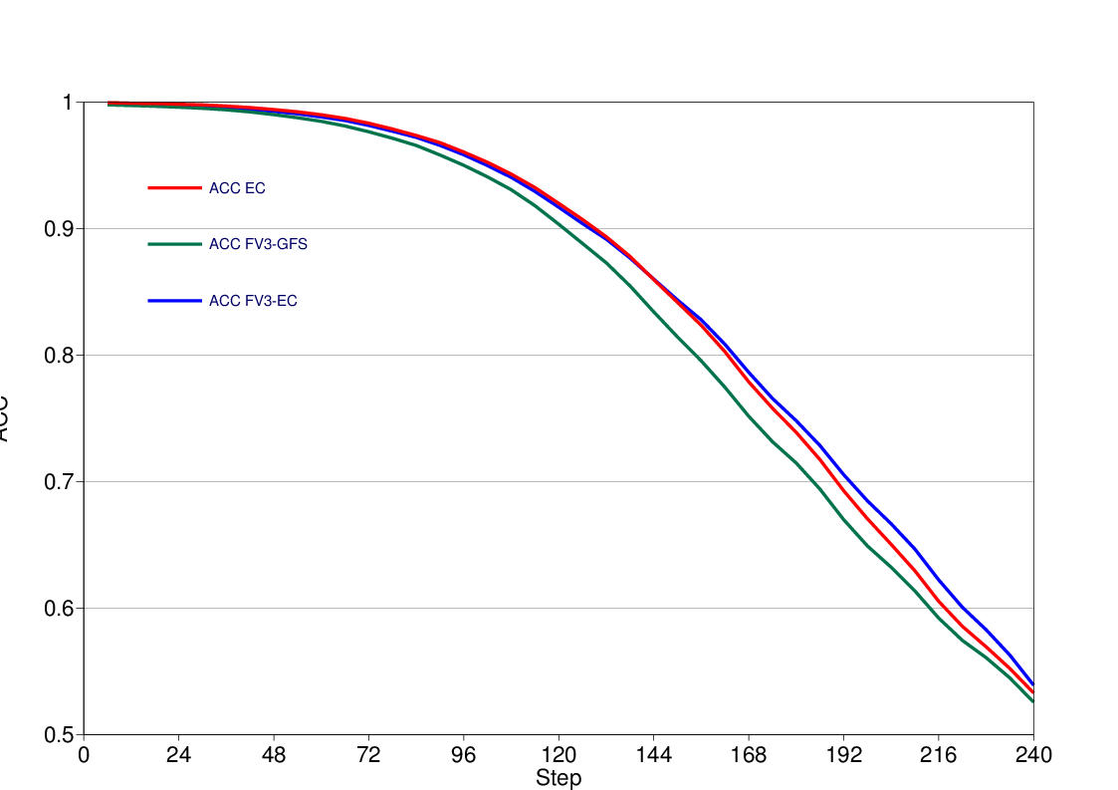
Aug 2015 – Aug 2016 (73 cases)
fvGFS with GFS IC – green
fvGFS with IFS IC - blue
RMSE and activity
ACC
EC –red
FV3-GFS – green
FV3-EC - blue
(Courtesy of Linus Magnusson, ECMWF)

Slide 9
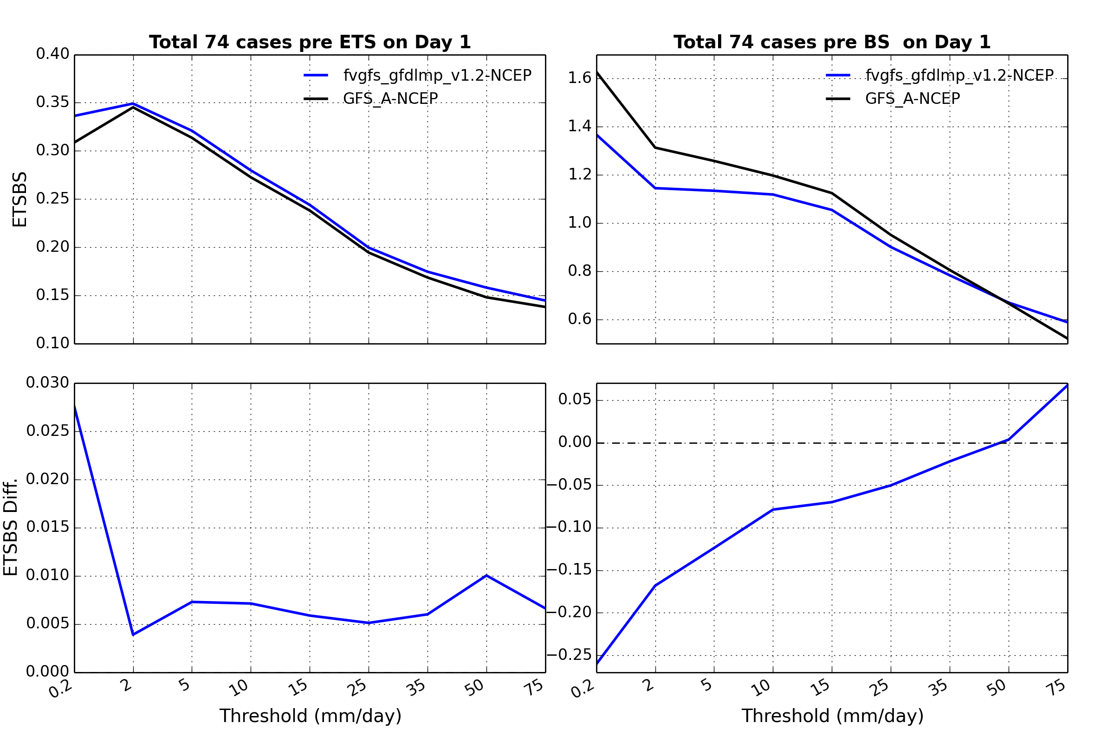
Precip skill
ETS/BS on Day 1
ETS: the higher, the better
BS: the closer to 1, the better

Slide 10
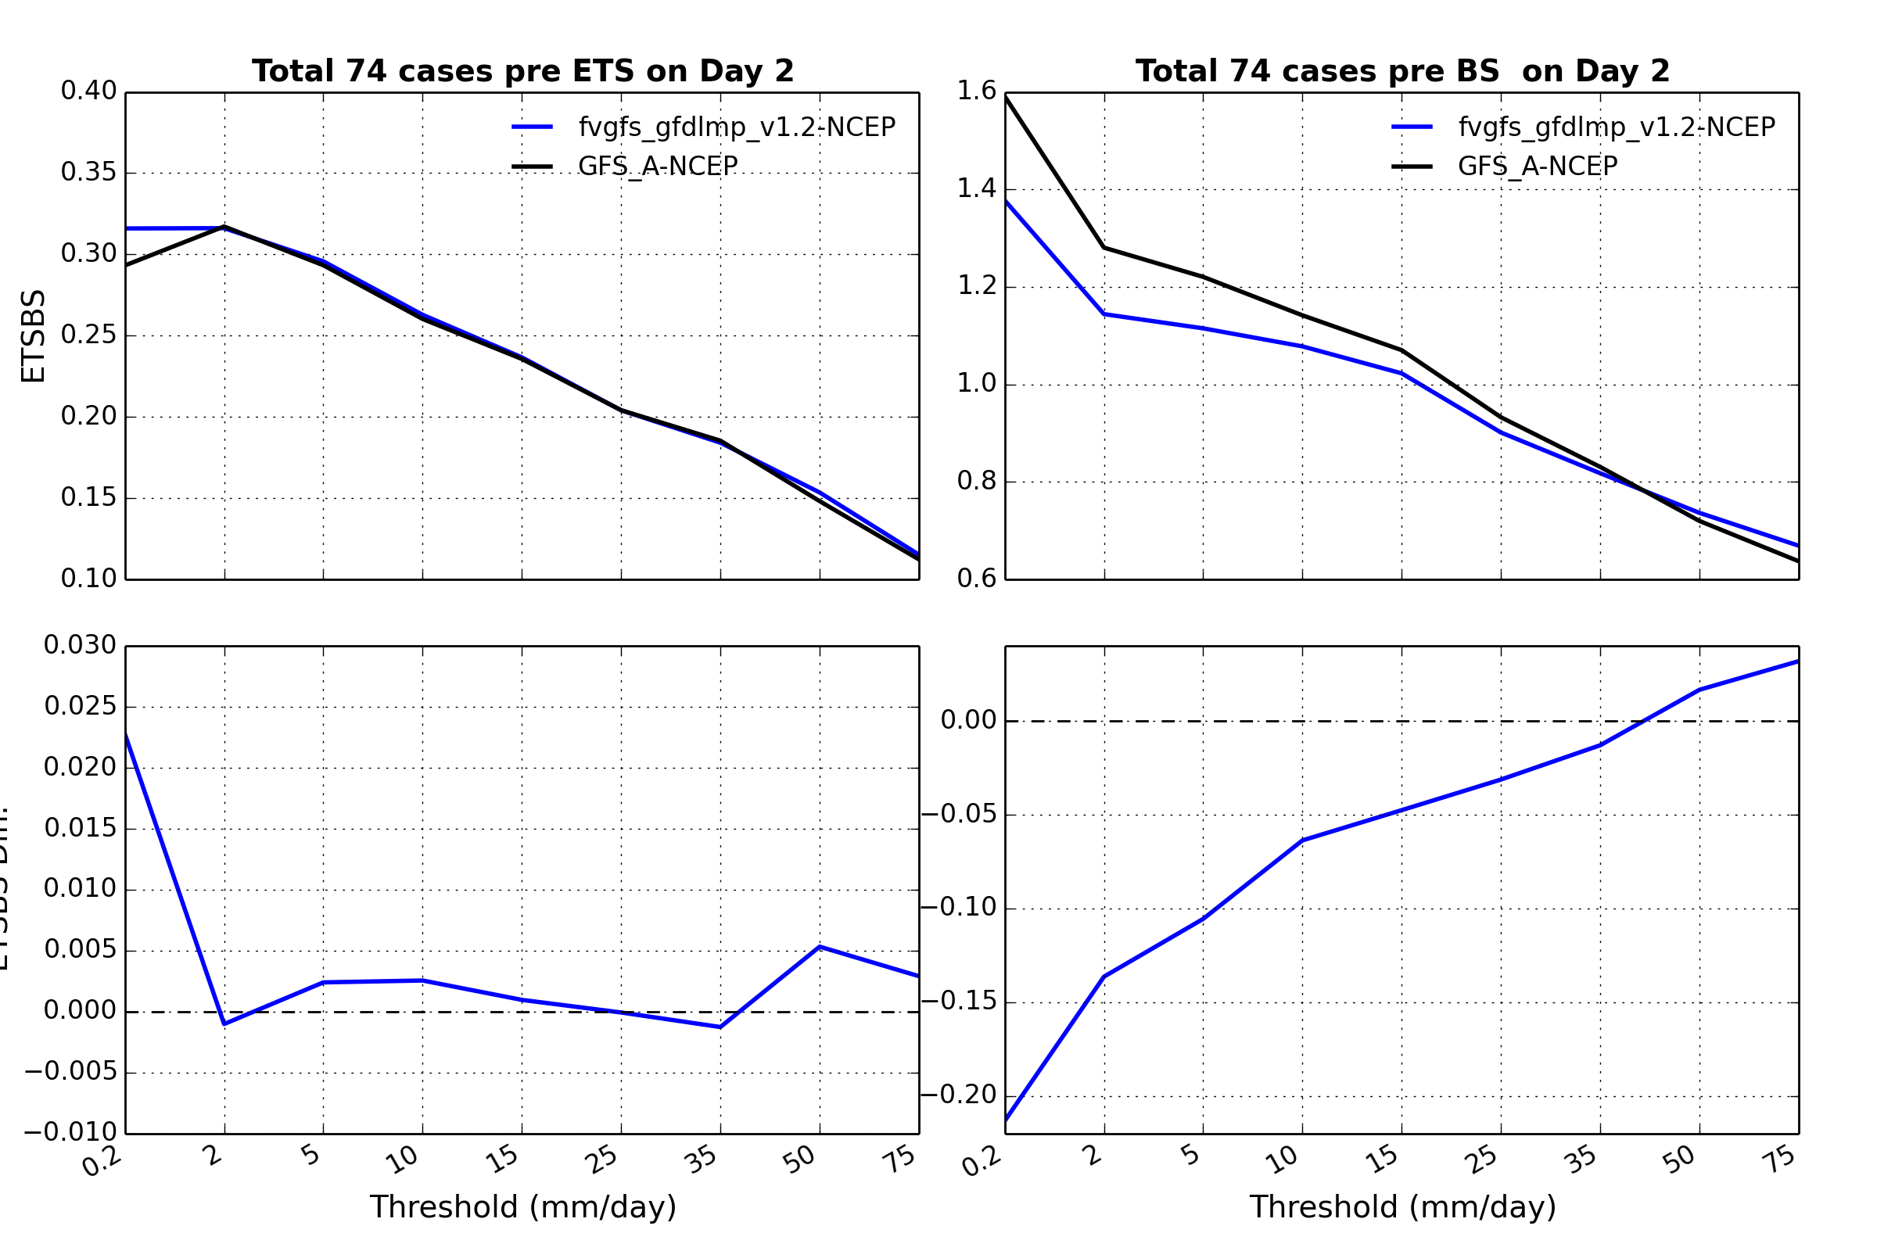
ETS/BS on Day 2
ETS: the higher, the better
BS: the closer to 1, the better

Slide 11
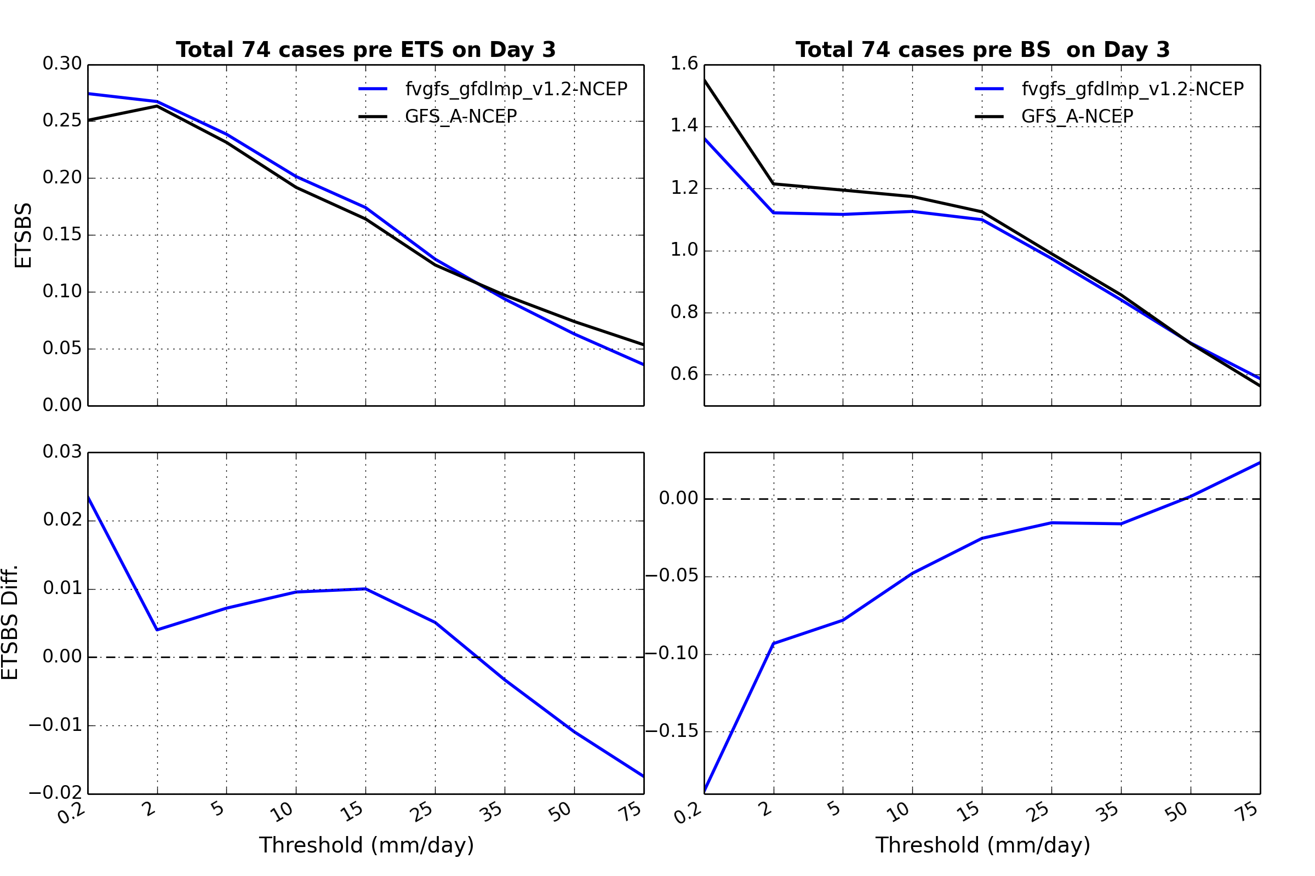
ETS/BS on Day 3
ETS: the higher, the better
BS: the closer to 1, the better

Slide 12
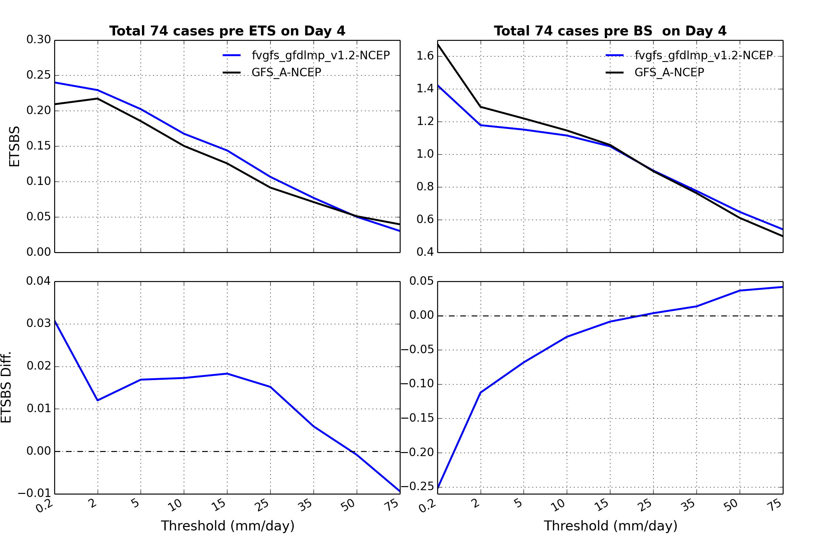
ETS/BS on Day 4
ETS: the higher, the better
BS: the closer to 1, the better

Slide 13
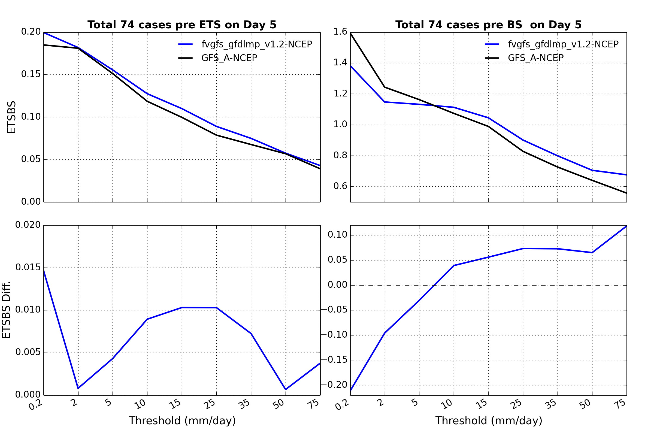
ETS/BS on Day 5
ETS: the higher, the better
BS: the closer to 1, the better

Slide 14
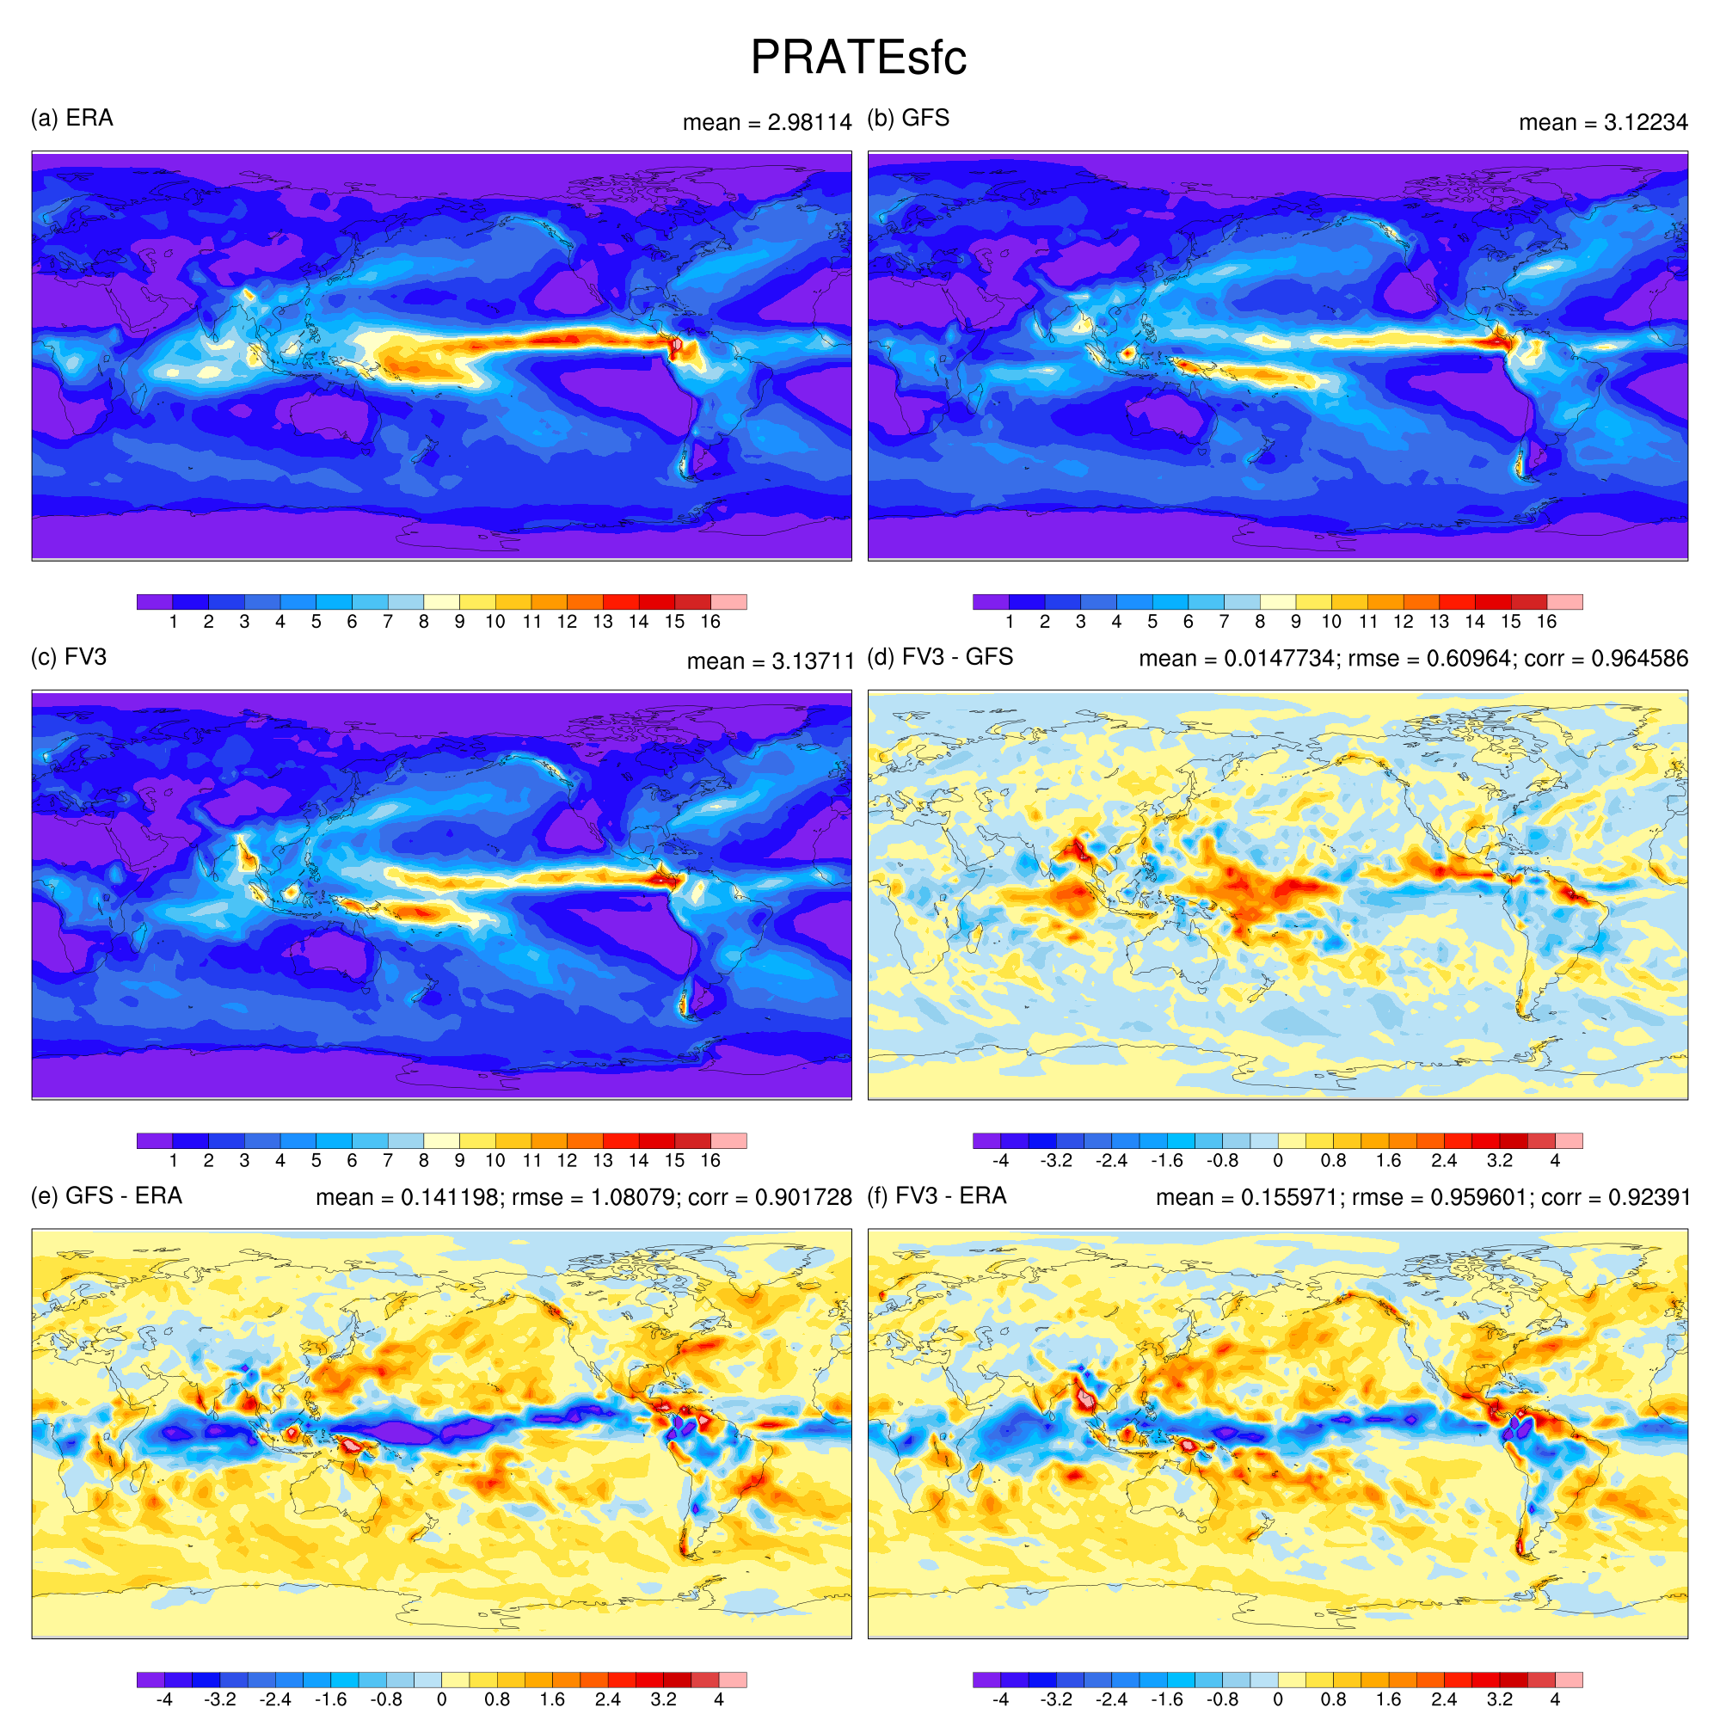
(74 cases, last 5-day average)
Total Precipitation Rate
Double ITCZ in GFS and fvGFS

Slide 15
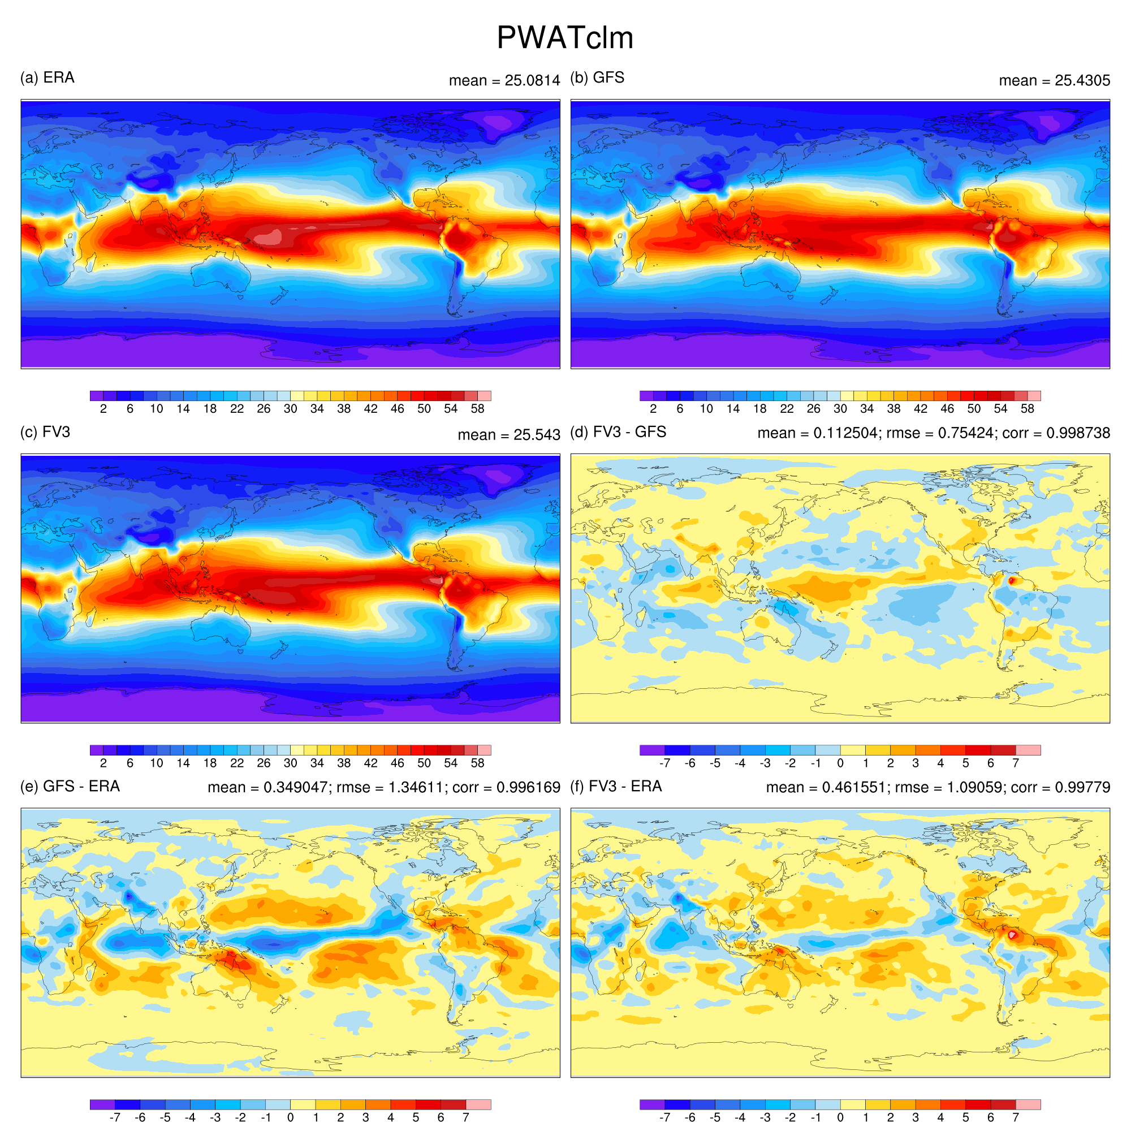
(74 cases, last 5-day average)
Precipitable Water
fvGFS errors noticeably smaller

Slide 16
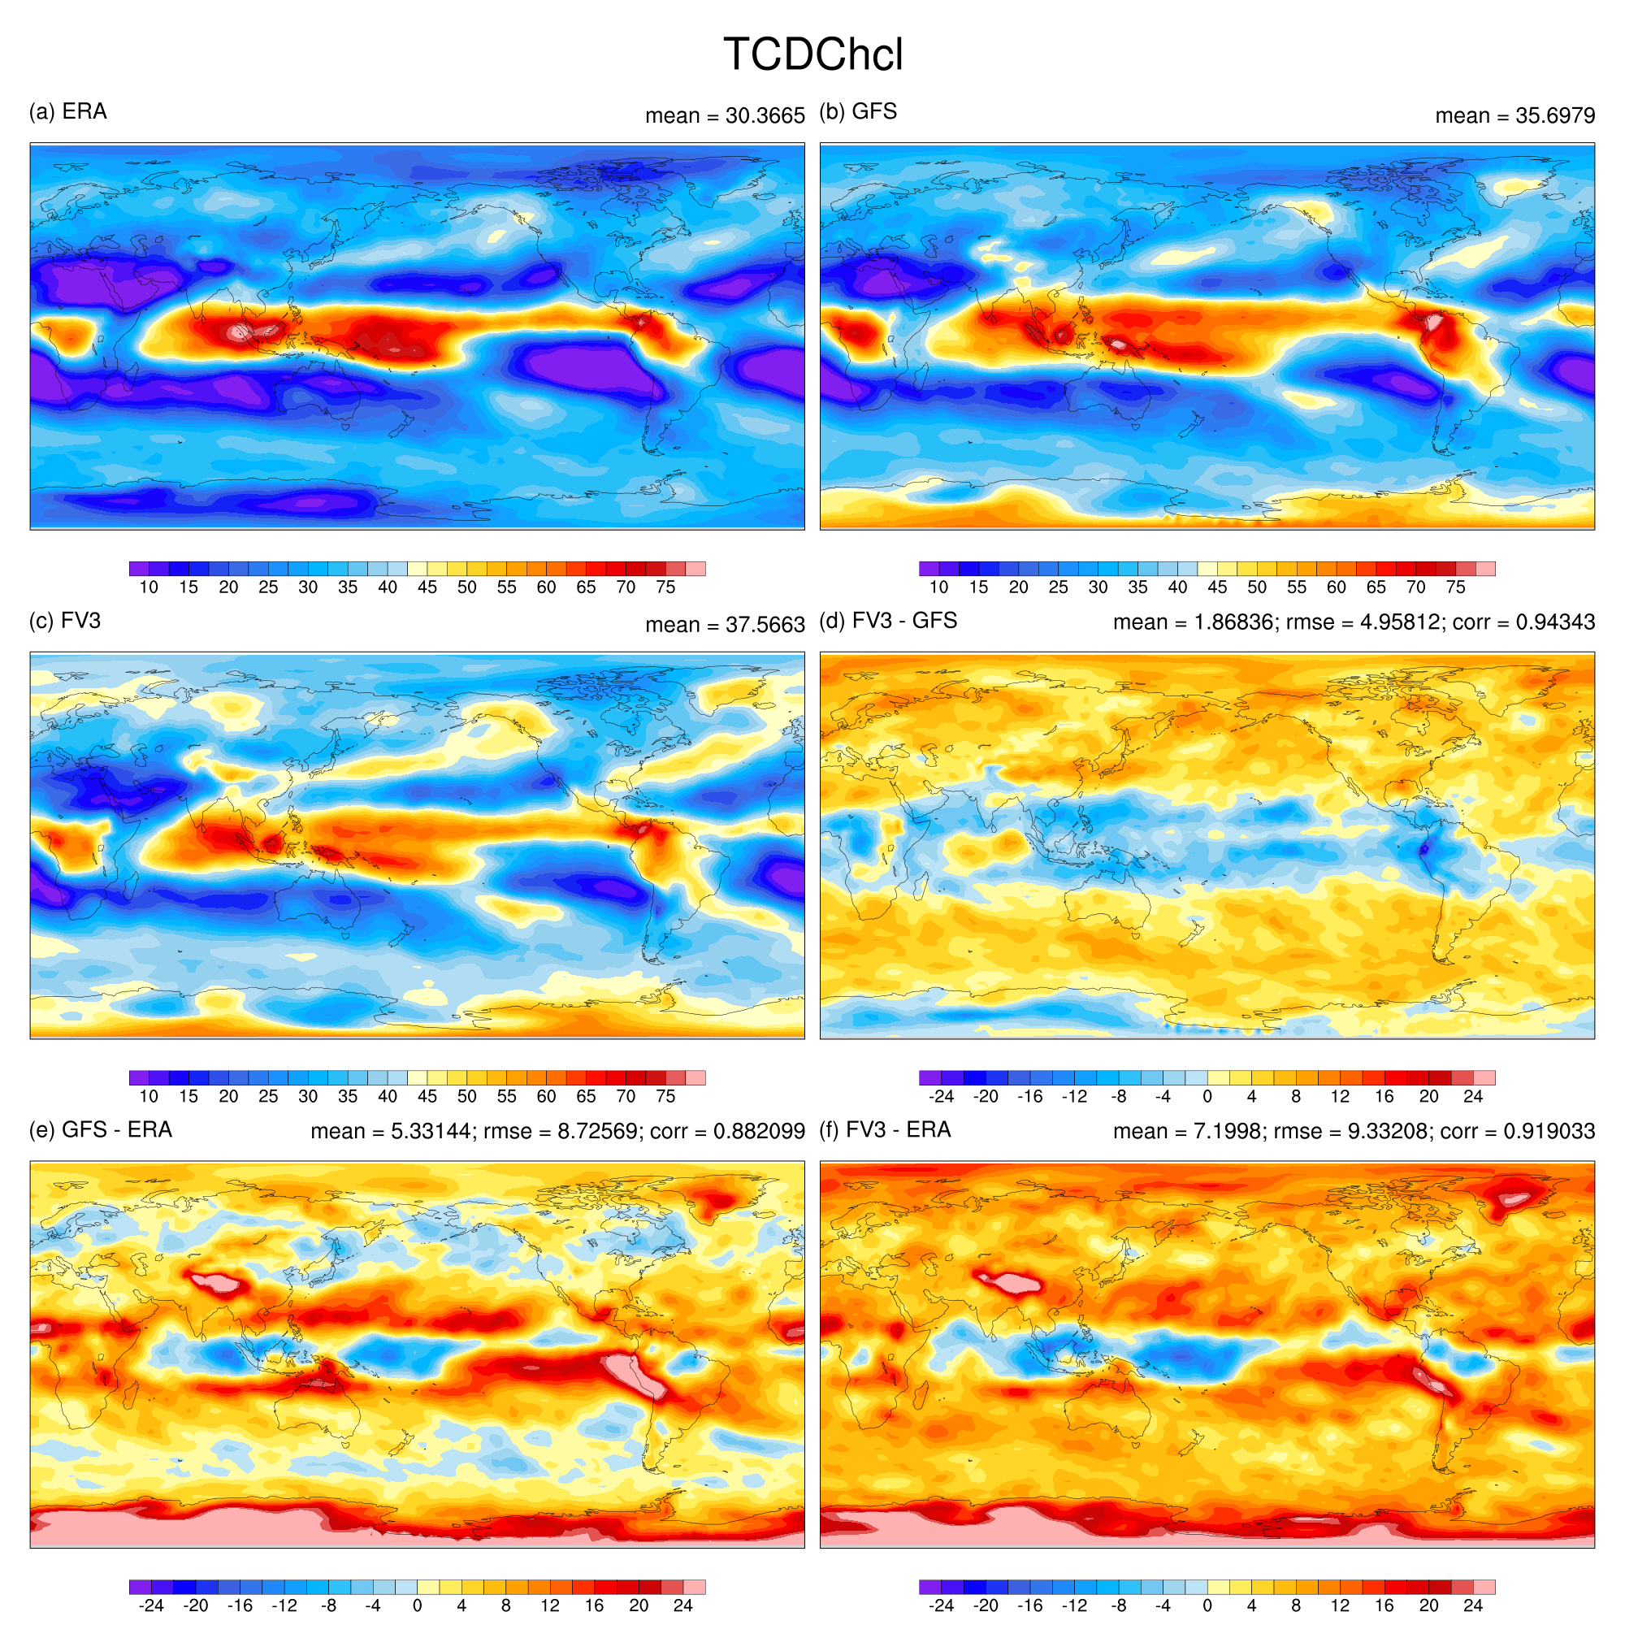
(74 cases, last 5-day average)
fvGFS produced slightly more High Clouds

Slide 17
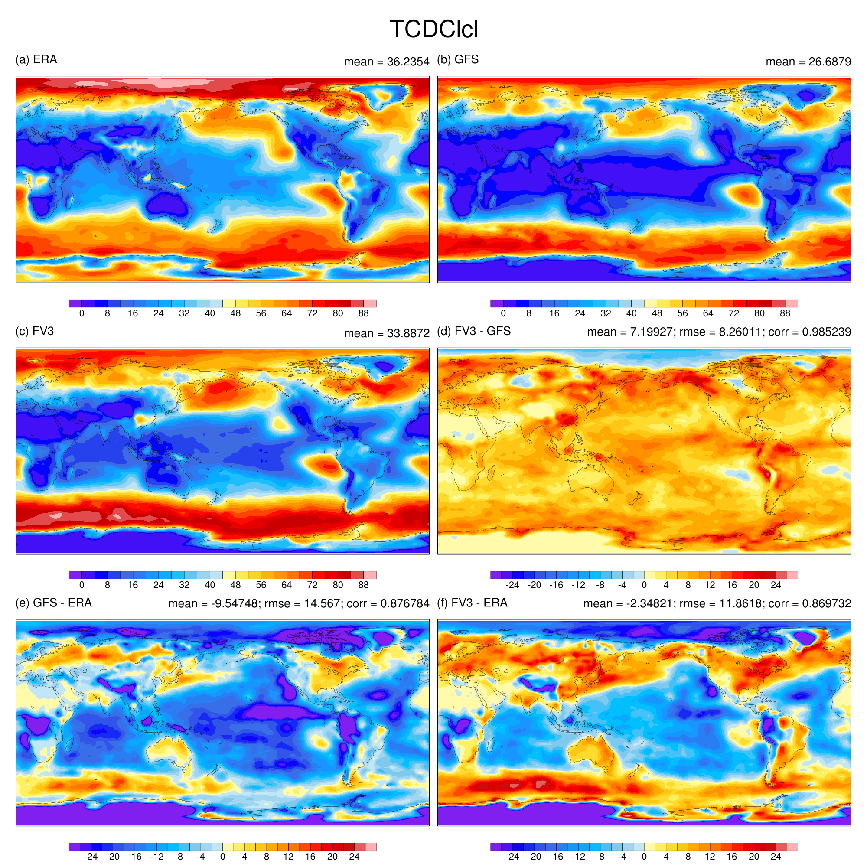
(74 cases, last 5-day average)
fvGFS produced significantly more low Clouds (in the right direction)

Slide 18
Global Budget (74 cases, last 5-day average)
Radiation | ERA | GFS | fvGFS
TOA SW Down | 344.16 | 340.26 | 340.26
TOA SW Up | 100.65 | 86.83 | 87.85
TOA LW UP | 245.34 | 242.03 | 250.47
TOA Net | -1.83 | 11.39 | 1.94
Surface SW Down | 186.58 | 207.27 | 202.18
Surface SW Up | 23.56 | 29.95 | 25.93
Surface LW Down | 343.97 | 338.32 | 338.88
Surface LW Up | 399.61 | 399.27 | 400.69
Latent Heat | 85.12 | 87.16 | 90.69
Sensible Heat | 17.49 | 16.75 | 18.32
Surface Net | 4.77 | 12.45 | 5.42

Slide 19
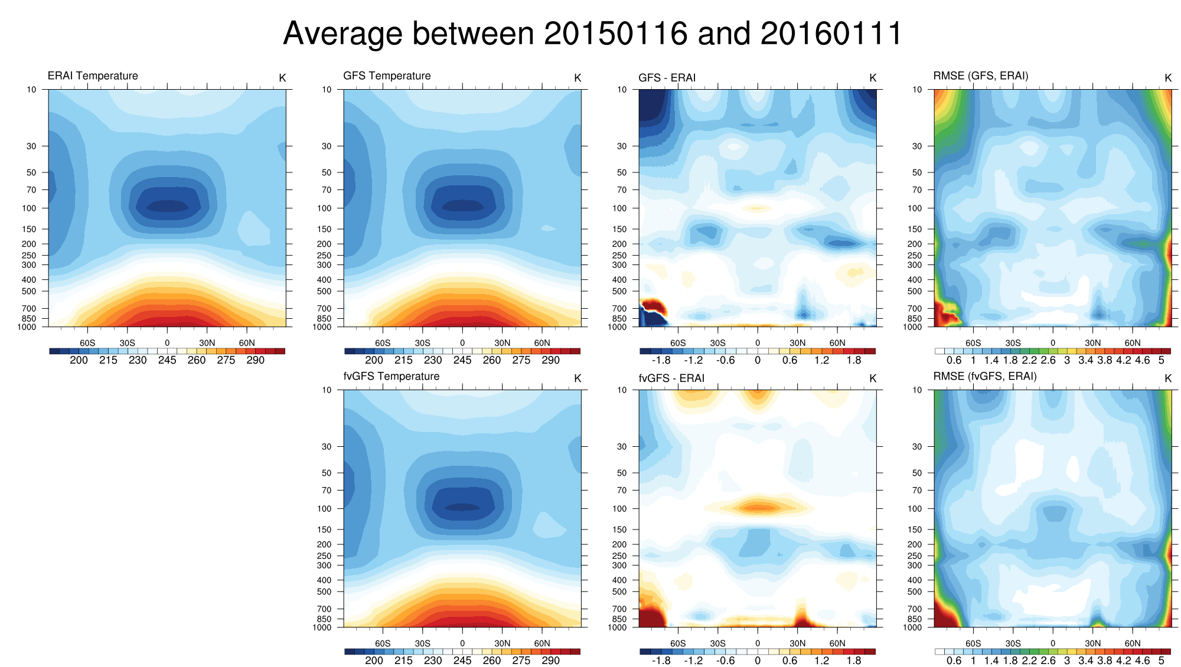
(last 5-day average)

Slide 20
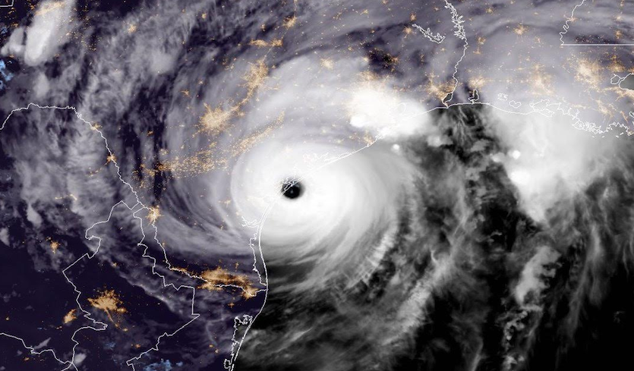
Hurricanes:
Two FV3 configurations:
The standard (uniform resolution) C768L63
Stretched C768L63 with a 3-km Atlantic Basin nest
Both configurations running quasi-real-time on Jet (Gaea as the backup)

Slide 21
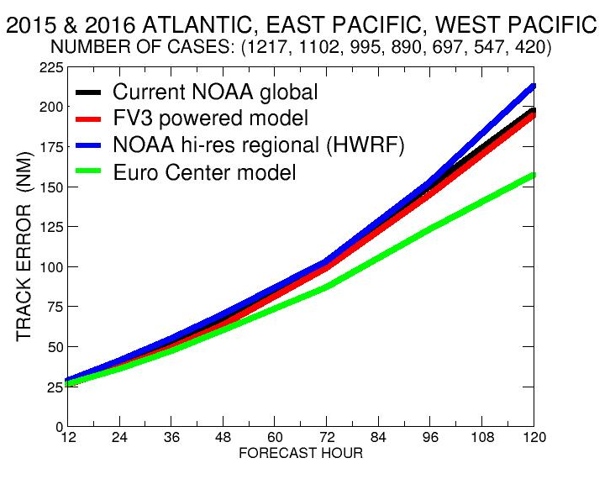
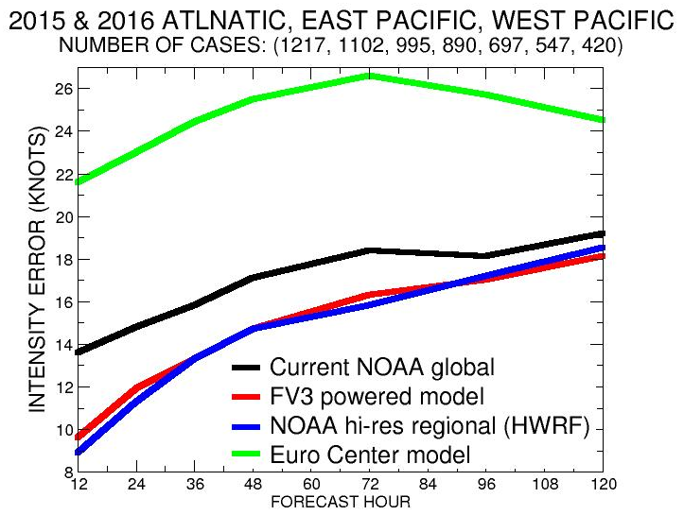
Statistics for 2-year period: 2015 & 2016
C768L63 (13-km) for all basins
Real-time FV3-powered Global Runs
vs. Operational Models
Error in hurricane center location (nm)
Lower
Errors are
better
(Source: Morris Bender)
Intensity skill is as good as HWRF

Slide 22
Wind –SLP correlation
Blue dots: operational GFS
Red dots: fvGFS with Zhao-Carr
Black dots: obs (best track)
(Source: Jan-Huey Chen)

Slide 23
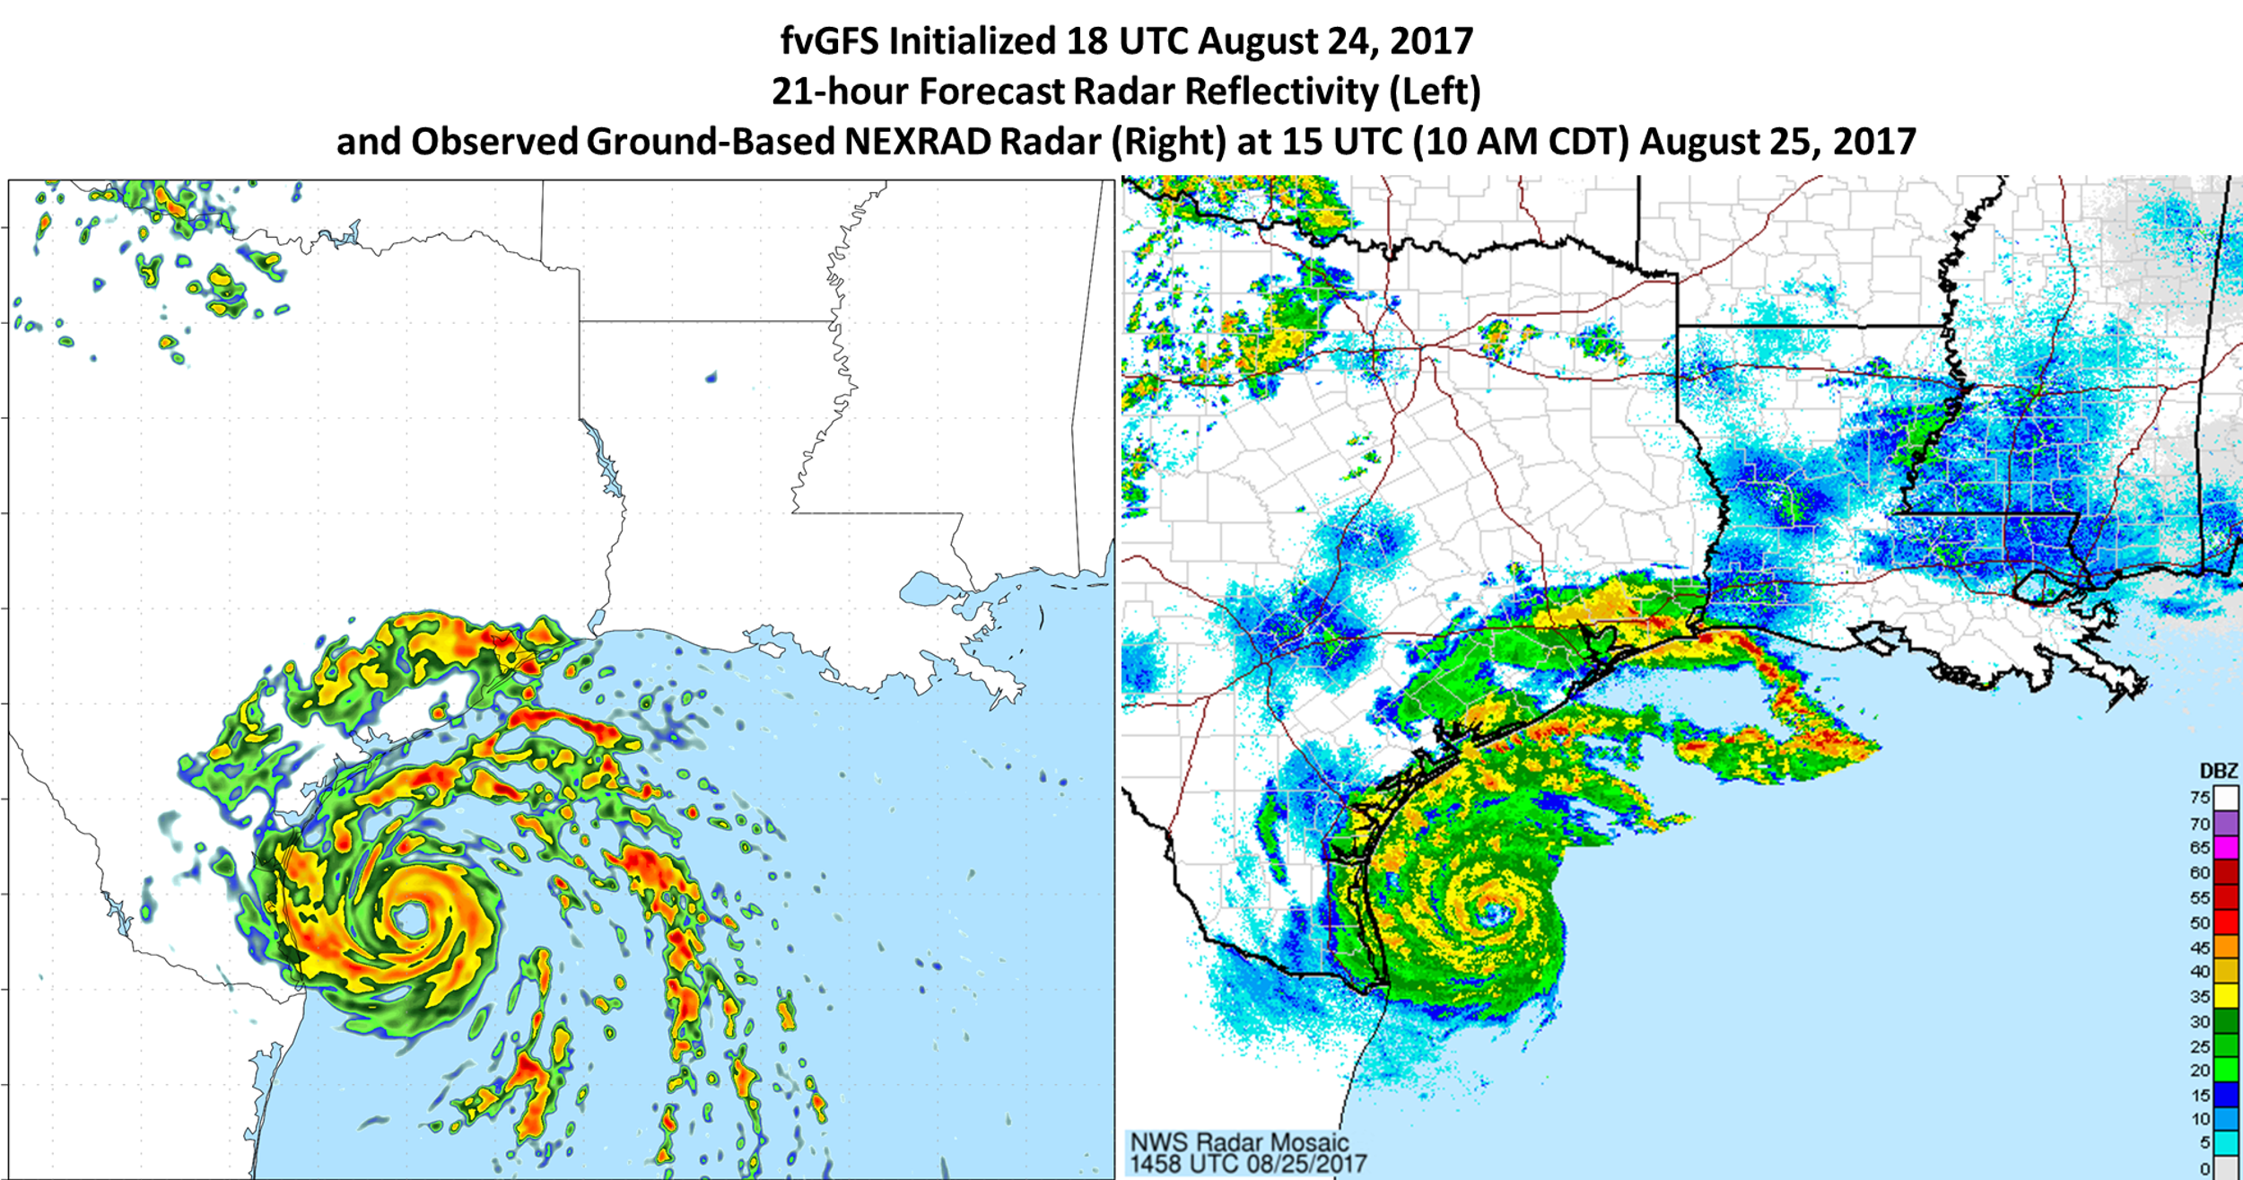
Forecast Reflectivity Structure vs. NEXRAD Observations
(Source: Andrew Hazelton)
Notes:
This is a very good simulation; it spun up in 21-hr from the GFS, which have no vortex information.
Interestingly, the model REFL is higher than observed.

Slide 24
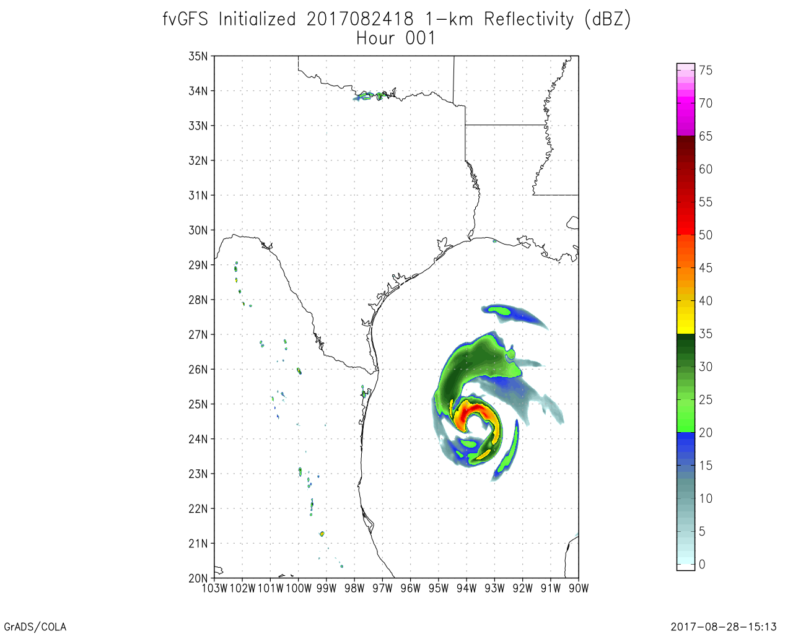
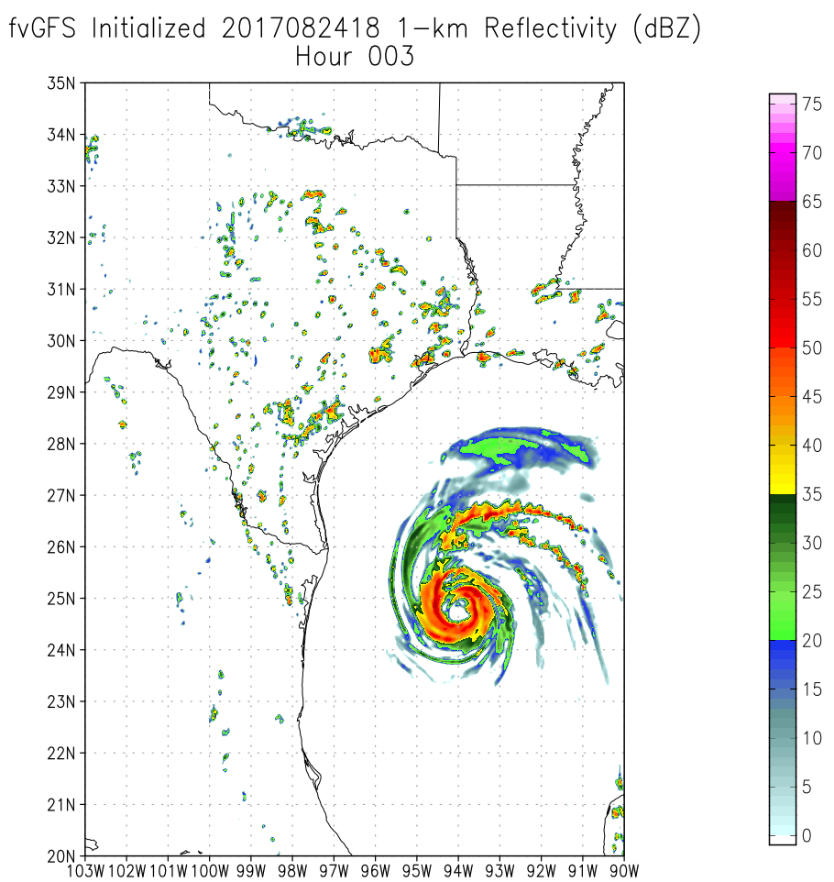
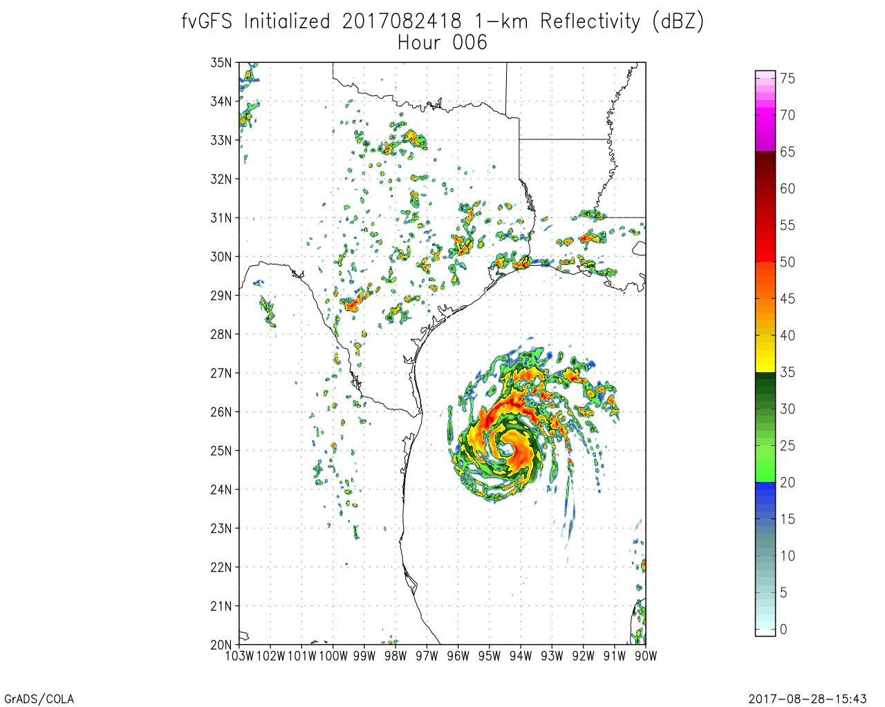
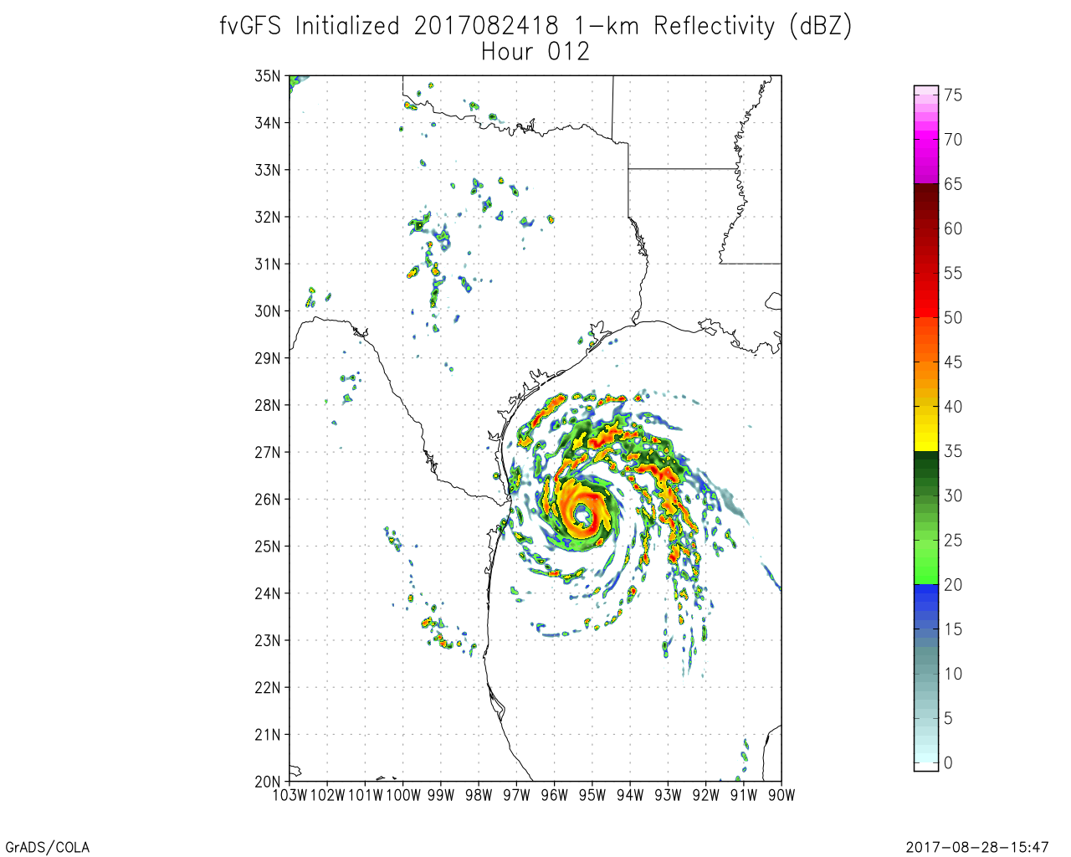
Spin-up From GFS (13-km) ICs
-At hour 1, core is starting to spin up, but looks very low-res
-At hour 3, isolated cells over Texas and rain bands are well-developed; Core still looks somewhat too coarse
-By hour 6 the core appears to me mostly spun up
(Source: Andrew Hazelton)
Notes:
Andy: great slide. This should be useful for many presentations to come.
Thanks.

Slide 25
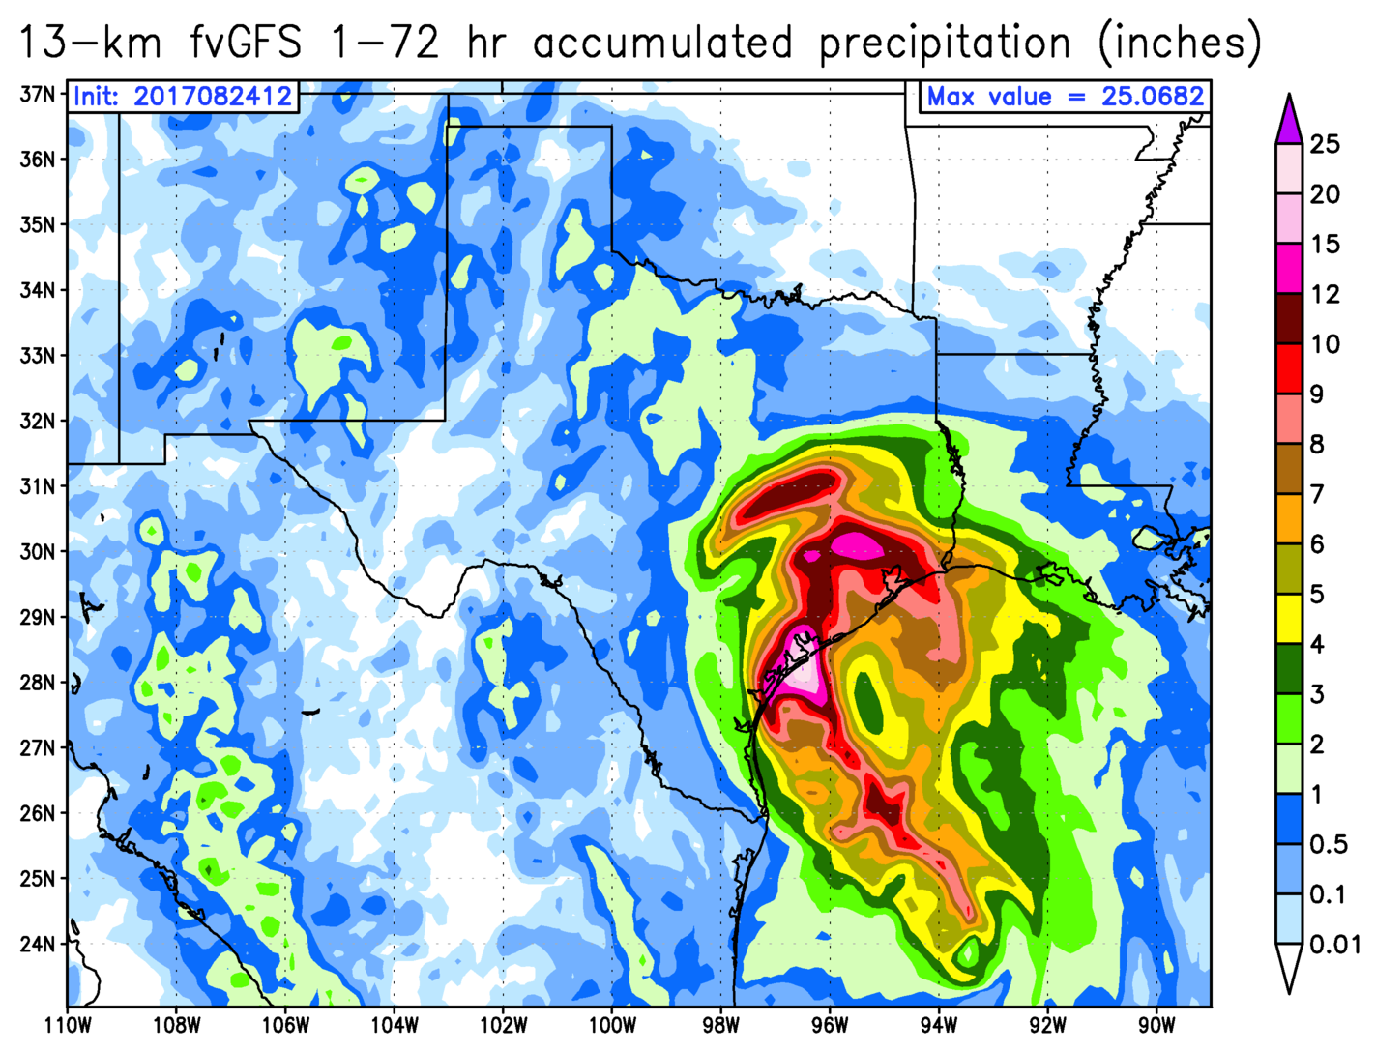
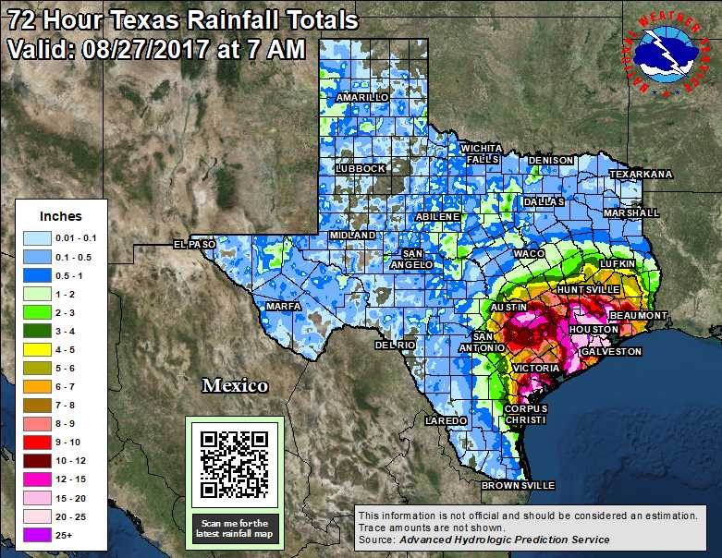
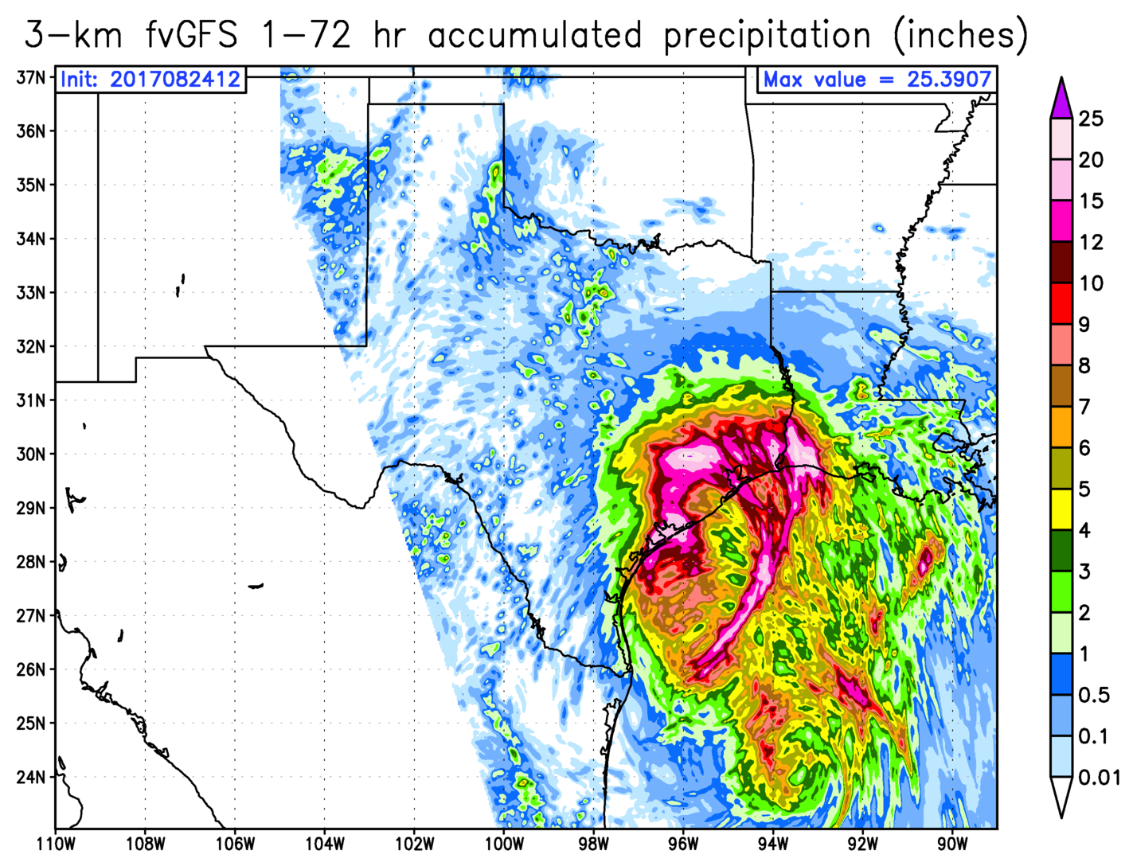
Precipitation Verifications in Inches
(from Thursday 8am through Sunday 8am)
13 km FV3
INIT: 2017082412
OBSERVED 72h PRECIPITATION TOTALS
3 km FV3

Slide 26
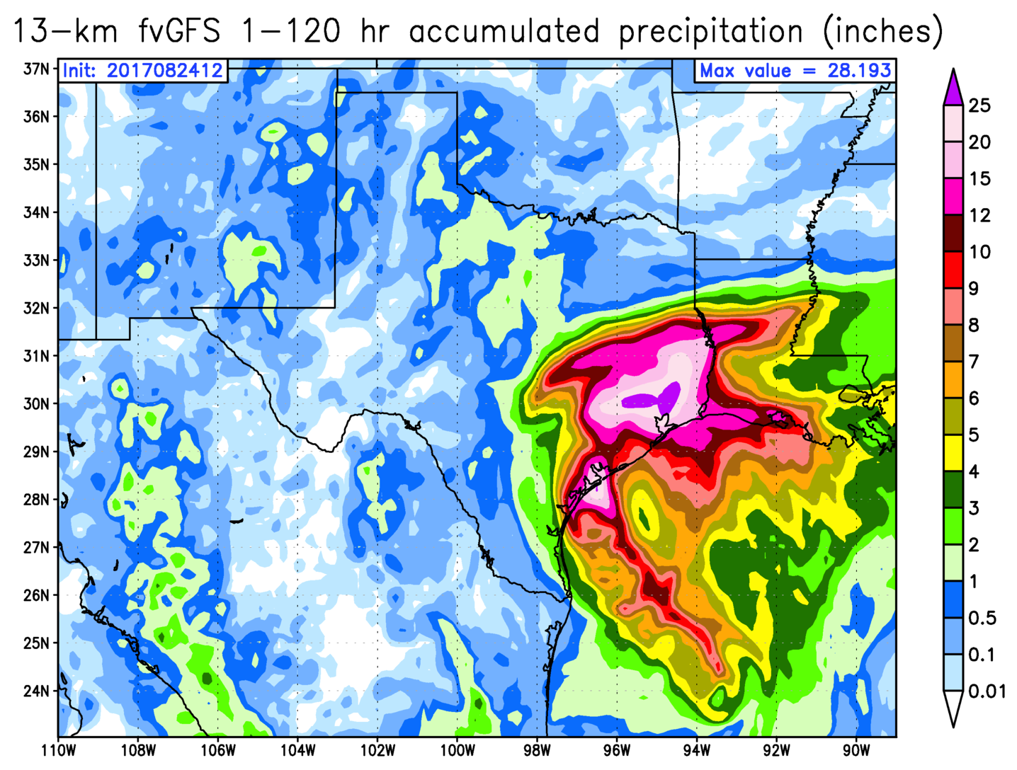
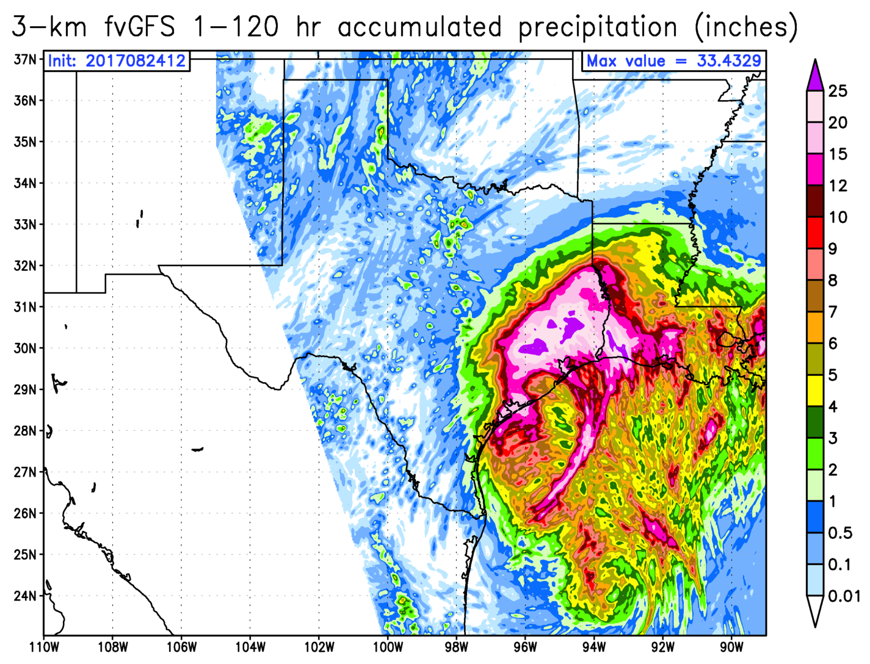
5 day Total Precipitation in Inches
(from Thursday 8am through Tuesday 8am)
INIT: 2017082412
13 km FV3
3 km FV3

Slide 27
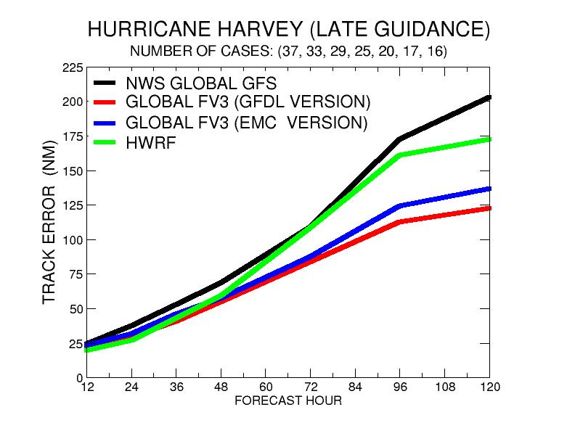
(Source: Morris Bender)

Slide 28
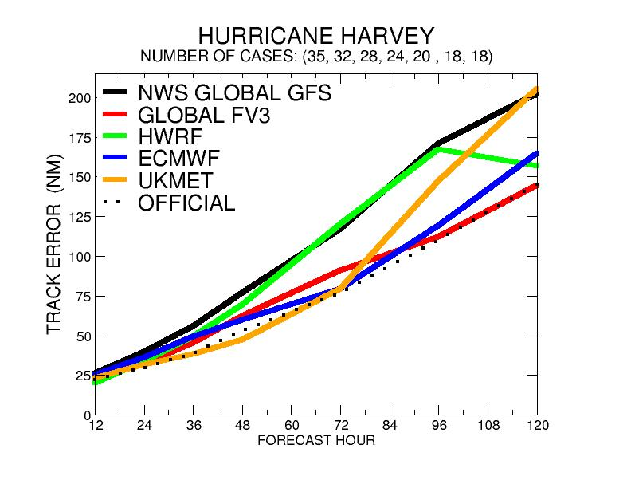
(Source: Morris Bender)

Slide 29
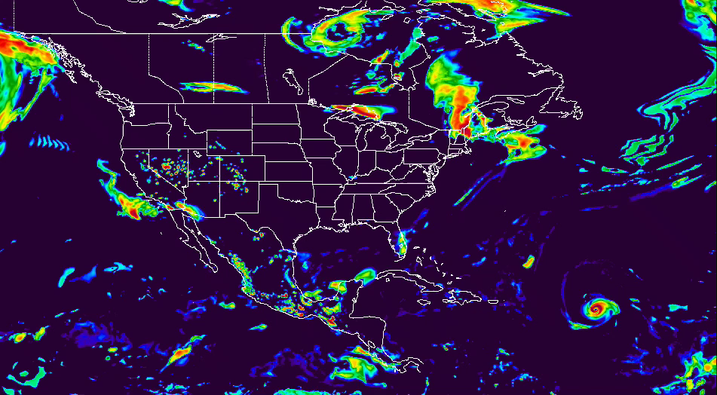
Hurricane Irma
Simulated Composite Radar Reflectivity
INIT: 00Z_20170904 fvGFS C768L63
ncview “rainbow” color with min=-20, max=54 (dBz)
fvGFS at C768L63 with GFDL MP

Slide 30
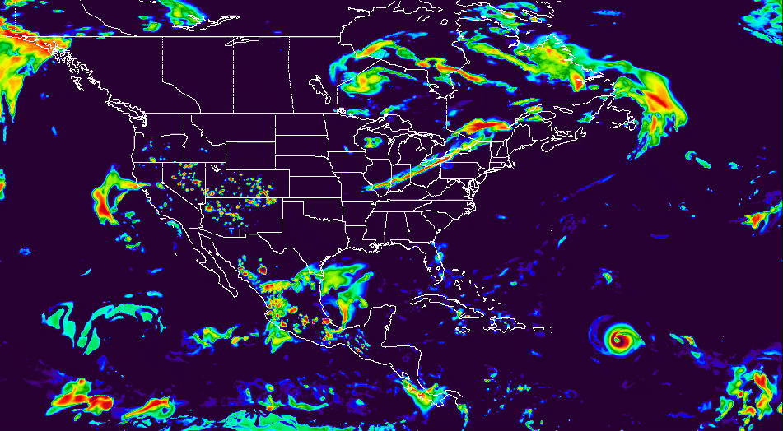
Hurricane Irma
Simulated Composite Radar Reflectivity
INIT: 00Z_20170905 fvGFS C768L63
ncview “rainbow” color with min=-20, max=54 (dBz)
fvGFS at C768L63 with GFDL MP

Slide 31
To do list:
Further optimize the FV schemes with more scale-selective “two-delta-x constraints” (experimental at this stage; but we have a good candidate for “best ACC”)
Subgrid terrains within a finite-volume
Could this be the next revolution in “Dynamical Core”?
Double moment GFDL MP
Implement an optional user interface for “fast physics” within FV3 between the vertical remapping, to increase the computational efficiency for cloud-resolving applications

