Slide 1
Recent output field changes in NEMSfv3gfs history files
Jun Wang
Acknowledgement: Jeff Whitaker, Robert Oehmke, Gerhard Theurich, Shrinivas Moorthi, George Gayno, Fanglin Yang

Slide 2
Content
Interpolation methods from native cubed sphere grid to Gaussian grid
history file from model dynamics (atmf)
history files from model physics (sfcf)
* No changes when outputing from fms without write grid comp (QUILT=.false.)
Accumulated precipitation rate without bucket
https://docs.google.com/spreadsheets/d/19vD0KqcYBKD5-1P-7S1Z-8YMNCJhM6_sCUGbLbc-ZD4/edit#gid=129272089

Slide 3
Background: interpolation methods in history files
P. Pegion and J. Whitaker compared a forecast initialized with a restart file to a cold start initialized run created from the history file and they found that:
- pressure tendency after first time step from cold start shows significant gravity wave on steep orography
- Errors in the interpolation of the winds cause an imbalance that causes a shockwave in the pressure field
The problems can be resolved by:
Assuming a U.S. standard atmosphere lapse rate (6.5ºC/Km) improved the surface pressure field around steep orography, and associated initialization shock
Handling the wind field as vectors fixes initialization shock at poles
Phil and Jeff: FV3GFS initialization and stochastic physics, FV3GFS technical meeting 20170206

Slide 4
Interpolation methods in dyn history files
Interpolation methods:
Bilinear interpolation (no change):
3D fields: temperature, tracers, delp, delz, dzdt
2D field: hgtsfc
Vector bilinear interpolation:
3D fields: ugrd, vgrd
Bilinear interpolation variation:
2D fields: pressfc, interpolated through (P/P0)**(rd/g*LapseRate)

Slide 5
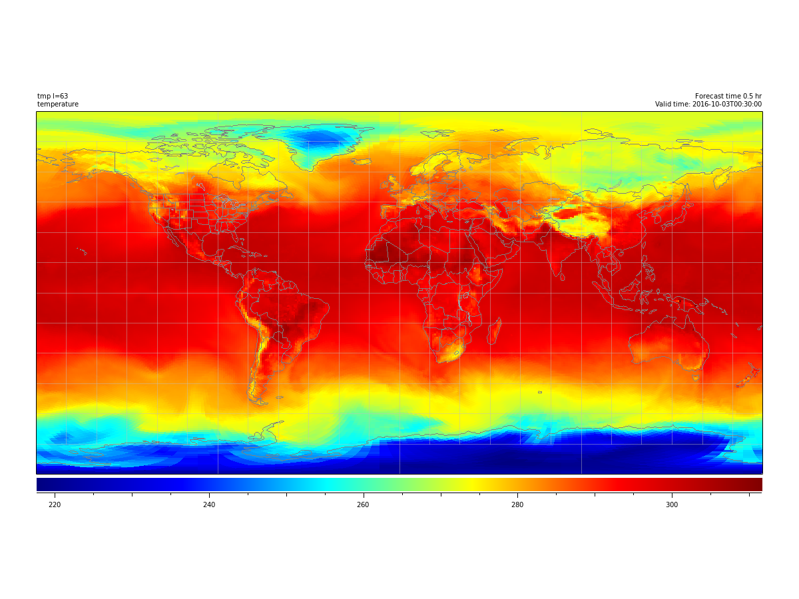
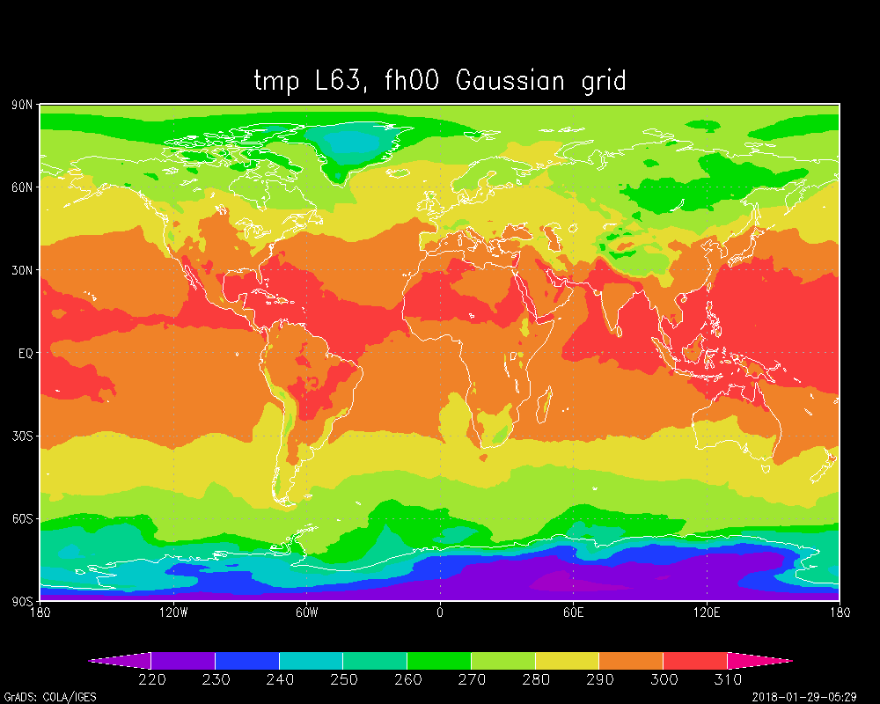
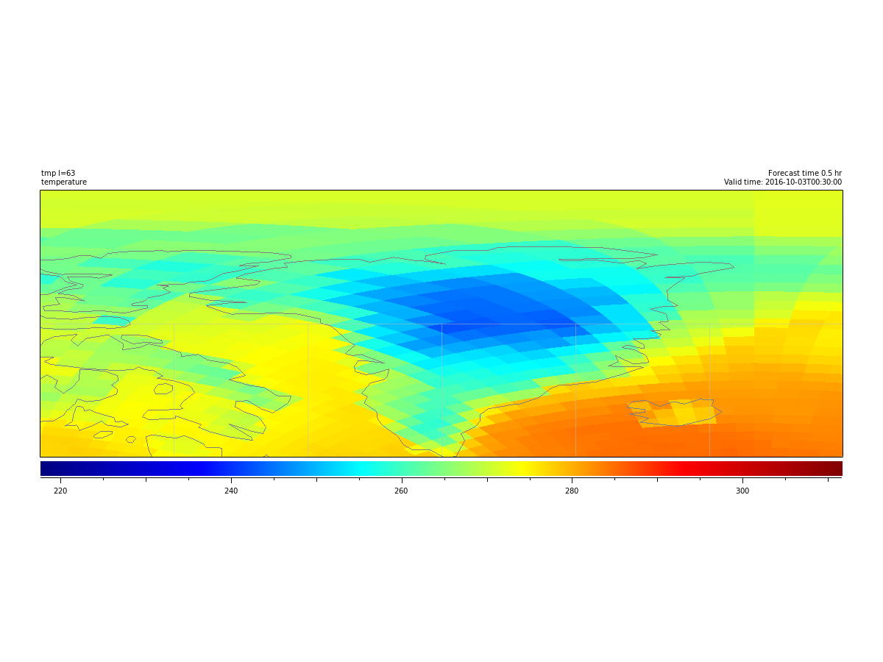
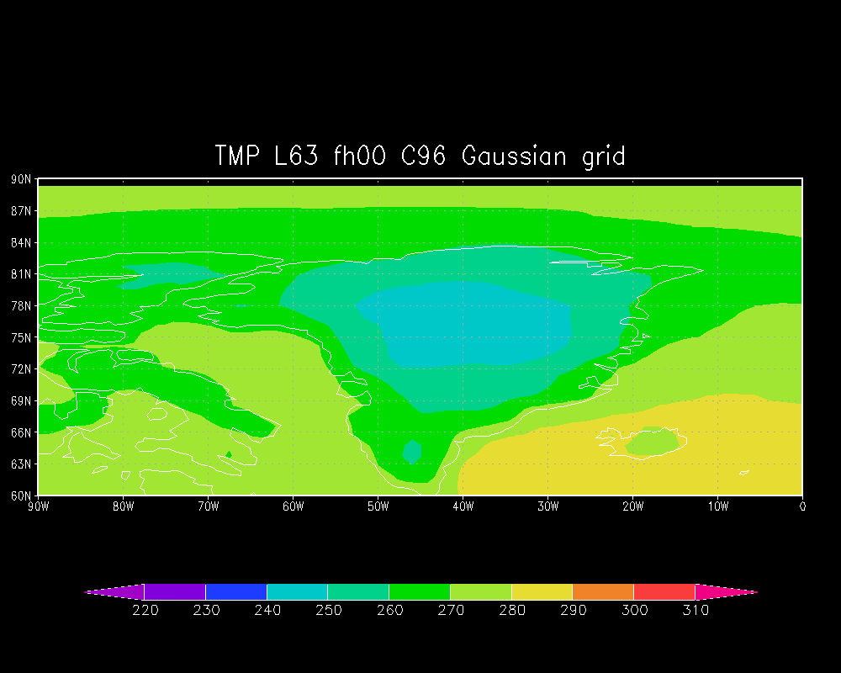
Bilinear interpolation: temperature

Slide 6
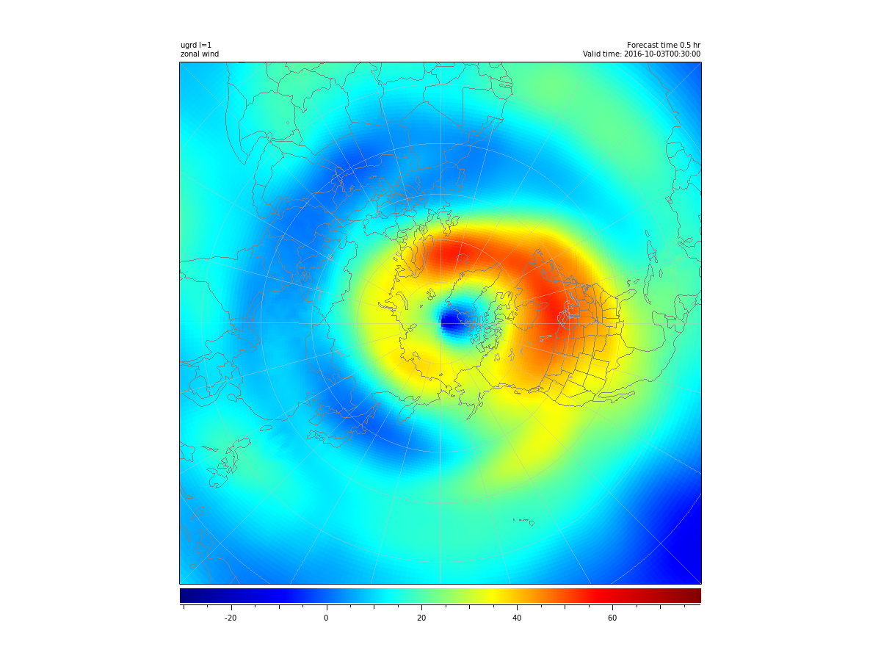
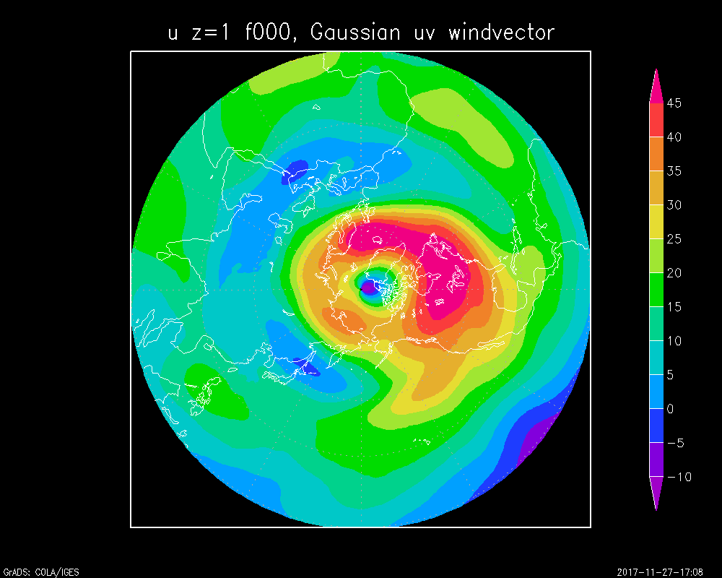
Full wind vector interpolation
U on native cubed-sphere grid
-Cubed sphere to cubed sphere, No interpolation, no wind vector
U on Gaussian grid
-Cubed sphere to Gaussian grid
Wind vector bilinear interpolation

Slide 7
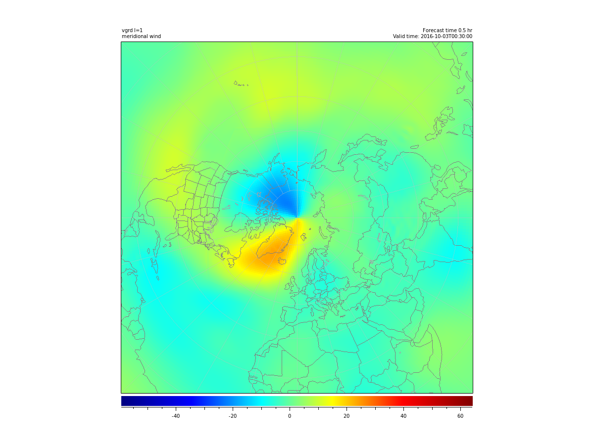
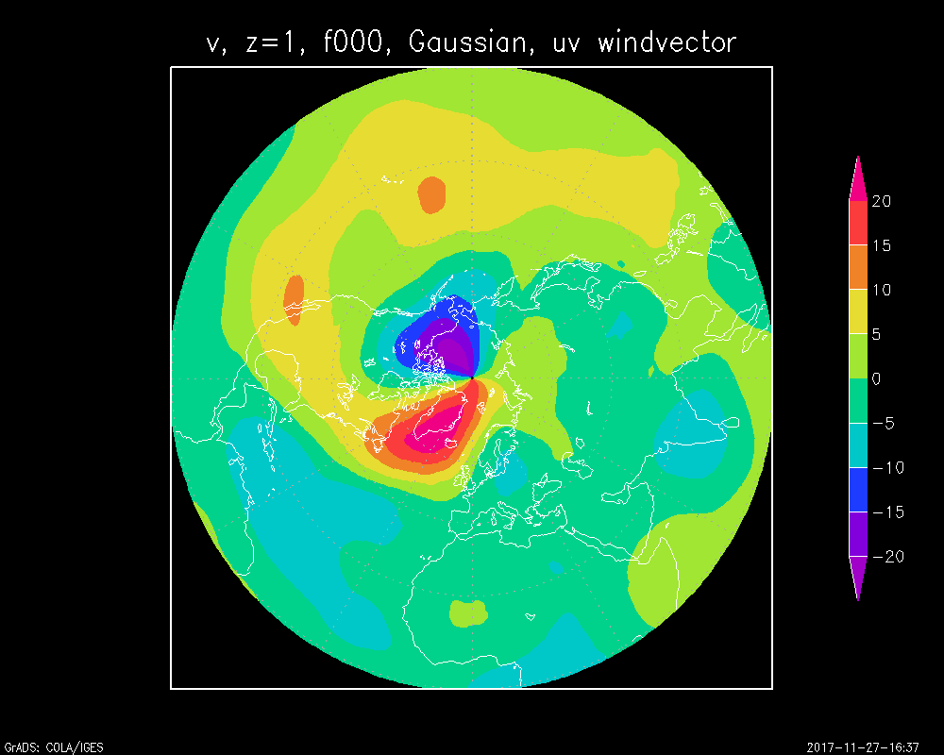
Full wind vector interpolation
V on native cubed-sphere grid
-Cubed sphere to cubed sphere, -No interpolation, no wind vector
V on Gaussian grid
-Cubed sphere to Gaussian grid
-Wind vector interpolation

Slide 8
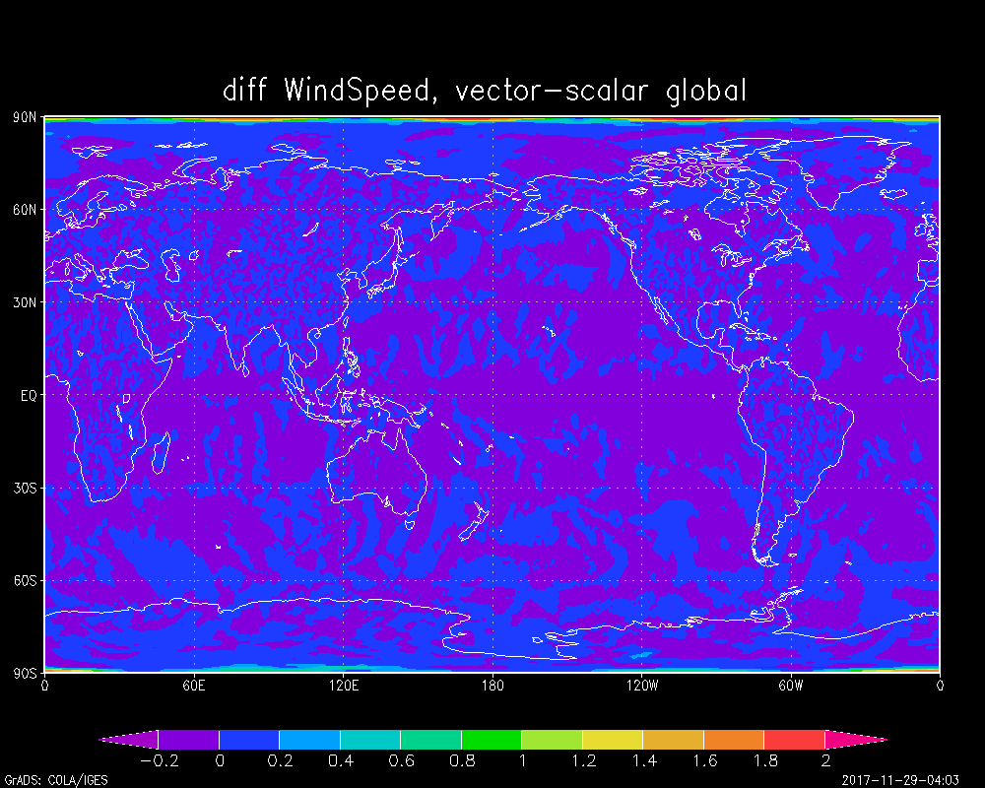
Wind speed difference on Gaussian grid
vector interpolation – scalar interpolation
Differences are mainly near poles

Slide 9
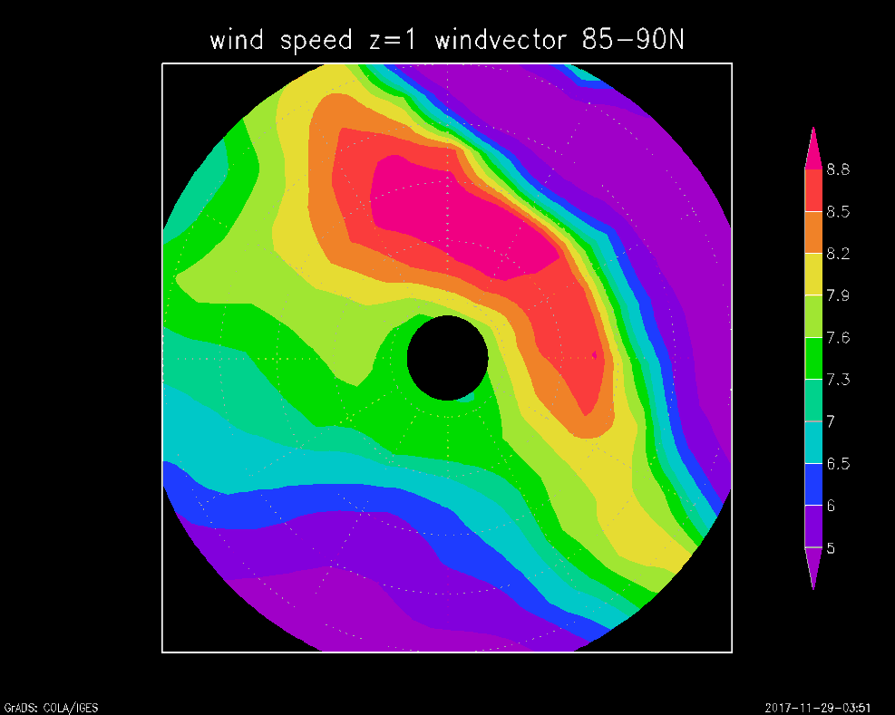
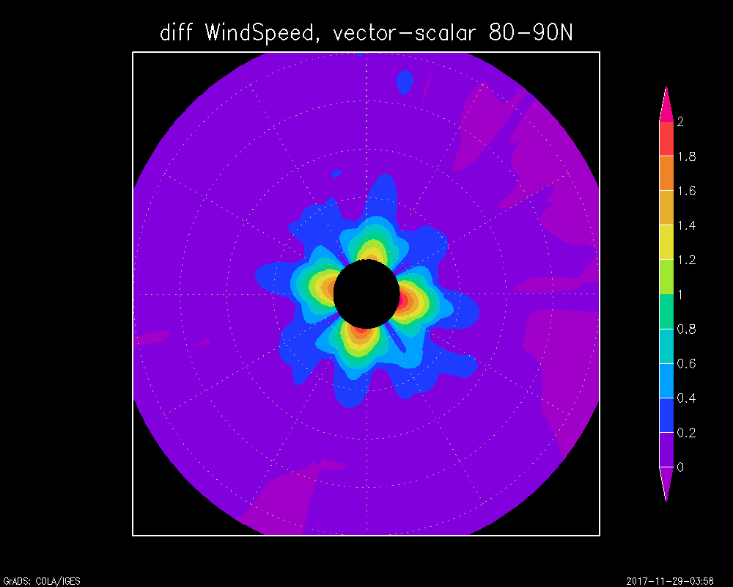
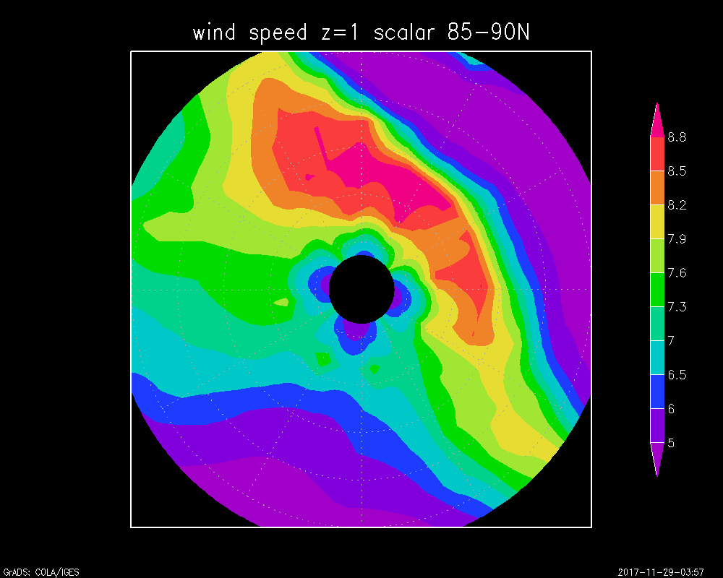
Wind speed from vector interpolation is smoother than the wind speed from scalar, especially near the pole region.

Slide 10
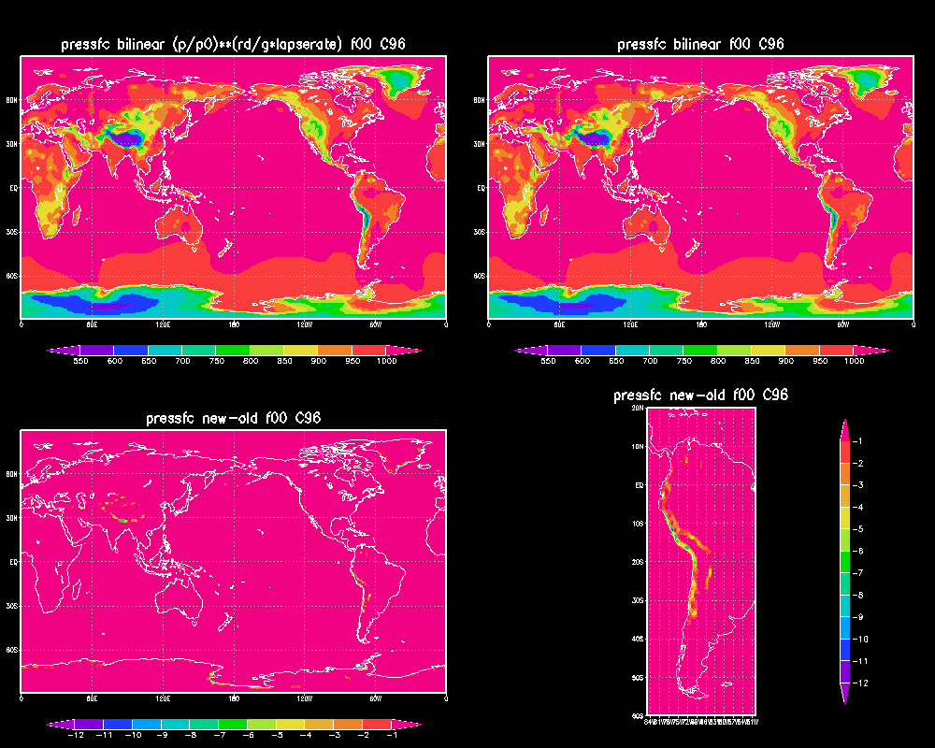
Surface pressure interpolation

Slide 11
Interpolation methods in phys history files
Interpolation methods:
Nearest neighbor interpolation:
All the surface related fields such as land sea mask, soil type, veg type etc
Bilinear interpolation:
radiation fields:
precip field
2m temperature/specific humidity
Vector interpolation:
wind fields: u10/v10, ugrd/vgrd at lowest model layer

Slide 12
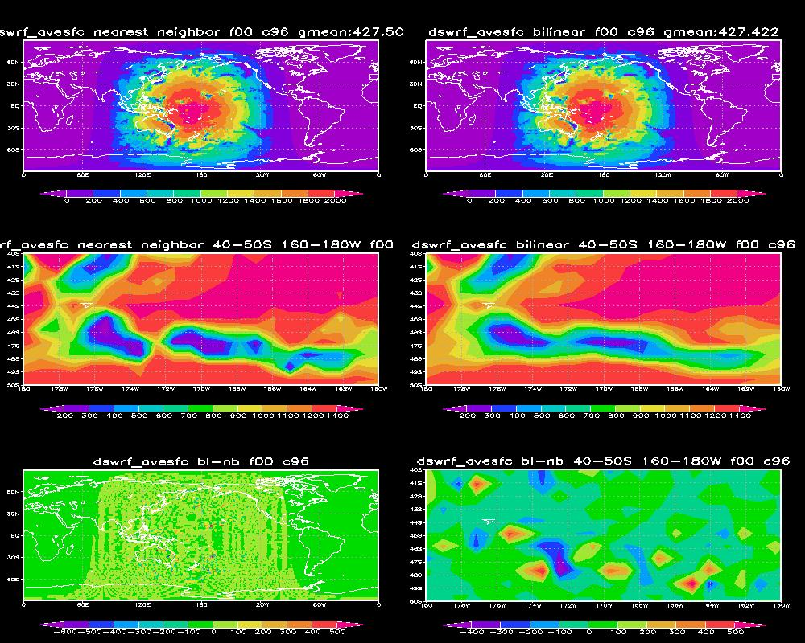
Dswrf_ave sfc interpolated through bilinear and through nearest neighbor

Slide 13
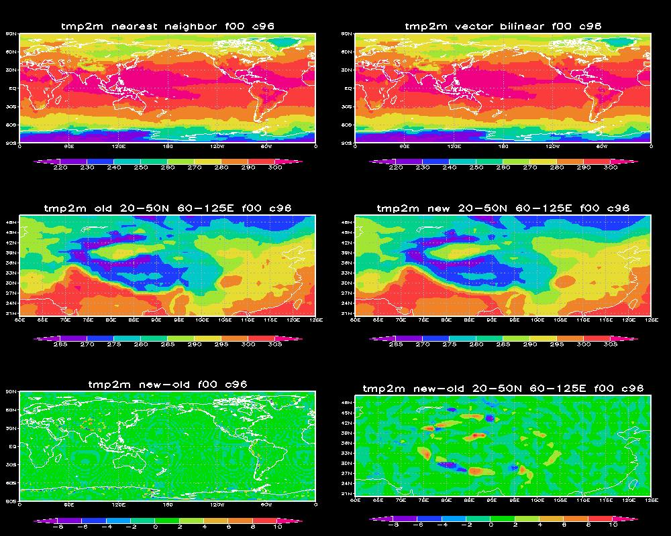
2 m TMP interpolated through bilinear and through nearest neighbor

Slide 14
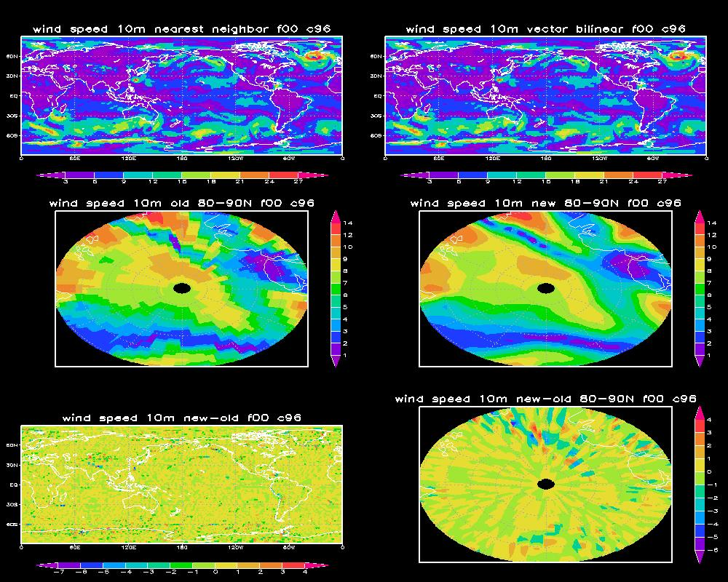
10 meter wind interpolated through vector bilinear and through nearest neighbor

Slide 15
Accumulated precipitation rate
Current operational GFS outputs precipitation rate with bucket.
It is proposed to output the accumulated precipitation rate in NEMSfv3gfs
A physics namelist variable lprecip_accu is added and output in the sfcf files
default is .true., precip rate is accumulated through the whole integration period.
When lprecip_accu is set to .false., the old precip rate with bucket (decided by fhzero) will be output

Slide 16
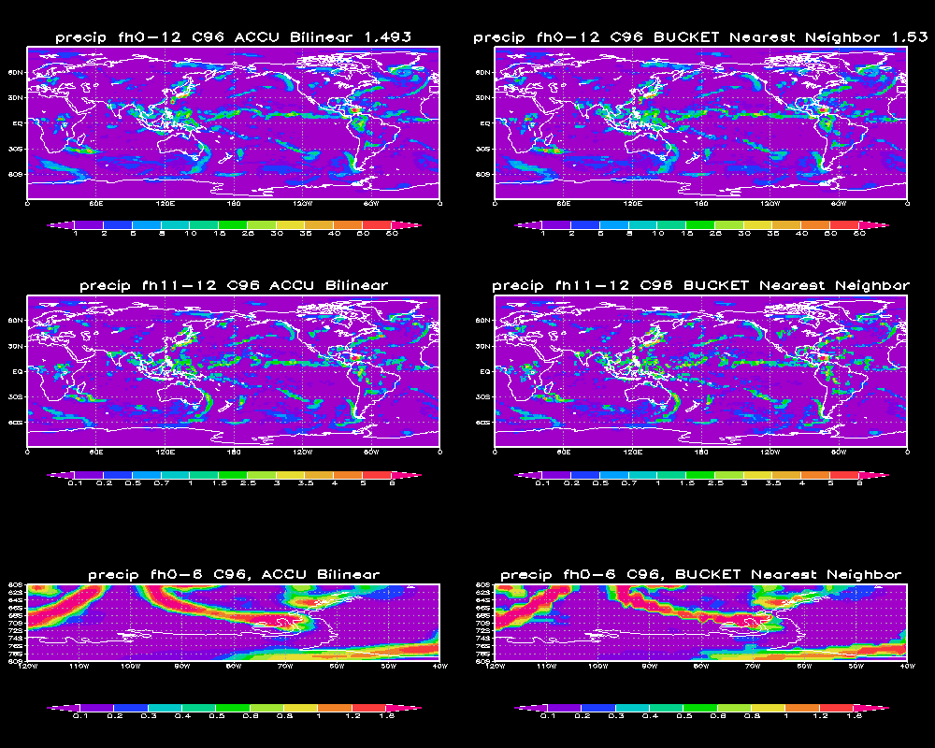
Precip rate interpolated through bilinear and nearest neighbor

Slide 17
Summary
Different Interpolation methods have been applied in the NEMSfv3gfss history output fields.
The winds fields through vector interpolation fixes the issue when winds cross poles.
Assuming a U.S. standard atmosphere lapse rate (6.5ºC/Km) improved the surface pressure field around steep orography
Bilinear interpolation applied to radiation, air temperature and precip fields make the fields smooth.
Near neighbor interpolation is applied to surface related fields to obtain consistency among those fields.
An option is added to output accumulated precipitation rate through bilinear interpolation.

