Slide 1
INSST in FV3GFS
Xu Li
EMC/NCEP/NOAA
Acknowledgements:
John Derber, Andrew Collard (DA)
Moorthi Shrinivas, Jun Wang (Model, NEMSIO)
Diane Strokes, SST Group (SST)
Ilya Rivin & Carlos Lozano (NSST model initial stage)
Fanglin Yang, Russ Treadon, George Gayno (Parallel run, validation, chgres)
Xingren Wu, David Buheringer (Sea ice, Coupled)
Dennis Keyser & Jeff Whiting (Data)
Others (DA & Model)

Slide 2
Outline
What is NSST in NCEP GFS
  Motivation
  Foundation temperature & NSST
  NSST in NCEP GFS
    Model & analysis
NSST in FV3GFS

Slide 3
Motivation of NSST
In the prediction mode of the current NCEP GFS, SST is basically prescribed as an independent analysis at the initial time, although it is modified with its climatology
The NSST project aims to improve the SST and then satellite assimilation and weather forecasting of the NCEP GFS by
  Analyzing SST together with the atmospheric analysis variables with the advanced GSI data assimilation techniques
  Resolving SST diurnal variability in the prediction

Slide 4
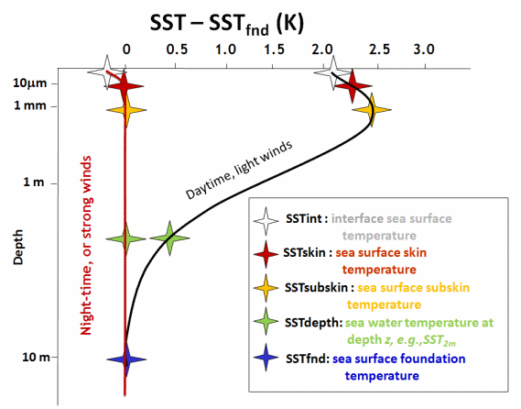
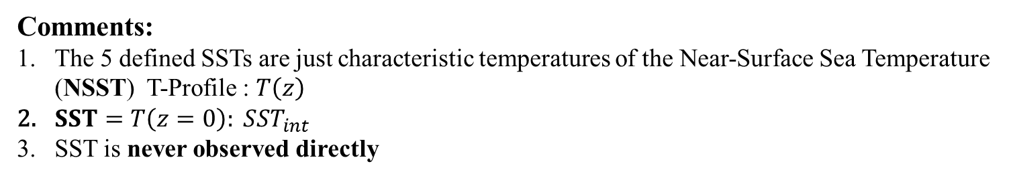



Foundation temperature and NSST definition
IR: $15 μm$
MW: $1 −30 mm$
In situ :
20 $cm −3+ m$
Hypothetical vertical profiles of temperature for the upper 10m of the ocean surface
in high wind speed conditions or during the night (red) and for low wind speed during the day (black).
Comments:
The 5 defined SSTs are just characteristic temperatures of the Near-Surface Sea Temperature (NSST) T-Profile : $T\left(z\right)$
$SST=T\left(z=0\right): {SST}_{int}$
SST is never observed directly

Slide 5
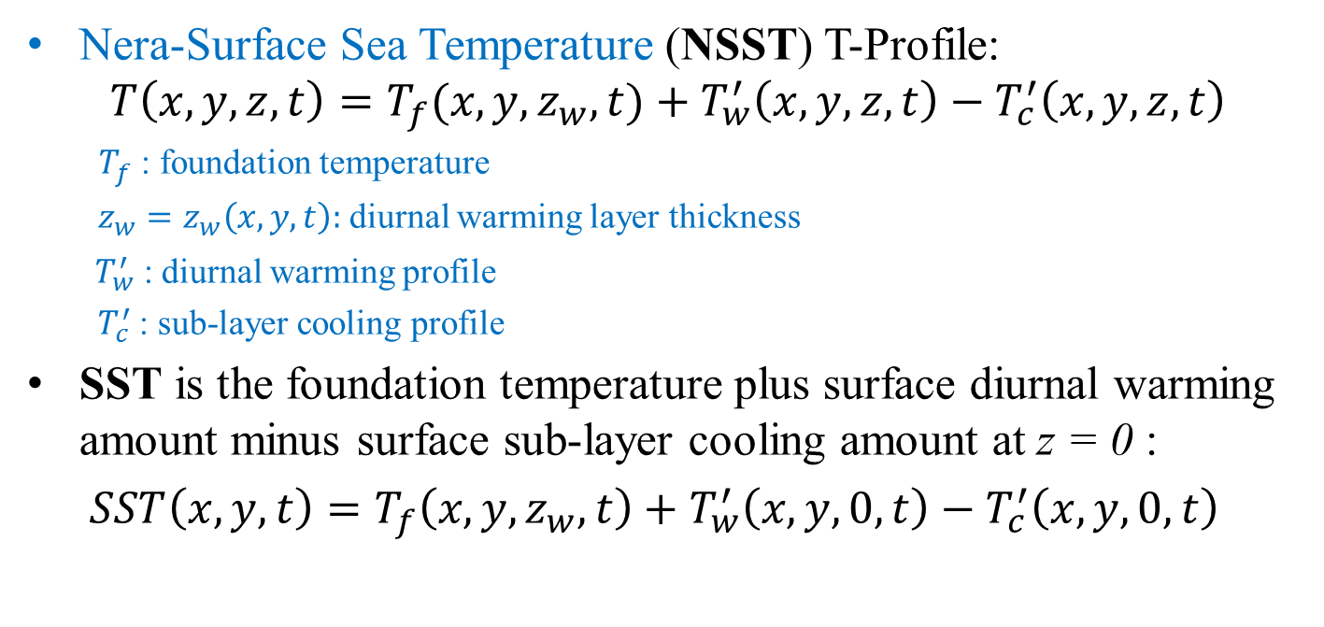
  NSST & SST can split into three components
Nera-Surface Sea Temperature (NSST) T-Profile:
$$T\left(x,y,z,t\right)=T_{f}({x,y,z}_{w},t)+T_{w}^{′}\left(x,y,z,t\right)−T_{c}^{′}\left(x,y,z,t\right)$$
: foundation temperature $T_{f}$
diurnal warming layer thickness$z_{w}=z_{w}\left(x,y,t\right):$
: diurnal warming profile$T_{w}^{′}$
: sub-layer cooling profile$T_{c}^{′}$
SST is the foundation temperature plus surface diurnal warming amount minus surface sub-layer cooling amount at z = 0 :
$SST\left(x,y,t\right)=T_{f}\left({x,y,z}_{w},t\right)+T_{w}^{′}\left(x,y,0,t\right)−T_{c}^{′}\left(x,y,0,t\right)$

Slide 6
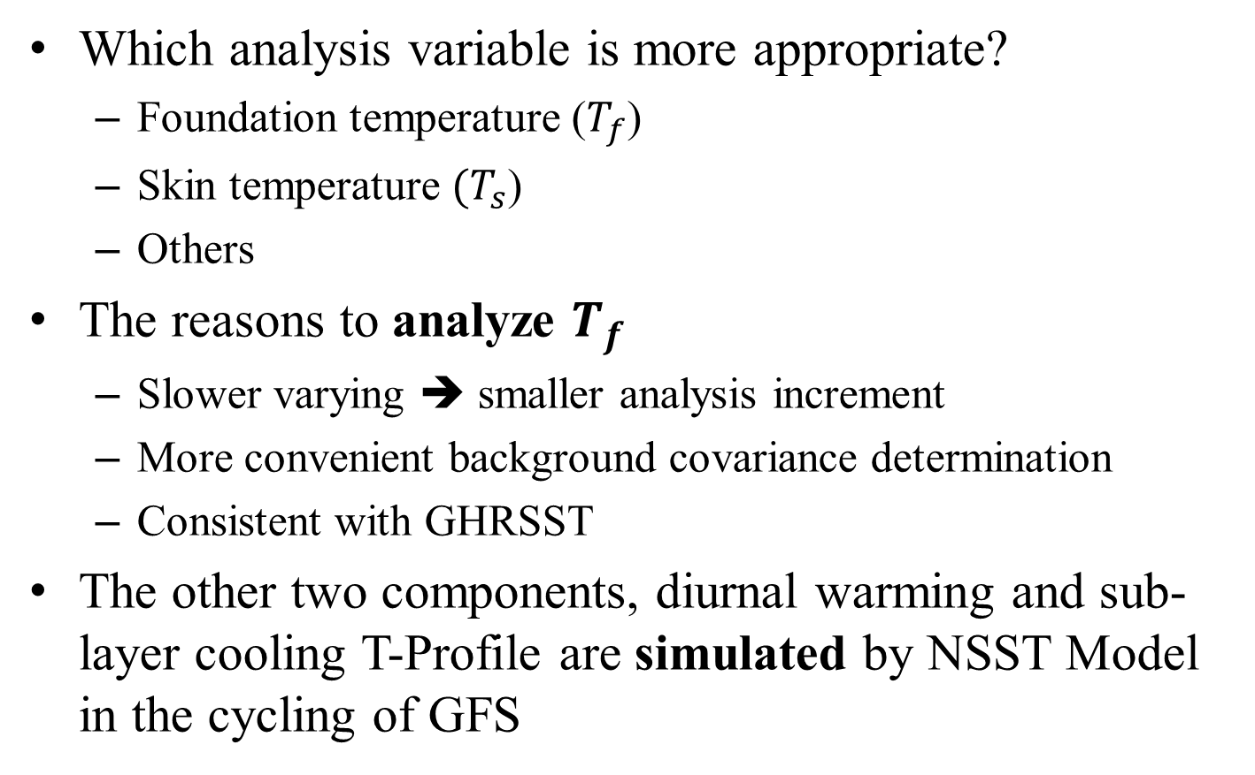
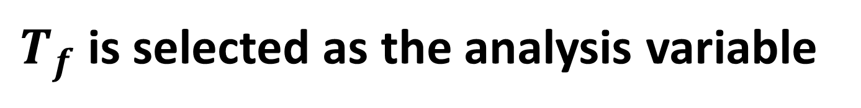
is selected as the analysis variable $T_{f}$
Which analysis variable is more appropriate?
  Foundation temperature ()$T_{f}$
  Skin temperature )${(T}_{s}$
  Others
The reasons to analyze $T_{f}$
  Slower varying ➔ smaller analysis increment
  More convenient background covariance determination
  Consistent with GHRSST
The other two components, diurnal warming and sub-layer cooling T-Profile are simulated by NSST Model in the cycling of GFS

Slide 7
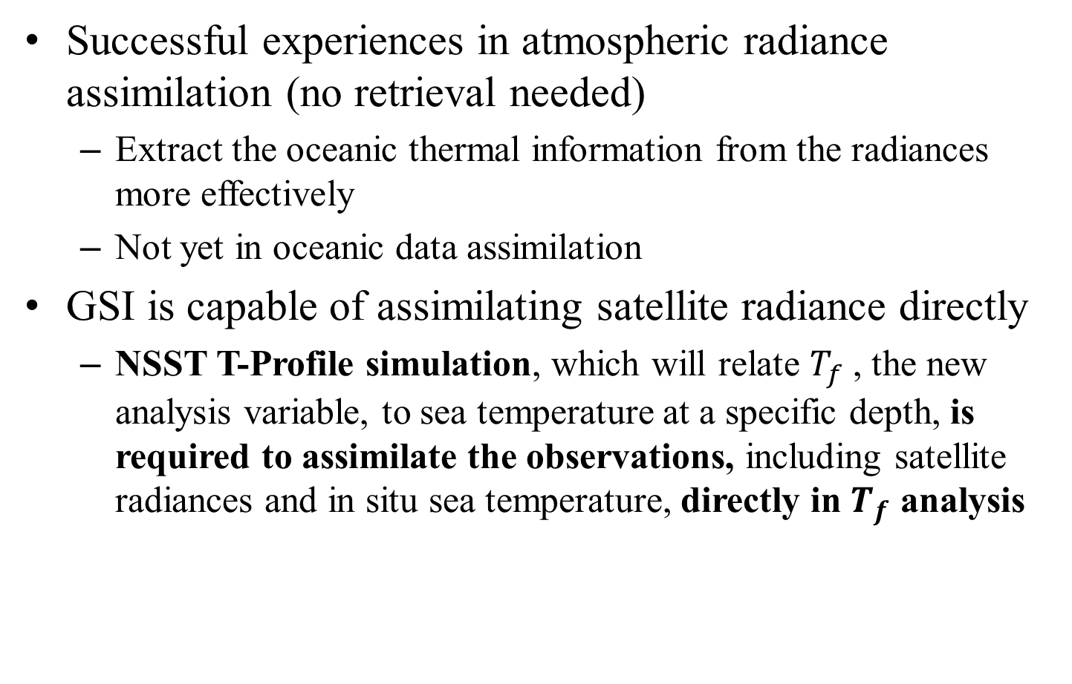
Direct assimilation
Successful experiences in atmospheric radiance assimilation (no retrieval needed)
  Extract the oceanic thermal information from the radiances more effectively
  Not yet in oceanic data assimilation
GSI is capable of assimilating satellite radiance directly
  NSST T-Profile simulation, which will relate , the new analysis variable, to sea temperature at a specific depth, is required to assimilate the observations, including satellite radiances and in situ sea temperature, directly in analysis$T_{f}$$T_{f}$

Slide 8

Why analyze , an oceanic variable, within an integrated atmospheric prediction system?$T_{f}$
More consistent NWP initial conditions
  A single cost function for two media
More effective use of the observations
  Direct assimilation: extract the signal from the satellite radiance more optimally
More advanced data assimilation algorithm
  The atmospheric data assimilation system, such as GSI, is advanced and updated frequently
A direction towards the coupled data assimilation
  Surface sensitive channel radiances depend on both atmosphere and ocean ➔ both media need to be adjust to fit the observation in their analysis

Slide 9
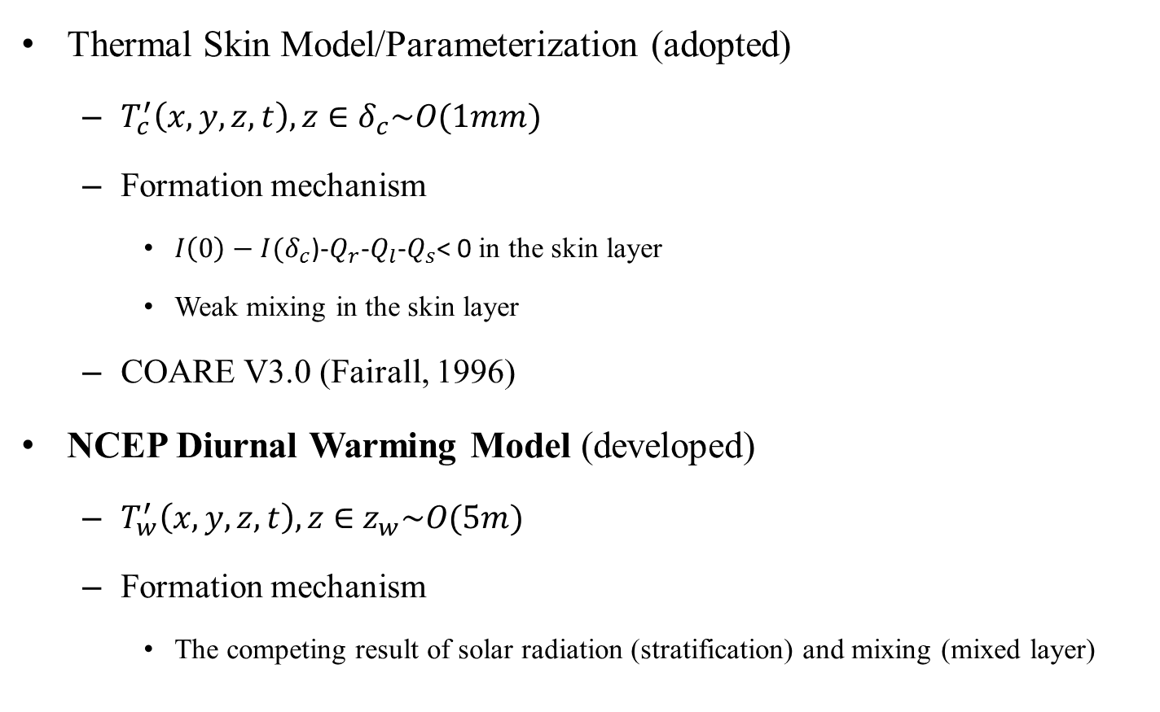
NSST Model (NSSTM)
Thermal Skin Model/Parameterization (adopted)
  $T_{c}^{′}\left(x,y,z,t\right), z∈$$δ_{c}\sim O(1mm)$
  Formation mechanism
    )---< 0 in the skin layer $I\left(0\right)−I(δ_{c}$$Q_{r}$$Q_{l}$$Q_{s}$
    Weak mixing in the skin layer
  COARE V3.0 (Fairall, 1996)
NCEP Diurnal Warming Model (developed)
  $T_{w}^{′}\left(x,y,z,t\right), z∈$$z_{w}\sim O(5m)$
  Formation mechanism
    The competing result of solar radiation (stratification) and mixing (mixed layer)

Slide 10
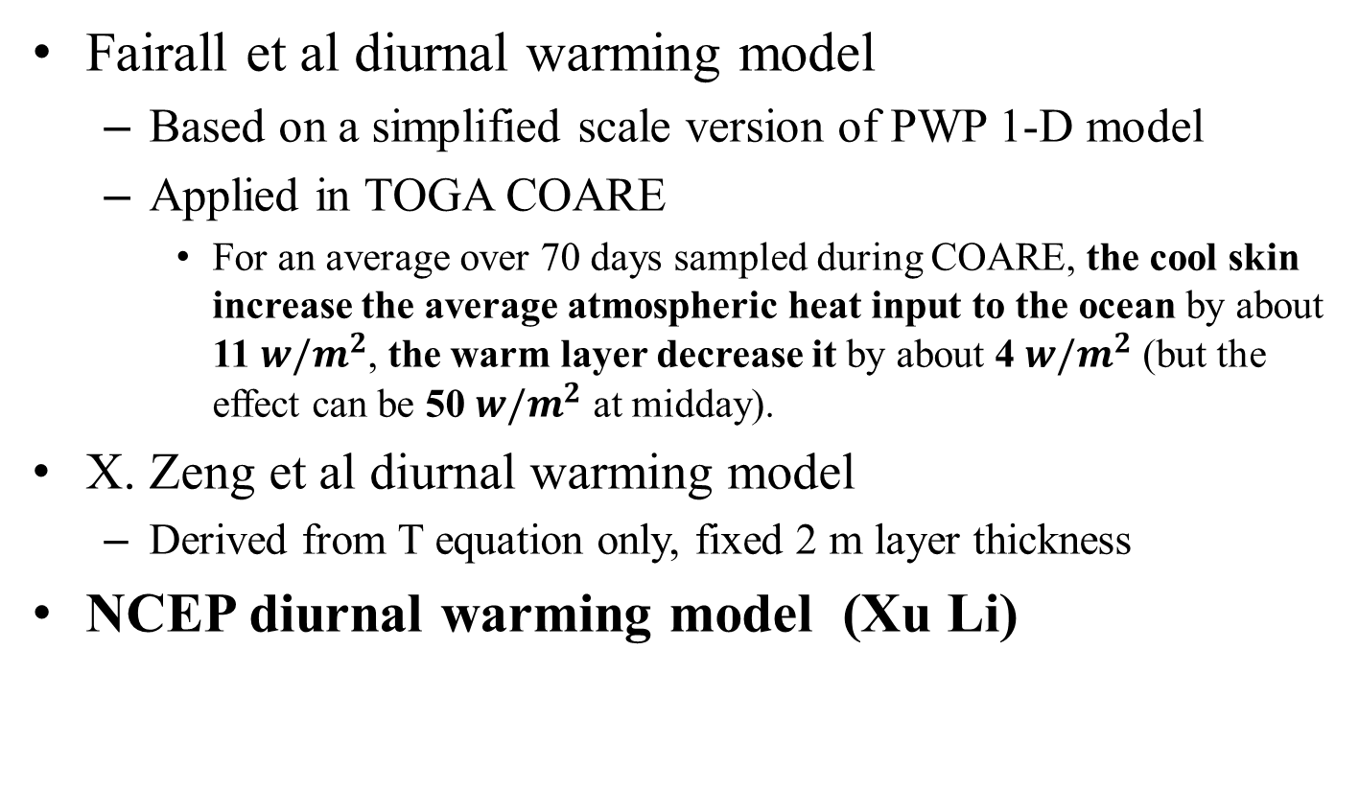
Brief review on diurnal warming models
Fairall et al diurnal warming model
  Based on a simplified scale version of PWP 1-D model
  Applied in TOGA COARE
    For an average over 70 days sampled during COARE, the cool skin increase the average atmospheric heat input to the ocean by about 11 , the warm layer decrease it by about 4 (but the effect can be 50 at midday).$w/m^{2}$$w/m^{2}$$w/m^{2}$
X. Zeng et al diurnal warming model
  Derived from T equation only, fixed 2 m layer thickness
NCEP diurnal warming model (Xu Li)

Slide 11
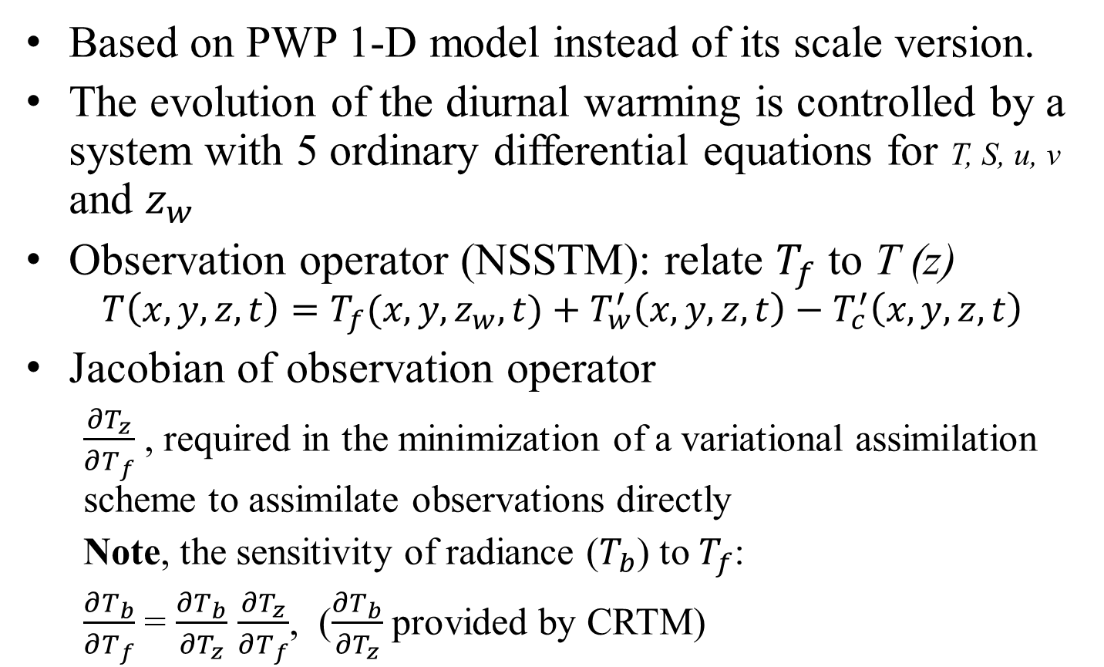
NCEP diurnal warming model
Based on PWP 1-D model instead of its scale version.
The evolution of the diurnal warming is controlled by a system with 5 ordinary differential equations for T, S, u, v and $z_{w}$
Observation operator (NSSTM): relate to T (z)$T_{f}$
$$T\left(x,y,z,t\right)=T_{f}({x,y,z}_{w},t)+T_{w}^{′}\left(x,y,z,t\right)−T_{c}^{′}\left(x,y,z,t\right)$$
Jacobian of observation operator
  , required in the minimization of a variational assimilation scheme to assimilate observations directly$\frac{∂T_{z}}{∂T_{f}}$
  Note, the sensitivity of radiance () to :$T_{b}$$T_{f}$
  = , ( provided by CRTM)$\frac{∂T_{b}}{∂T_{f}}$$\frac{∂T_{b}}{∂T_{z}}$$\frac{∂T_{z}}{∂T_{f}}$$\frac{∂T_{b}}{∂T_{z}}$

Slide 12
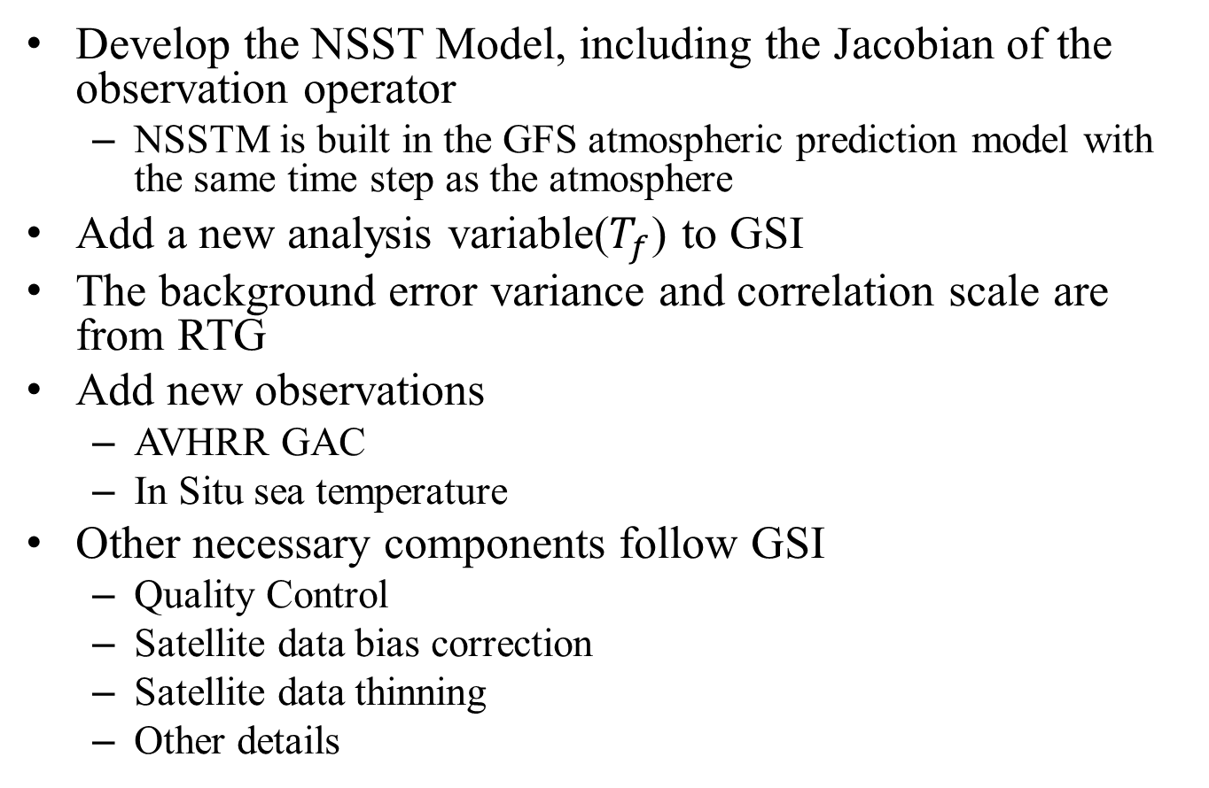

Analyze within the NCEP GFS$T_{f}$
Develop the NSST Model, including the Jacobian of the observation operator
  NSSTM is built in the GFS atmospheric prediction model with the same time step as the atmosphere
Add a new analysis variable() to GSI$T_{f}$
The background error variance and correlation scale are from RTG
Add new observations
  AVHRR GAC
  In Situ sea temperature
Other necessary components follow GSI
  Quality Control
  Satellite data bias correction
  Satellite data thinning
  Other details

Slide 13
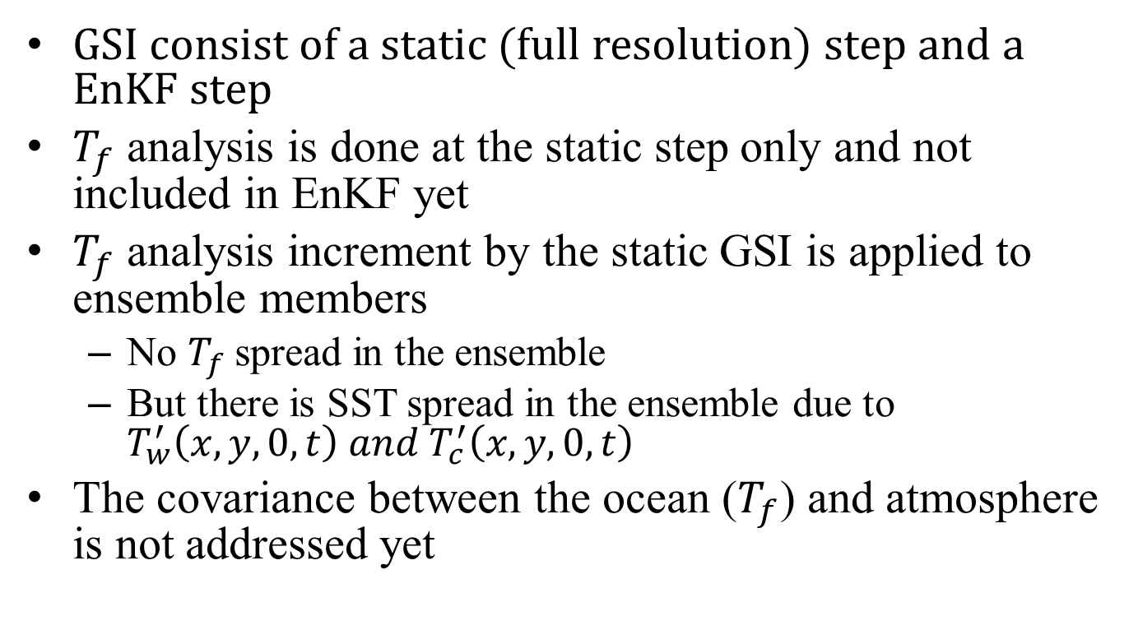
NSST in Hybrid EnKF GSI
GSI consist of a static (full resolution) step and a EnKF step
analysis is done at the static step only and not included in EnKF yet$T_{f}$
analysis increment by the static GSI is applied to ensemble members $T_{f}$
  No spread in the ensemble$T_{f}$
  But there is SST spread in the ensemble due to $T_{w}^{′}\left(x,y,0,t\right) and T_{c}^{′}\left(x,y,0,t\right)$
The covariance between the ocean () and atmosphere is not addressed yet$T_{f}$

Slide 14
Verifications
Oceanic analysis and prediction
  Positive
The use of satellite data (O-B)
  Positive
Weather Prediction
  Neutral for NH and SH, positive for tropics, when verified against to the own analysis
  Slightly positive when verified against the conventional observations

Slide 15
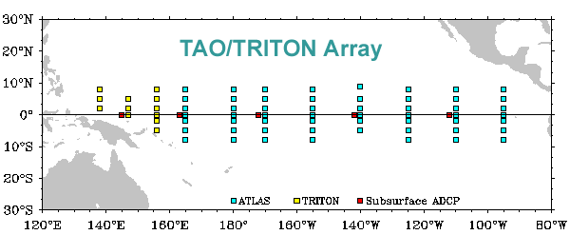

Slide 16
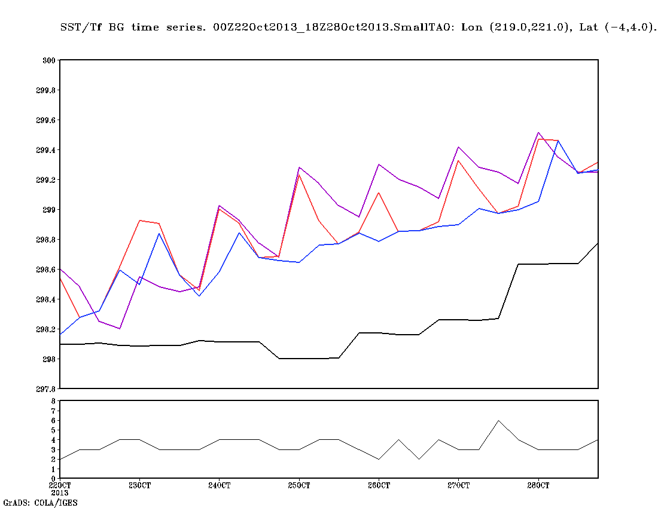
Time series of SST/Tz/Tf BG and buoy observation. Area: (141 W – 139 W, 4S – 4N)
RTG SST
NSST Tz
NSST Tf
Buoy_T (z=1m)
N_Obs

Slide 17
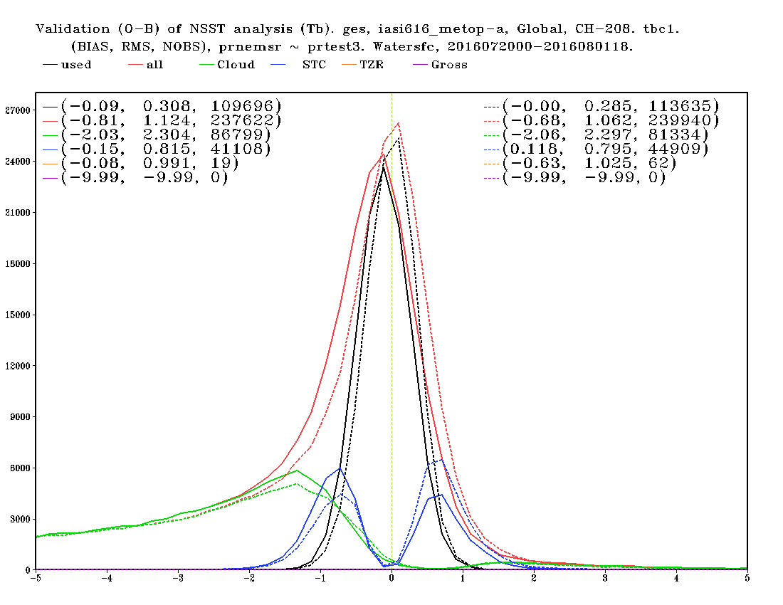
Improved satellite data use by NSST. Based on 13-day (O-B) statistics, with NEMS/GSM and GSI

Slide 18
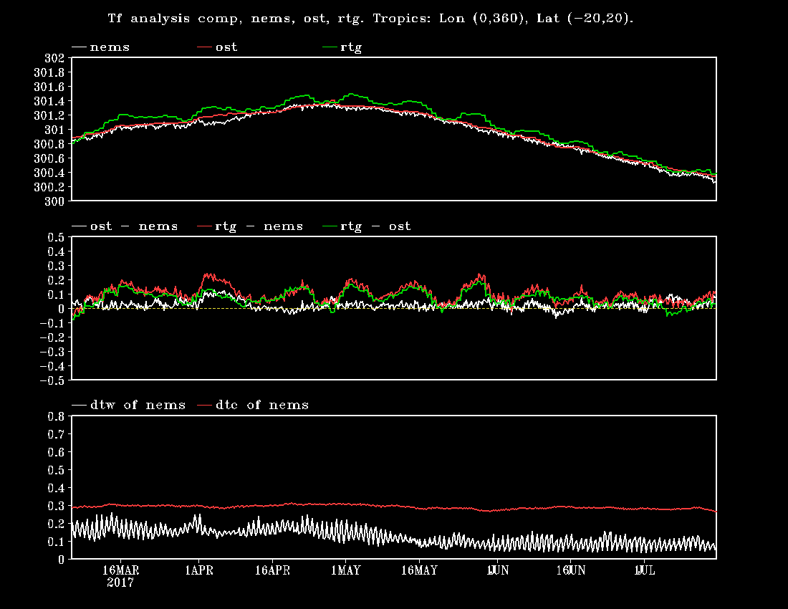

Slide 19
Status of NSST in FV3GFS
Model
  Basically ready
    Ready in GSM
    Cold start issue was resolved in FV3GFS model (Rusty & Fanglin)
    More tests
Analysis
  IO
    Write component
      Add NSST variables to history file
      A new reading utility in GSI
    Regrid
Possible issues

Slide 20
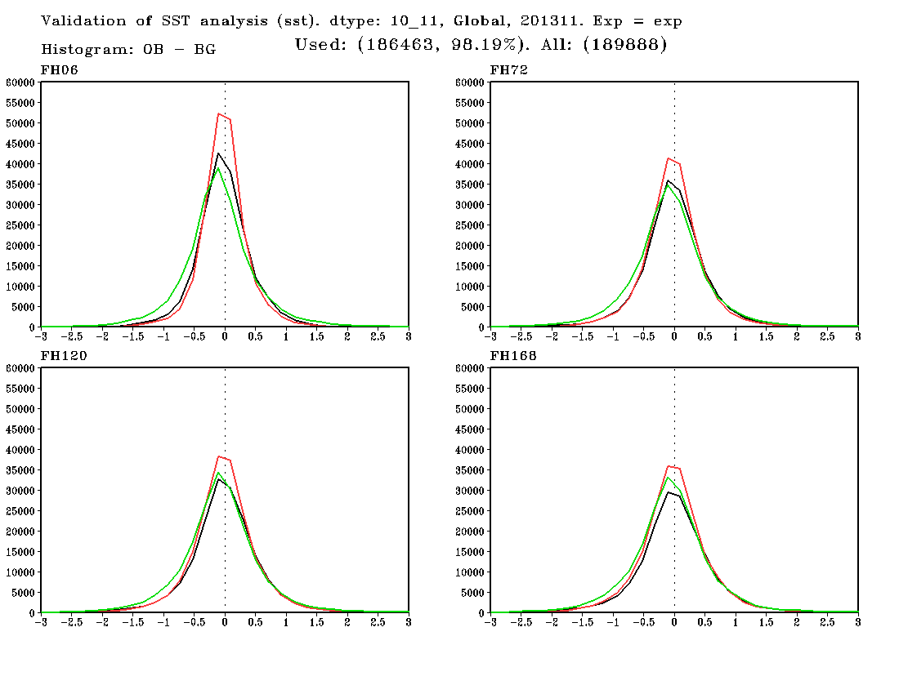
Histogram of (F-O), against Buoy. Based on 30 predictions in November, 2013. Global
Daily SST
NSST Tz
Weekly SST

