Slide 1
Introduction to the kinetic energy spectrum analysis in FV3
Xi Chen and the FV3 team
2017-7-19

Slide 2
What is the kinetic energy spectrum?

Slide 3
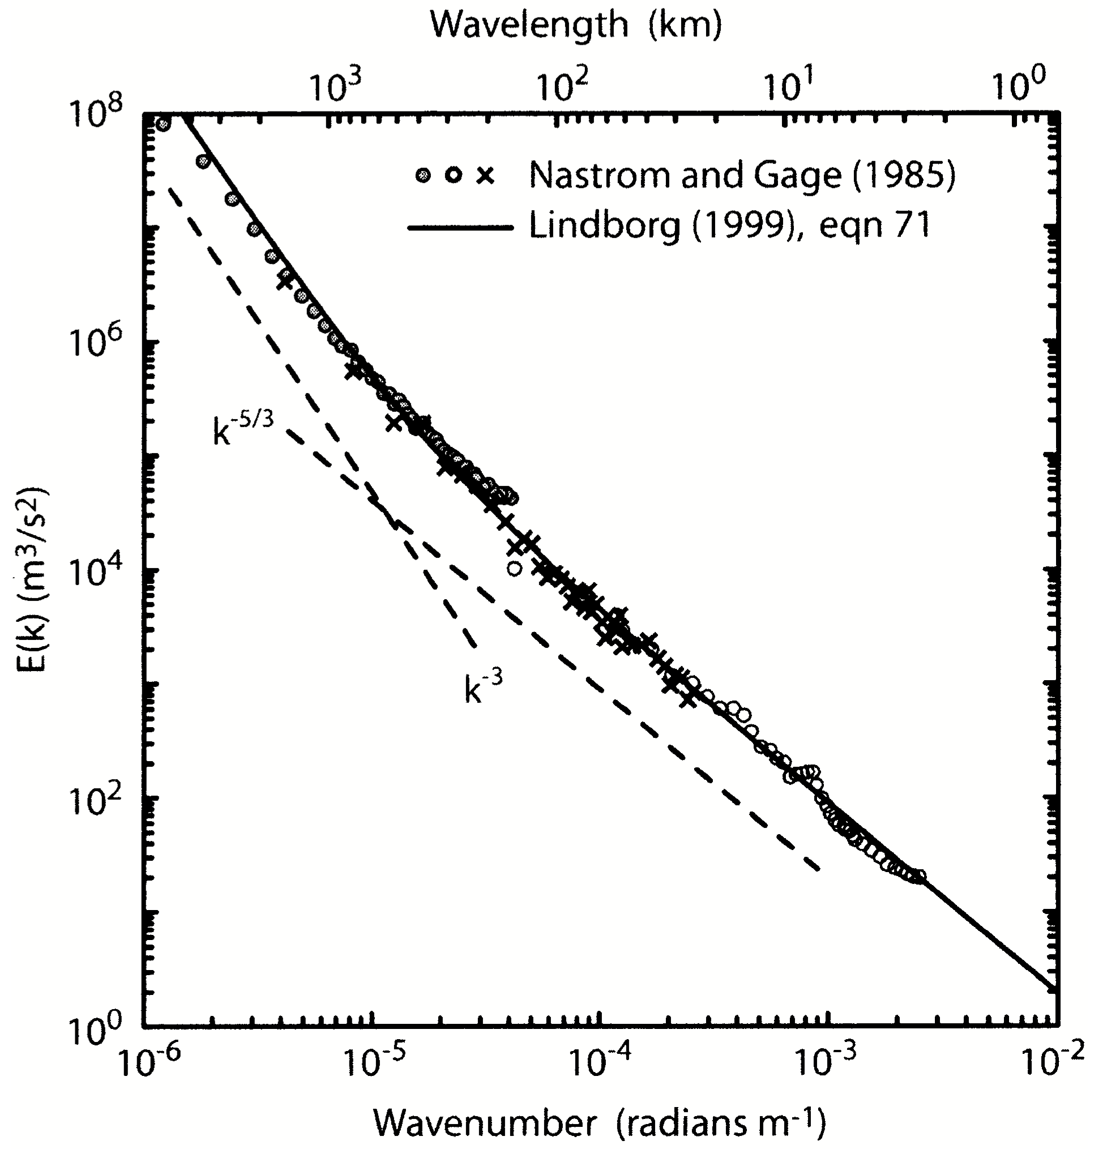
KE200 spectrum analysis is inspired by observations
Observations
Nastrom and Gage (1985) - Global Atmospheric Sampling Program (GASP) dataset
Lindborg (1999) - Measurement of Ozone and Water Vapor by Airbus In-Service Aircraft (MOZAIC) aircraft observations
Model calculation
Computes vector spherical harmonic analysis of vector fields.
For example, NCL’s vhaeC() function
Large scale - k⁻³, Mesoscale - k^{-5/3}

Slide 4
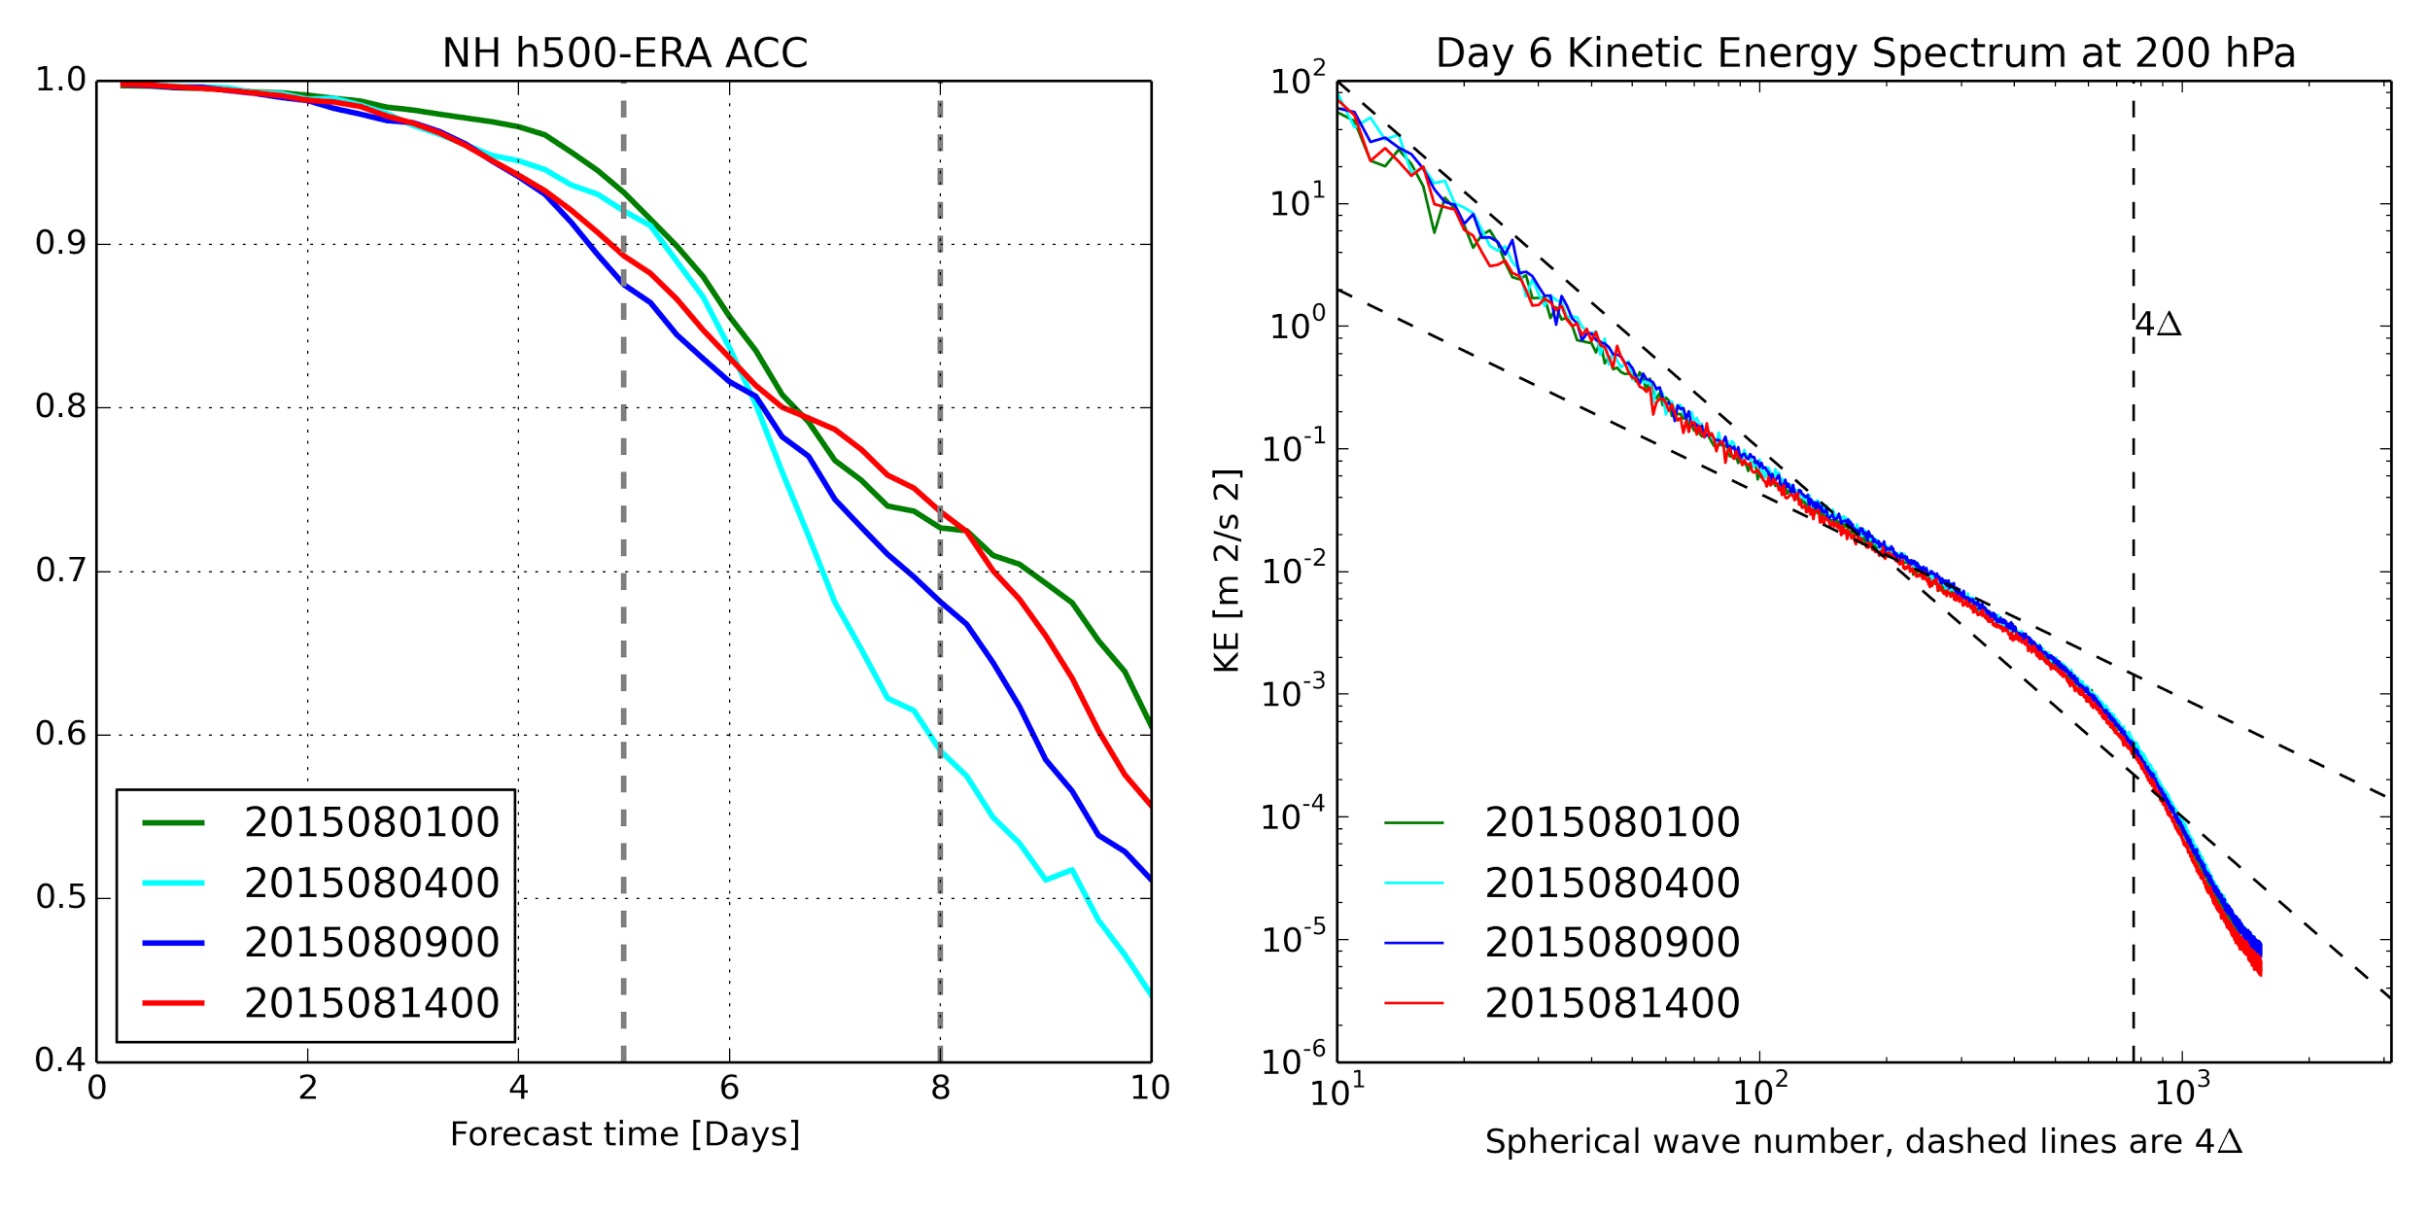
KE200 spectrum is the fingerprint of the dyn-core
ACC varies between different runs, but KE SPC is consistent

Slide 5
Does it change with validation times?

Slide 6
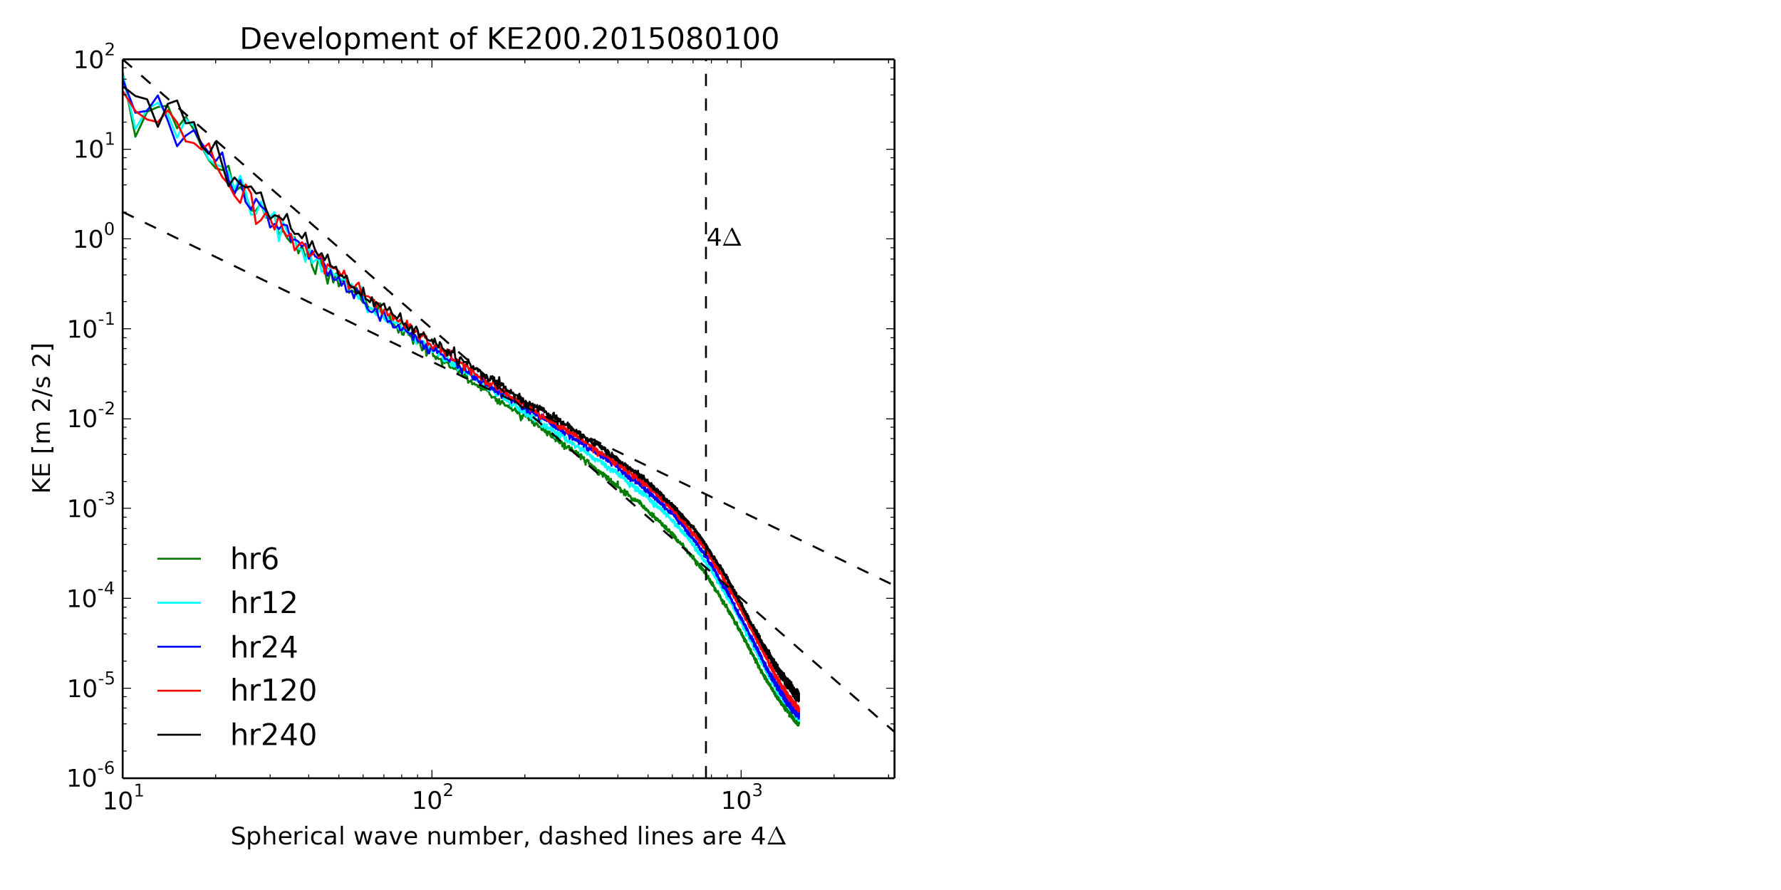
KE200 SPC development with time
A “healthy” dynamical core is indicated by:
Rapid spin-up to stable status.
Effective noise control
FV3 KE200 SPC demonstrates:
Large scale 2D turbulence
Mesoscale 3D turbulence
highly scale-selective diffusion removes 2-Δ waves
-3
-5/3
KE SPC reveals dissipative properties

Slide 7
What’s the relationship between the diffusion settings and the KE spectrum?

Slide 8
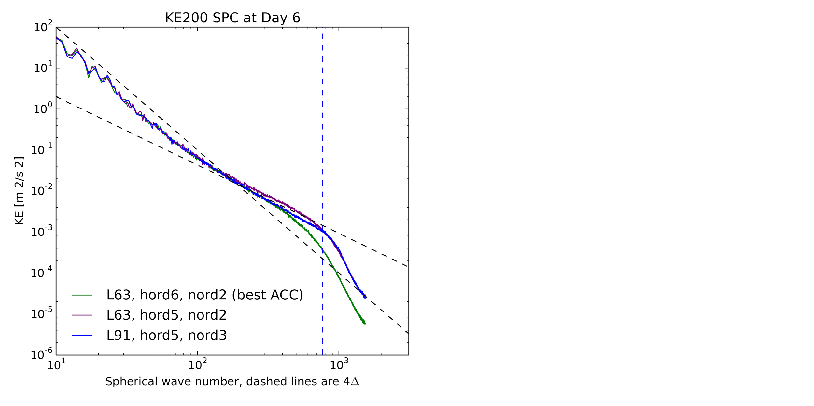
Diffusion settings vs KE200 SPCs
nord => the order or divergence damping. Larger value means higher scale-selective (2-delta)
hord => horizontal transport scheme: hord6 is more diffusive than hord5.
L[N] => number of model layers. Still looking into the impact to the KE200 SPC…
Other parameters: vtdm4, dddmp, etc. Check FV3 diffusion references.
A “better looking” SPC does not necessarily leads to a better ACC

Slide 9
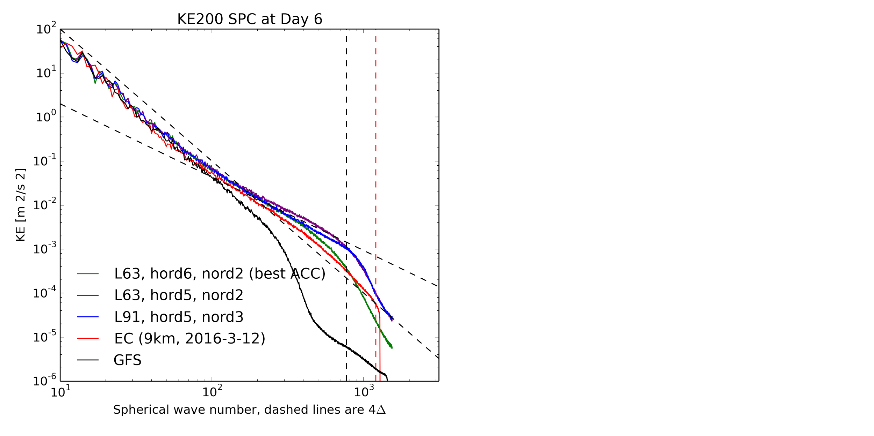
Diffusion settings vs KE200 SPCs
Different 4-deltas: ECMWF uses 9 km horizontal resolution, while GFS and FV3 use 13 km horizontal resolution.
Fingerprints of the models
EC data courtesy of Linus Magnusson
KE200 SPCs between models show a larger variance

Slide 10
How does FV3 team do PP?

Slide 11
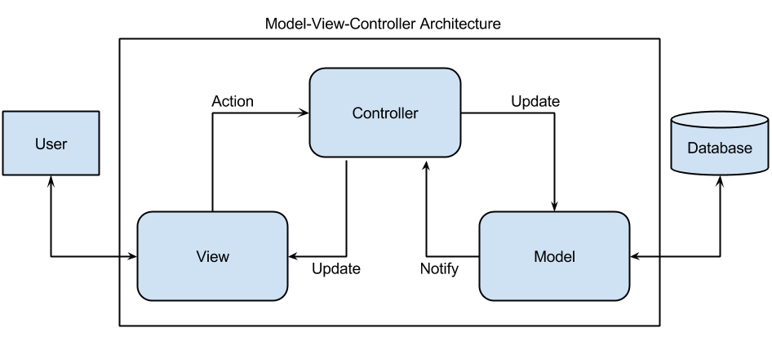
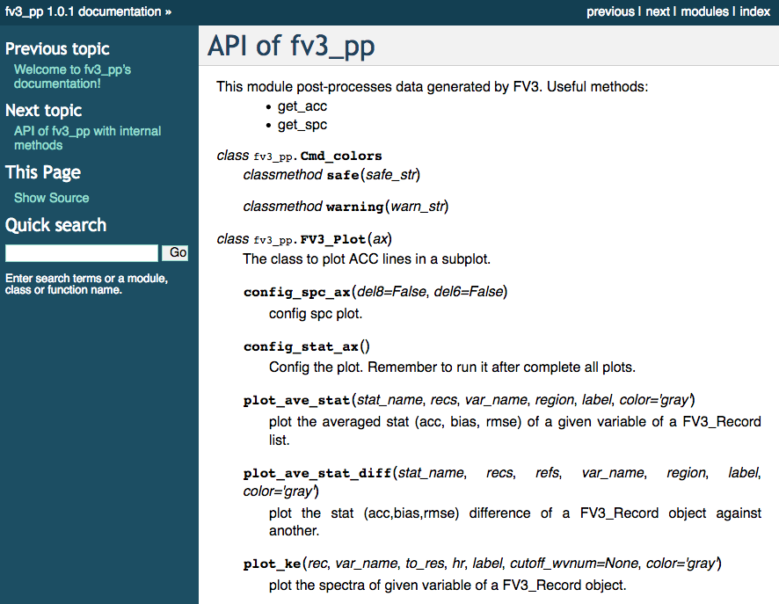
FV3 team “in-house” post-processing solutions
User’s control
class FV3_Record()
With various utilities
class FV3_Plot()
$ fv3_ke_spc.py --help
usage: fv3_ke_spc.py [-h] --u_file U_FILE --v_file V_FILE --pp_frame PP_FRAME
[--ke_path KE_PATH] [--lon_name LON_NAME]
[--lat_name LAT_NAME] [--u_name U_NAME] [--v_name V_NAME]
[--ncl_name NCL_NAME]
get kinetic energy spectrum from horizontal 2D u,v variables
optional arguments:
-h, --help show this help message and exit
--u_file U_FILE your run result that has 2D u vars
--v_file V_FILE your run result that has 2D v vars
--pp_frame PP_FRAME frame number to pp
--ke_path KE_PATH pped result of kinetic energy spectrum,
default=ke200.nc
--lon_name LON_NAME name of the 1D lon, default = grid_xt
--lat_name LAT_NAME name of the 1D lon, default = grid_yt
--u_name U_NAME name of the 2D u, default=u200
--v_name V_NAME name of the 2D v, default=v200
--ncl_name NCL_NAME name of the ncl script, default = test_ncl
Notes:
MVC architectural pattern

Slide 12
FV3 team “in-house” post-processing solutions
FV3_pp project - experimental, inspired by pp for much larger runs:
Variable based instead of file based regridding
On-demand variable processing (lazy-initialization)
PP is an embarrassingly parallel problem
Status checking system (allowing pp call repeatedly - cron job)
Object oriented
Improvement: speed, flexibility, scalability
Notes:
MVC architectural pattern

Slide 13
Thank you!

Slide 14
Supplementary materials

Slide 15
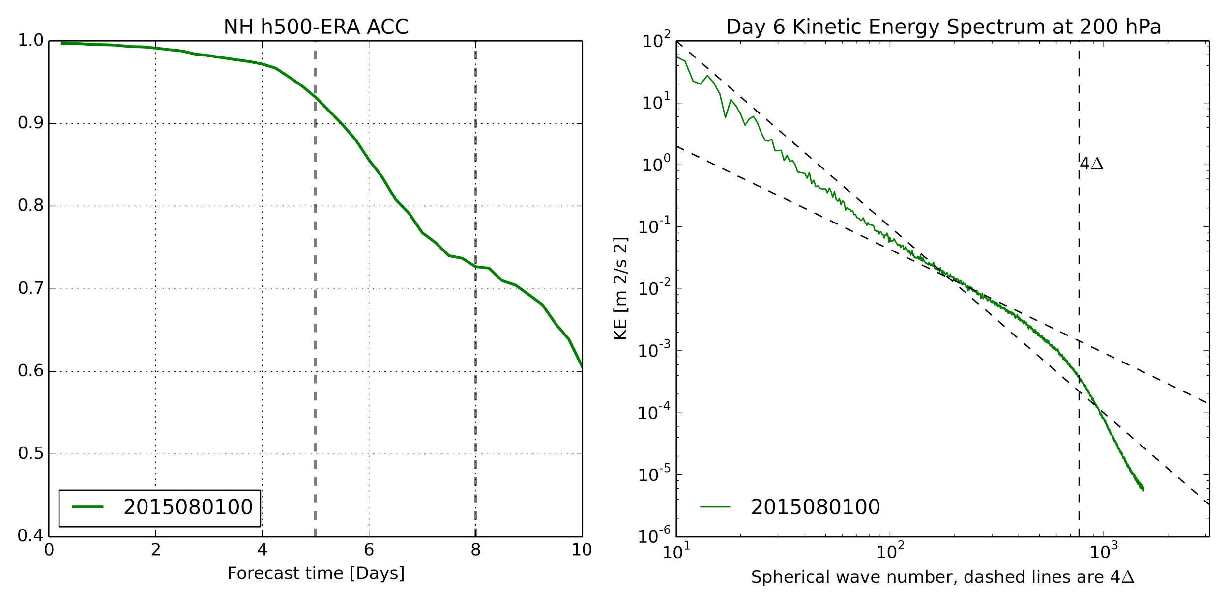
KE200 spectrum is the fingerprint of the dyn-core
KE SPC is a stat for each single run - 2D analysis at a certain level

Slide 16
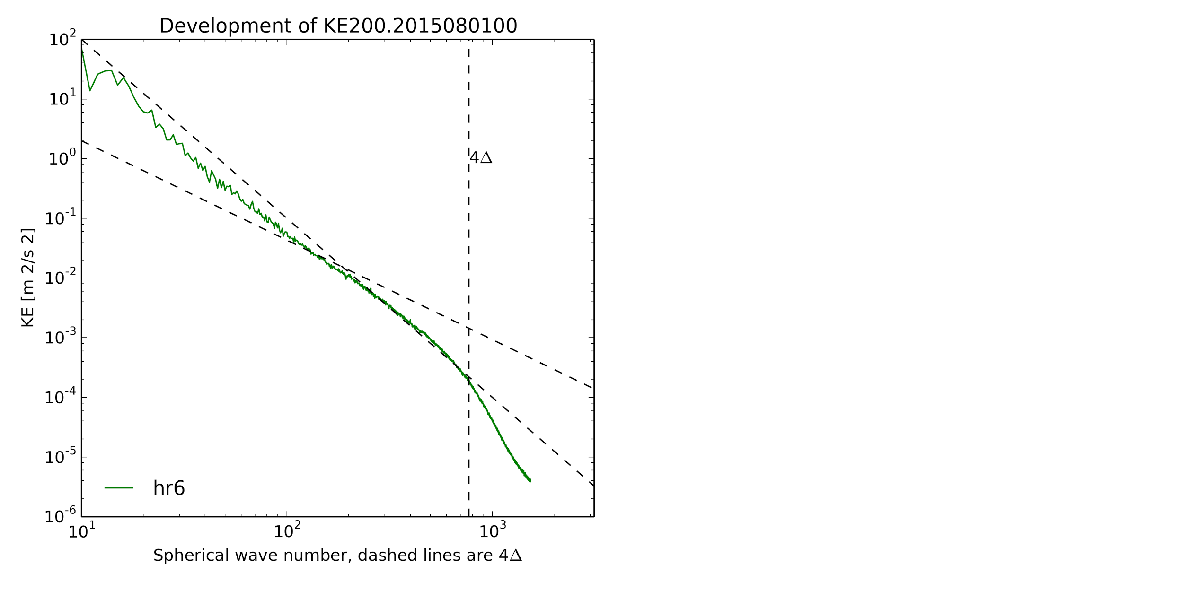
KE200 SPC development with time
ICs do not contain enough small scales due to smoothing

Slide 17
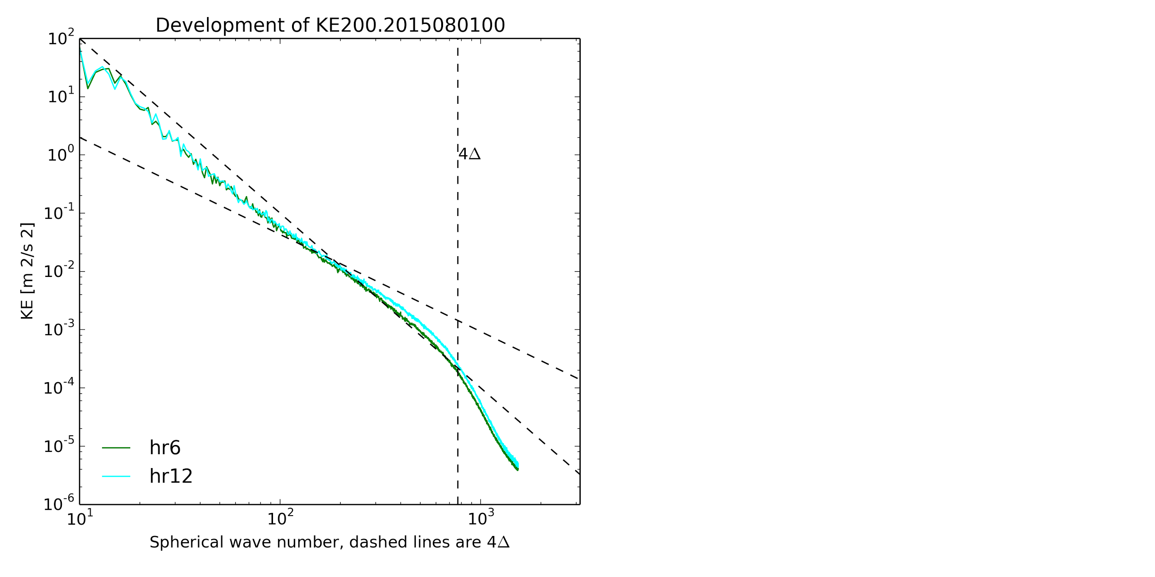
KE200 SPC development with time
The “Growth” of the SPC
dyn-core develops the small-scaled features

Slide 18
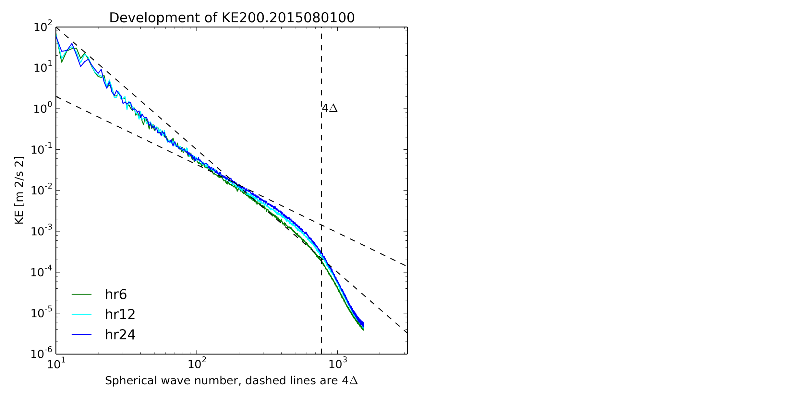
KE200 SPC development with time
Approaching to a stable status
Not an indefinite “growth”!!

Slide 19
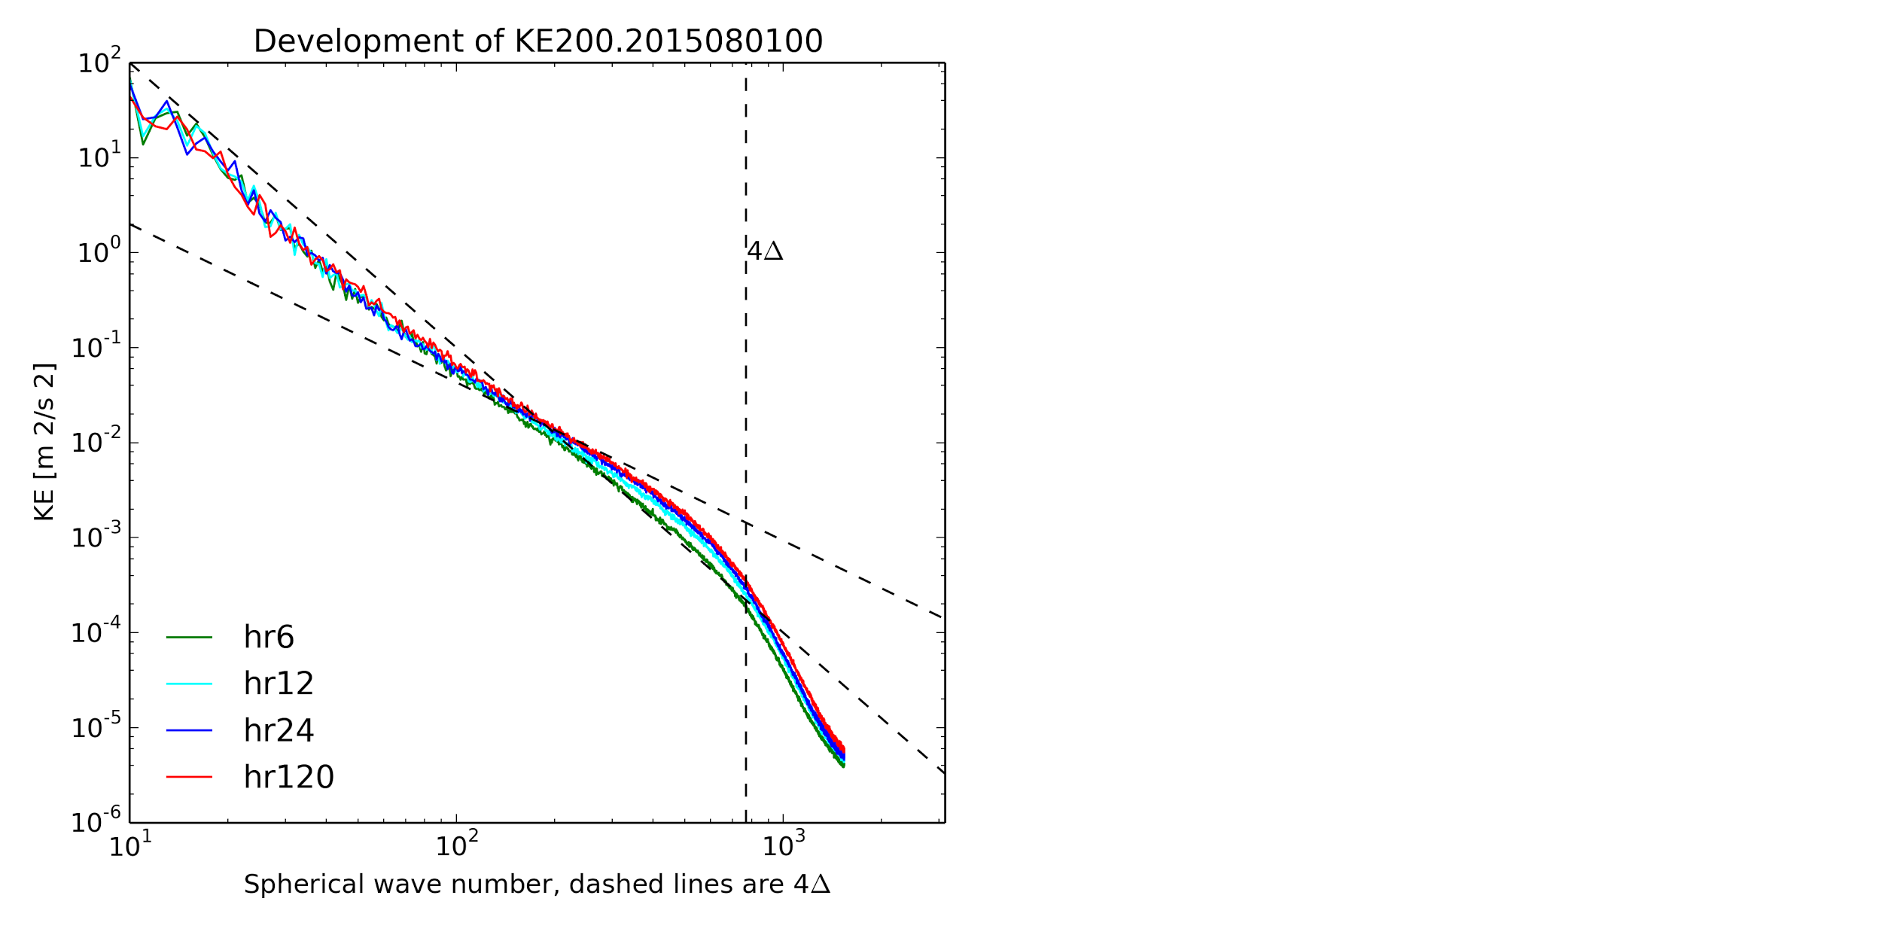
KE200 SPC development with time
The dyn-core need more than 6 hours to get fully “spinned-up”.
The stable status is developed within the first 24 hours.
Numerical noise is usually of wavelengths smaller than 4Δ and gets damped out rapidly.

