Slide 1
Setting Up and Running an FV3 Nest
Jim Abeles Tom Black
NOAA/NWS/NCEP/EMC
20 July 2017
Thanks to Lucas Harris, Shannon Rees, and Rusty Benson
Version 1.0
xxxx

Slide 2
Fundamental Procedure
There are two basic steps needed to generate a nested forecast.
➤
Preprocessing: Produce the grid, orography and initial conditions.
➤
Integration: Execute the FV3 forecast model.
Detailed instructions for setting up and running an FV3 forecast with a nest on WCOSS and theia
are available in google docs.
https://docs.google.com/a/noaa.gov/document/d/1o7OIk7UhgmpgjbkvcYUiLiTUcudmoAderFHr10jHVhM/edit?usp=sharing

Slide 3
Preprocessing for the Grid and Orography: Grid Driver
The following parameters must be set by the user.
stretch_fac - stretching factor for the cube
target_lon - central longitude of the nest’s center
target_lat - central latitude of the nest’s center
refine_ratio - ratio of parent grid increment to nest’s
istart_nest - location of nest’s starting i index on the parent’s supergrid
jstart_nest - location of nest’s starting j index on the parent’s supergrid
iend_nest - location of nest’s ending i index on the parent’s supergrid
jend_nest - location of nest’s ending j index on the parent’s supergrid

Slide 4
Nest Extent on Parent Grid
parent supergrid cell 24
i
iend_nest=24
23
22
istart_nest=21
X
X
X
X
X
X
X
nest cell
corners
nest
parent compute grid cell 12
grid
cell 1
full extent of nest in i
npx = (iend_nest - istart_nest + 1 ) * refine_ratio /2 +1 = (24 - 21 + 1 ) * 3 /2 + 1 = 7
= number of nest grid cell corners in i

Slide 5
Output from the grid driver:
Grid details for the six faces of the cube plus the nest.
Orography data for each face and the nest.

Slide 6
Preprocessing for the ICs: Chgres Driver
Copy the prepared script and set key parameters for your forecast including:
gtype = nest
machine = WCOSS, WCOSS_C, or THEIA
CASE = C768
CDATE = yyyymmddhh
Execution of the script will generate sfc_data and gfs_data files for each face of the cube and the nest.

Slide 7
Run a Forecast
Populate your working directory with all necessary input files.
Set appropriate namelist values including:
MPI task layout
x and y dimensions + 1
grid refinement (parent-to-nest grid increment ratio)
ioffset - starting i of nest on parent compute grid
joffset - starting j of nest on parent compute grid
Build the NEMS FV3 executable.
Copy, edit, submit runscript.

Slide 8
Location of Nest on a Cube Face
istart_nest
(parent supergrid)
(1,1)
joffset
jstart_nest
(parent
(parent supergrid)
ioffset, joffset
compute
grid)
are specified by the user in the nest namelist file in the forecast’s working directory.
(1,1)
ioffset
(parent
compute
grid)
Nest
Cube Face
ioffset = ( istart_nest -1 ) /2 +1
joffset = ( jstart_nest -1 ) /2 +1

Slide 9
Test Forecast Run Specs for a 3 km Nest
C768 grid increments
Tile 6: ~9 km
stretch factor=1.5
Nest: ~3 km
refinement=3
Domains
Parent: 768 x 768 x 6 = 3538944 pts ; dyn timestep = 12.857 sec
Nest: 1729 x 1441 = 2491489 pts ; dyn timestep = 4.5 sec
Work ratio
⟹
( Nest pts / Parent pts ) x ( Parent dt / Nest dt ) = 2.0
Nested run resources - 144 nodes / 2 threads
Parent: 48 nodes (576 MPI tasks)
Nest: 96 nodes (1152 MPI tasks)
NAM 3 km CONUS nest is larger than this FV3 nest.

Slide 10
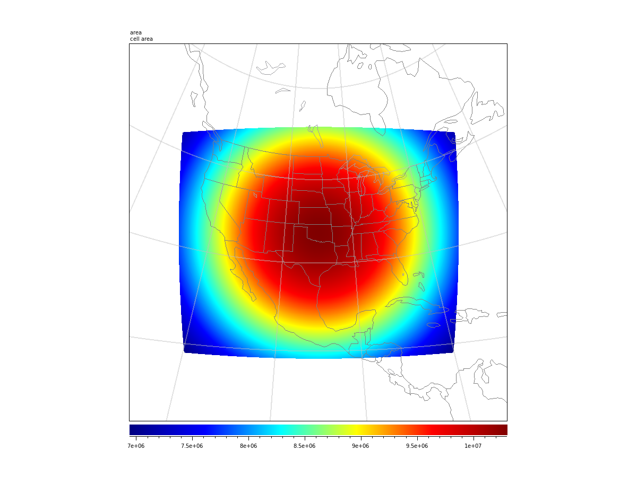
3 km Nest Domain
Cell Area

Slide 11
Forecast Run Times - 48 hr forecast
WCOSS Cray
Parent with nest: 44.8 min
with output
Parent without nest: 34.5 min
Parent with nest: 35.7 min
without output
Parent without nest: 29.5 min
Theia
Parent with nest: 57.6 min
with output
Parent without nest: 35.5 min
Parent with nest: 44.3 min
without output
Parent without nest: 32.6 min
NOTE: C768 runs with a 3 km nest do not work on theia at this time.

Slide 12
Sample Fields
48 hour forecast
from 00Z 01 March 2017

Slide 13
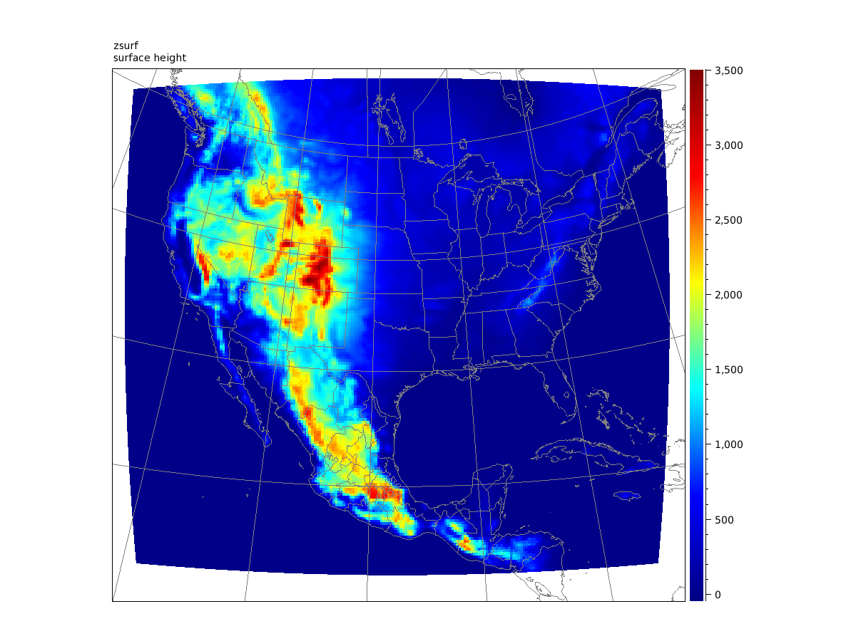
Surface Elevation - C96 Nest (~25 km)
meters

Slide 14
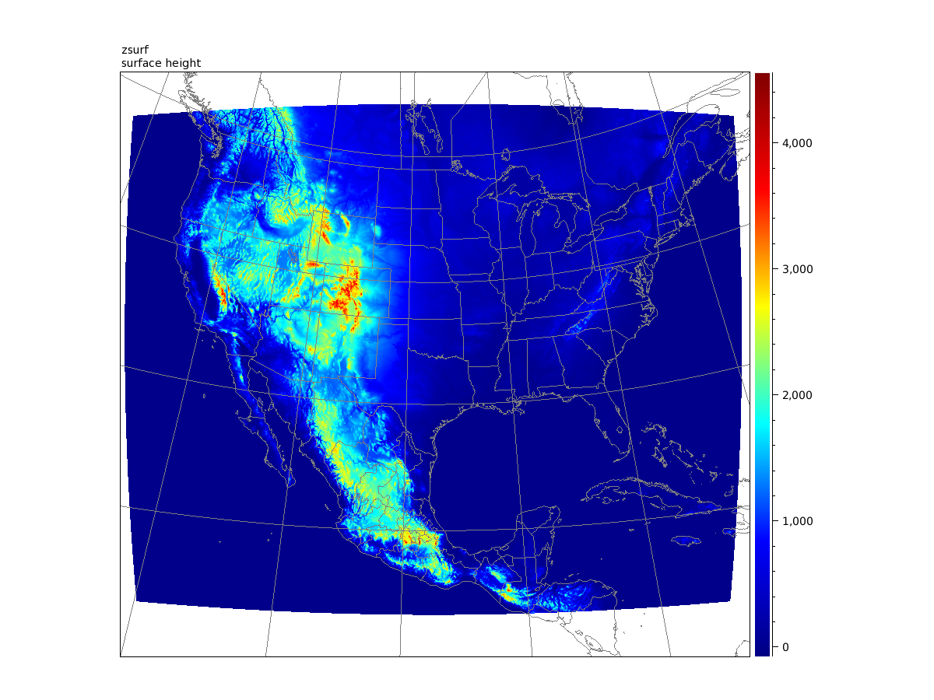
Surface Elevation - C768 Nest (~3 km)
meters

Slide 15
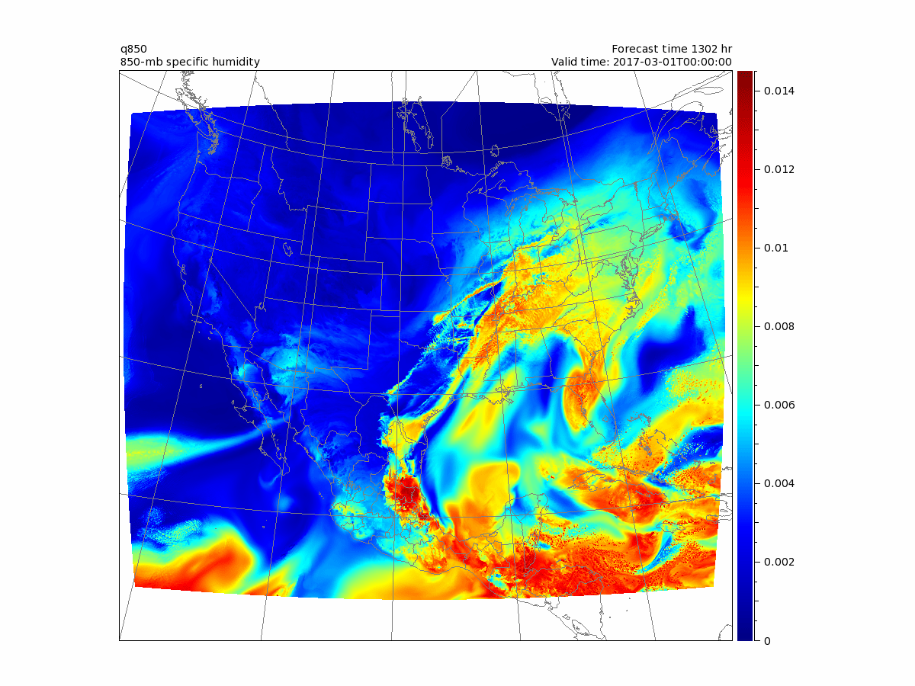
850 mb Specific Humidity - 6 hours
kg / kg

Slide 16
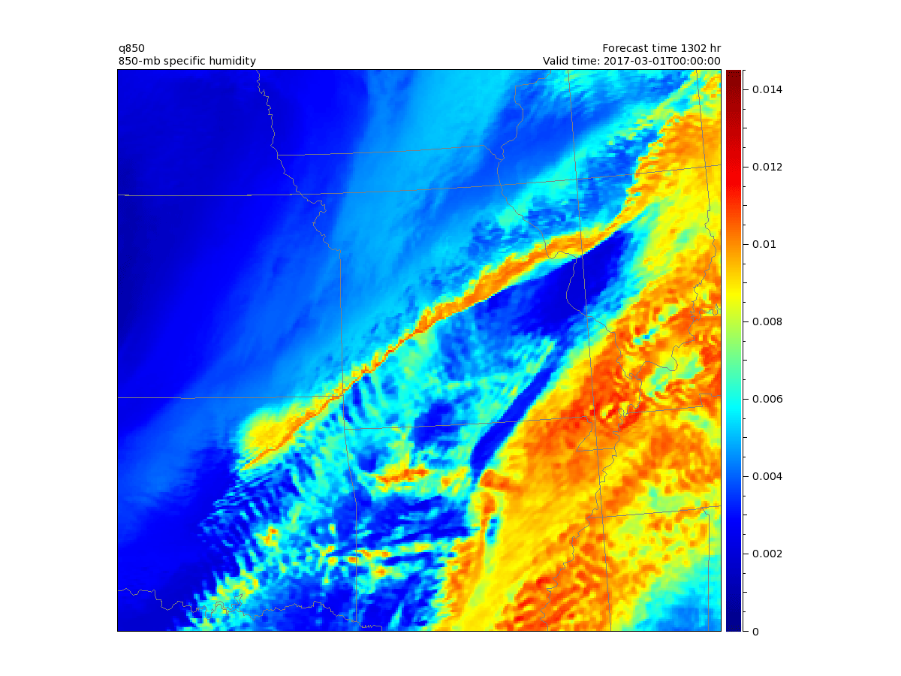
850 mb Specific Humidity - 6 hours
Zoom
kg / kg

Slide 17
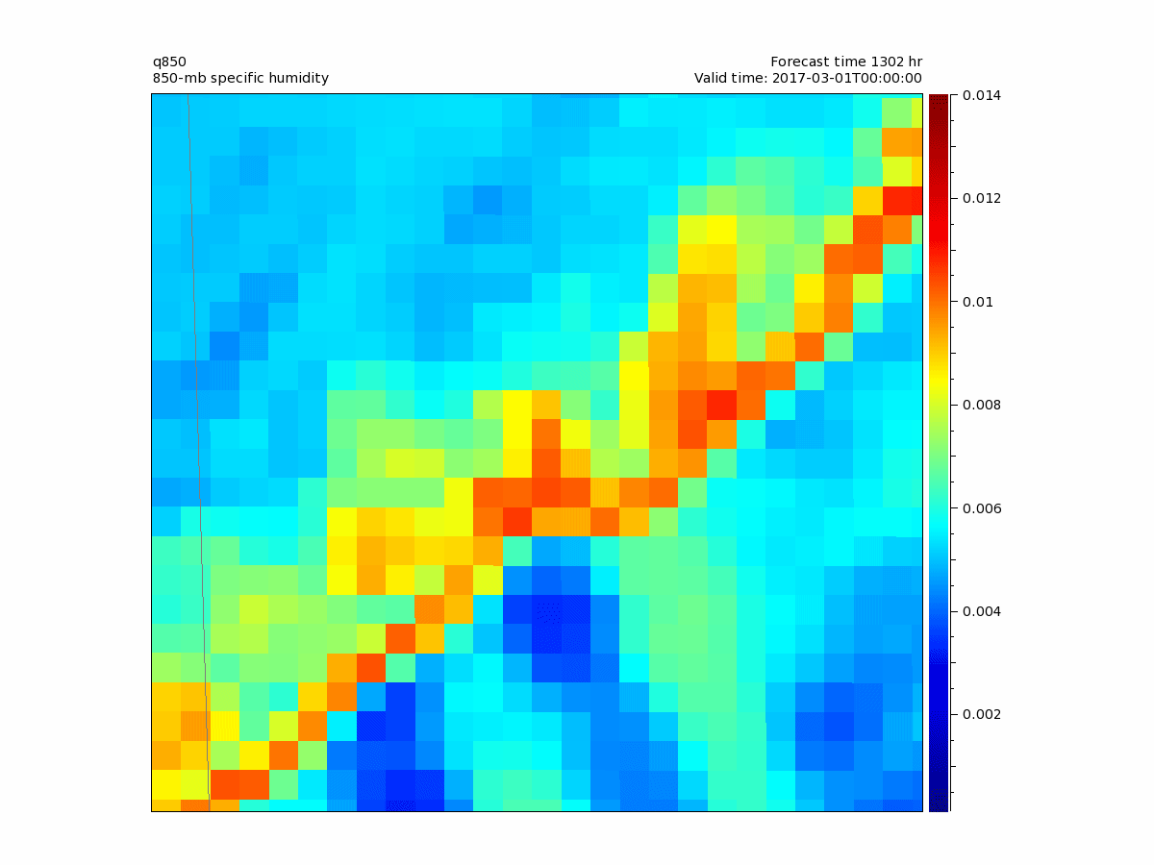
850 mb Specific Humidity - 6 hours
Deep Zoom
kg / kg

Slide 18
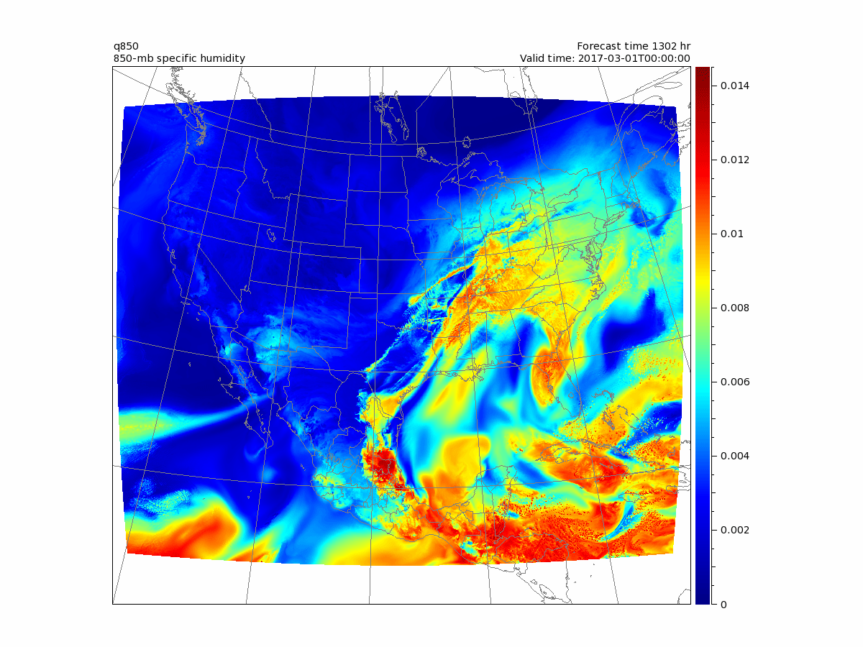
850 mb Specific Humidity - 6 through 48 hours
kg / kg

Slide 19
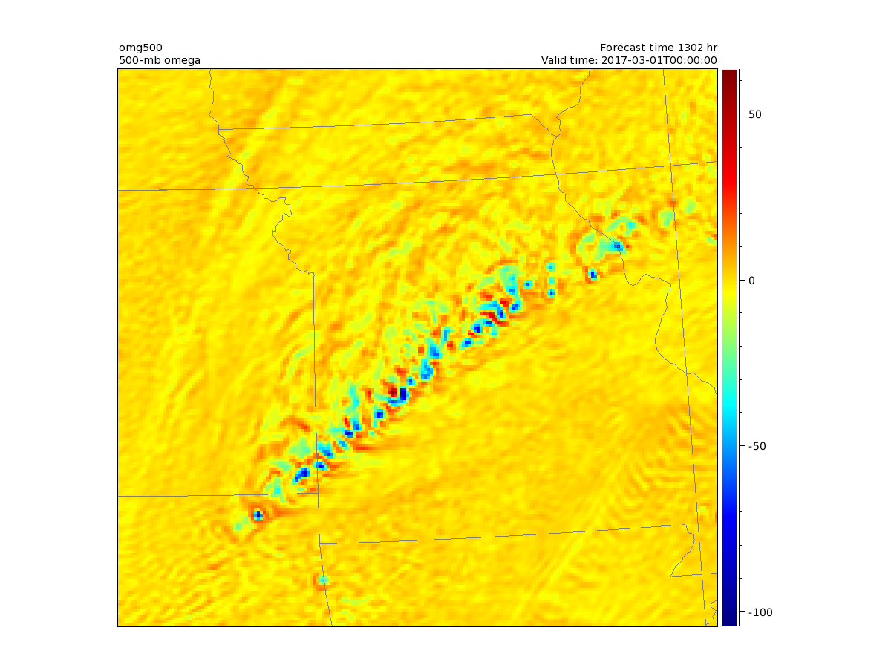
500 mb Omega - 6 hours
Zoom

Slide 20
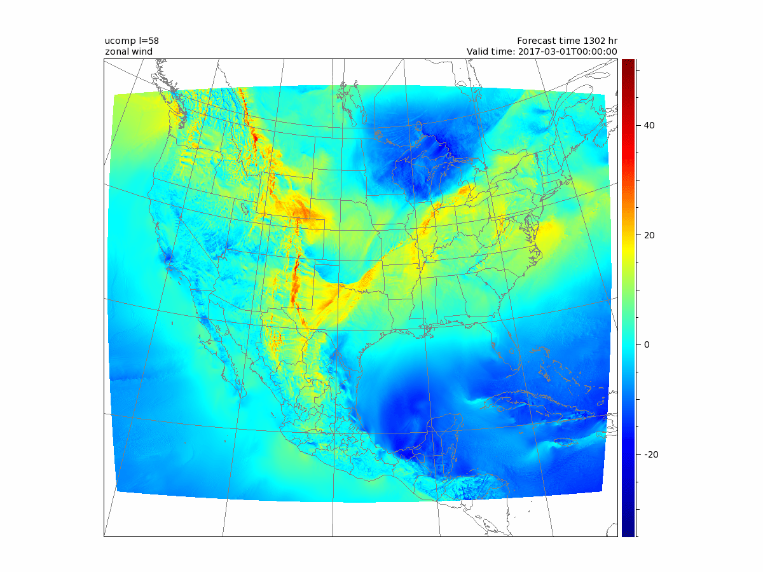
Layer 58 U component - 6 through 48 hours
m / s

Slide 21
Select a Nest Using the fv3grid Tool

