Slide 1
fregrid
post-processing
NEMS FV3GFS Community Modeling System Training and Tutorial:
Planning and Preparation Meeting
19-20 July, 2017

Slide 2
fregrid
Remaps scalar data from native grid to target grid
Interpolation algorithms available:
conserve_order1¹ (default)
conserve_order2^{1,2}
bilinear
Can create reusable weight files for common re-mappings between two grid representations
Source can be built two ways:
OpenMP capable
hybrid MPI-OpenMP capable
¹ conservation requires cell areas in the presence of land-sea masked quantities
² smoother results, but overshoots may result in negatives in quantities with near-zero values

Slide 3
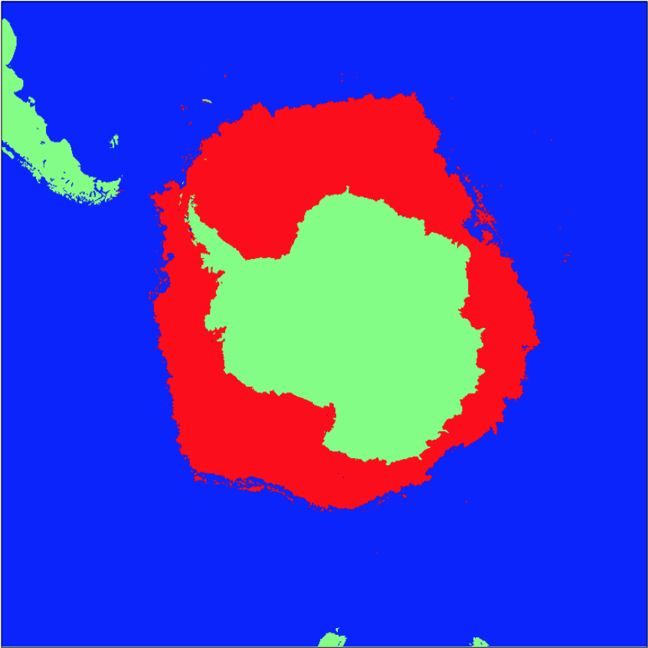
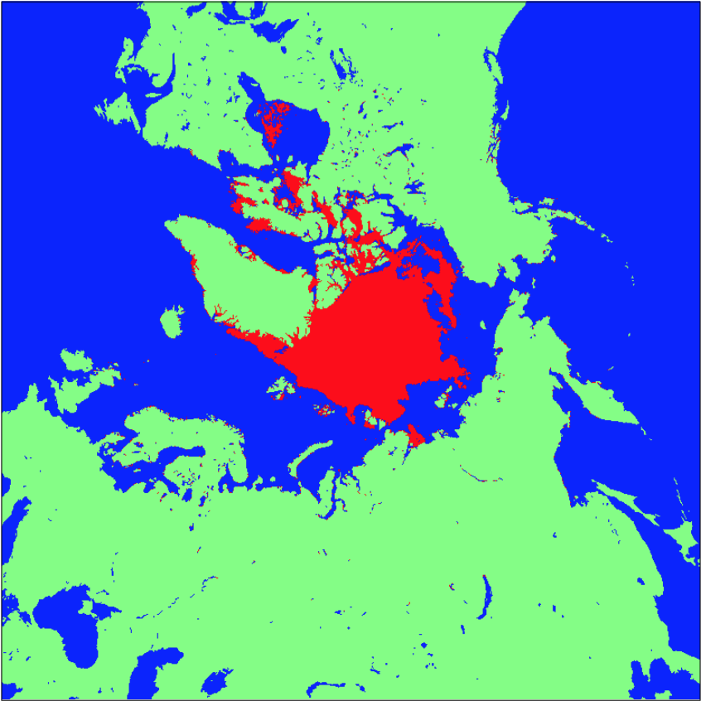
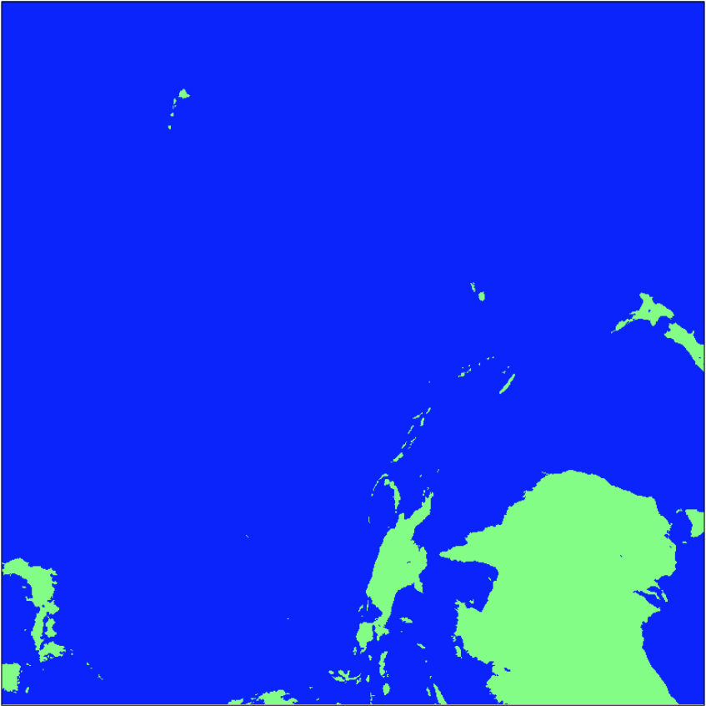
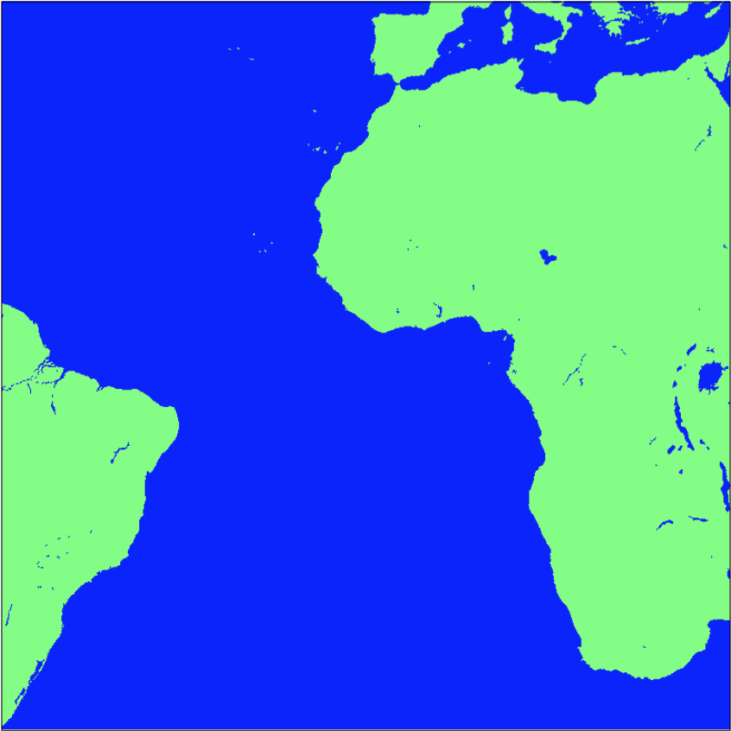
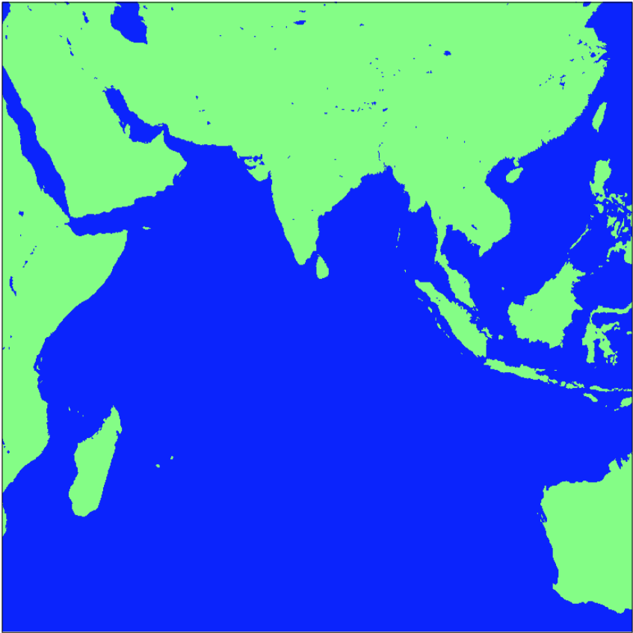

Slide 4
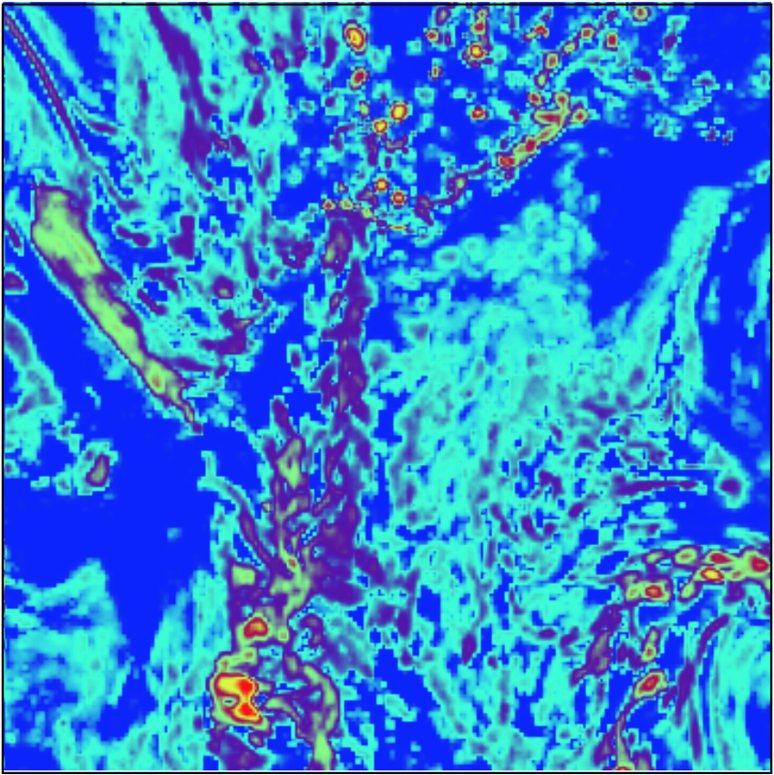
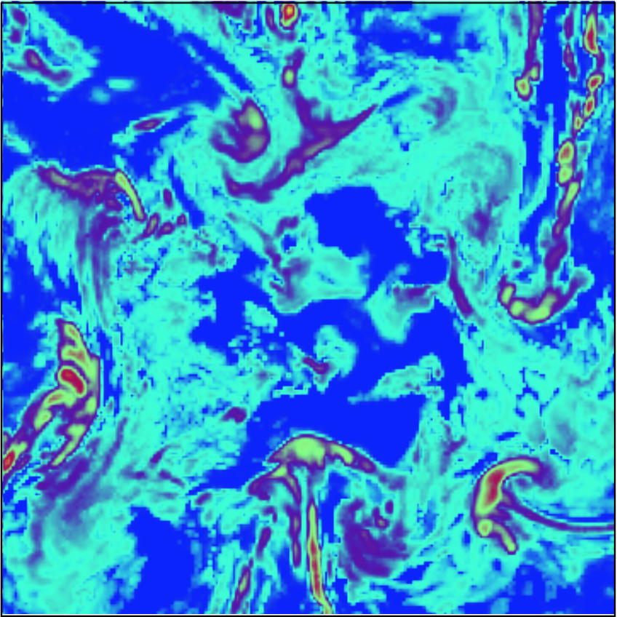
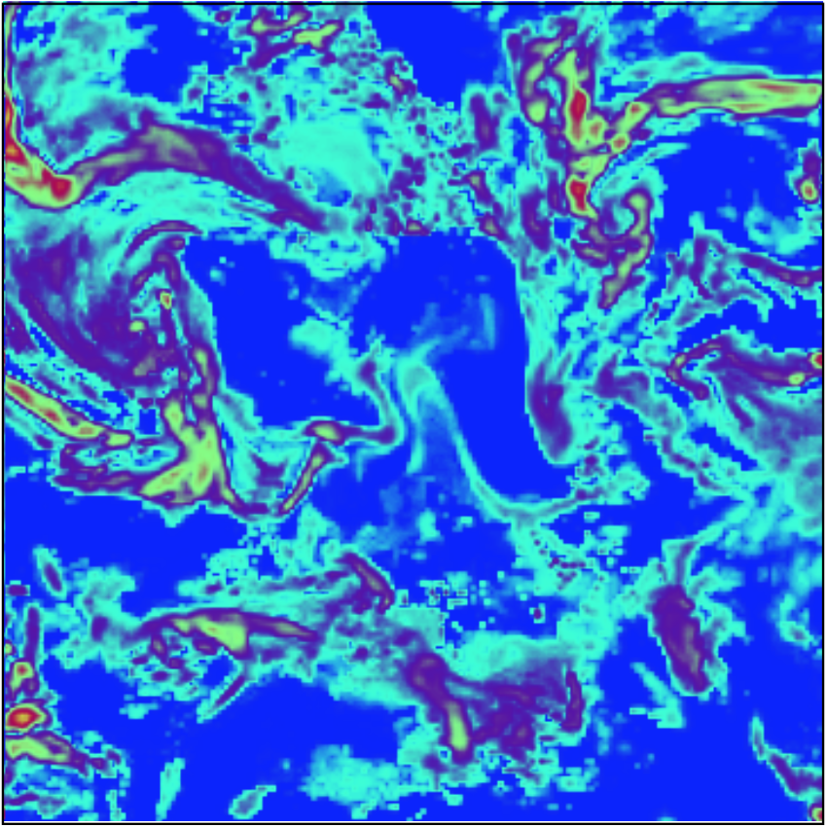
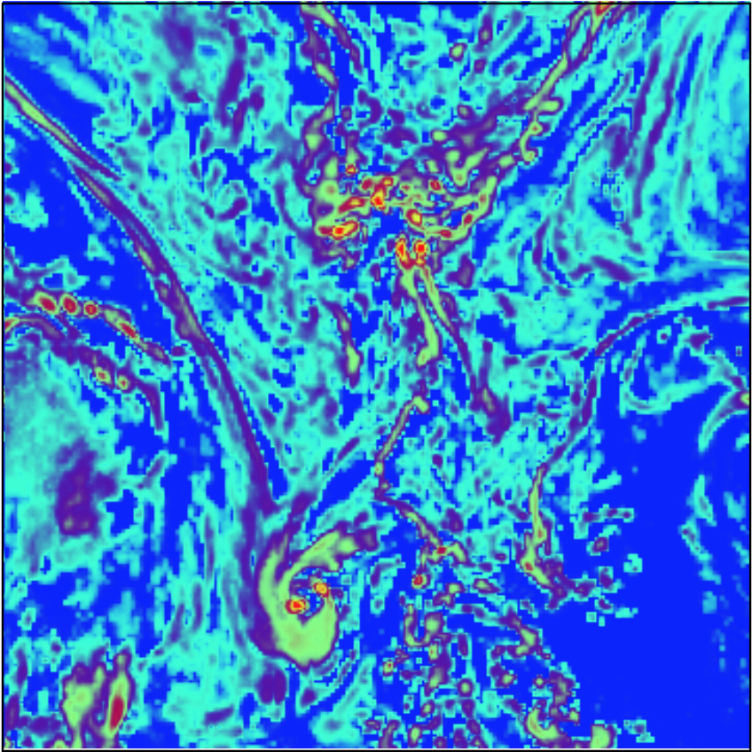
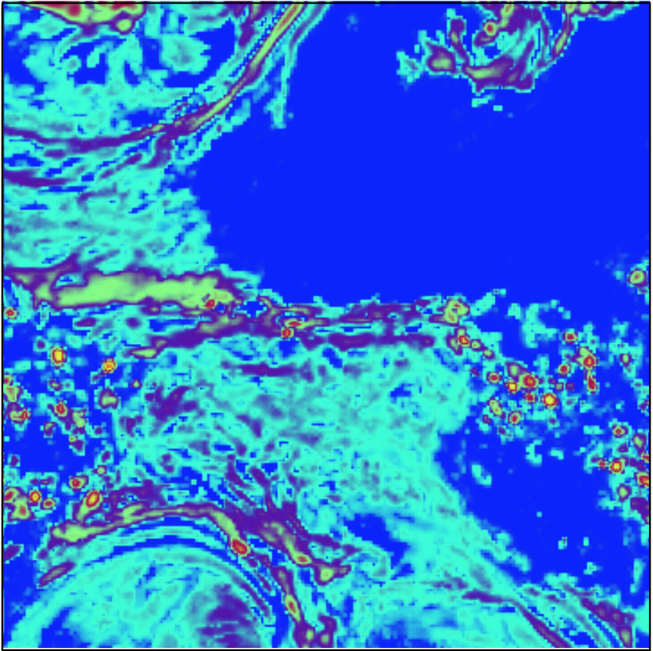
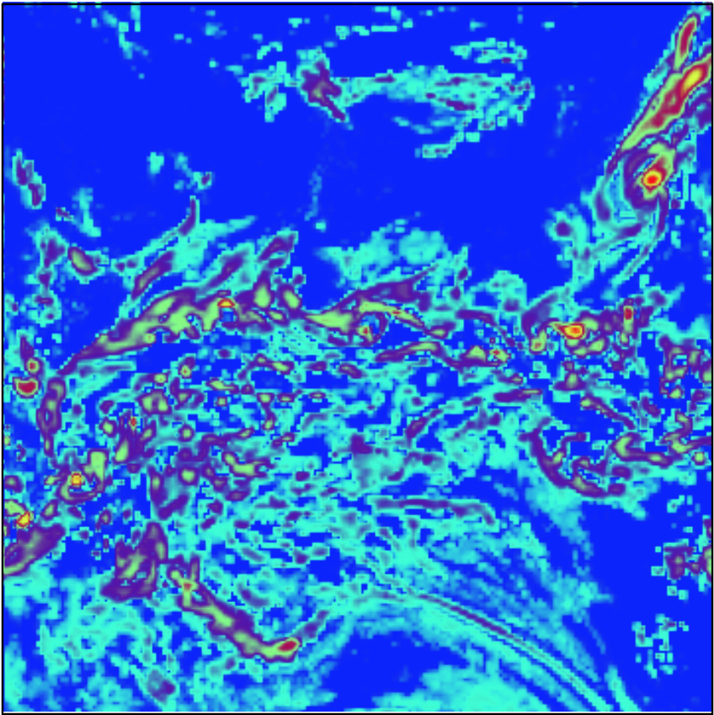
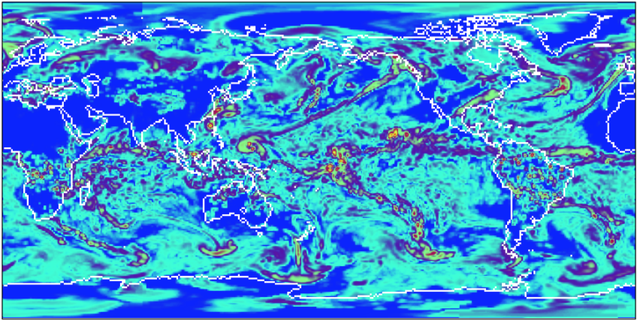
Re-gridding
Total precipitation rate (kg/m2/s)

Slide 5
ESMF_regrid
Engaged with ESMF team to match fregrid capabilities
read GRIDSPEC Mosaic files using existing ESMF API (prerequisite for reading weights into ESMF_Regrid)
input field and grid data from separate files
output interpolated data into separate data files
input pre-computed weights from a file
translate NetCDF attributes into ESMF attributes
add stream of operations, with timestamp, as global attributes
remap to lat-lon representation via command line options
support for operations on fields defined by attributes (cell_methods, cell_measures, etc)
support for additional interpolation algorithms

