Slide 1



FMS Superstructure Layer
NEMS FV3GFS Community Modeling System Training and Tutorial:
Planning and Preparation Meeting
19-20 July, 2017

Slide 2
What is FMS
FMS Superstructure
Coupler Layer
User Code
Model Component Layer
FMS Infrastructure
Abstraction Layer
Machine Layer
Flexible Modeling System effort began in 1998, with GFDL’s first distributed memory machine
Superstructure design allows the building of multiple models
Supports multiple dynamical cores, components (ocean, ice, land, etc) and atmospheric physics packages
Infrastructure comprised of common utilities needed by model components

Slide 3
Superstructure Layer
Consists of:
System driver performs init, integrate, and end phases
By default, all models run as ensembles
Abstracted types hold fluxes and properties to be exchanged between model components
Component drivers provide unified interfaces between system driver and user code
    system driver
    flux exchange
    ensemble manager
    component drivers

Slide 4
System Driver
Template-based driver allows for agile transformations as coupling science evolves
Static interfaces ensure support for component drivers
Components can be prognostic, data, or null
Hybrid MPI-OpenMP with support for nested OpenMP
Dynamic OpenMP under certain conditions
Process placement handled explicitly
understands multiple levels of Hyper-Threading
Highest level of coupling broken up into “ATM” and “OCN” segments that can run serially or concurrently

Slide 5
Concurrent Coupling/Serial Radiation
ATM Pelist
OCN Pelist
Atmos Dynamics
Ocean
Atmos Radiation
Atmos Down
fast loop
Land fast
Ice fast
Atmos Up
Update State
Land slow
Ice slow
OpenMP capable
MPI rank

Slide 6
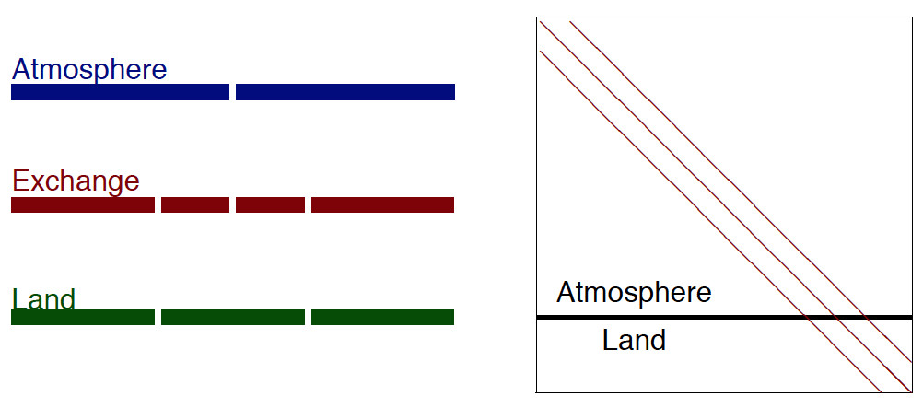
Fast Process Coupling
Implicit coupling between tightly coupled components
Tridiagonal solver across multiple components and grids

Slide 7
Concurrent Coupling & Radiation
ATM Pelist
OCN Pelist
Atmos Dynamics
Atmos
Radiation
Ocean
Atmos Down
Land fast
fast loop
Ice fast
Atmos Up
Update State
Land slow
Ice slow
OpenMP capable
MPI rank

Slide 8
Component Driver
Like System Driver, template-based to allow for agile transformations
Static interfaces ensures direct support for multiple component subtypes
dycore: FV3, FV-LL, B-grid, Zetac
physics: AM2, AM3, HiRAM, AM4
land: LM2, LM3, LM4
ice: CICE, SIS, SIS2
ocean: GOLD, MOM5, MOM6
Derived types hold flux data for exchange

Slide 9
Flux Exchange
Used for data exchange between models. Key features include:
Conservation: required for long runs
Resolution: imposes no constraints on component model timesteps and spatial grid. Supports both explicit and implicit timestepping
Exchange grid: union of component model grids, where detailed flux computations are performed (Monin-Obukhov, tridiagonal solver for implicit diffusion, ...)
Fully parallel: Calls are entirely processor-local: exchange software will perform all inter-processor communication
Highly efficient: currently able to couple atmos/ocean explicitly at each ocean timestep, atmos/land/ice implicitly at each fast timestep

Slide 10
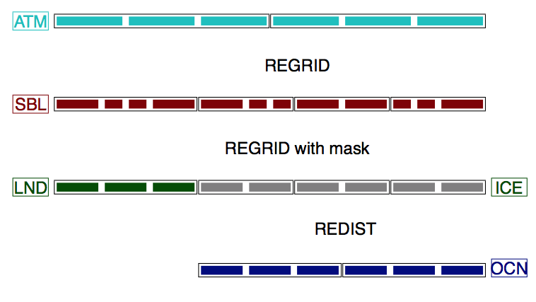
Exchange Grid

Slide 11
Exchange Grid
Each cell on exchange grid “belongs” to one cell on each parent grid
Conservative interpolation up to second order
All calls exchange local data
data-sharing among processors is internal to the exchange software, and non-blocking
Physically identical grids (e.g ocean and sea ice) exchange data without interpolation
Exchange grid is computed and stored offline

