Slide 1
Physics Packages Available Under the Inter Operable Physics Driver (IPDv4) in NEMS/FV3GFS Ruiyu Sun, Shrinivas Moorthi, Yu-tai Hou
NEMS FV3GFS Community Modeling System Training and Tutorial: Planning and Preparation Meeting
19-20 July @GFDL Rm 217

Slide 2
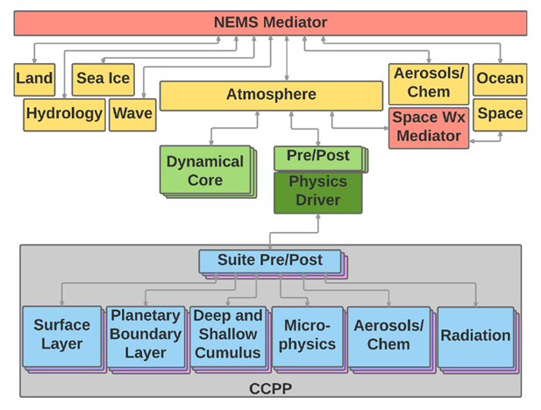
Schematic of NEMS FV3GFS

Slide 3
Lower Boundary – Land Surface
Although the Land Model is being developed as an external component coupled through the mediator, so long as it shares the horizontal grid with the atmosphere, a column version might be available in the physics driver
Externally coupled Land Model could be beneficial when land and atmospheric grids are different.

Slide 4
Planned Land Surface Upgrades in FV3GFS
Upgrade the current Noah LSM v3.0 to Noah MP which includes multilayer snow model and seasonal variation of LAI and roughness length.
Incorporate freshwater lake "Flake" model to NEMS
Update some LSC (land surface characteristic) dataset such as near realtime GVF from NESDIS

Slide 5
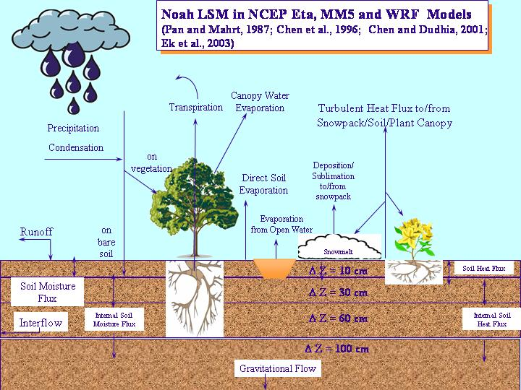
New Generation Noah-MP Community Land Model
VEGETATION:
Leaf area index (prescribed; predicted)
Soil moisture stress factor for transpiration (Noah; SSiB; CLM)
Canopy stomatal resistance (Jarvis; Ball-Berry)
Biogeochemical Advances, e.g. nitrogen (in addition to carbon)
Plant growth/Crop modeling
CANOPY:
Radiation transfer (explicit vegetation canopy):
Modified 2-stream: Gap = F(3D structure; solar zenith angle) ≤ 1-GVF
Two-stream applied to the entire grid cell: Gap = 0
Two-stream applied to fractional vegetated area: Gap = 1-GVF
SNOW:
Snow surface albedo (BATS; CLASS)
Frozen soil permeability (Noah; Niu and Yang, 2006) (3-layers)
Supercooled liquid water (Noah; Niu and Yang, 2006)
RUNOFF AND GROUNDWATER:
TOPMODEL with groundwater
TOPMODEL with equilibrium water table (Chen&Kumar, 2001)
Original Noah scheme
BATS surface runoff and free drainage
OTHER:
Partitioning of precipitation to snowfall & rainfall (CLM; Noah)
Turbulent transfer (Noah; NCAR LSM)
More to be added!
Collaborators: Yang, Niu (UAriz), Chen, Barlage et al (NCAR), Ek et al (NCEP/NOAA), and others.
Niu et al. (2011)

Slide 6
Lakes
Thousands of lakes on scale of 1-4km not resolved by SST analysis -> greatly influence surface fluxes; explicit vs subgrid.
Freshwater lake “FLake” model (Dmitrii Mironov, DWD).
Two-layer.
Atmospheric forcing inputs.
Temperature & energy budget.
Mixed-layer and thermocline.
Snow-ice module
Specified depth/turbidity.
Used in COSMO, HIRLAM, NAM (regional), and global ECMWF, CMC, UKMO.
Yihua Wu, NCEP/EMC

Slide 7
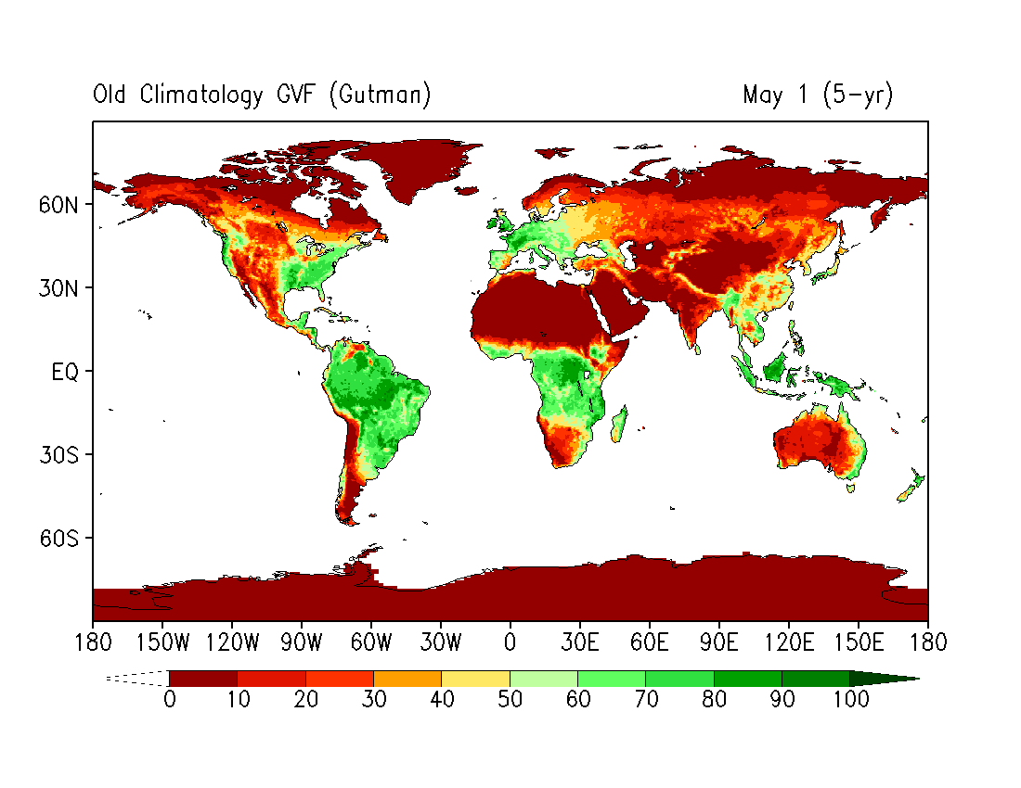
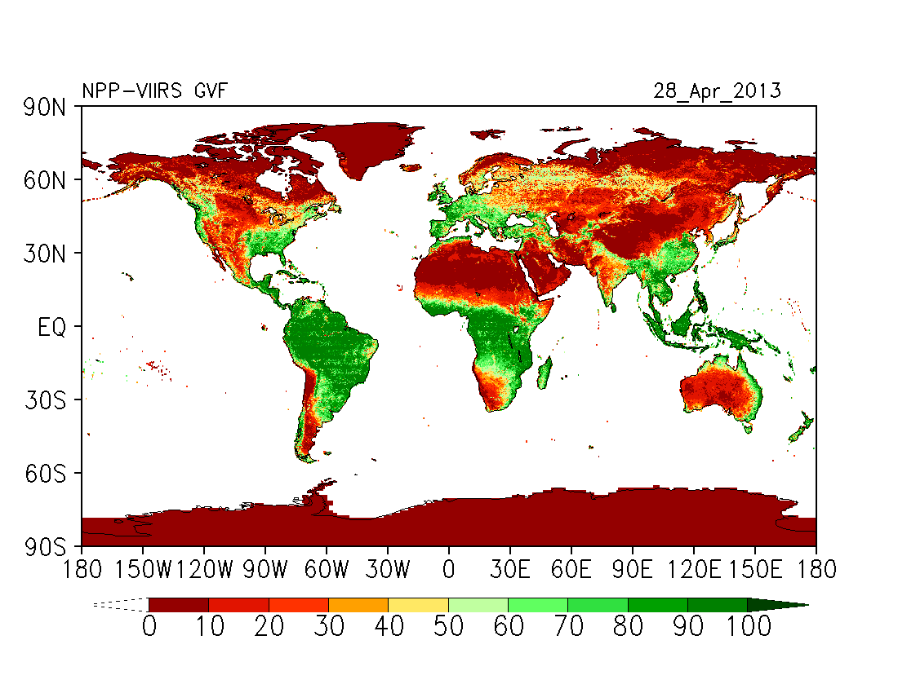
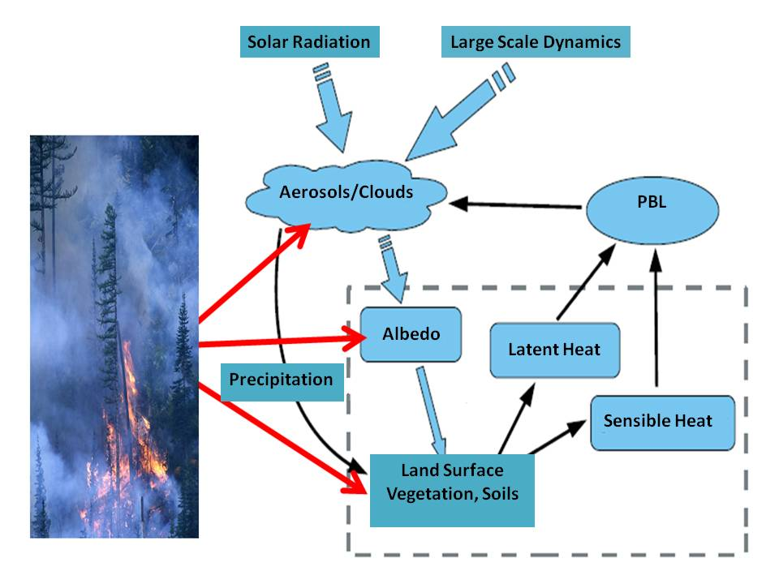
Land Data Sets: Green Vegetation Fraction (GVF)
• Use of near real-time (remotely-sensed) GVF leads to better partition between surface heating & evaporation --> impacts surface energy budget, ABL evolution, clouds/convection.
AVHRR 5-YR
Climatology
VIIRS near-
realtime

Slide 8
Boundary Layer and Shallow Convection

Slide 9
Scale-aware TKE-based Moist Eddy-Diffusivity Mass-Flux (EDMF) Parameterization for Convective Boundary Layer and Stratocumulus-top-driven Turbulence Mixing - Jongil Han and Chris Bretherton
A new TKE-based moist eddy-diffusivity mass-flux (EDMF) planetary boundary layer (PBL) scheme with a scale-aware parameterization for sub-kilometer resolution where the non-local mass flux decreases with increasing grid resolution.
Single column model (SCM) test results show that compared to the large-eddy simulation (LES) results, the new scheme well simulates daytime well-mixed PBL and marine stratocumulus-topped boundary layer.
In medium-range forecast experiments with NEMS/GSM, the new scheme shows a significant improvement in the 500mb height anomaly correlations while showing neutral impact on the continental US precipitation forecast skill.
Currently being ported to NEMS/FV3 through IPDv4

Slide 10
Single Column Model Test Results
Convective boundary layer
Stratocumulus-topped Boundary Layer

Slide 11
Simplified High Order Closure (SHOC) A Community based R2O project through CPO/CTB/CPT Belochitski, Moorthi, Krueger, Bogenshutz, Thakur
Unified treatment of turbulence, shallow convection, sub-grid scale condensation and cloud fraction
SHOC is a 1.5-order turbulence closure with novel representations of eddy length scale for clear and cloudy grid boxes, which allows for an improved representation of SGS TKE.
Higher moments are closed by using a joint PDF of SGS vertical velocity, total water, and moist static energy. The latter allows for coupling subgrid interactions of vertical motions and buoyancy.
For most cloud regimes, the joint PDF can be shown to be a trivariate double Gaussian (e.g Larson et al (2002), Bogenschutz et al. (2010)), where the first Gaussian can be thought of as representing cloud-free environment, and the second - the cloud.
After some simplifying assumptions, 10 moments (3 means, which are prognosed, and 7 higher order moments, which are diagnosed using prognostic SGS TKE following Redelsperger and Sommeria (1986), Bechtold et al. (1992), and Canuto et al. (2001)) are sufficient to select a particular PDF member from the assumed functional form.
The selected PDF is used to compute other higher order terms that have to be closed, e.g. buoyancy flux, cloud fraction, subgrid condensation.

Slide 12
Status of SHOC in NCEP Global Models
SHOC is now in NEMS/GSM as well as NEMS/FV3 (via IPDv4)
Turbulent diffusion coefficients computed by SHOC via predicted SGS TKE are now used in place of current boundary layer and shallow convection parameterizations
SHOC provided condensation is used in microphysics
Unlike the current operational model, radiation now uses SHOC estimated cloud fraction
Currently, SHOC overestimates upper tropospheric tropical cloudiness because it diagnoses unrealistically narrow subgrid-scale PDF distributions of total cloud water where it is detrained from deep convection, as compared to those produced in high-resolution (100 m grid size) LES simulations of tropical deep convection.
To alleviate this issue, we are currently in the process of implementing a prognostic representation of variances of total water and moist static energy following approach of Golaz et al (2002) with an addition of a source of variance due to detrainment from deep convection following Klein et al (2005).

Slide 13
Deep (and Shallow) Convection in IPD4

Slide 14
Updates in the NCEP GFS Cumulus Convection Schemes with Scale and Aerosol Awareness Jongil Han, Weiguo Wang, Young C. Kwon, Song-You Hong, Vijay Tallapragada, and Fanglin Yang
The current operational GFS deep and shallow cumulus convection schemes have been updated with scale-aware parameterization based on Arakawa & Wu (2013) and Grell & Freitas (2014).
A aerosol-aware parameterization is included, based on Lim & Hong (2012), where rain conversion and cloud condensate detrainment in the convective updraft are a function of CCN number concentration.
The cloud base mass-flux computation in the deep convection scheme has been modified to use convective turn-over time as cumulus time scale.
Rain conversion rate is modified to decrease with decreasing air temperature above the freezing level.
Convective inhibition (CIN) in the sub-cloud layer is also used for trigger condition.
Convective cloudiness (for radiation) is enhanced by considering suspended cloud condensate in the updraft.
The updated GFS (GSM) cumulus convection scheme shows significant improvement especially in the CONUS precipitation forecasts.
Currently this scheme is being installed in NEMS/FV3/IPDv4

Slide 15
Chikira-Sugiyama Convection with Arakawa-Wu Extension (CSAW) A community R2O project via CPO/CTB/CPT Chikira, Randall, Dazlich, Moorthi, Cheng
Based on Chikira-Sugiyama (2010) and Arakawa-Wu(2013)
A Generalization of the Unified parameterization – Chikira, Randall and Dazlich (CSU)
“What matters in generalizing the conventional cumulus parameterization is the dependence on the fractional convective cloudiness, not directly on the grid spacing” - Arakawa and Wu (2013)
CSAW follows the above in applying unified parameterization to CS (i.e. the updraft fraction is not directly determined by grid spacing).

Slide 16
CSAW in IPDv4
Based on entraining plume model
Spectral representation of updraft ensemble – cloud types represented by cloud base updraft velocity
Entrainment rate changes vertically depending on buoyancy and vertical velocity (Gregory, 2001).
Cloud base mass flux determined using prognostic Arakawa-Schubert approach (Pan and Randall, 1998).
Generalized unified parameterization – convective contributions through eddy flux convergence and local condensation/evaporation
Downdraft in CSAW is very simple (non-spectral)
CSAW has been tested with NEMS/FV3 at C96L127, C384L127, C768L127

Slide 17
Other Convection Options
RAS Version 2, with Cheng and Arakawa downdraft (unsaturated) is also available in IPDv4
Grell-Freitas scheme will be added probably by GMTB via CCPP (GMTB has tested a version with NEMS/GSM)

Slide 18
Microphysics Schemes and Radiation

Slide 19
Available MP options
 | Ferrier &Aligo | GFDL MP | WSM6 | MG (double) (from GMAO) | Thompson (double) 2008/2014
prognositic variables | qv, qc, qr, qi+qs+qg, RF1/2 | qv, ql, qi, qs, qr, qg | qv, ql, qi, qs, qr, qg | qv, ql, ,nl, qi, ni (qr, nr, qs, ns) Aerosol aware | qv, ql, qi, qs, qr, qg, ni, nr (2008) + nc, nwfa, nifa (2014 aerosol-aware)
condensation and evaporation | Asai (1965) | Lord et al ( 1984) and Tao (1989) | Yau and Austin (1997) | MG2008, MG2015, Barahona et al 2014 SHOC 2013 | Yau and Austin (1997), Thompson and Eidhammer(2014)
mixed-phase clouds | yes | yes | yes | yes | yes
precipitation sedimentation | qi, qr, qs, qg sediment vertically | qi,qr,qs,gq sediment verically | qi, qr, qs,qg sediment vertically | qc and qi sediment vertically (testing prognostic qr and qs) | qi, qr, qs, qg sediment vertically

Slide 20
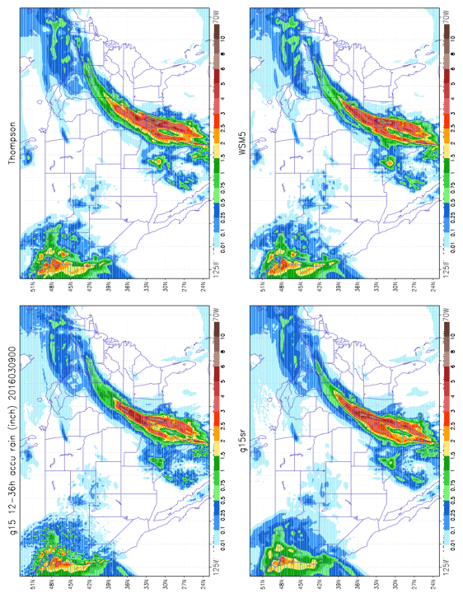
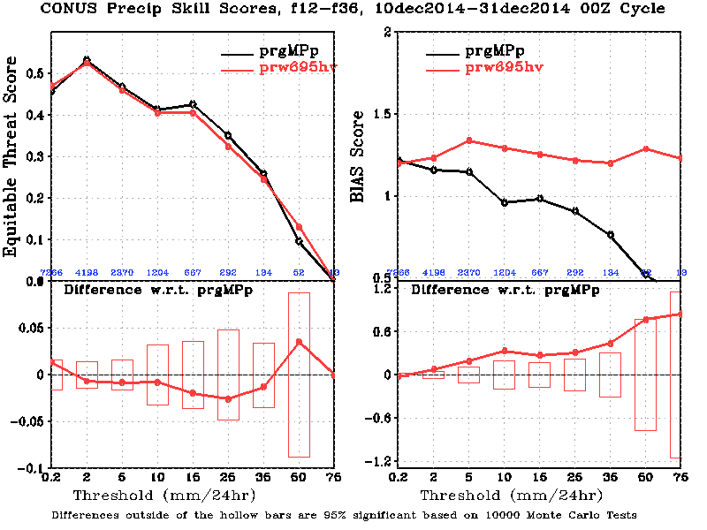
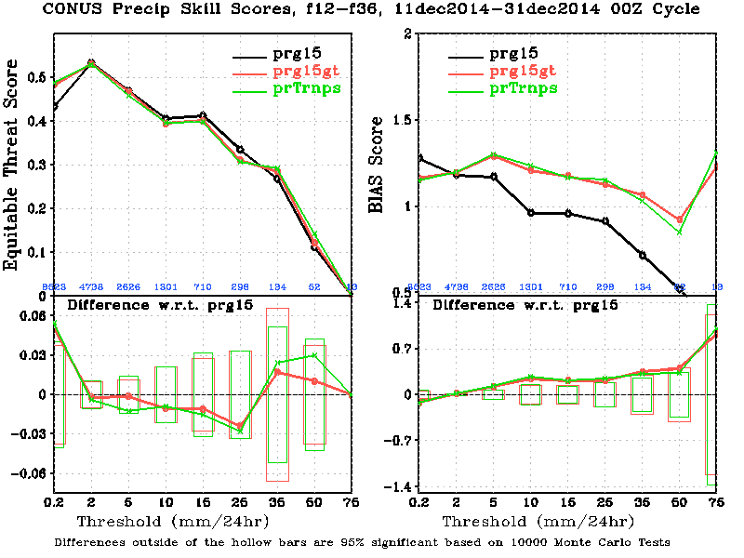
Thompson and WSM6 MPs
Ruiyu Sun
Both schemes were Tested in the operational GFS
Thompson MP significantly improved the cloud radiative effects
Thomspon MP significantly improved the precipitation skill score in the light rain, but degraded in the moderate range
Both scheme eliminated spotty precipitation seen in the GFS with Zhao and Carr (1997)
Thompson MP is testing in FV3GFS
Notes:
20

Slide 21
MG Microphysics
Cheng, Moorthi, Barahona, DaSilva, S. Lu, Y. Hou
Based on MG microphysics from GMAO, with an option to predict rain, snow and their number concentration (added at EMC)
Takes in to account the detrained condensates from RAS, CSAW, or any other convective parameterizations.
Couples with either GMAO macrophysics or SHOC (needs some work)
Couples with prognostic GOCART via internal tracers.
Can use “prescribed” GOCART aerosols via external files, either GEOS-4 GOCART monthly climatology or NGAC output or MERRA2 aerosol reanalysis (proposed) for an affordable approach.
Notes:
21

Slide 22
Ferrier-Aligo MP and GFDL MP are not yet in NEMS/FV3 IPDv4
CAM (regional) FV3GFS runs (at 3km) will test different schemes – (Thompson, Ferrier-Aligo, WSM etc and PBL/Shallow convection options – Brad Ferrier).
For Radiation, when available RRTMGP will be installed in IPDv4 (YuTai Hou)

Slide 23
Schematic Radiation Module Structure
Driver Module
Astronomy Module
Gases Module
Cloud Module
Init/update
Init/update
Init/update
initialization
main driver
ozone
prog cld1
mean coszen
co2
prog cld2
rare gases
diag cld
Aerosol Module
SW Param Module
LW Param Module
Init/update
SW Data Table Module
LW Data Table Module
clim aerosols
SW Main Module
LW Main Module
GOCART aerosols
Derived Type :
aerosol_type
initialization
initialization
sw radiation
lw radiation
Outputs :
total sky heating rates
surface fluxes (up/down)
toa atms fluxes (up/down)
Optional outputs:
clear sky heating rates
spectral band heating rates
fluxes profiles (up/down)
surface flux components
Outputs :
total sky heating rates
surface fluxes (up/down)
toa atms fluxes (up/down)
Optional outputs:
clear sky heating rates
spectral band heating rates
fluxes profiles (up/down)
Surface Module
initialization
SW albedo
LW emissivity
Derived Type :
sfcalb_type

Slide 24
Sub-grid Scale Gravity Waves

Slide 25
1I
Physics Plans for Integrating Unified Gravity Wave Physics into the
Next Generation Global Prediction System
V. Yudin², Jordan C. Alpert¹, T. J, Fuller-Rowell*², and R. A. Akmaev³
NOAA/NWS and CU-CIRES collaborative research to support upgrades and improvements of GW physics in the NEMS global atmosphere models, CFS, GFS and WAM. The planned improvements for the NEMS atmosphere model are:
Calibration of model physics for higher vertical and horizontal resolution and an extended vertical range of simulations,
Upgrades to GW schemes, including the turbulent heating and eddy mixing due wave dissipation and breaking, and
Implements improved representation of non-orographic GWs to improve simulation of QBO.
3
*PI
2I

Slide 26
Non-Orographic Gravity Wave Drag
Priorities
Unified parameterization including momentum deposition
in the stratosphere and turbulent heating and eddies that are
missing due to wave dissipation and breaking
Tested and evaluated four candidate GW solvers
Integration of Unified GW physics into NEMS/FV3 IPDv4
Status:
Unified GW physics V0 is planned Q3FY18 for implementation
Adapted GFDL modification for sub-grid orography

Slide 27
Prognostic Aerosols and Chemistry
GOCART is available in NEMS – should be possible to connect to IPDv4
CPO/CTB supported project to port MAM7 to NEMS is underway
(GMAO version of MG microphysics is also part of this port)
(A collaboration between GMAO, EMC, SUNY)

Slide 28
Stratospheric Ozone Photochemistry and Water Vapor Parameterization
Updated ozone coefficients including dependency on temperature and column ozone (from NRL)
New water vapor parameterization to account for methane oxidation in the stratosphere (from NRL)
Result of a CPO funded multi-agency reanalysis project
Already in IPDv4

Slide 29
Physics for the Whole Atmosphere Model (WAM)
The Whole Atmosphere Model (WAM) has top ~ 600km
RRTM radition does not work right above ~ 100km – updated radiation needed for regions of NLTE
Spatially variable 3D molecular viscosity need to be taken in to account
Improved gravity wave dissipation in the thermosphere
Etc etc etc
IPD needs to include necessary physics for WAM

Slide 30
Thompson MP Test in the FV3GFS
Ruiyu Sun
Fanglin, Jun, Rusty, Greg Thompson, Vijay, Moorthi, Yu-Tai, Anning, Huiya, Jongil, and other colleagues

Slide 31
10 Day Forecast Experiments (ICs = 2017042800)
fv3test2: default physics with Zhao & Carr (Zhao&Carr)
fv3gto2r1: fv3test2 + original 2008 Thompson MP replaces Zhao_carr + close coupling with radiation + ice number for detrained cloud ice from deep and shallow convection + snow treated as ice in cloud cover calculation in radiation (dt=120s) (2008 Thompson)
fv3gto2r11f: fv3gto2r1 + modifications of cloud drop number and ice nucleation (dt=120s) (Modified Thompson 1)
fv3gto2r12f: fv3gto2r11f + rhc partial cloudiness (dt=120s) (Modified Thompson2:rhc)

Slide 32
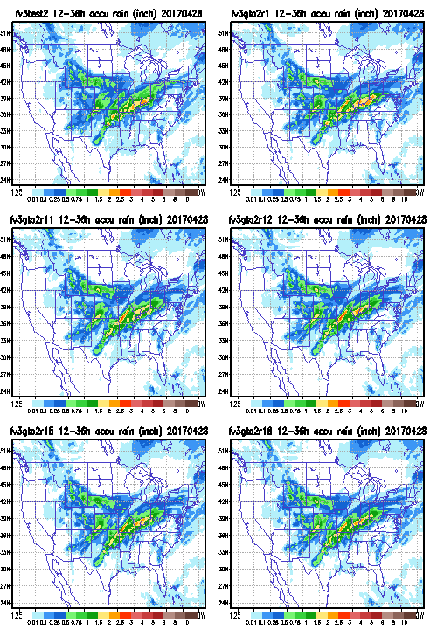
12-36h CONUS Precipitation Map
Zhao &Carr
2008 Thompson
Modified Thompson1
Modified Thompson2
rhc

Slide 33
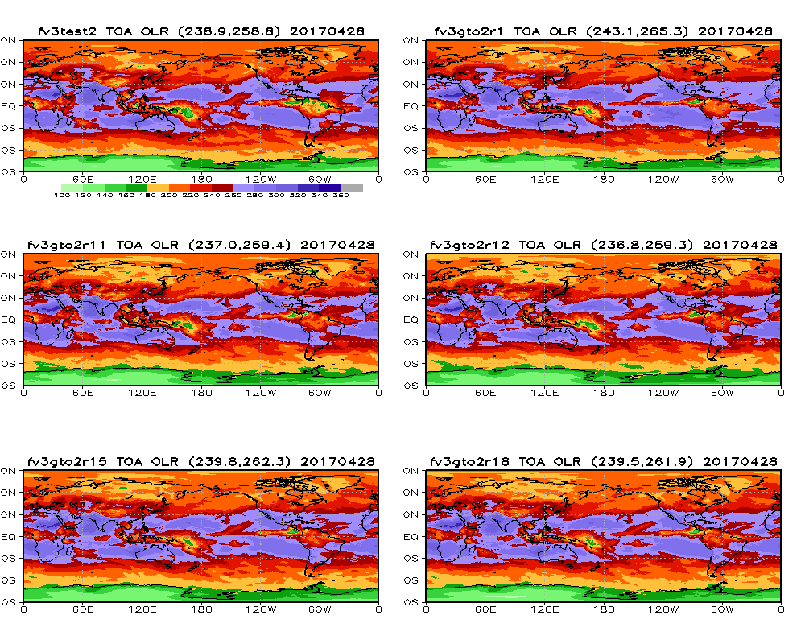
2-10day Mean Global OLR
Zhao &Carr
2008 Thompson
Modified Thompson1
Modified Thompson2 rhc

Slide 34
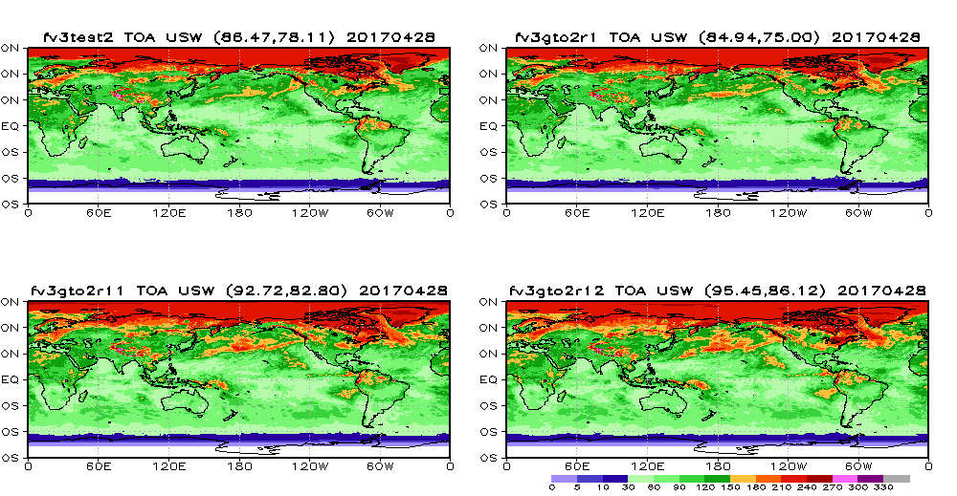
2-10day Mean Global USW at TOA
2008 Thompson
Zhao &Carr
Modified Thompson1
Modified Thompson2 rhc

Slide 35
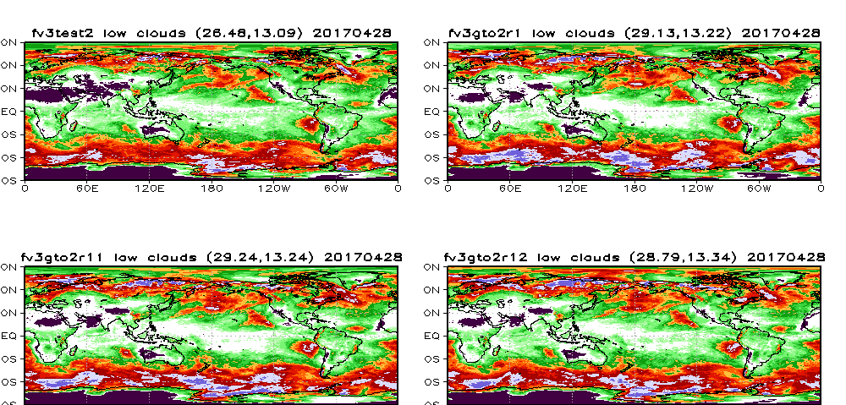
2-10day Mean Global Low Clouds
Zhao &Carr
2008 Thompson
Modified Thompson1
Modified Thompson2 rhc

Slide 36
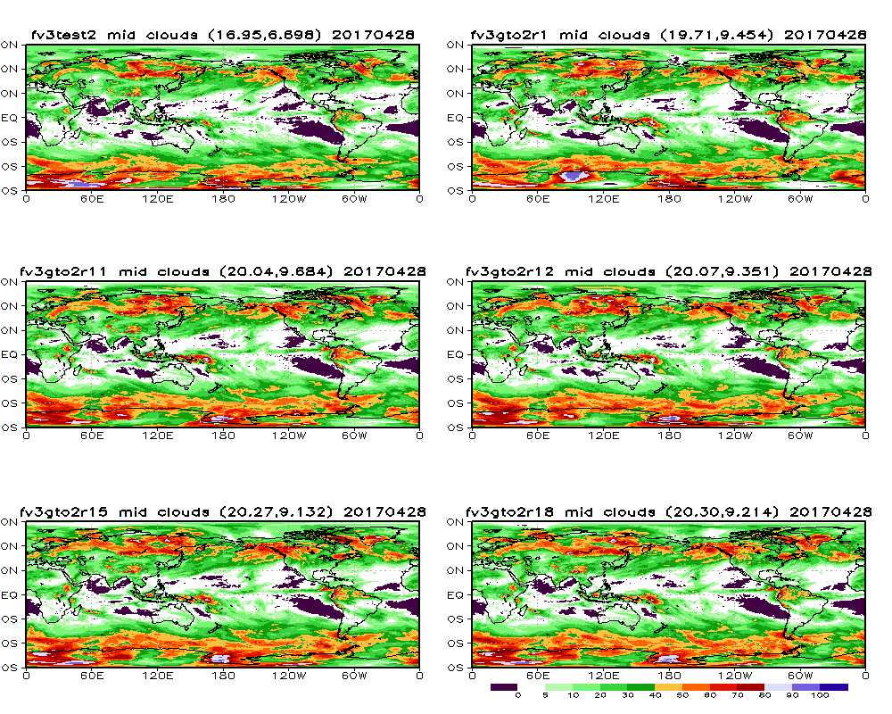
2-10day Mean Global Middle Clouds
Zhao &Carr
2008 Thompson
Modified Thompson1
Modified Thompson2 rhc

Slide 37
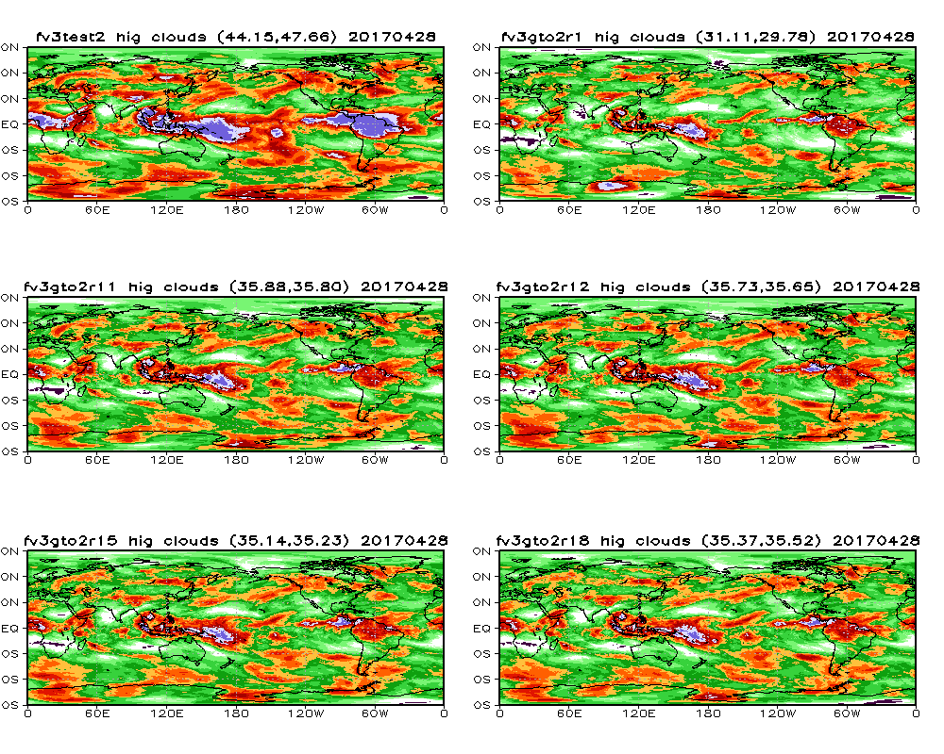
2-10day Mean Global High Clouds
Zhao &Carr
2008 Thompson
Modified Thompson1
Modified Thompson2 rhc

Slide 38
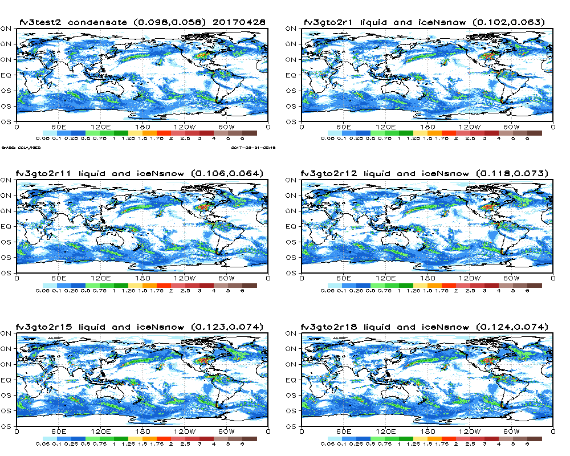
2-10day Global Condensate Path (ice + liquid + snow)
Zhao &Carr
2008 Thompson
Modified Thompson2 rhc
Modified Thompson1

Slide 39
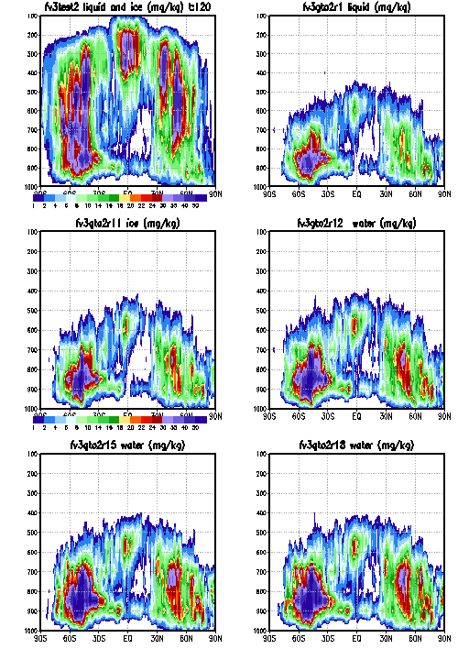
Liquid Cross-section at 120h
Zhao &Carr
2008 Thompson
Modified Thompson1
Modified Thompson2 rhc

Slide 40
Precipitation Statistics (I)
– 20170105-20170228 (need more)
1. fv3l65: Fanglin's fcst only run (control=default physics with Zhao & Carr, previous Zhao&Carr)
2. fv3gfsT: fv3l65 + original 2008 Thompson MP replaces Zhao_carr + close coupling with radiation + ice number for detrained cloud ice from deep and shallow convection + snow treated as ice in cloud cover calculation in radiation + modifications of cloud drop number and ice nucleation (dt=225s) (Modified Thompson1)
3. fv3gfsT1: fv3gfsT + rhc partial cloudiness (dt=225s) (Modified Thompson2:rhc)

Slide 41
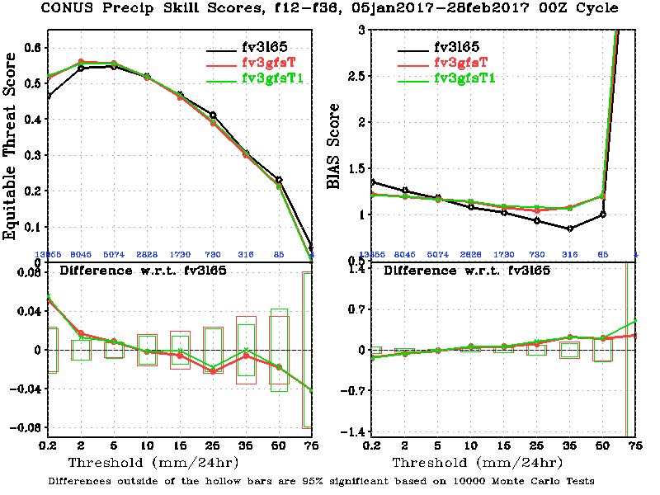
Precip Time Series

Slide 42
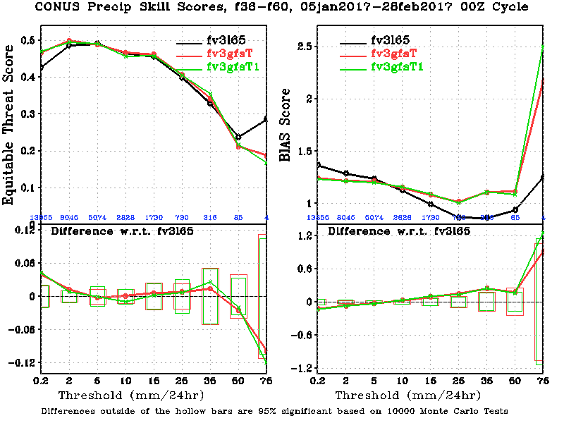
Precip Time Series

Slide 43
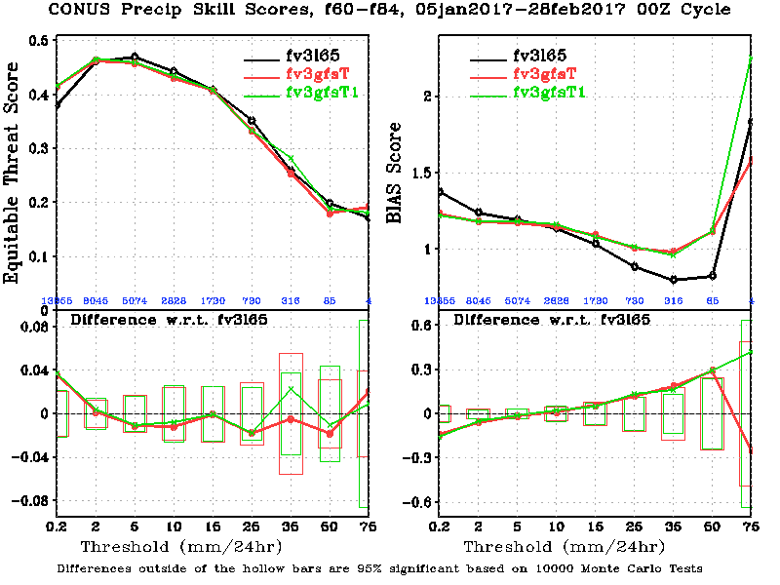
Precip Time Series

Slide 44
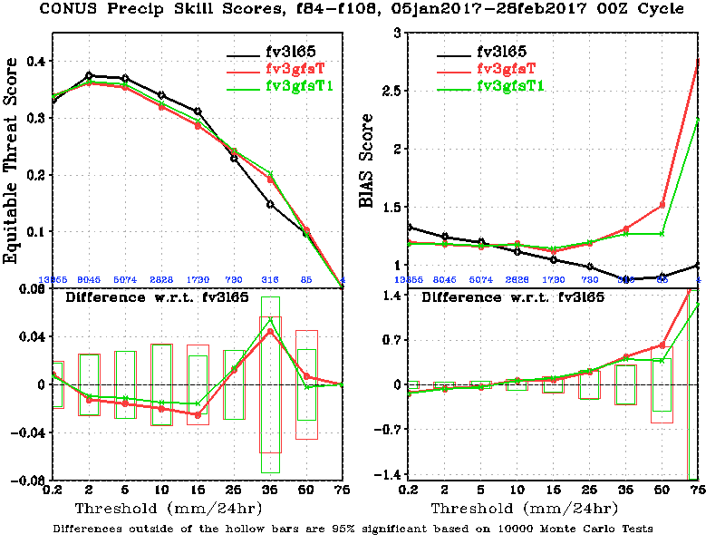
Precip Time Series

Slide 45
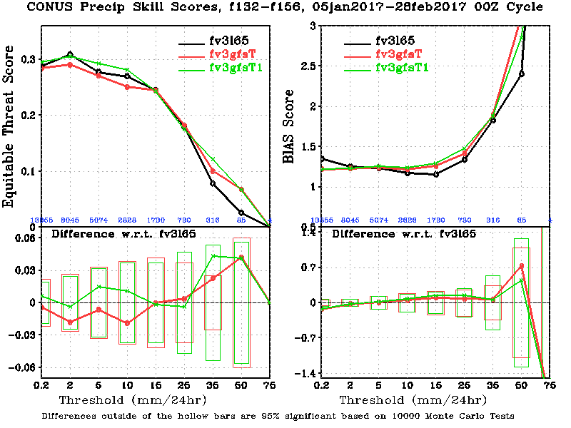
Precip Time Series

Slide 46
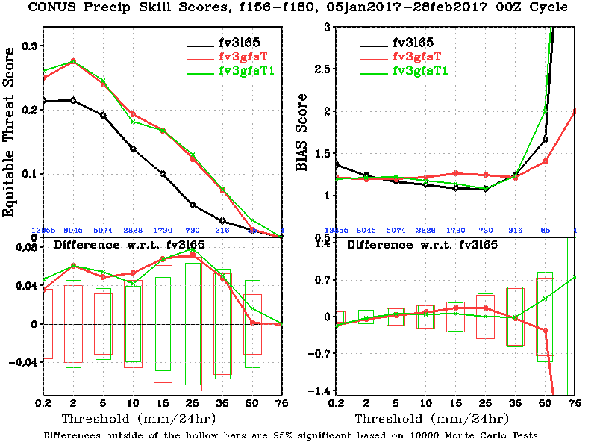
Precip Time Series

Slide 47
Precipitation Statistics (II)
– 20170105-20170228 (need more)
1. nemsx: NEMS parallel
2. fv3l65: Fanglin's fcst only run (control=default physics with Zhao & Carr, previous Zhao&Carr))
2. fv3gfsT1: fv3l65 + original 2008 Thompson MP replaces Zhao_carr (dt=120s) + close coupling with radiation + ice number for detrained cloud ice from deep and shallow convection + snow treated as ice in cloud cover calculation in radiation + modifications of cloud drop number and ice nucleation + rhc partial cloudiness (dt=225s)

Slide 48
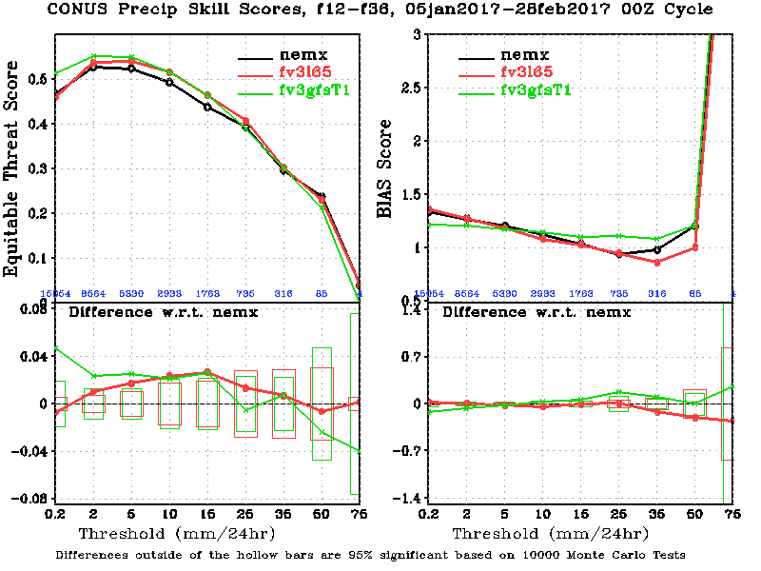
Precip Time Series

Slide 49
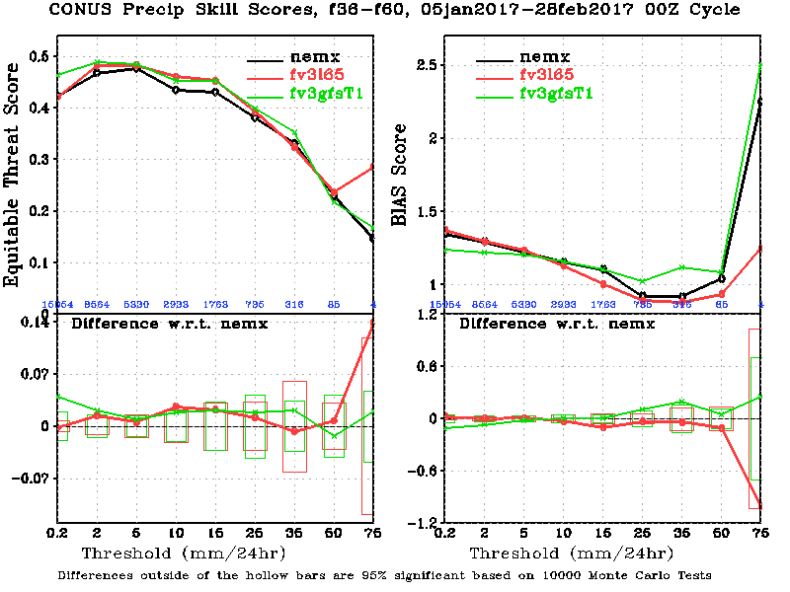
Precip Time Series

Slide 50
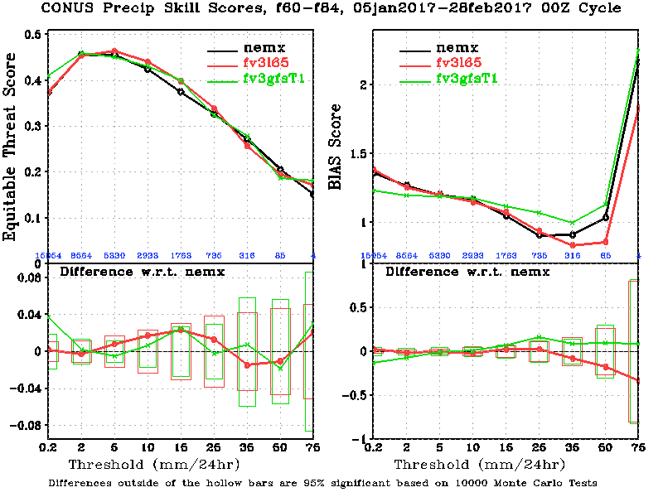
Precip Time Series

Slide 51
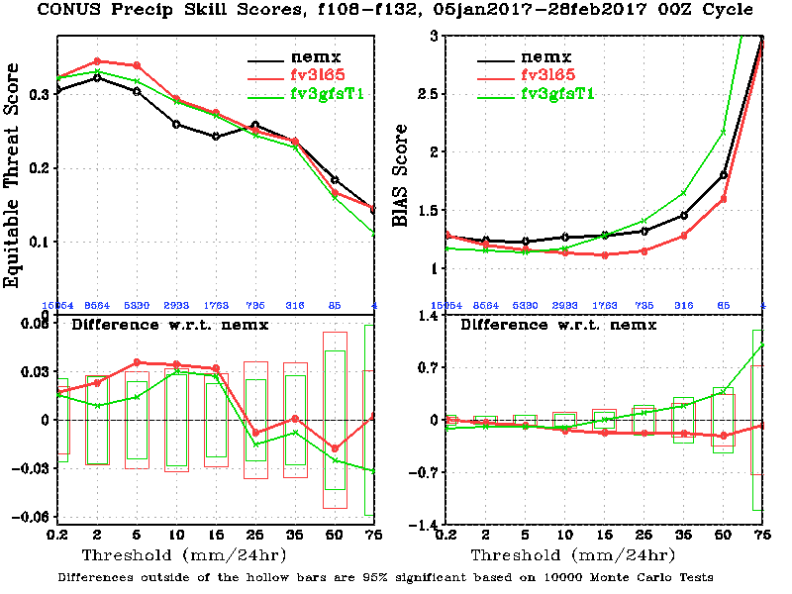
Precip Time Series

Slide 52
Preliminary Update of MG in FV3GFS
Anning Cheng
Shrinivas Moorthi, Yu-tai Hou, Fanglin Yang, Jun Wang, Ruiyu, Sun, Jongil Han, Vijay Tallapragada and collegues in EMC;
FV3 Dynamics and Physics Meeting
Notes:
52

Slide 53
Experiment Design
EXP Name | Microphys | Macrophys | Deep convection | Cost for 10 day C768 with 768 tasks
SAS-Zhao (FV3 C768L64) | Zhao and Carr | Large-scale condensation | SAS
SAS-MG (FV3 C768L64) | MG | GMAO Macro | SAS | 3 hours (dynamic core used 60%, physics 15%)
RAS-MG (FV3 C768L64) | MG | GMAO Macro | RAS
dt_atmos=dtf=dtp =225 seconds
npes=768 tasks=768
nth_f=2 npe_node_f=24 task_per_node=12
MODE=64bit TYPE=hydro
IPD enabled LEVS=64
CASE1=C768
Notes:
Add a reference under the title: Cheng et al. (2010). Put dx0 and dz0 values somewhere.
53

Slide 54
Ten Day Forecast Experiment with 00Z 04-26-2017 IC
(currently one case)

Slide 55
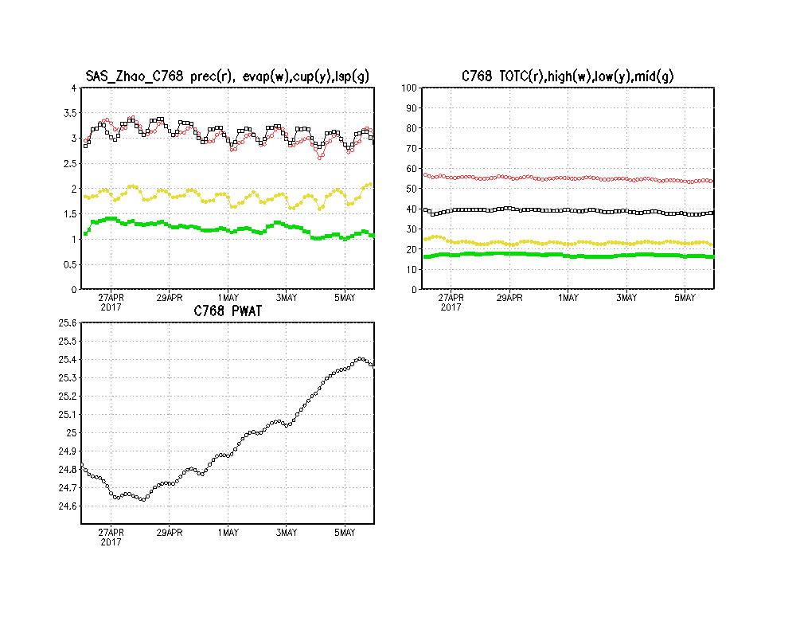
Time series for SAS-ZH
Low high, middle, and low cloud amount
Notes:
55

Slide 56
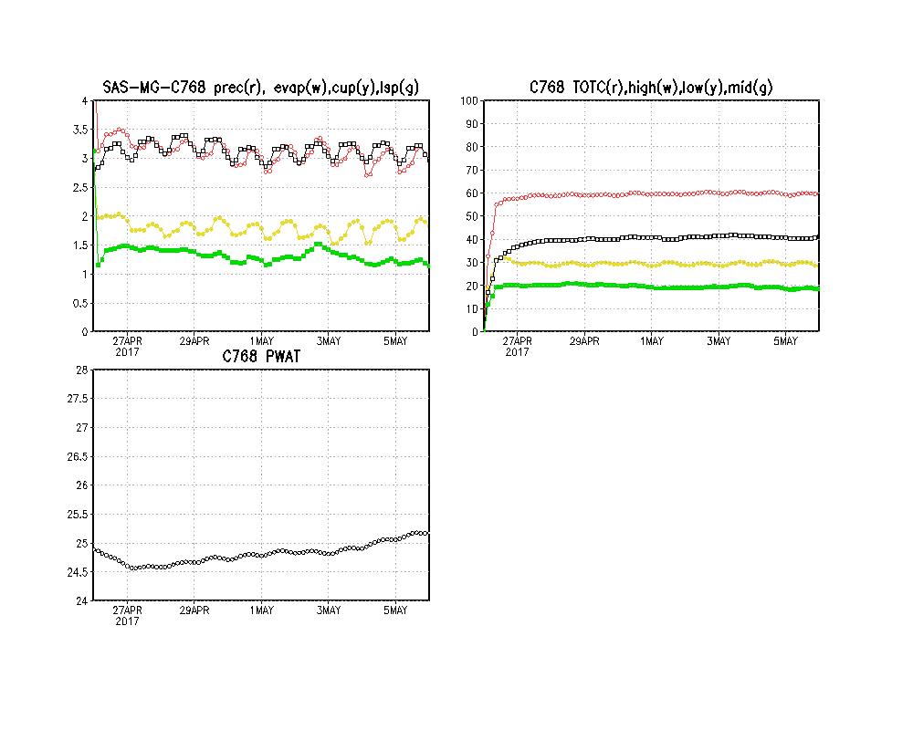
Time series for SAS-MG
More middle and low clouds
Scale awareness for precipitation is better
Notes:
56

Slide 57
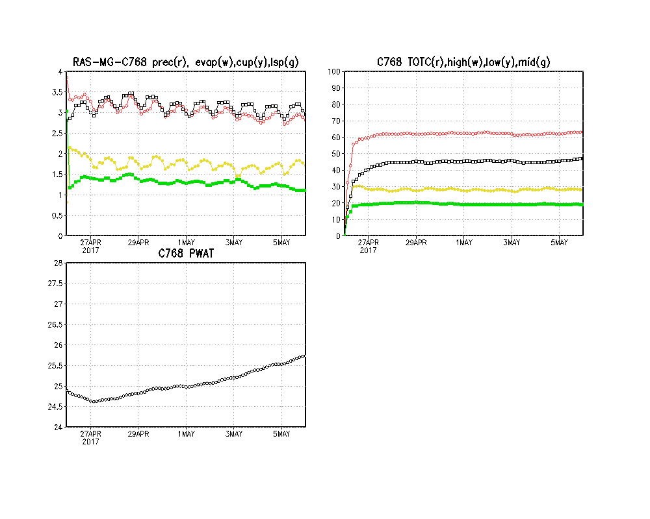
Time series for RAS-MG
Similar to SAS-MG
Notes:
57

Slide 58
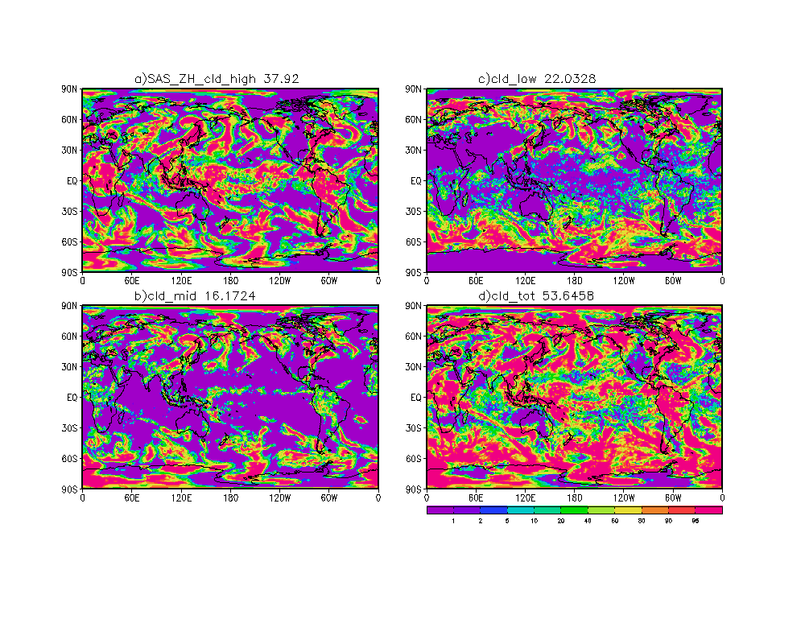
Low-, Middle-, and High-CLD SAS-ZH
Overall good evaporation and precipiation balance
Cloud fraction low
Notes:
58

Slide 59
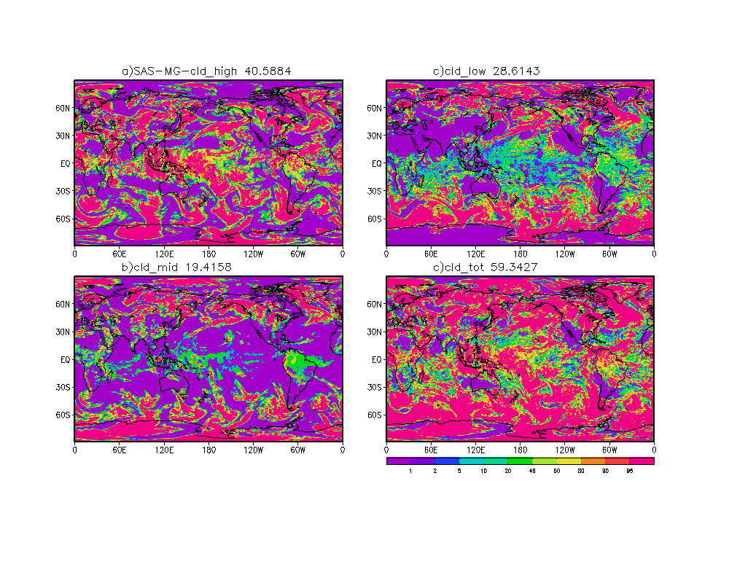
Low-, Middle-, and High-CLD SAS-MG
Good Diurnal cycle
Nice evaporation and precipiation balance
Low cloud amount
Notes:
59

Slide 60
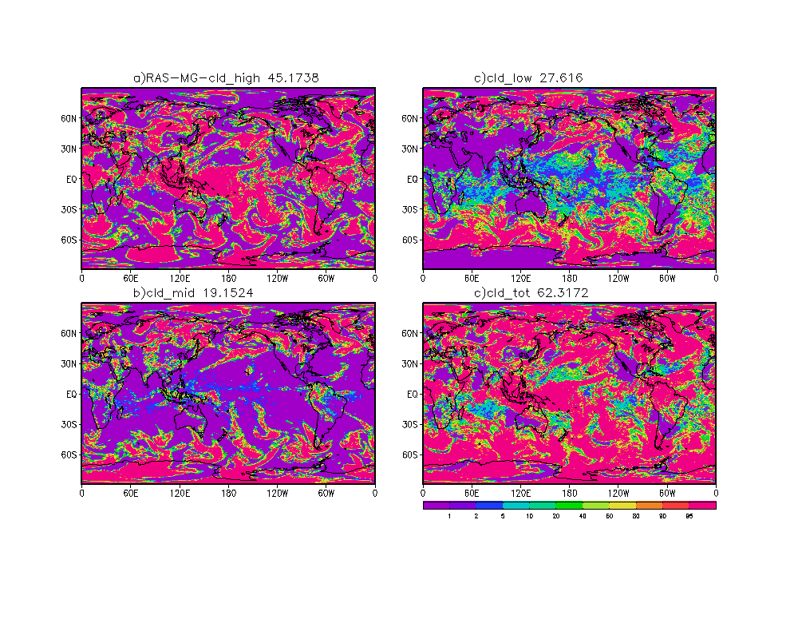
Low-, Middle-, and High-CLD RAS-MG
Good Diurnal cycle
Nice evaporation and precipiation balance
Low cloud amount
Notes:
60

Slide 61
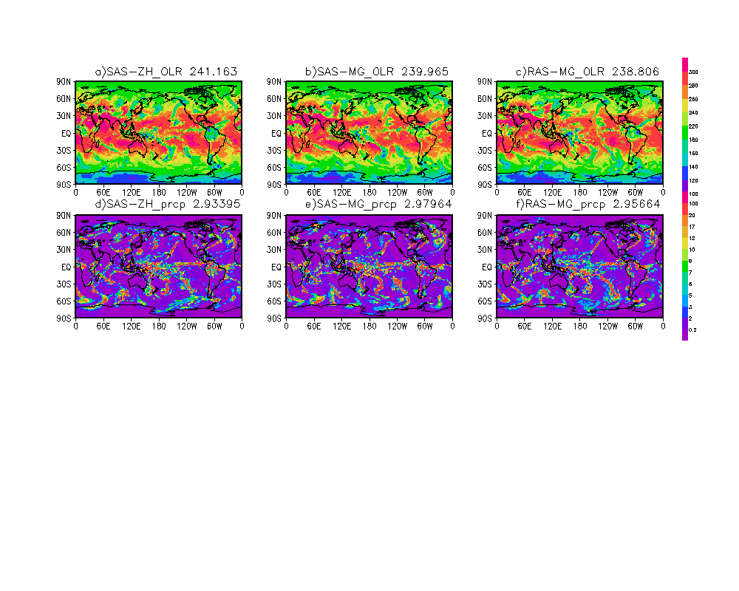
OLR and PRCP comparison
Notes:
61

Slide 62
To Do:
1. More diagnoses of the results from the completed experiments
2. Experiments in Summers
3. Comparison with GFDL MP and MG, and others
Need GFDL MP code in FV3GFS

Slide 63
Thanks

Slide 64
BACKUP SLIDES

Slide 65
Moist workshop recommendations(01/2015)
6
The most promising treatment of moist physics at or near the current state-of-the-art that roughly 100 US and international scientists agreed on:
“Two moment microphysics with multiple categories of ice habits. This implies that all particles are predicted (not diagnosed) and fall with finite velocity”.
“Utilizing these approaches, especially the two-moment microphysics, places demands on other components of the model including dynamics (especially advection schemes) and aerosol representation”

Slide 66
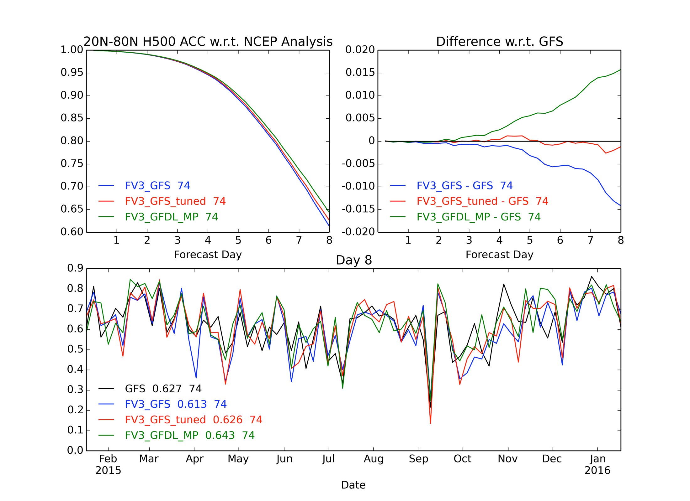
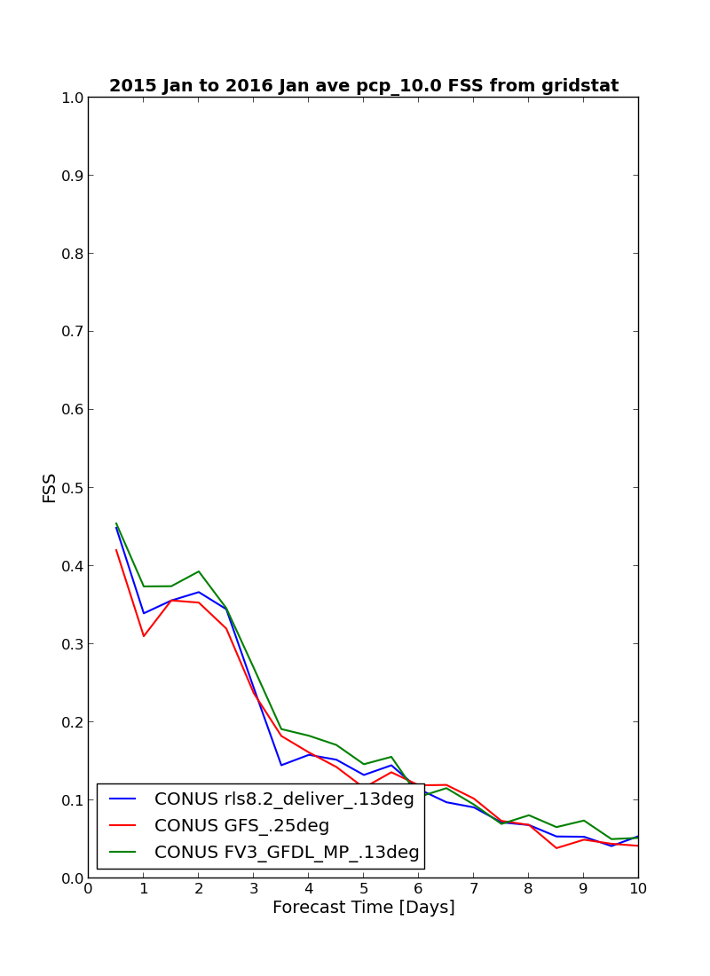
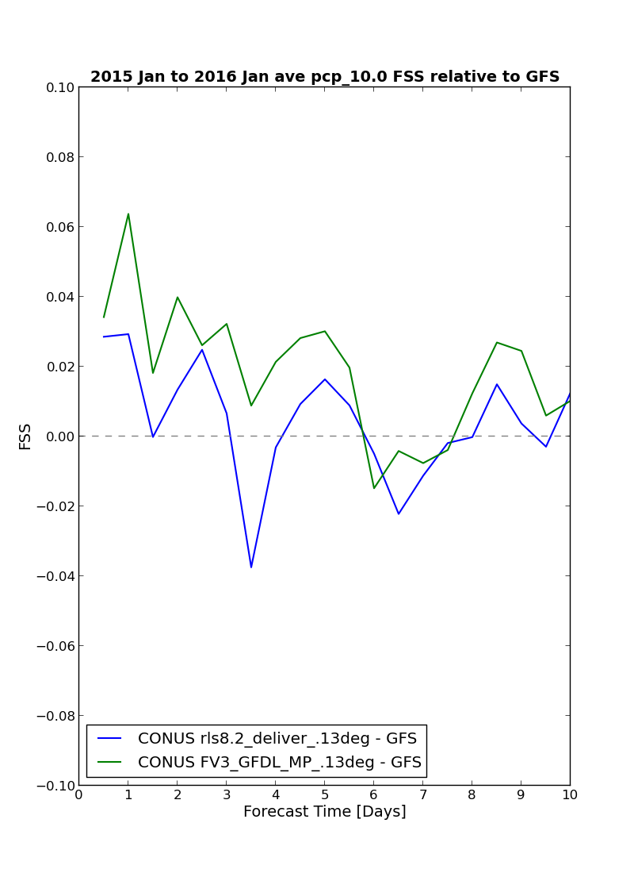
Current status
—GFDL MP
7
Fractions Skill Score over CONUS
(based on NGGPS 74 cases)
Relative Skill to Operational GFS
13-km fvGFS with GFDL_MP
Designed for seasonal predictions (Chen & Lin 2011) and climate simulations, with “scale-aware” vertical & horizontal sub-grid distribution
Based on 1st principles: “Ooyama-compliant” and consistent with FV3 (heat & momentum transported by falling condensates)
Time-implicit fall of precipitating condensates (rain, snow, graupel, and cloud ice)
Compatible with cloud fields from latest IFS
GFDL_MP made a significant improvement
13-km fvGFS with tuned GFS
Precipitation Events >= 10.0mm/6hr
13-km fvGFS (no tuning)
FSS by MET tool, using Stage IV data
The scheme is being tested
with FV3 in NGGPS
Courtesy of Dr S.J. Lin
from FV3 workshop

Slide 67
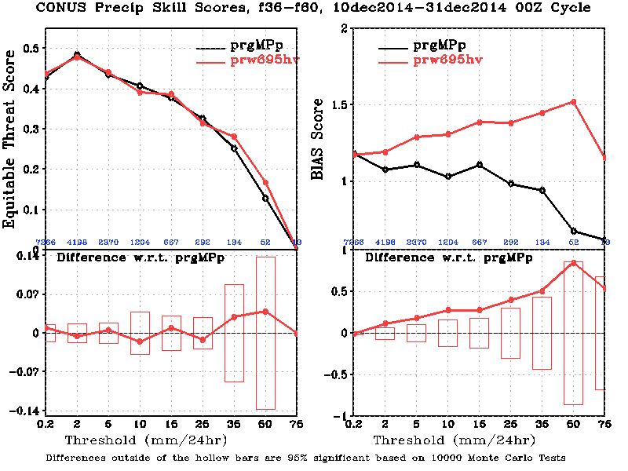
Current status
—WSM6
8
Spotty precipitation
Tested in the operational GFS
Precipitation ETS score is close to GFS
Cloud radiative effect is a little weaker than the GFS
Eliminated spotty precipitation seen in the GFS with Zhao and Carr (1997)

Slide 68
Current status
—Thompson’s MP
9
Spotty precipitation
Tested in the operational GFS
Significantly improved the cloud radiative effects
Significantly improved the precipitation skill score in the light rain, but degraded in the moderate range
Eliminated spotty precipitation seen in the GFS with Zhao and Carr (1997)
In a version of NEMS now.
GFS
Thompson

Slide 69
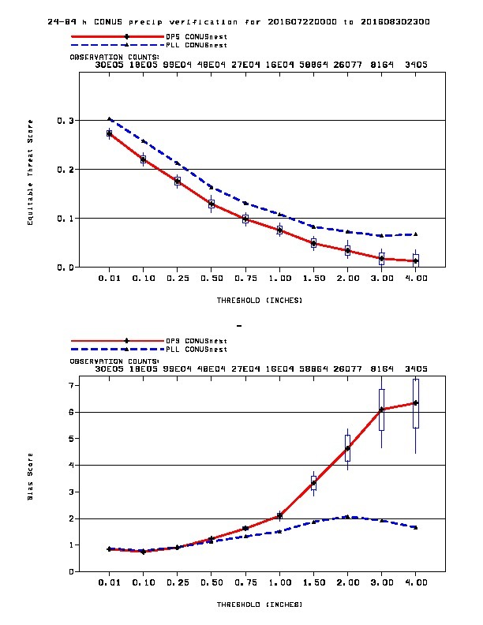
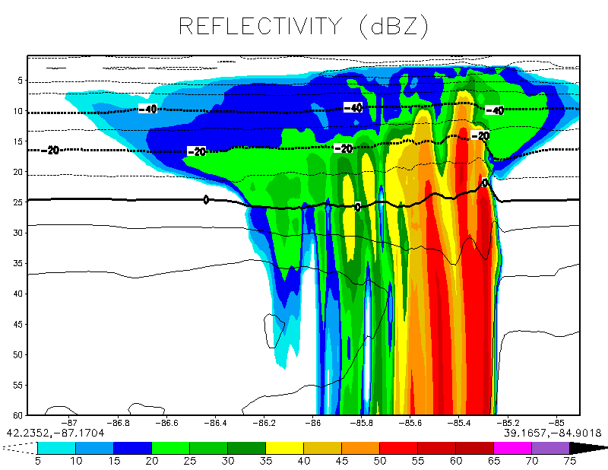
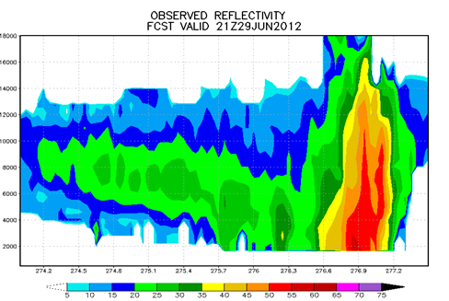
PrecipitationScores(CONUS Nests)
Ferrier-Aligo MP (in NAM)
11
19 July – 29 August 2016 (0-24 h + 12-36 h + 24-48 h + 36-60 h)
A
Equitable Threat
Old (4 km)
B
New (3 km)
A
(Note different vertical coordinate)
B
Bias = F/O
A - Reduced reflectivity in stratiform anvils
B - Increased reflectivity & rainfall below anvils
C - Improved dBZ (from objective verification)
Courtesy of Brad Ferrier
and Eric Aligo
Bias = 1 (perfect)

Slide 70
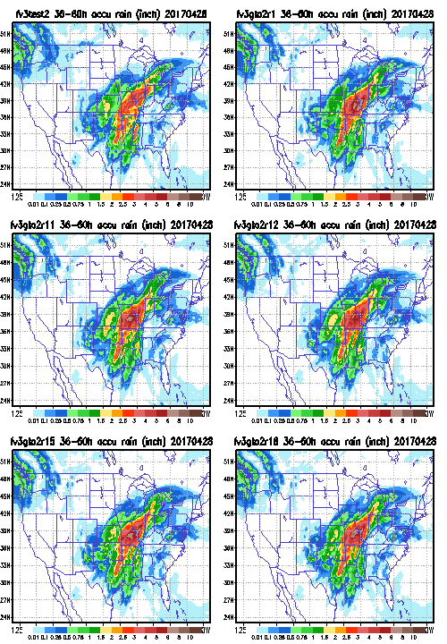
36-60h CONUS Precipitation Map
Zhao &Carr
2008 Thompson
Modified Thompson1
Modified Thompson2 rhc

Slide 71
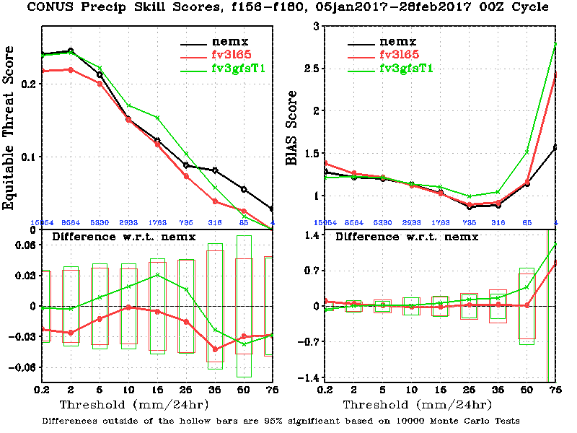
Precip Time Series

Slide 72
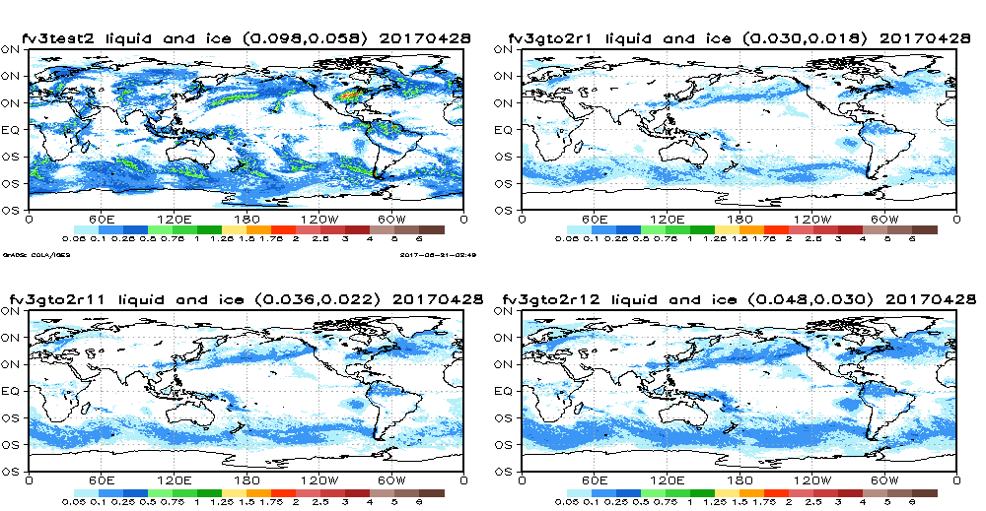
2-10day Global Condensate Path (ice + liquid water)
Zhao &Carr
2008 Thompson
Modified Thompson1
Modified Thompson2 rhc

Slide 73
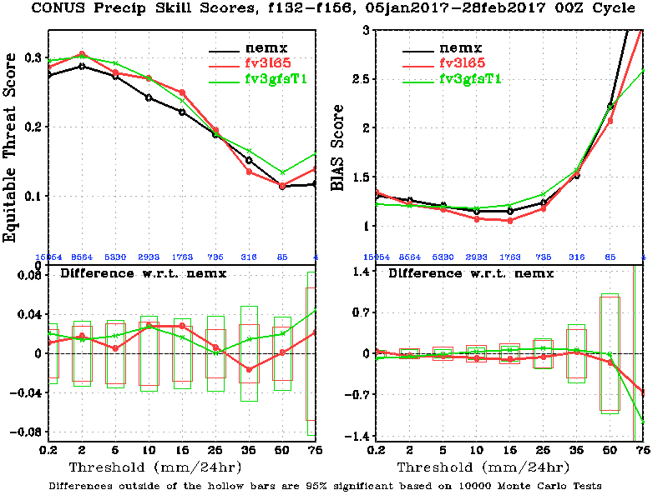
Precip Time Series

Slide 74
Summary
1. The FV3gfs-Thompson MP generated more low and middle clouds, less high clouds, and less total clouds (Will be compared with satellite observation) than the FV3gfs-Zhao&carr
2. FV3gfs-Thompson MP generated a little less OLR and more USW at the TOA than theFV3gfs-Zhao&carr.
3. The FV3gfs-Thompson MP signficant better precipitation and bias scores in the light rain range and in the 156h-180h fcst period.
4. The FV3gfs-Thompson MP produced better precipation scores than the NEMX.

Slide 75
Discussions
The difference between RAS and SAS is small, but results from any combination with MG are encouraging.
Cloud fields are consistent with OLR and Precipitation.
Some work may needs in vertical structure.
Works on CS and SHOC
Time to run verification package?

Slide 76
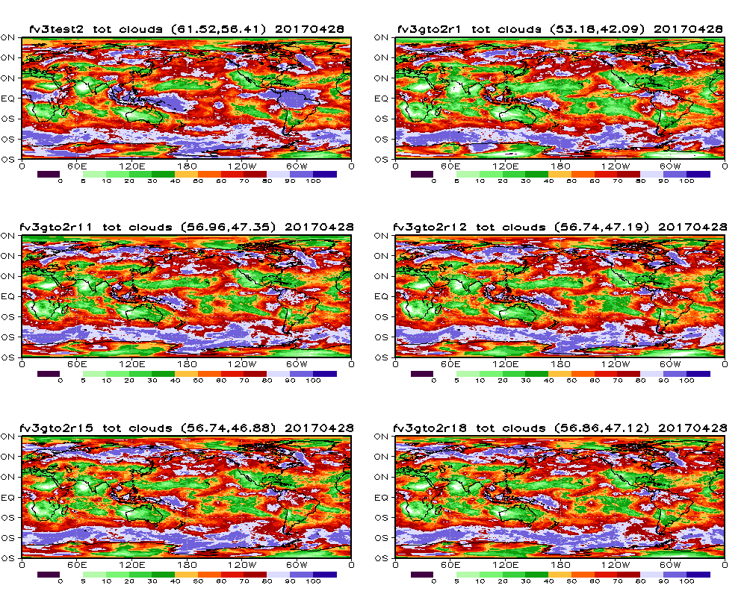
2-10day Mean Global Total Clouds
Zhao &Carr
2008 Thompson
Modified Thompson1
Modified Thompson2 rhc

