Slide 1
DTC MET Verification at GFDL
Shannon Rees and Bill Stern
NEMS FV3GFS Community Modeling System Training and Tutorial
July 19, 2017

Slide 2
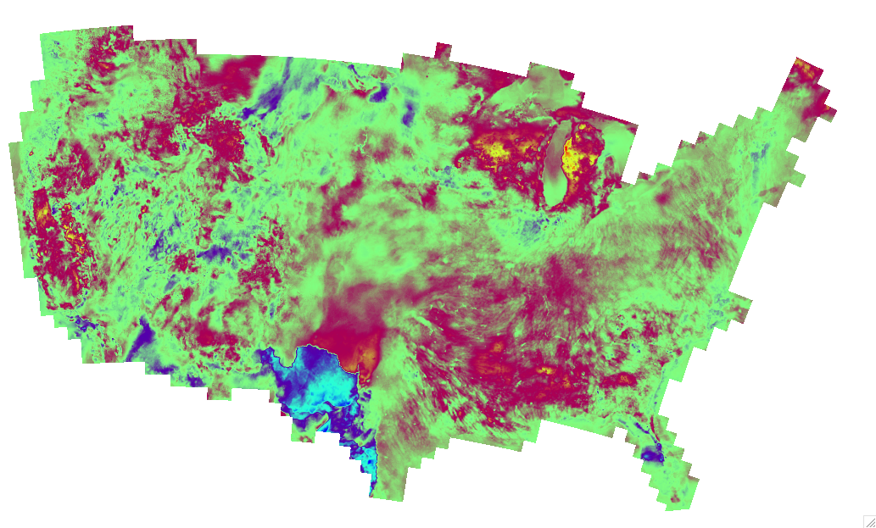
Grid-stat
Compares two gridded fields (fcst v fcst or fcst v analysis)
Variables
  Precip rate (NCEP Stage IV)
  2m temp, dew point (RTMA)
  MSLP (NCEP Reanalysis)
  500 mb height (NCEP Reanalysis)
MET 5.2 updated to:
  run faster with high resolution
  weight by latitude or grid cell area
Statistics
  Categorical (contingency table): FBIAS, GSS
  Continuous: RMSE, ANOM_CORR (NCEP daily climo), FBAR, OBAR, ME, MBIAS
  Neighborhood: FBIAS, FSS, F_RATE, O_RATE

Slide 3
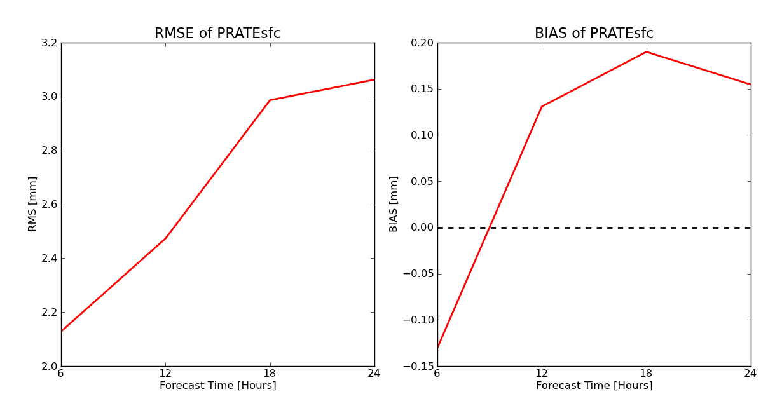
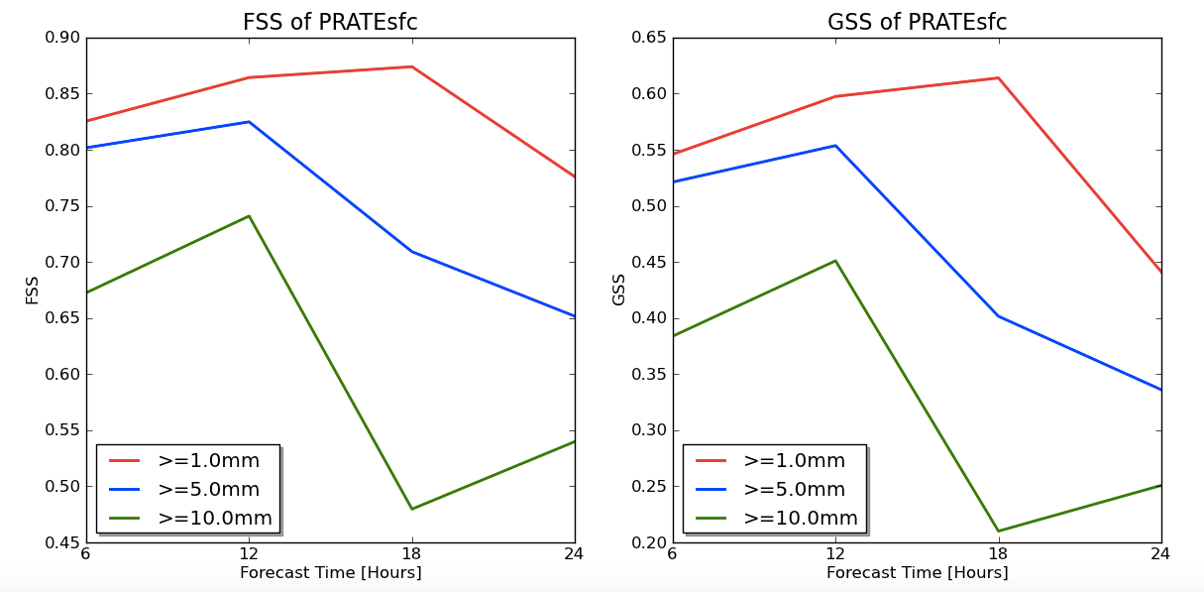
Grid-stat Output

Slide 4
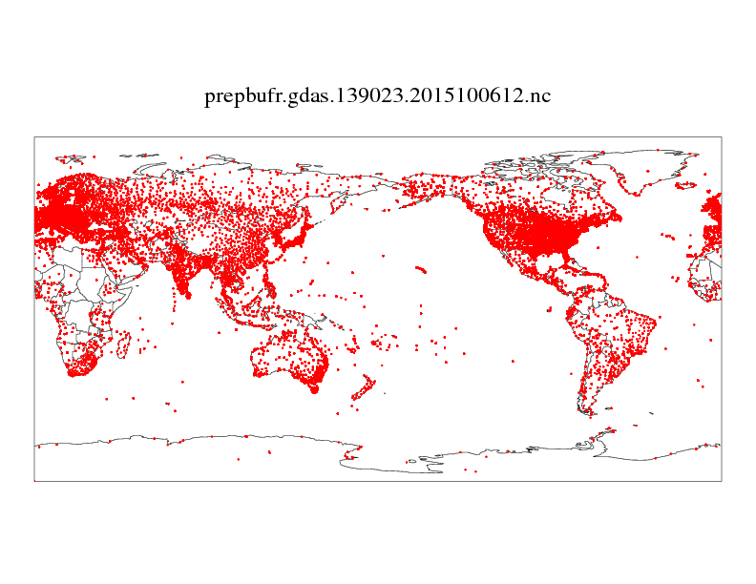
Point-stat
Compares a gridded field with point observations (fcst v prepbufr)
Variables:
  MSLP
  500 mb height
Not many obs in the SH
Our MET analysis showed
lower skill scores than NCEP’s
analysis

Slide 5
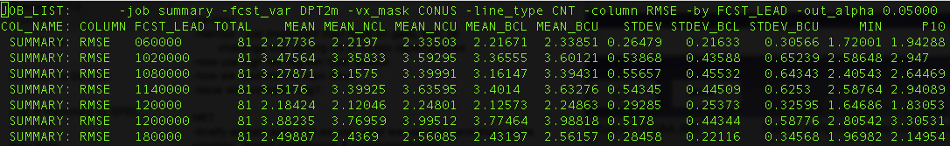
Stat-analysis
Computes summary statistics and filters grid-stat and point-stat output - ie mean of many forecasts filtered by lead time

Slide 6
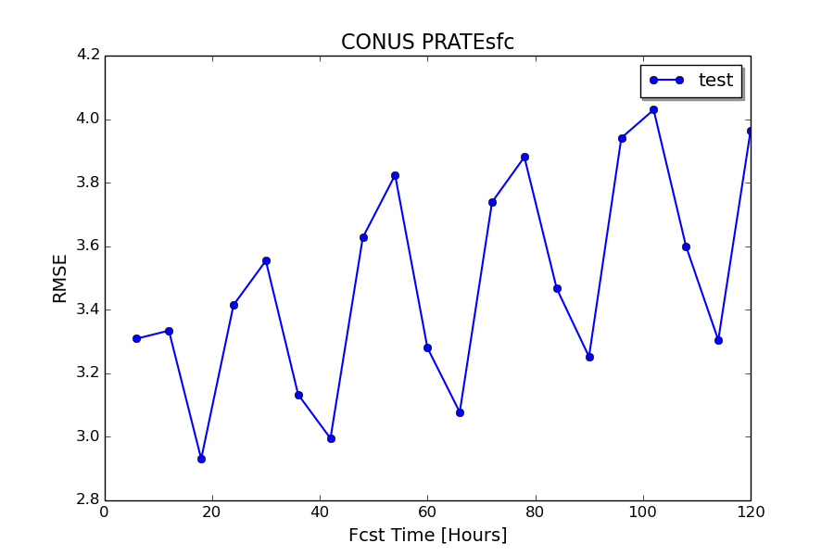
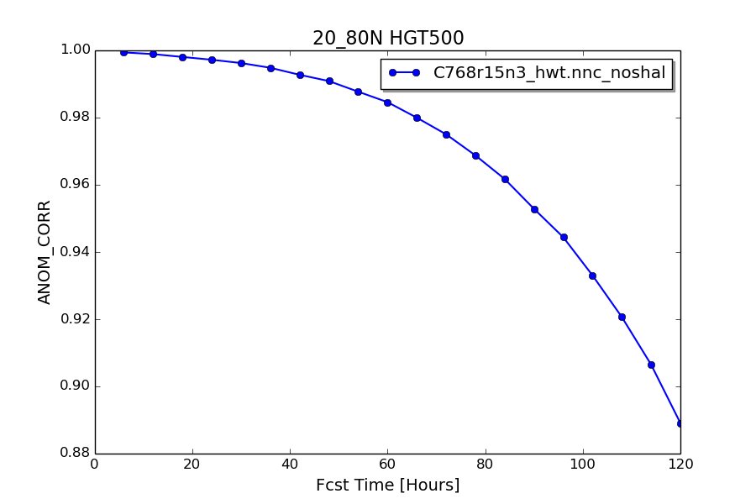
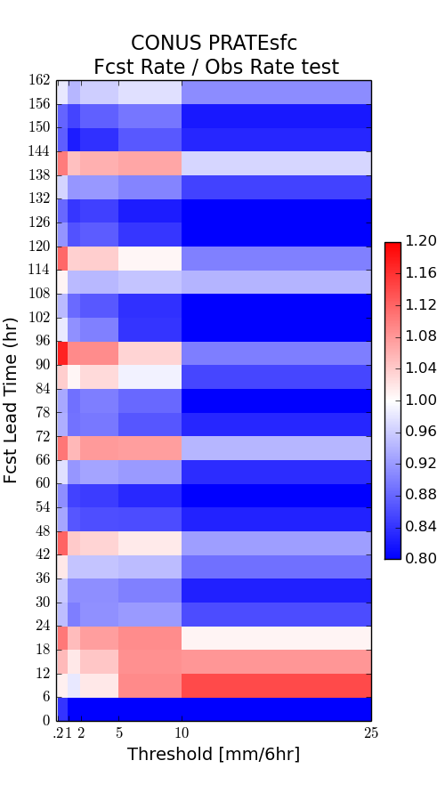
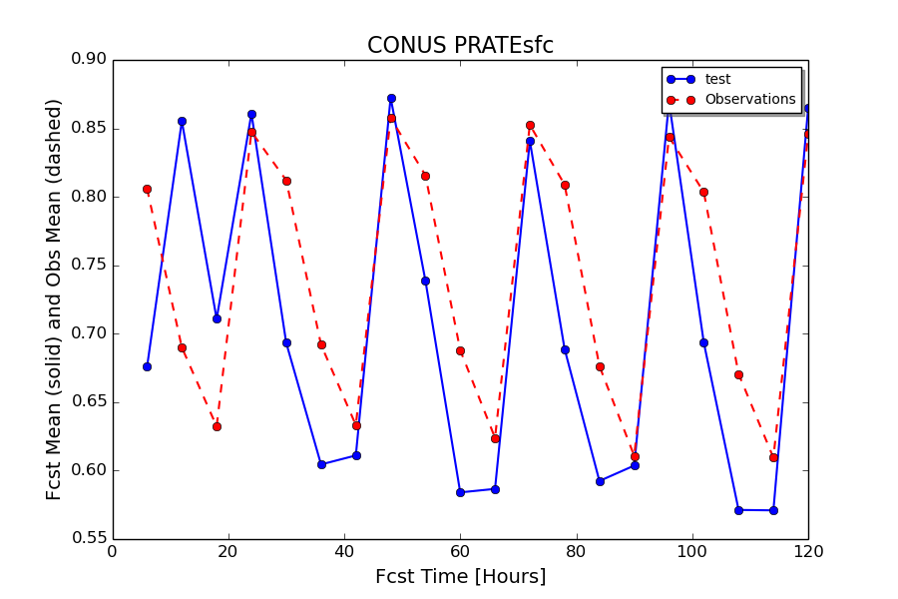
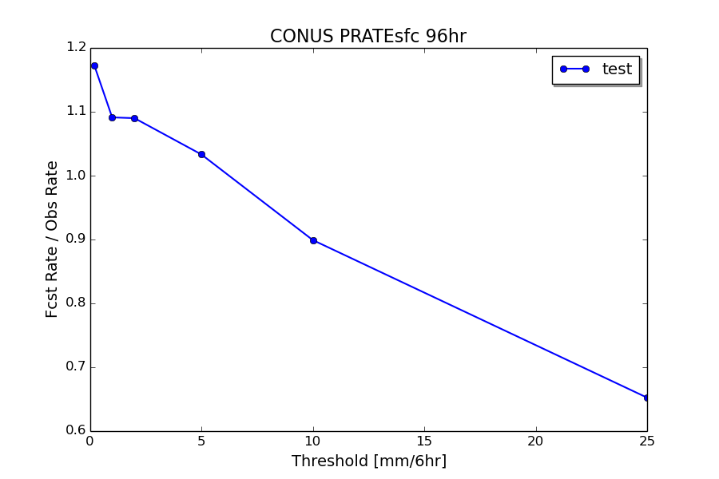

Slide 7
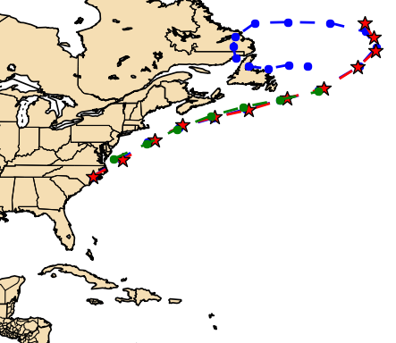
MET-TC
TC-pairs - verification of TC forecasts in ATCF format
  Position, wind, mslp, distance to land
  Winter storms
TC-stat - summary statistics and filtering of tc-pairs output (like stat-analysis)
  Mean (with confidence intervals), standard deviation, min, max, 10th, 25th, 50th, 75th, 90th percentiles

Slide 8
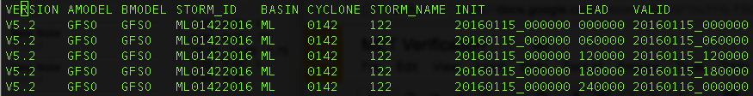
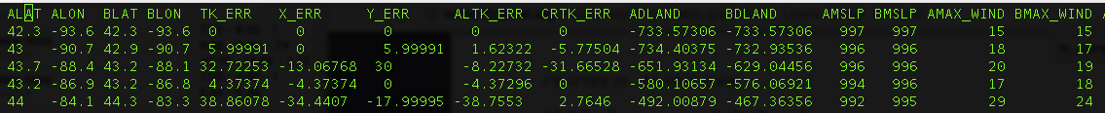
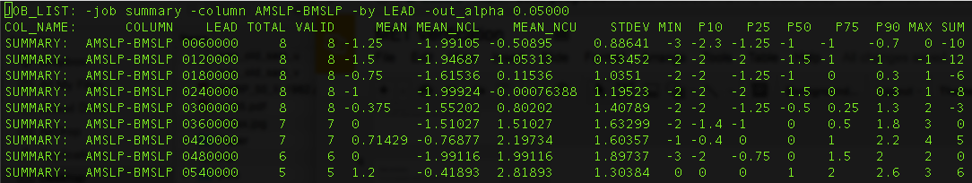
TC-pairs output
TC-stat output

Slide 9
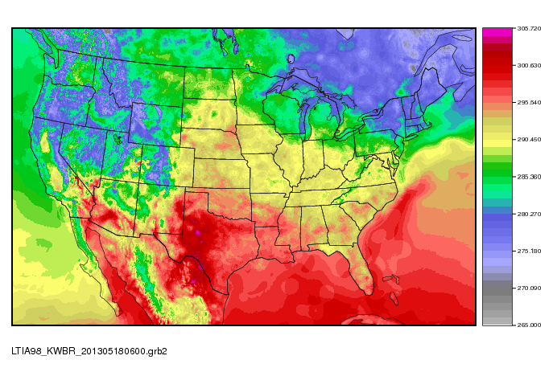
Benefits
Detailed documentation and tutorials
MET Helpdesk
Frequent updates and patches
Comes with reformatting tools,
standard masks
Already compiled on many systems:
Jet, Theia, Tide/Gyre, Luna/Surge,
Cheyenne, Yellowstone
In-person Training - bringing
together all of the tools
Notes:
Plot_data_plane, plot_point_obs tools

Slide 10
Issues
“MET is designed to be a highly-configurable, state-of-the-art suite of verification tools. It was developed using output from the WRF modeling system but may be applied to the output of the other modeling systems as well.”
Grid-stat was slow for high resolution global grids
Running tools for many forecast times - shell scripts
Must take care not to overload system with too many jobs
NetCDF format
EMC-centric - what about university researchers, model developers?
Plotting - MetViewer
Some trouble with the build and install
Notes:
Grib and netcdf handling, slow gridstat for high res global grid continuous stats (memory allocation issue), poor error messages for formatting issues

Slide 11
Future MET Use
MET+ Python wrappers
Cyclone-relative verification
Expand our own Python plotting
Series-analysis
  Accumulates stats separately for each horizontal grid location
  Plot map to see where error is highest over a year of forecasts
MODE (Method for Object-Based Diagnostic Evaluation)
  Best for high resolution spatial precip forecasts
  Creates its own graphical output

Slide 12
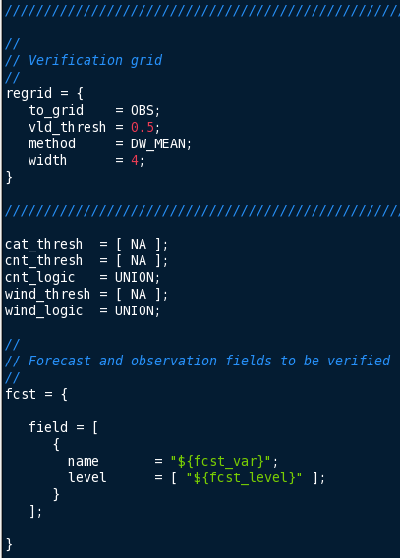
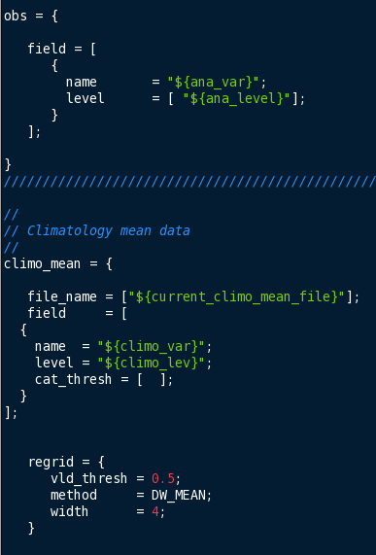
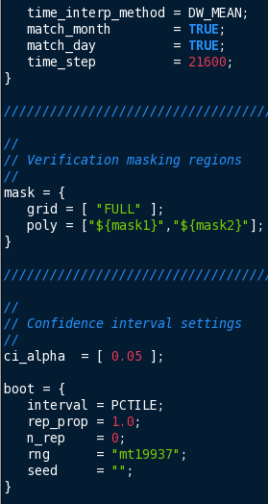
Grid-stat Config File

Slide 13
