Slide 1
How to run NEMS FV3
Jun Wang
NEMS architecture development team

Slide 2
Overview
Standalone NEMS FV3 architecture
How to run a NEMS FV3 test case
How to run NEMS FV3 regression test

Slide 3
ESMF based NEMS FV3 - object oriented design
NEMS (NOAA Environmental Modeling System) is a common modeling framework. It is based on ESMF (Earth System Modeling Framework) and follows NUOPC (The National NEMS Unified Operational Prediction Capability) convention
A numerical model in NEMS is represented by software and is implemented as an ESMF grid component through a NUOPC CAP wrapped around the model
A FV3 cap is implemented to integrate native FV3 model into NEMS.
FV3 is currently running in standalone mode inside NEMS
Integrating FV3 in coupled system is under development

Slide 4
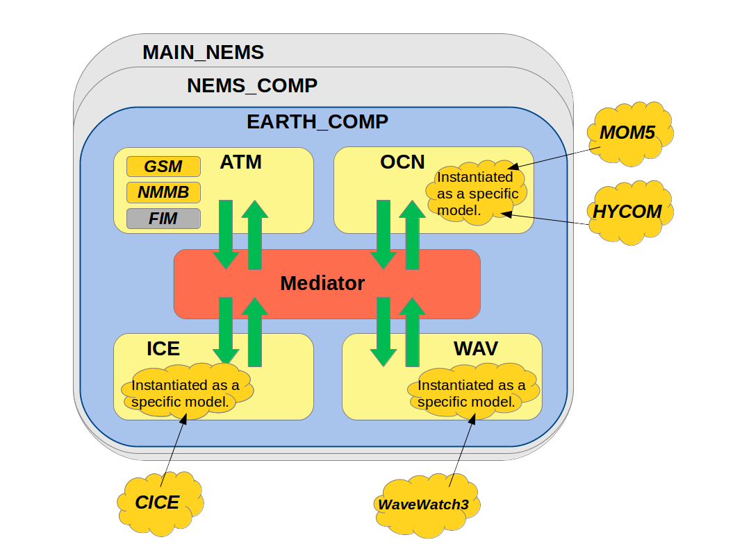
NEMS coupled system
GSM
FV3

Slide 5
NEMS FV3 Standalone System
Program Main
NEMS description
layer
NEMS grid comp
NEMS NUOPC
Layer & mediator
Earth grid comp
(ensemble)
FV3 CAP
Mediator
DYN
IPD4
Phys
User’s code
Fcst grid comp
write grid comp(s)
DYN
IPD4
Phys
NEMS Infrastructure
ESMF grid component

Slide 6
NEMS FV3 repository and code management
EMC is switching from Subversion (svn) repository to NOAA Virtual Lab (vlab) git repository.
Currently NEMS FV3 svn repository and VLAB git repository are co-existing.
Code updates are managed through svn trac system. Code changes are committed to svn repository and synced to VLAB git repository
First Git training was conducted on Jul 10. A series of training on git, VLAB ticketing system and review system will be started in the first week of August. The repository will be switched to git by Sept.

Slide 7
NEMS FV3 repository
SVN repositories:
https://svnemc.ncep.noaa.gov/projects/nems/apps/NEMSfv3gfs
https://svnemc.ncep.noaa.gov/projects/fv3
https://svnemc.ncep.noaa.gov/projects/nems
To check out code:
svn co https://svnemc.ncep.noaa.gov/projects/nems/apps/NEMSfv3gfs/trunk fv3test
VLAB git repository
https://user.name@vlab.ncep.noaa.gov/git/comfv3
To check out code:
% git clone https://user.name@vlab.ncep.noaa.gov/git/comfv3 fv3test
% cd fv3test
% git submodule init
% git submodule update

Slide 8
Compile NEMS fv3 code
To compile:
1. compile.sh
% cd fv3test/tests
% compile_option='HYDRO=N 32BIT=Y‘
%FV3_full_path =`pwd`/../FV3
% machine_name=“theia”
%num_exec =1
%./compile.sh $FV3_full_path $machine_name "$compile_option" $num_exec
Fv3test/release/v0/exp/build.sh is a script using compile.sh
2. NEMSAppBuild
./appbuild.sh $FV3_full_path standaloneFV3 $num_exec
An executable fv3_${num_exec}.exe will be shown in fv3test/tests directory

Slide 9
Run a NEMS fv3 test case
To run a nemsfv3 test case:
Job card
Job card for theia and wcoss cray can be found at:
Fv3test/release/v0/exp: runjob_cray.sh runjob_theia.sh
Script: Fv3test/release/v0/scripts/exglobal_fcst_nemsfv3gfs.sh
Set up date, run and IC directories, resolution specific parameters, run configurations, set up IC, copy fixed files, namelist variable for different configuration, launch the job, and save and clean data
Input data
IC conditions: (See George Gayno’s presentation on creating initial conditions)
gfs_data.tile$N.nc, sfc_data.tile$N.nc
If read_increment: fv3_increment.nc
Fixed files:
Grid and orography: grid_spec.nc, C${RESOLUTION}_grid.tile$N.nc, oro_data.tile$N.nc
Climatology: co2historicaldata_$YYYY.txt, albedo, glacier …
A full list of fix files can be found at:
/scratch4/NCEPDEV/nems/noscrub/emc.nemspara/FV3GFS_V0_RELEASE (theia)
/gpfs/hps/emc/nems/noscrub/emc.nemspara/FV3GFS_V0_RELEASE

Slide 10
Run a NEMS fv3 test case (cont.)
2. input data (cont.)
Data field: data_table, diag_table, field_table
Configuration and namelist: nems.configure, model_configure, input.nml
nems.configure:
EARTH_component_list: ATM
ATM_model: ${atm_model:-fv3}
runSeq::
ATM
::
Module_confgiure:
total_member: 1
print_esmf: .true.
PE_MEMBER01: 1728
start_year: 2016
start_month: 09
start_day: 29
start_hour: 00
start_minute: 0
start_second: 0
nhours_fcst: 24
RUN_CONTINUE: .false.
ENS_SPS: .false.
dt_atmos: 225
calendar: 'julian'
memuse_verbose: .false.
atmos_nthreads: 1
use_hyper_thread: .false.
ncores_per_node: 24
restart_interval: 0
Module_confgiure (cont.):
use_hyper_thread: .false.
ncores_per_node: 24
restart_interval: 0
quilting: .true.
write_groups: 2
write_tasks_per_group: 96
num_files: 2
filename_base: 'dyn' 'phys'
output_grid: "cubed_sphere_grid"
nfhout: 3
nfhmax_hf: 120
nfhout_hf: 1
nsout: -1

Slide 11
Run a NEMS fv3 test case (cont.)
3. Remapping to lat/lon grid
fregrid_parallel is used to map the 6 tiles cubed sphere grid data on to lat-lon grid
https://svnemc.ncep.noaa.gov/projects/nems/apps/NEMSfv3gfs/tags/fv3gfs.v0release/release/v0/sorc/fre-nctools.fd/
Compile
% cd fre-nctools.fd
% ./BUILD_TOOLS.csh machine_name (wcoss_cray, theia or jet)
fregrid_parallel will be located under: sorc/../exec
- Run remapping:
job card example: runjob_cray.sh, runjob_theia.sh
script: fv3gfs_remap.sh
Please see Hui-ya Chuang presentation on post processing

Slide 12
NEMS FV3 regression test
NEMS FV3 regression test:
Currently 8 tests on C96
Control, decomposition reproducibility, threading reproducibility, restart
Read incremental test, stretched grid test, stretched nest, nems app build test
Supported on theia, wcoss phase1,2 and cray, and jet
Developers need to run the regression test, the regression test has to pass on all platforms or has verified new baseline before the code can be committed
Consider to add C384 for ensemble/climate, and C768 for high resolution test
The regression test can evolve, once implemented, operational setting will become new control test
A unified workflow system is under development and it will support all the NEMS application regression test.
Testing FV3 in both standalone model and coupled mode remains challenging

Slide 13
NEMSFV3 regression test (cont.)
To run NEMS fv3 regression test:
Rocoto based nems regression test
To run full regression test:
% cd fv3test/NEMS/tests
% ./rt.sh –f
To create new baseline:
% ./rt.sh –b fv3
To add a new test:
In fv3test/compsets, add new test in fv3.input,
Check if special resources need to be set for the new set
add test name in test list in all.input

Slide 14
NEMSFV3 regression test (cont.)
To run NEMS fv3 regression test 2:
Fv3 application test
- Contain all the extensive test, might not be in the nems test
To run full regression test:
% cd fv3test/tests
% ./rt.sh –f
To run specific test(s):
- % ./rt.sh –l rt.conf1
To create new baseline:
% ./rt.sh –c fv3
To add a new test:
Cd fv3test/tests/tests, add a new test
Cd fv3test/test, add test name in the rt.conf

Slide 15
Making changes to NEMS FV3
fv3 repository is evolving fast. The future updates may involve changes in namelist and model configuration.
Suggestion to work with fast evolving system
Ticket system: document all the code changes
Merge to trunk as frequently as possible
Break big task into small pieces and make several commits
Complexity
Many components, it is impossible to understand all the pieces
Communication is the key

Slide 16
Thanks!

