Slide 1
Grid nesting:
Boundary Conditions
Strategy: fill halo (ghost) cells with boundary conditions
Interior of solver needs no changes
All variables linearly interpolated in space into nested grid halo.
Concurrent nesting: BCs extrapolated in time so nest and coarse grids can run simultaneously.
Two-time level extrapolation requires saving BCs across restarts to ensure run-to-run reproducibility
Nesting references: Harris and Lin (2013, MWR), Harris and Lin (2014, JClim)

Slide 2
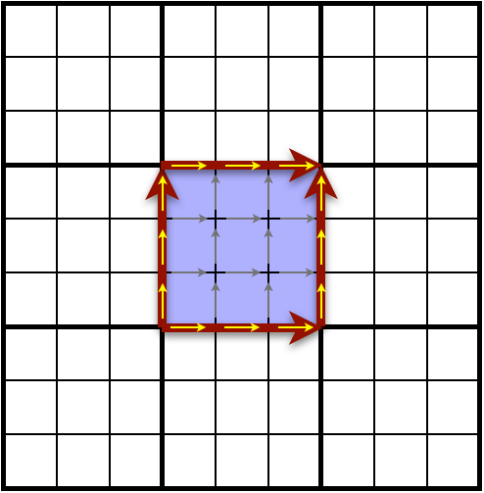
Two-way
Interaction
Averaging update consistent with FV discretization
  For consistency, the initialized coarse-grid topography is updated from the nested-grid using the same algorithm
Cell average on scalars, including δz and w
In-line average for winds, to conserve vorticity

Slide 3
Mass conservation and
Two-way nesting
Conservation usually requires flux BCs at the nested-grid boundary
These are difficult to implement with the time-extrapolation BC
Our approach: Update everything except mass (δp) and tracers
Very simple! Works regardless of BC and grid alignment
  Two-way nesting over-specifies coarse-grid solution
  Less updating, less over-specification
Because δp is the vertical coordinate, we then need to remap the nested-grid data to the coarse grid’s vertical coordinate

Slide 4
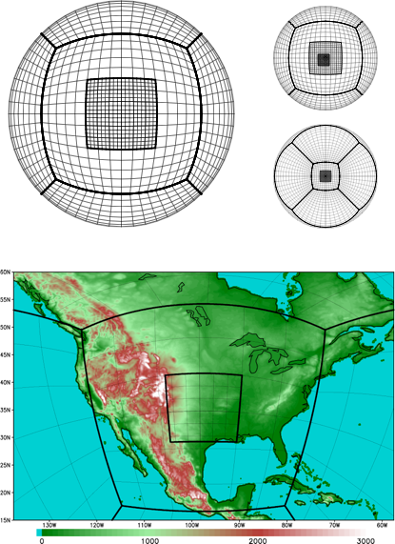
NESTING IMPLEMENTATION in fv³
The nested grid is an additional tile beyond the six for the cubed sphere.
There can exist many nests or nests within nests (under development).
Each nested grid has its own processor list and is integrated concurrently.
This greatly aids load balancing between grids.

Slide 5
k_split
“remapping” loop
n_split “acoustic” loop
dt_atmos
fv_dynamics()
FV³ solver
setup_nested_grid_BCs()
or setup_regional_BCs()
OpenMP on k
c_sw(), etc.
C-grid solver
[physics]
dyn_core()
Lagrangian dynamics
d_sw()
Forward Lagrangian dyn.
OpenMP on k
Twoway_update()
OpenMP on k
fv_tracer2d()
Sub-cycled tracer transport
OpenMP on k
update_dz_d()
Forward δz evaluation
OpenMP on k
fv_update_phys()
Consistent field update
riem_solver()
Backwards vertical PGF,
sound wave processes
(i,k) OpenMP on j
Lagrangian_to_Eulerian()
Vertical Remapping
(i,k) OpenMP on j
one_grad_p()/nh_p_grad()
Backwards horizontal PGF
OpenMP on k

Slide 6
Nested-Grid workflow
Nested grids can be generated online, although orography, land-surface information, and initial conditions have to be generated.
Modifications of standard NCEP tools allow offline generation of grid information and ICs
Each grid gets its own namelist
Any runtime parameter can be customized for the individual grids
GFDL fregrid can perform conservative remapping of nested-grid output onto a regional regular latitude-longitude grid. It is also possible to use common software (GrADS, Python, NCL, etc) to plot the native nested grid.

Slide 7
Vertical Nesting
Currently the nested grid and the global grid are restricted to having the same number of levels with the same reference coordinate
Vertical nesting is being tested that allow the grids to use different levels.
  Global grid can use a high top to ensure stratosphere is well-resolved
  Nest can use a lower top and set up very high tropospheric resolution
The BC fields need to be remapped onto the nested-grid coordinate.
  Remapping to the coarse grid coordinate is already done for two-way updating
  During two-way updating, coarse and nested grids are blended to avoid updating Rayleigh-drag region of nest onto coarse grid

