Slide 1
Orography Generation and
CHGRES
George Gayno NCEP/EMC
FV3GFS Community Modeling System Training and Tutorial, 19-20 July 2017

Slide 2
Orography Generation
Location of source code:
  https://svnemc.ncep.noaa.gov/projects/fv3gfs/trunk/global_shared.v15.0.0/sorc/orog.fd
Compile with “build_orog.sh” located in ./global_shared.v15.0.0:
  Invoke “build_orog.sh” with argument “cray” (WCOSS-Cray)
  Invoke “build_orog.sh” with argument “theia” (Theia)
  Executable - ./global_shared.v15.0.0/exec/ml01rg2.x
Creates the following fields for each tile. Many are required by the GWD.
  Land mask (0-non-land; 1-land) (“slmsk”)
  Land fraction (decimal percent) (“land_frac”)
  Mean terrain height – records for raw (“orog_raw”) and filtered (“orog_filt”) are identical. Terrain is filtered by ./sorc/fre-nctools.fd/tools/filter_topo
  Standard deviation of height (“stddev”)
  Convexity (“convexity”)
  Asymetry – four directional (W/S/SW/NW) components (“oa1-4”)
  Length scale – four directional (W/S/SW/NW) components (“ol1-4”)
  Angle of mountain range with respect to east (“theta”)
  Aniostropy (“gamma”)
  Slope (“sigma”)
  Maximum height about mean (“elvmax”)

Slide 3
Orography Generation
Raw land mask and terrain datasets. Located in ./global_shared.v15.0.0/fix/fix_orog:
  UMD 1-km global land cover classification (Hansen et al. 2000) – Filename: “landcover30.fixed”
  USGS 1-km GTOPO30 data (outside of Antarctica). Filename: “gtopo30_gg.bin”.
  Radarsat Antarctic Mapping Project (RAMP) Digital Elevation Model - Liu, H. et al. (2001).
    1-km dataset that resolves the large ice sheets.
    Filename: “thirty_second.antarctic.new.bin”
  Beta version of the code replaces GTOPO30 with USGS 1-km Global Multi-Resolution Terrain Data 2010 (GMTED2010).
    See this ticket for details: https://svnemc.ncep.noaa.gov/trac/fv3gfs/ticket/17

Slide 4
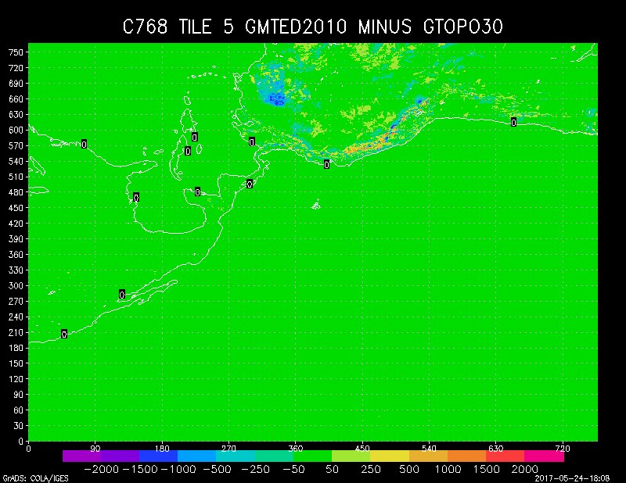
Orography Generation

Slide 5
Orography Generation
Program run script:
  ./global_shared.v15.0.0/ush/fv3gfs_driver_grid.sh
Runs the following in sequence:
  make_hgrid (via fv3gfs_make_grid.sh)
  Orography generation (via fv3gfs_make_orog.sh)
  filter_topo (via fv3gfs_filter_topo.sh). No filtering for nests.
Compile “make_hgrid” and “filter_topo” using ./sorc/fre-nctools.fd/BUILD_TOOLS.csh:
  Invoke BUILD_TOOLS.csh w/ argument “cray” or “theia”

Slide 6
Orography Generation
“fv3gfs_driver_grid.sh” contains job cards for Theia and Cray. To run:
  cat fv3gfs_driver_grid.sh | bsub (Cray)
  qsub fv3gfs_driver_grid.sh (Theia)
  Also on Theia, set variable machine=theia.
Default is a uniform C96 grid.
  Modify script variable “res” to change it.
To run a stretched grid, set gtype=stretch. Other settings:
  Stretching factor is “stetch” (default is 1.5).
  Center lat/lon of highest resolution tile is “target_lat” and “target_lon” (default is central CONUS).

Slide 7
Orography Generation
To run a nest, set gtype=nest. Additional settings:
  Refinement ratio is “refine_ratio”. Default is 3.
  Halo size is “halo”. Default is 3.
  Starting/ending i/j indices within parent tile
    istart_nest, jstart_nest, iend_nest, jend_nest
Upon successful run, all files saved to “out_dir”. Working directory is “TMPDIR”.

Slide 8
CHGRES
Location of source code:
  https://svnemc.ncep.noaa.gov/projects/fv3gfs/trunk/global_shared.v15.0.0/sorc/global_chgres.fd
Compile with “build_chgres.sh” located in ./sorc.
  Invoke with argument ‘cray’ or ‘theia’.
  Executable named “global_chgres” placed in ./global_shared.v15.0.0/exec
Only accepts GFS files as input.
  Atmospheric restart files in NEMSIO or SIGIO (spectral coefficients) format.
  Surface restart files in NEMSIO or SFCIO format.
  NST restart files in NEMSIO format.
  As of July 19, GFS OPS uses NEMSIO.

Slide 9
CHGRES
Run using the “global_chgres_driver.sh” script located on Theia in /scratch4/NCEPDEV/da/noscrub/George.Gayno/chgres_tutorial.
  Version in ./global_shared.v15.0.0/ush will be updated soon.
  Some minor additional testing required for the Cray.
  This driver script calls ./ush/global_chgres.sh
Set the following variables for your test environment:
  “BASE_GSM” to your ./global_shared directory.
  “DATA” to your working directory.
  “machine” to “THEIA” (only option currently).
  “FIXgsm” is the GFS fixed file directory.
    Contains surface fixed data such as albedo.
    And the definitions of the vertical levels (i.e., “global_hyblev.l64.txt”)
    On Theia: /scratch4/NCEPDEV/global/save/glopara/svn/fv3gfs/fix/fix_am
    On Cray: /gpfs/hps/emc/global/noscrub/emc.glopara/svn/fv3gfs/fix/fix_am
  “FIXfv3” is the directory containing the grid and orography files for the target FV3 grid.
    On Theia: /scratch4/NCEPDEV/global/save/glopara/svn/fv3gfs/fix/fix_fv3
    On Cray: /gpfs/hps/emc/global/noscrub/emc.glopara/svn/fv3gfs/fix/fix_fv3.

Slide 10
CHGRES
Pointing to the input GFS data.
  “INIDIR” is the directory containing the data.
  “CDATE” is the YYYYMMDDHH of the data.
  Set “ictype=opsgfs” if input is old format (pre-July 19). Set to “nemsgfs” if nemsio format.
    Also sets namelist options to properly handle the new soil/veg/albedo data (July 19 implementation).
Creating the FV3 data.
  Set “OUTDIR” to where you want the output FV3 data to be saved. The surface and NST data are in the same file.
  Set “CASE” for the desired resolution (default C96).
  Set “LEVS” for the number of hybrid levels. Will use corresponding “global_hyblev.l${LEVS}.txt” from the FIXgsm directory.
  To run a nest, set gtype=nest. Will create ICs for the six global tiles and one nest.

Slide 11
CHGRES
CHGRES runs separately for the surface and atmosphere.
  For atmosphere, all FV3 tiles are created in one call.
  For surface, only one FV3 tile is processed at a time (i.e., called six times for a global grid).

Slide 12
Next Generation CHGRES
Have a working prototype that interpolates directly from one cubed-sphere grid to another (including nests).
Built around ESMF re-gridding routines.
  Geo-referencing via the mosaic and grid files.
Working for NST and surface fields.
  Ingests and outputs the tiled NetCDF restart files.
Thinking about the atmospheric fields.
  Does GFDL have a code that does this? If yes, incorporate it into CHGRES or keep as separate code?

Slide 13
Next Generation CHGRES
Includes the current special handling for certain fields.
  Soil temperature adjustment for terrain height differences.
  Recomputes frozen portion of the total soil moisture for temperature differences.
  Rescales soil moisture for differences in soil type. Required to preserve the sensible and latent heat fluxes.

Slide 14
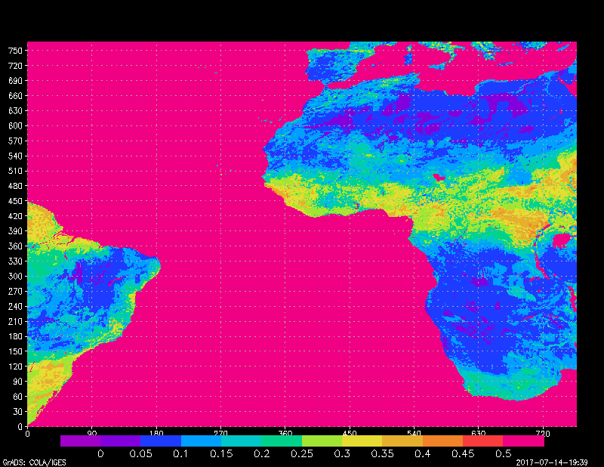
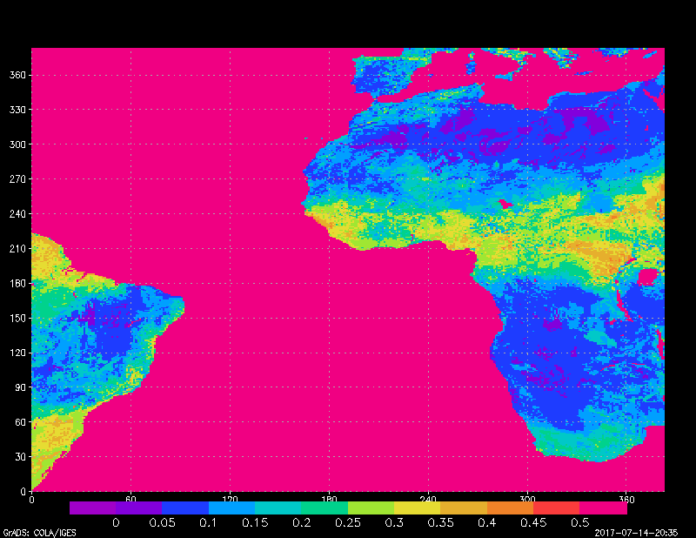
C768 to C384
C768 tile 1
C384 tile 1
TOP LAYER SOIL MOISTURE

Slide 15
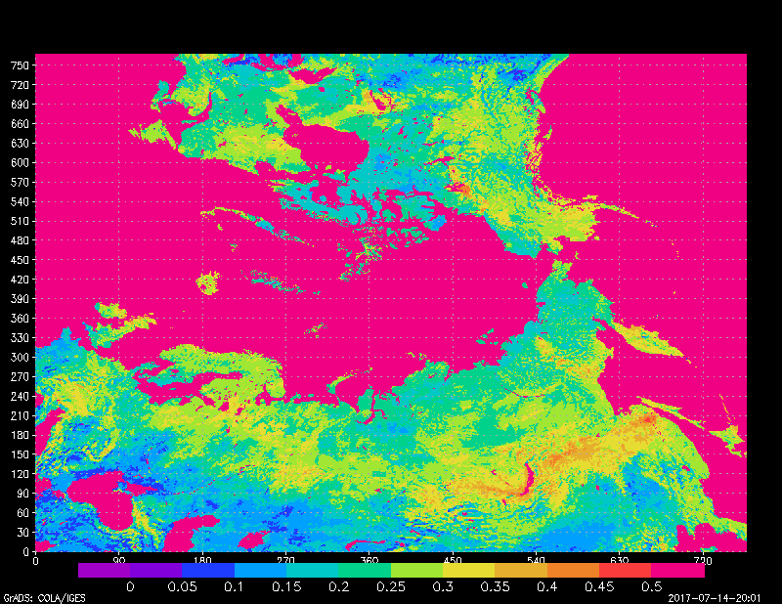
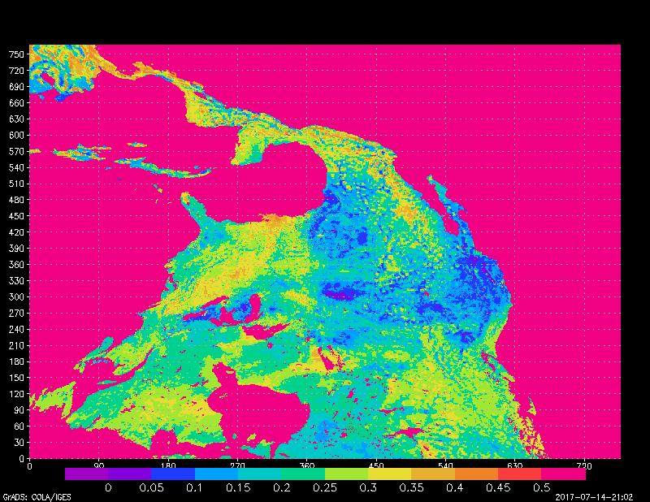
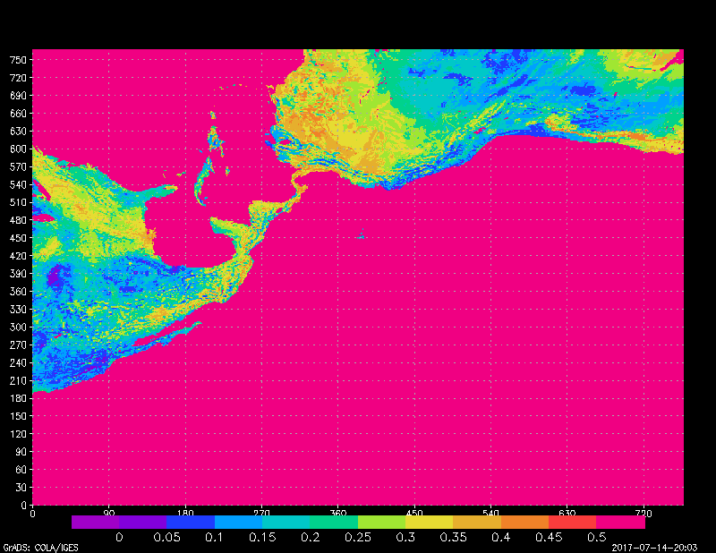
C768 to C768 Stretched
Input tile 3
Input tile 5
Tile 6 – stretched grid

Slide 16
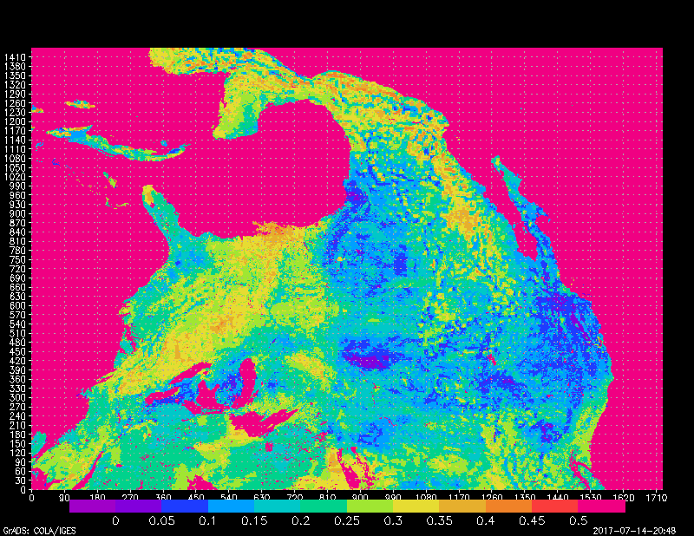
C768 to C768 stretched nest
Input tile 3
Nest
Input tile 5

Slide 17
QUESTIONS?
Don’t hesitate to contact me at george.gayno@noaa.gov if you have questions or run into problems.

